Slide 1
Sensitivity of WRF Regional Climate Simulations to Choice of Land Use Dataset
Megan Mallard¹, Tanya Spero¹, & Stephany Taylor^{1,2}
¹ National Exposure Research Laboratory, U.S. EPA
² North Carolina Agricultural & Technical State University
15th Annual CMAS Conference
October 26, 2016
Office of Research and Development
National Exposure Research Laboratory, Systems Exposure Division

Slide 2
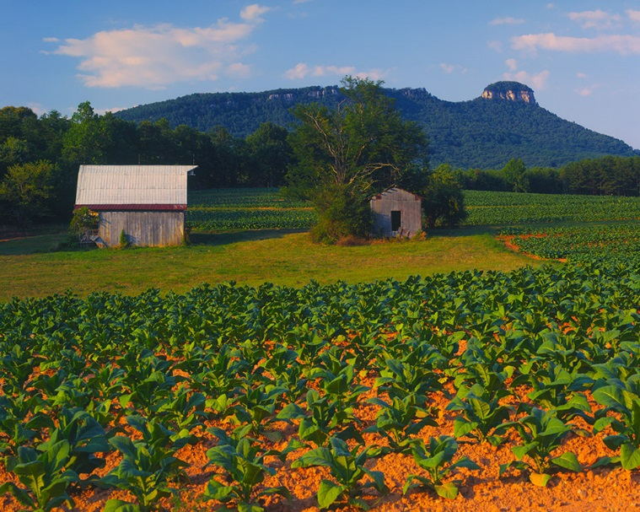
Land Use in Regional Climate Modeling
Accurate representation of air-surface interactions is needed for regional climate projections.
  Land use (LU) significantly influences air-surface interactions; modulates exchanges of heat, moisture & momentum.
  Therefore, LU can affect long-term means & extremes of temperature and precipitation.
In WRF model, LU is static.
Several land-surface interactions are linked to LU via look-up table.
http://www.learnnc.org

Slide 3
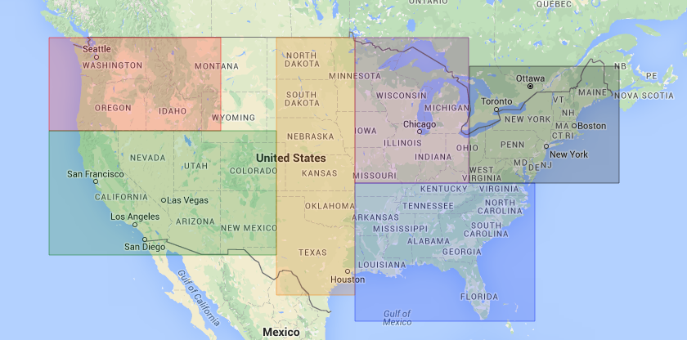
Comparing LU for Dynamical Downscaling
WRF v3.8, 108- & 36-km domains
Continuous 3 year runs with 3 month spin-up (Oct ‘87 – Dec ’90)
Driven by NCEP-DOE Reanalysis 2
LU interpolated using 4-pt bilinear method
Physics:
  Noah Land Surface Model
  YSU boundary layer scheme
  MM5 Monin-Obukhov surface scheme
  KF cumulus parameterization
  RRTMG radiation scheme
Spectral nudging of momentum, temperature, & geopotential heights
Regional-averages shown over Plains, Midwest, Southeast

Slide 4
USGS vs. NLCD
U.S. Geological Survey (USGS) Global Land Cover Characteristics
  AVHRR satellite imagery collected during 1992 to 1993
  1 km resolution
  24 categories
National Land Cover Dataset (NLCD)
  2006 data from Landsat
  30 second resolution
  40 categories
    20 NLCD categories inside CONUS
    17 categories from Moderate Resolution Imaging Spectroradiometer (MODIS) data outside CONUS

Slide 5
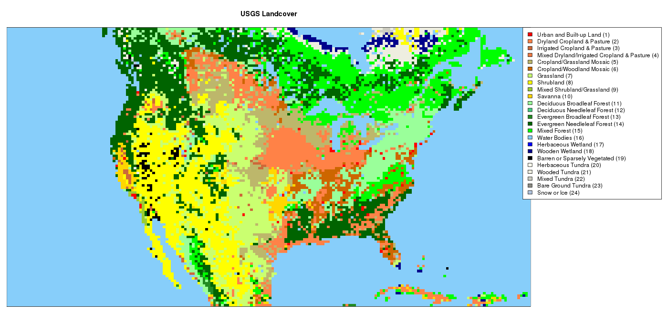
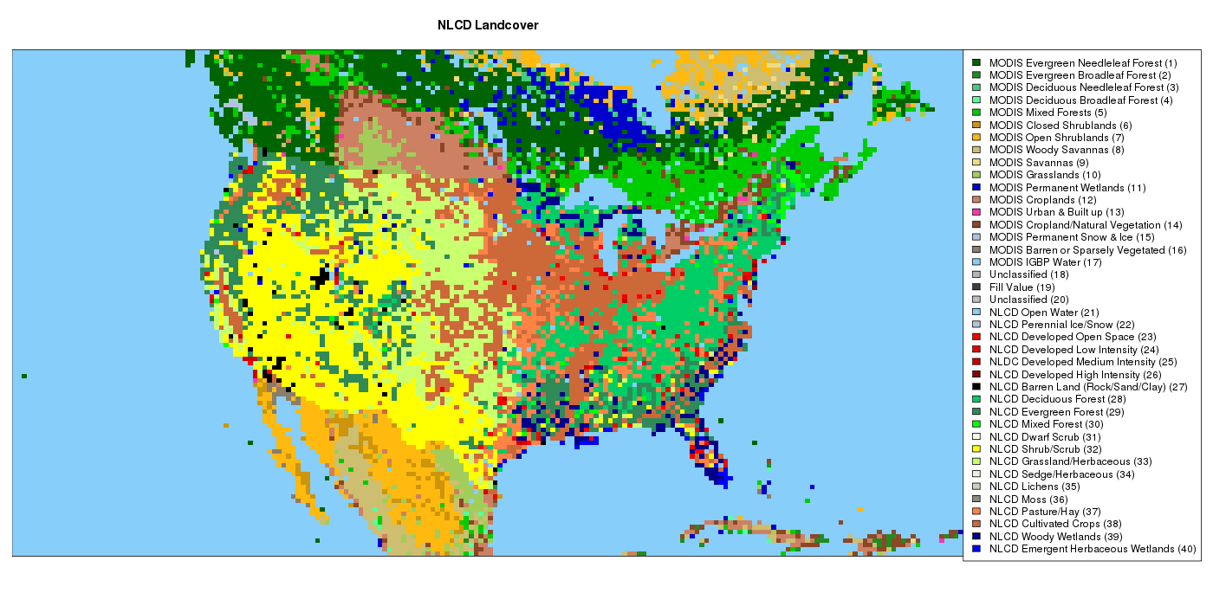
USGS
Dominant LU on 36-km Grid
NLCD

Slide 6
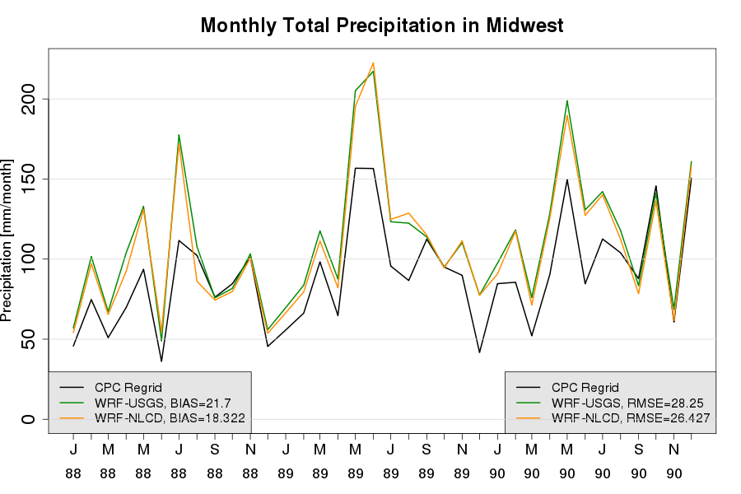
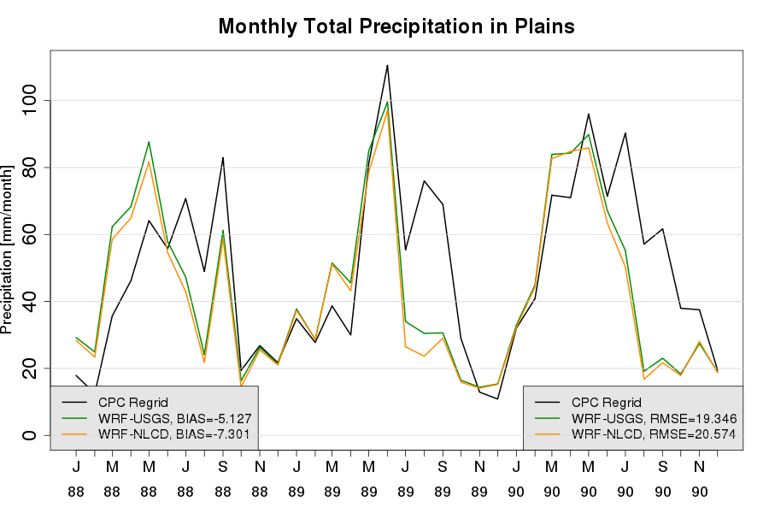
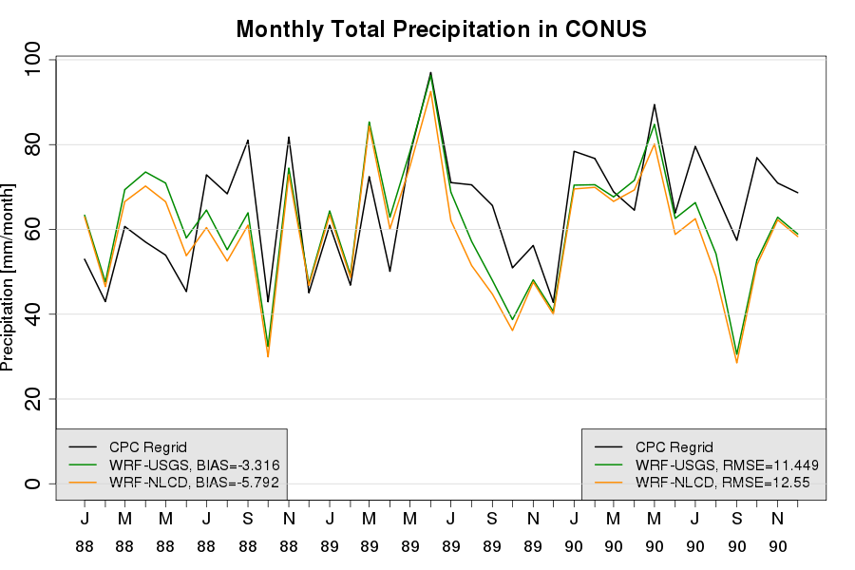
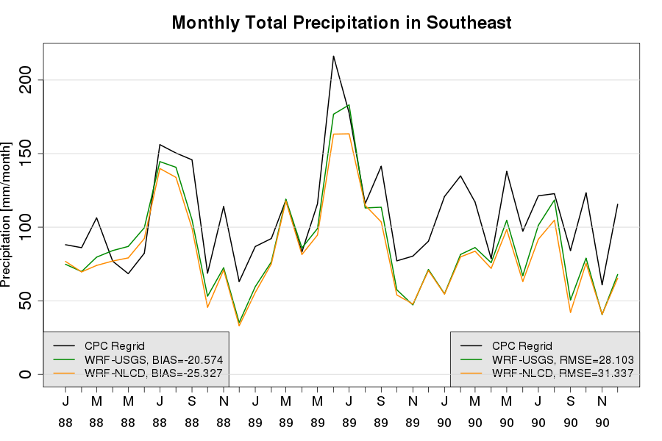
Precipitation
Midwest
WRF-USGS run consistently wetter than WRF-NLCD both across CONUS & in regions.
LU sensitivity is small compared to model error.
Plains
CONUS
Southeast
Monthly precipitation totals, spatially averaged & shown with NOAA Climate Prediction Center (CPC) Unified Precipitation regridded to 36-km
Notes:
CONUS: diff bt USGS and NLCD range is -0.4 to 6.6, mean difference is 2.2
MW: -6.2 to 21, usually 9 or under though, mean is 3.3
PL: -.6 to 7.5, mean is 2.1
SE: -1.9 to 19, usually 10 or under though, mean is 4.7

Slide 7
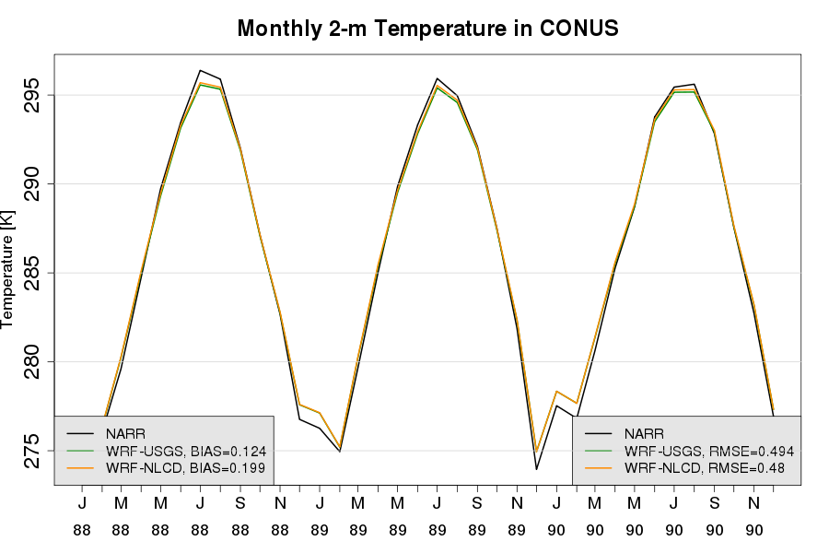
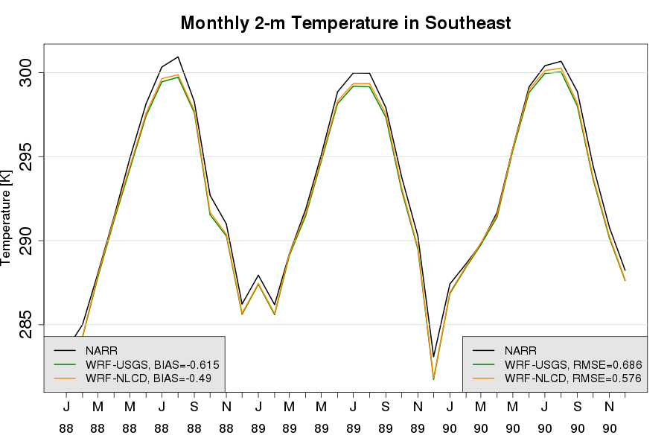
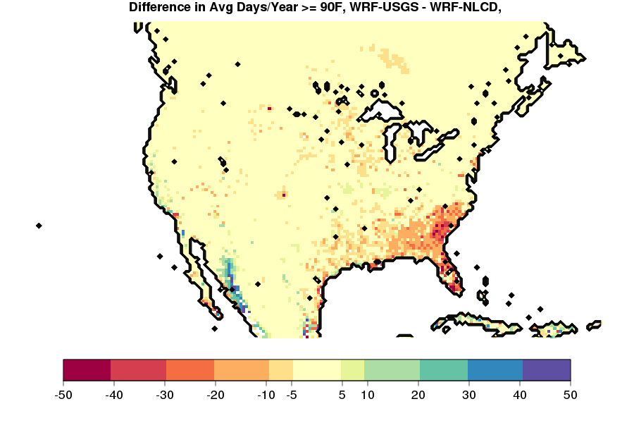
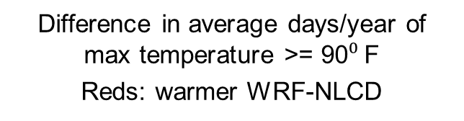
Temperature
CONUS
Mean 2-m temperatures slightly warmer in summer in WRF-NLCD than in WRF-USGS.
Increases in number of hot days in some areas, mainly Southeast.
Southeast
Monthly 2-m temperature, spatially averaged & shown with North American Regional Reanalysis (NARR) data
Difference in average days/year of max temperature >= 90$⁰$F
Reds: warmer WRF-NLCD
Notes:
Days Over plot range: greater than 100, several 20 and 50 plus areas
SE: range is -0.23 to -0.044. Mean is -0.125
CONUS: range is -0.139 to 0.003, all but 2 values are negative. Mean is -0.07

Slide 8
Consolidated LU
For comparison between LU datasets with difference categorization systems, present study uses general “umbrella” categories to group LU types under common themes.

Slide 9
Consolidated LU
For comparison between LU datasets with difference categorization systems, present study uses general “umbrella” categories to group LU types under common themes.
Consolidated LU | USGS | NLCD
Forest | Deciduous Broadleaf Forest (11) Deciduous Needleleaf Forest (12) Evergreen Broadleaf (13) Evergreen Needleleaf (14) Mixed Forest (15) | Evergreen Needleleaf Forest (1) Evergreen Broadleaf Forest (2) Deciduous Needleleaf Forest (3) Deciduous Broadleaf Forest (4) Mixed Forest (5) Deciduous Forest (28) Evergreen Forest (29) Mixed Forest (30)

Slide 10
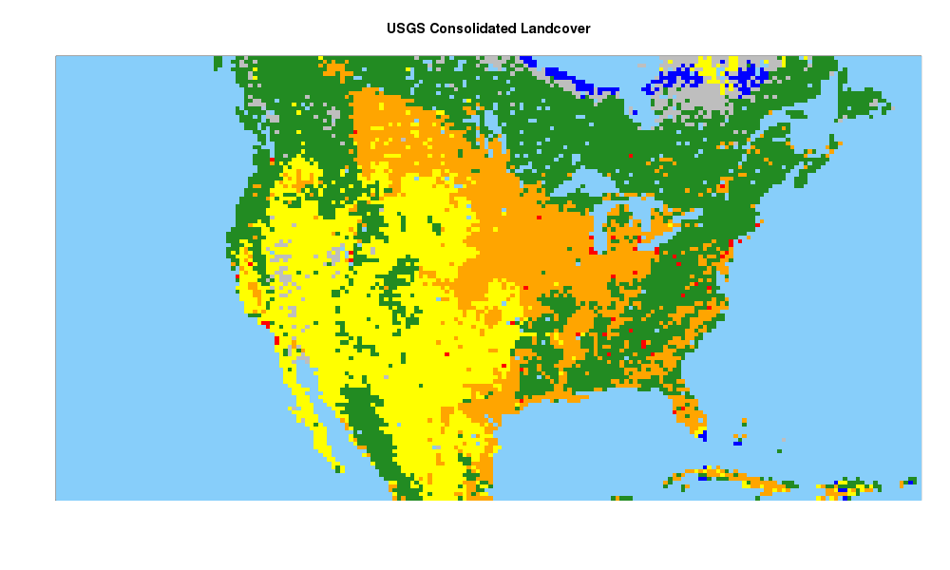
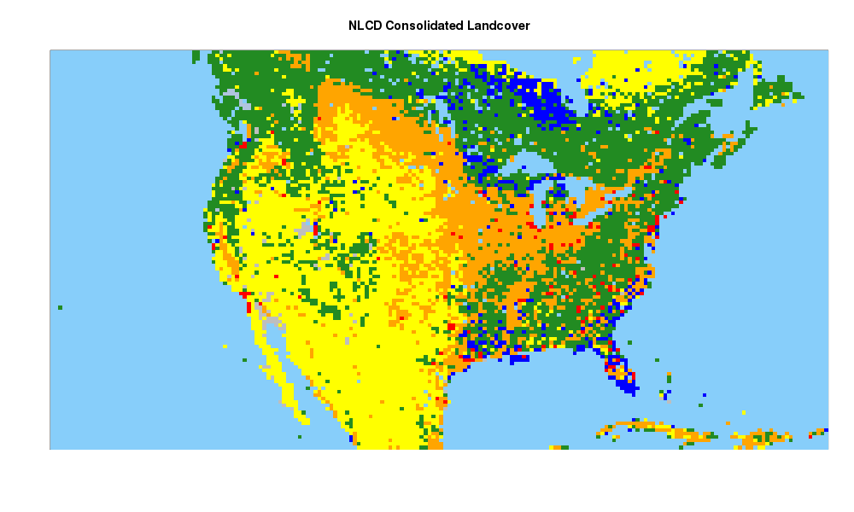
Land Use Change
0.2%
USGS-NLCD
3%
-1%
Largest LU changes from USGS to NLCD:
  Less forest & agricultural
  More grass/shrubland & wetlands
-4%
3%
-7%
6%
USGS
NLCD
Urban
Agricultural
Grass/Shrub
Forest
Wetlands
Barren/Tundra
Ice/Snow
LU filled by Consolidated LU Category

Slide 11
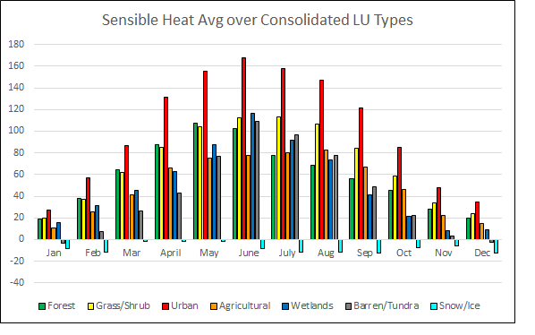
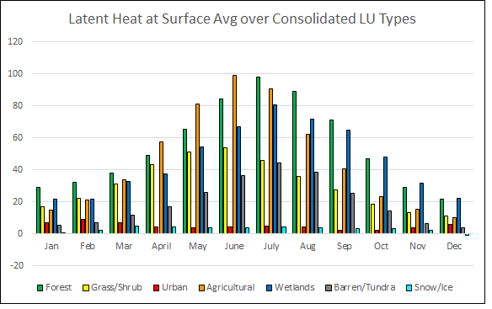
Surface Fluxes
Urban LU highest source of sensible heat. Grass & shrubland are 2nd highest over the year.
Forest LU types major contributor to surface latent heat release (followed by wetlands & agricultural).
Loss of forest & agricultural land in in NLCD → drier, warmer than WRF-USGS.
Annual cycle of surface heat fluxes averaged over grid cells in each consolidated LU category in WRF-USGS
Similar results with WRF-NLCD

Slide 12
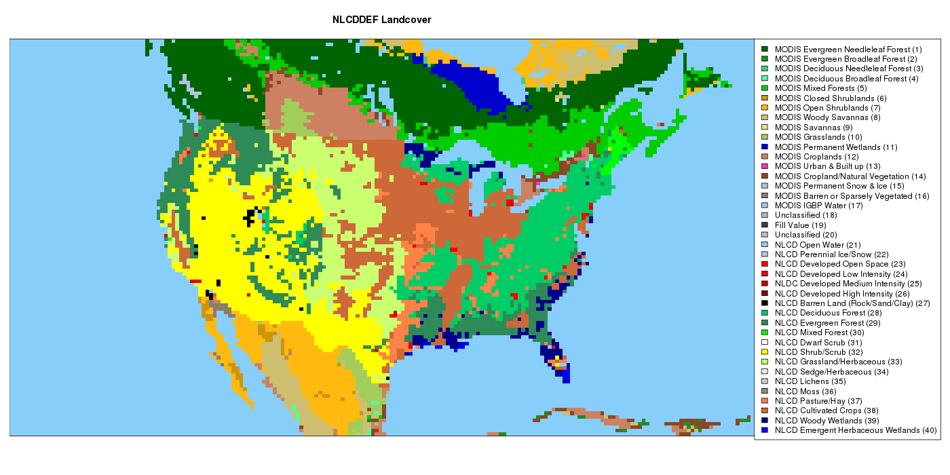
NLCD Sensitivity to Interpolation Method
LU used in WRF domains is set during preprocessing.
Default interpolation techniques:
  USGS: 4 point bilinear
  NLCD: grid cell averaging
Initial comparisons used NLCD with bilinear method (to match USGS).
What if default technique is used for NLCD?
WRF- NLCD – 4pt, as before
“WRF-NLCDDEF” – default
grid cell avg.

Slide 13
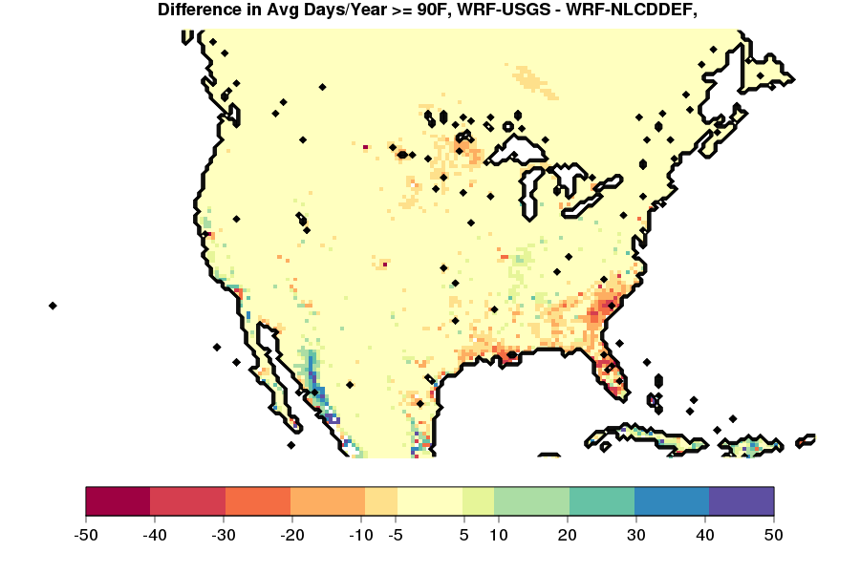
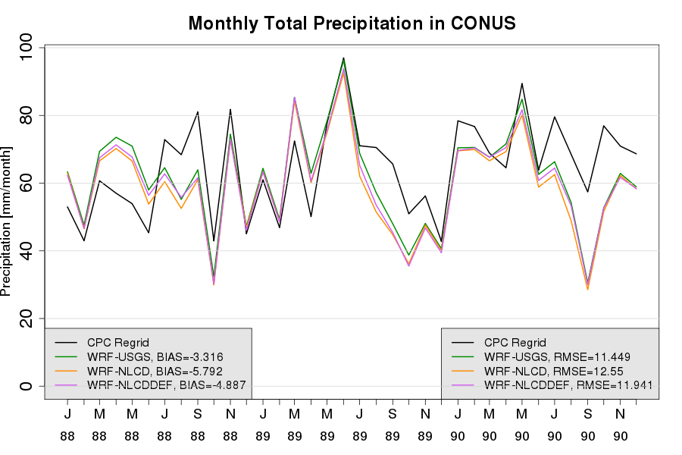
Interpolation Method
WRF-NLCDDEF shows smaller LU changes, relative to USGS in most categories.
Representation of 2-m temperature & precipitation more similar to USGS.
Notes:
Precip: USGS v NLCDDDEF: range is -0.156 to 0.07, mean is -0.06, most values but not all are negative.
NLCD v NLCDDEF: 0.033 to 0.099. mean is 0.06, all positive values.
Day count range: range is similar, number of high values is less.

Slide 14
Conclusions
When using same interpolation technique, use of NLCD land use results in:
  Less precipitation
  Warmer 2-m temperatures in some regions
  Changes linked to loss of forest & agricultural LU cells
  Less surface evaporation & precipitable water vapor (not shown)
When both LU datasets are allowed to use default interpolation schemes, consistent contrasts are found in temperature & rainfall, but smaller magnitudes.
Results suggest that NLCD can be used with confidence for WRF regional climate simulations with Noah LSM.
The views expressed in this presentation are those of the authors and do not necessarily represent the views or policies of the U.S. Environmental Protection Agency.

