Slide 1
How do we improve the treatment of atmospheric photochemistry in future air quality models?
Deborah Luecken (USEPA)
From discussions with:
Havala Pye, Bill Hutzell, Golam Sarwar, Kathleen Fahey (US EPA)
Dick Derwent (rdscientific) , Bill Carter (UC Riverside), Harvey Jeffries (UNC)
Ajith Kaduwela (UC Davis, CARB), and many others
Office of Research and Development
NERL/CED
CMAS Annual Meeting
Chapel Hill, NC, September 24, 2016

Slide 2


Atmospheric chemistry in AQMs must account for robust integration across media/phases and address many issues
This is the part I’m going to focus on
this morning
Extended, customized Mechanistic Gas phase chemistry: Organic and inorganic
Extensible aqueous chemistry and deposition
Aerosol formation: mechanistic and parameterized
* * *
* * * *
*
*
O . *
Surface reactions (parameterized)
CMAQ is working to:
Strengthen linkages and consistency across scales/application
Customize mechanisms to facilitate linkages
Improve two-way information flow

Slide 3
What I’m going to talk about
Difficulties representing atmospheric chemistry in Air Quality Models
Why it is important to find a better and more consistent way to create these mechanisms
A prototype for developing the types of mechanisms we need for future applications

Slide 4
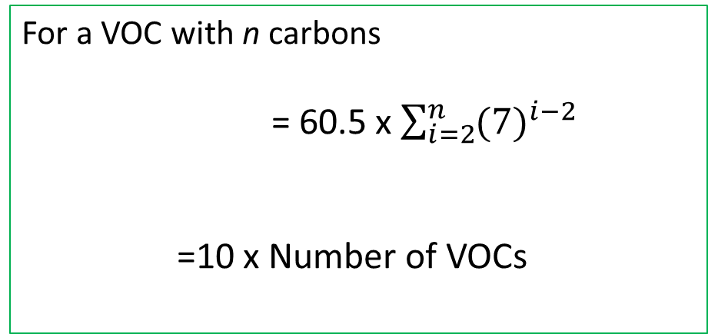
The problem with modeling atmospheric photochemistry is that there are so many organics
~ 80% of VOC emissions can be treated with only 50 VOCs (Simon et al., Atmos. Poll. Res., 2010)
For a VOC with n carbons
= 60.5 x $\sum_{i=2}^{n}{{(7)}^{i−2}}$
=10 x Number of VOCs
Number of Distinct VOCs produced
(Aumont et al., Atmos. Phys. Chem. 2005)
Number of reactions required
 | SAPRC07 | CB6
# species | 173 | 118
# reactions | 464 | 297
Need ~ 50,000,000 species and 0.5 billion reactions
What we use right now

Slide 5


Ways to treat 50,000,000 VOCs in Air Quality Models
Example: n-butane
CH3-CH2-CH2-CH3
More condensed
By molecular structure i.e. CB05
CH3-CH2-
CH2-
PAR + OH → 0.870*XO2 + 0.130*XO2N + 0.110*HO2 +
0.060*ALD2 – 0.110*PAR + 0.760*ROR + 0.050*ALDX
PAR
More explicit
By reactive species, i.e. SAPRC07
CH3
CH3
CH3
CH3
CH3
“Representative species” i.e. CRI
CH3-CH2-CH2-CH3
ALK3
Not real species
Not real reactions
Loss of information
CL-CH=CH-Cl
CH3-C-CH3
|
CH3
CH3-CH2-CH2-CH3
CH3-S-CH3
CH3-CH2-OH
NC4H10
ALK3 + OH → 0.695*xHO2 + 0.236*xTBUO + 1.253*RO2C + 0.07*RO2XC + 0.07*zRNO3 + 0.026*xHCHO + 0.445*xCCHO + 0.122*xRCHO + 0.024*xACETONE + 0.332*xMEK + 0.983*yROOH + 0.017*yR6OOH -0.046*XC
OH + NC4H10 → RN13O2
RN13O2 + NO → MEK + HO2 + NO2
RN13O2 + NO → CCHO + C2H5O2 + NO2
Can get very large (i.e. computationally expensive)
Depends on how you define “representative”

Slide 6
See Bill Carter’s talk at 2014 CMAS for more details……
Development of Gas-Phase Atmospheric Chemical Mechanisms
William P. L. Carter
University of California, Riverside, CA
October 27, 2014
Overview
Mechanism development objectives, evaluation, levels of detail
SAPRC mechanisms: components, versions, updates
Recommendations and thoughts on the future

Slide 7
Problems common to all condensed chemical mechanisms
Difficult to modify
  Hard to keep at state-of-the-science
  Hard to adapt to secondary aerosol formation, new species
Rely largely on developer’s judgement
  Lack of transparency, documentation
Hard to evaluate/compare
  Can’t measure condensed species
  Naming conventions differ
  Unclear protocol for evaluation
wouldn’t it be great if we could fix these?

Slide 8
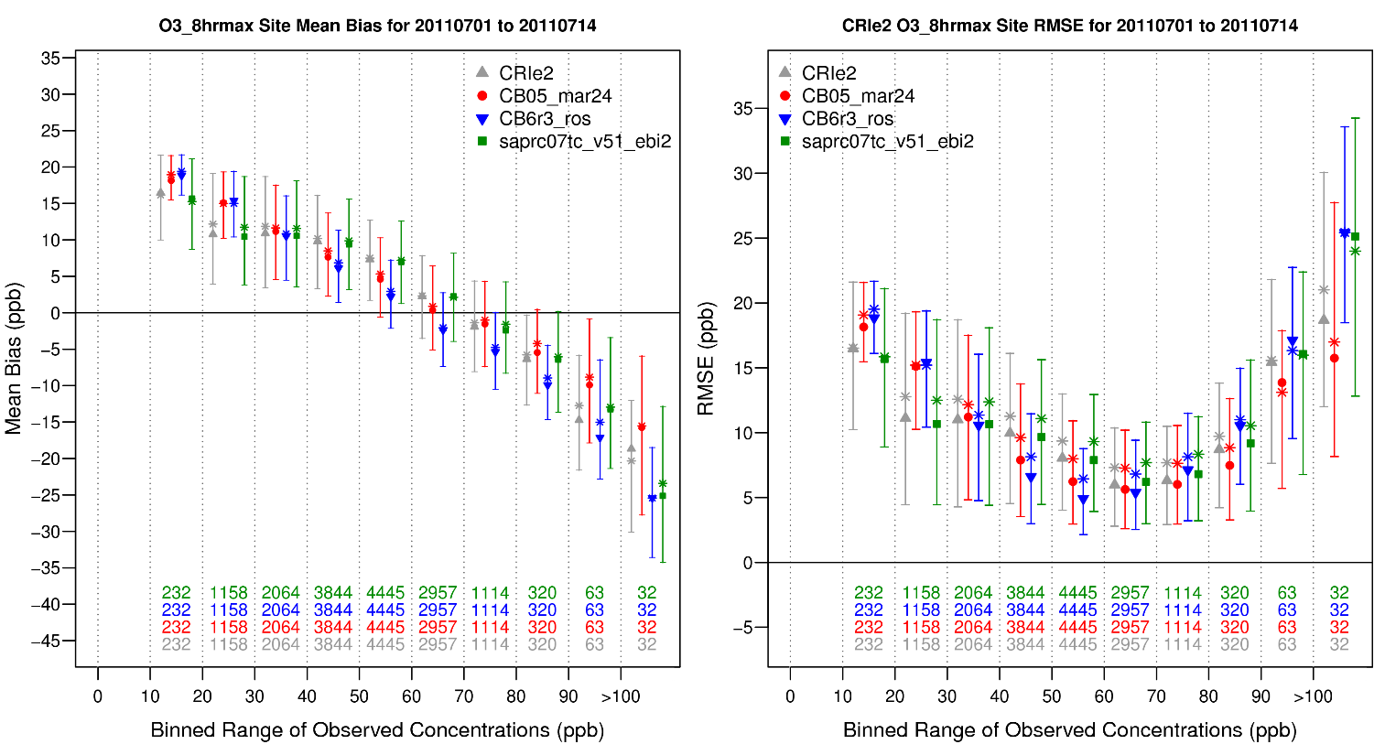
Does it really matter how the mechanism represents VOCs?
Mean Bias and root mean square error in modeled ozone compared to monitored data, binned by observed values, daily 8-hr maximum ozone, over continental US, for July 1-14, 2011.
CRI (early version)
CB05 (e51)
CB6
SAPRC07
Vastly different mechanisms give similar predictions for current ozone

Slide 9
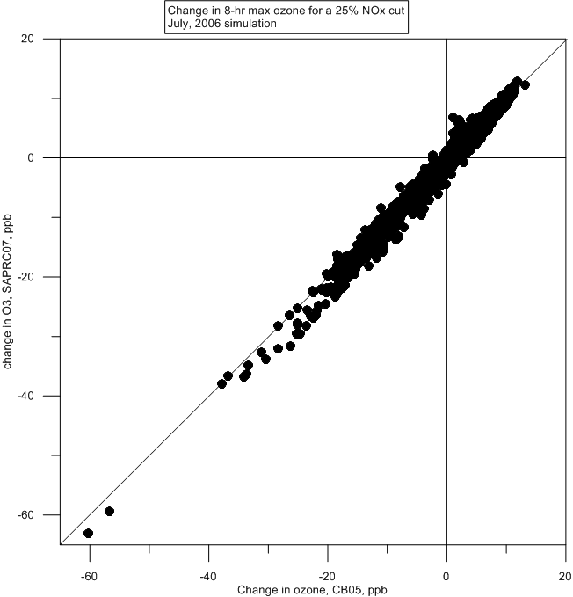
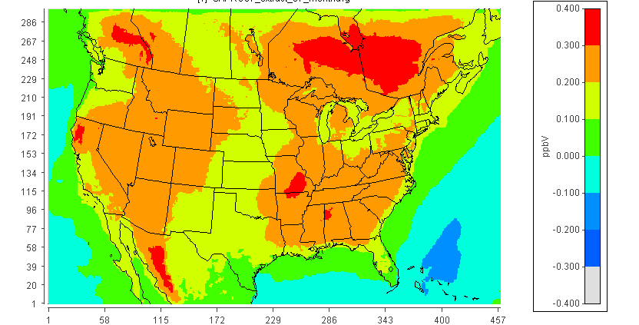
CB05 and SAPRC07 even give similar response to emission controls (here for a 25% NOx reduction)
But they can give different concentrations of intermediate species.
~no points here
Fractional difference in H₂O₂: CB05-SAPRC07T
0.40
0.20
0.
-0.2
-0.40
or here
The importance of having more detail in intermediate species will have implications when we look beyond ozone, NOx, organic and primary PM

Slide 10
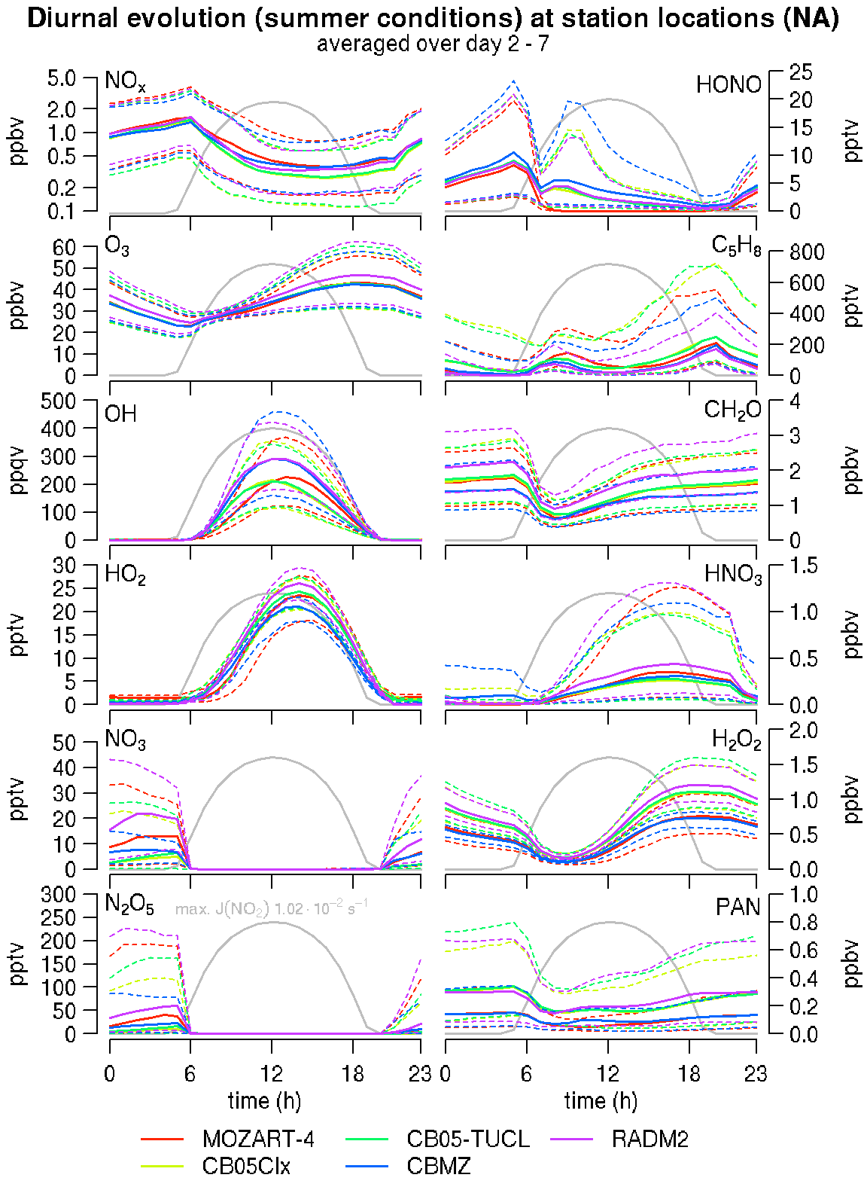
Other studies show the same thing: similar ozone formation, but (sometimes large) differences in intermediates
Median ozone: +/- 5% ppb
Median OH: +/- 40%
Median H₂O₂: +/- 25%
(Knote et al., Atmos. Env., 2014)

Slide 11
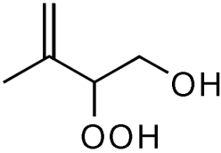
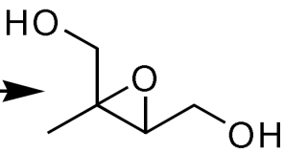
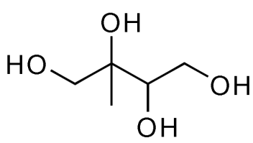
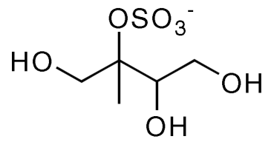
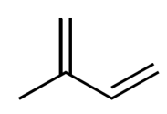
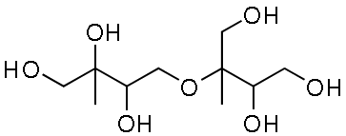
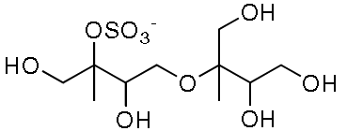
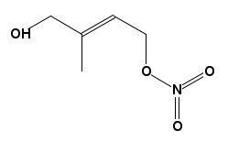

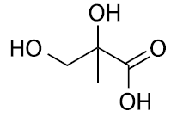
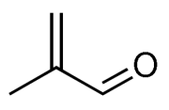
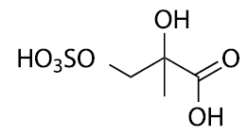
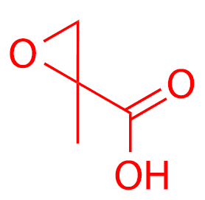
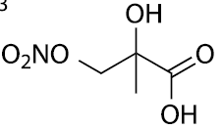
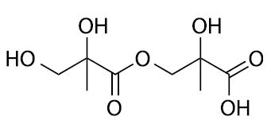
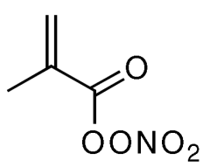
Why intermediates matter when predicting SOA from isoprene +OH
GLY + HCHO +MGLY
large route for SOA from isoprene
+OH / NO or HO2
+H₂O
ISOPOOH
+OH
acid
+SO₄⁻²
IEPOX
+NO₃⁻
+ HCHO, MVK, MACR
+HO₂
+RO₂
HCHO, MVK,MACR
+OH,O₂
isoprene
ISOPO₂ +
SV_ISO1
+NO
SV_ISO2
AISO1
isoprene nitrates
AISO2
Rxn with O₂ or decomp
oligomer
HCHO + MACR + MVK + C5-aldehydes
+SO₄⁻²
+NO₃⁻
+OH, NO₂
acid
+NO₃⁻
Chemistry described in Pye et al., ES&T, 2013
+OH
MAE
MEK + HCHO +MGLY
Decomp, hν
minor route for SOA from isoprene
MPAN
HMML
Where we have information on SOA formation, we should use it!
Notes:
Dependence on NOx, NO2, water, acidity, sulfate….

Slide 12
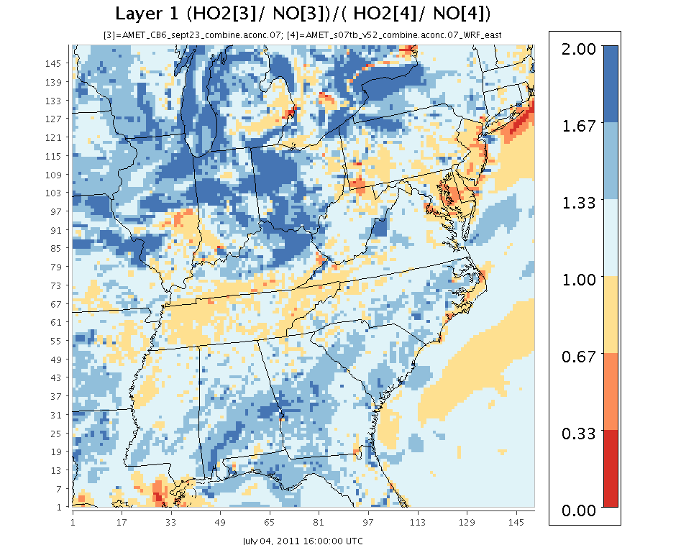
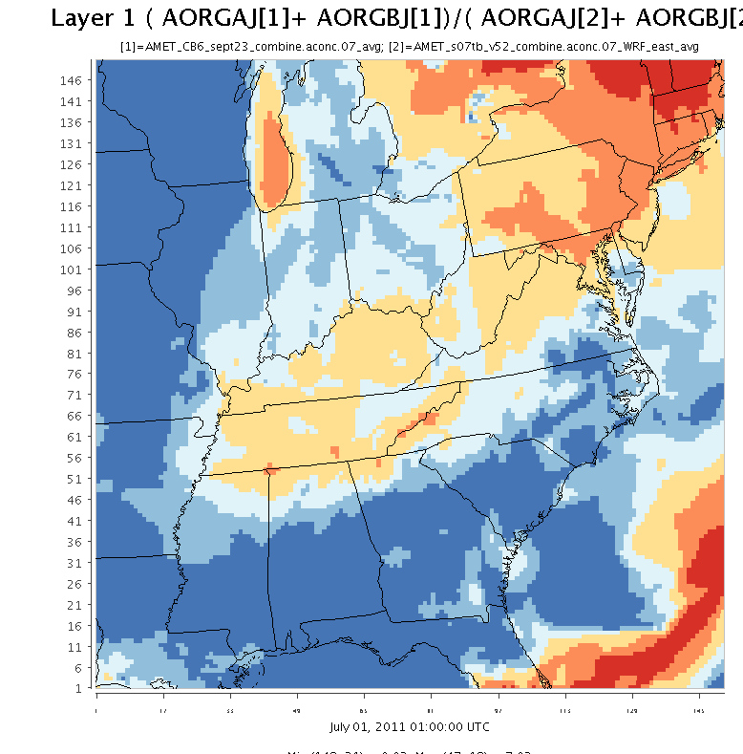
Differences in intermediates can influence secondary organic aerosol formation
Ratio of HOx to NO importance CB6/SAPRC07 - hourly value at 11 AM
Blue indicates where CB6 has higher throughput via HO₂
Ratio of 14-d avg SOA concentrations CB6/SAPRC07
..and more SOA
..and more SOA
orange indicates where SAPRC07 has higher throughput via HO₂
Differences in OH, HO₂ and NO/HO₂ ratios can make a large difference in SOA predictions

Slide 13
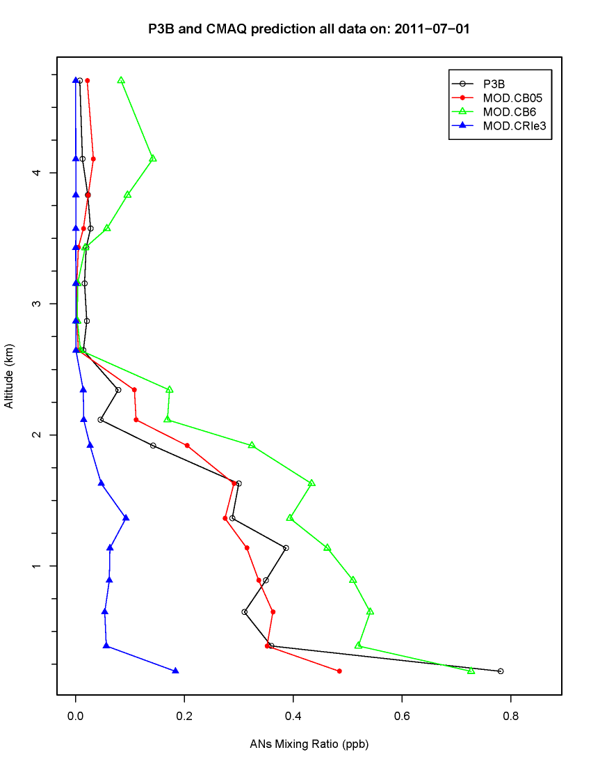
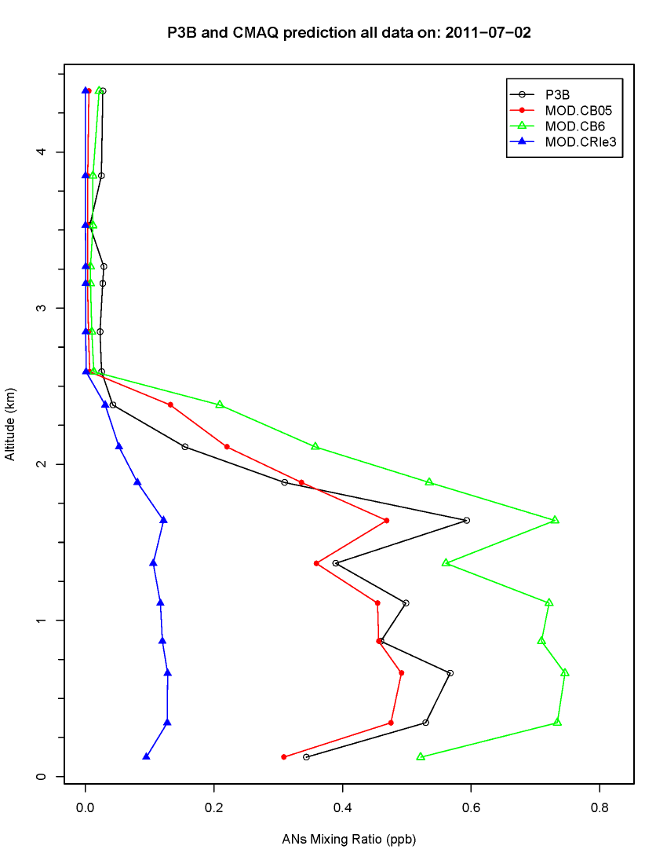
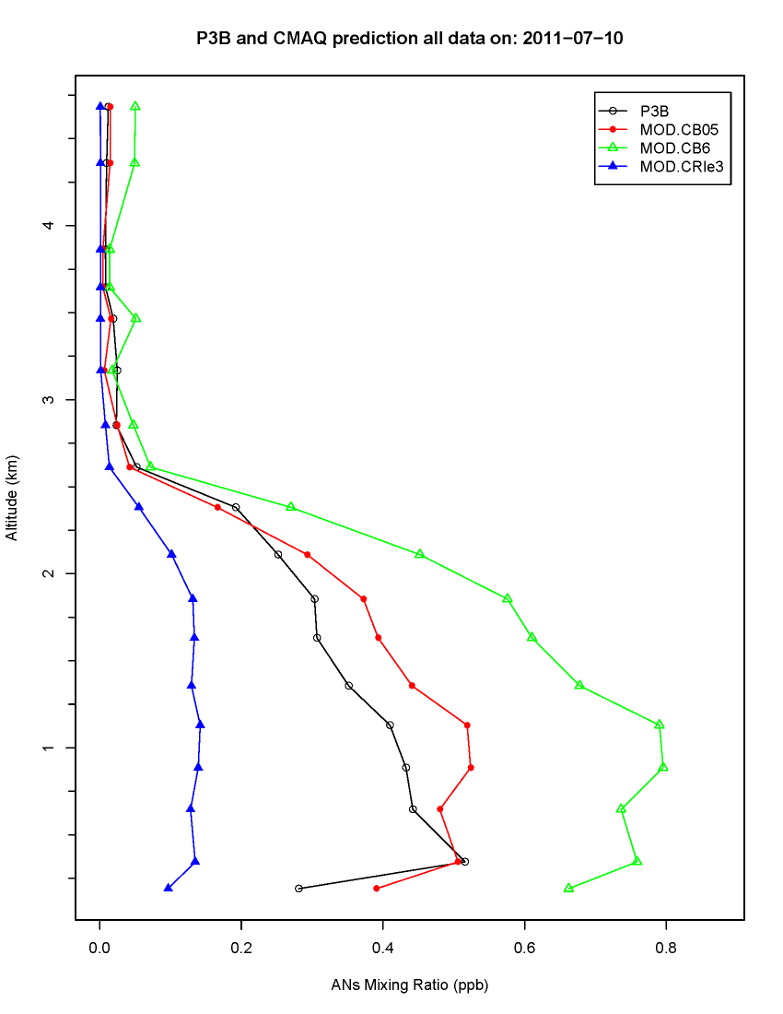
Another example of differences: vertical profiles of alkylnitrates compared to aircraft data in DISCOVER-AQ (Baltimore)
Measurements
CB05e51
CB6
CRI
4 km
3 km
2 km
1 km
Alkyl nitrate predictions depend on mechanism you choose (factor of 5 difference here!)

Slide 14
Errors in alkylnitrates can propagate to errors in criteria pollutants and deposition
aldehydes, acids, hydroperoxides, etc.
removal
+HO₂, RO₂
Example of semi-mechanistic description for biogenic nitrate SOA formation
Ozone
Peroxy radical
NO₂
+ OH, Cl, hν
+NO
+O₃
Alkyl nitrates
aerosols
VOC
aldehydes
+NO₃
Nitrooxy-peroxy radical
Organic nitrogen dry deposition
Organic nitrogen wet deposition
(Pye et al., ES&T, 2015)
(impact on nitrogen deposition discussed in Schwede CMAS presentation 2014)

Slide 15
The techniques that we have used in the past to create chemical mechanisms for Air Quality Models work well for ozone (what they were developed for), but don’t work so well for predicting concentrations of other species that will be important for future applications
Emerging pollutants
Aerosol components
Scale appropriate (i.e. urban→ global, surface →stratosphere)

Slide 16
Prototype for future mechanisms
New research findings
Mechanism for ozone and PM regulatory applications
Compare back for consistency
Highly detailed chemical mechanism with documentation
Automated series of condensation rules dependent on application
Mechanism for remote atmospheres
Mechanism for specialized applications, i.e. oil and gas applications
Mechanism when individual VOCs and organic aerosol components are available
Mechanisms for different applications are consistent, documented, and (relatively) easily generated (and updated)

Slide 17
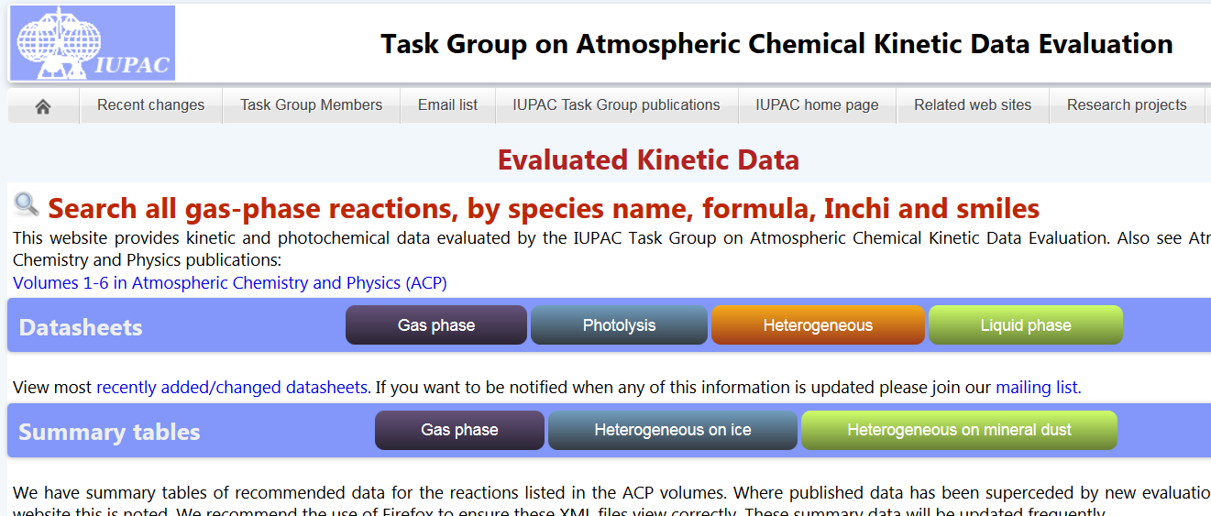
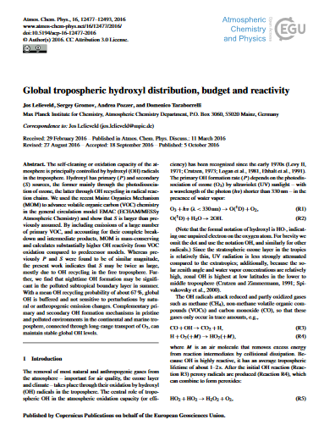
Components of the prototype: New research findings
New research findings
http://iupac.pole-ether.fr/
Other examples of sources:
http://jpldataeval.jpl.nasa.gov/
http://kinetics.nist.gov/kinetics/index.jsp
New data continually being updated and evaluated and is readily available, but we need a way to use it in models

Slide 18
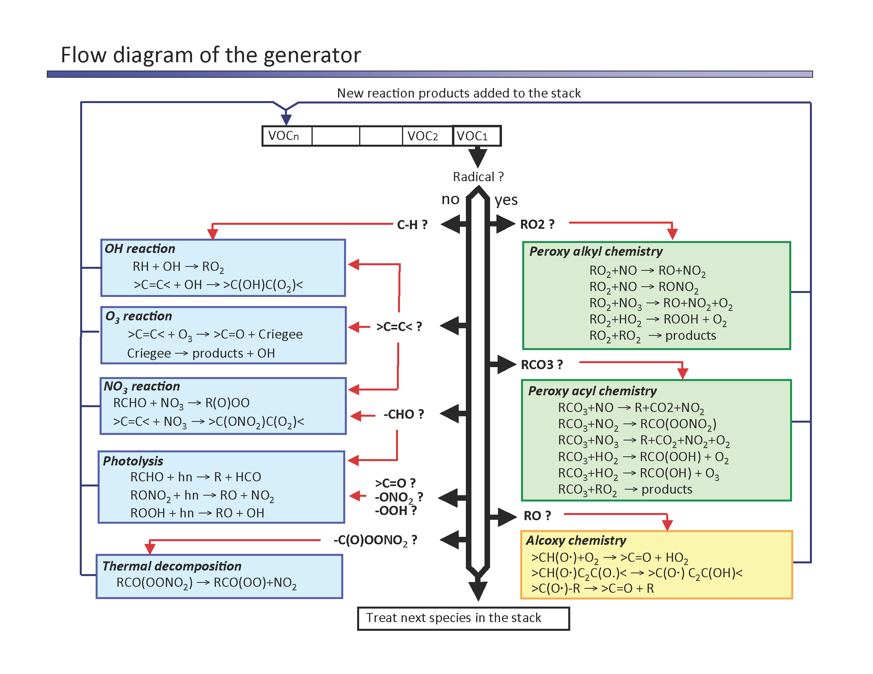
Components of the prototype: detailed mechanisms
Highly detailed chemical mechanism with documentation
Master Chemical Mechanism (http://mcm.leeds.ac.uk/MCMv3.3.1/home.htt)
SAPRC07 Mechanism Generation System
Bernard Aumont’s Automated Generator
(Aumont et al., Atmos. Phys. Chem. 2005)
Techniques are available for doing this but need more resources (and consistency!)

Slide 19
Components of the prototype: condensation techniques
Automated series of condensation rules dependent on application
Average of absolute change in O₃ for scenarios at various degrees of condensation for SAPRC-07
Carter “lumped process” derivations for SOA
Change in ozone
“Morpho” representation of detailed chemistry
Greg Yarwood (Ramboll ENVIRON): Test of protocol for condensation of alkane chemistry in MCM to Carbon Bond mechanism (emulating MCM in CB6)
CH3-CH2-CH2-CH3
Increased degree of condensation
(Carter presentation, CMAS, 2014)
alkane
Some proposals on how to do this but need more innovative ideas and input, more automation and resources, community “buy in”

Slide 20
Possible Futures for chemical mechanisms
Door number 1: Keep using the mechanisms that we have
  hope nothing bad happens
Door number 2: Continue using techniques we have, but try to keep patching them up
  updating mechanisms whenever some university/Agency has resources
  pursue a partially-mechanistic SOA formation route.
Door number 3: Step back and rethink how we develop mechanisms
  invest seriously in a better way to do this, so that different mechanisms/models are consistent, transparent and flexible for our future needs.

