Slide 1
Multi-Model Comparison of Lateral Boundary Contributions to Surface Ozone
Over the United States
Peng Liu¹, Christian Hogrefe¹, Johannes Bieser², Ulas Im³, Rohit Mathur¹, Uarporn Nopmongcol⁴, Shawn Roselle¹, Tanya Spero¹
¹ National Exposure Research Laboratory, U.S. Environmental Protection Agency, Research Triangle Park, NC, 27711, USA
² Helmholtz-Zentrum Geesthacht, Institute of Coastal Research, Max-Planck-str. 1 21502 Geesthacht, Germany
³ Aarhus University, Department of Environmental Science, Roskilde, Denmark
⁴ Ramboll Environ, 773 San Marin Drive, Suite 2115, Novato, CA 94945, USA
CMAS Conference
Chapel Hill, NC, October 24-26, 2016
Notes:
Focus: compare H-CMAQ with other 3 global CTMs

Slide 2
Motivation & Goals
As the National Ambient Air Quality Standards (NAAQS) for ozone become more stringent, there has been growing attention on characterizing the contributions and the uncertainties in ozone from outside the US to the ozone concentrations within the US.
The Air Quality Model Evaluation International Initiative Phase III (AQMEII3) provides an opportunity to investigate this issue through the combined efforts of multiple research groups from the US and Europe.
In this study, results from 4 models are analyzed, covering a range of important components of model uncertainty (Solazzo and Galmarini, 2016).
The implementation of chemically inert boundary tracers may help to provide process-level insights on model differences associated with simulated impacts of BCs on surface O₃.
diagnostic tool, NOT source apportionment approach
Notes:
Winter largest (Rural minus Urban), could be challenging to simulate
Similar inert tracer conc b/w rural and urban

Slide 3
Model Description
Operation Institution | Global Meteo Driving Field | Regional Modeling System | Horizontal Resolution | Vertical Layers | Gas Phase Chemistry Module | Dry Deposition
Helmholtz-Zentrum Geesthacht | NCEP | COSMO-CLM/ CMAQ5.0.1 | 24km | 30 layers ~40m to 50hPa | CB05-TUCL | Pleim and Ran (2011)
U.S. EPA | NCEP | WRF3.4/ CMAQ5.0.2 | 12km | 35 layers ~19m to 50hPa | CB05-TUCL | Pleim and Ran (2011)
RAMBOLL Environ | NCEP | WRF3.4/ CAMx6.2 | 12km | 26 layers to 97.5hPa | CB05 | Zhang et al. (2003)
Aarhus University | ECMWF | WRF/ DEHM | 50km | 29 layers to 100hPa | Brandt et al. (2012) | Simpson et al. (2003)
Chemical boundary conditions: ECMWF’s C-IFS
Anthropogenic Emissions: WRF/DEHM----HTAP (Janssens-Maenhout et al., 2015)
other models----gridded hourly emissions provided by EPA using SMOKE
same annual total
Spin-up: a spin-up of about 10 days before the year-long simulation (year 2010)
Notes:
Difference in models are summarized in this table
covering a range of representations of chemical and physical processes, vertical and horizontal resolutions, and meteorological fields to drive the regional chemical transport models (CTMs), all of which are important components of model uncertainty.
HTAP emissions: annual total for each grid (0.1 by 0.1 degree, which is comparable with the 12km WRF/CMAQ emissions). The key difference in emission process is how speciation and temporally allocation is done for HTAP and SMOKE emissions.

Slide 4
Model Description Cont’d ----
AQMEII3 Boundary Condition Tracers for Ozone
Modeling groups used chemically inert tracers.
These tracers were designed to track the inflow of ozone from the lateral boundaries at different altitude ranges:
  BC1: O₃ boundary conditions below 750 mb
  BC2: O₃ boundary conditions between 750 mb and 250 mb
  BC3: O₃ boundary conditions above 250 mb
  BC4: O₃ boundary conditions at any altitude
The tracers undergo advection, diffusion, cloud mixing/transport, scavenging, and deposition, with no emissions or chemical formation/destruction occurring within the modeling domain.

Slide 5
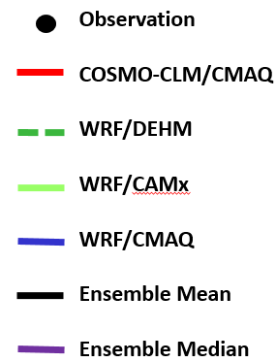
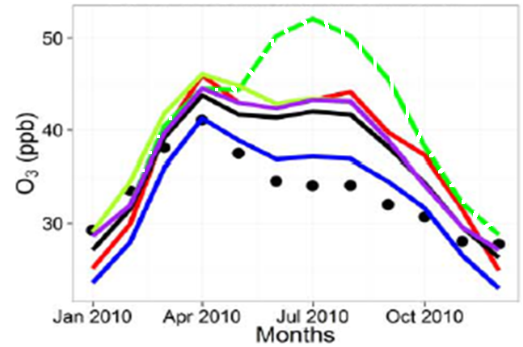
Model Performance For Monthly Averaged Hourly and DM8A O₃
How may BCs contribute to the difference? --- investigate spatial gradients in O₃ and tracers (rural vs. urban sites)
--- investigate spatial distributions of O₃ and tracers
Similar seasonal trend for all models except WRF/DEHM.
In general, WRF/CMAQ outperforms with respect to monthly mean, especially from Apr to Nov 2010, suggesting WRF/CMAQ has smaller bias in long-term processes, such as seasonal variation in biogenic emissions and O₃ from lateral boundaries.
For winter, other 3 models tend to be better.
(courtesy of Ulas Im, Aarhus University )
O3 concentration is averaged over all sites, including CASTNet, AQS, NAPS, some sites in Canada.
Notes:
Similar year trend for all models except WRF/DEHM
In general, WRF/CMAQ outperforms, especially from Apr to Nov 2010
For winter and early spring, other 3 models tend to be better.

Slide 6
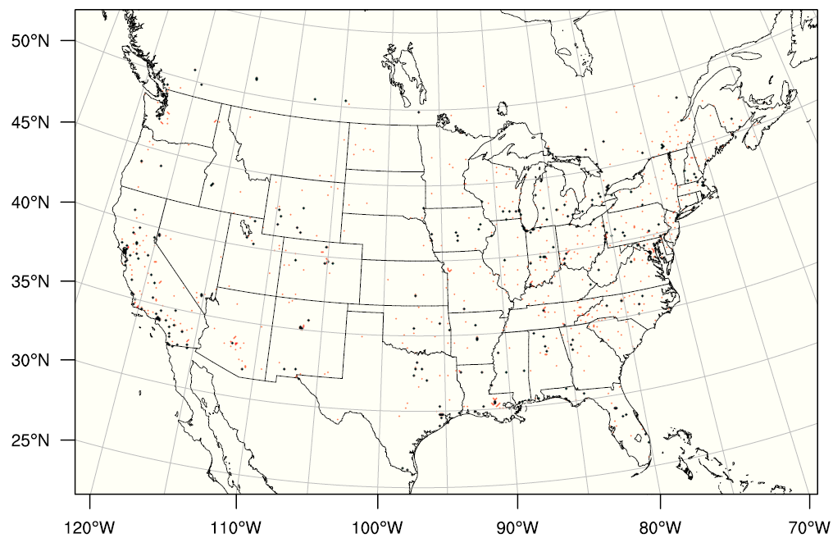
DM8A O₃ in 2010: Rural vs. Urban sites
Metric of interest:
[DM8A of all rural sites]
minus
[DM8A of all urban sites]
[ ]: average over sites
Rural sites (618)
Urban sites (277)
Notes:
Model’s ability to simulate the spatial gradient of O3 concentrations

Slide 7
WRF/CMAQ and WRF/CAMx
DM8A O₃ of 2010: Rural vs. Urban sites
 | Obs (ppt) | WRF/ CMAQ | WRF/ CAMx
year | 3.6 | 2.3 | 2.4
winter | 5.7 | 3.3 | 3.6
spring | 3.5 | 2.1 | 2.4
summer | 1.8 | 0.9 | 0.8
fall | 3.6 | 2.7 | 2.6
Observational data showed there is a clear contrast b/w rural and urban sites throughout the year, with the largest difference during winter (~ 6 ppb).
WRF/CMAQ and WRF/CAMx show little difference, with the following common features:
(1) underestimate the contrast (as expected), with ~ 2ppb in winter and ~1ppb in other seasons
(2) reproduce the peaks
Reasons behind the similar performance? (e.g. similar performance at the process level or compensating effects?) Does BC O3 play a role?
Notes:
Obs gives largest contrast druing winter.
WRF/CMAQ and WRF/CAMx show little difference, with features:
Both are able to reproduce the peaks all over the year
Both underestimate the contrast by 2 ppb in winter, and about 1ppb in other seasons.
But reasons behind similar performance ?

Slide 8
WRF/CMAQ and WRF/CAMx
DM8A O₃ of 2010: Rural vs. Urban sites----Cont’d
DM8A O₃ (total tracer) | Rural Sites |  | Urban Sites
 | WRF/CMAQ ppb | WRF/CAMx ppb | WRF/CMAQ ppb | WRF/CAMx ppb
winter | 33.5 (29.8) | 37.4 (33.7) | 30.2 (30.1) | 33.9 (33.6)
spring | 49.1 (40.4) | 51.8 (42.7) | 47.0 (41.0) | 49.4 (42.7)
summer | 50.2 (35.3) | 52.3 (40.1) | 49.2 (35.7) | 51.4 (39.6)
fall | 42.1 (32.5) | 42.1 (33.8) | 39.4 (32.9) | 39.5 (33.9)
DM8A O₃ (total tracer) | Rural Sites |  | Urban Sites
 | WRF/CMAQ ppb | WRF/CAMx ppb | WRF/CMAQ ppb | WRF/CAMx ppb
winter | 33.5 (29.8) | 37.4 (33.7) | 30.2 (30.1) | 33.9 (33.6)
spring | 49.1 (40.4) | 51.8 (42.7) | 47.0 (41.0) | 49.4 (42.7)
summer | 50.2 (35.3) | 52.3 (40.1) | 49.2 (35.7) | 51.4 (39.6)
fall | 42.1 (32.5) | 42.1 (33.8) | 39.4 (32.9) | 39.5 (33.9)
3.9 ppb
3.7 ppb
2.7 ppb
2.4 ppb
2.1 ppb
2.2 ppb
0.0 ppb
0.1ppb
Except fall, WRF/CAMx exhibits higher DM8A O₃ with similar magnitude at rural and urban sites.
Major factors that drive uniformly higher O₃ are not related to chemical processes.
WRF/CAMx also exhibits uniformly higher mixing ratios of inert tracers.
Higher surface O₃ in WRF/CAMx may result from more O₃ originated from lateral boundaries.
Notes:
All seasons except fall, WRF/CAMx consistly has higher estimate in O3, with similar magnitude in higher O3 between urban and rural sites (~ 4ppb in winter, and ~2ppb in spring and summer). Meanwhile, WRF/CAMx also consistly higher values in tracer concentrations.
Suggesting that higher predicted surface O3 in CAMx may be related to model’s different response to O3 from lateral boundaries.

Slide 9
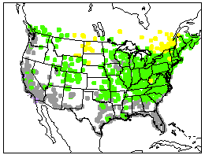
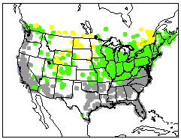
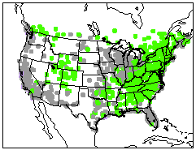
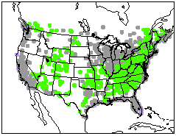

WRF/CMAQ and WRF/CAMx
Spatial Patterns in O₃ Differences vs. Tracer Differences
WRF/CAMx minus WRF/CMAQ
Winter Spring
DM8A O₃ Tracer (ppb)
DM8A O₃ Tracer (ppb)
(ppb)
(ppb)
The spatial distributions of modeled differences in O₃ and tracer mixing ratios are highly correlated, suggesting model’s response to O₃ from lateral boundaries may play a major role in causing the differences in predicted surface O₃.
Notes:
Spatial pattern give us more confidence w.r.t the role played by BC O3 in model difference

Slide 10
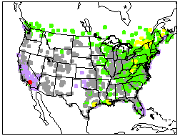
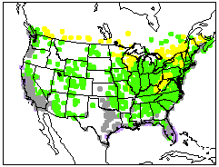
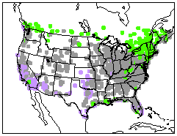
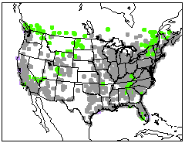
WRF/CMAQ and WRF/CAMx
Spatial Patterns in O₃ Differences vs. Tracer Differences----Cont’d
WRF/CAMx minus WRF/CMAQ
Summer Fall
DM8A O₃ Tracer (ppb)
DM8A O₃ Tracer (ppb)
(ppb)
(ppb)
In summer, the spatial distributions of modeled differences in O₃ and tracer mixing ratios do not match with each other, suggesting model differences in chemical processes play a larger role in causing model-to-model surface O₃ differences while the models’ different response to O₃ from lateral boundaries becomes less important.
Notes:
Spatial pattern give us more confidence w.r.t the role played by BC O3 in model difference

Slide 11
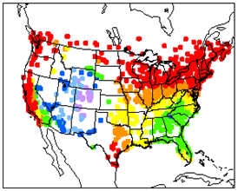
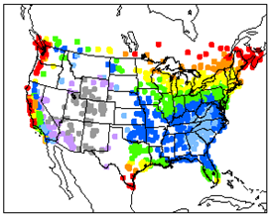

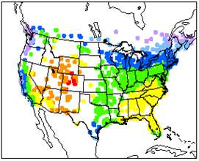
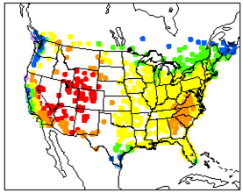

WRF/CMAQ and WRF/CAMx
Processes Leading to Different Contributions of Boundary O₃ to Surface O₃
Vertical Mixing
WRF/CMAQ WRF/CAMx
percentage of tracer from
lower atmosphere (>750 hPa)
to total tracer at surface
Chemically inert tracers at different altitudes provide insights.
(%)
percentage of tracer from
middle atmosphere
(250 ~ 750 hPa)
to total tracer at surface
Dry Deposition (on going)
(%)
Notes:
I will emphasize the relative contribution is to BC4, not surface O3 mixing ratio

Slide 12
COSMO-CLM/CMAQ and WRF/DEHM
DM8A O₃ of 2010: Rural vs. Urban Sites
 | Obs (ppb) | COSMO-CLM/ CMAQ | WRF/ DEHM
year | 3.6 | 0.6 | 1.7
winter | 5.7 | 0.7 | 2.2
spring | 3.5 | 0.7 | 1.4
summer | 1.8 | 0.4 | 1.3
Fall | 3.6 | 0.6 | 1.9
As spatial resolution get coarser (24km for COSMO-CLM/CMAQ and 50km for WRF/DEHM), the models are not able to reproduce the spatial gradient between rural and urban sites.

Slide 13
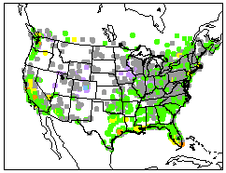
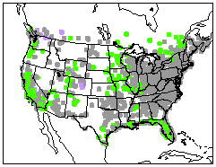

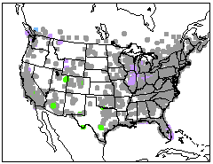
COSMO-CLM/CMAQ and WRF/CMAQ
Spatial Patterns in O₃ Differences vs. Tracer Differences
COSMO-CLM/CMAQ minus WRF/CMAQ
Winter Spring
DM8A O₃ Tracer (ppb)
DM8A O₃ Tracer (ppb)
(ppb)
(ppb)
In seasons when the impact from BCs is usually strong, the spatial distributions of modeled differences in O₃ and tracers are little correlated , suggesting model’s difference in O₃ may not be explained by the impacts from BCs.
Notes:
Not compared with WRF/DEHM, because it turns out that DEHM did not include the deposition process for tracers. Hence, COSMO-CLM/CMAQ is compared with other 2 models.
Compare the spatial distribution of tracer and DM8A in COSMO-CLM/CMAQ minus WRF/CMAQ
the overestimate of O3 in COSMO-CLM/CMAQ are not spatially correlated to overestimate of tracer, which is on the contrary to WRF/CAMx minus WRF/CMAQ

Slide 14
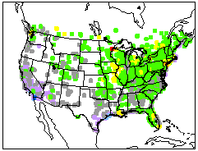
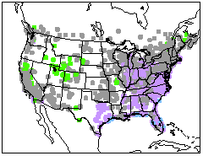
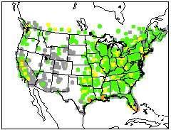
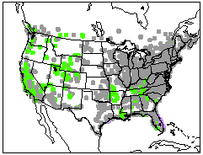
COSMO-CLM/CMAQ and WRF/CMAQ
Spatial Patterns in O₃ Differences vs. Tracer Differences
COSMO-CLM/CMAQ minus WRF/CMAQ
Summer Fall
DM8A O₃ Tracer (ppb)
DM8A O₃ Tracer (ppb)
(ppb)
(ppb)
The model’s difference in surface O3 may mainly result from the impacts of model resolutions on chemical processes.
Notes:
Not compared with WRF/DEHM, because it turns out that DEHM did not include the deposition process for tracers. Hence, COSMO-CLM/CMAQ is compared with other 2 models.
Compare the spatial distribution of tracer and DM8A in COSMO-CLM/CMAQ minus WRF/CMAQ
the overestimate of O3 in COSMO-CLM/CMAQ are not spatially correlated to overestimate of tracer, which is on the contrary to WRF/CAMx minus WRF/CMAQ

Slide 15
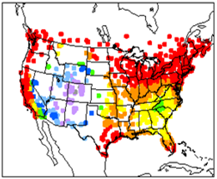
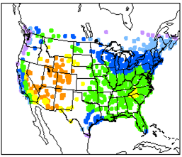
COSMO-CLM/CMAQ , WRF/CMAQ and WRF/CAMx
Difference in Vertical Mixing
Diff MET; Same CTM
Same MET; Diff CTM
COSMO-CLM/CMAQ
WRF/CMAQ
WRF/CAMx
Percentage of tracer from
lower atmosphere
to total tracer at surface
(%)
Percentage of tracer from
middle atmosphere
to total tracer at surface
(%)
Notes:
Compare the 3 models in terms of vertical mixing processes through inert tracers
Also say middle atmosphere has the largest impact on surface O3 from lateral boundaries

Slide 16
Conclusions & Future Work
The analysis of results contributed by different AQMEII3 modeling groups shows substantial model-to-model differences in terms of O₃ concentrations, spatial gradients and spatial distribution of DM8A O₃.
The analysis of chemically inert tracers suggests that the model-to-model differences can in part result from models responding differently to BC O₃ due to model configurations and process representations.
We hypothesize that the treatment of vertical mixing may play an important role in determining the model’s response to BC O₃. The impact of dry deposition is still under investigation.
More analysis will be conducted regarding the vertical profile of O₃ and tracers, and process analysis of WRF/CMAQ simulations.

Slide 17
References
Solazzo, E. and Galmarini, S. (2016): Error apportionment for atmospheric chemistry-transport models – a new approach to model evaluation, Atmos. Chem. Phys., 16, 6263-6283, doi:10.5194/acp-16-6263-2016.
Janssens-Maenhout, G., Crippa, M., Guizzardi, D., Dentener, F., Muntean, M., Pouliot, G., Keating, T., Zhang, Q., Kurokawa, J., Wankmüller, R., Denier van der Gon, H., Kuenen, J. J. P., Klimont, Z., Frost, G., Darras, S., Koffi, B., and Li, M. (2015) : HTAP_v2.2: a mosaic of regional and global emission grid maps for 2008 and 2010 to study hemispheric transport of air pollution, Atmos. Chem. Phys., 15, 11411-11432, doi:10.5194/acp-15-11411-2015.
Brandt, J., J. D. Silver, L. M. Frohn, C. Geels, A. Gross, A. B. Hansen, K. M. Hansen, G. B. Hedegaard, C. A. Skjøth, H. Villadsen, A. Zare, and J. H. Christensen (2012): An integrated model study for Europe and North America using the Danish Eulerian Hemispheric Model with focus on intercontinental transport. Atmospheric Environment 53, 156-176.
Pleim, J., Ran, L. (2011): Surface Flux Modeling for Air Quality Applications. Atmosphere 2, 271-302
Zhang, L., J. R. Brook, and R. Vet. (2003): A revised parameterization for gaseous dry deposition in air-quality models. Atmos. Chem. Phys., 3, 2067–2082.
Simpson, D., Fagerli, H., Jonson, J.E., Tsyro, S., Wind, P., Tuovinen, J.-P. (2003): Transboundary Acidification, Eutrophication and Ground Level Ozone in Europe, PART I, Unified EMEP Model Description, p. 104.
Notes:
Do we expect the results be different if make O3 tracers involved in chemistry? What kind of modification needed to make O3 tracer active?

Slide 18
Back Up Slides

Slide 19
WRF/CMAQ and WRF/CAMx
DM8A Ozone of 2010: Rural vs. Urban site ---- Cont’d
DM8A O3 (total tracer) | Observation |  | WRF/CMAQ |  | WRF/CAMx
 | Rural | Urban | Rural | Urban | Rural | Urban
winter | 37.5 | 31.8 | 33.5 (29.8) | 30.2 (30.1) | 37.4 (33.7) | 33.9 (33.6)
spring | 48.6 | 45.1 | 49.1 (40.4) | 47.0 (41.0) | 51.8 (42.7) | 49.4 (42.7)
summer | 46.7 | 44.9 | 50.2 (35.3) | 49.2 (35.7) | 52.3 (40.1) | 51.4 (39.6)
fall | 40.9 | 37.2 | 42.1 (32.5) | 39.4 (32.9) | 42.1 (33.8) | 39.5 (33.9)

Slide 20
COSMO-CLM/CMAQ and WRF/CMAQ
DM8A Ozone of 2010: Rural vs. Urban sites
DM8A O3 (total tracer) | COSMO-CLM/CMAQ |  | WRF/CMAQ
 | Rural | Urban | Rural | Urban
winter | 34.8 (31.3) | 34.1 (32.0) | 33.5 (29.8) | 30.2 (30.1)
spring | 50.8 (40.5) | 50.1 (41.1) | 49.1 (40.4) | 47.0 (41.0)
summer | 52.7 (34.1) | 52.3 (34.5) | 50.2 (35.3) | 49.2 (35.7)
fall | 45.7 (33.7) | 45.1 (34.3) | 42.1 (32.5) | 39.4 (32.9)
COSMO-CLM/CMAQ vs. WRF/CMAQ
Similar inert tracer concentrations though using different meteorological drivers and different model resolution
Higher O3 in COSMO-CLM/CMAQ, but less difference b/w rural and urban sites
Suggesting that the different model configuration (especially in the spatial resolution) b/w COSMO-CLM/CMAQ and WRF/CMAQ has:
(1) little impacts of transport, vertical mixing and wet/dry deposition on O3
(2) more impact on chemical processes, especially at urban sites.
Notes:
Not compared with WRF/DEHM, because it turns out that DEHM did not include the deposition process for tracers.

