Slide 1
Source Apportionment of Fine Particulate Matter in Yunlin County, Taiwan
Yi-Ju Lee and Fang-Yi Cheng
Department of Atmospheric Science, National Central University
Oct 25, 2015
Notes:
Good morning everyone, my name is Yi-Ju Lee. In today’s presentation I would like to talk about source apportionment of fine particulate matter in Yunlin County in Taiwan.

Slide 2
Outline
Introduction and Motivation
Model configuration
Experiments
Discussion
Conclusion
Reference
Notes:
This is my outline. Firstly, I want to introduce some information for you and why did I do this study. After that we will look at the setup of the models and the experiments, and finally I’ll show you the results.

Slide 3
Introduction and Motivation
Notes:
To begin with the short introduction and motivation.

Slide 4
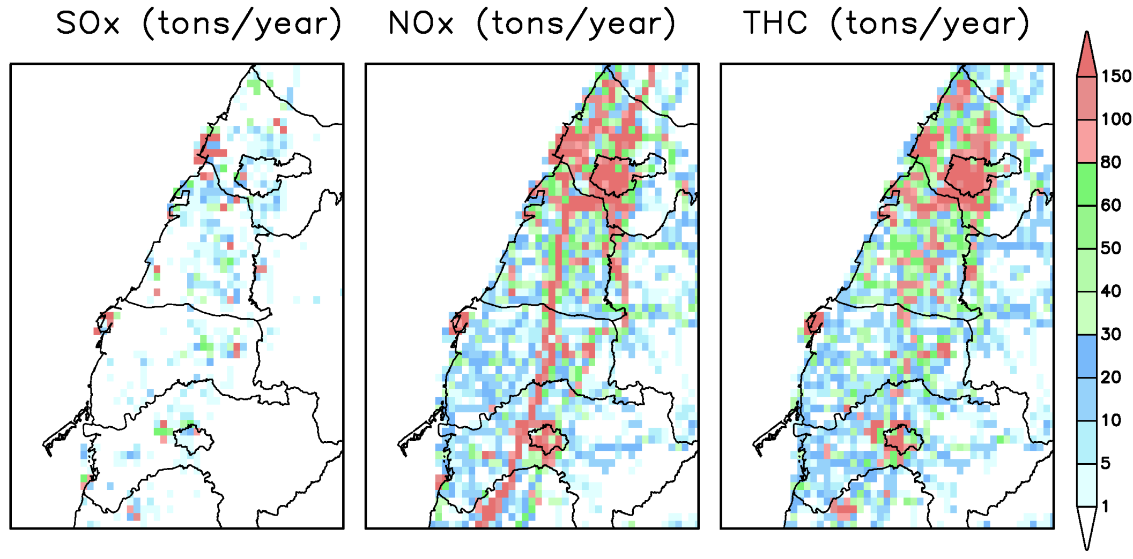
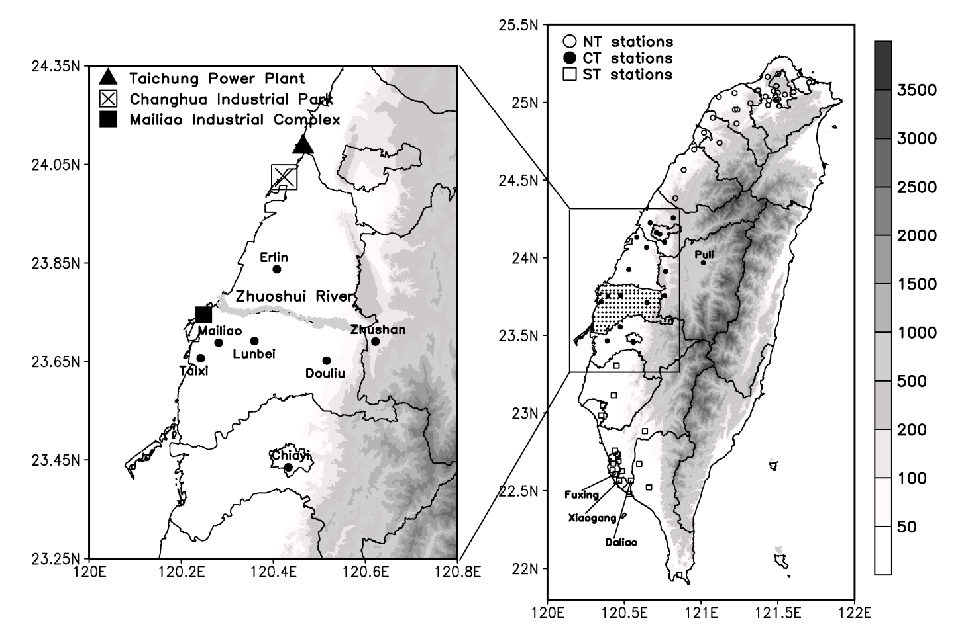
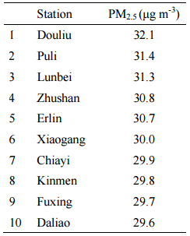
Introduction
Yunlin County is located in central portion of western Taiwan.
Major emissions : industry, vehicle exhausts and burnings of agricultural wastes
Taiwan Emission
Inventory
2014 - 2015
Taichung
power plant
Taichung
■
Changhua
Mailiao
industry
Yunlin
Unit : m
(Hsu and Cheng, 2016)
Notes:
Taiwan is an island on the northwest side of the Pacific Ocean. And, Yunlin County is located in central-southern portion of western Taiwan. The black dots on the picture represent the location of the EPA surface monitoring stations. And, it also points out some locations of industrial plants like Mailiao industrial complex, Changhua industrial park and Taichung power plant. From 2014 to 2015, the averaged PM_{2.5} concentration in Douliu and Lunbei are ranked as the top highest stations in Taiwan. The average concentration of PM_{2.5} was higher than the annual average standard which is 15μg/m3. (microgram per cubic meter)
In order to improve the air quality, the first important thing we must be know is where did the pollutants come from? From Taiwan emission inventory, the major emissions in Yunlin are industrial emissions, vehicle exhausts, and burnings of agricultural wastes.

Slide 5
Objective
Hsu and Cheng (2016) showed that PM_{2.5} concentrations in Yunlin County can be affected by different weather patterns.
The local circulation might transport the air pollutants toward the inland areas and induce high concentration.
Objective: to investigate main emission source that contributes to PM_{2.5} concentration in Yunlin County under different weather conditions using CMAQ source apportionment technique.
Notes:
In additions, previous study had shown that meteorological environment was associated with the concentrations of pollutants. The local circulation such as the land-sea breeze might transport the air pollutants toward the inland areas and induce high concentration. This study investigated the main emission source that contributes to the PM_{2.5} concentration in Yunlin in the different weather conditions using the CMAQ source apportionment technique.

Slide 6
Source apportionment
SA provides information as to the most important potential sources of PM_{2.5}.
Brute Force Method (BFM) – source sensitivity
Comparing results of base model and model with perturbed emissions.
Integrated Source Apportionment Method (ISAM) – tag species
Tracking tagged species from emission source groups and/or regions.
Computational time is less then BFM.
Notes:
There were some methods for us to study where did the pollutants come from. Source apportionment is a tool that provides information as to the most important potential sources of PM_{2.5}. BFM is source sensitivity method that compares results of base model and the model with perturbed emissions. On the other hand, ISAM is tagged species method that tracks tagged species from specific emission sources groups or regions. Furthermore, the computing time that ISAM needed is less than BFM. This study used both methods which are belongs to source–oriented method.

Slide 7
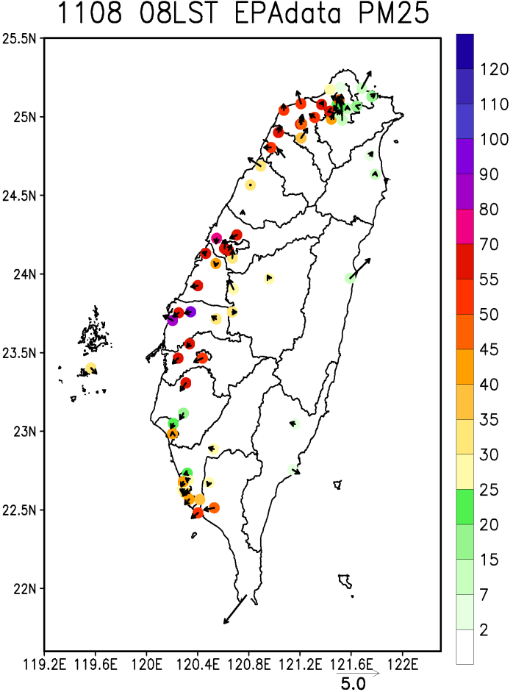
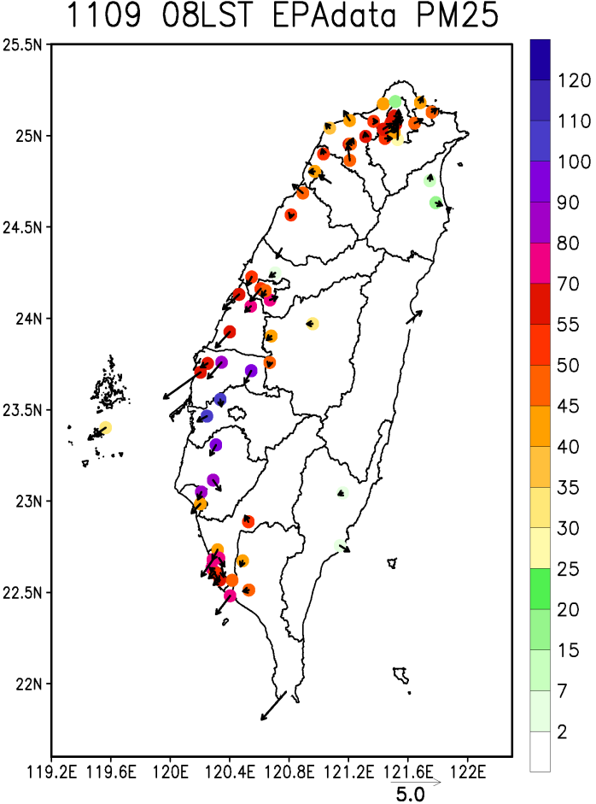
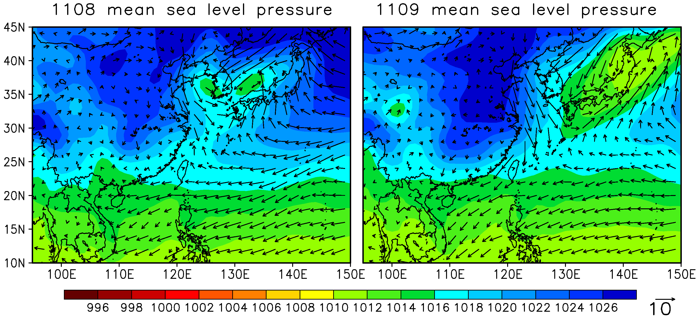
Description of simulation episode (11/8 – 11/9, 2015)
Nov 8 was associated with weak synoptic weather condition.
Nov 9 was affected by weak northeasterly monsoonal flaw.
PM_{2.5} concentration is higher on Nov 9 than on Nov 8.
NCEP FNL reanalysis data
Color unit : hPa ; Bar unit : m/s
Unit : μg/m³
Notes:
The high pollution episode is from Nov 8 to Nov 9, 2015. According to NCEP FNL reanalysis data, Nov 8 was associated with a weak synoptic weather condition. On Nov 9, Taiwan was affected by a continental anticyclone. The wind became northeasterly and the wind speed was also higher than Nov 8. On Nov 8, the environment of slower wind speed was conducive to the accumulation of pollutants and caused high concentration. On the other hand, excepted of local emission, the wind direction turned to northeasterly and brought northern emissions to Yunlin. It caused the PM_{2.5} concentration was higher on Nov 9 than on Nov 8. This study focused on the different environments to investigate the sources of PM_{2.5}.

Slide 8
Model configuration
Notes:
Now let’s move on to model configuration.

Slide 9
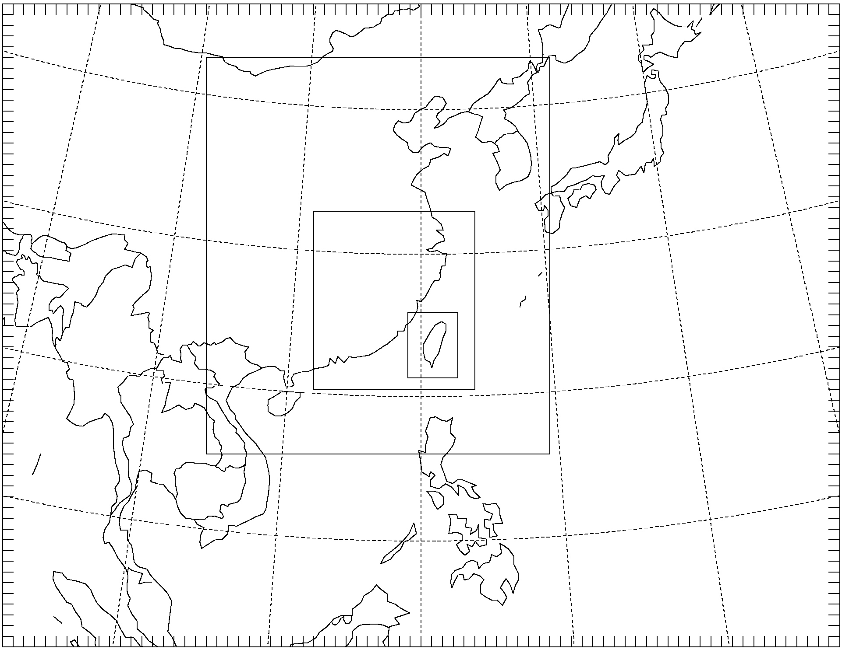
Model configuration
WRFv3.7.1 | D01 | D02 | D03 | D04
Resolution | 81km | 27km | 9km | 3km
Reanalysis data | NCEP FNL (1°x1°, 6 hour)
Vertical levels | 48 (top 5000Pa)
Boundary-layer scheme | YSU
Observational nudging | X |  |  |  | V
Simulation periods :
2015/11/03 00UTC – 11 00UTC
OBSnudging : every hour
CWB and EPA monitoring stations data
Temperature and wind
CMAQv5.0.2
Resolution |  | 3km
Vertical levels |  | 20
Meteorology |  | WRFv3.7.1 / MCIPv4.2
Emission | Anthropogenic | Taiwan emission inventory
 | Biogenic | MEGANv2.04
Chemical mechanism |  | CB05tucl
Aerosol chemistry |  | AERO6
D01
D02
D03
D04
Notes:
The meteorological data for CMAQ was simulated through WRF version 3.7.1 and set the four nested domains with the resolutions 81/27/9/3 km. The simulation periods are from Nov 3, 2015 to Nov 10, 2015. Besides, the observational nudging technique is applied in WRF model to nudge surface observed temperature, wind speed and wind direction data from Taiwan CWB and EPA stations to improve the meteorological conditions. The CMAQ version 5.0.2 is conducted with the same simulation periods as WRF model.

Slide 10
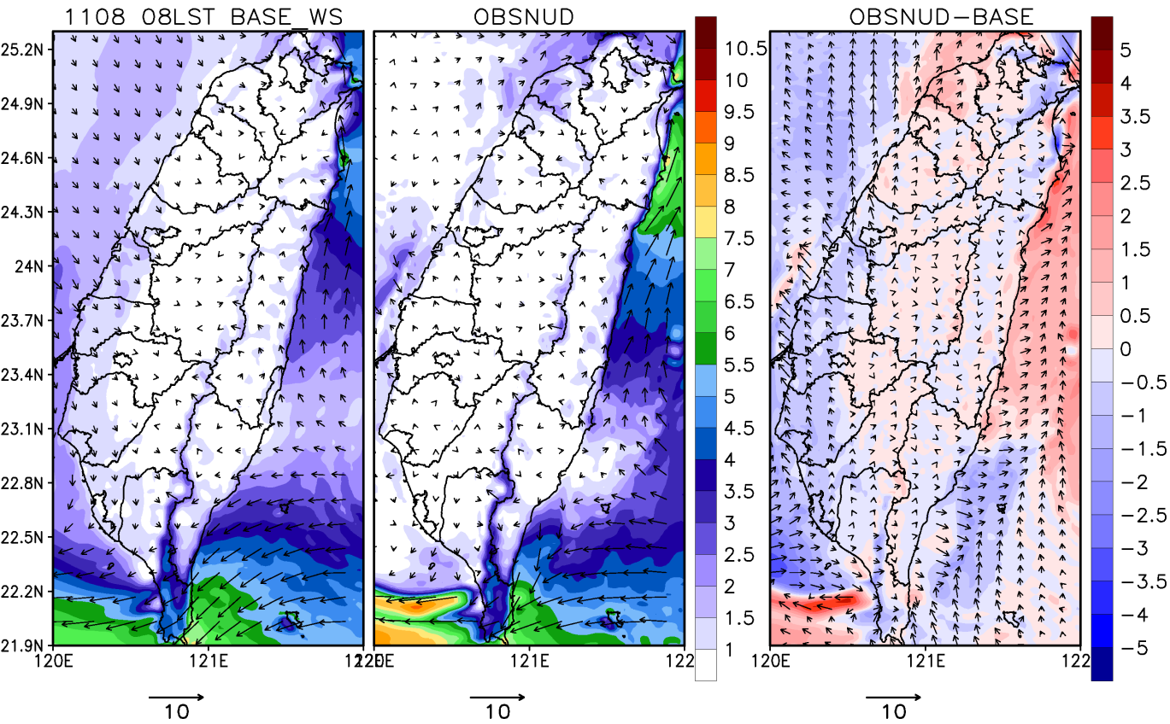
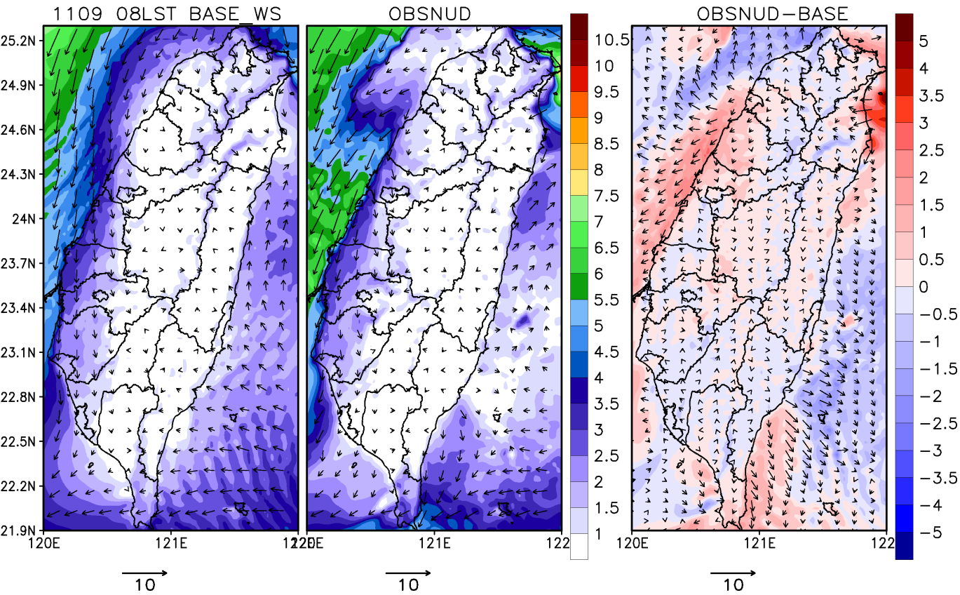
Comparison of simulated wind fields
Wind speed was weaker on Nov 8 due to weak synoptic weather forcing.
There was a weak northeasterly monsoonal flow on Nov 9.
OBSNUD simulates lower wind speed than base case in central portion of western Taiwan.
1108 08LST
1109 08LST
Unit : m/s
Unit : m/s
Notes:
According to the simulated results from WRF, the left picture is base model, the center picture is OBSNUD and the right picture is the difference. The color shaded and the vectors are representing the wind speed and wind direction, respectively. Nov 8 had the lower wind speed than Nov 9. Besides, there was weak south wind component on Nov 8 but turned to northeasterly wind on Nov 9. After nudging the observation data, the wind speed becomes smaller in central portion of western Taiwan which may cause the pollutants to stay in place to accumulate.

Slide 11
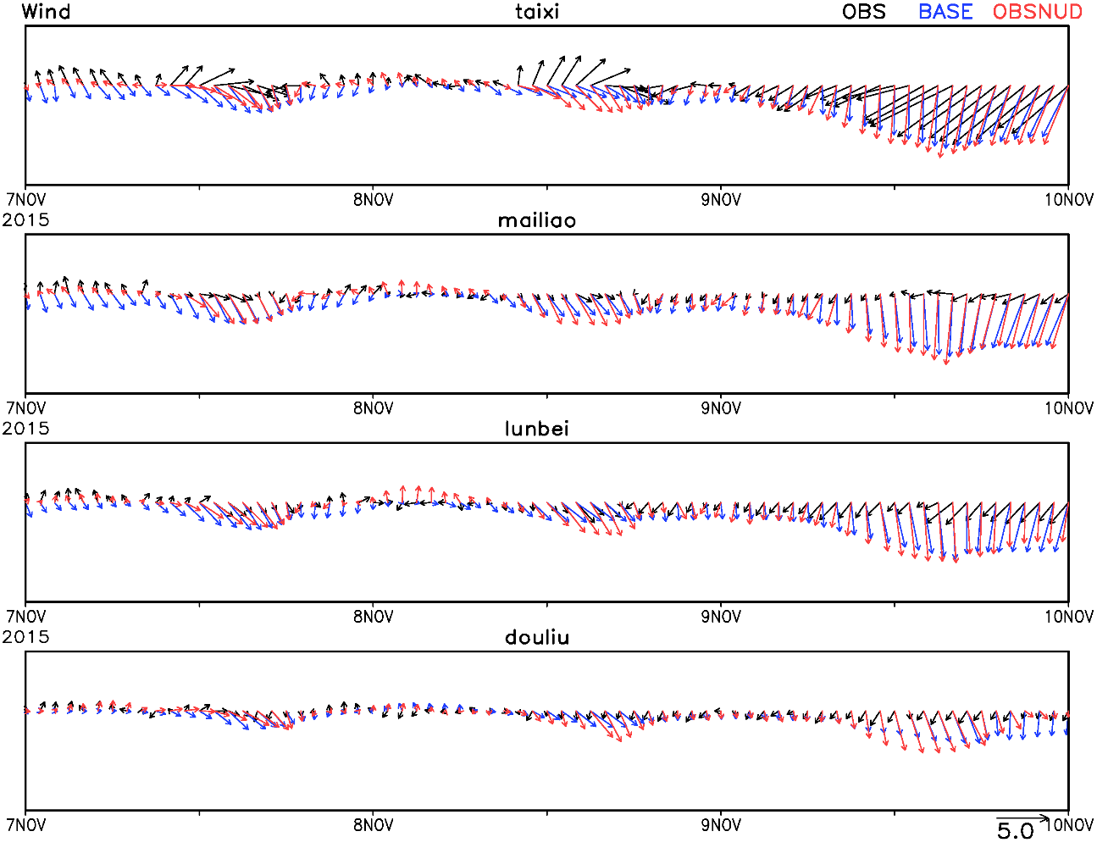
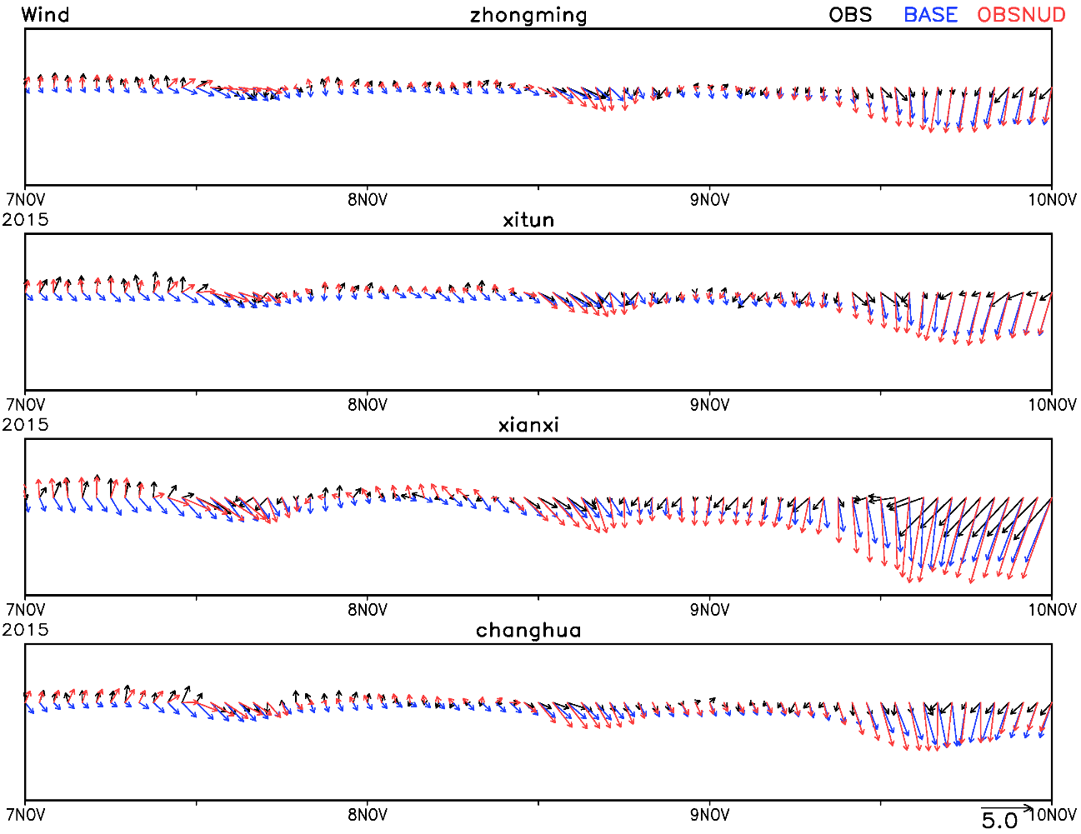
Evaluation of simulated wind fields
WRF simulation with OBSnuding technique improves the simulation of wind fields showing weaker wind speed and better land-sea breeze flow.
Yunlin
Taichung
Unit : m/s
Unit : m/s
Notes:
Comparing to the monitoring stations in Yunlin and Taichung. The black, blue and red vectors are representing the wind from observation, base model and OBSNUD, respectively. The pattern of wind direction from OBSNUD is similar to the observed value.

Slide 12
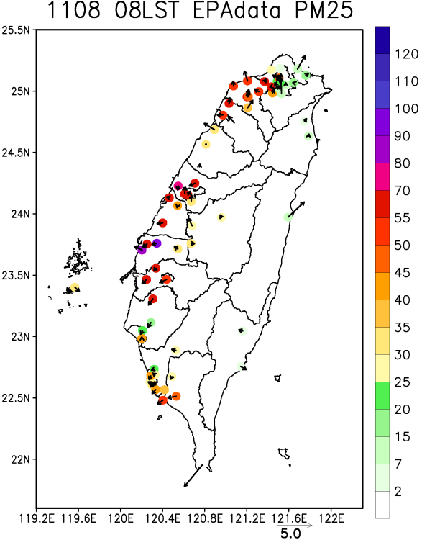
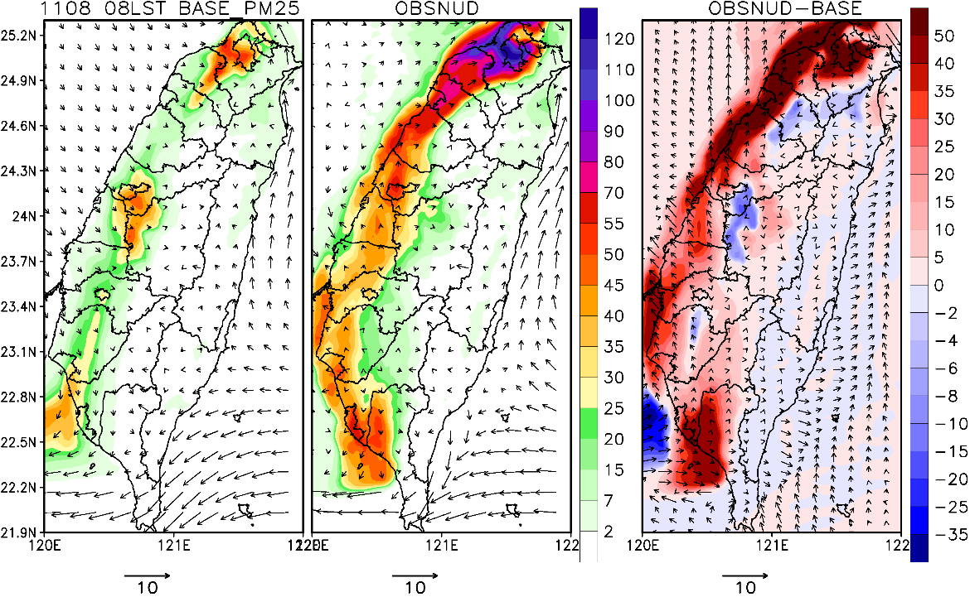
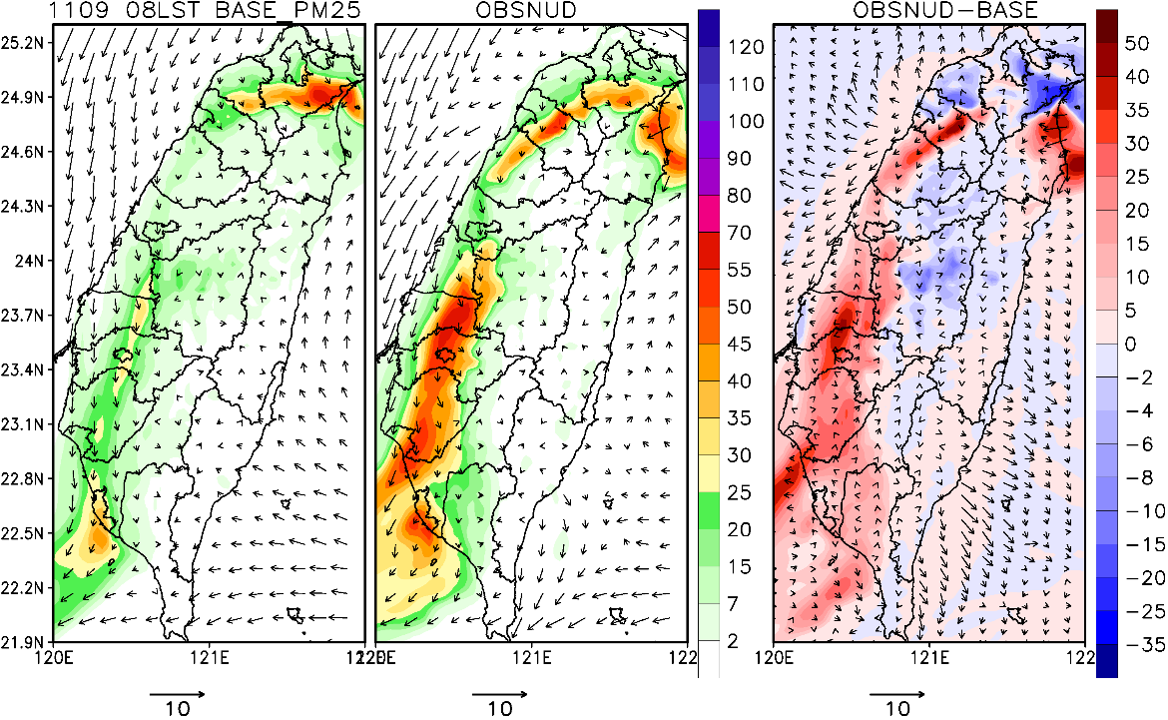
Comparison of simulated PM_{2.5} concentration
CMAQ simulation with OBSNUD shows weaker wind fields that accumulates more PM_{2.5} near emission source region.
1108
08LST
1109
08LST
Color unit : μg/m³
Bar unit : m/s
Notes:
Therefore, for the PM_{2.5} concentration. This is observed values from EPA stations. The left picture used base data from WRF, the center picture used OBSNUD and the right picture is the difference. Using the meteorological data from OBSNUD for simulating PM_{2.5} through CMAQ would obtain a better result.

Slide 13
Design of Source Apportionment Experiments
Simulation periods: 2015/11/03 00UTC – 11 00UTC
Taichung power plant
The largest coal-fired power plant in the world
Yunlin and Taichung
Local emissions and metropolitan area
Mailiao industrial complex
The largest emission source in Yunlin
Taichung
power plant
Taichung
Mailiao
industry
Yunlin
Taiwan Emission Inventory Data
Notes:
We want to know where the pollutants came from during the high pollution episode. We had designed three experiments and the simulation periods were as same as CMAQ model. The first experiment was about Taichung power plant. It is the largest coal-fired power plant in the world. And, according to Taiwan emission inventory, Taichung metropolitan area had the large emissions. We surmised the emissions in Taichung also had a certain impact. As a result, the second experiment was focused on local emission and emissions from Taichung metropolitan area. The last experiment was focused on Mailiao industrial complex which was the largest emission source in Yunlin.

Slide 14
Discussion
Notes:
Now I would like to discuss about each experiments.

Slide 15
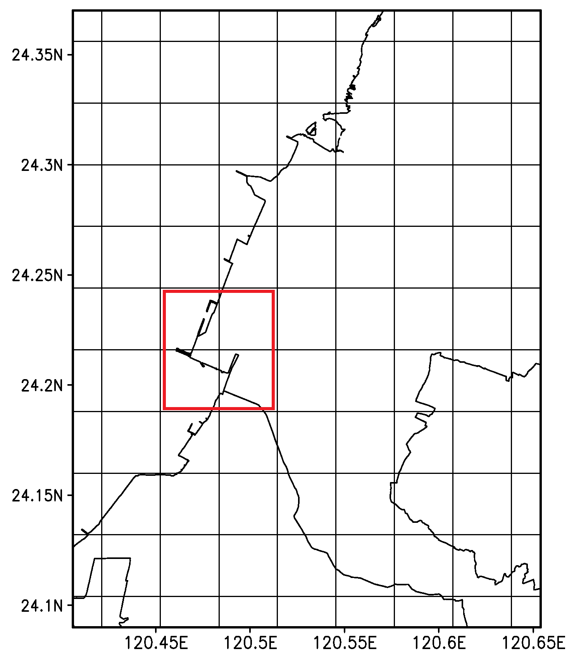
1St Source Apportionment Experiment
Taichung power plant : point source
- BFM : zero-out
TCplant.SOX
TCplant.NOX
- ISAM
Sulfate and nitrate
→ compare results between BFM and ISAM
 | tons/year | region.%
PM_{2.5} | 1293.54 | 72.6%
SO_{X} | 15319.21 | 93.2%
NO_{X} | 24923.36 | 95.0%
CO | 3969.47 | 93.6%
Notes:
For the Taichung power plant experiment, we removed the point source of SO_{X} and NO_{X} emissions from the Taichung power plant region through BFM and tagged the precursors of sulfate and nitrate from the region through ISAM. We wanted to compare the contributions to PM_{2.5} between two methods. It is noteworthy that the SO_{X} and NO_{X} emissions from power plant accounted for 93.2% and 95% of the region.

Slide 16
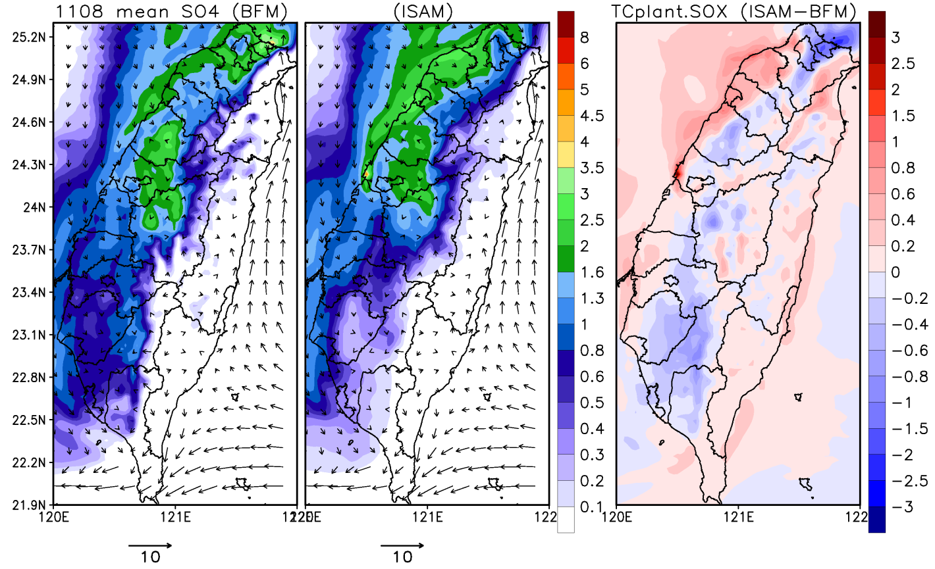
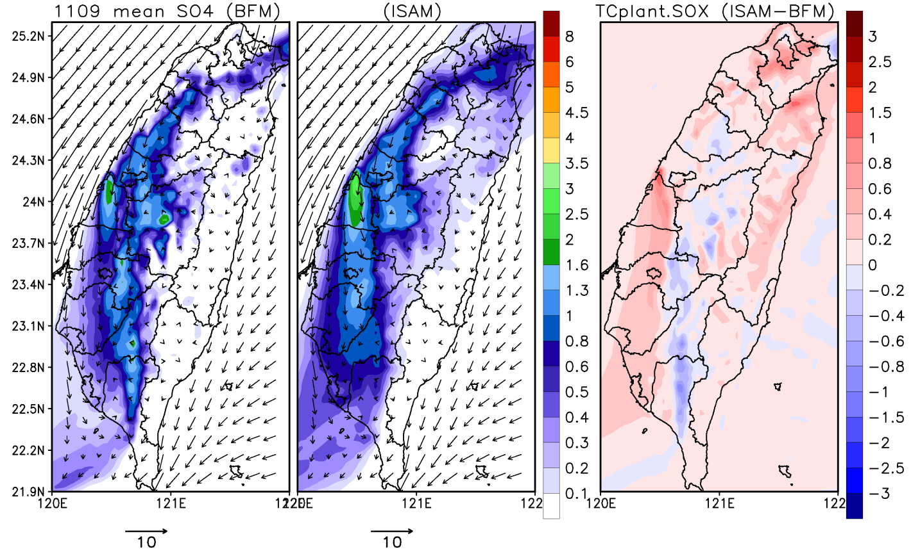
BFM vs ISAM (TCplant: SO_{X}-SO₄ )
Simulated patterns were similar between BFM and ISAM.
Emission source contribution area were different on Nov 8 and Nov 9.
ISAM calculated higher contributions (about 0.4-0.6 μg/m³) in Yunlin and location of maximum value was closer to emission sources than BFM.
11/08 mean
11/09 mean
BFM
ISAM
BFM
ISAM
Color unit : μg/m³
Bar unit : m/s
Color unit : μg/m³
Bar unit : m/s
Notes:
Because of the limit of ISAM, all the simulated concentrations of PM_{2.5} would only show I and J modes. Looking at the picture, the left picture shows the contribution of SO_{X} to sulfate calculated by BFM, the center picture is by ISAM and the right picture is the difference. The patterns of contributions of SO_{X} and NO_{X} to the concentrations of sulfate and nitrate calculated by BFM and ISAM were similar. On Nov 8, the daily mean wind speed was lower and has a south wind component during the day. As a result, the emissions from Taichung power plant mainly affected the northwest region of Taiwan. On the other hand, northeasterly wind transported the pollutants to the downwind area and reduce the air quality on Nov 9. The contributions of SO_{X} to sulfate calculated by ISAM was higher than by BFM about 0.4-0.6 μg/m³ in Yunlin and the position of maximum value was closed to emission sources.

Slide 17
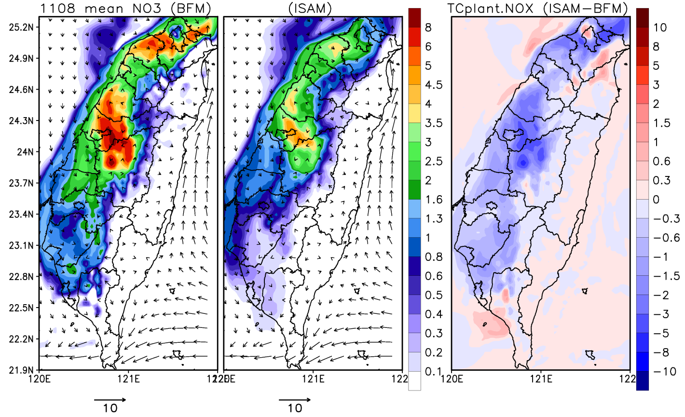
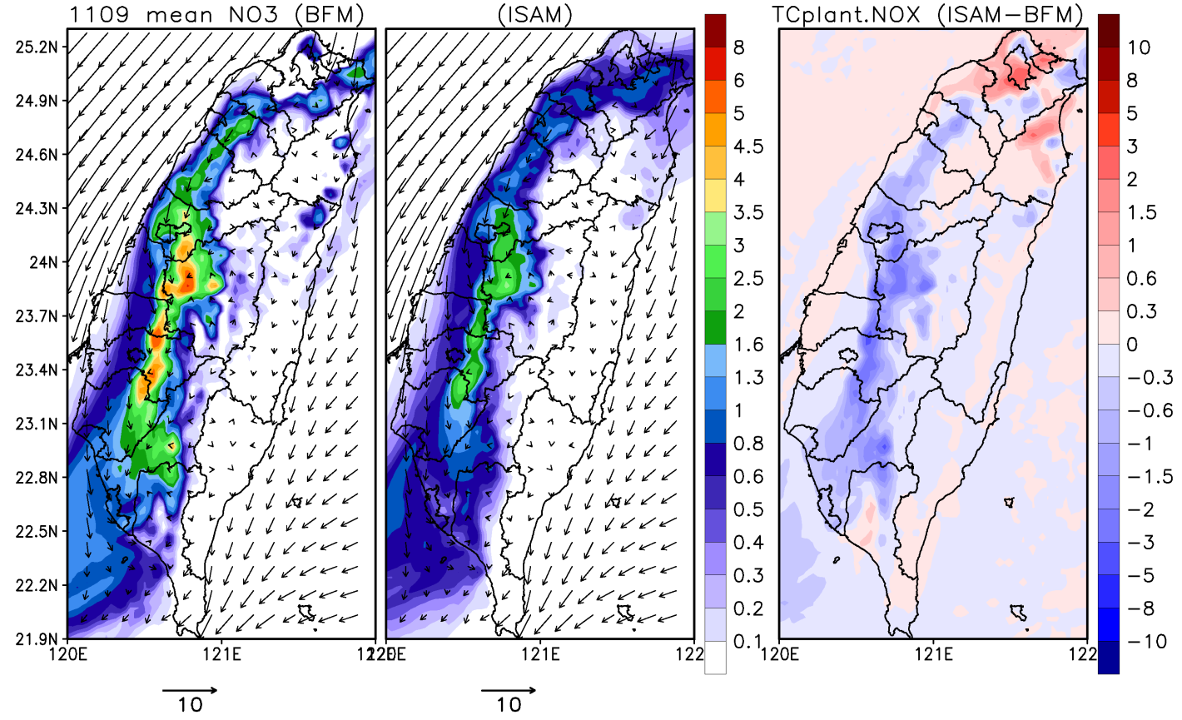
BFM vs ISAM (TCplant: NO_{X}-NO₃ )
ISAM calculated lower contributions (about 1.5-2 μg/m³) in Yunlin than BFM.
The discrepancy was due to higher nonlinearity in NO_{X} chemistry.
ISAM calculates the source contributions, but BFM estimates the responses of zero-out concentration.
11/08 mean
11/09 mean
BFM
ISAM
BFM
ISAM
Color unit : μg/m³
Bar unit : m/s
Color unit : μg/m³
Bar unit : m/s
Notes:
But, the contribution of NO_{X} to nitrate calculated by ISAM was lower than by BFM about 1.5-2 μg/m³ in Yunlin. The discrepancy between BFM and ISAM was because of higher nonlinearity in the NOx chemistry. And, ISAM calculates the source contributions, but BFM zero-out estimates the responses of remove emissions.

Slide 18
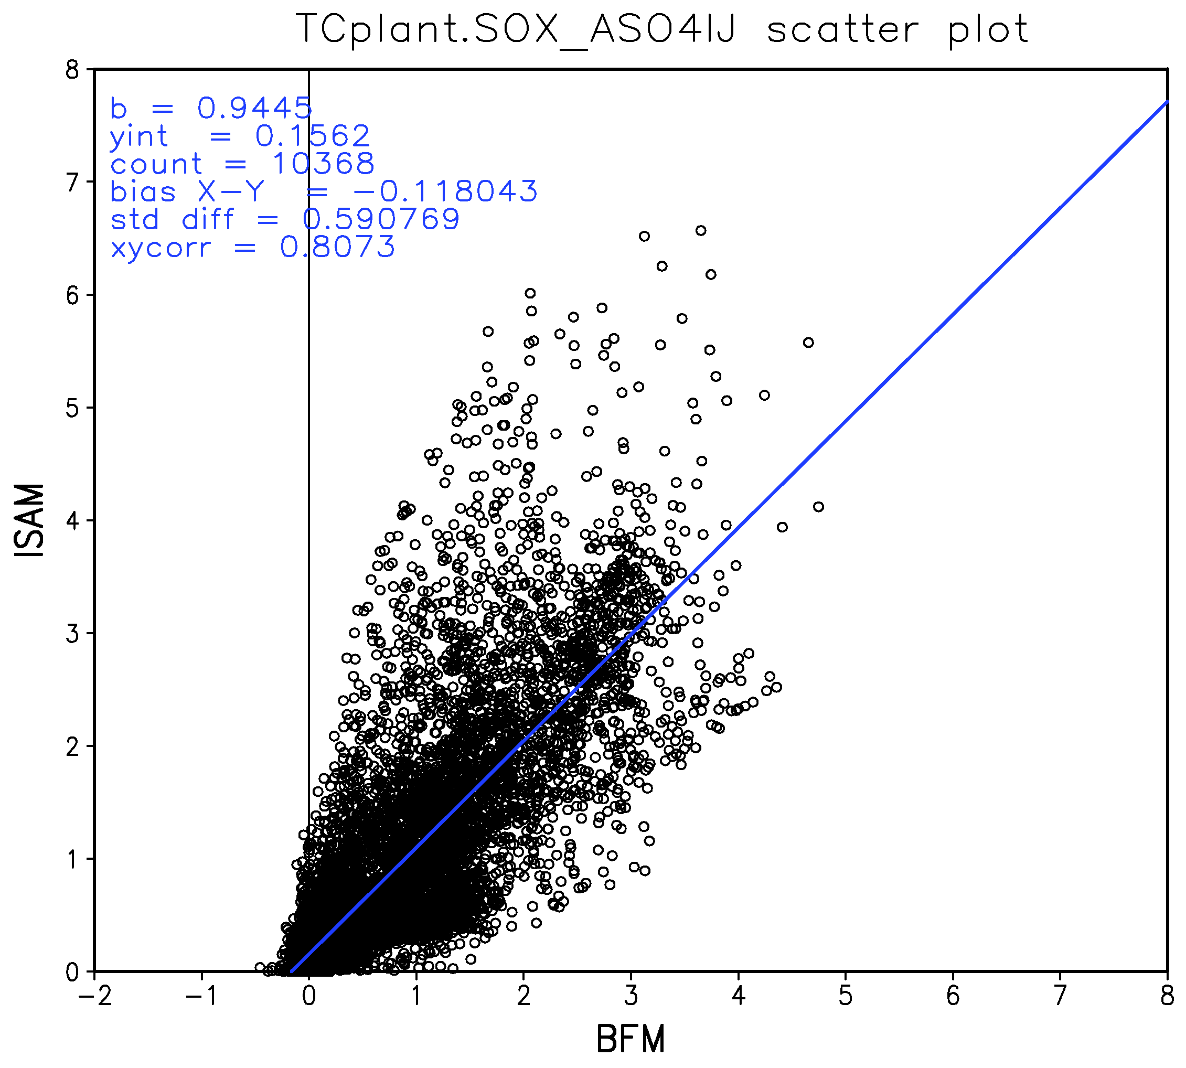
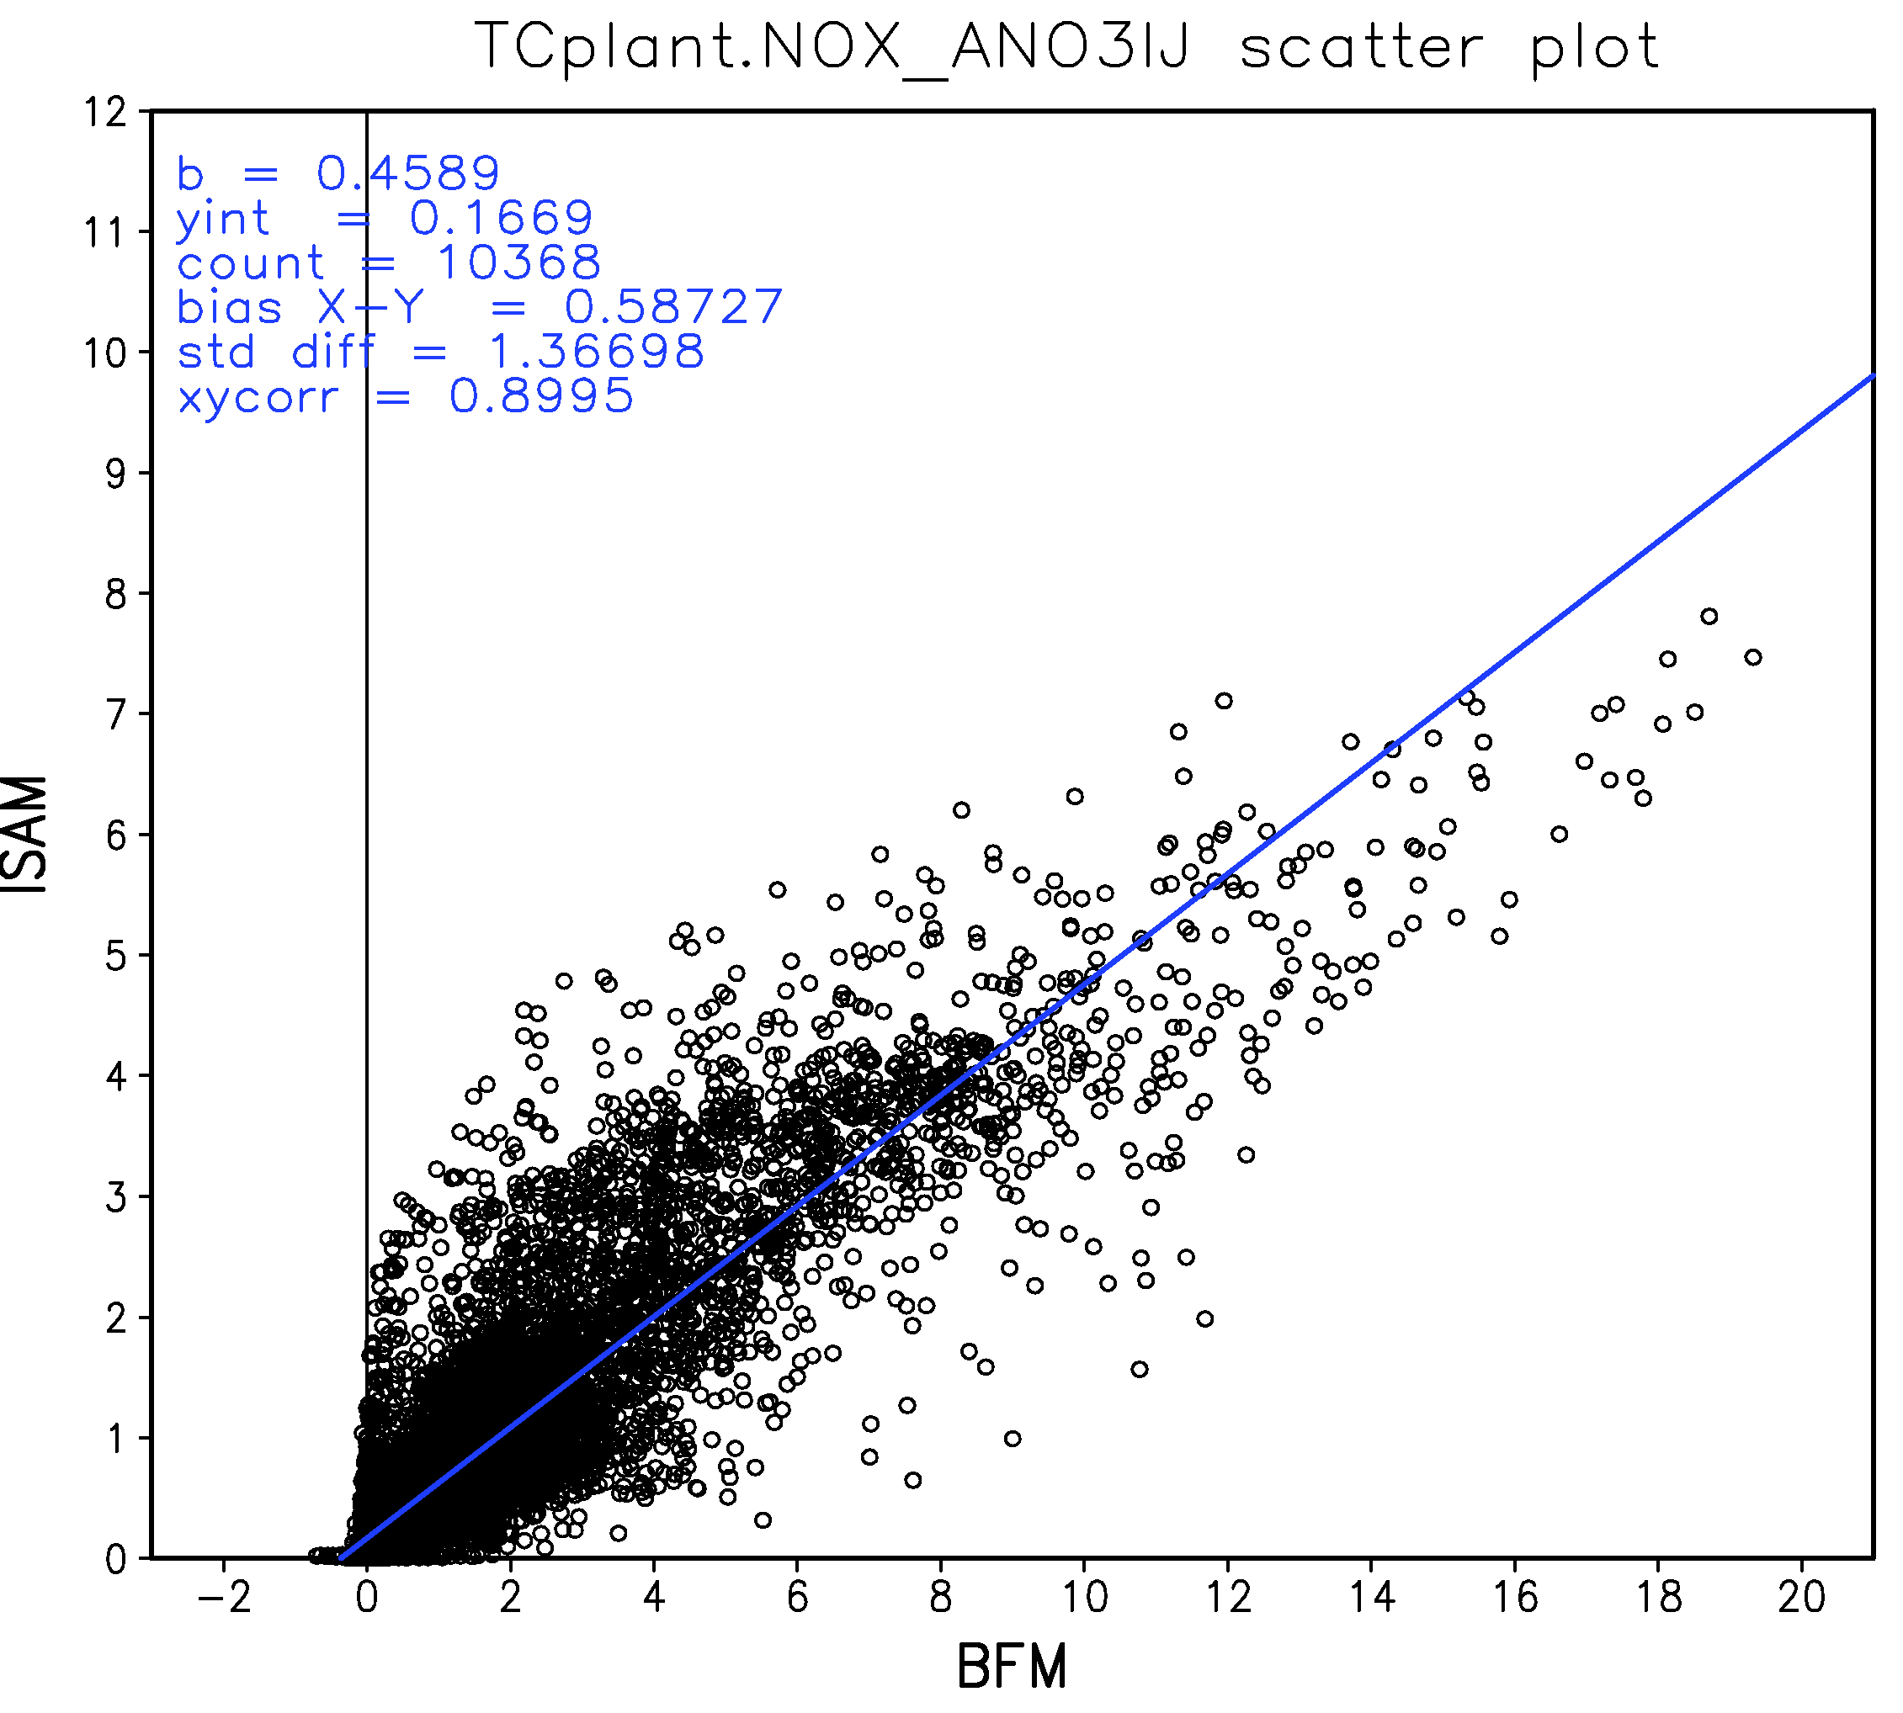
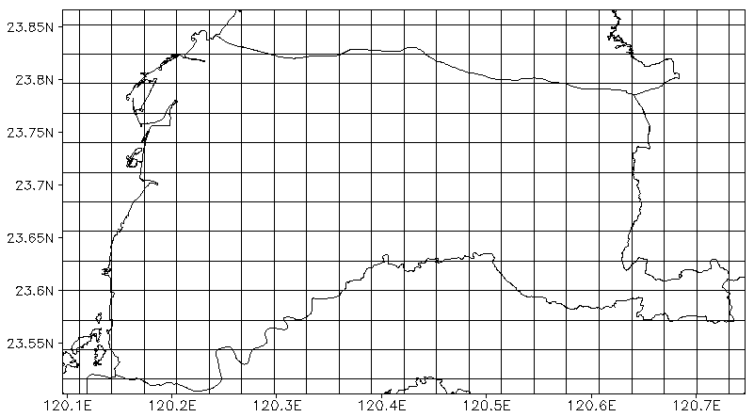
BFM vs ISAM
TCplant: SO_{X} – ASO₄IJ
TCplant: NO_{X} – ANO₃IJ
Region : Yunlin (Red line)
Number of grids : 216
Time : 48hr (11/08-11/09)
R: 0.8073
R: 0.8995
Unit : μg/m³
Unit : μg/m³
Notes:
In order to examine the similarity of the two methods, we calculated the correlation coefficient of Yunlin area. The contribution of NOx and SOx to nitrate and sulfate calculated by BFM and ISAM displayed the high correlation. Using ISAM only can reduce the computing time.

Slide 19
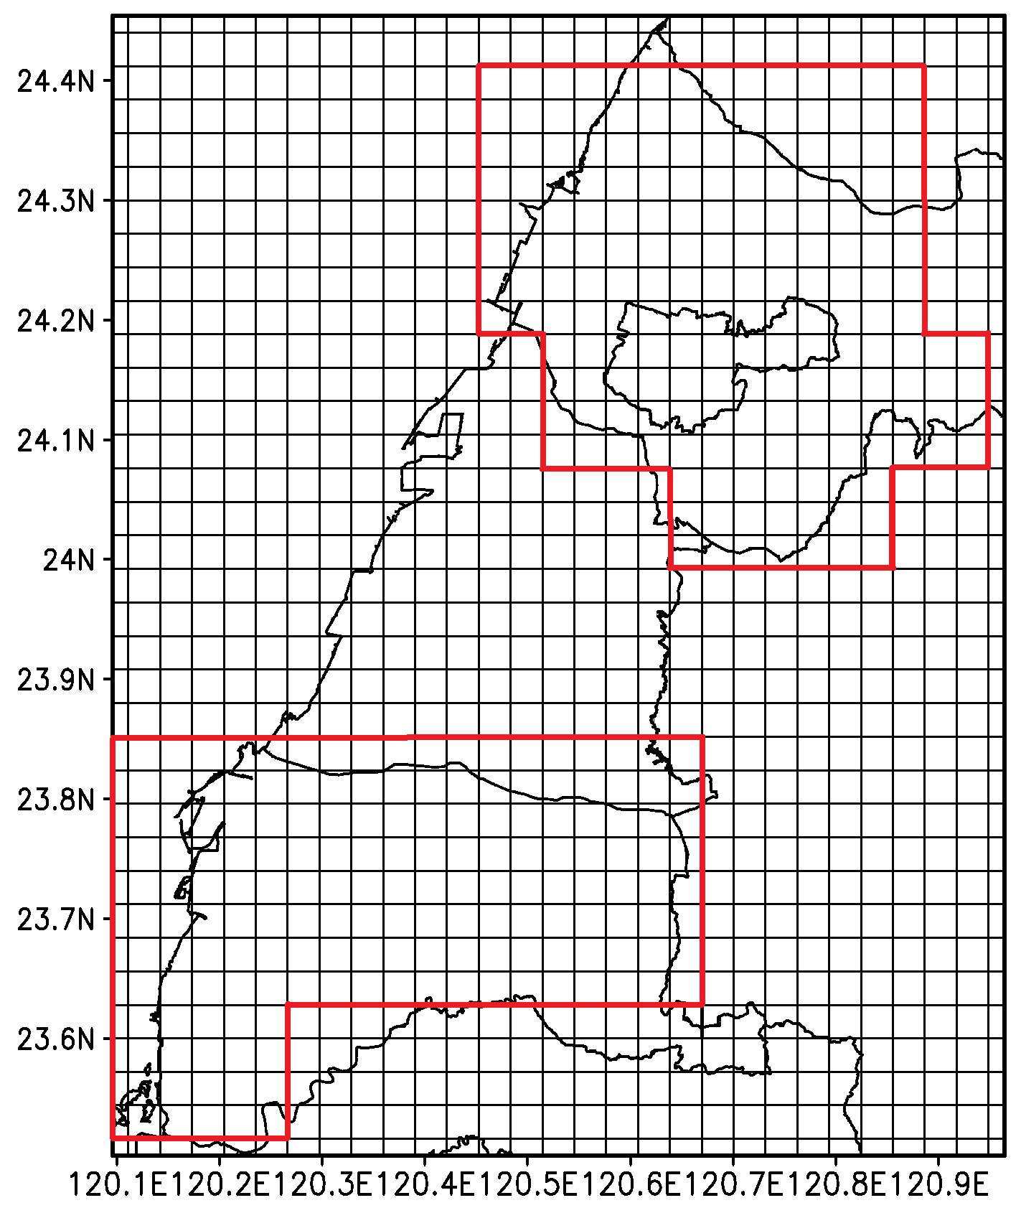
2nd Source Apportionment Experiment
Yunlin and Taichung
- ISAM only
Point, area and line sources
Sulfate and nitrate
Yunlin (YL) and Taichung (TC)
TC
●
▲
In Taichung,
only consider the emission from metropolitan area
YL
▲ Mailiao industrial complex ● Taichung power plant
Notes:
For the experiment about Yunlin and Taichung, we used the ISAM to calculate the contributions of all emissions to sulfate and nitrate.

Slide 20
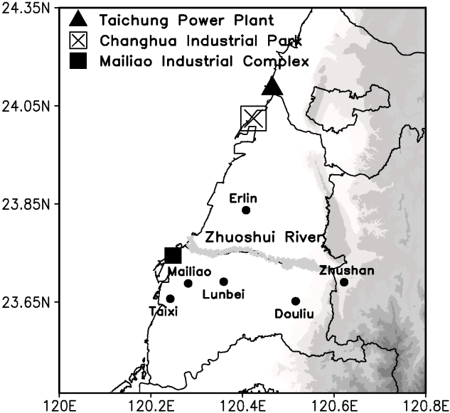
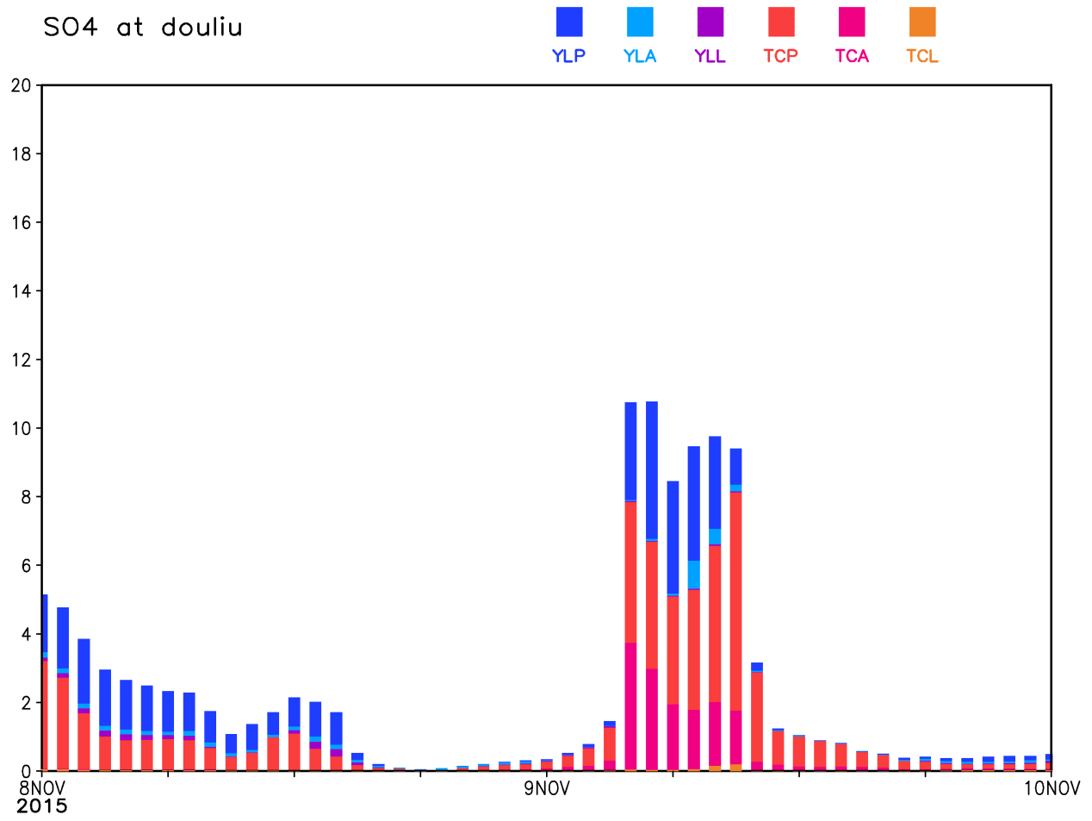
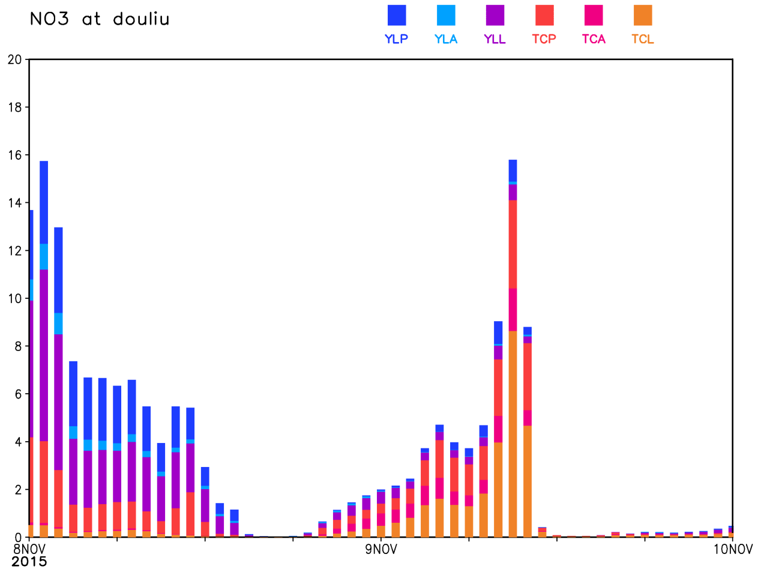
Source apportionment at Douliu, Yunlin County
On 11/08 (with weak synoptic), emissions are mainly from Yunlin
On 11/09 (with NE flow), emission are mainly from upwind of Taichung.
In addition to point sources, sulfate is also contributed from area and nitrate from line emission sources.
SO₄
YL TC
NO₃
Nov 8 Nov 9
Nov 8 Nov 9
Unit : μg/m³
Unit : μg/m³
Notes:
The figure shows the results of source apportionment at Douliu station. The x and y directions represent local time and contributions, respectively. And, each color means the different emission sources. Douliu station in Yunlin had the same results that pollutants mainly came from Yunlin on Nov 8 and from Taichung on Nov 9. Furthermore, both sulfate and nitrate came from point sources. In addition to point sources, sulfate also came from area sources and nitrates came from line sources.

Slide 21
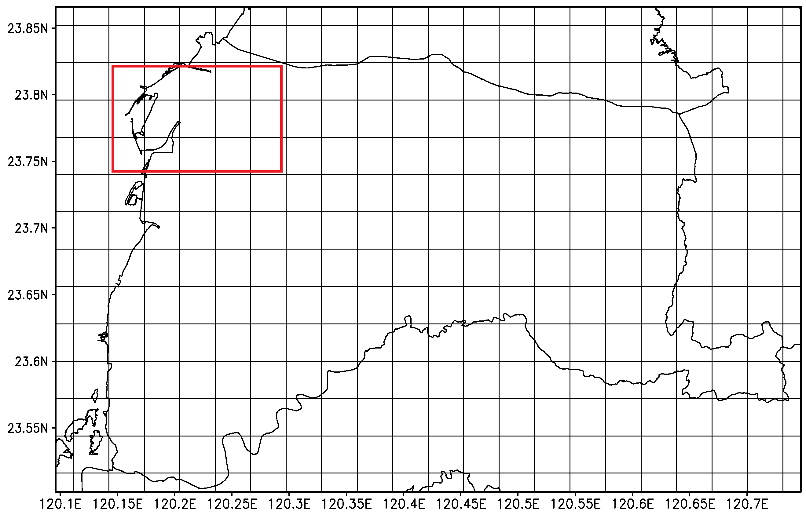
3rd Source Apportionment Experiments
Mailiao industrial areas
- ISAM only
Point source
Sulfate and nitrate
Mailiao (ML)
ML
 | tons/year
PM_{2.5} | 717.84
SO_{X} | 5726.90
NO_{X} | 14924.29
Notes:
The last experiment tagged the precursors of sulfate and nitrate through ISAM and focused on the emissions from Mailiao industrial area. It was the largest emission point source in Yunlin. And, the NO_{X} emissions are higher than SO_{X} emissions.

Slide 22
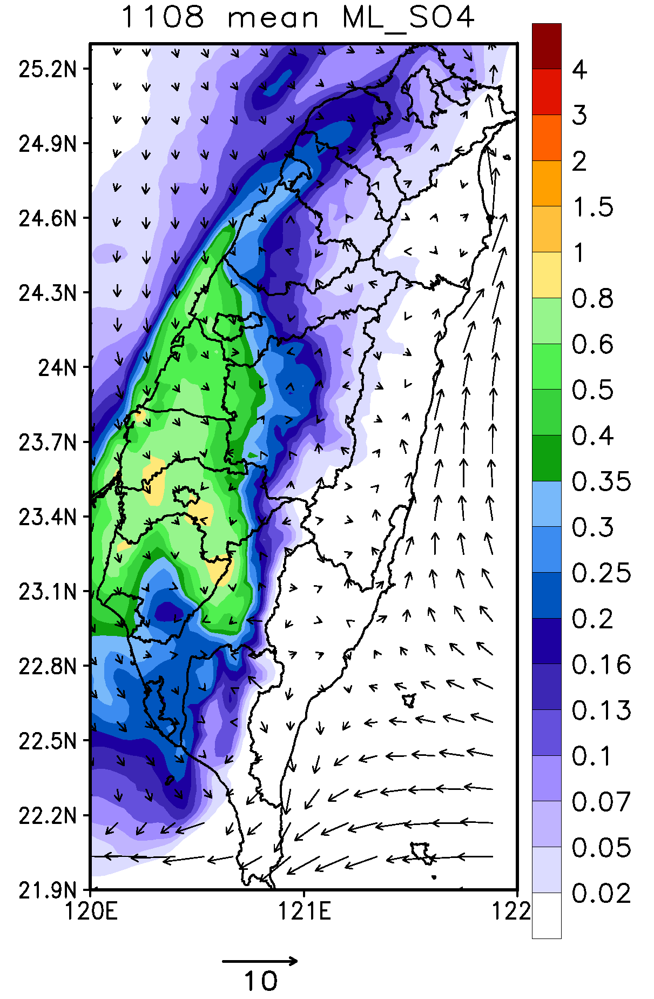
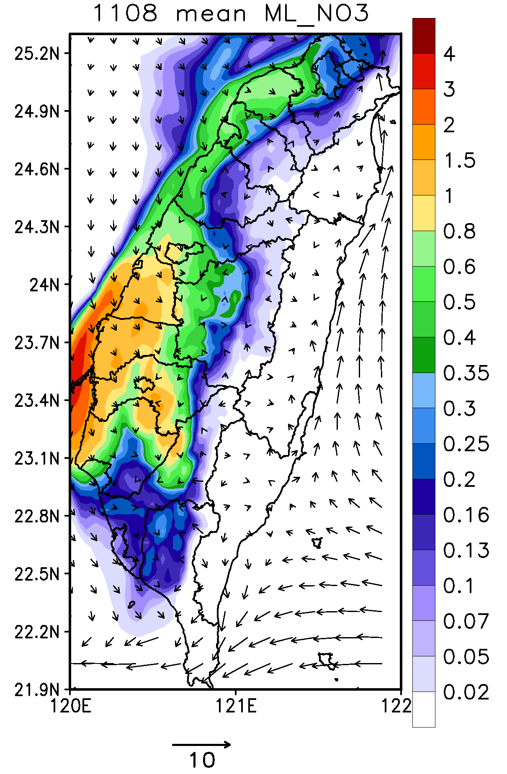
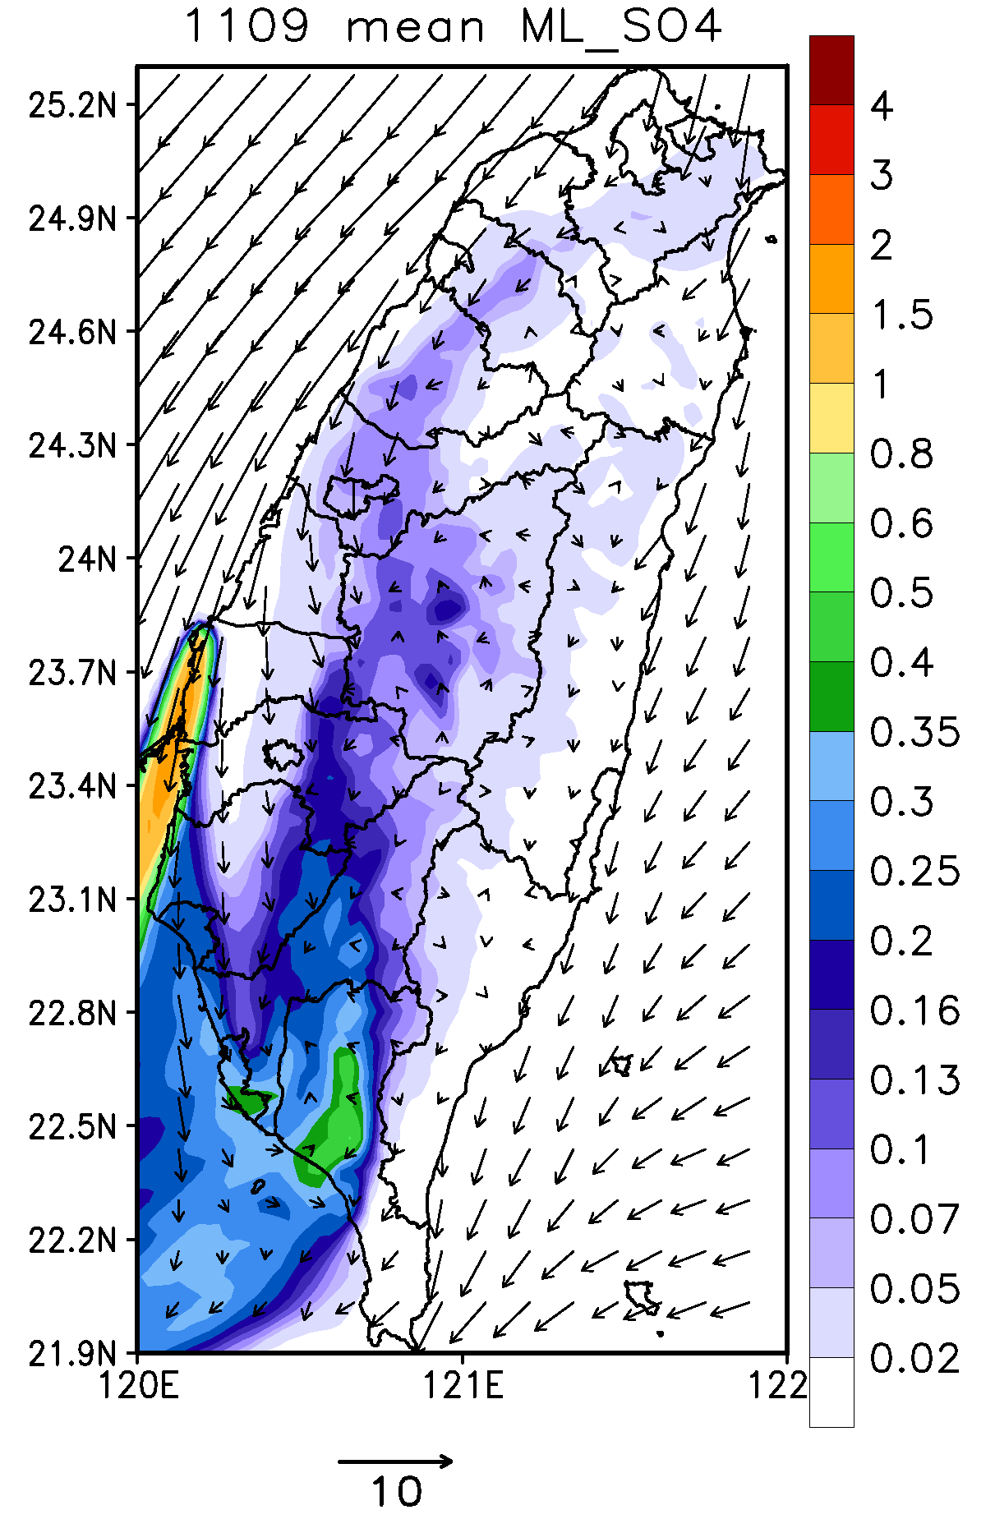
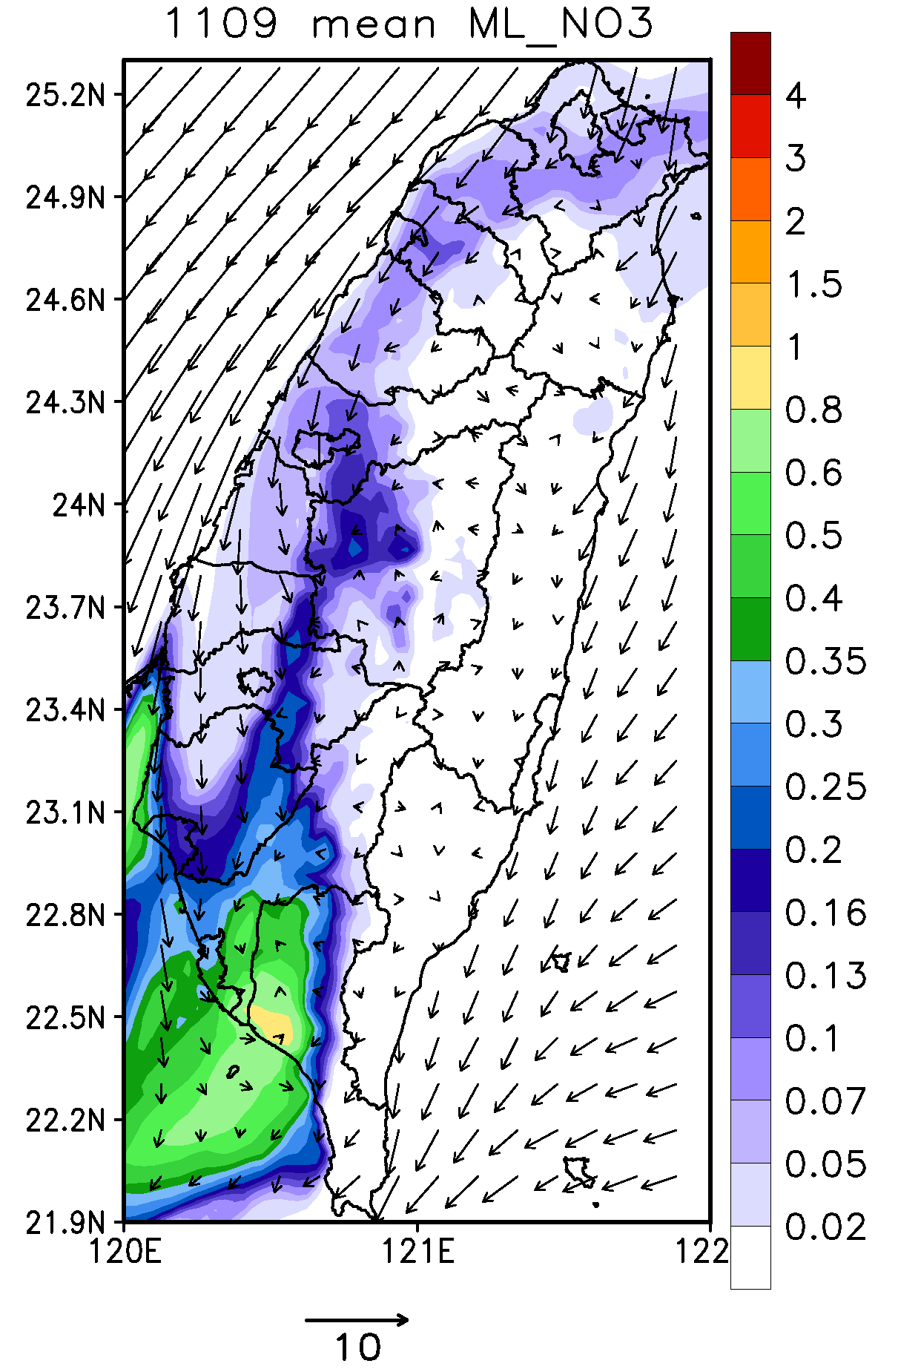
3rd SA experiment: Source contributions from Mailiao Emissions
On 11/08 (with weak synoptic weather), Mailiao emissions mainly affect Yunlin and surrounding county areas, and even toward inland area due to onshore sea breeze.
On 11/09 (with NE flow), Mailiao emissions mainly affect downwind southern Taiwan.
1108 mean
1109 mean
Color unit : μg/m³
Bar unit : m/s
Color unit : μg/m³
Bar unit : m/s
Notes:
On Nov 8, emissions were transported to inland area by sea-breeze during the day and weak southerly wind made emissions affect the air quality in neighboring regions. The contribution of NO_{X} to nitrate was higher than SO_{X} to sulfate due to the emission size. The northeasterly wind transported the pollutants to downwind side on Nov 9. And, the highest contributions area of sulfate was closed to the emission sources. Obviously, the affected areas were distinct in different weather.

Slide 23
Conclusion
Notes:
That concludes my presentation.

Slide 24
Conclusion
CMAQ with BFM and ISAM are applied to investigate emission sources contributions to PM_{2.5} concentrations in Yunlin from Nov 8 to Nov 9, 2015.
Results from BFM and ISAM are close to each other.
- Contribution of SO_{X} to sulfate calculated by ISAM was higher than by BFM,
but the contribution of NO_{X} to nitrate was opposite.
- Discrepancy between BFM and ISAM was larger in nitrate because of
higher nonlinearity in the NO_{X} chemistry.
In terms of sulfate, the maximum calculated by ISAM is higher and closer to emission sources than BFM.
Notes:
This study used CMAQ with BFM and ISAM to investigate mainly sources of PM_{2.5} in Yunlin during 2015/11/08-09. The results of BFM and ISAM about Taichung power plant displayed the high correlation. The contribution of SOX to sulfate calculated by ISAM was higher than by BFM, but the contribution of NO_{X} to nitrate was opposite. The discrepancy between BFM and ISAM was larger in nitrate because of higher nonlinearity in the NOx chemistry. Besides, the highest contributions area of sulfate was closed to the emission sources.

Slide 25
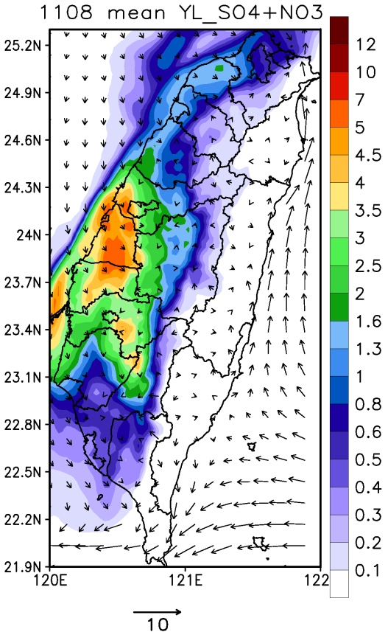
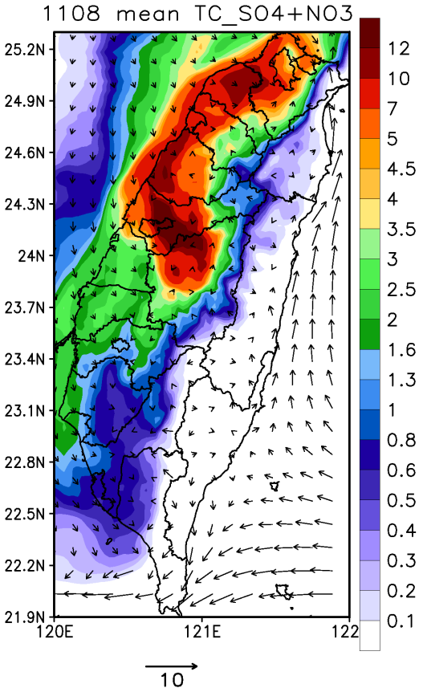
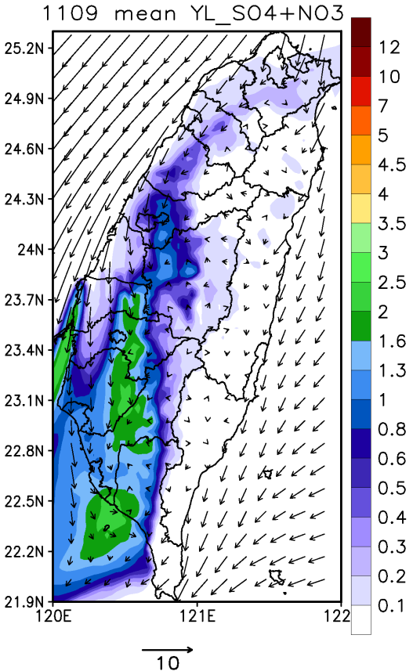
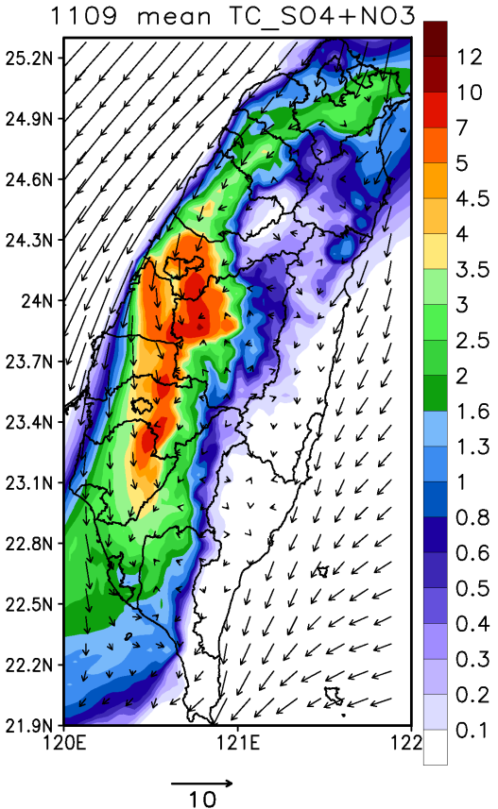
Conclusion
Nov 8 was with weak synoptic weather and PM_{2.5} in Yunlin County are mainly contributed from local Yunlin emission sources.
Nov 9 was affected by by northeasterly monsoonal flow and PM_{2.5} are mainly contributed from upwind Taichung area.
PM_{2.5} concentration in Yunlin County can be contributed from different emission source region under different weather conditions.
Nov 8
Nov 9
YL
TC
YL
TC
Color unit : μg/m³
Bar unit : m/s
Notes:
The figure shows the contributions of total emissions from Yunlin and Taichung to sulfate and nitrate. Nov 8 was weak synoptic weather and PM_{2.5} in Yunlin mainly from local emission. But, the northeasterly wind transported the emissions from Taichung metropolitan area to downwind area. It caused PM_{2.5} not only from local emission, but mainly from Taichung on Nov 9, especially the Douliu station. And this was the reason why Nov 9 has slightly faster wind speed than Nov 8, but still has higher PM_{2.5} concentration. Therefore, different weather may affect the transfer and diffusion of pollutants and cause pollutants in Yunlin come from different regions.

Slide 26
Reference
Hsu, Chia-Hua, Fang-Yi Cheng. (2016). Classification of weather patterns to study the influence of
meteorological characteristics on PM_{2.5} concentrations in Yunlin County, Taiwan. Submitted.
Kwok, R. H. F., Napelenok, S. L., & Baker, K. R. (2013). Implementation and evaluation of PM 2.5 source
contribution analysis in a photochemical model. Atmospheric Environment, 80, 398-407.

Slide 27
Thank You
Notes:
Thank you for your attention. If anyone has any questions, I’ll do my best to answer them.

