Slide 1


Atmospheric Aerosol Modeling Needs for Next Generation Air Quality Models
Michael J. Kleeman, UC Davis
CMAS Conference
October 2016

Slide 2
Future Modeling Needs
Improved meteorological predictions for stagnation events
Higher spatial resolution for neighborhood scale analysis
Organic Aerosol
Predictions for emerging pollutants of concern
  Ultrafine Particles – PM0.1 and number
Air – Climate – Energy Interactions

Slide 3
Improved Meteorological Models
Concentrations reflect the balance between emissions, meteorology, and chemical reaction
We now take it for granted that meteorological fields can be easily generated using models like WRF
Very little time spent analyzing bias in meteorological predictions and the impact on air quality predictions

Slide 4
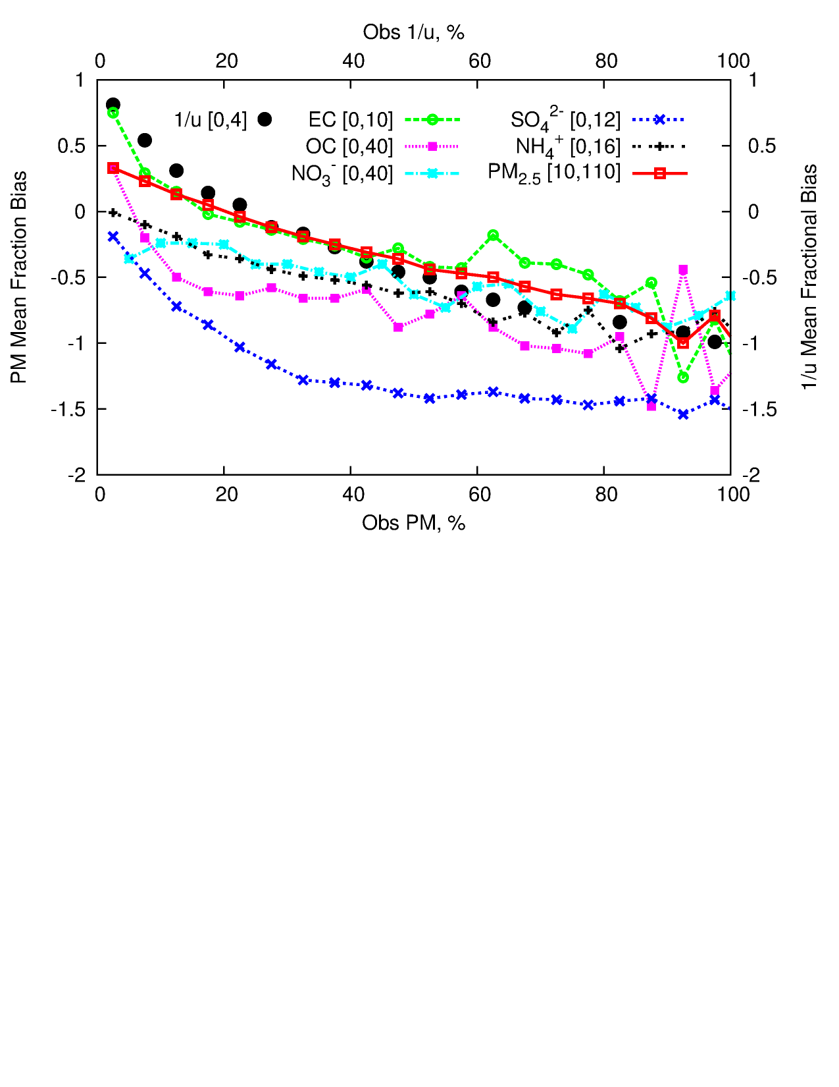
Effect of Wind Speed Bias on Concentrations
Source: 2015 J. Hu, H. Zhang, Q. Ying, S. Chen, F. Vandenberghe, and M.J. Kleeman. Long-term Particulate Matter Modeling for Health Effects Studies in California – Part I: Model Performance on Temporal and Spatial Variations. Atmospheric Chemistry and Physics, 15(6), pp3445-3461

Slide 5
Higher Spatial Resolution
What does air pollution mean for my family?
  Are my children at risk from childhood asthma because we have poor air quality in our neighborhood?
  Am I at risk from early death?
Are the policies that we enact to improve air pollution and reduce climate change fair to all socio-economic segments?
4km spatial resolution isn’t sufficient to answer these questions

Slide 6
Oakland LES Simulations
Source: 2014 D.K. Joe, H. Zhang, S.P. DeNero, H.H. Lee, S. chen, B.C. McDonald, R.A. Harley, and M.J. Kleeman. Implementation of a High-Resolution WRF/Chem Model at the Port of Oakland, Atmospheric Environment, 82, pp351-363

Slide 7
EC Rail – Close up in Oakland
Source: 2014 D.K. Joe, H. Zhang, S.P. DeNero, H.H. Lee, S. chen, B.C. McDonald, R.A. Harley, and M.J. Kleeman. Implementation of a High-Resolution WRF/Chem Model at the Port of Oakland, Atmospheric Environment, 82, pp351-363

Slide 8
Organic Aerosol Predictions
Organic aerosol accounts for one third to one half of PM2.5
Model predictions for organic aerosol are lower than measured values in most locations
Mechanistic approaches to improve detailed chemistry
  Isoprene chemistry
  Water in the organic phase
Approximate approaches using fits to chamber data
  2 product models
  VBS / SOM

Slide 9
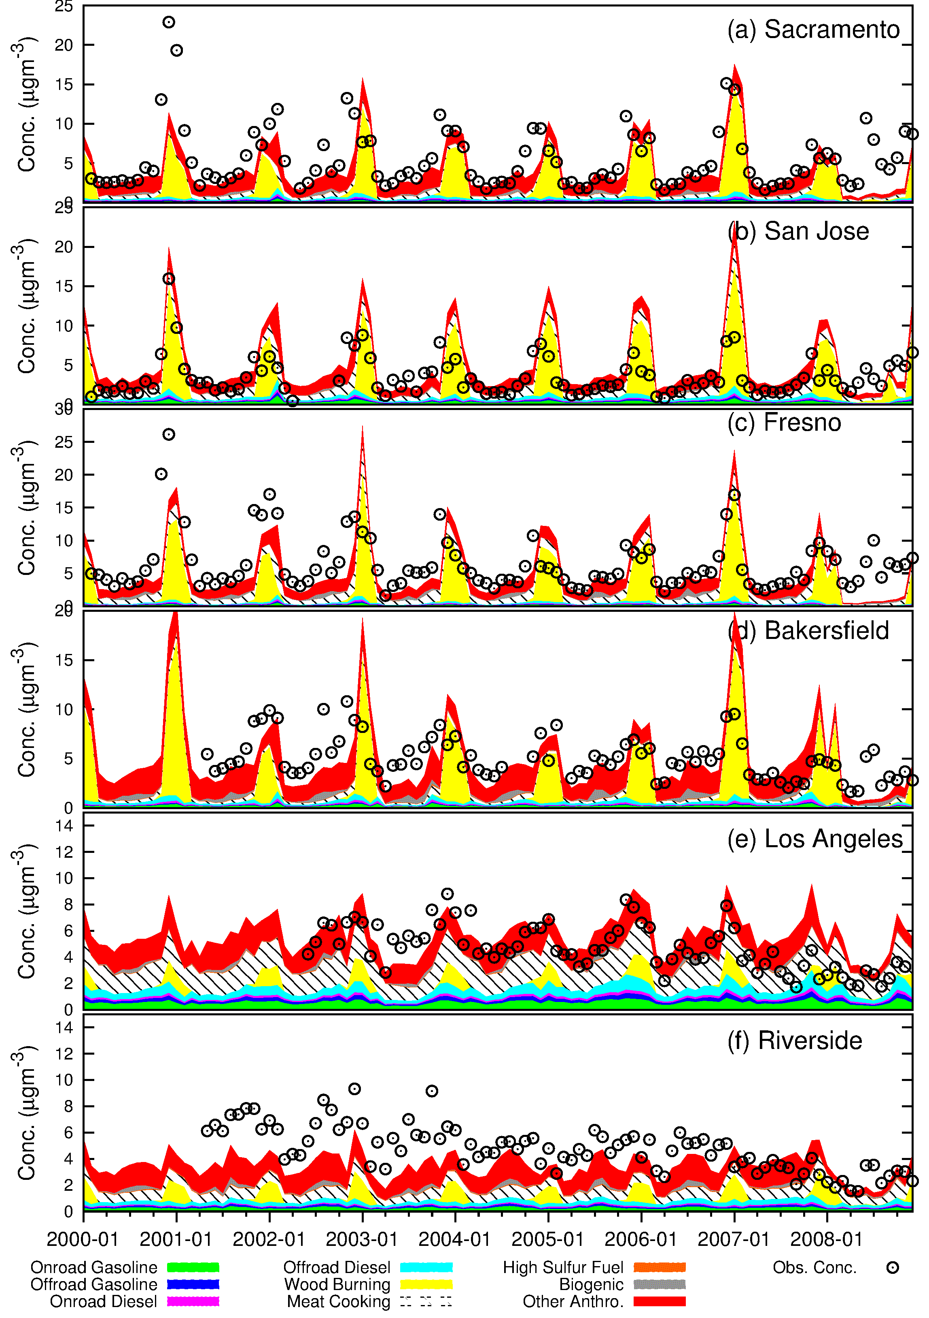
Model Evaluation
PM2.5 OC
Time Series
Monthly average concentrations
Dots – measurements
colors - predictions
Major seasonal trends are captured at most sites
Source: J. Hu, S. Jathar, H. Zhang, Q. Ying, S. Chen, C.D. Cappa, and M.J. Kleeman. Long-term Particulate Matter Modeling for Health Effects Studies in California – Part II: Concentrations and Sources of Ultrafine Organic Aerosols. In preparation.

Slide 10
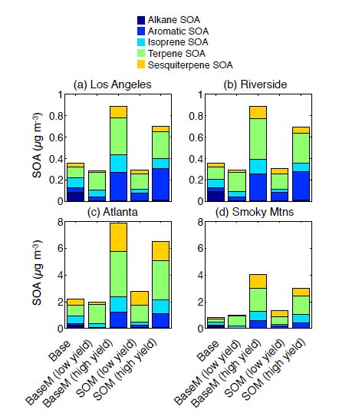
Base CMAQ model vs. SOM low yield=high NOx high yield=low NOx
Source: S.H. Jathar, C.D. Cappa, A.S. Wexler, and M.J. Kleeman. Simulating secondary organic aerosol in a regional air quality model using the statistical oxidation model – Part 1: Assessing the influence of constrained multi-generational ageing. Atmospheric Chemistry and Physics, 16, 2309-2322, 2016.

Slide 11
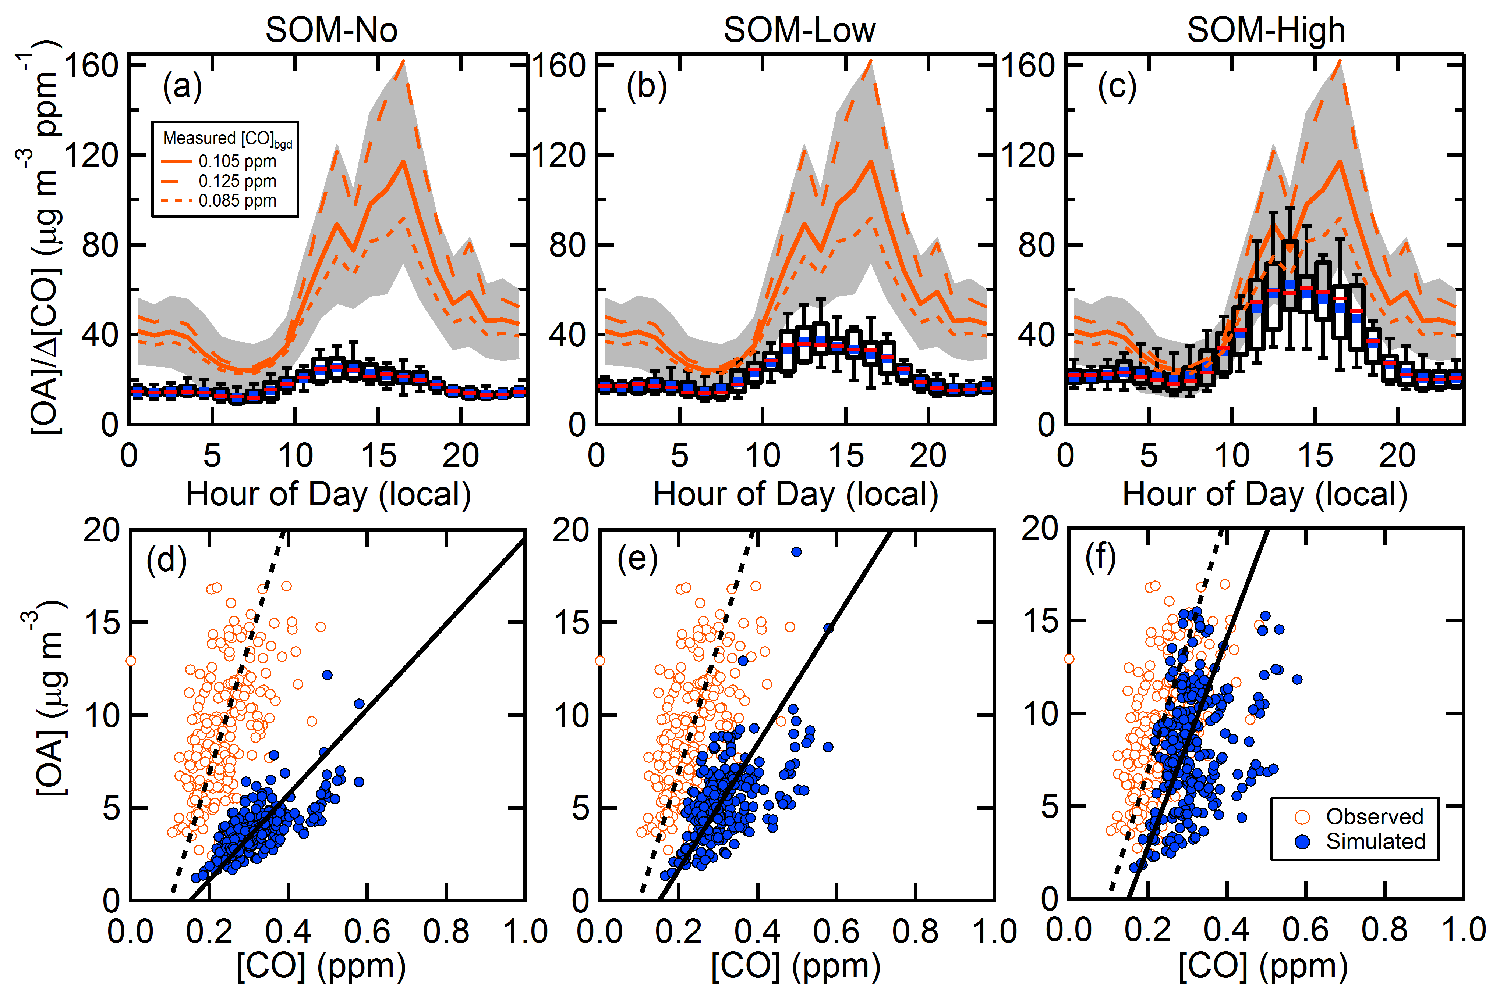
Diurnal Profiles of OA During SOAR
Source: C.D. Cappa, S.H. Jathar, M.J. Kleeman, K.S. Docherty, J.L. Jimenez, J.H. Seinfeld, and A.S. Wexler. Simulating secondary organic aerosol in a regional air quality model using the statistical oxidation model – Part 2: Assessing the influence of vapor wall losses. Atmospheric Chemistry and Physics, 16, 3041-3059, 2016.

Slide 12
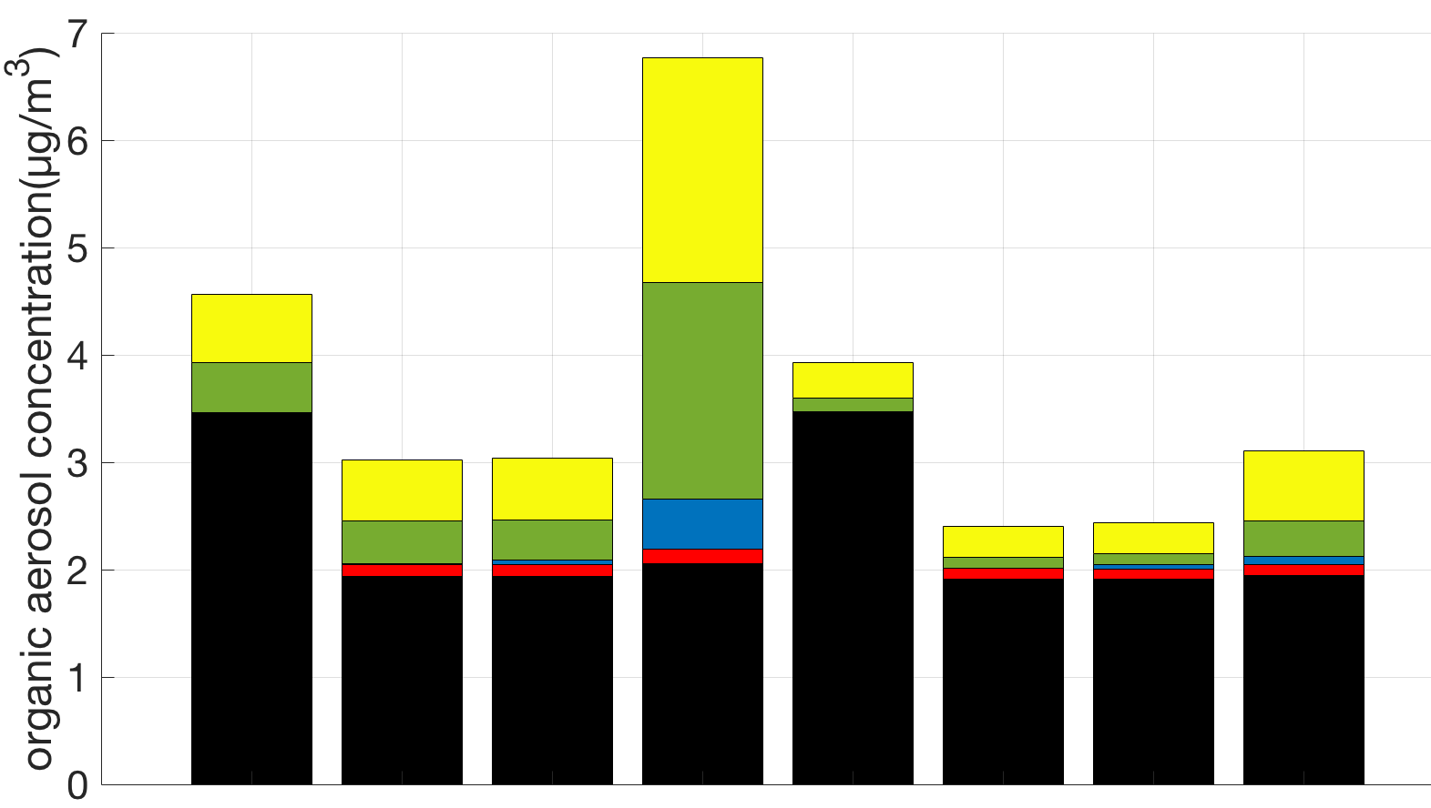
Primary emissions still dominate organic aerosol (OA)
Accounting for vapor wall losses is important only in low NO_{x} environments
Biogenic SOA
Alkane & Aromatic SOA
IVOC SOA
Oxygenated POA
POA
Low NO_{x}
High NO_{x}
Los Angeles (2-week average - July 20th to August 2nd 2005)
SVPOA
Traditional
SVPOA
Traditional
IVOC + SVPOA
IVOC + SVPOA
VWL + IVOC + SVPOA
VWL + IVOC + SVPOA
Source: A. Akherati, C.D. Cappa, M.J. Kleeman, S.H. Jathar. Simulating secondary organic aerosol in a regional air quality model using the statistical oxidation model – Part 3: Assessing the influence of primary organic aerosol volatility. Atmospheric Chemistry and Physics, in preparation, 2016.

Slide 13
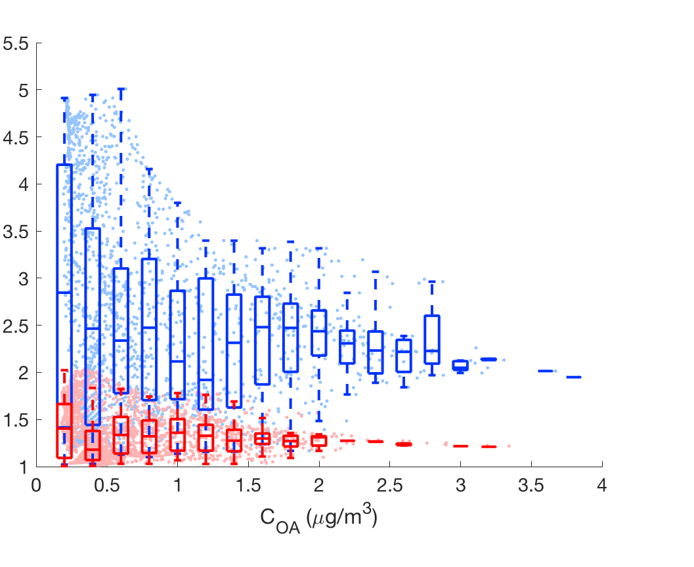

In high NO_{x} regions, ~30% enhancement in
domain-wide OA
low NO_{x}
high NO_{x}
$$\frac{SOA with vapor wall loss}{SOA without vapor wall loss}$$
Source: A. Akherati, C.D. Cappa, M.J. Kleeman, S.H. Jathar. Simulating secondary organic aerosol in a regional air quality model using the statistical oxidation model – Part 3: Assessing the influence of primary organic aerosol volatility. Atmospheric Chemistry and Physics, in preparation, 2016.

Slide 14
Ultrafine Particle Predictions
Toxicologists find that ultrafine particles are harmful
Epidemiologists have difficult time finding associations between ultrafine particles and public health
Expand investigations to include other metrics of ultrafine particles such as PM0.1

Slide 15
UFP number is most widely used metric
UFP number is easy to measure with commercial instruments but may not be the “best” UFP metric for health effects
PM0.1 is better correlated with particle surface area
Source: 2013 T. Kuwayama, C.R. Ruehl, and M.J. Kleeman. Daily Trends and Source Apportionment of Ultrafine Particulate Mass (PM0.1) over and Annual Cycle in a Typical California City. Environmental Science and Technology, dx.doi.org/10.1021/es403235c..

Slide 16
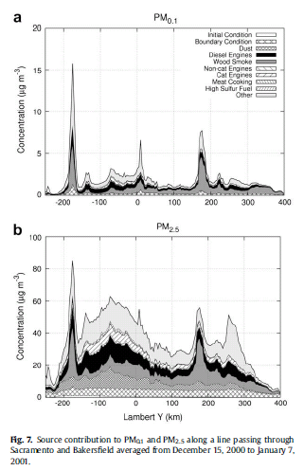
UFP Gradients are sharper than PM2.5 Gradients
The central site monitor strategy employed for PM2.5 will be difficult to use for UFP
Source: Ying, Q. Lu J., Kaduwela, A. and Kleeman, M.J. Modeling Air Quality during the California Regional PM10/PM2.5 Air Quality Study (CPRAQS) using the UCD/CIT Source Oriented Air Quality Model - Part III. Regional Source Apportionment of Secondary and Total Airborne PM2.5 and PM0.1. Atmospheric Environment, 43, pp419-430, 2009.

Slide 17
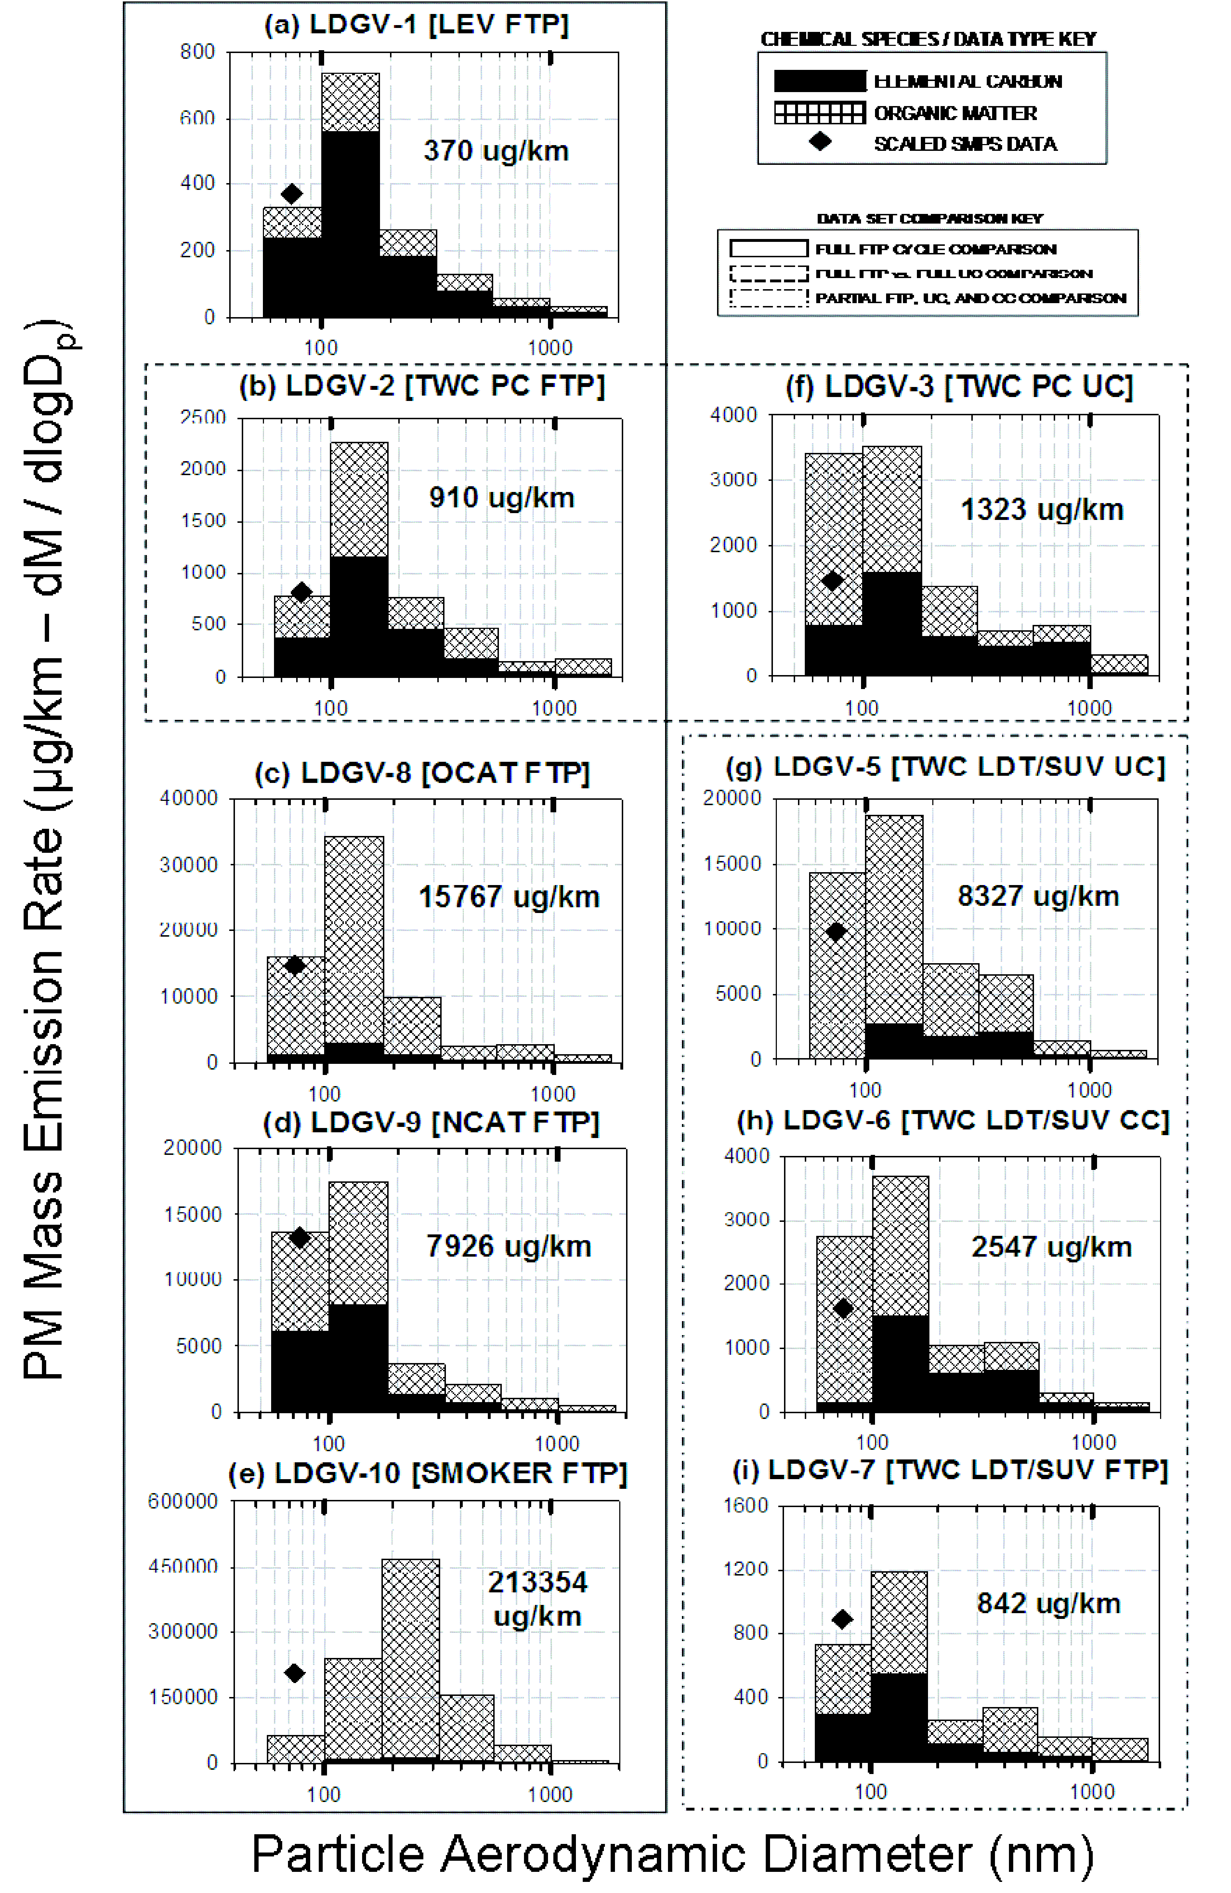
Light Duty Vehicle Particle Distributions
LEV = Low Emissions Vehicle
TWC = Three Way Catalyst
OCAT = Oxidation Catalyst
NCAT = Non Catalyst
SMOKER = smoking vehicle
FTP = Federal Test Procedure
UC = Unified Cycle
CC = Correction Cycle
Source: 2007 Robert, M.A., C.A. Jakober, S. VanBergen, and M.J. Kleeman, Size and Composition Distribution of Particulate Matter 1. Light-duty Gasoline Vehicles. Journal of the Air and Waste Management Association, 57, pp1414-1428.

Slide 18
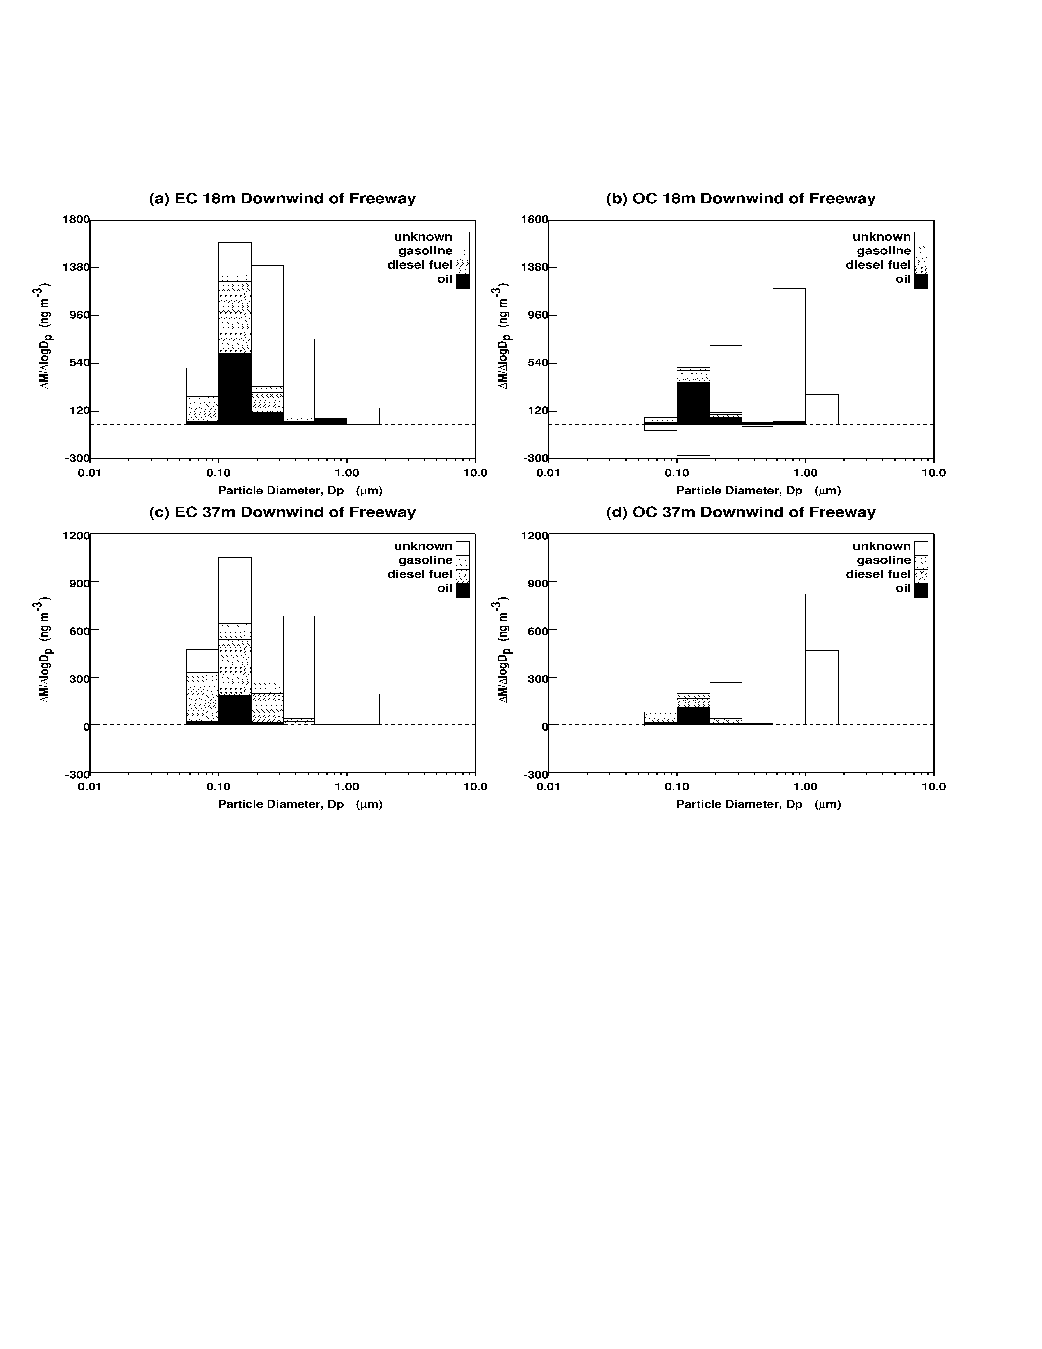
Size-Resolved Source Apportionment of Near Roadways
Source: 2008 Riddle, S., M.A. Robert, C.A. Jakober, M.P. Hannigan, and M.J. Kleeman. Size-resolved Source Apportionment of Airborne Particulate Matter in a Roadside Environment. Environmental Science and Technology, 42, pp6580-6586.

Slide 19
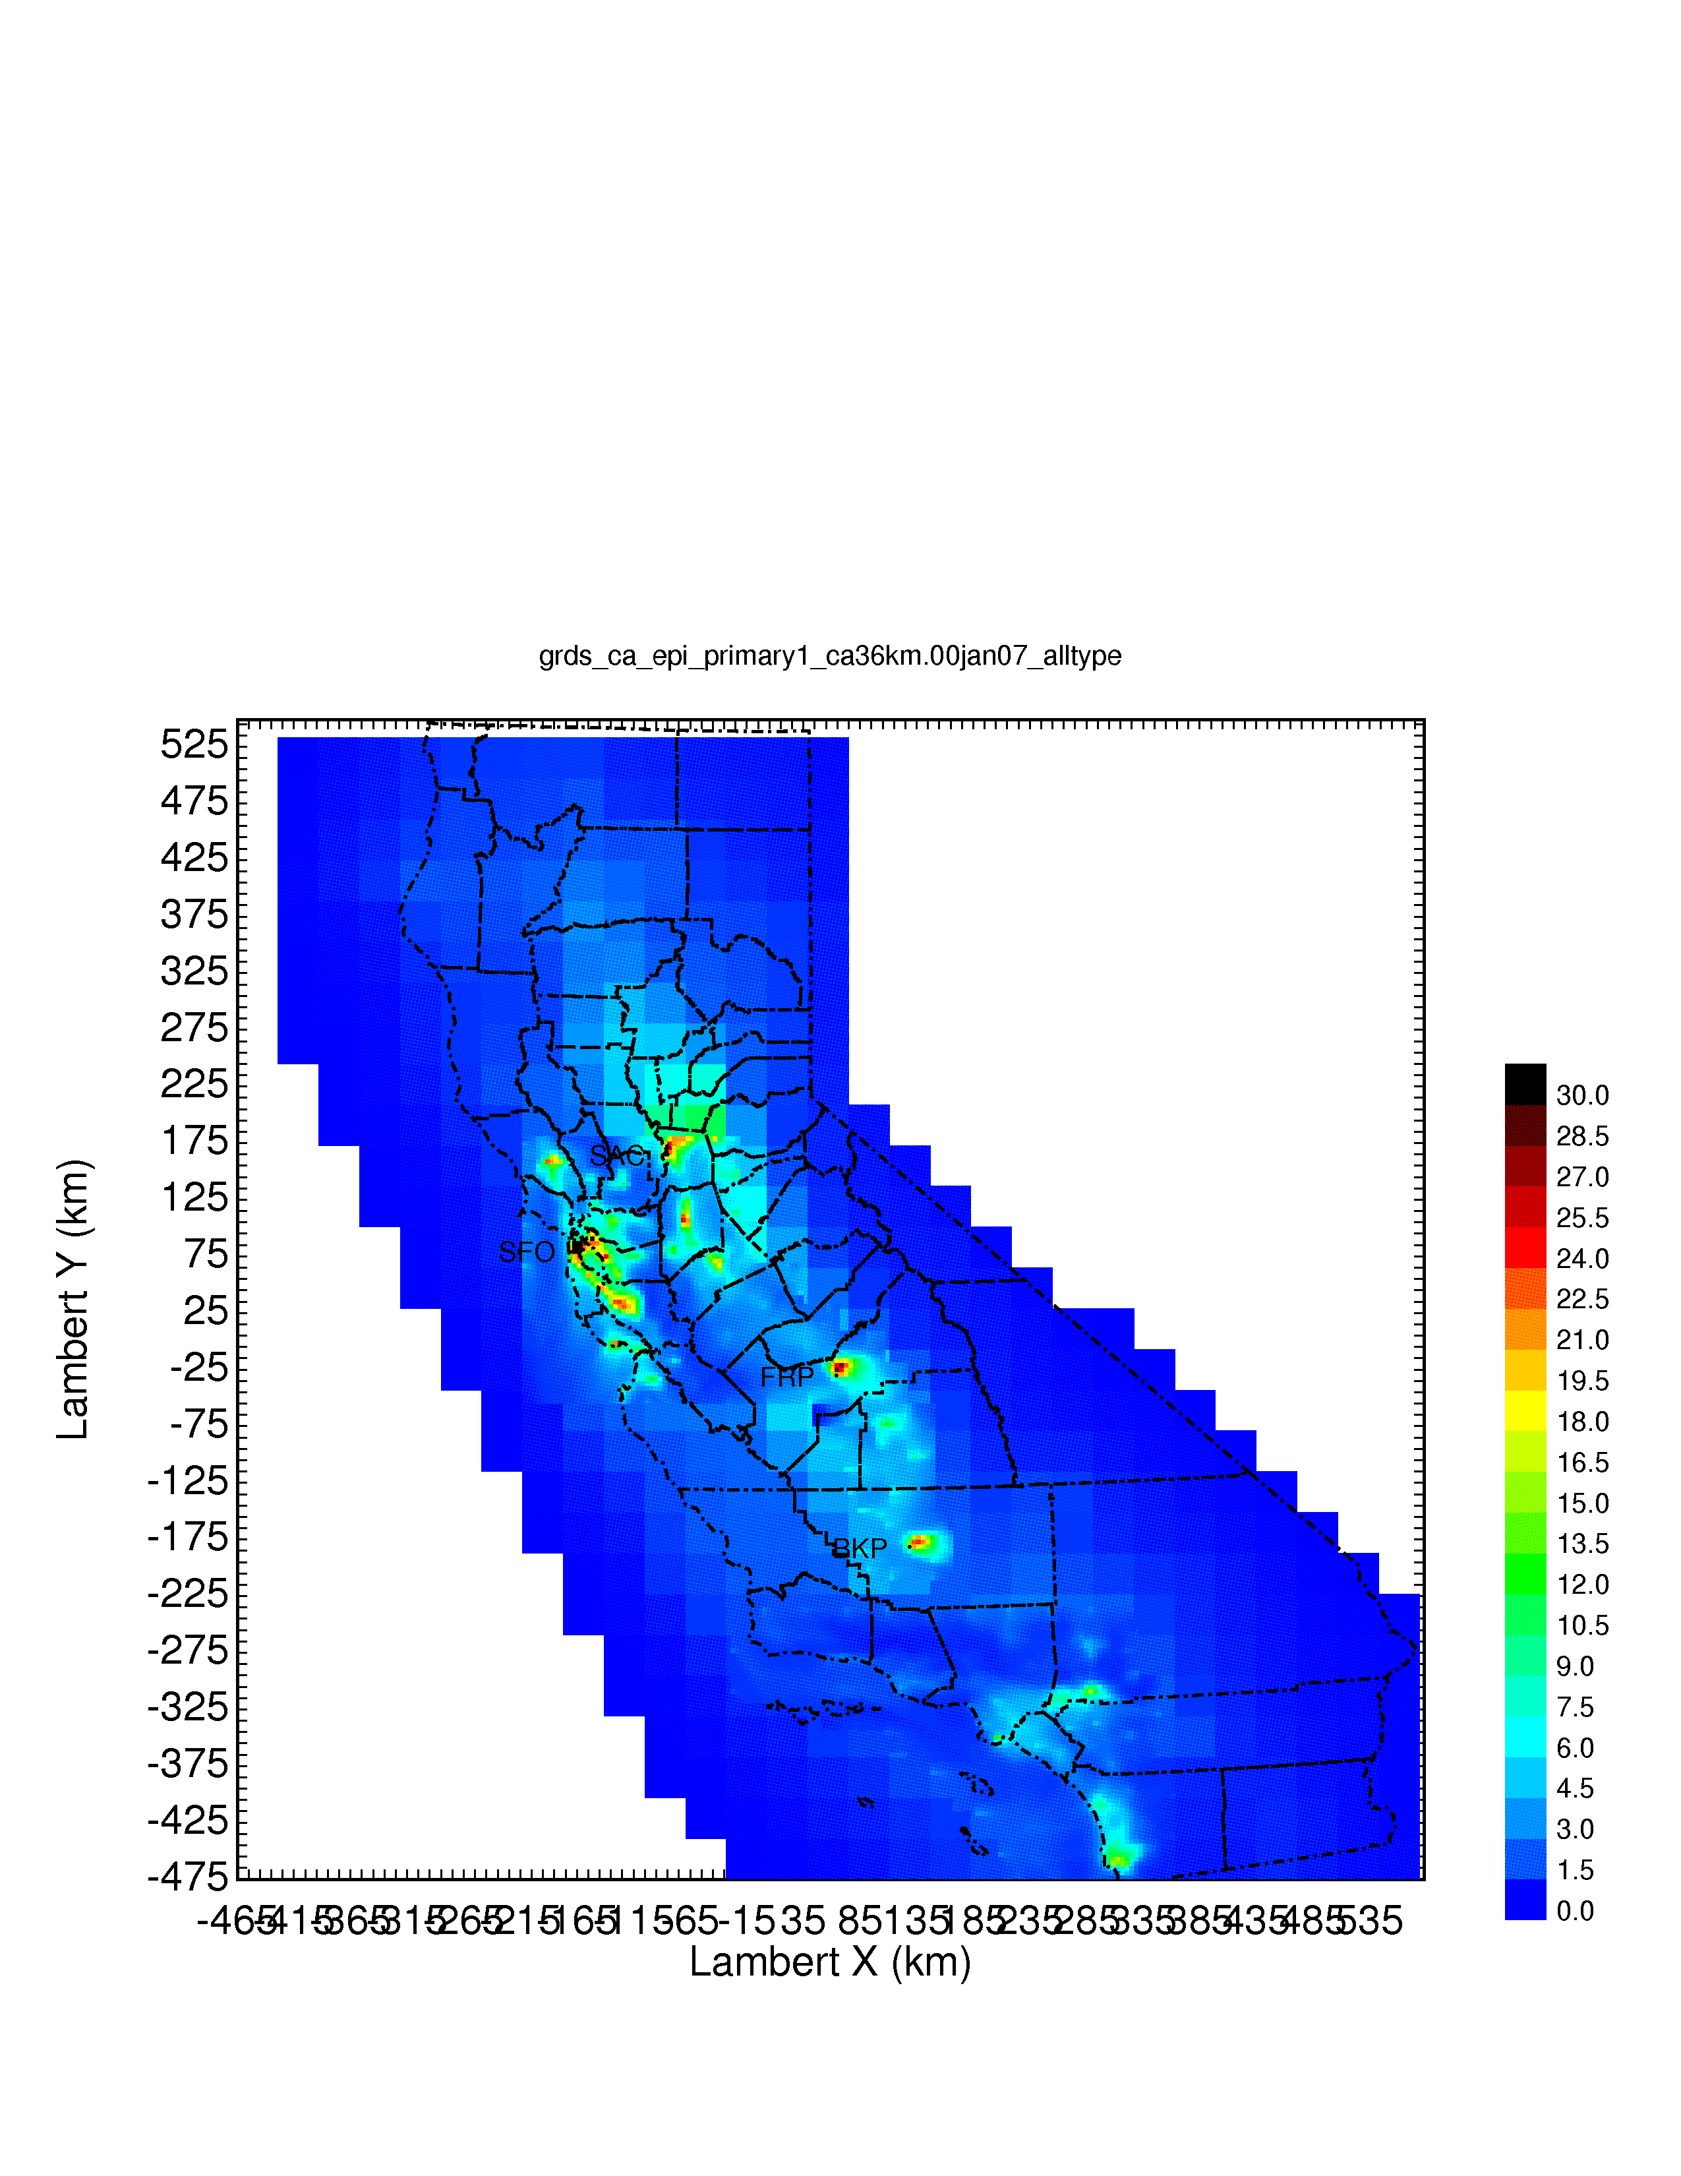
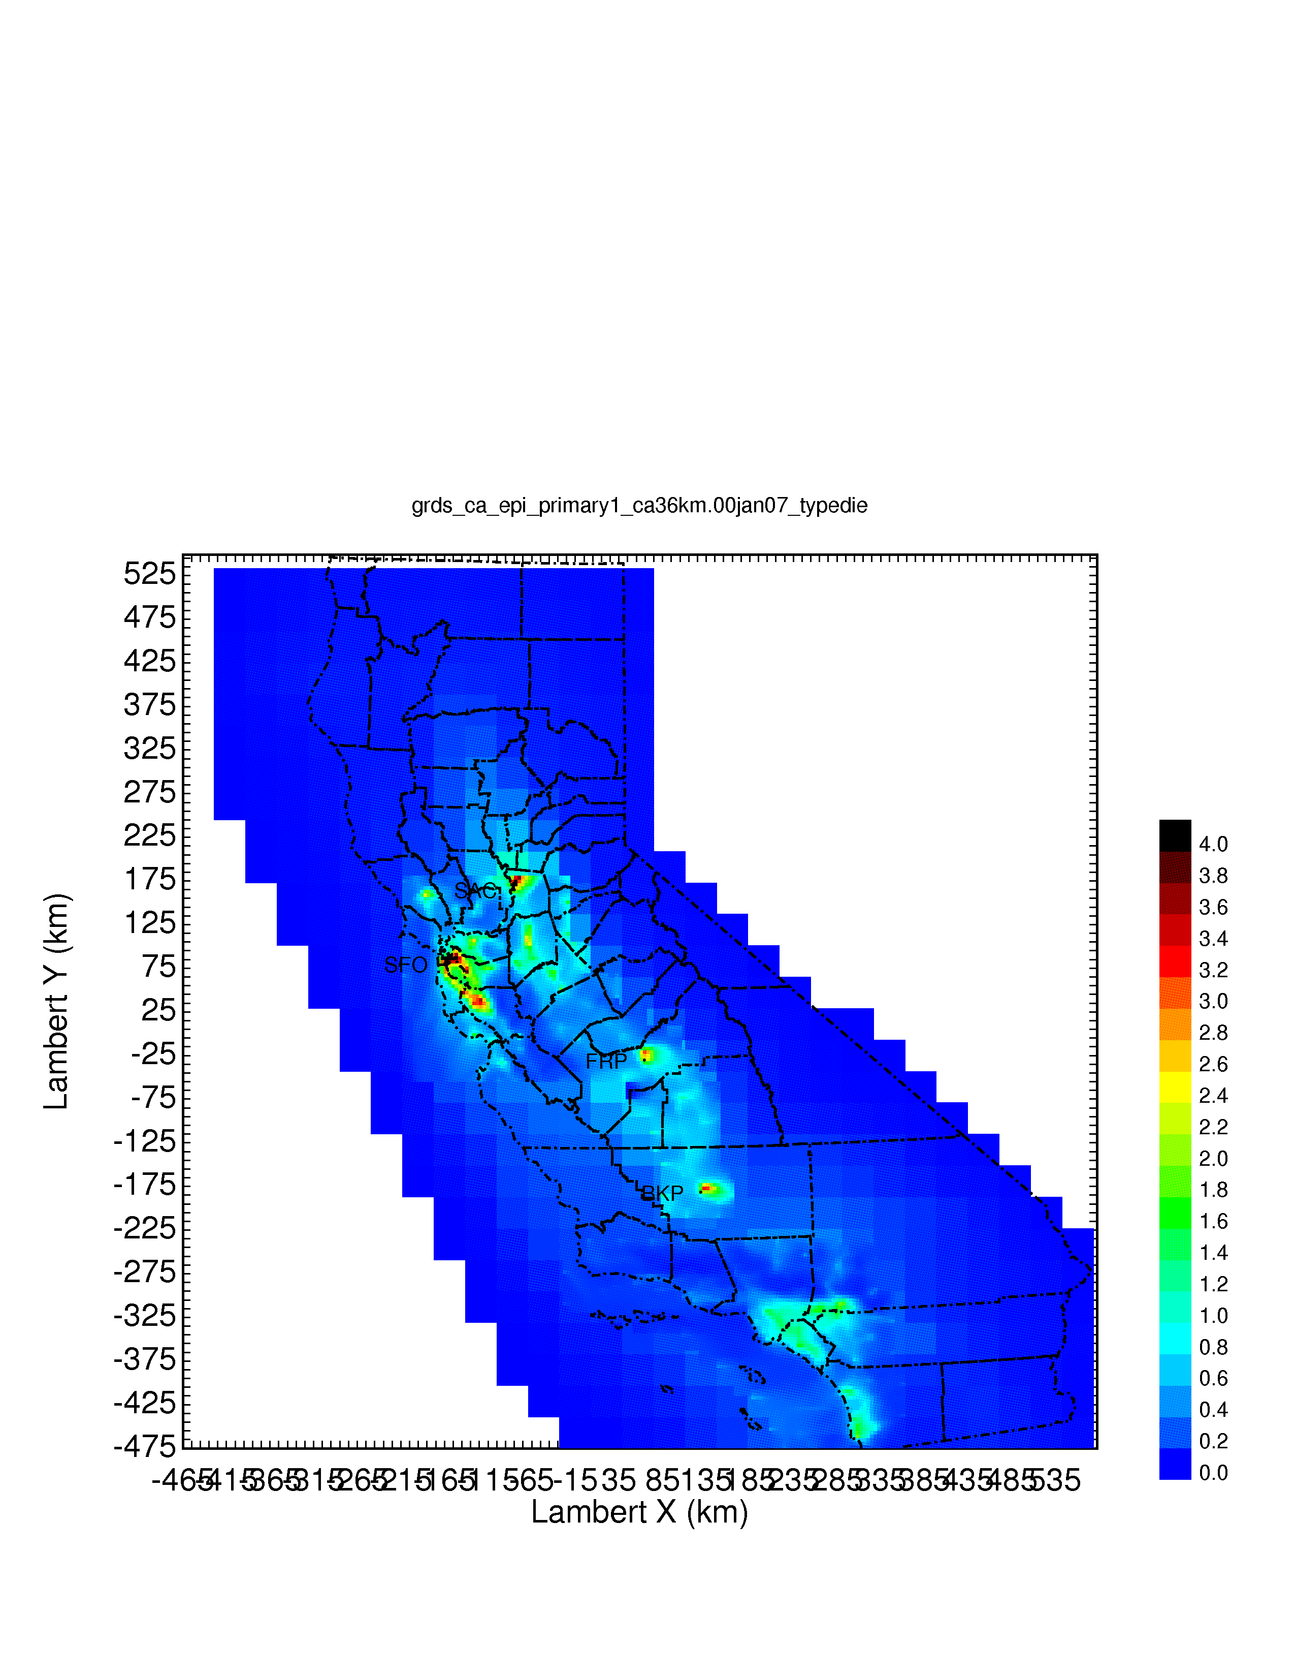

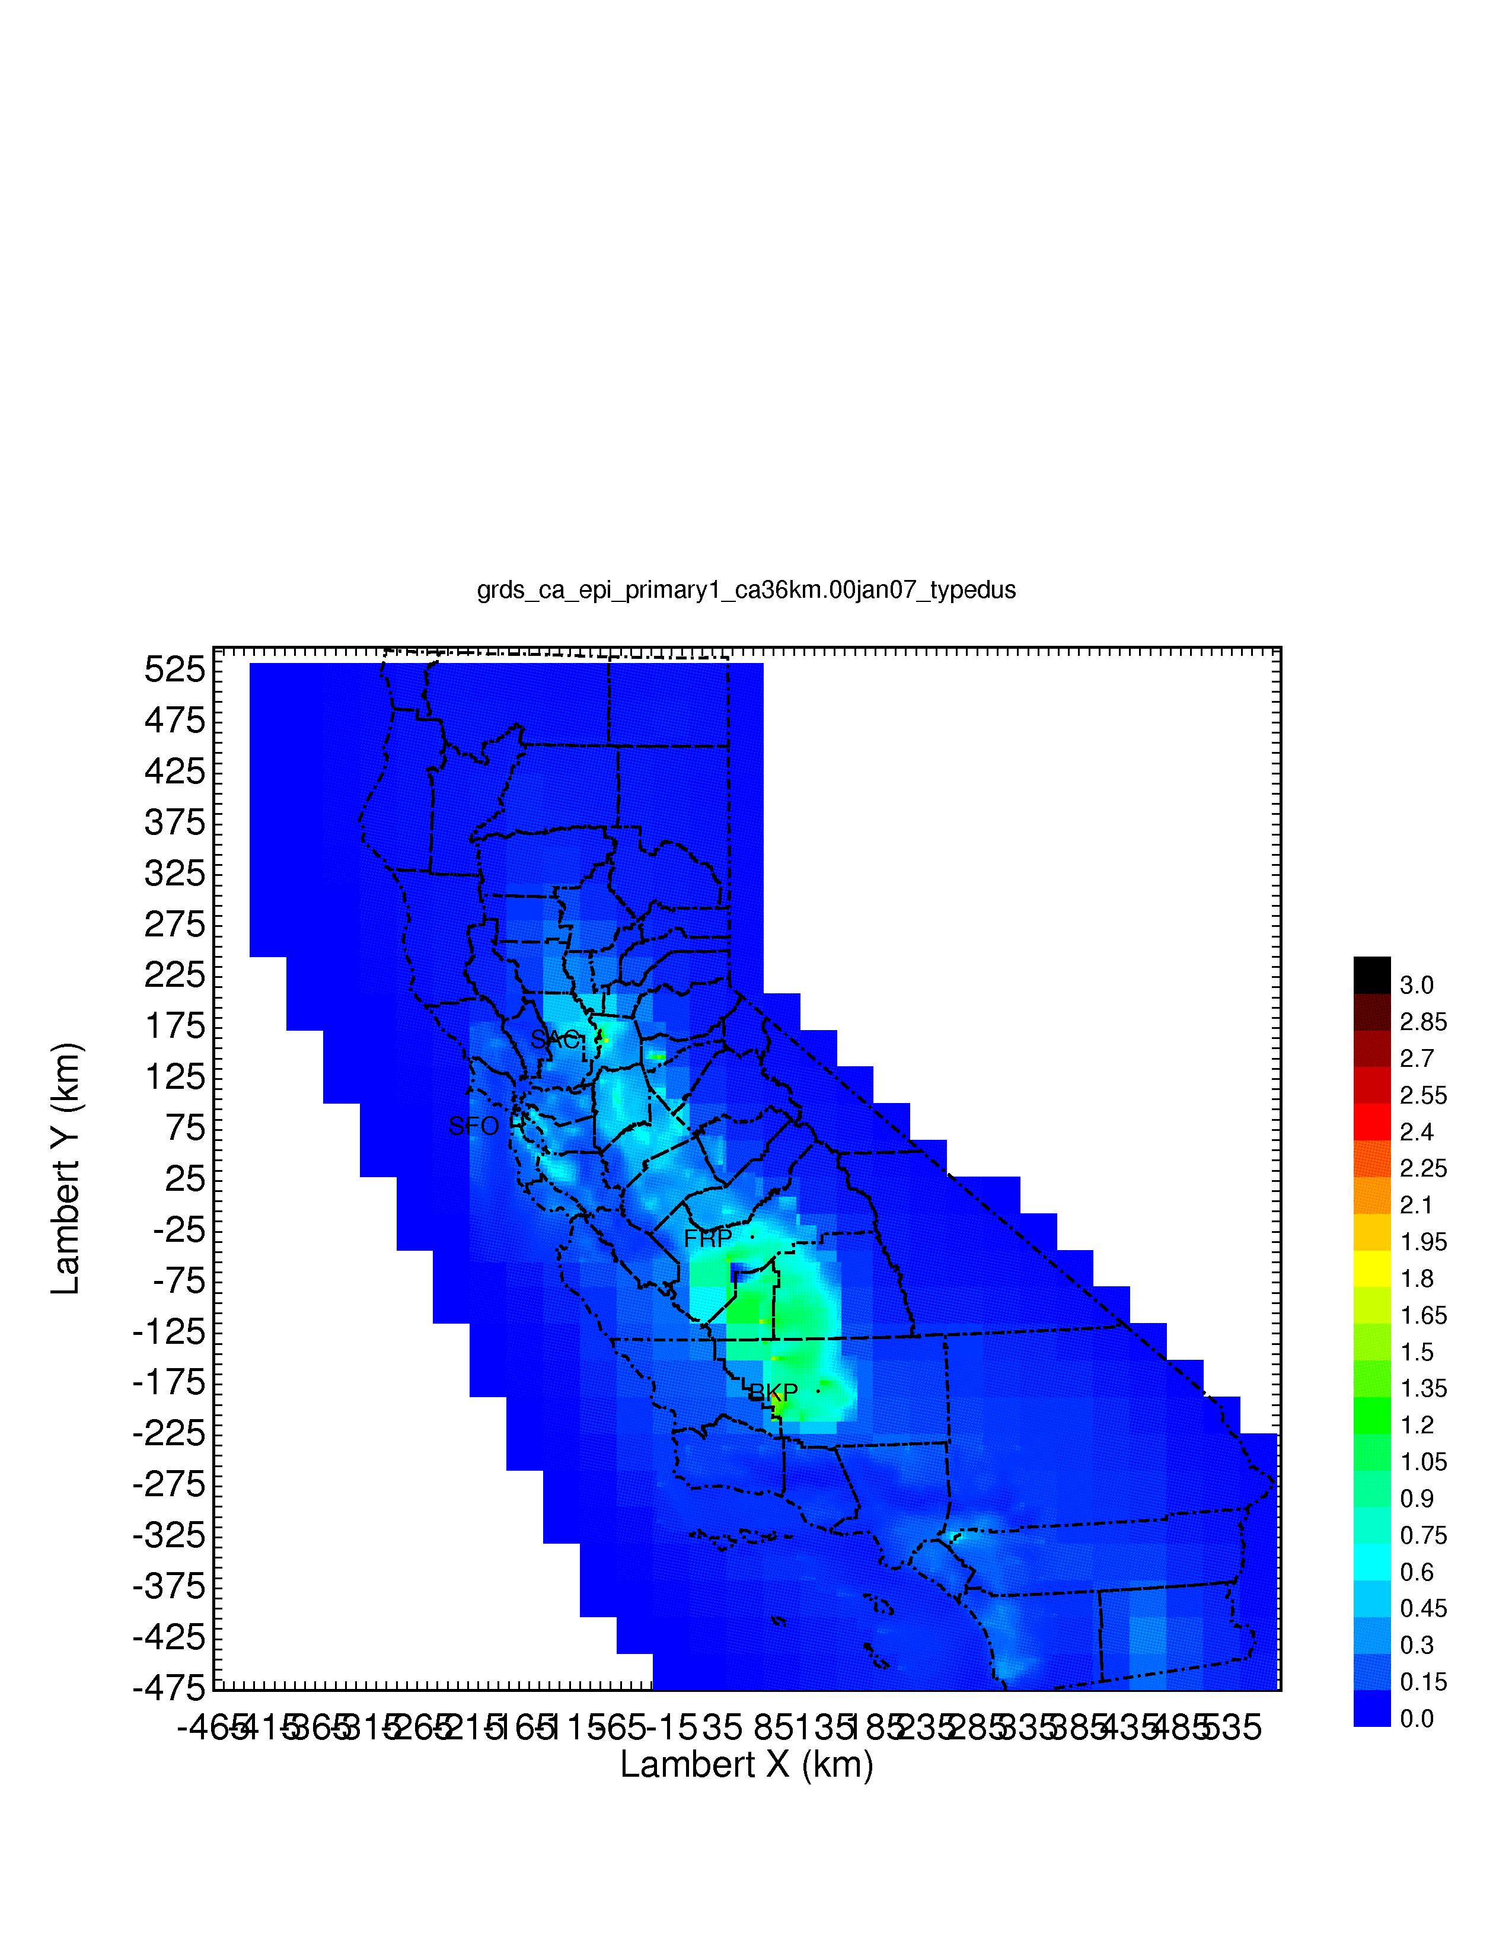
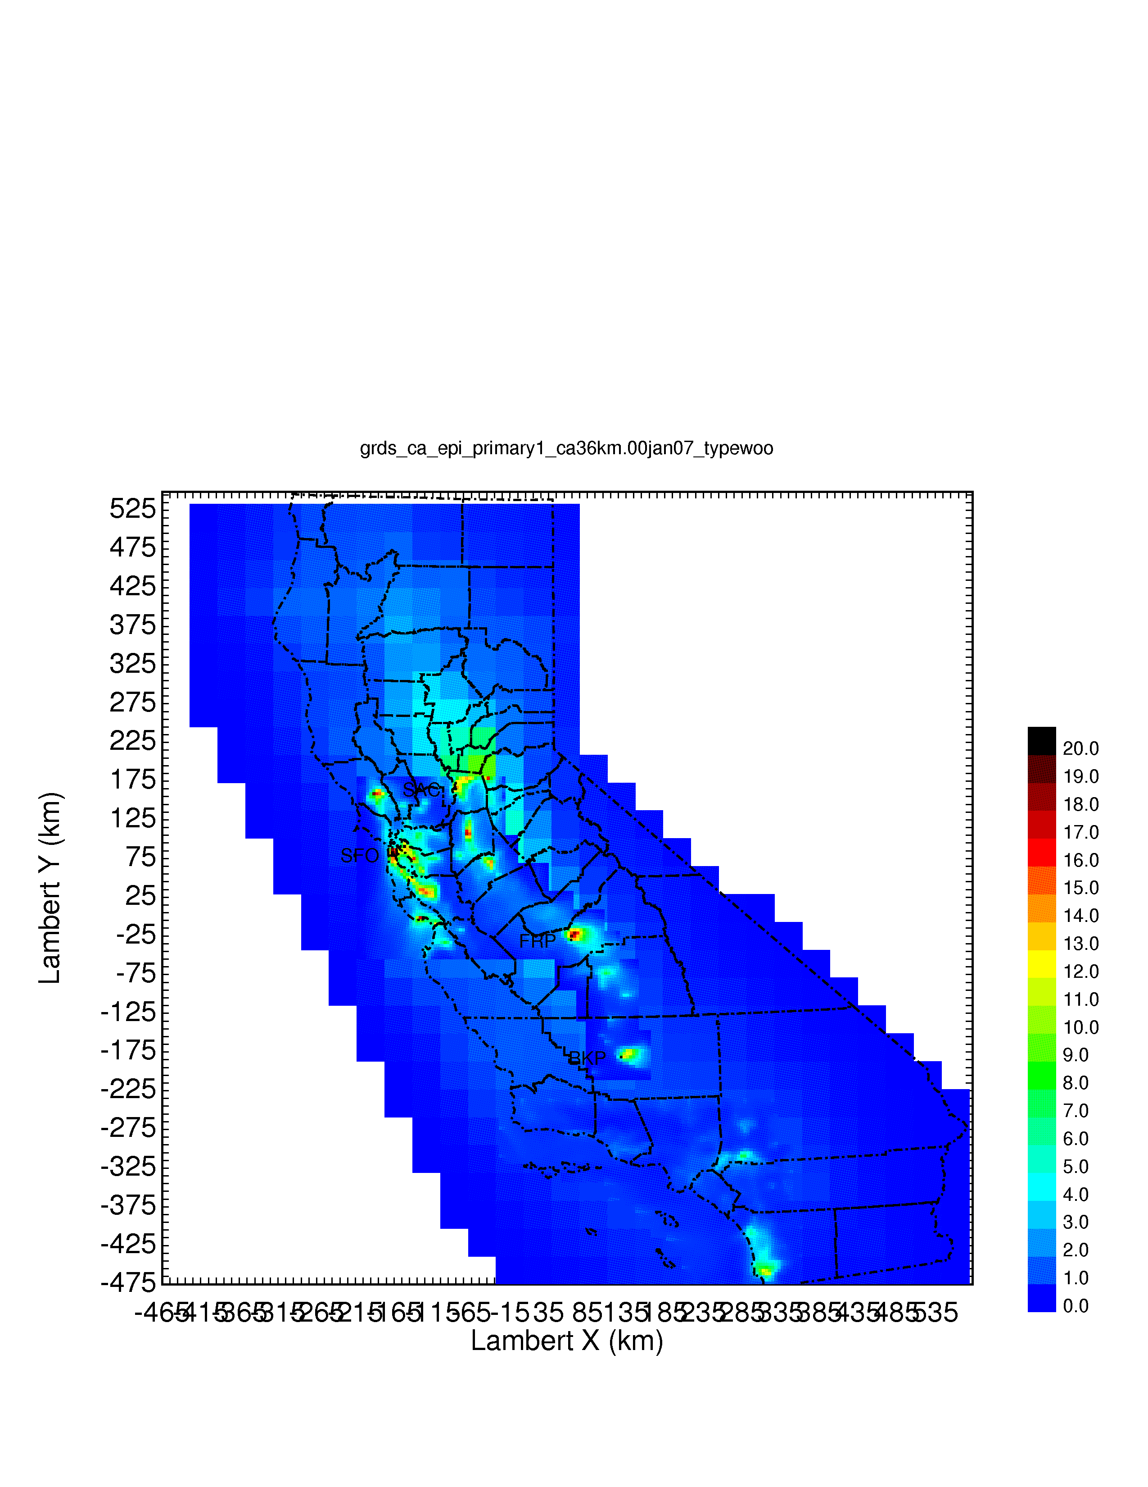
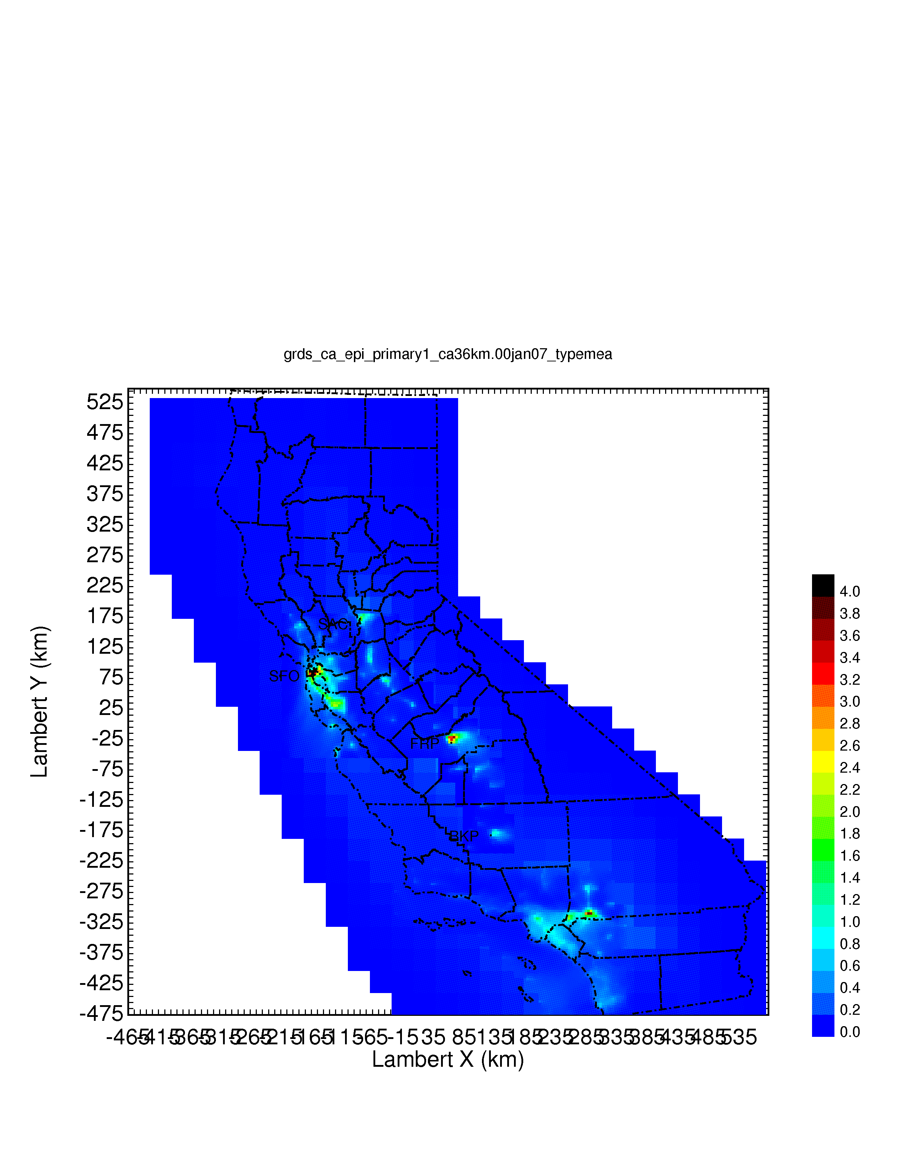
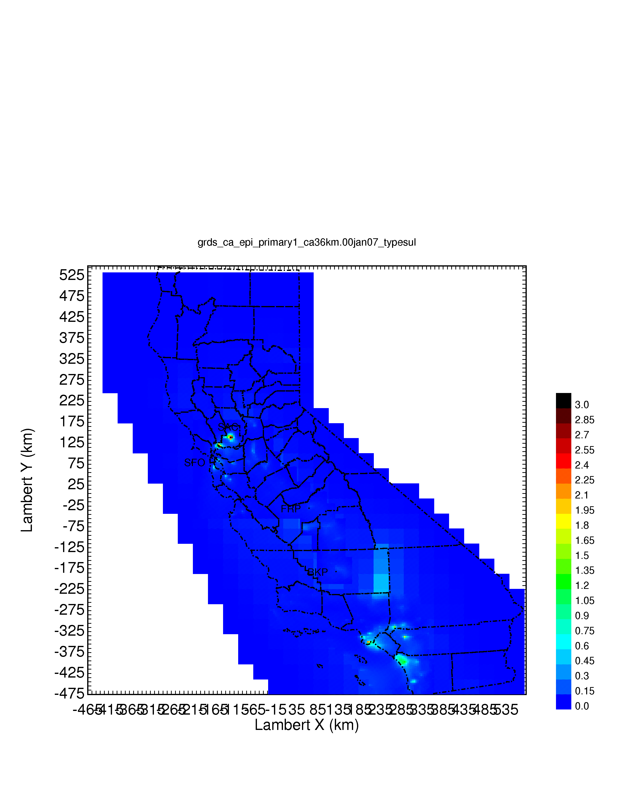
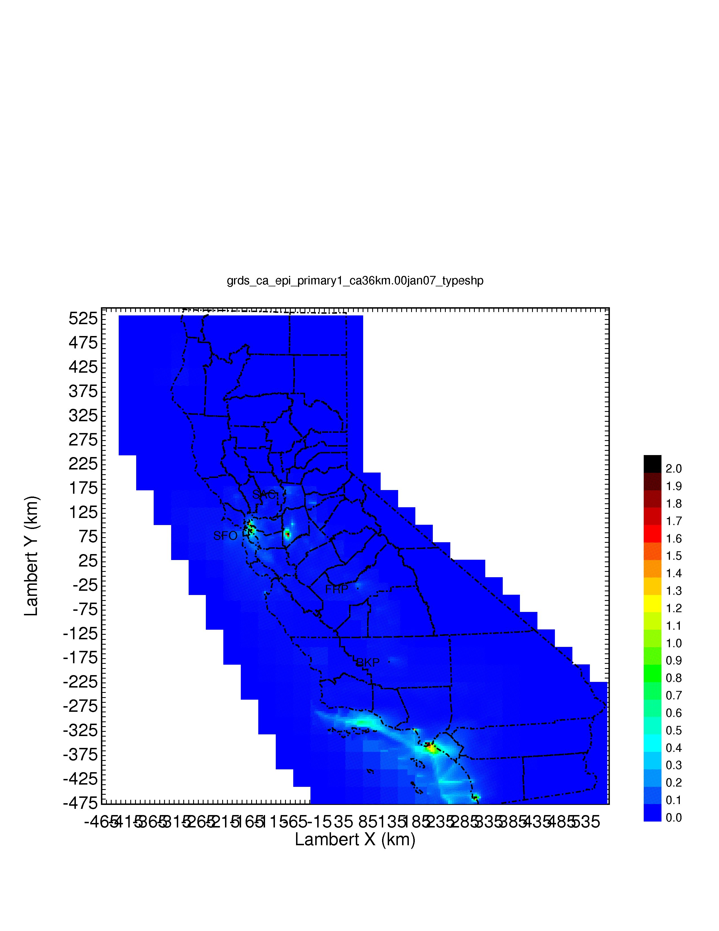
Regional Source Apportionment of UFP Mass
Download from faculty.engineering.ucdavis.edu/kleeman
PM0.1 Mass
Diesel Engines
Gasoline Engines
Dust
Wood Burning
Meat Cooking
High Sulfur Fuel
Shipping
Source: 2014 J. Hu, H. Zhang, S. Chen, Q. Ying, C. Wiedinmyer, F. Vandenberghe, and M.J. Kleeman. Identifying PM2.5 and PM0.1 Sources for Epidemiological Studies in California. Environmental Science and Technology, 48(9), pp 4980-4990.

Slide 20
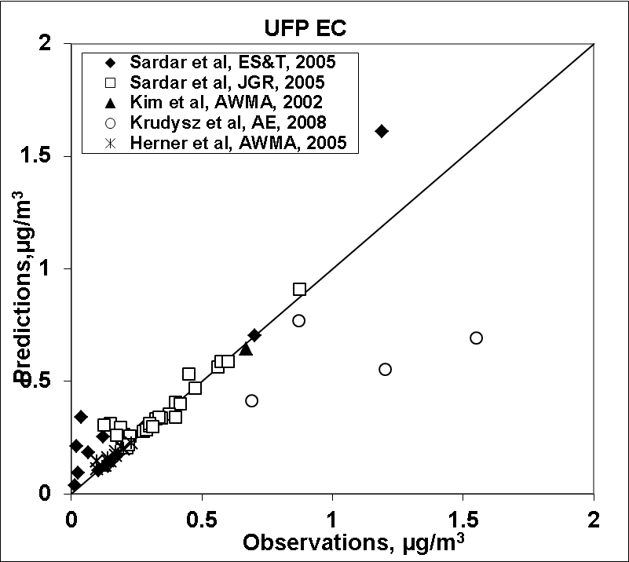
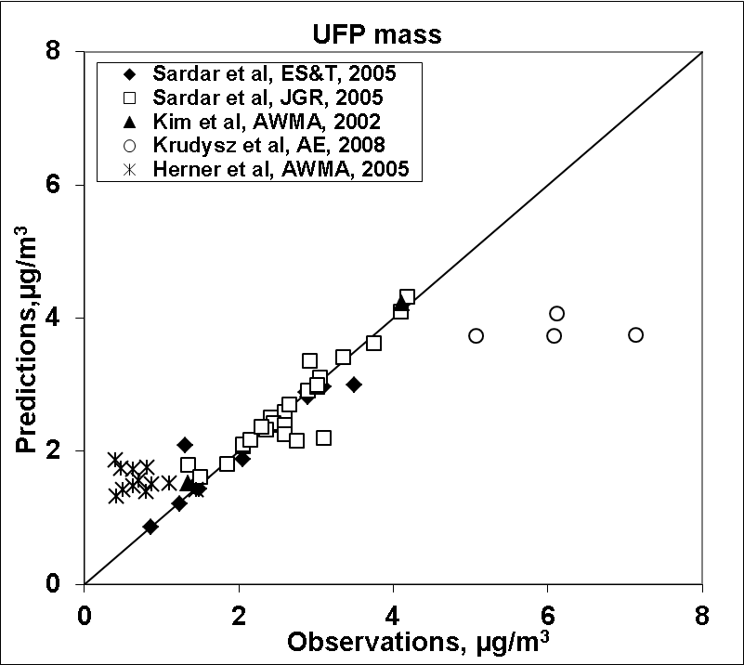
Comparison to PM0.1 Measurements

Slide 21
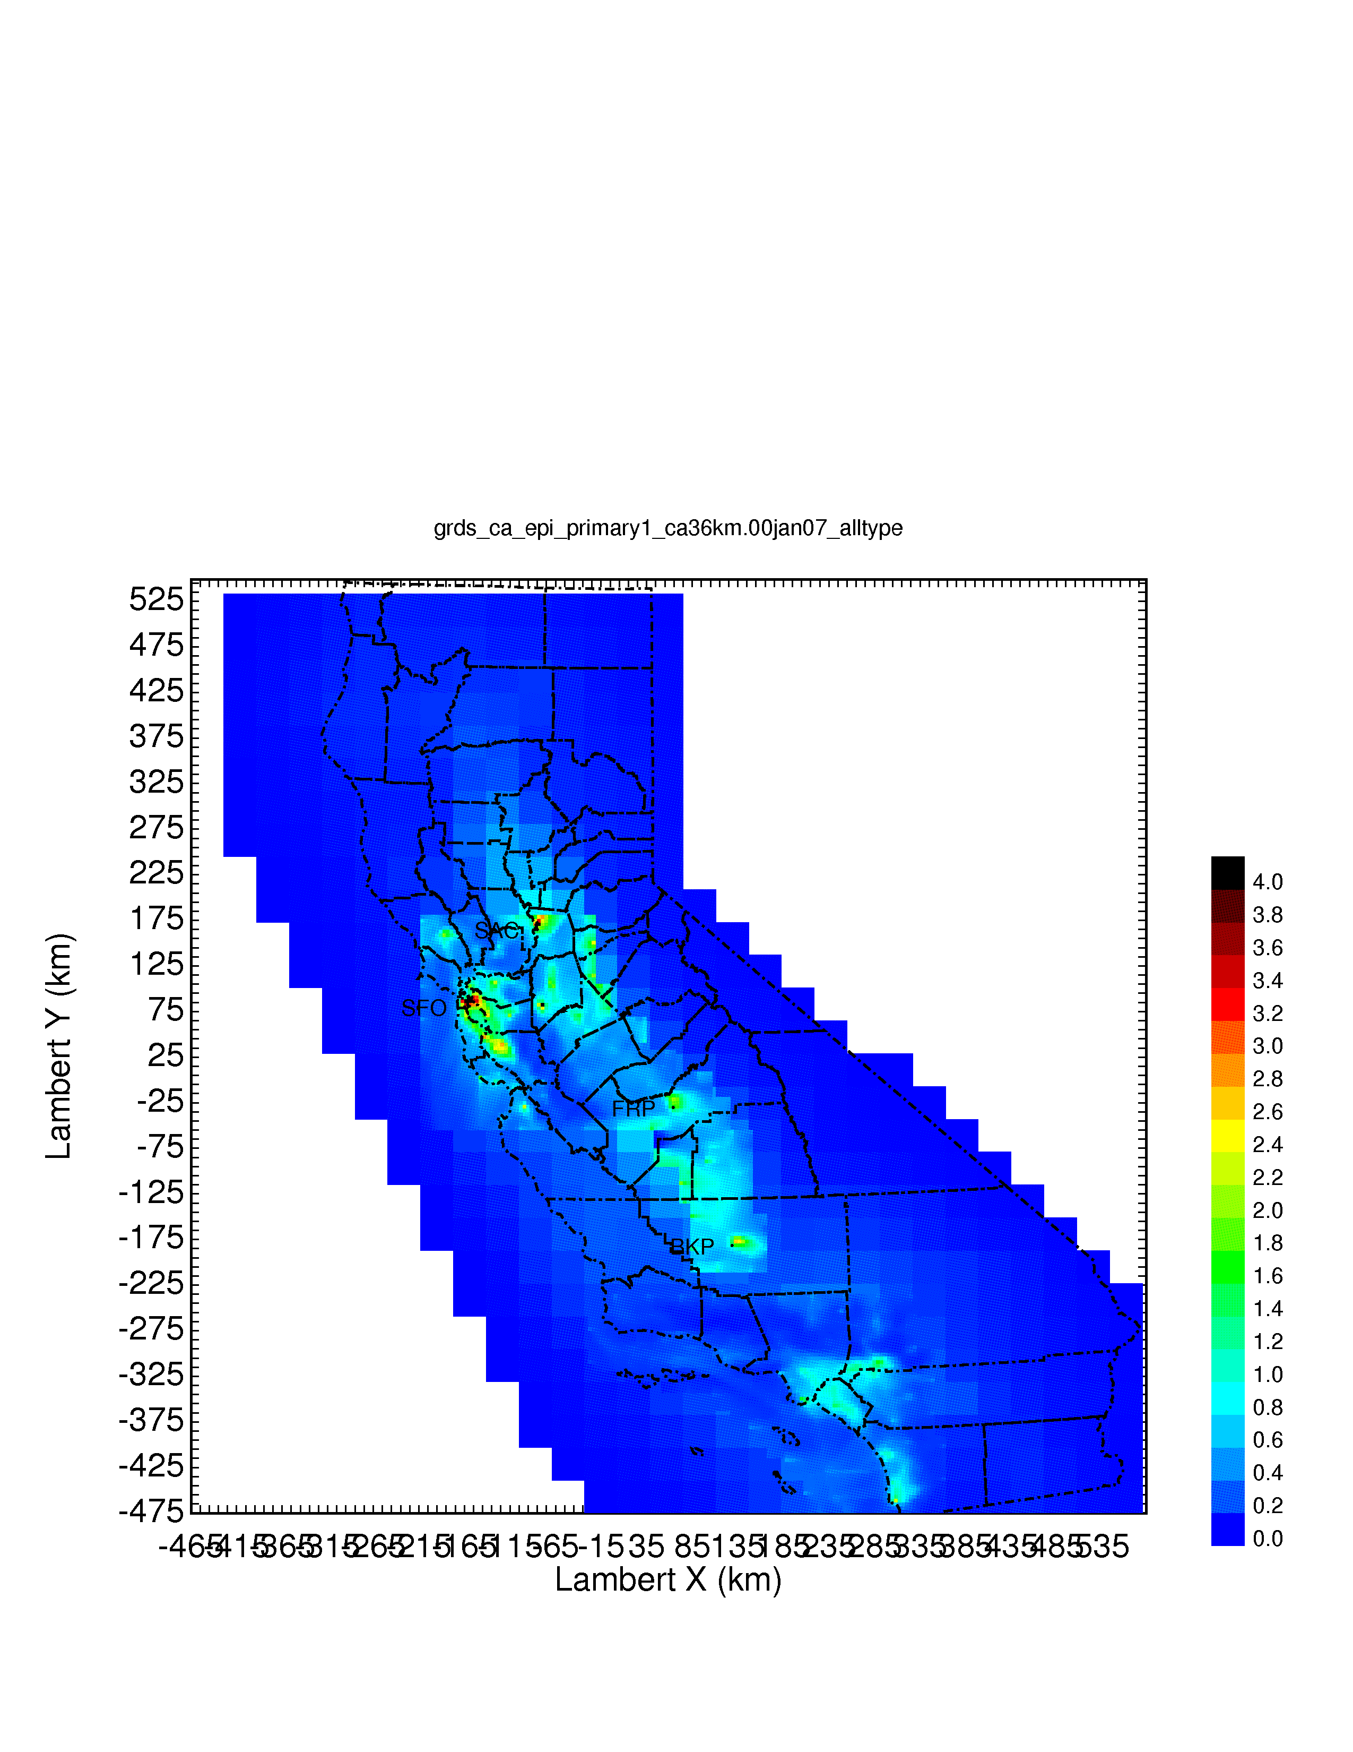


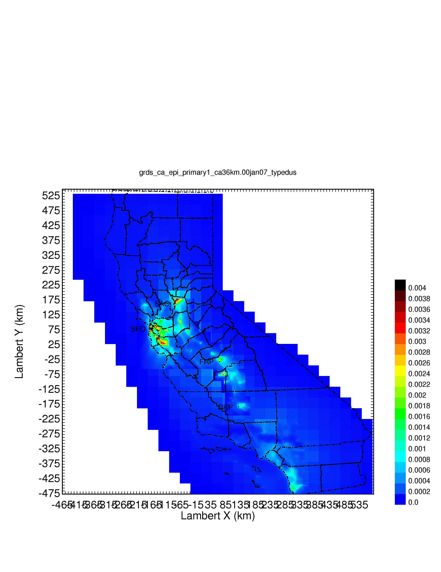
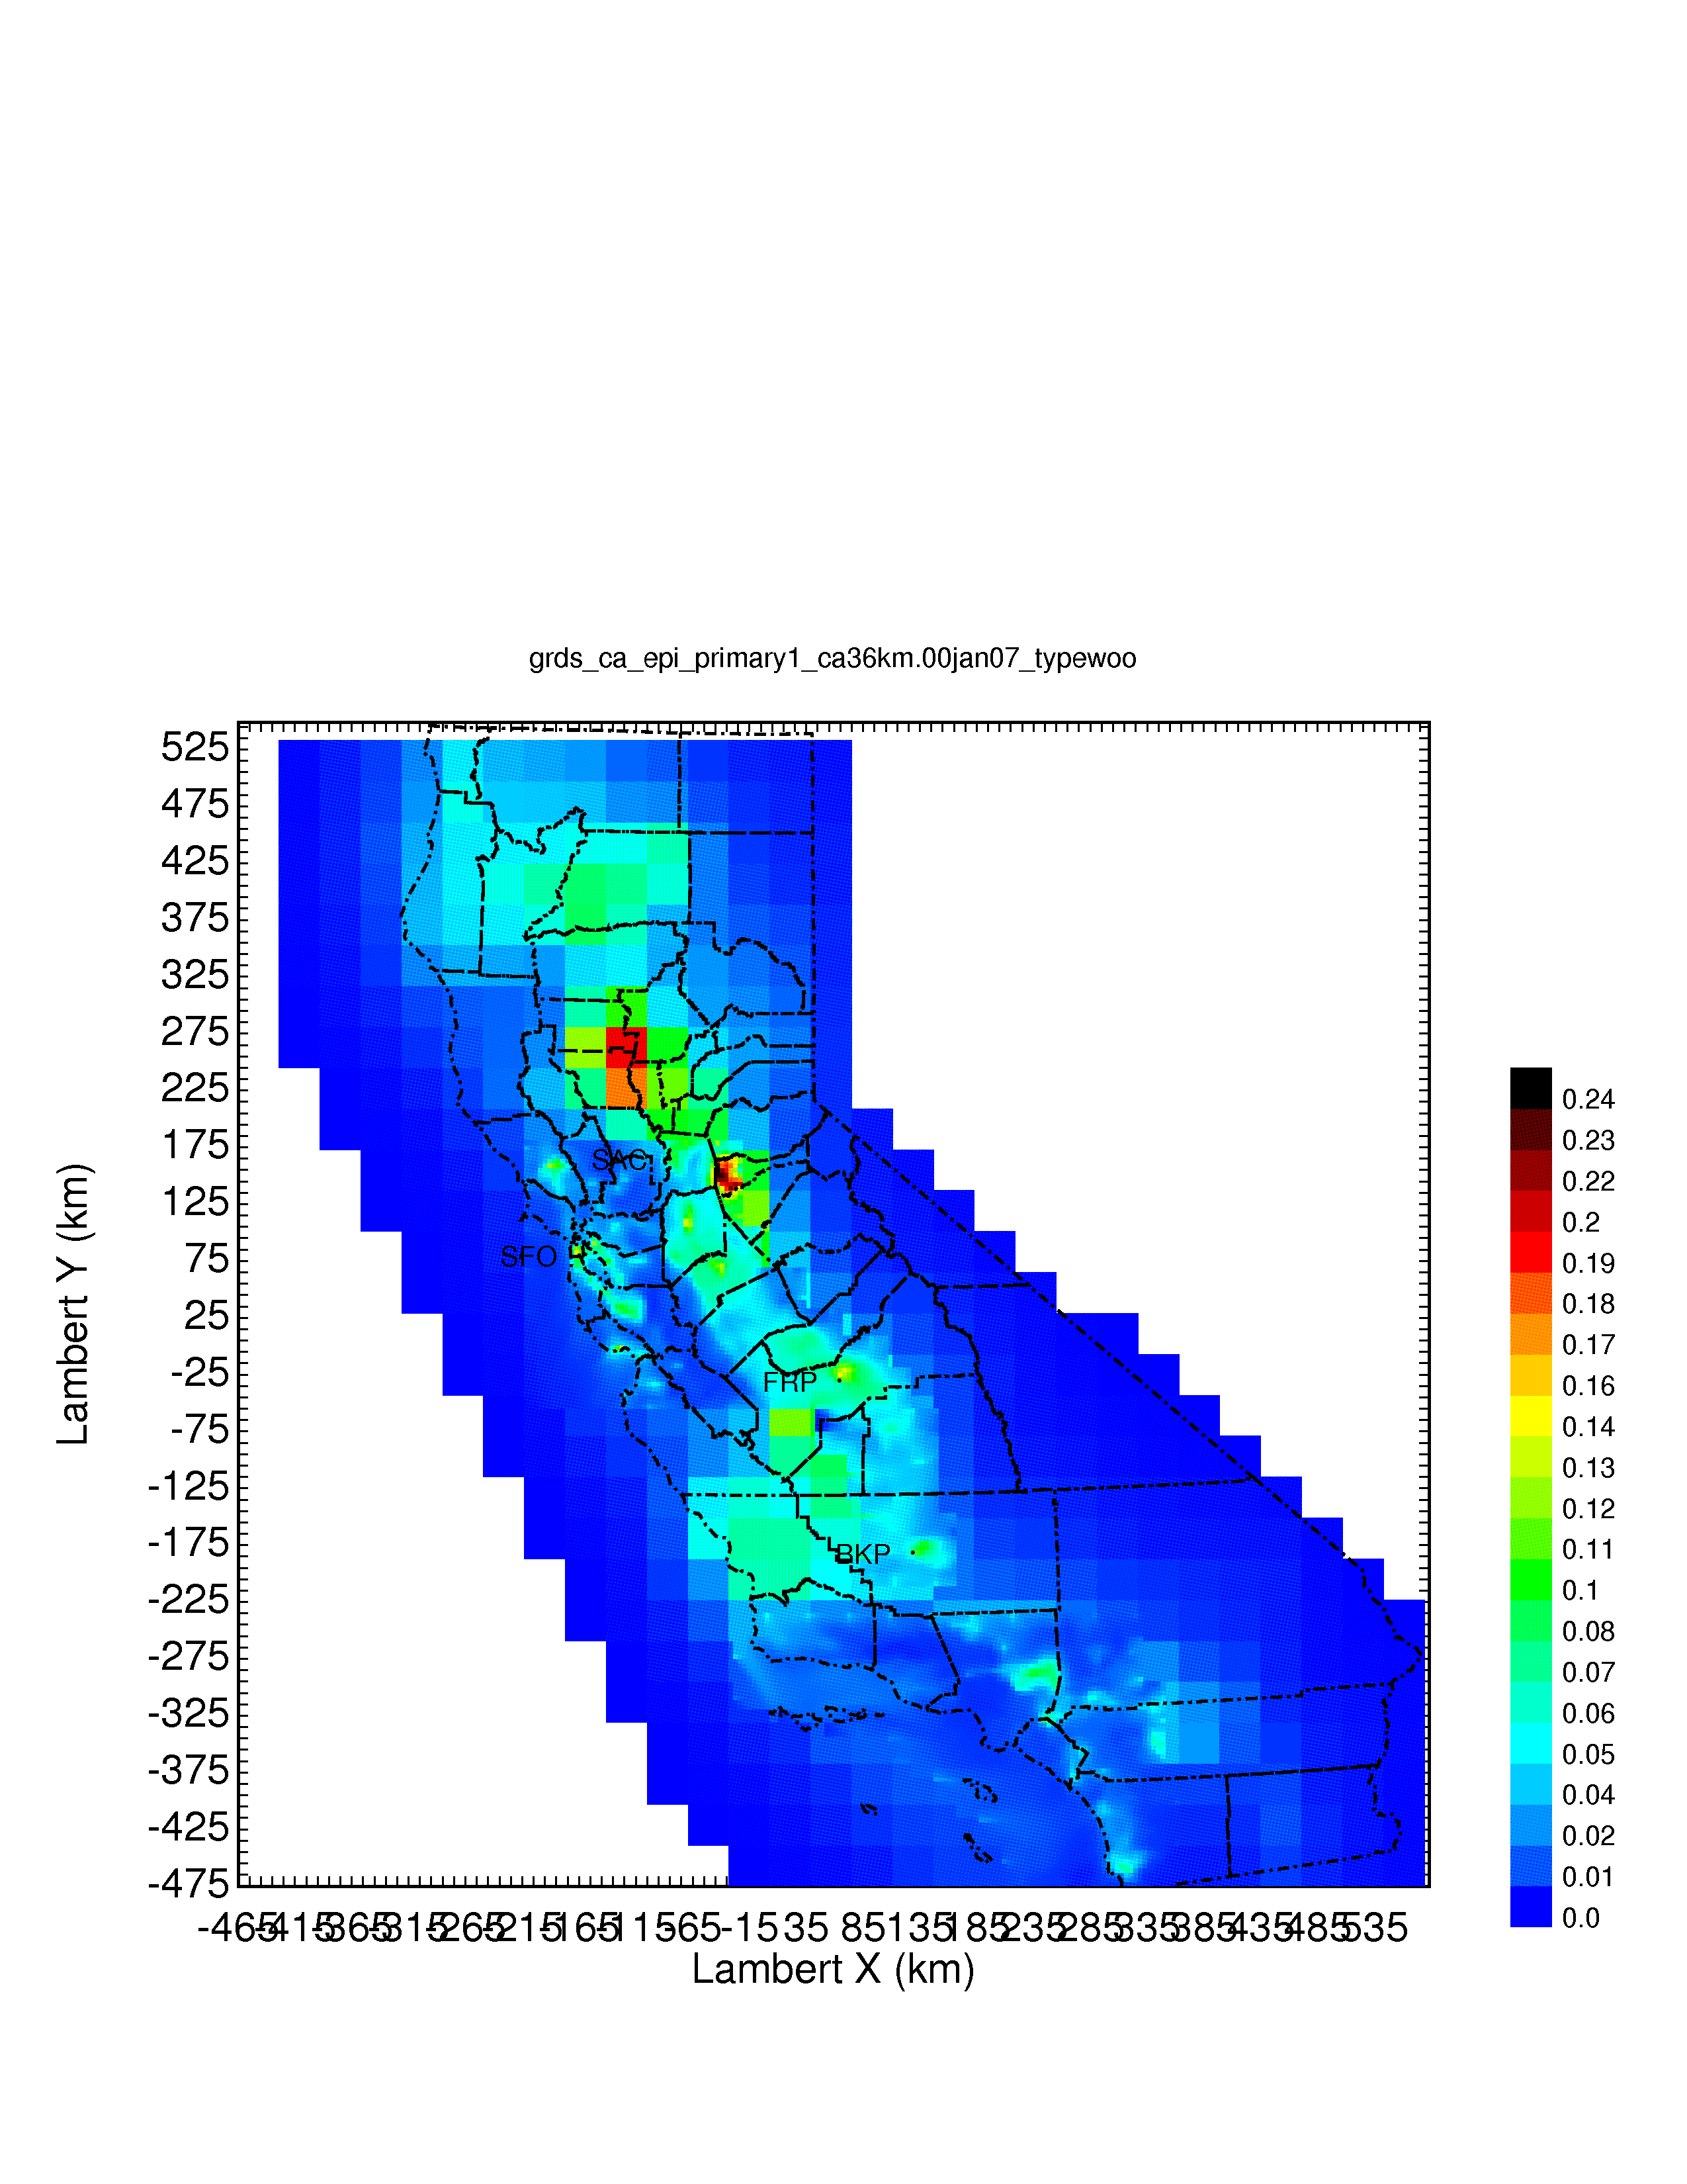



Regional Source Apportionment of UFP EC
Download from faculty.engineering.ucdavis.edu/kleeman
PM2.5 Mass
Diesel Engines
Gasoline Engines
Dust
Wood Burning
Meat Cooking
High Sulfur Fuel
Shipping
Source: 2014 J. Hu, H. Zhang, S. Chen, Q. Ying, C. Wiedinmyer, F. Vandenberghe, and M.J. Kleeman. Identifying PM2.5 and PM0.1 Sources for Epidemiological Studies in California. Environmental Science and Technology, 48(9), pp 4980-4990.

Slide 22
PM0.1 EC Source Apportionment
Source: 2014 J. Hu, H. Zhang, S. Chen, Q. Ying, C. Wiedinmyer, F. Vandenberghe, and M.J. Kleeman. Identifying PM2.5 and PM0.1 Sources for Epidemiological Studies in California. Environmental Science and Technology, 48(9), pp 4980-4990.

Slide 23
CTS Hazard ratios (HR) and 95% CI for IQRs of association of PM0.1 with Ischemic Heart Disease Mortality
Analysis also indicates that PM0.1 mass and each constituent and source provides better fit of the data than does corresponding PM2.5
Source:2015 B. Ostro, J. Hu, D. Goldberg, P. Reynolds, A. Hertz, L. Bernstein, and M.J. Kleeman. Long-term exposures to fine and ultrafine particles, species and sources: Results from the California Teachers Study Cohort. Environmental Health Perspectives, 123(6) pp 549-556.

Slide 24
Energy Futures
Air pollution has improved dramatically in the United States over the past 25 years
Climate change is now the greatest unsolved problem facing the US
Strategies to address climate change involve new energy systems
We need to optimize our energy choices now to maintain healthy air quality in the future

Slide 25
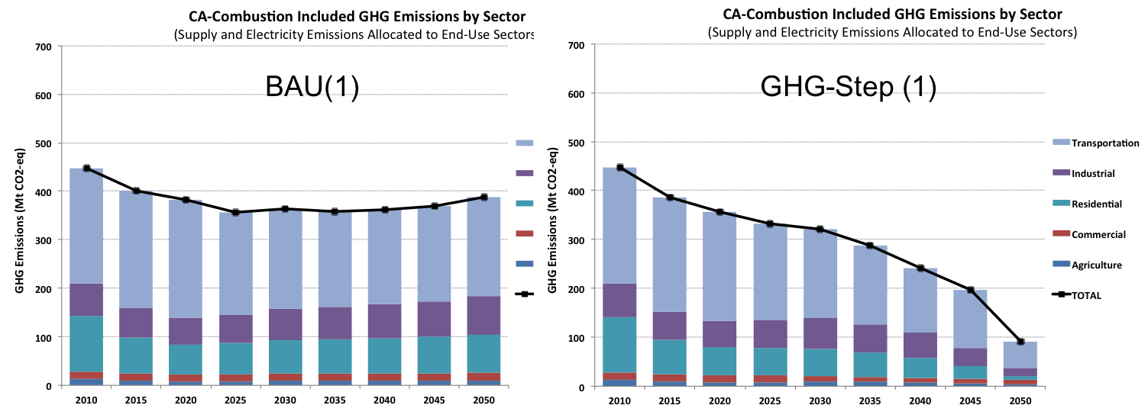
Approach: CA-TIMES Results – GHG emissions
GHG emissions in BAU and Primary GHG scenario (GHG-Step)
GHG-Step scenario achieves 75% GHG reduction
  CCS and nuclear power are not available in this scenario
  Ignores out-of-state aviation and marine travel and excludes offsets
  Significant emissions reduction across all sectors (44 to 81% reduction)
  Transportation continues to contribute majority of emissions
2020 Target (391 MtCO2e)
2050 Target
78 MtCO2e
25

Slide 26
Change in Statewide Emissions Relative to BAU
Notes:
(Potential things to point out):
Note how some emissions increase for certain sectors and pollutants.
Increase in CNG in off-road causes OC and CO increase.
More biomass based marine fuel consumption in BAU than GHGAi.
Large metal reduction from vehicle brake wear reductions from electric vehicles.
Due to the large variable spatial distribution and abundance of these emissions, the PM2.5/ozone concentration look very different.

Slide 27
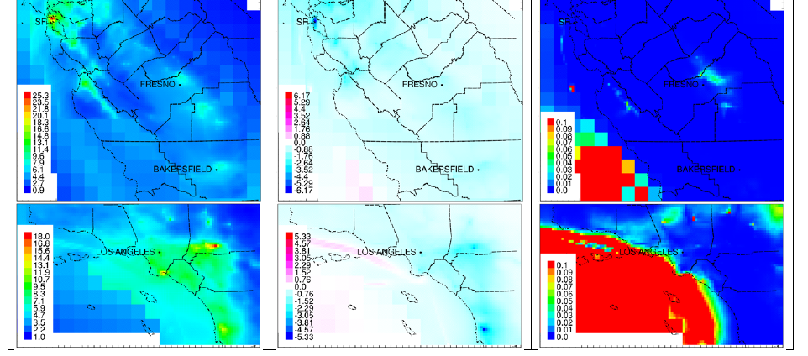
2054 Annual Avg. PM2.5 (µg m⁻³)
BAU
GHGAi-BAU
P-value
Notes:
Significant PM2.5 reductions nearly everywhere.

Slide 28
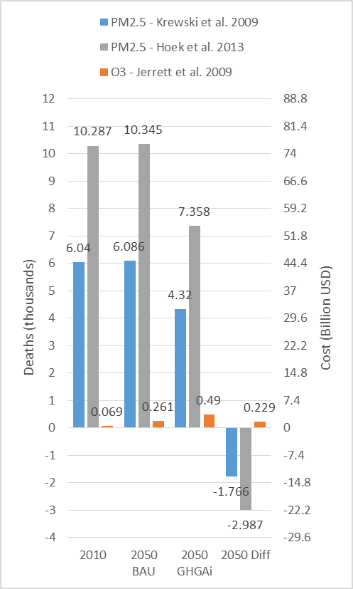
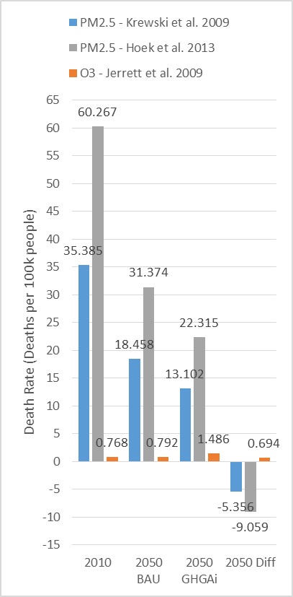
Death and Cost Death Rate
Notes:
PM2.5 deaths decrease and O3 deaths increase, but O3 contributes only 2-4.4% of the deaths (as shown in the orange bars).
PM2.5 and O3 attributed deaths would remain practically constant in the 2010 to 2050 BAU scenario.
As shown in Figure 14a, it is estimated that roughly 6,400-10,600 people would die annually in the California 2050 BAU scenario due to exposure to PM_{2.5} and O₃ in 2050. In the California GHG-Step scenario, total PM_{2.5} and O₃ mortality would decrease to 4,800-7,900 deaths annually (24-26% reduction).
Statewide there is a 24-26% lower mortality rate, 14.59-23.81 versus 19.25-32.16 deaths per 100k, in the 2050 GHG-Step scenario compared to the BAU scenario. The 2050 GHG-Step statewide PM_{2.5} and O₃ mortality rate is ~54-56% lower than the 2010 base scenario.

Slide 29
Number of Summer Exceedance Days With Population Weighted O3 ≥ 70 ppb
Notes:
Note the decline in O3 in the SJV counties.
Downwind LA counties of Riverside and San Bernardino continue to have high number of summer exceedance days.

Slide 30
Summary of Future Modeling Needs
Improved meteorological models
Continued integration of Big Data
Push to higher spatial resolution
Continued research about organic aerosol predictions
Ultrafine particles – source data, ambient data, model representations
Air-Climate-Energy interface for future predictions

Slide 31
Supporting Information

Slide 32
Wind Speed Bias During Stagnation in California

Slide 33
Big Data
We live in the age of big data – our behavior is tracked, analyzed, and used for targeted advertising
The “internet of things” will only increase that trend
We have an opportunity to develop tools that take advantage of big data to better understand emissions from mobile, commercial, and residential sources

Slide 34
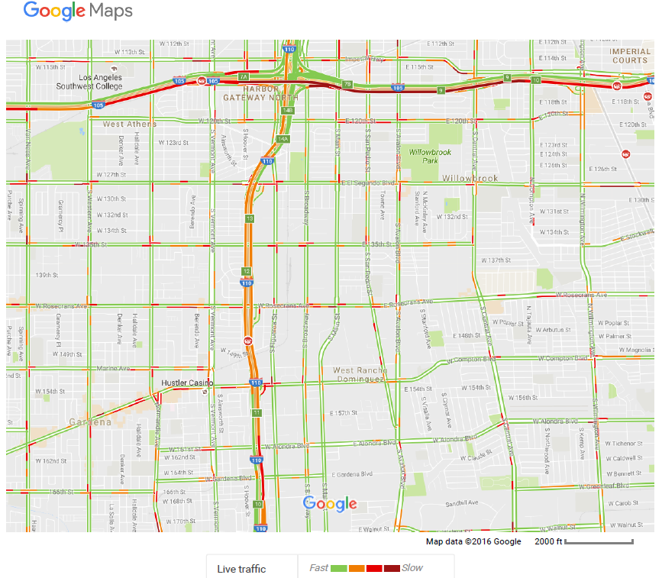
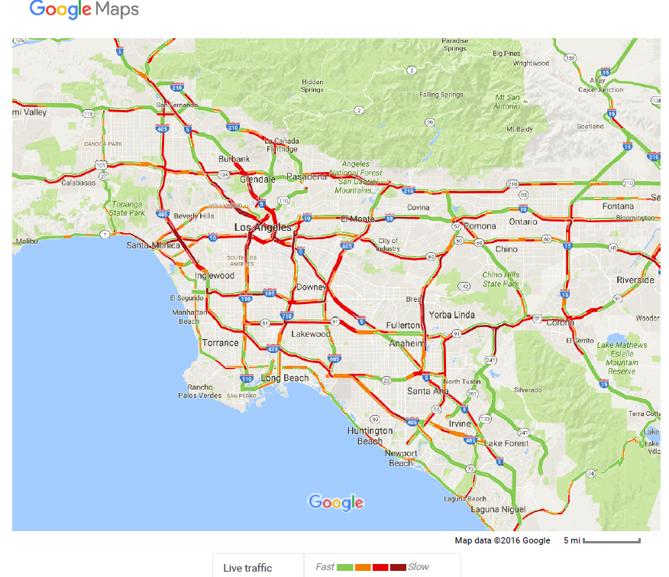
Real Time Traffic

Slide 35
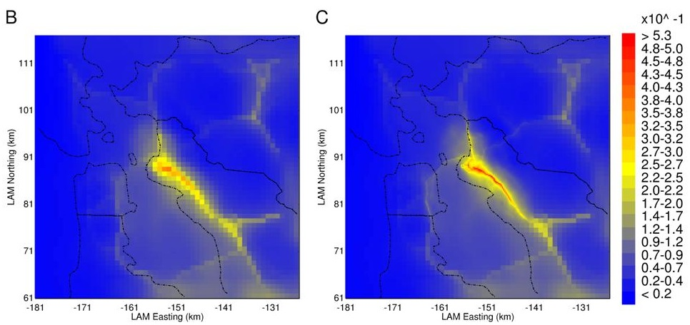
PM2.5 EC On-Road Diesel
Source: 2014 D.K. Joe, H. Zhang, S.P. DeNero, H.H. Lee, S. chen, B.C. McDonald, R.A. Harley, and M.J. Kleeman. Implementation of a High-Resolution WRF/Chem Model at the Port of Oakland, Atmospheric Environment, 82, pp351-363

Slide 36
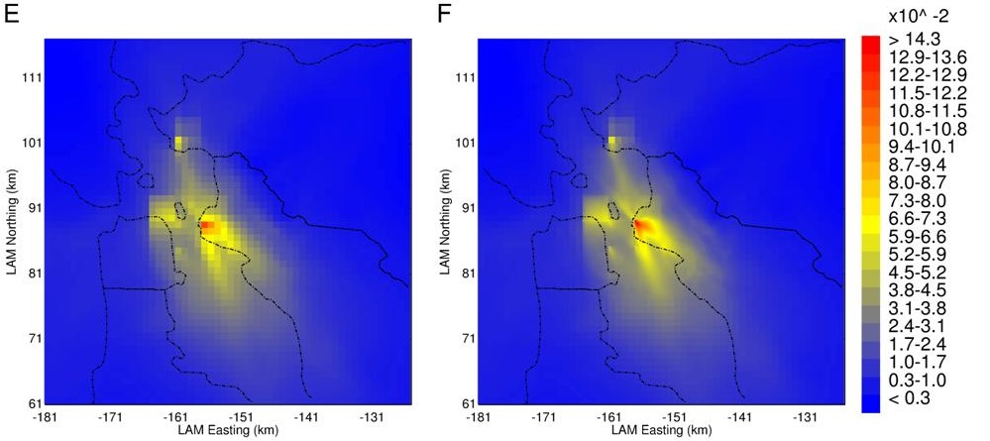
PM2.5 EC Shipping
Source: 2014 D.K. Joe, H. Zhang, S.P. DeNero, H.H. Lee, S. chen, B.C. McDonald, R.A. Harley, and M.J. Kleeman. Implementation of a High-Resolution WRF/Chem Model at the Port of Oakland, Atmospheric Environment, 82, pp351-363

Slide 37
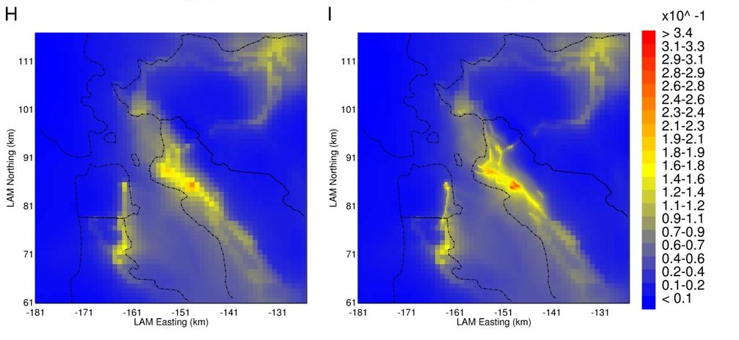
PM2.5 EC Rail
Source: 2014 D.K. Joe, H. Zhang, S.P. DeNero, H.H. Lee, S. chen, B.C. McDonald, R.A. Harley, and M.J. Kleeman. Implementation of a High-Resolution WRF/Chem Model at the Port of Oakland, Atmospheric Environment, 82, pp351-363

Slide 38
UCD/CIT Model Specification for California
July 15th to August 2nd 2005 (21 days in summer)
24 km resolution and nested 8 km simulation
California Regional PM10/PM2.5 Air Quality Study (CRPAQS) inventory 2000 scaled up for 2005
FINN (Fire Inventory for National Center
for Atmospheric Research)
MEGAN (Model of Emissions of Gases
and Aerosols from Nature)
WRF v3.4 model for meteorological data
MOZART-4/NCEP for initial condition
and boundary condition
SAPRC-11 for Gas-phase Chemistry
total Organic Aerosol
24km resolution
Concentration (µg/m³)
8km resolution

Slide 39
16 Systematic Simulations
Simulation | Semi-volatile POA | Unspeciated Organic Compound (IVOC) | Vapor Wall Loss | Multigenerational Chemistry
Traditional | ✖ | ✖ | ✖ | ✓
2 | ✓ | ✖ | ✖ | ✓
3 | ✓ | ✓ | ✖ | ✓
4 | ✓ | ✓ | ✓ | ✓
Every simulation have been performed for low NO_{x} and high NO_{x} parameterization with 24km and 8km resolution

Slide 40
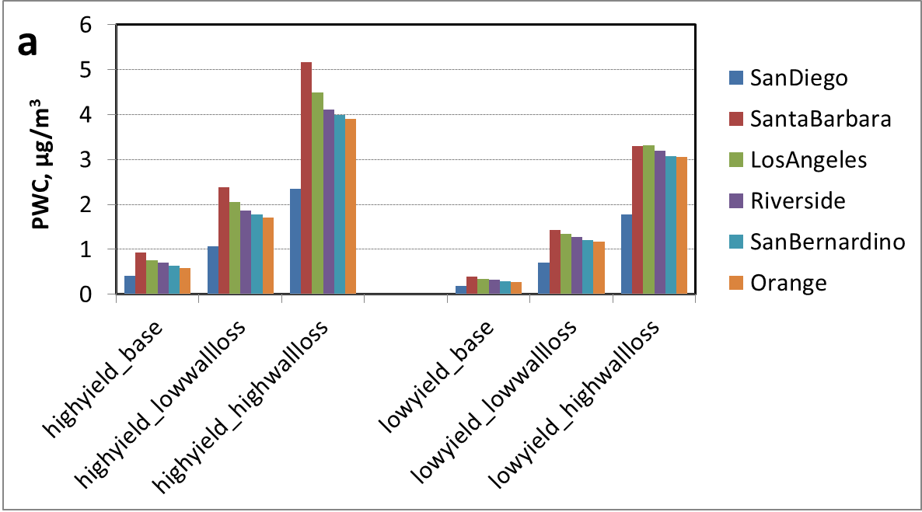
Potential Effect of NOx and Wall Losses
Source: J. Hu, S. Jathar, H. Zhang, Q. Ying, S. Chen, C.D. Cappa, and M.J. Kleeman. Long-term Particulate Matter Modeling for Health Effects Studies in California – Part II: Concentrations and Sources of Ultrafine Organic Aerosols. In preparation.

Slide 41
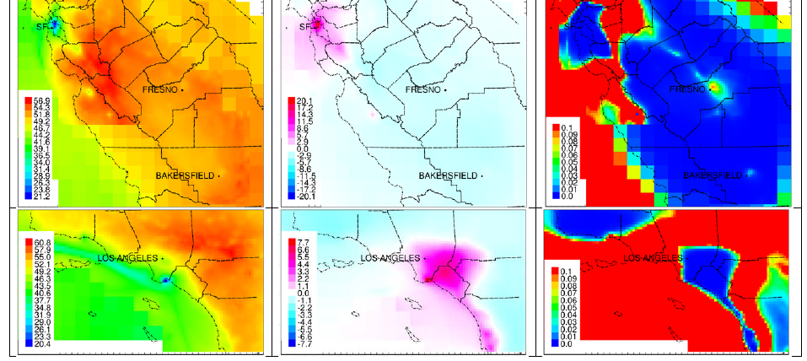
2054 Annual 8-hr Average O3 (ppb)
BAU
GHGAi-BAU
P-value
Notes:
Increases of O3 occur in NOx-saturated urban city centers in the GHGAi scenario due to reduction of NOx emissions.
Note how low the overall annual average of O3 is projected to be.

Slide 42
PM Size Distribution Changes
Notes:
Largest reductions in the particulate ultrafine size range, indicative of combustion emission particulate mode.

