Slide 1
Predicting PM_{2.5} Concentrations that Result from Compliance with National Ambient Air Quality Standards (NAAQS)
James T. Kelly, Adam Reff, and Brett Gantt
Office of Air Quality Planning and Standards
U.S. Environmental Protection Agency
15th Annual Community Modeling and Analysis System (CMAS) Conference, Chapel Hill, NC, Oct. 24-26, 2016
1

Slide 2
Background
Epidemiology-based human health risk assessments have been conducted during periodic reviews of the PM NAAQS
Risk has been assessed for different air quality conditions using information on ambient PM_{2.5} concentrations and concentrations that correspond to just meeting existing and alternative NAAQS
Ambient concentrations have been characterized directly from measurements
Concentrations for scenarios where the NAAQS is “just met” have been characterized by adjusting ambient concentrations to lower levels (i.e., applying “rollback”)
Statistical adjustment methods have been used previously to rollback ambient PM_{2.5} concentrations in urban-area case studies
A prescribed spatial pattern of PM_{2.5} reduction is applied in an area (e.g., in the proportional method, a fixed percentage of reduction is applied to PM_{2.5} at all monitors in an area such that the NAAQS is just met).
Policy relevant background (PRB) has been used to set a floor for adjustments
2

Slide 3
Motivation for Developing a PM Adjustment Approach Based on Photochemical Modeling
Statistical adjustment approaches apply conceptually reasonable spatial patterns of PM reduction, but they do not directly represent the processes known to determine the spatial patterns (i.e., emissions, transport, chemistry, and deposition)
Photochemical grid models (PGMs) directly simulate air quality processes and could potentially be used to improve the scientific basis for PM adjustments for risk assessments
In the last ozone NAAQS review, a PGM-based approach was used for air quality adjustments; however, the method is not directly applicable to PM due to inherent differences between ozone and PM and their respective NAAQS
Here, a PGM-based method is demonstrated for adjusting PM_{2.5} concentrations to just meet NAAQS in a given area and compared with the proportional rollback method
3

Slide 4
Method Overview
CMAQ: PM Component Sensitivity
Modeled changes in PM_{2.5} components based on simulations with reductions in direct PM_{2.5} and NOx and SO₂ emissions
AQS: PM_{2.5} Data
PM_{2.5} at monitors in US
SMAT-CE: Adjustment Factors
PM_{2.5} adjustment factors based on CMAQ results in combination with speciated and total PM_{2.5} observations
Consistent with EPA modeling guidance and approaches for projecting DVs
Downscaler: Fill Missing Data
Time series of ambient PM_{2.5} with no missing data
Used as alternative to interpolation approaches of last review
Adjustment Code: Perform Rollback
Adjust PM_{2.5} time series at individual monitors such that a combination of annual and 24-hr NAAQS are just met in the area
Adjustment cases selected from direct PM_{2.5}, NOx and SO₂, or a combination
Composite monitor concentrations calculated using equal-weight averaging of individual monitors
Get ambient data
Get model-based adjustment factors
Perform rollback
4

Slide 5
Calculating Adjustment Factors:
CMAQ and SMAT-CE
CMAQ modeling was conducted for a reference emission case and two emission sensitivity cases
2011 reference simulation for national 12-km domain with NEI11v2
Simulation with 50% reductions of 2011 U.S. anthropogenic direct PM_{2.5}
Simulations with 25%, 50%, and 75% reductions of 2011 U.S. anthropogenic NOx and SO₂
SMAT-CE was run to calculate the relative response factors (RRFs) used to adjust PM_{2.5} concentrations
RRFs were calculated for the 24-hour and annual standards at each monitor for the combinations of reference and sensitivity simulations
PM_{2.5} RRFs were calculated as the weighted average of the speciated RRFs with weights based on the estimated species concentrations at the monitor
To apply the RRFs to rollback PM_{2.5}, RRFs were linearly scaled from the modeled emission reduction percentage to the emission reduction percentage needed to just meet the standard

Slide 6
Characterizing Ambient Conditions: AQS and Downscaler
PM_{2.5} data at monitors in the U.S. for 2010-2012 were acquired from AQS (i.e., data are centered on 2011 modeling period)
Daily data are not available at some monitors due to 1-in-3 and 1-in-6 day sampling and some missed measurements
Complete time series at individual monitors in an area facilitate equal-weight averaging of daily concentrations to yield the composite monitor concentrations used in previous risk assessments
Therefore missing data were imputed using predictions of the Downscaler model on days and locations without data
Downscaler is a statistical model that is routinely used to make predictions of pollutant concentrations by combining information from CMAQ modeling and ambient measurements

Slide 7
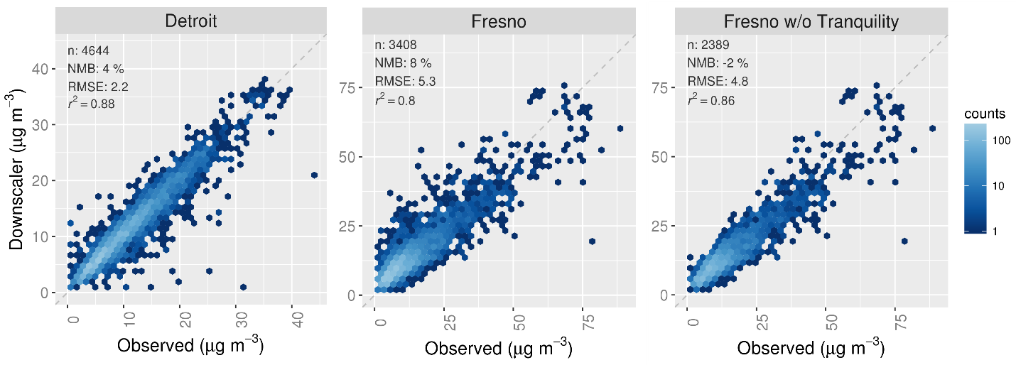
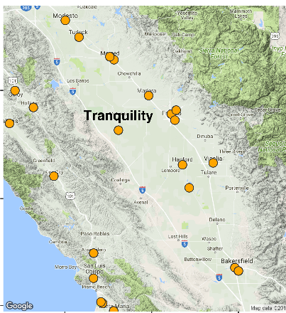
Cross-Validating Downscaler
Above, Downscaler predictions at individual sites are compared with observations on days where these observations were withheld from Downscaler calculations in series of simulations where each monitor in the area was sequentially withheld
Overall, there is very good agreement between Downscaler predictions and measurements in the Detroit (Wayne County) and Fresno (Fresno County) areas
Agreement for the Fresno area improves when the Tranquility site is excluded; Tranquility is isolated from the urban sites to the east and mountain sites to the west

Slide 8
Case Studies
The CMAQ-based adjustment method was applied for urban study areas and daily/annual standard combinations considered in the last PM NAAQS review
Key features observed from the case studies are
Monitors in the urban core tend to be more responsive to direct PM_{2.5} emission reductions, and outlying monitors tend to be more responsive to NOx and SO₂ emission reductions
Areas including complex terrain require careful consideration
The Detroit (Wayne County, MI) and Fresno (Fresno County, CA) areas were selected to illustrate these features below

Slide 9
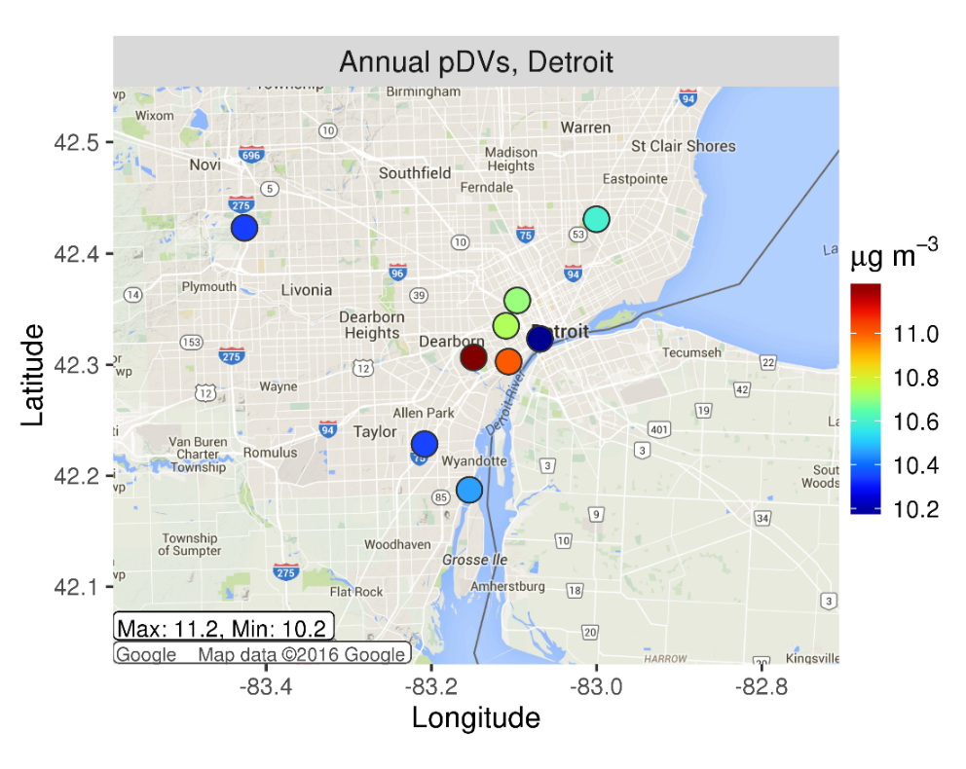
Detroit Case Study
Pseudo-Design Values (pDVs)*
Annual 2010-2012 PM_{2.5} pDVs in Detroit range from 10.2 to 11.2 μg m⁻³
The highest pDV occurs at the Dearborn site in the industrial core near a variety of PM_{2.5} emission sources
Dearborn
*The DVs presented here are unofficial because they are based on time series where missing data were filled; they are referred to as ‘pDVs’ to distinguish them from official DVs

Slide 10
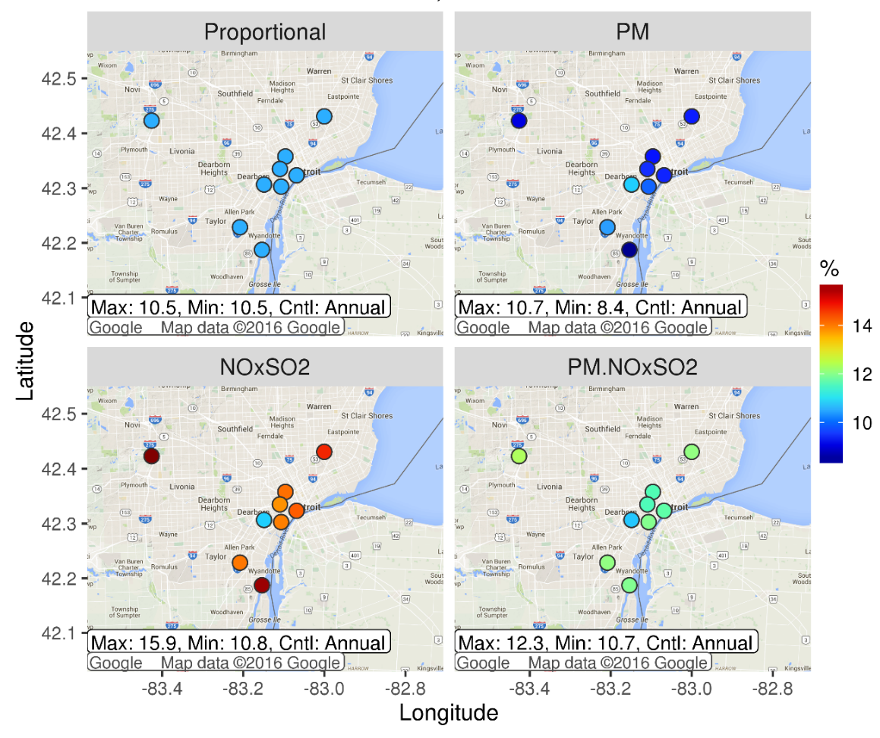
Spatial Patterns of Adjustment: Detroit 10/35
% Reduction in pDV to Attain
(a) Proportional adjustment yields a pDV reduction of 11% at all sites in the Detroit area to just meet a 10/35 (annual/24-hour) NAAQS scenario
(b) Direct PM_{2.5} emission adjustment reduces pDVs by 8 to 11%
(c) NOx and SO₂ emission adjustment reduces pDVs by 11 to 16%
(d) Combined direct PM_{2.5} and NOx and SO₂ emission adjustment reduces pDVs by 11 to 12%
Overall, monitors in the urban core are more responsive to direct PM_{2.5} emission reductions, and outlying monitors are more responsive to NOx and SO₂ reductions
(a)
(b)
Dearborn
Dearborn
(c)
(d)
Dearborn
Dearborn

Slide 11
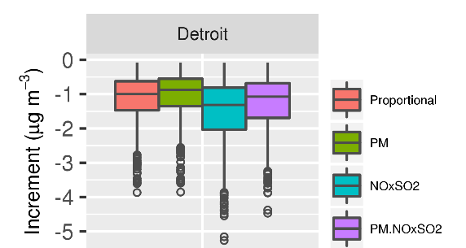
Incremental Concentrations:
Detroit, 10/35
Above is a comparison of the incremental PM_{2.5} concentrations (i.e., adjusted – ambient) associated with just meeting standards in the 10/35 Detroit case for all days in 2010-2012 for the proportional and CMAQ-based adjustment approaches (increments are based on composite concentrations)
Direct PM_{2.5} adjustments lead to the smallest increments because sources of direct PM_{2.5} are close to the controlling monitor, and so this approach efficiently reduces exceedances
NOxSO2 adjustments lead to the largest increments

Slide 12
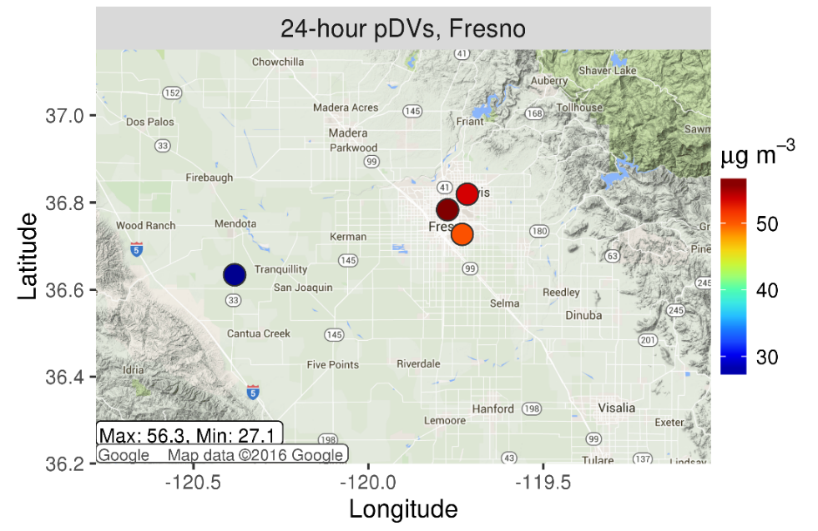
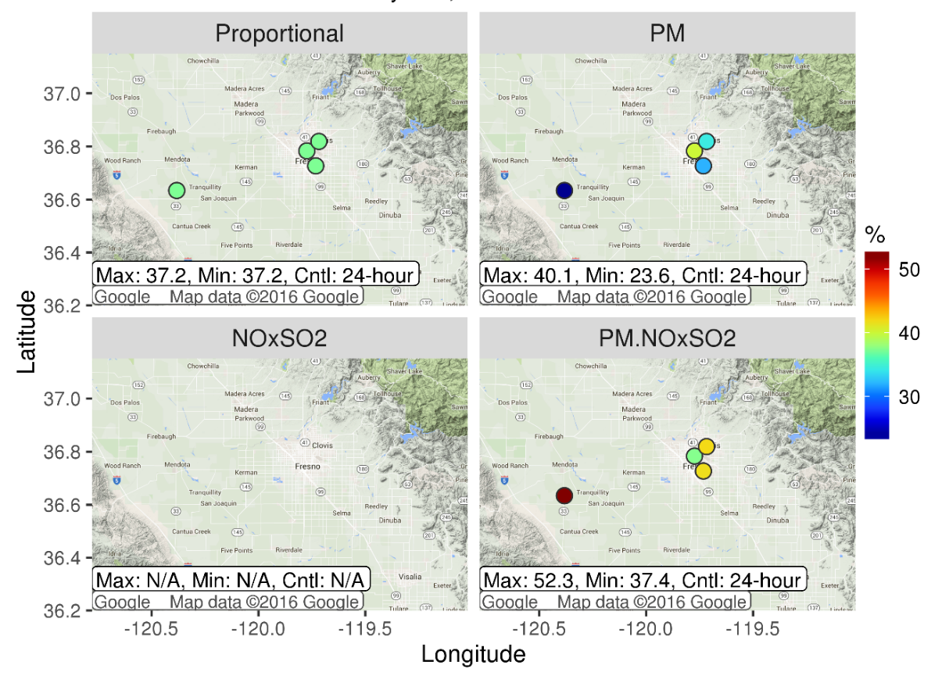
Fresno Case Study, 12/35
Pseudo-Design Values
% Reduction in pDV to Attain
(a)
(b)
Tranquility
(c)
(d)
24-hour pDVs at the three urban Fresno sites are greater than 50 μg m⁻³; pDV at Tranquility is 27 μg m⁻³ (left)
Proportional adjustment reduces pDVs by 37% at all sites to just meet the 12/35 NAAQS (a, right)
Direct PM_{2.5} adjustment reduces pDVs by 24 to 40% (b, right)
Combined NOx, SO₂, and direct PM_{2.5} adjustment reduces pDVs by 37 to 52% (d, right)

Slide 13
Summary
A PM_{2.5} adjustment approach based on photochemical grid modeling has been developed and could potentially be used to inform epidemiology-based risk assessments (although no decisions have been made about possible future assessments)
The method incorporates sensitivity modeling with CMAQ and leverages tools routinely applied in AQ analyses (i.e., SMAT-CE is used to develop adjustment factors, and downscaler is used to impute missing data)
Results indicate that the urban core is more responsive to direct PM_{2.5} emission reductions and outlying sites are more responsive to NOx and SO₂ reductions
These patterns are consistent with a conceptual model of an urban PM_{2.5} increment due to primary PM_{2.5} emissions relative to regional background levels of PM_{2.5}
Although results from the PGM-based approach are similar in some cases to those of the proportional method, the new approach
Provides enhanced credibility and avoids use of PRB
Enables adjustments to be applied over broader areas
Enables the sensitivity to different adjustment scenarios (i.e., combinations of primary and secondary PM_{2.5} reduction) to be examined
13

Slide 14
Acknowledgments and Disclaimer
Acknowledgments: The authors recognize the contributions of the OAQPS Model Platform Development Team, Norm Possiel, Allan Beidler, James Beidler, Chris Allen, and Lara Reynolds.
Disclaimer: Although this work was reviewed by EPA and approved for presentation, it may not necessarily reflect official Agency policy.
14

