Slide 1
Dynamic Evaluation of CMAQ-Modeled Ozone Response to Emission Changes in The South coast air Basin
Prakash Karamchandani¹, Ralph Morris¹, Andrew Wentland¹, Tejas Shah¹, Thomas Pavlovic¹, Julia Lester², Timothy French³
¹Ramboll Environ, Novato, CA
²Ramboll Environ, Los Angeles, CA
³EMA, Chicago, IL
15th Annual CMAS Conference
Chapel Hill, North Carolina, October 24-26, 2016

Slide 2
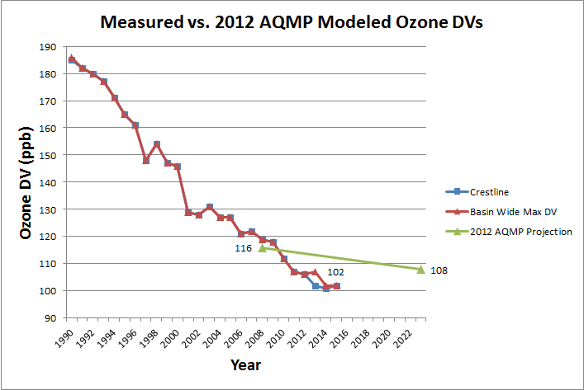
Background
Observed reduction rate in maximum SoCAB ozone Design Value (DV) for 2008-2015 (2.80 ppb/year) is much greater than projected by 2012 AQMP modeling for 2008-2023 (0.53 ppb/year)
2015 observed ozone level (102 ppb) is already below the 2012 AQMP-projected ozone level for 2023 (108 ppb)
Suggests that modeled 2023 future year base case ozone levels are overstated:
Attainment may be achieved faster than modeled projections
Required NOx reductions to achieve attainment may be overestimated

Slide 3
Objectives & Approach
Evaluate modeled ozone trends using 2012 AQMP modeling database over a long period (25 years) to determine if modeled response to emissions changes over this period is slower than indicated by measurements
Draft 2016 AQMP modeling database has been recently released (in August 2016) and is believed to correct some of the deficiencies in the 2012 AQMP modeling database
Determine if draft 2016 AQMP modeling database shows a similar or improved response to emission changes over the years as compared to final 2012 AQMP modeling database
Approach: Use final 2012 AQMP modeling database and draft 2016 AQMP modeling database as starting points to conduct CMAQ simulations for historical years and recent years

Slide 4
Key Differences between 2012 AQMP and 2016 AQMP
2012 Final AQMP
Base year: 2008
Meteorology: WRF 3.3
CMAQ Version: 4.7.1
Chemistry: SAPRC99
Emissions for base year and future years (2014, 2023)
2016 Draft AQMP
Base year: 2012 (Measured ozone design values for 2012 lower than 2008 DVs)
Meteorology: WRF 3.6
CMAQ Version: 5.02
Chemistry: SAPRC07
Emissions for base year and future years (2023, 2031)

Slide 5
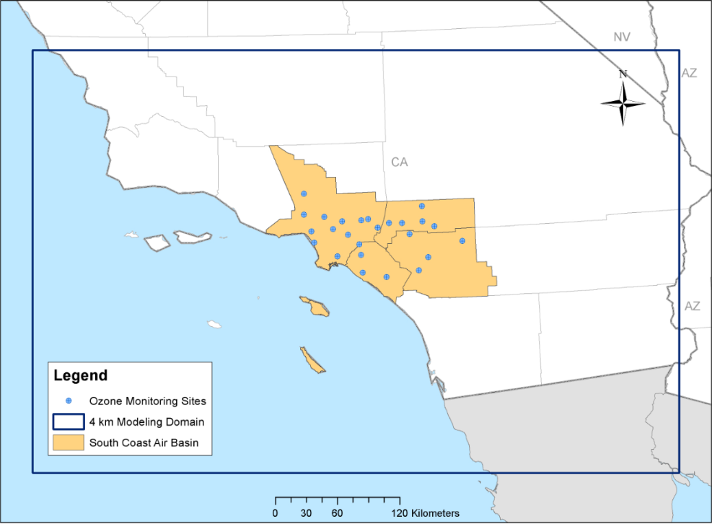
Modeling Domain

Slide 6
Dynamic Evaluation Approach
2012 Final AQMP (Base year 2008) Dynamic Evaluation:
Develop historical year (1990, 2000, 2005) emissions from 2008 emissions
Compare modeled and measured ozone trends from 1990 to 2014 and from 2008 to 2014
2016 Draft AQMP (Base year 2012) Dynamic Evaluation:
Develop historical year (1995, 2000, 2005, 2008) and current year (2015) emissions from 2012 emissions
Compare modeled and measured ozone trends from 1995 to 2015 and from 2008 to 2015
2012 AQMP vs 2016 AQMP
Compare ozone trends from two different modeling databases (2012 and 2016 AQMP)
Compare future year ozone reduction rates from 2012 and 2016 AQMP

Slide 7
Development of Historical Year Emissions
Scale base year CMAQ-ready emissions using SoCAB summer season emission totals for base years and historical years (from California ARB emission summaries)-spatial and temporal variation same as in base year
Account for changes in ozone forming potential of volatile organic gas (VOC) emissions between base year and historical year
Base year and historical year emissions also used by study collaborator, STI, for emissions reconciliation analysis with ambient measurements (Steve Reid’s talk in Emissions Inventories session)

Slide 8
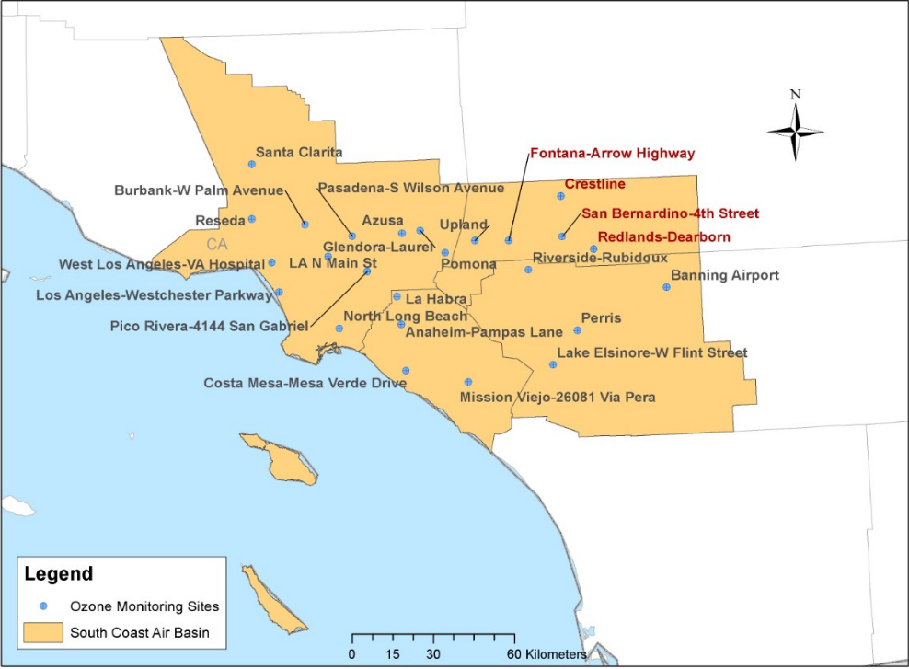
SoCAB Monitoring Locations

Slide 9
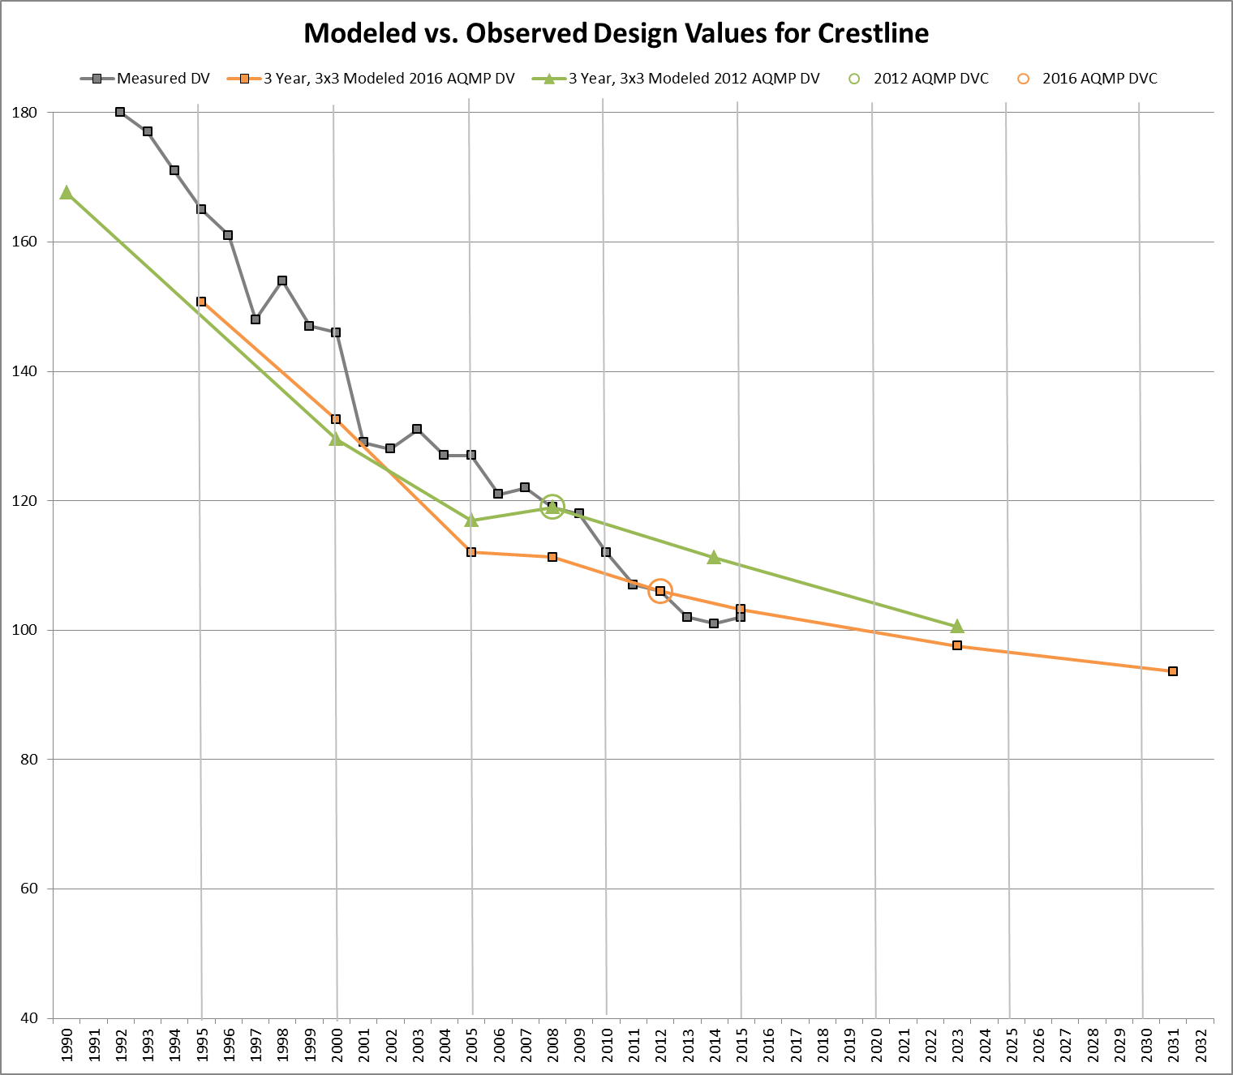
Ozone Design Values at Crestline
ppb reduction/year
Measured, 1990-2015: 3.5
2012 AQMP, 1990-2014: 2.4
2016 AQMP, 1995-2015: 2.4
Measured, 2008-2015: 2.8
2012 AQMP, 2008-2014: 1.3
2016 AQMP, 2008-2015: 1.2

Slide 10
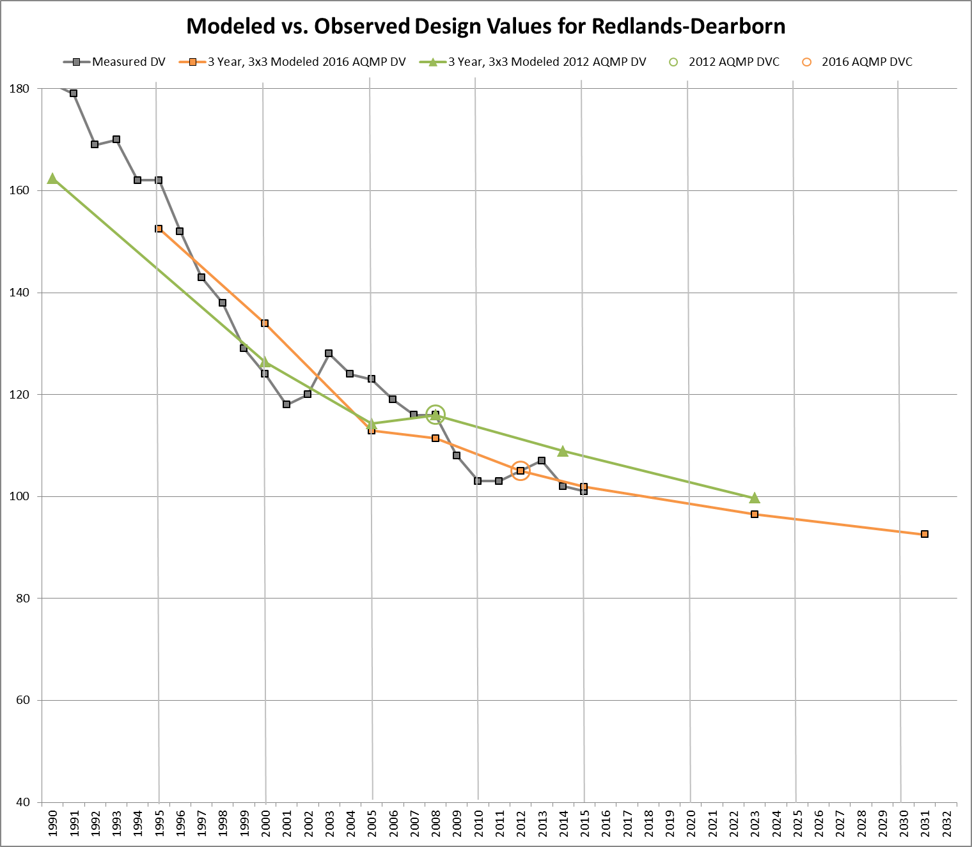
Ozone Design Values at Redlands
ppb reduction/year
Measured, 1990-2015: 3.2
2012 AQMP, 1990-2014: 2.2
2016 AQMP, 1995-2015: 2.5
Measured, 2008-2015: 1.4
2012 AQMP, 2008-2014: 1.2
2016 AQMP, 2008-2015: 1.4

Slide 11
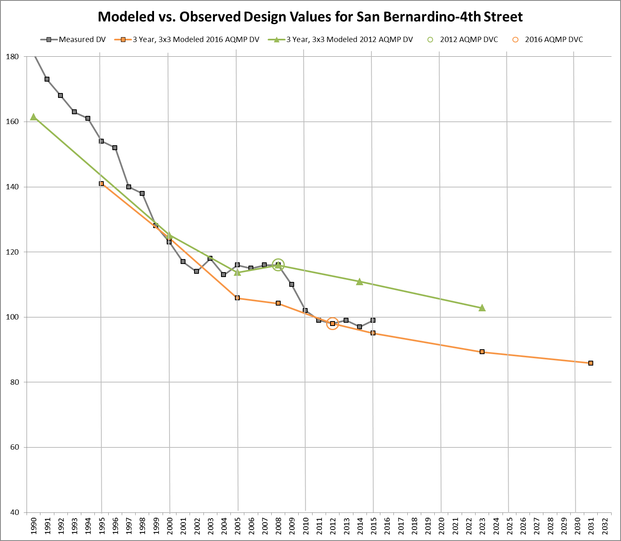
Ozone Design Values at SAN BERNARDINO
ppb reduction/year
Measured, 1990-2015: 3.2
2012 AQMP, 1990-2014: 2.1
2016 AQMP, 1995-2015: 2.3
Measured, 2008-2015: 2.3
2012 AQMP, 2008-2014: 0.9
2016 AQMP, 2008-2015: 1.3

Slide 12
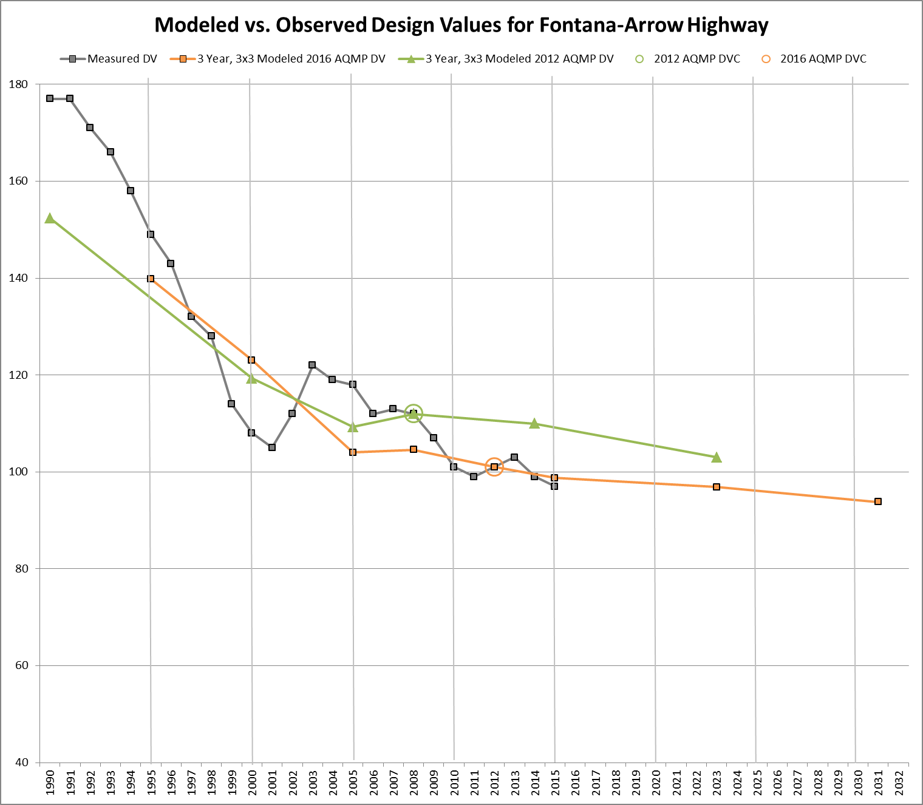
Ozone Design Values at Fontana
ppb reduction/year
Measured, 1990-2015: 3.0
2012 AQMP, 1990-2014: 1.8
2016 AQMP, 1995-2015: 2.0
Measured, 2008-2015: 1.6
2012 AQMP, 2008-2014: 0.3
2016 AQMP, 2008-2015: 0.8

Slide 13
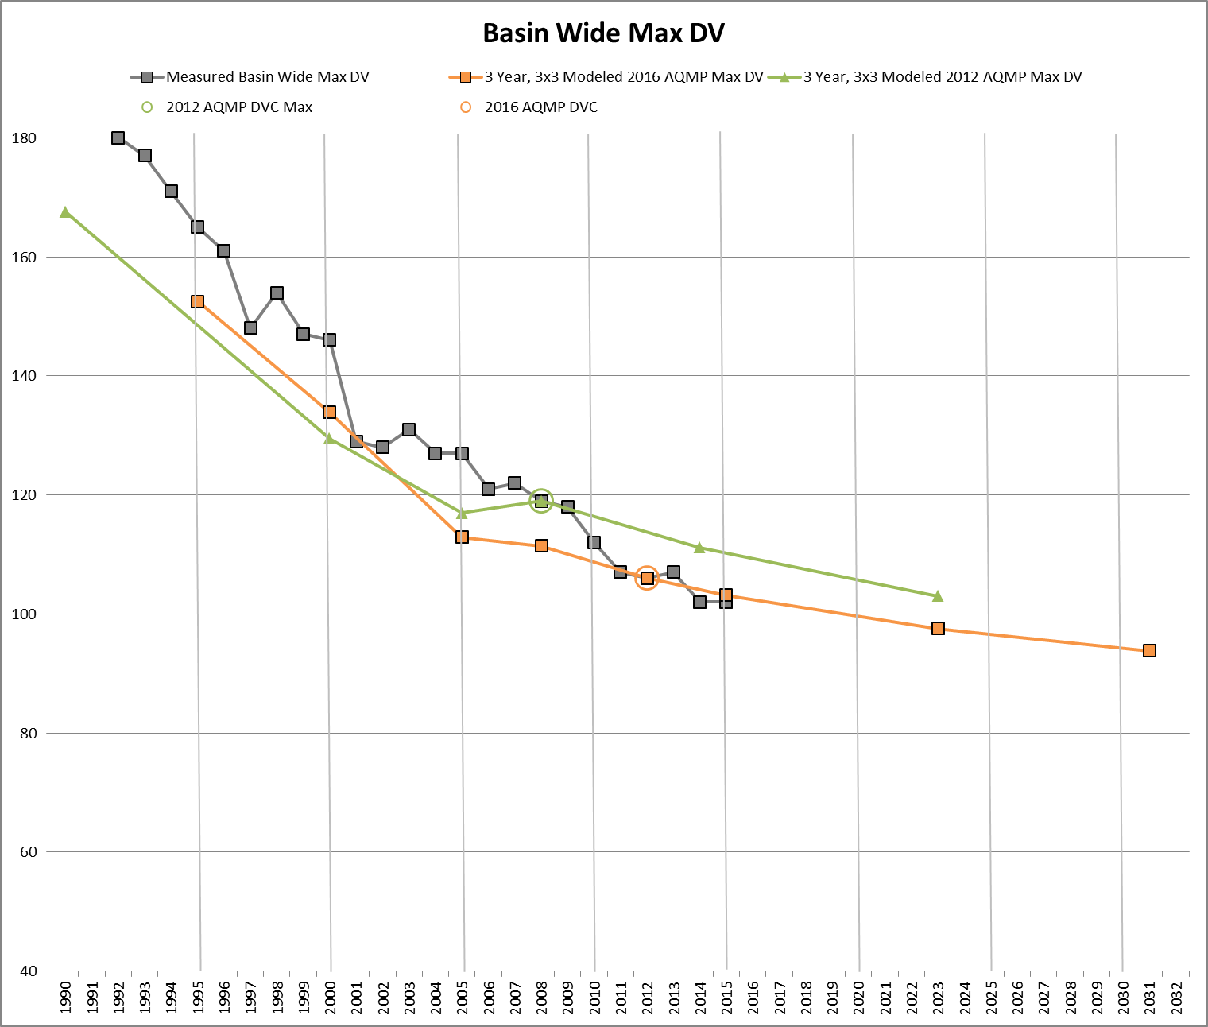
BASIN-WiDE MAXIMUM Ozone Design Values
ppb reduction/year
Measured, 1990-2015: 3.5
2012 AQMP, 1990-2014: 2.4
2016 AQMP, 1995-2015: 2.5
Measured, 2008-2015: 2.6
2012 AQMP, 2008-2014: 1.3
2016 AQMP, 2008-2015: 1.2

Slide 14
Summary: measured reductions 2008-2015 compared to predictions from 2012 & 2016 AQMP
Location | Predicted Ozone Reduction Rates (ppb/year) |  | Measured Ozone Reduction Rates (ppb/yr)
 | 2012 AQMP (2008-2014) | 2016 AQMP (2008-2015) | Monitoring Stations (2008-2015)
Crestline | 1.3 | 1.2 | 2.8
Redlands | 1.2 | 1.4 | 1.4
San Bernardino | 0.9 | 1.3 | 2.3
Fontana | 0.3 | 0.8 | 1.6
Basinwide Max | 1.3 | 1.2 | 2.6

Slide 15
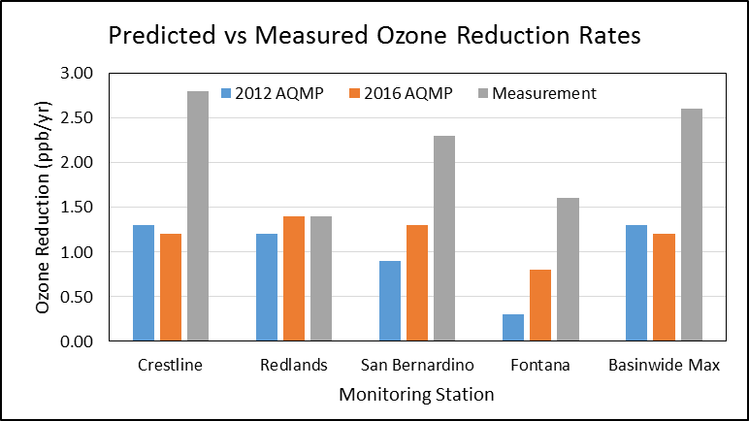
Predicted vs measured ozone reduction rates 2008→2015

Slide 16
How Do Projected future RESPONSES from 2012 AQMP and 2016 AQMP COMPARE?
Location | Ozone Reduction Rate, 2008 to 2023 (ppb/year) |  | Ozone RRF (2023 DV/2008 DV)
 | 2012 AQMP | 2016 AQMP | 2012 AQMP | 2016 AQMP
Crestline | 1.23 | 0.92 | 0.85 | 0.88
Redlands | 1.09 | 1.00 | 0.86 | 0.87
San Bernardino | 0.88 | 1.00 | 0.89 | 0.86
Fontana | 0.60 | 0.51 | 0.92 | 0.93
Basinwide Max | 1.07 | 0.93 | 0.87 | 0.88

Slide 17
SUMMARY & CONCLUSIONS
Modeled rates of ozone reductions at key monitors over a 20 to 25 year period are lower than observed rates by about 30% using both the 2012 AQMP and 2016 AQMP modeling databases
Modeled rates of ozone reductions at key monitors over the last 7 years are lower than observed rates by about 50% using both the 2012 AQMP and 2016 AQMP modeling databases
Future year ozone relative response factors from the two modeling databases are remarkably similar, indicating that differences in future year ozone projections from the two databases are primarily due to differences in the base year design values
Control strategy decisions are guided by modeling results so it is essential to understand the reasons for the lower rates of ozone reductions predicted by the model and to improve model projections of future air quality

Slide 18
ONGOING & FUTURE WORK
Quantify uncertainties via sensitivity studies:
Boundary conditions
Meteorology
Chemistry
Emissions
Investigate EMFAC limitations and use findings to develop alternative mobile source emission scenarios
Review previous work to reduce ozone forecast errors and apply methods to improve model response

Slide 19
Questions?

