Slide 1
Lightning NO_{X} Production in CMAQ
Part I - Using Hourly NLDN Lightning Strike Data
Daiwen Kang, Nicholas Heath, David Wong, Jon Pleim, Shawn Roselle, Kristen Foley, and Rohit Mathur
Computational Exposure Division, National Exposure Research Laboratory, U.S. Environmental Protection Agency, Research Triangle Park, NC 27711, USA
15th Annual CMAS Conference
Chapel Hill, North Carolina, USA
24-26 October, 2016

Slide 2
Current Understanding about Lightning NO_{X}
NO is produced within a lightning stroke channel during the rapid heating and cooling process by N₂ and O₂
The global Lightning NO_{X} (LTNO_{X}) production is estimated to be in the range 2-8 Tg N yr⁻¹ (compare with present-day anthropogenic and biomass burning sources of ~26 Tg N yr⁻¹; ~10-15% of the total NO_{X} budget)
NO yields per flash range from 50 to 1100 moles (NO) flash⁻¹, most recent literature converges on the range from 250 to 350 moles (NO) flash⁻¹.

Slide 3
Lightning and Air Quality
Lightning NO_{X} is produced mainly in the free troposphere and thus has a strong influence on the tropospheric burden of O₃ and OH.
The lifetime of lightning NO_{X} in the free troposphere is a few days instead of hours at the surface, and O₃ production efficiencies (OPE) are an order of magnitude higher.
The impact of lightning NO_{X} on “policy-relevant background” (PRB) is increasing due to the decrease of anthropogenic emissions.
Courtesy of Lee Murray, Curr Pollution Rep., 2016

Slide 4
Lightning NO_{X} in Air Quality Models
Due to limited understanding and its relative small impacts on the surface, despite its large influence on the background composition of the troposphere, regional air quality models are just beginning to take lightning NO_{X} into the modeling consideration in recent years.
The National Lightning Detection Network (NLDN) and various satellite data provide the scientific bases and data needs for air quality models to parameterize lightning NO_{X} productions.

Slide 5
Lightning NO_{X} Production in CMAQ
A primitive parameterization scheme: 1 mm/hr convective precipitation in CMAQ (RC, Rain Convective) => 147 lightning flashes for a 36x36 km horizontal model grid cell, which is adjustable to other resolution configurations.
An observation-based parameterization scheme: using the monthly mean NLDN data to constrain the lightning strikes over the domain and distribute the total lightning strikes to the local grid cells by relating NLDN strikes to grid-level RC values.

Slide 6
Two Practical Scenarios for Modeling Lightning NO_{X}
Retrospective model simulations with NLDN data available
  Use NLDN data (gridded hourly) to generate LTNO_{X} directly in the model
NLDN data not available, e.g., air quality forecast and future climate simulations
  Parameterize the LTNO_{X} production based on variables (such as convective precipitation) predicted by the upstream meteorological model: needs to quantify the relationship between the variable used and the lightning strikes.

Slide 7
Good News!
We now have access to the NLDN raw data over the continental United States through the lightning data contract signed by the National Weather Service (NWS) within NOAA with Vaisala, Inc. which specifies that “NWS’s contract allows the Federal Government to obtain real-time cloud-to-ground lightning data from the 48 contiguous states”.
As a result, we now can directly use the NLDN data over the continental US domain to generate LTNO_{X} in CMAQ for retrospective simulations (the raw data is gridded into hourly data as input to CMAQ)

Slide 8
Sum of Monthly Domain Column LTNG NO Produced by the CMAQ parameterization schemes and Hourly NLDN Strike Data for 2011
The primitive lightning NO_{X} production scheme (using number 147) generates substantially too much NOx (> 2x) than the schemes based on NLDN data.
Hrly
Mhly
P147
NLDN
Base
P147

Slide 9
Sum of Monthly Domain Total Column LTNO
2010
Hrly
Mhly
2011
Hrly
Mhly
Hrly
Mhly
Hrly
Mhly
2012
2013

Slide 10
Performance evaluations for WRF-CMAQ Simulations with Monthly and Hourly NLDN data
WRF 3.8
CMAQ 5.1
CB05, AE6
Emissions: 2011 NEI
US 12km domain for July 2011
Scenarios:
  Monthly NLDN lightning strike data
  Hourly NLDN lightning strike data
Observations: AQS Hourly O3

Slide 11
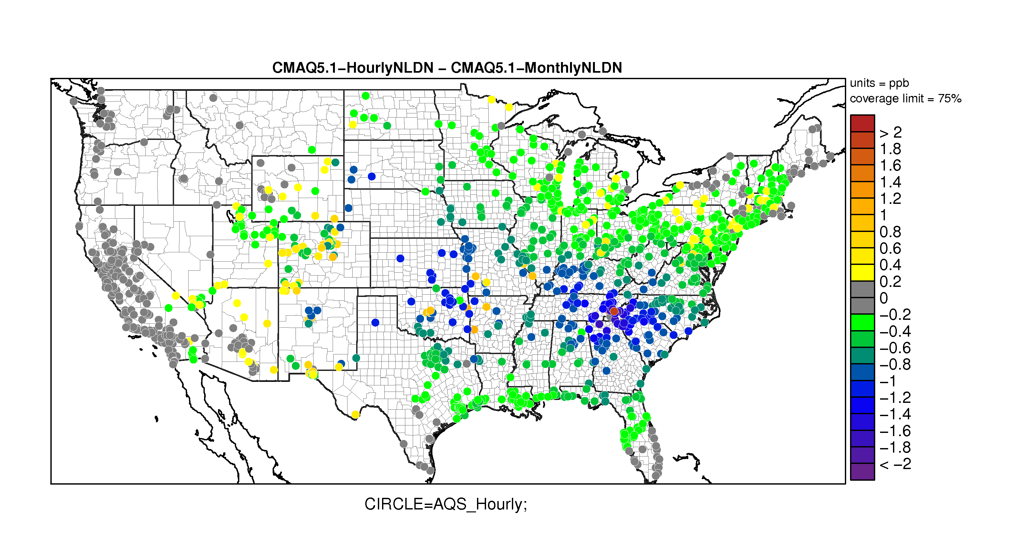
O₃ bias difference Hourly NLDN – Monthly NLDN over the domain
The bias at the majority of the sites decreases (cool colors), especially in the southeast region where lightning events are more prevalent

Slide 12
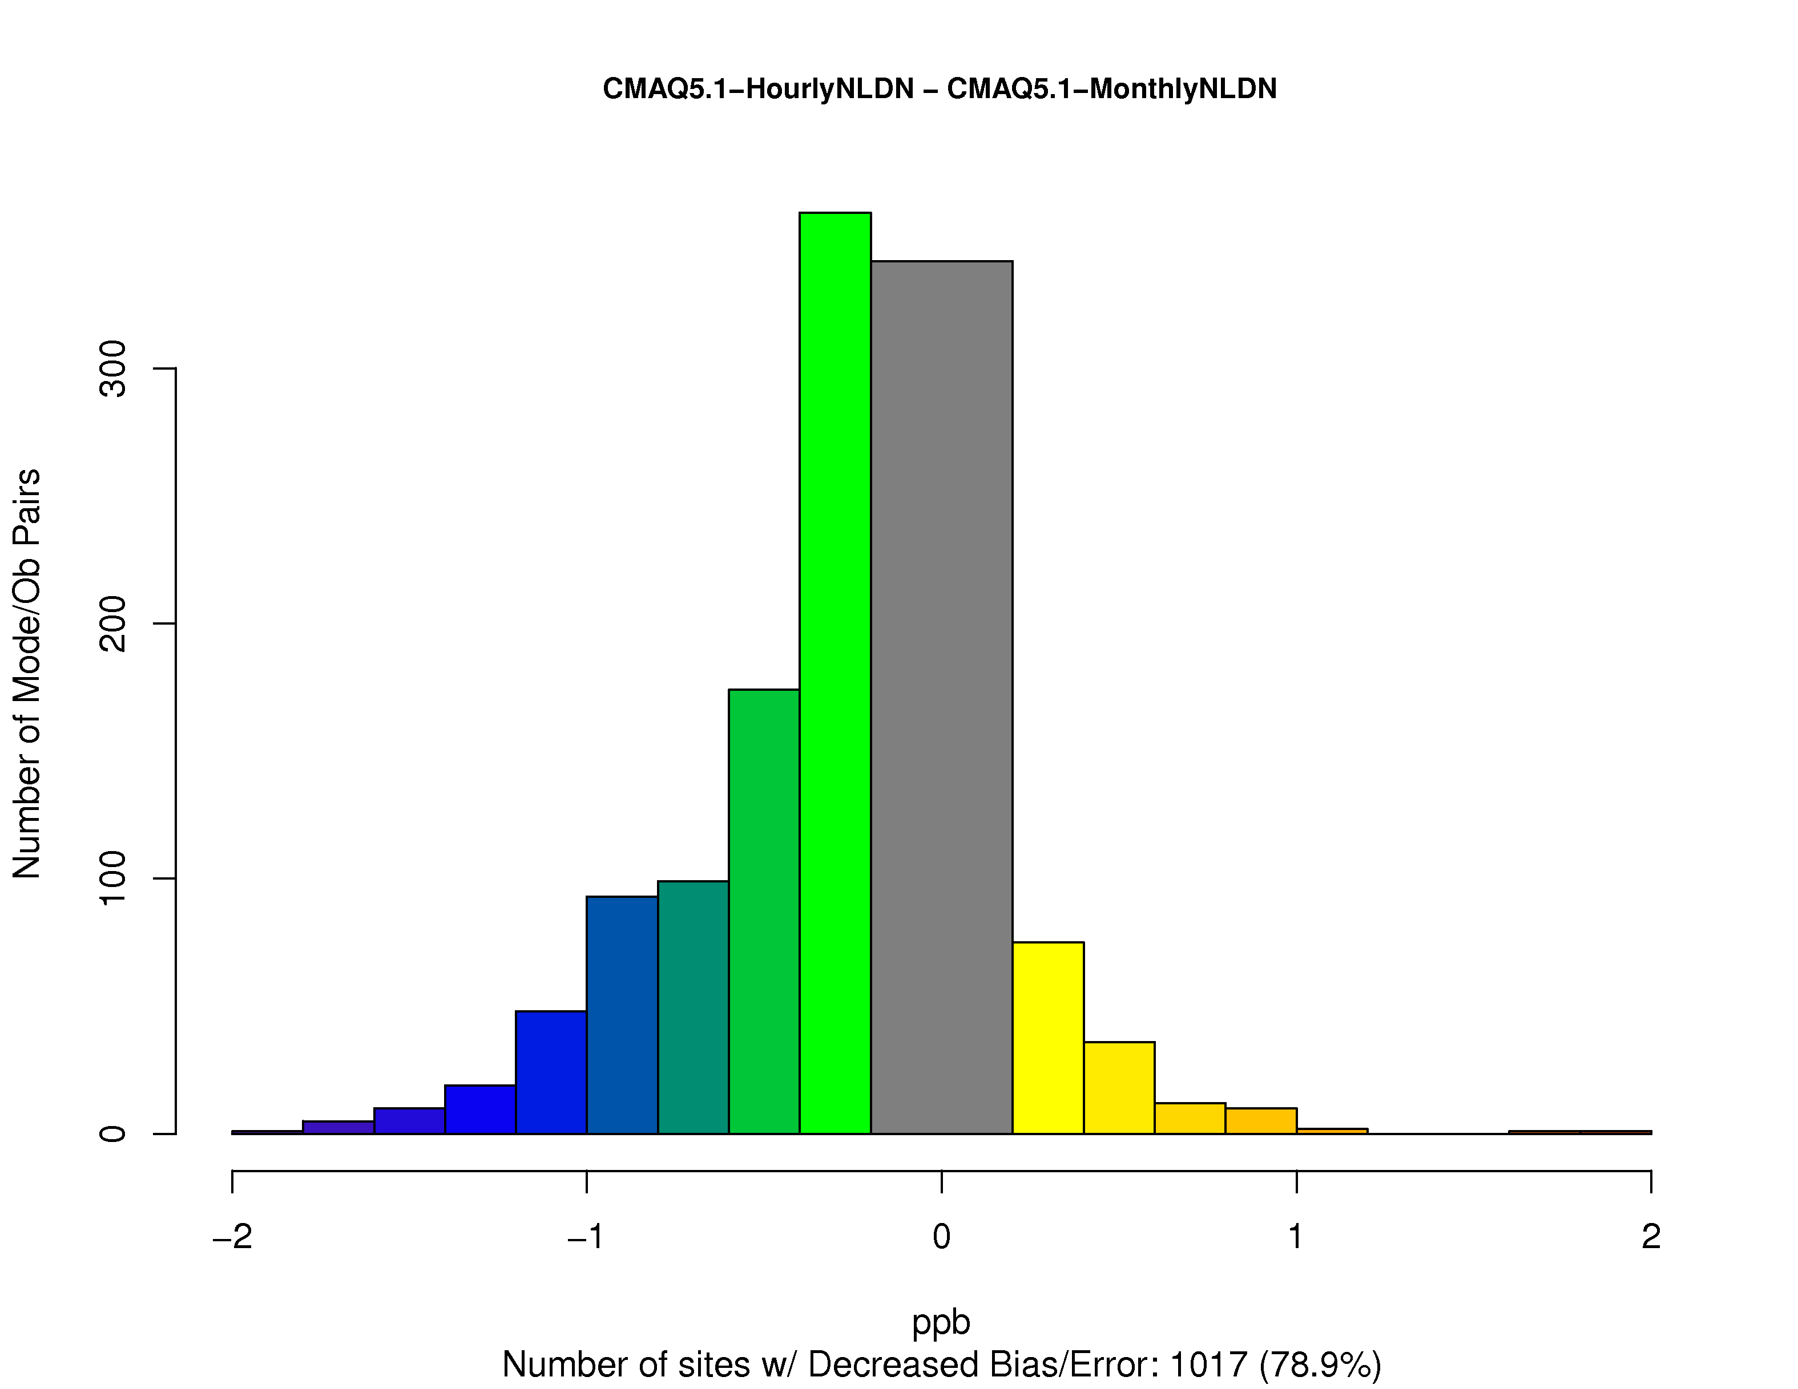
O₃ bias difference Hourly NLDN – Monthly NLDN over the domain
O₃ bias decreases at 79% of the sites

Slide 13
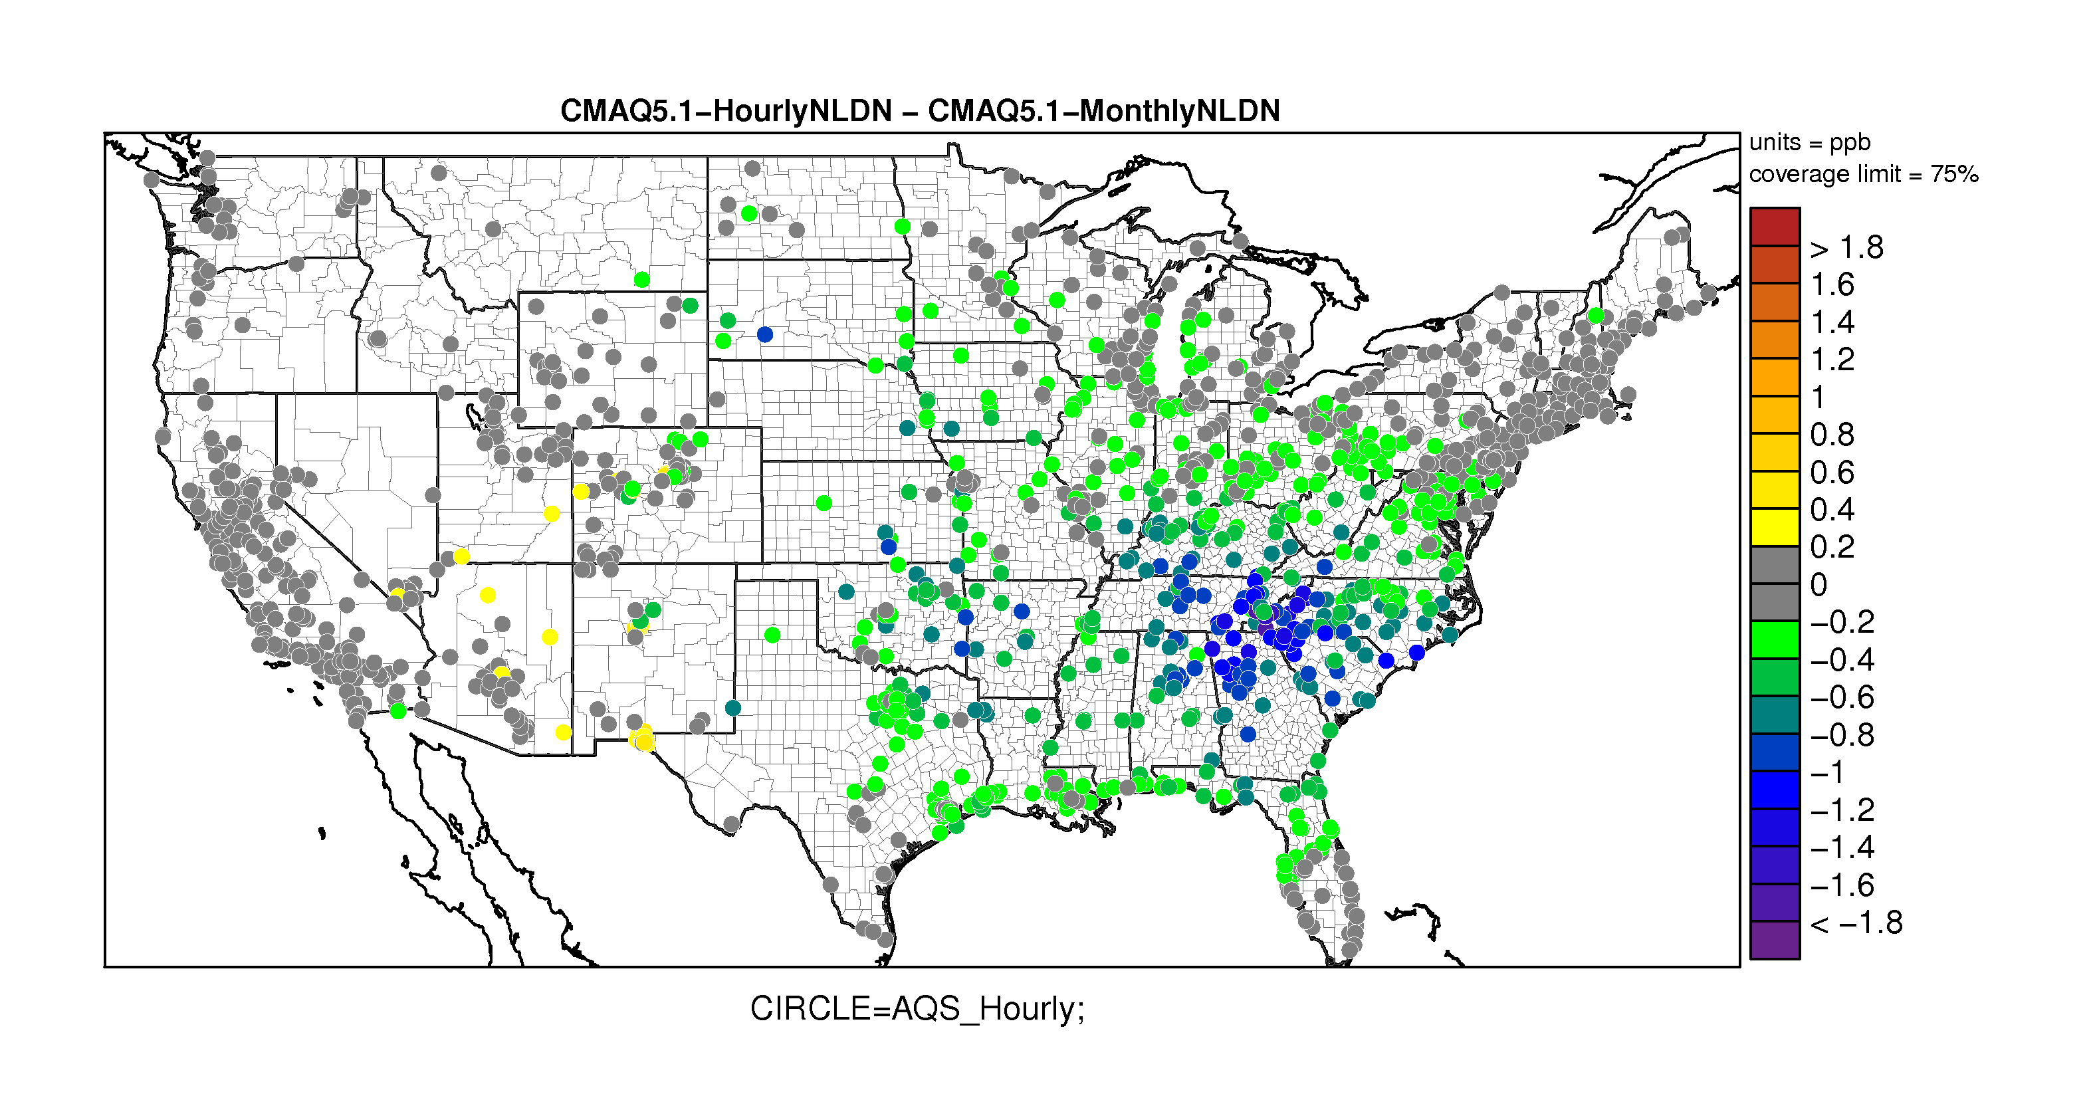
O₃ error difference Hourly NLDN – Monthly NLDN over the domain
Similarly, the errors at the majority of the sites also decreases (cool colors), especially in the southeast region where lightning events are more prevalent

Slide 14
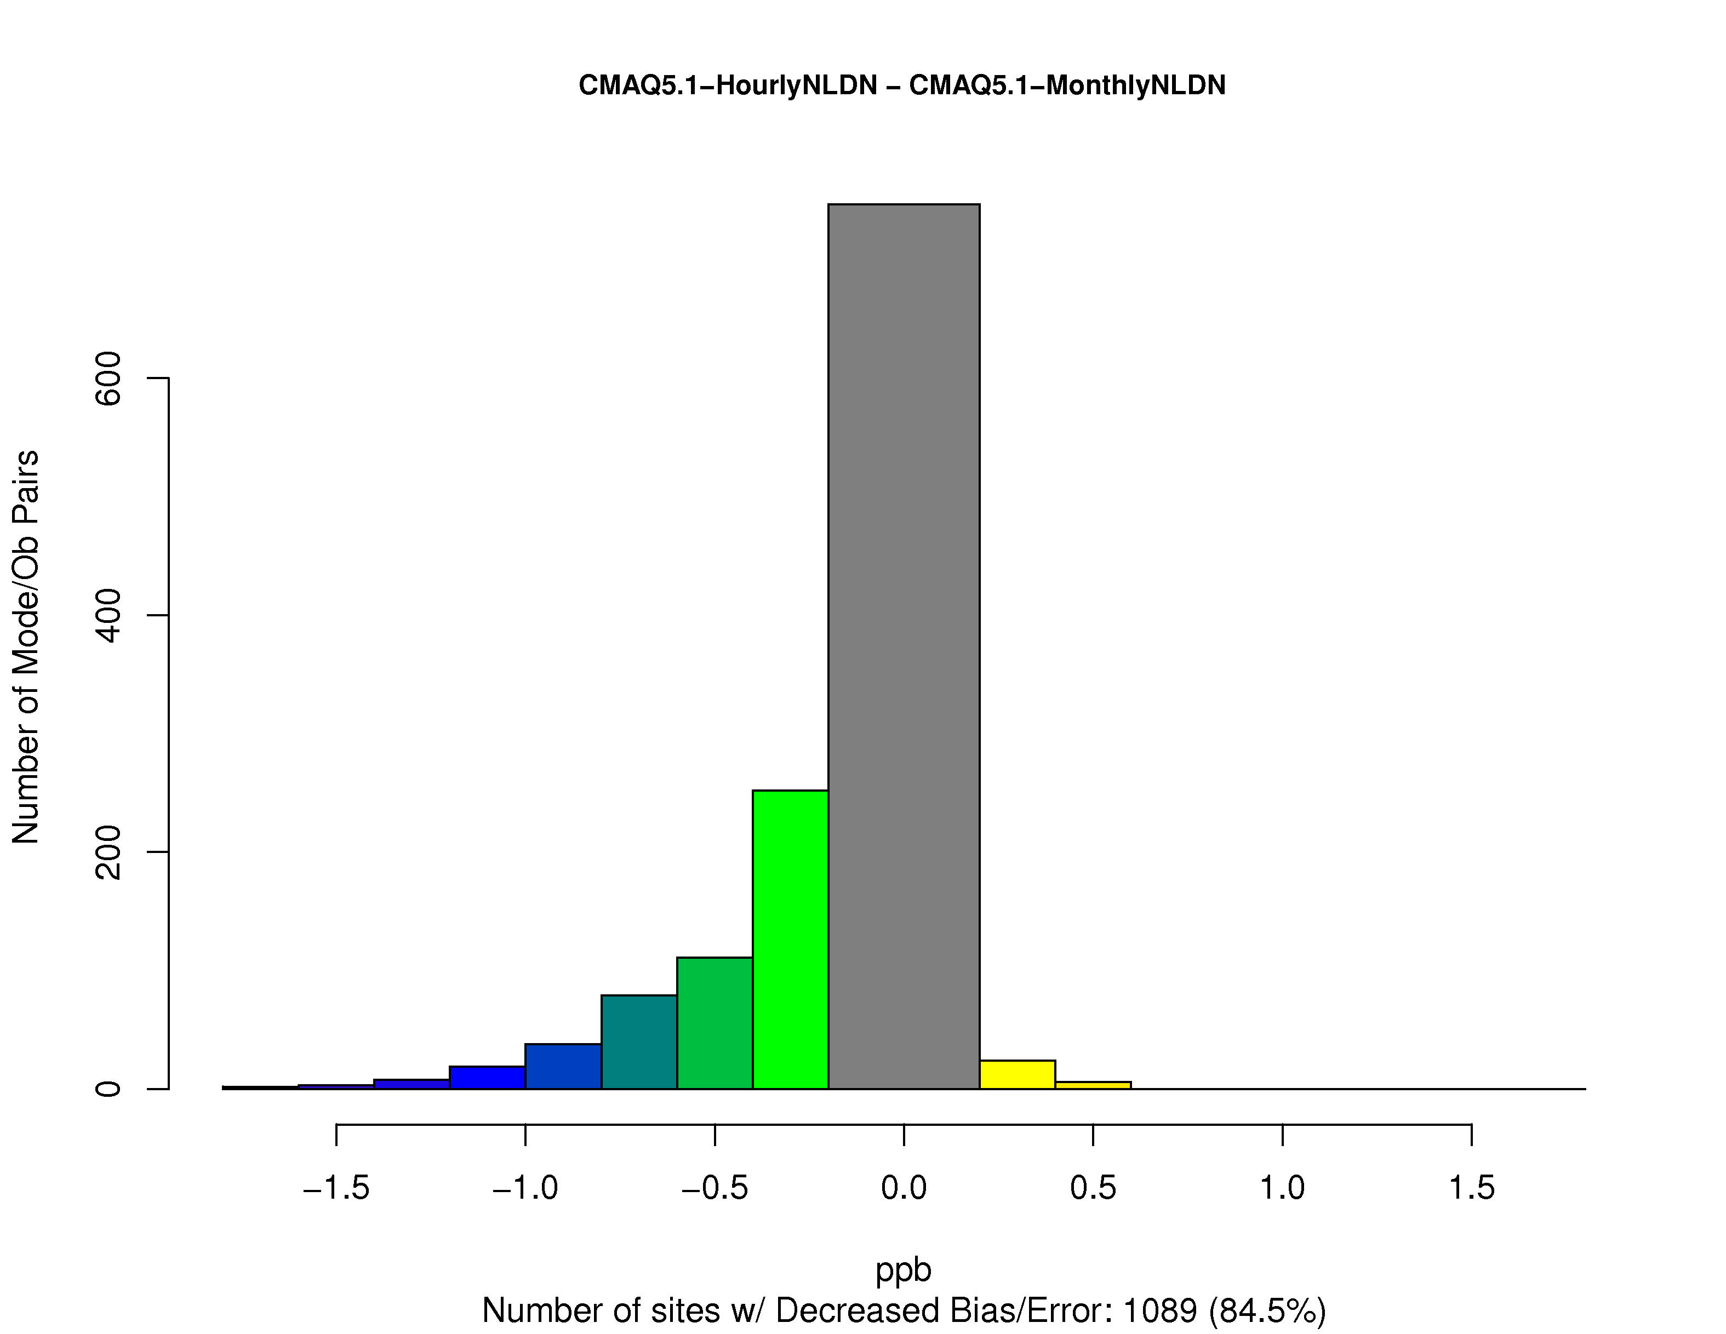
O₃ error difference Hourly NLDN – Monthly NLDN over the domain
O₃ error decreases at 84.5% of the sites

Slide 15
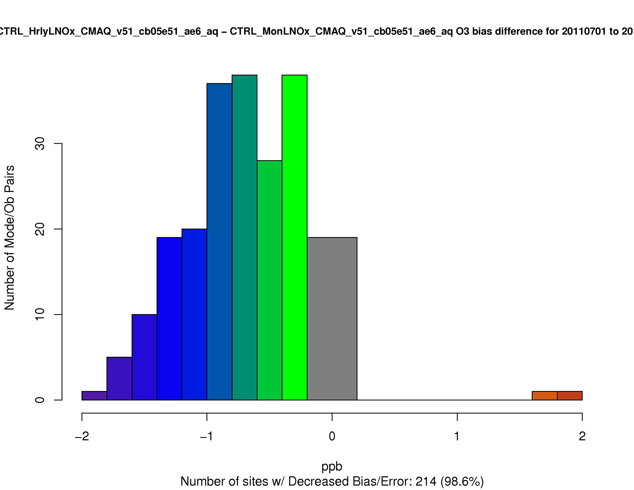
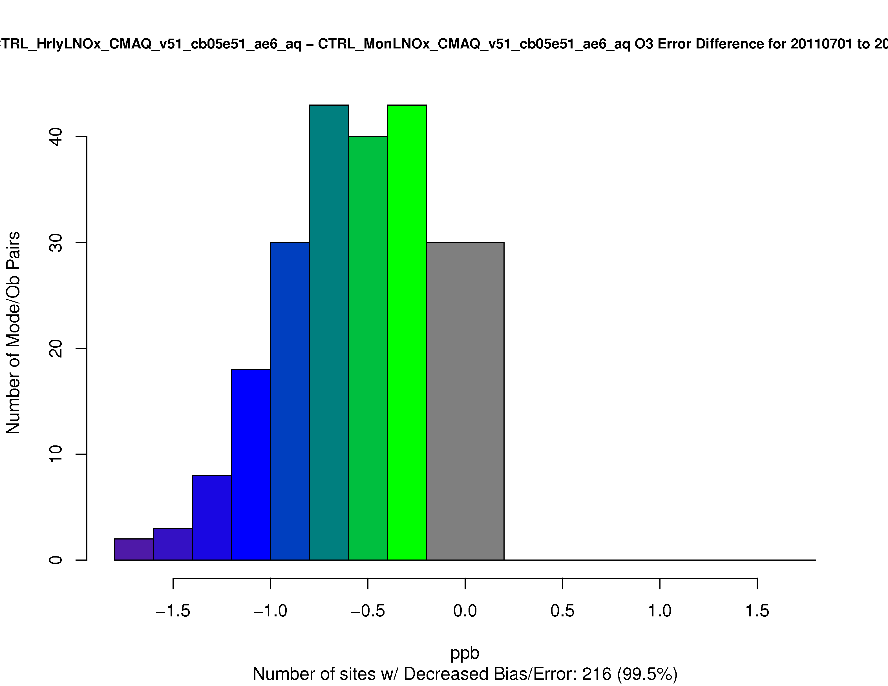
O3 bias/error difference Hourly NLDN – Monthly NLDN over the southeast
O₃ bias decreases at 99% of the sites
O₃ error decreases at 99% of the sites

Slide 16
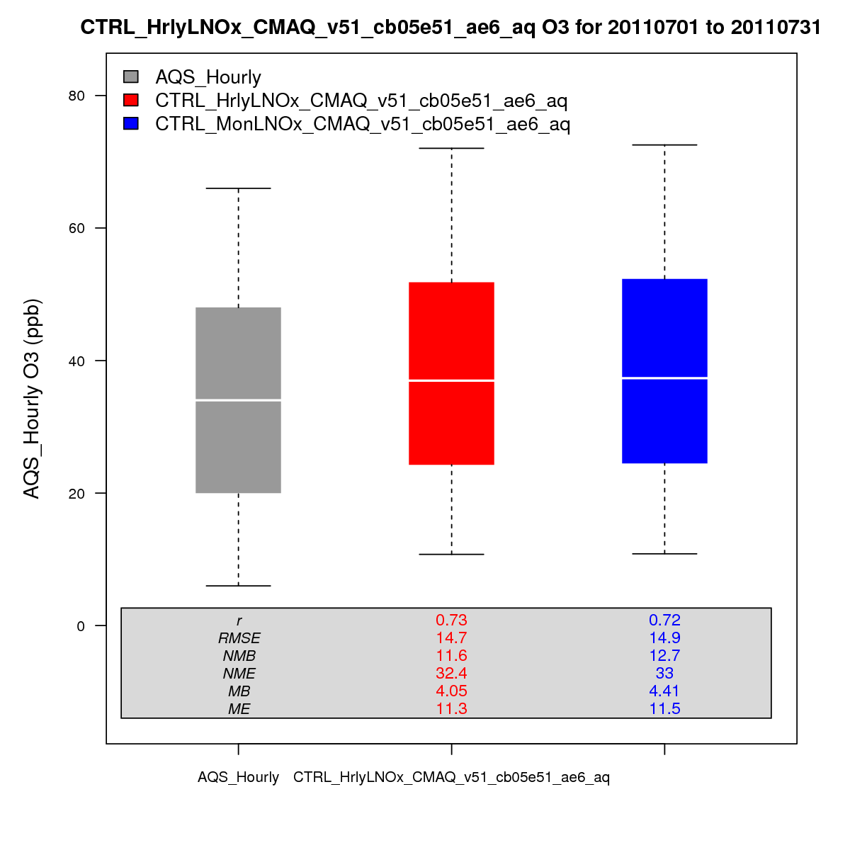
O₃ mixing ratios and basic statistics for July, 2011 over the domain
r | 0.73 | 0.72
RMSE | 14.7 | 14.9
NMB | 11.6 | 12.7
NME | 32.4 | 33
MB | 4.05 | 4.41
ME | 11.3 | 11.5
AQS HrlyLTNOx MonLTNOx

Slide 17
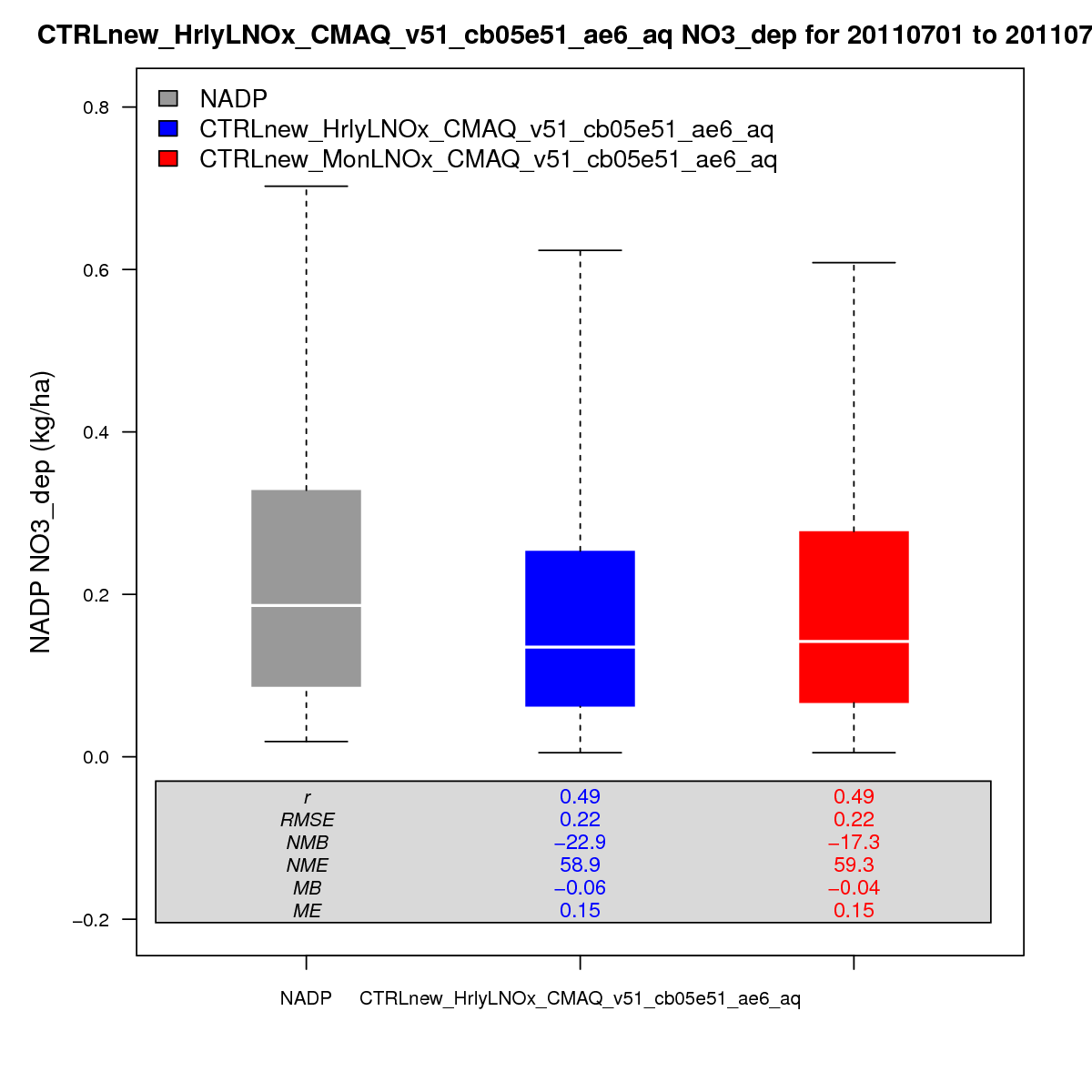
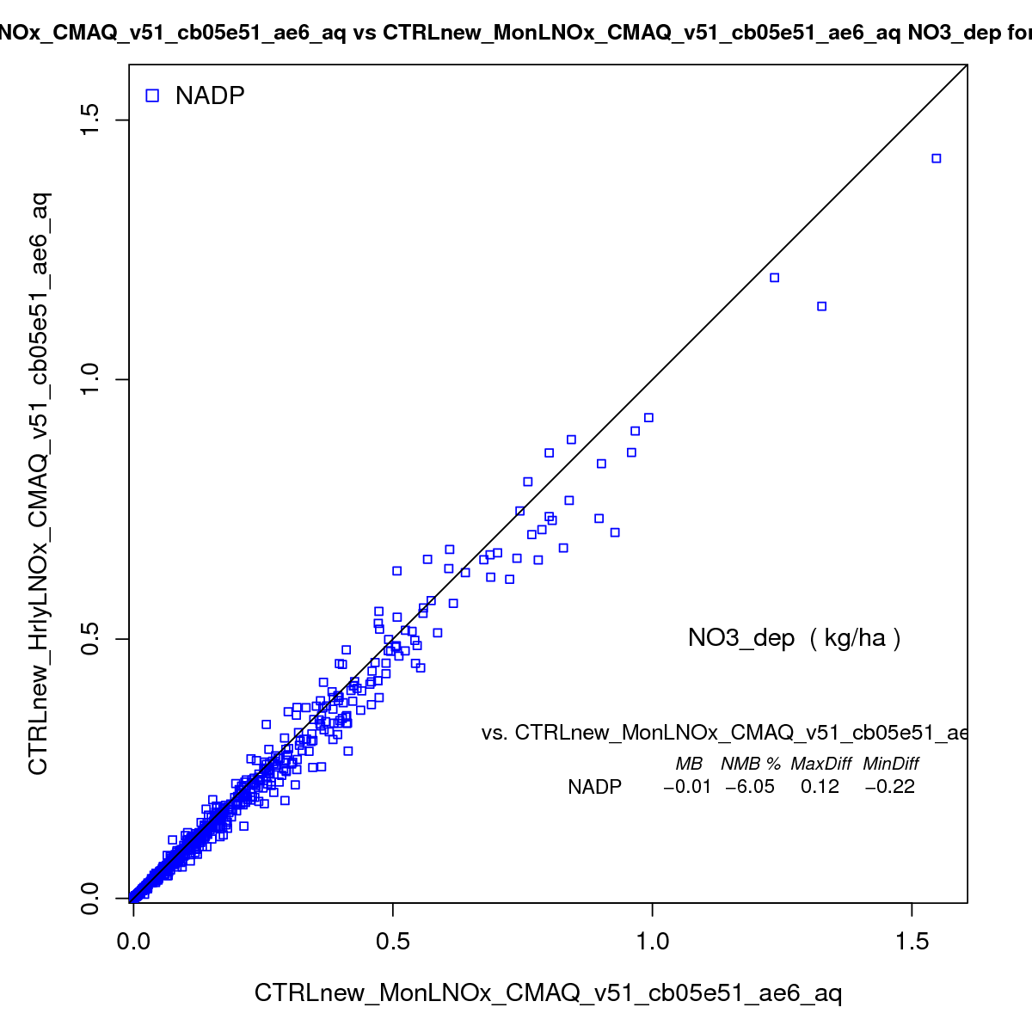
NO₃ Wet deposition and basic statistics for July, 2011 over the domain
NO₃_dep with HrlyLTNOx (kg/ha)
NADP HrlyLTNOx MhlyLTNOx
NO₃_dep with MhlyLTNOx (kg/ha)

Slide 18
Take-home Message
When the hourly instead of monthly NLDN data are used:
O₃ mean bias and mean error decrease 1-2 ppb
Largest performance improvements in eastern U.S., especially over the southeast – 99% of sites had improvements in O₃ prediction
Slight decrease in NO₃ wet deposition
Minor impact on PM_{2.5}

Slide 19
CMAQ updates – CMAQv5.2
Significant code changes in LTNG_DEFN.F (over 200 lines modifications/additions)
Two input files:
  The hourly gridded NLDN lightning strike data (24hours/day)
  Parameter file – ocean mask, climatological IC/CG ratios, and parameters for parameterization scheme when NLDN data are not available (e.g. forecast and future climate studies). Details to be presented next
Two diagnostic files: vertical profile (3D) and column total (2D)
Compare to CMAQv5.1, no preprocessing for the lightning parameters are needed for users.

Slide 20
Run script configurations
setenv LTNGNO "InLine“
setenv LTNGPARAM Y
setenv USE_NLDN Y
setenv LTNGOUT1 $OUTDIR/${EXEC}"_LTNGDIAG1".${CTM_APPL}
setenv LTNGOUT2 $OUTDIR/${EXEC}"_LTNGDIAG2".${CTM_APPL}
setenv NLDN_STRIKE $NLDN_LTpath/NLDN.12US1.${today}.ioapi
setenv LTNGPARMS_FILE $IN_LTpath/LTNG_AllParms_12US1.ncf

Slide 21
Gridded NLDN lightning strike data availability
Hourly data over the conus US 12km domain in IOAPI format (direct input to CMAQ) and able to provide data for any other finer/coarser domains if domain description files are provided.
30 minutes data over the conus US 4km domain in netCDF format (for WRF input and next generation air quality models) – plan to release publicly. Can be re-gridded into different domains and/or time intervals (make a regrid program available)

Slide 22
What’s Next:
  Evaluate the vertical profiles with field measurements (such as aircraft, sonde, lidar measurements) and make necessary adjustment.
  Test the sensitivity to LTNO production rate and obtain the confidence interval
  Expand to hemispheric or even global applications through acquisition of global lightning data

