Slide 1

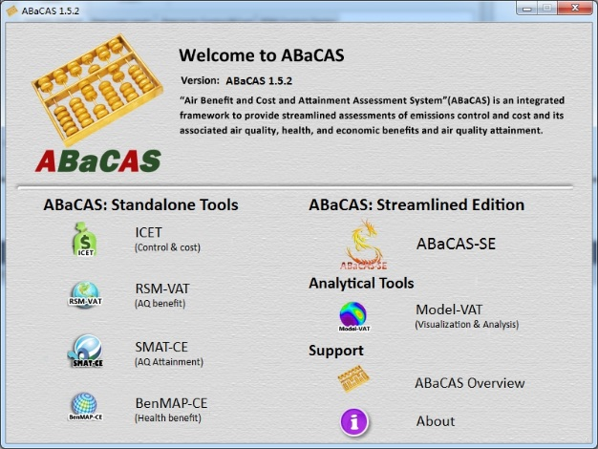

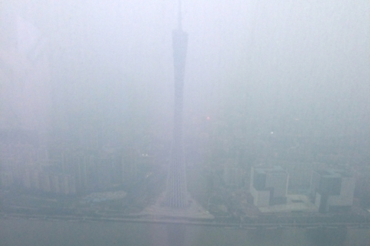

Development and Applications of Next-Generation Integrated Air Quality Decision Support System (ABaCAS)
Air Pollution
(PM2.5 & O3)
Cost/Benefit & Attainment
ABaCAS
Emissions Control & Cost
Health & Economic
Benefit
AQ
Benefit & Attainment
Science
Policy
Actions
Carey Jang, U.S.EPA/Air Quality Modeling Group
Zac Adelman & Dongmei Yang, UNC-CH, Institute of Environment
Dustin Zhu, South China Univ. of Technology, China
Shuxiao Wang and Jia Xing, Tsinghua Univ.
CMAS Conference, RTP, NC, October 25, 2016

Slide 2






Outline
Development of Next-Generation Integrated AQ Decision Support System: “ABaCAS”
  “ABaCAS ”: Air Benefit and Cost and Attainment Assessment System
    An international collaborative project supported by DOS, EPA, China MEP, Taiwan EPA and Energy Foundation
    Developed jointly by a team of U.S. and international scientists
    Built upon EPA’s new-generation modeling assessment tools: SMAT-CE, RSM/CMAQ, and BenMAP-CE.
Recent Development & Applications:
  “Streamlined ABaCAS-SE” : Integrated assessment of AP control cost and AQ, health/economic & attainment benefits to support policy analysis
  International Applications : China YRD & PRD cases, Western USA case, (other Asian and USA cases under development)
ABaCAS

Slide 3
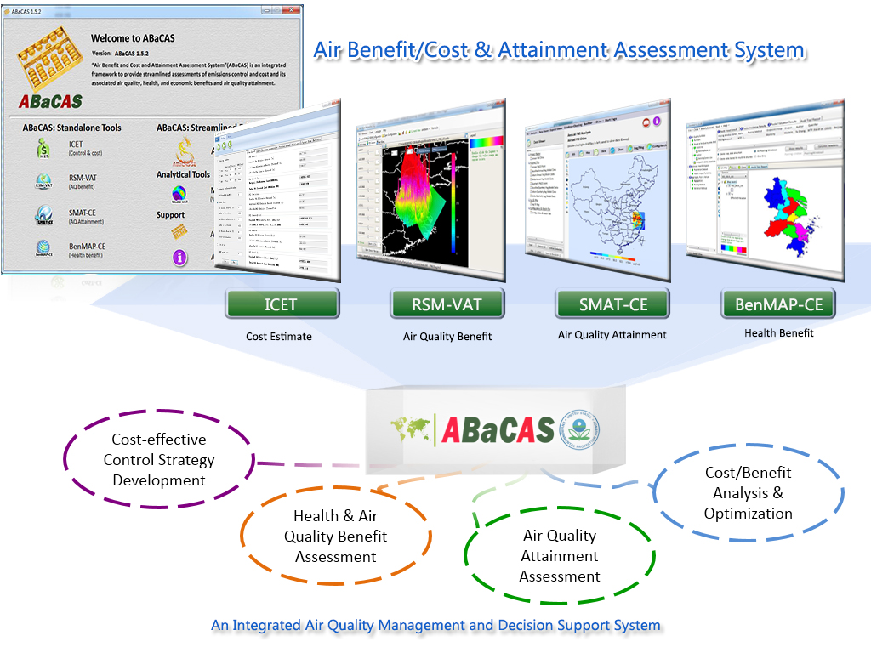
ABaCAS : Air Benefit and Cost & Attainment Assessment System
Integrated AQ Decision Support System (http://www.abacas-dss.com)
Integrated
Cost/Benefit
& Attainment
Assessment
Control
& Cost
Estimate
Real-time
Air Quality
Benefit
Air Quality
Attainment
Assessment
Health &
Economic
Benefit

Slide 4
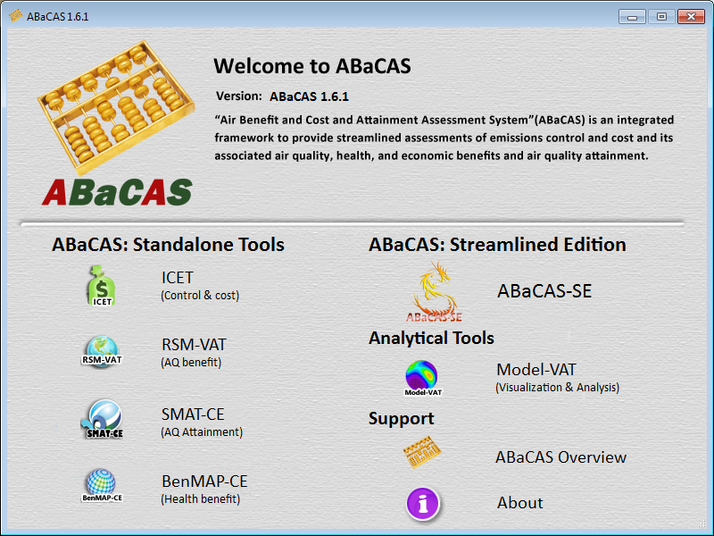
“ABaCAS”: Air Benefit and Cost & Attainment Assessment System
An integrated AQ Decision Support System
Developed for “Scientists” and “Policy Makers”

Slide 5
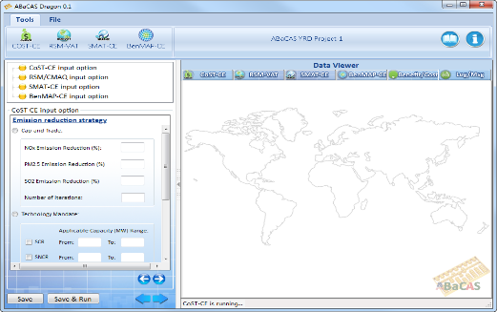

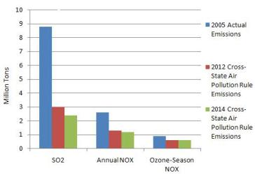

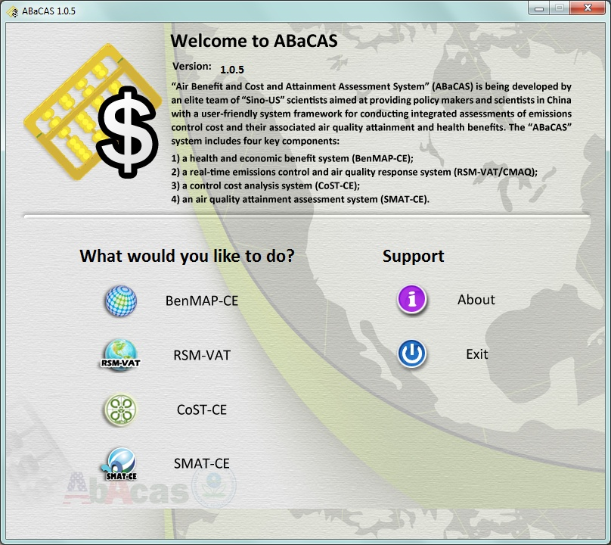
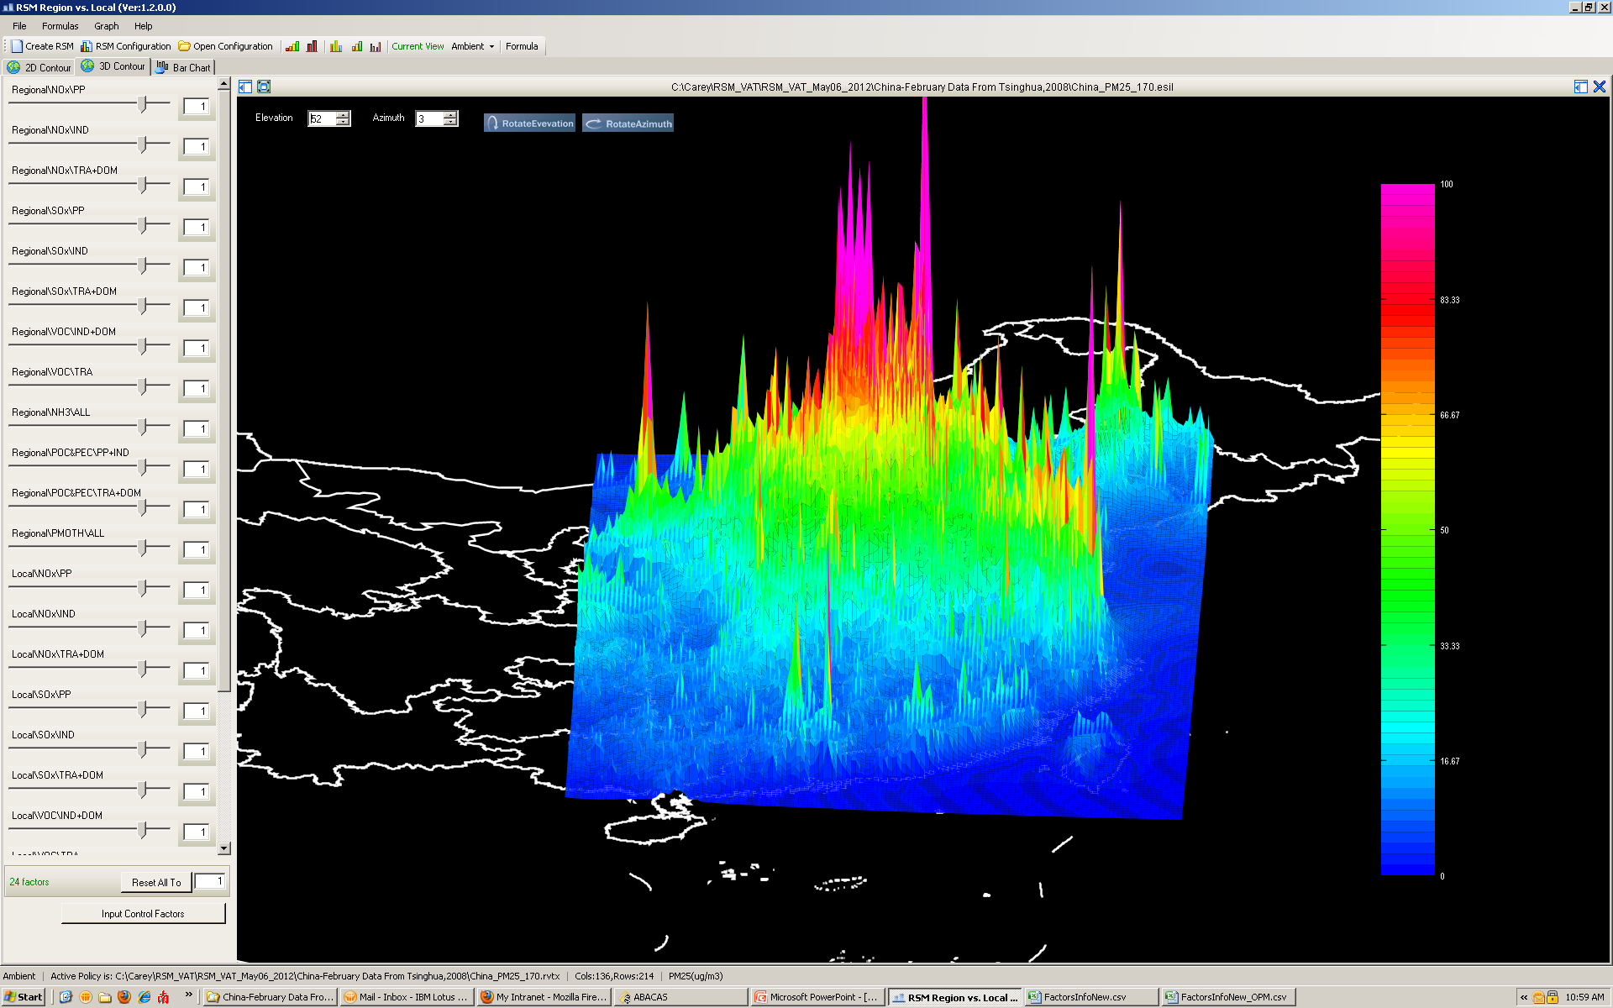


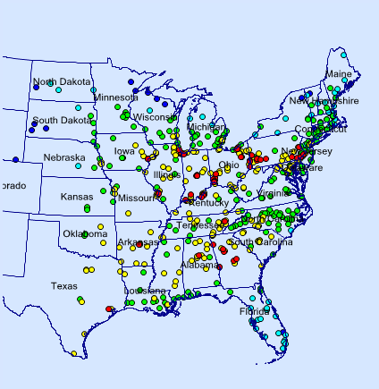

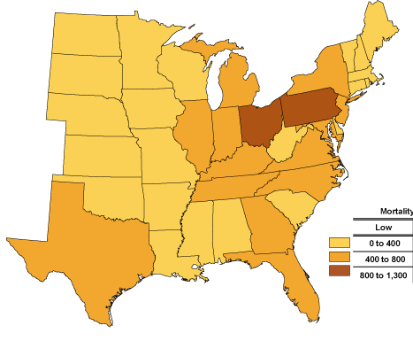
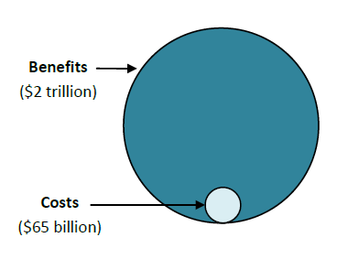
“ABaCAS-SE ” (Streamlined Edition”)
(2015-2016)
Control Policy Scenarios
Control Strategy
A
Control Strategy
B
Control Strategy
C
……………
ABaCAS-SE
ABaCAS-SE Master Script
Cost estimate ($$)
ICET
ICET script
AQ Benefit (ug/m³)
RSM-VAT
RSM-VAT script
> 12 ug/m³ (non-attainment)
SMAT-CE
SMAT-CE script
Attainment (DVs)
BenMAP-CE
BenMAP-CE script
BenMAP-CE
Health Benefit ($$)
Streamlined Assessment
Benefit ($$)/Cost ($$)
Notes:
spatial field: A Spatial Field refers to air pollution estimates made at the center of each grid cell in a specified modeling domain. For example, MATS might calculate ozone design values for each grid cell in the modeling domain. Several types of Spatial Fields can be calculated for ozone and PM.
利用环境监测数据、模型数据（主要是CMAQ模拟的结果）作为模型输入，并利用优化的数理统计技术对大气复合污染状况进行模拟，实现对环境空气质量标准的达标评估。其中包括point estimate和spatial field estimate。

Slide 6
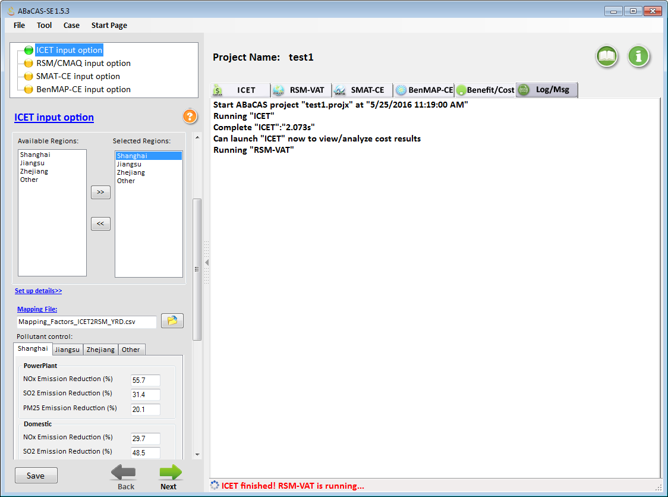
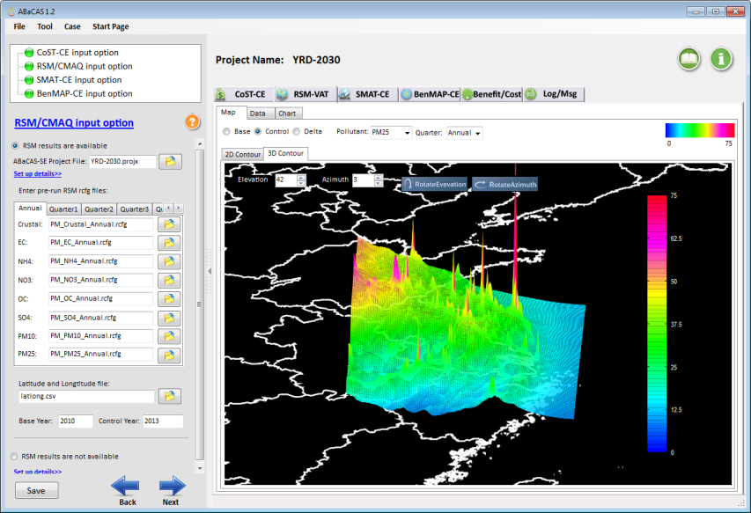
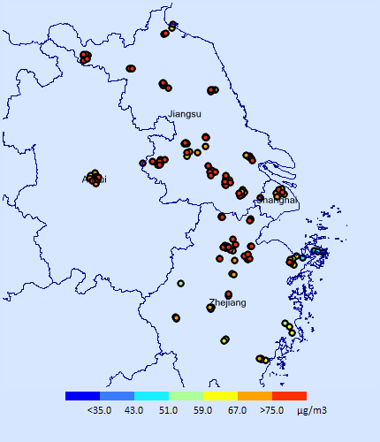
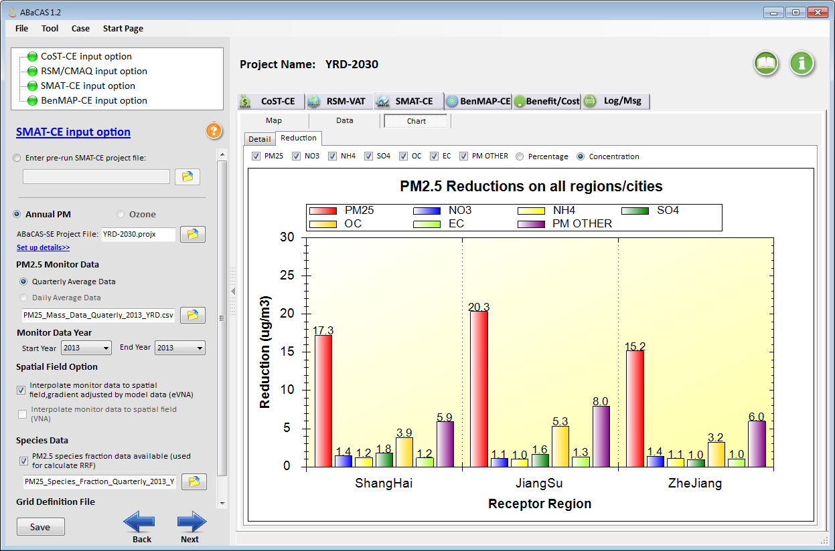
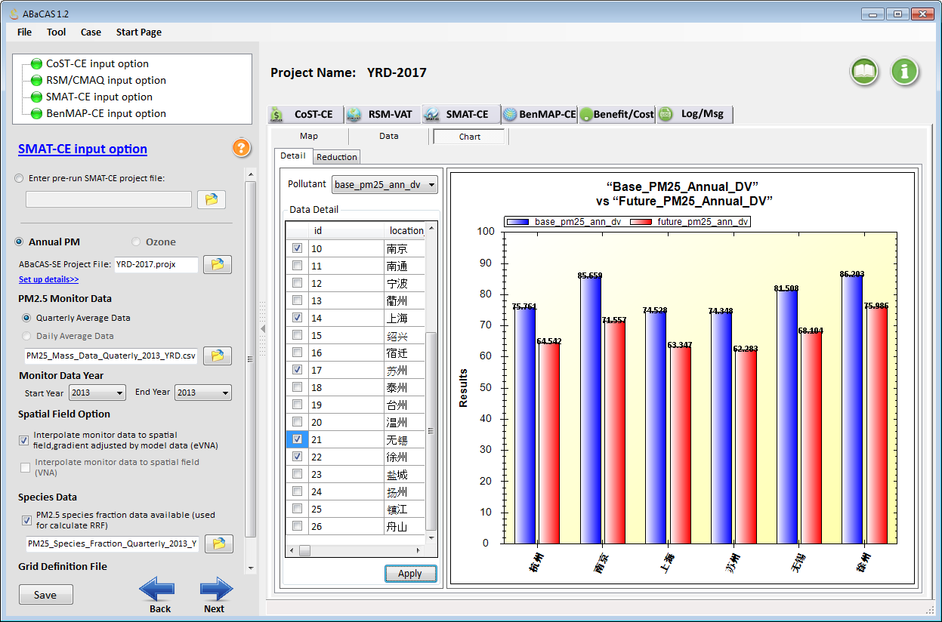
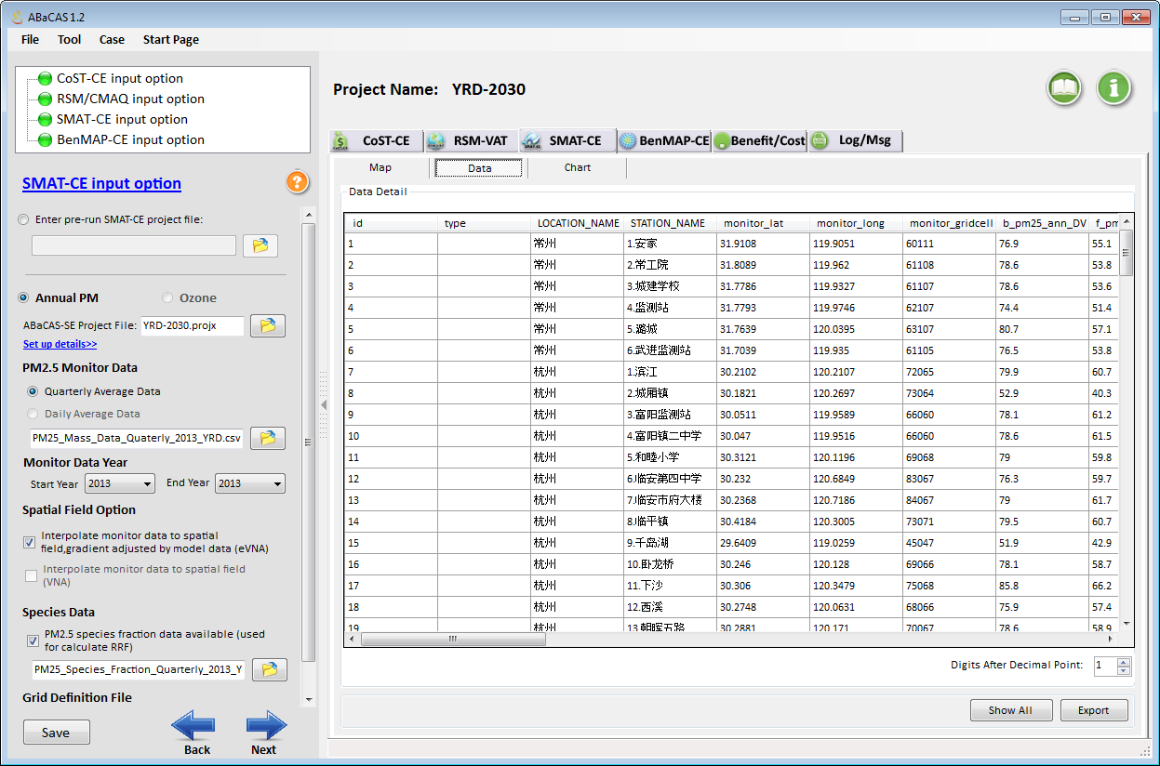
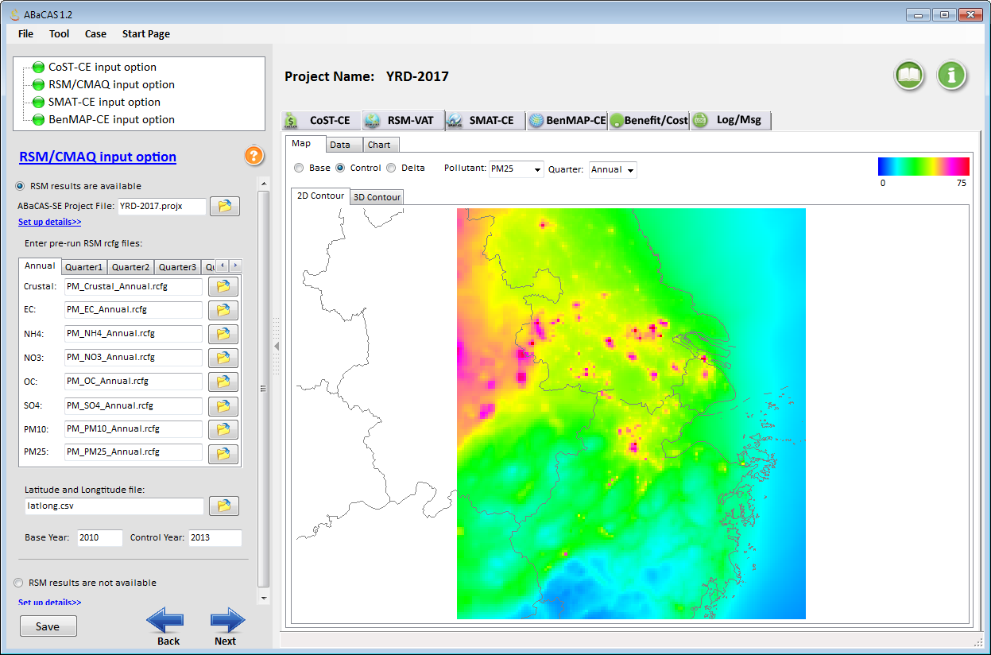
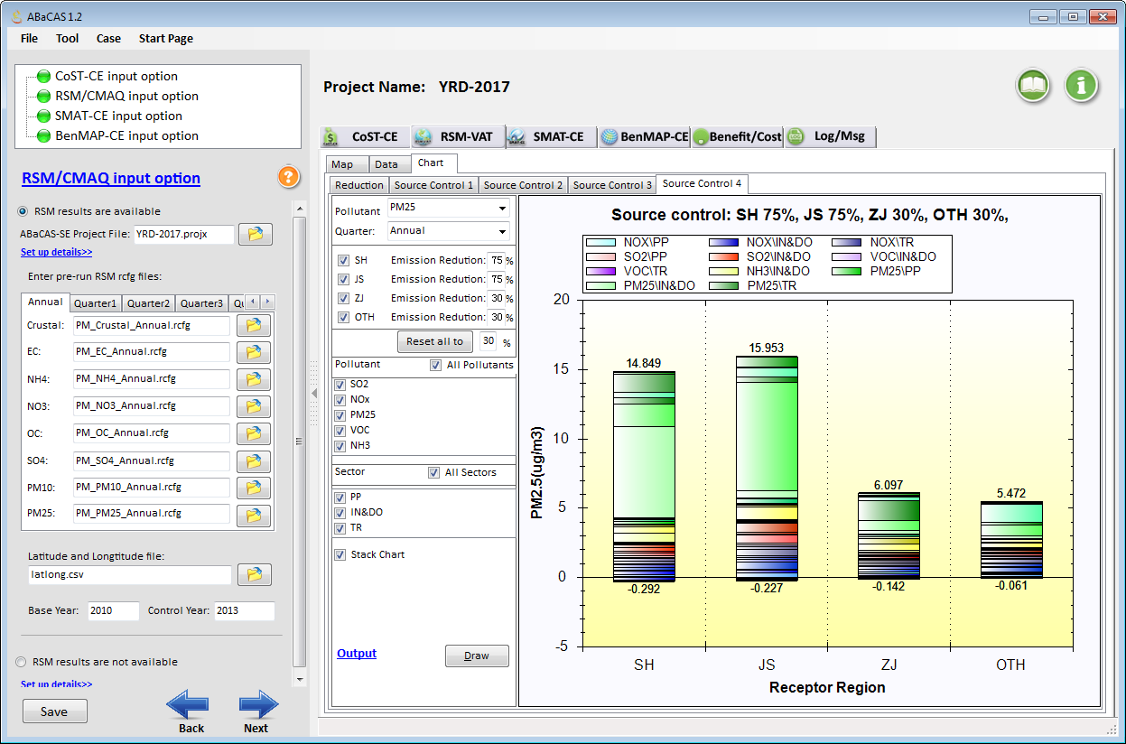
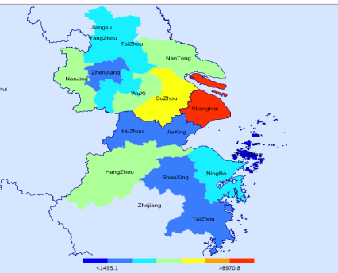
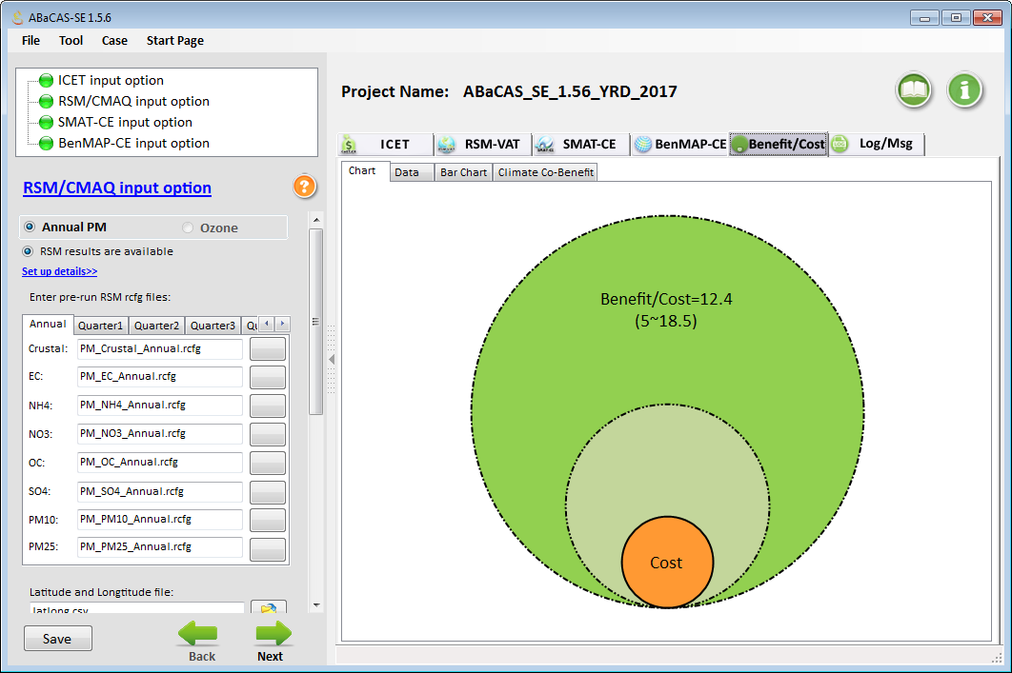
“ABaCAS-SE” (Streamlined Edition, 2015):
Developed for Policy-Making and Analysis
ABaCAS-SE “YRD 2017 case”:
5~10 minutes to complete a run
ABaCAS-SE

Slide 7
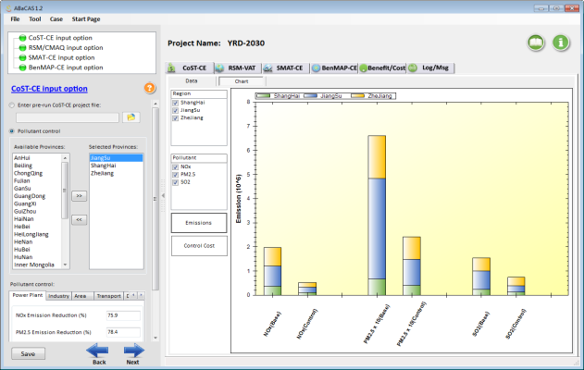
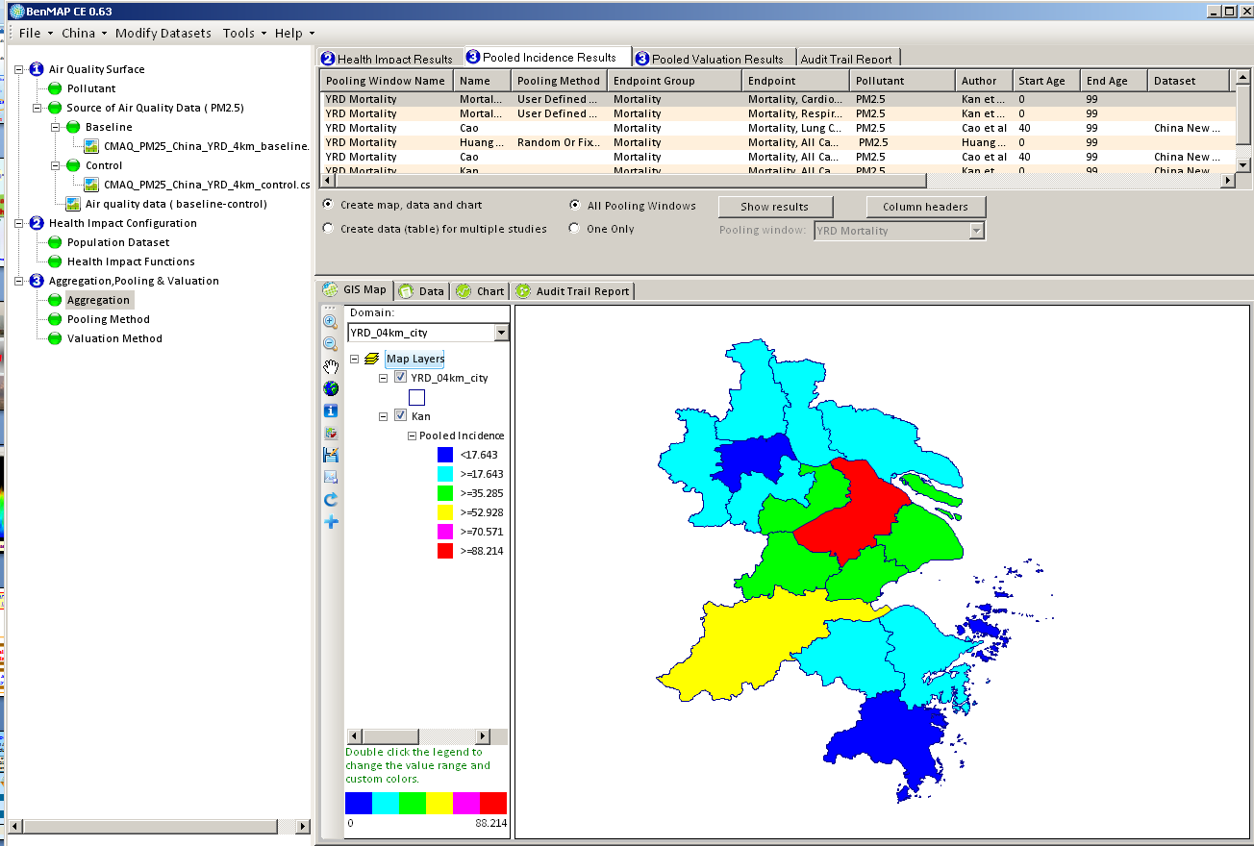
ABaCAS-SE：China YRD/Shanghai Case Study
China National Air Pollution Control Plan (2013)
Region | Annual PM_{2.5}
BJ-TJ-Hebei | 25% ↓
YRD/Shanghai (Yangtze River Delta) | 20% ↓
PRD/Guangzhou | 15% ↓
Beijing | 60 ug/m³
Other Cities (333 cities) | 10% ↓ (PM₁₀)
ICET
Emissions Control & Cost
RSM/CMAQ
AQ Response to Emissions Control
AQ Attainment in YRD:
2017: PM2.5 20% ↓
2030: Attain China NAAQS
SMAT-CE
AQ Attainment
BenMAP-CE
Health and Economic Benefits

Slide 8
AP Control Measures Considered in YRD
2030
2010
2017
2030
HED+FGD+LNB+SCR
ESP+FGD+LNB+SCR
Energy
Infrastrure
Control
18%
18%
New and clean energy
21%
38%
39%
Advanced
coal-fired power
34%
61%
Conventional
coal-fired power
43%
28%
(PI: Prof. Shuxiao WANG, Tsinghua Univ., June 2014)

Slide 9
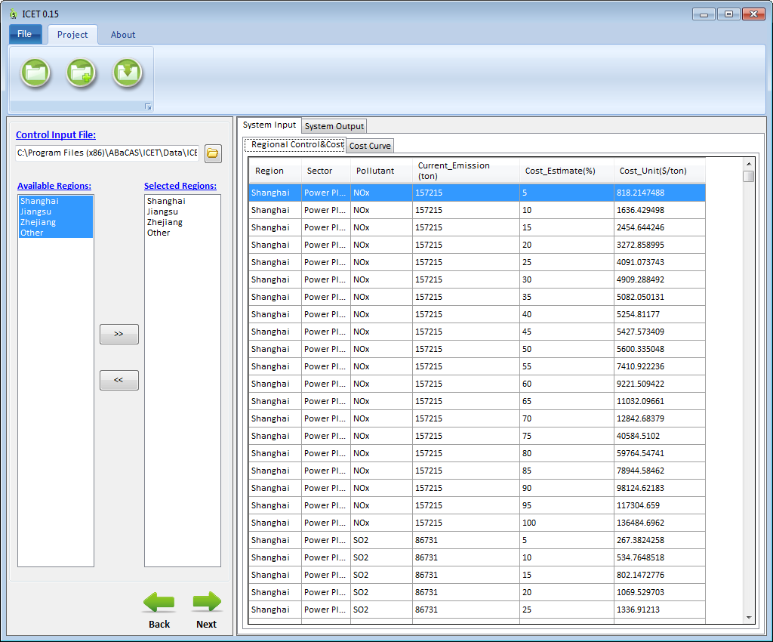
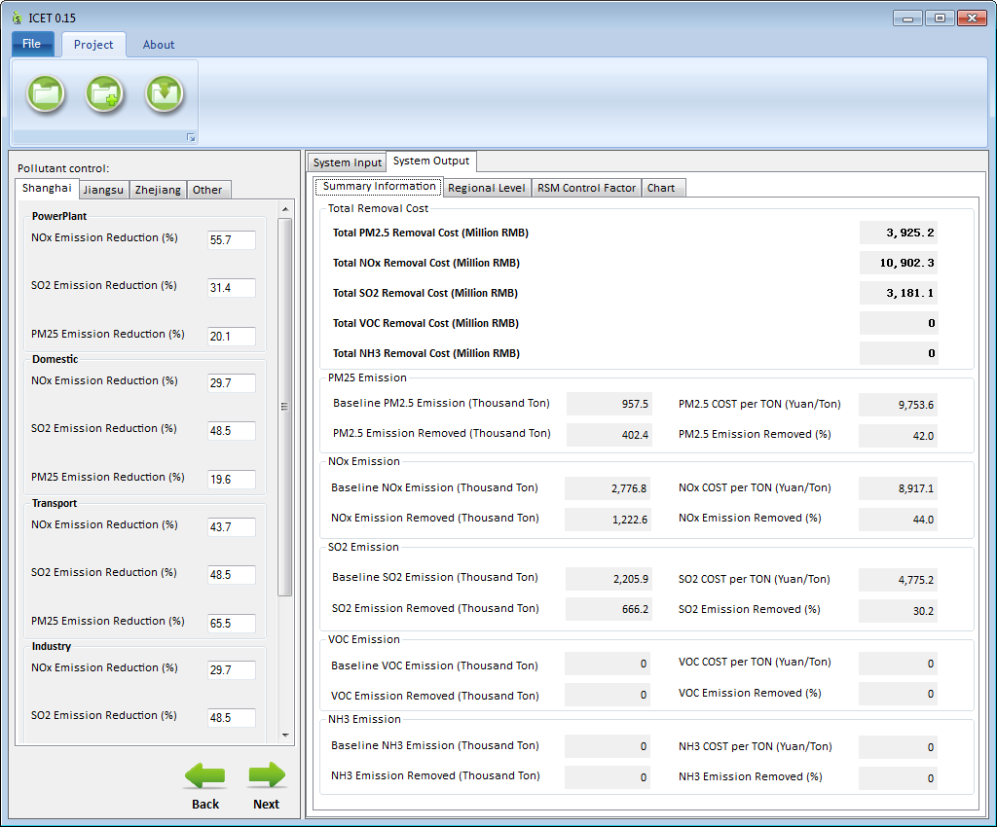
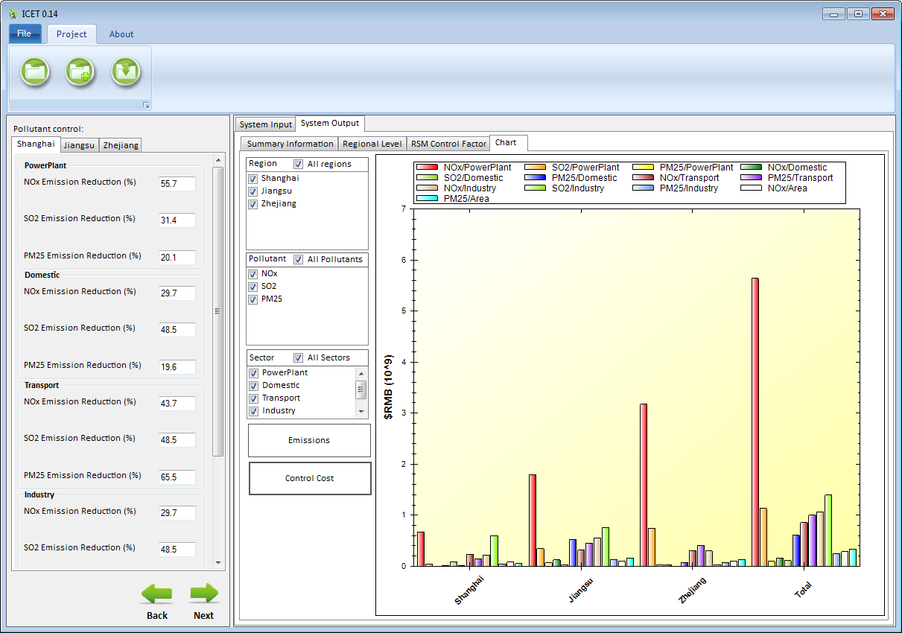
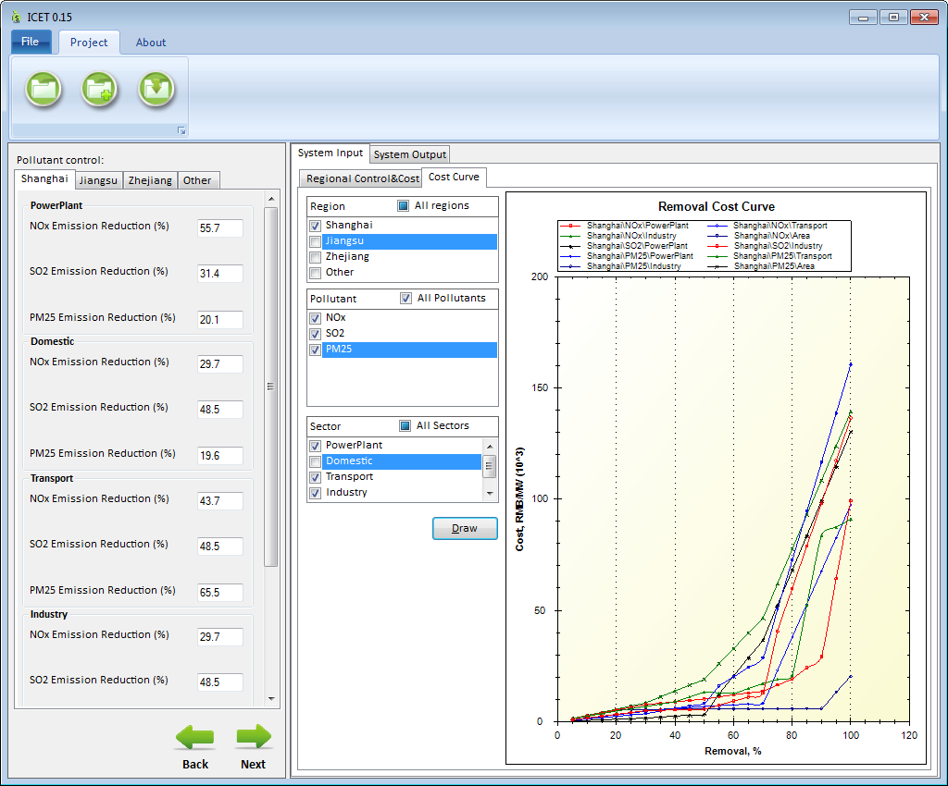
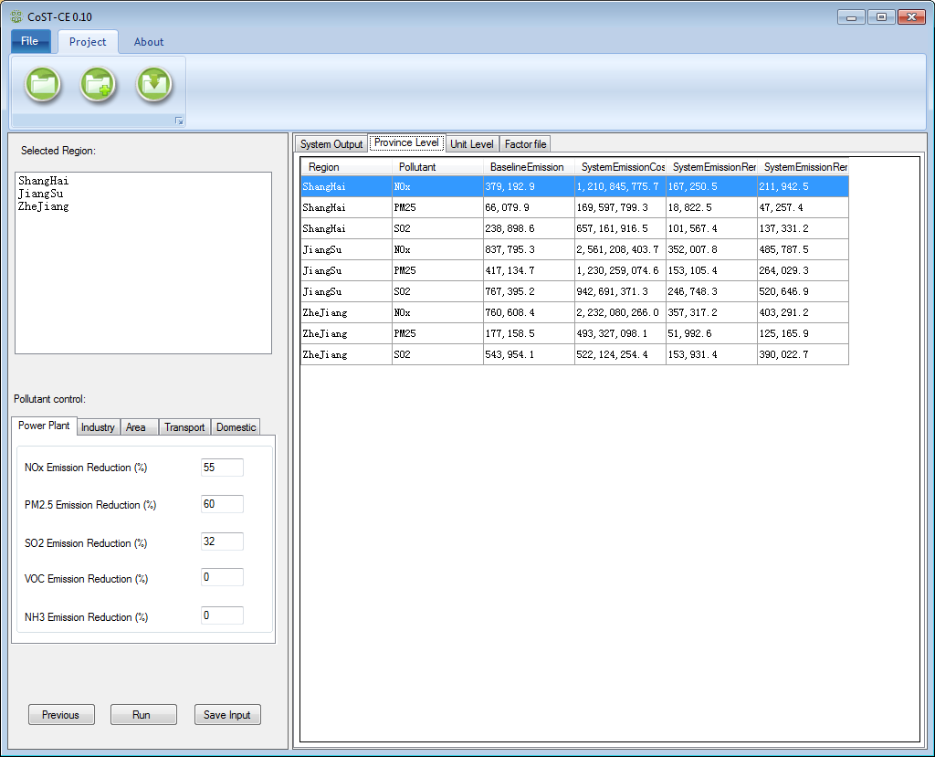
ICET: International Control Cost Estimate Tool
Provide control Technology cost
2. Selections of regions,
pollutants, and Sectors
3. Calculations of
control cost & analysis

Slide 10
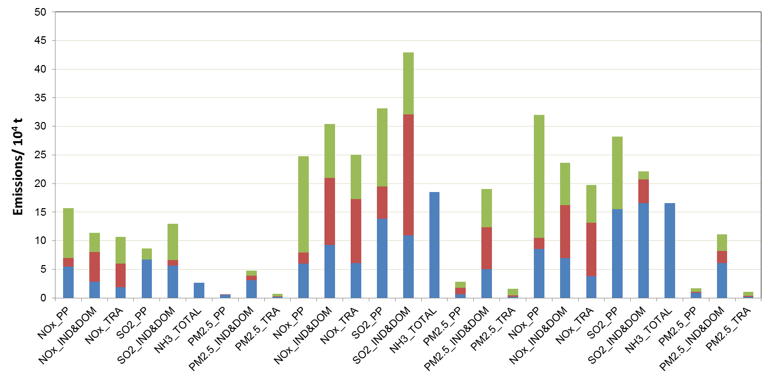
Emission reductions to attain the air quality goals
  YRD: By 2017, the PM_{2.5} concentrations decrease by 20% on the basis of 2012 levels. Attaining the Ambient Air Quality Standard by 2030.
Jiangsu
Zhejiang
2012
Emissions/ 10⁴ t
2017
2030
Shanghai
(PI: Prof. Shuxiao WANG, Tsinghua Univ., June 2014)
RSM Control Policy Factors

Slide 11
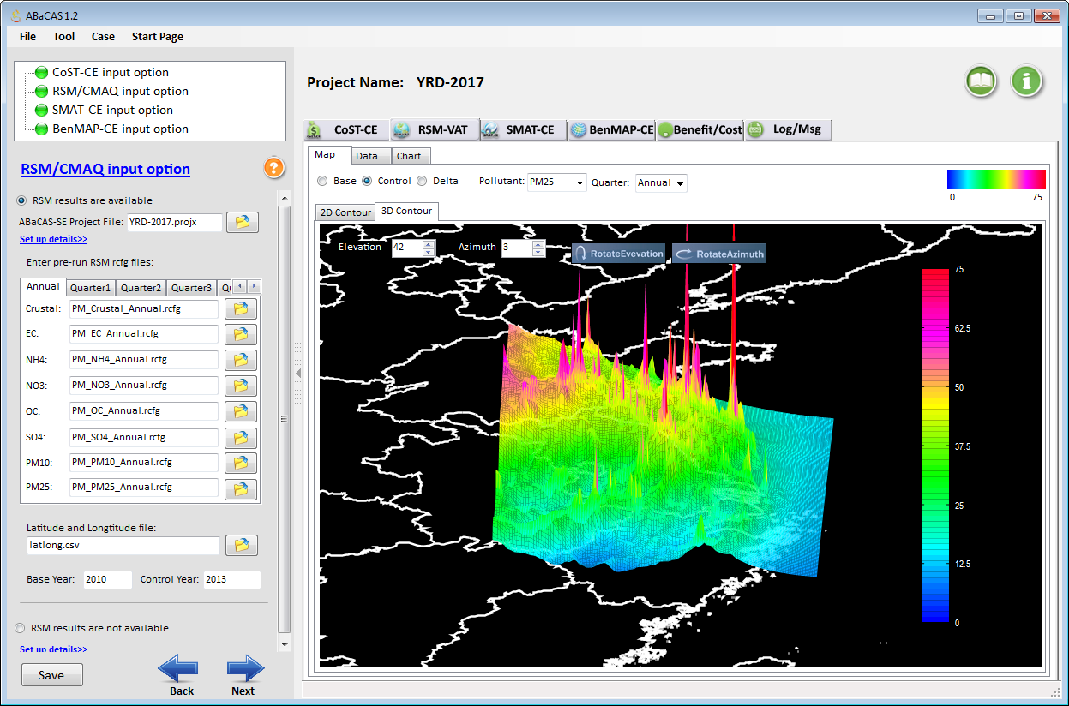
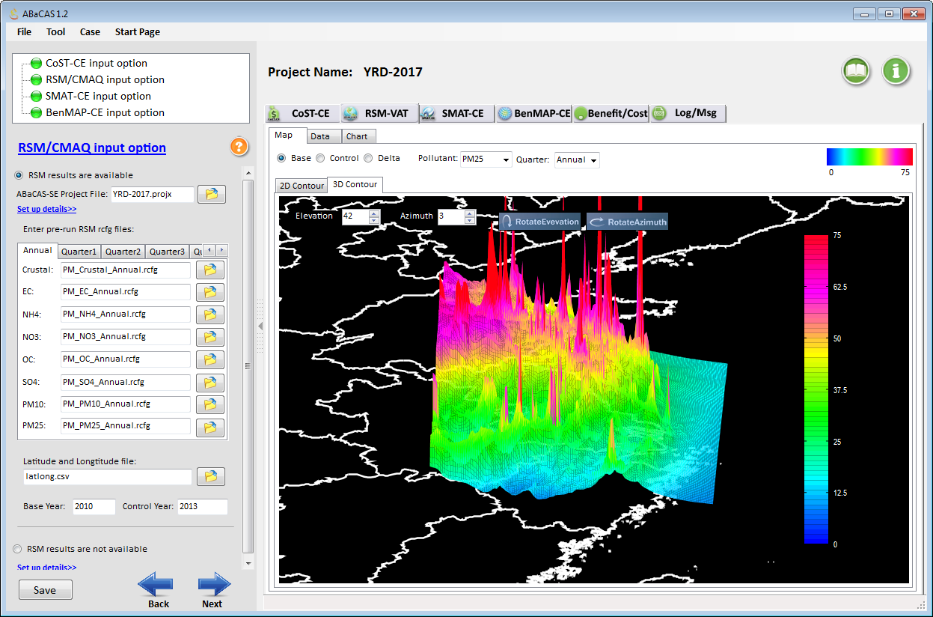
”RSM/CMAQ” in “ABaCAS-SE”: PM2.5
YRD: Base vs. Control (2010 vs. 2017)
Base
Control

Slide 12
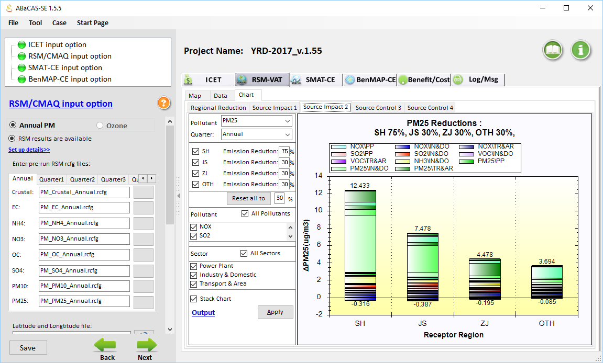
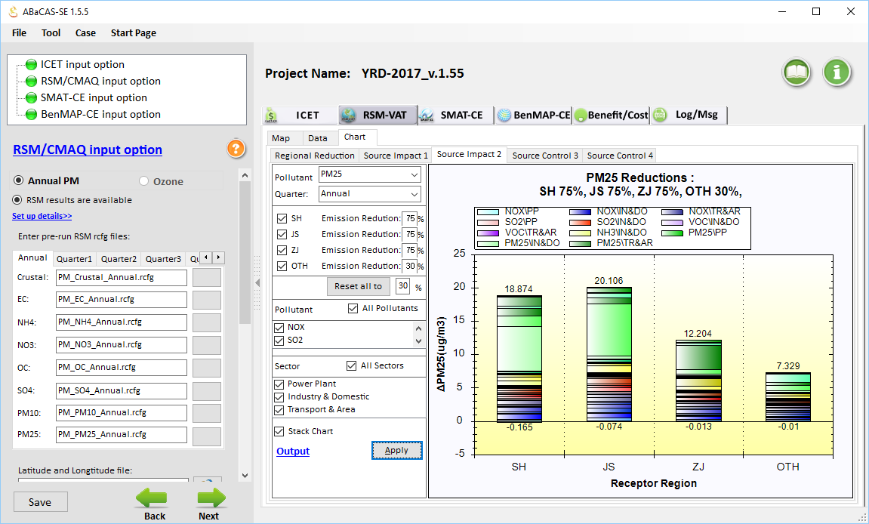
”RSM/CMAQ” in “ABaCAS-SE”
YRD 2017 case: PM2.5 Source Contribution

Slide 13
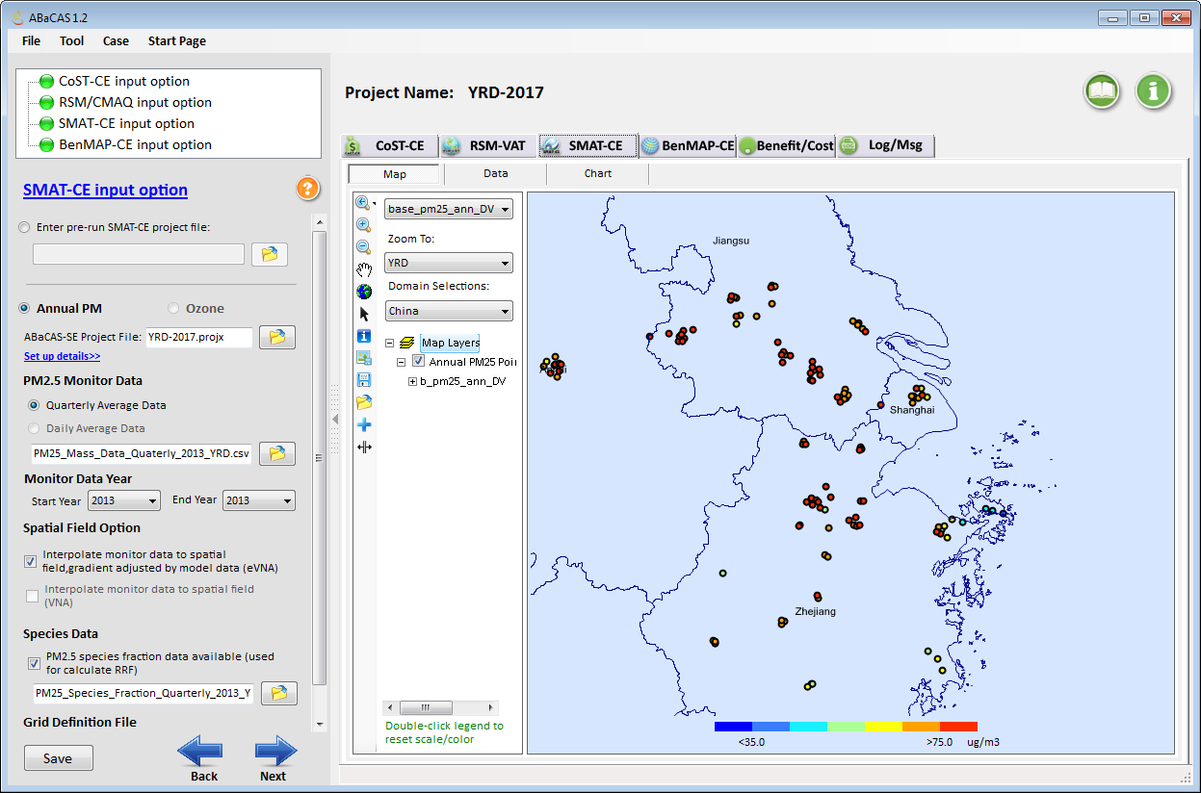
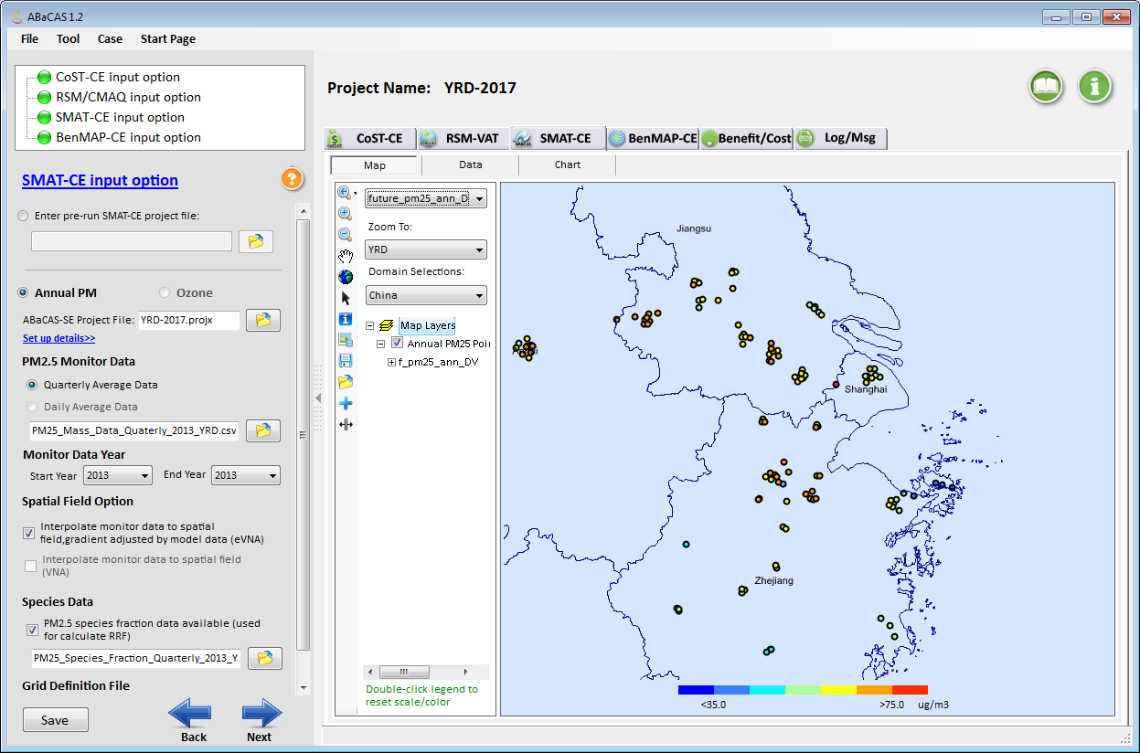
”SMAT-CE” in “ABaCAS-SE”: PM2.5 Attainment
YRD Base vs. Control (2013 vs. 2017)
Control
Base

Slide 14
”SMAT-CE” in “ABaCAS-SE”: PM2.5 Attainment
YRD Base vs. Control (2013 vs. 2017)

Slide 15
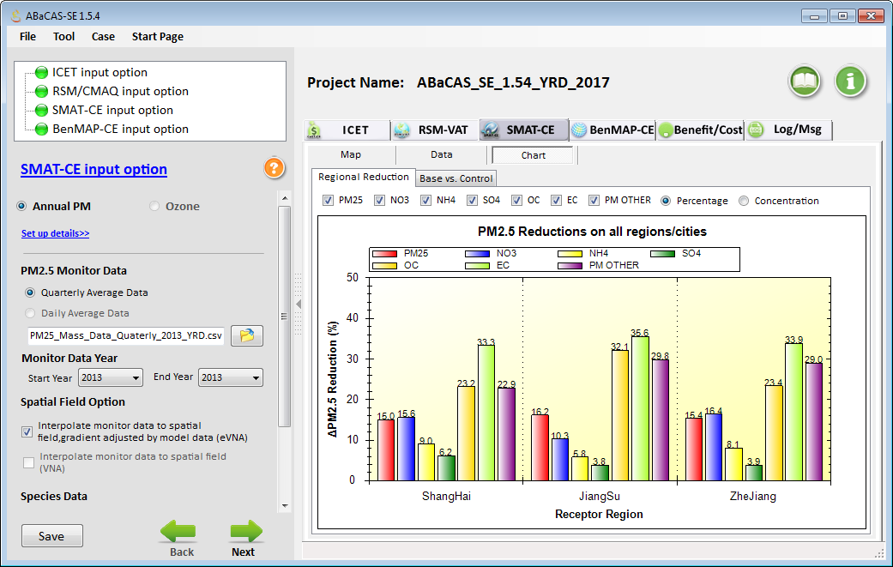
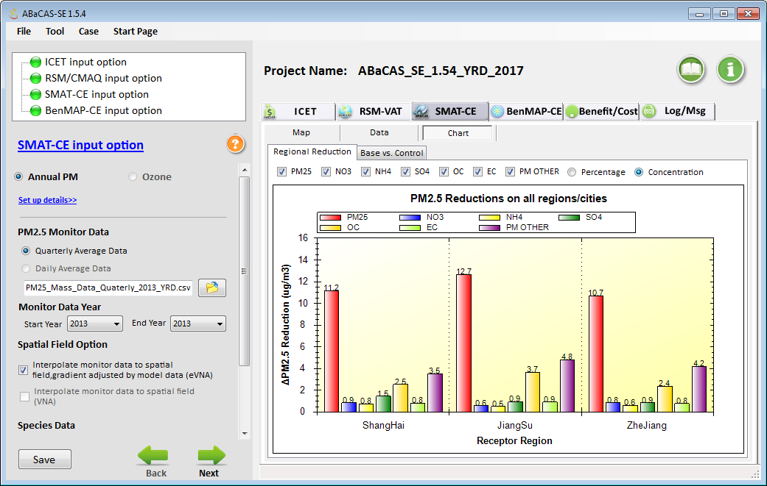
”SMAT-CE” in “ABaCAS-SE”
YRD 2017 case: PM2.5 Attainment (Reduction)

Slide 16
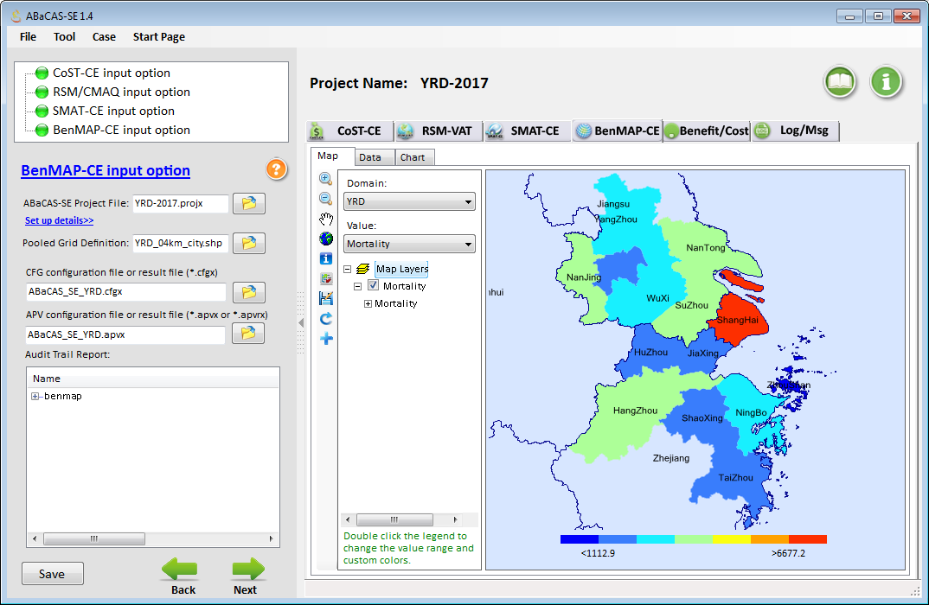

”BenMAP-CE” in “ABaCAS-SE”
YRD 2017 Case: Mortality (Lives Saved)
”BenMAP-CE” in “ABaCAS-SE”
YRD 2017 Case: Valuation ($$ Saved)

Slide 17
“ABaCAS-SE”: China YRD 2017 case (vs. 2011)
Developed for supporting policy-making & analysis
ABaCAS-SE “YRD 2017 case”:
5~10 minutes to complete a run
Benefit/Cost =
~12.5
ABaCAS-SE

Slide 18
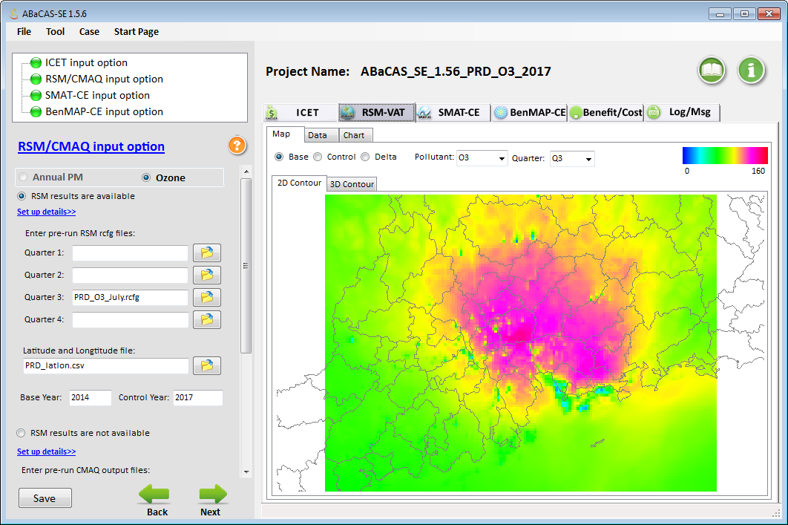
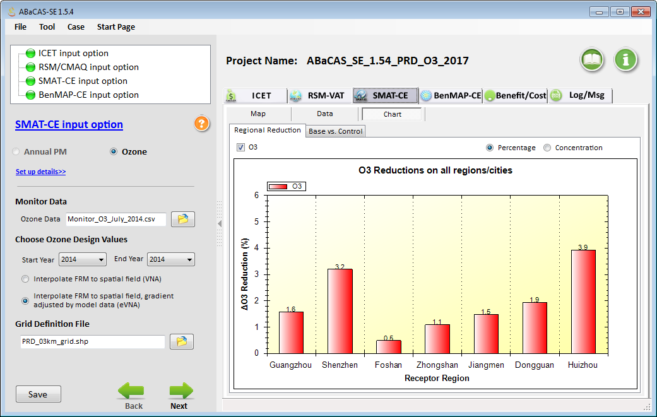
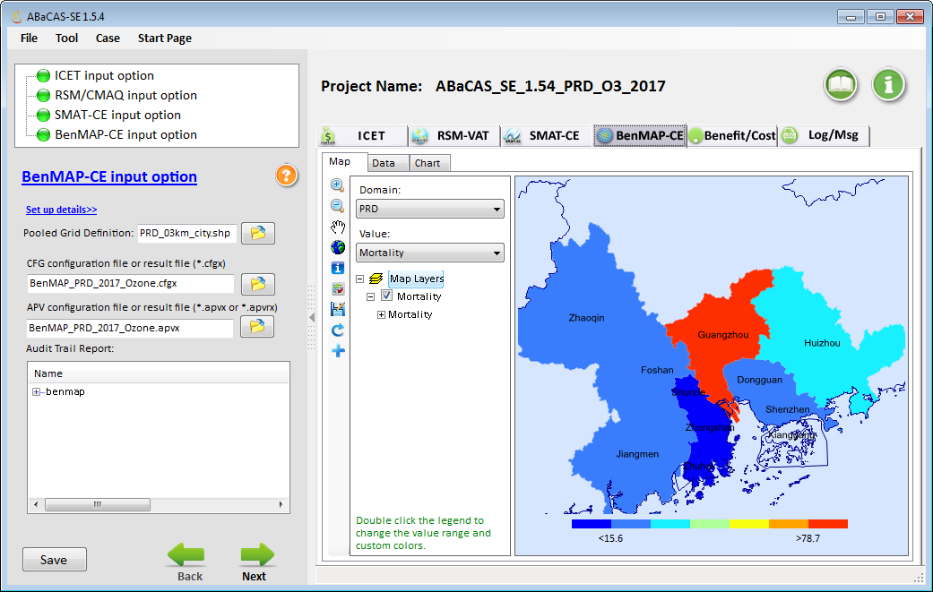
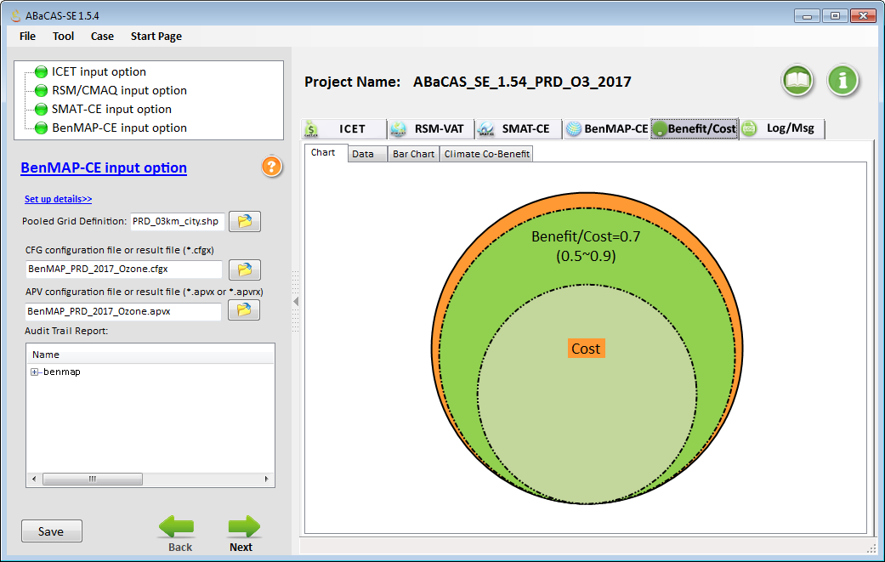
China Pearl River Delta (PRD) Ozone Case Study
RSM/CMAQ
(PI: Prof. ZHU Yun, SCUT)
SMAT-CE
BenMAP-CE
Benefit/Cost

Slide 19
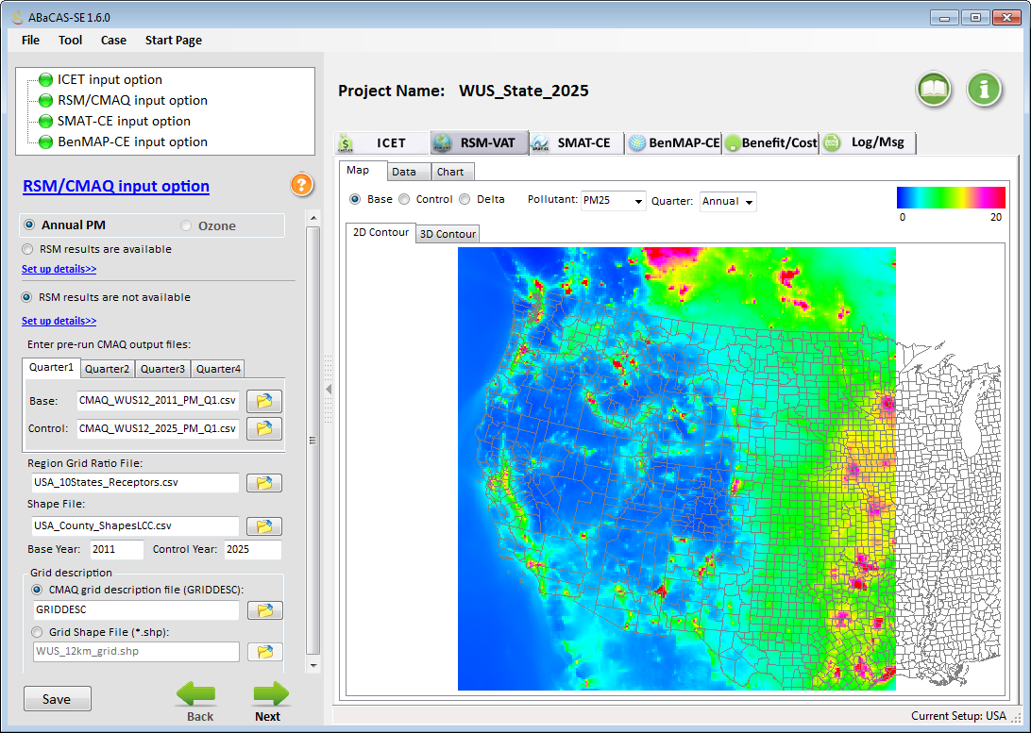
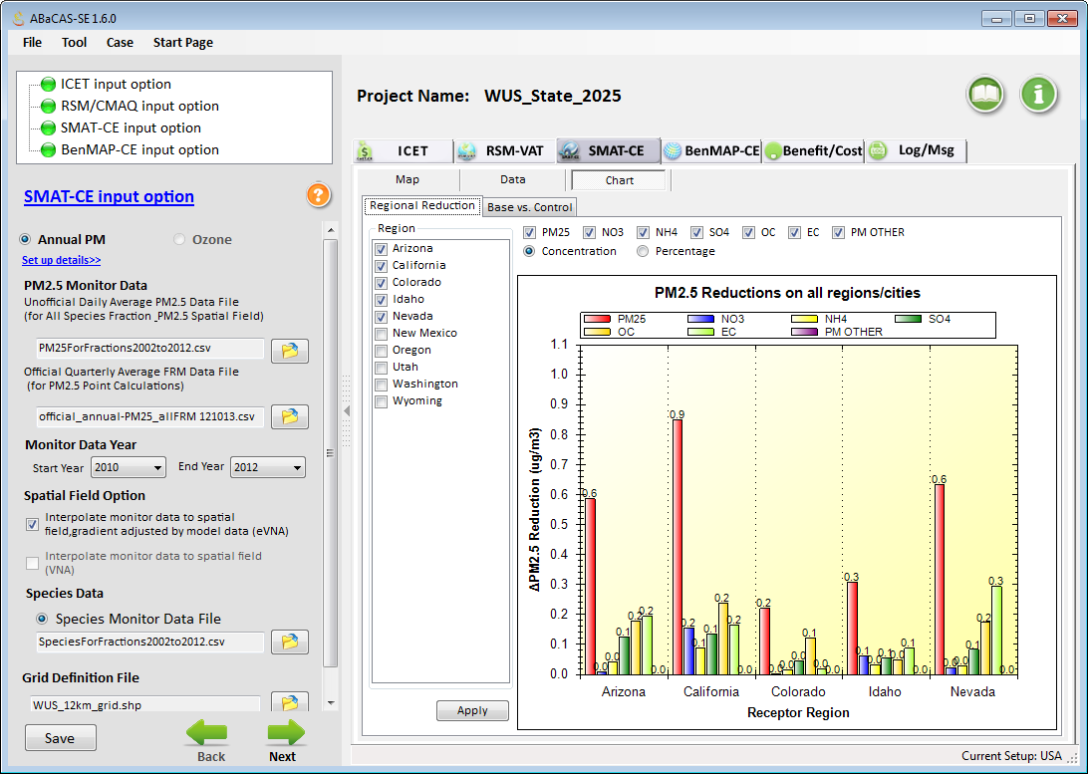
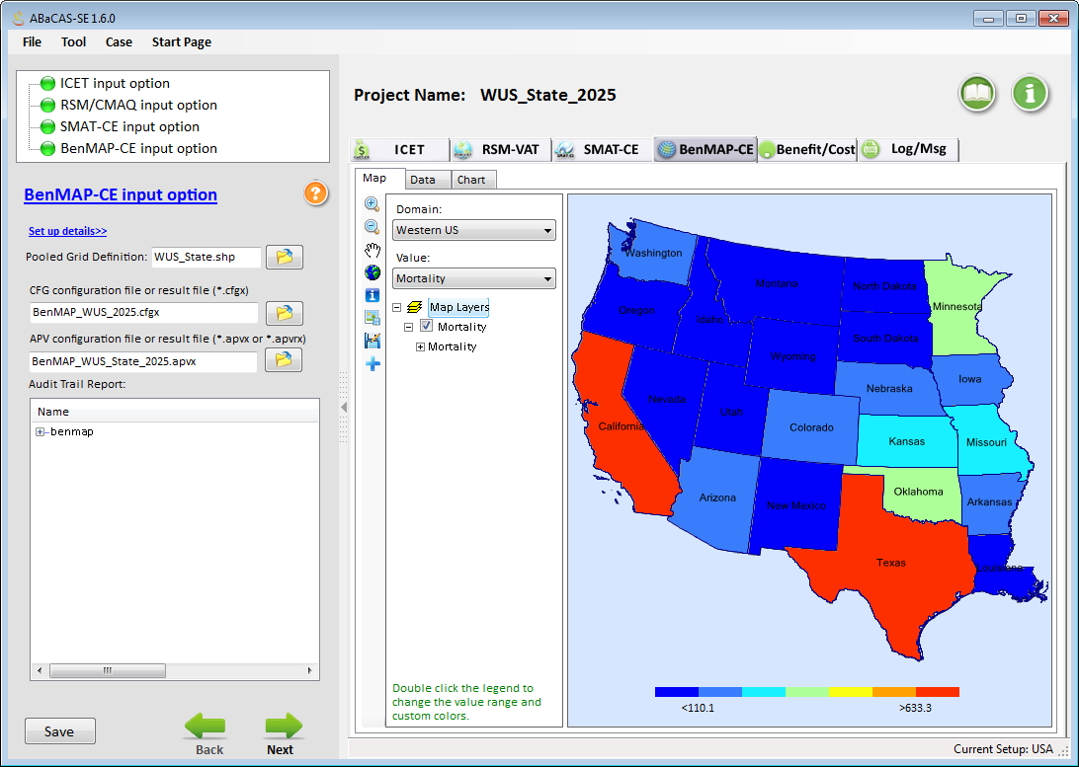
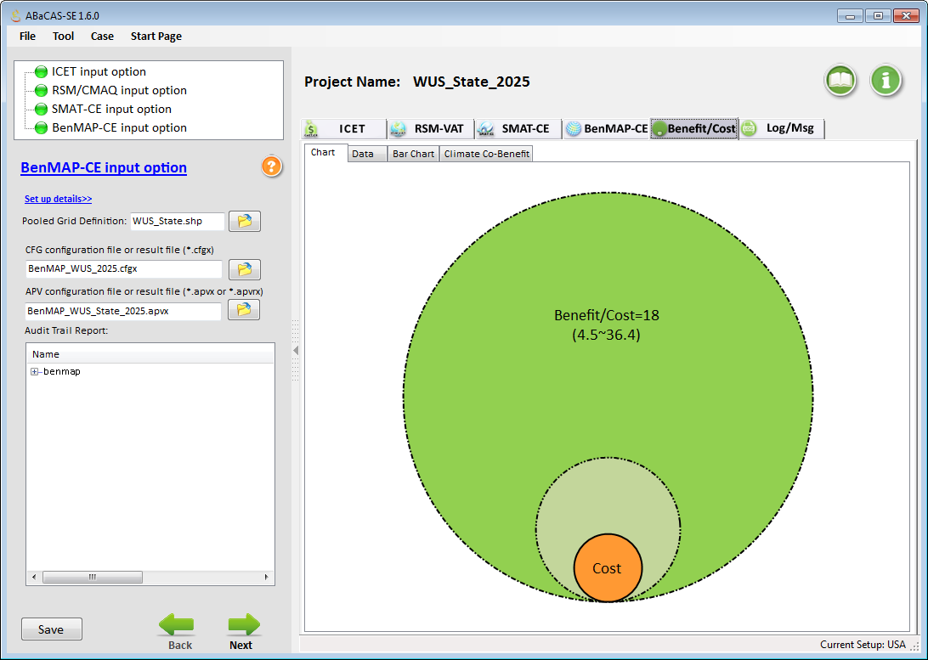
Western U.S. Case Study (ABaCAS-SE)
CMAQ (no-RSM)
(PI: UNC-Chapel Hill)
SMAT-CE
BenMAP-CE
Benefit/Cost

Slide 20
New & Ongoing Development of ABaCAS System (2016 – 2017)
  Fully functional “ABaCAS website” (abacas-dss.com) and on-line user manuals & quick start guides
  Enhanced “ABaCAS-SE” and “no-RSM” option
  International control cost estimate tool (ICET)
  Single Source Impact Analysis (SSIA) for PM2.5 & O3
  New analytical & supporting tools: Model-VAT & Data Fusion Tool (under development)
  Integrated AQ & climate assessment: GCAM-ABaCAS (plan for 2016-2017)

Slide 21
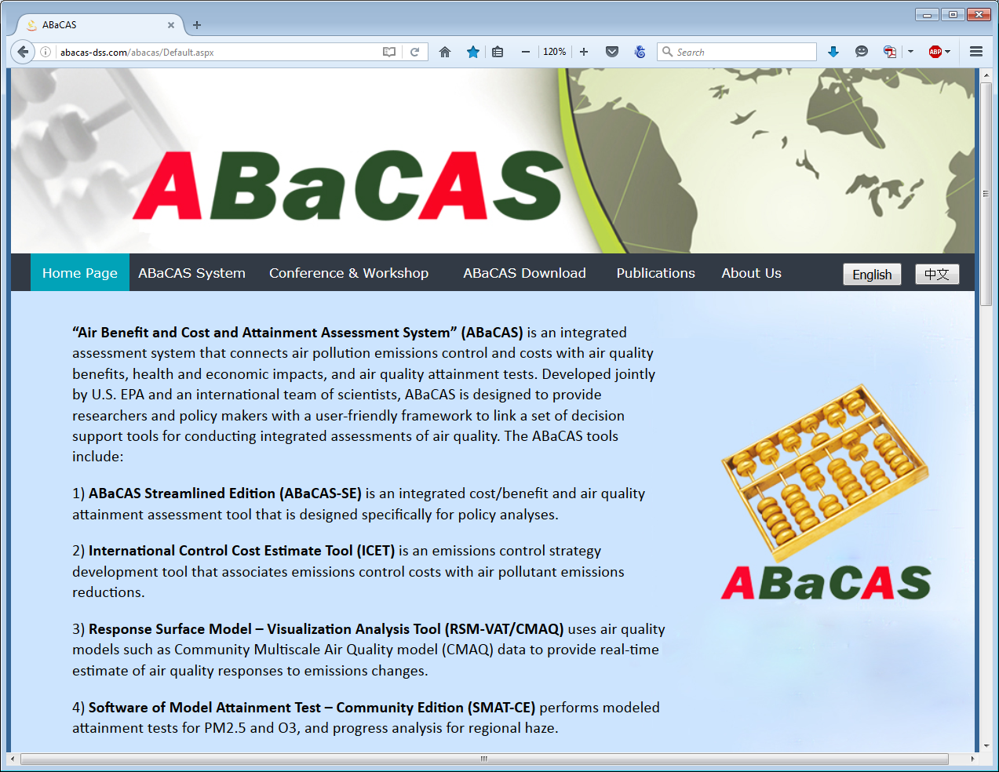
“ABaCAS” Website (www.abacas-dss.com)

Slide 22
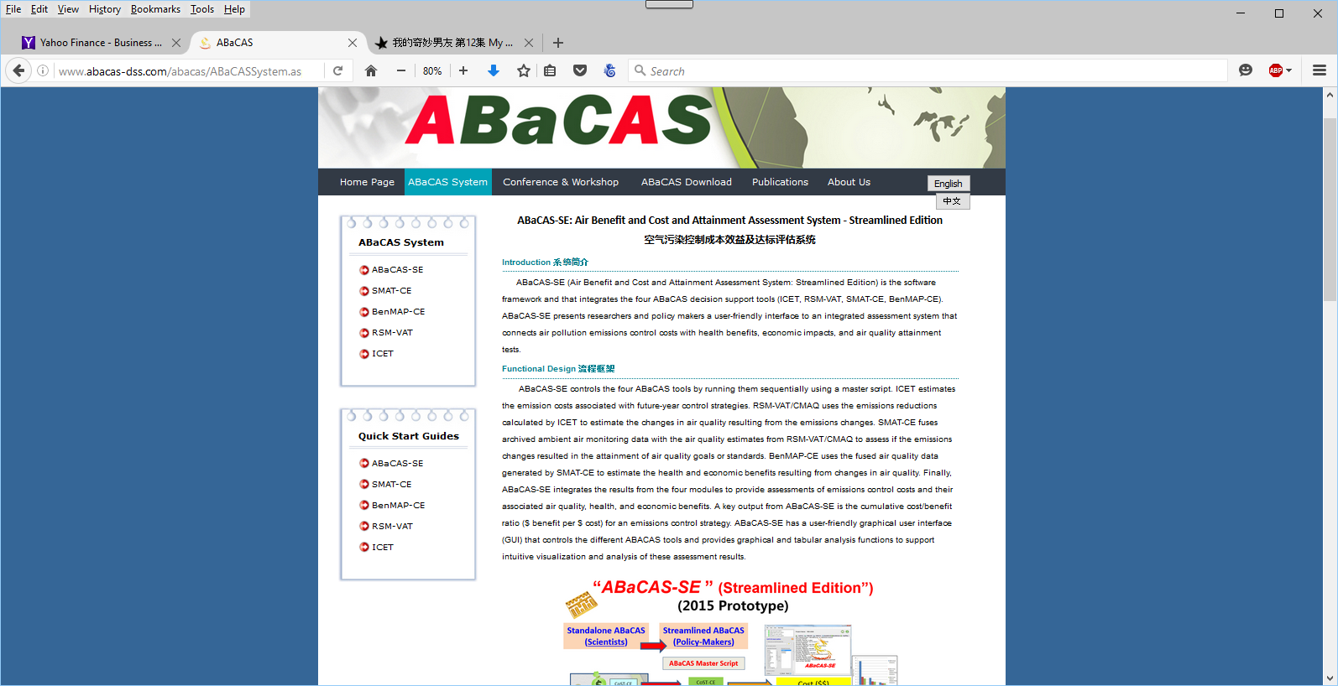
“ABaCAS System” & Tools: Overview &UG

Slide 23
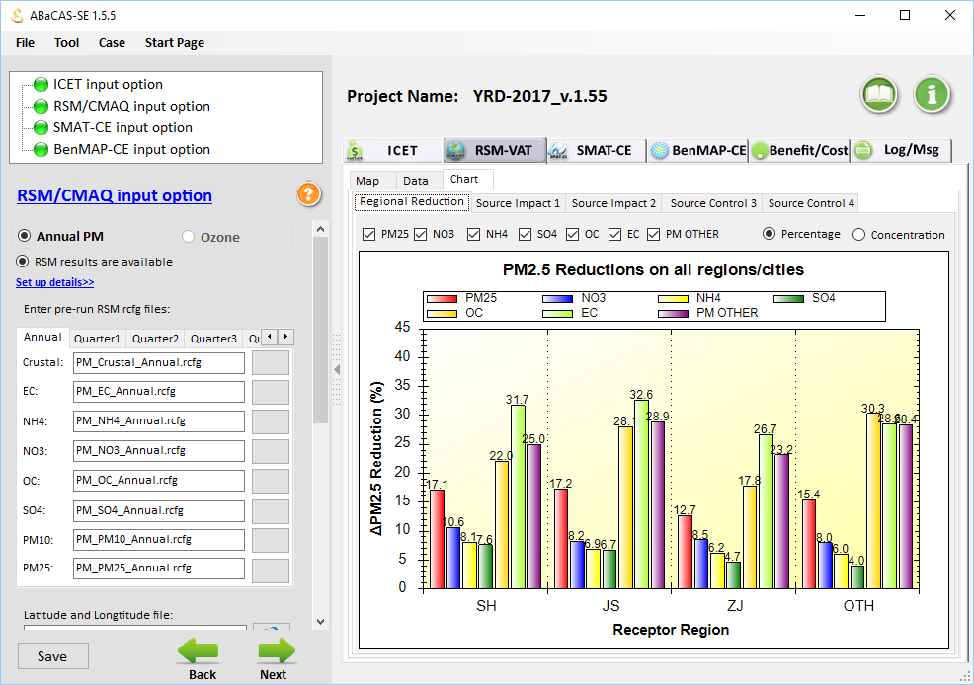
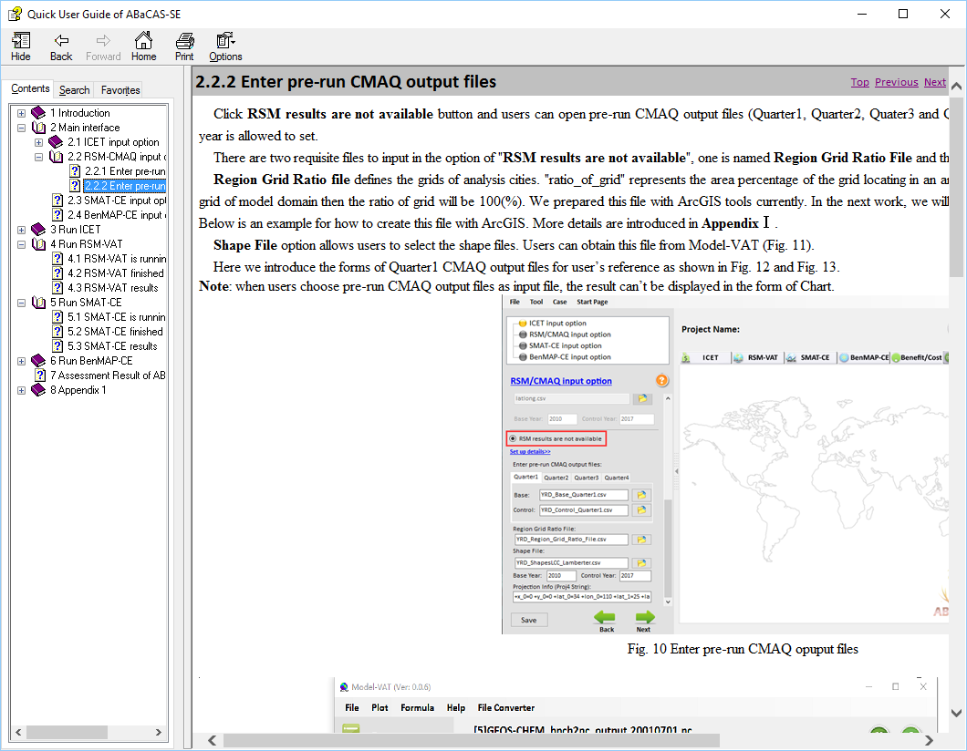
“ABaCAS”: Online User Manuals

Slide 24

“ABaCAS Download”: System Package (free)

Slide 25

“ABaCAS” Conferences/Workshops

Slide 26





Model-VAT:
Multi-Scale Model Visualization & Analysis Tool
Combined
GOES-Chem
CMAQ
H-CMAQ
(SCICHEM, AERMOD, CAMx,
Combined CMAQ/AERMOD underway)
User-Friendly V/A & Eval. Tool for Photochemical & Dispersion Models

Slide 27

“GCAM-ABaCAS”: Conceptual Framework
Integrated Climate-AQ Benefit/cost Assessment
ABaCAS
(CPP, Paris Agreement, etc.)
Climate/AQ Policies
Input Data
Air Pollutant
Emissions
Reduction
RSM/CMAQ
SMAT-CE
ICET
BenMAP-CE
Control cost
AQ Benefit
Attainment Benefit
Health/Econ. Benefit
GCAM
Output Data
GHG
Emissions
Reduction
Radiative Forcing & Global mean temp
Global Change
Assessment Model
Climate benefit/Cost
assessment
AQ benefit/Cost
assessment
Social Cost of Carbon
Climate & AQ co-benefit/cost Assessment
Development Plan for 2016-2017, PI: Prof. Jia Xing, Tsinghua Univ.

Slide 28

Summary
Effective AQ management requires scientifically sound assessment tools for supporting and attaining AQ goals
“ABaCAS” can serve as an international decision support community tool for air pollution cost/benefit and attainment assessment
Scientists and policy-makers Need to work closely together with to lead to a successful application for AQ attainment
PM 2.5
O3
Emission Control
Health & Economic.
Benefit
Air Quality Attainment
Notes:
Comment: This is an important slide, but needs to be improved. Consider to use animations to highlight the key features & differences

Slide 29
“ABaCAS” Contributors
USA:
  EPA: Carey Jang, Charles Fulcher, Neal Fann, Brian Timin, Kirk Baker, Scott Voorhees, Dale Evarts, Tyler Fox, etc.
  UNC-IE: Adel Hanna, Zac Adelman, Dongmei Yang, etc.
  Univ. of Tennessee: Joshua Fu, Xinyi Dong, Jian Sun, etc.
International:
  Tsinghua Univ.: HAO Jiming, WANG Shuxiao, XING Jia, etc.
  South China Univ. of Technology: ZHU Yun, LONG Sicheng, etc.
  Taiwan CJC Univ.: LAI, H.C., WU Pei-Chi, etc.
  Sponsors/Partners: DOS, Energy Foundation, China MEP, Taiwan EPA, Clean Air Alliance of China, Clean Air Asia, etc.

Slide 30


ABacAS Demo Booth (4-5 pm, Tue., 10/25)
USEPA/Office of Air Quality Planning & Standards
Univ. of North Carolina – Institute of Environment
Notes:
Because of the limited time, we can not introduce all. Some slides are listed behind as appendix. ///(forward and back)here it is/// Thanks for your attention; and thanks very much for the EPA team’s help again.

Slide 31



YRD 2030 Case Study (ABaCAS-SE)
RSM/CMAQ
(5~10 minutes to run)
SMAT-CE
BenMAP-CE
Benefit/Cost = 9.3

Slide 32


“ABaCAS Publications”: Recent Published Paper

Slide 33


2015 ABaCAS Conference/Training Workshop (Guangzhou, 6/23-35)
2016 ABaCAS Conference/Training Workshop (Shanghai, 6/14-16)

Slide 34

“ABaCAS”: Air Benefit and Cost & Attainment Assessment System
New Tool: Model-VAT (2016)

Slide 35

New & Ongoing Development of ABaCAS System (2015 – 2016)
  Fully functional “ABaCAS website” (abacas-dss.com) and on-line user manuals & quick start guides
  Enhanced “ABaCAS-SE” and “no-RSM” option
  International control cost estimate tool (ICET)
  Single Source Impact Analysis (SSIA) for PM2.5 & O3
  New analytical & supporting tools: Model-VAT & Data Fusion Tool (under development)
  Integrated AQ & climate assessment: GCAM-ABaCAS (plan for 2016-2017)

Slide 36




  Single-Source Impact Analysis (SSIA): PM 2.5 & O3
    Feature:
    Fuse results of “Dispersion” (e.g., AERMOD) & “Grid ” (e.g., CMAQ) model
  1. “Dispersion Model”:
    Provide SSIA of Primary PM2.5
    (local or near-source impact)
  2. “Photochemical Grid Model”:
    Provide SSIA of Secondary PM2.5
    (regional or downwind impact)
Grid
(CMAQ)
Dispersion (AERMOD)
Fused
Example of fused results of
“Dispersion Model” (AERMOD) and
“Grid Model” (CMAQ)

Slide 37

“ABaCAS Website”: Chinese Version

Slide 38
ABaCAS Application in JJJ
- Effects of China Air Pollution Control Action Plan (2012-2017)
Reductions
RRF
27.2%
31.5%
28.7%
27.1%
16.5%
12.3%
32.8%
Health Benefit (GBD Avoided Death): BenMAP-CE
24.1%
Health Endpoint (Age Range) | Beijing | Tianjin | Hebei
COPD (0-99) | 596 | 230 | 2073
Lung Cancer (0-99) | 1017 | 393 | 3495
Ischemic heart disease (25-99) | 568 | 222 | 1876
Stroke (25-99) | 1201 | 475 | 3651
Total | 3382 | 1320 | 11096
-7.0%
(Profs. WANG Shuxiao and XING Jia, Tsinghua Univ., 2016)
Notes:
38

Slide 39


“ABaCAS-China” Project Team
China:
  Tsinghua Univ.: HAO Jiming, WANG Shuxiao, XING Jia, etc.
  South China Univ. of Technology: YE Daiqi, ZHU Yun, XIE Junping, etc.
  Zhejiang Univ.: CEN Kefa, GAO Xiang, LUO Kun, CHEN Linghong, etc.
  Chinese Academy of Environmental Sciences: CHAI Fahe, GAO Jian, etc.
  Chinese Academy of Environ. Planning: LEI Yu, XUE Wenbo, etc.
  Shanghai Academy of Sciences: CHEN Changhong, Li Li, etc.
  Shanghai EMC: FU Qingyan, WANG Qian, etc.
  Sponsors/Partners: Energy Foundation, Clean Air Alliance of China, Clean Air Asia, etc.
USA:
  EPA: Carey JANG, Dale Evarts, Jeremy Schreifels, Scott Voorhees, etc.
  Univ. of North Carolina: Zac Adelman, Limei RAN, Dongmei YANG, etc.
  Univ. of Tennessee: Joshua FU, Xinyi DONG, Jian SUN, etc.

Slide 40
“ABaCAS-China” Project Team
China:
  Tsinghua Univ.: HAO Jiming, WANG Shuxiao, XING Jia, etc.
  South China Univ. of Technology: YE Daiqi, ZHU Yun, XIE Junping, etc.
  Zhejiang Univ.: CEN Kefa, GAO Xiang, LUO Kun, CHEN Linghong, etc.
  Chinese Academy of Environmental Sciences: CHAI Fahe, GAO Jian, etc.
  Chinese Academy of Environ. Planning: LEI Yu, XUE Wenbo, etc.
  Shanghai Academy of Sciences: CHEN Changhong, Li Li, etc.
  Shanghai EMC: FU Qingyan, WANG Qian, etc.
  Sponsors/Partners: Energy Foundation, Clean Air Alliance of China, Clean Air Asia, etc.
USA:
  EPA: Carey JANG, Dale Evarts, Jeremy Schreifels, Scott Voorhees, etc.
  Univ. of North Carolina: Zac Adelman, Limei RAN, Dongmei YANG, etc.
  Univ. of Tennessee: Joshua FU, Xinyi DONG, Jian SUN, etc.

Slide 41
Effective AQ Management Requires Scientifically Sound Benefit/Cost & Attainment Assessment Tools
Emission
Control
Identify and compare cost of alternative control strategies
CoST-CE
Emission Control & Cost
AQ
Benefit
Assess air quality benefit and attainment of emissions control
RSM/CMAQ & SMAT-CE
Health & Economic
Benefit
AQ
Benefit & Attainment
Health
Benefit
Assess health and Environ.
benefit of emissions control
BenMAP-CE

Slide 42

“ABaCAS”: Air Benefit and Cost & Attainment Assessment System
An integrated AQ Decision Support System
Developed for “Scientists” and “Policy Makers”

Slide 43





ABaCAS : Air Benefit and Cost & Attainment Assessment System
BenMAP-CE
RSM/CMAQ
Provide Health Impacts and Economic Benefits Estimate
Provide Real-time Air Quality
Response of Emissions Control
Please visit ABaCAS website for more information:
http://www.abacas-dss.com
CoST-CE
SMAT-CE
Provide Emissions Control Cost Analysis and Estimate
Provide Attainment Test/Demo for
PM2.5 & O3 Non-attainment Areas

Slide 44
Air Quality
Benefit
Attainment
Test/Demo
RSM/CMAQ
SMAT-CE
Control Cost
Estimate
Health & Env.
Benefit
ABaCAS
CoST-CE
BenMAP-CE
Cost-effective Control Strategy Development
Cost/Benefit Analysis & Optimization
Health & Air Quality Benefit Assessment
Air Quality Attainment Assessment
An Integrated Air Quality Management and Decision Support System
“www. abacas-dss.com”

Slide 45



Applications of ABaCAS in China
BenMAP-CE
RSM/CMAQ
Provide Health Impacts and Economic Benefits Estimate
Provide Real-time Air Quality
Response of Emissions Control
Please visit ABaCAS website for more information:
http://www.abacas-dss.com
CoST-CE
SMAT-CE
Provide Emissions Control Cost Analysis and Estimate
Provide Attainment Test/Demo for
PM2.5 & O3 Non-attainment Areas

Slide 46

BenMAP-CE: Environmental Benefit Mapping & Analysis (Community Edition)
BenMAP-CE
BenMAP-CE
(2012-2014)
Provide Health Impacts & Economic Benefits Estimate:
Developed by USEPA and International ABaCAS team to estimate health & environmental impacts and economic benefits due to changes in AQ
Notes:
Comment: This is an important slide, but needs to be improved. Consider to use animations to highlight the key features & differences

Slide 47



Baseline
Control
1st Step: AQ Data
Setup
AQ Benefit

Slide 48

Health Impact &
Incidence Estimate
2nd Step: Health
Impact
Estimate
Population-weighted
AQ Benefit (gridded)

Slide 49

Health & Economic
Benefits Estimate
(Aggregated & Pooled)
3rd Step:
Aggregation, Pooling, Valuation, Uncertainty Analysis
“Spatial” Aggregation &
“Multi-study” Pooling (uncertainly analysis)
Incidence (gridded)

Slide 50
RSM: Response Surface Model
RSM-VAT
RSM/CMAQ
(2011-2015)
Provide Real-time AQ Response of Emissions Control:
Developed by USEPA & international ABaCAS team to provide real-time response of AQ concentrations to changes in emissions
Notes:
Comment: This is an important slide, but needs to be improved. Consider to use animations to highlight the key features & differences

Slide 51


  Air Benefit & Control Assessment (ABaCAS)
Decision-maker/Analyst
Decision Support System
Integrated
Assessment
Policies
Impacts
Modeling Framework
RSM
Response Surface Model
CoST
Cost Analysis Tool
CMAQ
Air Quality Model
BenMAP
Health Benefits Model
Emissions
Air Quality
Air Pollution Abatement Cost Tool
Community Multi-scale Air Quality Model
Benefit Mapping Tool
Cost/Benefit Analysis
Emissions Control
Air Quality Benefit
Health
Benefit

Slide 52



RSM/CMAQ Application in East China
Emission Source groupings
China RSM
Control
Base
Control
Policy
Factor
PP: Power Plant IND: Industry
TRA: Transportation DOM: Domestic
50% reduction of SO2, NOx & PM
Regional control
Regional contribution of PM2.5 can be more important than
local contribution in Beijing
Local control
Beijing
PM2.5
(1) Wang et al., Env. Sci. & Tech., 2011; (2) Xing et al., ACP, 2011; (3) Zhao et al., submitted ES&T., 2014
Notes:
52

Slide 53


CoST-CE: Control Strategy Tool (Prototype)
China Pollution Abatement Cost Model
CoST-CE
(2014-2015)
Database & Optimization Model
Provide Control Cost Analysis and Estimate : A prototype under development to give an estimate of control cost and link to RSM/CMAQ & BenMAP for cost/benefit assessment
Notes:
Comment: This is an important slide, but needs to be improved. Consider to use animations to highlight the key features & differences

Slide 54


CoST-CE: Prototype
Selections of regions,
pollutants, and technology
Calculations of
control cost & analysis

Slide 55

SMAT-CE: Software for Model Attainment Test
SMAT-CE
(Community Edition)
(2013-2015)
Developed by U.S.EPA and international “ABaCAS” team to perform attainment assessment for EPA’s national rules and/or SIPs on PM2.5, O3, and visibility
Notes:
Comment: This is an important slide, but needs to be improved. Consider to use animations to highlight the key features & differences

Slide 56





SMAT-CE: Attainment Test (U.S.A)
Annual PM2.5
(12 ug/m³)
Daily PM2.5
(35 ug/m³)
Ozone
(75 ppb, MD8hr)
> 12 ug/m³ (non-attainment)
> 35 ug/m³ (non-attainment)
> 75 ppb (non-attainment)
2011
2011
2011
2018
2018
2018

Slide 57




SMAT-CE: Status/Progress
    Software for Model Attainment Test- Community Edition
    Fully functional for annual & daily PM2.5, O3, visibility attainment test
    Open-source program with user-friendly framework & GUI
    Increased computational efficiency by 2~3 times faster than MATS
    Developed “Data Viewer” w/ GIS mapping/data analysis capabilities
    Developed a pilot “SMAT-Asia” module
    Developed (1) “BenMAP” benefit module and (2) “Single Source Impact Analysis” (SSIA) module
User-Friendly GUI framework
Streamlining operations & reports

Slide 58



“SMAT-Asia” Prototype Development
“SMAT-Asia”: a customized version for Asia based on “SMAT-CE”
Modified GUI & data inputs/functions to accommodate different monitor data structure & technologies in Asia (e.g., optional PM2.5 species)
USA
|
USA
China
Taiwan
China YRD/Shanghai Pilot Study
Monitor Data
Model Data
Attainment Test
Shanghai
Shanghai

Slide 59


  Single-Source Impact Analysis (SSIA) in SMAT-CE
    Feature:
    Fuse results of “Dispersion” (e.g., AERMOD) & “Grid ” (e.g., CMAQ) model
  1. “Dispersion Model”:
    Provide SSIA of Primary PM2.5
    (local or near-source impact)
  2. “Grid Model”:
    Provide SSIA of Secondary PM2.5
    (regional or downwind impact)
Grid
(CMAQ)
Dispersion (AERMOD)
Fused
Example of fused results of
“Dispersion Model” (AERMOD) and
“Grid Model” (CMAQ)

Slide 60
“ABaCAS”: Air Benefit and Cost & Attainment Assessment System
An Integrated AQ Decision Support & Assessment System
Developed for “Scientists” and “Policy Makers”

Slide 61
“ABaCAS-SE ” (Streamlined Edition”)
(Prototype: 2014-2015)
Standalone ABaCAS
(Scientists)
Streamlined ABaCAS
(Policy-Makers)
ABaCAS-SE
ABaCAS Master Script
Cost ($$)
CoST-CE
CoST-CE script
AQ Benefit (ug/m³)
RSM-VAT
RSM-VAT script
> 12 ug/m³ (non-attainment)
SMAT-CE
SMAT-CE script
Attainment (DVs)
BenMAP-CE
BenMAP-CE script
BenMAP-CE
Health Benefit ($$)
Benefit ($$)/Cost ($$)
Notes:
spatial field: A Spatial Field refers to air pollution estimates made at the center of each grid cell in a specified modeling domain. For example, MATS might calculate ozone design values for each grid cell in the modeling domain. Several types of Spatial Fields can be calculated for ozone and PM.
利用环境监测数据、模型数据（主要是CMAQ模拟的结果）作为模型输入，并利用优化的数理统计技术对大气复合污染状况进行模拟，实现对环境空气质量标准的达标评估。其中包括point estimate和spatial field estimate。

Slide 62
ABaCAS-SE：China YRD Case Study
National AP Control Plan
Region | Annual PM_{2.5}
JJJ/Beijing | 25% ↓
YRD/Shanghai | 20% ↓
PRD/Guangzhou | 15% ↓
Beijing | 60 ug/m³
Other major cities (333 个) | 10% ↓ (PM₁₀)
CoST-CE
Emissions Control & Cost
RSM/CMAQ
AQ Response to Emission Control
AQ Attainment in YRD:
2017: PM2.5 20% ↓
2030: Attain China NAAQS
SMAT-CE
AQ Attainment
BenMAP-CE
Health and Economic Benefits
(PI: Prof. Shuxiao WANG, Tsinghua Univ., 2015)

Slide 63

“ABaCAS-SE” (Streamlined Edition, 2014-2015):: Developed for Policy-Making and Analysis
ABaCAS-SE “YRD 2017 case”:
5~10 minutes to complete a run
ABaCAS-SE

Slide 64

”CoST-CE” in “ABaCAS-SE”
YRD 2017 Case Study

Slide 65


”CoST-CE” in “ABaCAS-SE”: Emissions & Cost
YRD: Base vs. Control (2010 vs. 2017)

Slide 66

”RSM/CMAQ” in “ABaCAS-SE”: PM2.5
YRD: Base vs. Control (2010 vs. 2017)

Slide 67
”RSM/CMAQ” in “ABaCAS-SE”: PM2.5
YRD: Base vs. Control (2010 vs. 2017)

Slide 68

”RSM/CMAQ” in “ABaCAS-SE”
YRD 2017 case: PM2.5 Source Contribution

Slide 69
”SMAT-CE” in “ABaCAS-SE”: PM2.5 Attainment
YRD Base vs. Control (2013 vs. 2017)

Slide 70
”SMAT-CE” in “ABaCAS-SE”: PM2.5 Attainment
YRD Base vs. Control (2013 vs. 2017)

Slide 71


”SMAT-CE” in “ABaCAS-SE”
YRD 2017 case: PM2.5 Attainment (Reduction)

Slide 72
”BenMAP-CE” in “ABaCAS-SE”
YRD 2017 Case: Mortality (Lives Saved)
”BenMAP-CE” in “ABaCAS-SE”
YRD 2017 Case: Valuation ($$ Saved)

Slide 73


”BenMAP-CE” in “ABaCAS-SE”
YRD 2017 Case: Mortality (Lives Saved)
”BenMAP-CE” in “ABaCAS-SE”
YRD 2017 Case: Valuation ($$ Saved)

Slide 74


”Benefit/Cost” in “ABaCAS-SE”
YRD 2017 Case: Benefit/Cost Analysis (Ratio=~11)

Slide 75

YRD 2030 Case Study
(“CoST-CE” in ABaCAS-SE)

Slide 76
YRD 2030 Case Study (ABaCAS-SE)
RSM/CMAQ
(5~10 minutes to run)
SMAT-CE
BenMAP-CE
Benefit/Cost =~ 9

Slide 77



“ABaCAS”
Website
(abacas-dss.com)
“ABaCAS”
System Package
(free download)
“ABaCAS”
System Overview

Slide 78
Next Steps & Work Plan
Continue to upgrade/improve ABaCAS system and sub tools and expand international applications
Develop a pilot “ABaCAS-SE” study in a selected U.S. region
Incorporate “Extended RSM” (ERSM/CMAQ) into RSM-VAT
Develop an international control strategy tool (iCoST) linking to RSM/CMAQ & a “climate co-benefit” module
Develop a “Model-VAT” tool to provide multi-model, multi-scale data visualization and analysis
Develop a standalone “Data Fusion” (DF) tool to fuse monitoring and model data (spatial field)
Initiate ABaCAS pilot projects for PM2.5 & O3 assessment in Asia (Thailand, Philippines, South Korea, Taiwan, etc.)
Plan to provide ABaCAS training workshops in Asia (December 2015 in Bangkok & June 2016 in Shanghai)
PM 2.5
O3
Emission Control
Health & Economic
Benefit
Air Quality Attainment
Notes:
Comment: This is an important slide, but needs to be improved. Consider to use animations to highlight the key features & differences

Slide 79

Blue Skies for our Children !
THANK YOU! 谢谢!
Carey Jang, U.S. EPA, Jang.carey@epa.gov

Slide 80







ABaCAS Applications in Taiwan
Control Cost & Analysis
S-1 | Control-1 | Cost-1 | Health-1
S-2 | Control-2 | Cost-2 | Health-2
. . . | . . . | . . . | . . .
TECAS
Emissions control cost & strategies
ABaCAS-Taiwan
Emissions scenarios & strategies
Health & Economic benefit
Real-time AQ response to emission changes
Health & economic benefit using local data
AQ
assessment
RSM/CMAQ
BenMAP-CE
PI:
Prof. H.C. Lai,
Chang Jung C. Univ.

Slide 81
ABaCAS-SE
Cost/Benefit
Attainment
CoST
SMAT
BenMAP
Emissions
Control & Cost
RSM/CMAQ
Health/Economic Benefit
AQ Benefit
$$ (cost)
AQ (benefit)
$$ (benefit)
Tons (emis)
Tons (emis)
AQ (benefit)
AQ (benefit)
$$ (benefit)
$$ (cost)
$$ (cost)
“abacas-dss.com”

Slide 82




Slide 83
“ABaCAS” Team
USA:
  EPA: Carey Jang, Dale Evarts, Jeremy Schreifels, Scott Voorhees, Charles Fulcher, Neal Fann, Brian Timin, Kirk Baker, Tyler Fox, etc.
  UNC-IE: Adel Hanna, Limei Ran, etc.
  Univ. of Tennessee: Joshua Fu, Xinyi Dong, Jian Sun, etc.
International:
  Tsinghua Univ.: HAO Jiming, WANG Shuxiao, WU Yue, etc.
  South China Univ. of Technology: YE Daiqi, ZHU Yun, XIE Junping, etc.
  Zhejiang Univ.: CEN Kefa, GAO Xiang, LUO Kun, CHEN Linghong, etc.
  Sponsors/Partners: Energy Foundation, Clean Air Alliance of China, Clean Air Asia, etc.

Slide 84
Summary
Effective AQ management requires scientifically sound assessment tools for supporting and attaining AQ goals
“ABaCAS” can serve as a key decision support community tool for air pollution cost/benefit and attainment assessment in Asia
Need to work closely together with Asian scientists and policy makers to lead to a successful application for AQ attainment in Asia
PM 2.5
O3
Emission Control
Health & Economic.
Benefit
Air Quality Attainment
Notes:
Comment: This is an important slide, but needs to be improved. Consider to use animations to highlight the key features & differences

Slide 85

Work Plan (2015-2016)
New PM2.5 standards and attainment requirements provide a unique opportunity for “ABaCAS-SE” and “SMAT-CE” applications in Asia
Propose to expand pilot projects for “ABaCAS-SE” and “SMAT-CE” applications for PM2.5 (& O3) attainment assessment in Asia (Taiwan, Thailand, South Korea, etc.)
Plan to provide ABaCAS training workshops in Asia (likely mid December 2015 in Bangkok)
PM 2.5
O3
Notes:
Comment: This is an important slide, but needs to be improved. Consider to use animations to highlight the key features & differences

