Slide 1
Changing Particle Size Distribution from Emissions in the Community Air Quality Model
A Case Study of Commercial Aircraft emissions
Jiaoyan Huang¹, Lakshmi Pradeepa Vennam¹, Ben Murphy², Francis Binkowski¹, and Sarav Arunachalam¹
¹Institute for the Environment, University of North Carolina, Chapel Hill
²US Environmental Protection Agency
Community Modeling and Analysis System
Oct 24 – 26, 2016
Chapel Hill, NC
Opinions, findings, conclusions and recommendations expressed in this material are those of the author(s)
and do not necessarily reflect the views of ASCENT sponsor organizations.

Slide 2
Outline
Background information
  Particle size distribution (PSD) of emitted particles in CMAQ
  PSD of particles from aircraft emissions
  Goal of this study
Methods
  New module
  Sensitivity analysis
Results
  Aitken mode number concentrations and PM_{2.5}
  PSD and chemical composition
  Implications
Conclusions

Slide 3
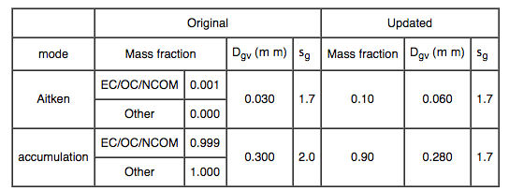
Current CMAQ uses uniform particle size distribution in all emission sectors
Nolte et al., 2015 GMD
However, this uniform setting of particle size distribution from emissions might not fit into all sources
Recent studies indicate that number concentrations in Aitken mode significantly increase due to LTO in LAX, BOS and AMST
Notes:
Mention the difference between v5.0.2 and v5.1
Talk about Elleman and Covert 2010 study
Also mention Nolte et al., 2015 paper

Slide 4
Motivation
PSD of aircraft emissions
nvPM: PEC, vPM: PSO4, POC
Reference | Species | Emission split factor | GMD (nm) | GSD
Petzold et al., 1999 , JGR | Black Carbon, Cruise tail Plume | Figure 2 and Table 2 | 25-35 Aitken 150-160 Accumulation | 1.55-1.87
Kinsey et al., 2010, Atmo. Env. | Total number, Surface Plume | Figure S3 | 10-35 Aitken | 1.2-2.3
Herndon et al., 2008, ES&T | Total number, Surface Plume | Figure 3
Keuken et al., 2015 , Atmos. Env. | Total number, Surface Plume | Figure 9
Wey et al., 2007, JPP | Total number, Surface Plume | Figure H-11 | 15-40 Aitken
Peck et al., 2012 ,JEGTP | Soot and volatile, Surface Plume with dilution | Figure 3 and 8 | 15 Nucleation 35 soot
Onasch et al., 2009, JPP | Soot and volatile, Surface Plume | Figure 8 and 9 | 20 100
Barrett, 2010* |  |  | 5-20 Aitken vPM 40 Aitken nvPM
This study | Total, PSO4, POC, PEC | 91.8 Aitken 8.2 Accumulation | 20 Aitken vPM 40 Aitken nvPM 150 Accumulation | 1.5-1.6
*based on Herndon et al., 2005, AST; Lobo et al., 2007, JPP; Timko et al., 2010, JEGTP
Emission split factor of Aitken : accumulation from aircraft emission = 91.8 : 8.2 %.
How this can impact ambient air PM_{2.5} concentrations near airports from CMAQ simulation?
Notes:
Mention emission split factor
Talk a bit about in different conditions these PSD profiles could be changed
Add some supporting slides of PSD from airc in the end of the ppt

Slide 5
Objectives
Goal
To investigate the changes of particle size distribution (PSD) and chemical composition due to PSD changes from aircraft emissions near major airports
Objectives
  To understand changes of Aitken mode number concentrations and PM_{2.5}
To investigate changes of deposition, heterogeneous chemistry , and partitioning
To determine shifts of PSD and chemical compositions
Impacts
Available surface areas and size of particles which could impact dry and wet deposition, heterogeneous chemistry, partitioning process
Notes:
Talk slightly detail for impacts

Slide 6
Approach
all non-aircraft emissions (background)
AERO_
EMIS.o
Total particle emissions rates
aircraft
ACAERO_EMIS.o
read particle emissions from a specific source (in this study: aircraft emissions) separately
assign different emission split factors and GMD and GSD for different species
These emissions are added back to emissions from all other sources (AERO_EMIS.o)
Notes:
Only AERO_EMIS.F from original source codes was slightly modified

Slide 7
Approach
Blue indicates the difference between background and base scenarios
Red indicates the difference between base and sensitivity scenarios
Base – bkgd : aircraft contribution
Sens – bkgd : aircraft contribution
Sens – bkgd : PSD change in aircraft emissions
nvPM: PEC, vPM: PSO4, POC
annual scenarios
 | Emission split factor | GMD (nm) | GSD | Emission data
Background (bkgd) | EC/OC/NCOM Aitken: 0.1 Accumulation: 99.9 OTHER Aitken: 0 Accumulation: 1 | EC/OC/NCOM Aitken: 30 Accumulation: 300 OTHER Accumulation: 300 | EC/OC/NCOM Aitken: 1.7 Accumulation: 2.0 OTHER Accumulation: 2.0 | All emissions without aircraft emissions
Base (base) | nvPM Aitken: 0.1 Accumulation: 99.9 vPM Aitken: 0.1 Accumulation: 99.9 | nvPM Aitken: 30 Accumulation: 300 vPM Aitken: 30 Accumulation: 300 | nvPM Aitken: 1.7 Accumulation: 2.0 vPM Aitken: 1.7 Accumulation: 2.0 | All emissions and aircraft emissions in separate files
Sensitivity (sens 6) | nvPM Aitken: 91.8 Accumulation: 8.2 vPM Aitken: 91.8 Accumulation: 8.2 | nvPM Aitken: 40 Accumulation: 150 vPM Aitken: 20 Accumulation: 150 | nvPM Aitken: 1.6 Accumulation: 1.87 vPM Aitken: 1.5 Accumulation: 1.87 | All emissions and aircraft emissions in separate files
CMAQ v5.0.2 simulations (CB05_tump with AE06) were cut into two halves of year (Jan 2005- June 2005 with 11days spin up in Dec 2004; and Jul 2005-Dec 2005 with 11 days spin up in Jun 2005)
Post-process for CMAQ outputs have been done into monthly, seasonal (MAM, JJA, SON, DJF), and annual data
Notes:
Mention we are using CMAQv5.0.2
Data showed in this presentation are all annual average

Slide 8
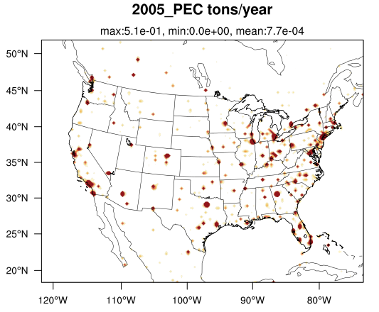

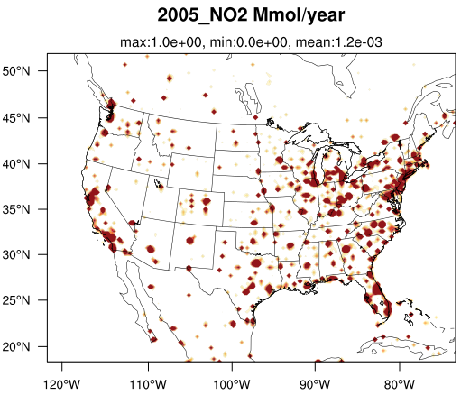

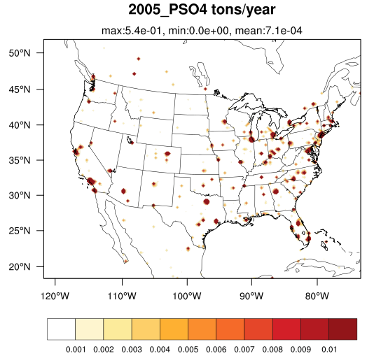
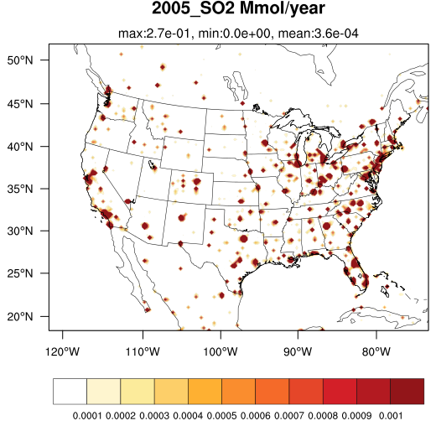
Annual aircraft emission rates in North America
B
A
Only landing and take-off (below 3000 ft) includes climb out, approach, taxi, and idle
Estimated from Aviation Environmental Design Tool (AEDT) based on the aircraft locations
NOx, SO2, VOC, CO + 3 directly emitted particles
Notes:
Slightly talk about AEDT
4426 airports cells in North America
Gas species + 3 aerosol species

Slide 9
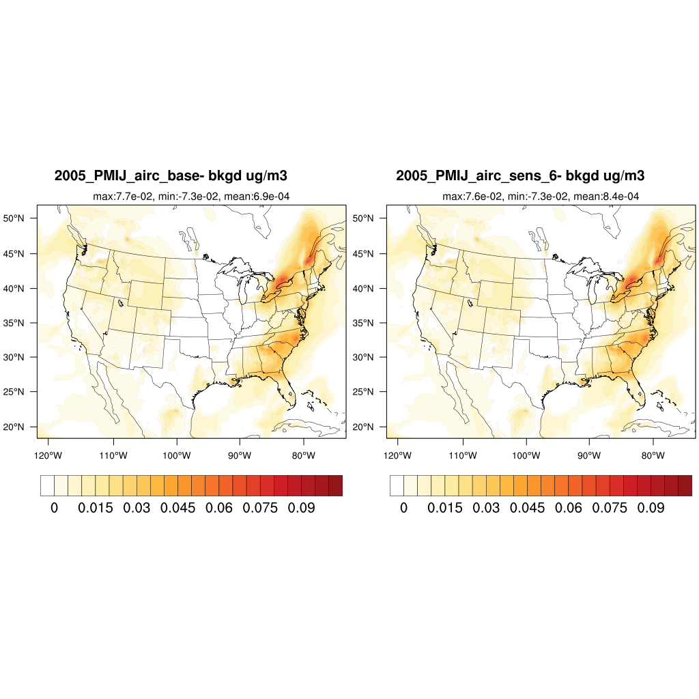
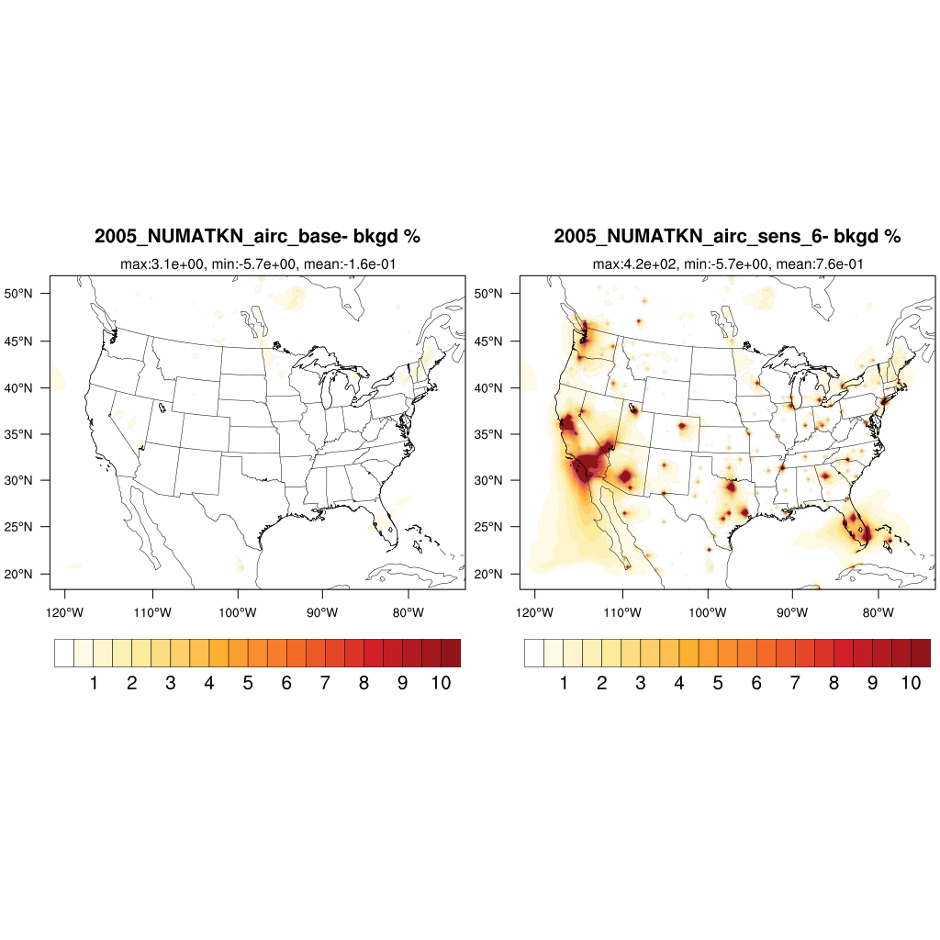
Aircraft emission impacts on ambient air particles
delta PM_{2.5} [ug/m3]
Base-bkgd
Sens-bkgd
delta number concentration in Aitken mode [number/m3]
Base-bkgd
Sens-bkgd

Slide 10
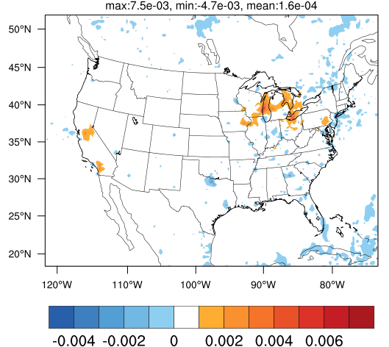
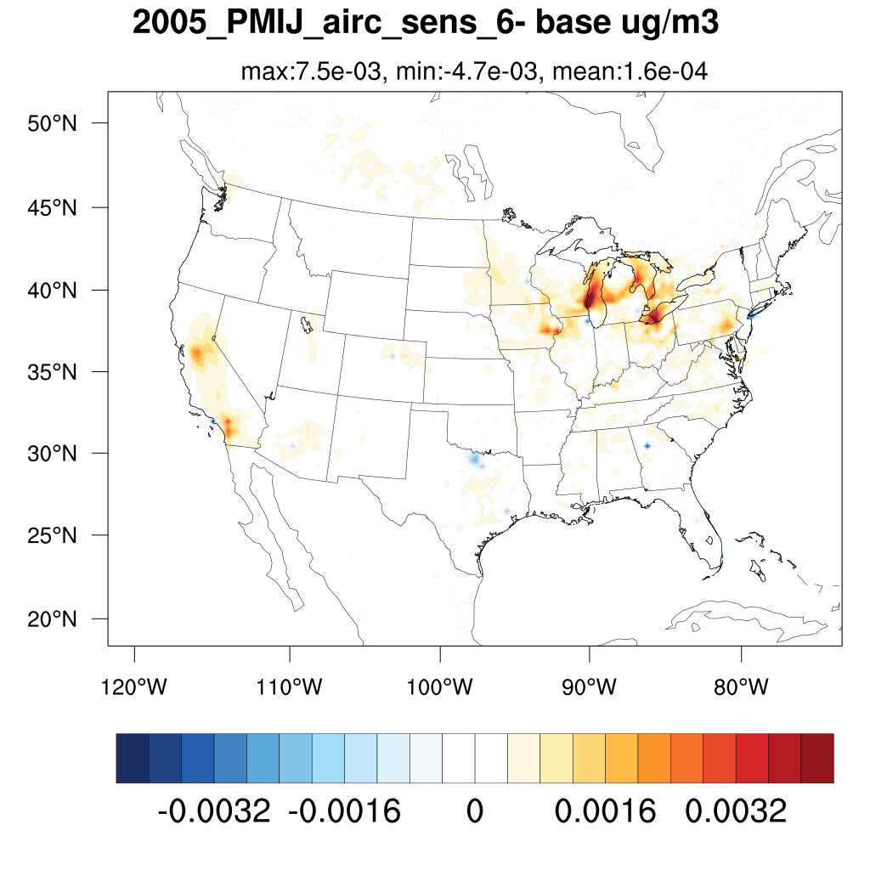
Annual ∆PM_{2.5} and ∆number concentration in Aitken mode 2005 due to PSD change in aircraft emissions
∆ PM_{2.5} [ug/m3]
Aitken mode number concentration sens – base [#/m3]
PM_{2.5} sens – base [ug/m3]
Color bar is non linear here
PM_{2.5} decreases in most major airport cells, and clear plot will be shown later; however, number concentrations in Aitken mode increases in ALL airport cells.
PM_{2.5} increasing is mainly from NO3 and decreasing from SO4
Notes:
Put deposition plots in the end for backup
Do not have time for seasonal variations plots in the end

Slide 11
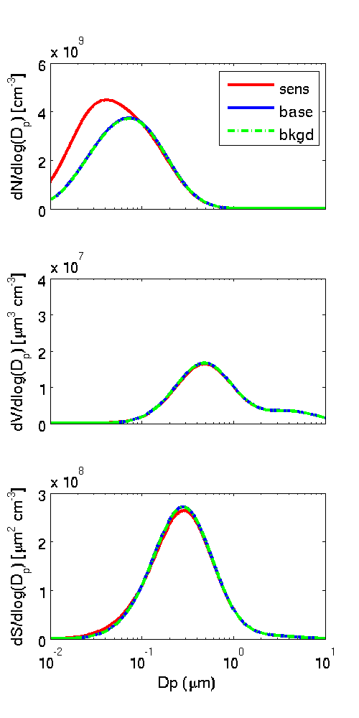
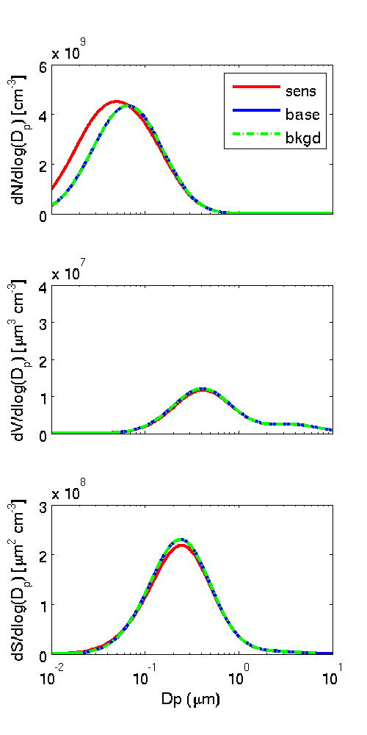
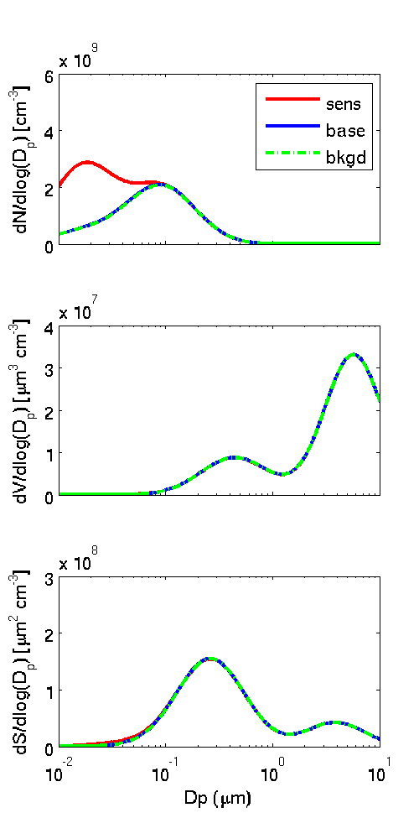
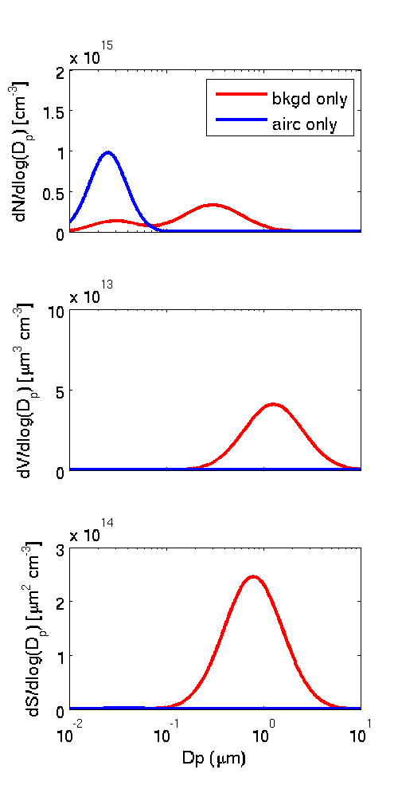
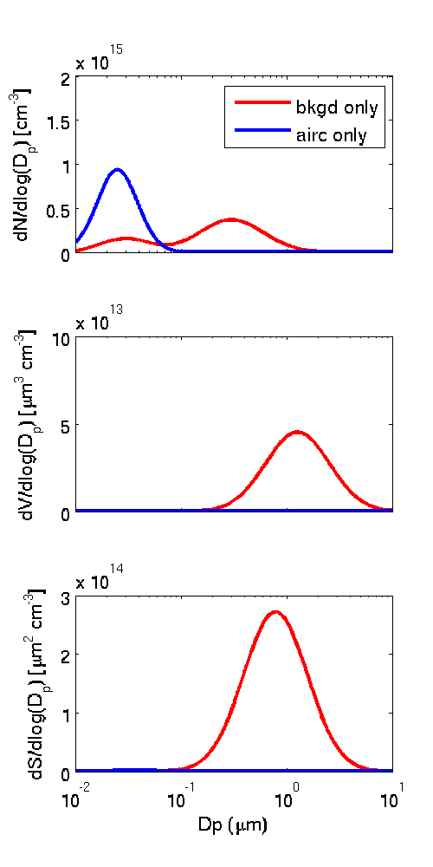
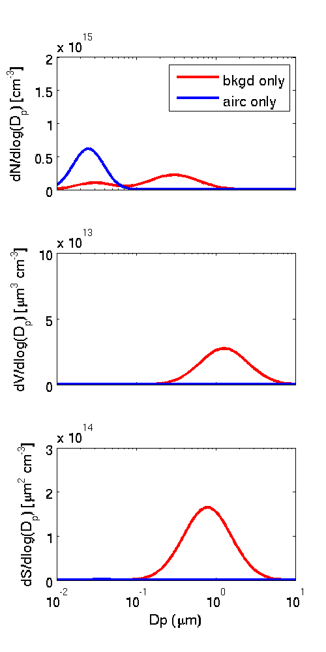
Impacts of PSD change in aircraft emissions on ambient air
Ambient_ATL
Ambient_ORD
Ambient_LAX
H
36 km
36 km
Emis_ATL
Emis_ORD
Emis_LAX
This change increases number concentration in Aitken mode in major airport cells; however, the impacts varies with airports
Notes:
In emission the patterns are similar in all three airports, but differences are seen in ambient air concentrations

Slide 12
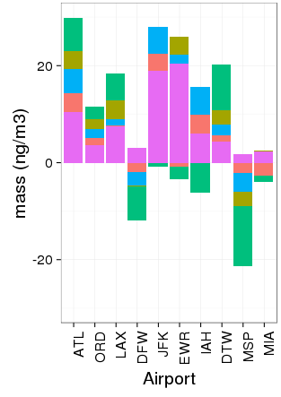
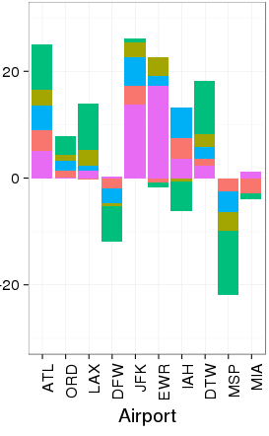
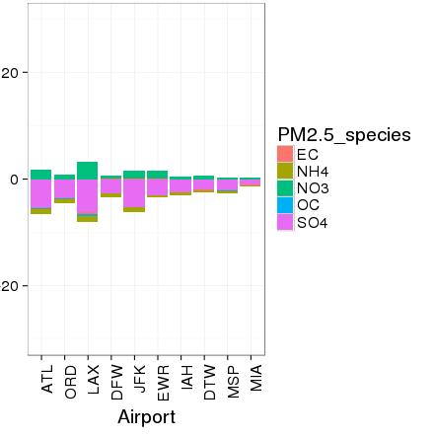
change of chemical composition in ambient air due to PSD change
Base-bkgd
Sens-bkgd
Sens-base
Patterns in ATL, ORD, LAX in base-bkgd is similar to the results in Woody et al., 2011
PSD change causes decrease of SO4 and increase of NO3
Notes:
ANOIJ increase due to increased surface area
Results in base case are similar to the fractions in Woody et al., 2011, 2013
Negative ASOIJ cannot be fully explained, sulfate ratio, nucleation
Positive ANO3IJ partitioning with large surface area

Slide 13
Conclusions
Aircraft contributions of ambient PM_{2.5} mass can be up to ~0.035 ug m⁻³ in airports.
In airport cells, values of PM_{2.5} mass decrease (up to ~25%) and number of number concentration in Aitken mode increase (up to 5x) are due to particle size distribution change from aircraft emissions. However, CONUS PM_{2.5} is slightly increase.
A negative change of SO4 in all top 10 airports is the major species causing PM_{2.5} decrease. However, NO3 increases in all top 10 airports, which is probably due to large amount of NOx emissions during landing and takeoff

Slide 14
Implications and Future work
Recent field measurements indicate PM number concentrations near airports due to LTO can increase 4-5 times which is consistent with the results from our sens scenario (Hudda et al., 2014)
Investigate how particle size distribution change from emission impact chemistry
Apply the new module to understand how the particle size distribution change impacts other emission sectors
Link our research to public health related to ultrafine particles (Hudda et al., 2016)

Slide 15
Acknowledgement
This work is supported by FAA under the Air Transportation Center of Excellence for Alternative Jet Fuels and Environment (AJFE) Cooperative Agreement 13-C-AJFE-UNC
IE UNC, Chapel Hill: Carlie Coats, B. H. Baek, Alejandro Valencia, Shih-Ying Chang
US EPA: Matt Woody

Slide 16
References
Nolte, C. G. and Appel, K. W. and Kelly, J. T. and Bhave, P. V. and Fahey, K. M. and Collett Jr., J. L. and Zhang, L. and Young, J. O., Evaluation of the Community Multiscale Air Quality (CMAQ) model v5.0 against size-resolved measurements of inorganic particle composition across sites in North America, Geo. Mod. Dev., 2015, 8, 2877-2892.
Lobo, P., D. E. Hagen, P. D. Whitefield and D. J. Alofs. "Physical characterization ofaerosol emissions from a commercial gas turbine engine." Journal of Propulsion and Power, 2007, 23, 919-929.
Petzold, A., A. Döpelheuer, C. A. Brock, and F. Schröder, In situ observations and model calculations of black carbon emission by aircraft at cruise altitude, J. Geophys. Res., 1999, 104(D18), 22171–22181
Timko, M. T.; Onasch, T. B.; Northway, M. J.; Jayne, J. T.; Canagaratna, M. R.; Herndon, S. C.; Wood, E. C.; Miake-Lye, R. C.; Knighton, W. B. Gas turbine engine emissions – Part II: Chemical properties of particulate matter. Journal of Engineering for Gas Turbines and Power, 2010, 132, 061505.
Herndon, S.C., Onash, T.B., Frank, B.P., Marr, L.C., Jayne, J.T., Canagaratna, M.R., Grygas, J., Lanni, T., Anderson, B.E., Worsnop, D., and Miake-Lye, R.C. Particulate emissions from in-use commercial aircraft, Aerosol Sci. Tech., 2005, 8, 799-809
Woody, M., Haeng, B., Adelman, Z., Omary, M., Fat, Y., West, J.J., Arunachalam, S., 2011. An assessment of Aviation ’ s contribution to current and future fine particulate matter in the United States. Atmos. Environ. 45, 3424–3433.
Hudda, N., Fruin, S.A., 2016. International Airport Impacts to Air Quality: Size and Related Properties of Large Increases in Ultrafine Particle Number Concentrations. Environ. Sci. Technol. 50, 3362–3370. doi:10.1021/acs.est.5b05313 .
Hudda, N., Gould, T., Hartin, K., Larson, T. V., Fruin, S.A., 2014. Emissions from an international airport increase particle number concentrations 4-fold at 10 km downwind. Environ. Sci. Technol. 48, 6628–6635. doi:10.1021/es5001566

Slide 17
Supplemental Information
Sensitivity analysis
Particle size distribution from aircraft emissions
Sensitivity analysis
Annual speciation spatial variation
Annual PM_{2.5} deposition
Seasonal variation of PM_{2.5} and number concentration in Aitken mode in airport cells
How to plot PSD from aircraft emissions

Slide 18
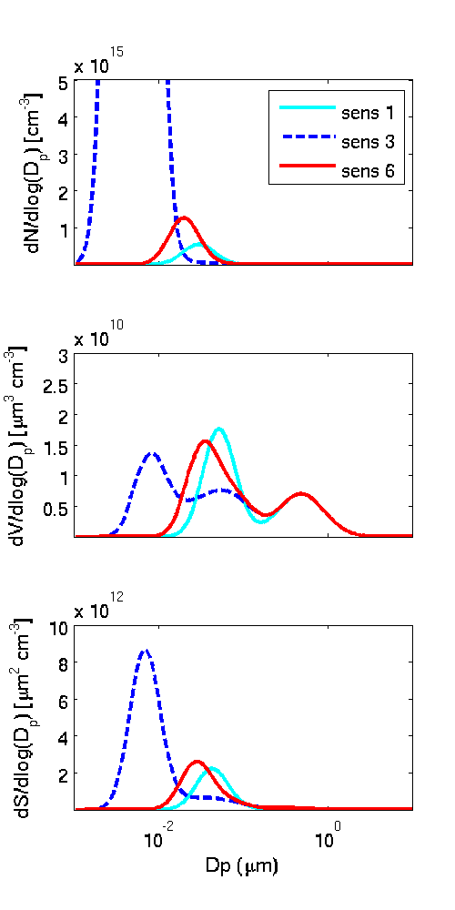
Approach
Red indicates the difference from AC_base (sens_1)
vPM_Ait_20nm (sens_6) is selected
nvPM: PEC vPM: PSO4, POC
sensitivity analysis
 | Emission split factor | GMD (nm) | GSD
AC_base Sens_1 | nvPM Aitken: 91.8 Accumulation: 8.2 vPM Aitken: 91.8 Accumulation: 8.2 | nvPM Aitken: 30 Accumulation: 150 vPM Aitken: 30 Accumulation: 150 | nvPM Aitken: 1.55 Accumulation: 1.87 vPM Aitken: 1.55 Accumulation: 1.87
5050_vPM Sens_2 | nvPM Aitken: 91.8 Accumulation: 8.2 vPM Aitken: 50 Accumulation: 50 | nvPM Aitken: 30 Accumulation: 150 vPM Aitken: 30 Accumulation: 150 | nvPM Aitken: 1.55 Accumulation: 1.87 vPM Aitken: 1.55 Accumulation: 1.87
vPM_Ait_5nm Sens_3 | nvPM Aitken: 91.8 Accumulation: 8.2 vPM Aitken: 91.8 Accumulation: 8.2 | nvPM Aitken: 40 Accumulation: 150 vPM Aitken: 5 Accumulation: 150 | nvPM Aitken: 1.6 Accumulation: 1.87 vPM Aitken: 1.5 Accumulation: 1.87
5050_vPM_Ait_5nm Sens_4 | nvPM Aitken: 91.8 Accumulation: 8.2 vPM Aitken: 50 Accumulation: 50 | nvPM Aitken: 40 Accumulation: 150 vPM Aitken: 5 Accumulation: 150 | nvPM Aitken: 1.6 Accumulation: 1.87 vPM Aitken: 1.5 Accumulation: 1.87
AC_base_NCOM Sens_5 | nvPM Aitken: 91.8 Accumulation: 8.2 vPM Aitken: 91.8 Accumulation: 8.2 | nvPM Aitken: 30 Accumulation: 150 vPM Aitken: 30 Accumulation: 150 | nvPM Aitken: 1.55 Accumulation: 1.87 vPM Aitken: 1.55 Accumulation: 1.87
vPM_Ait_20nm Sens_6 | nvPM Aitken: 91.8 Accumulation: 8.2 vPM Aitken: 91.8 Accumulation: 8.2 | nvPM Aitken: 40 Accumulation: 150 vPM Aitken: 20 Accumulation: 150 | nvPM Aitken: 1.6 Accumulation: 1.87 vPM Aitken: 1.5 Accumulation: 1.87
Notes:
Sens 2 was used to see how different ESF of vPM impact PMIJ results are normal
Sens 3 and 4, different GMD of vPM, however, this lead a small GMD with large variations. The particle size distribution might have two modals, one in nucleation regime and one close to accumulation mode. CMAQ cannot handle large portion of emitted particles in this small particle size.
Sens_5 increases the uncertainties of CMAQ, we think this could be important and will investigate this in future work

Slide 19
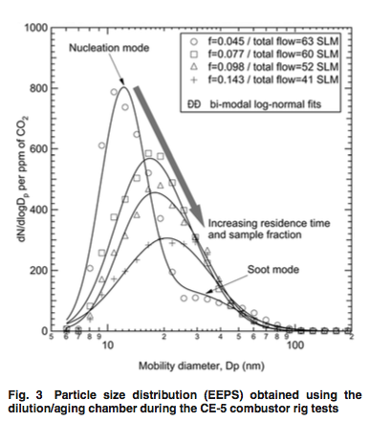
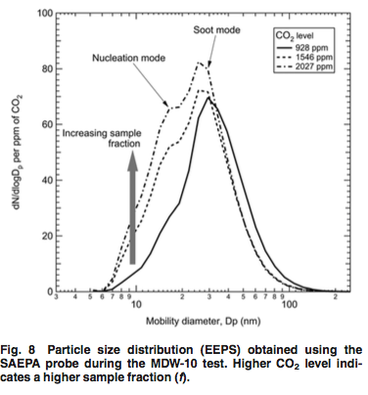
Particle size distribution from aircraft emissions
Peck et al., 2012 JEGTP
GMD of nvPM ~ 35nm and vPM ~15nm

Slide 20
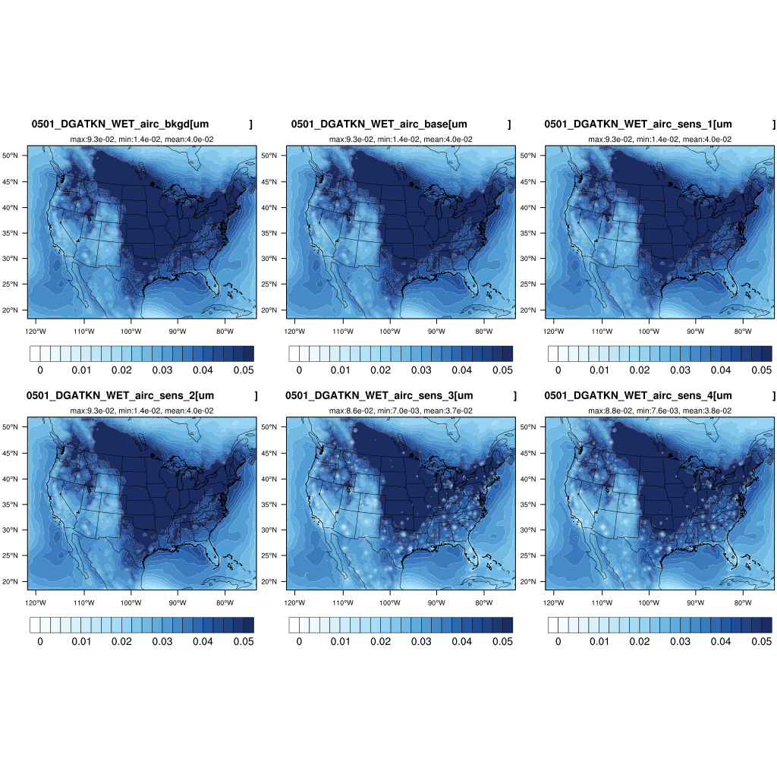
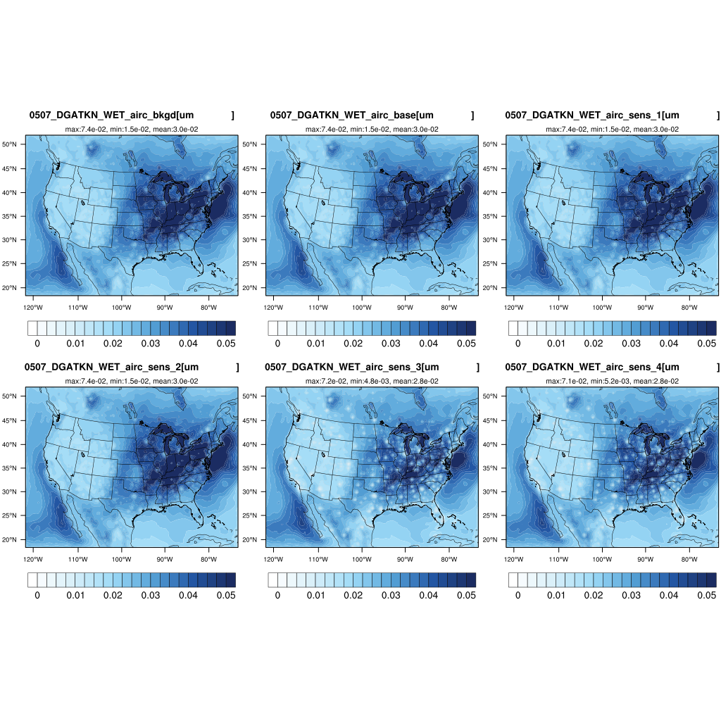
Sen_3 and Sen_4 GMD
winter
summer

Slide 21
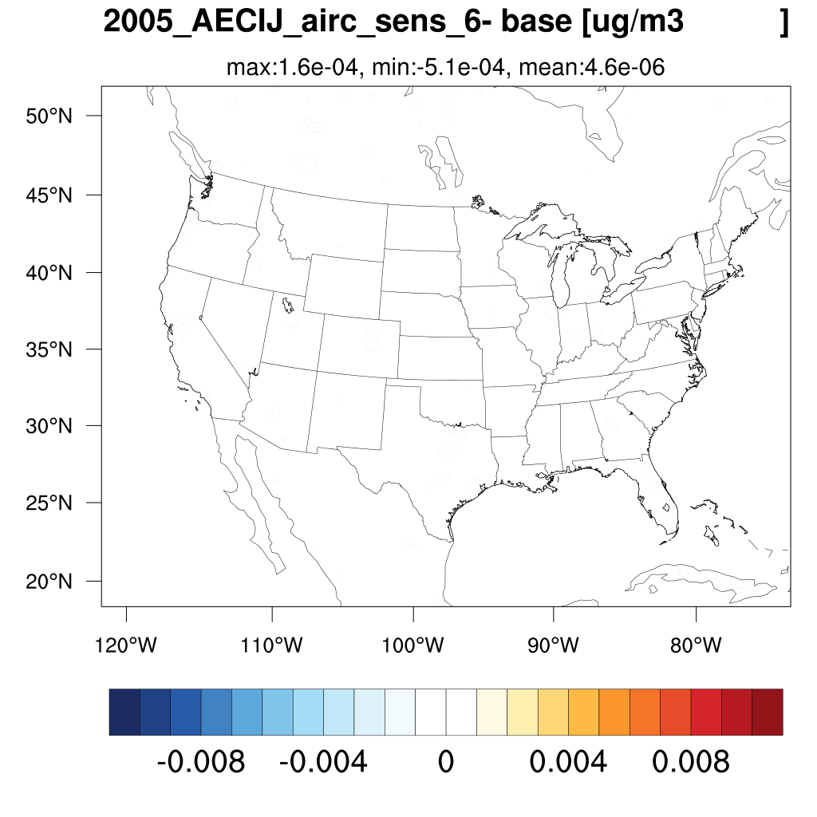
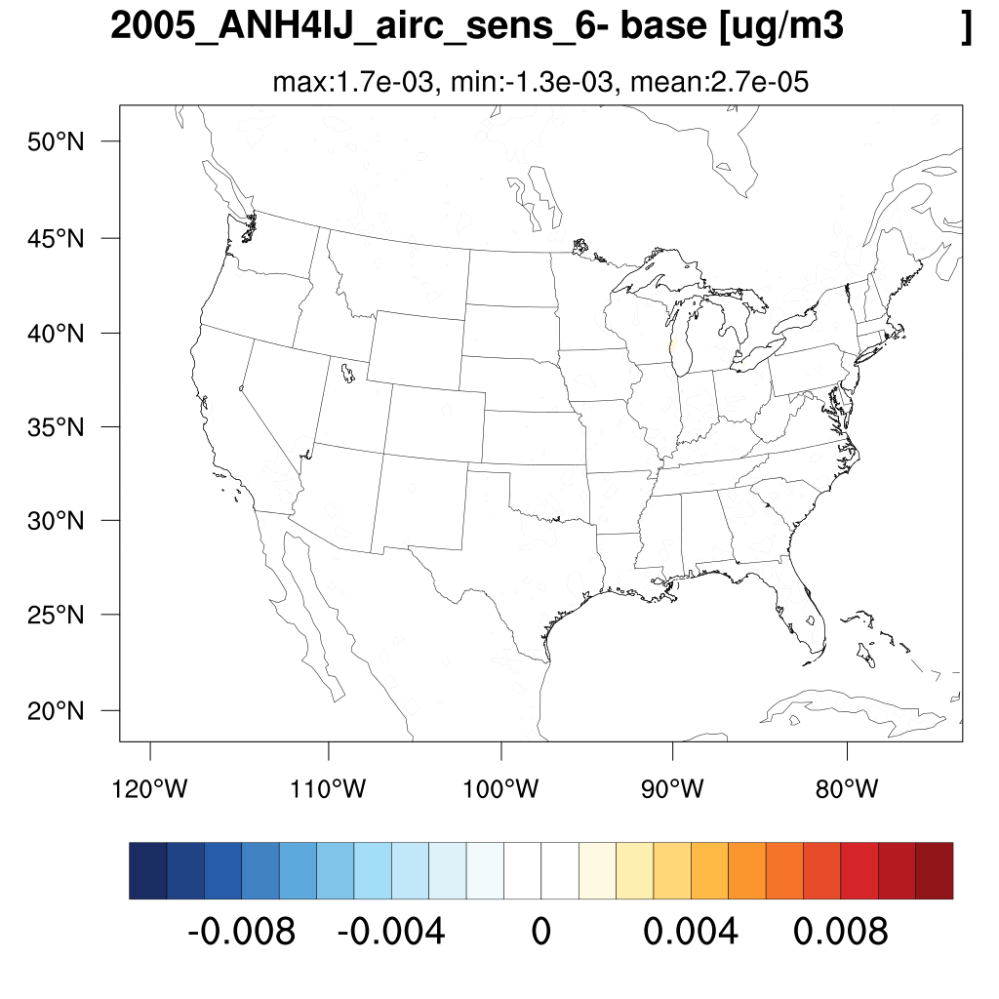
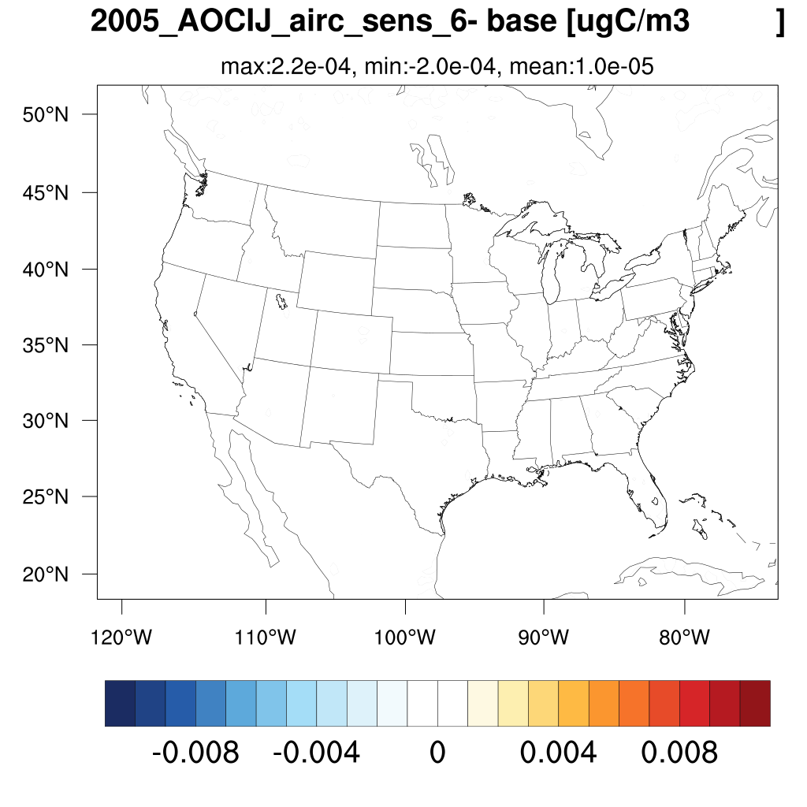


Annual speciation spatial variation ∆mass
Notes:
Color bar

Slide 22
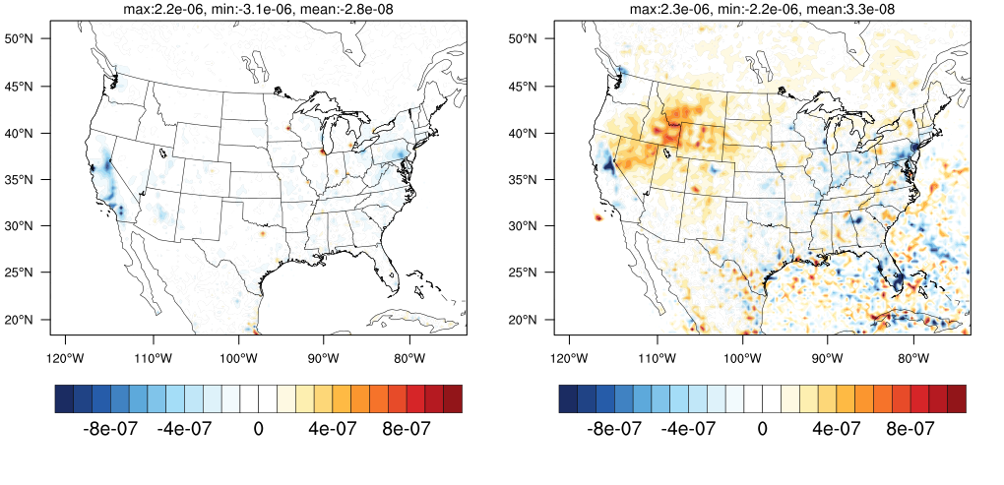
Annual ∆PM_{2.5} deposition
∆PM_{2.5} dry deposition kg/ha
∆PM_{2.5} wet deposition kg/ha
Notes:
Color bar

Slide 23
Seasonal ∆PM_{2.5}
spring
summer
fall
winter
Notes:
Color bar

Slide 24
Seasonal number concentration in Aitken mode
spring
summer
fall
winter
Notes:
Might want to change to percent

Slide 25
How to plot PSD from aircraft emissions
Cut diameter from 10 to 10000 nm into 1000 small segments (dx) and to assign a diameter (dp) for each dx based on a log-normal distribution with GMD and GSD.
In each dx, number concentration is calculated based on equation 1 in Binkowski and Roselle (2003, JGR). Built on this, surface (dp²) and volume concentrations (dp³) are calculated with an assumption of spherical aerosols.
GMD and GSD in the AERO_EMIS and ACAERO_EMIS modules are directly used.
Unit in emission files for particle is g/s, this number was divided by the cell volume and multiplied by time (year) to convert the unit to µg m-3.
This mass concentration was then converted to number concentrations using equation 7b in Binkowski and Roselle (2003).

Slide 26
Percentage of grid with percent difference between two scenarios higher/lower than a criteria
base - bkgd |  | CONUS |  | airport_US
 | criteria | > criteria | < - criteria | > criteria | < - criteria
PM2.5 | 1% | 0.80% | 0.32% | 0.00% | 0.00%
NUMATKN | 10% | 0.00% | 0.00% | 0.00% | 0.00%
SRFATKN | 1% | 2.79% | 5.66% | 0.86% | 5.22%
NO3 | 1% | 5.73% | 7.87% | 1.94% | 1.91%
SO4 | 1% | 0.02% | 0.00% | 0.08% | 0.00%
sens - bkgd |  | CONUS |  | airport_US
 | critiera | > criteria | < - criteria | > criteria | < - criteria
PM2.5 | 1% | 0.80% | 0.31% | 0.00% | 0.00%
NUMATKN | 10% | 0.94% | 0.00% | 3.02% | 0.00%
SRFATKN | 1% | 23.83% | 3.09% | 19.28% | 1.00%
NO3 | 1% | 5.88% | 7.83% | 2.02% | 1.89%
SO4 | 1% | 0.02% | 0.00% | 0.08% | 0.00%
sens - base |  | CONUS |  | airport_US
 | criteria | > criteria | < - criteria | > criteria | < - criteria
PM2.5 | 0.01% | 4.04% | 0.17% | 7.49% | 0.65%
NUMATKN | 10.00% | 0.97% | 0.00% | 3.12% | 0.00%
SRFATKN | 0.10% | 83.38% | 0.10% | 97.55% | 0.03%
NO3 | 0.01% | 49.53% | 1.48% | 60.81% | 1.43%
SO4 | 0.01% | 0.16% | 3.41% | 0.11% | 10.21%

Slide 27
Summary table for top 10 airports
 | PM_{2.5} ug/m3 | NUMATKN | SRFATKN | DRYDEP kg/ha | WETDEP kg/ha | Total DEP kg/ha | NUCLE RATE
 | sens-base | sens-base | sens-base | sens-base | sens-base | sens-base | (sens-base)/base
ATL | -0.0047 | 1.2E+09 | 1.9E-06 | 2.7E-07 | -2.0E-06 | -1.7E-06 | -0.0160
ORD | -0.0036 | 7.5E+08 | 1.1E-06 | 2.2E-06 | -3.8E-07 | 1.9E-06 | 0.0024
LAX | -0.0045 | 1.6E+09 | 2.5E-06 | 1.8E-07 | -2.7E-07 | -9.3E-08 | -0.1943
DFW | -0.0022 | 7.1E+08 | 1.1E-06 | 8.9E-07 | -1.9E-07 | 7.0E-07 | 0.0001
JFK | -0.0041 | 1.2E+09 | 1.7E-06 | 3.5E-07 | -9.1E-07 | -5.6E-07 | -0.0036
EWR | -0.0014 | 5.0E+08 | 8.2E-07 | 1.5E-07 | -2.1E-06 | -1.9E-06 | -0.0004
IAH | -0.0022 | 5.2E+08 | 6.9E-07 | 3.2E-07 | -1.1E-06 | -7.4E-07 | -0.0220
DTW | -0.0017 | 6.4E+08 | 1.1E-06 | 8.3E-07 | -2.1E-07 | 6.2E-07 | 0.0070
MSP | -0.0022 | 4.2E+08 | 7.1E-07 | 1.7E-06 | -1.0E-06 | 6.2E-07 | 0.0030
MIA | -0.0010 | 4.0E+08 | 5.0E-07 | 3.9E-08 | -1.0E-06 | -1.0E-06 | 0.0102
CONUS | 0.0002 | 5.3E+06 | 2.2E-08 | -2.8E-08 | 3.2E-08 | 4.0E-09
Reasons of decreased PM mass concentrations are hypothesized to be correlated to surface change or particle size change
Notes:
Smaller particles (ultrafine particles) increase PM dry deposition and decrease wet deposition.
Increased surface area enhances partitioning processes and slightly impact nucleation formation.

Slide 28
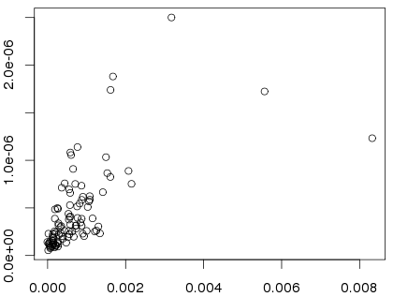
Regressions of ∆PM_{2.5} and ∆surface concentration in Aitken mode due to PSD change
delta = sens - base
R2 = 0.54
R2 = 0.40
Delta NO3 mass concentration [ug/m3]
Top 100 airport cells in North American
Delta number and surface concentrations in Aitken mdoe are negatively correlated to delta PM_{2.5}, especially in major airport
Deposition and SIA formation could be important, but not fully explain negative SO4
Notes:
Deposition
Chemistry
Partitioning coefficient

Slide 29
Summary table for top 10 airports sens - base
 | ANH4I | ANH4J | ANO3I | ANO3J | ASO4I | ASO4J | NUMI | NUMJ | SRFI | SRFJ
 | ug m⁻³ |  |  |  |  |  | # m⁻³ |  | m⁻² m⁻³
ATL | 0.0051 | -0.0062 | 0.0071 | -0.0053 | 0.0010 | -0.0068 | 1.36E+09 | -1.92E+07 | 2.06E-06 | -3.48E-07
ORD | 0.0015 | -0.0024 | 0.0024 | -0.0016 | 0.0004 | -0.0041 | 8.17E+08 | -1.07E+07 | 1.23E-06 | -1.73E-07
LAX | 0.0068 | -0.0081 | 0.0165 | -0.0133 | 0.0017 | -0.0080 | 1.69E+09 | -2.15E+07 | 2.60E-06 | -4.33E-07
DFW | 0.0006 | -0.0013 | 0.0023 | -0.0016 | 0.0008 | -0.0038 | 7.89E+08 | -1.07E+07 | 1.18E-06 | -1.57E-07
JFK | 0.0049 | -0.0059 | 0.0052 | -0.0035 | 0.0013 | -0.0069 | 1.28E+09 | -1.55E+07 | 1.85E-06 | -2.74E-07
EWR | 0.0040 | -0.0043 | 0.0037 | -0.0020 | 0.0007 | -0.0040 | 5.35E+08 | -6.55E+06 | 8.81E-07 | -1.46E-07
IAH | 0.0006 | -0.0012 | 0.0016 | -0.0010 | 0.0006 | -0.0033 | 5.80E+08 | -7.11E+06 | 7.61E-07 | -1.09E-07
DTW | 0.0026 | -0.0030 | 0.0041 | -0.0035 | 0.0010 | -0.0031 | 7.08E+08 | -9.48E+06 | 1.16E-06 | -1.69E-07
MSP | 0.0015 | -0.0020 | 0.0010 | -0.0007 | 0.0004 | -0.0024 | 4.54E+08 | -7.15E+06 | 7.58E-07 | -1.26E-07
MIA | 0.0015 | -0.0017 | 0.0006 | -0.0003 | 0.0011 | -0.0023 | 4.27E+08 | -4.75E+06 | 5.21E-07 | -8.24E-08
CONUS | 0.0002 | -0.0002 | 0.0004 | -0.0003 | 0.0002 | -0.0002 | 5.57E+06 | -1.11E+05 | 2.32E-08 | -4.22E-09
Mass concentrations increased in Aitken mode in all species, even there is no NH4 and NO3 emissions
Mass concentrations increased in accumulation mode in all species, due to available surface decrease and particle size distribution change in emissions

