Slide 1
Impacts of WRF lightning assimilation on offline CMAQ simulations
Nick Heath, Jon Pleim, Rob Gilliam, Daiwen Kang, Matt Woody, and Wyat Appel
Computational Exposure Division
National Exposure Research Laboratory
Office of Research and Development
CMAS Conference
October 2016

Slide 2
CMAQ is used in many retrospective applications
Atmospheric chemistry research
Case studies
Regulatory applications (e.g., emissions control simulations)
Accurate meteorological data is important for all air quality model applications

Slide 3
Four-dimensional data assimilation improves meteorological model
Used to “nudge” model values toward observations and/or analyses
Nudges temperature, humidity, and horizontal winds
Computationally efficient way to keep model close to reality
Deep convection still poorly simulated in retrospective runs, especially during the warm season

Slide 4
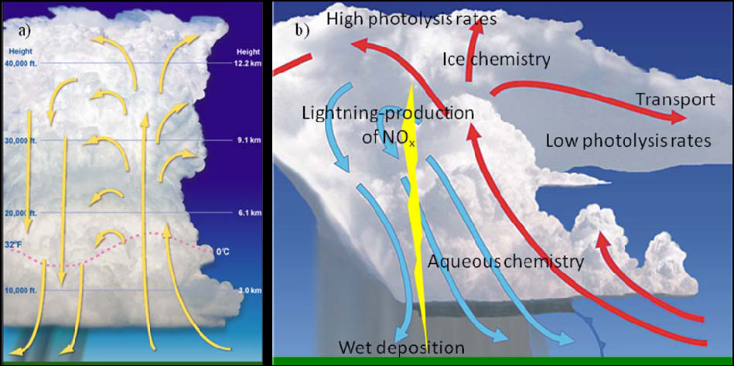
Deep convection important to air quality
Image courtesy of NCAR DC3 experiment
https://www2.acom.ucar.edu/dc3

Slide 5
WRF Lightning Assimilation in Kain-Fritsch
Use lightning data from the National Lightning Detection Network (NLDN)
Simple, computationally efficient approach: (builds off of Mansell et al. 2007)
Force deep convection where lightning is observed
Only allow shallow clouds where it is not
Is lightning present?
YES
Force thunderstorm
NO
Only allow shallow clouds

Slide 6
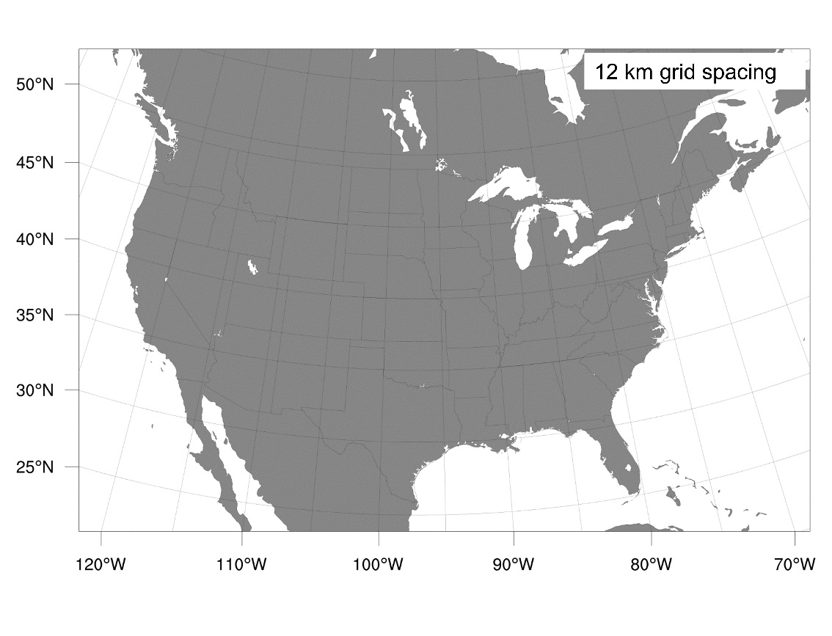
WRF Simulations for July 2011
WRFv3.8
CTRL= no lightning assimilation
LTGA= lightning assimilation
472 x 312 grid points
35 vertical layers
Kain-Fritsch cumulus scheme
ACM2 PBL
PX-LSM w/ indirect surface nudging
Morrison cloud microphysics
FDDA above the PBL
1 h output

Slide 7
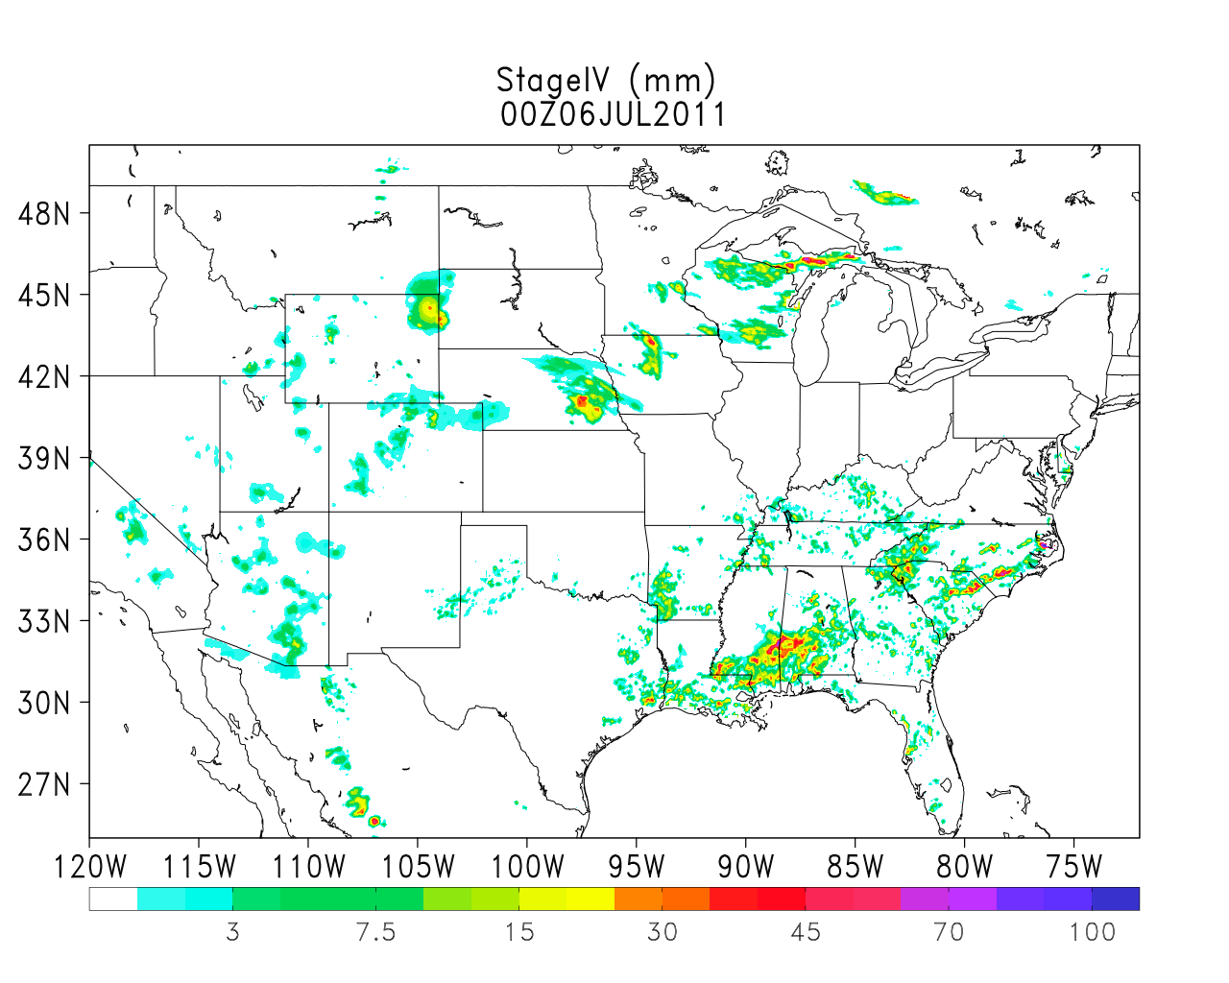
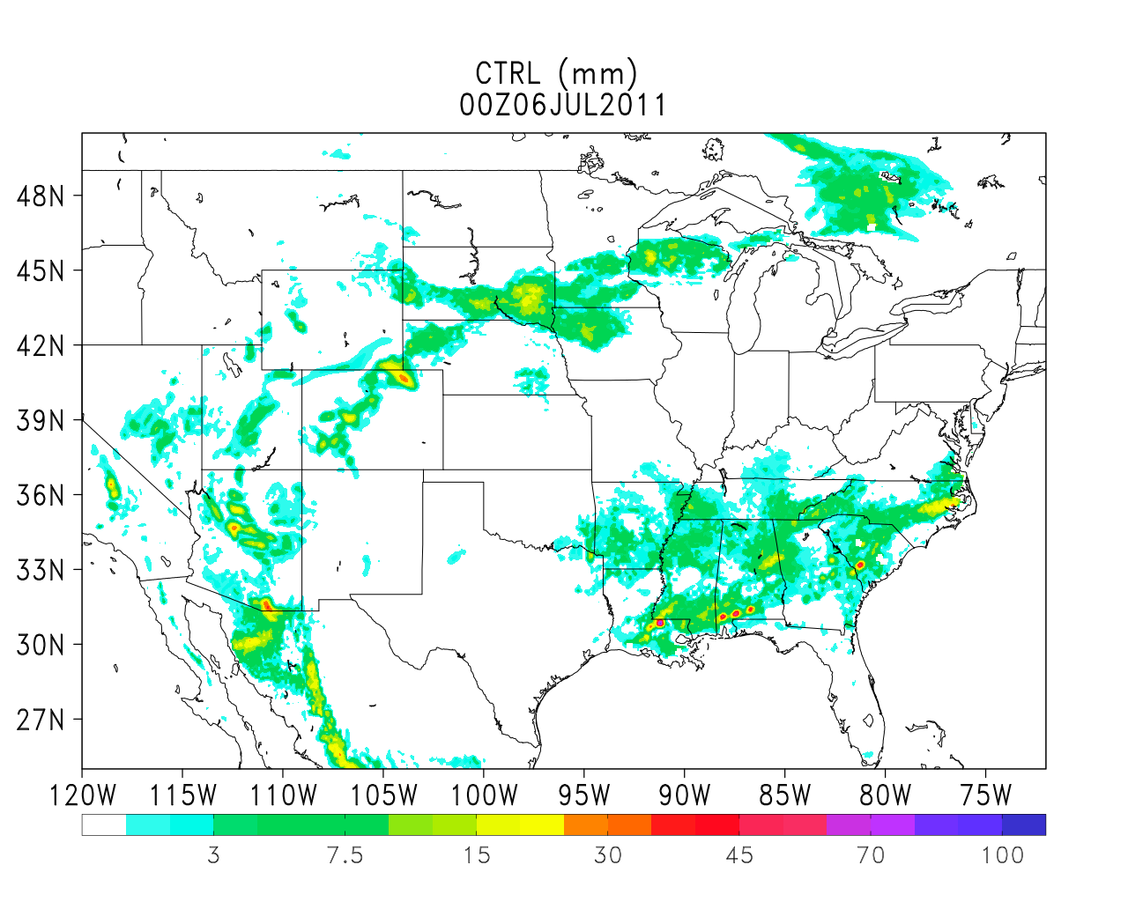
Snapshot of 6-h accumulated rainfall (mm)
00 UTC 6 July 2011
Stage-IV Observations
CTRL
(mm)

Slide 8
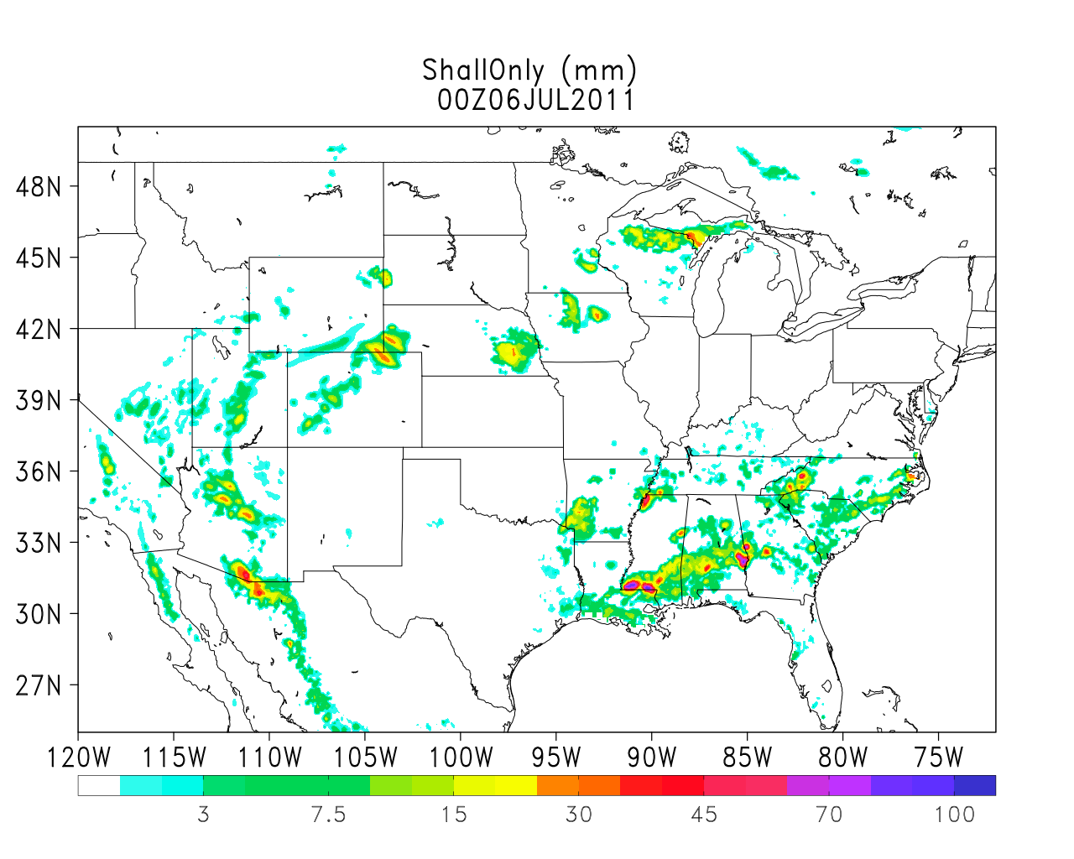
Snapshot of 6-h accumulated rainfall (mm)
00 UTC 6 July 2011
Stage-IV Observations
Lightning Assimilation
(mm)

Slide 9
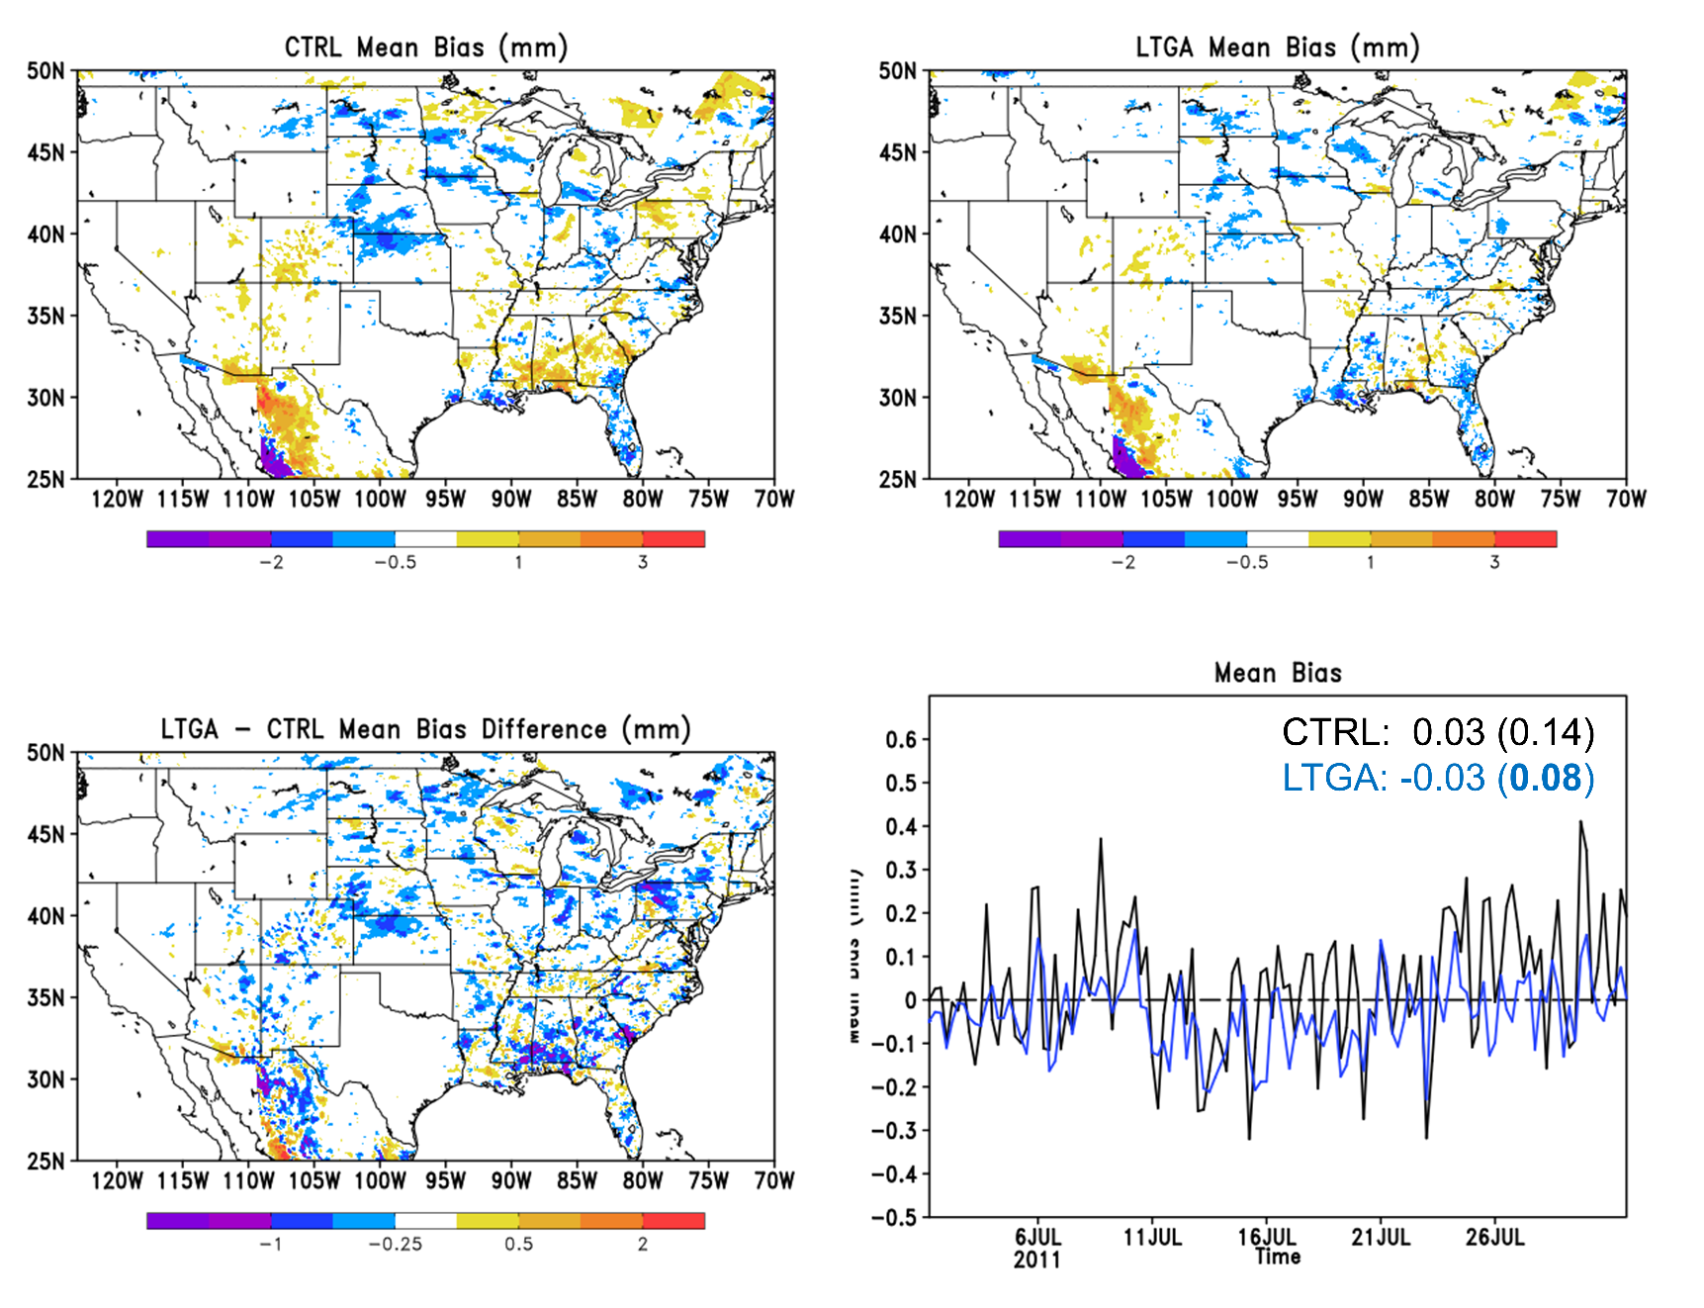
Monthly-averaged comparisons with stage-IV rainfall observations (July 2011)
CTRL
LTGA
Mean Bias in
6-h accumulation
(mm)
(mm)
Domain-Averaged
LTGA - CTRL
Mean Bias (mm)
(mm)

Slide 10
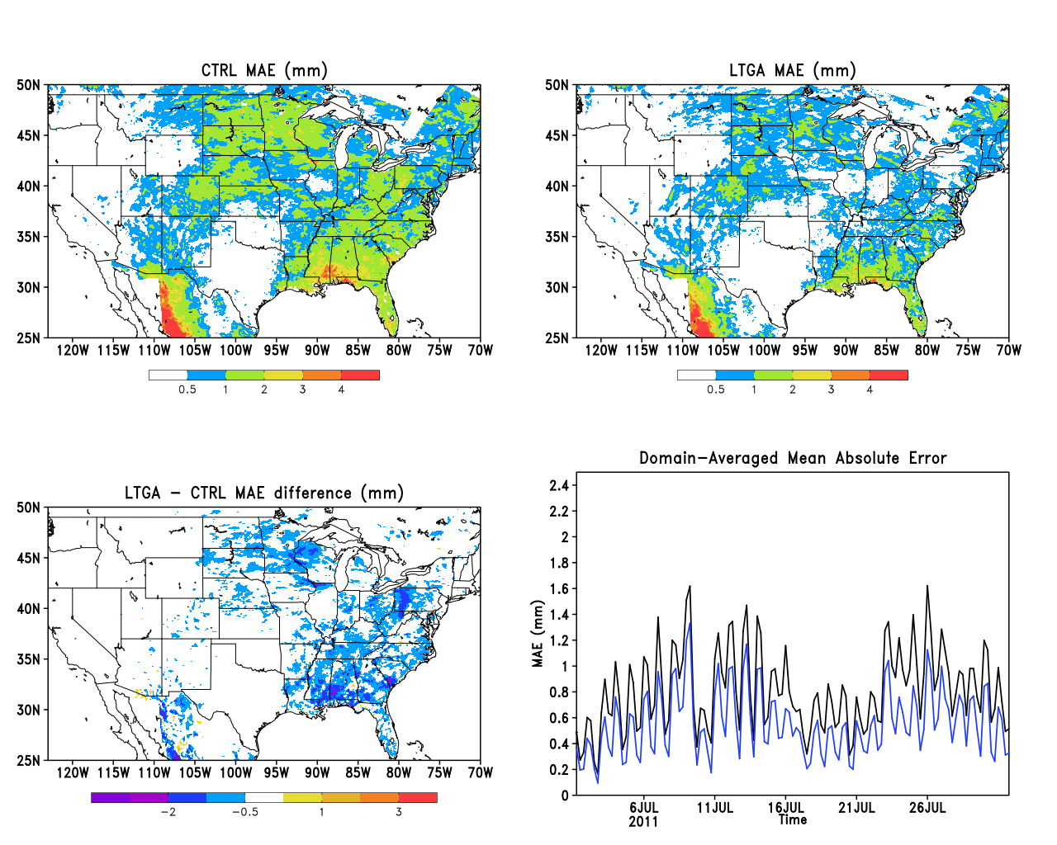
Monthly-averaged comparisons with stage-IV rainfall observations (July 2011)
CTRL
LTGA
Mean Absolute Error
6-h accumulation
(mm)
(mm)
Domain-Averaged
LTGA - CTRL
CTRL: 0.81
LTGA: 0.56
Large improvements over eastern U.S.
MAE (mm)
(mm)

Slide 11
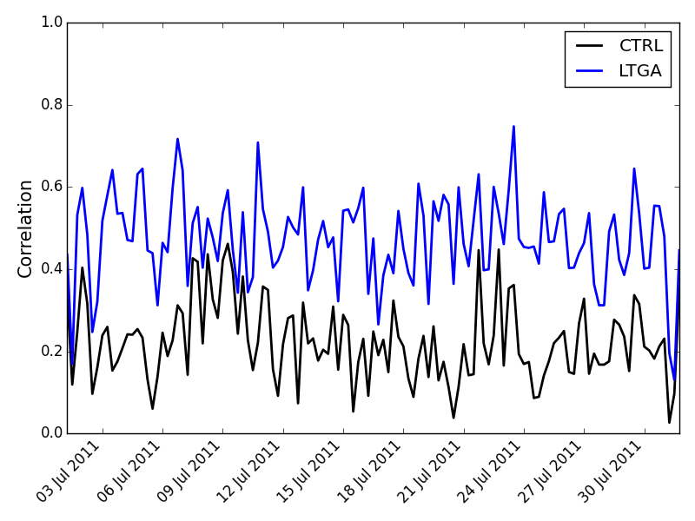
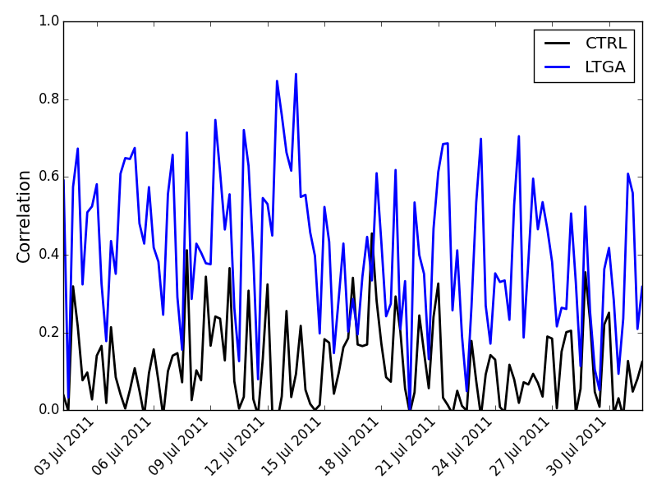
Major improvements in spatial correlation
July 2011
Spatial Correlation
Full Domain
Southeast U.S.
0.22
0.47
0.11
0.41

Slide 12
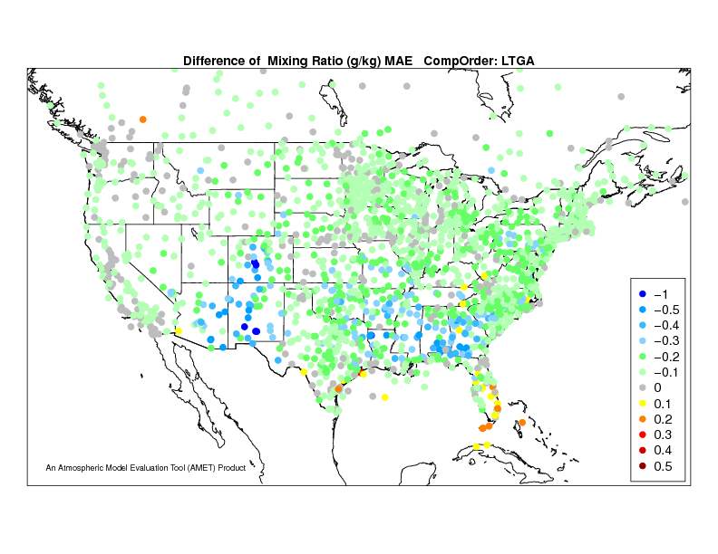
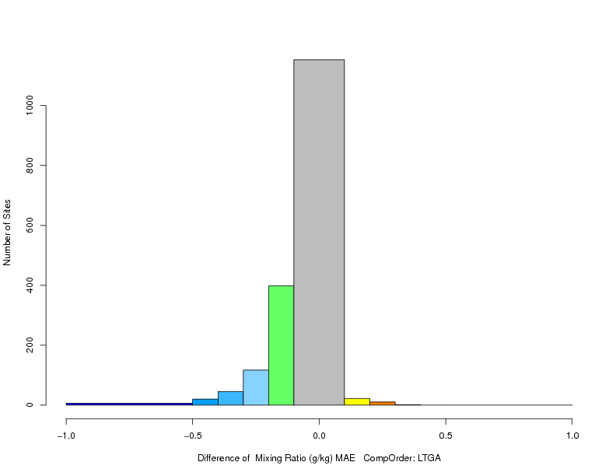
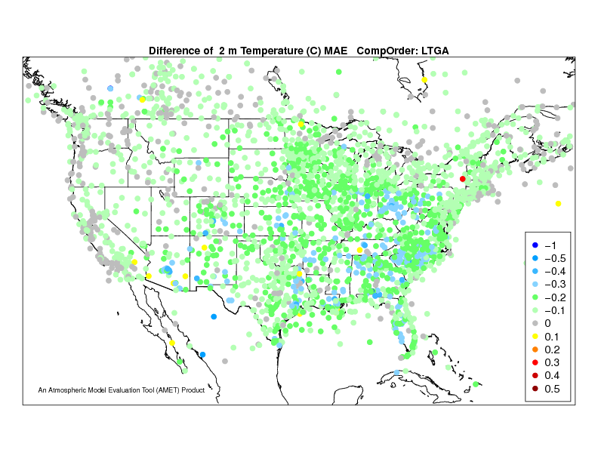
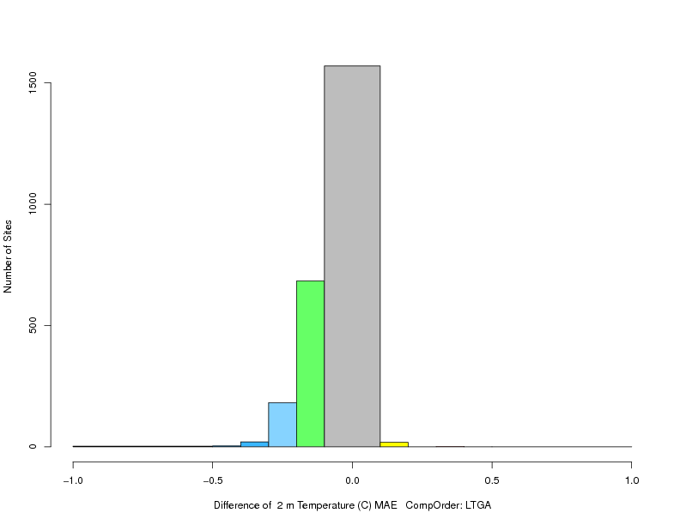
Worse MAE
July 2011
Monthly Average
LTGA - CTRL
82% of sites improved
Improved MAE
Number of Sites
0 200 400 600 800 1000
Difference in 2-m Mixing Ratio MAE
Worse MAE
-1.0
-0.5
0
0.5
1.0
Mixing Ratio (g/kg)
LTGA - CTRL
Difference in 2-m Temperature MAE
Improved MAE
82% of sites improved
Number of Sites
0 500 1000 1500
-1.0
-0.5
0
0.5
1.0
Temperature (K)

Slide 13
CMAQ Simulations
CMAQv5.1: CMAQ-CTRL and CMAQ-LTGA
Carbon-Bond 05 gas phase chemical mechanism
Inorganic aerosol partitioning based on ISORROPIA II
2-product based semi-volatile organic aerosol partitioning
NEI 2011 Emissions
Biogenic emissions from BEISv3.61 with BELDv4 vegetation
Evaluation:
Ozone, PM_{2.5}, and wet deposition of Sulfate, Nitrate, and Ammonium

Slide 14
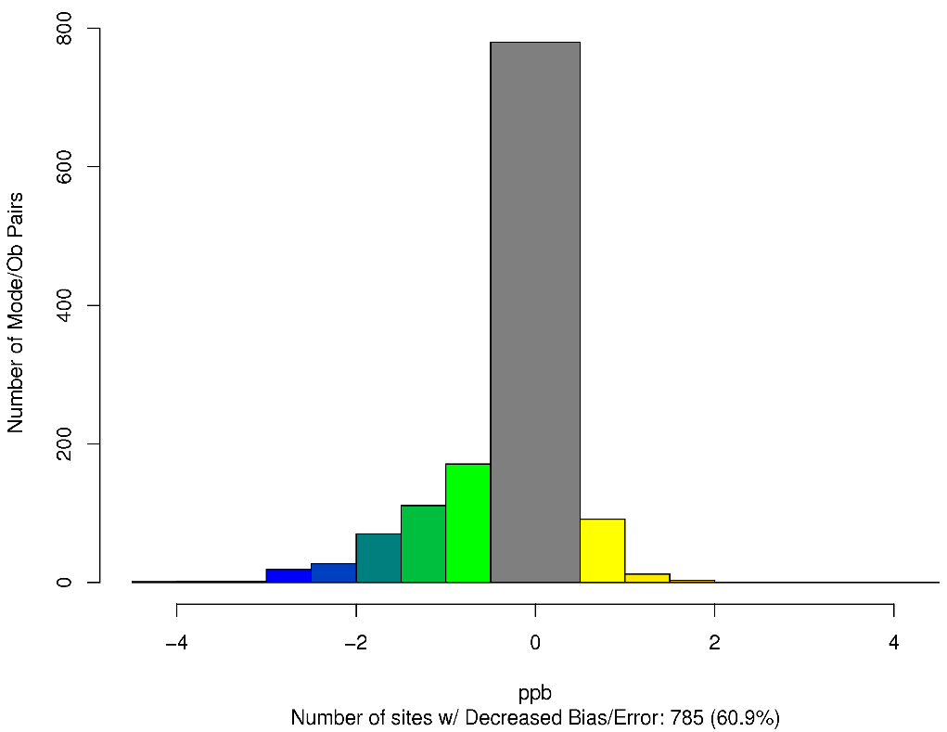
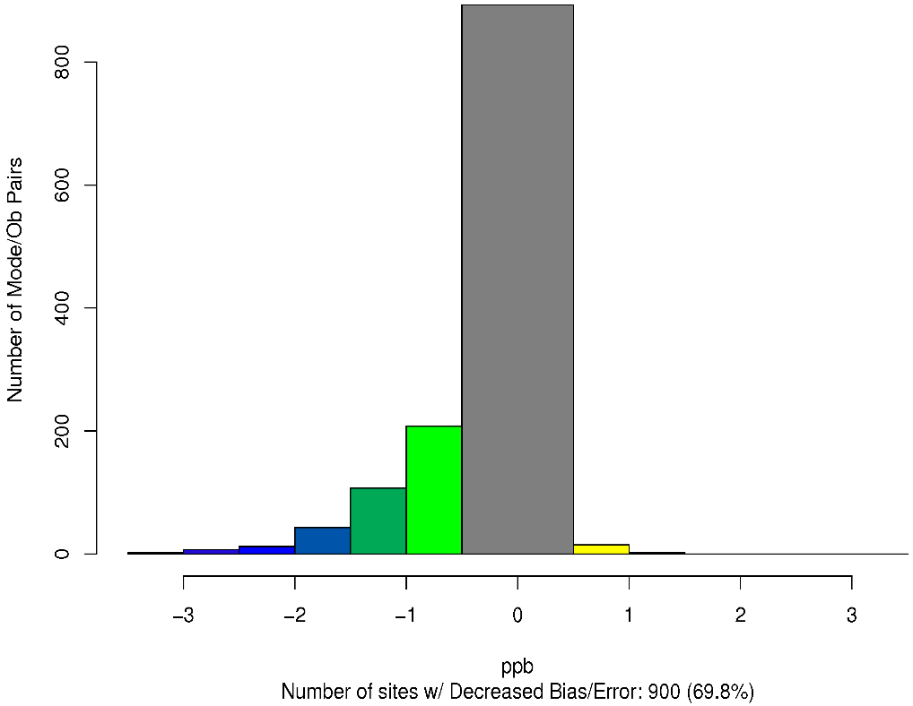
Worse Bias
LTGA – CTRL Ozone Bias Difference
July 2011
Hourly Ozone
Worse Bias
61% of sites improved
Improved Bias
Improved Bias
Worse MAE
LTGA – CTRL Ozone Error Difference
Worse Error
70% of sites improved
Improved MAE
Improved Error

Slide 15
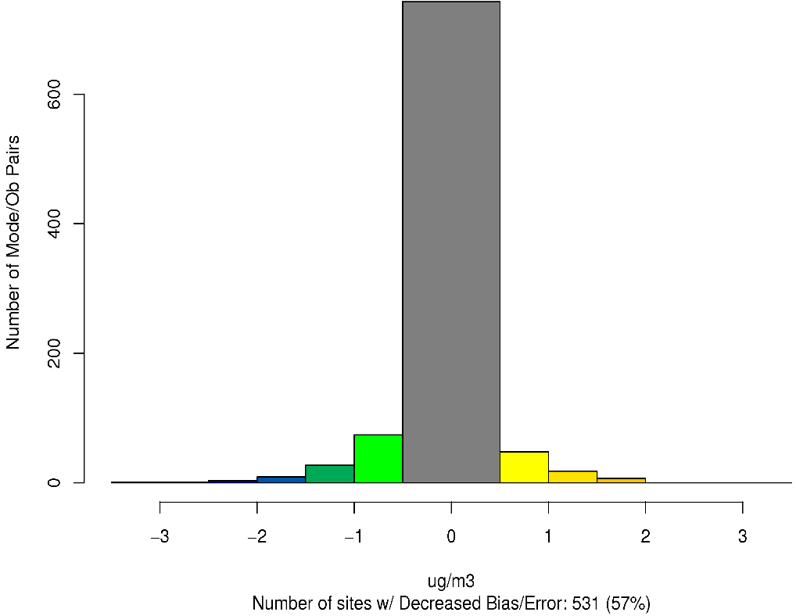
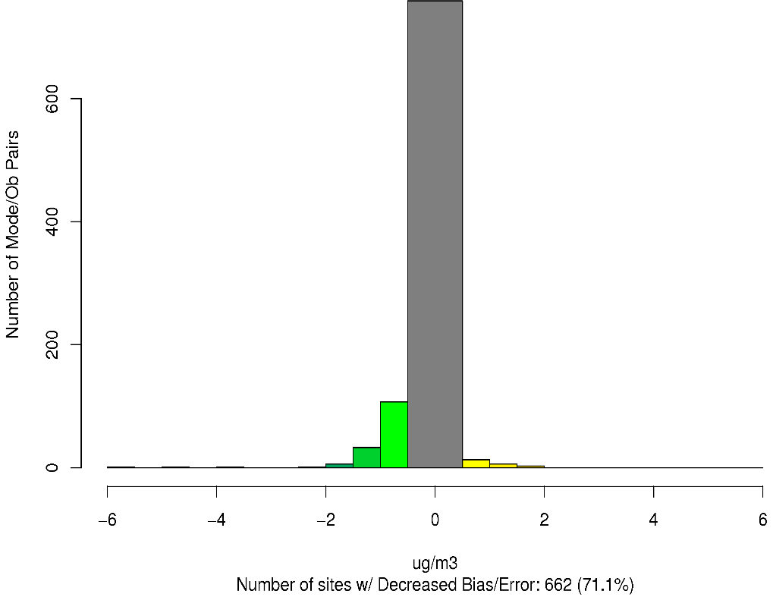
Worse Bias
LTGA – CTRL PM_{2.5} Bias Difference
July 2011
PM_{2.5}
Worse Bias
57% of sites improved
Improved Bias
Improved Bias
Worse MAE
LTGA – CTRL PM_{2.5} Error Difference
Worse Error
71% of sites improved
Improved MAE
Improved Error

Slide 16
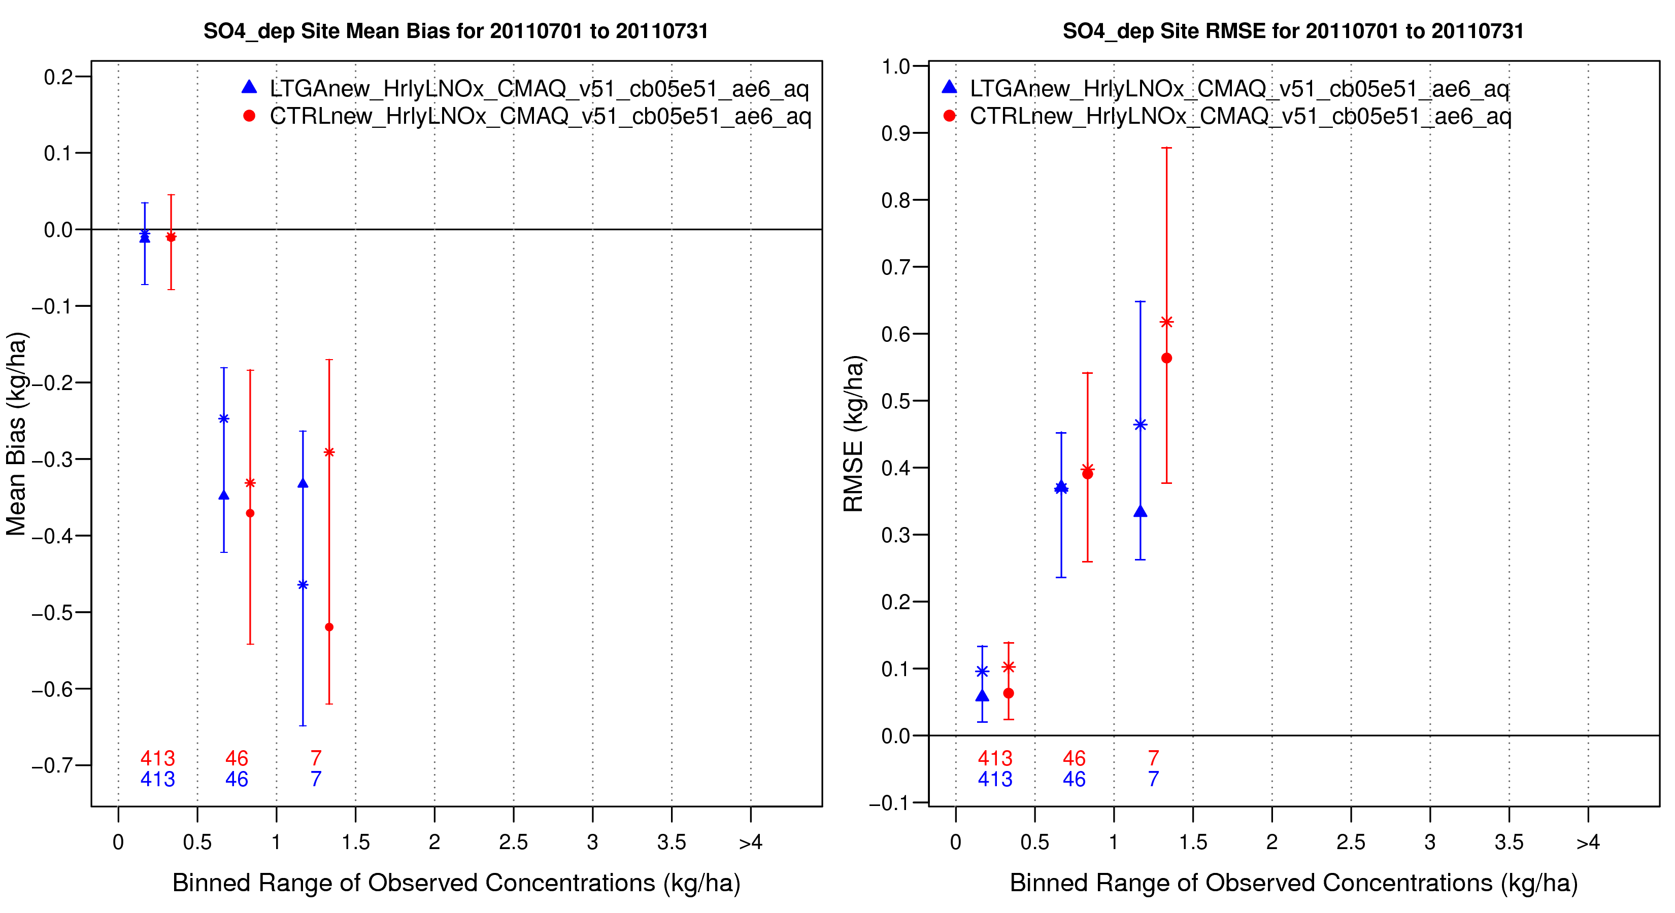
Sulfate Wet Deposition (July 2011)
Mean Bias
RMSE
LTGA
CTRL

Slide 17
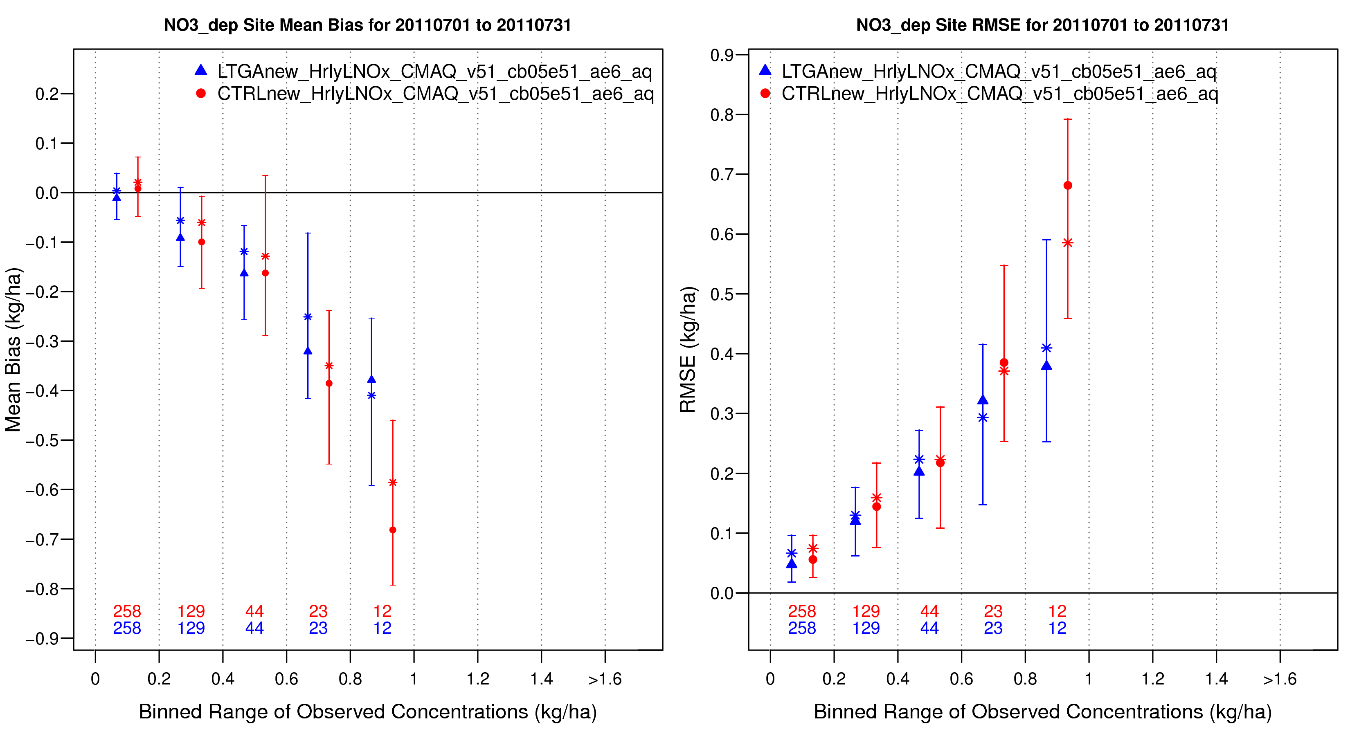
Nitrate Wet Deposition (July 2011)
Mean Bias
RMSE
LTGA
CTRL

Slide 18
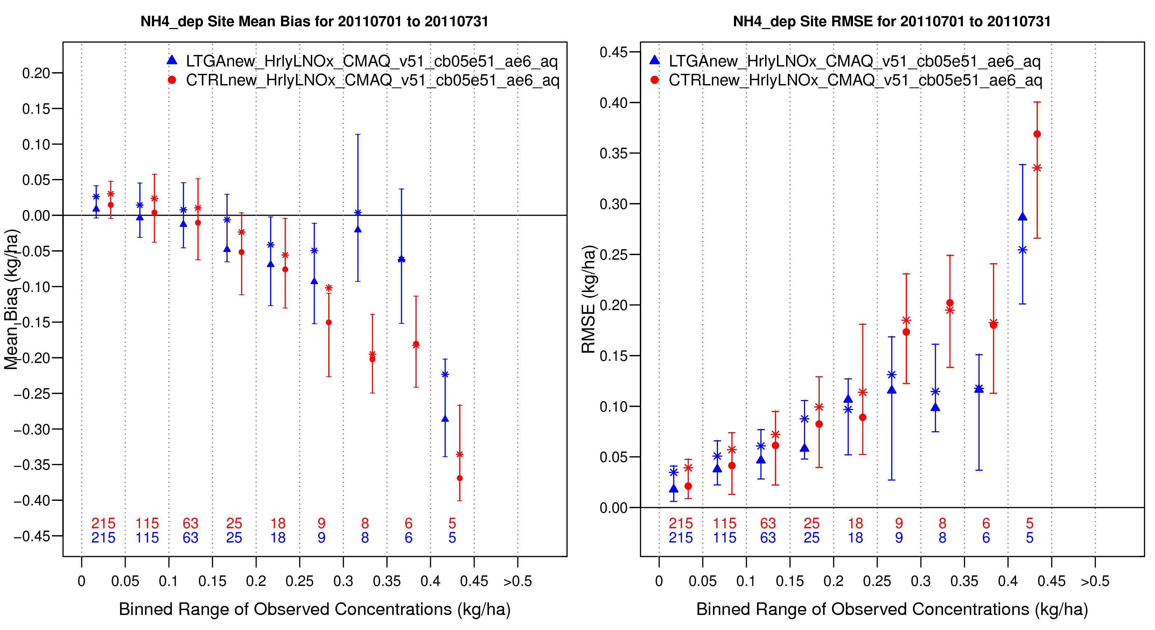
Ammonium Wet Deposition (July 2011)
Mean Bias
RMSE
LTGA
CTRL

Slide 19
Summary
Lightning assimilation implemented into Kain-Fritsch scheme in WRF
Precipitation, 2-m temperature, and 2-m mixing ratio improved with lightning assimilation
Meteorological improvements led to improvements in CMAQ simulations
Ozone bias and error reduced 1-3 ppb
PM2.5 bias and error reduced 0.5-2 ug/m3
Wet deposition improved at higher end values
Currently working to add assimilation code to WRF public release and make NLDN data publicly available

