Slide 1

The Community Modeling and Analysis System
CMAS
15 Years Serving the Community
Adel Hanna
Director, CMAS
15th Annual CMAS Conference, October 2016

Slide 2

The University of North Carolina at Chapel Hill
CMAS Center at UNC
  Established in 2001, the EPA’s CMAS Center has been hosted at UNC since 2003, which works with the agency to lead the international, open-source, community-based air quality modeling and analysis software used to evaluate and propose regulations.
    Bridge between segments of the air quality modeling community
    Fosters growth of developer and user communities
    Hub for modeling education and training
  CMAS Functions
    User Support
    Computational research and development
    Application and training
    Outreach
Notes:
ESIP Federation partners (now numbering 160) work globally to connect various domain, sector, and agency communities to exchange knowledge about emerging Earth science data, technical, and science topics. The overall goal is to improve discovery, access, and use of broadly distributed Earth
science data. With this new cohort of nine additional partners, the ESIP Federation is broadening its reach in the community of providers and users of Earth science data and information technology.
The CMAS Center has been added as a Type II ESIP partner, which designates that it is primarily a research center.

Slide 3
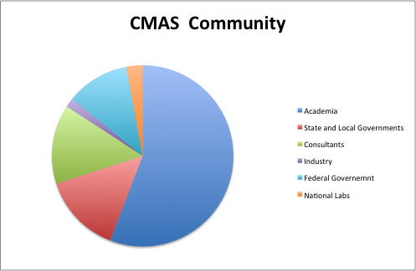
The University of North Carolina at Chapel Hill
Notes:
Our Community

Slide 5

Modeling and Analysis Tools
The University of North Carolina at Chapel Hill
CMAS Product Downloads
June 2015 – June 2016
Model/Tool Released (This Year)
Verdi 1.6 Alpha
CMAQ 5.1
C-Line 3.0
I/O API 3.2
MCIP 4.3
FEST-C 1.2 with updates on the interface and EPIC model parameters
Spatial Allocator (SA 4.2) – with updates on FEST-C tools, GOES satellite processing tools, and surrogate merging tool
Notes:
SA 4.1 includes upgrades to facilitate the utilization of MODIS remote sensing products for modeling applications
the Fertilizer Emission Scenario Tool for CMAQ
FEST-C is a Java-based interface system which is used to simulate daily fertilizer application information for CMAQ domain grid cells within the US using the Environmental Policy Integrated Climate (EPIC) model.
A required input for the CMAQ bi-directional NH₃ modeling is then extracted from the daily EPIC output
RLINE, part of ORD’s ongoing evaluation of air quality impacts in the near- road environment, has been developed primarily to support risk assessments and health studies related to near-road pollutants.
For example, CMAQ 5.0.2 will include capabilities for sulfur track- ing, the decoupled direct method (DDM), source apportionment, advanced plume treatment, and volatile basis set;
NEW FEATURES IN VERDI V1.5:
Java3D binaries are provided with the installation.
All messages are now passed through a single logger.
Updated underlying libraries to Java 7-compatibility.
Streamlined installation. Administrator privileges are no longer required to install VERDI.
Now Released on 64-bit Windows 7 in addition to 32-bit and 64-bit Linux, 32-bit Windows 7 and Mac

Slide 6
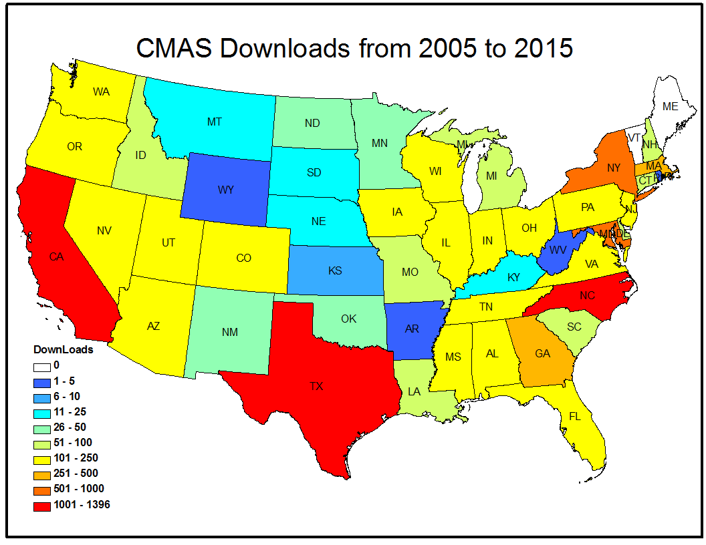
The University of North Carolina at Chapel Hill
Notes:
ESIP Federation partners (now numbering 160) work globally to connect various domain, sector, and agency communities to exchange knowledge about emerging Earth science data, technical, and science topics. The overall goal is to improve discovery, access, and use of broadly distributed Earth
science data. With this new cohort of nine additional partners, the ESIP Federation is broadening its reach in the community of providers and users of Earth science data and information technology.
The CMAS Center has been added as a Type II ESIP partner, which designates that it is primarily a research center.

Slide 7
The University of North Carolina at Chapel Hill
CMAS Center at UNC - User Support
  Website-based internet support for users
  Email-based query system for questions/bugs
  Help desk as backup for web-based support
    Technical and operational support: CMAQ, SMOKE, MCIP, Spatial Allocator, VERDI, AMET, BenMAP, R-LINE, C-Tools, FEST-C, and I/O API
    New IT solutions tailored to specific functions of the CMAS Center
    GitHub used for model source code and script distribution
    Expand GitHub use to include “issues” feature for tracking bugs, new feature requests, and to-do lists for each CMAS-supported tool
Notes:
The CMAS website (http://www.cmascenter.org/) connects community members to an array of support, educational, and outreach resources offered by CMAS.
The CMAS e-mail listserv help desk is a free web-based support database. The help desk connects community members with expert modelers who address technical questions about all the CMAS-supported software around the clock.
GitHub is a web-based Git repository hosting service offering distributed revision control and source code management functionality of Git

Slide 8
The University of North Carolina at Chapel Hill
User Support (II)
  Share model output data sets and other information
  Maintain on-line archive for model users
    CMAS Data Exchange (CDX) to respond to CMAS user community
    CDX will inventory air quality modeling data available in the community
    Online resource available for the community to request and share meteorology, emissions, and air quality modeling data
    CMAS is a member of ESIP
Notes:
Work with EPA to design and implement data sharing solutions to transfer model output datasets and auxiliary information through the CMAS website.
We propose to develop the CMAS Data Exchange (CDX) in response to demand from the CMAS community and following a suggestion from the current CMAS External Advisory Committee. The objective of the CDX will be to inventory the air quality modeling data that are available in the community. This voluntary, online resource will be available to the CMAS community to request and share meteorology, emissions, and air quality modeling data. The concept of the CDX is to provide an exchange through which modelers can share information about available data.
Earth Science Information Partners (ESIP) ESIP Federation partners (now numbering 160) work globally to connect various domain, sector, and agency communities to exchange knowledge about emerging Earth science data, technical, and science topics. The overall goal is to improve discovery, access, and use of broadly distributed Earth
science data. With this new cohort of nine additional partners, the ESIP Federation is broadening its reach in the community of providers and users of Earth science data and information technology.
The CMAS Center has been added as a Type II ESIP partner, which designates that it is primarily a research center.

Slide 9
The University of North Carolina at Chapel Hill
User Support (III)
  Maintain on-line archive for model users
    Distribute CMAS software packages as both GitHub online archives and as stand-alone file archives
    Work with EPA to develop high quality user and developer manuals
Notes:
ESIP Federation partners (now numbering 160) work globally to connect various domain, sector, and agency communities to exchange knowledge about emerging Earth science data, technical, and science topics. The overall goal is to improve discovery, access, and use of broadly distributed Earth
science data. With this new cohort of nine additional partners, the ESIP Federation is broadening its reach in the community of providers and users of Earth science data and information technology.
The CMAS Center has been added as a Type II ESIP partner, which designates that it is primarily a research center.

Slide 10
The University of North Carolina at Chapel Hill
Computational Research an Development
Land-Atmosphere Fluxes
The Fertilizer Emission Scenario Tool for CMAQ (FEST-C) for CMAQ Bi-directional NH₃ Modeling
http://www.cmascenter.org/fest-c/
  FEST-C is a Java-based interface system which is used to simulate daily fertilizer application information for CMAQ domain grid cells within the US using the Environmental Policy Integrated Climate (EPIC) model.
  A required input for the CMAQ bi-directional NH₃ modeling is then extracted from the daily EPIC output.
  Spatial Allocator BELD4 tool which processes tiled MODIS land cover data (MCD12Q1) and with built 2001 and 2006 crop tables for US and Canada. To be used in the WRF/CMAQ consistently by EPA.
  Spatial Allocator Capability to compute surrogates for polygon shapefiles (e.g. census tracts)

Slide 11
The University of North Carolina at Chapel Hill
Computational Research and Development(II)
Radiative Effects of Aerosols
Reduce uncertainty in the modeling of the direct radiative effects of aerosols, by improving the representation of aerosol size distributions, chemical composition, and aerosol mixing state on which aerosol optical properties strongly depend.
Notes:
We modified the current CMAQ treatment in a one-dimensional or column model. Note that the major output variable from the column model is Aerosol Optical Depth (AOD). In the model we added an optical class for water-soluble organic carbon (WSOC). When elemental carbon (EC) is present, we use our modified coated sphere approach. Recall that the modification assumes that there is some EC in the shell. When there is water present in the shell, then this is an aqueous solution where the WSOC can interact with the inorganics.
The base case is the current CMAQ approach. The next case is the base case with the inclusion of EC from aircraft
The values of AOD that we observed in the beginning of Year 6 from MODIS, AERONET, and CALIOP are often much larger than the values we obtained from the test cases. One of the missing pieces is the effect of biomass burning materia

Slide 12
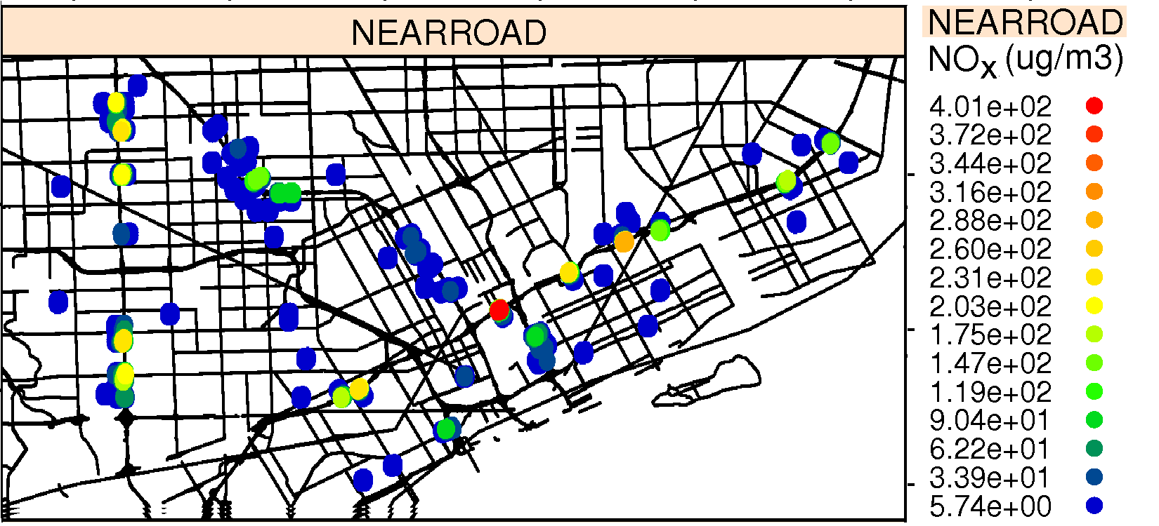
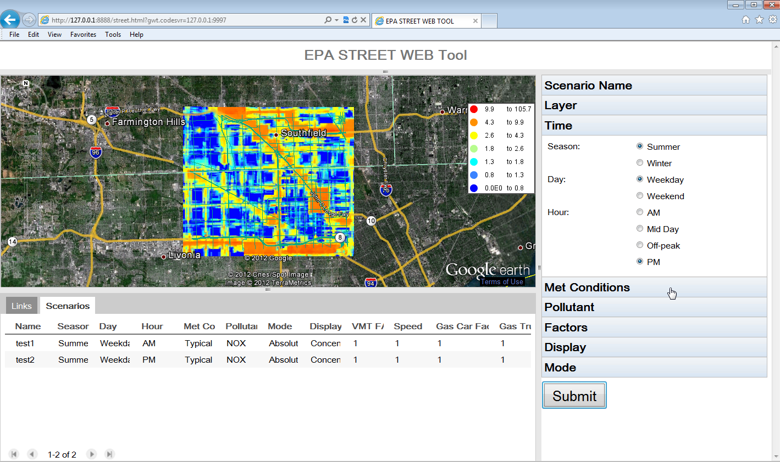
Fine-Scale Modeling
The University of North Carolina at Chapel Hill
Computational Research and Development(III)
RLINE: EPA ORD's research dispersion modeling tool for near roadway assessments (Snyder et al, 2013; Venkatram et al, 2013; Heist et al, 2013)
RLINE can support health and risk assessments, epidemiology studies, and community based tools
UNC is developing C-LINE, a decision support tool for evaluating effects of alternate transportation options on community health
Notes:
Detroit Near-Road Exposure to Air Pollutants Study (NEXUS)
databases developed from September 2010 to May 2012 for the NEXUS study
We will apply AERMOD and AERLINE for the period corresponding to the extended phase of the study to estimate outdoor concentrations of the primary traffic-generated air pollutants, such as PM_{2.5}, PM components (e.g., EC, OC), NO_{x}, CO, and mobile-source air toxics (MSATs), such as benzene.
The study area will include Macomb, Oakland, and Wayne counties in Michigan, and Essex County in Ontario, Canada. Area sources will include port- and airport-level sources in the Detroit study area.
UNC developed application of RLINE, AERMOD and to estimate new method to estimate background concentrations for the “Near-Road EXposures to Urban air pollutants Study” (NEXUS) in Detroit examining the role of near-road exposures on asthmatic children who live near major roadways.

Slide 13
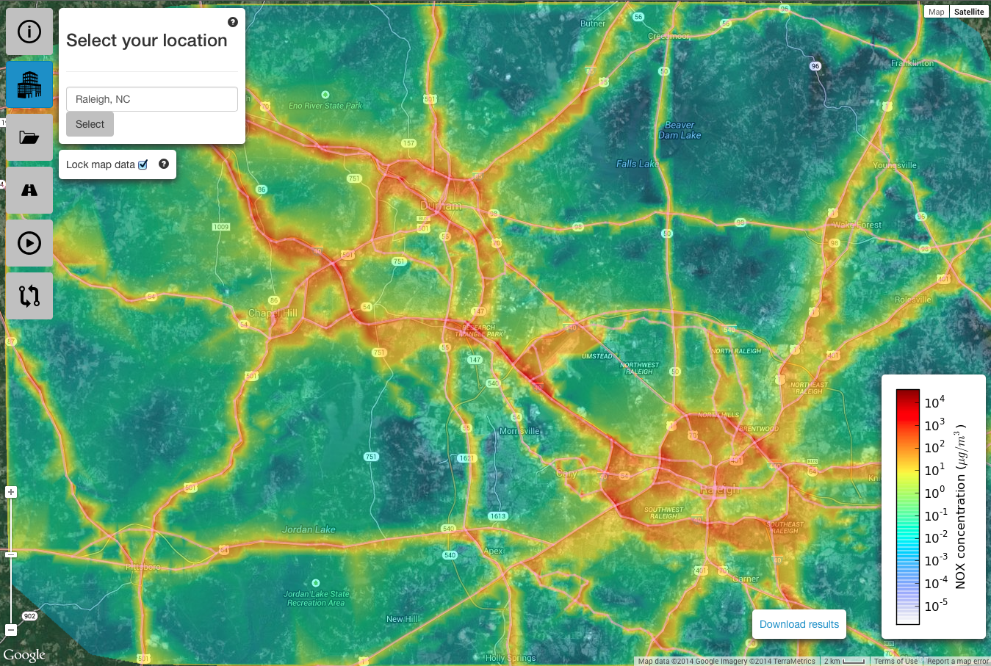
Community LINE Source Model (C-LINE)
The University of North Carolina at Chapel Hill
https://www.cmascenter.org/r-line/
C-LINE is based on the R-LINE model
  Web-based easy-to-use GUI, with national coverage
  Model traffic-related near-road air pollution on-demand
  Back-end includes AERMET-based meteorology, FHWA Road Network/activity, and MOVES-based Emis. Factors
  Ability to change emissions or meteorological condition
    Changes in fleet composition or activity
  Visualize absolute and relative changes in near-road air pollution
  CO, NO_{x}, PM_{2.5}, MSATs
Notes:
Mobile Source Air Toxics (MSAT)

Slide 14
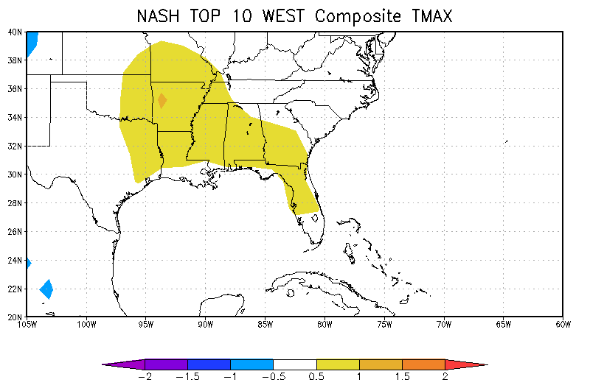
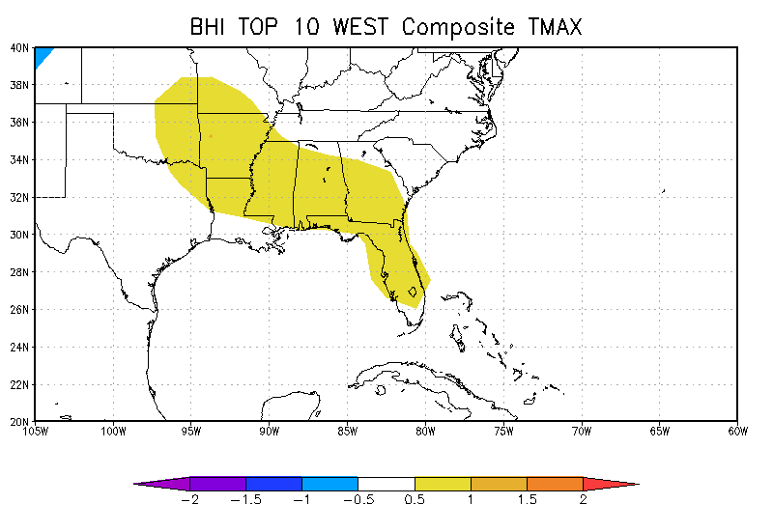
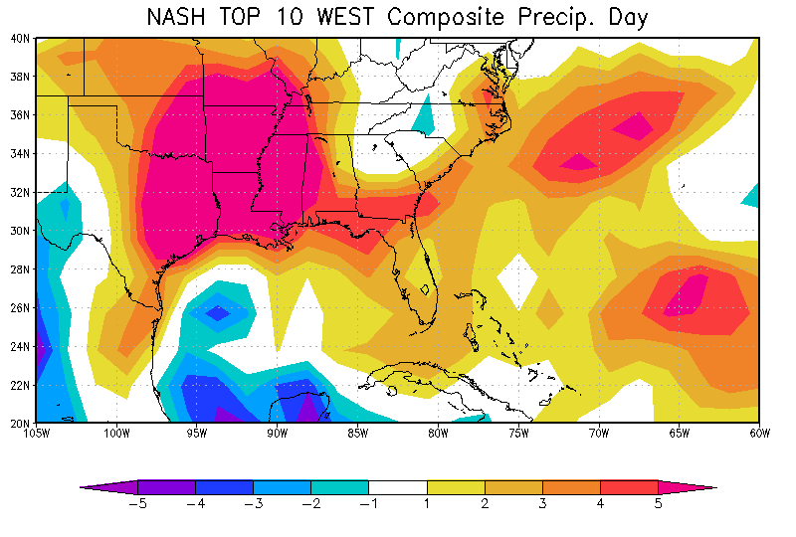
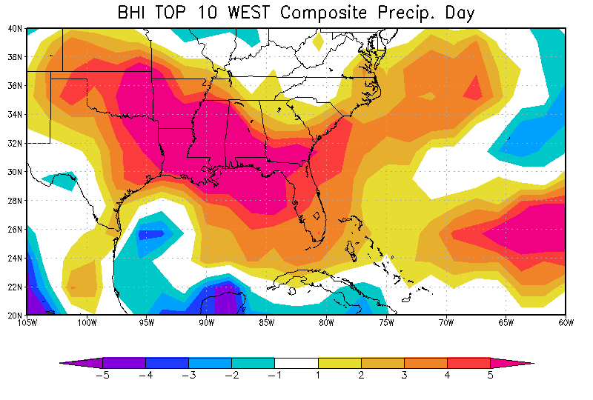
Regional Climate Change SE US
The University of North Carolina at Chapel Hill
Computational Research and Development(IV)
NASH Westward Shift
Most intense NASH
Temperature
Precipitation
Notes:
Figure 4: Anomalies of 2-m Maximum Temperature (top) and Number of Days with Precipitation <=0.1 inches. Left is based on the top 10 westward shifts years as defined by the NASH. Right is based on the top 10 most intense NASH years events as defined by the BHI.
North Atlantic Subtropical High (NASH).
NASH position and intensity
Figure 4 is an example plot of the anomalies of maximum temperature and number of days with rain less than a tenth of an inch. There is a mean increase in the average temperature during northwest shifts of more than 1°C for the entire summer. There is also additional number of days without rainfall of approximately one week.
2005 WRF monthly average 2-m temperature with lake option top and off bottom
tool that provides GFDL initial, lateral, and surface boundary conditions for WRF. Details on the tool can be found in the April monthly report
used the tool to downscale GFDL-CM3 using several new options in WRFv3.6; these included adjustments to the Kain-Fritsch (KF) convective parameterization scheme for subgrid cloud effects in the RRTMG radiation scheme, and a lake scheme obtained from the Community Land Model (CLM) v4.5. The simulations were initialized on January 1, 2004, and run for two years, ending on December 31, 2005. The first year was used for spin-up because we are unsure of the amount of spin-up required for the lake scheme. Here we report on simulations testing the CLM lake scheme (either off or on) with the KF modifications; additional analyses are summarized in the WA final report. Both simulations included analysis nudging throughout the entire simulation. Figure 1 is a plot of the mean temperature for January and July. Turning on the lake option improved the surface temperature gradient in the Great Lakes for both the sum­mer and the winter months. As for precipitation (Figure 2), the most obvious difference is during January. Without the lake scheme, there was more precipitation in and around the Great Lakes. The increased precipitation was expected because the lake surface temperatures for southern Great Lake points are erroneously warm. The combination of cold air temperatures and erro­ne­ously warm lake surface created unrealistic precipitation features in and around the Great Lakes

Slide 15
The University of North Carolina at Chapel Hill
Applications and Training
  Training Sessions Onsite and Offsite
    Two training sessions onsite at UNC
    International (Hong Kong, Korea, Brazil, China, Columbia, Bulgaria, Canada, Greece, Mexico, India)
    SMOKE and CMAQ on-line training
    Special Training; Python for Air Quality Research na Applications
Notes:
Since its inception, the CMAS Center has trained researchers from state, local, national, and private agencies on how to use the products it supports. We provide introductory training on SMOKE and CMAQ using both lecture and hands-on material that we continually update to keep current with the modeling software. Due to increasing demands for training opportunities in air quality modeling and analysis, we have continued to expanded the number of training classes we offer to include courses on the Spatial Allocator, graphical and statistical analysis tools, and process analysis techniques in CMAQ. In 2015 we launched an online training program that includes introductory classes on SMOKE and CMAQ.

Slide 16
The University of North Carolina at Chapel Hill
CMAS Training Sessions
Notes:
Since its inception, the CMAS Center has trained researchers from state, local, national, and private agencies on how to use the products it supports. We provide introductory training on SMOKE and CMAQ using both lecture and hands-on material that we continually update to keep current with the modeling software. Due to increasing demands for training opportunities in air quality modeling and analysis, we have continued to expanded the number of training classes we offer to include courses on the Spatial Allocator, graphical and statistical analysis tools, and process analysis techniques in CMAQ. In 2015 we launched an online training program that includes introductory classes on SMOKE and CMAQ.

Slide 17
The University of North Carolina at Chapel Hill
  CMAS Promotes and facilitates collaboration and information sharing
    Conferences
      3rd CMAS South America Conference (Brazil, August 2017)
      Student best poster
    Webinar series
    Listservs for community-based discussions
    CMAS wiki
    Visiting Scientists program
    Newsletter
    CMAQ peer review
    Peer reviewed journal articles
    Specialty workshops
Notes:
We have also continued to expand the presence of CMAS internationally through conferences and trainings at off-site locations throughout the world. In addition, the CMAS Visiting Scientist Program has continued to host air quality researchers from around the world providing them the opportunity to consult with CMAS research and development staff on specific modeling and software engineering topics. We also provide an educational opportunity for the air quality modeling community to share their experiences, application and research results, and discuss current modeling techniques and technologies during the annual CMAS conference, at no additional cost to the EPA contract.
Peer Reviewed journal articles; including Journal of Atmospheric Pollution Research, Journal of Applied Meteorology, Atmospheric Environment, and Journal of the Air & Waste Management Association

Slide 18
The University of North Carolina at Chapel Hill
Workshops
  Urban Database Planning Workshop (May, 2006)
  Panel review of CMAQ model process upgrades and model applications and evaluations (December, 2006)
  International conference on Atmospheric Chemical Mechanisms (December, 2008)
  Workshop for atmospheric modeling planning (July, 2008)
  CMAQ Adjoint Workshop (November, 2010)
  Meteorology-Hydrology Linkage Workshop (January, 2011)
  Panel review of the CMAQ model process applications, and evaluations (June, 2011)
  Workshop on integrated meteorology and chemistry modeling (October, 2012)
  Workshop on providing regional climate change projections for the southeastern US (April, 2013)

Slide 19
Main Conference Technical Events
The University of North Carolina at Chapel Hill
Plenary Session
  Emerging Issues in Air Quality Modeling. Chaired by the U.S. EPA’s Rohit Mathur and Jon Pleim
CMAS Developer/User’s Forum
    Alternative future realities: considerations for modeling
    Moderator, Tom Moore (WESTAR-WRAP); Panelists: Michael Barna (National Park Service - Air Resources Division), Chris Emery (Ramboll-Environ), Dan Loughlin (U.S. EPA), Tanya Spero (U.S. EPA)
ABaCAS Software Demo. Carey Jang. U.S. EPA
  Air Benefit and Cost Attainment Assessment System (ABaCAS)
Notes:
Themes from past years and this conference
Big Data
Developing a vision for the next generation of air modeling tools
Interpreting model results: getting to the right answers for the right reasons

Slide 20
The University of North Carolina at Chapel Hill
CMAS Team at UNC
Applications and Training | Zac Adelman, B.H. Baek, Sarav Arunachalam, Uma Shankar, Alex Valencia, Liz Adams
Software Development | Sarav Arunachalam, Carlie Coats, Alex Valencia, Mohamed Omary, Jo Ellen Brandmeyer
Modeling Research | Uma Shankar, Frank Binkowski, Jared Bowden, Michelle Snyder,
Technical Editing | Margaret Ledyard-Marks
Communications and Events | Brian Naess and Kathleen Clabby O’Rawe
Director | Adel Hanna

Slide 21
Thank You
CMAS Community, EAC members, and Session Chairs
Dr. Band for opening this conference
UNC-Chapel Hill
CMAS-EPA Project Manager (Thomas Pierce)
Special Thanks To Dr. Bill Benjey (former CMAS-EPA Project Manager)

Slide 22


