Slide 1
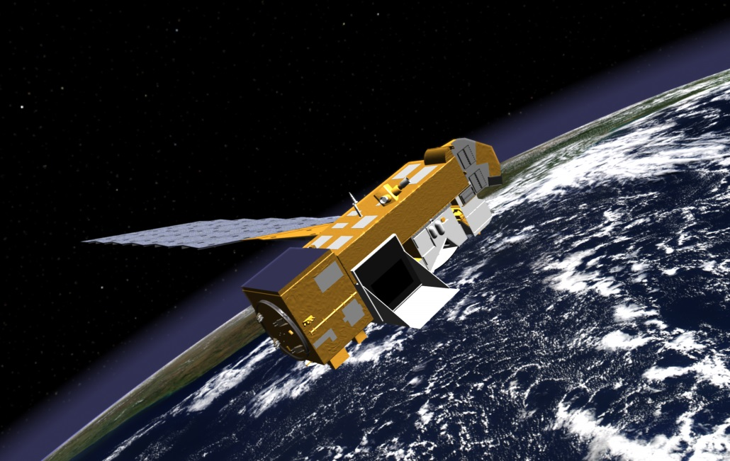
HIGH-RESOLUTION OMI SATELLITE RETRIEVALS OF TROPOSPHERIC NO₂ IN THE EASTERN UNITED STATES
IN COLLABORATION WITH THE EPA-FUNDED
AIR, CLIMATE & ENERGY (ACE) SEARCH CENTER
Aura satellite
Image from: http://earthobservatory.nasa.gov/
PRESENTATION BY:
Dan Goldberg¹
Co-Authors: Lok Lamsal², Christopher Loughner^{2,3}, Zifeng Lu¹ & David Streets¹
¹University of Chicago & Argonne National Laboratory, Argonne, IL
²NASA Goddard Space Flight Center, Greenbelt, MD
³NOAA Air Resources Laboratory, College Park, MD
15th Annual CMAS Conference: October 26, 2016
Notes:
Thank you Roger, and thank you all for joining me this morning. This project is part of the EPA-funded Air, Climate, and Energy, ACE, center called SEARCH (Solutions for Energy, Air, Climate, and Health). (If session chair does not announce title then say…) Today I will be showing you a new technique for developing high resolution retrievals from OMI. I would like to thank my co-authors: Lok Lamsal, Chris Loughner, Zifeng Lu and David Streets.

Slide 2
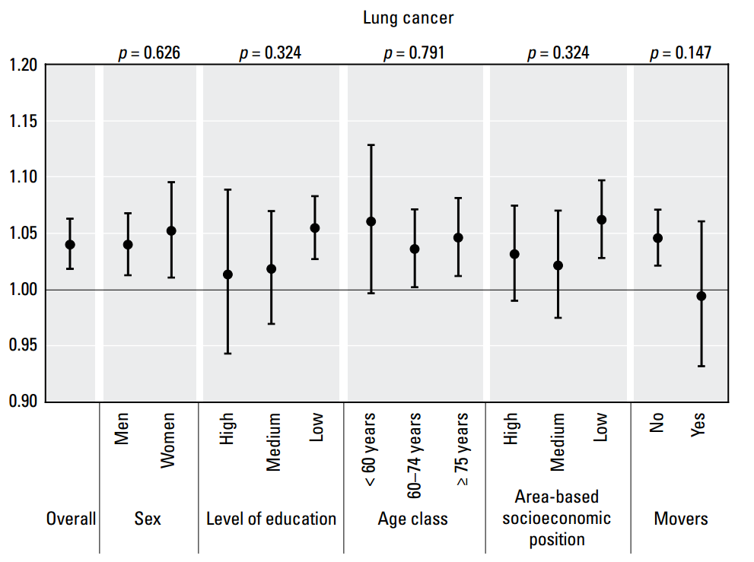
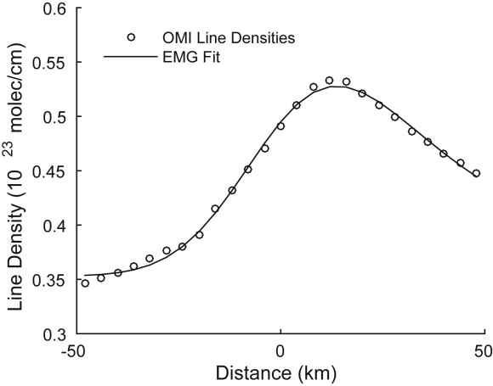
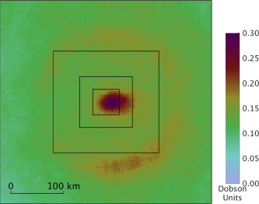
ouR MOTIVATION TO GENERATE HIGH-RESOLUTION SATELLITE PRODUCTS
There’s a need in the health assessment community for more observations at the urban-scale to better estimate exposure to air pollutants (NO₂, PM_{2.5}).
Hazard ratio of lung cancer associated with a 5 ppb increase in NO₂
Rome, Italy study, Cesaroni et al., 2013; EHP
Can provide better emission estimates, especially of point sources or localized sources such as those from major highways or shipping routes.
Emission estimates of NO₂ from Crystal River Power Plant (FL) using OMI
de Foy et al. 2015; AE
Also see:
India: Lu et al., 2012; EHP
China: Wang et al., 2012; ACP
Notes:
Why is there a need for high resolution satellite retrievals? (Pause) First, there’s a need in the health assessment community for more observations at the urban-scale for their studies. At the upper right, I show a study explaining that for every increase in NO2 by 5 ppb, there is a 3% increase in the incidence of cardiovascular diseases such as lung cancer. To do these studies, researchers must calculate the pollution burden in metropolitan areas. Unfortunately, due to cost constraints, there are only a handful of monitors measuring air pollutants in many metropolitan areas. Many of which are 10s of kilometers from each other, making the area in between the great “unknown”. Certainly, we can interpolate between monitors but this may not be appropriate for pollutants with short lifetimes such as NO2, which has so much spatial inhomogeneity in urban areas.
A high resolution satellite product will also allow the scientific community to develop better top-down emission estimates. Ben De Foy’s work published last year in Atmospheric Environment shows an example of this. He was able to develop top-down emission estimates from satellites using an exponentially modified Gaussian (EMG) fit which compared well with observations from power plant emissions data also known as CEMS data. Furthermore, he found that the 12 km BEHR high resolution product, developed by Berkeley, was much better in the correlation.

Slide 3
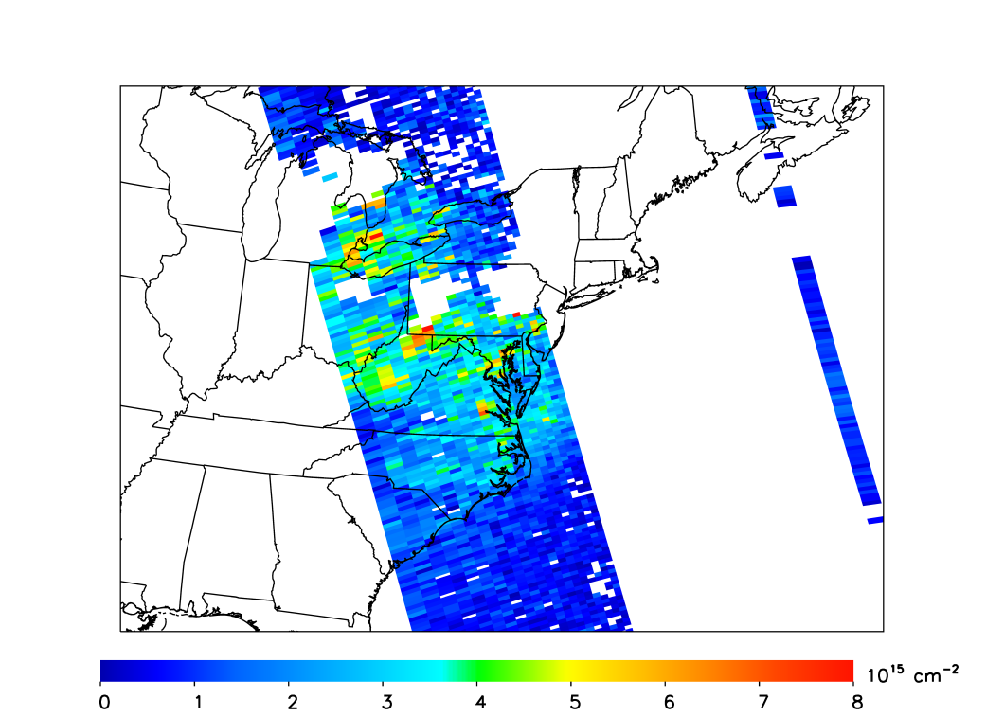
CURRENT OPERATIONAL NASA OMI NO₂ Product
Footprint of the Ozone Monitoring Instrument (OMI) at nadir (i.e., looking straight down) is 13 × 24 km (312 km²)
  About 50% of pixels have areas greater than 500 km² (Kim et al., 2016; GMD)
  Product can be oversampled to a finer horizontal resolution (an example will be shown later).
Example: OMI overpass July 18, 2011
Row anomaly
Notes:
To make sure we are all on the same page, on the left side I show a snapshot of NO2 from an OMI overpass on a single day July 18th. The resolution of OMI is 13 x 24 km at nadir, when looking directly down. At the swath edges, each pixel can be 100s of kilometers of wide. We can also see the row anomaly in this figure. Since 2010, a piece of equipment is blocking the field of view on one side, so at best, only half of the satellite data has been available since then.

Slide 4
Introduction to AIR Mass FACTORS (AMF)
w_{satellite} = scattering weight, or sensitivity of the satellite, at the particular altitude
S_{Model} = shape factor, or % of NO₂ estimated by a model, at the particular altitude
Can we improve these “observations” by using a high resolution (1.33 km) CMAQ simulation to re-calculate the air mass factors?
Operational NO₂ products use a monthly average from a global simulation (200 × 200 km; NASA:GMI, DOMINO:TM4) in their calculation of the AMF
Need a priori information from a model in order to
calculate the tropospheric column

Slide 5
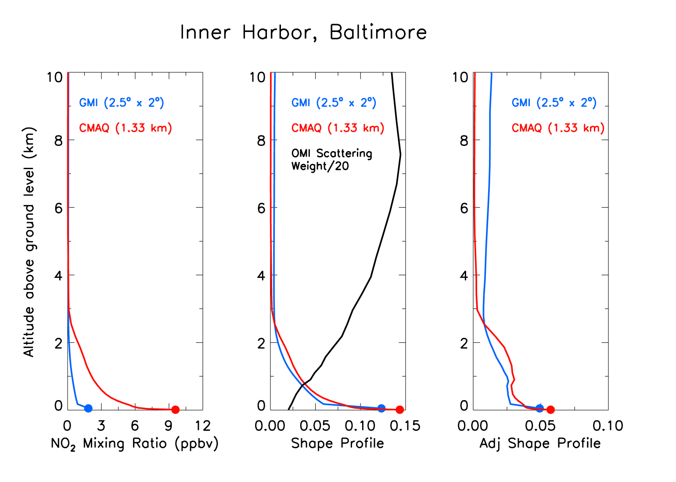
How do we re-calculate air mass factors (IN VISUAL FORMAT)?
Downtown Baltimore, Maryland
×
Shape profile x Scattering Weight
× = NO₂* observation, NO₂* = Σ(NO+NO₂+PeroxyNitrates+AlkylNitrates)
NO₂ = ~60 – 90% NO₂* in urban areas
AMF_{CMAQ} < AMF_{GMI} in Baltimore
*Monthly mean data is shown
Notes:
On the left, I am showing the NO2 vertical profiles from the two models GMI and CMAQ. This is the same as two slides ago, in which I showed better agreement at surface using CMAQ. On the center panel, I now show the shape profiles for each model. The black line is a measure of the satellite’s sensitivity. This is defined as the scattering weight. Note it is divided by 10 in this plot. At 7.5 km, the scattering weight is 3, but at the surface it is 0.4, which makes the satellite an order of magnitude more sensitive to upper tropospheric NO2. To the naked eye, the two model shape profiles look to be in stunning agreement. And, in short, there are. But unfortunately the satellite is very sensitive to differences in the upper troposphere. On the right, I show the adjusted shape profile, which is simply the shape profile multiplied by the scattering weight. And now we can see a big difference. CMAQ is saying NO2 is much more concentrated near the surface. GMI shows a relatively more even distribution throughout the column. Finally, if you remember from the previous slide, the air mass factor is the integral of the adjusted shape profile. The area under the blue curve is larger than the red curve, so the air mass factor is smaller when using CMAQ. And since the air mass factor is inversely proportional to the total column, a smaller air mass factor will result in a larger tropospheric column.

Slide 6
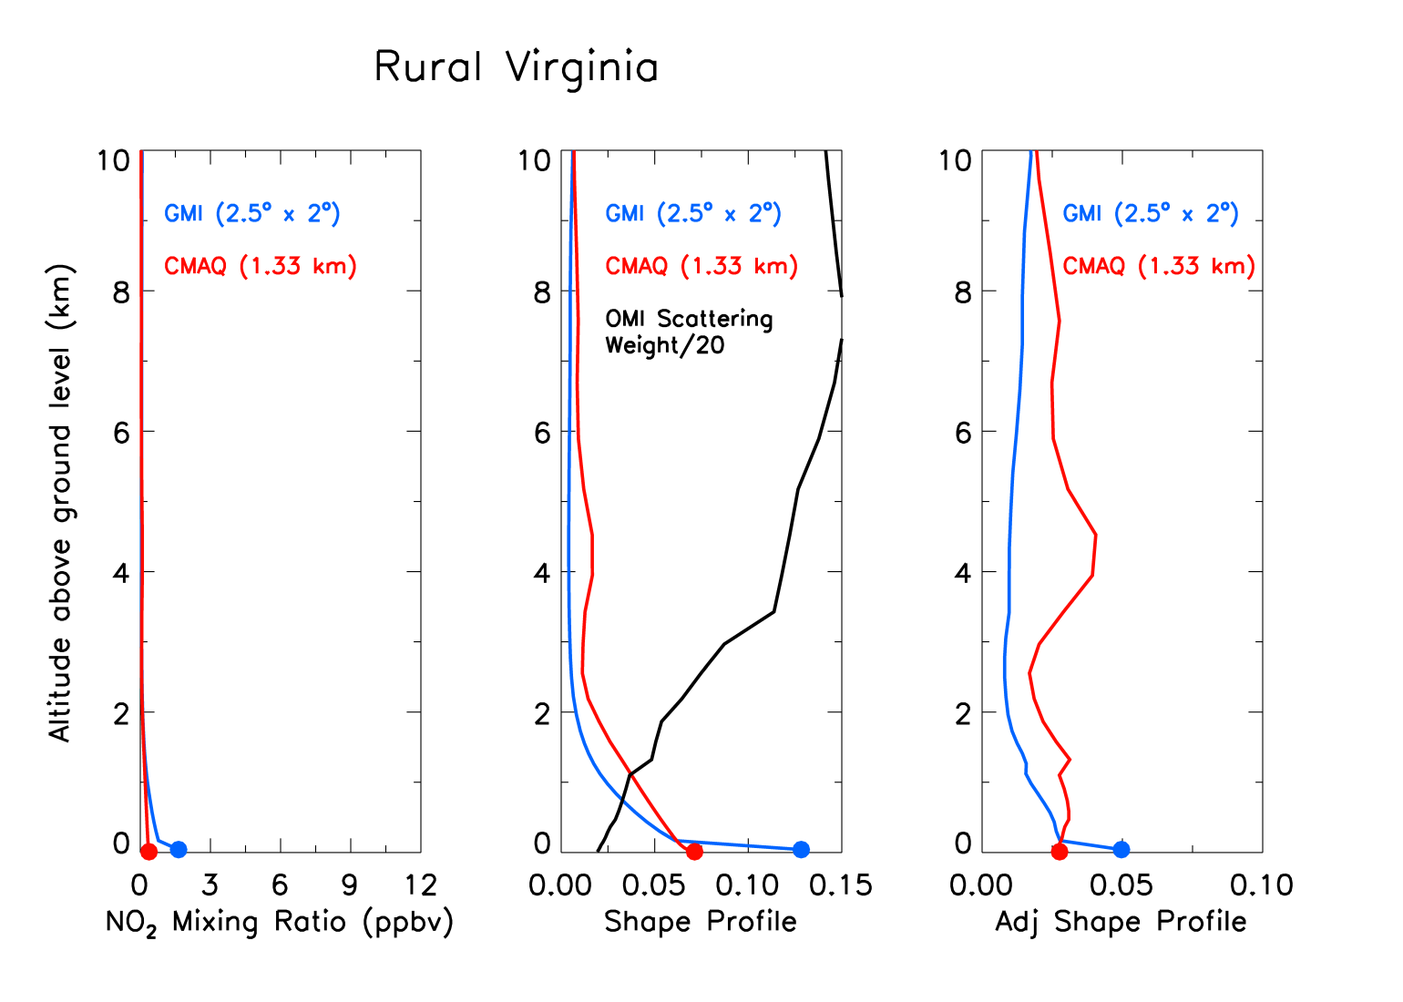
How do we re-calculate air mass factors (IN VISUAL FORMAT)?
Rural Virginia (southwest of Richmond)
Shape profile x Scattering Weight
AMF_{CMAQ} > AMF_{GMI} in Rural Virginia
*Monthly mean data is shown
Notes:
And lastly, I am showing the same thing for rural Virginia not near a large point source. CMAQ is saying NO2 is much more distributed throughout the vertical column. Remember, the GMI simulation likely includes the Richmond metro region in its pixel since it its 100s of kilometers in width. The area under the blue curve is now much smaller than the red curve, so the air mass factor is larger when using CMAQ. A larger air mass factor will result in a smaller tropospheric column in rural areas.

Slide 7
Methodology
Use a CMAQ 1.33 km simulation of June & July 2011 to re-generate summertime NO₂ vertical shape profiles, which are used in the calculation of air mass factors (AMF)
  AMF = ƒ(NO₂ shape profile, vertical sensitivity of satellite)
Re-calculate tropospheric column NO₂ using the new air mass factors
Generate a high resolution (oversampled) view of NO₂ in the mid-Atlantic for a 5-year period (2008-2012)
  Compare NO₂ columns to ground observations of NO₂* during the 5-year period to see if the new product better captures the spatial variability of NO₂
A similar method (i.e., steps 1 & 2) is used to generate the Berkeley High Resolution (BEHR) NO₂ product
Main difference: BEHR uses a 12 km simulation, we are using a 1.33 km simulation
*NO₂ at ground sites is measured by the chemiluminescence method, which has a high bias when compared to NO₂ from more precise methods such as cavity ring-down [Fehsenfeld, et al, 1987, Brent et al., 2013]
Notes:
To generate the high resolution satellite product, I use this 1.33 km CMAQ simulation of June and July to re-generate summertime vertical NO2 shape profiles. The shape profiles are used to calculate the air mass factor, which I just showed an example of. I will then re-calculate the tropospheric column NO2 using the new air mass factors. This is a very similar process that the Berkeley group has used in generating their high resolution product. I will then oversample to get a long-term average. Lastly, I will compare to ground observations of NO2 to determine whether this new product has a better correlation. A long-standing issue with OMI data is that it cannot capture NO2 surface concentrations, can we fix this?

Slide 8
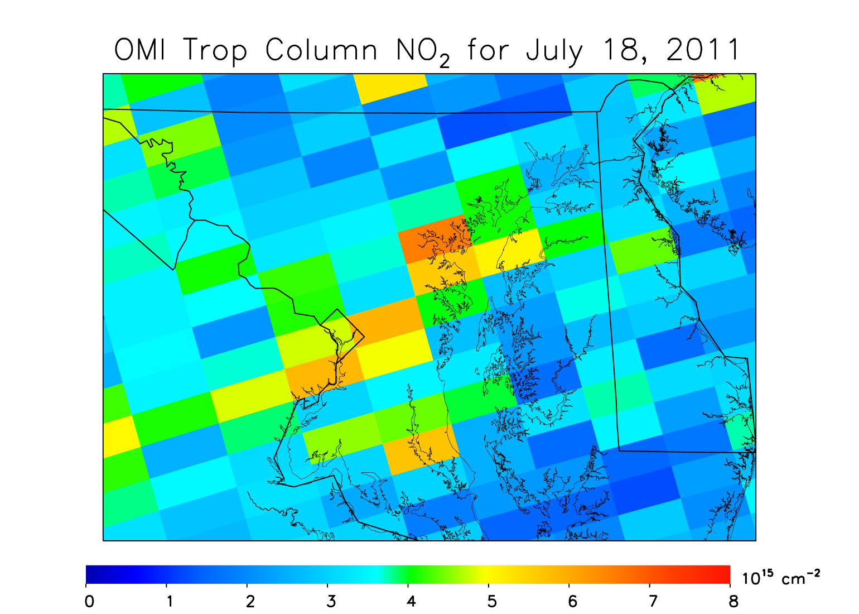
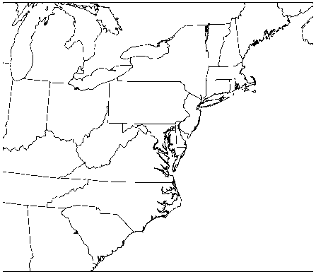
Overview of calculation METHOD, part 1
NASA OMI NO₂ Level 2 Tropospheric Column: July 18, 2011
Un-adjusted OMI NO₂ data from the July 18, 2011 overpass
Resolution at nadir 13 × 24 km
Notes:
Here is the same July 18th, 2011 satellite data shown on slide number 3, but zoomed into the Baltimore and Washington, DC metropolitan region. I will now go through a series of slides to illustrate the calculation method.

Slide 9

Overview of calculation METHOD, part 2
Re-gridded NASA OMI NO₂ Level 2 Tropospheric Column: July 18, 2011
Grid data to a finer resolution (i.e., 1.33 km)
Un-adjusted OMI NO₂ data from the July 18, 2011 overpass
But now gridded to a 1.33 km grid
Notes:
First I re-grid the data to the model’s native 1.33 km grid. No interpolation is needed since we are using such a fine grid. Essentially this is an identical snapshot.

Slide 10
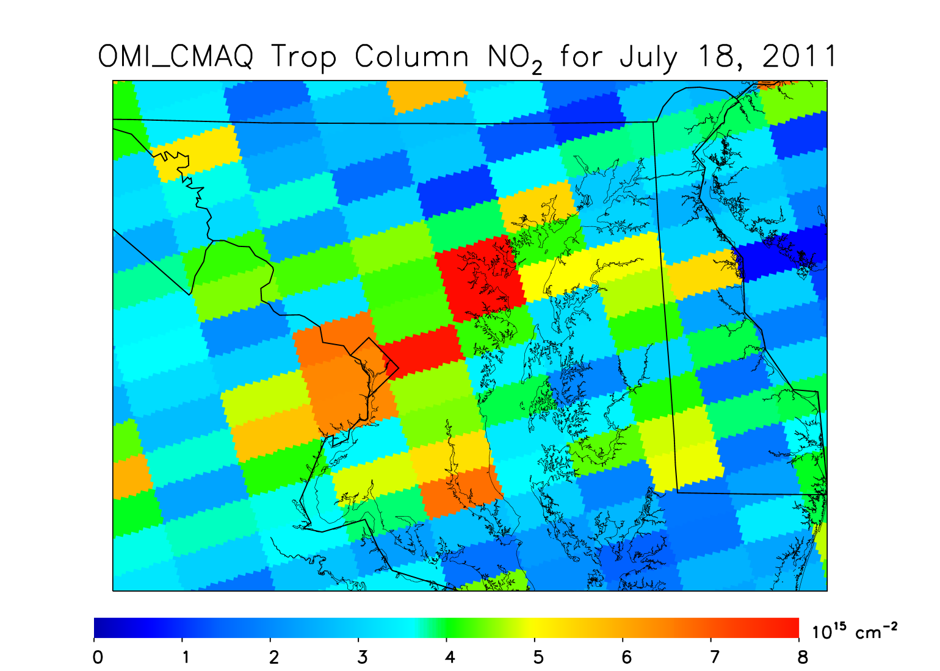
Overview of calculation METHOD, part 3
Adjusted OMI NO₂ Tropospheric Column: July 18, 2011
Re-calculate the tropospheric column based on the procedure outlined in the first part of the talk.
Adjusted OMI NO₂ data from the July 18, 2011 overpass
Based on air mass factors from CMAQ 1.33 km simulation, averaged across pixel
Notes:
Then I re-calculate the tropospheric column based on the new air mass factor. Clearly there are differences in many locations. In this plot I am using the average air mass factor over the entire pixel to in the calculation of the tropospheric column. So in essence, the average of hundreds of air mass factors.

Slide 11
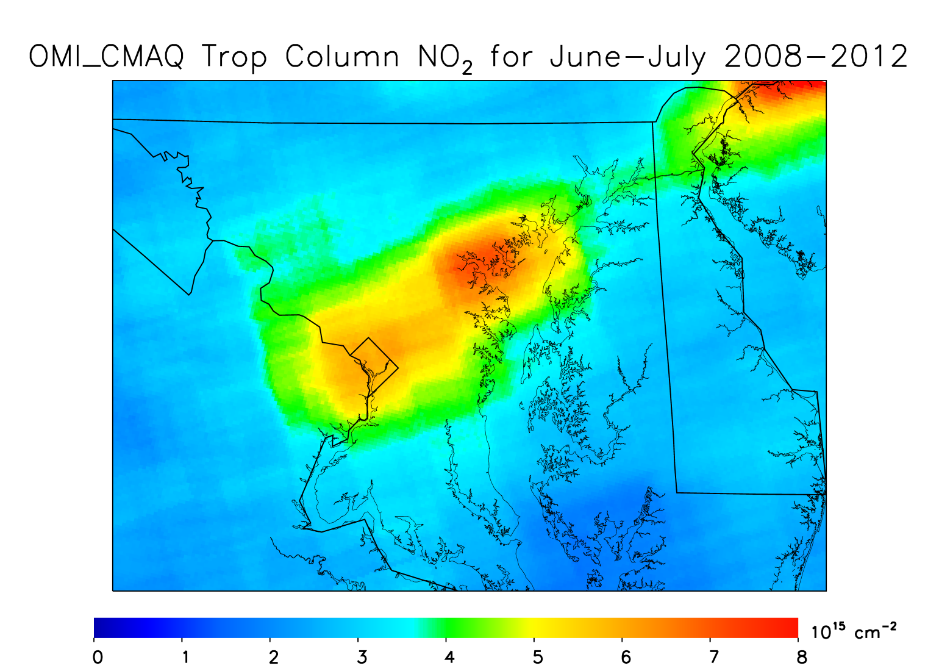
OVERSAMPLING of adjusted no₂ product
Adjusted OMI NO₂ Tropospheric Column: June & July 2008 - 2012
*Shape factors are based on an average of the 2011 CMAQ simulation
Average NO₂ during June – July, 2008 – 2012*
Average of all valid gridded data during the 10 months
OMI_CMAQ
Notes:
I then performed the same procedure for every day in June and July over 5 years: 2008 to 2012. I take average of these 10 months to show an oversampled view of NO2. We can see a lot of interesting features. Urban cores. Interstate Highways. Intrastate highways. Power plants. And even shipping lanes. How does this compare to the operational product?

Slide 12
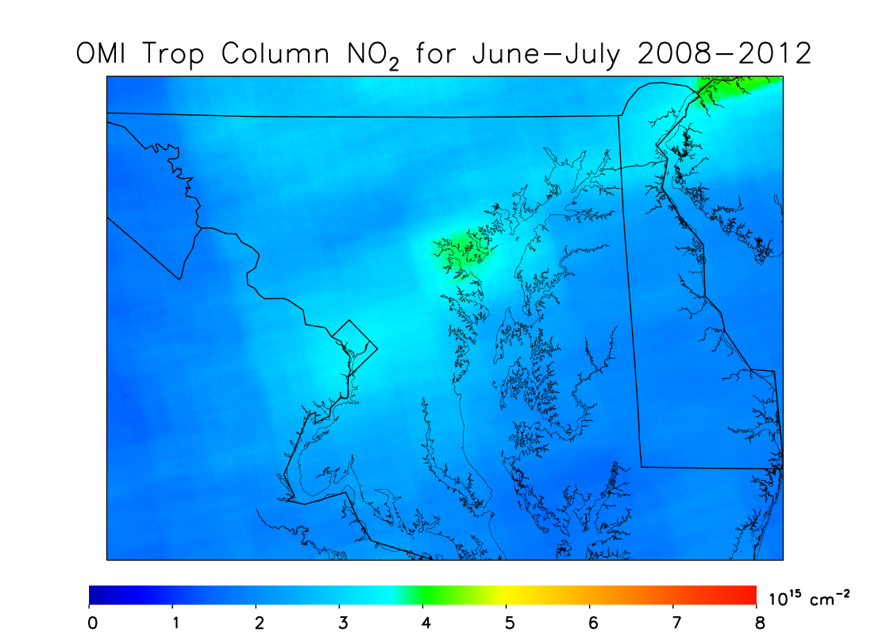
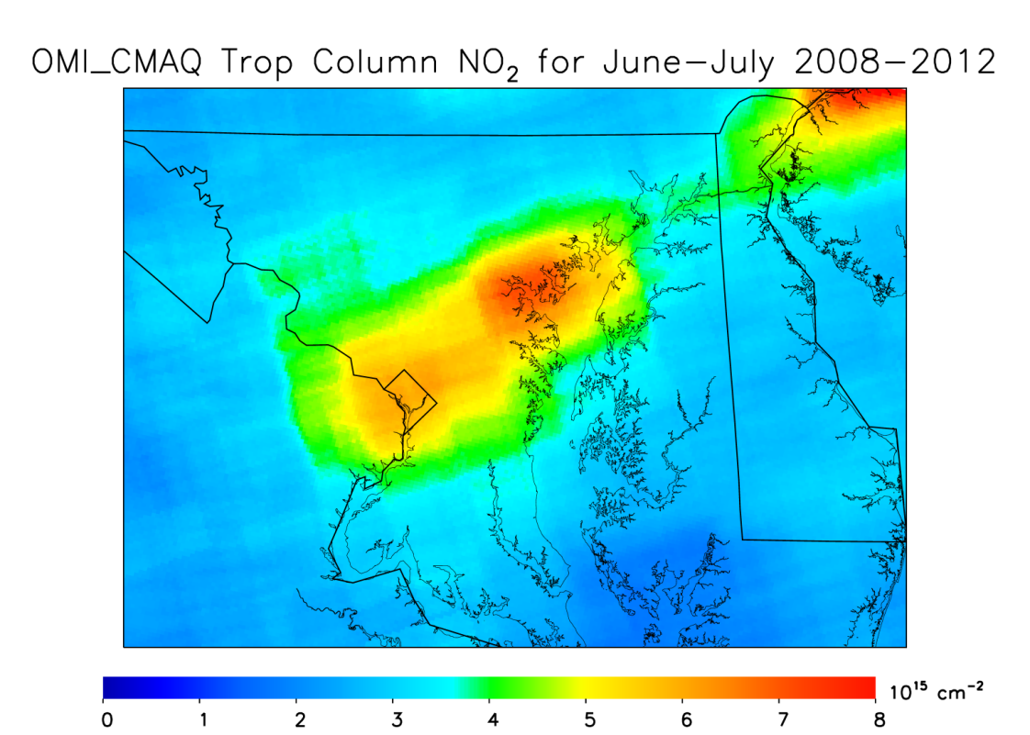
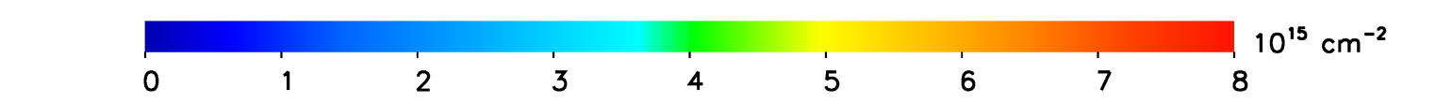
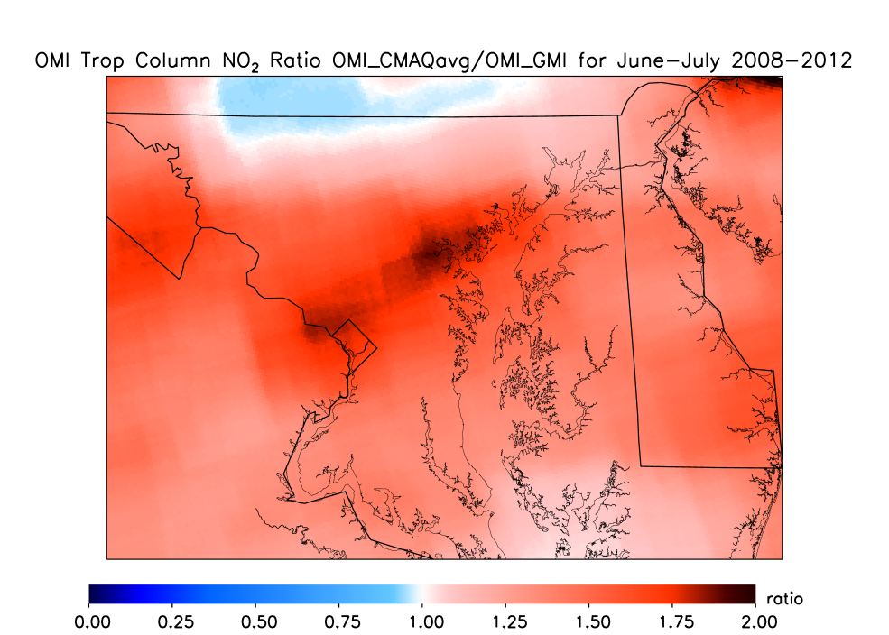
Oversampled view of tropospheric Column NO2
NASA OMI_GMI NO₂ Standard Product
OMI_CMAQ NO₂ Product
But we can do better!
r²=0.34
r²=0.39
Correlation with ground NO₂ monitors
All plots are showing June & July 2008 - 2012
Ratio: OMI_CMAQ / OMI_GMI
NO₂ columns are higher in most areas in the new OMI_CMAQ product, especially in urban areas
Rural areas in northern Maryland see slight decreases
Small increase in correlation with ground monitors (r²=0.34 to r²=0.39)
Notes:
On the left is the operational product oversampled during the same 2008 to 2012 period. And on the right, we have the re-processed product, which is the same plot as displayed on the previous slide. There are big differences. The operational product barely shows any variability between urban cores and the rural areas upwind. When looking at something new like this, I like to take a step back. Does this make sense? NO2 has a short lifetime during summer, and due to this, must have large spatial heterogeneities. So the large heterogeneities introduced by the new calculation method make sense.

Slide 13
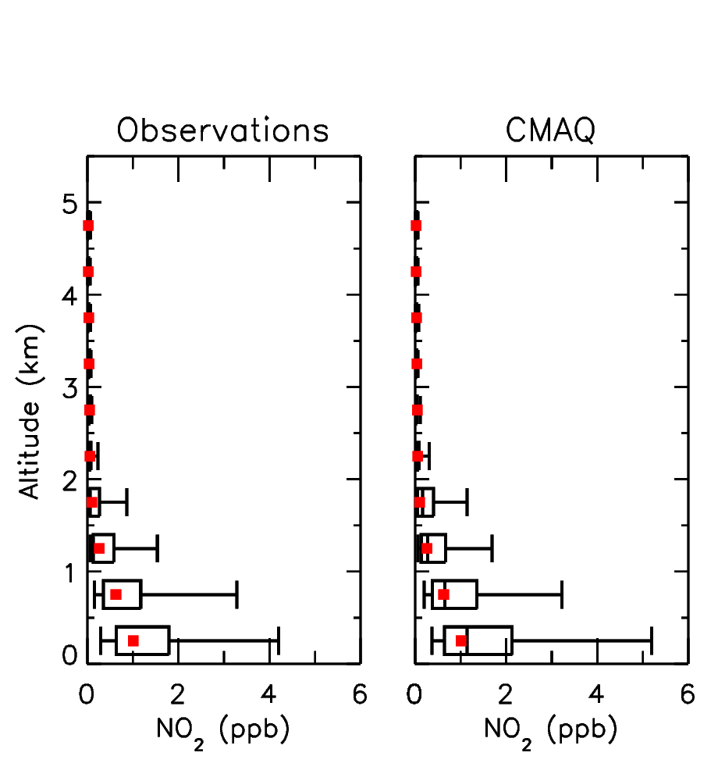
SCALED NO₂ PROFILES based on DISCoVER-AQ Maryland observations
Observations CMAQ
Adapted from Goldberg et al., 2016; GRL
DISCOVER-AQ Maryland was a field experiment (aircraft & ground measurements) that took place over urban and suburban Maryland during July 2011
Percentage at which the median of the observations lie in comparison to the model
139%
142%
148%
60.2%
95.0%
96.5%
88.3%
*Scaling may not be fully representative of rural areas or years outside of 2011, but this is a way to bypass completing another 1.33 km simulation over 5 years.
I will apply a scaling* factor based on this comparison…
88.3% between 0 – 500 m, 96.5% between 500 – 1000 m, etc.
Above 3.5 km I will switch back to GMI average profiles, since it appears to have a better representation of upper tropospheric NO_{x} (Lamsal, et al., submitted; JGR)
Notes:
Furthermore, what’s particularly great about using the Maryland area to develop this product is that the DISCOVER-AQ field campaign was conducted during July 2011. On the left I show observations of NO2 during DISCOVER-AQ from the P3-B aircraft. In the center and left panels, I show coincident model data from CMAQ and CAMx respectively. We found that there is a model overestimate of NO2 near the surface and a model underestimate above 2 km. The reasons for this are beyond the scope of this project. We can then adjust the vertical profiles of NO2 based on observations. I apply scaling factors for data within each respective vertical level. So all model data between the surface and 500 is scaled by 0.88, between 500 and 1000 m by 0.965. In essence this is a crude way of data assimilation.

Slide 14
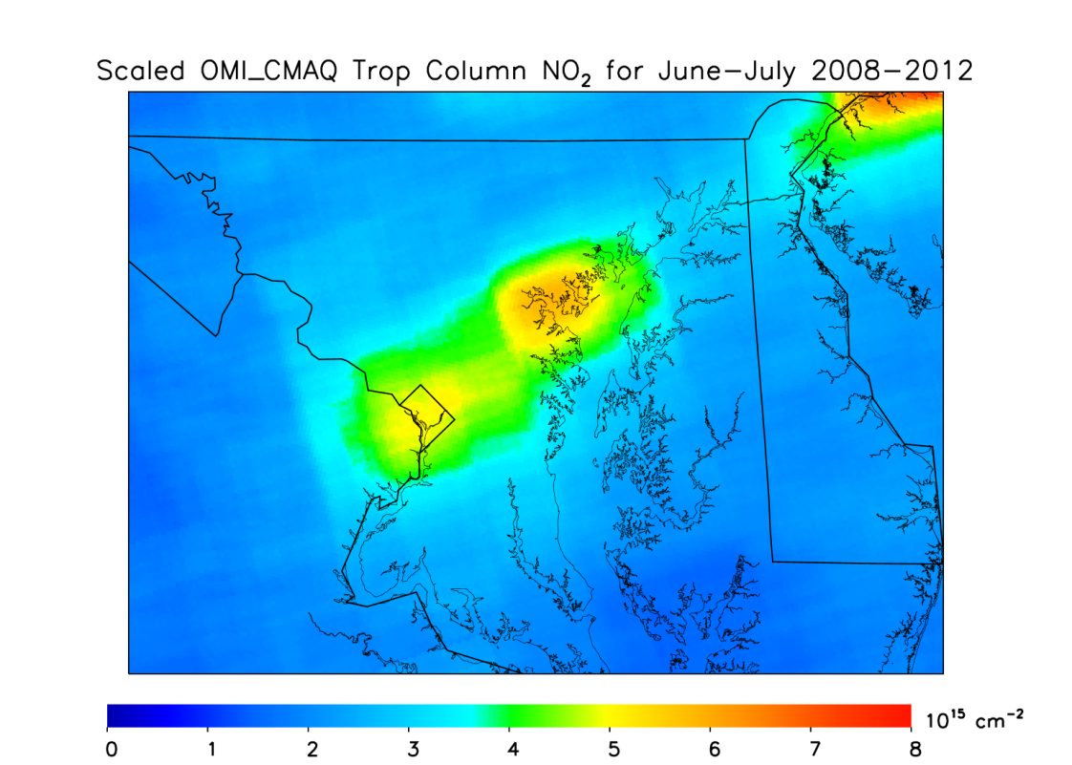
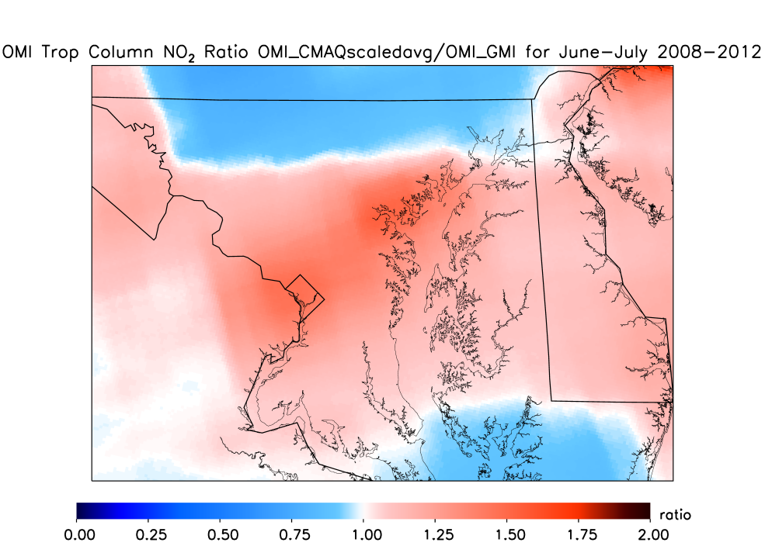
Oversampled view of tropospheric Column NO2
NASA OMI_GMI NO₂ Standard Product
Scaled OMI_CMAQ NO₂ Product
But we can do better!
r²=0.34
r²=0.43
Correlation with ground NO₂ monitors
All plots are showing June & July 2008 - 2012
Ratio: Scaled OMI_CMAQ / OMI_GMI
NO₂ columns are higher in urban and suburban areas
Rural areas in northern and southern Maryland see decreases
Further increase in correlation with ground monitors (r²=0.34 to r²=0.43)
Notes:
On the left is the operational product oversampled during the same 2008 to 2012 period. And on the right, we have the re-processed product, which is the same plot as displayed on the previous slide. There are big differences. The operational product barely shows any variability between urban cores and the rural areas upwind. When looking at something new like this, I like to take a step back. Does this make sense? NO2 has a short lifetime during summer, and due to this, must have large spatial heterogeneities. So the large heterogeneities introduced by the new calculation method make sense.

Slide 15
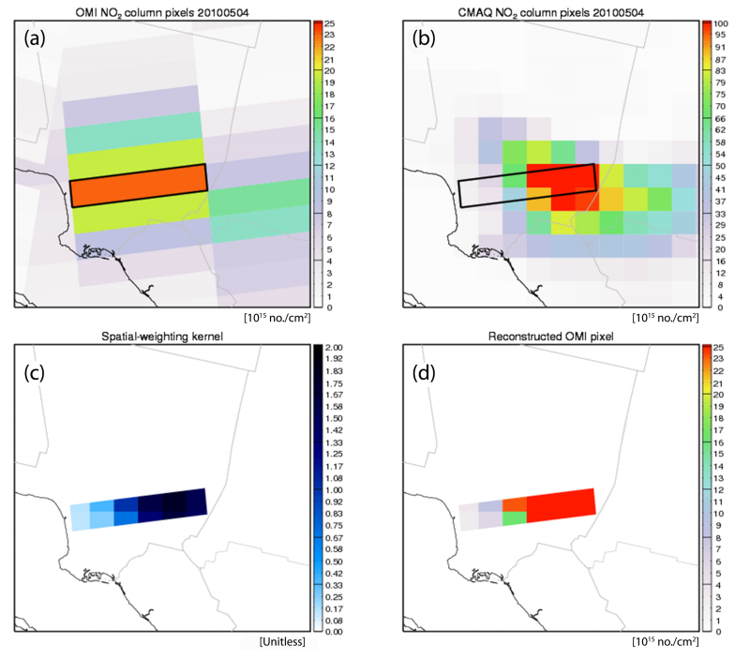
Spatial-weighted Downscaling
OMI NO₂ on May 4, 2010
CMAQ NO₂ on May 4, 2010
Figure 5 from Hyun Cheol Kim et al., 2016, Geosci. Model Devel. (GMD)
Figure is showing a snapshot in the
Los Angeles basin in southern California
Spatial-weighting kernel
Reconstructed OMI pixel

Slide 16
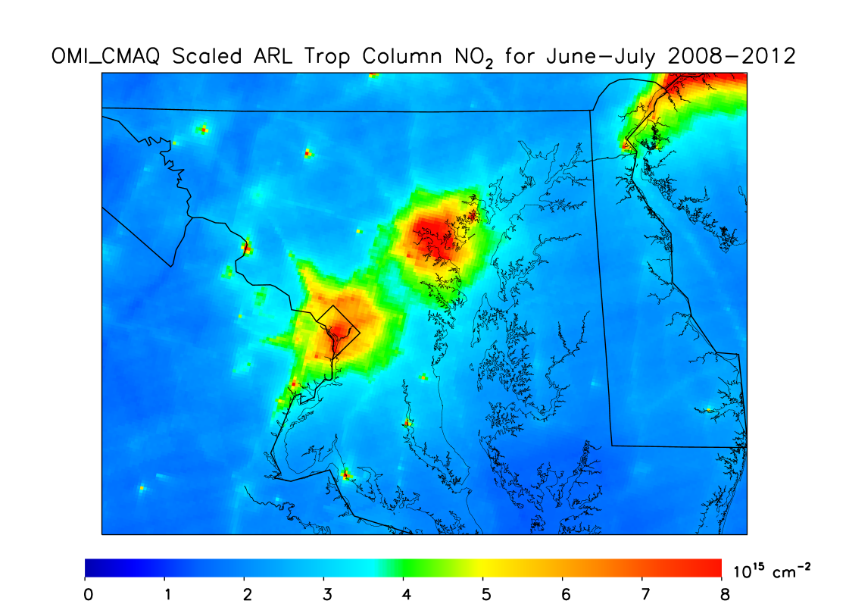
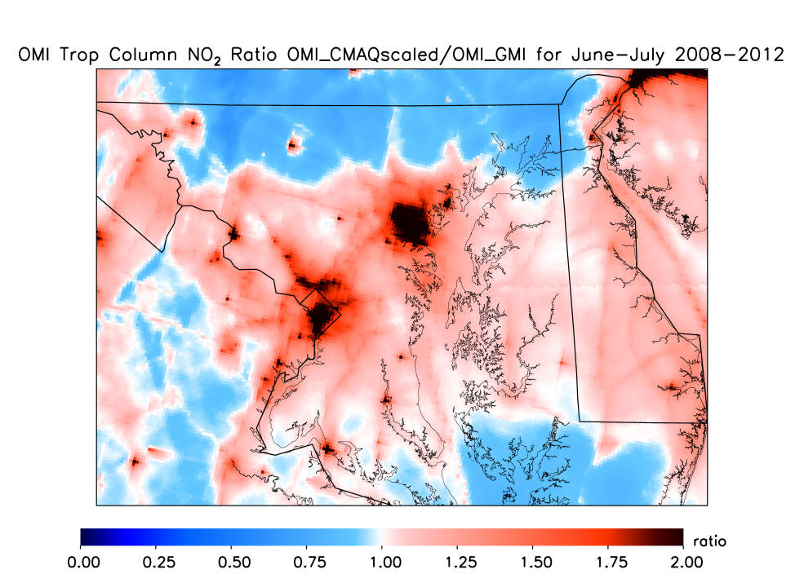
Oversampled view of tropospheric Column NO2
NASA OMI_GMI NO₂ Standard Product
Scaled & Spatial Weighted OMI_CMAQ NO₂ Product
r²=0.34
r²=0.61
Correlation with ground NO₂ monitors
Ratio: Scaled & Spatial Weighted OMI_CMAQ / OMI_GMI
NO₂ columns are much higher in urban areas and near power plants
Rural areas see decreases
Very large increase in the correlation with ground monitors!
All plots are showing June & July 2008 - 2012
*Spatial weighting based on an average of the 2011 CMAQ simulation
Notes:
On the left is the operational product oversampled during the same 2008 to 2012 period. And on the right, we have the re-processed product, which is the same plot as displayed on the previous slide. There are big differences. The operational product barely shows any variability between urban cores and the rural areas upwind. When looking at something new like this, I like to take a step back. Does this make sense? NO2 has a short lifetime during summer, and due to this, must have large spatial heterogeneities. So the large heterogeneities introduced by the new calculation method make sense.

Slide 17
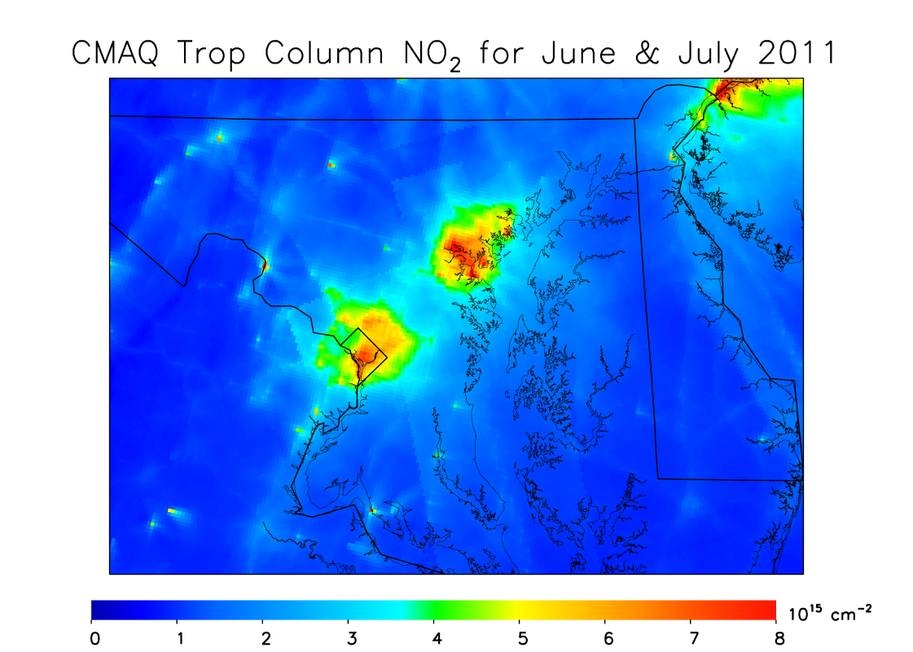
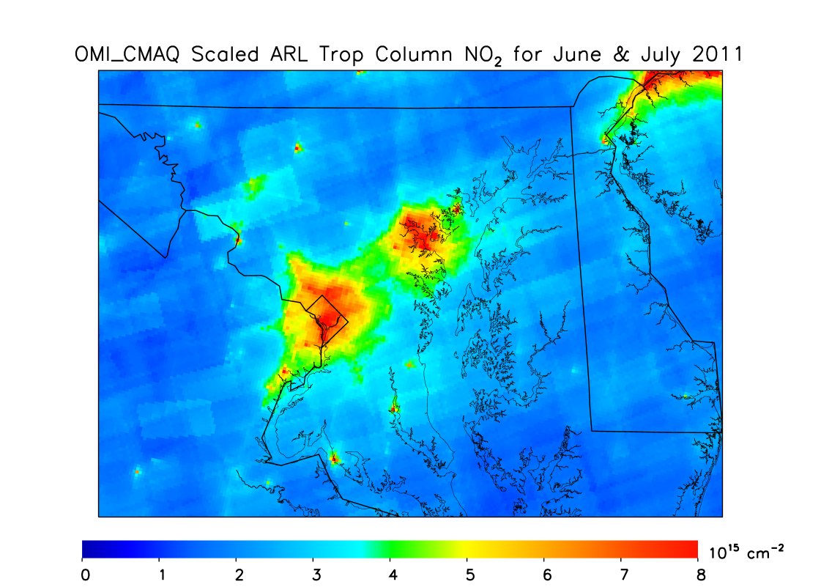
How does this compare with CMAQ?
CMAQ during valid satellite overpass
Scaled & Spatial Weighted OMI_CMAQ NO₂ Product
June & July 2011 only
NO₂ columns in CMAQ are similar in urban areas, but lower than “observed” by the satellite in rural areas.
Possible reasons for rural underestimate:
  Lack of soil NO_{x} emissions
  Lightning NO_{x} emissions incorrectly spatially allocated or too low
  Not enough recycling of alkyl nitrates to NO₂
  Not enough lofting of pollutants during large-scale convection
Notes:
On the left is the operational product oversampled during the same 2008 to 2012 period. And on the right, we have the re-processed product, which is the same plot as displayed on the previous slide. There are big differences. The operational product barely shows any variability between urban cores and the rural areas upwind. When looking at something new like this, I like to take a step back. Does this make sense? NO2 has a short lifetime during summer, and due to this, must have large spatial heterogeneities. So the large heterogeneities introduced by the new calculation method make sense.

Slide 18
CONCLUSIONS
A priori information used in operational NO₂ satellite products (NASA & KNMI) is insufficient for urban-scale studies. Instead, we suggest using a priori information from regional models (i.e., CMAQ), which better simulates surface concentrations of NO₂.
We’ve developed a new satellite product that yields higher NO₂ columns than the operational product near urban areas and large point sources and lower NO₂ columns in rural areas .
  In Baltimore: Operational: 4 × 10¹⁵ cm⁻² , New: 8 × 10¹⁵ cm⁻²
  In rural areas: Decreases by 20 – 40 %
New satellite product better captures the urban-scale variability of NO₂ and has a much better correlation with ground monitors, which is very valuable for health assessment studies.
  Operational, r² = 0.34
  New product, r² = 0.39
  New scaled product, r² = 0.43
  New spatially-weighted & scaled product, r² = 0.61

Slide 19
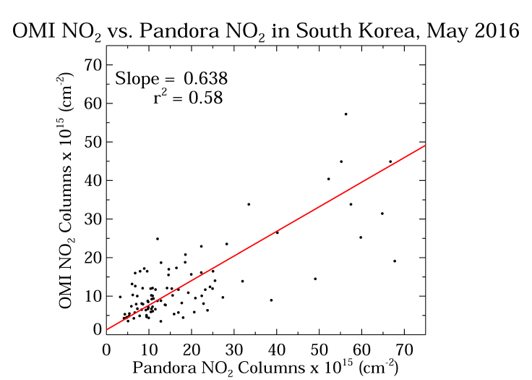
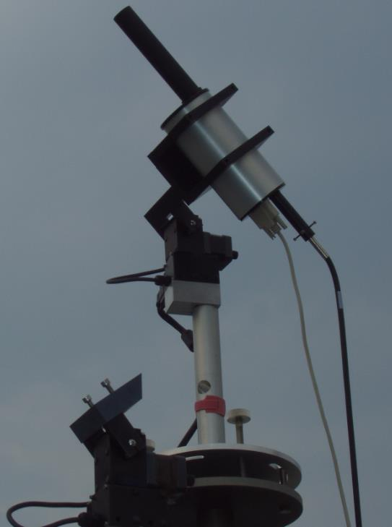
Next steps
Compare with observations from the SEARCH campaign to assess the new product’s ability to observe local variability
  50 monitors will be installed within 50 km of downtown Baltimore
Perform similar analysis for east Asia; there appears to be an underestimate of satellite OMI NO₂ columns in urban areas.
Pandora is a ground-based spectrometer that measures total NO₂ columns.

Slide 20
EXTRA SLIDES

Slide 21
Re-calculating NO₂ tropospheric vertical columns using high resolution airmass factors
Calculate shape factors (S_{Model}) for each model layer at each x-y grid point. Shape factors are the partial columns (x_{a}) between model layers divided by the total column amount (Σx_{a}).
Re-calculate tropospheric air mass factors (AMF_{trop_Model}) for each x-y point based on the CMAQ shape factors (S_{Model}). Air mass factors are the sum of the shape factors at each point multiplied by the scattering weight (w) (i.e., the satellite’s sensitivity at each model layer).
Re-calculate NO₂ tropospheric vertical columns (VC_{trop_OMI_Model}) for each x-y point. Tropospheric vertical columns are inversely proportional to the new tropospheric air mass factor (AMF_{trop_Model}).
Notes:
How do we re-calculate the air mass factors? (Pause) First, we calculate model shape factors. These are the partial columns at each model layer divided by the total tropospheric column. We then multiply the shape factor at each model layer by the scattering weight, which is the satellite’s sensitivity at each pressure level. Lastly, we can re-calculate the vertical tropospheric column by dividing the slant tropospheric column, alpha, by the air mass factor. And if you zoned out for the last 60 seconds because there’s a lot of text on this slide, you’re in luck I show the same thing in visual format the next few slides.

Slide 22
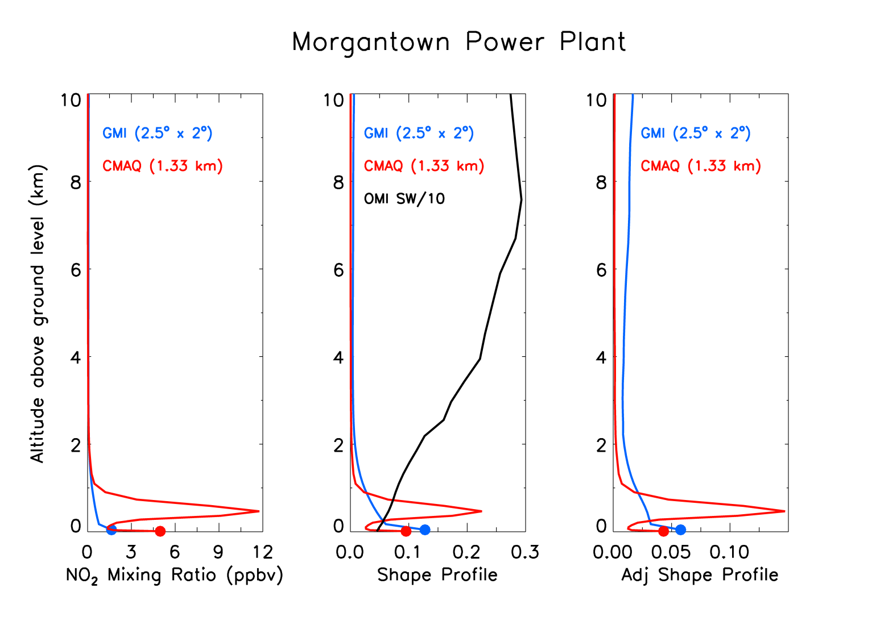
How do we re-calculate air mass factors (IN VISUAL FORMAT)?
Shape profile x Scattering Weight
AMF_{CMAQ} < AMF_{GMI} in urban areas & near large point sources
*Monthly mean data is shown
Notes:
I am now showing the same thing for the power plant in southern Maryland. In this scenario, the shape profiles differ greatly. Let’s go through the same procedure. CMAQ is saying NO2 is much more concentrated near the surface. The area under the blue curve is much larger than the red curve, so the air mass factor is smaller when using CMAQ. And once again since the air mass factor is inversely proportional to the total column, a smaller air mass factor will result in a larger tropospheric column.

Slide 23
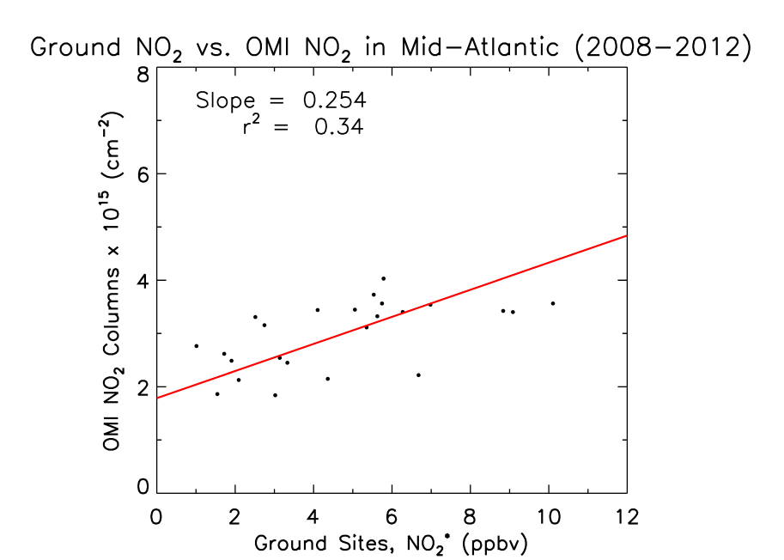
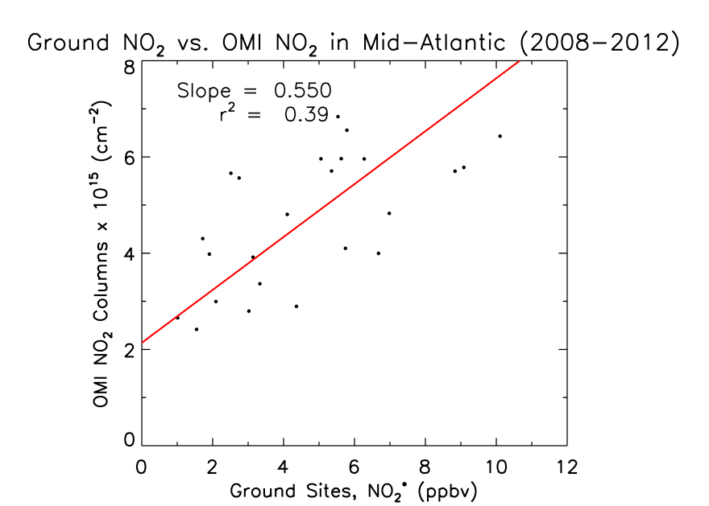
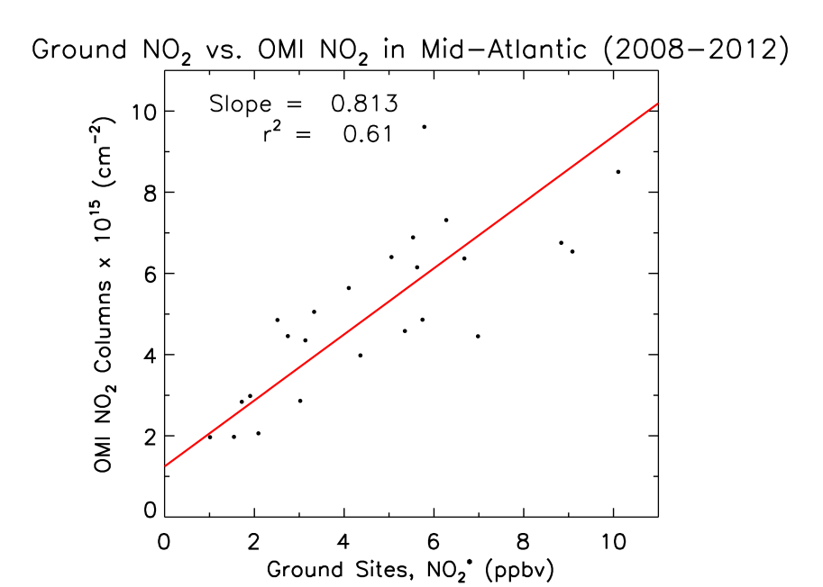
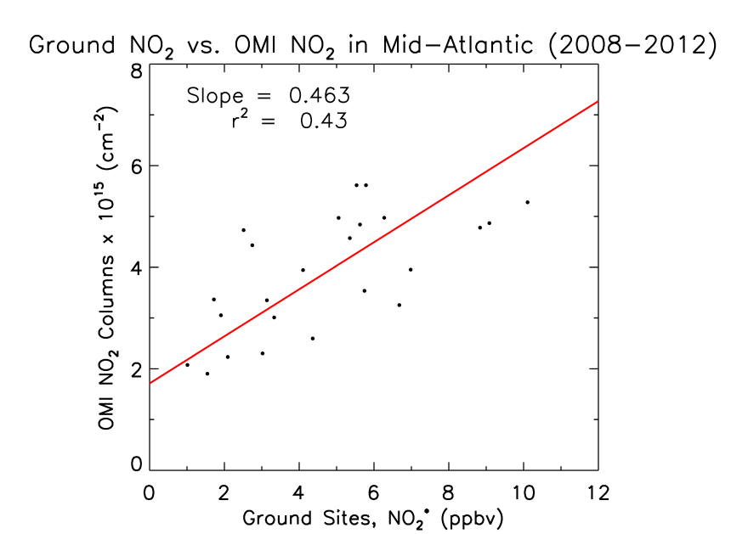
Comparison with ground monitors
Operational
Using CMAQ AMF
Using spatial-weighted
CMAQ-scaled AMF
Using CMAQ-scaled AMF
Notes:
To determine whether these products better capture the urban-scale variability of NO2, I compare these products to surface observations of NO2. The operational product has total columns between 2 and 4 times 10 to the 15 molecules per cm-squared and does not show a strong correlation with surface observations. The new product shows a larger slope and greater variability in NO2 columns; total column values are now between 2 and 7. Furthermore, the correlation also improves from 0.34 to 0.39. Lastly, the product with the scaled air mass factor shows the best correlation. We’ve now improved correlation to 0.43. Both updated versions of the product show better correlation with ground observations, and likely better represent the actual total column mount.

