Slide 1
Estimating age-segregated per-vehicle health benefits for the Canadian fleet
Angele Genereux Amanda Pappin Amir Hakami

Slide 2
Outline
Background
Introduction to the Per-vehicle health benefit [PVHB]
Marginal Damages
Emission Factor Modeling: Methodology & Results
PVHB: Methodology & Results
Applications
Future Work
2

Slide 3
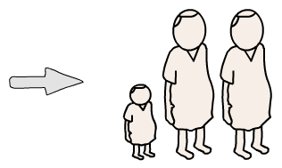
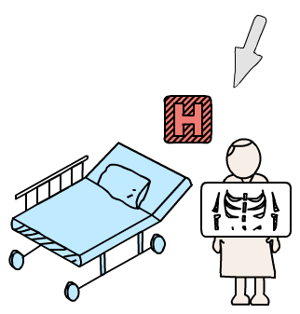
Transportation & Emissions
3

Slide 4
Per-vehicle health benefit
Defined as:
The Canadian public health damage resulting from a single vehicle per year
or
The Canadian public health benefit of removing a single vehicle from the road per year
4

Slide 5
Per-vehicle health benefit
Defined by the following equation:
(PVHB)=(MD)(EF)(VKT)
Where:
PVHB : Per-vehicle health benefit ($/vehicle-yr)
MD : Marginal damage ($/ton NO_{X})
EF : Emission factor (g/km)
VKT : Distance travelled by an average vehicle per year (km/ vehicle-yr)
Note: These results are specific to Canada and therefore are presented in CAD$
5

Slide 6
Marginal Damages
(PVHB)=(MD)(EF)(VKT)
6

Slide 7
Marginal Damages
Defined as:
The Canadian public health damage resulting from 1 ton of pollutant (i.e. NO_{X}) emissions
or
The Canadian public health benefit of reducing emissions of a pollutant (i.e. NO_{X}) by 1 ton
7

Slide 8
Marginal Damages
The MDs used in this study were estimated using an adjoint sensitivity analysis approach for atmospheric models in Canada (Pappin et al., 2016)
CMAQ Model Domain: 36 x 36 km (34 layers)
Episode: May 1st – September 30th, 2007 (O₃ season)
The authors estimate location-specific MDs for chronic effects of O₃, NO₂, and PM_{2.5} exposure
Example: Ottawa
MD(NO₂) = $504 000/ton
MD(O₃) = $32 400/ton
MD(PM_{2.5}) = $227 000/ton (New – unpublished)
8

Slide 9
Emission Factor Modeling
(PVHB)=(MD)(EF)(VKT)
9

Slide 10
1. Software
MOBILE6.2 Vehicle Emission Modeling Software (US EPA, 2006)
Used to generate fleet-average emission factors (in g/mi) for NO_{X} and PM_{2.5}
Accounts for evolving parameters with time, such as:
Emission standards and regulations
I/M test database
Vehicle population/activity
Vehicle deterioration with age
Not currently in use – replaced by MOVES
10

Slide 11
2. Limitations
MOBILE6.2 vs. MOBILE6.2c
Regulations (LDV – model years up to 2009)
Is not capable of handling fuel ranges available in 2016
Over-estimates deterioration – linear assumption
Spatial scale is limited
11

Slide 12
2. Limitations
MOBILE6.2 vs. MOBILE6.2c
MOVES is used in both Canada & US
Regulations (LDV – model years up to 2009)
MOVES includes up to Tier 3
Is not capable of handling fuel ranges available in 2016
MOVES is up-to-date
Over-estimates deterioration – linear assumption
MOVES has an updated methodology for calculating deterioration effects
Spatial scale is limited
MOVES allows the user to specify boundaries/custom domains
11

Slide 13
3. Methodology
Input data for Canada
Preparation of MOBILE6.2 Input
Modify age distribution files
Run MOBILE6.2
Group vehicles by fuel type
Post-Processing
Group vehicles into age bins
Emission Factors (g/mi)
12

Slide 14
3. Methodology
Temperature
RH
Sulfur Content
VKT
Input data for Canada
Preparation of MOBILE6.2 Input
Modify age distribution files
Run MOBILE6.2
Group vehicles by fuel type
Post-Processing
Group vehicles into age bins
Emission Factors (g/mi)
12

Slide 15
3. Methodology
Temperature
RH
Sulfur Content
VKT
Age Fractions
Input data for Canada
Preparation of MOBILE6.2 Input
Modify age distribution files
Run MOBILE6.2
Group vehicles by fuel type
Post-Processing
Group vehicles into age bins
Emission Factors (g/mi)
12

Slide 16
3. Methodology
Temperature
RH
Sulfur Content
VKT
Age Fractions
Input data for Canada
Preparation of MOBILE6.2 Input
Modify age distribution files
Run MOBILE6.2
Gasoline
Diesel
Group vehicles by fuel type
Post-Processing
Group vehicles into age bins
Emission Factors (g/mi)
12

Slide 17
3. Methodology
Temperature
RH
Sulfur Content
VKT
Age Fractions
Input data for Canada
Preparation of MOBILE6.2 Input
Modify age distribution files
Run MOBILE6.2
Age Bins:
0-2, 3-5, 6-9,
10-13, 14+ y
Gasoline
Diesel
Group vehicles by fuel type
Post-Processing
Group vehicles into age bins
Emission Factors (g/mi)
12

Slide 18
4. Results
Current: MOBILE6.2 Vehicle Emission Modeling Software (US EPA, 2006)
Canada-Specific Input:
Daily Temp: 38.6 F – 54 F
Model Years: 2001 – 2016
Future: MOVES Motor Vehicle Emission Simulator (US EPA, 2015)
2016 2011 2006 2001
13

Slide 19
Age-Based Per-Vehicle Health Benefit
(PVHB)=(MD)(EF)(VKT)
14

Slide 20
Age-Based PVHB: Methodology
Emission Factors
(g/mi)
Marginal Damage ($/ton)
VKT (km/veh-yr)
PVHB ($/veh-yr)
15

Slide 21
PVHB: Canada (LDGV,0-2)
Note: The PVHBs shown above are for emissions of NO_{X} for LDGV only (estimated benefits for PM_{2.5} are not shown)
16

Slide 22
PVHB: Canada (LDGV,0-2)
Vancouver, BC
Montreal, QC
Toronto, ON
Note: The PVHBs shown above are for emissions of NO_{X} for LDGV only (estimated benefits for PM_{2.5} are not shown)
16

Slide 23
PVHB: Canada (LDGV,3-5)
Note: The PVHBs shown above are for emissions of NO_{X} for LDGV only (estimated benefits for PM_{2.5} are not shown)
17

Slide 24
PVHB: Canada (LDGV,6-9)
Note: The PVHBs shown above are for emissions of NO_{X} for LDGV only (estimated benefits for PM_{2.5} are not shown)
18

Slide 25
PVHB: Canada (LDGV,10-13)
Note: The PVHBs shown above are for emissions of NO_{X} for LDGV only (estimated benefits for PM_{2.5} are not shown)
19

Slide 26
PVHB: Canada (LDGV,14+)
Note: The PVHBs shown above are for emissions of NO_{X} for LDGV only (estimated benefits for PM_{2.5} are not shown)
20

Slide 27
PVHB: Ottawa, Toronto, Montreal (LDGV)
M
T
O
21

Slide 28
PVHB: Ottawa, Toronto, Montreal (LDGV)
M
ΔPVHB(NO₂) ≈ $6 340 /veh-yr
T
ΔPVHB(NO₂) ≈ $2 570 /veh-yr
O
21

Slide 29
PVHB: Ottawa, Toronto, Montreal (LDDV)
M
T
O
22

Slide 30
PVHB: Ottawa (LDGV)
23

Slide 31
PVHB: Ottawa (LDGV)
23

Slide 32
PVHB: Ottawa (LDGV)
23

Slide 33
PVHB: Ottawa (LDDV)
24

Slide 34
PVHB: Ottawa (LDDV)
24

Slide 35
PVHB: Ottawa (LDDV)
8 8 9 11 36
24

Slide 36
Applications of Research
25

Slide 37
1. Heavy-Duty Vehicles
PVHB in terms of dollars per distance travelled ($/10³ km)
Gasoline
Diesel
T
O
T
O
PVHB(NO₂) PVHB(O₃) PVHB(PM_{2.5})
26

Slide 38
1. Heavy-Duty Vehicles
PVHB in terms of dollars per distance travelled ($/10³ km)
Gasoline
Diesel
PVHB(NO₂) = $4170 /10³ km
T
O
PVHB(NO₂) = $3240 /10³ km
PVHB(NO₂) = $1800 /10³ km
T
PVHB(NO₂) = $1400 /10³ km
O
PVHB(NO₂) PVHB(O₃) PVHB(PM_{2.5})
26

Slide 39
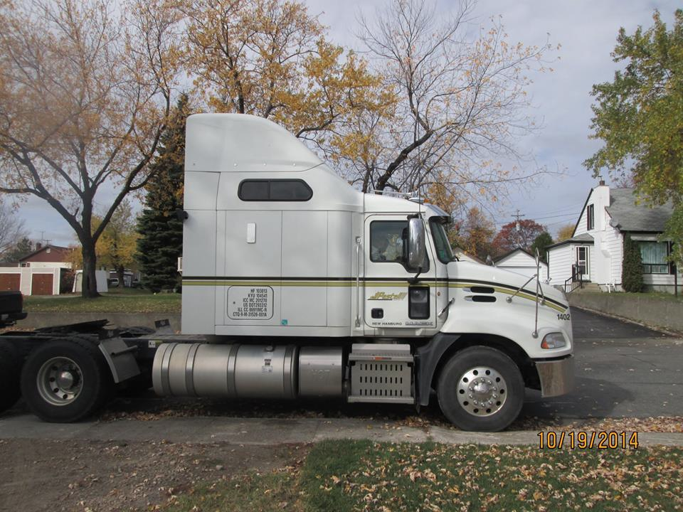
1. Heavy-Duty Vehicles
Example: HDDV (Canada-wide Transport)
Age = 2 years (fairly new)
VKT_{AVG} = 111 x 10³ km/year ^{[1]}
MD(NO₂)_{CAN,AVG} = $204 900/ton
MD(O₃)_{CAN,AVG} = $22 200/ton
^{[1]} Estimated from Transportation in Canada Reports
27
Notes:
EF(avg) = 0.24 g/mi
-If all of this driving occurred IN OTTAWA:
PVHB(NO2) = $ 8452, PVHB(O3)=$ 544, PVHB(PM2.5) = $ 182

Slide 40
1. Heavy-Duty Vehicles
Example: HDDV (Canada-wide Transport)
Age = 2 years (fairly new)
VKT_{AVG} = 111 x 10³ km/year ^{[1]}
MD(NO₂)_{CAN,AVG} = $204 900/ton
MD(O₃)_{CAN,AVG} = $22 200/ton
PVHB (NO₂) = $3 390
PVHB (O₃) = $153
^{[1]} Estimated from Transportation in Canada Reports
27
Notes:
EF(avg) = 0.24 g/mi
-If all of this driving occurred IN OTTAWA:
PVHB(NO2) = $ 8452, PVHB(O3)=$ 544, PVHB(PM2.5) = $ 182

Slide 41
2. Volkswagen Damage
Example: Recent news concerning Volkswagen
Models affected: 2009-2015
Average NO_{X} emission factor
Measured (“true”) = 1.45 – 1.50 g/mi (Oldenkamp et al., 2016 & Barrett et. al., 2015)
Standard Mobile6.2 (“predicted”) = 0.102 g/mi
MD(NO₂)_{CAN,AVG} = $204 900/ton NO_{X}
MD(O₃)_{CAN,AVG} = $22 200/ton NO_{X}
28

Slide 42
2. Volkswagen Damage
29

Slide 43
2. Volkswagen Damage
Total Damage (NO₂-Basis) = $1.1 billion
Total Damage (O₃-Basis)= $50.5 million
30

Slide 44
2. Volkswagen Damage
 | United States | Canada
Total # Affected Vehicles (VW & Audi) | ~480 000 | ~100 000
Scale Factor | 4.8
Min Damage ($, million) | 450 | 94
Max Damage ($, million) | 840 | 175
Do these results make sense?
TD(NO₂-Basis) = $1.1 billion
TD(O₃-Basis)= $50.5 million
How much larger are they?
6-12 times larger than U.S. estimate
We attribute this difference in damage largely to NO₂
31
Notes:
Avg of 6.4 & 11.95 = 9.175

Slide 45
2. Volkswagen Damage
STANDARD (EF=0.102 g/mi)
ACTUAL (EF=1.45 g/mi)
100 200 400 700 1200 2200
$/vehicle-yr
32
Notes:
Assuming VKT = 13566 km/vehicle-year (average)

Slide 46
Conclusions
The PVHB provides an estimation of public health damage from transportation-related emissions
The PVHB provides an incentive to remove older vehicles from the road (as benefits increase with age)
Results are given on a per-year basis, by age category
Estimates for the HDV sector are available (in $/10³ km) and show a similar trend with age
33

Slide 47
Future Work
EF Estimates Using MOVES: Create a new database of emission factors for Canada using MOVES
Current PM results are for primary species: We do not have secondary PM damage estimates (yet)
Resolution & Domain: This is a coarse resolution damage estimation
Thank you for your attention!
34

Slide 48
Acknowledgements
Dr. Amir Hakami
Carleton University
Dr. Amanda Pappin
Carleton University
Dr. Deniz Karman
Carleton University
Brett Taylor
Environment Canada
35

Slide 49
References
Barrett, S. R., Speth, R. L., Eastham, S. D., Dedoussi, I. C., Ashok, A., Malina, R., et al. (2015). Impact of the Volkswagen emissions control defeat device on US public health. Environmental Research Letters , 10 (11), 1-10.
ECCC. (2015, 09 22). Archived - Government of Canada opens an investigation into Volkswagen's alleged use of defeat devices to circumvent emissions regulations. Retrieved from news.gc.ca: http://news.gc.ca/web/article-en.do?nid=1017319
Environment Canada. (2014). Sulphur in Liquid Fuels 2010-2012. Oil, Gas and Alternative Energy Division. Gatineau: Environment Canada.
Government of Canada. (2016, 04 19). Canadian Climate Normals 1981-2010 Station Data. Retrieved from http://climate.weather.gc.ca/climate_normals/results_1981_2010_e.html?stnID=4333&lang=e&StationName=ottawa&SearchType=Contains&stnNameSubmit=go&dCode=1
Government of Ontario. (2015, 10 07). Volkswagen diesel models and emissions testing. (G. Murray, Producer, & Ministry of the Environment and Climate Change) Retrieved from www.ontario.ca: https://www.ontario.ca/page/volkswagen-diesel-models-and-emissions-testing
Holland, S. P., Mansur, E. T., Muller, N. Z., & Yates, A. J. (2016). Damages and Expected Deaths Due to Excess NOx Emissions from 2009 to 2015 Volkswagen Diesel Vehicles. Environmental Science & Technology , 50, 1111-1117.
NRC. (2011). Canadian Vehicle Survey: 2009 Summary Report. Office of Energy Efficiency. Ottawa: Energy Publications.
OC Transpo. (2014, 12 31). Bus Fleet Stats. Retrieved from http://www.octranspo1.com/about-octranspo/bus_fleet
Oldenkamp, R., van Zelm, R., & Huijbregts, M. A. (2016). Valuing the human health damage caused by the fraud of Volkswagen. Environmental Pollution , 212, 121-127.
Pappin, A., Hakami, A., Blagden, P., Nasari, M., Szyszkowicz, M., & Burnett, R. (2016). Estimating the benefits of reducing NOx emissions in the presence of epidemiological and atmospheric nonlinearities. Environmental Research Letters .
US EPA. (2006). MOBILE6 Vehicle Emission Modeling Software. Retrieved from https://www3.epa.gov/otaq/m6.htm
US EPA. (2015). MOVES (Motor Vehicle Emission Simulator). Retrieved from https://www3.epa.gov/otaq/models/moves/index.htm
36

Slide 50
Appendix
Sample Calculations
Estimation of min/max daily temperature
Grouping by fuel type
Grouping by vehicle age
PVHB
VW
37

Slide 51
Sample Calculations
1. Estimation of min/max daily temperature
Temperature data for four major cities was gathered from the Government of Canada website (Canadian Climate Normals 1981-2010 Station data)
Data was averaged for four major cities:
 | Daily Max (AVG in F) | Daily Min (AVG - in F) | Range
Ottawa | 52.52 | 35.42 | 17.1
Toronto | 55.22 | 42.62 | 12.6
Vancouver | 57.02 | 44.24 | 12.78
Montreal | 51.26 | 31.97 | 19.29
Average | 54.00 | 38.56
38

Slide 52
Sample Calculations
2. Grouping by fuel type
Mobile6.2 designates 28 vehicle classes
Vehicle classes are combined by fuel type as follows:
39

Slide 53
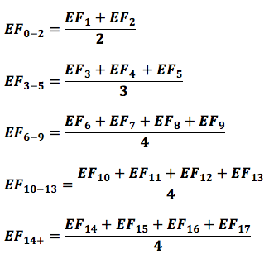
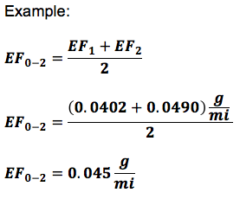
Sample Calculations
3. Grouping by vehicle age
The 2009 Canadian Vehicle Survey outlines the following 5 vehicle age bins:
<3, 3-5, 6-9, 10-13, 14+
Emission factors are calculated by averaging the results for each bin using the respective model years, as follows:
40

Slide 54
A1. Sample Calculations
4. Per-vehicle health benefit
Assume:
VKT = 15 366 km/veh-yr for one average Canadian vehicle (CVS, 2009)
41

Slide 55
2. Damage Estimation
42

Slide 56
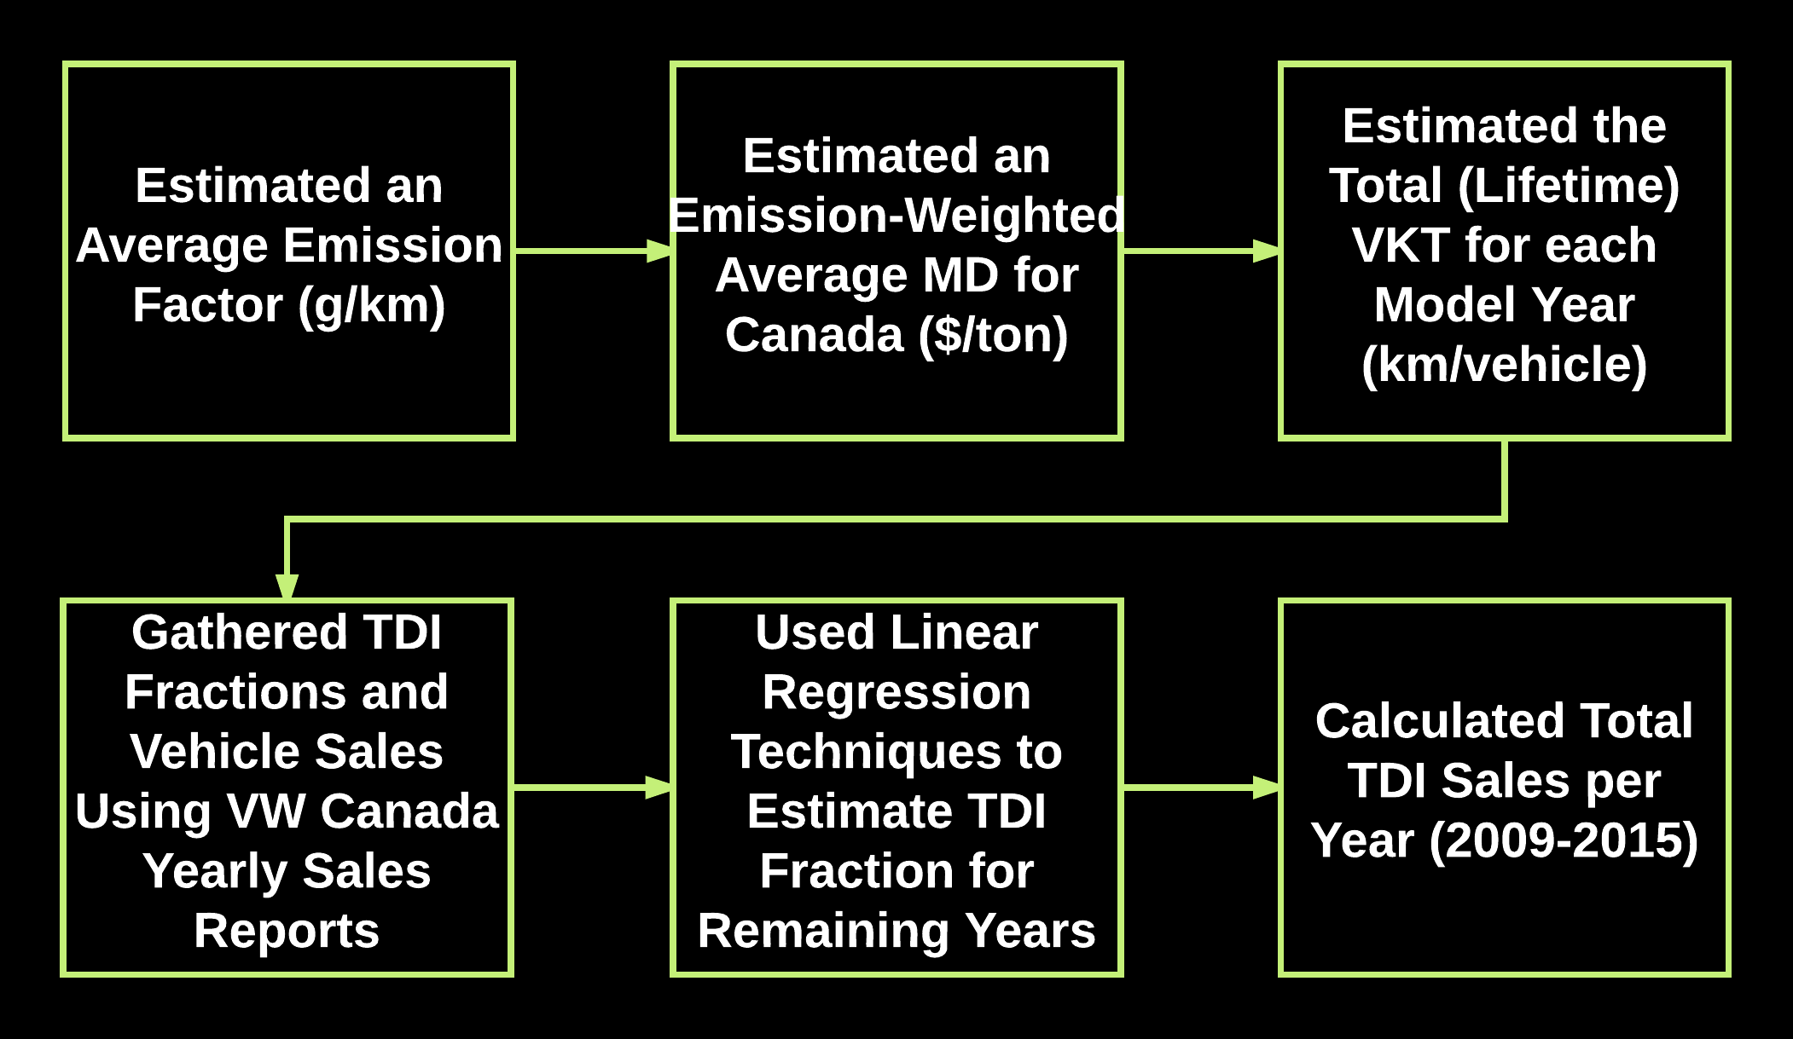
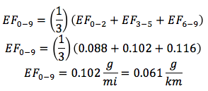
2. Damage Estimation
43
Notes:
--EDIT THE REST OF THIS SLIDE WITH NEW COLORS/BACKGROUND

Slide 57
2. Damage Estimation
44

Slide 58
2. Damage Estimation
45

Slide 59
2. Damage Estimation
Calendar Year | VW Canada Sales (# Vehicles, total) | TDI Fraction (%)
2009 | 40 059 | 26
2010 | 45 388 | 29
2011 | 52 604 | -
2012 | 59 132 | -
2013 | 62 688 | 23.5
2014 | 65 677 | 20
2015 | 50 418 | -
46

Slide 60
2. Damage Estimation
Calendar Year | TDI Fraction (%)
2009 | 26
2010 | 29
2011 | 25.3
2012 | 23.9
2013 | 23.5
2014 | 20
2015 | 19.8
47

Slide 61
2. Damage Estimation
48

Slide 62
Sample Calculations
5. VW Estimations
Total Damage Estimation:
 | 2009 | 2010 | 2011 | 2012 | 2013 | 2014 | 2015 | Total
Total VKT over lifetime (km/vehicle) | 123 219 | 106 619 | 91 526 | 74 386 | 57 999 | 38 909 | 20 219 | -
TDI Fraction of Models sold (%) | 26 | 29 | 25.3 ^{[2]} | 23.9 ^{[2]} | 23.5 | 20 | 19.2 ^{[2]} | -
Number of affected TDI models | 10 415 | 13 163 | 13 313 | 14 157 | 14 732 | 13 135 | 10 002 | 89 k
Total Damage (NO₂-Basis, $ in millions)^{[1]} | 220 | 241 | 209 | 181 | 147 | 88 | 35 | 1.118
Total Damage (O₃-Basis, $ in millions)^{[1]} | 9.9 | 10.9 | 9.4 | 8.2 | 6.6 | 4 | 1.6 | 50.5

