Slide 1
Evaluation of Intensity-Duration-Frequency (IDF) Curves Developed from Dynamically Downscaled Regional WRF Simulations
Chuen Meei Gan¹ & Tanya Spero²
1) CSRA LLC , RTP, NC 27709 USA
2) NERL, U.S. EPA, RTP, NC 27711 USA
15th Annual CMAS Conference

Slide 2
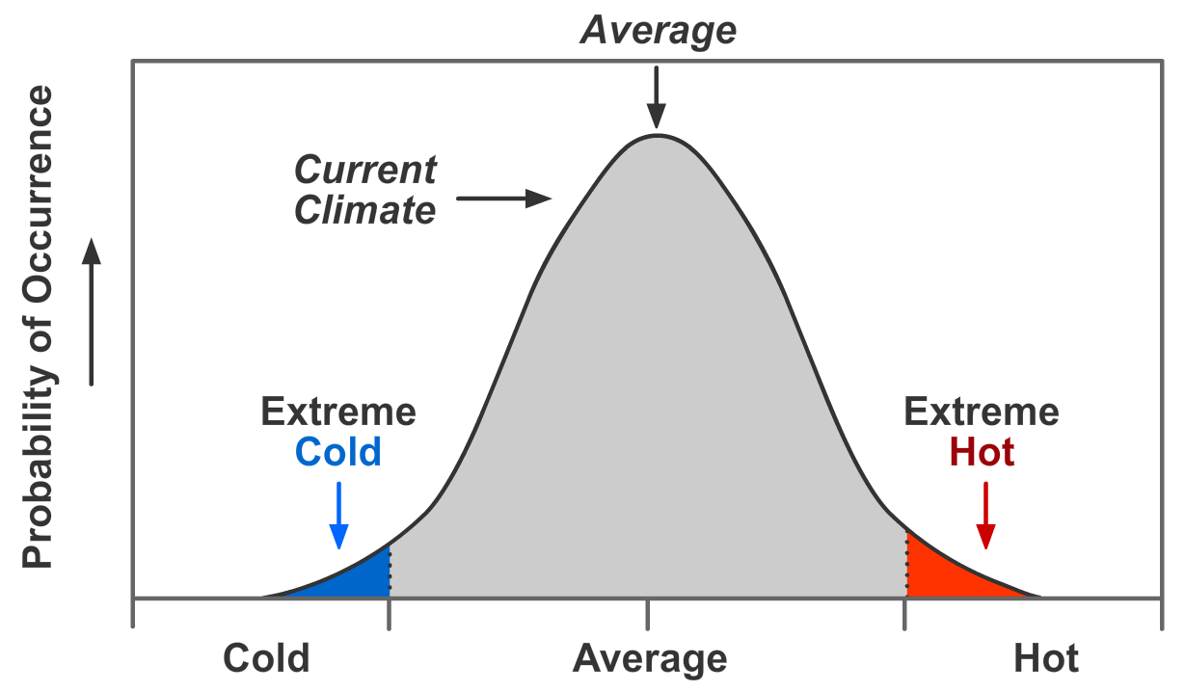
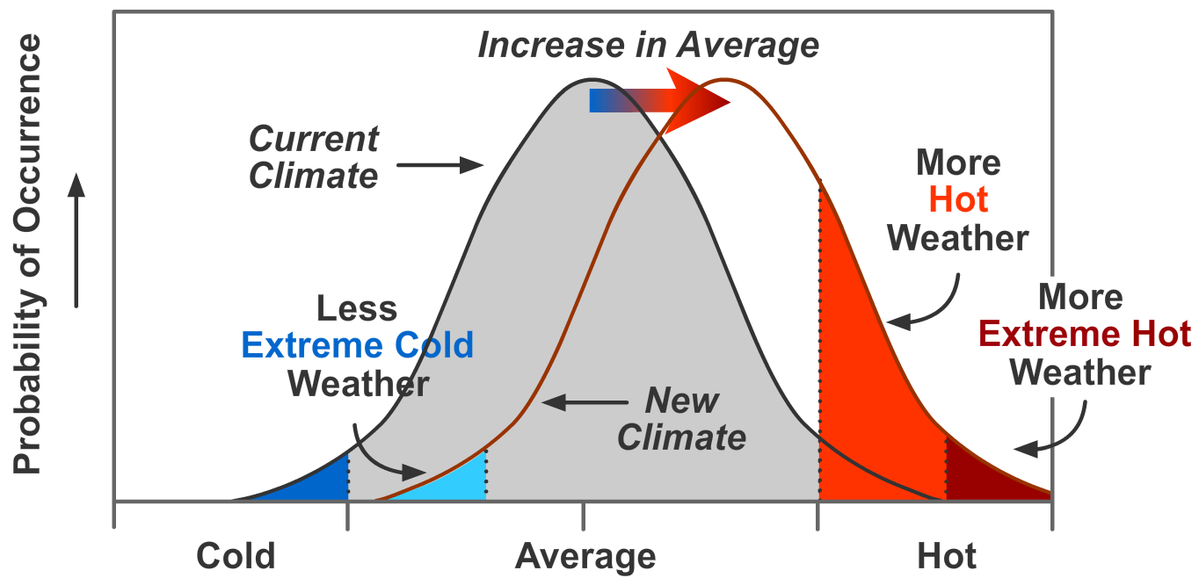
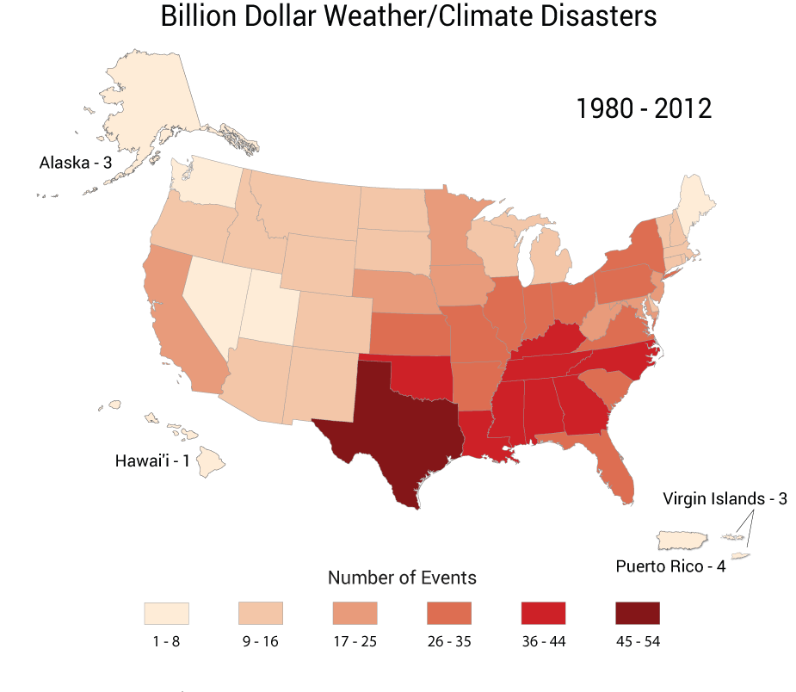
Motivation
Extreme weather (e.g. drought, hurricanes, tornadoes) ⬄ climate change
temperature
Figure source: NOAA NCDC
Frequency: Are extreme precipitation events occurring more often than they did in the past?
Intensity: Are extreme events intensifying with the potential for more damaging societal effects?
Duration: Are events lasting longer than in the past?
Timing: Are events occurring earlier or later in the season or the year other than they used to? Are their associations with other weather events changing?
IDF curve applications help in the planning, design, and management of water resources projects.

Slide 3
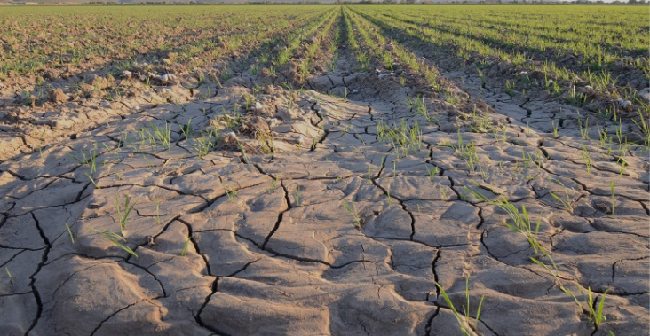
News
http://floodlist.com/america/usa/

Slide 4
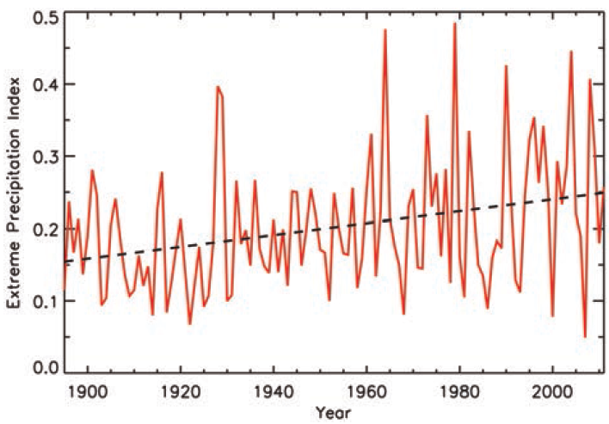
Study Design
IDF curves are developed from long time series of precipitation (simulation and observation).
A 23 year (1988–2010), 36-km historical downscaled WRF simulation (CONUS domain) is used.
Hourly precipitation data is obtained from National Centers for Environmental Information.
Develop Intensity-Duration-Frequency (IDF) curve using Gumbel distribution
Compare IDF curves from downscaled WRF to IDF curves from observations.
Determine if this methodology can be applied using downscaled future climate simulations to project changes in precipitation.

Slide 5
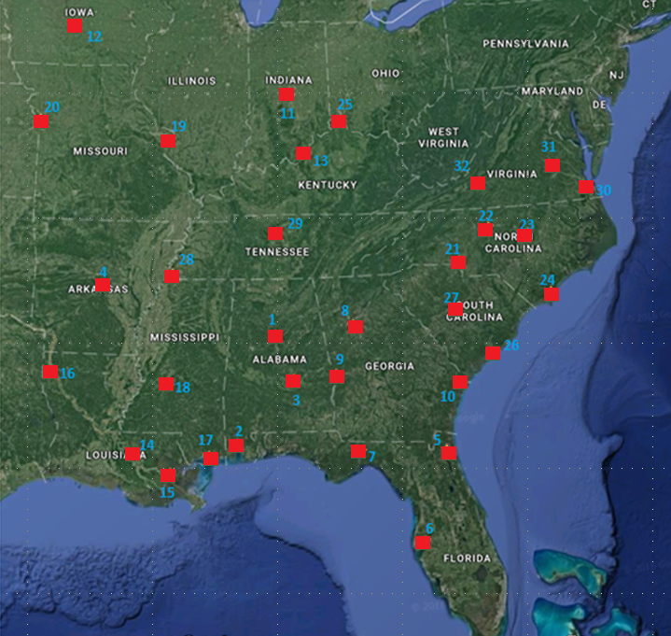
Evaluating IDF Curves across the Southeastern US

Slide 6
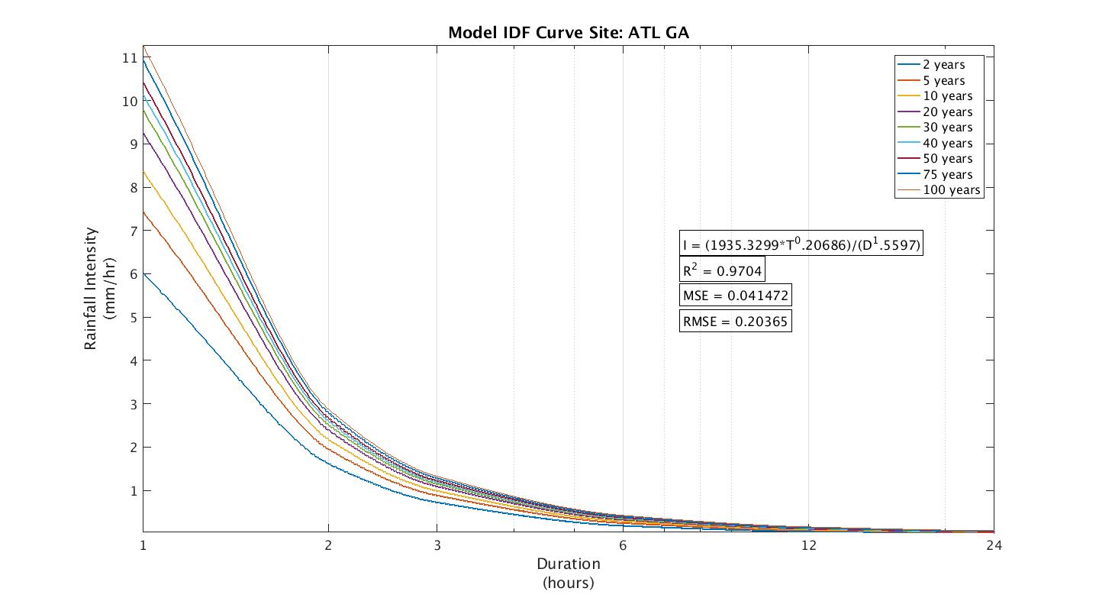
Developing IDF Curves
Hourly precipitation at each study site is calculated using the mean of:
Observed hourly rain gauge values from at least 10 sites in and around the city.
Downscaled WRF values from a 3x3 (9-cell) patch centered on each city.
Maximum precipitation is recorded within each year and city for durations of 1, 2, 3, 6, 12, and 24 hours.
Running averages are used for durations longer than 1 hour.
Gumbel distributions are used to analyze the maximum observed and modeled series.
Expected annual maximum intensities are determined for return periods of 2, 5, 10, 20, 40, 50, 75, and 100 years.
Frequency Precipitation computed from Gumbel Distribution

Slide 7
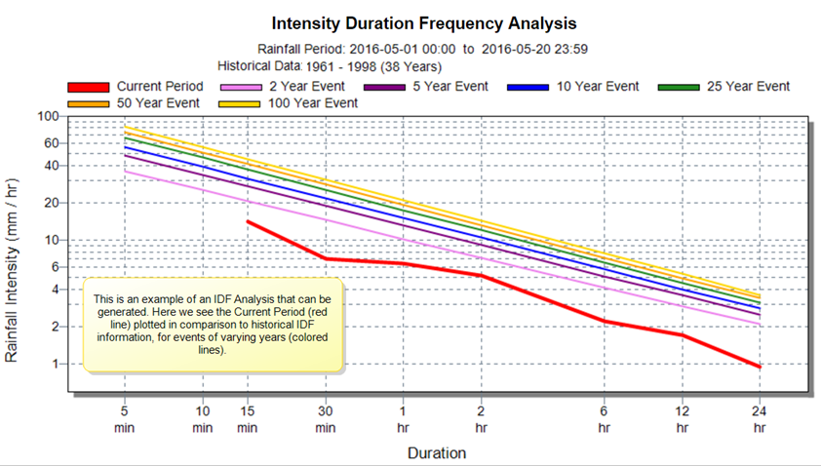
How to interpret IDF Curves?
Example
Heavy rain
Rainfall intensity in the IDF Curve is the average rainfall depth that falls per specific time duration.
In particular, estimates of extreme rainfall intensities are required for the design of safe and economical flood control, drainage or sewer systems.
Low probability of occurrence
Light rain
Adapted from https://support.flowworks.com/hc/en-us/articles/208464566-IDF-Curves-Explained
Notes:
Simplified, high rainfall intensity indicates that it’s raining really hard and low intensity that it’s raining lightly.

Slide 8
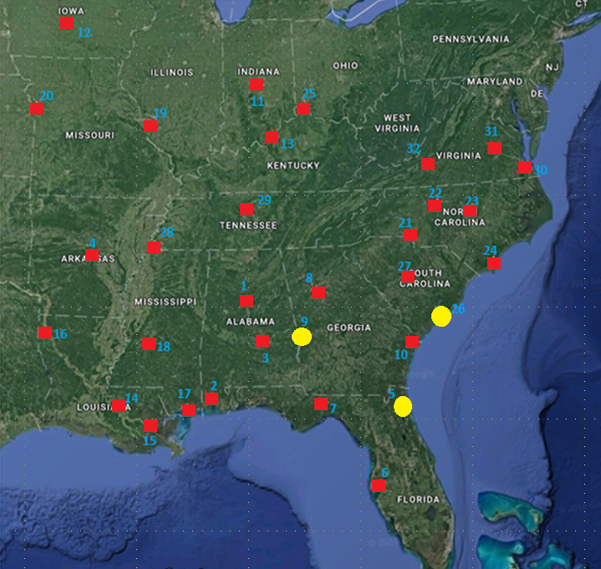
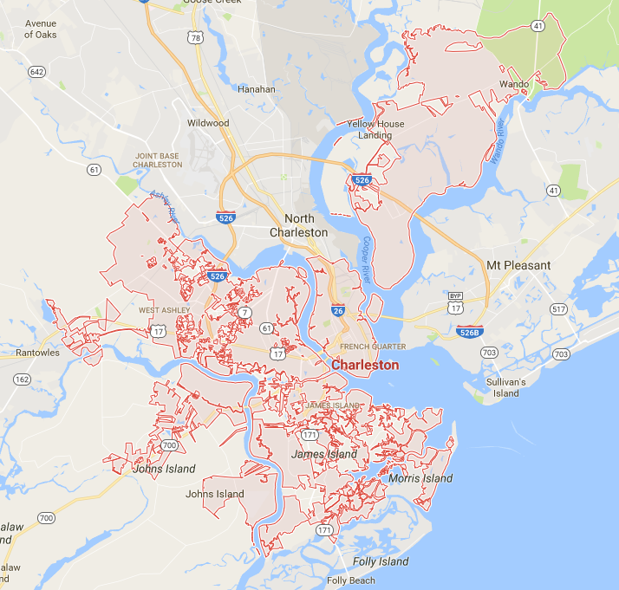
1) Charleston, South Carolina

Slide 9
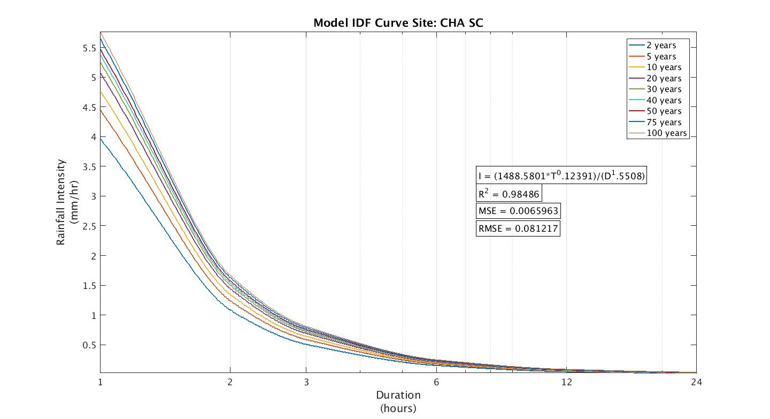
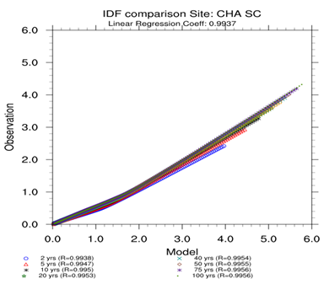
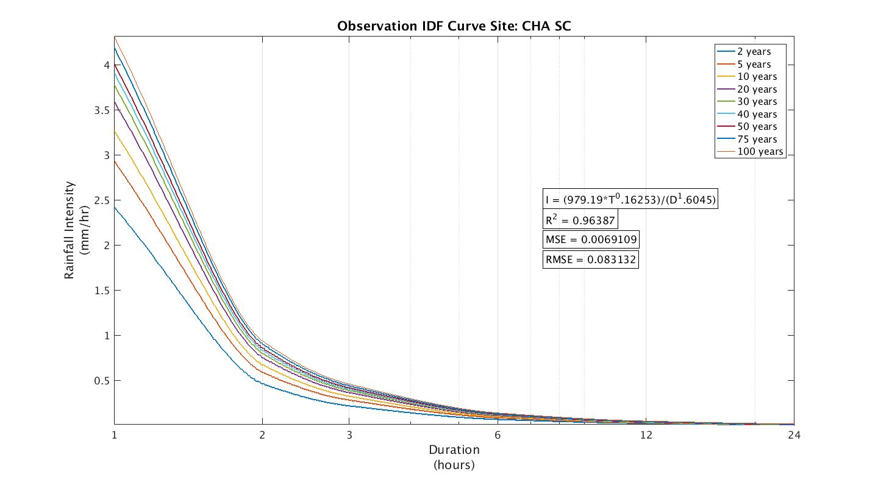
Charleston, South Carolina
Coastal area
Humid subtropical climate

Slide 10
2) Columbus, Georgia

Slide 11
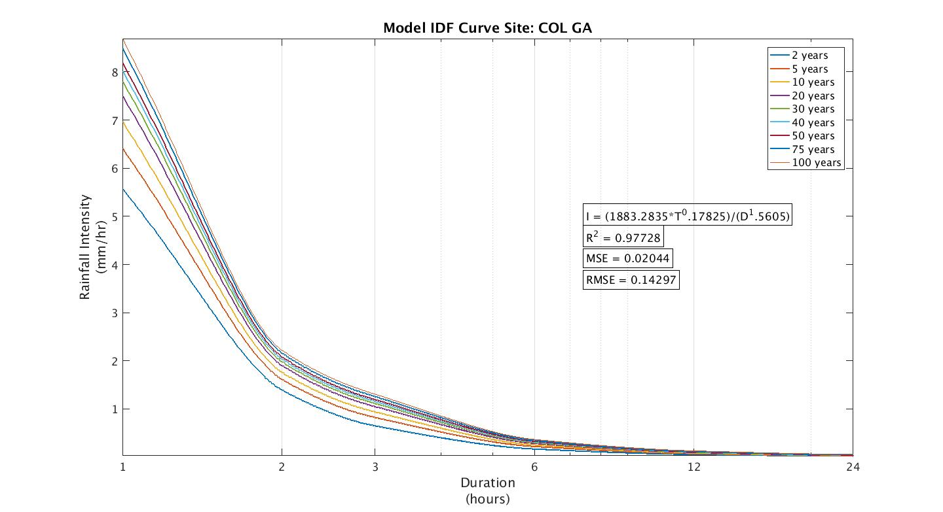
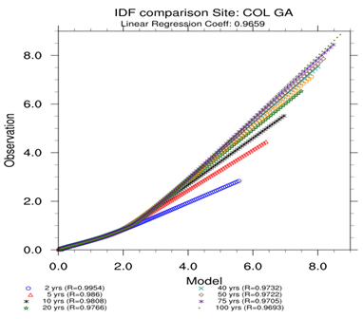
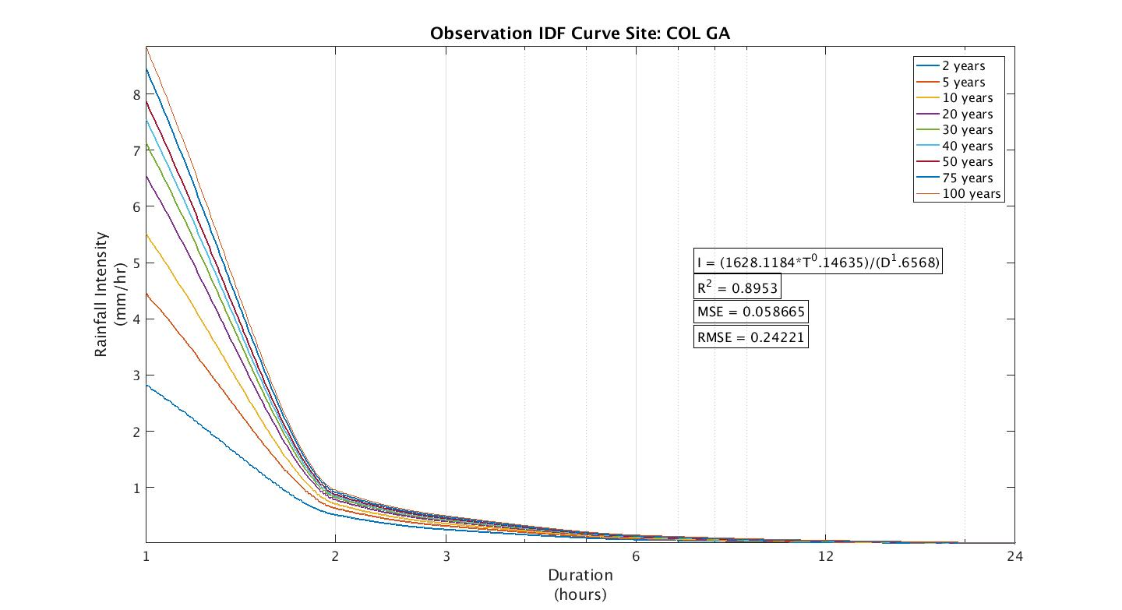
Columbus, Georgia
Inland with major river
Humid subtropical climate

Slide 12
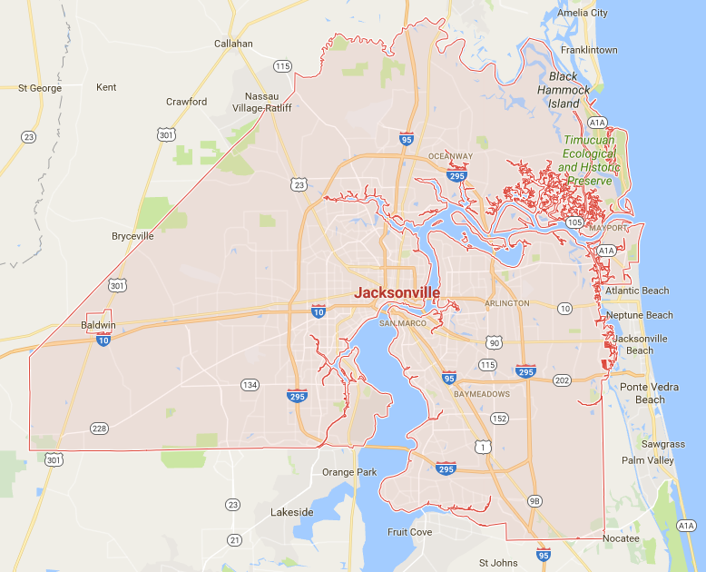
3) Jacksonville, Florida

Slide 13
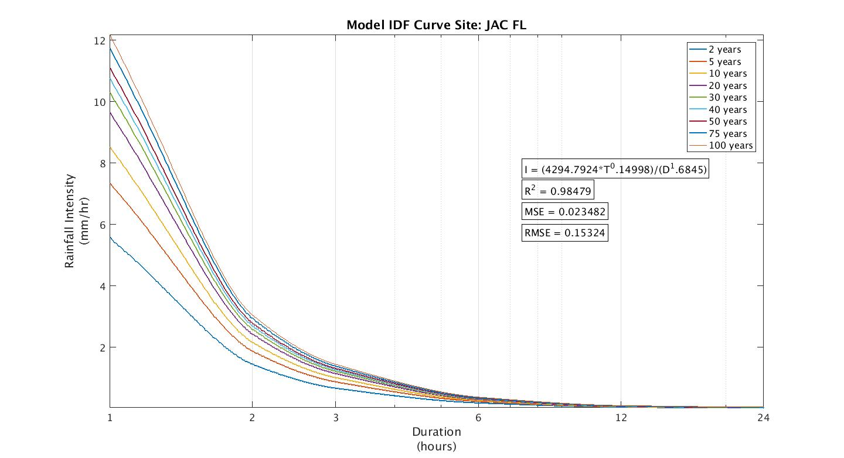
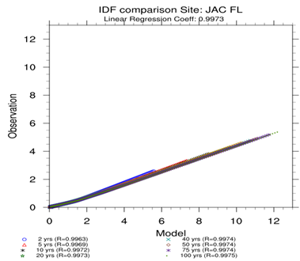
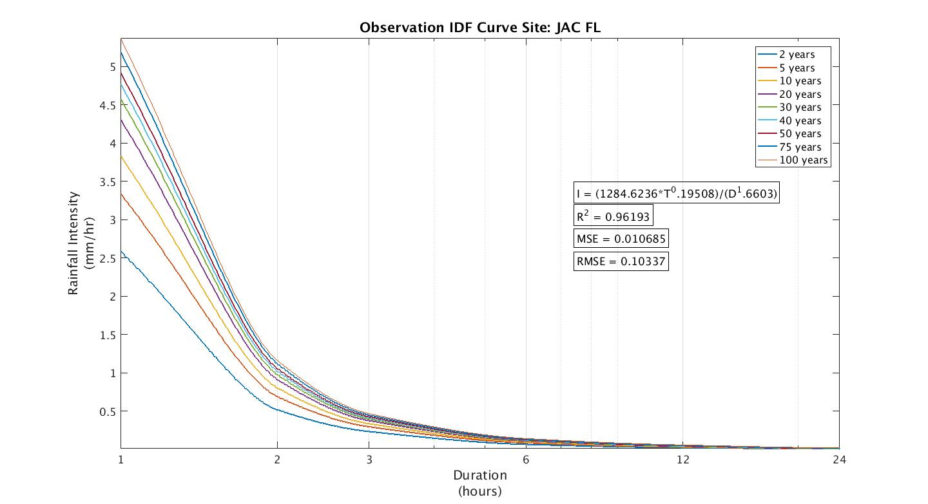
Jacksonville, Florida
Coastal area
Humid subtropical climate

Slide 14
Duration vs. Return Period for All Sites
Mean of the differences of the computed intensities (obs minus model).
 | Return period, Tr (year)
Duration (hr) | 2 | 5 | 10 | 20 | 30 | 40 | 50 | 75 | 100
1 | 2.8343 | 2.8598 | 2.8766 | 2.8928 | 2.9021 | 2.9087 | 2.9137 | 2.9229 | 2.9294
2 | 0.9677 | 1.1026 | 1.1920 | 1.2777 | 1.3270 | 1.3617 | 1.3886 | 1.4373 | 1.4717
3 | 0.4309 | 0.5033 | 0.5512 | 0.5971 | 0.6236 | 0.6422 | 0.6566 | 0.6827 | 0.7012
6 | 0.1059 | 0.1279 | 0.1424 | 0.1564 | 0.1644 | 0.1700 | 0.1744 | 0.1823 | 0.1879
12 | 0.0274 | 0.0348 | 0.0397 | 0.0444 | 0.0471 | 0.0490 | 0.0505 | 0.0532 | 0.0551
24 | 0.0167 | 0.0208 | 0.0236 | 0.0262 | 0.0277 | 0.0287 | 0.0296 | 0.0310 | 0.0321
Standard deviation of the differences of the computed intensities (obs minus model).
 | Return period, Tr (year)
Duration (hr) | 2 | 5 | 10 | 20 | 30 | 40 | 50 | 75 | 100
1 | 0.9880 | 1.5745 | 2.0212 | 2.4664 | 2.7268 | 2.9117 | 3.0553 | 3.3164 | 3.5019
2 | 0.2219 | 0.3415 | 0.4318 | 0.5220 | 0.5747 | 0.6122 | 0.6413 | 0.6943 | 0.7319
3 | 0.0951 | 0.1528 | 0.1960 | 0.2389 | 0.2639 | 0.2816 | 0.2954 | 0.3204 | 0.3382
6 | 0.0244 | 0.0334 | 0.0418 | 0.0507 | 0.0561 | 0.0599 | 0.0629 | 0.0683 | 0.0722
12 | 0.0088 | 0.0109 | 0.0135 | 0.0164 | 0.0182 | 0.0194 | 0.0204 | 0.0223 | 0.0236
24 | 0.0038 | 0.0047 | 0.0057 | 0.0069 | 0.0076 | 0.0081 | 0.0085 | 0.0093 | 0.0098

Slide 15
Summary of preliminary Results
WRF captures the pattern found in the observations.
Correlation coefficient > 0.9
Magnitude of IDF curves from WRF is higher than observed:
High bias in WRF precipitation
IDF curves for longer rainfall duration hampered by uncertainties:
Inconsistent methods for taking measurements
Human error
Representativeness and scale of WRF
Mean bias and standard deviation increase with:
Shorter rainfall duration (e.g., hourly)
Longer return period (e.g., 100 years)

Slide 16
Future Work
Repeat IDF calculations using updated WRF downscaling for historical period.
Initial WRF simulations driven by coarser reanalysis data.
New WRF simulations underway using reanalysis data that better matches resolution of target global climate data.
Updated science included in new WRF simulations.
Compare new IDF curves to those calculated from observations.
Consider other methods of computing IDF curves .
Develop IDF curves for climate change scenarios from GCM scenarios downscaled with WRF.

Slide 17
References:
http://nca2014.globalchange.gov/report/regions/southeast
http://hdsc.nws.noaa.gov/hdsc/pfds/pfds_map_cont.html?bkmrk=va
http://www.ncdc.noaa.gov/cdo-web/search
http://www.nws.noaa.gov/oh/hdsc/PF_documents/Atlas14_Volume9.pdf
http://www.nws.noaa.gov/oh/hdsc/PF_documents/Atlas14_Volume2.pdf
I. Elsebaie, “Developing rainfall intensity-duration-frequency relationship for two regions in Saudi Arabia”, J. of King Saud University – Eng. Sciences, 24, 131-140. doi:10.1016/j.jksues.2011.06.001, 2012.
R. Dirk, “Frequency analysis of rainfall data”, The Abdus Salam International Centre for Theoretical Physics, 244-10, 2013.
P. Gao, G. Carbone and D. Guo, “Assessment of NNARCCAP model in simulating rainfall extremes using spatially constrained regionalization method”, International J. of Clim., doi:10.1002/joc.4500, 2015.
P. Xie and P. A. Arkin, “Global Precipitation: A 17-year Monthly Analysis Based on Gauge Observations, Satellite Estimates, and Numerical Model outputs”, Bulletin of the AMS, Vol. 78, No. 11,1997.

Slide 18
List of sites
Birmingham, Alabama
Mobile, Alabama
Montgomery, Alabama
Little Rock, Arkansas
Jacksonville, Florida
Tampa, Florida
Tallahassee, Florida
Atlanta, Georgia
Columbus, Georgia
Savannah, Georgia
Indianapolis, Indiana
Des Moines, Iowa
Louisville, Kentucky
Baton Rouge, Louisiana
New Orleans, Louisiana
Shreveport, Louisiana
Biloxi, Mississippi
Jackson, Mississippi
St. Louis, Missouri
Kansas City, Missouri
Charlotte, North Carolina
Greensboro, North Carolina
Raleigh, North Carolina
Wilmington, North Carolina
Cincinnati, Ohio
Charleston South Carolina
Columbia, South Carolina
Memphis, Tennessee
Nashville, Tennessee
Norfolk, Virginia
Richmond, Virginia
Roanoke, Virginia

Slide 19
Dataset
Observation:
Hourly precipitation dataset from the National Centers for Environmental Information of NOAA.
At least 10 stations are used for each site to ensure the number of samples are sufficient.
http://www.ncdc.noaa.gov/cdo-web/search
WRF 3.4.1Model:
Dynamically downscaled two-way nested 108-36km simulation(1988-2010).
Location (latitude and longitude)of the observation station is matched and a 9 x 9 cells box is subset for the same period.
Model Configurations:
PBL | Yonsei University (YSU)
Microphysics | WRF Single-Moment 6-class scheme
Surface layer | MM5 similarity
Cumulus | Kain-Fritsch
Radiation | RRTMG
Land Surface | Noah
Notes:
WRF v3.4.1
Dynamically downscaled two-way nested 108-36km simulation.
Not sure what you mean by “chemistry” option.

Slide 20
Gumbel Distribution
Frequency precipitation P_{T} (mm) for each duration with a specified return period T (year) is given as:
Rainfall intensity, I (mm/h) for return period T is calculated from:

