Slide 1
UDINEE Project:
First Results Comparing Observed and Modeled Time Series and Spatial Model Forecasting Results
Stefano Galmarini¹, Miguel A. Hernández Ceballos¹, Steven Hanna², Thomas Mazzola³, Joseph Chang⁴, Roberto Bianconi⁵, Roberto Bellasio⁵
and UDINEE modelling community
¹European Commission, Joint Research Centre
²Hanna Consultants, Kennebunkport, ME USA
³Engility, Lorton, VA, USA
⁴Homeland Security Studies and Analysis Institute, Falls Church, VA
⁵Enviroware srl, Concorezzo, Italy

Slide 2
URBAN DISPERSION INTERNATIONAL EVALUATION EXERCISE (UDINEE)
(November 2014 – March 2017)
Leading by EC - JRC in collaboration with USA-DTRA
Verify and evaluate the capacities of dispersion models to simulate realistic Radiological Dispersion Device (RDD) in urban environments
Atmospheric dispersion models (9 models)
JU2003 Urban field experiment in Oklahoma City → instantaneous non-buoyant releases at ground levels with gas/aerosol mixture
Web-based platform
ENSEMBLE system
2

Slide 3
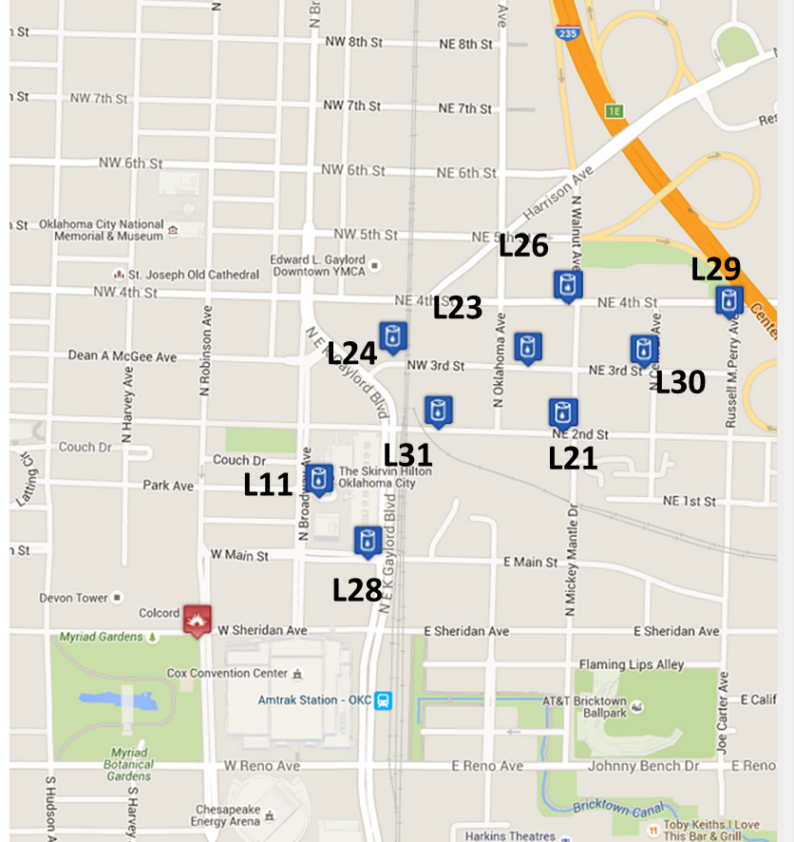
Information for the 151 fast response concentration time series (0.5 sec) from JU2003 used in this analysis
Release
Not all models produce concentrations for each IOP

Slide 4
Pairing SF6 concentrations in space and time:
  1) Valid pairs → Observed > 0 (above LOQ) and Predicted > 0
  2) False negative → Observed > 0 (above LOQ) and Predicted = 0
  3) False positive → Observed = 0 and Predicted > 0
  4) Zero-Zero → Observed = 0 and Predicted = 0
the most dangerous situation for emergency responders
Reference period → The portion of the observed cloud associated with Ta and Td (a much more robust measure than total time and remove the influence of small outliers or very low values near the minimum data limit
Ta = First time when the concentration is greater than or equal to 0.1 Cmax
Td = Last time when the concentration is greater than or equal to 0.1 Cmax
Ta
Td

Slide 5
Number of concentrations samplers for all time series and stated performance for individual models:
 | M4 | M2 | M6 | M1 | M8 | M9 | M3 | M5 | M10
Total Pairs | 61105 | 20123 | 67267 | 7733 | 64226 | 57541 | 83963 | 83963 | 64224
Pairs-Pairs (%) | 50.9 | 92.5 | 69.9 | 87.4 | 48.0 | 73.1 | 75.3 | 95.8 | 71.4
False Positive (%) | 0.3 | 3.3 | 1.9 | 2.7 | 0.4 | 1.4 | 1.4 | 1.6 | 1.0
False Negative (%) | 46.9 | 4.2 | 28.0 | 9.7 | 50.6 | 24.5 | 23.1 | 2.5 | 27.2
Zero-Zero (%) | 1.9 | 0.0 | 0.1 | 0.2 | 0.9 | 1.0 | 0.3 | 0.0 | 0.3
Large percentage of valid pairs → Identification of the plume
More false negatives than positives → Non detection of the plume
zero-zero few cases

Slide 6
Differences between day/night performance results:
Day: 5 IOPs (IOP01, IOP03, IOP04, IOP05, IOP06)
Night: 4 IOPs (IOP07, IOP08, IOP09, IOP10)
There is no systematic behaviour between models

Slide 7
Differences between locations – impact of downwind distance from the release
Methodology: Average results for each sampler location (maximum number of sampler is 31)
1) Pairs-Pairs vs downwind distance
Two behaviours:
Decrease with the distance → better identification close to the release point
Increase with the distance → Better identification far away

Slide 8
Differences between locations – impact of downwind distance from the release
2) False negative vs downwind distance
Two behaviours:
Increase with the distance → better identification close to the release point
Decrease with the distance → Better identification far away

Slide 9
How the agreement between observed and predicted concentrations is? → FA2, FA5 and > FA5
 | M4 | M2 | M6 | M1 | M8 | M9 | M3 | M5 | M10
Total_Pairs | 61105 | 20123 | 67267 | 7733 | 64226 | 57541 | 83963 | 83963 | 64224
FA2 (%) | 47.5 | 7.9 | 23.2 | 70.2 | 48.2 | 41.4 | 42.4 | 17.1 | 43.1
FA5 (%)(Without FA2) | 7.7 | 10.8 | 9.6 | 9.3 | 7.5 | 9.7 | 9.0 | 13.1 | 6.4
> FA5 | 44.8 | 81.3 | 67.2 | 20.5 | 44.4 | 48.9 | 48.5 | 69.8 | 50.5
General → FA2 > FA5 but large percentage of pairs > FA5
Day → Better results for FA2
Night → High values of FA5 and > FA5

Slide 10
Observations Model results
Maximum concentration
Travel time
Ta= Time difference between release time and time when the concentration is greater than or equal to 0.1 Cmax for the first time

Slide 11
FA5 is calculated without pairs within FA2
1) Maximum concentrations
Above FA5 > FA5 > FA2
FA2 (%) | 7.8 | 52.6 | 27.6 | 24.1 | 20.0 | 18.8 | 30.7 | 26.7 | 26.2
FA5 (%) | 18.3 | 10.5 | 41.4 | 29.6 | 29.2 | 30.7 | 28.7 | 37.3 | 36.1
> FA5 (%) | 73.9 | 36.8 | 31.0 | 46.3 | 50.8 | 50.5 | 40.7 | 36.0 | 37.7

Slide 12
FA5 is calculated without pairs within FA2
2) Travel time
FA2 > FA5 > above FA5
FA2 (%) | 51.3 | 100.0 | 65.5 | 85.2 | 82.5 | 86.1 | 48.0 | 78.0 | 17.2
FA5 (%) | 43.5 | 0.0 | 34.5 | 14.8 | 15.8 | 12.9 | 50.7 | 22.0 | 57.4
> FA5 (%) | 5.2 | 0.0 | 0.0 | 0.0 | 1.7 | 1.0 | 1.3 | 0.0 | 25.4

Slide 13
FA5 is calculated without pairs within FA2
3) Time A
FA2 > FA5 > Above FA5
FA2 (%) | 55.7 | 78.9 | 51.7 | 79.6 | 78.3 | 84.2 | 38.0 | 90.7 | 9.0
FA5 (%) | 38.3 | 15.8 | 17.2 | 17.6 | 17.5 | 11.9 | 18.0 | 7.3 | 45.1
> FA5 (%) | 6.1 | 5.3 | 31.0 | 2.8 | 4.2 | 4.0 | 44.0 | 2.0 | 45.9

Slide 14
Integrated concentrations →
FA5 is calculated without pairs within FA2
Total_Puffs | 115 | 19 | 29 | 108 | 120 | 101 | 150 | 150 | 122
FA2 (%) | 10.4 | 52.6 | 3.4 | 16.7 | 19.2 | 17.8 | 33.3 | 20.7 | 33.6
FA5 (%) | 10.4 | 15.8 | 20.7 | 25.9 | 19.2 | 16.8 | 34.0 | 26.0 | 32.0
> FA5 (%) | 79.1 | 31.6 | 75.9 | 57.4 | 61.7 | 65.3 | 32.7 | 53.3 | 34.4

Slide 15
Conclusions
For the puff period considered →
  the percentage of valid pairs is > 48 % but there is a large percentage of false negative in some of the models;
  Fewer percentages for false positives and zero-zero;
  Predominance of pairs within FA2 and above FA5
  Differences between day and night →
  Not systematically about FN, FP, PP or ZZ
  Day → Better results for FA2
  Night → High values of FA5 and > FA5
  Distance from the source has impact on the results → Predominance of:
  To increase the percentage of FN by increasing the distance;
  To decrease the FA2 and to increase the > FA5 by increasing the distance

