Slide 1
AQMEII3: the EU and NA regional scale program of the Hemispheric Transport of Air Pollution Task Force
The AQMEII 3 modelling team
S. Galmarini, C. Hogrefe, E. Solazzo
M. Vivanco, A. Colette

Slide 2
outline
Status of the model evaluation in phase 3
The error apportionment technique
The spatial representation of the model decomposition
How does the phase shift of model versus obs signal affects the error?
On going sensitivity studies
and more on the autocorrelation of errors

Slide 3
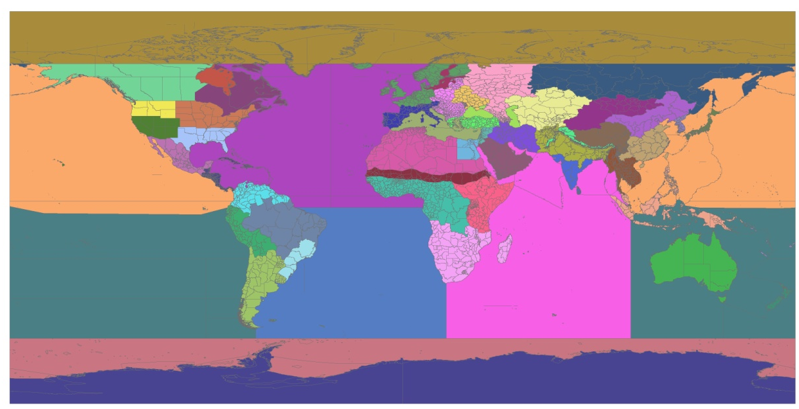
http://aqmeii.jrc.ec.europa.eu/
AQMEII
AQMEII
MICS Asia
HTAP2

Slide 4
AQMEII is now running its third
phase
Modelling systems
Simulating air quality over Europe and North America for the year 2010
Evaluation against observations
WRF-CMAQ
ECMWF-SILAM
ECMWF-L.-EUROS
WRF-CMAQ
WRF-WRF/Chem
WRF-CAMx
Cosmo CLM-CMAQ
WRF-WRF/Chem
WRF-CMAQ
WRF-DEHM
ECMWF-Chimere
WRF-CMAQ
CCLM-CMAQ
WRF-CMAQ
WRF-CAMx
gas phase
aerosol
precipitation chemistry
ozonesondes
meteorology
AERONET
AERONET PROFILES
MOZAIC
map concentration
map deposition
map emissions
Ozone: Hourly time series from 2190 (EU) and 1767 (NA) surface stations
PM: Hourly time series from 1837 (EU) and 1749 (NA) surface stations

Slide 5
Does the model provide the correct response for the right reason?
Operational metrics say just how good or bad the model-to-data comparison is in some ‘average’ sense.
- do not target the source of the modelling error and
- do not discriminate the reasons for good or poor performance
Evaluation must be diagnostic in focus: Error Apportionment
New model evaluation paradigm
moving away from metrics, focusing on the quality of the error
targeting the time-scale of the error, pointing to the components of the model that need improvement
sensitivity analysis to identify the contribution of external inputs (emissions, boundary conditions) to model bias

Slide 6
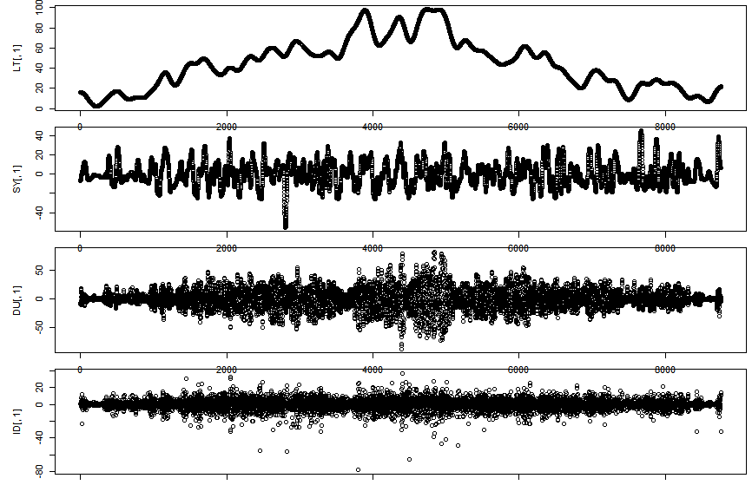
Spectral decomposition
Spectral decomposition of time series of pollutants derived from power spectrum analysis
Four components ID, DU, SY, LT
LT : Long term (processes > 21d)
SY : Synoptic (weather [2.5d;21d]
DU: diurnal (day/night [12h; 2.5d]
ID : intra-day (fast-acting < 12h)
LT is the base line, the other components are obtained using the filter as band-pass and have zero mean
LT
SY
DU
ID

Slide 7
Error Apportionment
ERROR
BIAS
VARIANCE
mMSE
LT
SY
DU
ID

Slide 8
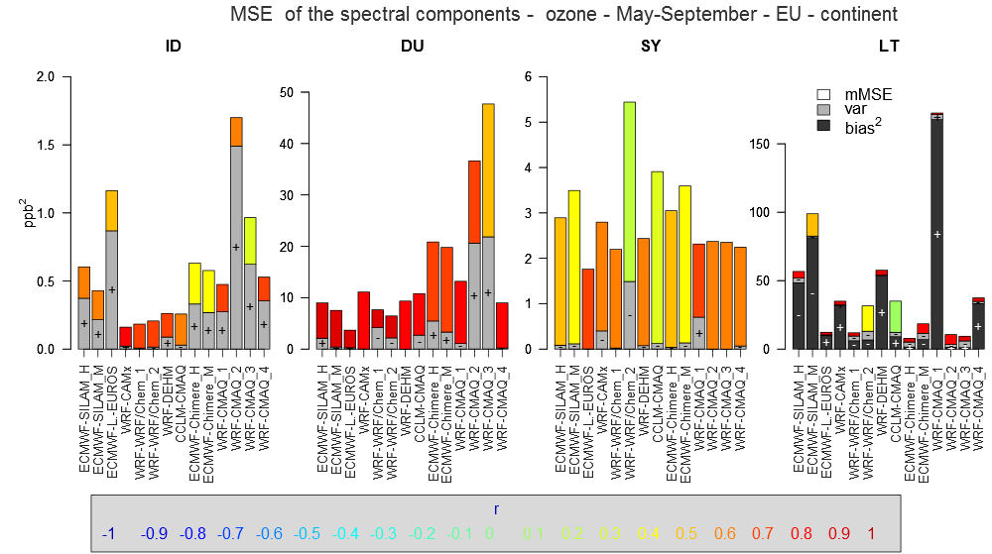

Slide 9
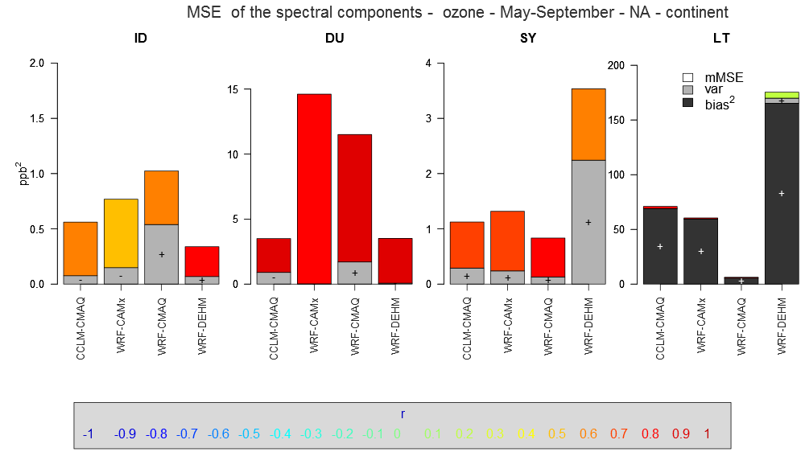

Slide 10
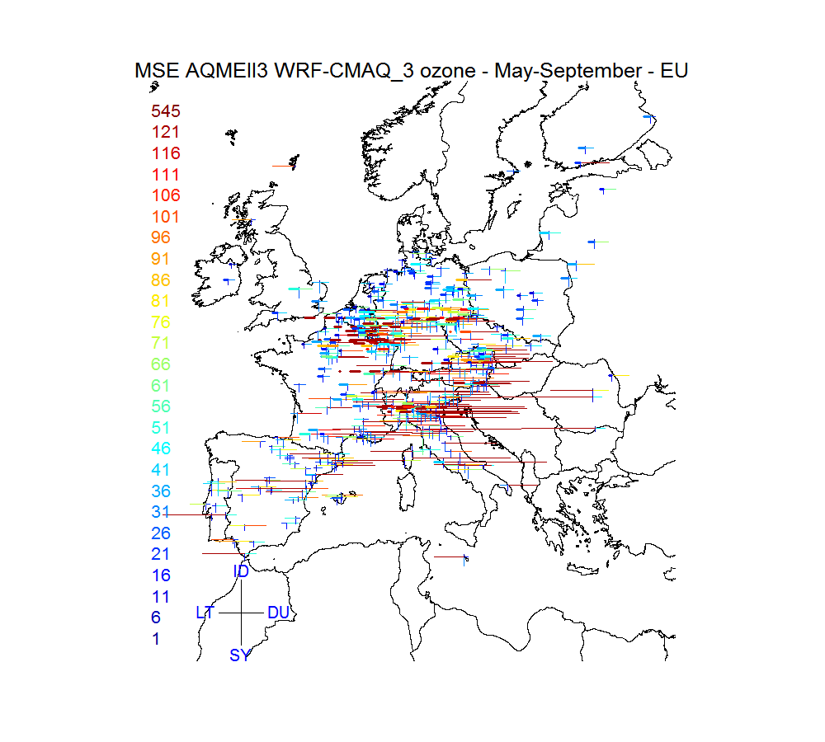

Slide 13
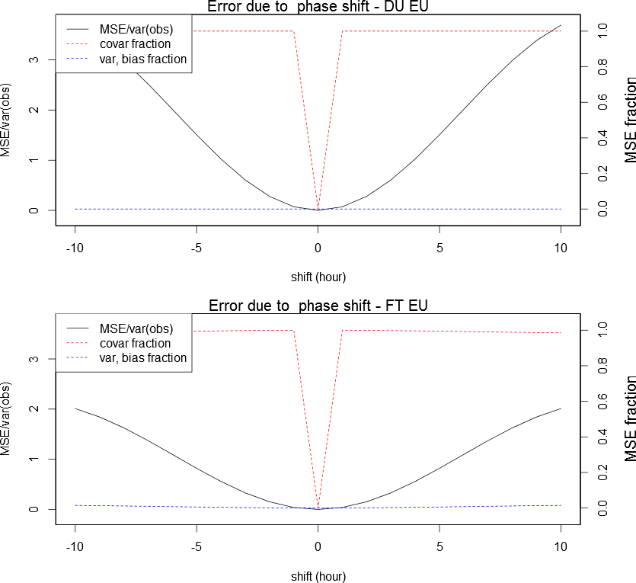
covariance
Phase shit of the diurnal signal and error relative to observational variance

Slide 14
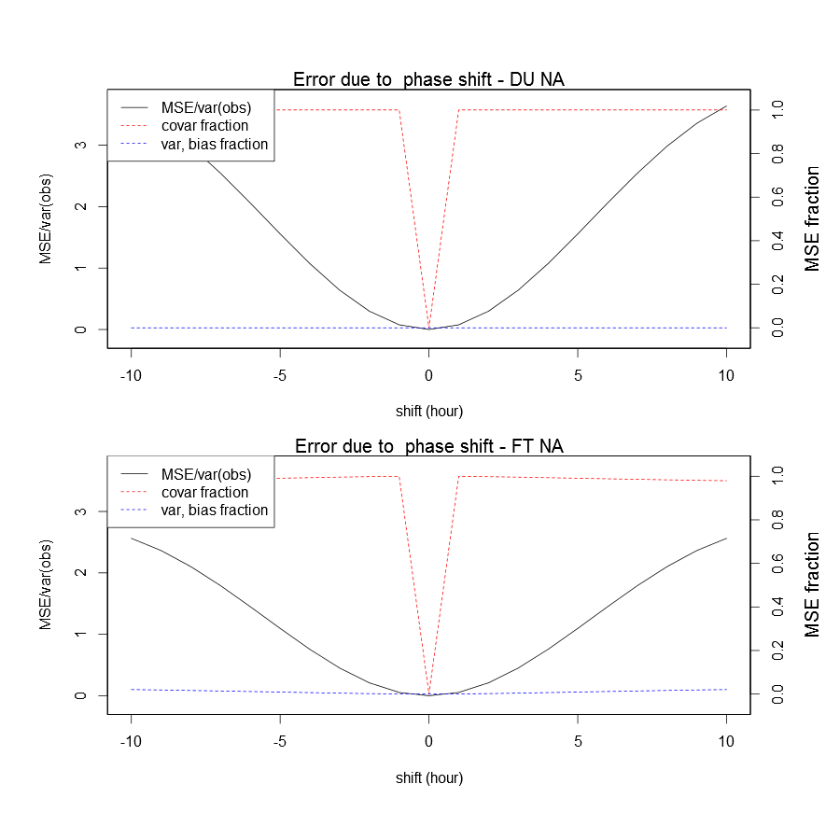
Phase shift of the diurnal signal and error relative to observational variance

Slide 15
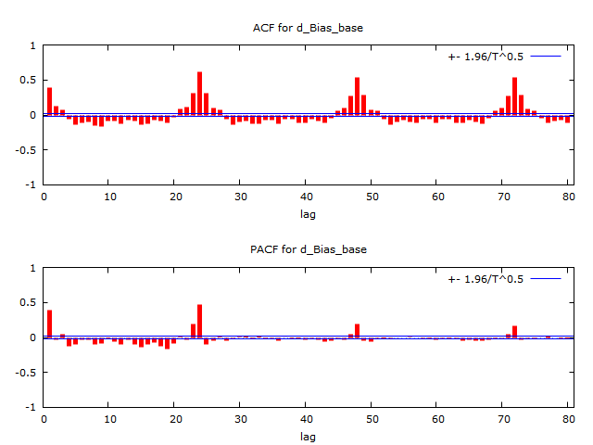
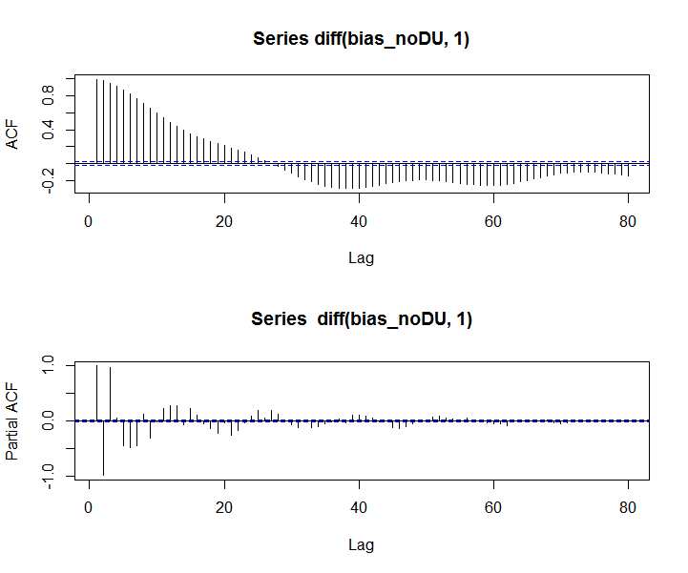
variance
CHIMERE EU

Slide 16
Summary
The error apportionment technique has been applied to the model results of AQMEII phase 3
We have to aim more an more to a qualification of the error other than its quantification
Examples in this sense have been given
sensitivity analysis
phase shifts impacts
error autocorrelation
TO BE CONTINUED …..

