Slide 1
A new physically-based windblown dust emission parametrization in CMAQ
Hosein Foroutan, Jeff Young, Limei Ran, Peng Liu, Jonathan Pleim, Rohit Mathur
Computational Exposure Division, National Exposure Research Laboratory, USEPA
15th Annual CMAS Conference, October 24-26, 2016 Chapel Hill, NC

Slide 2
Windblown Dust
Significant impacts on weather and climate, air quality and visibility, and human health
Alteration of solar radiative budgets
Modification of cloud properties and precipitation
Long-range transport of airborne bacterial species, and trace metals
Affecting ocean biogeochemistry through changing the iron cycle
Respiratory and cardiovascular disorders, meningococcal meningitis, conjunctivitis
Cardiopulmonary deaths caused by dust (Global) : 1.8%
Cardiopulmonary deaths caused by dust (countries in the “dust belt”) : 15-50%
[Giannadaki et al., ACP 2014]
Dust storms are expected to become more common under future climate change

Slide 3
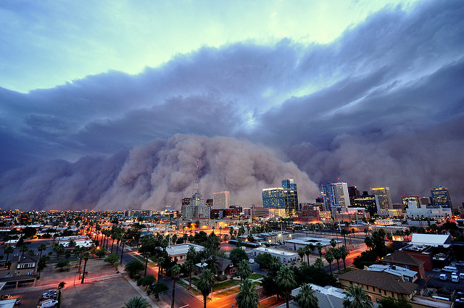
Windblown Dust
July, 2011 Phoenix, AZ
(Photo by Daniel Bryant)

Slide 4
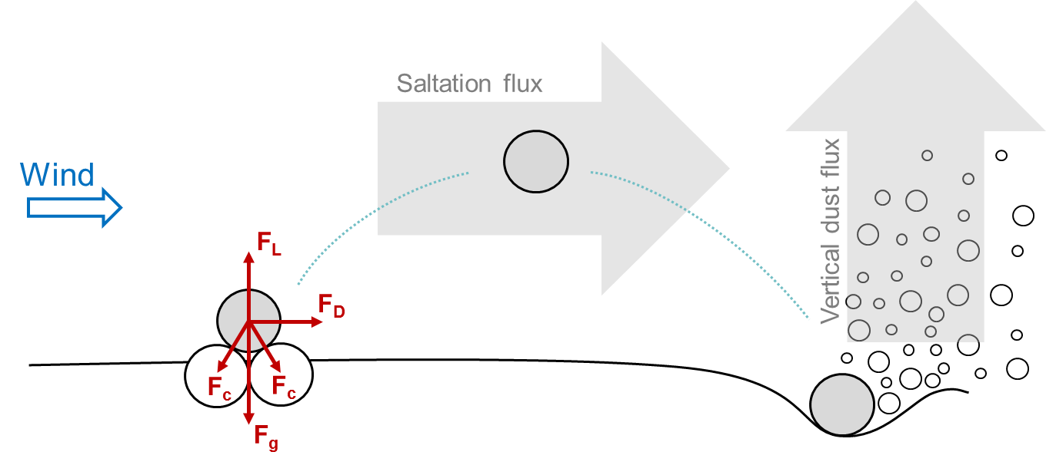
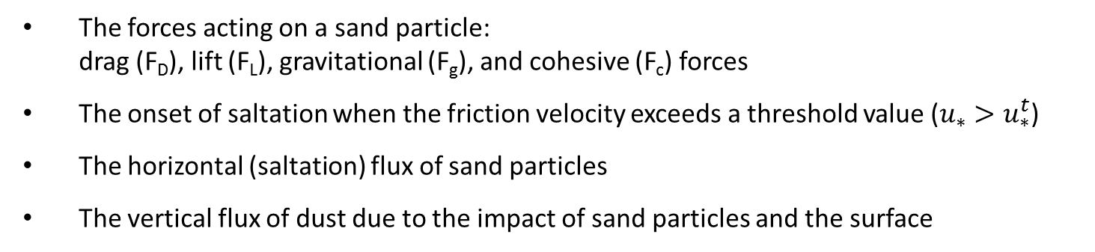
Dust Generation Mechanism
u*
The forces acting on a sand particle:
drag (F_{D}), lift (F_{L}), gravitational (F_{g}), and cohesive (F_{c}) forces
The onset of saltation when the friction velocity exceeds a threshold value ($u_{∗}>u_{∗}^{t}$)
The horizontal (saltation) flux of sand particles
The vertical flux of dust due to the impact of sand particles and the surface

Slide 5
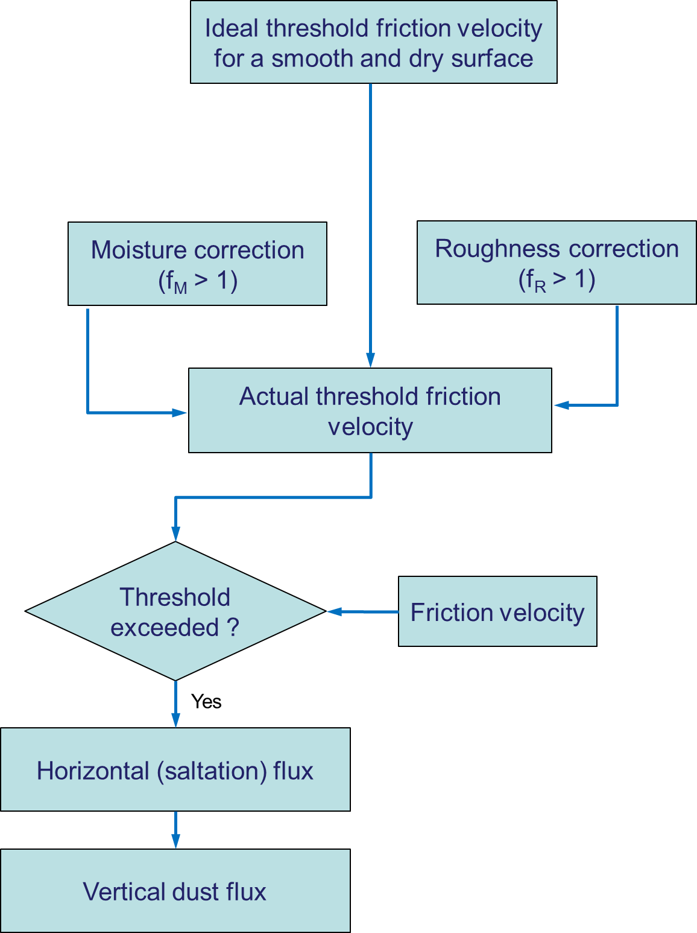
Parametrization of Dust Emission

Slide 6
Parametrization of Dust Emission
Size-resolved threshold friction velocity
(Shao and Lu, JGR 2000)
Cohesive forces dominant
Gravitational forces dominant

Slide 7
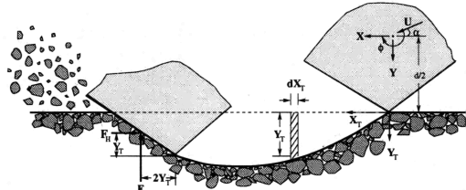
Parametrization of Dust Emission
A physics-based formulation based on the volume of soil removed by a sand particle
(Lu and Shao, JGR 1999)

Slide 8
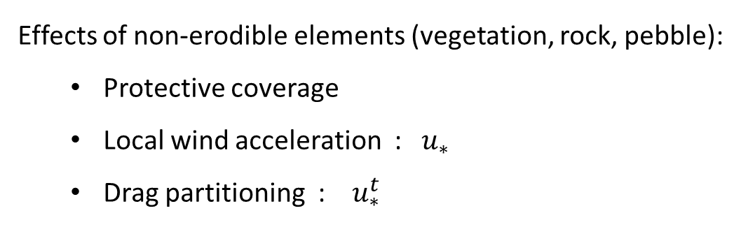
Surface Roughness in Dust Emission Applications
Effects of non-erodible elements (vegetation, rock, pebble):
  Protective coverage
  Local wind acceleration : $u_{∗}$
  Drag partitioning : $u_{∗}^{t}$
Friction velocity from WRF is NOT applicable in dust emission scheme
    It is the friction velocity above the canopy
    It uses significantly higher values of roughness length (see VEGPARM.TBL)
    It has very limited variability
We need to calculate the friction velocity at the surface using the “microscopic” roughness

Slide 9
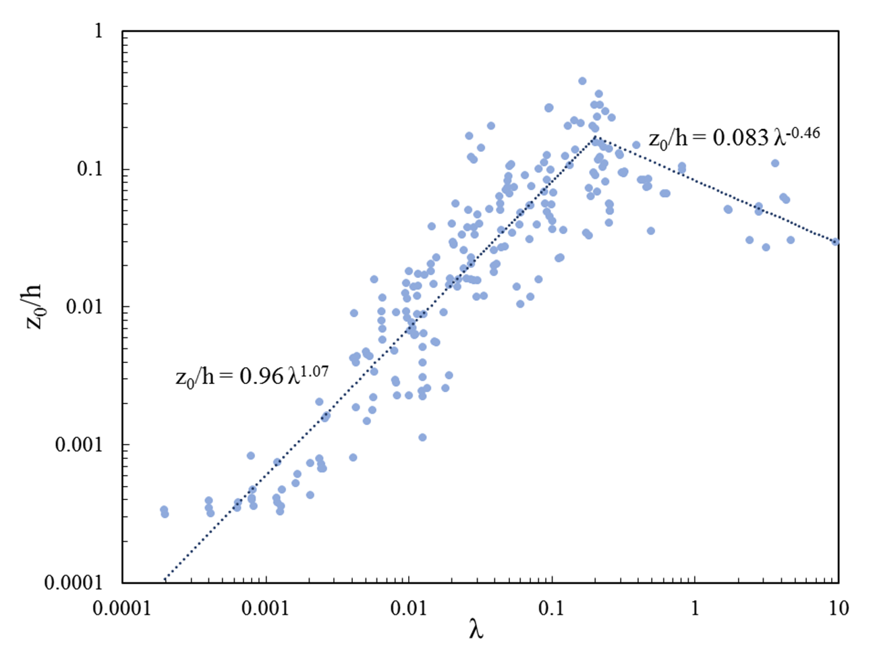
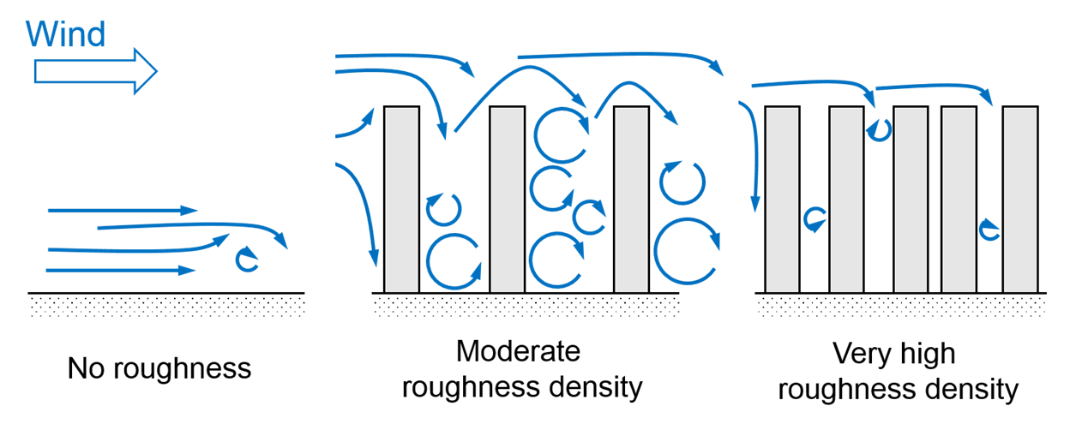
Surface Roughness in Dust Emission Applications
Data source : 20 different field and laboratory measurements (1961 – 2006)
roughness length
roughness density
MODIS FPAR Sat. Obs. – 0.01 deg – 8 days
(Spatial and temporal variability)

Slide 10
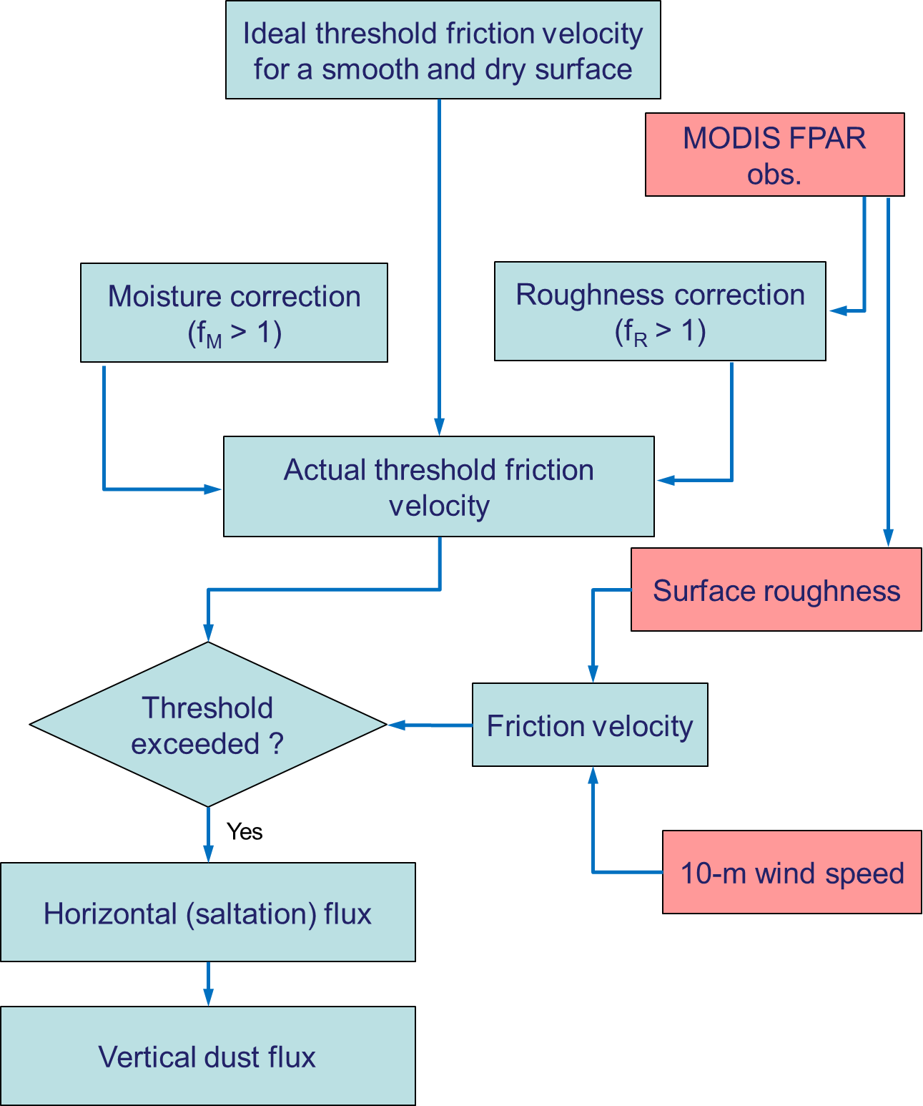
Parametrization of Dust Emission
2011-03-15
2011-04-15
2011-05-15
Vegetation fraction based on the MODIS FPAR Obs.

Slide 11
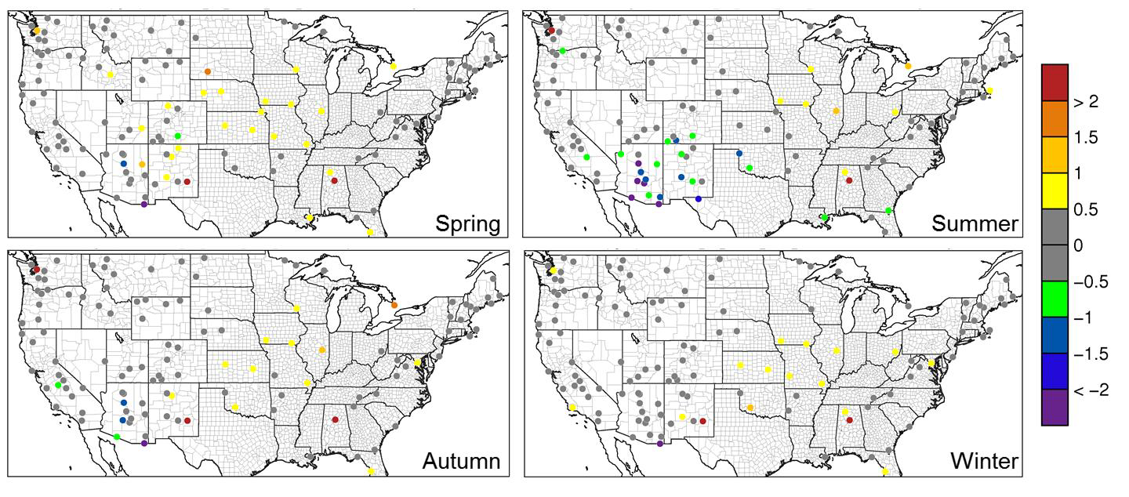
Model Evaluation
CMAQ v5.1 with the new windblown dust model
Met fields from WRF v3.7 simulations
Annual 2011 simulations
Continental United States (CONUS)
12-km horizontal resolution grid
More details: Wyat Appel’s talk, Wed. 9:50 AM
µgm⁻³
Fine soil seasonal mean bias (µgm⁻³) for the IMPROVE network sites in the CONUS
[Soil]=2.2 [Al]+2.49 [Si]+1.63 [Ca]+2.42 [Fe]+1.94 [Ti]

Slide 12
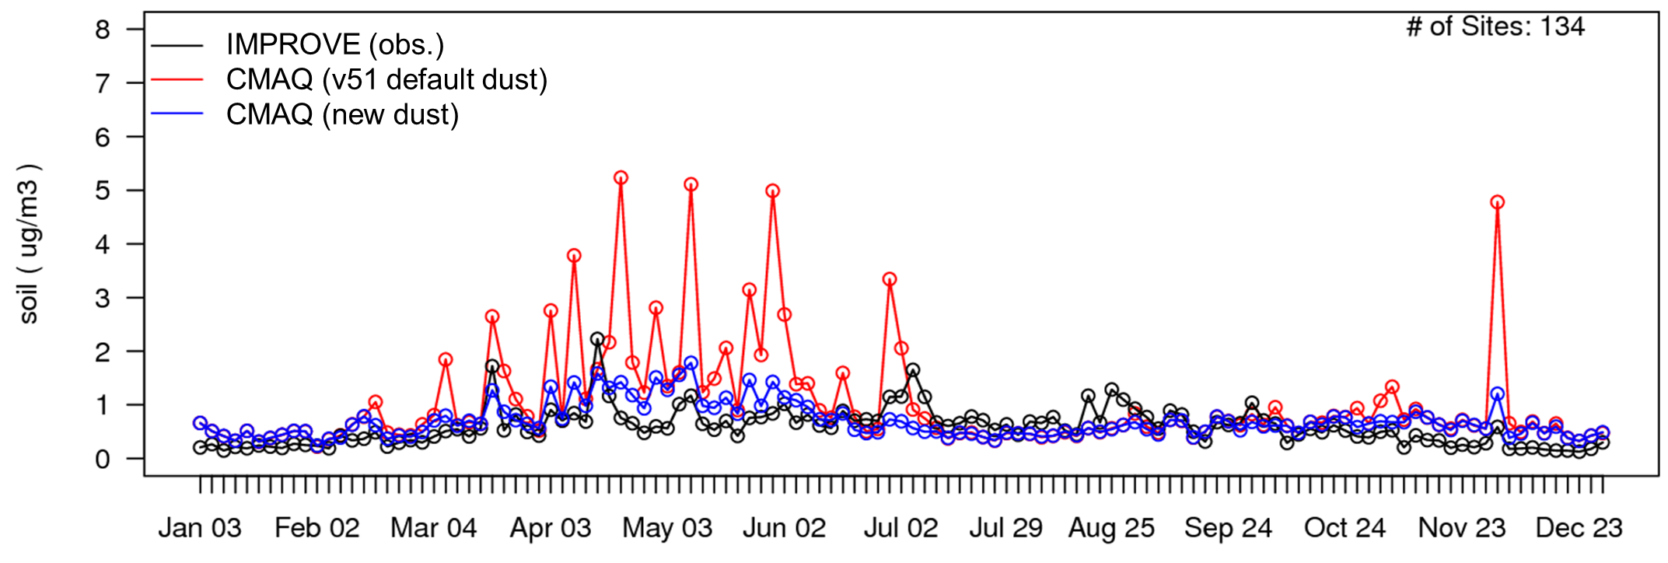
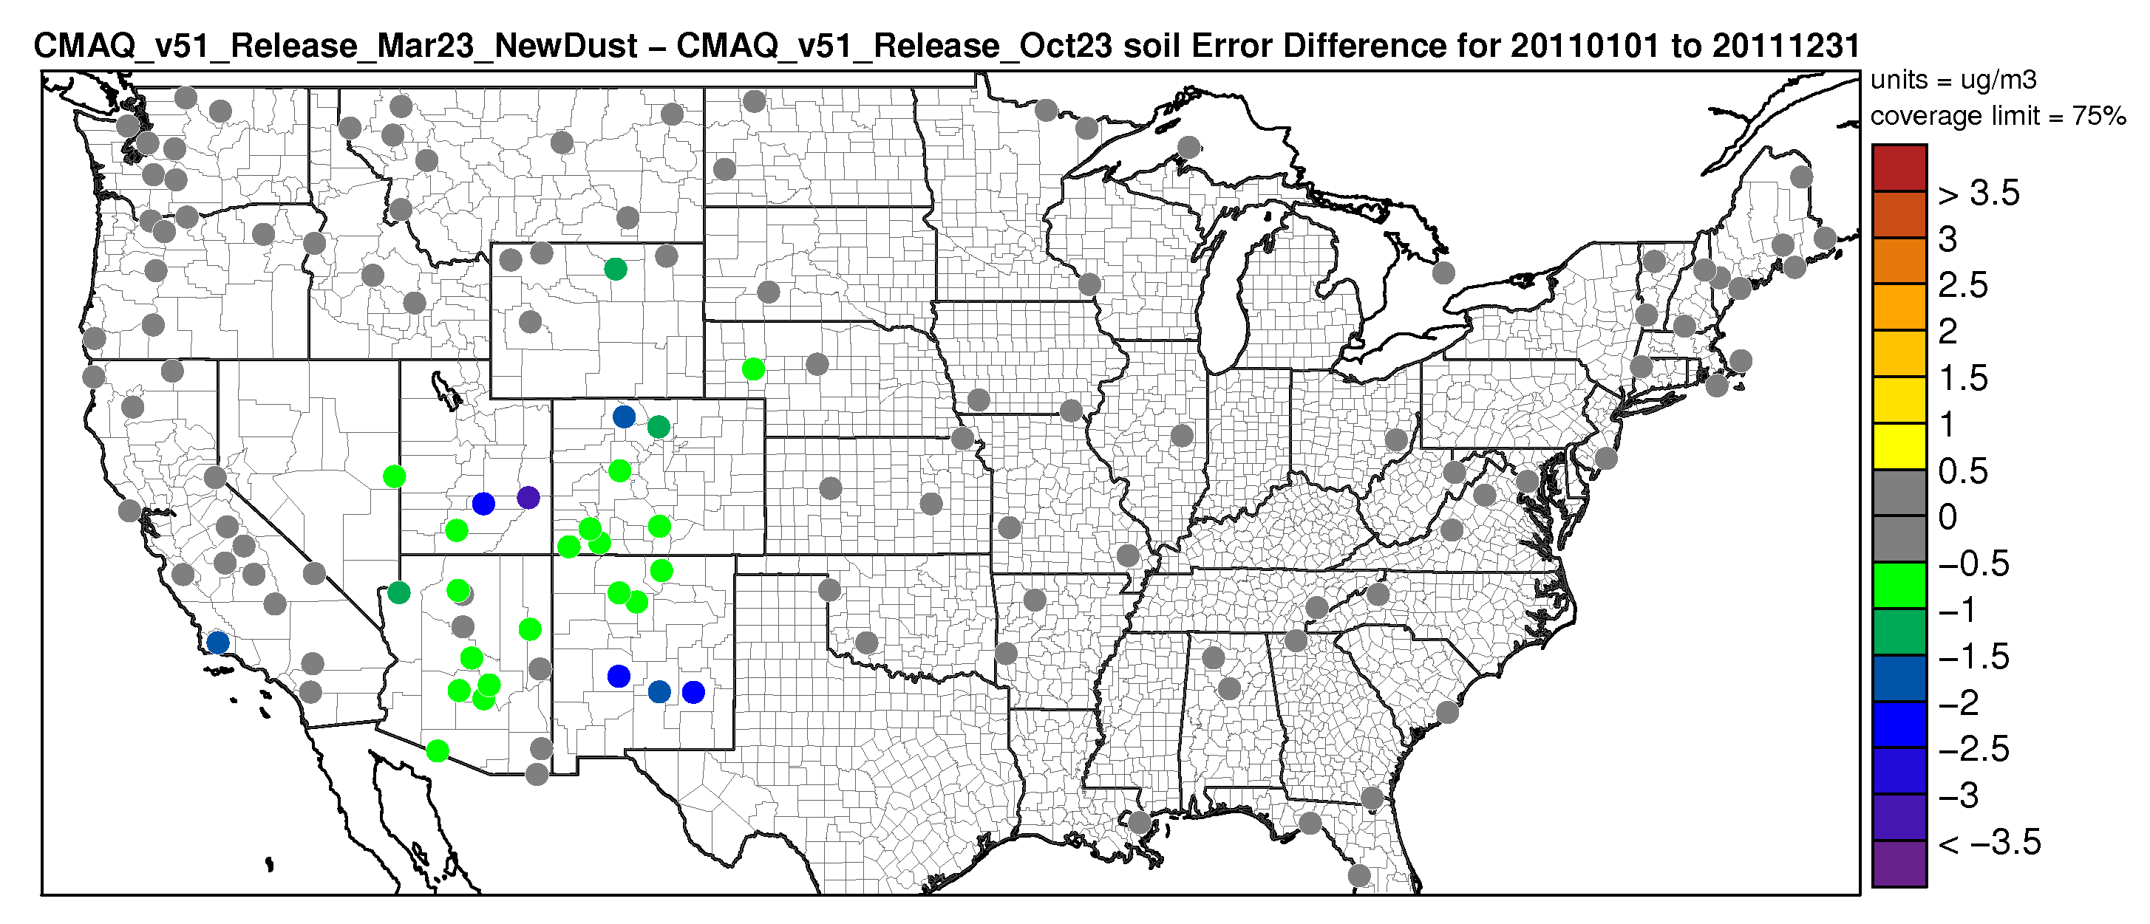
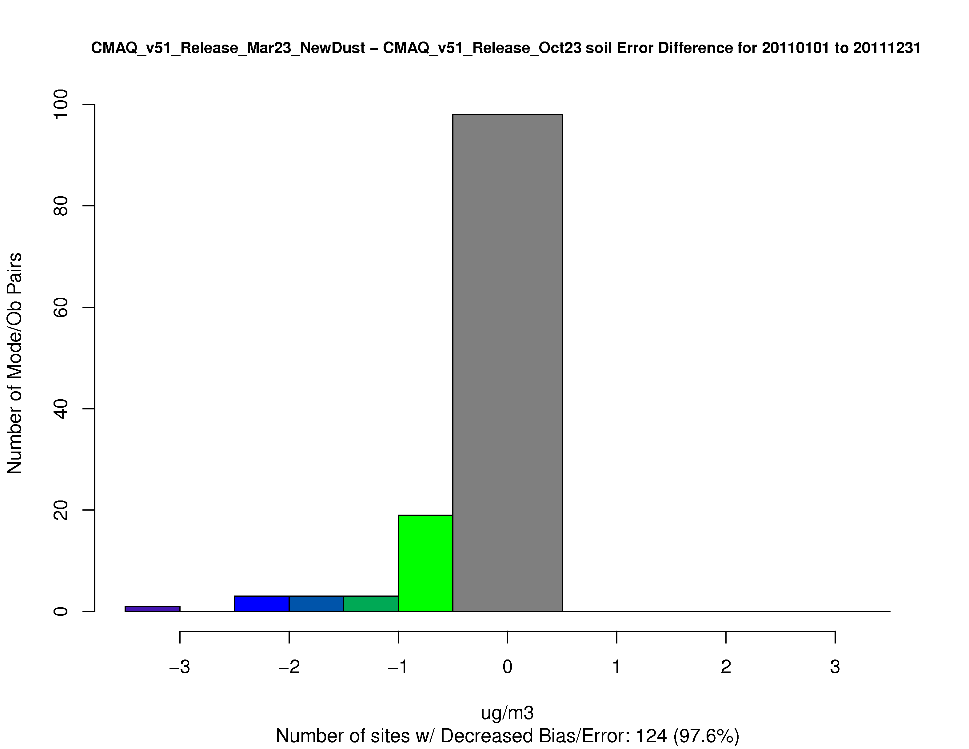
Model Evaluation
Increase in Error
The time series of fine particulate soil for all IMPROVE sites in the CONUS in 2011
Increase in Error
~ 98% of sites
Decrease in Error
Decrease in Error
Cool colors represent a decrease in soil error using the new dust model

Slide 13
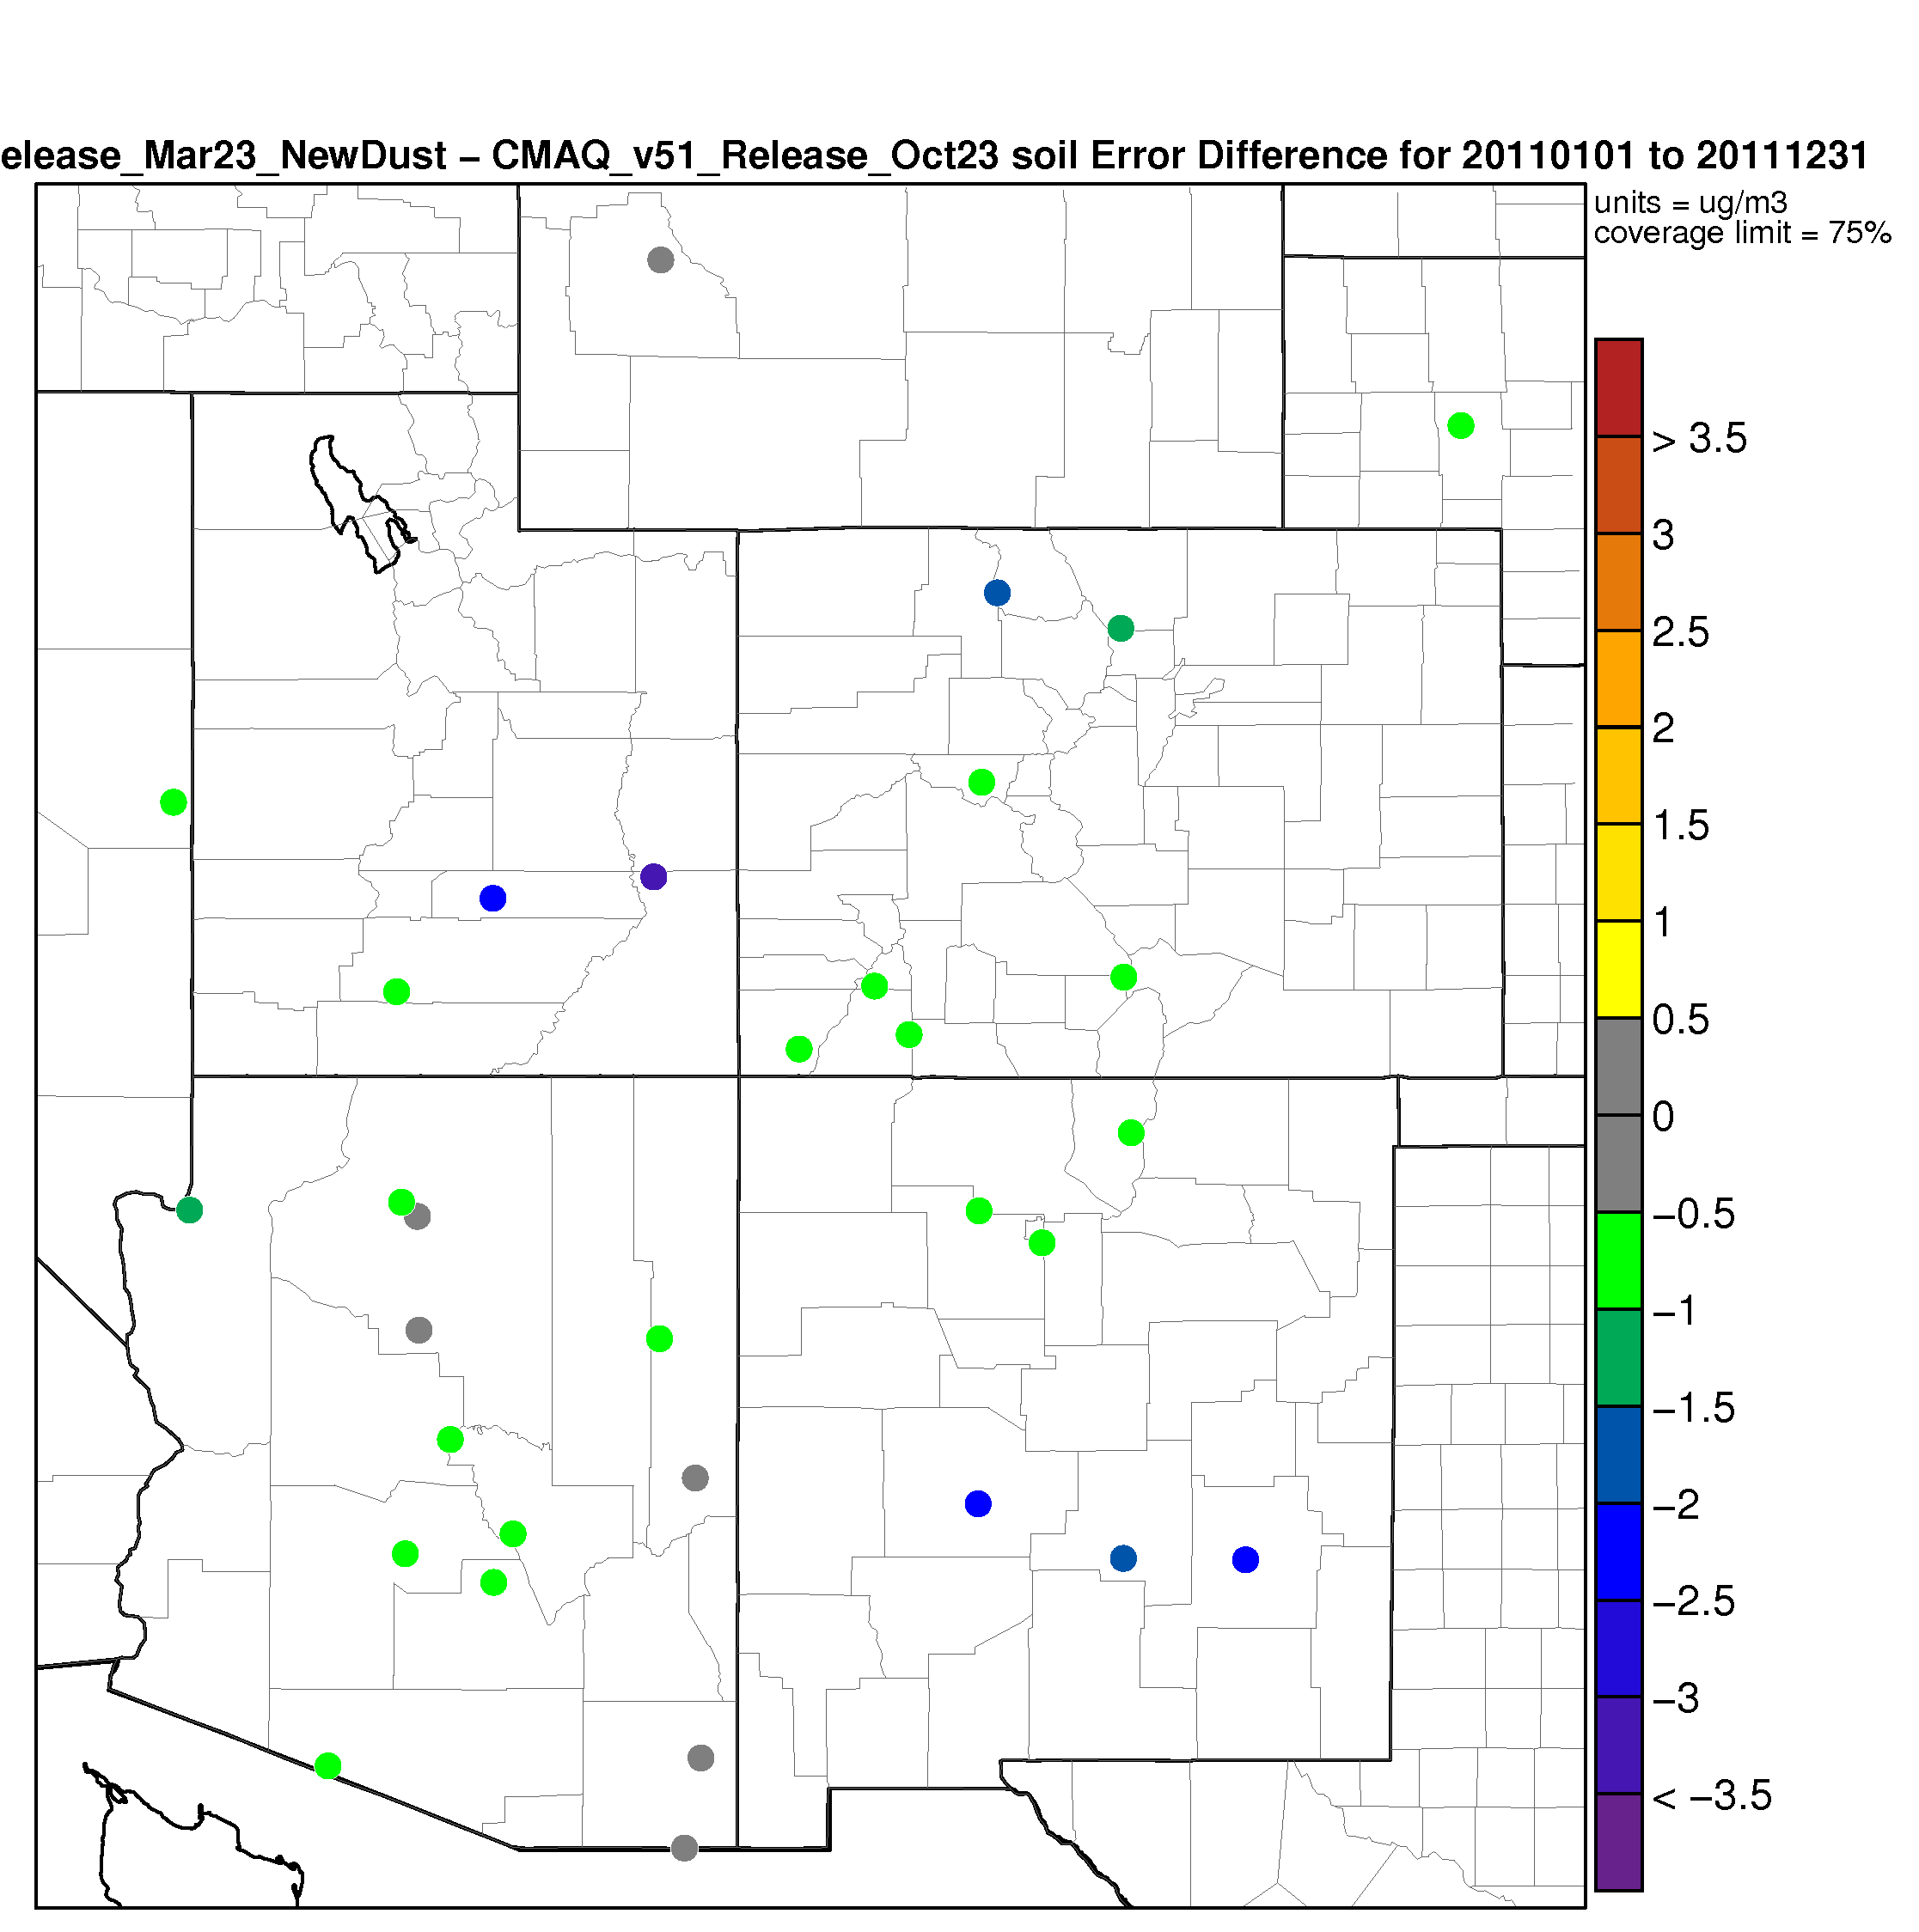
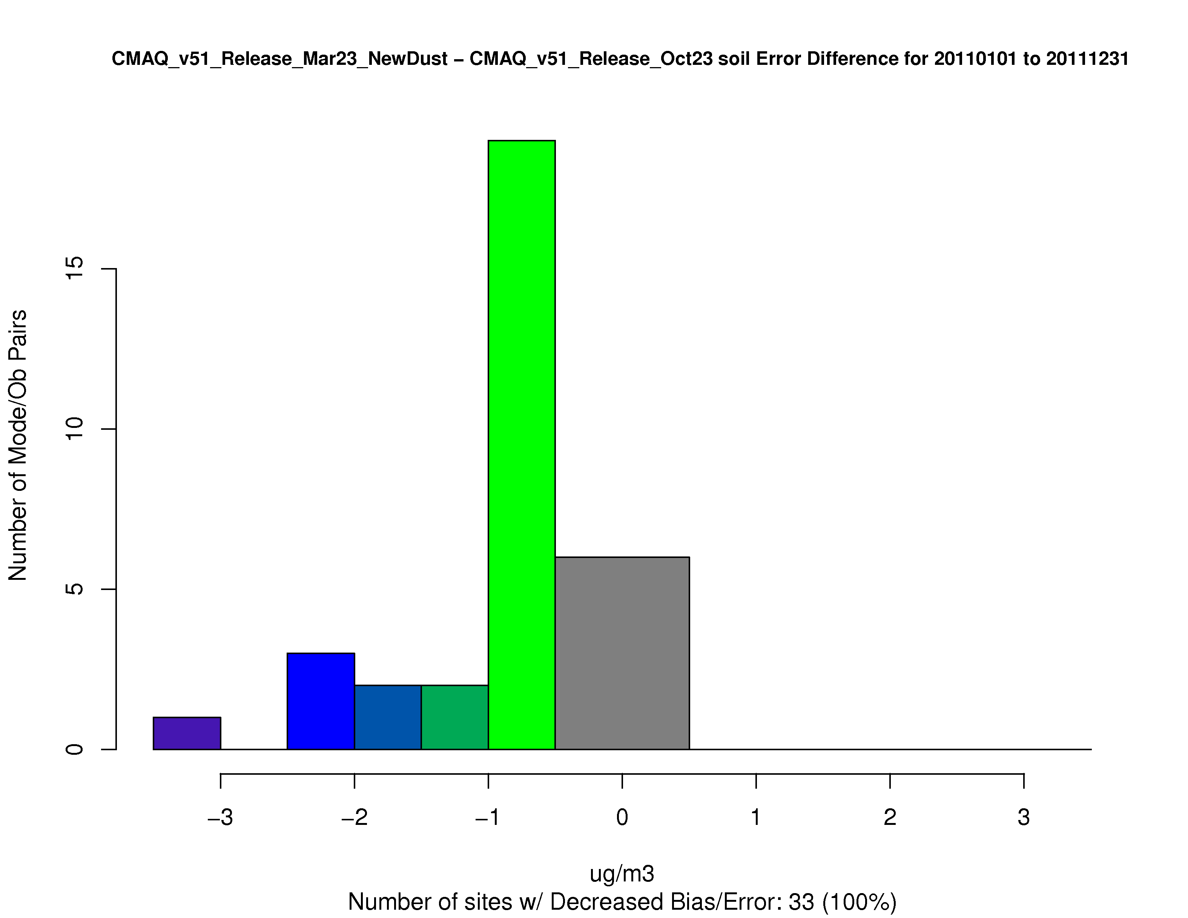
Model Evaluation
Increase in Error
The Southwest United States
~ 100% of sites
Increase in Error
Decrease in Error
Decrease in Error

Slide 14
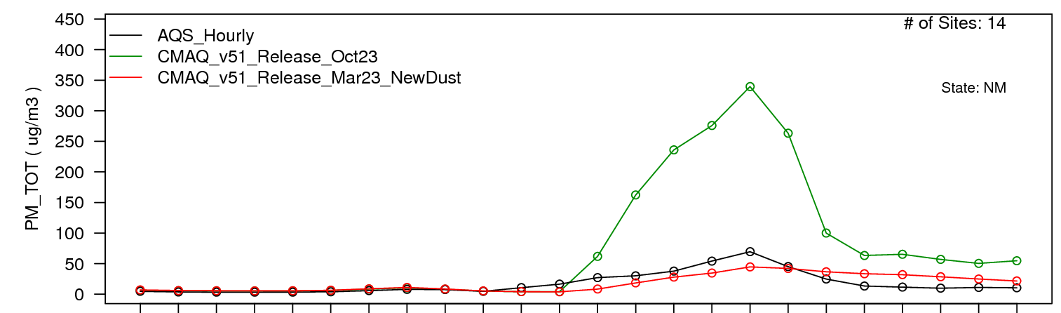
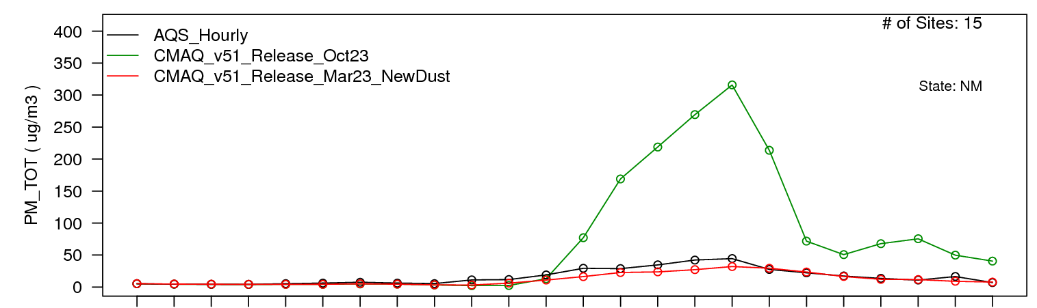
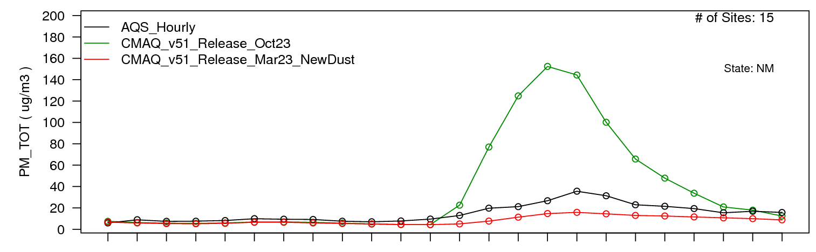
Dust outbreaks
22:00 3/7/11 – 03:00 3/8/11
AQS
National Weather Service storm database (https://www.ncdc.noaa.gov/stormevents/)
AQS
CMAQ v51 – old dust
CMAQ v51 – new dust
17:00 4/3/11 – 06:00 4/4/11
AQS
AQS
CMAQ v51 – old dust
CMAQ v51 – new dust
20:00 5/29/11 – 03:00 5/30/11
AQS
AQS
CMAQ v51 – old dust
CMAQ v51 – new dust

Slide 15
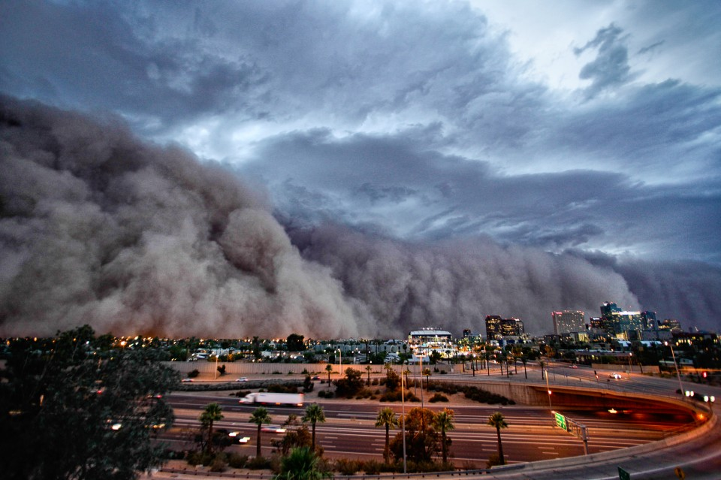
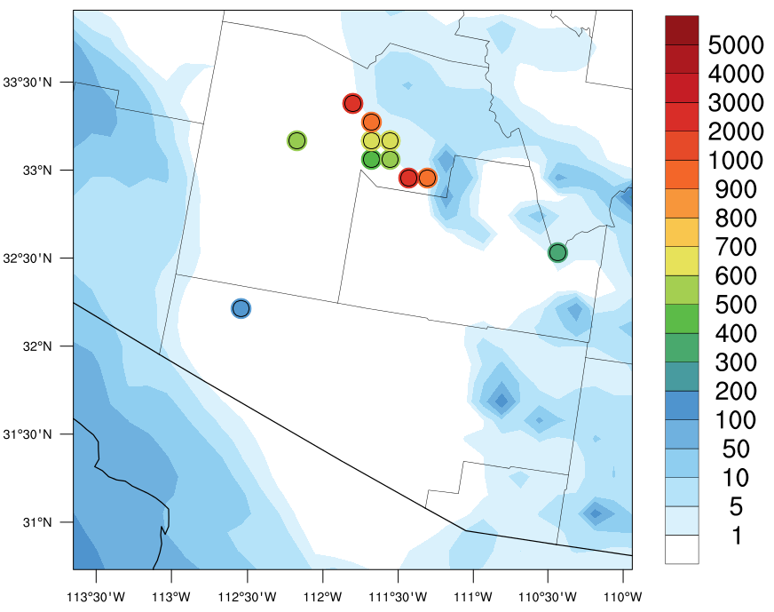
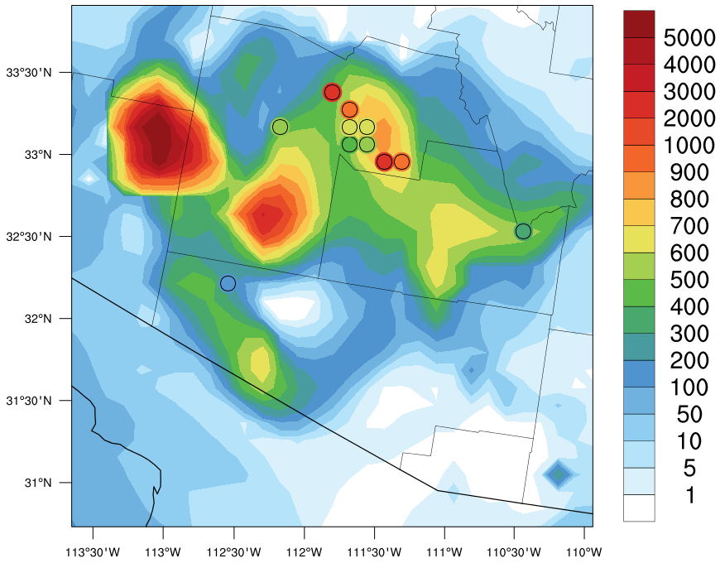
In Progress…
Subgrid wind speed variability
Includes the effect of wind gustiness due to dry and moist convection
- Improve predictions in large-scale simulations (hemispheric run)
- Improve predictions of convective dust storms (important in summertime)
PM₁₀ concentrations (µgm⁻³) at 04:00 UTC July 6, 2011
Sever convective dust storm (haboob)
July, 2011 Phoenix, AZ
Default Dust
Subgrid wind variability
+ lightning assimilation
(See Nick Heath’s talk, Wed. 9:50 AM)

Slide 16
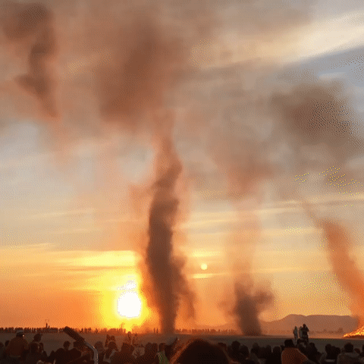
Summary
Comprehensive updates to the windblown dust module in CMAQ
Science update and “careful” implementation
Significant improvements over CMAQ v5.1 in an annual 2011 CONUS run
Release as part of the CMAQ v5.2
Dust devils in the Black Rock Desert (courtesy of Steph Goralnick)

Slide 18
Extras

Slide 19
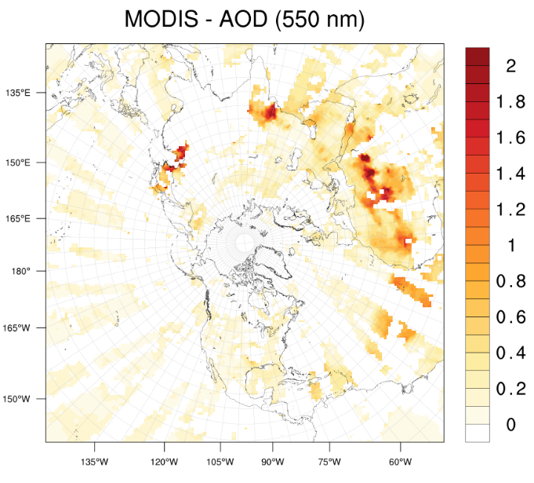
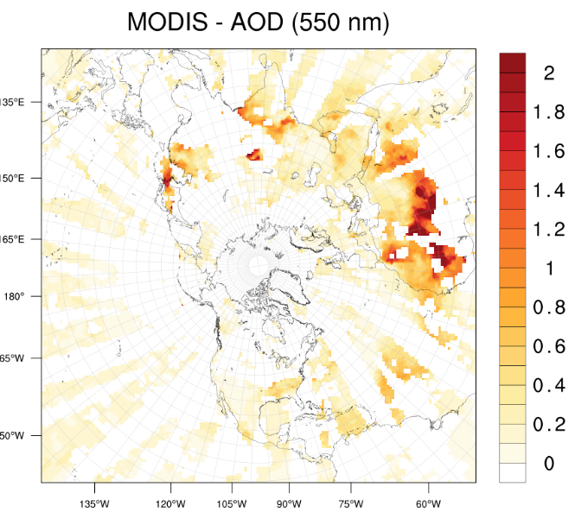
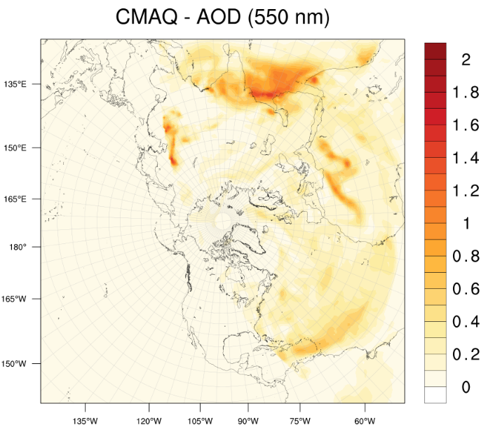
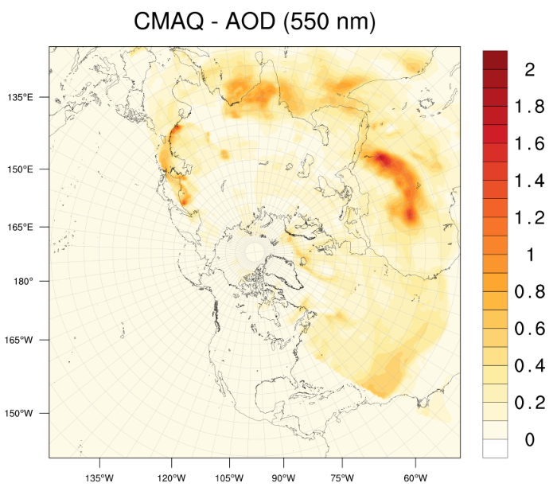
Model Evaluation – Northern Hemisphere
March 6, 2006
June 6, 2006
June 11, 2006

Slide 20
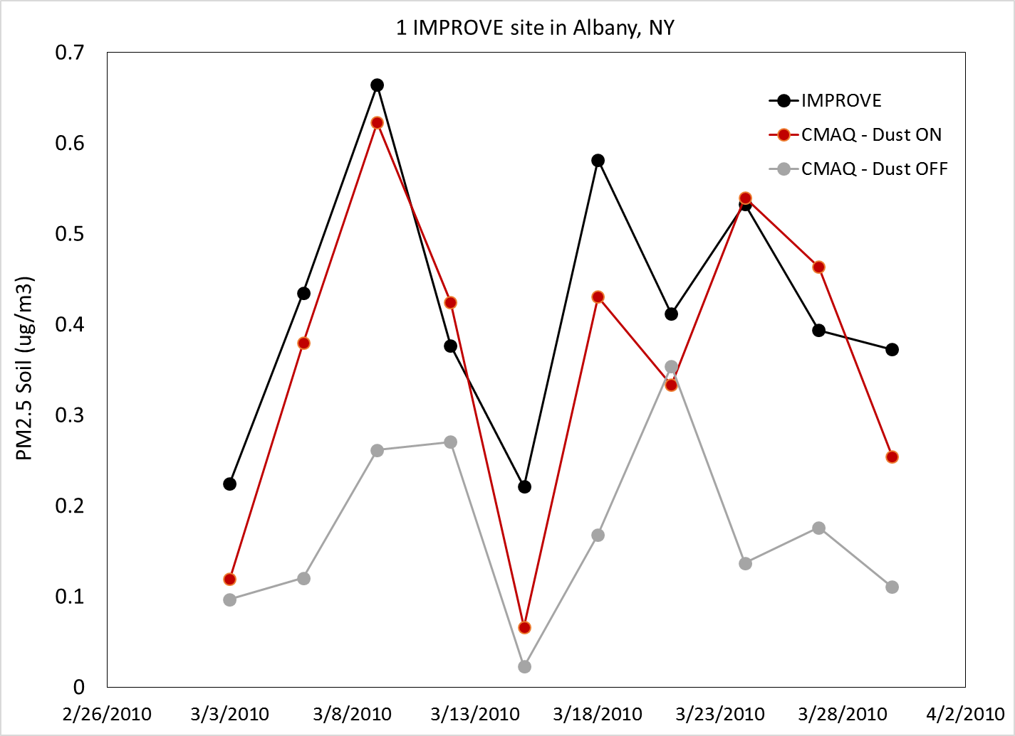
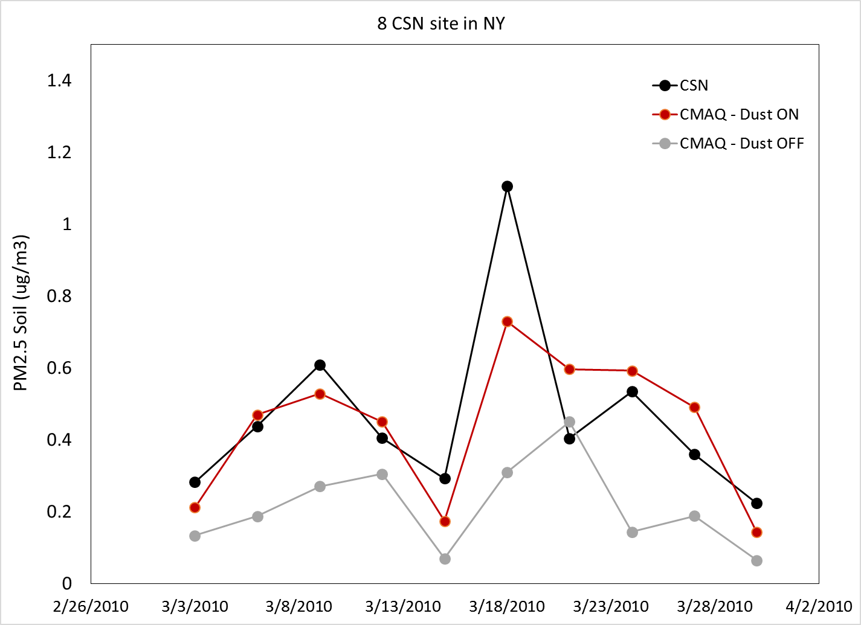
Model Evaluation – Northern Hemisphere
The transpacific transport of Asian dust to the Northeast US
NOAA-HYSPLIT backward trajectories

Slide 21
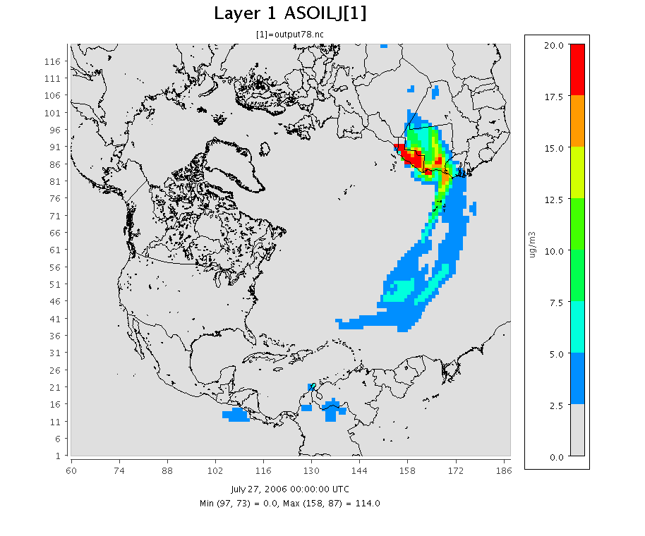
Model Evaluation – Northern Hemisphere

Slide 22
Model Evaluation – Southwest US

Slide 23

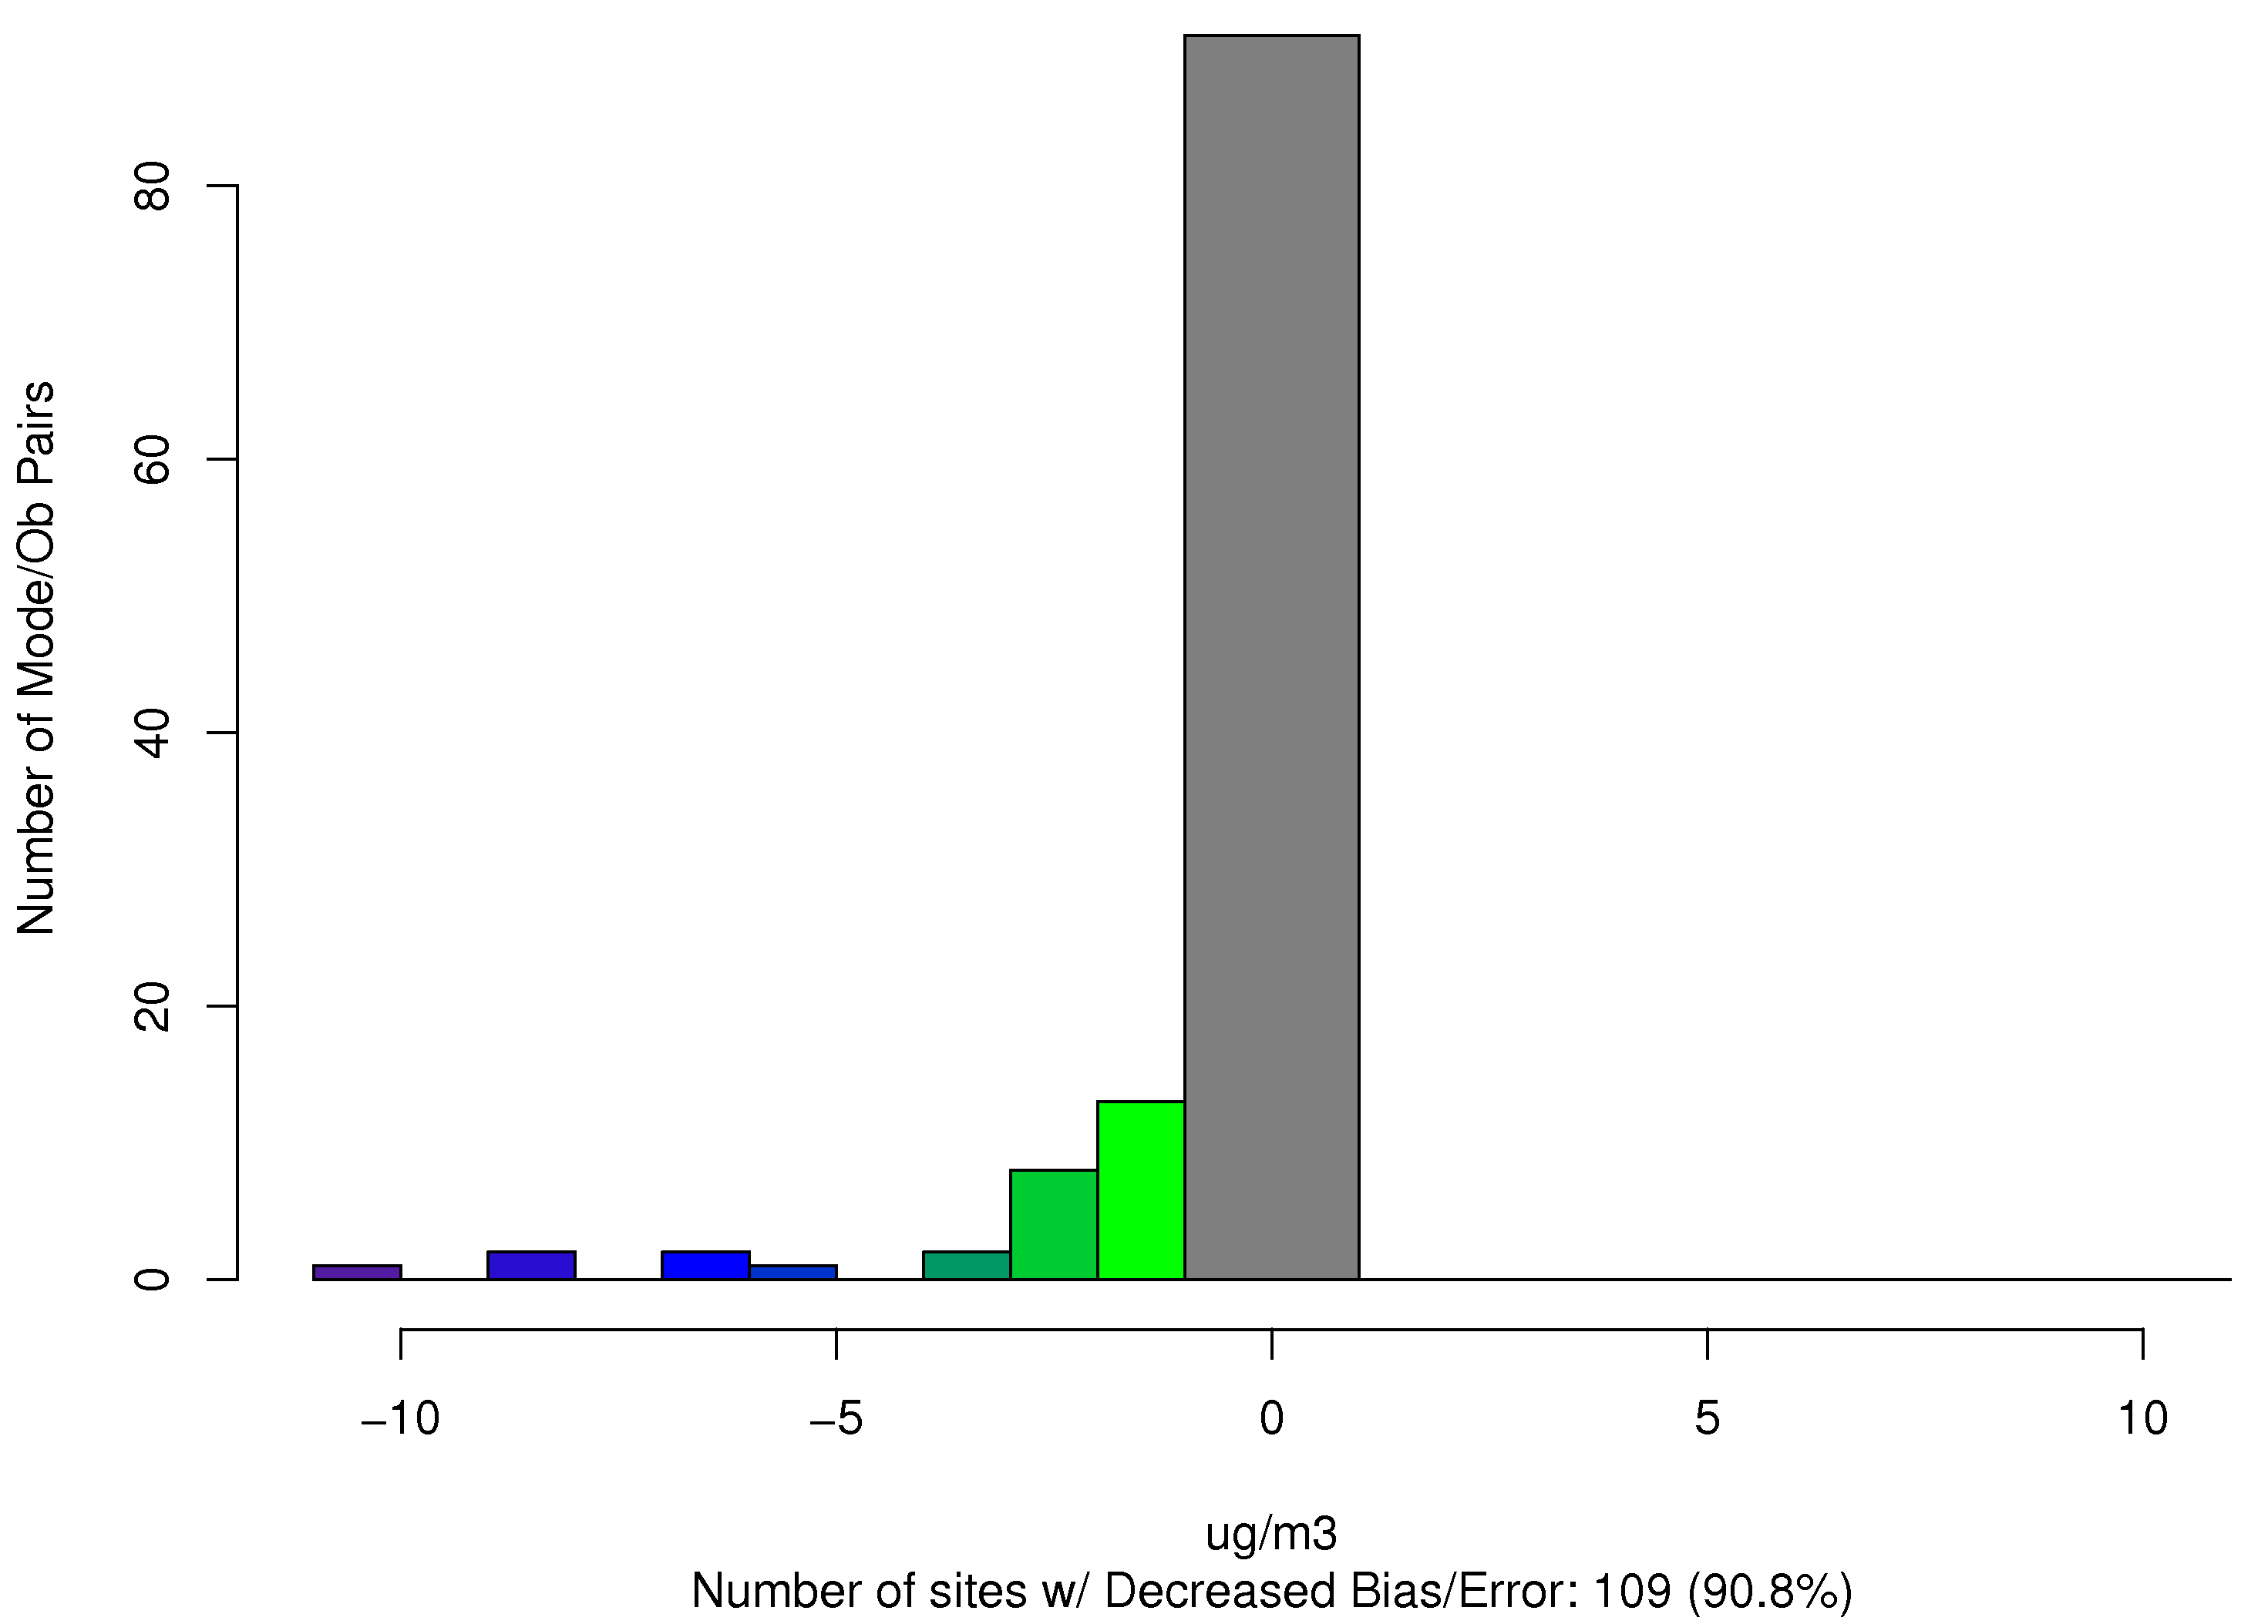
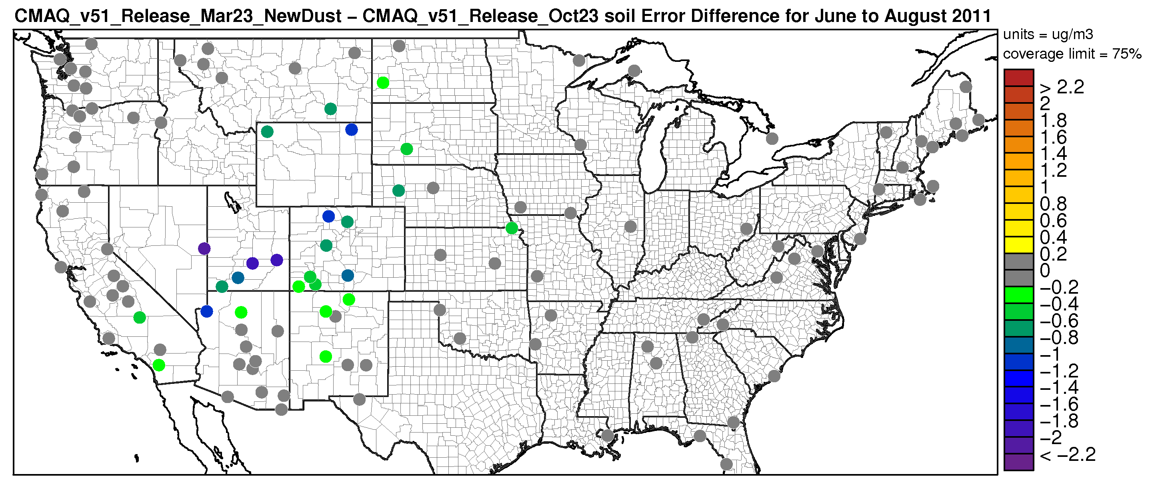
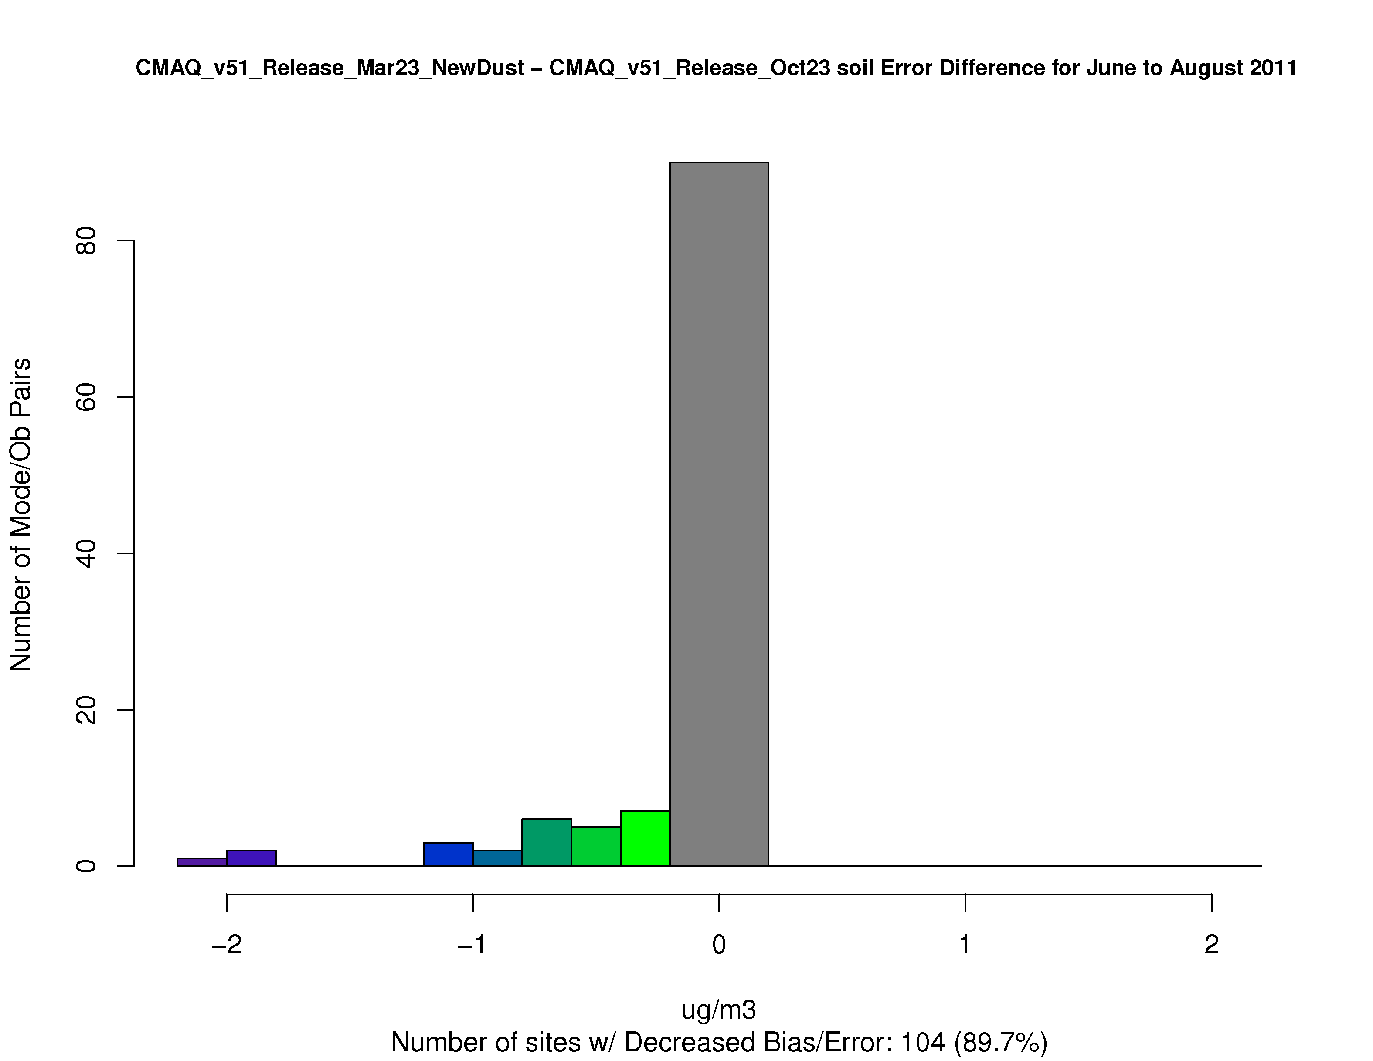
Model Evaluation - CONUS

Slide 24
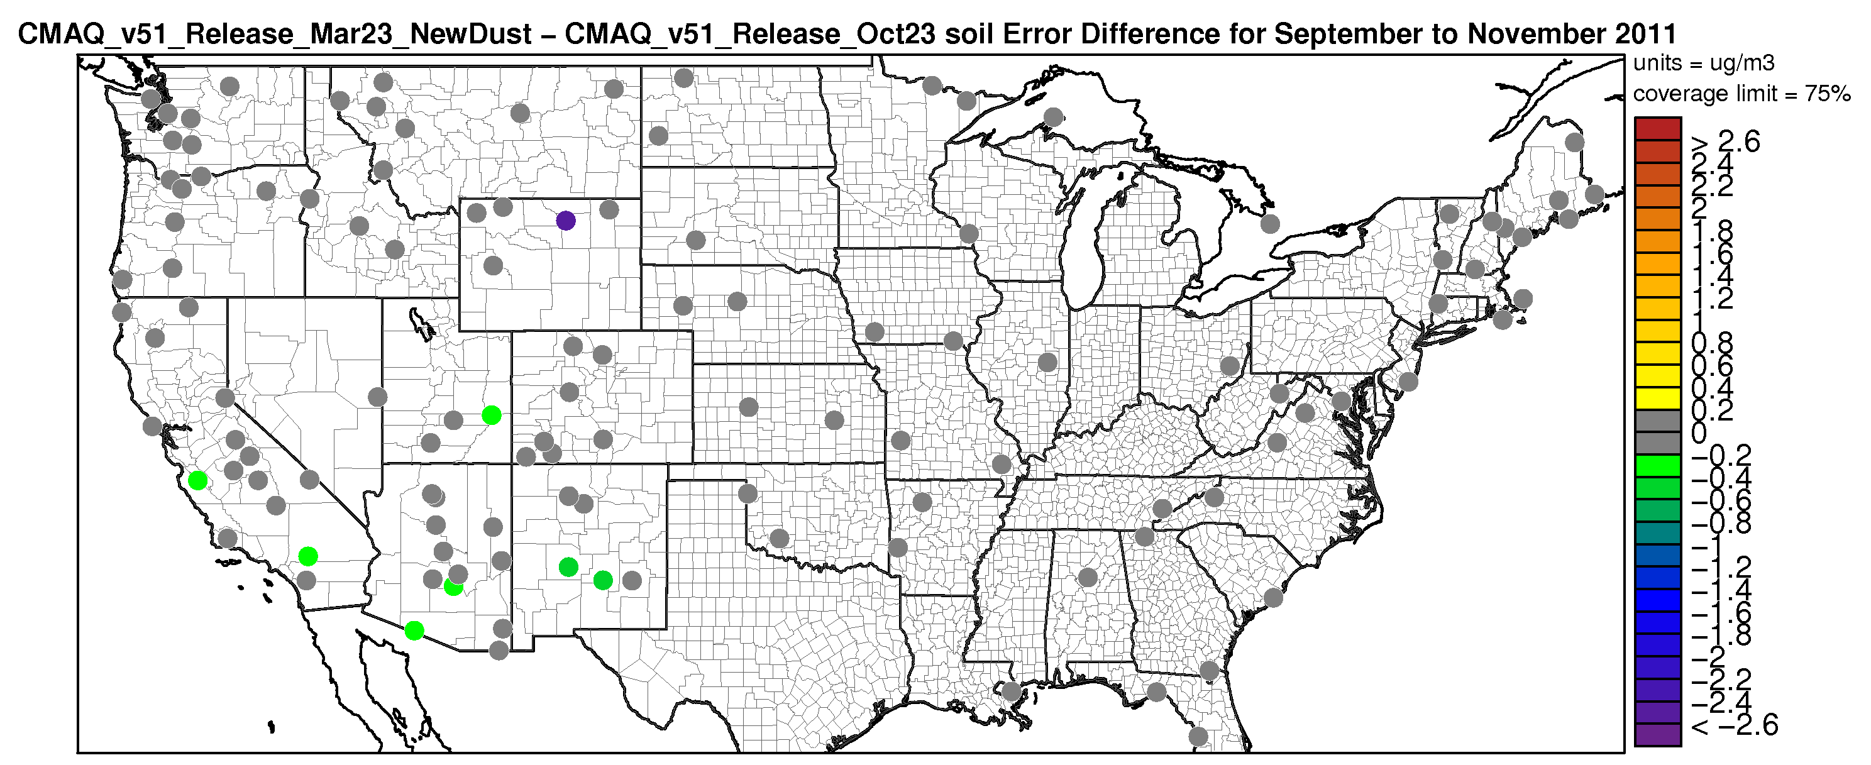
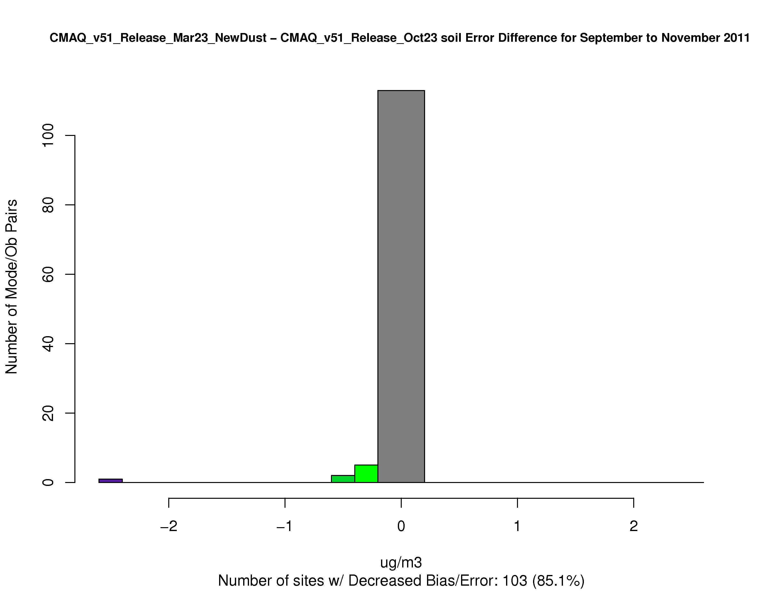
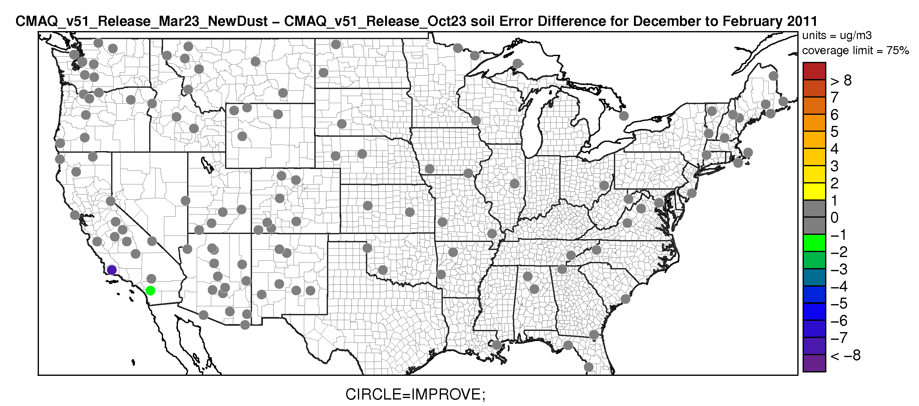
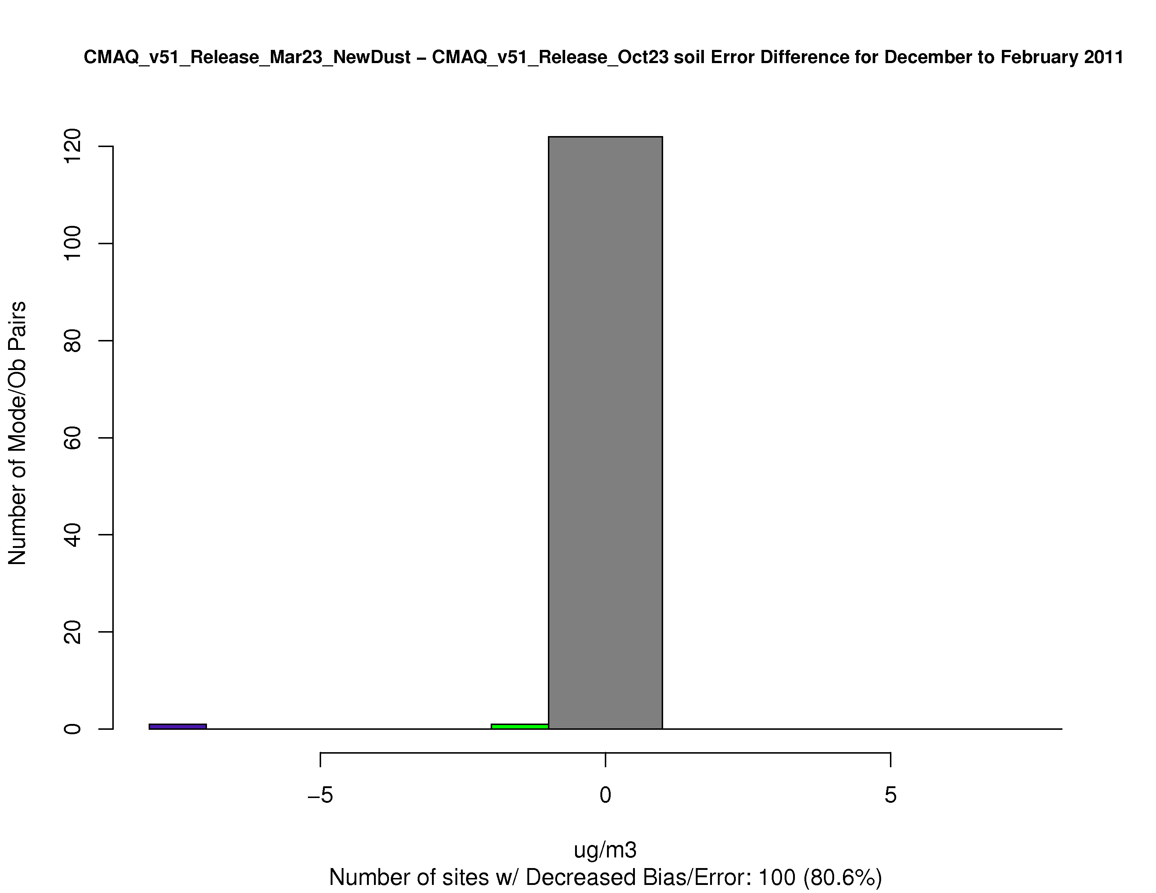
Model Evaluation - CONUS

