Slide 1
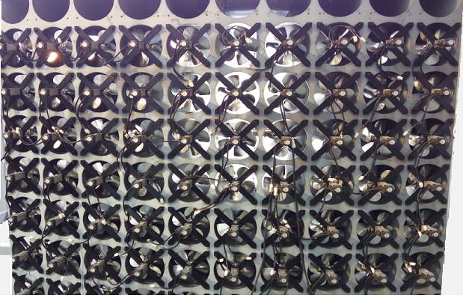
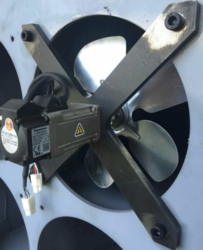
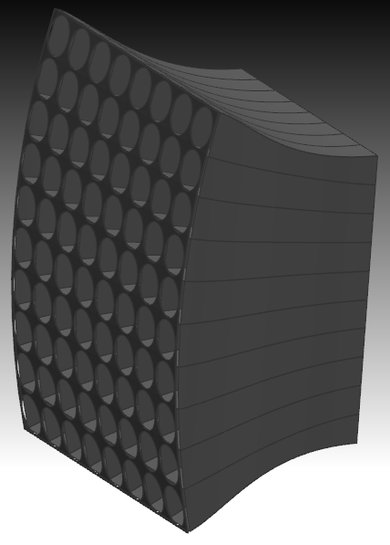
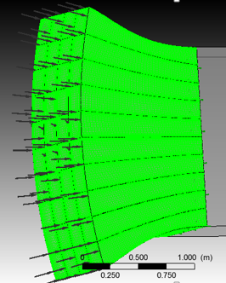
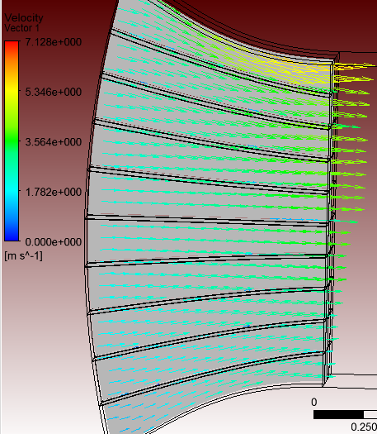
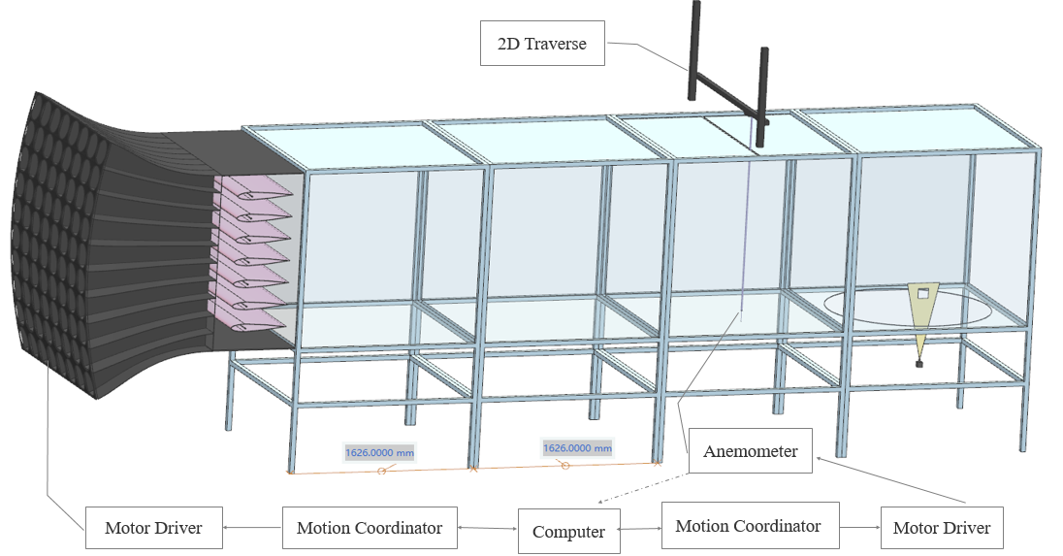
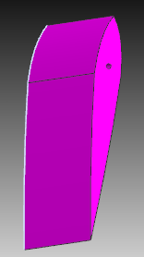
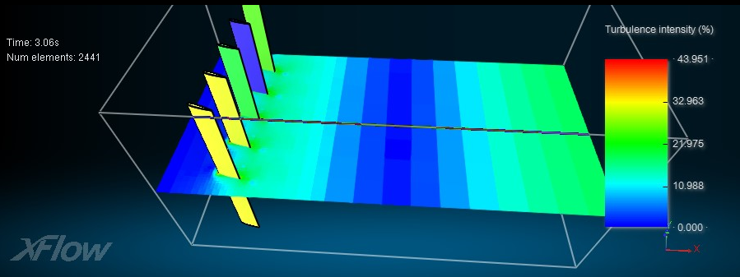
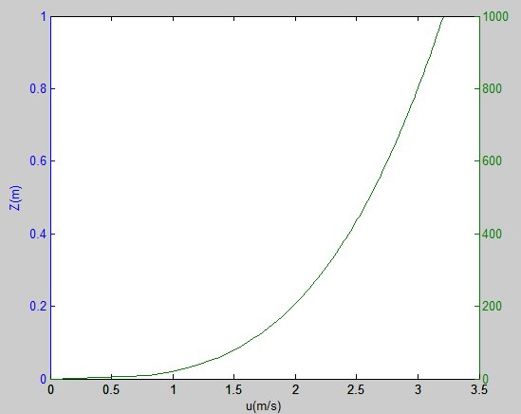
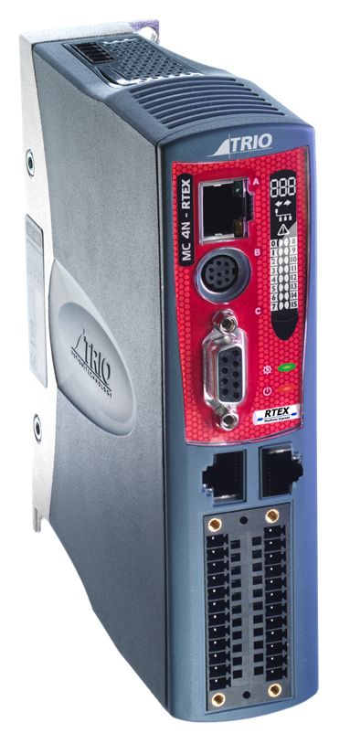
Construction of Multi-fan Wind Tunnel for Radionuclides Atmospheric Dispersion Haimin FAN, Yuanwei MA, Dezhong WANG School of Nuclear Science and Engineering, Shanghai Jiaotong University
Email: fanhaimin@sjtu.edu.cn
Introduction
Machinery manufacturing
Fluid simulation verification
To study the nuclear accident diffusion, the experiment is desperately needed to validate the atmospheric dispersion models. Many atmospheric tracer experiments are done before. But these experiments are not repeatable and hard to control variables. The atmospheric diffusion is affected by many factors, wind speed gradient, the turbulence, the deposition and so on. To explore these factors, the wind tunnel is used to simulate the dispersion. Traditionally, wind tunnel always takes the spires to simulate the atmospheric boundary layer passively. But the specific spire almost generates single wind profile. The multi-fan active wind tunnel is constructed to generate better wind profile.
In the wind tunnel, the constriction segment is designed according to the Witozinsky constriction curve , which is widely used in the wind tunnel. In addition, this part proved to accelerate the speed uniformly without the wall separation phenomenon by the CFX software.
Geometry Grids Post result Parameter settings
UG
ICEM
CFX
Software: CFX 15.0
Steady-state simulation
Number of Elements: Hexahedra 3799213
Model: k-epsilon
Inlet: U_{z}=2[m/s](z/1[m]) ^{0.25}
Outlet: Average Static Pressure
Wall roughness: 0.001m
Overview of multi-fan wind tunnel
The wind speed of design criteria is 10m/s, and this tunnel satisfy the criteria with the servo motor(Panasonic MSMF01). Every motor is controlled independently by a computer with the motion coordinator(Trio MC664), which communicates through the EtherCAT protocol. The procedure of control multi-fan and the hardware see the following pictures.
Besides, oscillating airfoils are also designed in the wind tunnel , which play a role in increasing the turbulence in the multi-fan wind tunnel. It found that the specific airfoil shape with the 2Hz flutter motion could increase the turbulence intensity to 20% averagely.
Overview of multi-fan wind tunnel
H: 2.7m
L:8.7m
Geometry Xflow result Parameter settings
Multi-fan control procedure
U_{z}=U₀(z/z₀)ª
Target wind
Software: Xflow 2015
Transient-state simulation: 10s
Viscosity Model: Newtonian
Motion Angular laws: 20sin(2t)
Adaptive refinement wake solution: 0.0125m
Wall roughness: 0.0007m
Motor Speed
Initial data according to target profile
Target velocity
Wind velocity measurement
Measure position one by one through anemometer
Flutter motion
Difference<ε
Conclusion
Fans change speed by neural network algorithm
Modify
No
The mechanical devices is installed as the above picture. The wind tunnel consists of the inlet, constriction, oscillating airfoils, developing segment and speed feedback system, and test segment. The inlet consists of 80 fans (8 columns * 10 rows), which are controlled by 80 servo motor. We can generate arbitrary wind profile, especially the wind profile which passive wind tunnel cannot generate. With the multi-fan wind tunnel and more advanced measurement technique, we can get large valuable experiment datum. Our goal is to build more accurate dispersion model and explore the particle motion law.
Yes
To conclude, wind tunnel construction is a challenging engineering system. It involves machinery manufacturing, electrical engineering, automatic control and fluid simulation. This wind tunnel is constructed with the ability to simulate the various wind profile. The dispersion result could be measured by DIPT system. More accurate results will come out and be the fundamental of dispersion model.
This wind tunnel is also assembled with aerosol generator, particle spectrometer and particle image velocimetry. Further study will focus on the scaled aerosol dispersion with a reasonable scale of aerosol diameter and atmospheric boundary layer.
End
Control hardware
Control target: 80 fans motion & 7 airfoils flutter
Hardware information
Motion Coordinator Trio MC664
Panasonic Motor Driver MADHNA1
Characteristics
EtherCAT communication
Mature software
32axis/module

