Slide 1
Development of 2011 Hemispheric Emissions for CMAQ
October 24, 2016
A. Eyth, J. Vukovich, M. Strum, P. Dolwick (US EPA OAQPS)
G. Pouliot (US EPA ORD) C. Allen, J. Beidler (CSRA)
B.H. Baek, Z. Adelman (UNC Chapel Hill)

Slide 2
Project Overview
Goal: Perform a hemispheric CMAQ run using the latest available 2011 emissions inventories
Process emissions for U.S., Canada, and Mexico using the EPA 2011v6.3 platform emissions / approach on a hemispheric grid
Process 2010 Hemispheric Transport of Air Pollutants (HTAP) v2 gridded inventory
Compare results with an earlier hemispheric run that used HTAP v2 but not the 2011 NEI

Slide 3
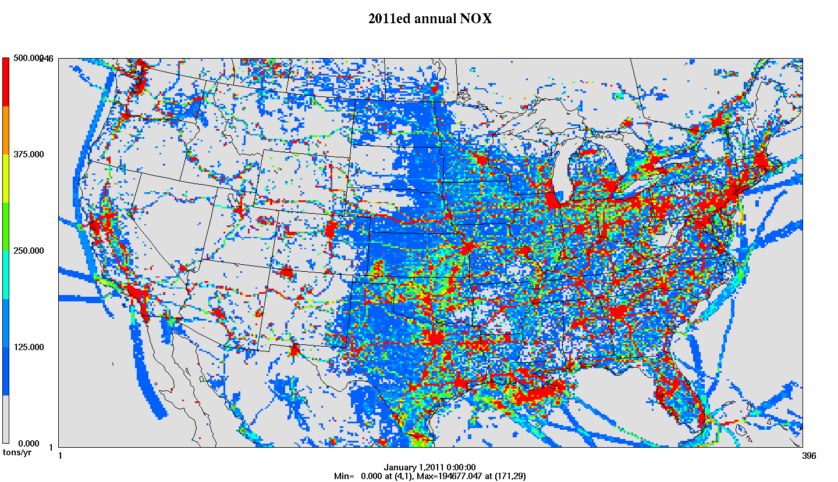
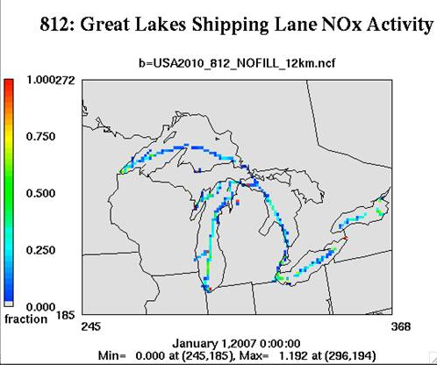
Emissions Modeling Process
Ancillary Data: profiles and cross references
SMOKE
SMOKE software performs temporal allocation, spatial allocation, speciation, and plume rise to create:
Temporal Profiles
Inventories (annual, monthly, daily, hourly)
Met. Data
Speciation Profiles
Gridded, hourly, speciated emissions in a format for an air quality model
Spatial Surrogates
Notes:
Go quickly: Ancillary data = temporal profiles, speciation profiles, spatial surrogates

Slide 4
Challenges
Achieving consistency throughout the hemisphere in speciation, spatial allocation, temporal allocation, and vertical allocation
Preparing spatial surrogates for the entirety of Canada and Mexico on hemispheric grid
Preparing emissions for the rest of the northern hemisphere based on gridded inventories
Accounting for time zones around the world
Obtaining hemispheric inventories for fires and biogenics
Zeroing out HTAP inventory over North America
Notes:
Give a quick introduction to emissions modeling
Specifics about 2011v6.2 platform

Slide 5
Use of HTAP inventories
Resolution: 0.1 degrees latitude by 0.1 degrees longitude for year 2010
Pollutants: CO, NMVOC, NO_{x}, SO₂, NH₃, PM₁₀, PM_{2.5}, black carbon (BC) and organic carbon (OC)
Emissions sectors: agriculture, aircraft, industry, power industry (i.e., energy), ground transport, residential, and shipping
Some sectors have monthly inventories, others annual
New in SMOKE 4.0: read gridded inventories and regrid them onto a desired modeling grid
Layering: uses constant layer fractions (J. Xing) since there are no stack parameters

Slide 6
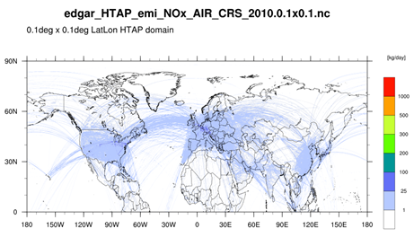
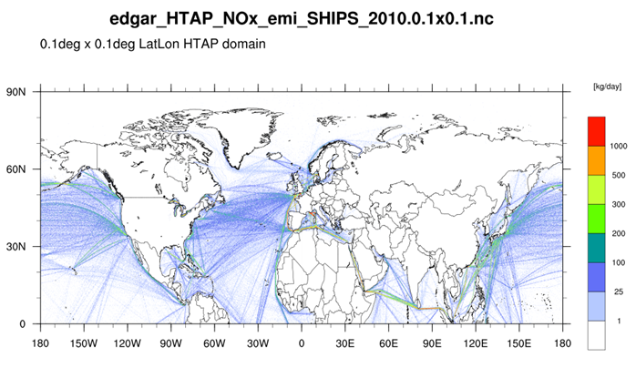
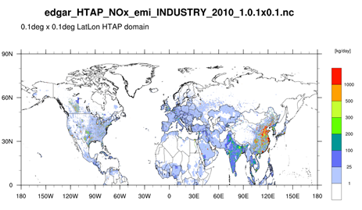
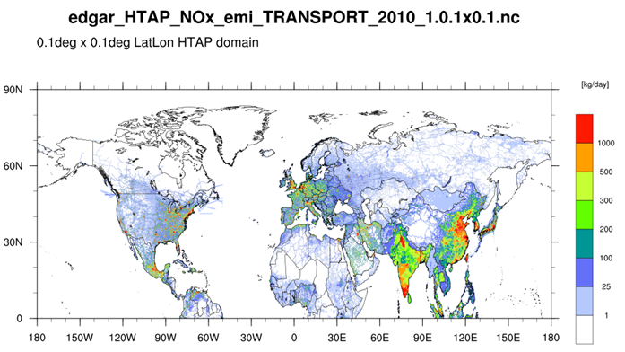
NOx from Selected HTAP Sectors
Aircraft Cruising
Shipping
kg NO_{x}/day
Industry
Ground transport

Slide 7
Other Inventories
U.S. anthropogenic inventories based on 2011 National Emission Inventory version 2, with updates
Including the inventories for Alaska, Hawaii, Puerto Rico, and Virgin Islands
U.S. fires from 2011NEIv2, 2010 fires used during spin up
Canada 2010, Mexico 2008
Fire INventory from NCAR (FINN) used outside U.S.
Climatological biogenic emissions from Global Emission Inventory Activity (GEIA), not BEIS
Agricultural fires for 2008 from EDGAR
Ocean chlorine consistent with modeling platform

Slide 8
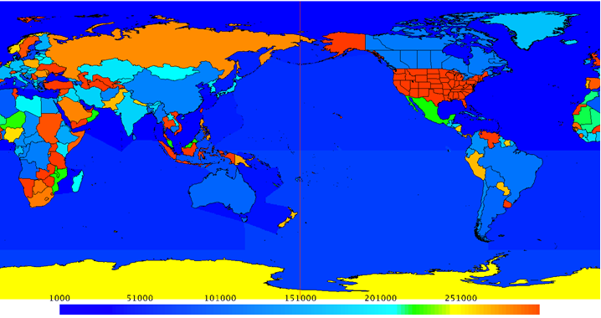
New SMOKE Input Files
GEOCODE contains all country, state, county and district definitions (replaces COSTCY)
GRIDMASK file (for 0.1x0.1 grid) assigns GEOCODEs and time zones to each grid cell

Slide 9
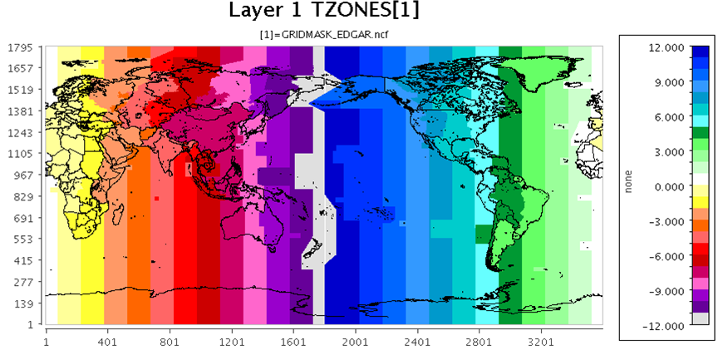
Temporal Allocation
2011v6.3 platform profiles for North America
Xing et. al (2015) profiles for HTAP area
GRIDMASK file assigns time zones to grid cells
Used to apply diurnal profiles outside of North Am.

Slide 10
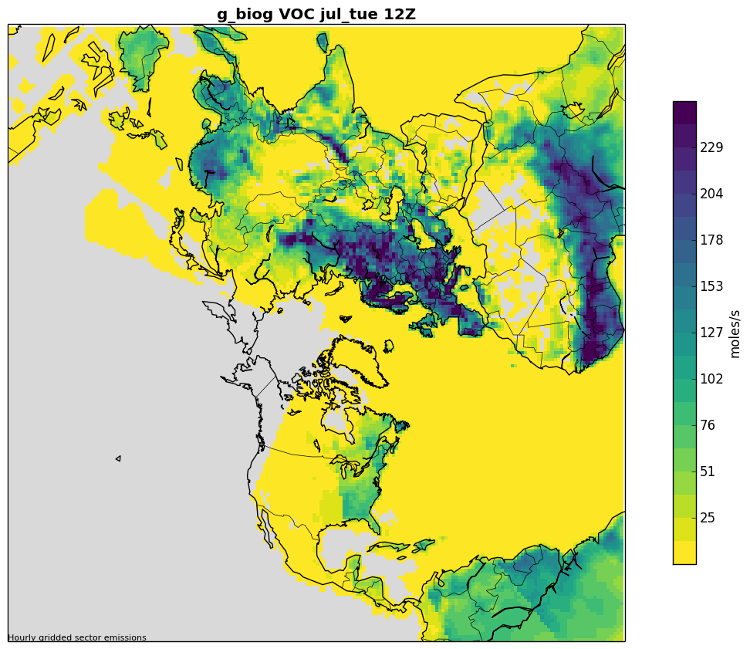
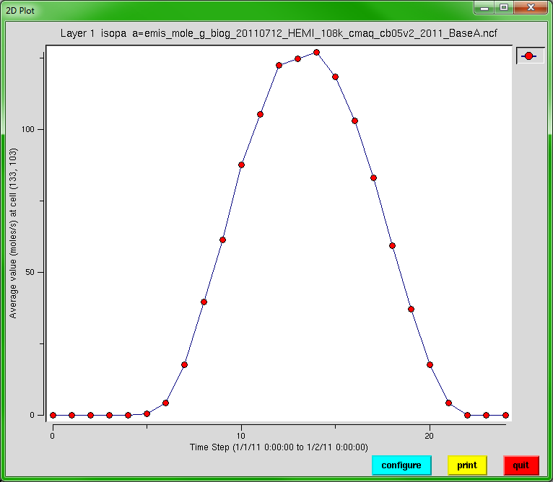
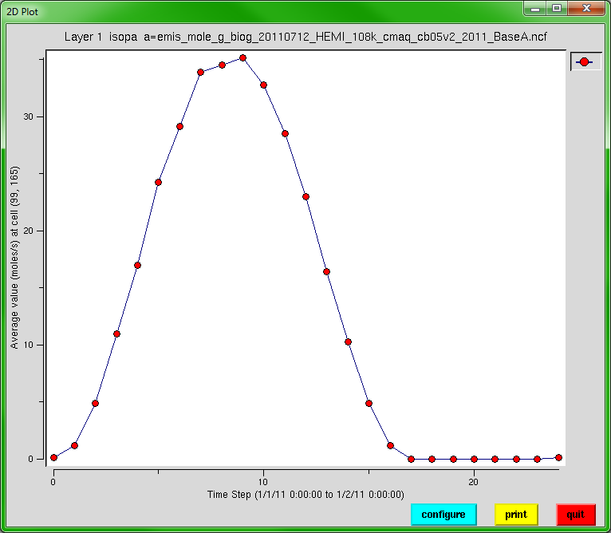
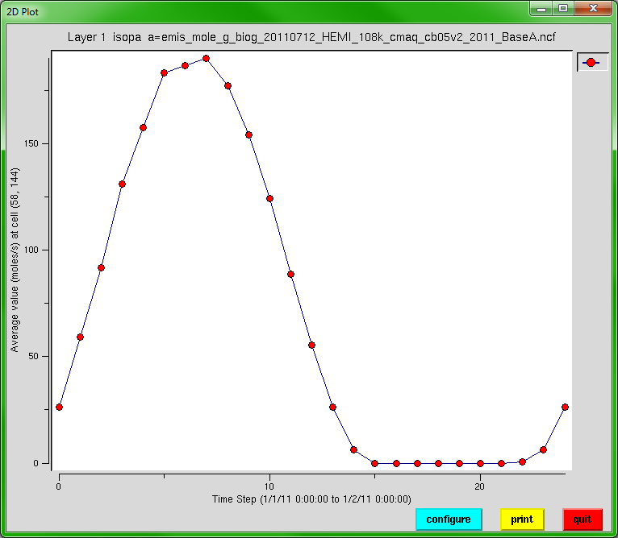
July Biogenic VOC emissions
These plots illustrate correlation of emissions with regional daylight
00Z
12Z
All times in GMT
France ISOP
India ISOP
China ISOP

Slide 11
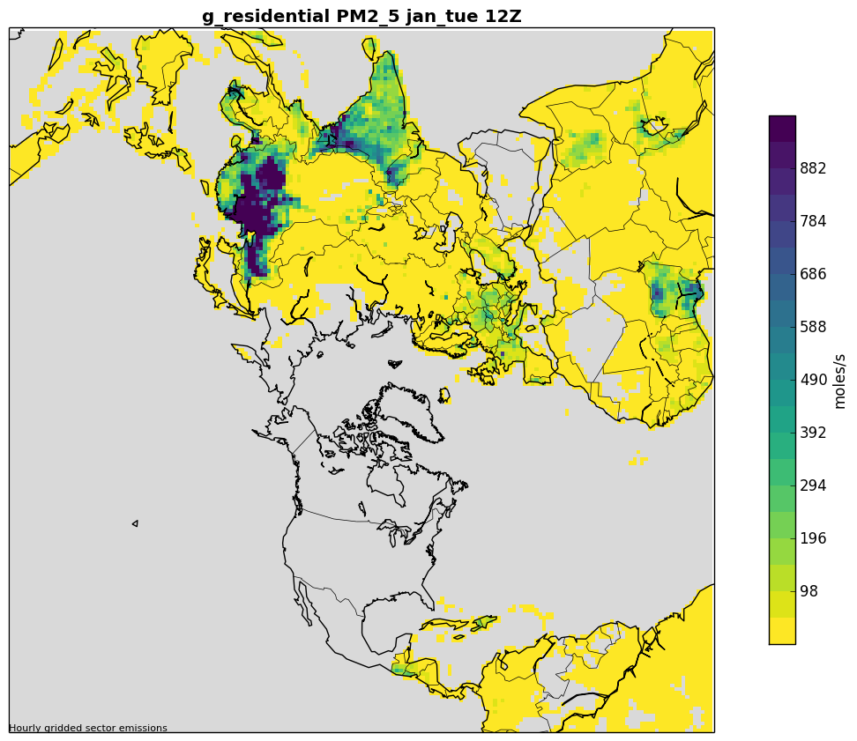
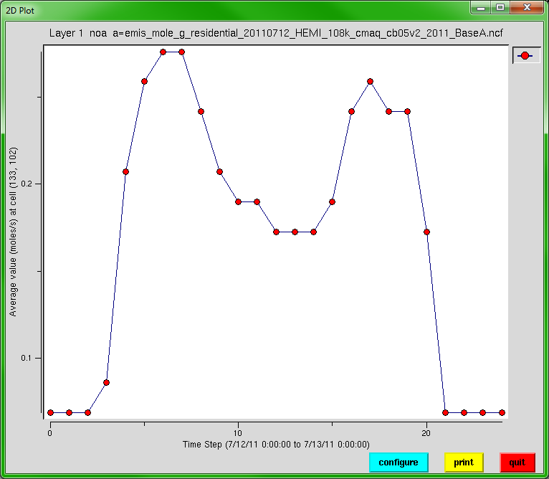
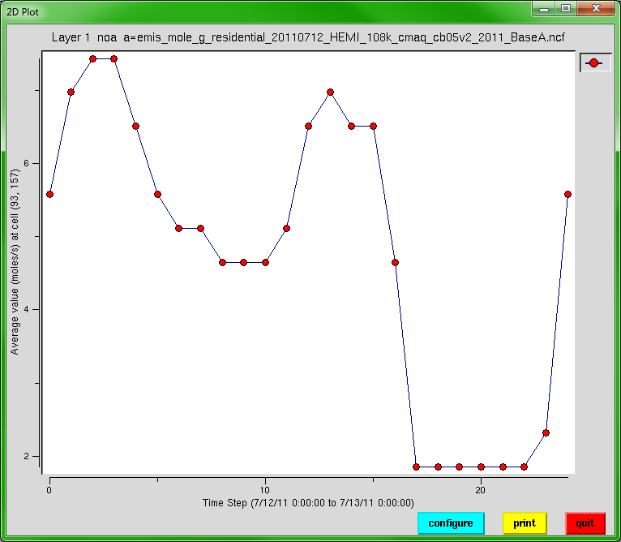
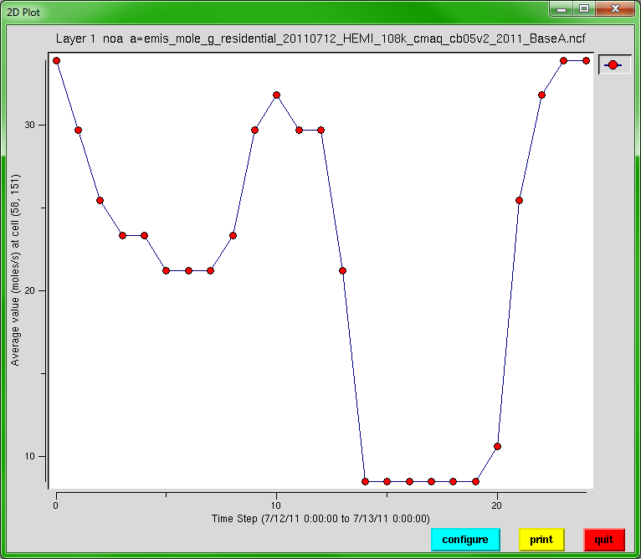
January Residential PM2.5
Residential emissions have two peaks: morning and evening local time
00Z
12Z
All times in GMT
France
India
China

Slide 12
Spatial Allocation
Spatial Surrogates for U.S., Canada, and Mexico developed for the hemispheric grid
187x187 polar stereographic 108km x 108km
Covered outlying areas: AK/HI/PR/VI
Spatial cross-reference had to be updated
No surrogates needed outside of North America because inventories are regridded

Slide 13
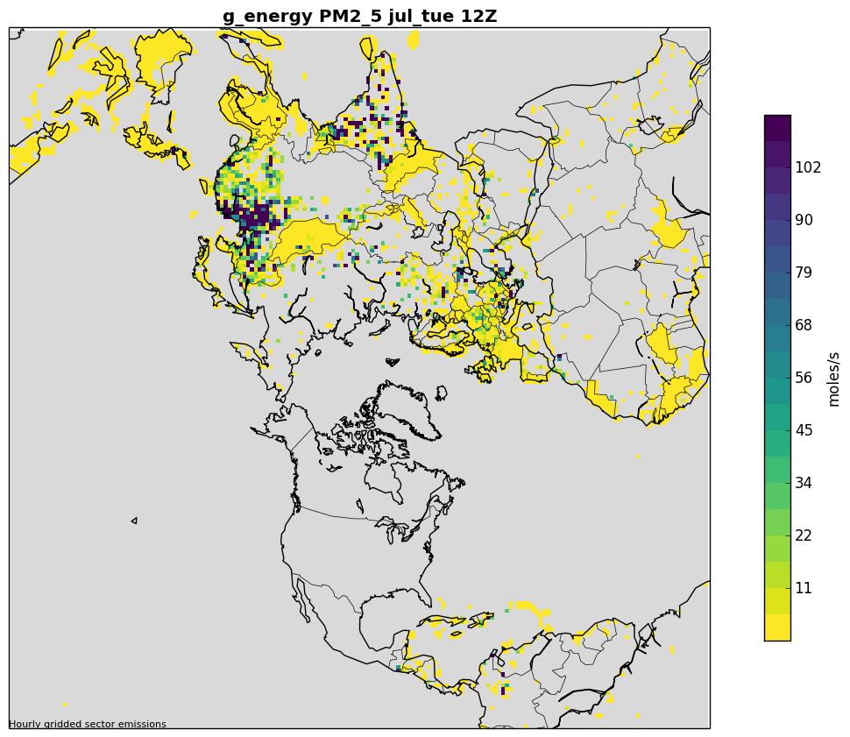
Examples of Gridded HTAP Emissions
Air Cruising PM2.5 Emissions
Energy PM2.5 Emissions

Slide 14
Vertical Distribution
Emissions created for 44 layers
Layer 1 median at 10m, and layer 44 at 18,200m
SMOKE plume rise used in North America
Based on stack parameters
Fires have a special treatment
HTAP emissions
Use SMOKE program Layalloc to put emissions at specific height ranges
Aircraft emissions split into landing and takeoff (layers 1-15), climbing and descent (16-33), and cruising (34-38)
Layering needs to be run every day because layer heights change with the meteorological data

Slide 15
Vertical Distributions by Sector
L | Km | L | Km
1 | .01 | 25 | 4.2
5 | 0.1 | 30 | 6.8
10 | 0.4 | 35 | 10
15 | 0.9 | 40 | 14
20 | 2.1 | 44 | 18

Slide 16
Speciation
Carbon Bond 2005 (CB05)-based speciation
Used 2011v6.3 platform within North America
Created new set of speciation profiles for HTAP based on the 2011 platform averages
For HTAP, only a single speciation profile can be used per sector, country and pollutant
HTAP BC and OC inventory pollutants were used directly
Rest of PM2.5 speciated into CMAQ’s AE6

Slide 17
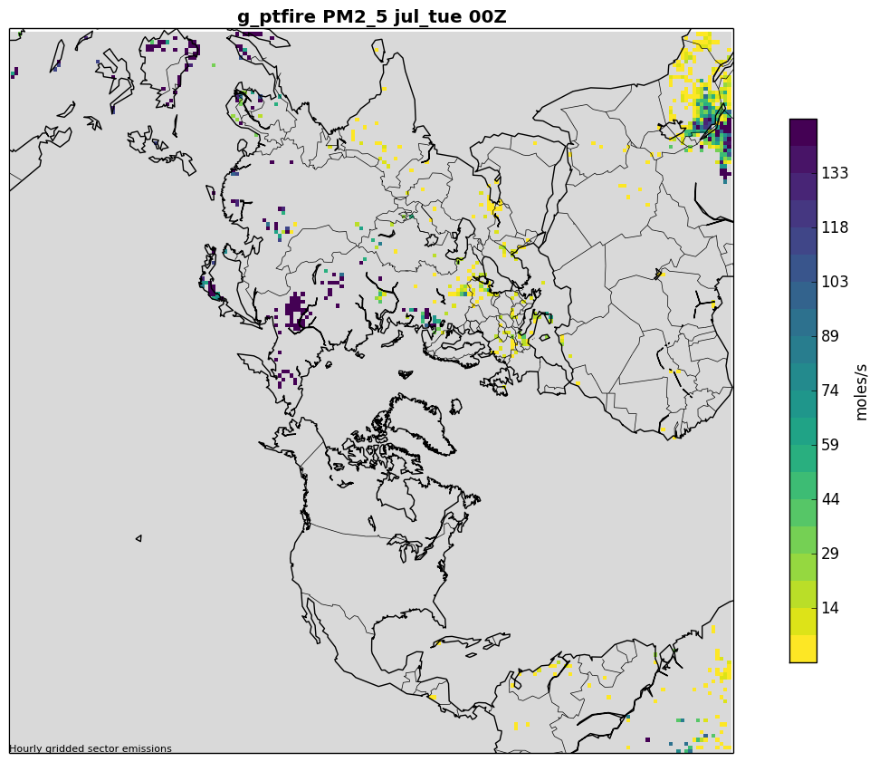
Difference: PM_{2.5} from FINN Fires
2011 FINN Fires in N. Africa differed from the EDGAR/HTAP persistent climatological fires used in earlier hemispheric and GEOS-Chem runs
January
July

Slide 18
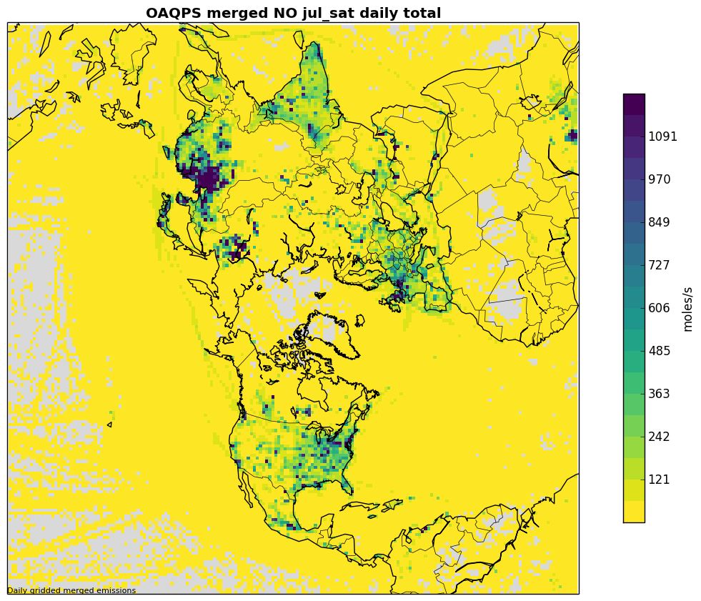
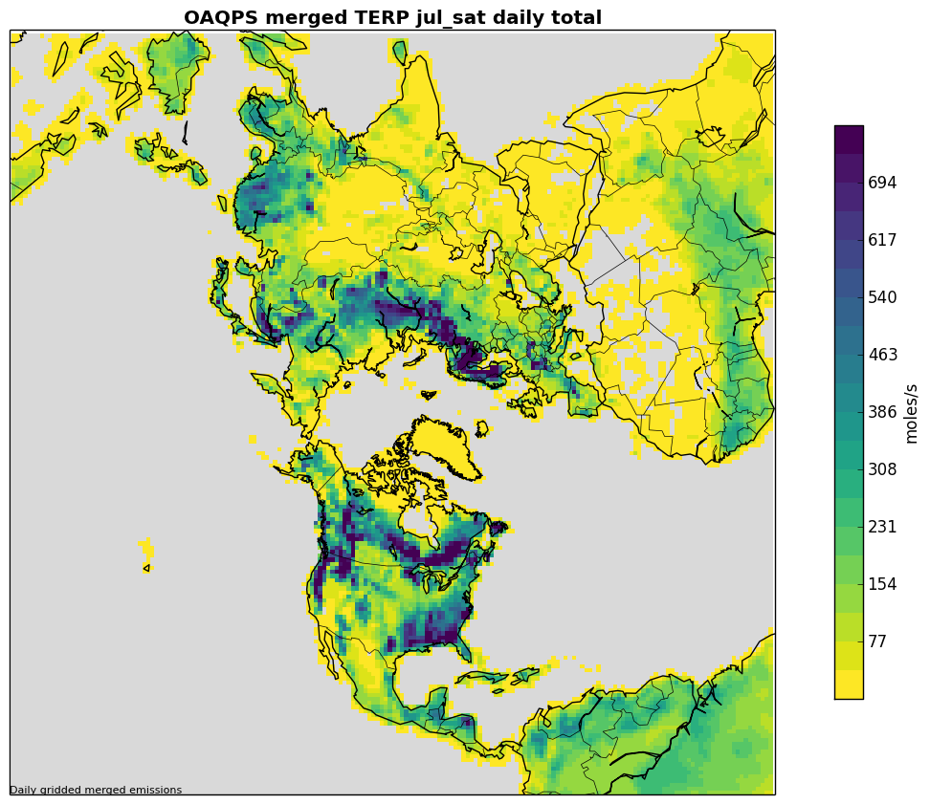
Examples of merged emissions
July Saturday NO
July Saturday Terpenes

Slide 19
Data Availability and Future Work
SMOKE 4.0 is available from www.cmascenter.org
Input data and scripts will be available from https://www.epa.gov/air-emissions-modeling/
Sensitivities where we evaluate the impact of changing emissions in other parts of the world
Future projections for non-U.S. emissions using trends from satellite data, especially NO2
Better integration of ag. fire with FINN emissions
Improvements to biogenic emissions
Improvements to layering
Questions can be directed to eyth.alison@epa.gov

Slide 20
References
Xing, J., R. Mathur, J. Pleim, C. Hogrefe, C.-M. Gan, D. Wong, C. Wei, R. Gilliam, and G. Pouliot (2015), Observations and modeling of air quality trends over 1990–2010 across the Northern Hemisphere: China, the United States and Europe, Atmospheric Chemistry and Physics, 15(5), 2723-2747
Xing, J., J. Pleim, R. Mathur, G. Pouliot, C. Hogrefe, C. M. Gan, and C. Wei (2013), Historical gaseous and primary aerosol emissions in the United States from 1990 to 2010, Atmos. Chem. Phys., 13(15), 7531-7549, doi:10.5194/acp-13-7531-2013
Janssens-Maenhout, G., M. Crippa, D. Guizzardi, F. Dentener, M. Muntean, G. Pouliot, T. Keating, Q. Zhang, J. Kurokawa, and R. Wankmüller (2015), HTAP_v2. 2: a mosaic of regional and global emission grid maps for 2008 and 2010 to study hemispheric transport of air pollution, Atmospheric Chemistry and Physics, 15(19), 11411-11432
Pouliot, G., T. Keating, G. Maenhout, C. Chang, J. Beidler, and R. Cleary (2014), The Incorporation of the US National Emission Inventory into Version 2 of the Hemispheric Transport of Air Pollutants Inventory, in Air Pollution Modeling and its Application XXIII, edited, pp. 265-268, Springer International Publishing.

