Slide 1
Modeling Single-Source
Ozone Impacts with HDDM
Sensitivity Analysis
Chris Emery, Tasko Olevski, Ralph Morris
CMAS: Fine Scale Modeling and Applications
October 25, 2016

Slide 2
Purpose
Investigate ozone sensitivity to single source emissions
Use contemporary PGM and US-wide dataset
  Simulate various hypothetical sources
  Report tons NOx & VOC per ppb ozone impact
Parallels work by Alpine Geophysics (AG) on single-source ozone and PM_{2.5} impacts using source apportionment (SA)

Slide 3
Approach
Modeling Database
Model:
  CAMx v6.11 with the Higher-order Decoupled Direct Method (HDDM)
Datasets:
  EPA 2011 12 km CONUS Platform, “2017EH” emissions (July 28, 2015 NODA)
    Run for May-September ozone season
  3 types of hypothetical sources typical of certain historical industry projects, NOT specific projects:
  G: 872 NOx, 171 VOC (TPY)
  R: 73 NOx, 86 VOC
  E: 339 NOx, 316 VOC
  HDDM reports ozone impacts for given emissions and for 0.5x and 2x NOx and VOC

Slide 4
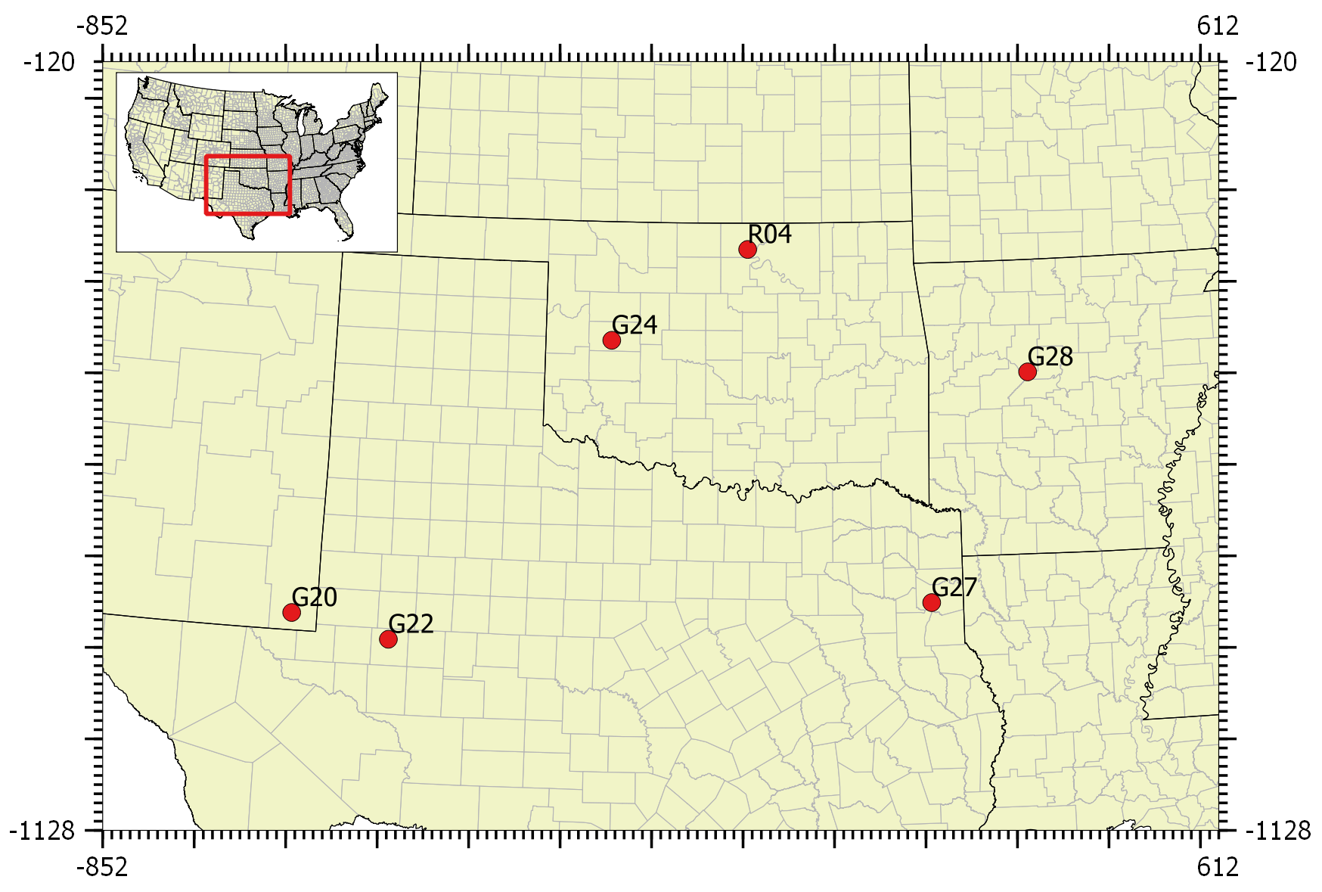
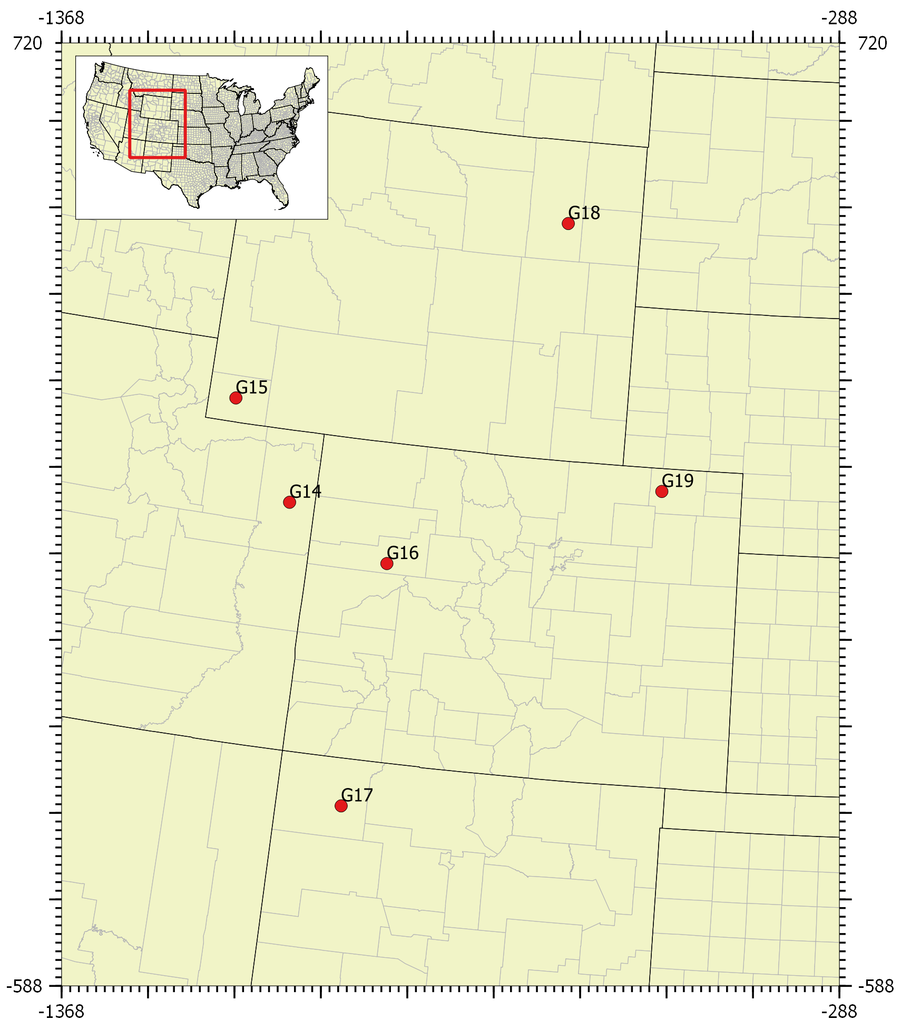
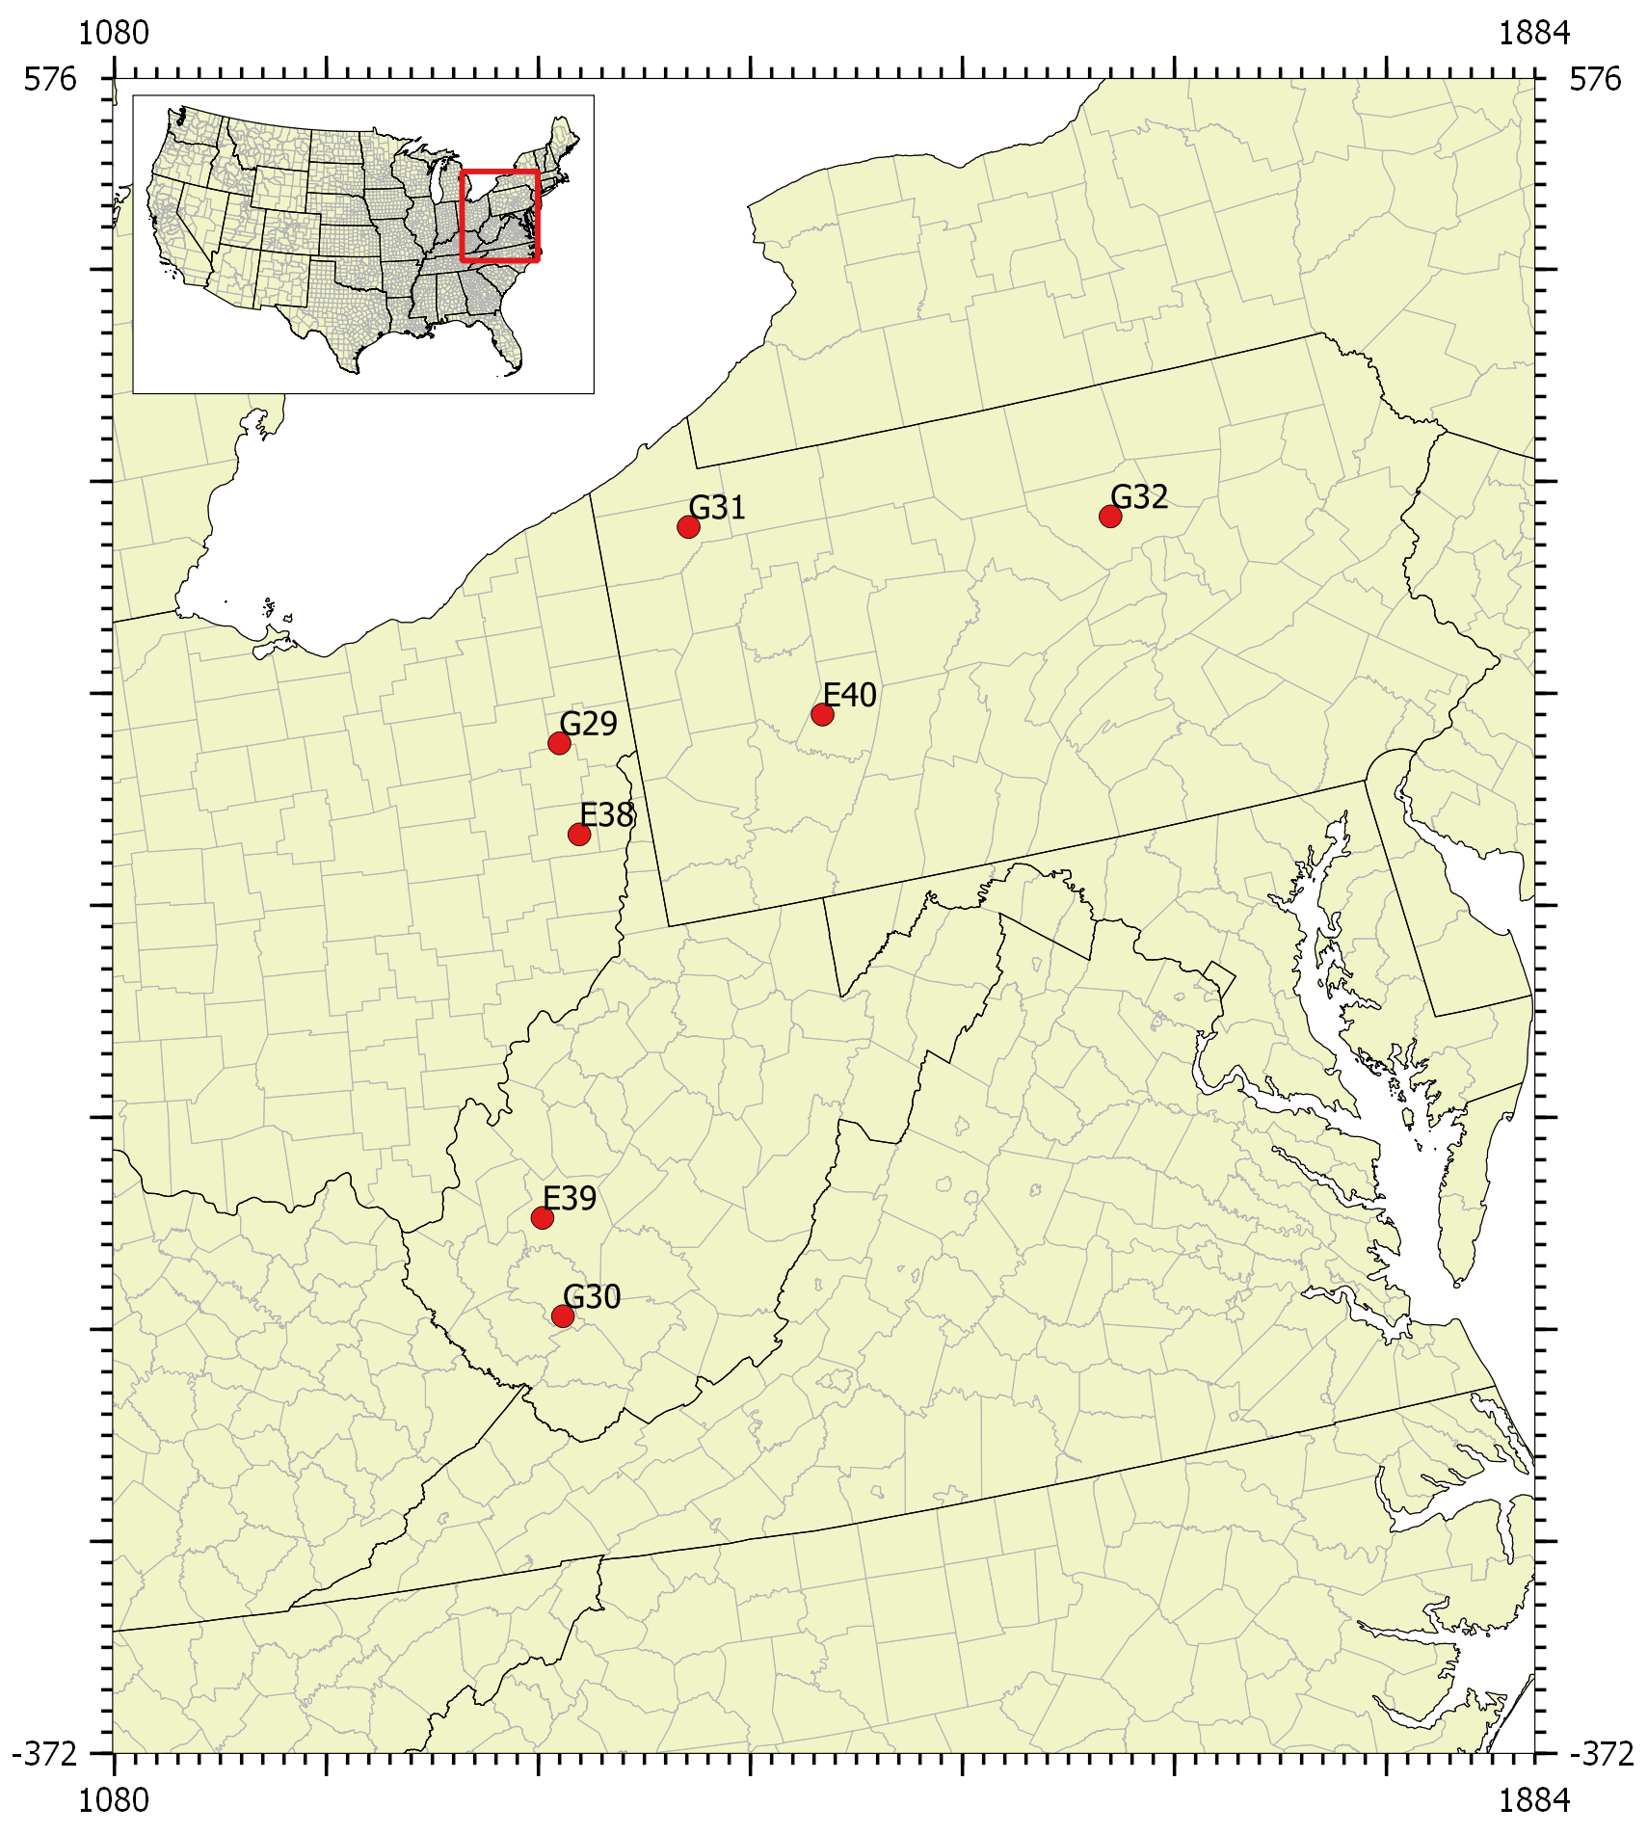
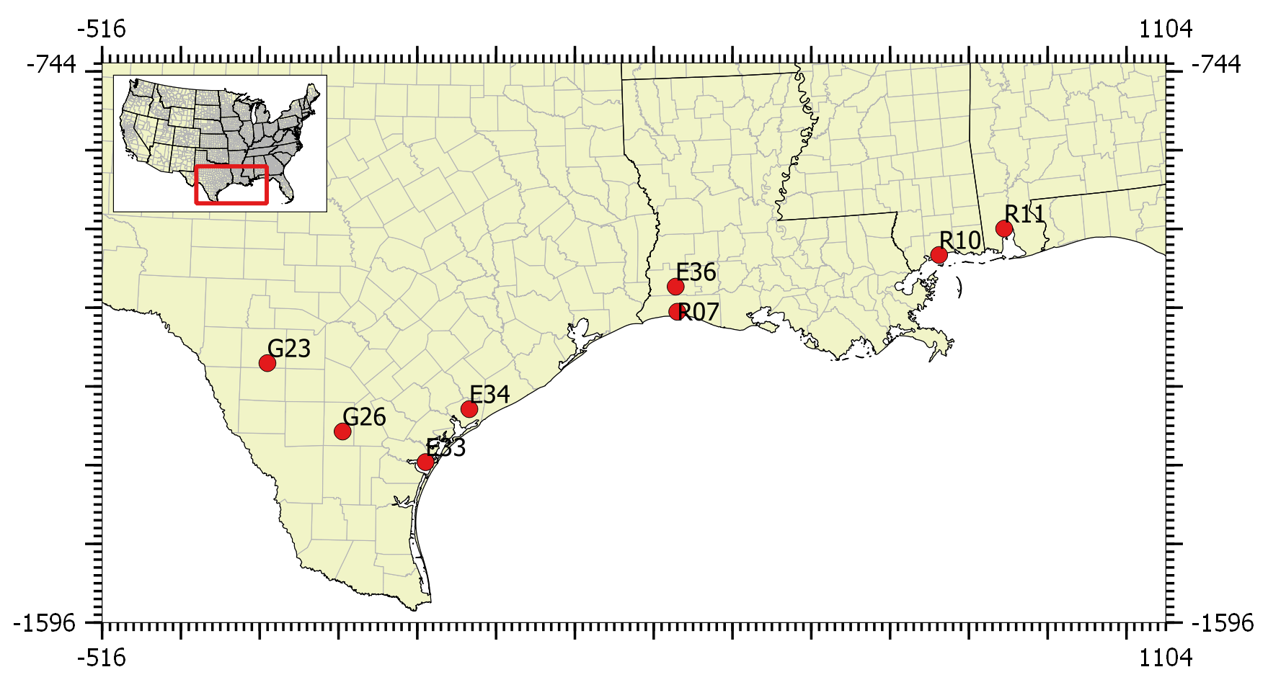
Approach
12 Hypothetical Sources
Located in attainment/unclassifiable areas where sources would be subject to PSD permitting requirements

Slide 5
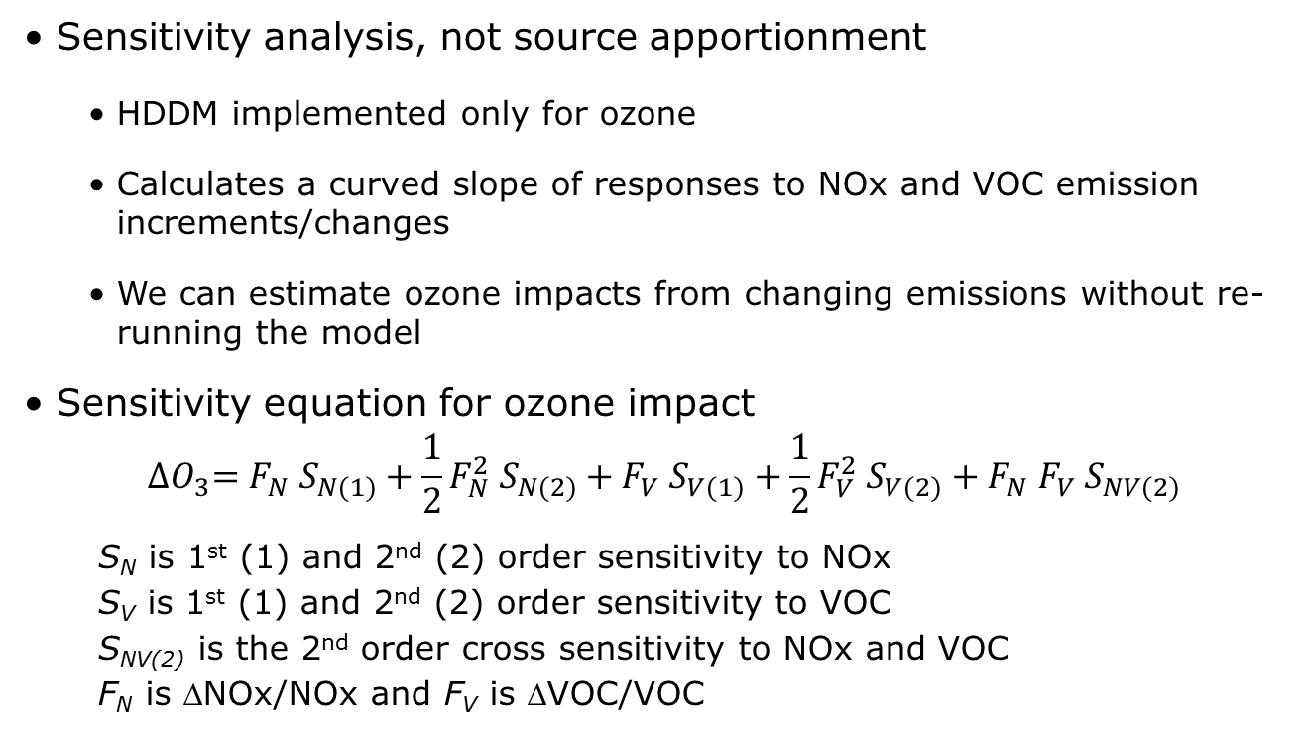
Approach
High Order Decoupled Direct Method
Sensitivity analysis, not source apportionment
  HDDM implemented only for ozone
  Calculates a curved slope of responses to NOx and VOC emission increments/changes
  We can estimate ozone impacts from changing emissions without re-running the model
Sensitivity equation for ozone impact
$${∆O}_{3}=F_{N} S_{N(1)}+\frac{1}{2}F_{N}^{2} S_{N(2)}+F_{V} S_{V(1)}+\frac{1}{2}F_{V}^{2} S_{V(2)}+F_{N} F_{V} S_{NV(2)}$$
S_{N} is 1st (1) and 2nd (2) order sensitivity to NOx
S_{V} is 1st (1) and 2nd (2) order sensitivity to VOC
S_{NV(2)} is the 2nd order cross sensitivity to NOx and VOC
F_{N} is ΔNOx/NOx and F_{V} is ΔVOC/VOC

Slide 6
Approach
Brute Force vs. SA vs. HDDM
ΔC_{HDDM}
ΔC_{BF}
HDDM
ΔC_{SA}
BF
Pollutant Concentration
SA
0
E₁
E₀
Emission
Notes:
SA implicitly assumes a linear response across the range of E. Implicit because it isn’t a sensitivity tool; Linear because it cannot account for non-linear interactions as precursors change. Along the way, SA can deviate from BFM and DDM substantially.

Slide 7
Results
Peak MDA8 Ozone Impacts
 | Distance from Source (km) | Max MDA8 O3 (ppb)
Grid 1
E36 | 10.5 | 0.43
G26 | 2.7 | 2.01
R11 | 5.4 | 0.10
Grid 2
G14 | 5.0 | 1.15
G18 | 35.1 | 0.49
G19 | 4.2 | 1.84
Grid 3
G22 | 15.8 | 1.67
G27 | 4.9 | 0.92
R04 | 0.4 | 0.11
Grid 4
E40 | 6.0 | 0.52
G30 | 4.3 | 2.76
G32 | 6.2 | 2.92
Impacts mostly < 2 ppb
Distances mostly < 12 km (grid cell containing source)
  Potential sensitivity to grid resolution
Results dependent on model, year, dataset/configuration
Let’s look at G14, E40 and G32 more closely

Slide 8
Results
G32 North-Central Pennsylvania

Slide 9
Results
G32 North-Central Pennsylvania
Ozone is strongly NOx-sensitive, VOC-insensitive
  NOx-heavy source in rural VOC-rich area
  3.6x ozone response for 4x NOx change – practically linear
Variation in ton/ppb efficiency also indicates non-linearity of ozone response
  i.e., degree you can trust a linearly extrapolated ozone impact from a single emissions case (SA)
Little variation in NOx efficiency
  Ozone extrapolation from one NOx scenario is OK

Slide 10
Results
G14 Eastern Utah

Slide 11
Results
G14 Eastern Utah
Ozone is NOx-sensitive
  NOx-heavy source in rural VOC-lean area
  3.2x ozone response for 4x NOx change – mostly linear
Moderate variation in NOx efficiency
  Ozone extrapolation from one NOx scenario may not be accurate (but would be conservative/high)

Slide 12
Results
E40 Pittsburgh, PA

Slide 13
Results
E40 Pittsburgh, PA
Ozone is both NOx-and VOC-sensitive
  Equivalent moderate NOx and VOC emissions within a photochemically active urban plume
  Indicates efficient ozone production along NOx-VOC “ridgeline”
  1.9-2.6x ozone response for 4x NOx change – not linear
  1.4-1.9x ozone response for 4x VOC change – not linear

Slide 14
Results
E40 Pittsburgh, PA
Large variation in both NOx and VOC efficiency
  Ozone extrapolation from one NOx and VOC scenario is not OK

Slide 15
Summary
BF = SA = HDDM only for linear problems (not ozone typically)
  HDDM can inform about non-linear effects w/o re-running the model
Ozone impacts mostly < 2 ppb
Distances to peak impacts mostly < 12 km (grid cell containing source)
  Potential sensitivity to grid resolution
Magnitude/distance impacts dependent on model, year, dataset/configuration
Ozone impacts fall off quickly with distance
Ozone formation is NOx-sensitive in most cases

Slide 16
Summary
NOx efficiency by source is mostly invariant
  Indicates fairly linear response to NOx
  Linear extrapolation to other NOx scenarios is usually OK
VOC efficiency is rather variable
  Indicates non-linear response to VOC, but typically not VOC-sensitive
  Extrapolation over large VOC changes (in VOC-sensitive conditions) is not OK

Slide 17
Thank You
Any questions?

Slide 18
Grid 1: Gulf Coast
= HDDM sources

Slide 19
Grid 2: Rockies
= HDDM sources

Slide 20
Grid 3: South Central
= HDDM sources

Slide 21
Grid 4: east
= HDDM sources

Slide 22
Overall Results
NOx Efficiency – all sources
NOx efficiency by source is mostly invariant, linear extrapolation to other NOx scenarios is usually OK

Slide 23
Overall Results
VOC Efficiency – all sources
VOC efficiency is rather variable, but ozone impact is typically not VOC-sensitive: linear extrapolation to large VOC changes is not OK

Slide 24
Overall Results
Ozone Impacts by Distance – G Sources
Whiskers: min to max
Bar: interquartile range
Diamond: Mean
Cross: 95%-tile

Slide 25
Overall Results
Ozone Impacts by Distance – E Sources
Whiskers: min to max
Bar: interquartile range
Diamond: Mean
Cross: 95%-tile

Slide 26
Overall Results
Ozone Impacts by Distance – R Sources
Whiskers: min to max
Bar: interquartile range
Diamond: Mean
Cross: 95%-tile

