Slide 1
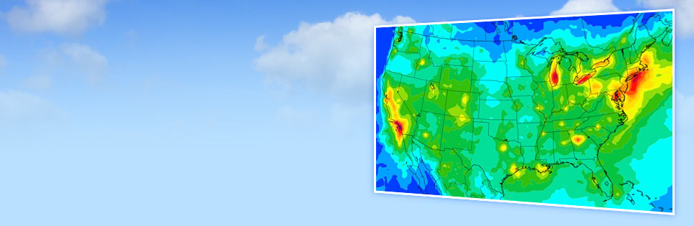
Overview and Recent Updates
Chris Emery, Bonyoung Koo, Gary Wilson, Greg Yarwood
CMAS: Model Development
October 25, 2016
Notes:
Alternative title slide. Image size: 8 cm x 25,4 cm or 302 x 960 pixels

Slide 2
CAMx Overview
Core Model
Large range of applicable scales
  2-way grid nesting extends scales from ~1 to 1000’s km
  Individual point sources plumes (<< 1 km) via Plume-in-Grid (PiG)
Multiple chemistry treatments
  Carbon Bond (CB05 and CB6 variants) and SAPRC07TC
  Aqueous sulfate and nitrate oxidation (RADM-AQ)
  Heterogeneous sulfate and aqueous SOA chemistry
  Partitioning among organic gases and aerosols (SOAP, VBS)
  Partitioning among inorganic gases and aerosols (ISORROPIA)
  Modal (CF) and sectional (CMU) size treatments
  Optional mercury chemistry

Slide 3
CAMx Overview
Core Model
Multiple map projections
  Lambert, Polar, Mercator, UTM, Geodetic (latitude/longitude)
Advection: PPM or Bott advection
Dry deposition: Wesely89 or Zhang03
PiG chemistry: condensed NOx-O₃ with PM, or full gas-phase
Surface chemistry/re-emission model
  User-defined heterogeneous chemistry on soil, vegetation, snow
Parallelization: shared (OMP) and/or distributed-memory (MPI)

Slide 4
CAMx Overview
Probing Tools
Source Apportionment Technology (O/PSAT)
  Track attribution to emissions by category and region
Decoupled Direct Method (H/DDM)
  Track sensitivity to emissions by category and region
Process Analysis tools (IPR, IRR, CPA)
  Additional information helps explain model predictions
Reactive Tracer sub-model (RTRAC, RTCMC)
  Run additional gas and PM species (toxics) with separate chemistry

Slide 5
Updates in CAMx v6.3 (2016)
Ozone Source Apportionment Update (TCEQ)
Issue
  O₃ can “hide from view” as NO₂
    O₃ + NO → NO₂
    NO₂ + hv → → O₃
  OSAT attributed “hidden O₃” to local NOx rather than transported O₃
Notes:
Changes in core model species are shown in blue, OSAT tracers are in black, the diamond represent the OSAT algorithms that determine ozone tracer production. ΔH2O2/ΔHNO3 is the indicator ratio used to determine NOx- or VOC-limited ozone production.

Slide 6
Updates in CAMx v6.3 (2016)
Ozone Source Apportionment Update
Approach (OSAT3) (Yarwood and Koo, 2015)
  OSAT3 tracks odd oxygen and nitrogen through NOy cycle
  Accounts for NOx recycling of ozone
  Harmonizes the N-tracers in OSAT and PSAT to a single method
  Extends 4 N/V precursor tracers to 10
  Reduces local O₃ production from NOx, increases fraction of transported O₃ by a few ppb
Notes:
Changes in core model species are shown in blue, OSAT tracers are in black, the diamond represent the OSAT algorithms that determine ozone tracer production. ΔH2O2/ΔHNO3 is the indicator ratio used to determine NOx- or VOC-limited ozone production. RGN apportions the nitrogen in NO2 whereas OON and OOV apportion the odd-oxygen in NO2.

Slide 7
Updates in CAMx v6.3 (2016)
Improved Snow Cover Treatment (UDAQ)
Sun
Issue
  Rural winter ozone events in western US O&G basins (clear, cold, stagnant)
  NOx + fugitive VOC + shallow mixing + high albedo → O₃ > 100 ppb
  Surface albedo is critical
Approach (Emery et al., 2015a)
  Adapt WRF snow albedo function (Wang and Zeng, 2010; Livneh et al., 2010; Barlage et al., 2010)
  Function of landuse, snow age/depth
Tested in Uinta Basin of Utah
  Results in much higher ozone
NOx
Ozone
VOC
Shallow
Industry
Snow
Original albedo assumption

Slide 8
Updates in CAMx v6.3 (2016)
CB6 Cold Temperature Chemistry (UDAQ)
Issue
  Models set constant branching ratio (α) for organic nitrate formation
  Addresses summer conditions
  But α is T/P-dependent
Approach (Emery et al., 2015a)
  CB6r3 includes T/P dependency for reactions involving alkanes (Arey et al., 2001)
Tested in Uinta Basin of Utah
  Results in slightly lower ozone
α

Slide 9
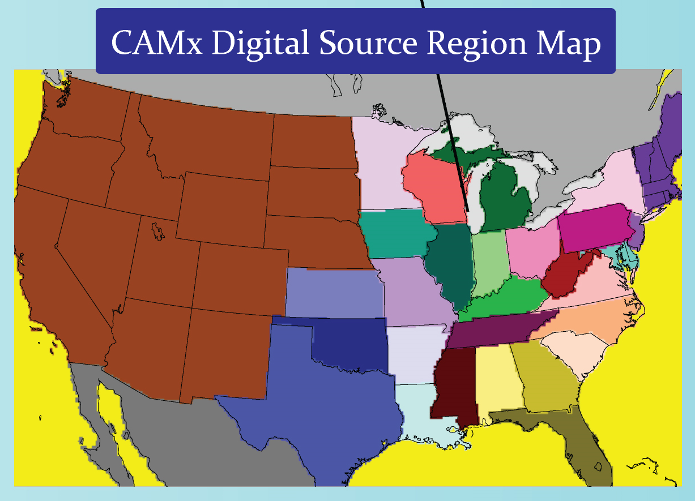
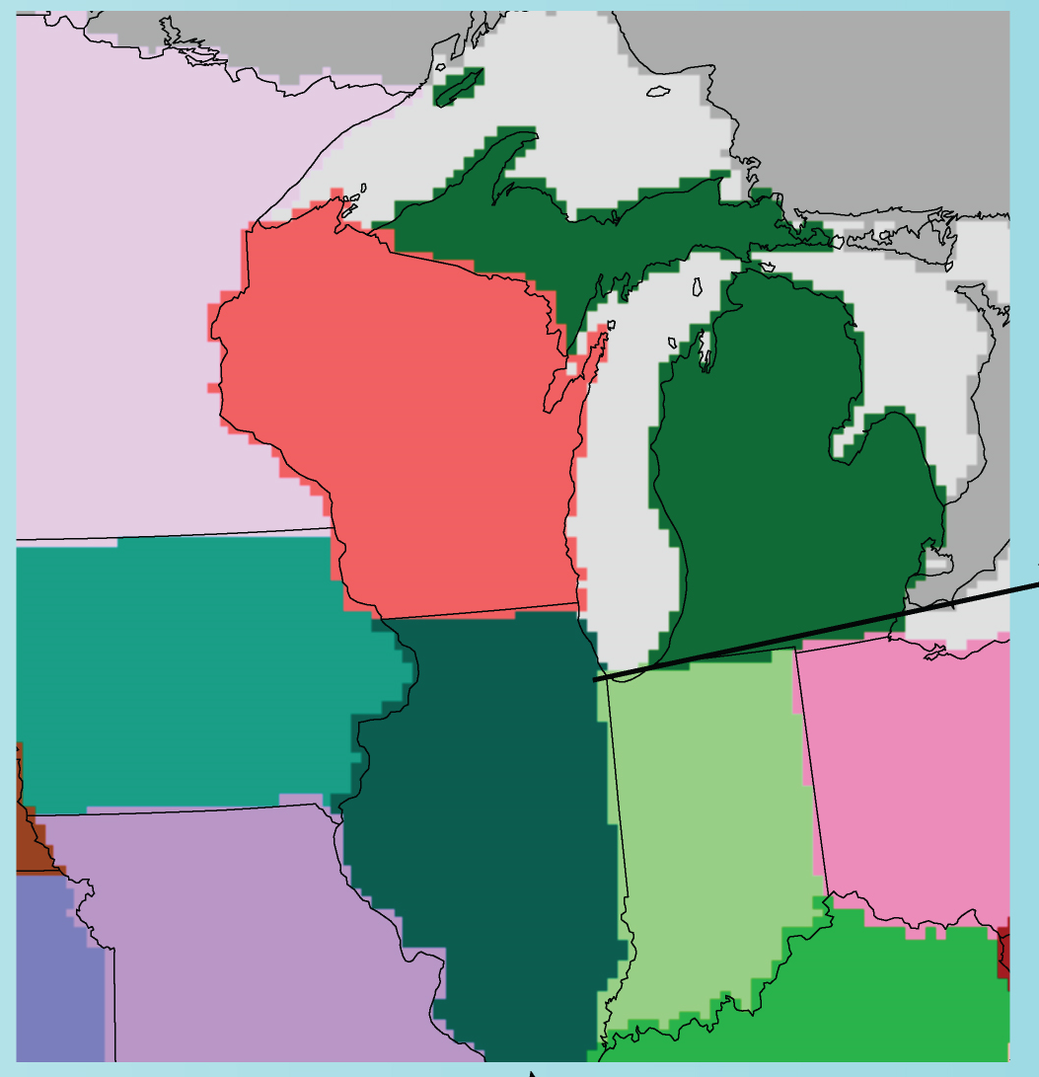
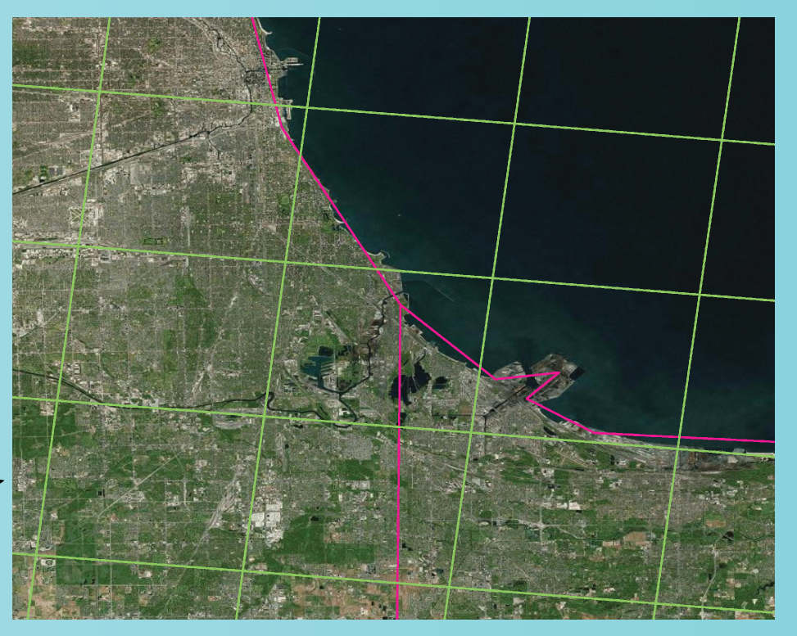
Updates in CAMx v6.3 (2016)
Fractional O/PSAT Regions (LADCo)
Issue
  Source regions are defined by digital maps of whole grid cells
  Region maps can be defined for each grid to maximize resolution
  Discretization contributes to attribution uncertainty

Slide 10
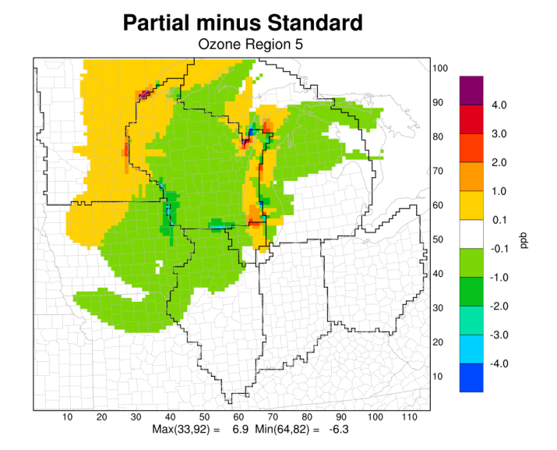
Updates in CAMx v6.3 (2016)
Fractional O/PSAT Regions
Approach (Emery et al., 2016a)
  Allocate fractional portions of each grid cell to multiple source regions
    E.g., multiple counties or states intersecting within a single cell
  Maintain the original integer region map file as default
  Utilize information from SMOKE report files on spatial allocation factors
    Special processor for SMOKE-MOVES
  Allow user to weight fractional areas by criteria pollutant (NOx, VOC, SO₂, PM or ALL)

Slide 11
Updates in CAMx v6.3 (2016)
Model Speedup (TCEQ)
Objective
  Improve algorithm efficiency, expand parallelization, increase model speed
Method
  Use a code profiler to track timing in each routine/process and CPU (parallelization)
  Identify and prioritize areas of the code for improvements
  Test compiler options, identify fast configuration w/o accuracy impacts
  Revise code, implement new optimized routines in order of priority
Results
  Runtimes reduced ~15-50% (depends on chipset, compiler, model configuration)

Slide 12
Updates in CAMx v6.3 (2016)
SAPRC and Map Projections
SAPRC07TC (Carter, 2010)
  Replaces outdated SAPRC99
  Consistent with CMAQ so that emissions work in either model
  Does not include EPA’s isoprene chemistry update
  117 species, 565 reactions, supports toxics (a BIG mechanism)
Map projections
  Added WRF’s definitions for polar stereographic and Mercator
  Supports high- and low-latitude applications globally
  Updates to several CAMx pre-processors

Slide 13
Updates in CAMx v6.4 (Late 2016)
Condensed Halogen Chemistry (TCEQ)
Issue
  CB6r2h adds 89 ozone-depleting reactions involving 41 oceanic I, Br, Cl species
  CB6r2h is disproportionately slow, inorganic Ix reactions most important but numerically “stiff”
Approach (Emery et al., 2016b)
  CB6r2 + 16-reaction Ix mechanism (I-16b)
    Includes fast EBI solution for I species and improved EBI performance overall
  Add in-line Ix emissions = f(O₃, SST, wind speed) (Carpenter et al., 2013)
  CB6r2h and I16-b result in similar ozone decrements (5‐7 ppb) over the Gulf of Mexico

Slide 14
Updates in CAMx v6.4 (Late 2016)
Additional Improvements (EPA)
Chemistry updates (Emery et al., 2016c)
  Combine I-16b halogen mechanisms + CB6r3 → CB6r4
    Includes tie-in to OSAT and H/DDM
  SOAP chemistry updates
    Literature update for SOA yields, saturation, water solubility
    Condense number of CG-SOA pairs from biogenic emissions
    Add aqueous SOA pathway from biogenic isoprene
    Include updates to PSAT (PM-DDM updates forthcoming)
  RADM-AQ aqueous PM chemistry updates
    Literature update for metal-catalyzed and peroxide sulfate oxidation
    Add heterogeneous sulfate chemistry on crustal aerosols
  Wet deposition update
    Formulation/efficiency improvements (more removal, less vertical transport)
ACM2 solver speedup as in CMAQ v5.1
  Extend ACM2 to work with H/DDM

Slide 15
Future Updates (2017)
NetCDF-4 output format (TCEQ 2017)
  Follow UCAR Climate and Forecast (CF) Metadata Conventions
“Cloud-in-Grid” (CiG) sub-grid treatment (Texas AQRP 2015)
  Shallow/deep convective transport, en/detrainment
  Explicit cloud-scale aqueous chemistry and wet deposition
  Tied to new WRF Kain-Fritsch (KF) output
  Implemented for core model (Emery et al., 2015b)
    Analyzed O₃, NOx, CO against 3-D aircraft data from 2013 Houston DISCOVER-AQ
  Needs testing for PM and extension to Probing Tools
Notes:
option

Slide 16
Thank you www.camx.com
Notes:
Endslide

Slide 17
References
Arey, J., S.M. Aschmann, E.S.C. Kwok, R. Atkinson, 2001. Alkyl nitrate, hydroxyalkyl nitrate, and hydroxycarbonyl formation from the NO x‐air photooxidations of C5‐C8 n‐alkanes. J. Phys. Chem., A 105, 1020‐1027.
Barlage, M., F. Chen, M. Tewari, K. Ikeda, D. Gochis, J. Dudhia, R. Rasmussen, B. Livneh, M. Ek, K. Mitchell, 2010. Noah land surface model modifications to improve snowpack prediction in the Colorado Rocky Mountains, J. Geophys. Res., 115, D22101, doi:10.1029/2009JD013470.
Carpenter, L.J., S.M. MacDonald, M.D. Shaw, R. Kumar, R.W. Saunders, R. Parthipan, J. Wilson, J.M.C. Plane, 2013. Atmospheric iodine levels influenced by sea surface emissions of inorganic iodine. Nature Geoscience, 6, no. 2: 108‐111.
Carter, W.P.L., 2010. Development of the SAPRC‐07 chemical mechanism. Atmos. Environ., 44, 5324‐5335.
Emery, C., J. Jung, B. Koo, G. Yarwood, 2015a. Improvements to CAMx Snow Cover Treatments and Carbon Bond Chemical Mechanism for Winter Ozone. Prepared for the Utah Department of Environmental Quality, Division of Air Quality, Salt Lake City, UT. Prepared by Ramboll Environ, Novato, CA (August 2015). http://www.deq.utah.gov/ProgramsServices/programs/air/research/projects/winterozone2/docs/2015/UDAQ_SnowChem_final_6Aug15.pdf
Emery, C., J. Johnson, D.J. Rasmussen, W.C. Hsieh, G. Yarwood, J. Nielsen‐Gammon, K. Bowman, R. Zhang, Y. Lin, L. Siu, 2015b. Development and Evaluation of an Interactive Sub‐Grid Cloud Framework for the CAMx Photochemical Model. Prepared for the Texas Air Quality Research Program, University of Texas, Austin, TX. Prepared by Ramboll Environ, Novato, CA and Texas A&M University, College Station, TX (July 2015). http://aqrp.ceer.utexas.edu/projectinfoFY14_15/14-025/14-025%20Final%20Report.pdf
Emery, C. G. Wilson, M. Jimenez, T. Pavlovic, T. Shah, 2016a. Development and Testing of Fractional Source Apportionment Regions for CAMx. Prepared for the Lake Michigan Air Directors Consortium, Rosemont, IL. Prepared by Ramboll Environ, Novato, CA (August 2016).
Emery, C., Z. Liu, B. Koo, G. Yarwood, 2016b. Improved Halogen Chemistry for CAMx Modeling. Prepared for the Texas Commission on Environmental Quality, Austin, TX. Prepared by Ramboll Environ, Novato, CA (May 2016).
Emery, C., B. Koo, P. Karamchandani, W.C. Hsieh, A. Wentland, G. Wilson, G. Yarwood, 2016c. Updates to CAMx: Secondary Organic Aerosol Chemistry, Heterogeneous Aerosol Chemistry, and Wet Deposition. Prepared for the US Environmental Protection Agency, Research Triangle Park, NC. Prepared by Ramboll Environ, Novato, CA (September 2016).
Livneh, B., Y. Xia, K. E. Mitchell, M. B. Ek, 2010. Noah LSM snow model diagnostics and enhancements. J. Hydromet., 11, doi:10.1175/2009JHM1174.1.
Wang, Z., and X. Zeng, 2010. Evaluation of snow albedo in land models for weather and climate studies. J. Appl. Met Clim., 49, doi: 10.1175/2009JAMC2134.1.
Yarwood, G. and B. Koo, 2015. Improved OSAT, APCA and PSAT Algorithms for CAMx. Final report prepared for the Texas Commission on Environmental Quality, Austin, Texas (August, 2015). Prepared by Ramboll Environ, Novato, CA. https://www.tceq.texas.gov/assets/public/implementation/air/am/contracts/reports/pm/5825543880FY1511-20150817-improved_OSAT_APCA_PSAT_for_CAMx.pdf

Slide 18
Technical Formulation
Source Apportionment (SA)
Apportions ozone and PM to emissions and initial/boundary conditions
  Emissions can be split by source region and/or source category
  Apportionment provided throughout the modeling domain
Tracks precursor emissions (NOx, SO₂, NH₃, VOC, primary PM)
Tracks secondary products (O₃, SO₄, NO₃, NH₄, SOA)
  Can choose which species groups to track: ozone, sulfur, nitrogen, organics, primary PM, Hg
Associates ozone/PM production with precursors present when formed– SA is tied into the model’s chemical mechanism
Distinguish ozone production under NOx and VOC sensitive conditions – accounts for non-linear photochemistry

Slide 19
Technical Formulation
Decoupled Direct Method (DDM)
Calculate 1st-order (DDM) and 2nd-order (HDDM) derivatives, or sensitivities
  Sensitivity of a concentration output to an emissions or IC/BC input
    PM: DDM only
    Ozone: DDM or HDDM
  Calculate many sensitivities at once
  Emissions may be specified by region and/or category
Applications
  Estimate effects of emission changes
  Rank relative importance of source region/categories to ozone reduction potential, or other species

Slide 20
Technical Formulation
Process Analysis (PA)
Gather and report additional information on model processes
  Chemistry, deposition, emissions, etc.
  Over entire modeling grid or user-defined analysis domains
Explain “how the model got the answer it got”
  Requires post-processing to be useful
Integrated Process Rate (IPR) – mass budgets
Integrated Reaction Rate (IRR) – detailed chemical rates
Chemical Process Analysis (CPA) – key chemical rates

Slide 21
Technical Formulation
Reactive Tracers (RTRAC)
Independent reactive gas and/or inert particle tracers (e.g., air toxics)
  Assumes reactive species have minimal impact on photochemistry
  Each tracer can be “tagged” for source apportionment
Tracers operate in parallel to the CAMx host model
  Tracer decay/production driven by modeled oxidant levels and photolysis rates
  “Recursive tracers” allows for several generations of products: secondary toxics
Can use IRON PiG and sampling grid for “fenceline” dispersion calculations

Slide 22
Computer Resources
Speed, Memory, Parallelization Scalability
V6.3 looks to be ~20% faster
Depends on:
  Number and sizes of grids
  Chemistry mechanism/solver
  Core model vs. PiG vs. Probing Tools
CAMx v6.2 on the EPA 2011 Modeling Platform:
  Single 12-km US grid (396x246, 25 layers), CB6r2 + CF PM, no PiG
  2.60 Ghz Intel Xeon chipsets, 24 hyper-threaded cores, PGF v15.7-0, MPICH v3.1.4
OMP | MPI | Total Cores | Duration (hr)
12 | 0 | 12 | 4:05:12
12 | 2 | 24 | 3:30:47
8 | 3 | 24 | 2:59:08
6 | 4 | 24 | 2:36:10
4 | 6 | 24 | 2:35:17
3 | 8 | 24 | 2:27:34
2 | 12 | 24 | 2:25:25
1 | 24 | 24 | 3:06:57

