Slide 1
15th Annual CMAS Conference
October 24-26, 2016
Direct Radiative Effect of Dust and Biomass Burning Over East Asia
Xinyi Dong¹, Joshua S. Fu^{1,2}, Kan Huang^{1,3}
¹Department of Civil and Environmental Engineering
University of Tennessee, Knoxville ,TN, USA
²Climate Change Science Institute and Computer Science and Mathematics Division
Oak Ridge National Laboratory, Oak Ridge, TN, USA
³Department of Environmental Science and Engineering
Fudan University, Shanghai, China
Oct. 25, 2016

Slide 2
Outline
Background & Research Motivation
Impact of Dust & Biomass Burning on Direct Radiative Forcing
Discussion & Summary

Slide 3
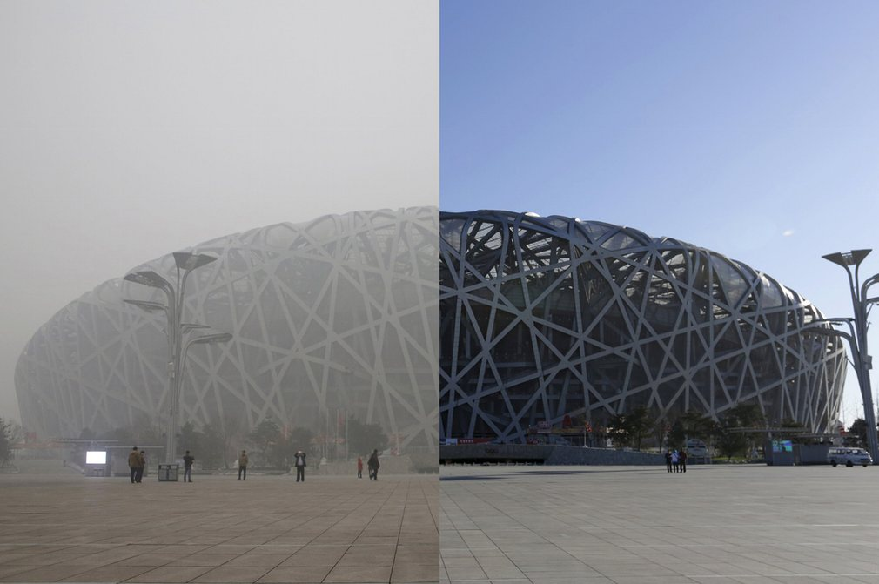
Background: Severe Air Pollution in Asia
Tourists taking photos in front of canvas @ Hong Kong
Bird’s Nest before & after haze @ Beijing
Aug.27, 2013
Dec.07, 2015
Courtesy of Alex Hofford for ChinaFotoPress
https://www.theguardian.com
Notes:
left figure: tourists taking photos in front of canvas which print out the clear skyline of Victoria Harbor
right figure: the Bird’s Nest before and after haze at Beijing
this slide is meant to demonstrate the severe air pollution issue

Slide 4
Background: Regional Climate Change in Asia
Yangtze River Basin: flooding area gets wetter
Yellow River Basin:
drought area gets drier
Notes:
both air pollution and regional climate change are obvious problems in East Asia, and we need to find the roles played by dust & biomass burning, this can help us to quantify the contribution of natural sources, and then manage the anthropogenic emission control

Slide 5
Research Motivation: Unknown Effects of Dust & Biomass Burning
Aerosol direct radiative forcing (W/m²)
cooling
warming
IPCC AR4 & AR5: can’t even decide the signs
sulfate
-0.4±0.2
nitrate
-0.11±0.06
black carbon
+0.2±0.15
organic carbon
-0.03
biomass burning (BB)
-0.2~0.2
mineral dust
-0.1±0.2
Difficulties in determining the impact of biomass burning:
(1). Injection height and vertical distribution of biomass burning plume
(1a). Above or under cloud ?
(1b). Stay in free troposphere or PBL ?
(2). Aging of biomass burning aerosol
(1b). Fresh particles has lower single scattering albedo
(2b). Aged particles involve in chemical reactions and have larger scattering albedo
Difficulties in determining the impact of dust:
(1). Large uncertainty in estimating dust emission
(2). Chemical compositions of dust particles are poorly represented in the model
(3). Heterogeneous chemistry will alter the optical properties of dust
(4). Competing shortwave and longwave radiative forcing effect

Slide 6
In order to understand the above mentioned questions, and reveal the impacts of dust & biomass burning, we:
Biomass Burning
Mineral Dust
(1). Developed the model ready biomass burning emission for CMAQ (Fu et al., 2012, ACP)
(2). Investigated the impacts on air quality during severe pollution episode (Huang et al., 2013, AE)
(4). Tested the default wind-blown dust emission scheme within CMAQ (Dong et al., 2014, CMAS Conference)
(5). Modified the dust emission scheme, added dust heterogeneous chemistry into CMAQ (Dong et al., 2015, CMAS; Dong et al., 2016, ACP)
(3). Quantified the inter-annual variability and identified the uplift motion of biomass burning plume (Dong and Fu, 2015, AE)
(5). Include all previous efforts into the two-way mode WRF/CMAQ, and investigated the impact of dust & biomass burning on regional climate (today’s talk)
Notes:
we have conducted a series of research studies aiming at investigate the role of dust and biomass burning

Slide 7
Brief Review of Method
Simulation domain:
Model Configuration:
Model: WRFv3.4/CMAQv5.0.1
Grid size: 36x36 km
Initial & Boundary Condition: from GEOS-Chem
Biomass burning emission: FLAMBE
Dust emission: modified CMAQ dust emission scheme with speciation profile and heterogeneous chemistry (Dong et al., 2016, ACP)
Simulation period: Mar. & Apr. 2006-2010
Quick view of model performance: did a good job for reproducing the meteorology field
Shortwave radiation flux evaluate against CERES
Evaluate against NCDC observations
 |  | Mean Obs(W/m²) | Mean Sim(W/m²) | MB (W/m²) | NMB (%) | R
TOA | Clear sky | 66.14 | 75.9 | 9.79 | 14.80 | 0.91
 | All sky | 113.98 | 109.45 | -4.53 | -3.98 | 0.89
SFC | Clear sky | 282.03 | 280.29 | -1.73 | -0.61 | 0.86
 | All sky | 221.55 | 238.98 | 17.43 | 7.87 | 0.93
 | Mean Obs | Mean Sim | MB | NMB (%) | R
T | 283.43 (K) | 282.49 (K) | -0.95 (K) | 3.9 | 0.94
Humidity | 5.36 (g/kg) | 5.61 (g/kg) | 0.25 (g/kg) | 4.6 | 0.95
WS | 3.98 (m/s) | 4.86 (m/s) | 0.87 (m/s) | 21.8 | 0.71
WD | 239.57 (°) | 258.03 (°) | 18.46 (°) | 7.7 | 0.83
Notes:
(1). Two-way WRF/CMAQ did a good job for reproducing the meteorology field
(2). SFC : surface

Slide 8
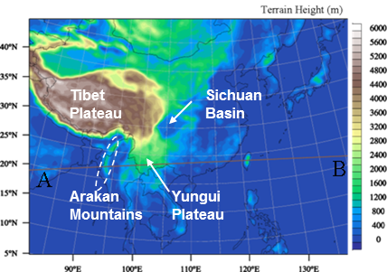
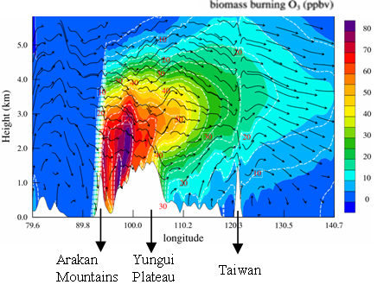
Results: Uplift Motion of Biomass Burning
Peninsular Southeast Asia (PSEA) biomass burning is uplifted up to 6km height along the eastward transport pathway (injection height of biomass burning is usually limited under 5km).
Topography
Cross-sectional Biomass Burning Ozone
A
B
Notes:
(1). Lee-side trough on the right side of Tibet Plateau, and the Yungui Plateau drives the PSEA biomass burning plume higher than the fire in Africa or Amazon
(2). Higher plume height means: less impact on local air quality, but stronger impact on radiative forcing (because it’s above cloud)

Slide 9
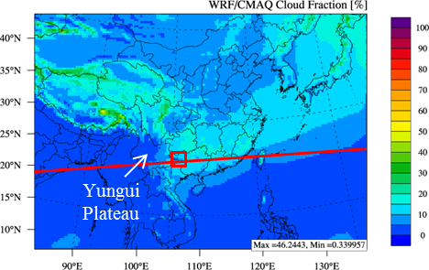
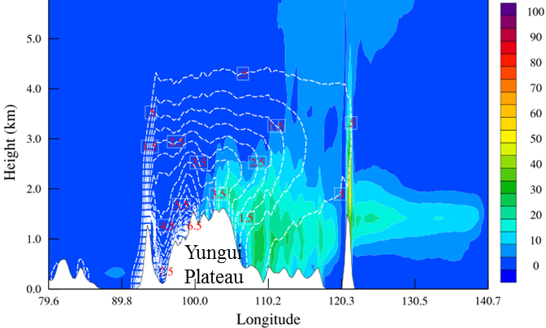
Biomass burning aerosols above persistent stratocumulus cloud
Previous studies (Galvin et al.,2007; Hsu et al., 2003; Lin et al., 2014) identified the presence of persistent stratocumulus cloud over Southeast Asia. Our simulation found out that the biomass burning plume is uplifted above the cloud layer.
Biomass Burning Black Carbon & Cloud fraction
WRF/CMAQ Cloud Fraction
black carbon concentration contour lines
black carbon above cloud
cloud

Slide 10
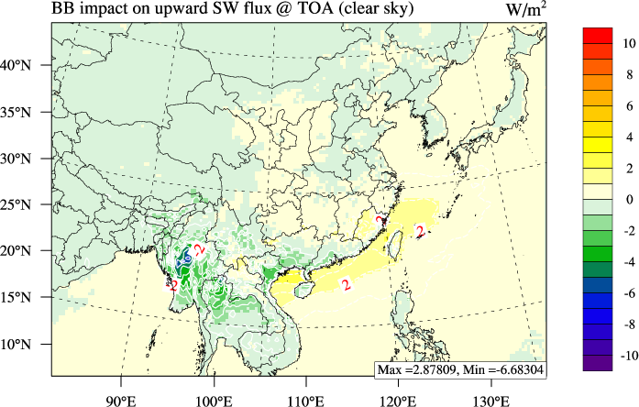
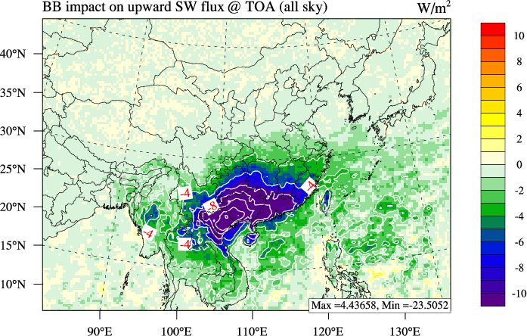
Biomass burning aerosol direct radiative effect @ TOA
Biomass burning induced Shortwave Radiation Change
Clear Sky
All Sky
Negative values (reduction in upwelling radiation flux @ TOA) indicate strong warming effect in the upper air
Notes:
(1). PSEA biomass burning has strong warming effect over south part of China
(2). Interesting fact: biomass burning shows much stronger impact under all sky condition than under clear sky condition, it means:
(2a). Impact of biomass burning is always related with cloud
(2b). The stratocumulus cloud enlarge the impact of biomass burning
(2c). But does the biomass burning aerosol also contribute to the formation of this cloud ? Are the cloud and biomass burning positively connected with each other? We donot know the answer to this question because two-way WRF/CMAQ doesn’t deal with indirect effect
TOA: upward – reflect to air – less- adsorption negative – warming effect
SUFR: downward – less- cooling

Slide 11
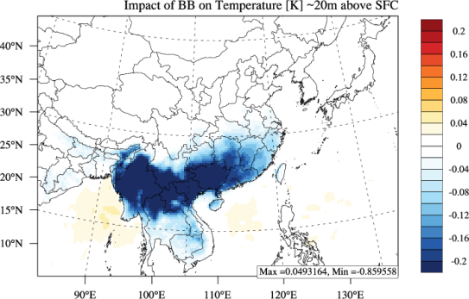
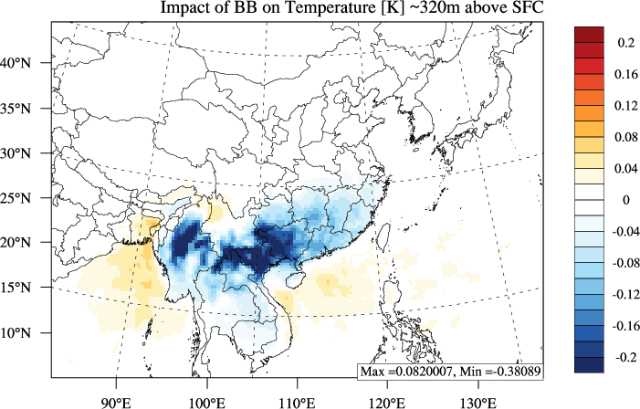
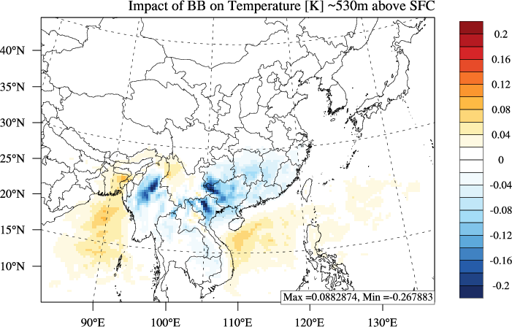
Biomass burning: cooling the near surface air
20m
320m
530m
Biomass burning aerosols block the downward solar radiation, thus reduce the near surface air temperature by 0.1 ~ 0.8 °K

Slide 12
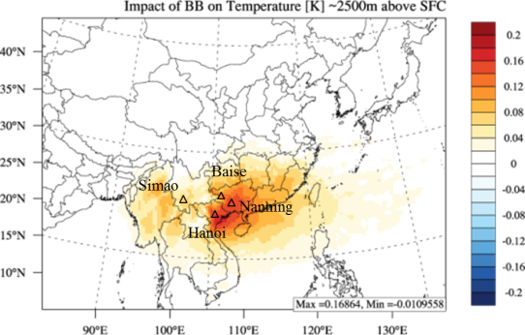
Biomass burning: warming the upper air
Daily maximum ΔT (2006-2010)
Daily maximum ΔT
ΔT @ 2500m (five-year average)
Conclusion: Significant warming effect above cloud
Notes:
Slightly cools the near surface air but significantly warms the upper air
Daily maxiuma in five years

Slide 13
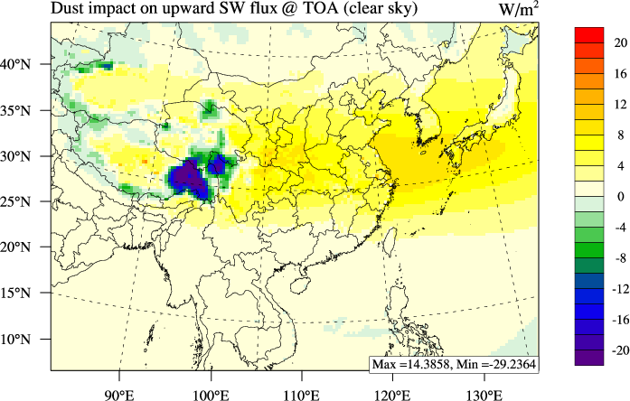
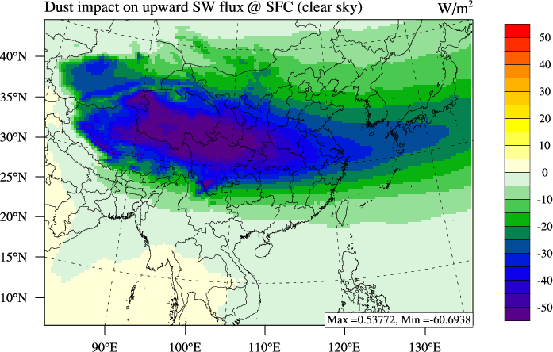
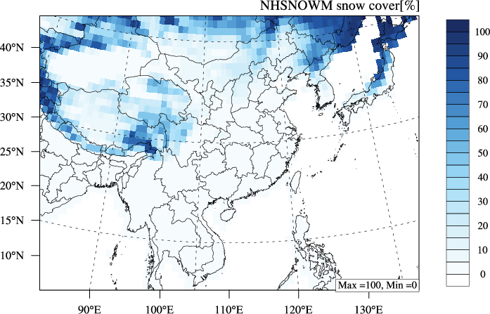
Dust aerosol direct radative effect
Dust induced Shortwave Radiation Change
Upward @ TOA
Downward @ Surface
Snow cover (NHSNOWM)
Compare with other studies
Region | Method | Dust induced change @ TOA (W/m²) | Dust induced change @ SFC (W/m²)
South Korea | CCM3 (Won et al., 2005) | 5 ~ 10 | -20 ~ -10
 | This study | 5 ~ 10 | -30 ~ -10
East China | CCM3 (Park et al., 2005) | 10 ~ 20 | -40 ~ -10
 | ADAM (Park et al, 2008) | - | -40 ~ -20
 | This study | 5 ~ 15 | -60 ~ -20
Tibet Plateau | MFRSR (Ge et al., 2011) | -4 ~ 3 | -20 ~ -10
 | fvGCM (Lau et al., 2006) | -2 | -13
 | WRF-Chem (Chen et al., 2013) | -4 | -6
 | This study | -30 ~ 5 | -10 ~ -60
Taklamkan | RTM, CALIPSO (Kuhlmann and Quaas, 2010) | - | -60 ~ -90
 | This study | 0 ~ 5 | -20 ~ -40
Hengduan Mountains
Notes:
ephsize negative is warming and positive is warming @ TOA
NHSNOWM satellite - suf radiation less dust – cooling
Snow or cloud reflect more – dust on top – adsorption – warming. Water is low so adsorption is less.

Slide 14
Vertical distribution of dust along the transport pathway
CALIPSO aerosol subtype product
Deserts: fresh dust
Central & East China: aging dust
West Pacific: polluted dust
Deserts dust is uplifted and polluted along the transport pathway.
Indication:
(1). fresh dust stays low in deserts: cooling surface air
(2). aging dust spread within 1~9km: cooling surface and warming upper air
(3). polluted dust at West Pacific: less cooling at surface and more warming at upper air
Notes:
(1). Dust is gradually uplifted from 1-2km (at Taklamakan ) to above 5km (at east China and Japan)
(2). Fresh dust stays close to the ground surface, so it is expected to be cooling because it increase the scattering coefficient
(3). Polluted dust suspended high in the atmosphere, so it is expected to be warming because it will absorbs more solar irradiance
(4). Next slide will show impact on temperature profile, which is consistent with expectation
Red color line

Slide 15
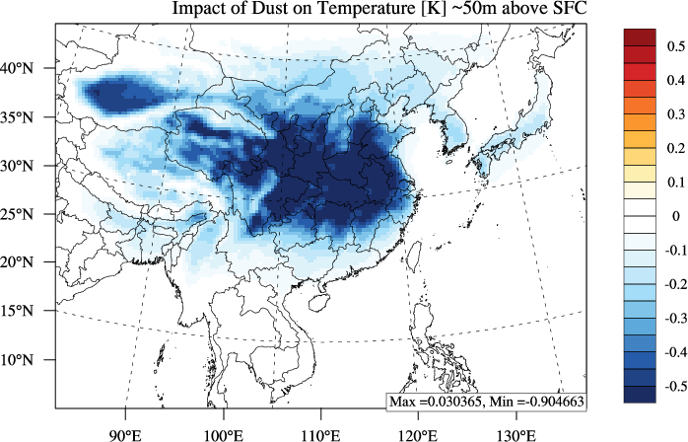
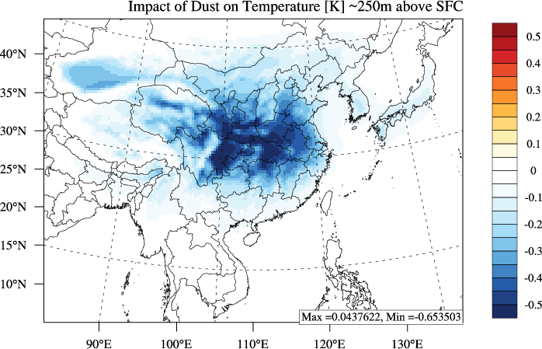
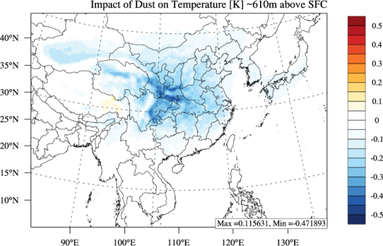
Dust induced changes of air temperature: Cooling the near surface air
50m
250m
610m
Dust induced temperature changes at near surface air: -0.9 ~ -0.1 °K

Slide 16
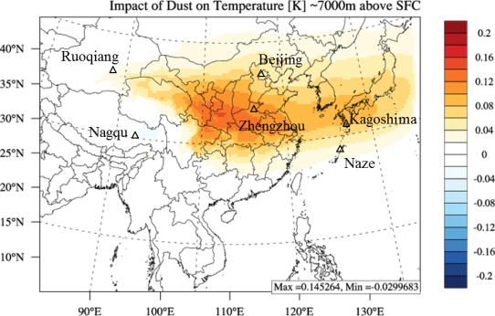
Dust induced changes of air temperature
ΔT @ 7km (five-year average)
Deserts
West Pacific
East China
Notes:
(1). Desert site: Ruoqiang & Nagqu (low, fresh dust, cooling); central China site: Zhengzhou & Beijing (aged dust, cooling at surface, warming at upper air); West Pacific site: Kagoshima & Naze (polluted dust, warming at upper air)

Slide 17
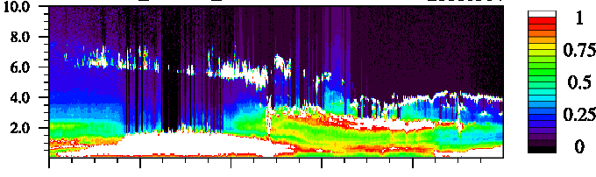
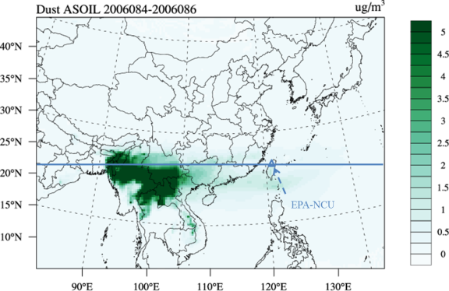
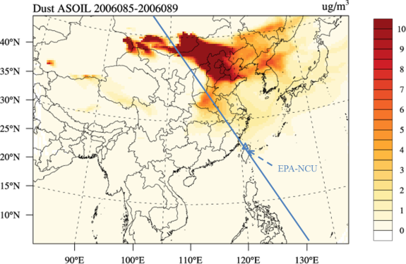
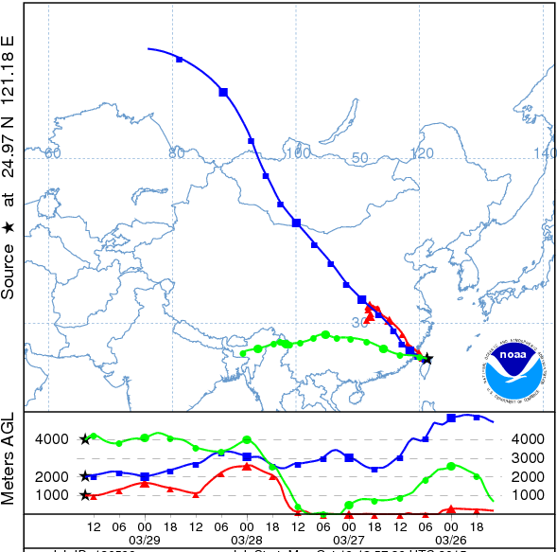
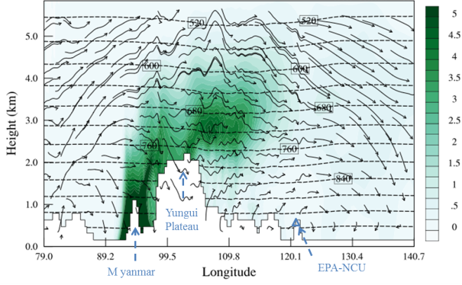
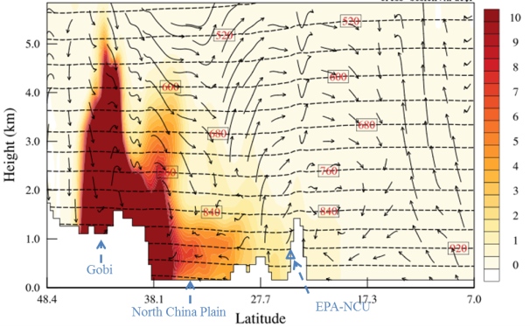
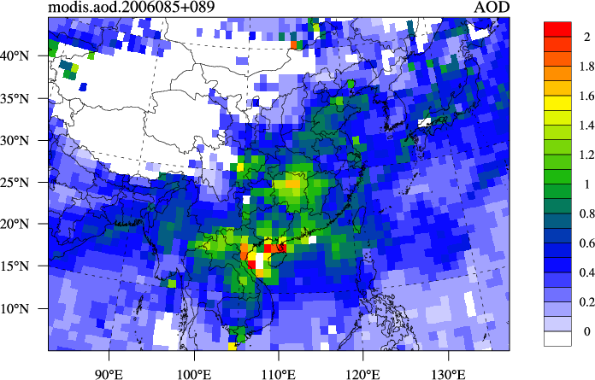
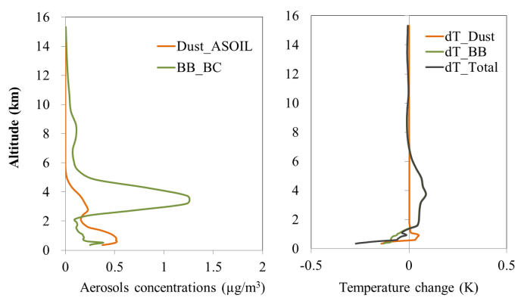
Overlaying of dust and biomass burning: Mar. 29th, 2006
(a) MPL normalized back scatter
(c) Biomass burning BC (µg/m³)
(d) Dust ASOIL (µg/m³)
Altitude (km)
0:00
5:00
10:00
15:00
20:00
23:00
2006-03-29
(b) HYSPLIT back trajectory
(e) MODIS AOD
(f) Vertical profiles
Notes:
(a). MPL lidar observation at Taiwan (National Central University: NCU site)
(b). HYSPLIT back trajectory: shows that biomass burning (green, 4KM at Taiwan) is above dust from Taklamakan (blue, 2KM at Taiwan)
(c). Spatial distribution (top) and cross section distribution (bottom) of biomass burning black carbon, cross line is following the trajectory of biomass burning (green) in (b)
(d). Spatial distribution (top) and cross section distribution (bottom) of dust, cross line is following the trajectory of dust (blue) in (b)
(e). MODIS AOD
(f). Vertical profiles of aerosol concentration (ug/m3, left) and temperature changes (K, right)

Slide 18
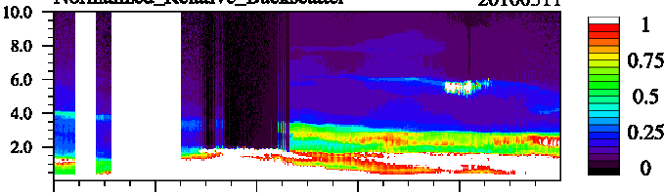
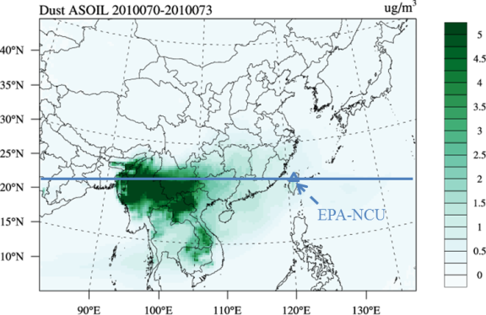
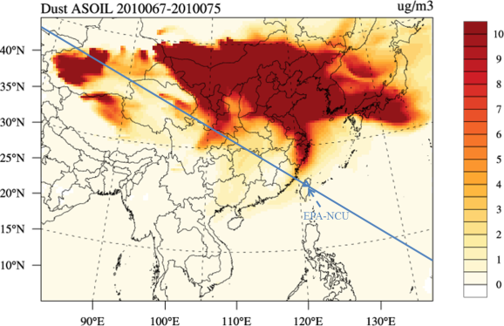
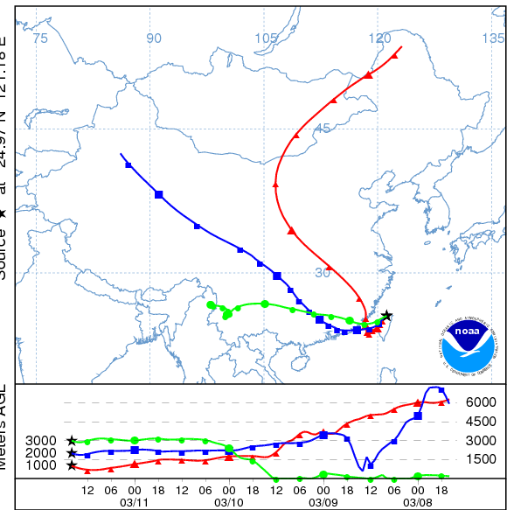
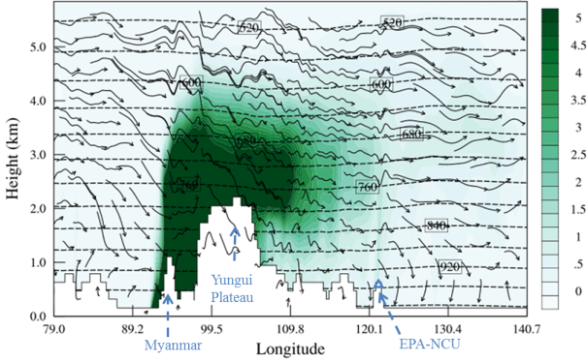
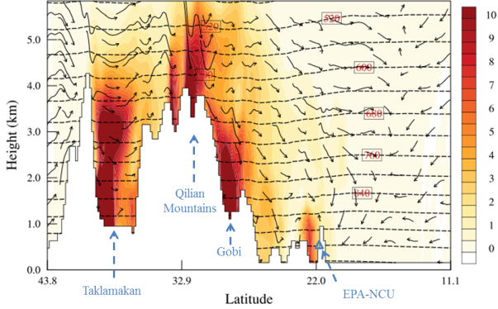
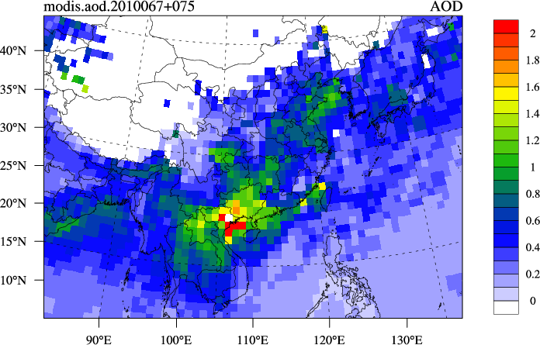
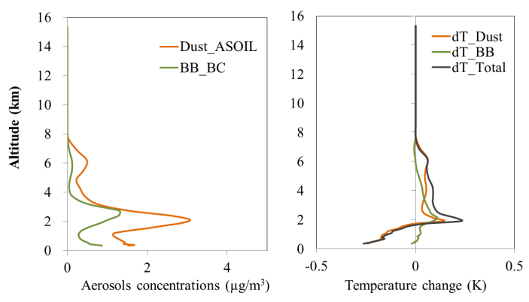
Mixing of dust and biomass burning: Mar. 11st, 2010
Cloud (white)
(c) Biomass burning BC (µg/m³)
(d) Dust ASOIL (µg/m³)
(a) MPL normalized back scatter
Altitude (km)
0:00
5:00
10:00
15:00
20:00
23:00
2010-03-11
(b) HYSPLIT back trajectory
(e) MODIS AOD
(f) Vertical profiles
Notes:
Same as last one, but for mixing case
Dust and biomass burning are mixed with each other at ~2km over Taiwan, biomass burning is slightly above dust
Cloud – white color

Slide 19
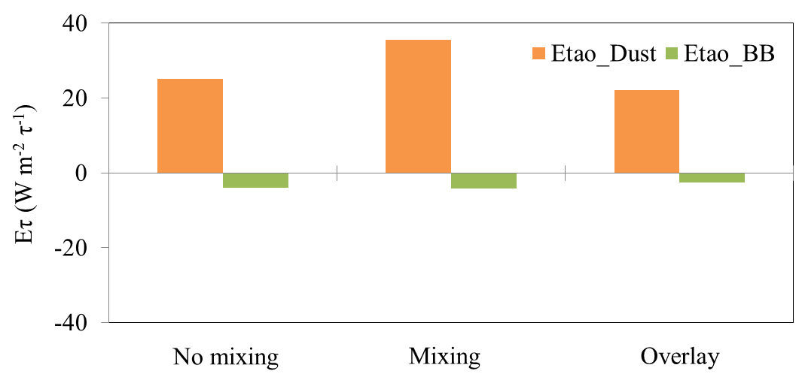
Aerosol direct radiative effect efficiency under mixing conditions
Aerosol induced changes of radiation flux
Aerosol Direct Radiative Effect Efficiency
Eτ = DRE / ΔAOD
Aerosol induced changes of aerosol optical depth
Result:
Mixing will enforce the cooling of dust and warming of biomass burning, while overlaying will weakening these effects.
Johnson et al. (2008) observed similar mixture of dust and biomass burning over West Africa. Changes of DRE efficiency should due to the changes of aerosol extinction coefficient.
NCU site
Notes:
(1). Concept: aerosol direct radiative effect efficiency: this parameter is usually used to identify the efficiency of radiative forcing effect caused by aerosol
(2). Higher values of Etao means higher efficiency of changing the radiative forcing, in the mixing case, it means the mixed aerosols increase the cooling effect of dust
(3). DRE is upwelling radiation flux at the ground surface, positive value means more radiation is reflected back into the space, so it is cooling (dust)
(4). Johnson used lidar observation and HadGEM2 model, results is 10% changes in DRE efficiency, consistent with our results
For example: NCU site
Dust – strong cooling
BB- warning

Slide 20
Summary
Preliminary Conclusions:
WRF/CMAQ can generally reproduce the meteorology field with same accuracy as WRF.
Dust and biomass burning are both found to have cooling effect on near surface air and warming effect on upper air.
Next Steps:
How is may affect the East Asia monsoon system ?
How biomass burning and dust affect the cloud ?

Slide 21
Acknowledgement
We acknowledge National Institute for Computational Sciences (NICS), ORNL OLCF (NCCS) for providing the computer and data storage resources for model simulations of this research and Lidar measurement data from National Central University, Taiwan.

Slide 22
Thank you ! & Questions ?

