Slide 1
Predicting the Impact of a Wood-Stove Change-Out Program on Ambient Particle Levels in Utah Valleys
Nancy Daher, Ph.D.
Christopher Pennell
Utah Division of Air Quality

Slide 2
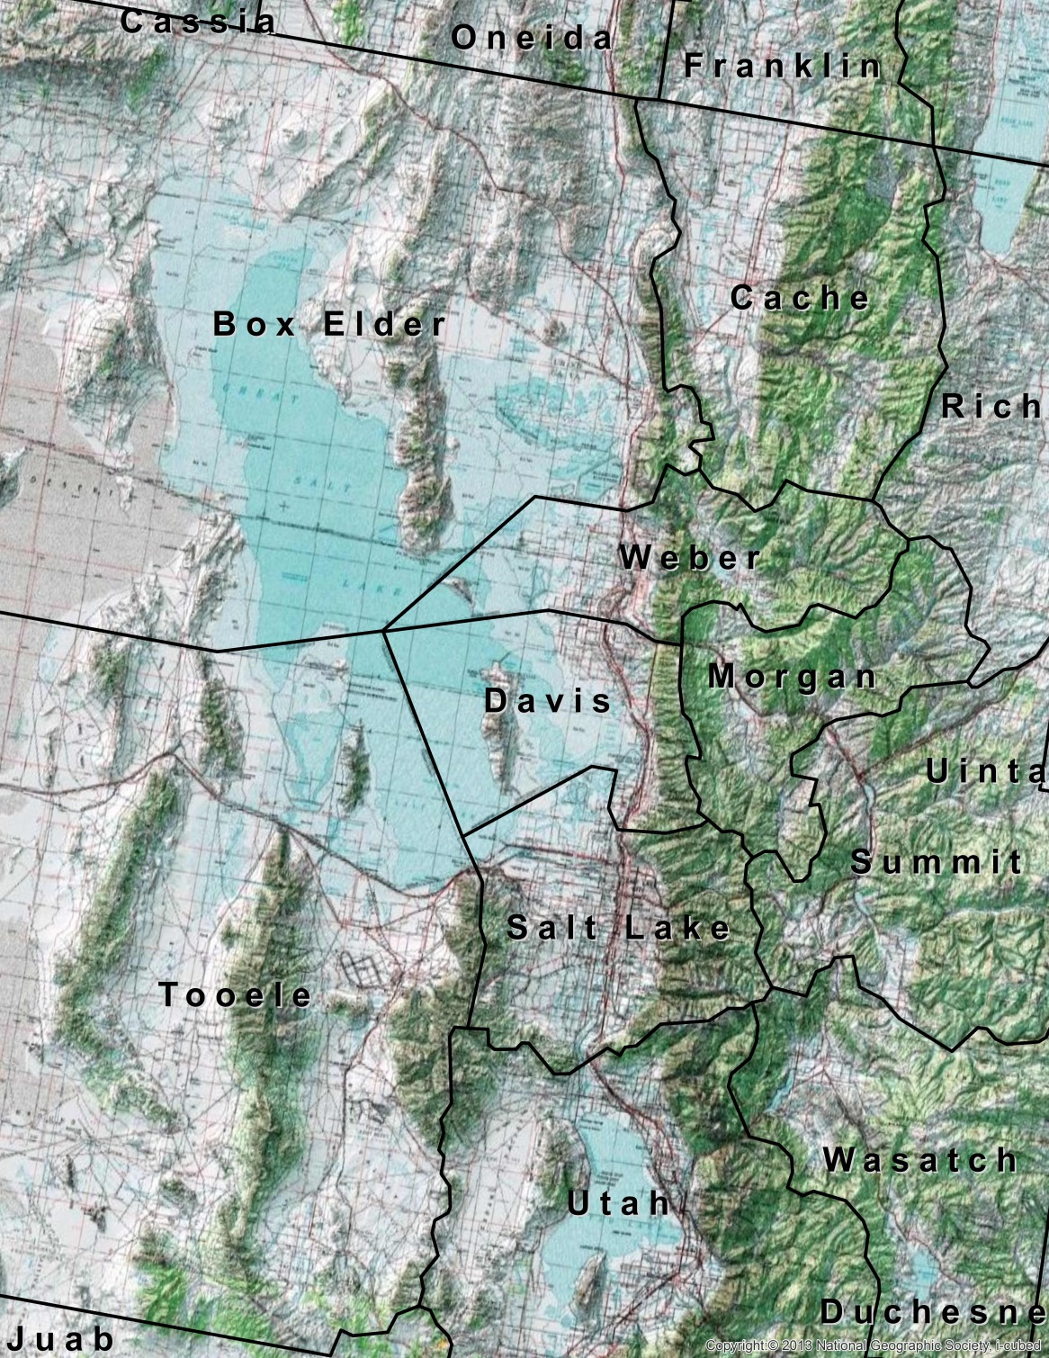

Overview
Three non-attainment areas
Confined topography
Susceptible to strong wintertime inversions
Exceedances of 24-hr PM2.5 NAAQS during wintertime inversions
Notes:
Wasatch Front: width,max= ~18 miles, Length = 120 mi
Elevation ~ 2200 m (7200 ft) above valley floor
Cache valley, Length = 37.3 miles, W = 12.4 miles, elev = 9700 ft

Slide 3
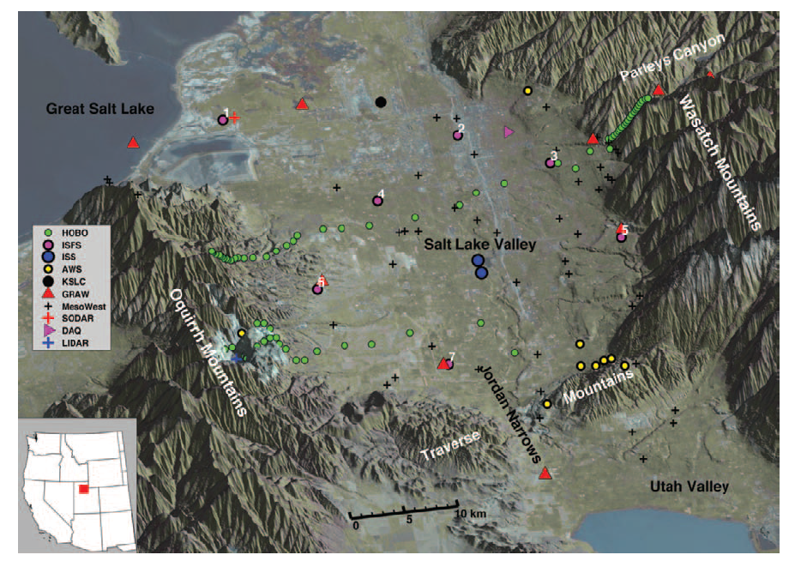
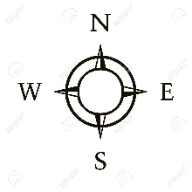
Overview
Three non-attainment areas
Confined topography
Susceptible to strong wintertime inversions
Exceedances of 24-hr PM2.5 NAAQS during wintertime inversions
NP Lareau et al. AMS 2013
Notes:
Wasatch Front: width,max= ~18 miles, Length = 120 mi
Elevation ~ 2200 m (7200 ft) above valley floor
Cache valley, Length = 37.3 miles, W = 12.4 miles, elev = 9700 ft

Slide 4
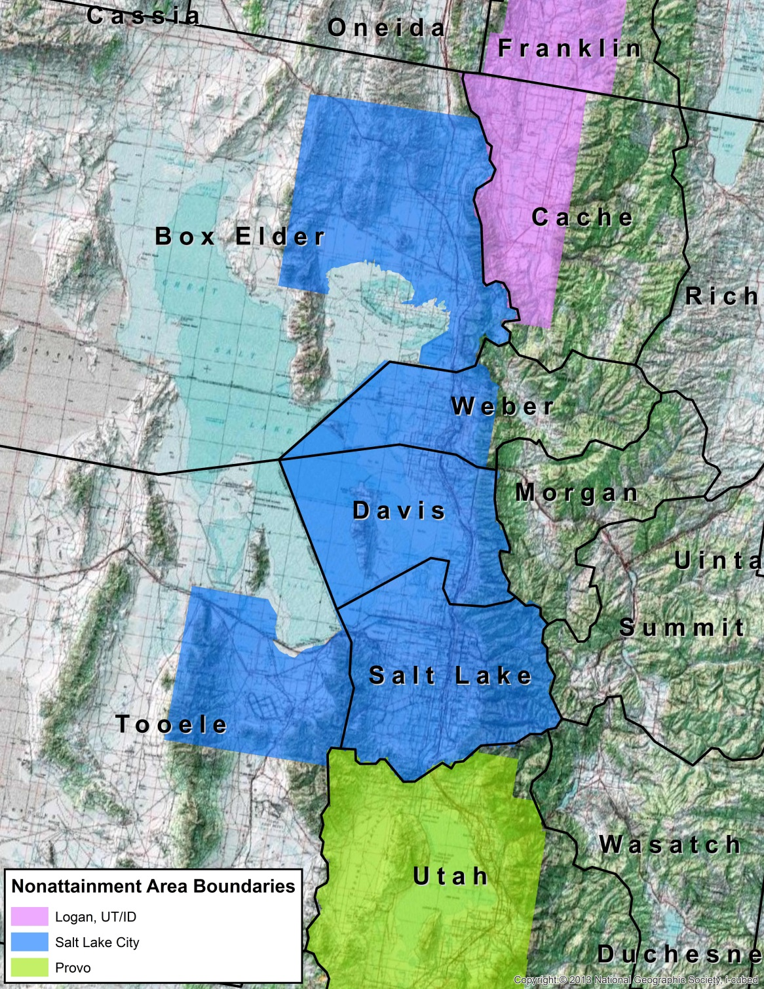
Overview
Three non-attainment areas
Confined topography
Susceptible to strong wintertime inversions
Exceedances of 24-hr PM2.5 NAAQS during wintertime inversions
Notes:
Wasatch Front: width,max= ~18 miles, Length = 120 mi
Elevation ~ 2200 m (7200 ft) above valley floor
Cache valley, Length = 37.3 miles, W = 12.4 miles, elev = 9700 ft

Slide 5
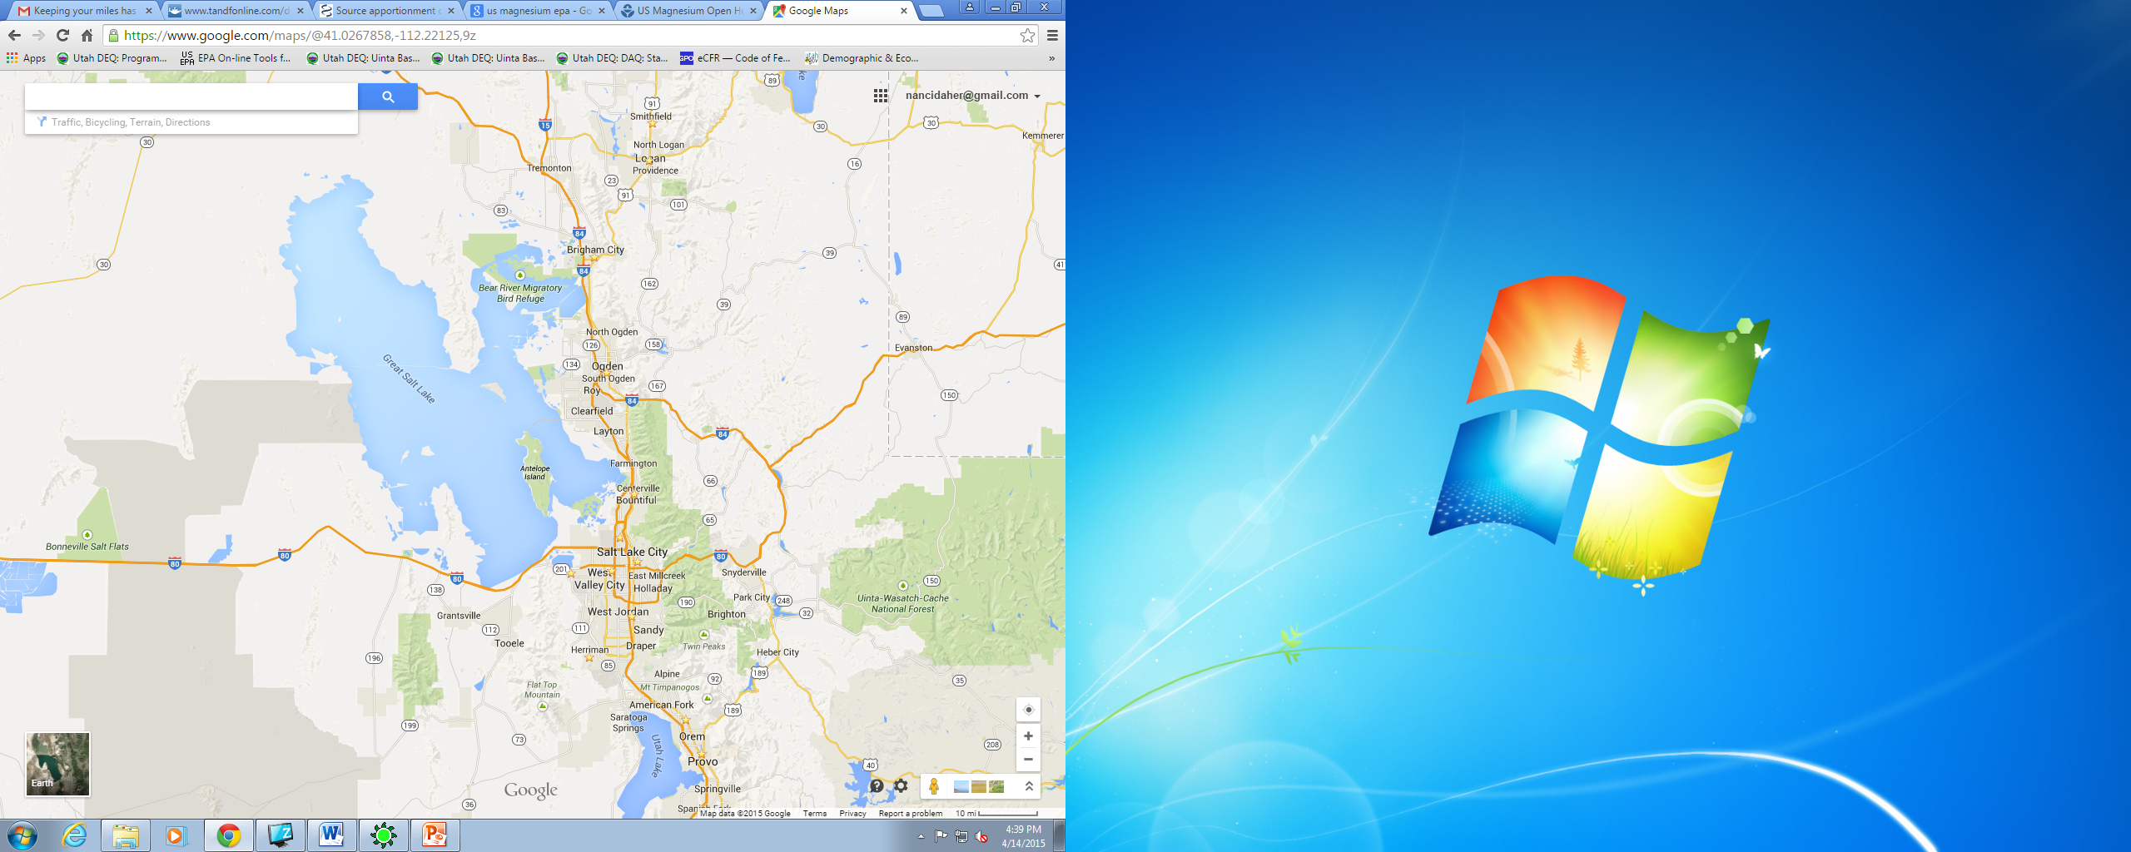
Overview
Wintertime PM2.5
Wintertime PM2.5
Residential Wood Combustion (RWC) accounts for 13-21% of wintertime PM2.5 in Utah’s non-attainment areas

Slide 6
Overview
Wintertime PM2.5
PMF results
winter 2014-2015

Slide 7
Objective
Determine the Impact of a Wood-Stove Change-out Program
Existing
wood-burning devices
EPA-certified
wood-burning devices

Slide 8
Approach
Base Run
Sensitivity Run
Baseline residential wood-burning inventory
Modified inventory
Wood-burning devices replaced by EPA-certified ones
Source Apportionment Modeling
Source Apportionment Modeling
CAMx6.3+PSAT
Notes:
2014 NEI back-casted to 2011. Emissions calculated using EPA RWC new tool (for 2014 NEI)
This assumes a complete and immediate replacement
purely a sensitivity run

Slide 9
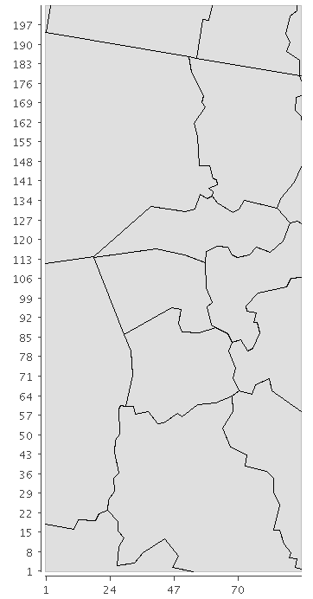
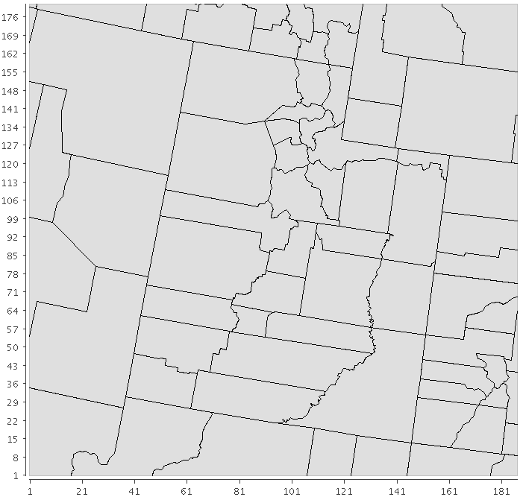
Model Configuration: CAMx6.3
1.33 km (201 x 90)
4 km (180 x 186)
Two-way Nesting
Notes:
Two‐way nesting propagates information both up‐ and down‐scale across all grids.

Slide 10
Model Configuration: CAMx6.3
4 km (180 x 186)
41 vertical layers
Two-way nesting
Cb6r2 aerosol scheme
Boundary/Initial conditions from MOZART
SMOKE3.6.5 emissions processor
WRF meteorology processor (University of Utah)
CAMx-PSAT source apportionment tool
1.33 km (201 x 90)
Notes:
Emissions: using EPA new tool for WS; back-projected to 2011
cb6r2: mechanism 2; No halogen chemistry
Two‐way nesting propagates information both up‐ and down‐scale across all grids.
Advection solver: PPM
Chemistry: EBI
Dry deposition: zhang
Horiz. Diffusion: k theory

Slide 11
Modeling Episode: Wintertime Inversion

Slide 12
Model Modifications
WRF Model Modifications*
- Land use/cover
- Snow cover fields
CAMx Model Modifications/Set up
- Snow cover adjustment
- Zeroing out of ozone deposition velocity
- kvpatch
Improved Inversion Simulation
Improved Nitrate Simulation
*University of Utah, Eric Crosman & Chris Foster
Notes:
improved land use, snow cover and snow albedo characterizations that more closely represent field observations.
Modifications to the NLCD 2011 dataset included reducing the areal extent of the Great Salt Lake to reflect the lake state at that time as well as changing the characteristics of a number of land use classifications (e.g., urban and barren land) to more closely match albedo observations obtained during PCAPS.
Snow cover obtained from North American Mesoscale (NAM) reanalysis was also modified to better match observations

Slide 13
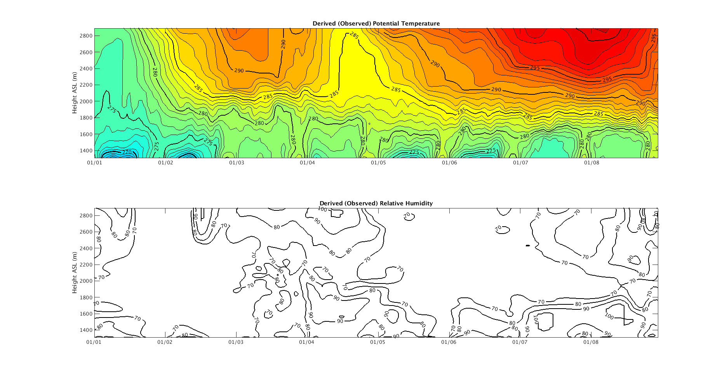
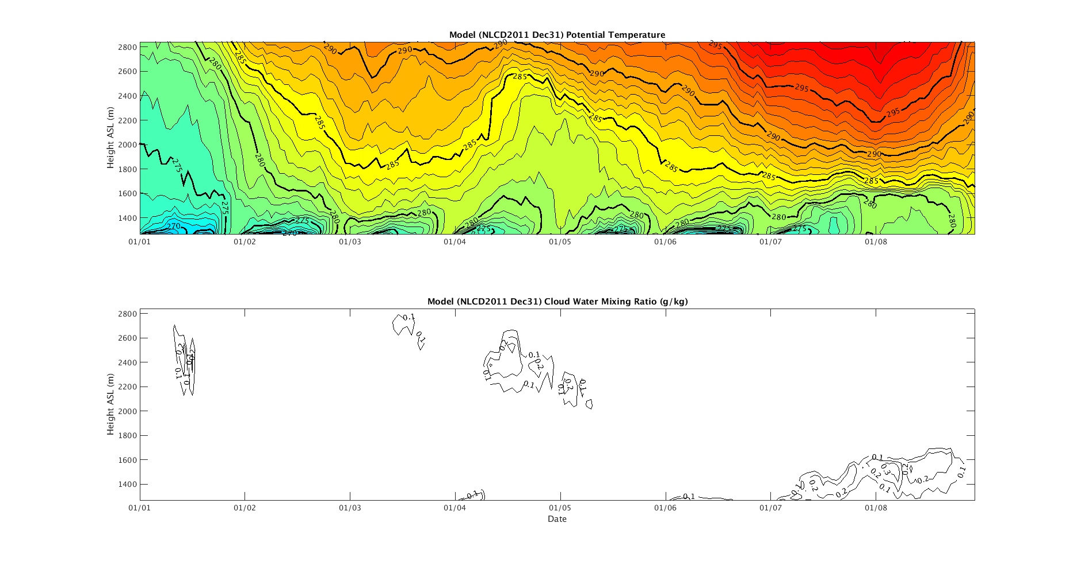
Base Case Model Performance: Primary OC
Observed boundary layer
Kvpatch
Enhance nighttime mixing
Simulated boundary layer
Notes:
improve the turbulent coupling between the surface and the lower boundary layer
WRF: MYJ PBL scheme

Slide 14
Base Case Model Performance: Primary OC
Urban STN sites

Slide 15
Base Case Model Performance: PM2.5
Hawthorne/Lindon:
- urban
Logan:
-rural
Notes:
HW, LN 2 urban sites, each representing a non-attainment area
logan, primarily an agricultural community; not nearly as urbanized as HW and LN
Distinct air basin

Slide 16
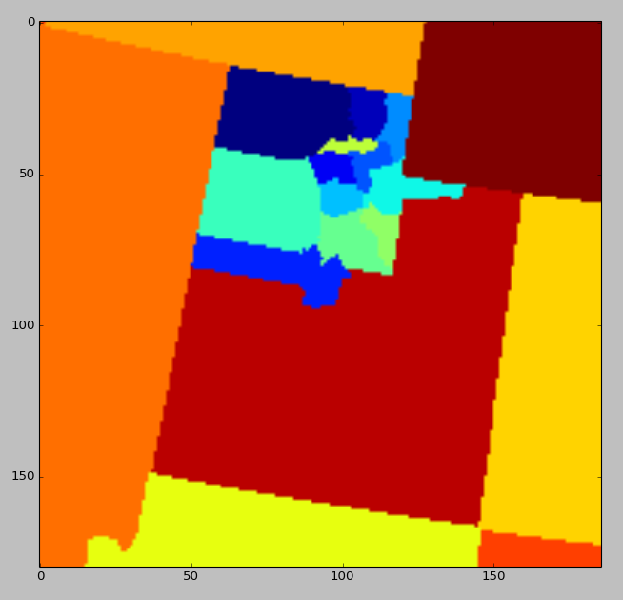
PSAT: Source Regions/Groups
Source Regions
Source Groups
20 Source Regions:
1-
2-
3-
4-
5-
Three groups:
Group 1: Residential wood combustion (RWC) emissions
Group 2: Non-RWC low-level emissions
Group 3: Point sources
Tracer Species
Primary PM species:
- Primary Organic Aerosol (POA)
- Elemental Carbon (PEC)
- Fine crustal material (FCRS)
- Other fine PM (FPRM)
20 source regions

Slide 17
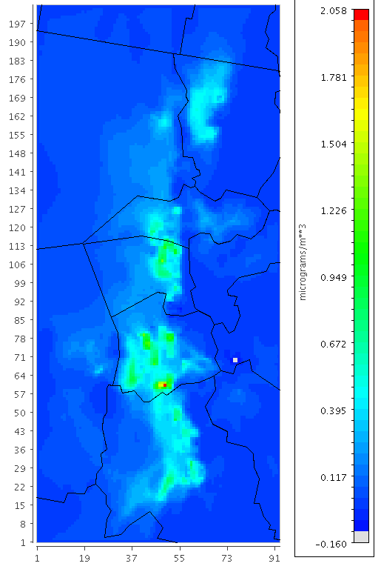
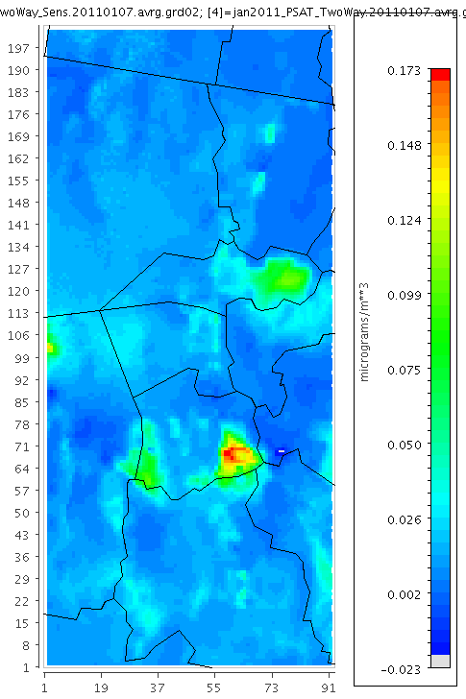
Absolute Drop in RWC (µg/m³)
Percent Drop in modeled PM2.5
Jan. 7
PM2.5 > 50 ug/m3
Jan. 7
PM2.5 > 50 ug/m3

Slide 18
Absolute Change in Ambient PM2.5 (µg/m³)
Apply % drop in PM2.5 modeled to PM2.5 measured

Slide 19
PMF vs. CAMx-PSAT
Compare Base Case to PMF results (receptor-based technique)
Determine RWC contribution relative to measured PM2.5
PSAT: January 2011
PMF: Winter 2014-2015
Urban
Semi-rural
Notes:
BR due to poorer model performance at this site

Slide 20
Findings
Change-out program has a limited air quality benefit
Generally good agreement between CAMx & PMF for primary RWC at urban sites
Overall good model performance for OC/PM2.5
Important implications for developing emissions control strategies
Notes:
Results help inform similar efforts aiming at investigating the impact of a WS change-out program

Slide 21
Acknowledgements
Gail Tonnesen
University of Utah: Dr. Erik Crosman, Dr. John Horel & Chris Foster
Ramboll Environ: Gary Wilson & Chris Emery

Slide 22
Thank You

Slide 24
Percent Reduction in Emissions
 | CO | NOx | PM2.5 | SO2 | VOCs
Salt Lake | 37.3% | 15.6% | 21.4% | 16.4% | 35.8%
Utah | 37.8% | 17.8% | 22.0% | 14.2% | 38.2%
Cache | 35.3% | 18.8% | 20.0% | 10.4% | 37.3%
Entire State | 38.4% | 18.7% | 22.0% | 12.8% | 40.2%

Slide 25
EPA RWC Estimation Tool
NEI 2011 tool
NEI 2014 tool
Appliance Fraction
Derived from the U.S. Department of Commerce, "American Housing Survey for the United States: 2005" and certified stoves were grown at an EPA estimated 1% per year.
Burn Rate
Based on USDA Forest Service Midwest or Great Plain state surveys performed in the 1990s. Rates were then adjusted to account for efficiencies in EPA certified stoves. County climate zones were also applied to further adjust burn rates.
Appliance Fraction
American Housing Survey + Energy information administration residential energy combustion survey
Logistic regression that estimates the likelihood of whether or not a home uses a wood-burning appliance. Uses demographic variables to predict the proportion of homes in each county that uses each appliance (home type; urban/rural setting; number of heating degree days; appliance type; burn type)
Burn Rate
Estimated using regression analysis based on each unique combination of home type, urban/rural setting, appliance type and burn type

Slide 26
Appliance type | Efficiency (%)
Uncertified freestanding cordwood stove | 54
Certified non-catalytic cordwood stove | 65
Certified catalytic cordwood stove | 70
Pellet Stove | 75
Uncertified cordwood fireplace insert | 49
Certified non-catalytic cordwood insert | 60
Certified catalytic cordwood insert | 65
Pellet insert | 70
Cordwood fireplace | 18

Slide 27
Difference in cords burned between EPA 2011NEIv2 tool & DAQ Survey
 | Fireplaces | Inserts | Stoves
All areas | 9.2% | -49.8% | -40.1%
Box Elder | -36.8% | -20.7% | 30.0%
Cache | -33.6% | -48.7% | -10.8%
Davis | -38.0% | -61.3% | -50.4%
Salt Lake | 59.3% | -53.9% | -55.0%
Tooele | -11.8% | -28.4% | -16.8%
Utah | -4.3% | -26.7% | -27.9%
Weber | -29.5% | -70.2% | -29.2%

Slide 28
Emissions Calculation
Notes:
Occupied housing units: American Community Survey (2014)
Appliance fraction: American Housing Survey + Energy information administration residential energy combustion survey
50 unique appliance fractions
Wood density: US Forest Service, Timber Products Output, 2005
Burn rate: estimated using regression analysis based on each unique combination of home type, urban/rural setting, appliance type and burn type

Slide 29
Observed boundary layer
Simulated boundary layer

Slide 30
KVPATCH Application
KVPATCH preprocessor applied to:
Enhance nighttime mixing over urban areas
Enhancement over user-specified surface layer depth
Day-by-day basis
Weak trough
Set depth = 200 m
Notes:
Increase dispersion by increasing the diffusivity coefficient that is estimated by WRF
Applies landuse-dependent minimum Kv values to layers below user-specified height.
enhance mixing below convective clouds
The cloud patch extends the daytime PBL Kv profile through capping cloud tops as a means to prohibit artificial collapse of the boundary layer when convection develops and to include convective venting to the free troposphere.
Applies minimum Kv values to layers below a user-defined height based on input landuse fields and surface layer stability within that depth

Slide 31
KVPATCH Application
KVPATCH preprocessor applied to:
Enhance nighttime mixing over urban areas
Enhancement over user-specified surface layer depth
Day-by-day basis
Set depth = 600 m
Notes:
Increase dispersion by increasing the diffusivity coefficient that is estimated by WRF
Applies landuse-dependent minimum Kv values to layers below user-specified height.
enhance mixing below convective clouds
The cloud patch extends the daytime PBL Kv profile through capping cloud tops as a means to prohibit artificial collapse of the boundary layer when convection develops and to include convective venting to the free troposphere.
Applies minimum Kv values to layers below a user-defined height based on input landuse fields and surface layer stability within that depth

Slide 32
Base Case Model Performance: Crustal Material

Slide 33
Base Case Model Performance: Primary OC
Meas. PM2.5 = 49.1 µg/m³
Meas. PM2.5 = 65.4 µg/m³

Slide 34
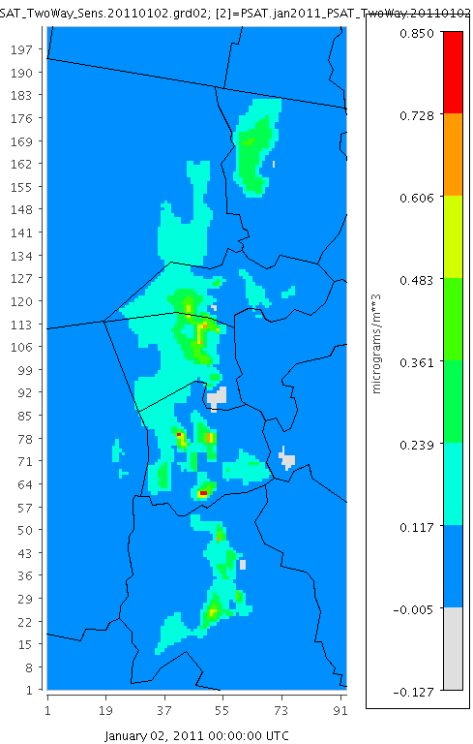
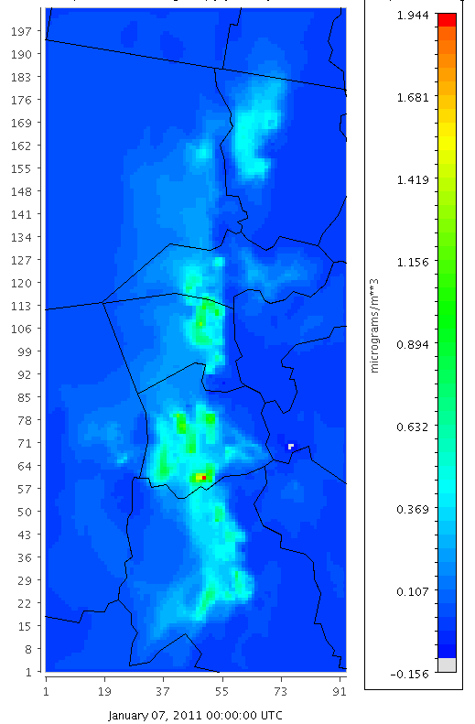
Absolute Change in POA
Jan. 2
PM2.5 < 25 ug/m3
Jan. 7
PM2.5 > 50 ug/m3

Slide 35
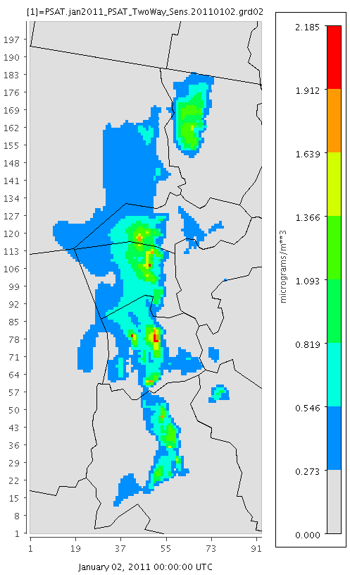
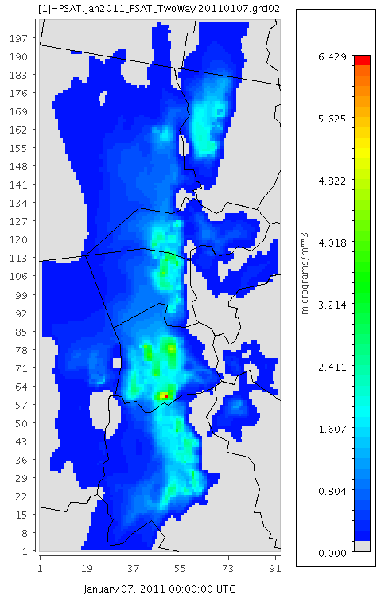
Residential Wood-combustion Source Estimates: Base Case
Jan. 2
PM2.5 < 25 ug/m3
Jan. 7
PM2.5 > 50 ug/m3

Slide 36
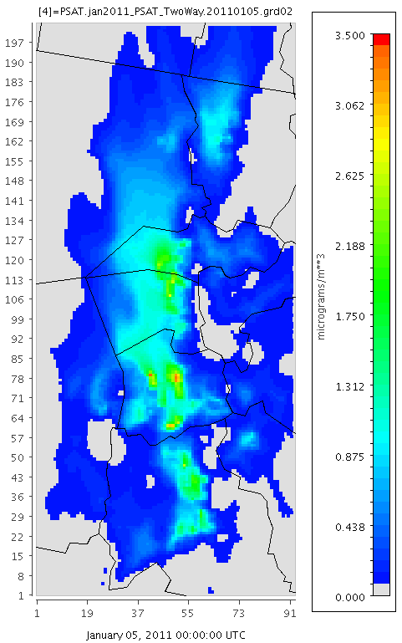
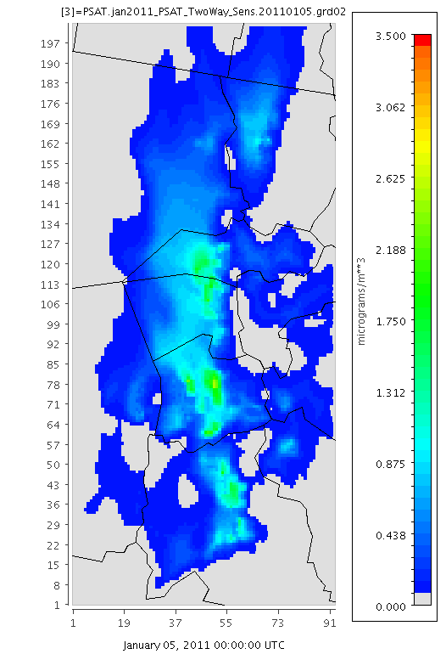
Sensitivity Analysis

Slide 37
Model Performance: Total PM2.5

Slide 38
Sensitivity Analysis

