Slide 1
Ozone Source Apportionment Modeling to Support Policy Initiatives in the Eastern United States
Kenneth Craig, Garnet Erdakos,
Lynn Baringer, and Stephen Reid
Sonoma Technology, Inc., Petaluma, CA
15th Annual CMAS Conference
Chapel Hill, NC
October 26, 2016
STI-6537

Slide 2
Outline
Motivation
Modeling approach
Results: multiple sources examples
Results: single-source example
Summary and insights

Slide 3
Motivation
Interstate transport has become increasingly important for addressing NAAQS attainment issues.
Source apportionment has become an important tool to quantify source impacts on downwind ozone and guide policy decisions (e.g., CSAPR).
CSAPR modeling provides state-level source contributions.
STI conducted new source apportionment modeling with detailed tagging to support policy initiatives in the eastern United States.

Slide 4
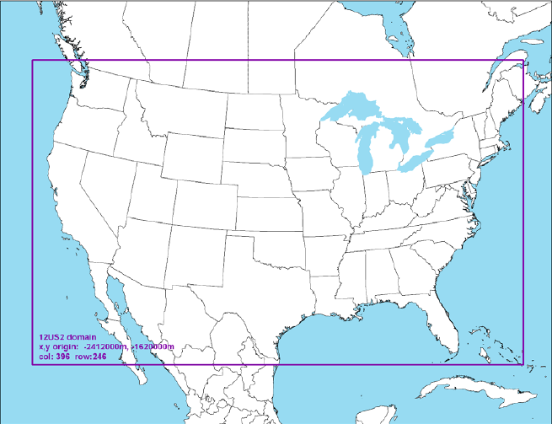
Modeling Approach
2011 ozone season (May-September) simulation with CAMx version 6.1
Configurations based on EPA’s 2011 modeling platform
  WRF version 3.4
  2011 NEI Version 1
  GEOS-Chem boundary conditions
  Carbon Bond 6r2
Ozone Source Apportionment Technology (OSAT) with APCA
APCA = Anthropogenic Precursor Culpability Analysis

Slide 5
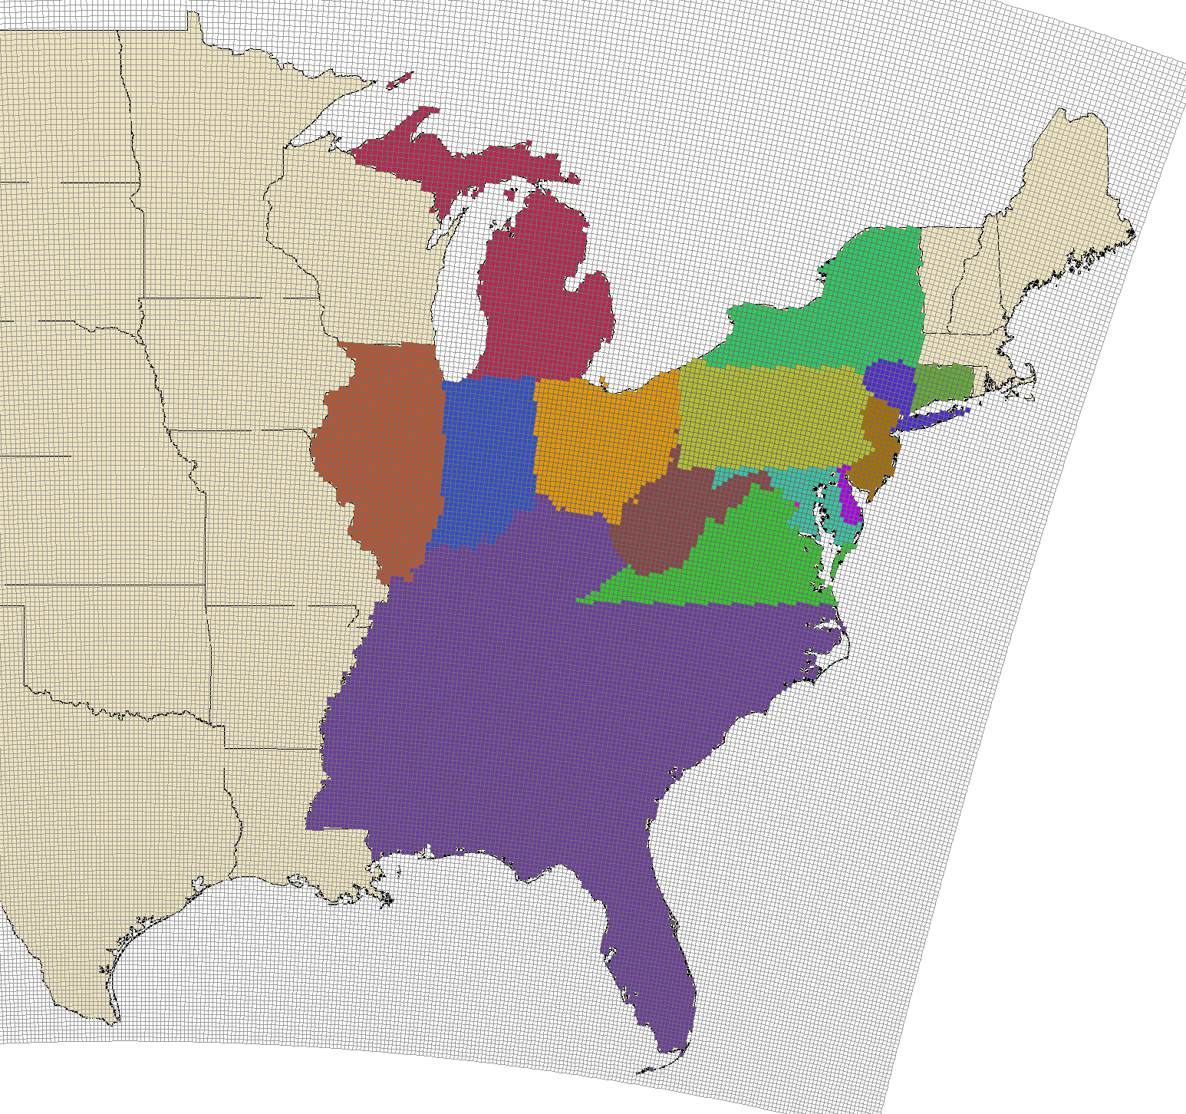
Source Apportionment Tagging
Approach
Category | Tags
Individual coal-fired power plants | 52
Groups of coal-fired power plants (several dozen EGU) | 49
Groups of non-EGU points sources within a region | 12
Non-point sources (biogenic, on-road, non-road, “other”) within 16 regions | 64
Initial and boundary conditions | 2
OSAT regions for non-point source category

Slide 6
Source Apportionment Tagging
Approach
Simulation | Description
1 | Point source tags (set 1)
2 | Point source tags (set 2)
3 | Geographic tags (e.g., on-road)
Processor: 16 CPU per simulation (2 nodes)
Memory: 10-12 GB RAM per node per simulation
Clock time: 3-4 weeks

Slide 7
OSAT Post-Processing
Approach
Hourly gridded
OSAT results
Daily peak 8-hr O₃ contributions
for each tag and receptor
at hour of peak modeled 8-hr O₃
Receptor Locations
(670 monitors in eastern U.S.)
Reflects contributions during time periods when ozone concentrations are highest
Guarantees that daily ozone contributions from all source tags sum to the total modeled 8-hr concentration

Slide 8
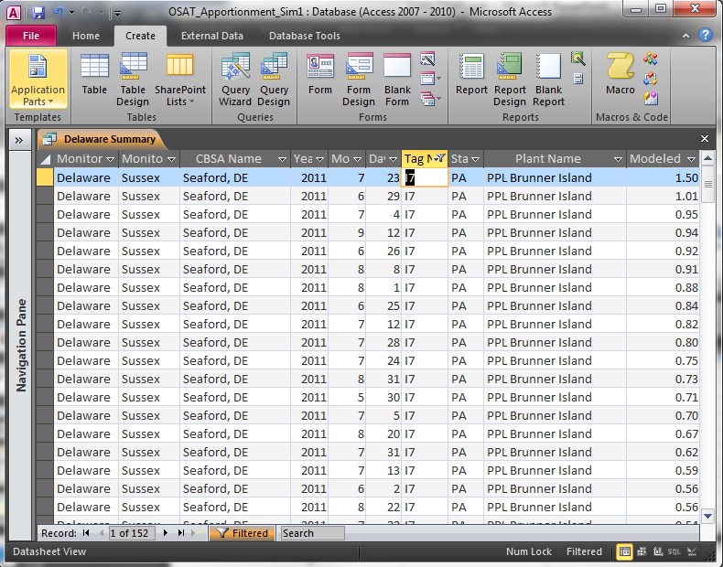
Access Database
Approach
Extracted ozone contributions for all tags at 670 monitoring sites across the
eastern U.S.
Developed sample queries to facilitate data exploration
Opportunity for future data mining

Slide 9
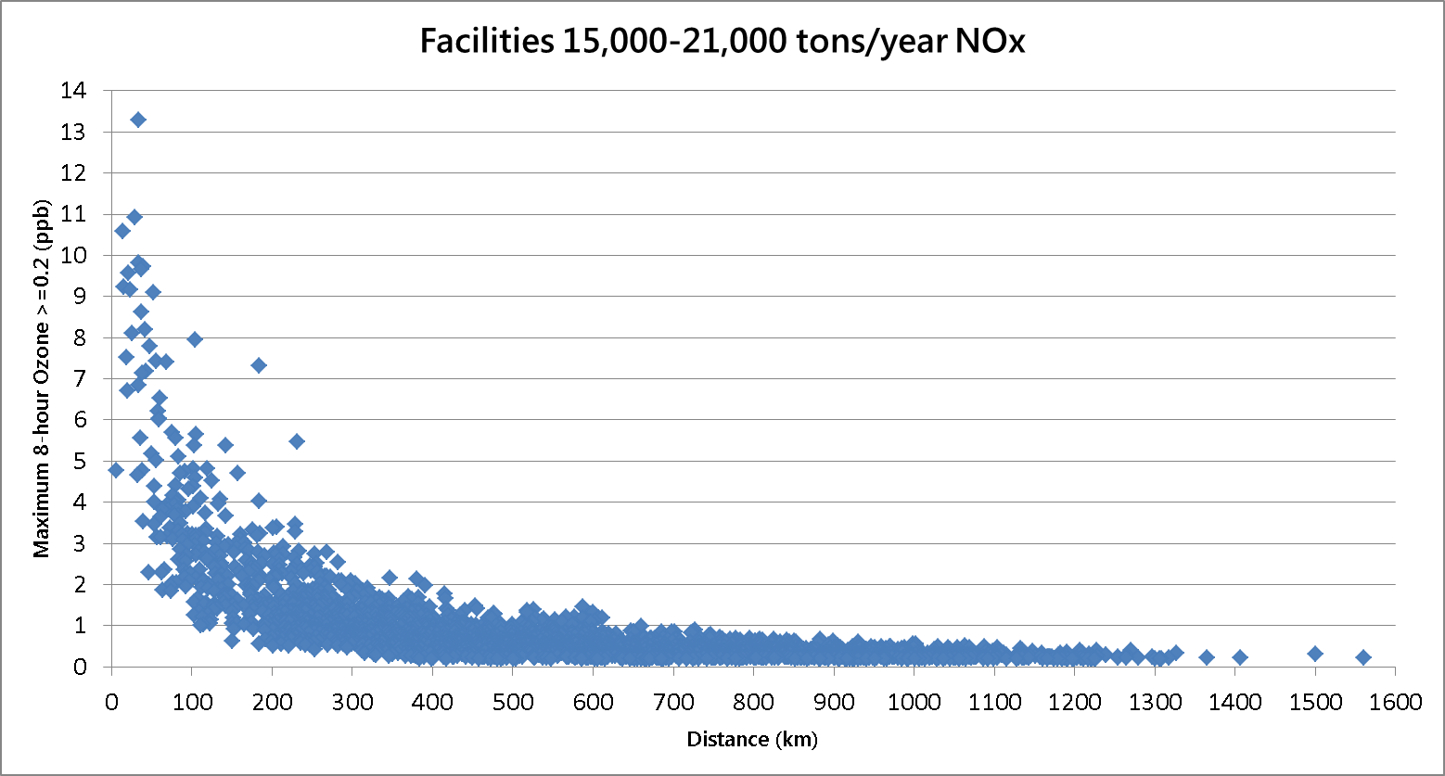
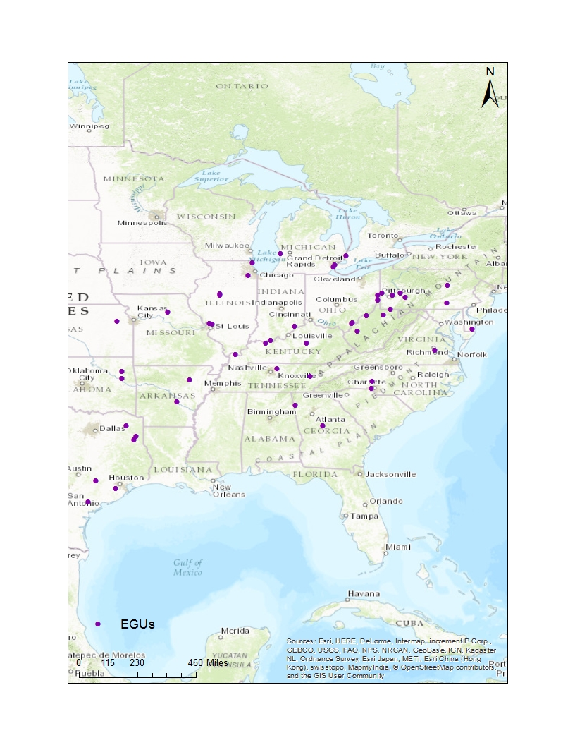
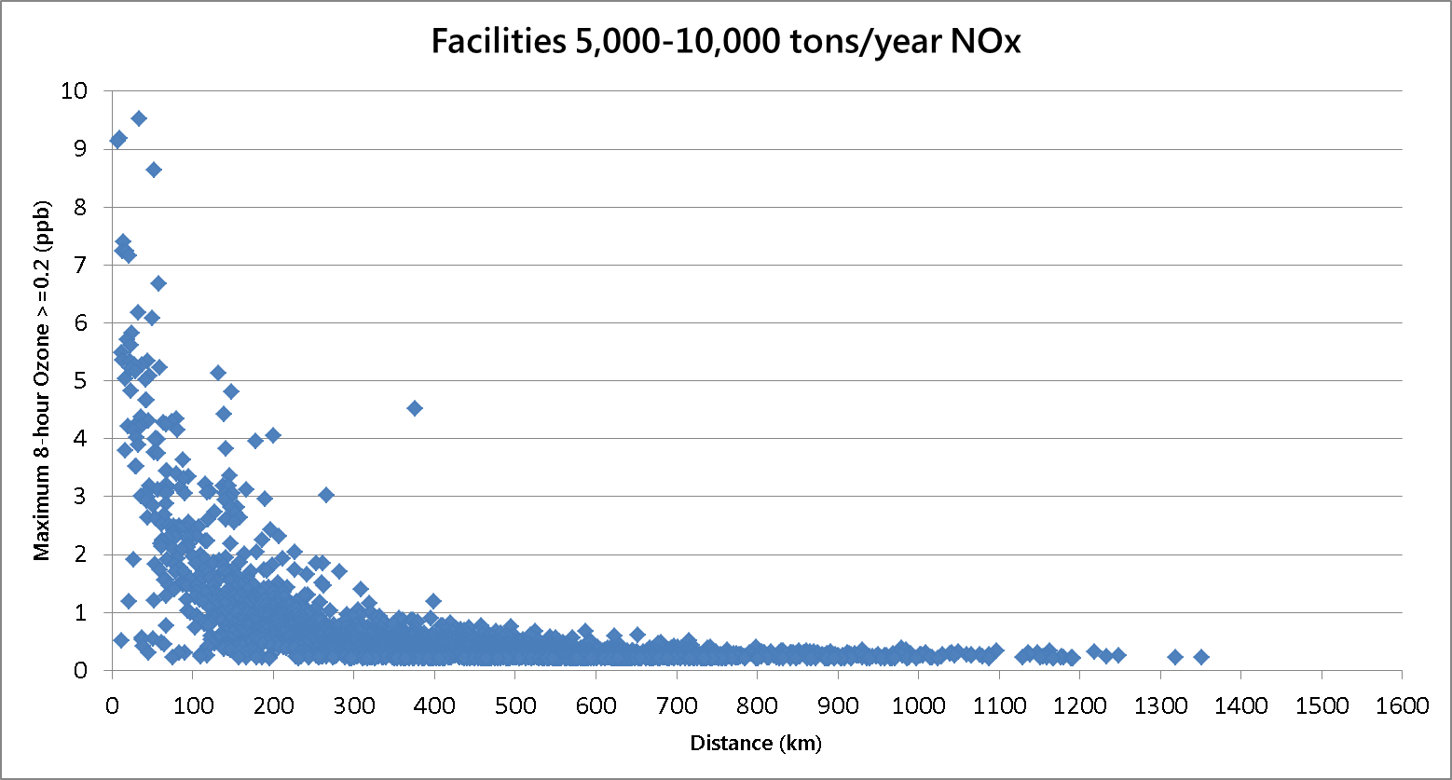
Ozone Impacts vs. Distance
Results: Multiple Sources
1 ppb is the proposed NAAQS significant impact level (SIL) for single-source ozone impacts.

Slide 10
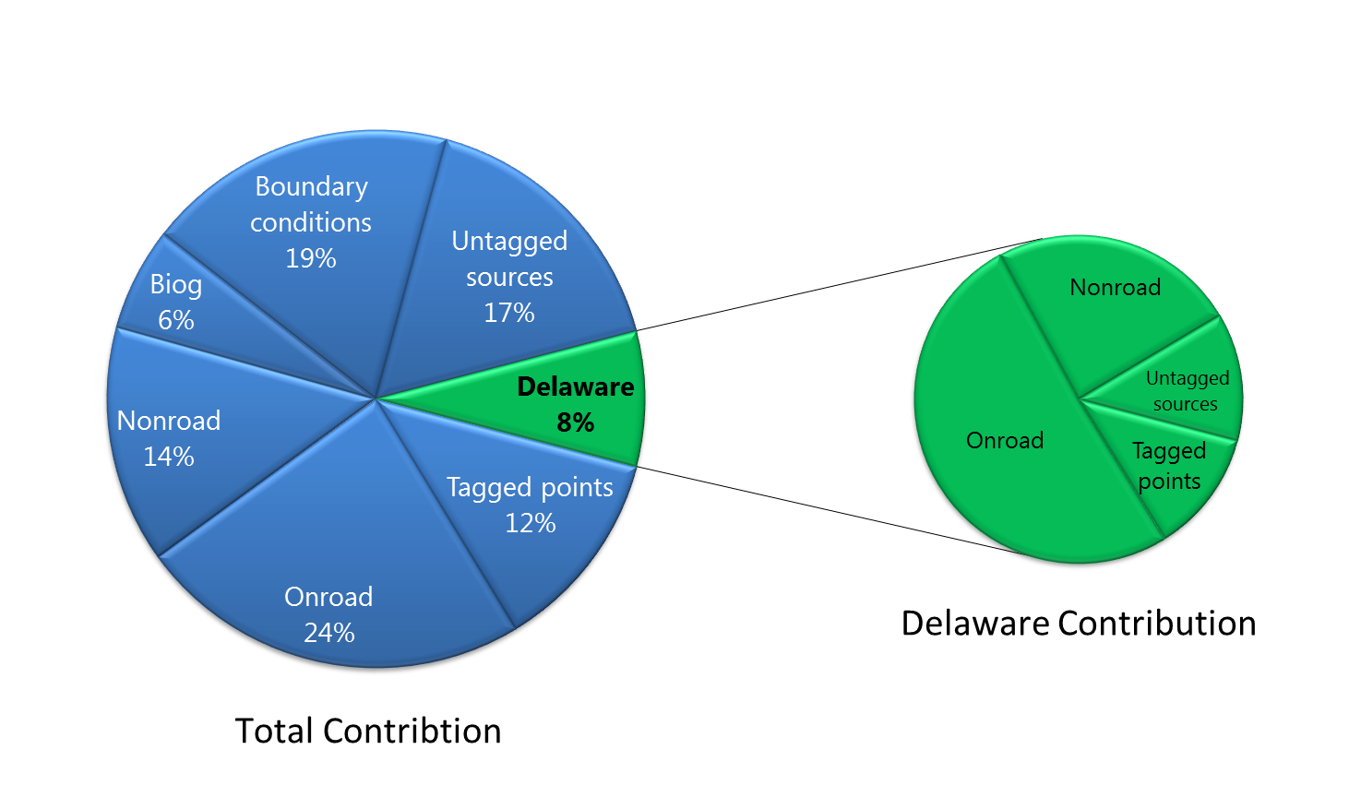
Single Receptor Analysis
Results: Multiple Sources
Delaware sources
Non-Delaware sources
(6.11 ppb)
Ozone contributions in Sussex County, DE, when modeled ozone was greater than 70 ppb (13 days)

Slide 11
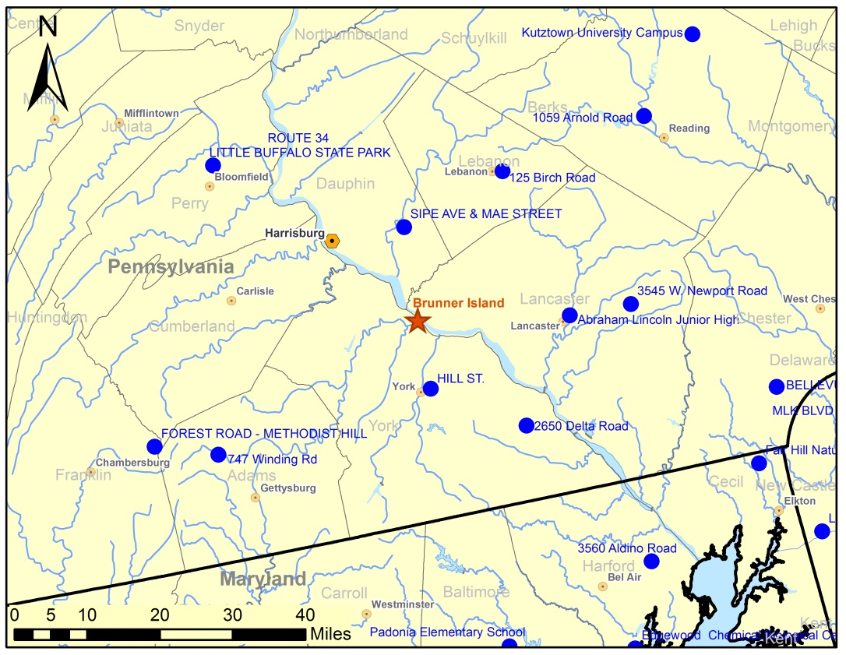
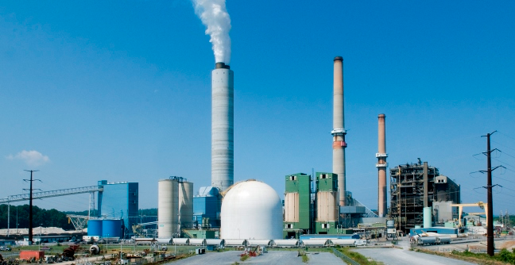
Point Source Analysis
Brunner Island
Results: Single Source
York Haven, PA
1411 MW generating capacity
2011 NO_{x} emissions: 16,800 tons
www.talenenergy.com
Brunner Island power plant in southeast Pennsylvania and nearby air quality monitoring sites.

Slide 12
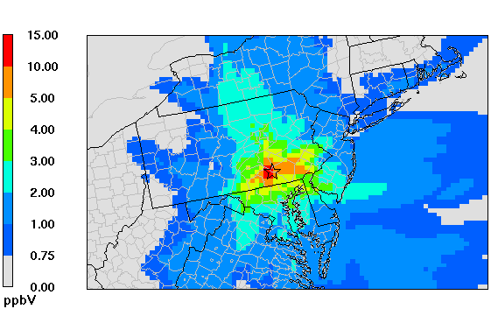
Brunner Island Ozone Impacts
Results: Single Source
Peak modeled 8-hr ozone impacts from the Brunner Island power plant during the 2011 ozone season.

Slide 13
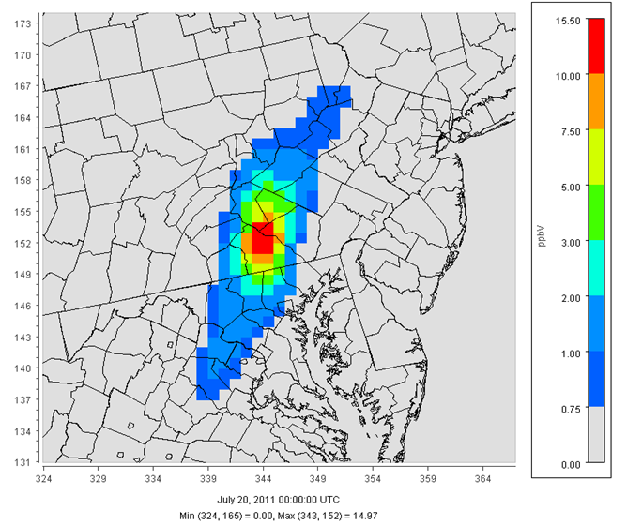
Brunner Island Ozone Impacts
Results: Single Source
Peak modeled 8-hr ozone impacts from the Brunner Island power plant on July 20, 2011.

Slide 14
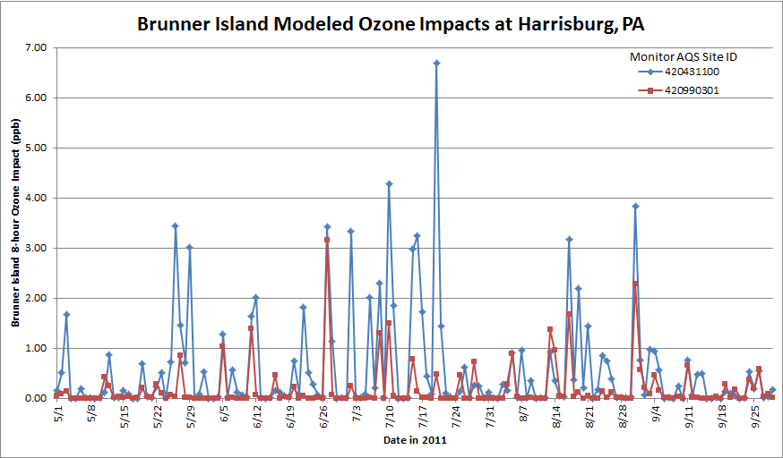
Daily Ozone Contributions
Results: Single Source
Significant (>0.75 ppb) 8-hr ozone impacts were modeled at one or more PA monitor(s) on 86% (79 of 92) of days during June-August.

Slide 15
Ozone Contributions at Pennsylvania Monitors
Results: Single Source
Significant (>0.75 ppb) 8-hr ozone impacts were modeled on at least one day at 75% of Pennsylvania monitoring sites.

Slide 16
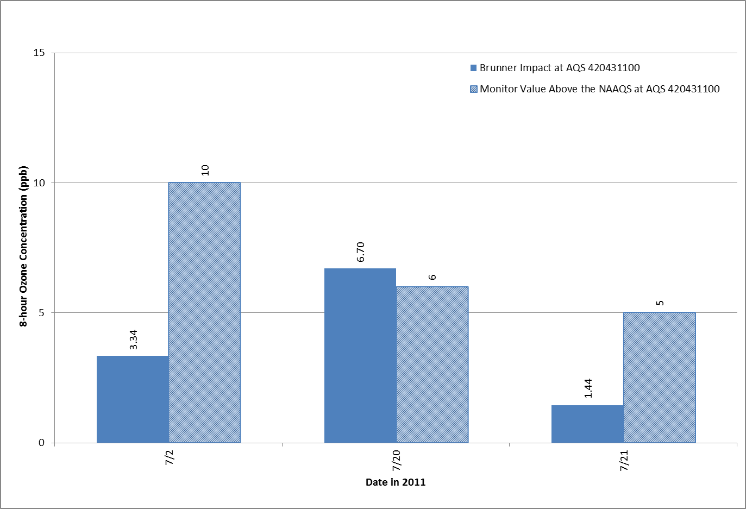
Impacts on High-Ozone Days
Results: Single Source
Brunner Island Impact
Monitor increment above NAAQS
10 ppb
6.70 ppb
6 ppb
5 ppb
3.34 ppb
1.44 ppb
July 2
July 20
July 21
Modeled 8-hr ozone impacts >0.75 ppb from Brunner Island and incremental monitored ozone concentrations above the NAAQS on days when the NAAQS was exceeded at the Sipe Ave. monitor near Harrisburg.

Slide 17
Ozone Contributions on
Neighboring States
Results: Single Source
Summary of significant (>0.75 ppb) modeled 8-hr ozone contributions from Brunner Island at monitoring stations in Pennsylvania and neighboring states.

Slide 18
Summary and Insights
Conducted source apportionment modeling to support policy initiatives in the eastern United States
Developed a database to support current analysis and future data mining
Multiple sources examples
  1-ppb impacts possible several hundred kilometers from large NO_{x} sources
  At some receptors, in-state ozone contributions are small compared to
  out-of-state contributions
Single-source example (Brunner Island)
  Significant (>0.75 ppb) ozone impacts in Pennsylvania on most summer days
  Significant impacts at Harrisburg on three NAAQS exceedance days in 2011
  Significant ozone contributions extend several hundred kilometers into neighboring states
Further discussion: Representativeness of modeling results from a transport perspective

Slide 19
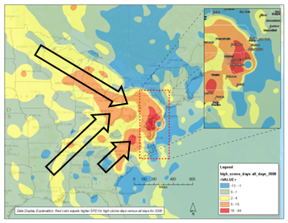
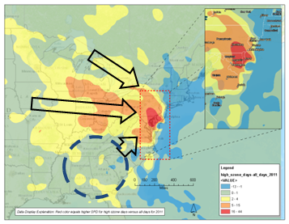
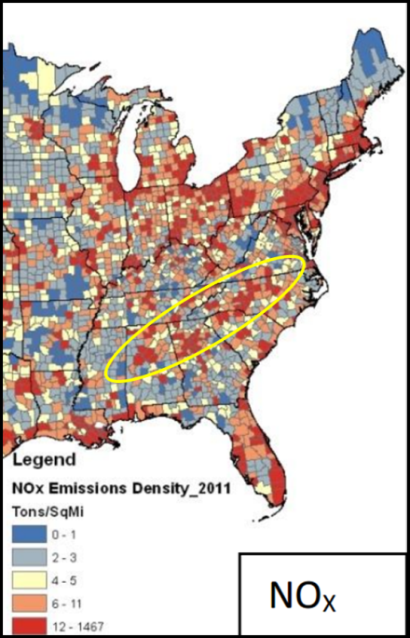
Trajectory Spatial Probability Density
(Difference plots: high-ozone days vs. all days)
2008
2011
Southwesterly transport toward Delaware is less pronounced in 2011 than in other years.

Slide 20

Contact
sonomatech.com
Kenneth Craig
Group Manager
Atmospheric Modeling
kcraig@sonomatech.com
707.665.9900
sonomatech.com @sonoma_tech

