Slide 1



Source apportionment of biogenic contributions to ozone formation over the United States
Rui Zhang^{1,2}, Daniel Cohan¹, Alex Cohan³, and Arastoo Pour-Biazar⁴
¹Rice University
²Now at National Park Service, Fort Collins, CO
³Lake Michigan Air Directors Consortium (LADCO)
⁴The University of Alabama in Huntsville
CMAS Annual Conference
October 25, 2016

Slide 2
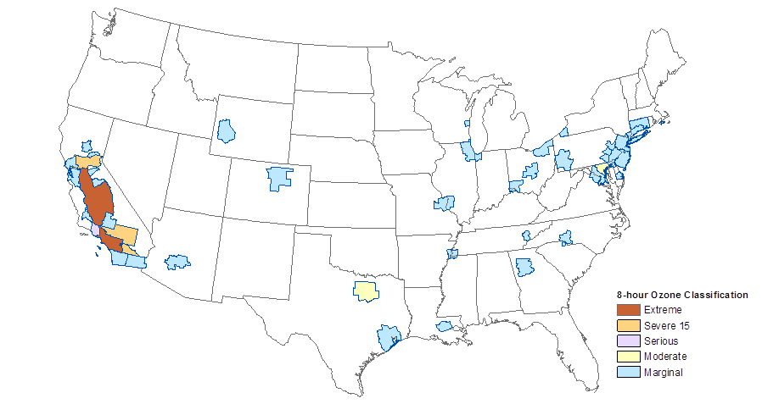
Ozone challenges remain despite
NO_{x} reductions
Ozone non-attainment areas*
OMI tropospheric NO2 VCD
*As of January 2015, for 75 ppb standard; NAAQS is now 70 ppb
Lamsal et al. (2015)

Slide 3
Biogenic VOCs and Ozone Source Apportionment
Biogenics are leading source of reactive VOCs
Solar insolation is leading source of BVOC uncertainty
  Satellite retrievals can improve estimates
Multiple techniques apportion ozone to VOC and NO_{x}
  Ozone Source Apportionment Technology: Assigns O₃ formation to NO_{x} or VOC based on P_{H2O2}/P_{HNO3}
  Brute force: Reduce emissions from each source
  High-order decoupled direct method
Notes:
BVOC emission estimates depend on land use categories, emission factors associated with different plant functional type (PFT), leaf area index (LAI), and the amount of radiation reaching the canopy known as photosynthetically active radiation (PAR)

Slide 4
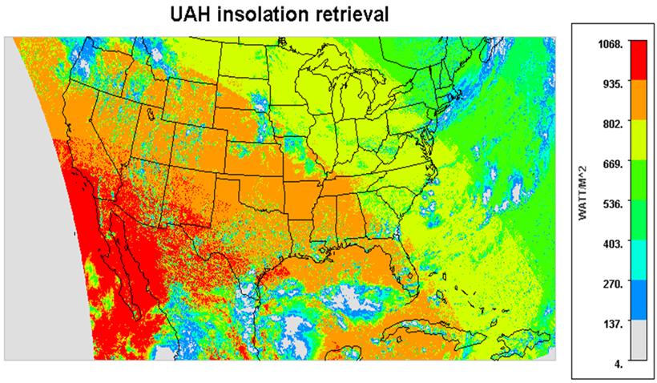
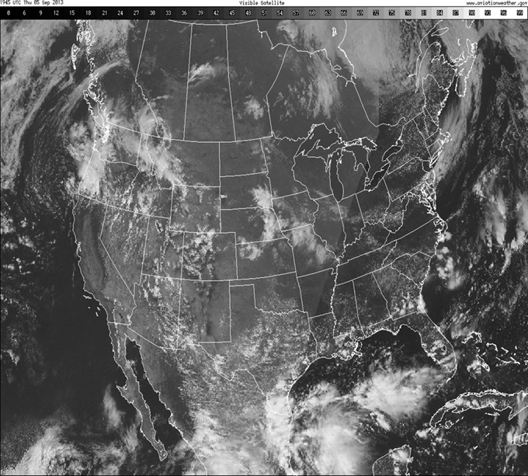
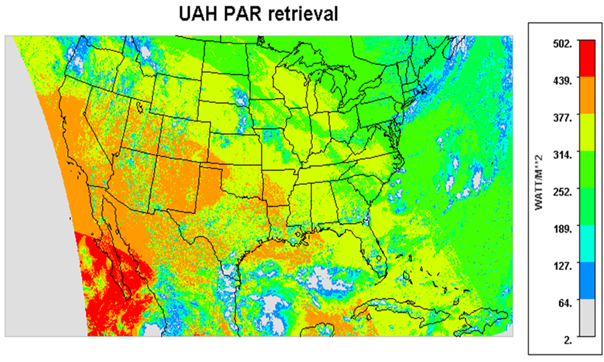

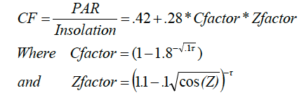
GOES satellite insolation and PAR retrievals
GOES satellite image
UAH algorithm for PAR fraction of solar insolation
Notes:
Comparison of satellite visible channel image and UAH insolation and PAR retrieval product with 4km X 4km resolution over continental U.S
from GOES satellite imager for Sep 5, 2013 at 19:45 UTC
In this PAR parameterization scheme, a conversion factor CF is introduced to represent the portion of incoming solar radiation (insolation) that is in photosynthetically active wavelengths and the its value can be adjusted by cloud attenuation (C factor) and zenith angle (Z factor).

Slide 5
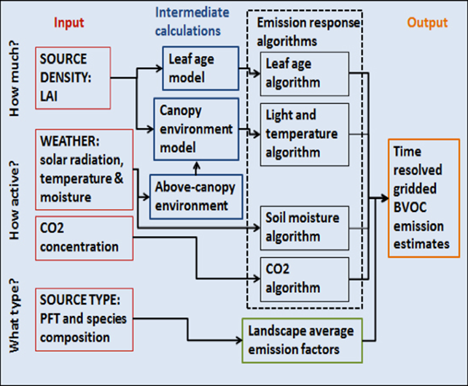
Biogenic emission models: BEIS and MEGAN
Annual isoprene emission estimates in 2008
BEIS (Pierce et al. 2002)
BEIS
MEGAN (Pouliot and Pierce, 2009)
MEGAN
Notes:
The primary differences in the isoprene algorithm of the two BVOC emission models lay whether it uses leaf-scale emission factor (BEIS) or canopy-scale factor (MEGAN) and how it treats the temperature and light adjustment either on top of the canopy (BEIS) or within the canopy (MEGAN) using a parameterized canopy environment emission model (Pouliot and Pierce, 2009)

Slide 6
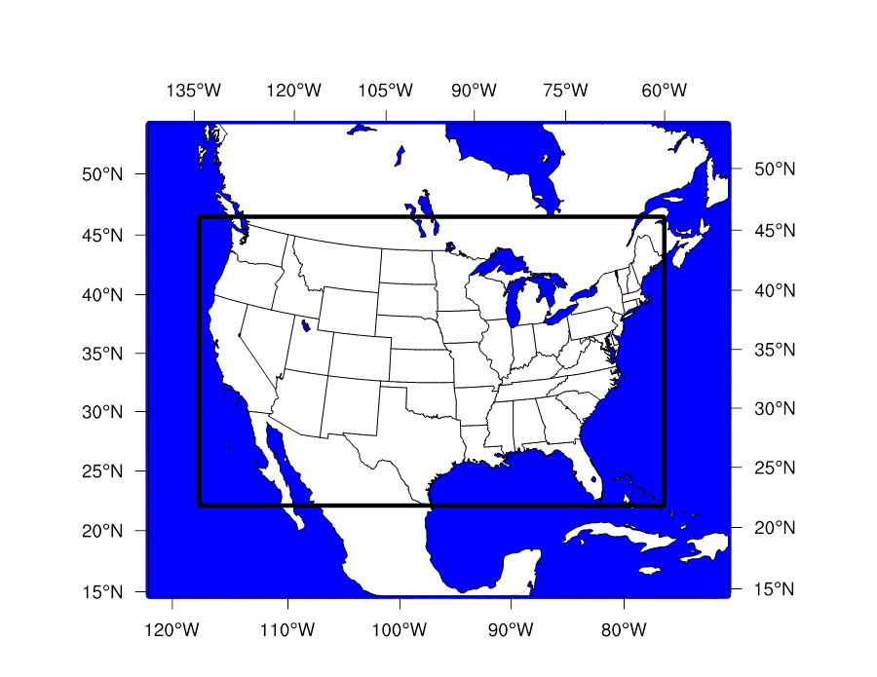
WRF-BEIS/MEGAN-CAMx simulation platform
Models used in simulation platform
CAMx configurations
12 km photochemical modeling domain over CONUS shown in black
Model period for SIP attainment demonstration:
Ozone Summer (May-Sep 2011)

Slide 7
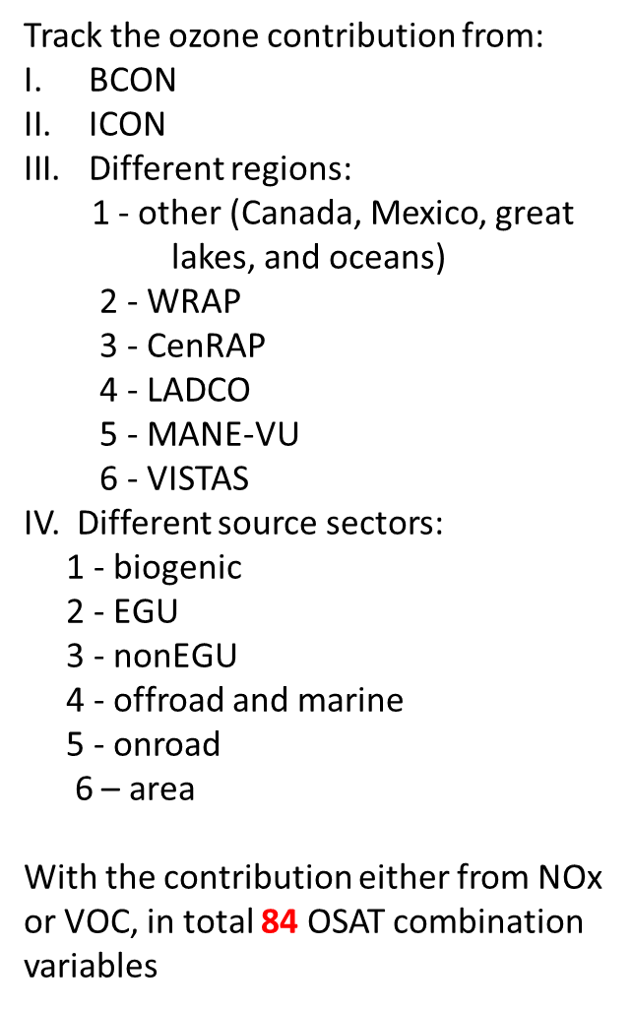
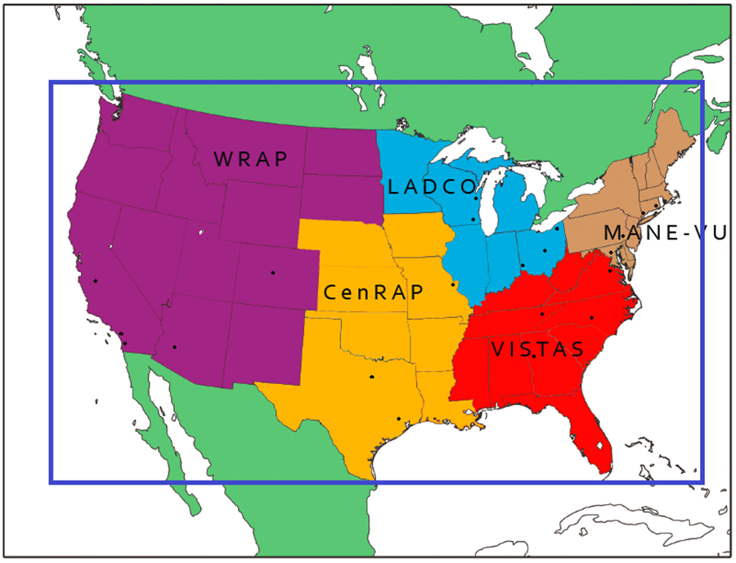
Tagged emission sources and regions
Notes:
Regional air resource management jurisdictional organization
WRAP (Western Regional Air Partnership), CenRAP (Central Regional Air Planning Association), LADCO (Lake Michigan Air Directors Consortium), VISTAS (Visibility Improvement State and Tribal Association of the Southeast), MANE-VU (Mid-Atlantic/Northeast Visibility Union)

Slide 8
Cases simulated
Biogenic emissions
  BEIS with WRF modeled PAR
  BEIS with GOES satellite PAR
  MEGAN with GOES satellite PAR
Brute force sensitivities
  Zero-out biogenics by region
  50% reductions in biogenics by region
Ozone Source Apportionment Technology (OSAT)
  Source apportionment for biogenic and other VOC and NO_{x} from each region

Slide 9
Evaluation of GOES satellite & WRF model insolation & PAR with ground monitors
Evaluations for May-September 2011 with available ground observations at SCAN and SUFRAD network
GOES satellite retrievals achieve lower bias and error than WRF model for insolation and PAR
Notes:
Surface Radiation Budget Network (SURFRAD) (http://www.esrl.noaa.gov/gmd/grad/surfrad/) maintained by NOAA
Soil Climate Analysis Network (SCAN) (http://www.wcc.nrcs.usda.gov/scan/) maintained by USDA
Comparing with BEIS results, the isoprene emission estimated by MEGAN is nearly a factor of 2 or even more at each region, especially over the heavily forest regions such as VISTAS (7.7×106 ton versus 3.1×106 ton) and CenRAP (6.6×106 ton versus 2.8×106 ton). Using satellite data consistently estimates less isoprene emission than its counterpart cases using WRF incoming solar radiation simulation for BEIS and MEGAN in all 5 regions. However, the BEIS isoprene estimates has less sensitive to the change of radiation input than MEAGN (2%-3% change for BEIS and 9%-12% change for MEGAN with the smallest change region in LADCO and the largest change region in VISTAS). These results suggest that using satellite insolation/PAR data tends to decrease the overall under-prediction of clouds by WRF model and the model bias in generating clouds at wrong locations and timing.

Slide 10
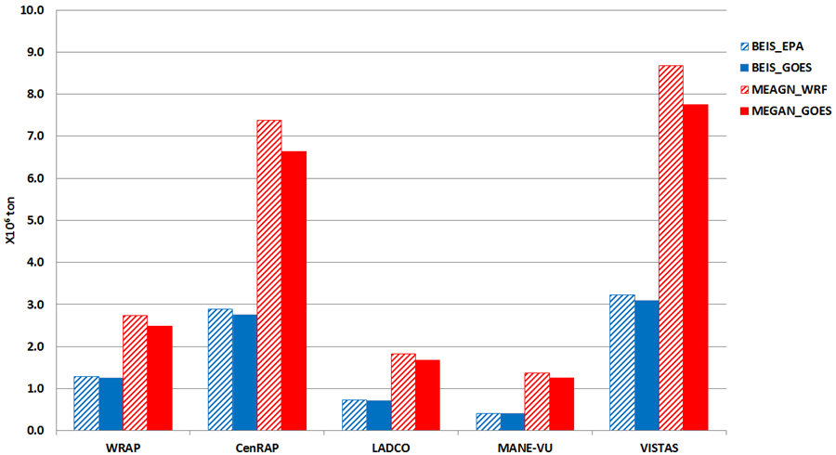
Isoprene emission estimates
MEGAN >> BEIS
WRF model PAR > Satellite retrieved PAR

Slide 11
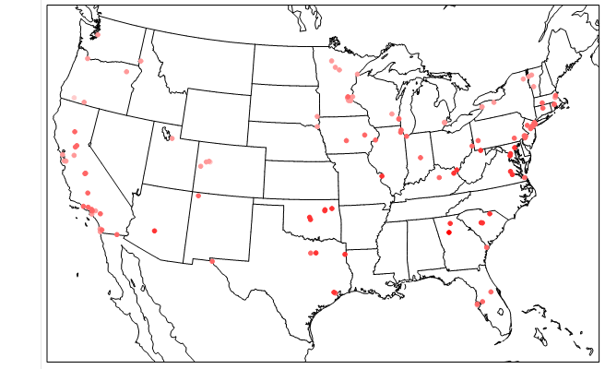


Isoprene model performance
BEIS w/ WRF PAR
BEIS w/ satellite PAR
MEGAN w/ satellite PAR
MEGAN overestimates isoprene concentrations at ground monitors
Notes:
The ‘MEGAN_GOES’ case on average over-estimates isoprene concentrations by a factor of 2.3 with the national mean observed value as 0.67 ppbV while the corresponding mean simulation value as 1.67 ppbV.

Slide 12
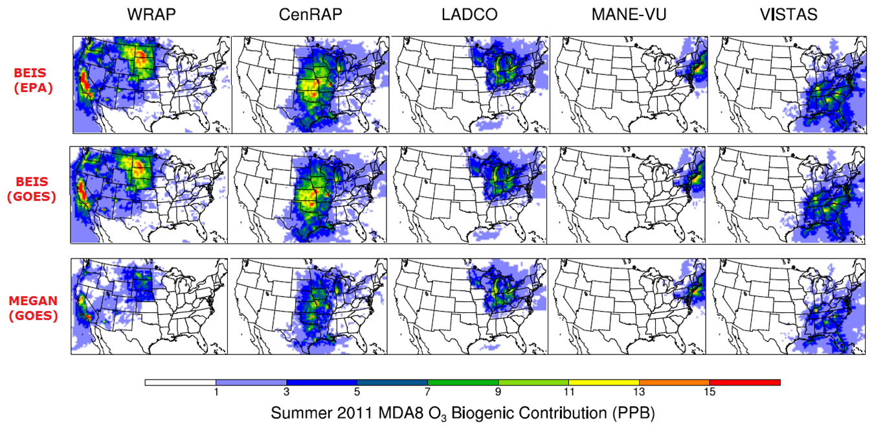
OSAT: Contributions of regional BVOC to O₃
BEIS
(WRF)
BEIS (GOES)
MEGAN (GOES)
Counter-intuitive result: Larger apportionment to BVOCs in BEIS case than in MEGAN
  More isoprene from MEGAN makes ozone more NO_{x} limited
Notes:
Even though the biogenic source from VISTAS region has the largest BVOC emission rate in US, its contribution to local ozone formation probe by OSAT is relatively modest with the typical value 5-11ppbV. In OSAT algorithm, it only attributes the ozone production due to biogenic VOC and anthropogenic NOx to biogenic source contribution under the VOC-limited condition. Since the ozone formation over Southeast states is normally with NOx-limited condition inferred with the high ratio of tropospheric columns of formaldehyde to NOx by OMI satellite observations, the OSAT has less chance to attribute the ozone contribution from biogenic sources than in Midwest states.

Slide 13
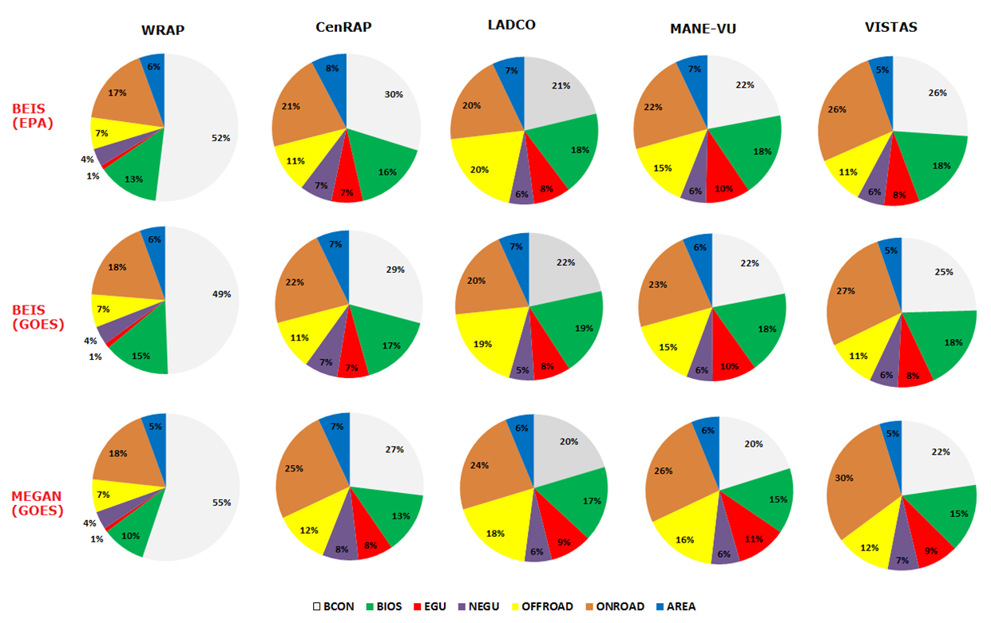
OSAT source apportionments by sector and region
BEIS
(WRF)
BEIS (GOES)
MEGAN (GOES)
Biogenic sources contribute 10-19% of ozone in each region
More ozone apportioned to BVOC in BEIS cases (counter-intuitive)
Anthropogenic source contributions: Onroad > Offroad > EGU/NEGU > Area
Notes:
The importance of boundary contributions, especially from stratospheric ozone intrusion to Denver area due to its high altitude, is reported in similar OSAT studies. The CAMx OSAT biogenic contribution to ozone using MEGAN BVOC emissions is consistently less than that using BEIS. This is due to the fact that MEGAN has generally more isoprene emissions than BEIS, therefore causing modeled local regional chemical environments to be less VOC limited and more NOx-limited.

Slide 14
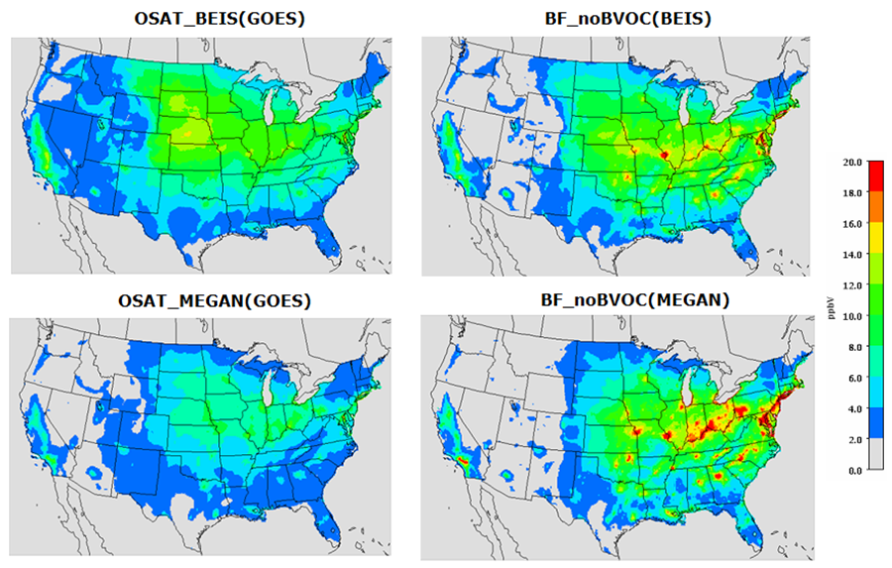
OSAT vs. brute force biogenic source contributions
OSAT Brute Force
BEIS
MEGAN
OSAT BVOC apportionments are more smoothly distributed
  Brute force zero-out BVOC impacts peak near cities with high NOx emissions
Brute force shows MEGAN >> BEIS for BVOC impacts (contrary to OSAT)
Notes:
The spatial pattern from the two approaches is different with The biogenic contribution from OSAT is less apparent with MEGAN emissions than the results using BEIS emissions.

Slide 15
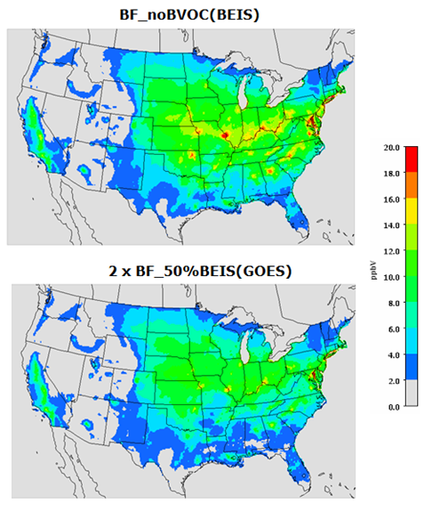
Nonlinear response to brute force emission reductions
Impact of zero-out BVOC case (top)
is more than 2x impact of 50% reduction (bottom)

Slide 16
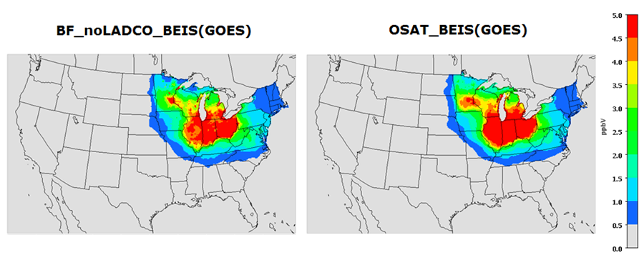
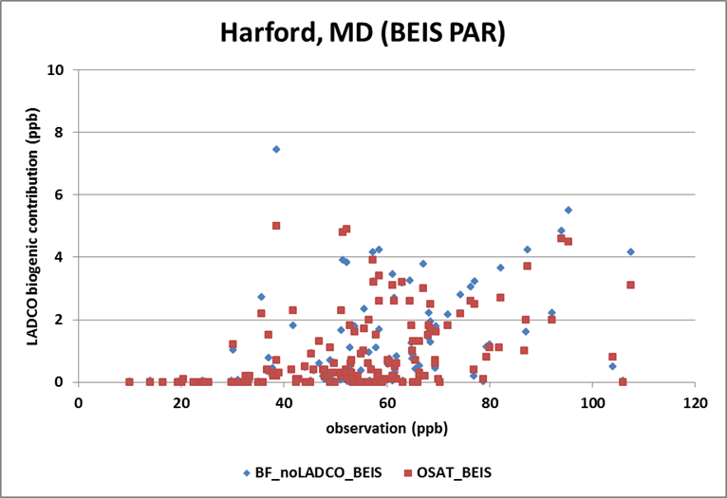
Impact from LADCO region biogenic VOCs
Most impact of LADCO BVOC occurs within LADCO region
Contribution of BVOCs is highest on high ozone days

Slide 17
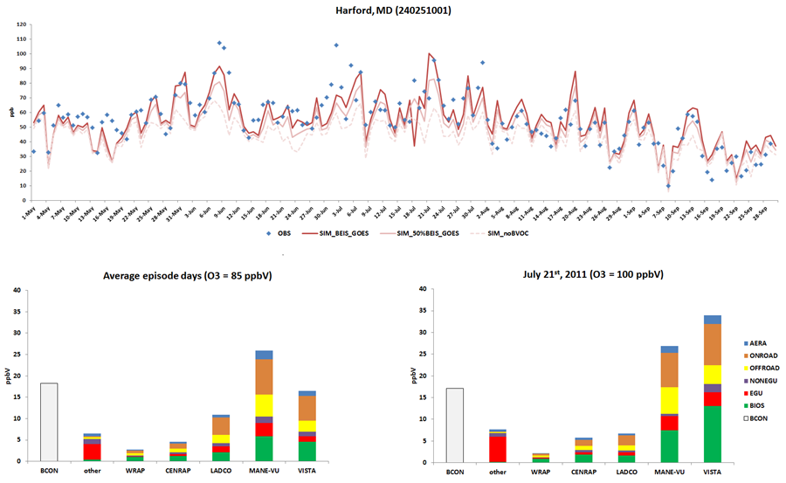
Temporal variability in BVOC contributions
BVOC ~ 21%
BVOC ~ 33%
Notes:
The source contribution results at receptor sites using the average episode days can be significantly different than the contribution during an ozone exeedance day.

Slide 18
Summary & Conclusion
Satellite retrievals yield lower and more accurate estimates of insolation and PAR
MEGAN >> BEIS for BVOC emission estimates
OSAT and brute force yield contrasting source apportionments
  OSAT apportions more ozone to BVOC for smaller BVOC emissions, since that makes ozone more NO_{x} limited
  Brute force shows larger ozone impact when BVOC emissions are large, since more emissions to zero-out
Spatial and temporal variability in BVOC impacts on ozone
  Greatest impacts where BVOC emissions interact with anthropogenic NO_{x}
  Impacts tend to increase on high ozone days

Slide 19

Acknowledgments
Conducted for NASA Air Quality Applied Sciences Team, DYNAMO tiger team
Baseline emissions inventory from US EPA
Satellite images from GOES satellite

