Slide 1

Quantifying the long-range transport and local pollution that contribute to PM_{2.5} in Taiwan under winter monsoon
Ming-Tung Chuangª*, Hui-Chun Hsu^{b}, Chung-Te Lee^{b},
aGraduate Institute of Energy Engineering, National Central University, Jhong-Li Dist, Taoyuan city, 32001 ,Taiwan
^{b}Graduate Institute of Environmental Engineering, National Central University, Jhong-Li Dist, Taoyuan city, 32001, Taiwan
Atmospheric Environment and Energy Assessment Laboratory (AEEAL)
http://aerg.atm.ncu.edu.tw
The 15th Annual CMAS Conference, October 24-26, 2016,
William and Ida Friday Center at Chapel Hill, NC, USA
Notes:
Good afternoon , all advancer and colleague, it is my pressure that we could all get together today to have this meeting
My name is 徐慧淳，I am a student from Environmental Engineering of national central University
My instructor is Dr.CT Lee and Dr. MT Chuang.
Today, I present my research topic is Quantifying the long-range transport and local pollution that contribute to PM_{2.5} in Taiwan under winter monsoon.

Slide 2
Motives
Is current air quality standard reasonable? What if long-range transport (LRT) accounts for most of air pollutants loading?
To find a acceptable method which can derive the quantity of LRT and local pollution (LP). Since monitoring sites are intensive in Taiwan, making use of long-term (10 years) monitoring datum can reflect more realistic air pollutants loading than air quality modeling do.
Air quality simulations contain uncertainty which includes bias of meteorology, emission, air pollutants chemistry, and numerical computing. Long-term (10 years) simulation costs a lot of human and computing resources.
This study use last 10 year monitoring data and only 3 month simulation to calculate the contribution of LRT and LP in cities in Taiwan.
Notes:
Accroding to Chuang et al., 2008 reference ,
If the leading edge of Asian continental high-pressure systems moves fast from China to Taiwan, PM_{2.5} events will occur accompanied by a prevailing strong northeast wind.
As this weather system moves over China coastal provinces, it carries pollutants southward. PM_{2.5} concentrations are aggravated when there is no rainfall in the front ahead of the high-pressure system. This specific weather pattern, defined as HPP.

Slide 3
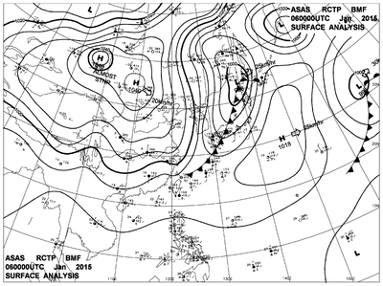
Meteorology
H
Korea
China
Japan
H
H
Taiwan
Philippines
It is already known that high PM_{2.5} air masses usually deteriorated the air quality in Taiwan via long-range transport (LRT), since Taiwan is located at the downwind area of Asian continent under prevailing northeast wind during the winter monsoon.
Notes:
Accroding to Chuang et al., 2008 reference ,
If the leading edge of Asian continental high-pressure systems moves fast from China to Taiwan, PM_{2.5} events will occur accompanied by a prevailing strong northeast wind.
As this weather system moves over China coastal provinces, it carries pollutants southward. PM_{2.5} concentrations are aggravated when there is no rainfall in the front ahead of the high-pressure system. This specific weather pattern, defined as HPP.

Slide 4
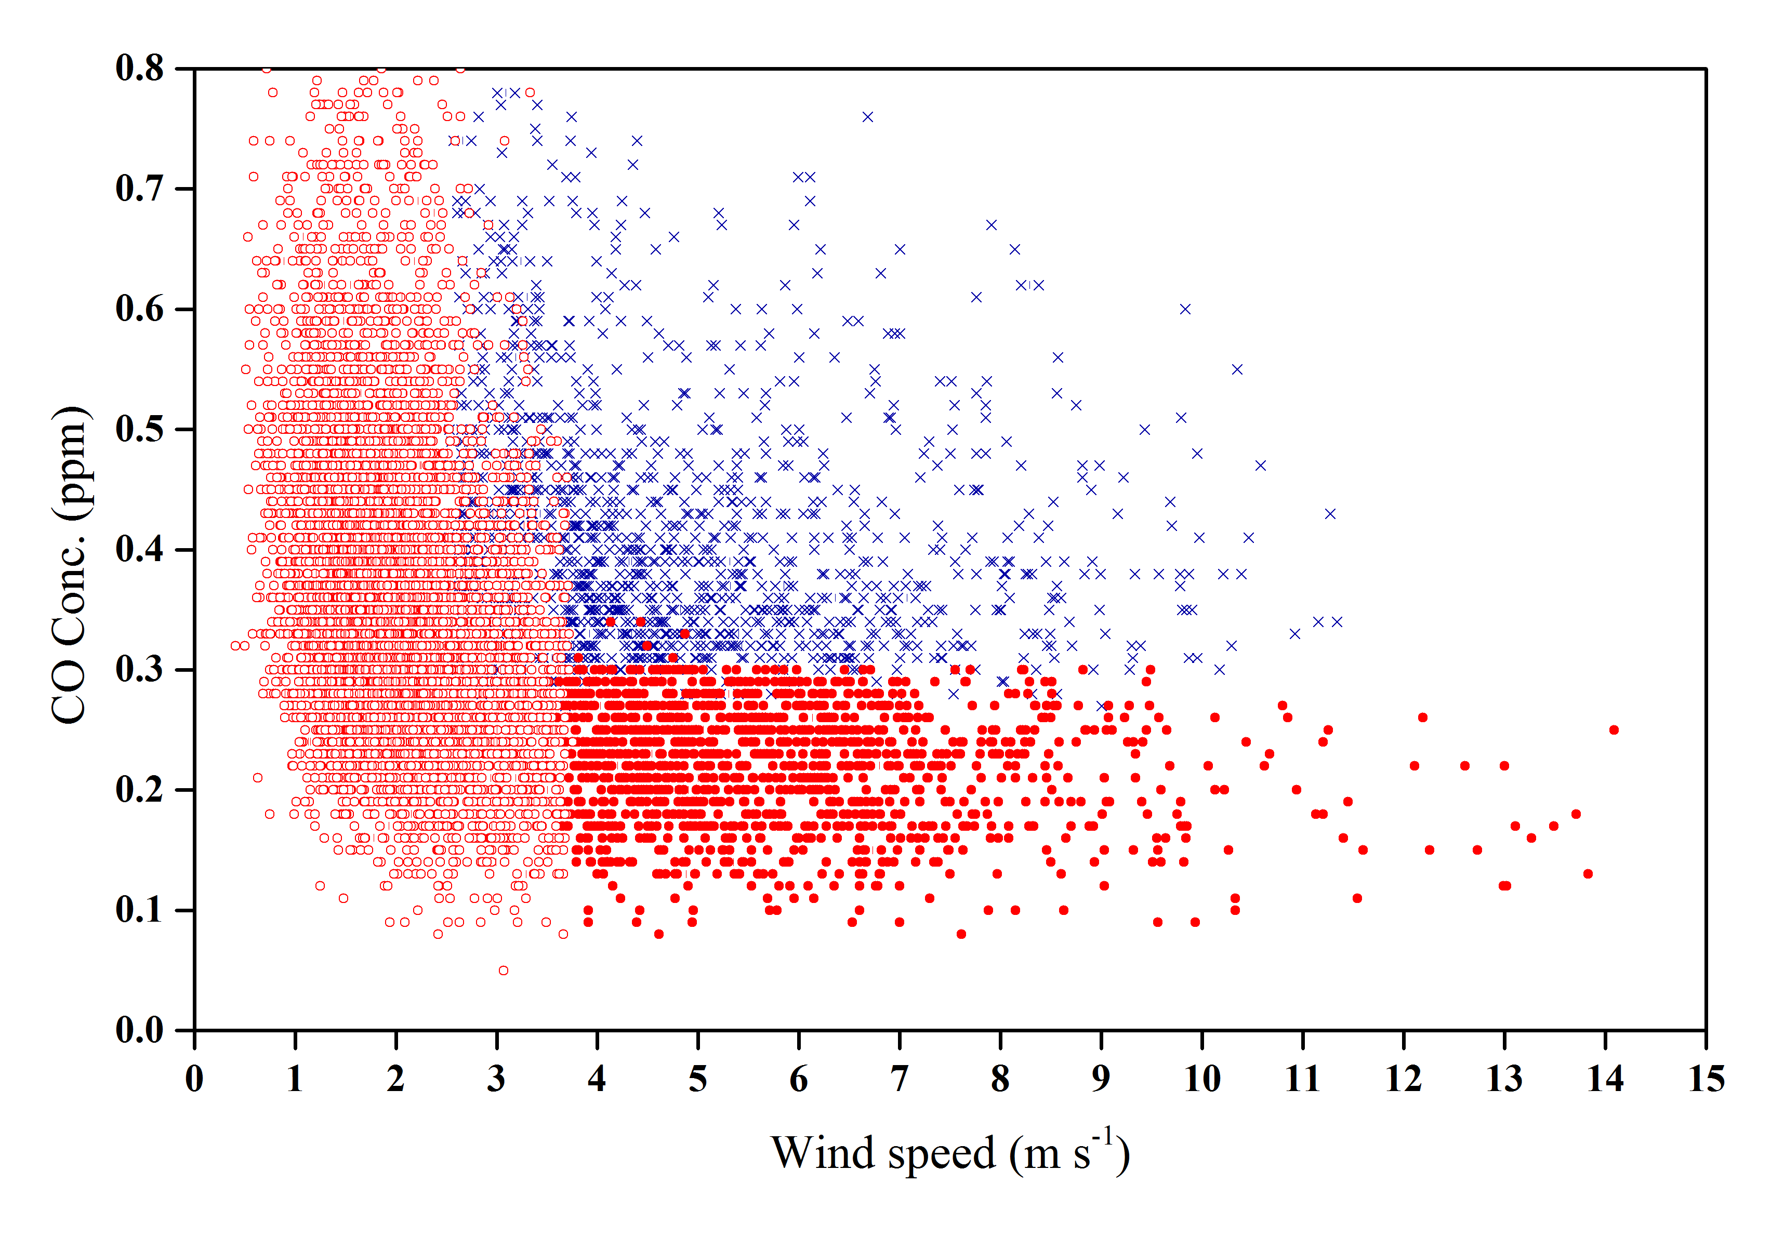
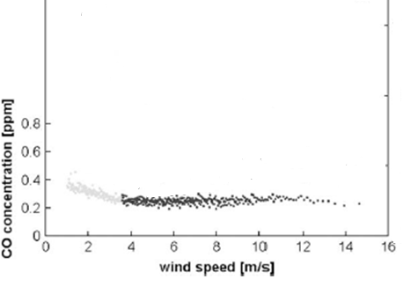
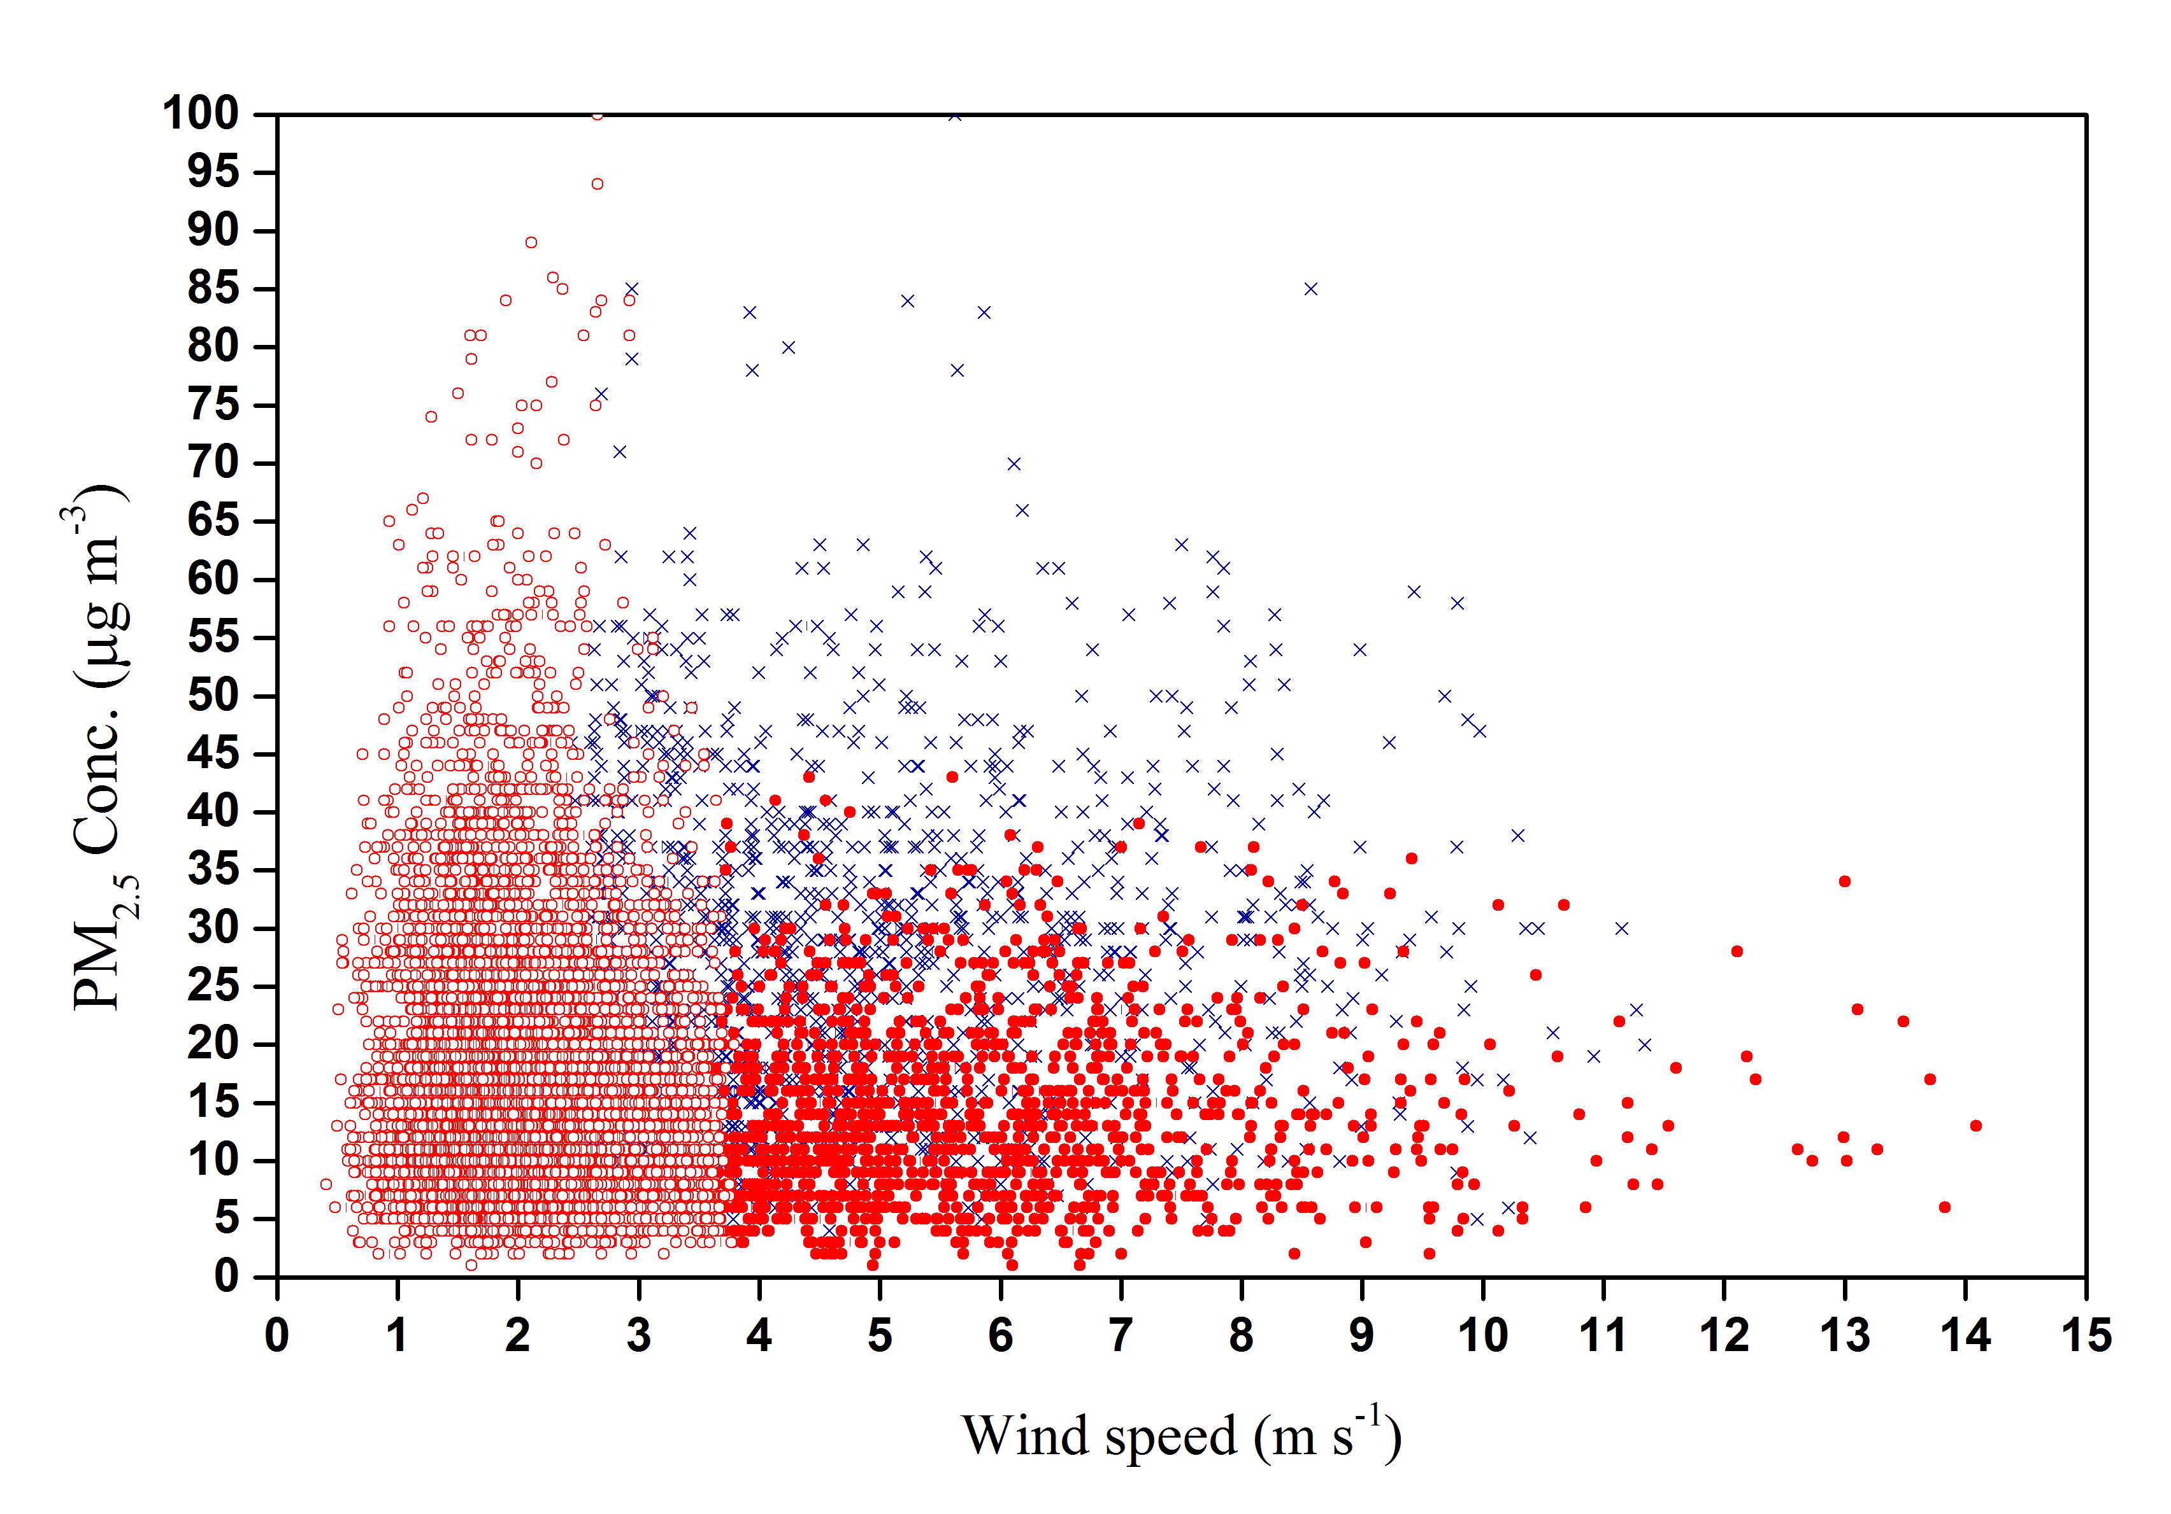

Threshold of wind speed
WL,DS,TS,KL,IL
2006.01~2015.12
Only WL
1993.09~2006.12
0.3 ppm
0.3 ppm
3.7 m s⁻¹
3.6 m s⁻¹
WL,DS,TS,KL,IL
2006.01~2015.12
Junker et al. (2009) (left) found that if WS is above a threshold value, CO concentration remained nearly constant, if WS is below the threshold value, CO is inversely proportional to WS. The constant CO is from LRT and CO inversely proportion to WS is from LP.
27 $μ$g m⁻³
3.7 m s⁻¹
Notes:
Junker et al. (2009) (left) found that if WS was above a threshold value, CO concentration remained nearly constant, if WS below the threshold value, CO were inversely proportionally to WS. The constant CO is from LRT and inversely proportioned CO is from LP.
So follow by Junker et al. (2009) and Chuang et al., (2008) method
Similar results (right) were found in this study and the threshold WS was about 3.7 m s ⁻¹ and the threshold CO was about 0.3 ppm.

Slide 5
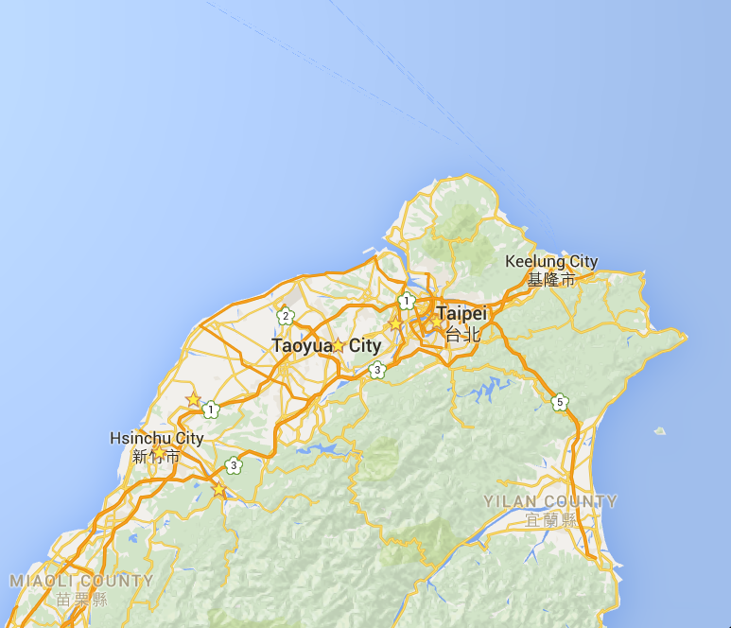
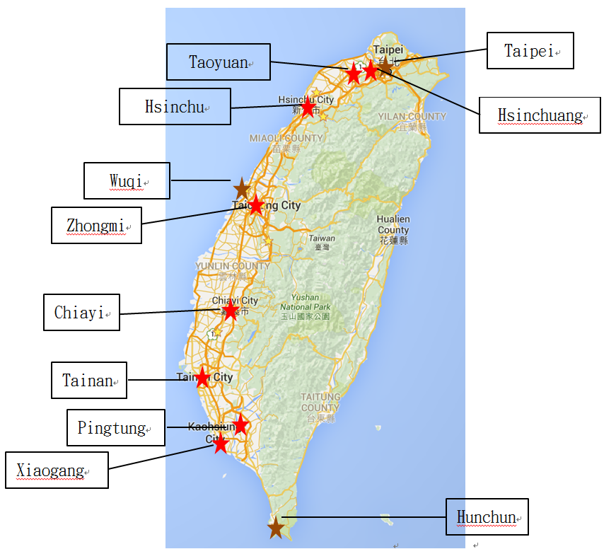
Observational data sets
Time series：2006.01.01 ~ 2015.12.31
Monitoring item ：CO、PM_{2.5}、wind speed、Wind Direction
Background station
PJY
TS
WL
KL
IL
DS
Notes:
Now, I start to describe detailed procedure.
This is observational data set.
Data is from January 2006 to December 2015.
Monitoering item include Carbon monoxide, PM_{2.5},Wind speed and wind direction.
So Use five northern station to calculate LRT PM_{2.5} concentration.
and Select representative station to estimate the proportion.

Slide 6
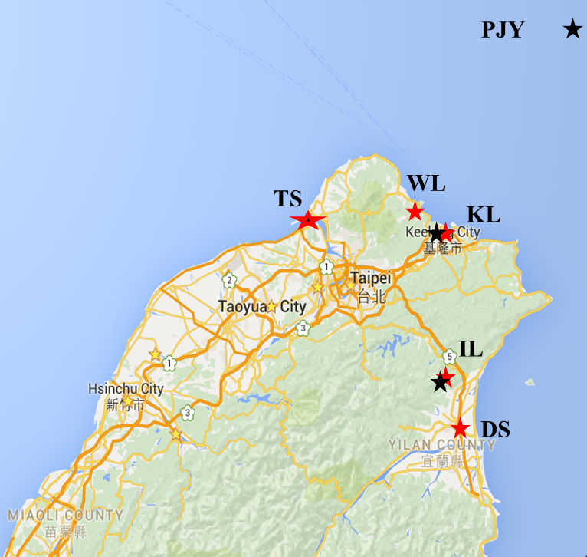
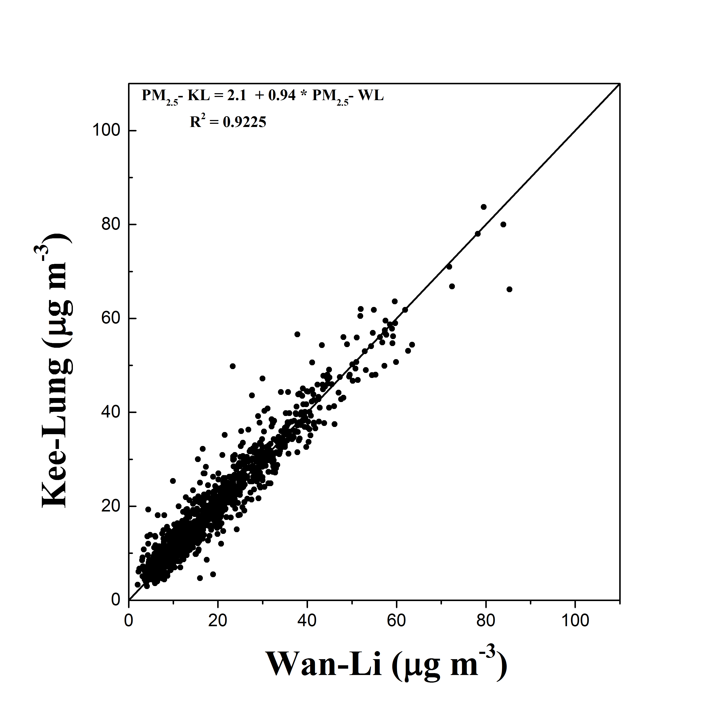
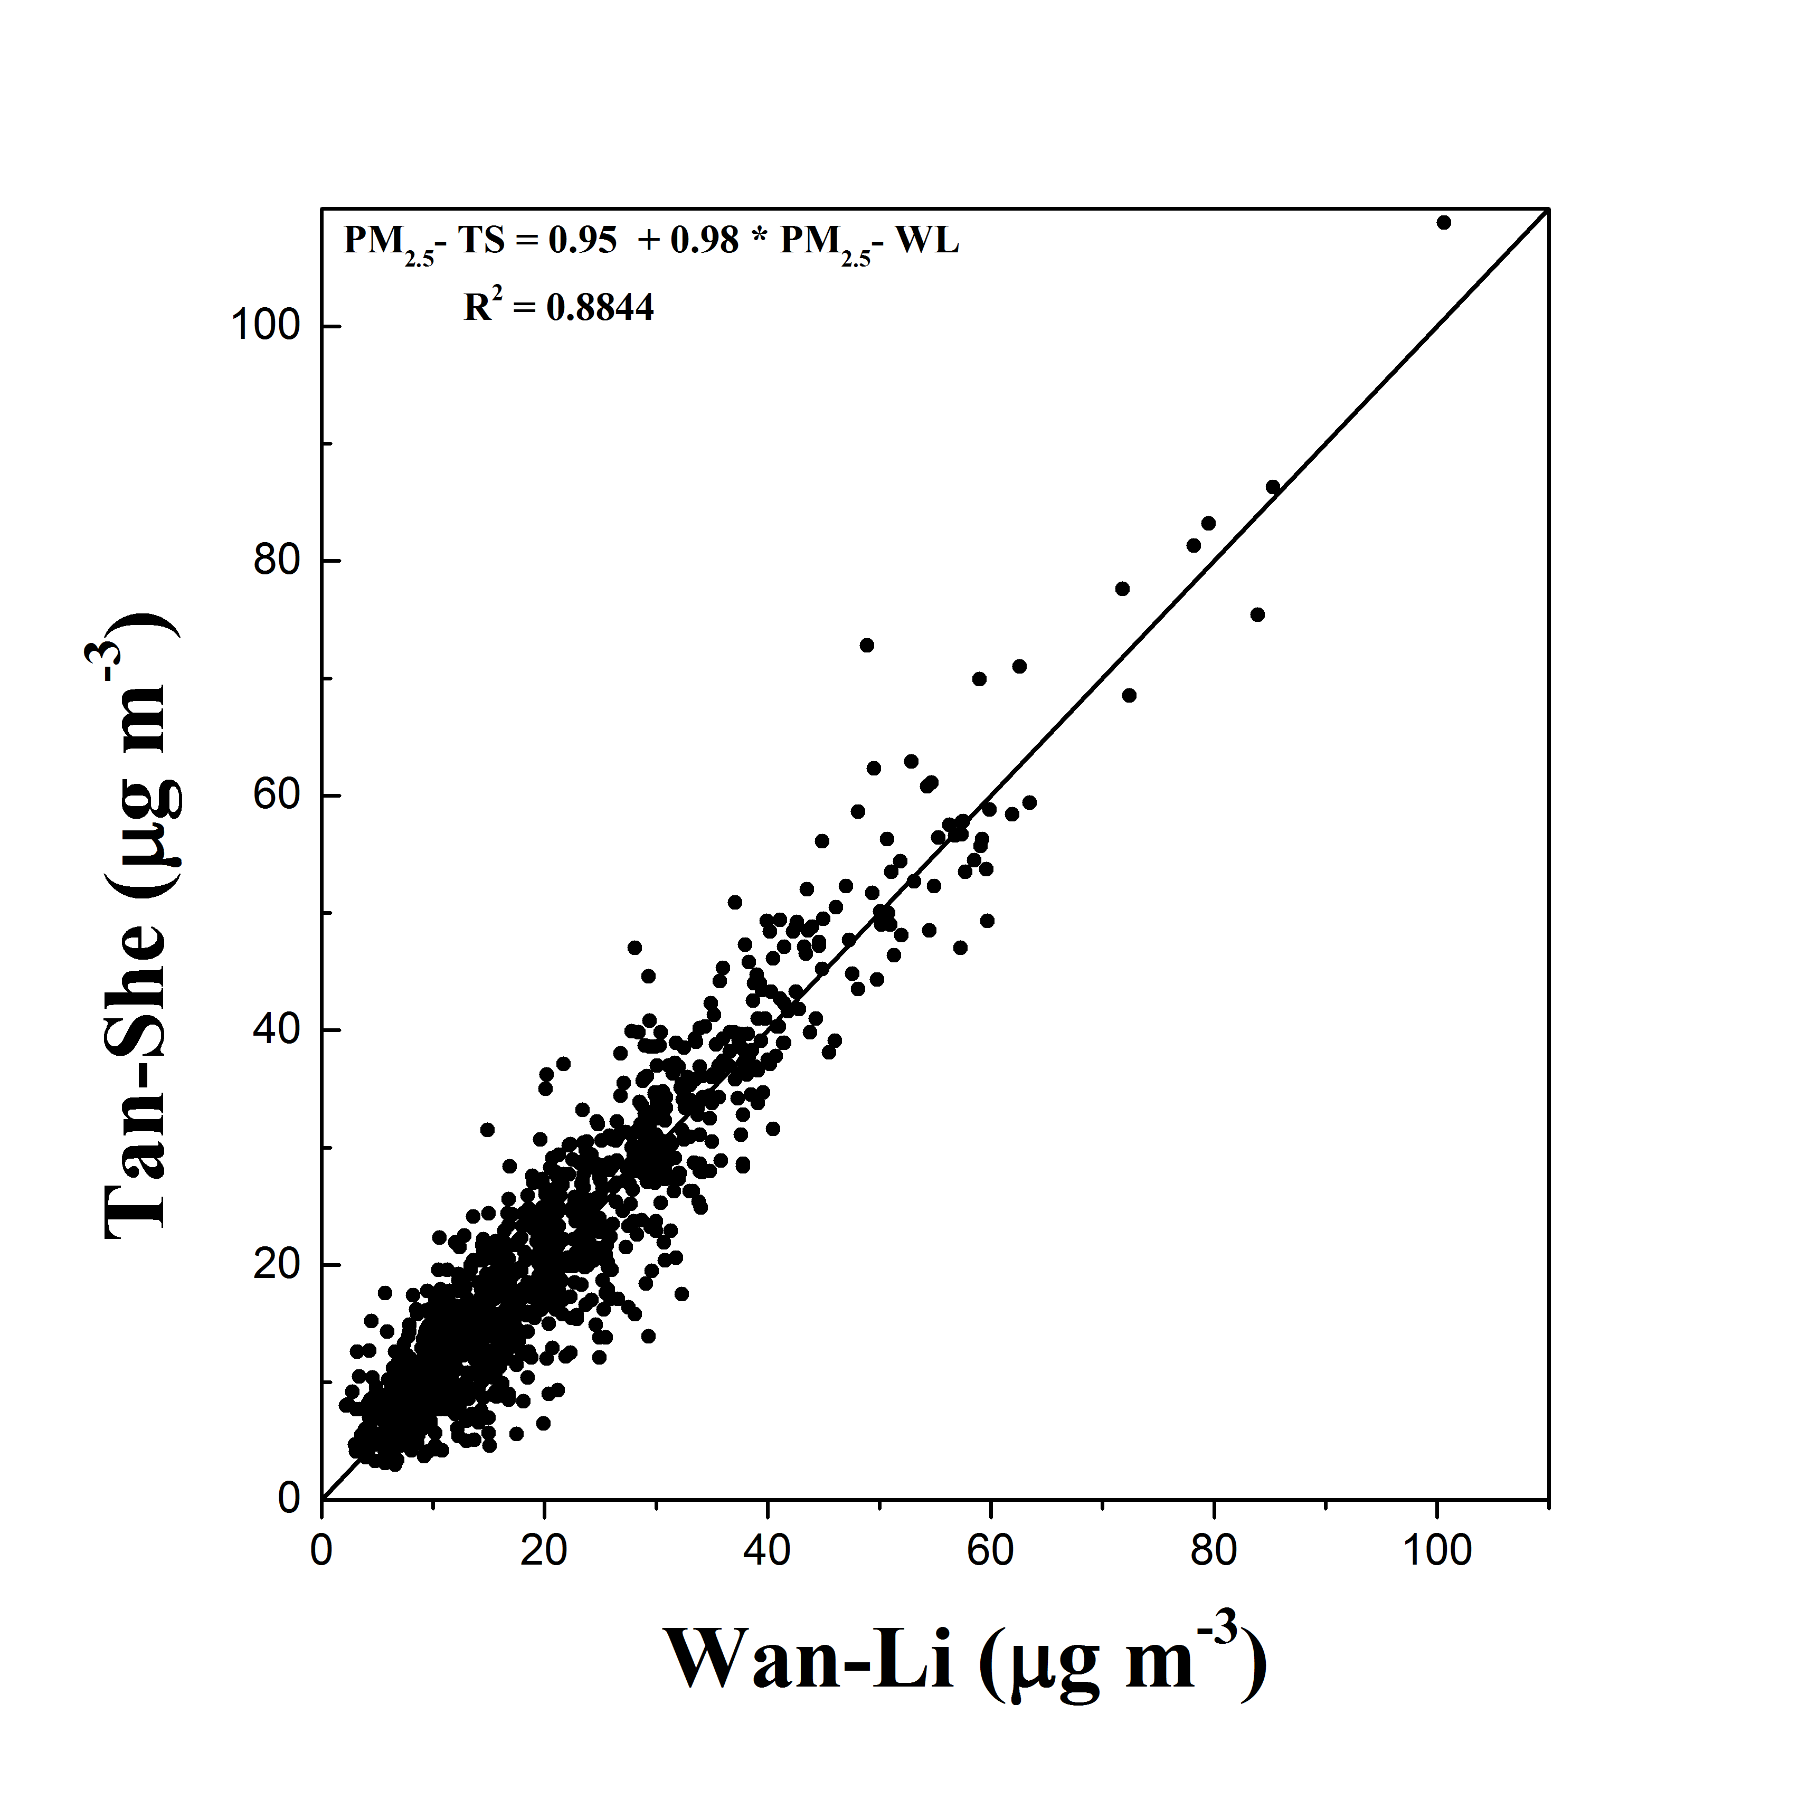
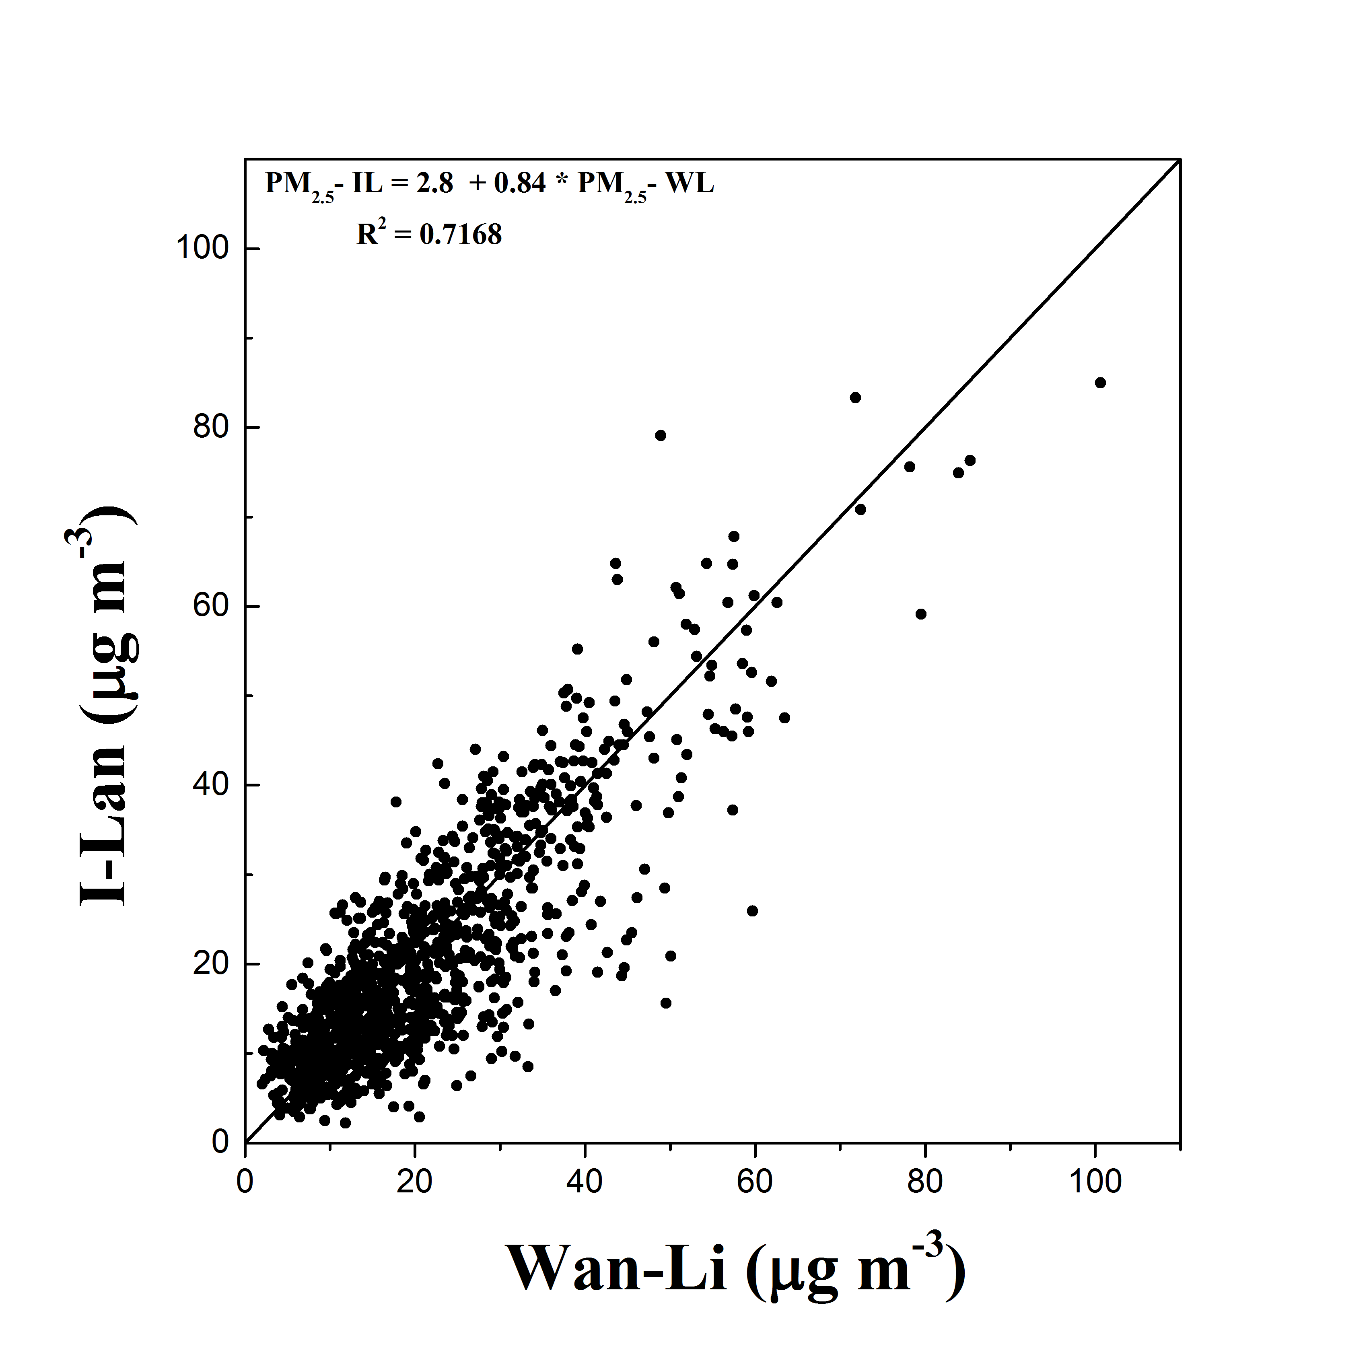

Verification of homogeneity
The correlation between wanli station and other stations is well established and R² is also above 0.7.
T-test don’t have significantly difference and represent pollution that is transported
in the form of plume.
8
Notes:
To prove the LRT plume transport from northern Taiwan to southern, we use wanli PM2.5 mass concentration and other station data to Carry on the regression analysis.
The correlation between wanli station and other stations is well established and R² is also above 0.75.
T-test don’t have remarkable difference and represent pollution that is transported.
in the form of plume.
The Animation can realize how the plume is transferred.

Slide 7
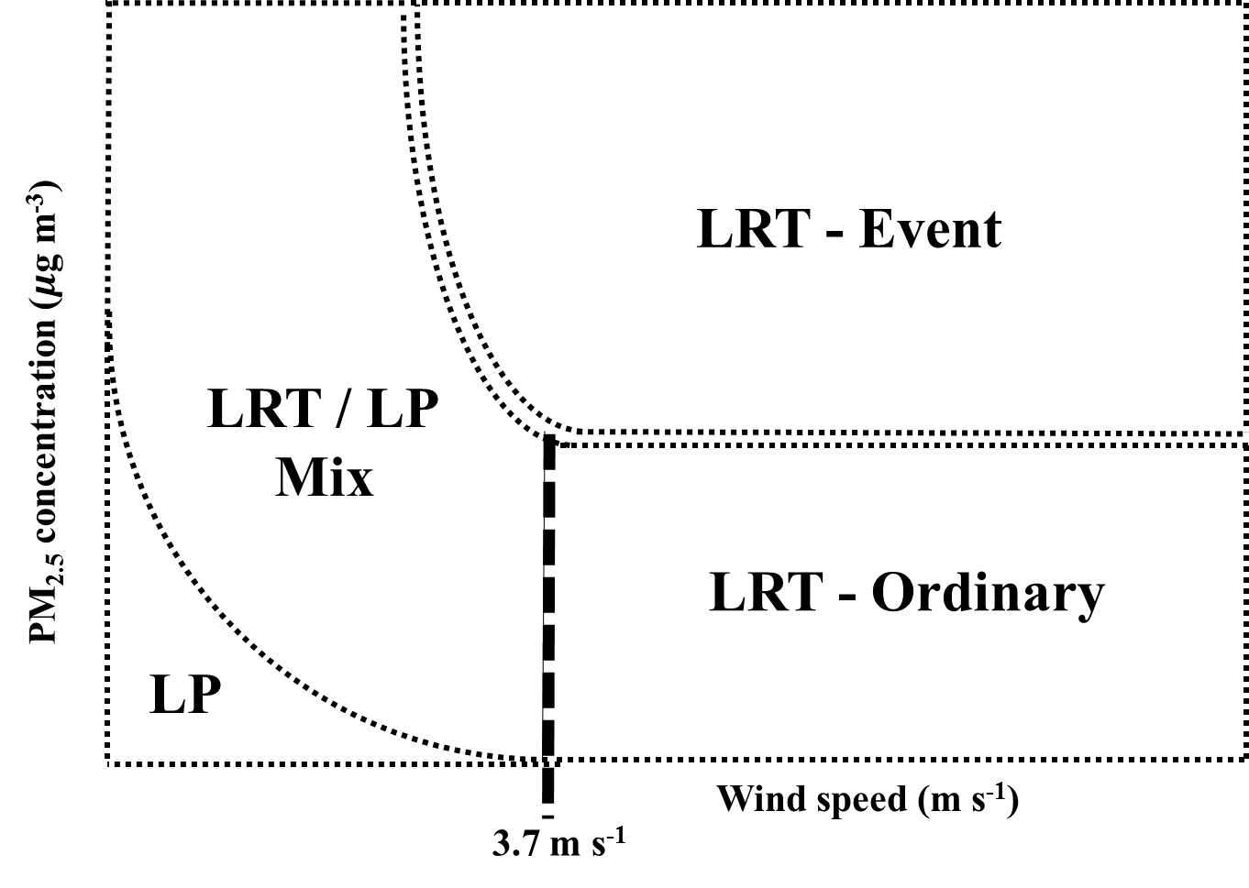
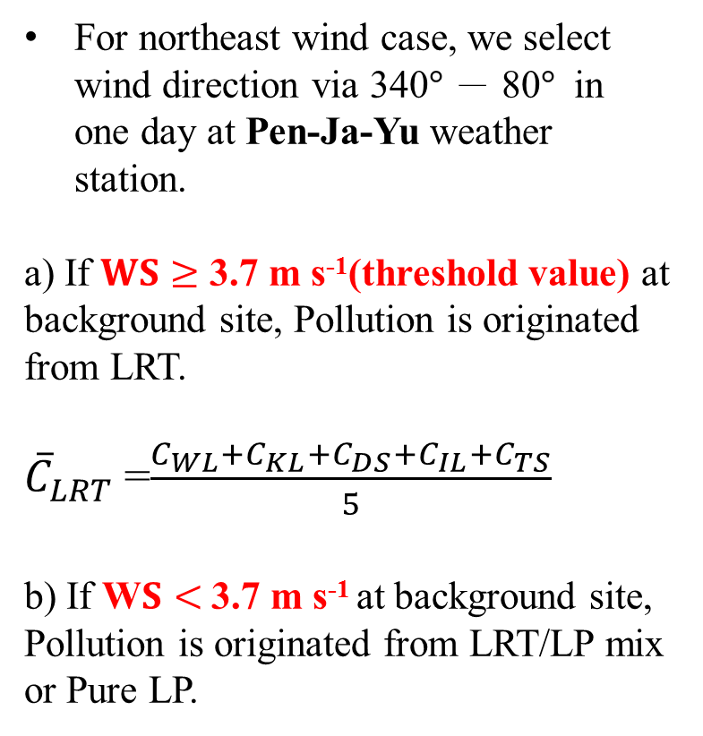
Calculate PM_{2.5} Concentration
First, find out the background PM_{2.5} Concentration in the long-range transport (LRT) situation at north tip of Taiwan.
WL,DS,TS,KL,IL (2006.01~2015.12)
For northeast wind case, we select wind direction via 340$°$ － 80$°$ in one day at Pen-Ja-Yu weather station.
a) If $WS≥$ 3.7 m s⁻¹(threshold value) at background site, Pollution is originated from LRT.
${\overline{C}}_{LRT}$=$\frac{C_{WL}+C_{KL}+C_{DS}+C_{IL}+C_{TS}}{5}$
b) If W$S<$3.7 m s⁻¹ at background site, Pollution is originated from LRT/LP mix or Pure LP.
9
Notes:
After I will introduce How to calculate PM2.5 concentration.
First, find out the background PM_{2.5} Concentration in the long-range transport (LRT) situation at north tip of Taiwan.
For northeast wind case, we select wind direction via 340$°$ － 80$°$ in one day at Pen-Ja-Yu weather station.
If $WS≥$ 3.7 m s⁻¹(threshold value) at background site, Pollution is originated from LRT.
In the situation, the long range transport concentration is the average of five station.

Slide 8
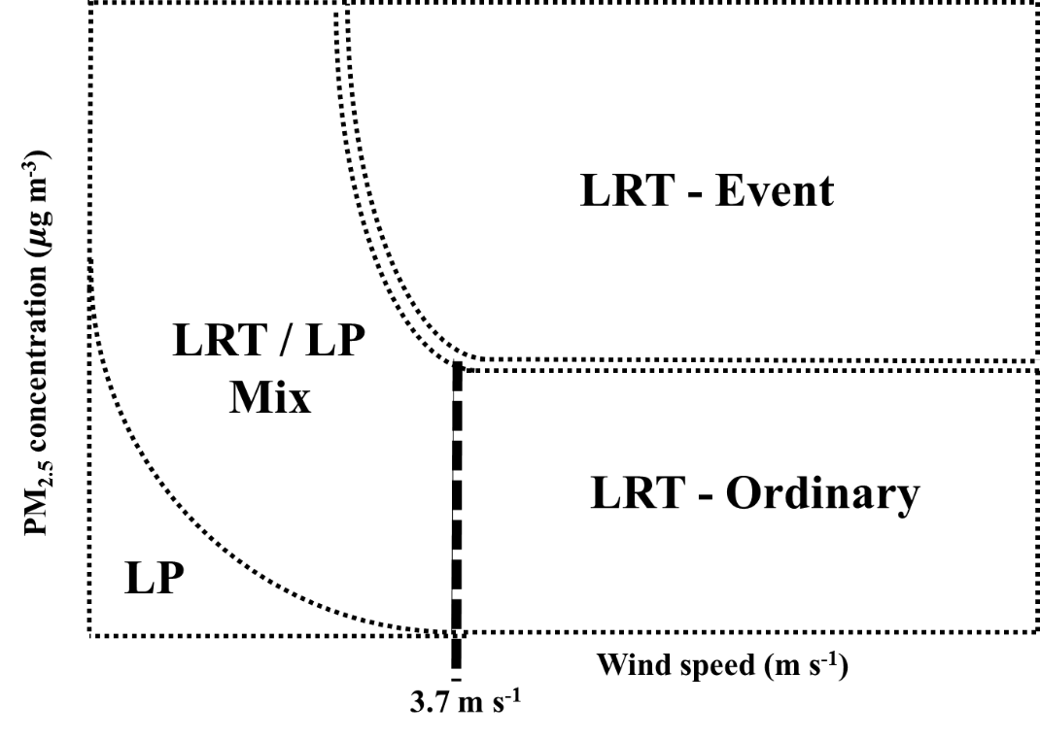


Calculate PM_{2.5} Concentration
Second, calculate PM_{2.5} concentration from different sources of pollution.
WL,DS,TS,KL,IL (2006.01~2015.12)
Type 1：LRT (included Event and Ordinary)
At the northern tip, we exclude the rainfall case.
C = C_{LRT}
C_{LP} = 0
For other places, if we neglect the impact of deposition and diffusion of LRT plume during the transport over western Taiwan
C_{LRT} = C_{LRT}
C_{LP} = C - C_{LRT}
10
Notes:
According to the concept of the first and second steps,
the third step is how to calculate PM_{2.5} concentration from different sources of pollution.
Introduce type1：Long range transport case
Assumed that LRT concentration reduction of Pollution is neglected and exclude the rainfall case.
So the LRT concentration is the same from north to south.
However , PM_{2.5} concentration(C₁) measures over land downstream, which can be obtained either in Taipei, Taichung, Tainan, or Kaohsiung.
C1 minus CLRT can get local pollution concentration.

Slide 9
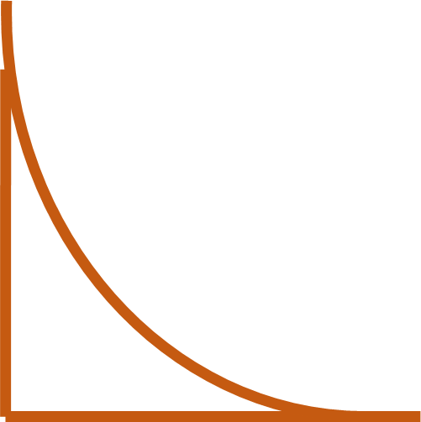
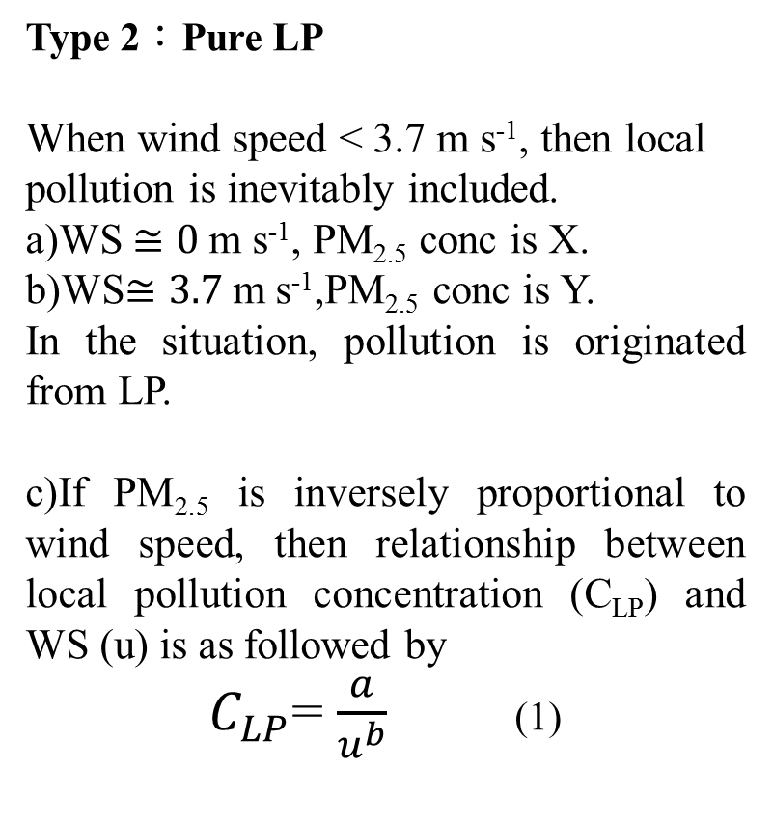
Calculate PM_{2.5} Concentration
Second, find out the Pure local PM_{2.5} Concentration (C_{LP}) .
Type 2：Pure LP
When wind speed < 3.7 m s⁻¹, then local pollution is inevitably included.
a)WS $≅0$m s⁻¹, PM_{2.5} conc is X.
b)WS$≅3.7$m s⁻¹,PM_{2.5} conc is Y.
In the situation, pollution is originated from LP.
c)If PM_{2.5} is inversely proportional to wind speed, then relationship between local pollution concentration (C_{LP}) and WS (u) is as followed by
$C_{LP}$= $\frac{a}{u^{b}}$ (1)
WL,DS,TS,KL,IL (2006.01~2015.12)
X
Y
11
Notes:
Second, find out the Pure local PM_{2.5} Concentration (C_{LP}) .
When WS is about $0$per second meter,PM2.5 concentration is X, WS is about $3.7$per second meter,PM2.5 concentration is Y
In the brown area, pollution is originated from LP.
If PM_{2.5} is inversely proportional to wind speed, then relationship between local pollution concentration (C_{LP}) and WS (U_{t}) is as followed by

Slide 10
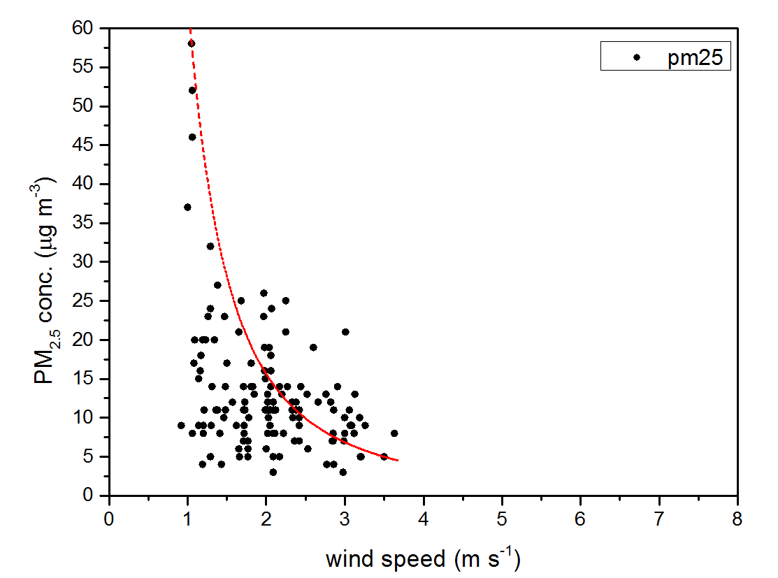
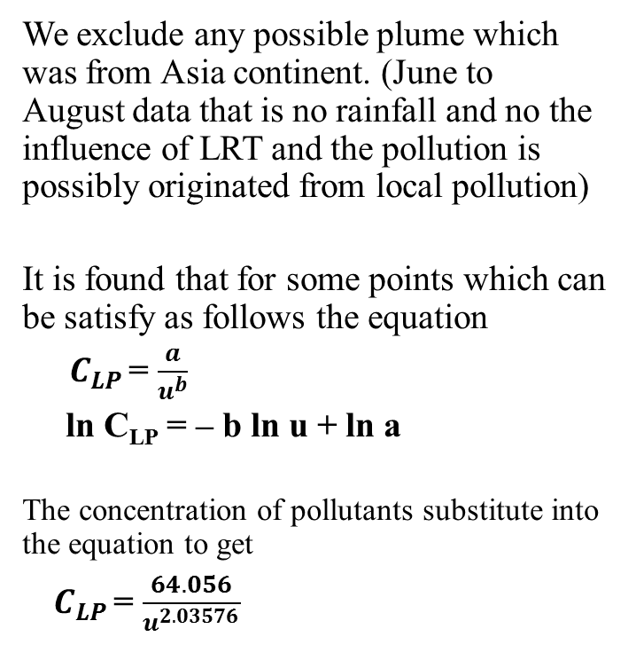
Calculate PM_{2.5} Concentration
WL,DS,TS,KL,IL (2006.01~2015.12)
We exclude any possible plume which was from Asia continent. (June to August data that is no rainfall and no the influence of LRT and the pollution is possibly originated from local pollution)
It is found that for some points which can be satisfy as follows the equation
${ C}_{LP }$= $\frac{a}{u^{b}}$
ln C_{LP} = – b ln u + ln a
The concentration of pollutants substitute into the equation to get
${ C}_{LP }$= $\frac{64.056}{u^{2.03576}}$
C_{LRT} = 0
C = C_{LP}
Notes:
Then, How to get the local pollution concentration equation?
We select summer cases (June to August) that is no rainfall and no the influence of LRT and the pollution is possibly originated from local pollution.
It is found point that can be simplified as follows the equation
The concentration of pollutants substitute into the equation to get

Slide 11
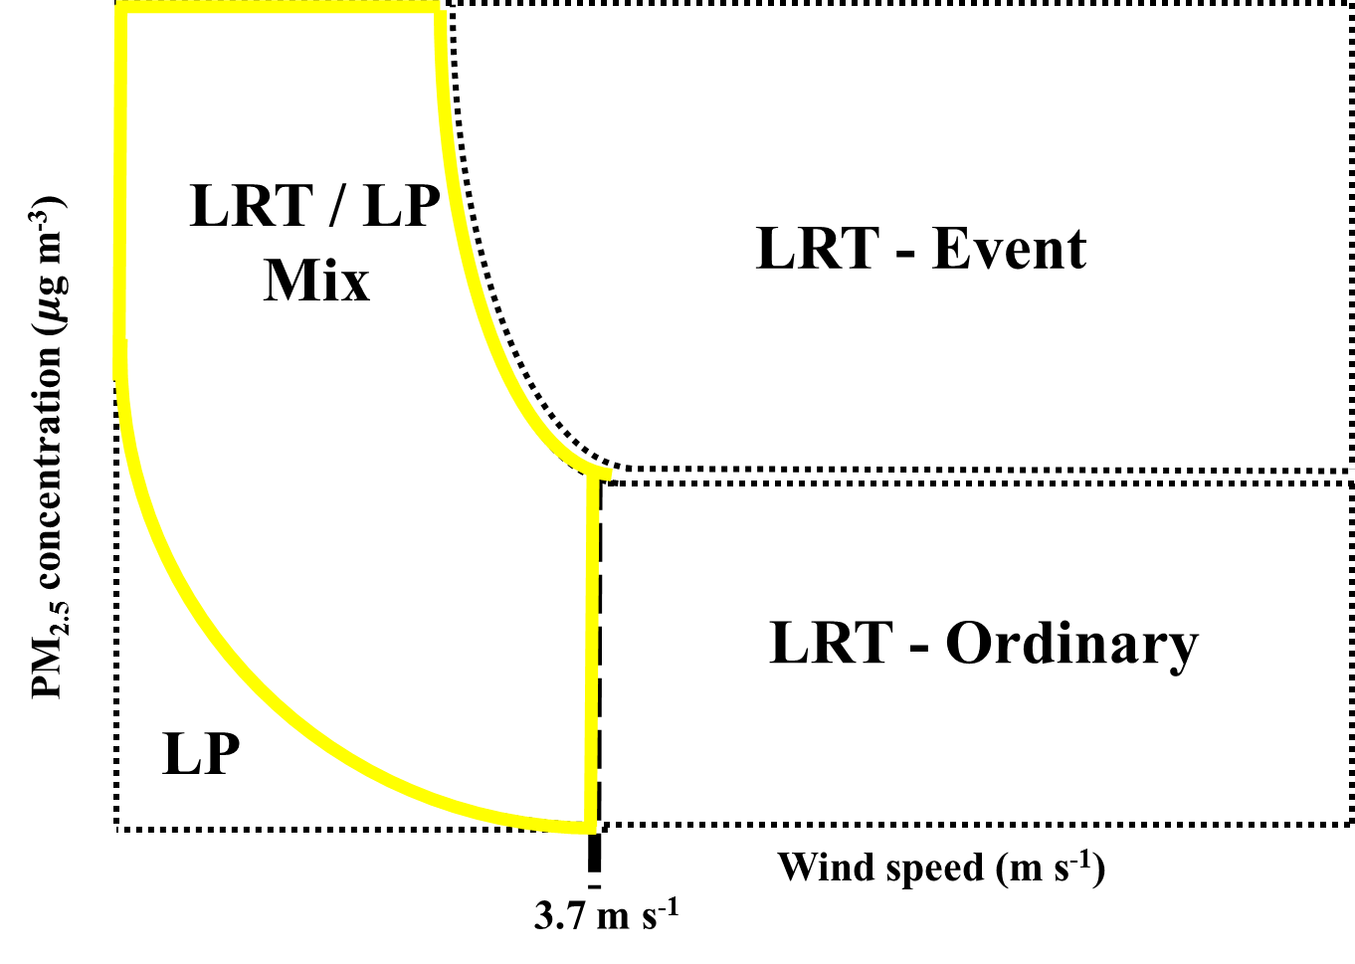
Calculate PM_{2.5} Concentration
Third, calculate PM_{2.5} concentration from different sources of pollution.
WL,DS,TS,KL,IL (2006.01~2015.12)
Type 3：LRT/LP Mix
When WS is u_{LRT/LP} , PM_{2.5} concentration is C1. We use the equation (1) to calculate PM_{2.5} concentration of LP, which is C_{1LP.}
C_{LP} = C_{1LP}
C_{LRT} = C₁ – C_{1LP}
For other places, if we neglect the impact of deposition and diffusion of LRT plume
C_{LRT} = C_{LRT}
C_{LP} = C₂- C_{LRT}
C₁
C_{1LP}
u_{LRT/LP}
13
Notes:
`Next
Type 2 is mix.
We use the aforementioned equation (1) to calculate PM_{2.5} concentration of LP, which is C_{2LP.}
If PM_{2.5} concentration is C_{2 ,}
C₂ minus C_{2LP} can get C_{LRT} in mix type.
Finally
Type 3 is Pure Local pollution.
The situation is no LRT concentration.
Therefore, the concentration is local pollution.

Slide 12
The above method still needs improvement
The above calculation could not express three terms and would overestimate the impact of LRT.
  The diffusion of LRT pollutants transporting from Taiwan northern tip to southern Taiwan.
  The deposition of LRT pollutants along the transport from north to south.
  The chemical reactions of LRT pollutants and LP pollutants.
Therefore we use two sensitivity test, with existence of local emission. and non-existence of local emissions. The difference can explain the deposition and diffusion mentioned above.
It is expected the impact of chemical reactions of LRT and LP pollutants is not important for LRT-event and LRT-ordinary cases since the LRT plume transport very fast from north to south and the reaction time is short.
Notes:
However the Long range transport PM2.5 will be reduced during the transmission procedure.
So I use the simulation data to discuss long range transport concentration reduction of Pollution from north to South .
Choose the 2010 to simulate because the emission data is complete.
In current, we only choose HPP case that exclude from rainfall case and to evaluate reduced ratio.

Slide 13
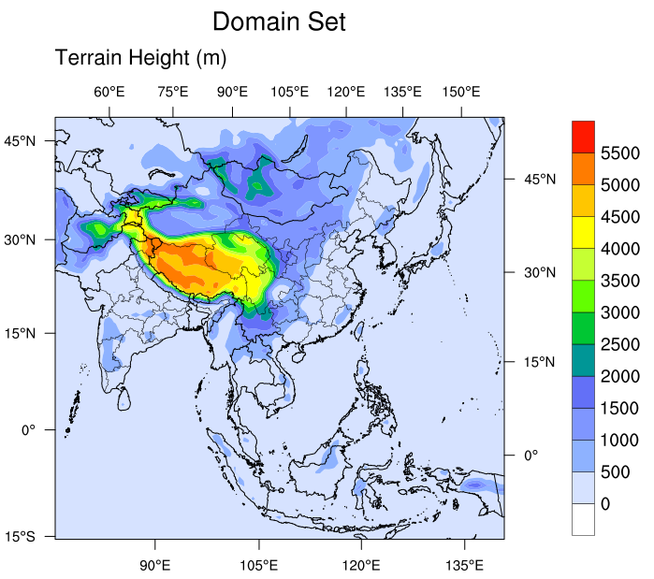
Simulation
Simulation time：
2010.01~2010.03
Emission data：
MICS – Asia 2010
(No Taiwan emission)
Horizontal resolution：
81km(d01)、27km(d02)
9km(d03)、3km(d04)
Vertical resolution ：
41 Sigma
WRF version：V3.7.1
CMAQ version：V5.1
D02
D04
D03
D02
D01
Notes:
However the Long range transport PM2.5 will be reduced during the transmission procedure.
So I use the simulation data to discuss long range transport concentration reduction of Pollution from north to South .
Choose the 2010 to simulate because the emission data is complete.
In current, we only choose HPP case that exclude from rainfall case and to evaluate reduced ratio.

Slide 14
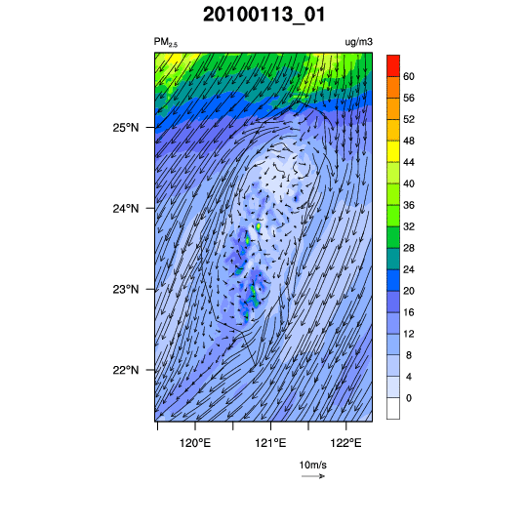
16

Slide 15
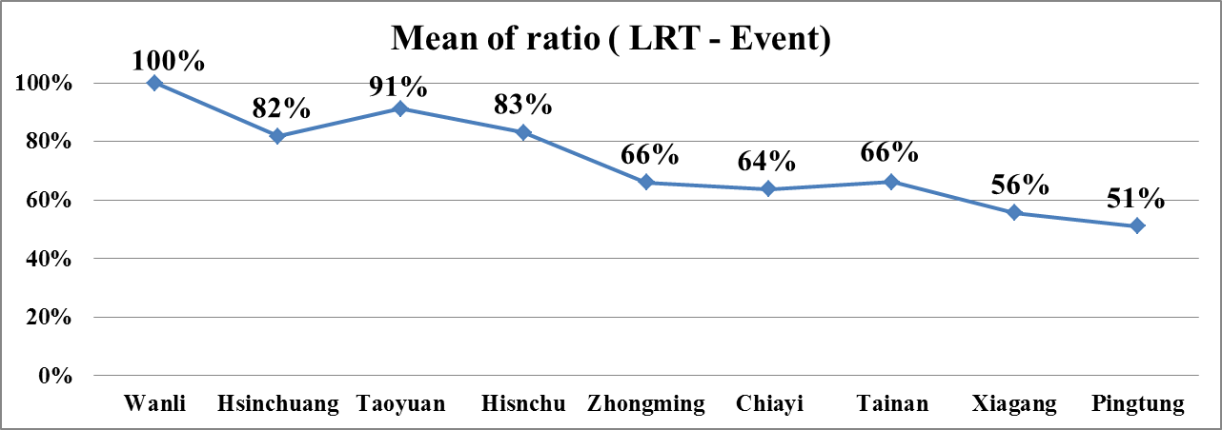
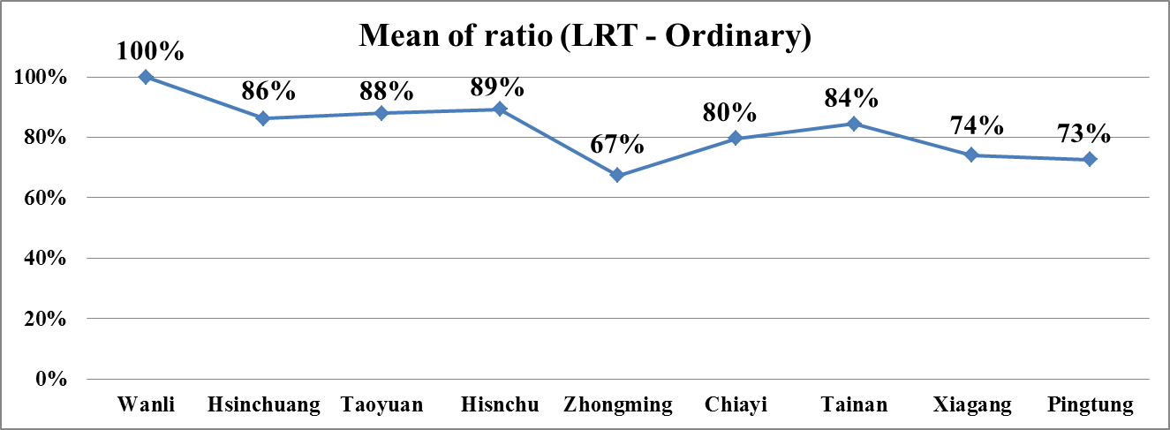
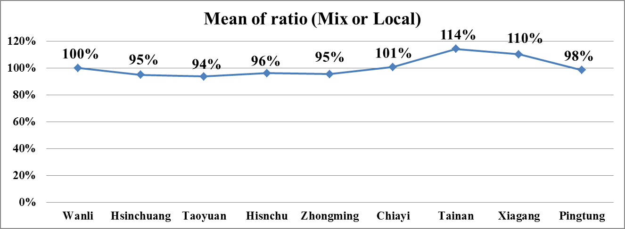
The reduced proportion of LRT PM_{2.5}
(North)
(Central)
(South)
17
Notes:
This simulation result that the impact of deposition and diffusion can reduced the LRT pm2.5 concertraion
We can see the curve that gradually decrease from northern to southern Taiwan.

Slide 16
None modification
Modification
Station | Sample number (none) | LRT(none) | LP(none) | Sample number (consideration) | LRT (consideration) | LP (consideration)
Hsinchuang | 1153 | 18±13 (68±27%) | 7±7 (32±27%) | 1297 | 16±11 (63±22%) | 9±7 (37±23%)
Taoyuan | 1176 | 18±13 (68±27%) | 8±7 (32±27%) | 1293 | 17±12 (64±25%) | 9±8 (36±25%)
Hsinchu | 1330 | 18±13 (60±24%) | 11±8 (40±24%) | 1352 | 16±11 (54±21%) | 13±8 (46±21%)
Zhongming | 1216 | 17±12 (53±27%) | 16±13 (47±27%) | 1340 | 13±9 (41±21%) | 19±12 (59±21%)
Chiayi | 1415 | 18±13 (39±22%) | 28±15 (61±22%) | 1430 | 14±9 (31±17%) | 32±16 (69±17%)
Tainan | 1391 | 18±12 (41±22%) | 25±13 (59±22%) | 1410 | 14±9 (35±18%) | 28±13 (65±18%)
Xiaogang | 1421 | 18±12 (34±21%) | 35±18 (66±21%) | 1444 | 13±8 (26±16%) | 40±18 (74±16%)
Pingtung | 1381 | 17±12 (37±23%) | 30±16 (63±23%) | 1424 | 12±7 (28±17%) | 35±16 (72±17%)
North
Central
South
overestimation
modification
Notes:
The left part don’t consider the dilute of concentration and the right part have consideration.
We can find that the contribution of LRT and LP will overestimate and underestimate under the non- modified situation.

Slide 17
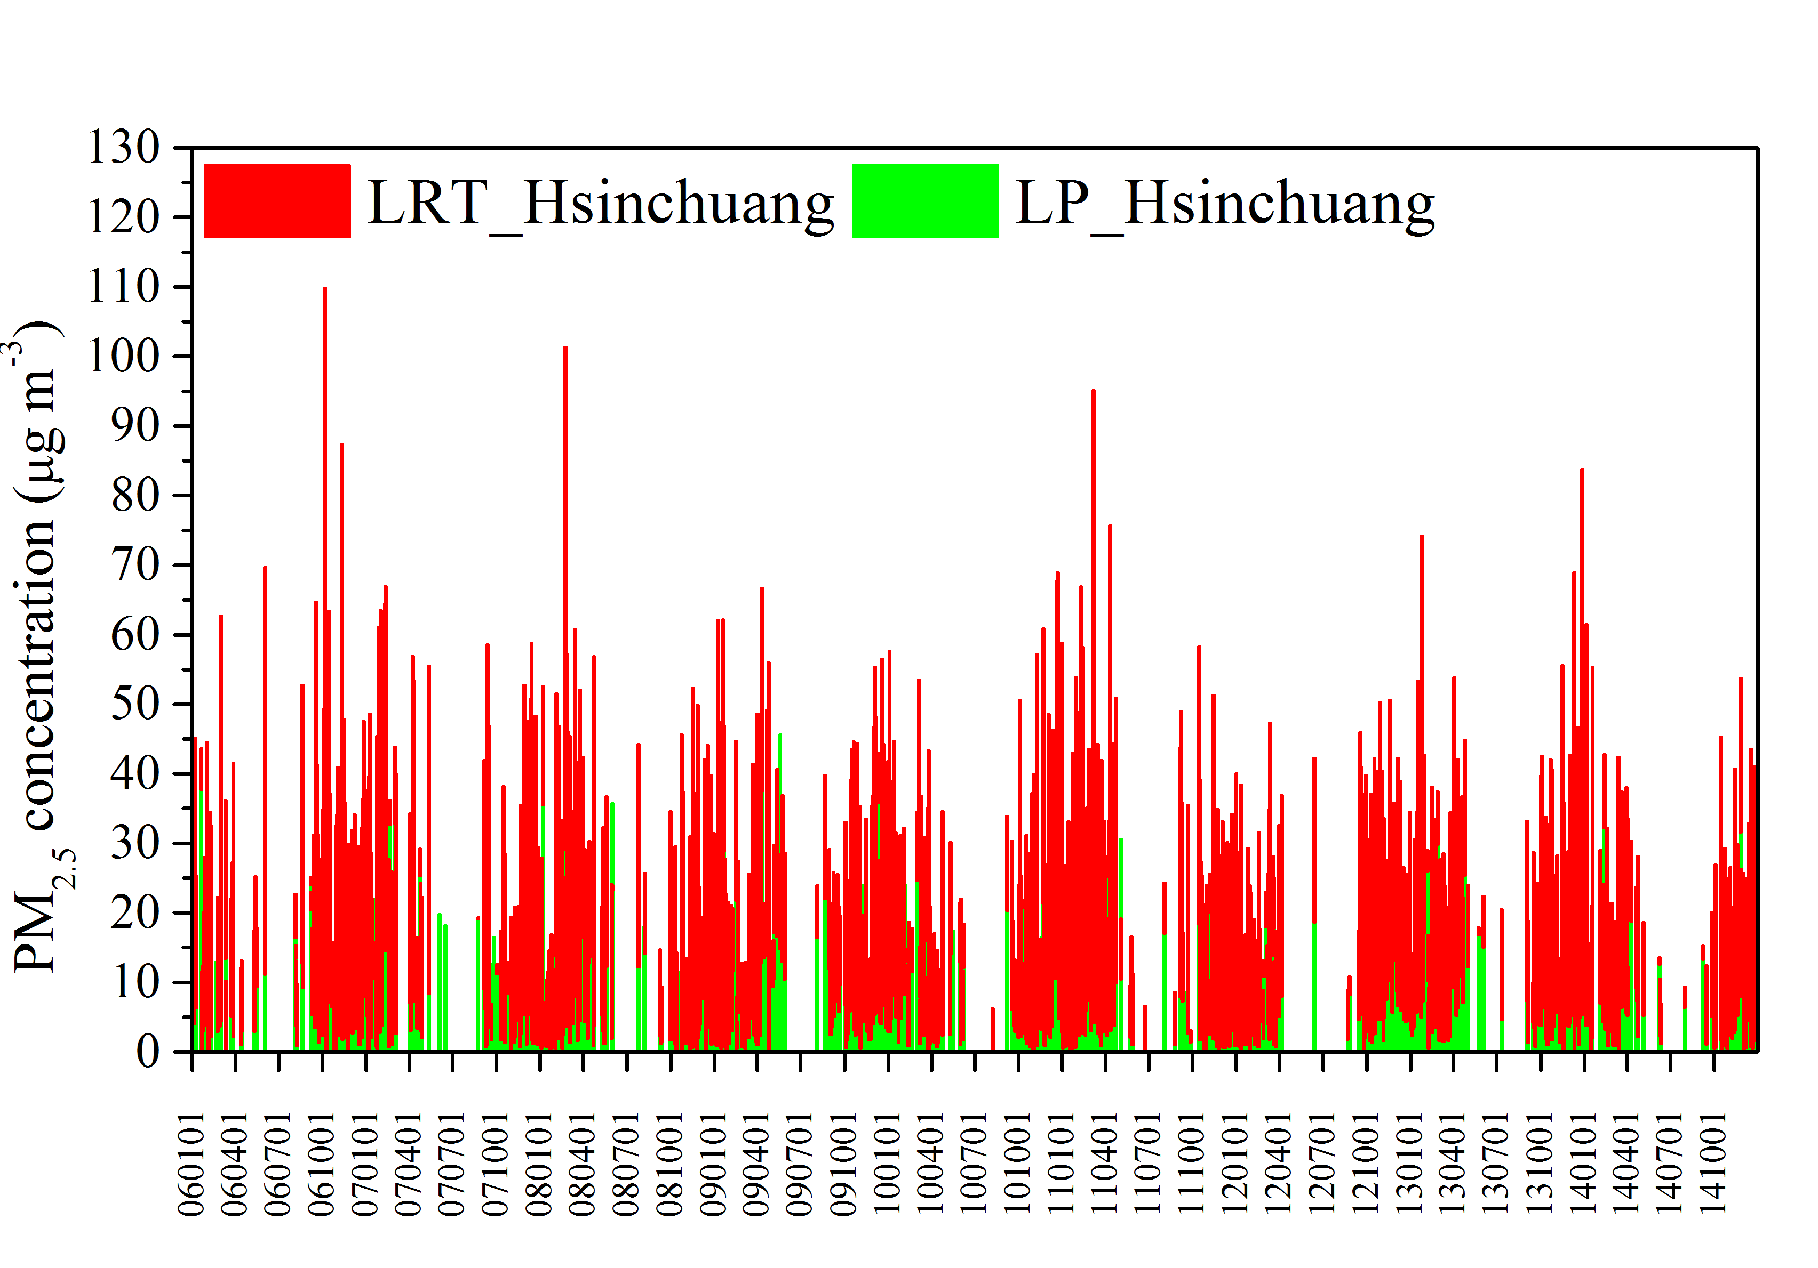
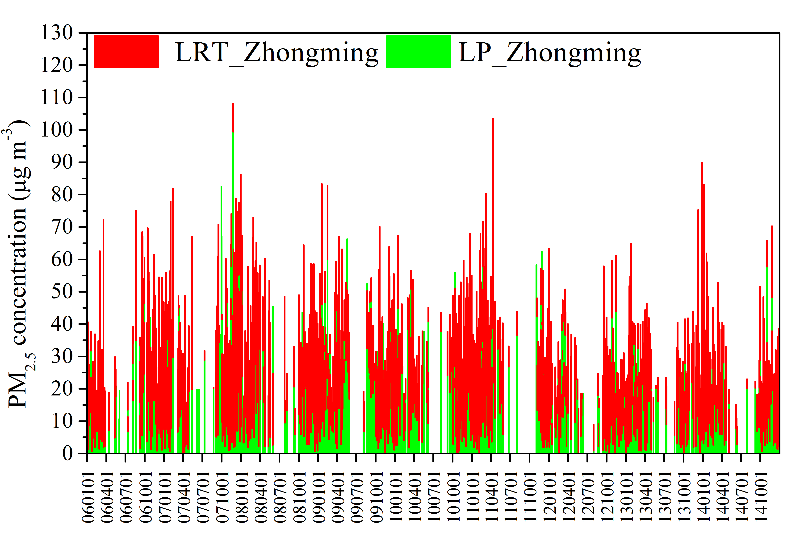
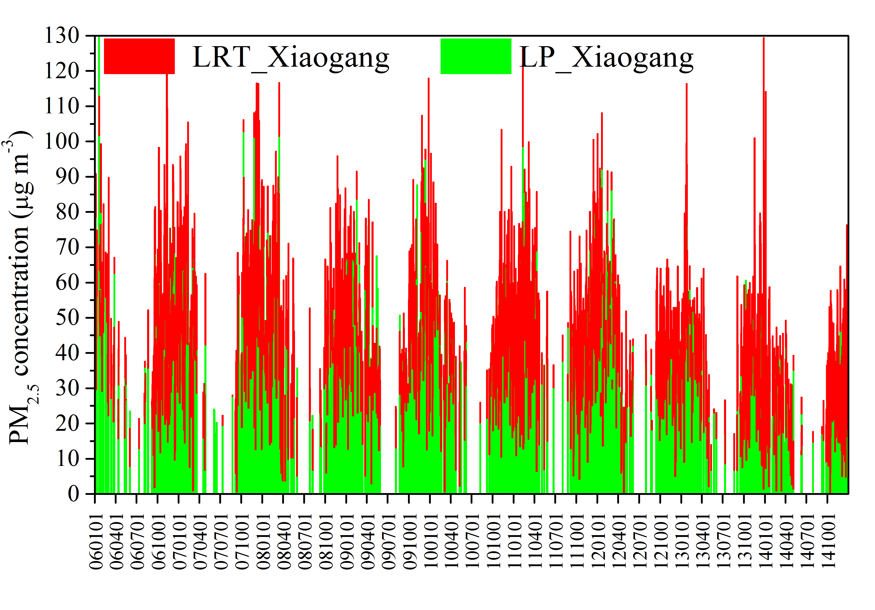
The contribution of LRT and LP (none)
Hsin-Zhuang
(Taipei,
North Taiwan)
Zhong-Ming
(Taichung,
Central Taiwan)
Xiao-Gang
(Kaoshung,
Southern Taiwan)
19
Notes:
We can see the obvious change from concentration time series diagram.
Red represent LRT and Green is local pollution.
First is northern station
Middle is central station
Last is southern station
Red gradually decrease and Green increase.

Slide 18
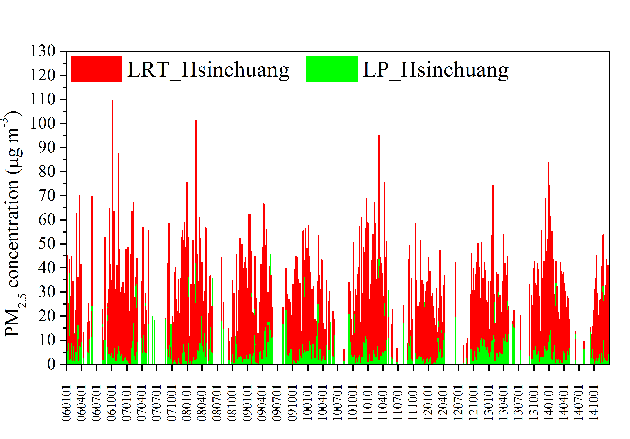
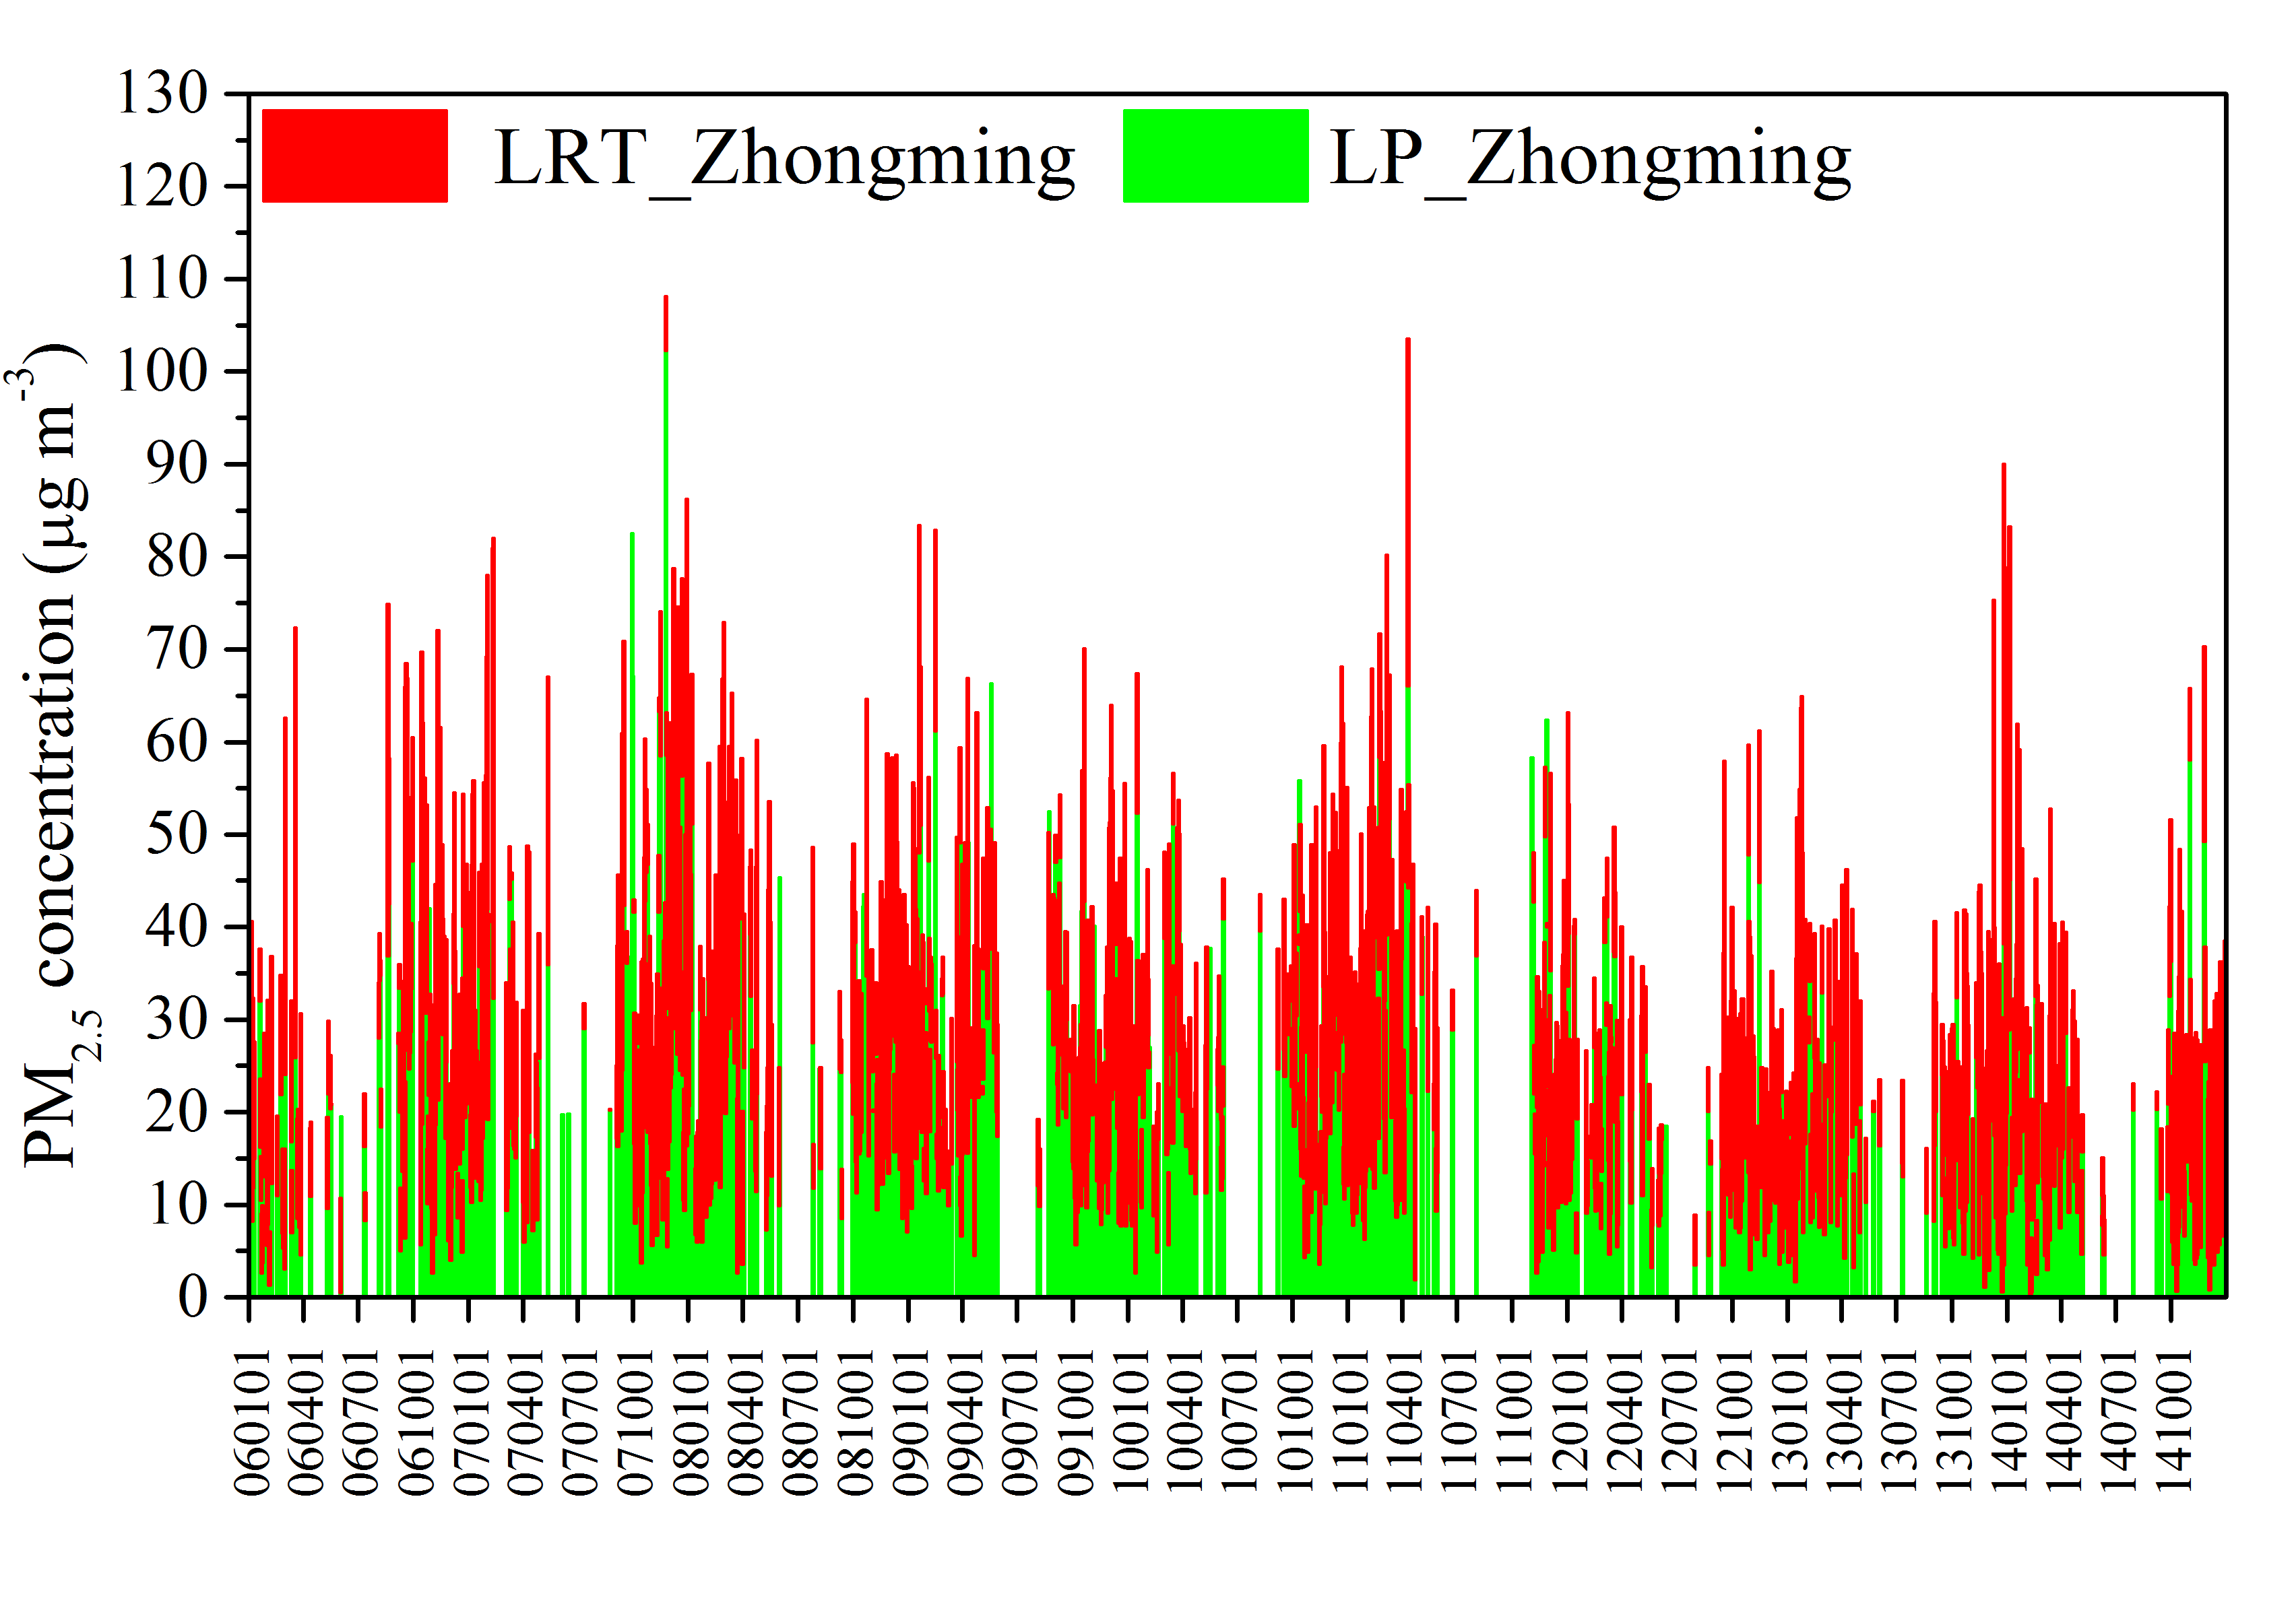
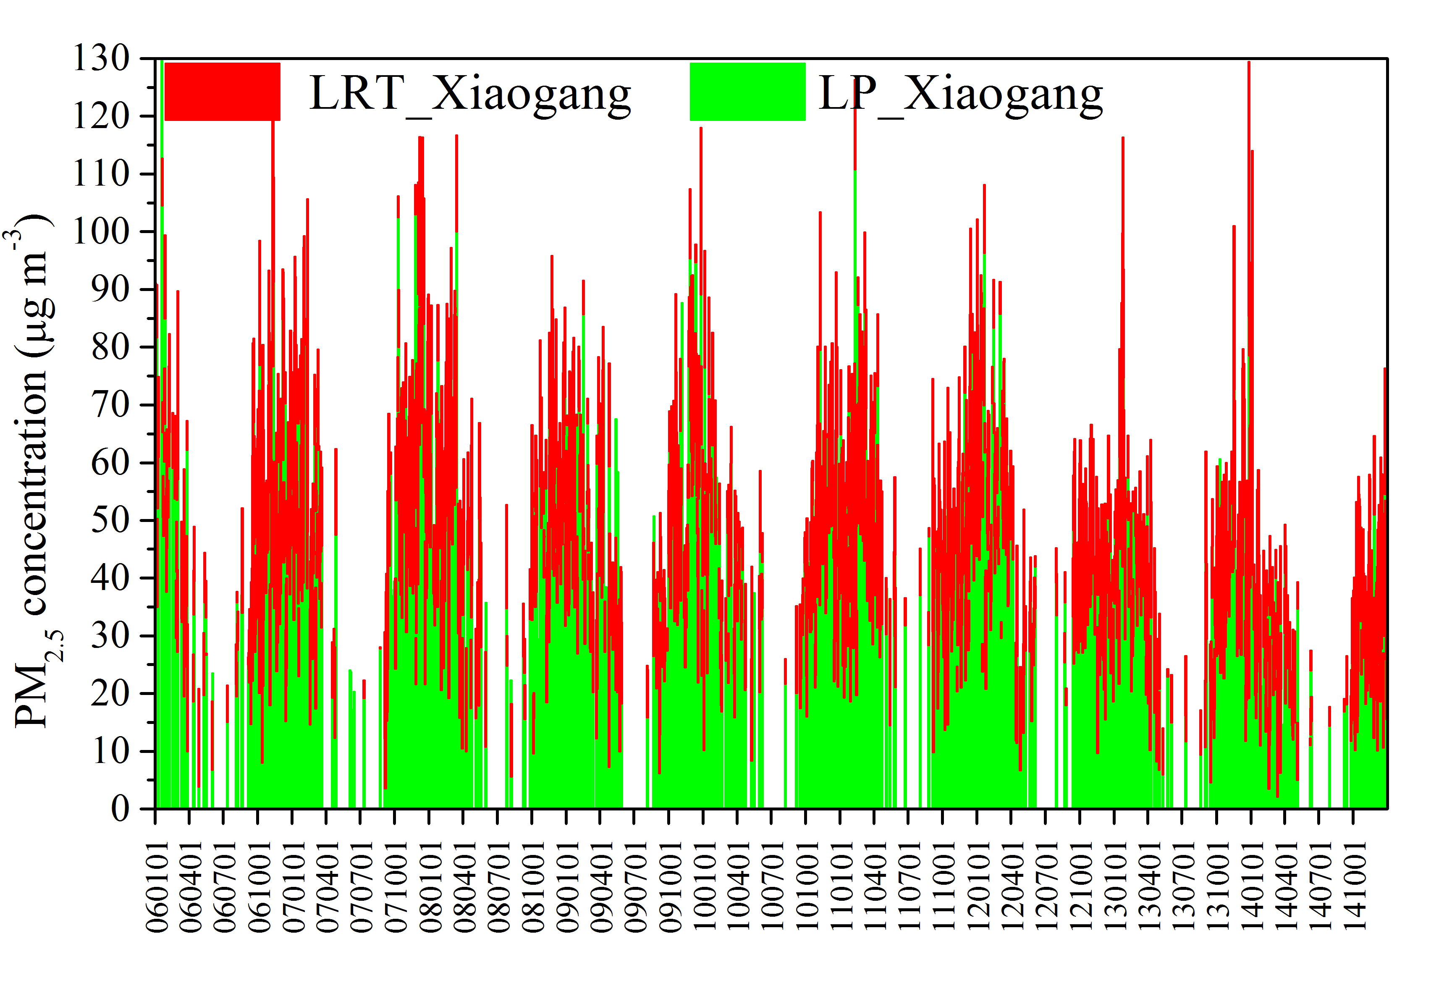
The contribution of LRT and LP (modified)
Hsin-Zhuang
(Taipei,
North Taiwan)
Zhong-Ming
(Taichung,
Central Taiwan)
Xiao-Gang
(Kaoshung,
Southern Taiwan)
20
Notes:
Consider the dilution of concentration
We can realize the long range transport effect is more larger in the north
The south is opposite.

Slide 19
The chemical reactions of LRT and LP pollutants
In order to evaluate the contribution of chemical reactions of LRT and LP pollutants, the present study conducted the following sensitivity tests:
  The base case, all emissions were included.
  The none case, only outside (other than Taiwan) emissions were included.
  The onlybio case, outside emissions and Taiwan biological emissions were included.
  The onlyanthrop case, outside emissions and Taiwan anthropogenic sources were included.
  The onlyTaiwan case, only Taiwan emissions were included (hasn’t conducted yet, the boundary conditions would play a role as outside emission. How to avoid such interfere?).
The difference contain the contribution of chemical reactions and LP
19
Notes:
Consider the dilution of concentration
We can realize the long range transport effect is more larger in the north
The south is opposite.

Slide 20
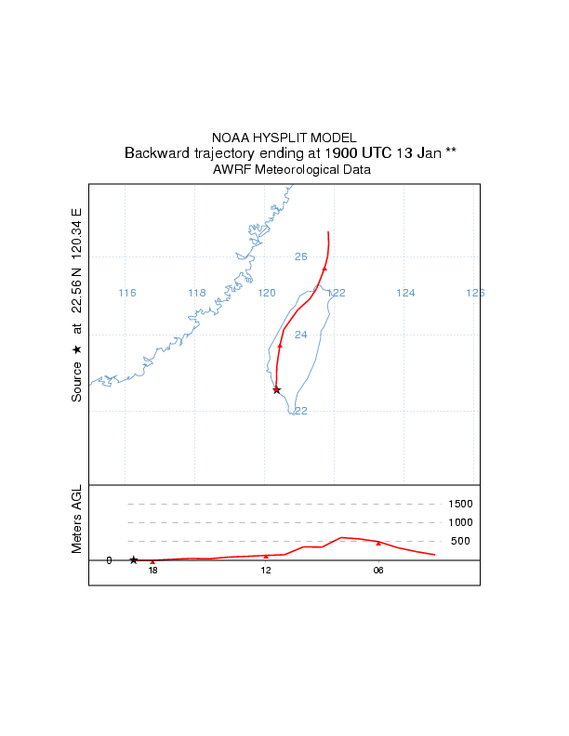
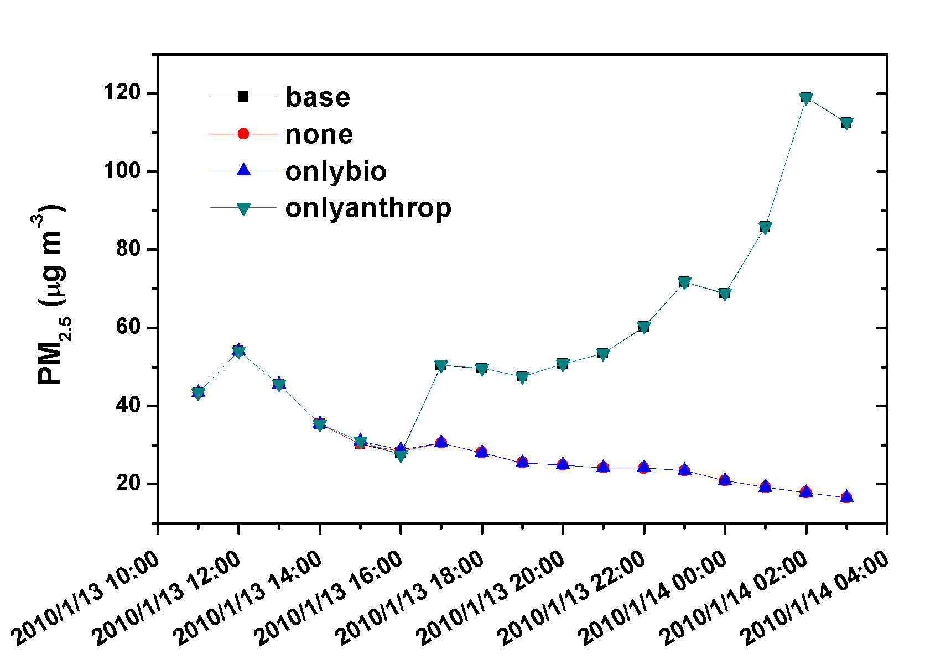
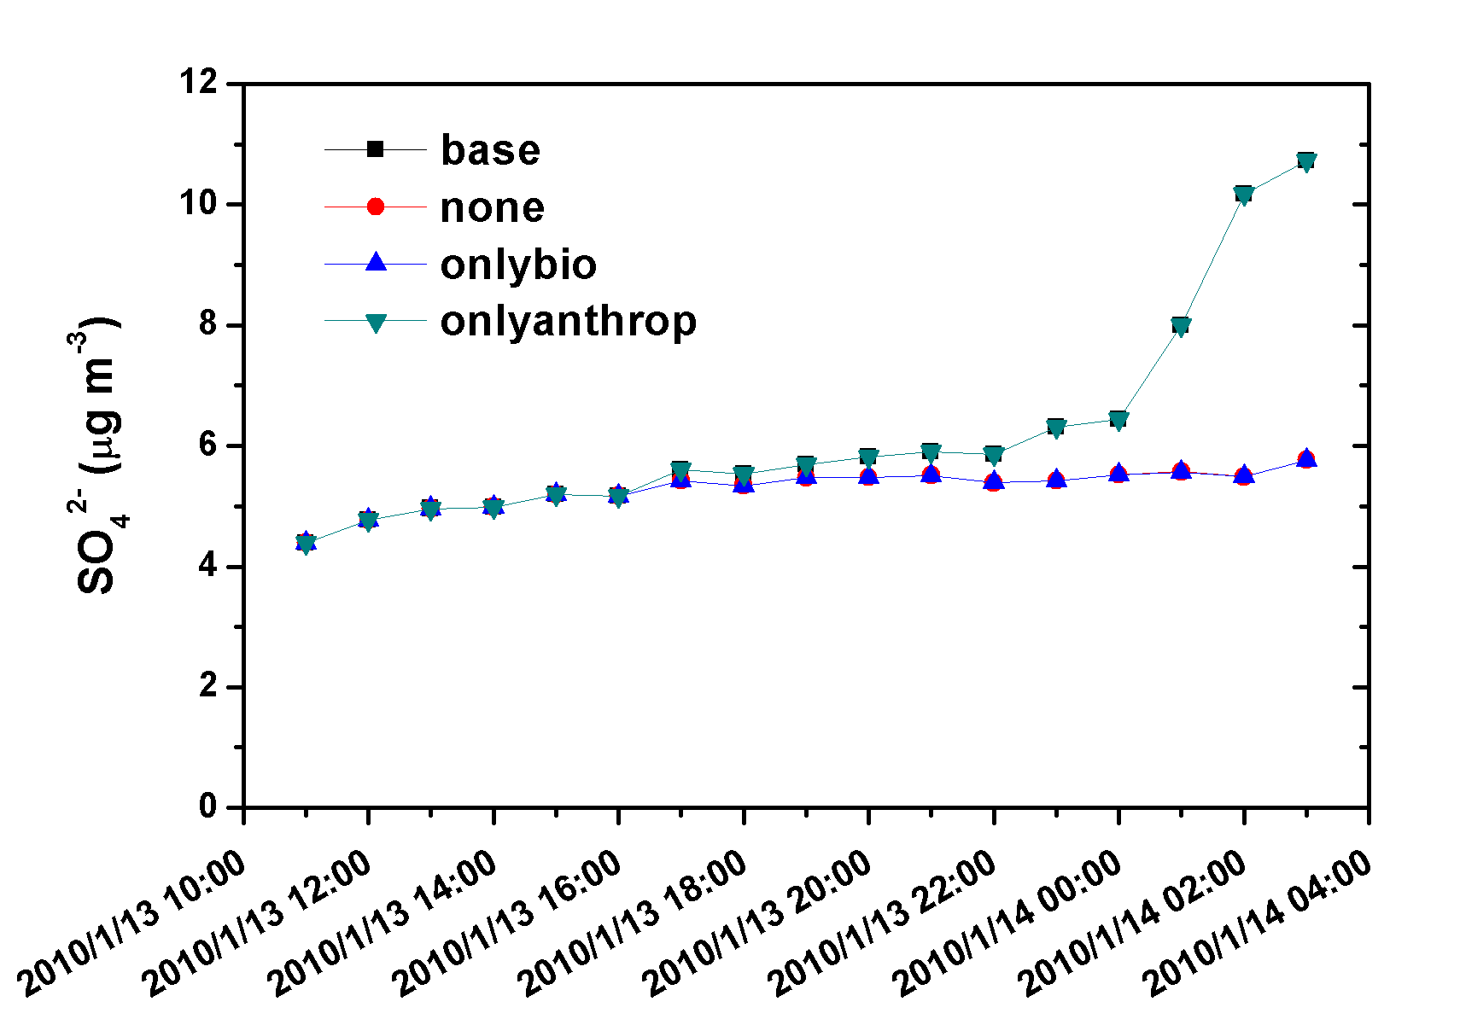
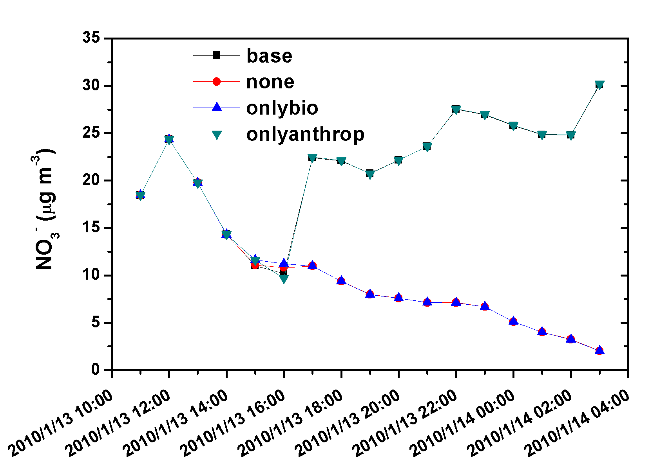
The chemical reactions of LRT and LP pollutants
2010/1/13 19Z LRT-event
Chemical reactions & LP
The LRT plume arrived at northern Taiwan around 15:00 pm
The difference contained the contribution of chemical reactions and LP
The proportion of LP gradually increased at southern Taiwan.
The biogenic sources nearly did not participate in the chemical reactions.
19
Notes:
Consider the dilution of concentration
We can realize the long range transport effect is more larger in the north
The south is opposite.

Slide 21
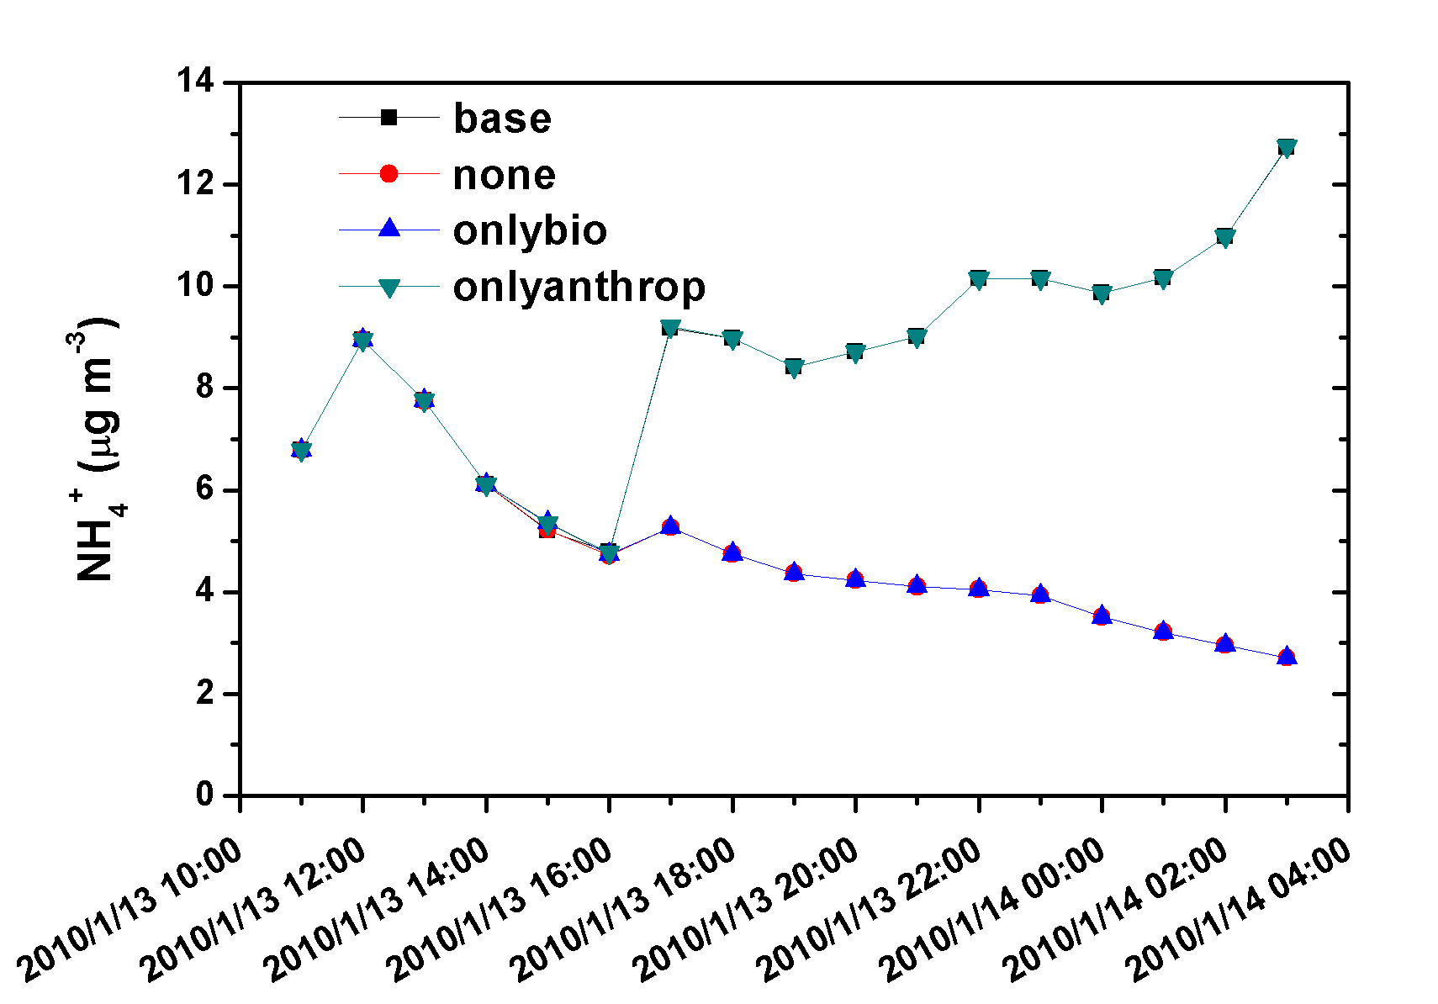
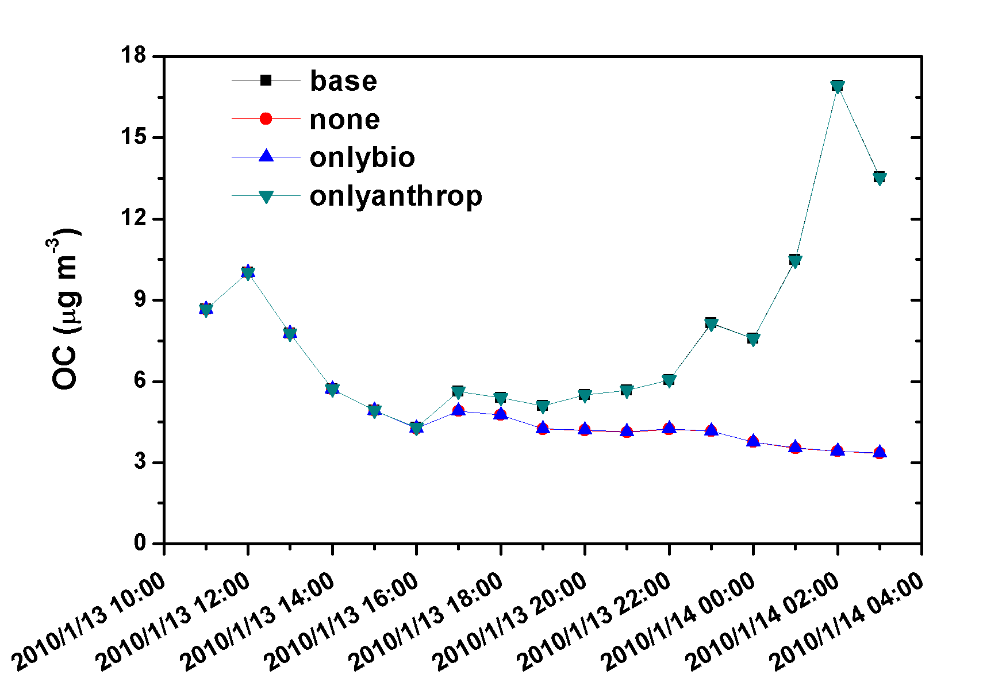
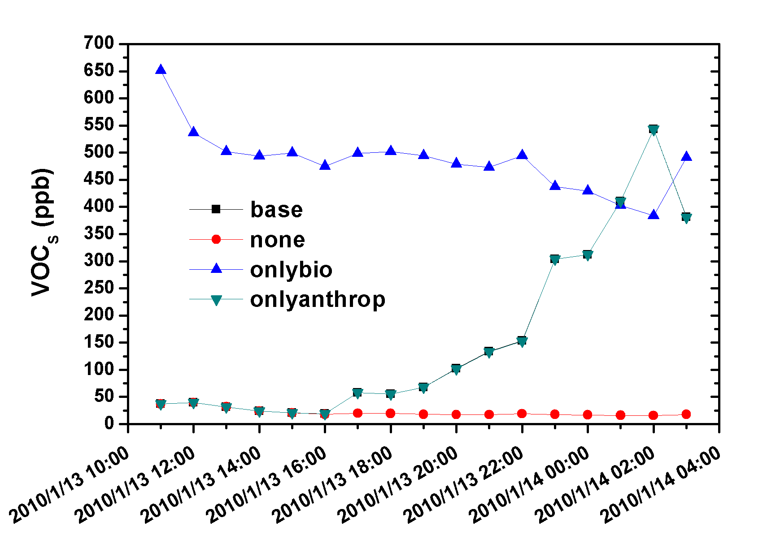
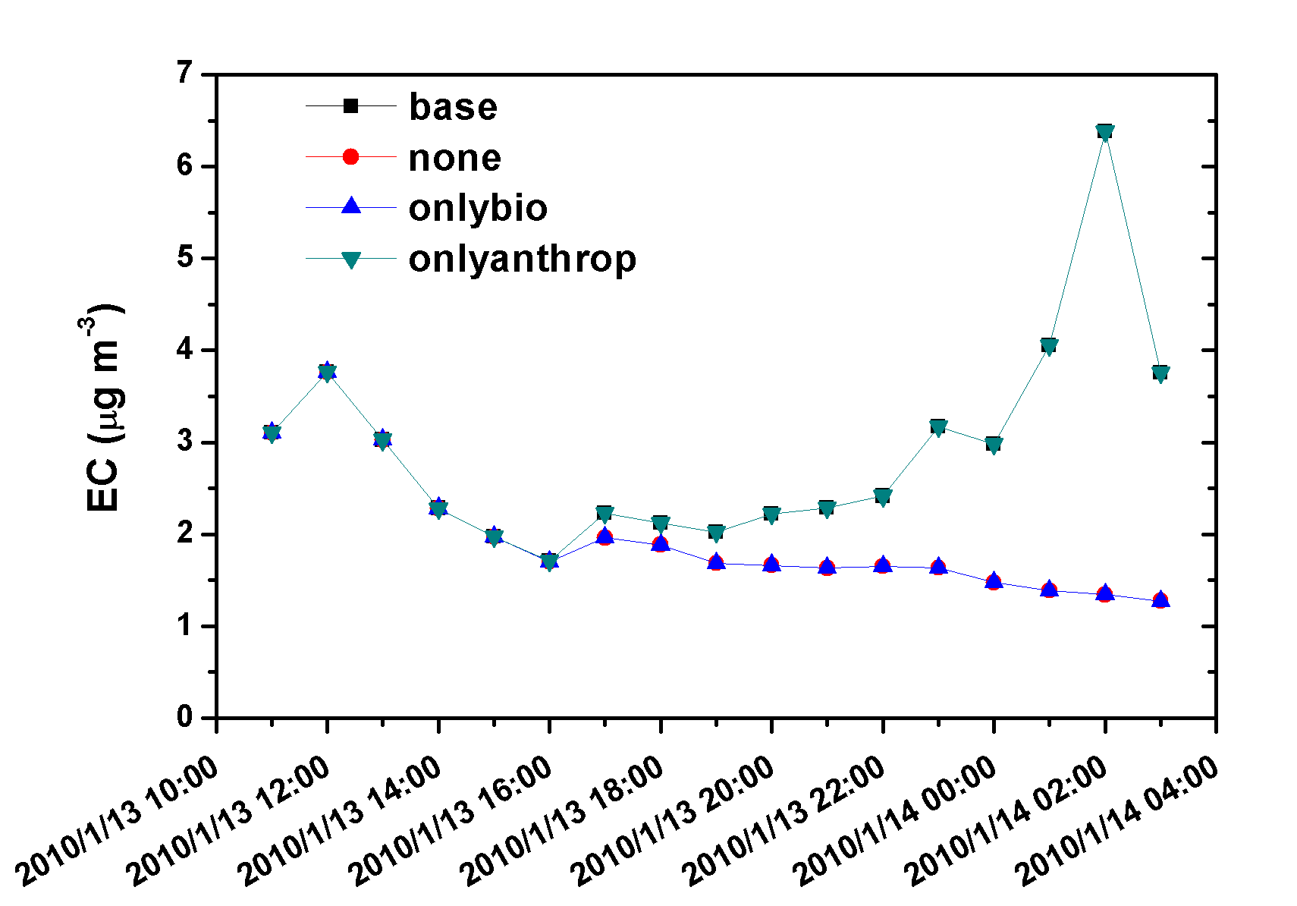
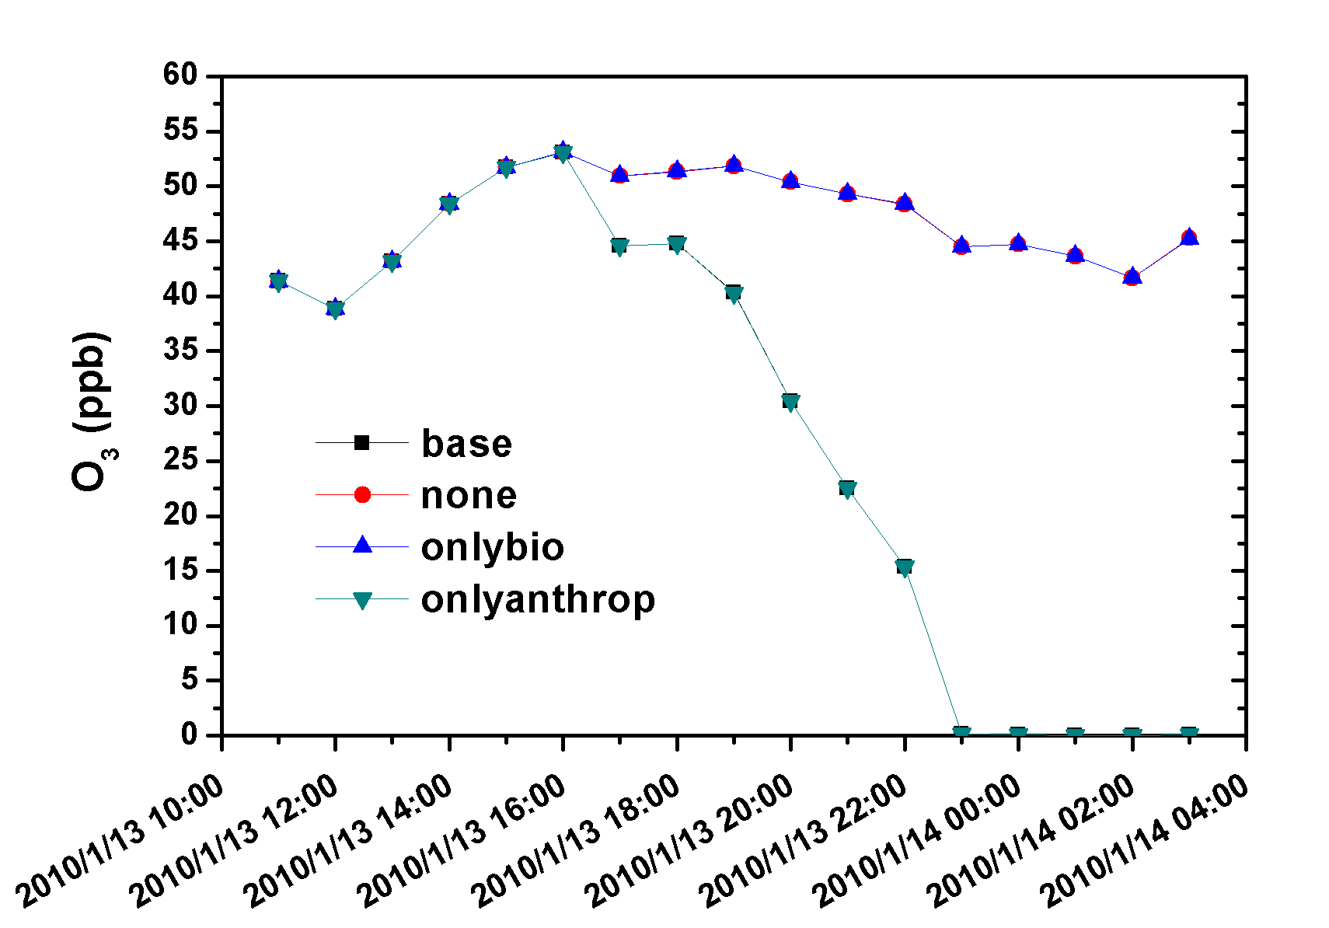
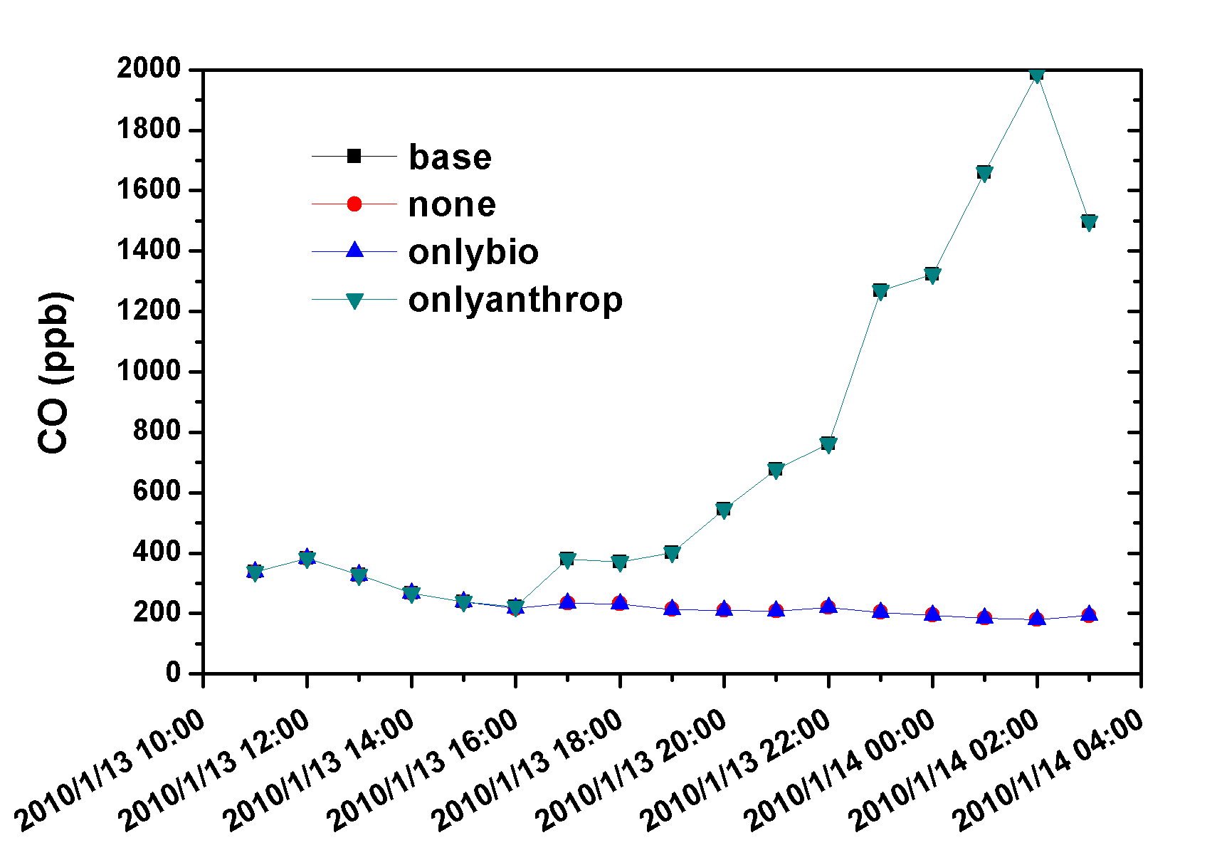
The chemical reactions of LRT and LP pollutants
2010/1/13 19Z LRT-event
The LRT O₃ was obviously titrated by the local NO during the nighttime.
The trend of NH₄⁺ is very similar to NO₃⁻.
The trend of Carbons (OC, EC, CO, VOC) are very similar, emitted by vehicles.
19
Notes:
Consider the dilution of concentration
We can realize the long range transport effect is more larger in the north
The south is opposite.

Slide 22
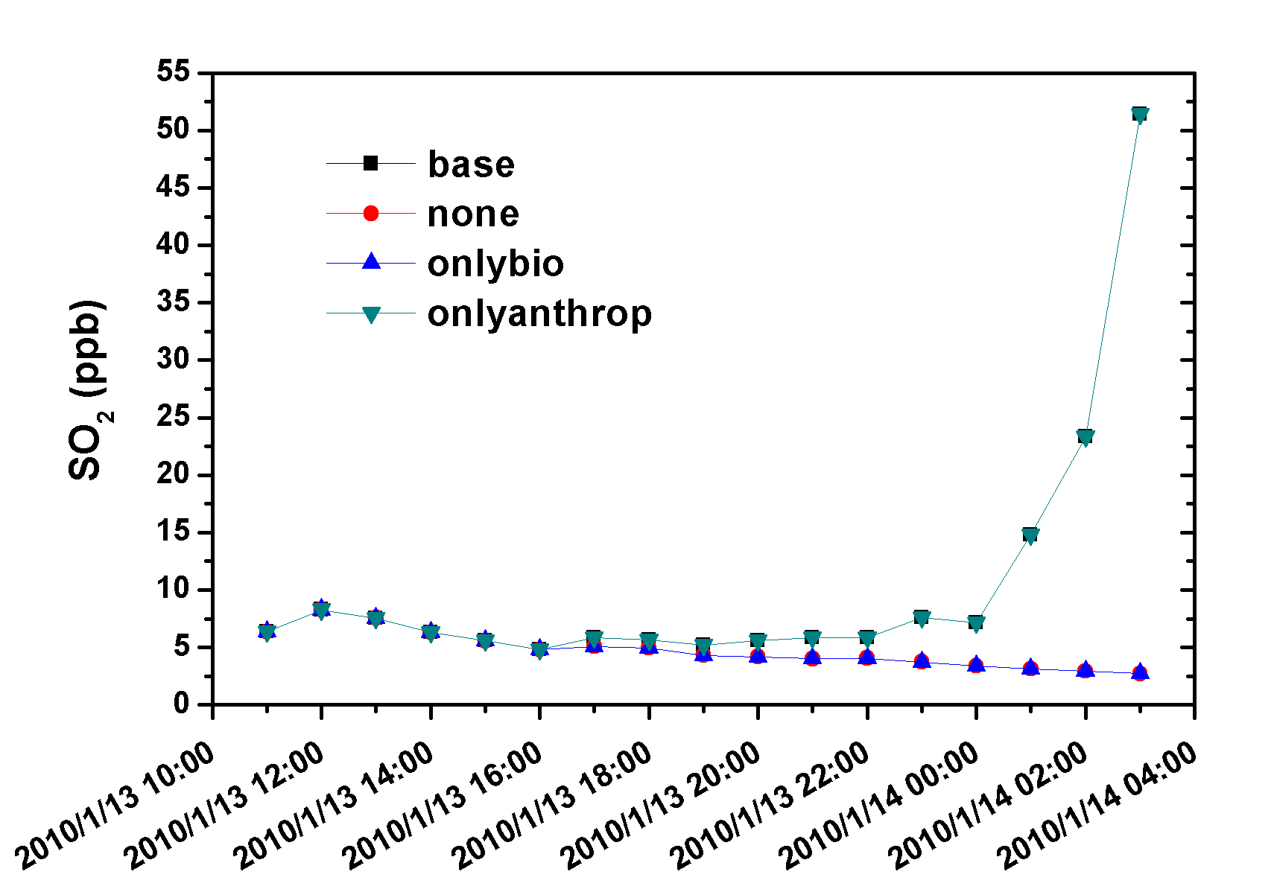
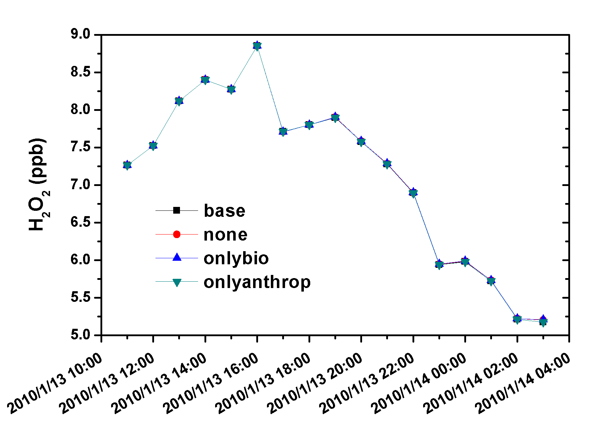
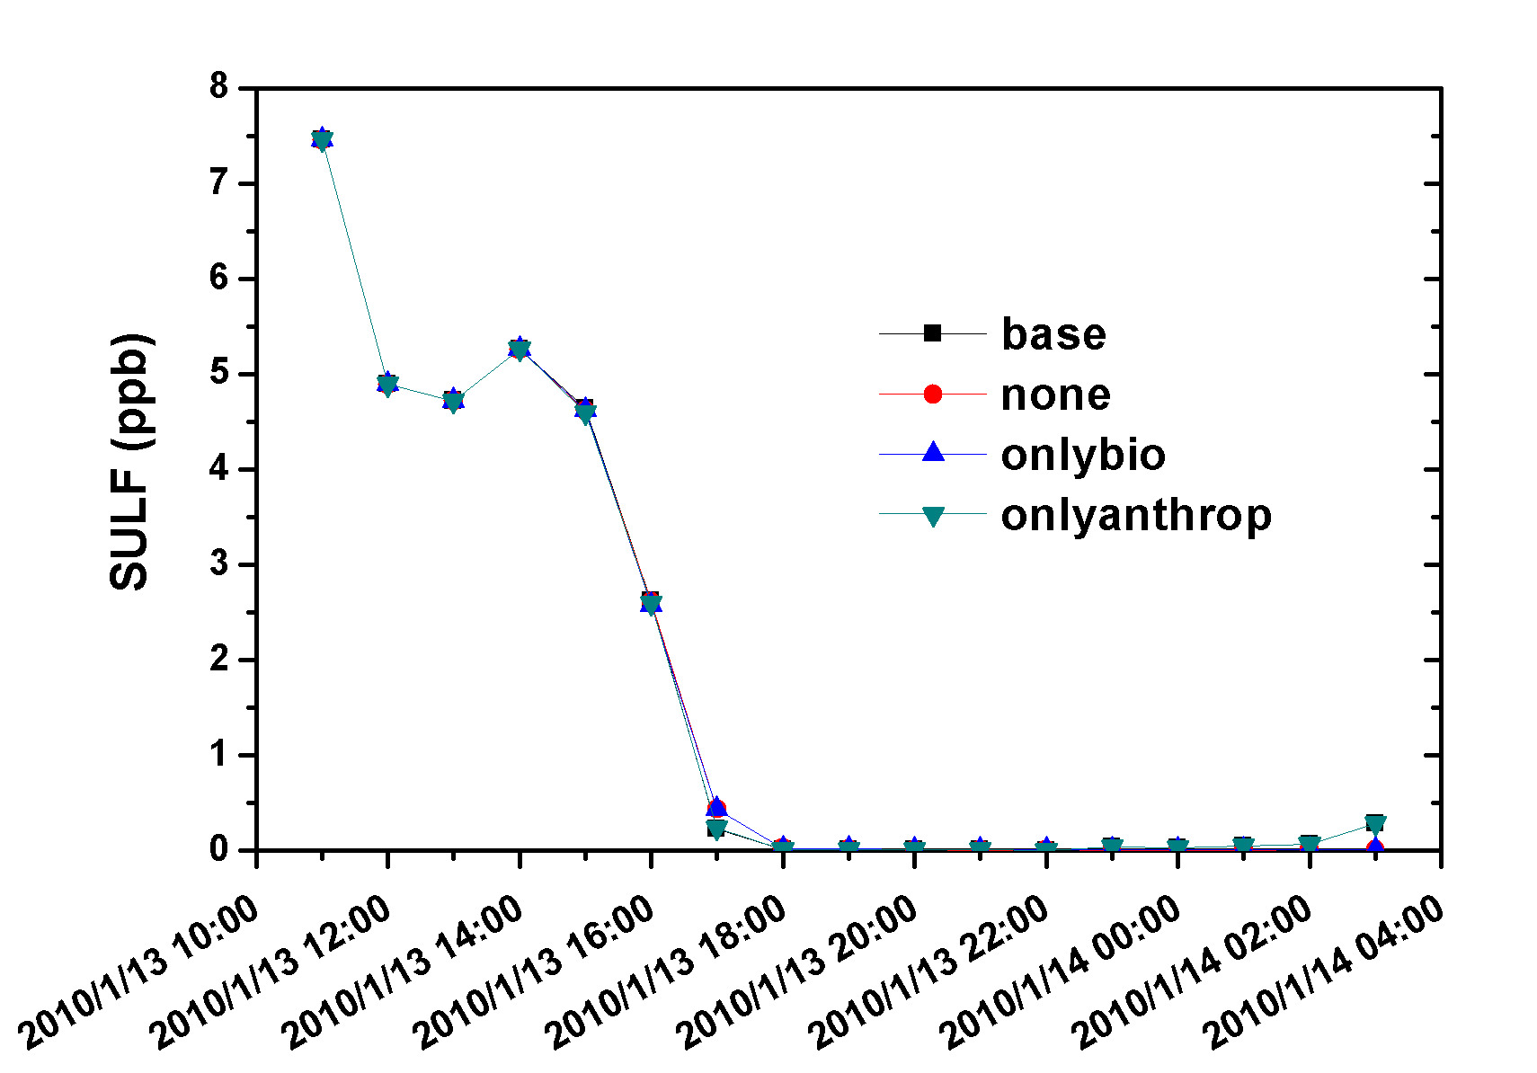
The chemical reactions of LRT and LP pollutants
2010/1/13 19Z LRT-event
The local SO₂ sources have little impact in the additional contribution of difference contain the contribution of chemical reactions and LP
19
Notes:
Consider the dilution of concentration
We can realize the long range transport effect is more larger in the north
The south is opposite.

Slide 23
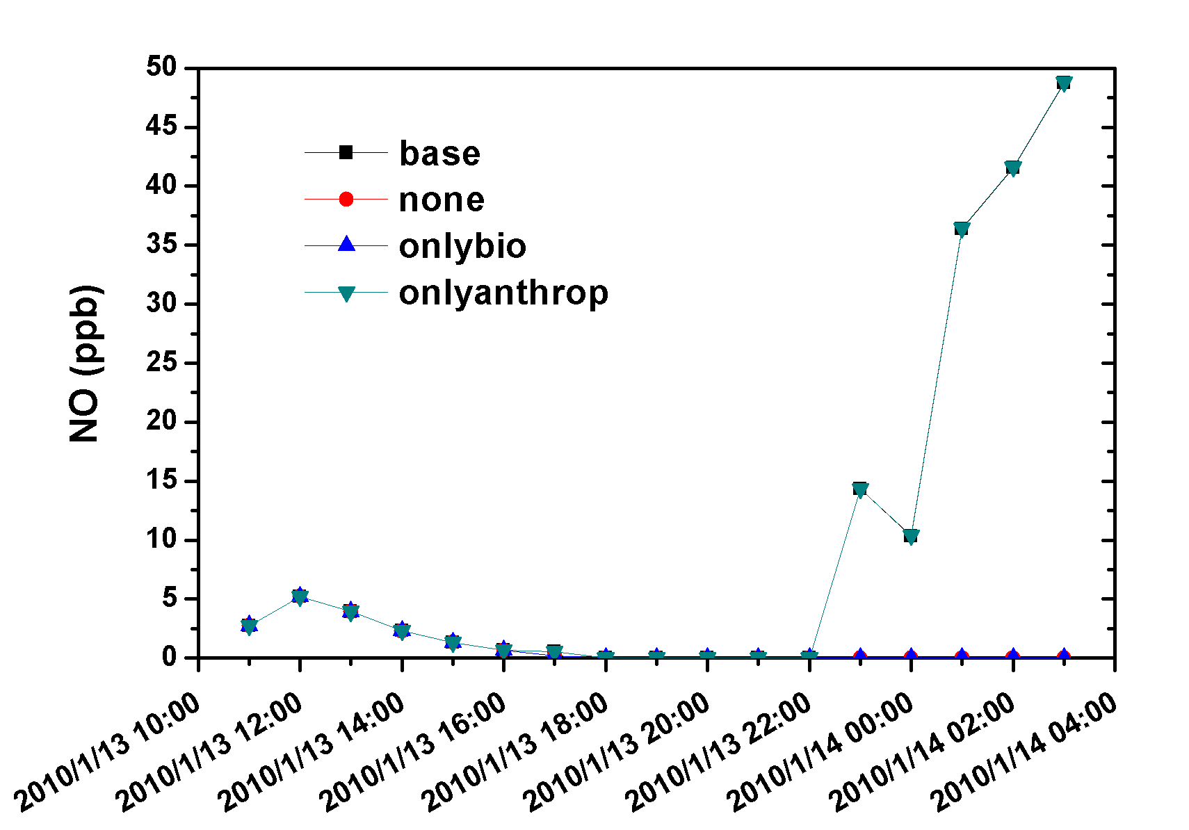
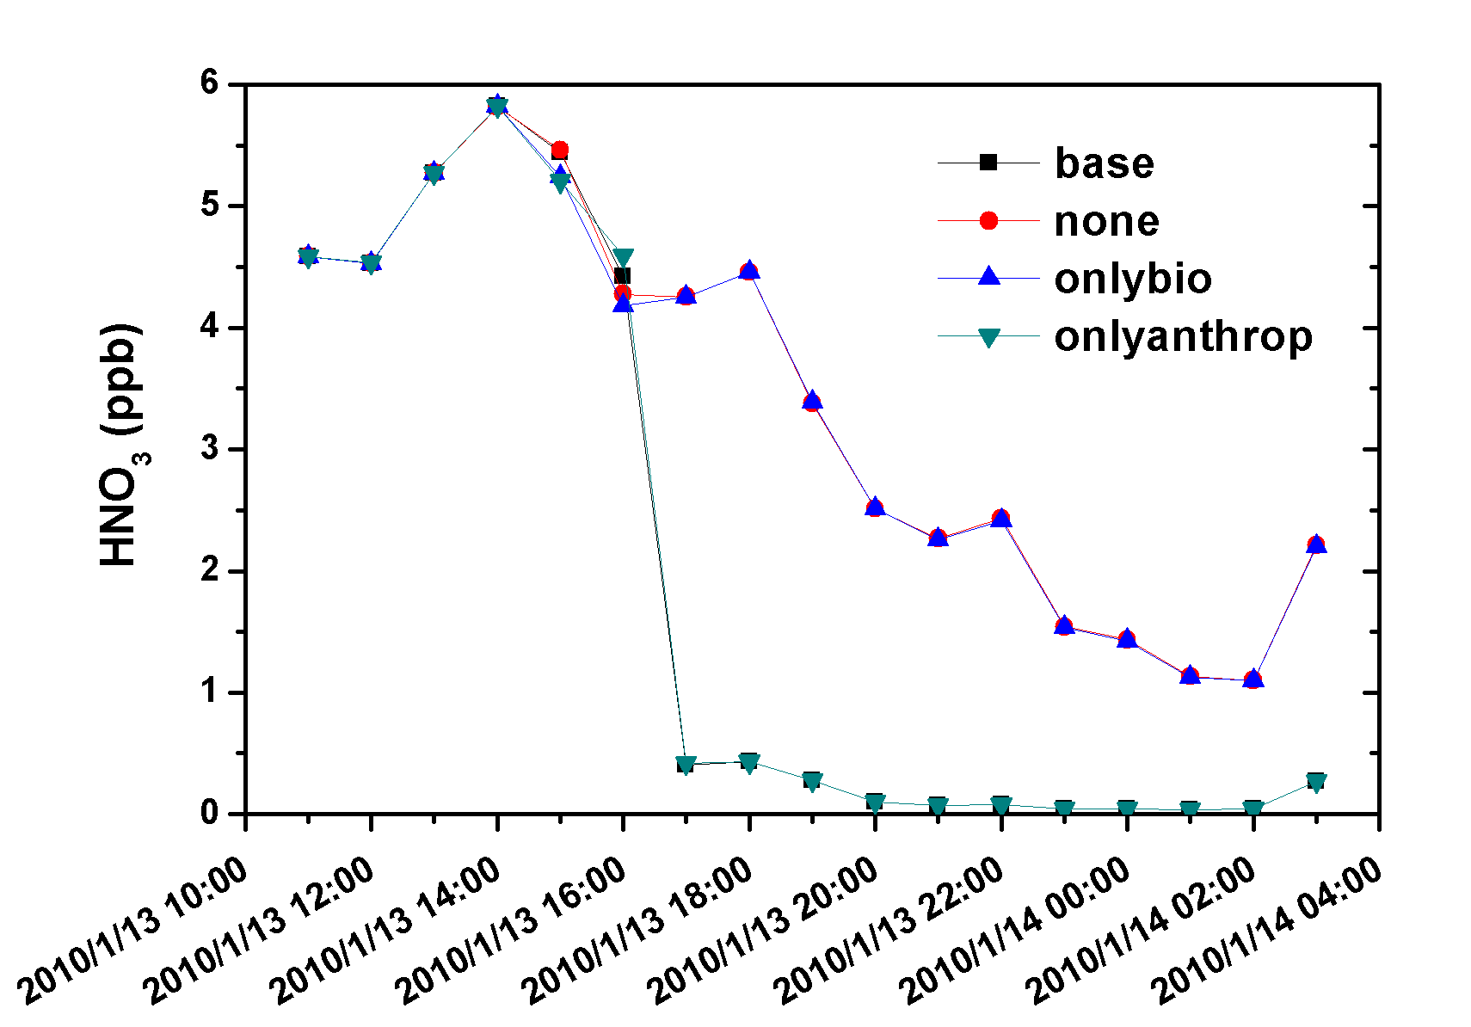
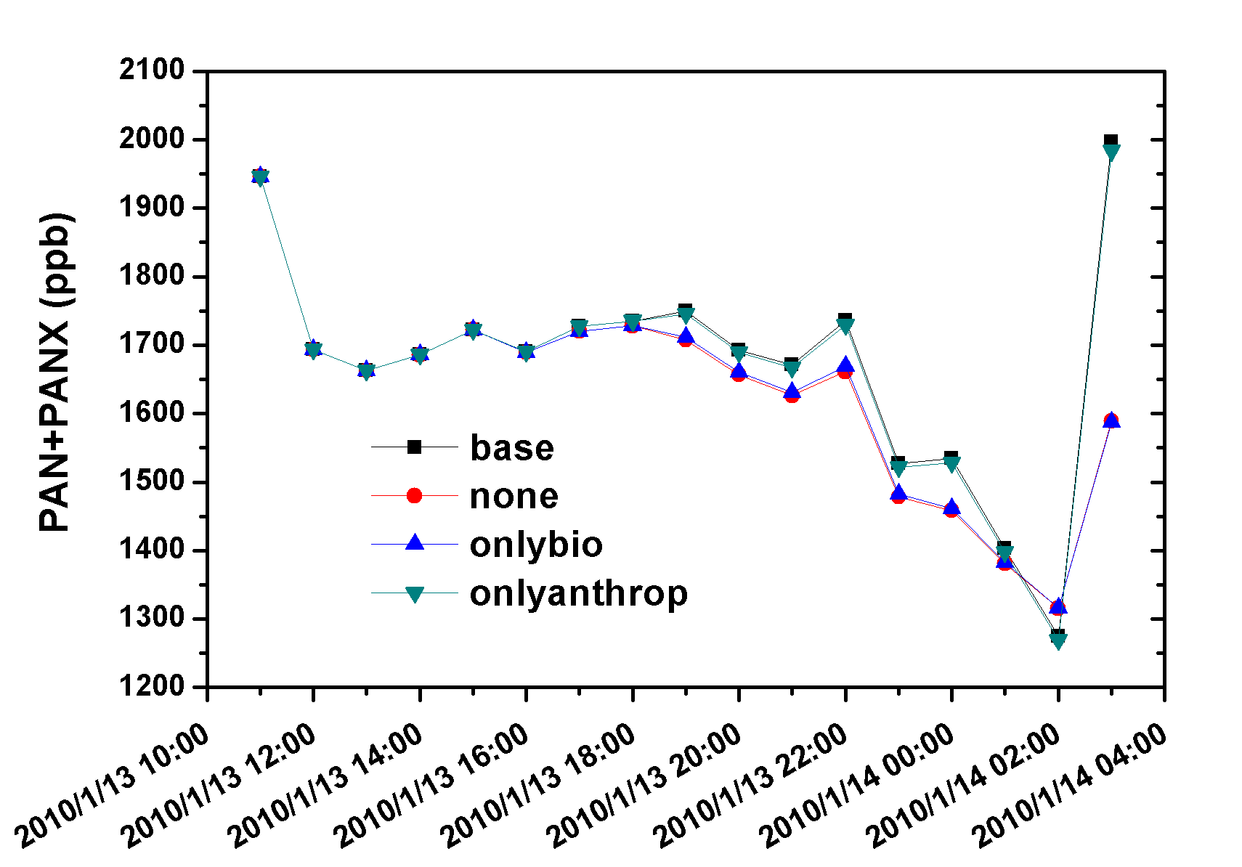
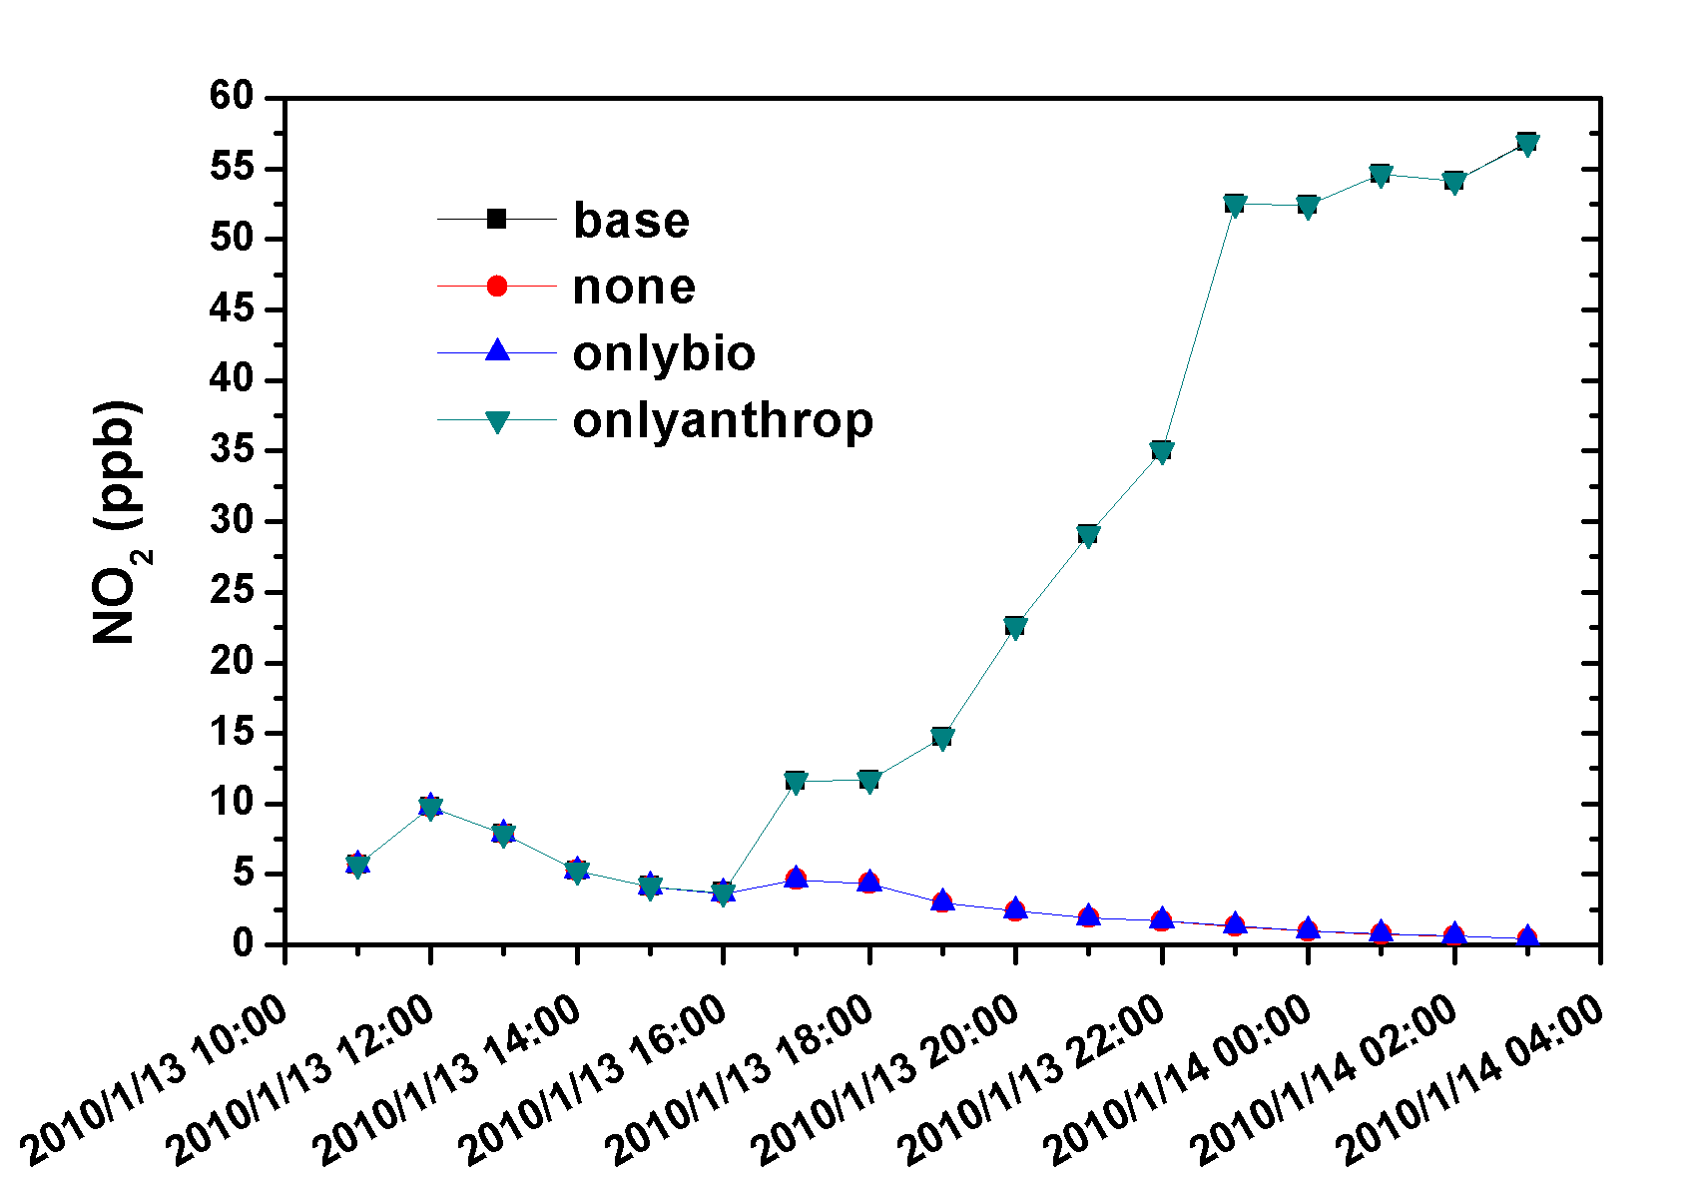
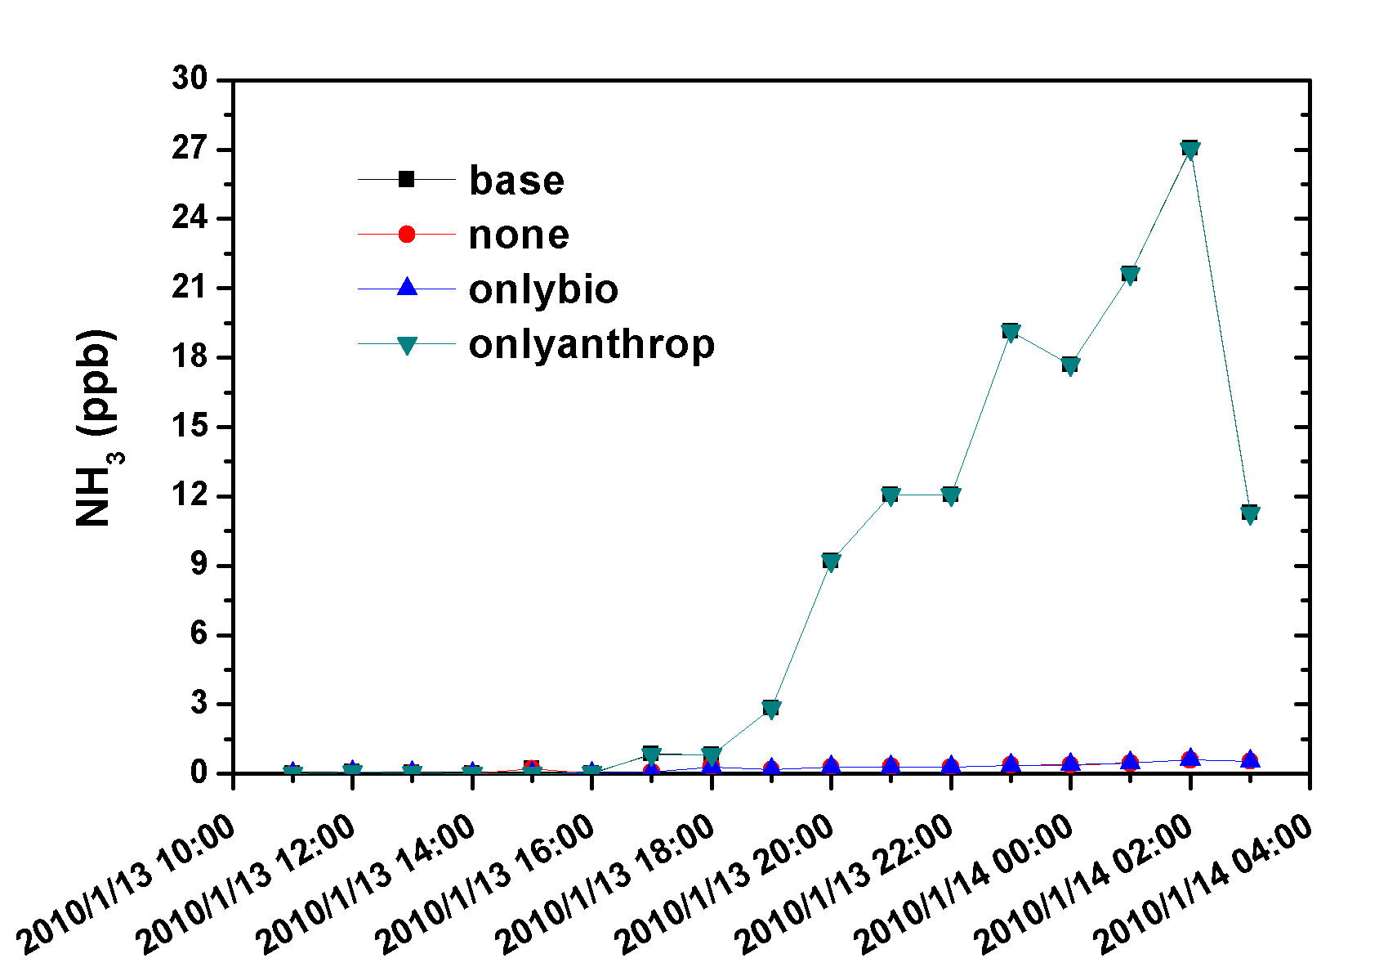
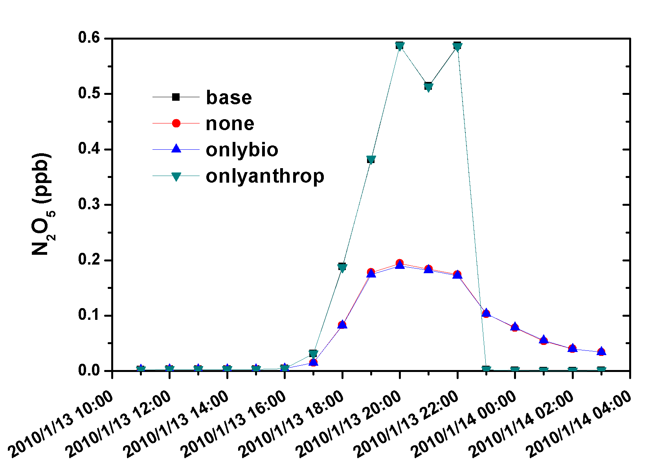
The local NOx is the cause of additional PM_{2.5} (the difference of scenarios with/without local pollutions)
The HNO₃ in the LRT plume is consumed very quickly once the LRT plume arrived at Taiwan.
The local NH3 is abundant all along the path of transport (western cities).
19
Notes:
Consider the dilution of concentration
We can realize the long range transport effect is more larger in the north
The south is opposite.

Slide 24
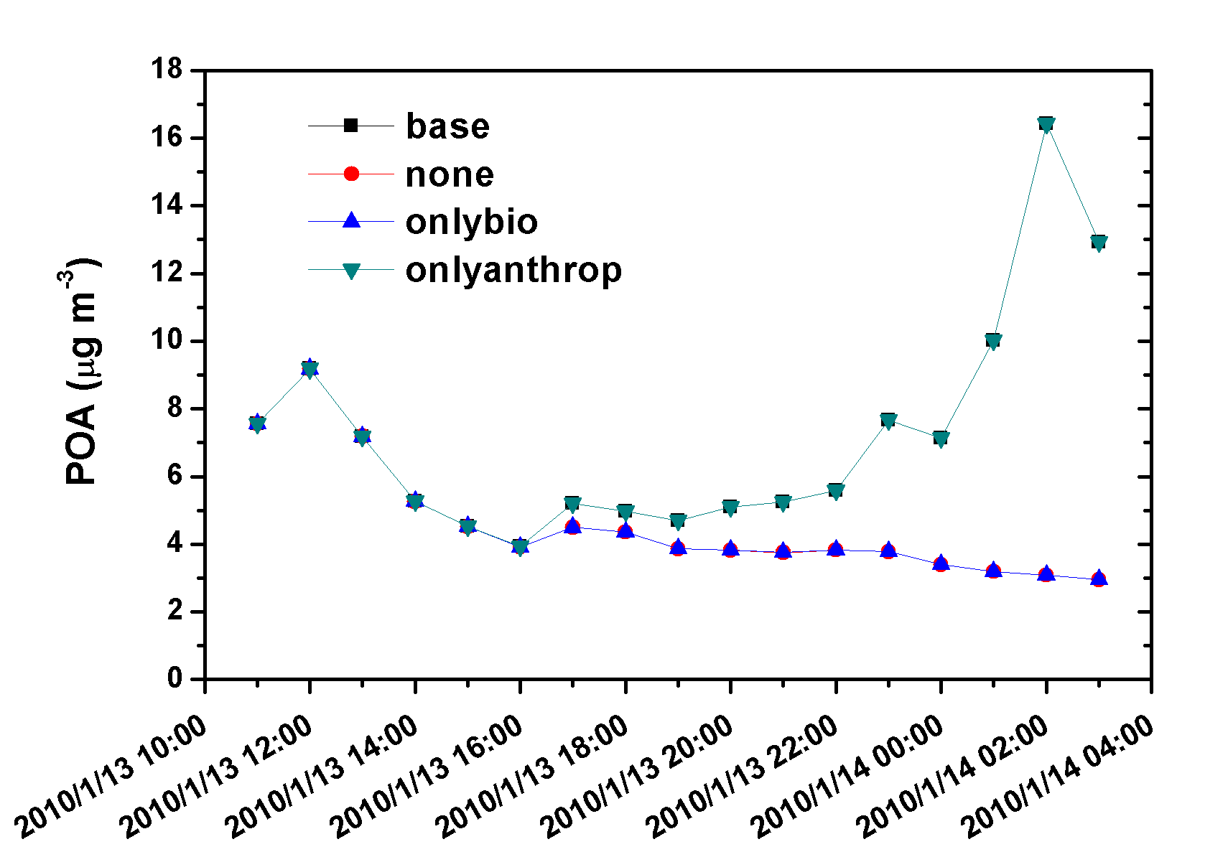
The chemical reactions of LRT and LP pollutants
2010/1/13 19Z LRT-event
The difference contain the contribution of chemical reactions and LP.
The OC mainly consists of anthropogenic primary organic carbon, SOA is minor.
Mostly, anthropogenic sources reacts with LRT pollutants. The biogenic sources nearly did not participate in the chemical reactions.
19
Notes:
Consider the dilution of concentration
We can realize the long range transport effect is more larger in the north
The south is opposite.

Slide 25
The chemical reactions of LRT and LP pollutants
Base - none
Chemical reactions & LP
LP
?
19
Notes:
Consider the dilution of concentration
We can realize the long range transport effect is more larger in the north
The south is opposite.

Slide 26
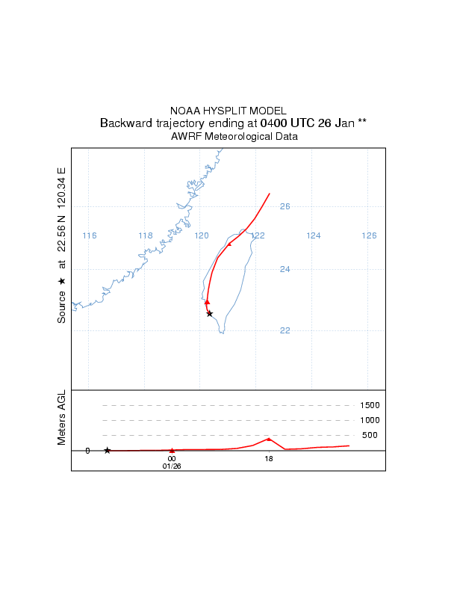
The chemical reactions of LRT and LP pollutants
2010/1/26 04Z LRT-ordinary
2010/2/26 04Z LRT/LP mix
More cases are analyzed.
The difference between LRT-event and LRT ordinary cases is little but considerable for LRT plume arrived at Taiwan at different time, like daytime or nighttime, the chemical reactions processes are different.
The prevailing wind speed for LRT/LP mix cases is less than the LRT-event and LRT-ordinary cases. This means the LRT pollutants have more time to react with LP pollutants.
19
Notes:
Consider the dilution of concentration
We can realize the long range transport effect is more larger in the north
The south is opposite.

Slide 27
Conclusion
Under northeast wind and modified situation, the contributions of LRT and LP for northern sites are about 60% and 40%, respectively; for central sites are about 40% and 60%, respectively; for southern sites are 25% and 75%, respectively.
The impact of LRT PM_{2.5} in Taipei (the biggest city located in northern Taiwan) is averagely 16±11 µg m⁻³, which is higher than the yearly standard (15 µg m⁻³) and that in Kaohsiung (the second biggest city located in southern Taiwan) is averagely 13±8 µg m⁻³. The local pollution in Kaohsiung is already 40±18 µg m⁻³, which make it difficult to meet daily standard (35 µg m⁻³).
The chemical reactions between LRT and LP pollutants just initialized in the present study and more cases are needed to be analyzed.

Slide 28

Thanks for your listening.

