Slide 1
Comparison of human exposure modeling using fine-scale CMAQ PM_{2.5} from Baltimore DISCOVER-AQ evaluation
Janet M. Burke, Yadong Xu, K. Wyat Appel, Shawn J. Roselle
US EPA ORD National Exposure Research Laboratory
CMAS Conference, October 25, 2016

Slide 2
Background and Objectives
Human exposure model results can potentially be improved using air quality modeling
Greater spatial and/or temporal resolution of air pollutant concentration fields
Evaluation of CMAQ v5.1 for the Baltimore DISCOVER-AQ study during July 2011 compared 12, 4 and 1 km grid-cell resolutions
Significant improvement in model performance for 4 vs. 12 km simulations compared to measurements
Small change in model performance between 4 and 1 km simulations
Performed case study to examine the impact of fine-scale CMAQ on human exposure model estimates of PM_{2.5} exposure variability
Applied SHEDS-PM (Stochastic Human Exposure and Dose Simulation for Particulate Matter) model
Three different hourly PM_{2.5} concentrations as input

Slide 3
PM_{2.5} Concentration Data Sources
CMAQ v5.1 for July 2011
1) 4x4 km domain (red)
2) 1x1 km domain (blue)
Hourly PM_{2.5} measurements
26 AQS sites during July 2011 (yellow dots) within 1x1 km domain
Baltimore
Washington, DC

Slide 4
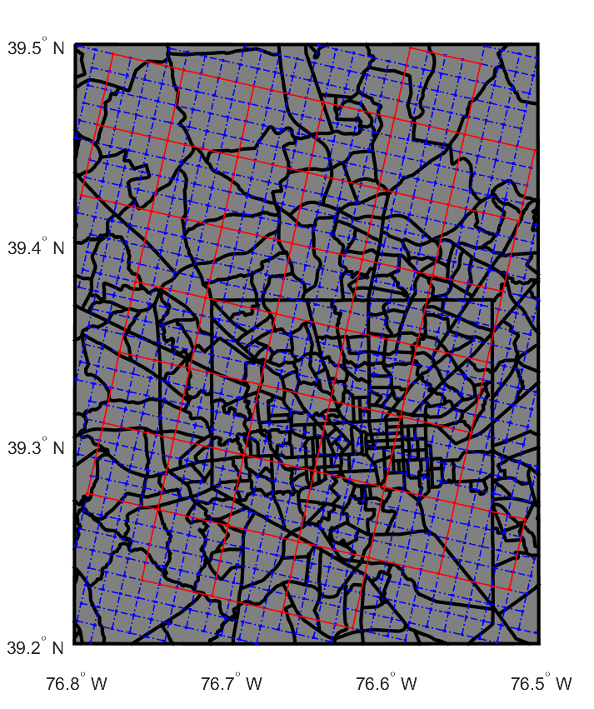
Methods
Assign gridded CMAQ output to census tracts for human exposure model input
Used spatial allocator tool to assign CMAQ (4x4km and 1x1km) hourly PM_{2.5} concentrations to census tracts
Only allocates attribute values spatially, not temporally; each hour had to be processed with census tract shapefiles separately
$${AttributeValue}_{tract}=\sum_{i}^{n}{\frac{{OverlappingArea}_{gridcell} × {AttributeValue}_{gridcell}}{{Area}_{tract}}}$$
https://www.cmascenter.org/sa-tools/documentation/4.0/html/alloc.html

Slide 5
Methods
Spatially interpolate PM_{2.5} measurements to census tracts for human exposure model input
Used kriging of the AQS data to estimate hourly PM_{2.5} at census tracts
Kriging - optimal interpolation method based on regression against observed values of surrounding data points, weighted according to space/time covariance values
Covariance model processed from the experimental covariance calculated directly from observed hourly PM_{2.5} at AQS sites
Covariance=76.55*(0.22*exp(-3*r/14.4)*exp(-3*t/0.15)+0.78*exp(-3*r/720)*exp(-3*t/3.2))
r = distance from the estimation point to the available data
t = time difference

Slide 6
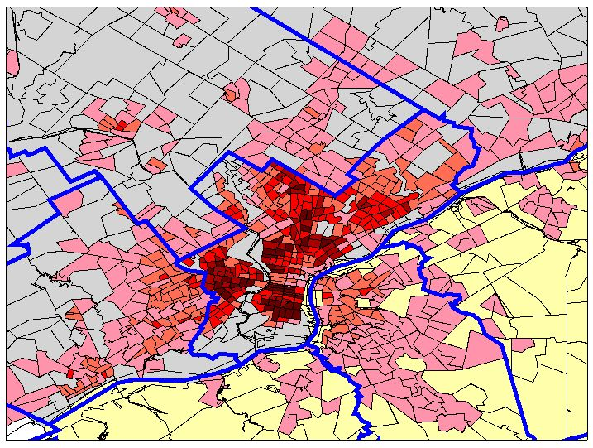
Methods
SHEDS-PM
Population-based human exposure model
Simulate PM exposures for representative individuals within geographic area
Stochastic
Characterize variability across population and within individuals over time
Exposure factors are input as distributions
Individual time series of inhalation exposure
Calculate based on:
Input PM concentrations for each census tract
Time spent in different locations from activity diaries (e.g. outdoors, indoors, in vehicle) matched to individual
Randomly sampled exposure factors influencing PM levels
Account for PM conc. differences with worker commuting
EXPOSURE
t_{o}
t₁
Time

Slide 7
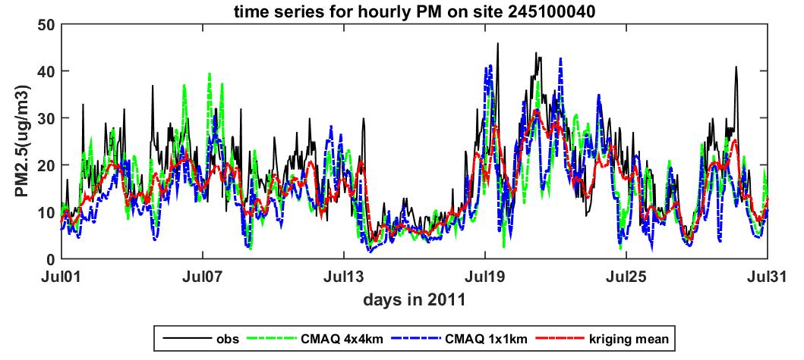
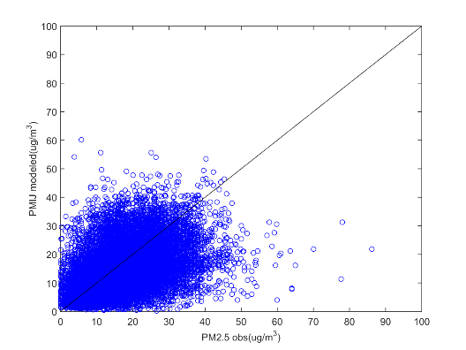
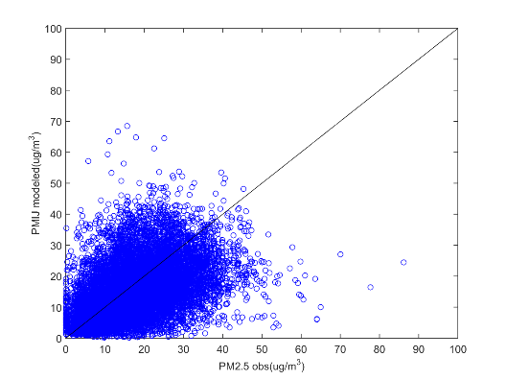
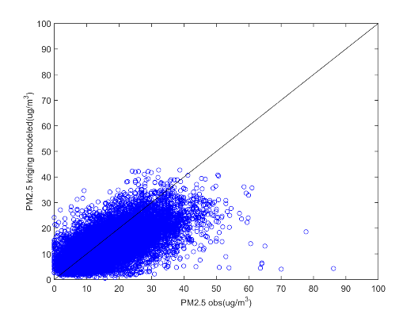
PM_{2.5} Concentrations – Modeled vs. Measured
Modeled PM_{2.5} (CMAQ, kriging) generally reflect observed temporal trends at AQS sites
Model performance across 26 AQS PM_{2.5} sites:
Hourly PM_{2.5} for AQS site in Baltimore (245100040)
 | Median Bias (ug/m³) | RMSE (ug/m³)
CMAQ 4x4km | -2.9 | 9.1
CMAQ 1x1km | -3.2 | 9.3
Kriging | -2.9 | 7.4
CMAQ 4x4km
CMAQ 1x1km
Kriging
Measured PM_{2.5}

Slide 8
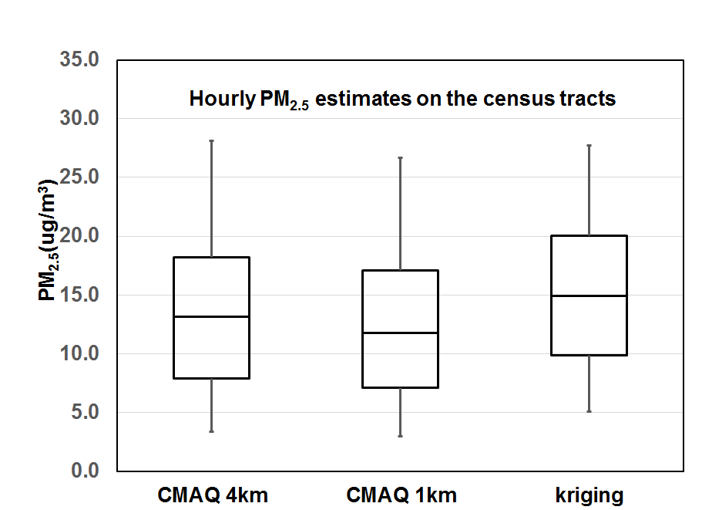
PM_{2.5} Concentrations – Modeled Data
Comparison of census tract hourly PM_{2.5} concentrations from CMAQ and kriging
CMAQ 1x1km generally lower than 4x4km
Kriging estimates are higher due to CMAQ under prediction of PM_{2.5}
 | Mean | Std Dev | Percentiles
 |  |  | p5 | p25 | p50 | p75 | p95
CMAQ 4x4km | 13.8 | 7.6 | 3.4 | 7.9 | 13.2 | 18.2 | 28.1
CMAQ 1x1km | 12.8 | 7.4 | 3.0 | 7.1 | 11.8 | 17.1 | 26.7
Kriging | 15.3 | 7.0 | 5.1 | 9.8 | 14.9 | 20.0 | 27.7
*N=1364 census tracts

Slide 9
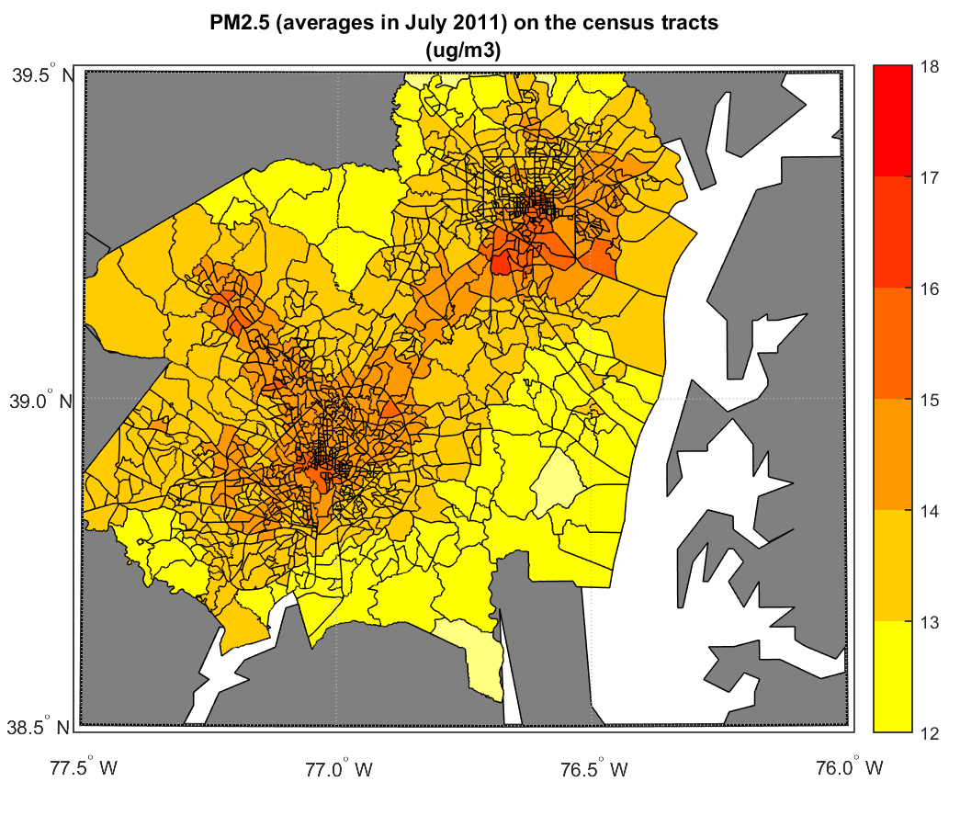
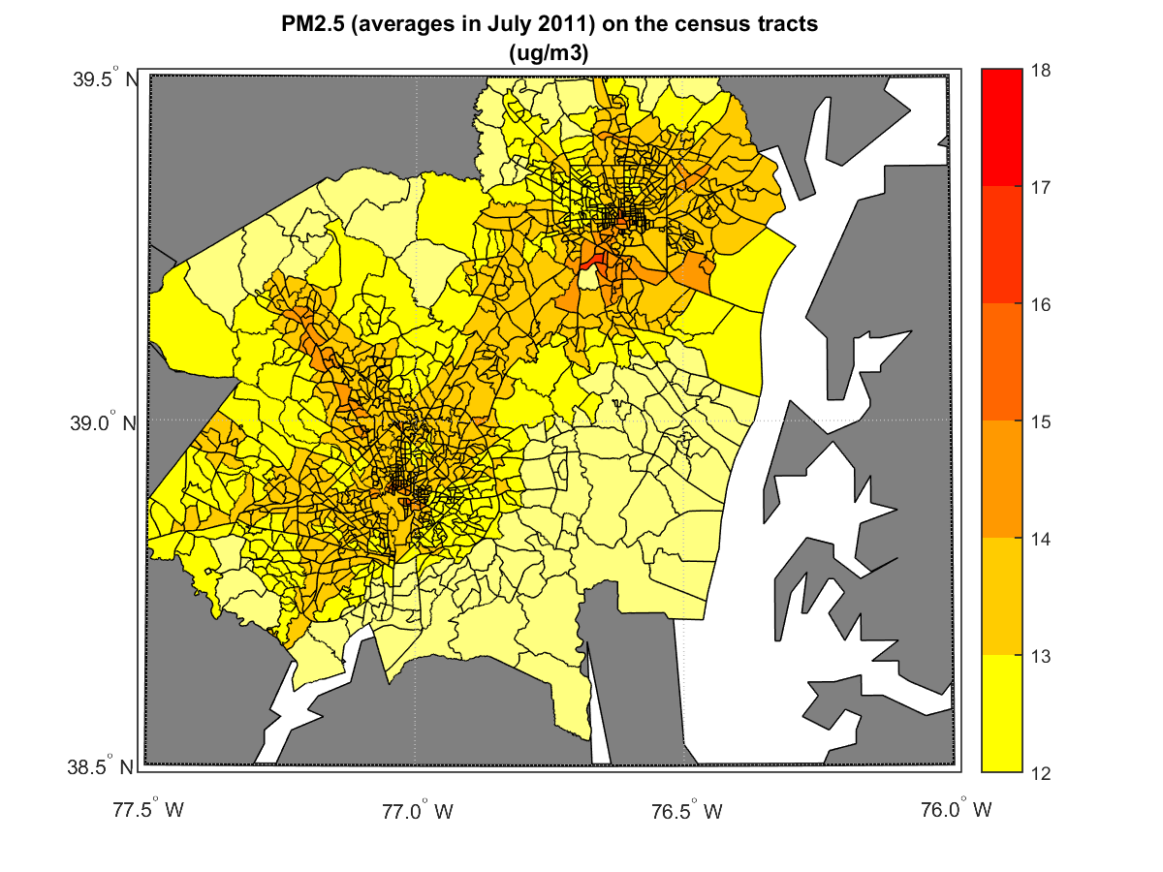
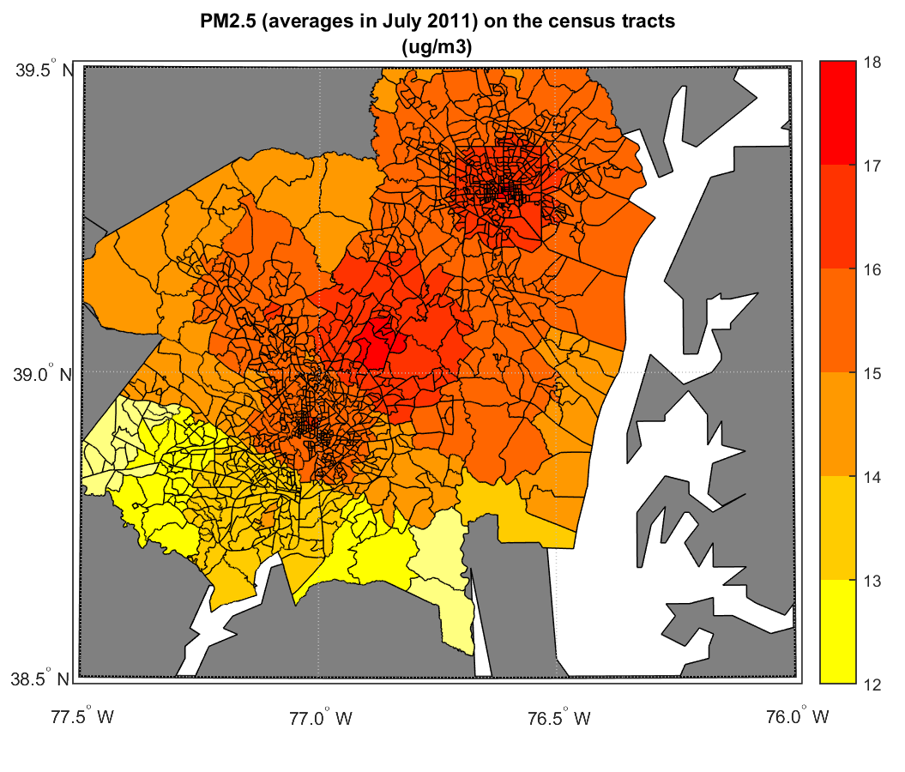
PM_{2.5} Concentrations – Spatial Trends
Comparison of census tract average of hourly PM_{2.5} for July 2011
CMAQ grid resolution and limited monitoring sites impact spatial pattern of modeled PM_{2.5} concentrations
Fewer areas of higher PM_{2.5} concentrations (> 15 µg/m³) for CMAQ 1x1km
CMAQ 4x4km
CMAQ 1x1km
Kriging
18
17
16
15
14
13
12
Baltimore
Washington, DC

Slide 10
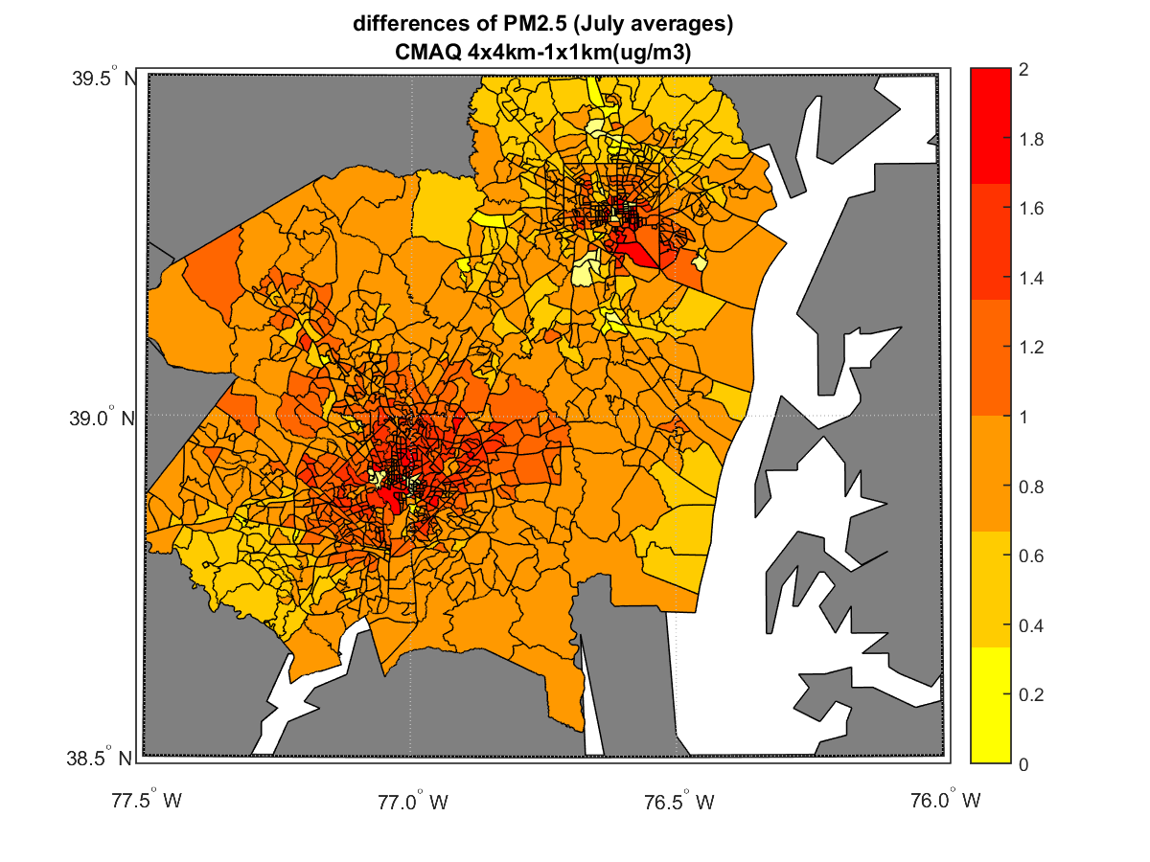
PM_{2.5} Concentrations – Spatial Difference
Difference in PM_{2.5} concentrations between CMAQ grid resolution
Differences of ~1 – 2 µg/m³ (July 2011 average) in urban areas
Potentially important for PM_{2.5} exposure estimates for urban populations
CMAQ 4x4km – CMAQ 1x1km
2.0
1.8
1.6
1.4
1.2
1.0
0.8
0.6
0.4
0.2
0
Baltimore
Washington, DC

Slide 11
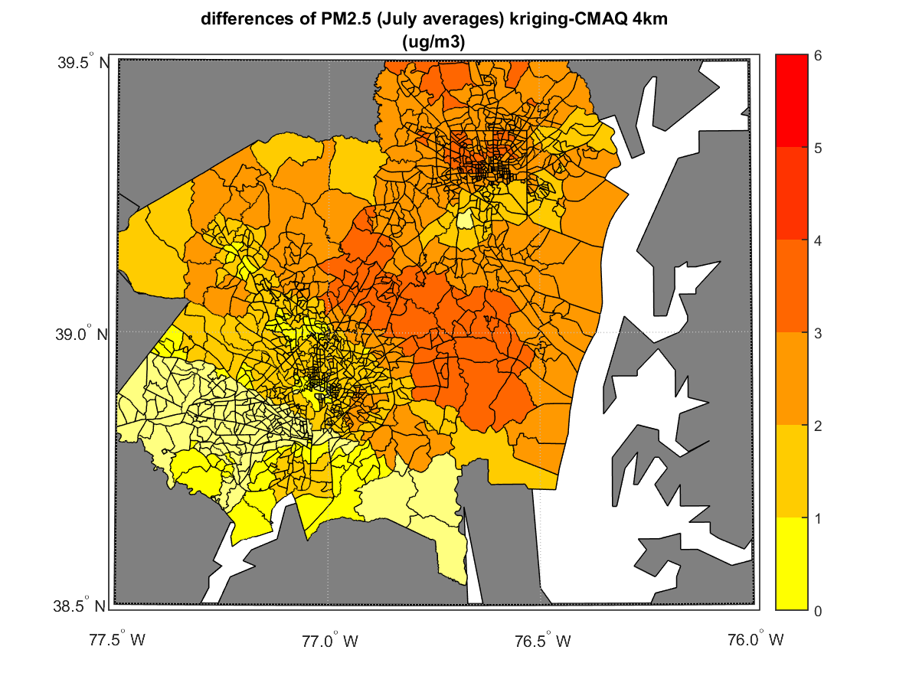
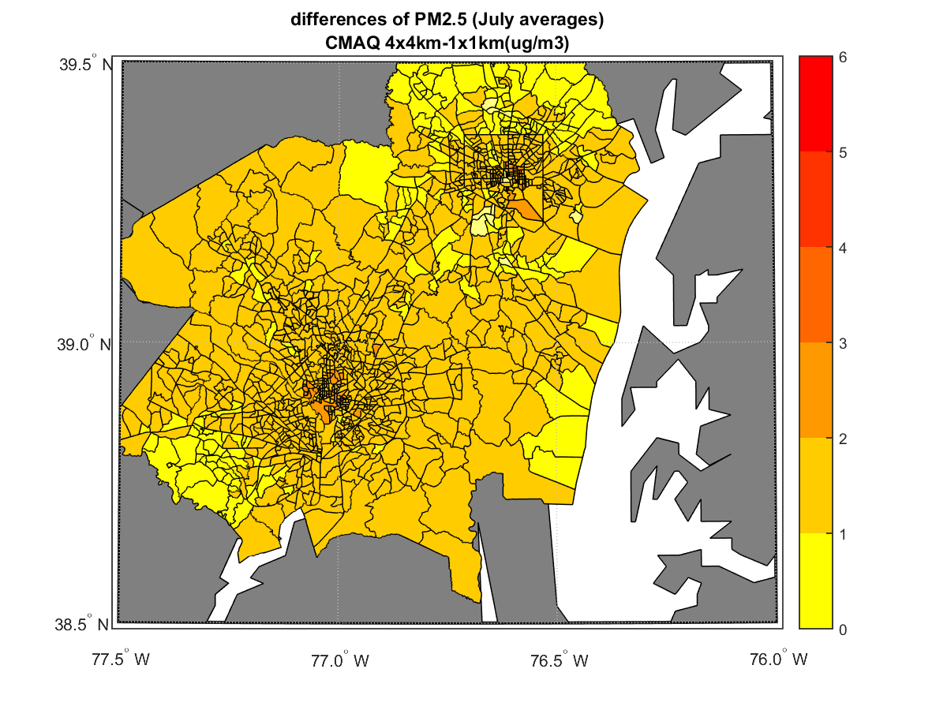
PM_{2.5} Concentrations – Spatial Difference
Greater difference in PM_{2.5} concentrations between kriging and CMAQ
Differences > 2 µg/m³ (July 2011 average) due to CMAQ underestimation of PM_{2.5}
Kriging – CMAQ 4x4km
CMAQ 4x4km – CMAQ 1x1km
6
5
4
3
2
1
0

Slide 12
SHEDS-PM PM_{2.5} Exposures
Population distributions of PM_{2.5} exposure
PM_{2.5} exposure distributions differ less than conc. input
Including worker commuting increases PM_{2.5} exposure only for CMAQ 1x1 km
Census tract average PM_{2.5} exposures
PM_{2.5} exposure ~60% of conc. input
Some variability by census tract, commuting
Exposure
Concentration

Slide 13
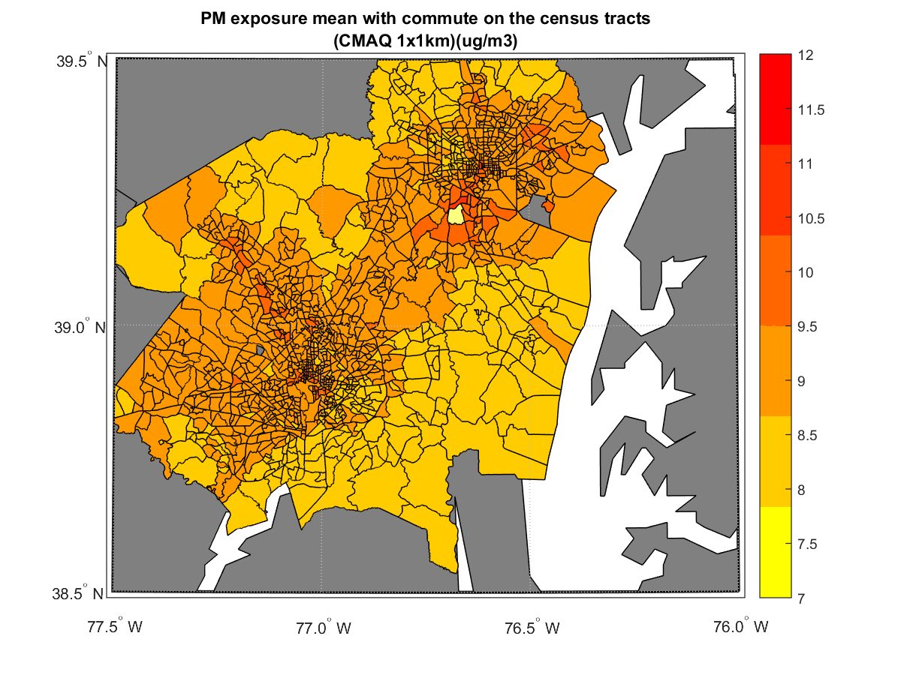
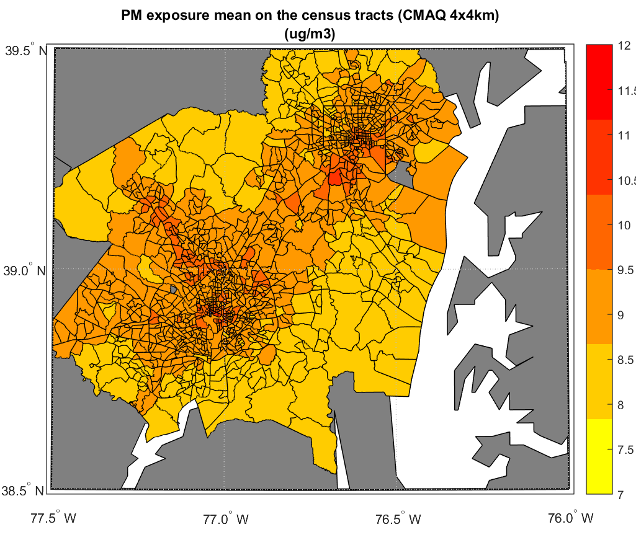
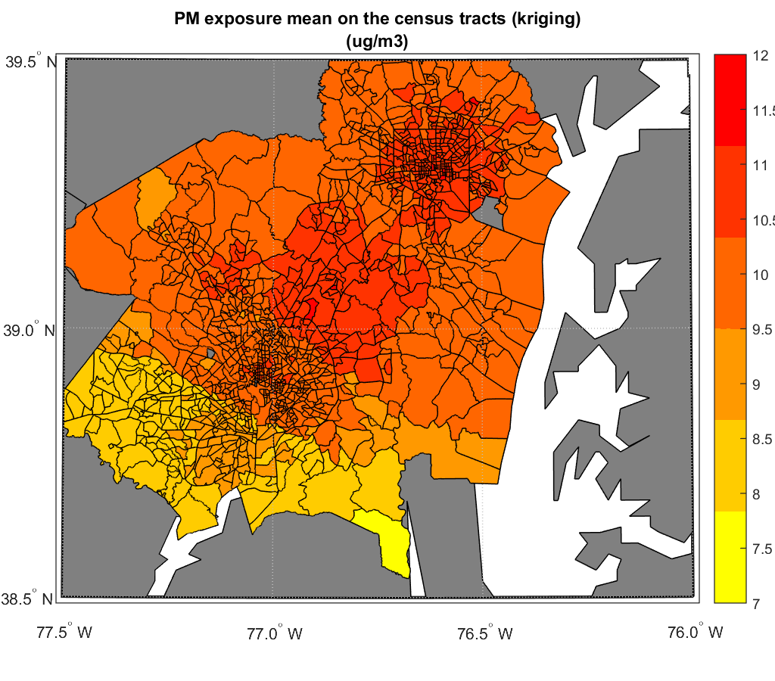
SHEDS-PM PM_{2.5} Exposures – Spatial Trends
Comparison of census tract average PM_{2.5} exposures for July 2011 without commuting
Average PM_{2.5} exposures similar spatially for CMAQ 4x4km and 1x1km
Higher magnitude and less variation in average PM_{2.5} exposures with kriging
CMAQ 4x4km
CMAQ 1x1km
Kriging
12
11
10
9
8
7

Slide 14
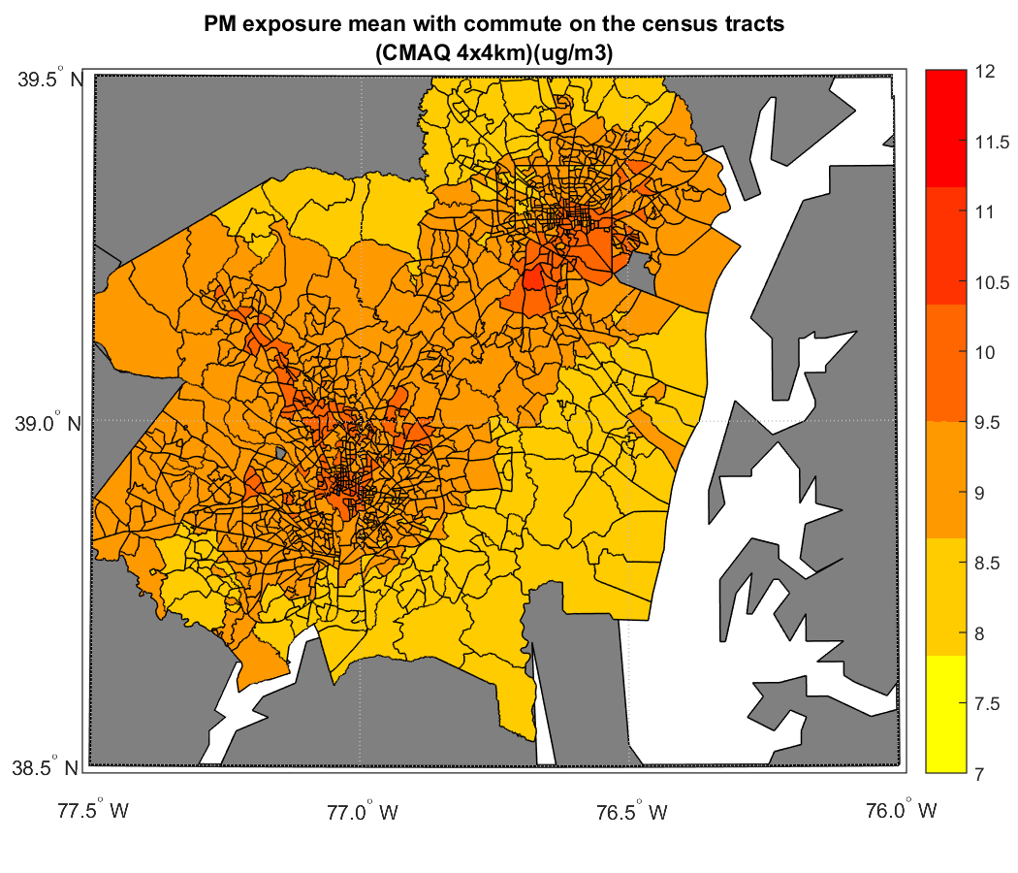
SHEDS-PM PM_{2.5} Exposures – Spatial Trends
Comparison of census tract average PM_{2.5} exposures for July 2011 with commuting
Average PM_{2.5} exposures more similar spatially for CMAQ 4x4km and 1x1km when include worker commuting; same for kriging
CMAQ 4x4km
CMAQ 1x1km
Kriging
12
11
10
9
8
7

Slide 15
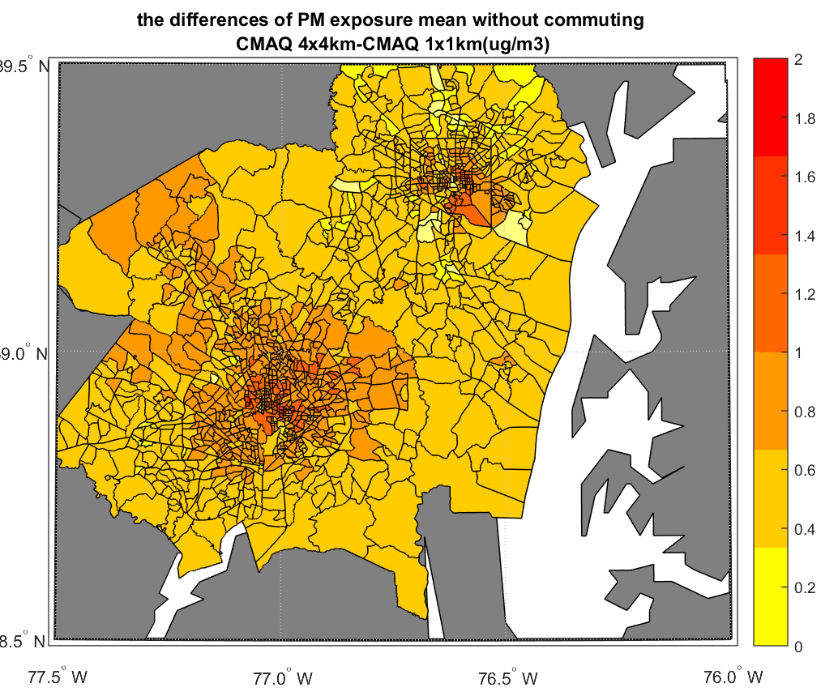
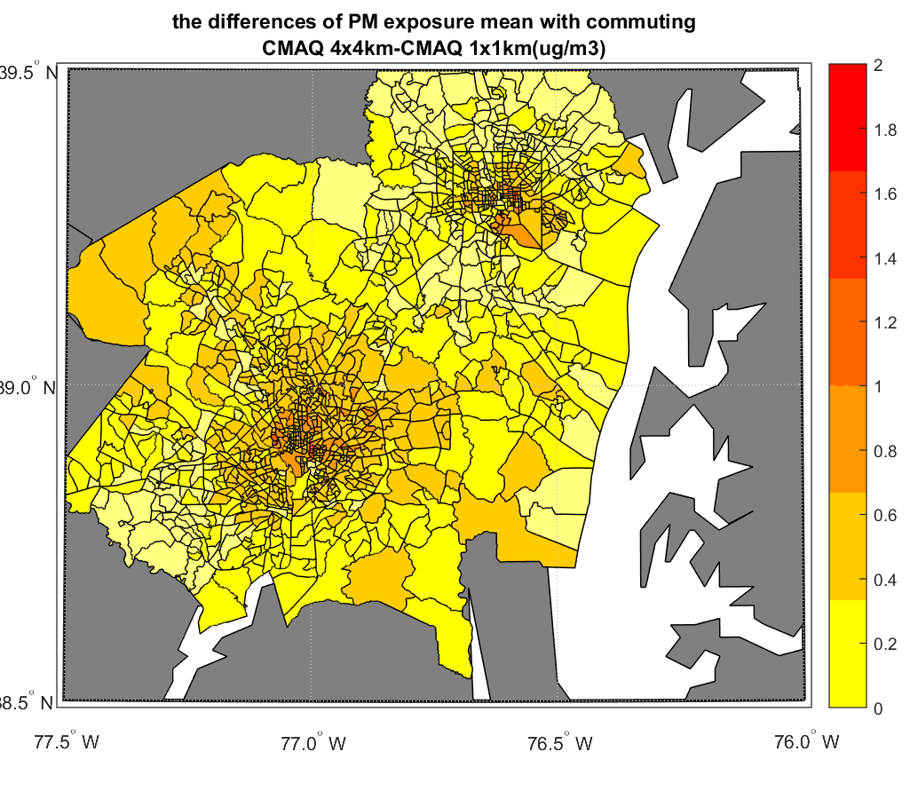
PM_{2.5} Conc. vs. Exposures – Spatial Difference
Comparison of differences between CMAQ grid resolutions (4x4km – 1x1km) for census tract average PM_{2.5} concentrations and exposures
PM_{2.5} concentrations differences ~1 – 2 µg/m³ vs. ~0.5 – 1.0 µg/m³ for PM_{2.5} exposure differences in urban areas, and < 0.5 µg/m³ for PM_{2.5} exposure with commuting
PM_{2.5} Concentration Difference
PM_{2.5} Exposure Difference
Without Commuting
PM_{2.5} Exposure Difference
With Commuting
2.0
1.5
1.0
0.5
0
Baltimore
Washington, DC

Slide 16
Summary
Results of case study application of SHEDS-PM indicate that:
Differences in modeled estimates of PM_{2.5} exposures are smaller than differences in PM_{2.5} concentrations between CMAQ grid resolutions
Incorporating time spent in indoor locations and factors influencing indoor PM_{2.5} levels may reduce magnitude of differences
Accounting for worker commuting to different census tracts with higher/lower concentrations further reduces magnitude
Due to lack of spatial coverage of monitoring sites in urban areas, using CMAQ output for human exposure modeling may provide improved characterization of spatial variability, with adjustment for model bias
Fine-scale CMAQ grid resolution of 4x4km may be sufficient for modeling PM_{2.5} exposures compared to 1x1km
Further analyses and future work
Investigate urban areas and populations more closely to confirm results
Incorporate temperature and wind speed data from WRF/CMAQ in estimates of residential air exchange rates

Slide 17
Questions?
Disclaimer: The views expressed in this presentation are those of the authors and do not necessarily represent the views or policies of the U.S. Environmental Protection Agency.

