Slide 1

Local to regional scale modeled wildland fire impacts on O₃ and PM
Kirk Baker, Luxi Zhou, Matt Woody
U.S. Environmental Protection Agency
Research Triangle Park, NC
October 2016

Slide 2
Motivation
Current and future human health impacts from wildland fires
O₃ and PM National Ambient Air Quality Standards (NAAQS)
  Exceptional Event demonstrations (e.g., Flint Hills impacts on O₃ in Kansas City)
Regional Haze Rule
National Air Toxics Assessment
Exposure and health impact assessments
Understand how well our regulatory modeling system (SMARTFIRE2, BLUESKY, SMOKE, CMAQ) represents wild and prescribed fires to best inform regulatory assessments

Slide 3
Outline
Started with regional scale assessment of the O₃ and PM2.5 impacts from a large wild and prescribed fire from 2011 using routine surface measurements
Currently using existing field study in-plume measurements of wildland fires to evaluation and potentially improve one or more components of the regulatory modeling system
  2013 prescribed cropland fire in SE Washington and central Idaho field study
  2013 in-plume measurements of the Rim fire in central California
Thinking toward using future field study measurements that will provide a more robust dataset to evaluate the modeling system and better characterizing the areas of greatest model development need

Slide 4
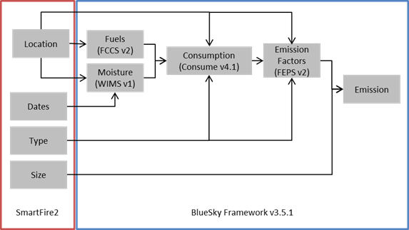
Regulatory Modeling System for Wildland Fire
SMOKE
CMAQ
CAMx
SPECIATE database
*2014 TSD documentation on estimating WLF emissions for the NEI

Slide 5
Schematic of wildland fire modeling
SMARTFIRE2 – Satellite information(NOAA/HMS), state/federal/tribal databases, helicopter perimeters reconciled to estimate size, location, date, and type of fires for input into BLUESKY
BLUESKY – Wildland fire emissions framework using information from SMARTFIRE2 for fire date, location, type, and burn area; outputs daily emissions for each fire for input to SMOKE
FCCS – Provides fuel type and loading information
WIMS – Provides fuel moisture information
CONSUME – Estimates total fuel consumed by the flaming and smoldering components of fire
FEPS –Pollutant emission factors
SMOKE – Provides temporal allocation of BLUESKY daily emissions to hour of the day and VOC and PM speciation; can optionally estimate plume rise based on the Briggs approach; outputs for CMAQ or CAMx
CMAQ – Estimates plume rise for wildland fires based on heat flux calculations and the Briggs approach; plume chemistry and transport (based on WRF model meteorology)

Slide 6
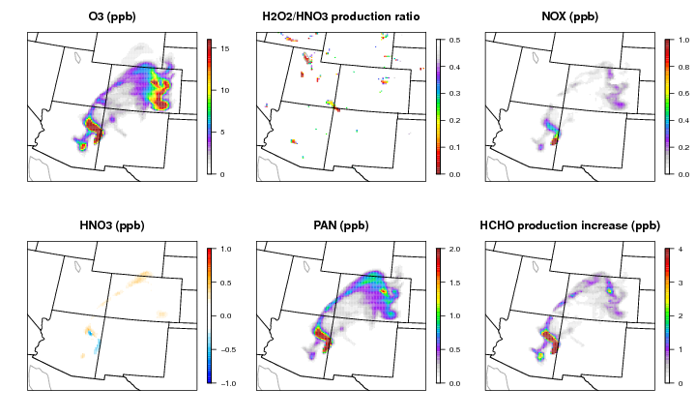
Ozone
Modeled impacts of Wallow fire shown for June 5, 2011 at 2pm LST
NO_{X} and VOC emissions from wildfires important
PAN and aldehydes important in local to regional scale O₃ production

Slide 7
Ozone
Model is providing useful chemical evolution information about wildfire plumes, how do we evaluate?
Hourly fire contribution paired with bulk model O₃ bias at rural CASTNET monitors
The model sensitivity includes solar radiation and photolysis rates more aggressively attenuated by modeled organic aerosol: treating organic carbon similar to black carbon
When the model estimates large wildland fire contribution to nearby CASTNET sites the model tends to overestimate O₃
Preferential to have in-plume measurements from specific wildland fires

Slide 8
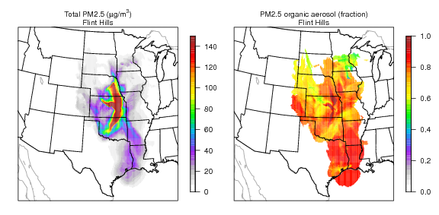
PM2.5
Episode maximum hourly impacts from the Flint Hills fire to PM_{2.5}.
POA largest component (treated as non-volatile in these simulations)
Daily averaged modeled Flint Hills fire contribution paired with bulk model speciated PM_{2.5} bias at rural IMPROVE monitors

Slide 9
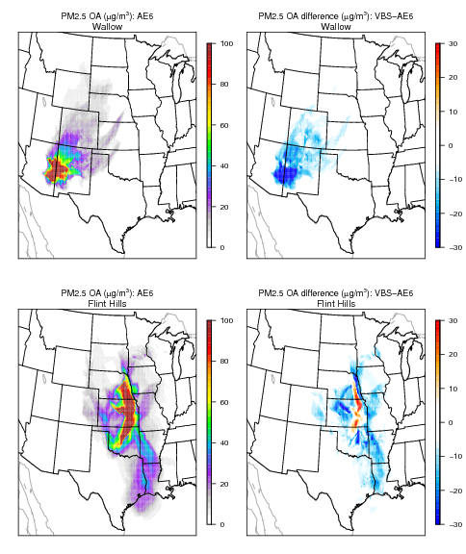
PM2.5 OA
Maximum hourly impacts from Wallow (top row) and Flint Hills (bottom row) fires to modeled PM_{2.5} organic aerosol.
The difference between the AE6 and standard VBS are also shown.
  Cool colors indicate less PM_{2.5} organic aerosol contribution with the sensitivity simulation
Disagreement about SOA formation from wildland fires within the scientific community—best approach not clear
In-plume measurements needed to inform these choices

Slide 10
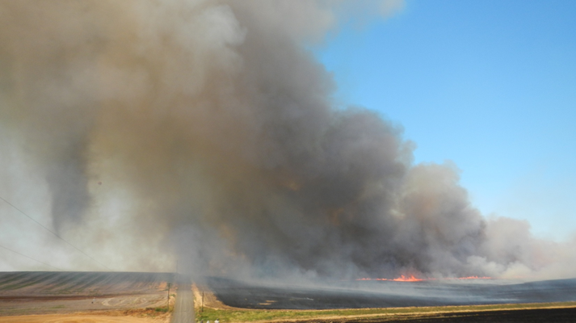
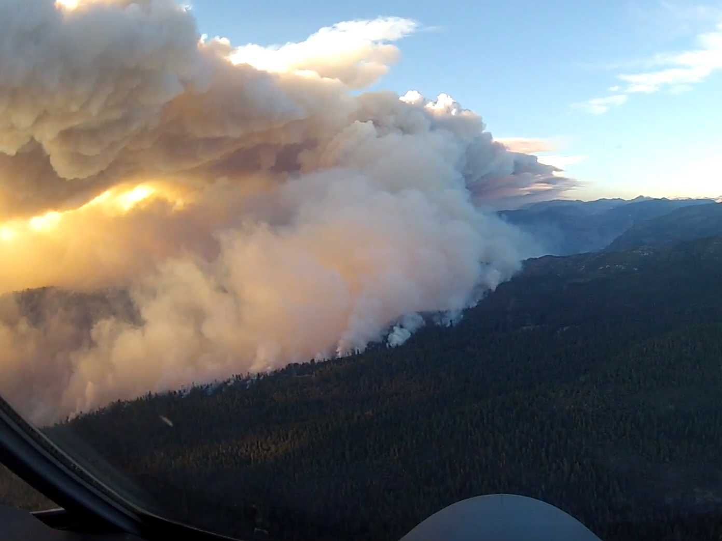
Current Modeling Projects
Currently working with existing field study measurements toward evaluating and development of the modeling system – not all projects intended to focus on each component of the modeling system
August 2013 Field Study (AgBurn) in eastern WA and central ID croplands
  WRF and CMAQ modeling at 2 km
  see Luxi Zhou poster “Modeling prescribed fire impacts on local to regional air quality and potential climate effects” this afternoon
August-September 2013 SEAC4RS measurements near the Rim Fire (central California)
  WRF and CMAQ modeling at 12 and 4 km
  see Matt Woody presentation “Assessment of Air Quality Impacts from the 2013 Rim Fire” immediately following this talk

Slide 11
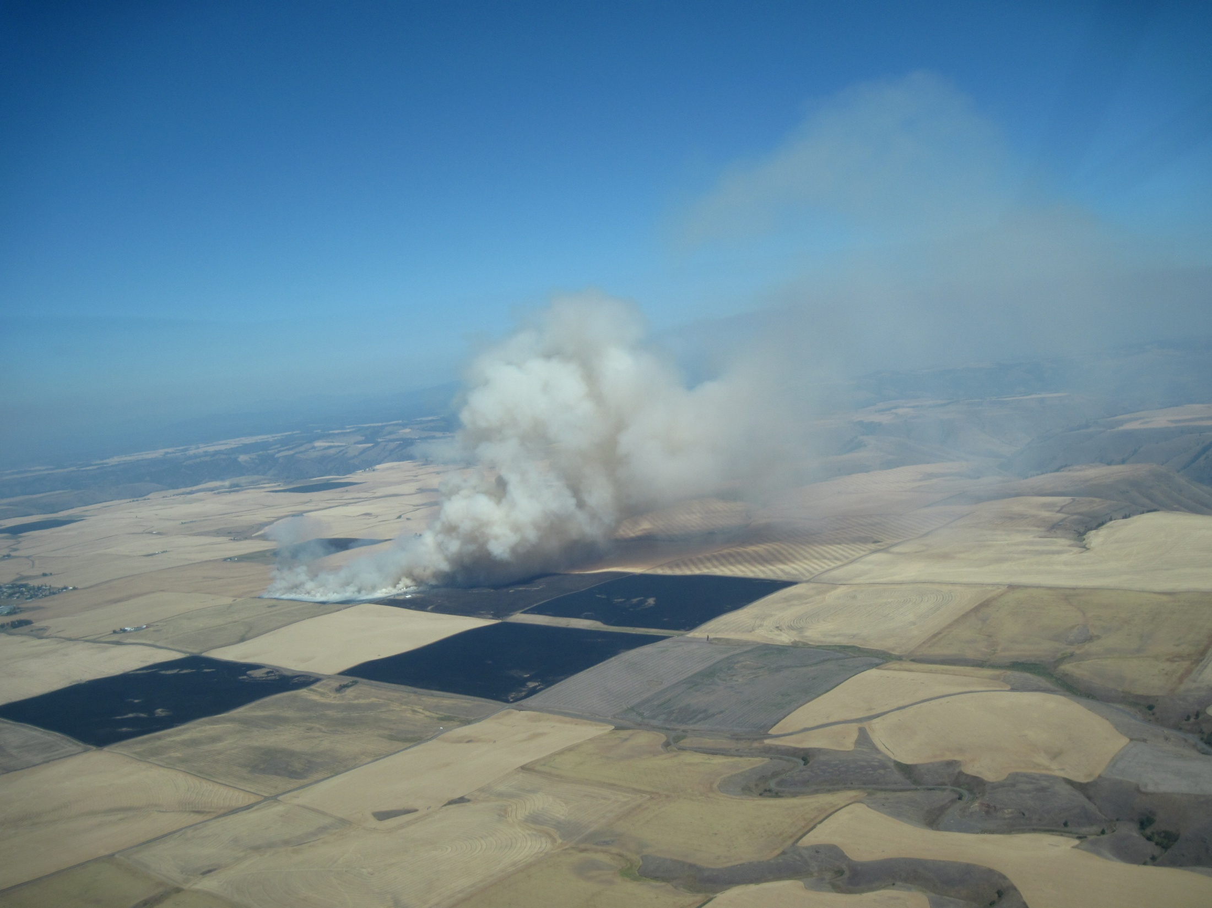
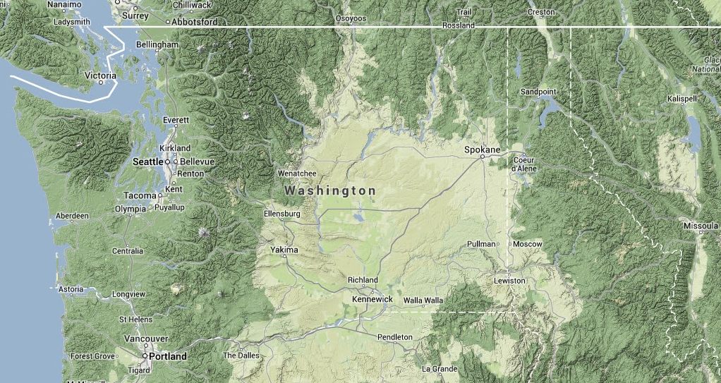
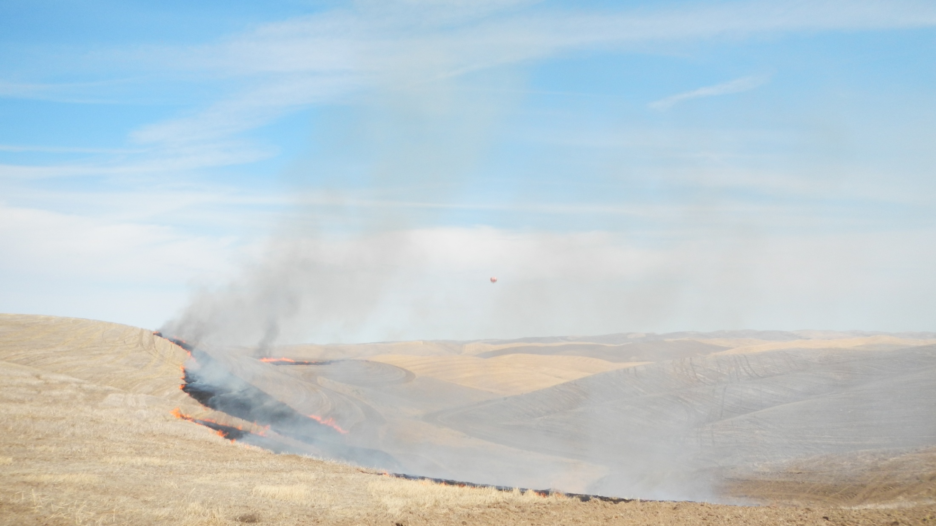
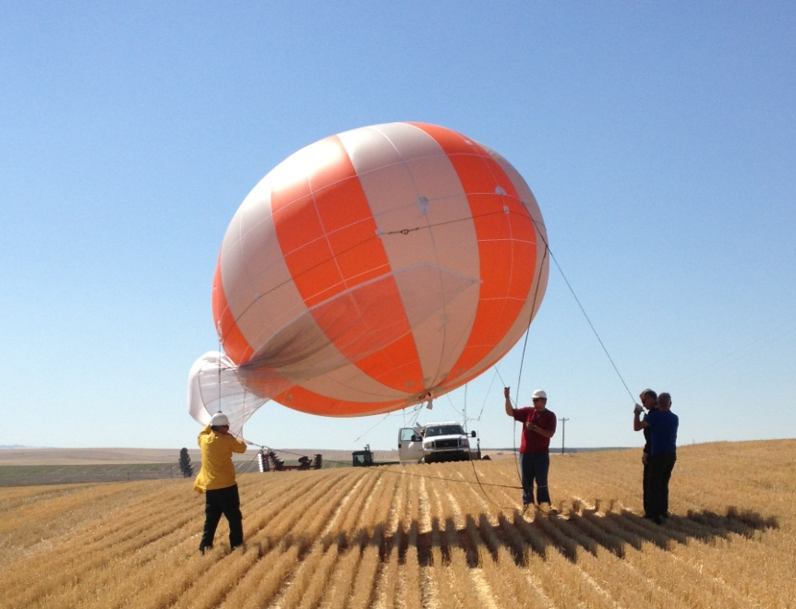
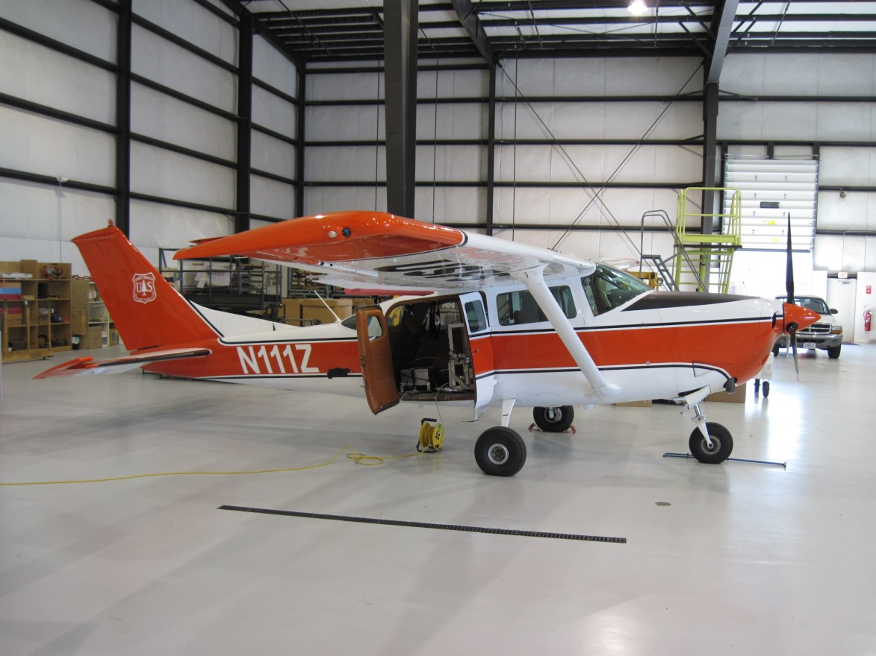
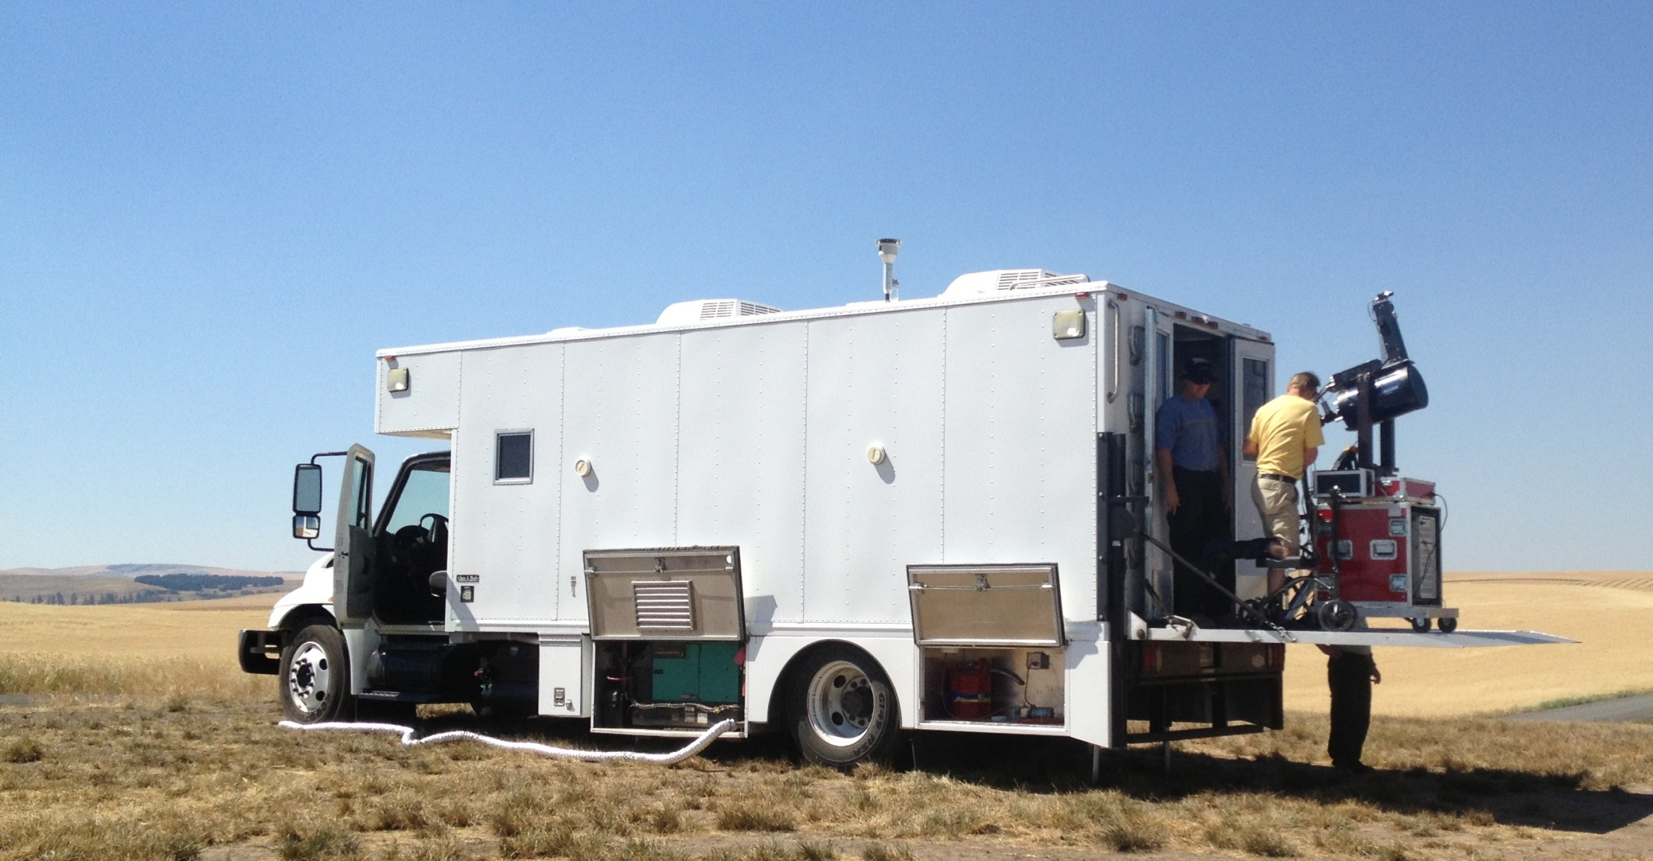
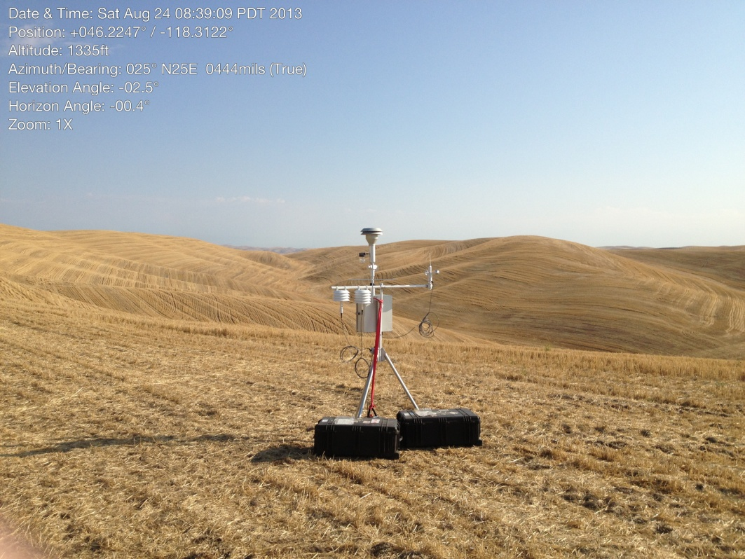
August 2013 Washington/Idaho Field Study
*see Luxi Zhou poster “Modeling prescribed fire impacts on local to regional air quality and potential climate effects” this afternoon for more details.
Nez Perce Reservation
Washington Palouse

Slide 12
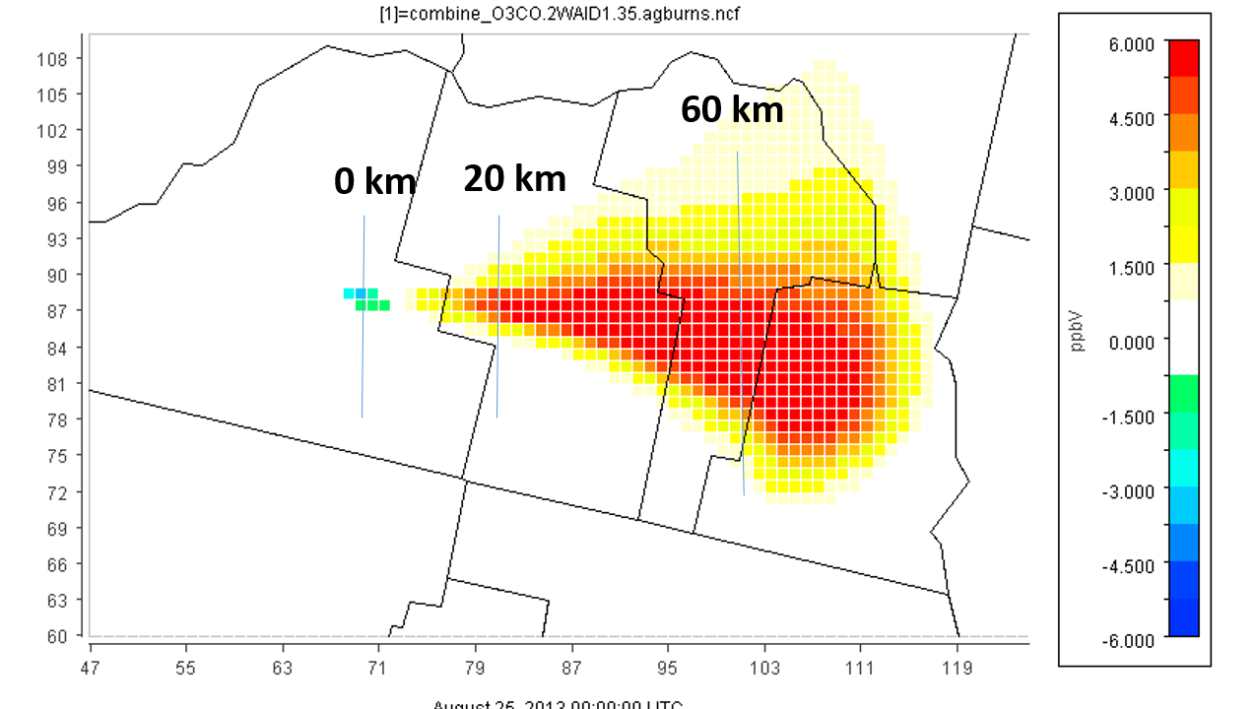
2013 Washington/Idaho Field Study Notes
Valuable information about fuel type, moisture content, and consumption
Ground and tethered balloon platforms useful for evaluating emission factors
Aircraft sampled at a scale relevant for a gridded modeling system
Lidar and ceilometer data useful for evaluating plume characterization
Very little information about gas or aerosol chemistry (not part of study goals)
Limited information about VOC and PM speciation, plume structure
Less relevant for wildfire or prescribed fires of fuels that are not crops
Modeled Ozone (ppb)

Slide 13
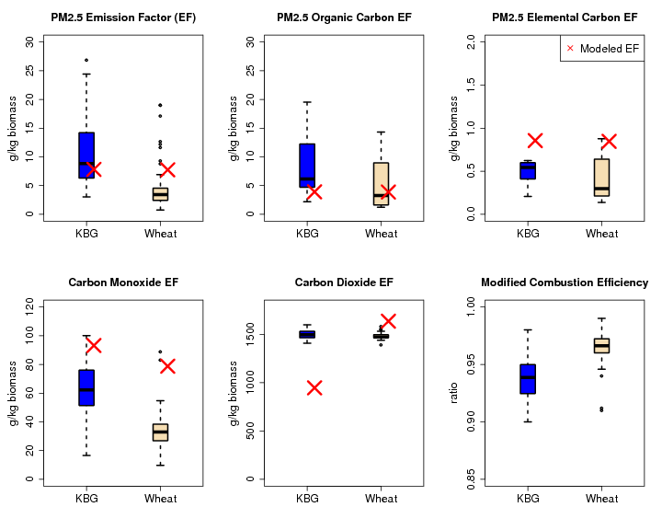
Emissions
Compare emission factors estimated by the Bluesky framework with the distribution of emission factors measured using the ground, aerostat, aircraft, and open burn test facility platforms
MCE (modified combustion efficiency) shown for measurements to indicate range of flaming to smoldering conditions

Slide 14
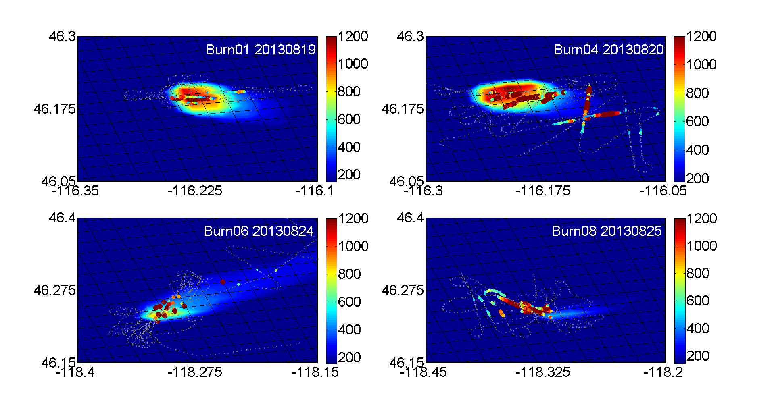
CO (ppb)
Figure courtesy of L. Zhou

Slide 15
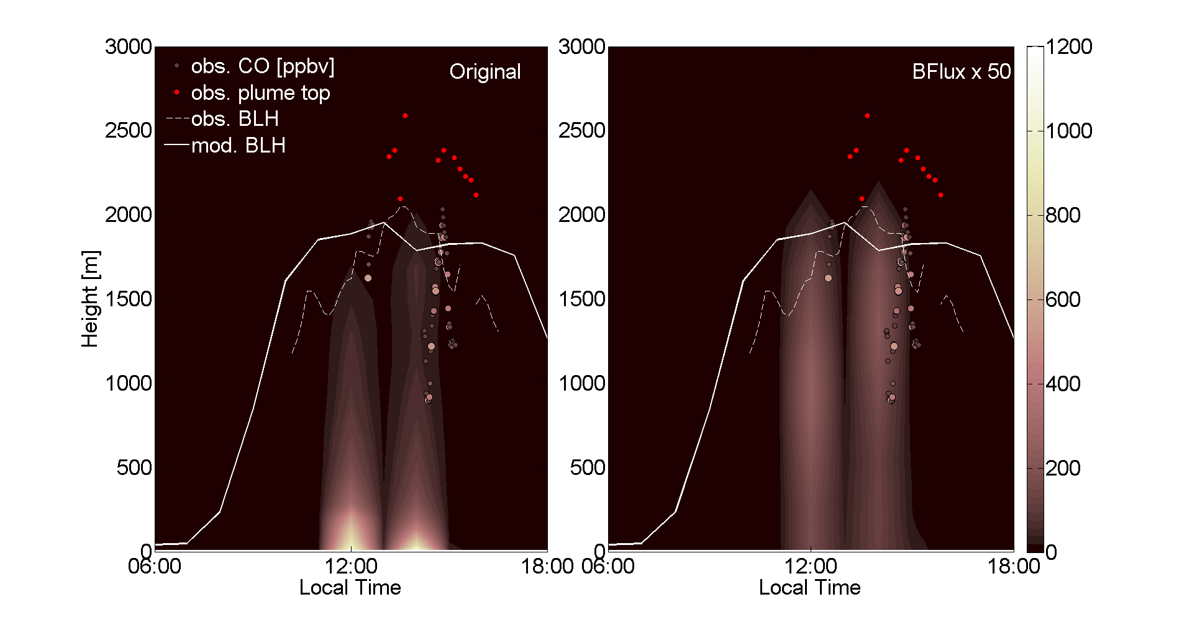
CO (ppb)
Figure courtesy of L. Zhou

Slide 16
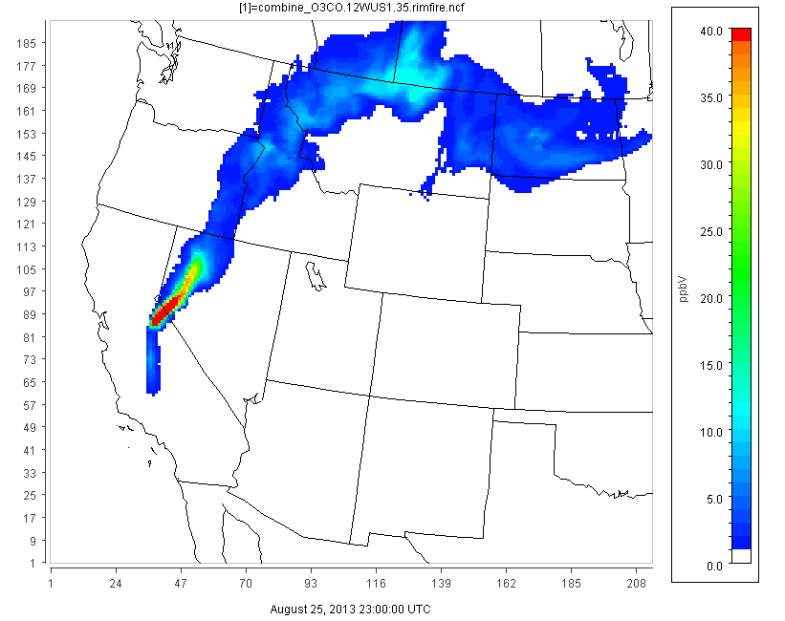
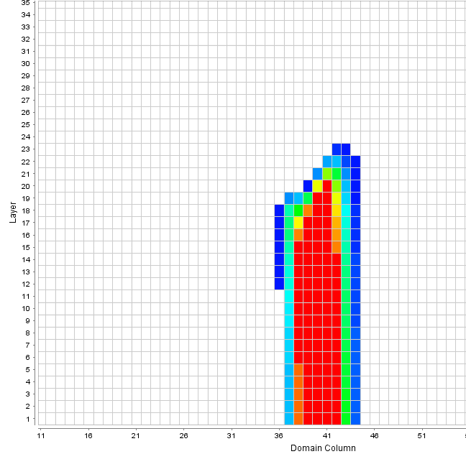
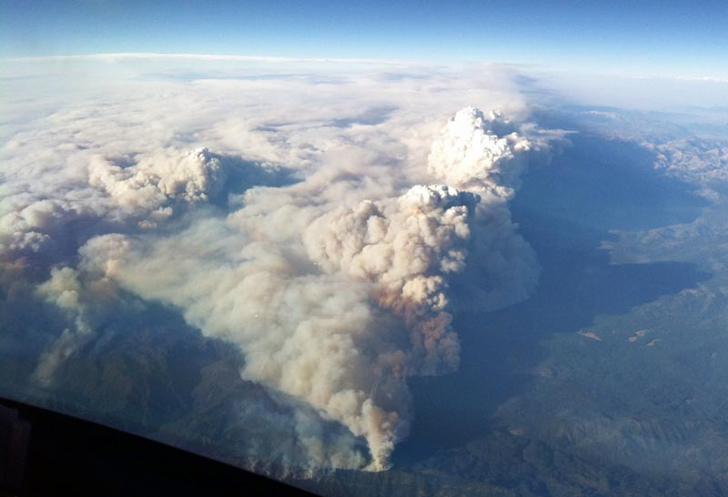
2013 Rim Fire in central California well studied and characterized
Plots show modeled O₃ at 3 pm Aug 25, 2013
Using aircraft measurements from the 2013 SEAC4RS and NASA-AJAX flights for model evaluation
Lidar plume measurements
O₃ from previous days of Rim Fire burning
4 km ->
1 km ->
  *see Matt Woody presentation “Assessment of Air Quality Impacts from the 2013 Rim Fire” immediately following this talk

Slide 17
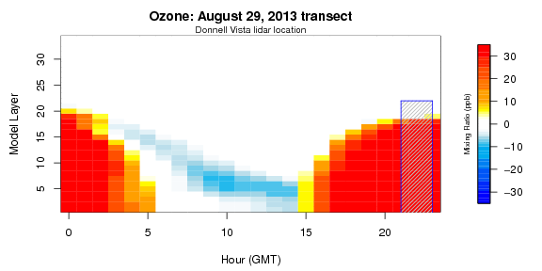
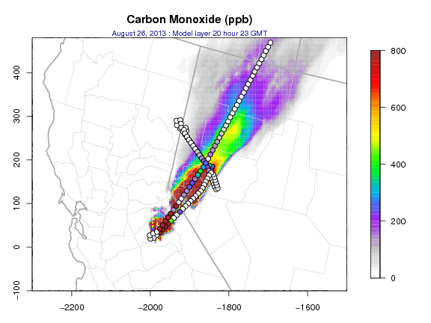
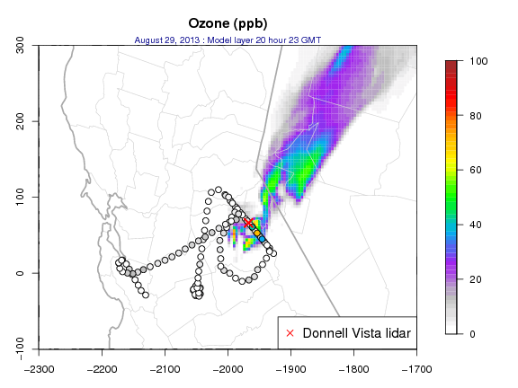
Rim Fire Impacts
CO (ppb)
O₃ (ppb)

Slide 18
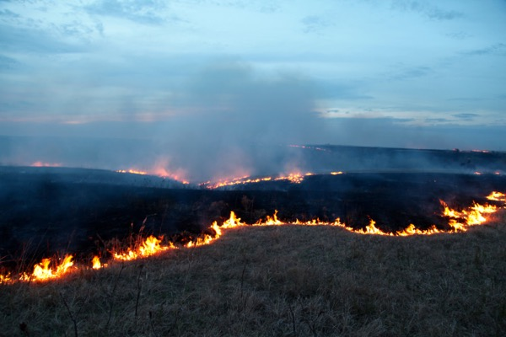
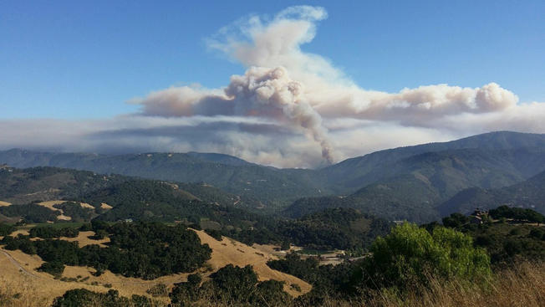
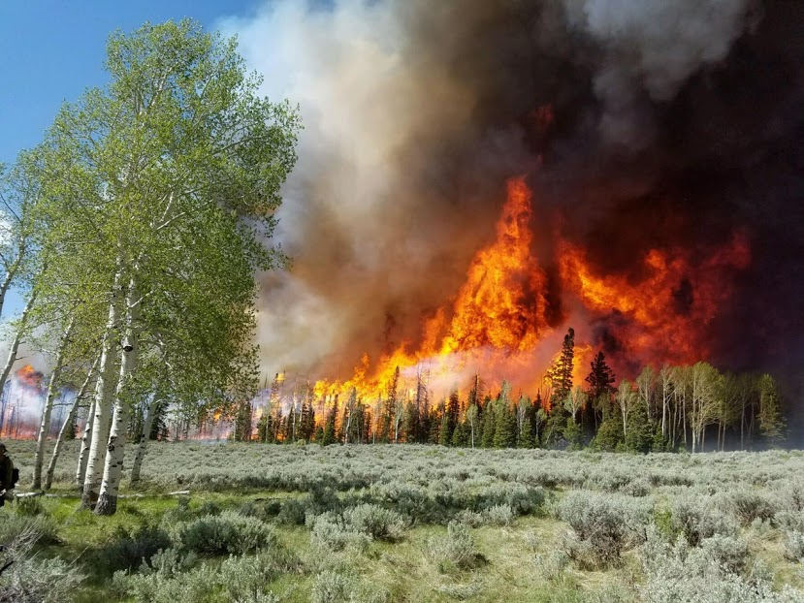
Upcoming Projects
Modeling additional wildland fire field studies
California Baseline Ozone Study (CABOTS) 2016
Flint Hills Fire Experiment (FLINT-FX) April 2017
FASMEE, FIREX, FIRECHEM and associated 2018
Flint Hills, KS 2017 (FLINT-FX)
Soberanes fire California 2016 (CABOTS)
Fishlake NF, UT 2018 (FASMEE)

Slide 19
Past and upcoming opportunities for model evaluation of wildland fire impacts

Slide 20
What are outstanding needs for local to regional scale O₃/PM wildland fire modeling?
Evaluate existing satellite detection process and new geostationary satellite scheduled to be operational by 2017
Fire emissions by fuel type and combustion component (flaming to smoldering)
  Includes speciation of VOC, directly emitted PM2.5, oxidized nitrogen gases
  Temporal (hour of the day) allocation of emissions by combustion component
Plume rise/vertical allocation for flaming and smoldering emissions in CMAQ photochemical model (and SMOKE) during day and night time
Near-event and downwind O₃ and PM_{2.5} chemistry during day and night time
Optical properties of smoke are not well characterized meaning photochemistry may be overstated near large fires
Projecting future year wildland fires for climate impact scenarios

Slide 21
Acknowledgements
James Beidler, Chris Allen, Allan Beidler, Lara Reynolds, Kathy Brehme – CSRA
Emma Yates, Laura Iraci – NASA-AMES
Tom Pierce, George Pouliot, Sergey Napelenok, Tyler Fox – US EPA
References
Baker KR, Woody M, Tonnesen G, Hutzell G, Pye H, Beaver M, Pouliot G, Pierce T. 2016. Contribution of regional-scale fire events to ozone and PM2.5 air quality estimated by photochemical modeling approaches. Atmospheric Environment, dx.doi.org/10.1016/j.atmosenv.2016.06.032.

Slide 22
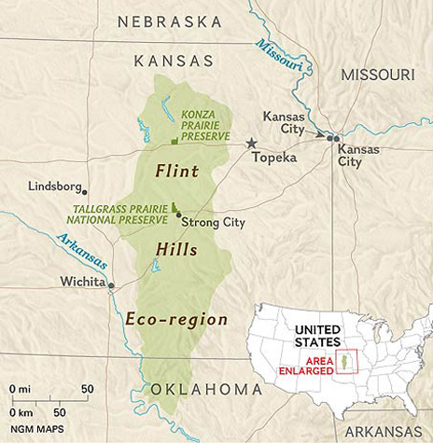
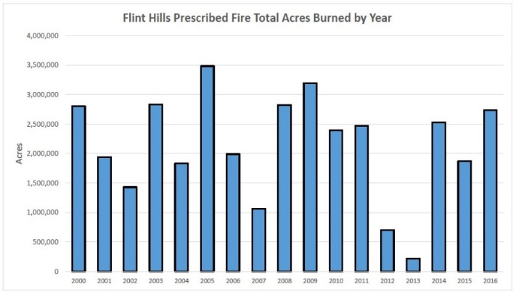
FLINT-FX 2017
Grass/rangeland prescribed burning practices in the Flint Hills region leads to elevated O₃ and PM regionally
Kansas developed an exceptional event demonstration for O₃ impacts in Kansas City during the spring of 2011
A field study planned for April 2017 at Fort Riley in central Kansas to improve emission estimates for these burns
Contact Kirk Baker (baker.kirk@epav) or Brian Gullett (gullett.brian@epa.gov) for information about this field study

Slide 23
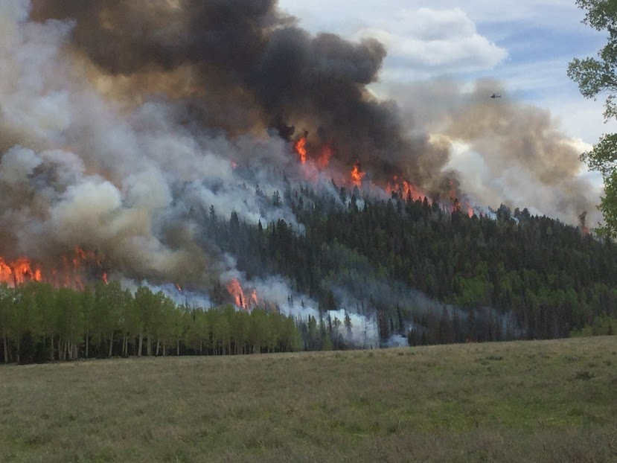
F3: FASMEE, FIREX, FIRECHEM
Field campaigns providing important chemical and optical measurements include FIREX (2018) and FIRECHEM (2018) for western U.S. wildfires
  http://www.esrl.noaa.gov/csd/projects/firex/
Field campaigns providing fuel information, area burned, plume structure, and chemical measurements include FASMEE for western U.S. (2018) and southeast U.S. (TBD) prescribed fires
  Fire and Smoke Modeling Evaluation Experiment (www.fasmee.net)

