Slide 1
Two Decades of WRF/CMAQ simulations over the continental U.S.: New approaches for performing dynamic model evaluation and determining confidence limits for the O3 design value
Marina Astitha¹, Huiying Luo¹, S.T. Rao¹, Christian Hogrefe², Rohit Mathur², and Naresh Kumar³
¹Department of Civil & Environmental Engineering, University of Connecticut, Storrs-Mansfield, CT, USA
² U.S. Environmental Protection Agency, Research Triangle Park, NC, USA
³ EPRI, Palo Alto, CA, USA
Email: marina.astitha@uconn.edu
15th Annual CMAS Conference and will be held on October 24-26, 2016 at the Friday Center, UNC-Chapel Hill
Notes:
`` AS’
\

Slide 2
OBJECTIVES
Analyze and interpret the features embedded in tropospheric ozone observations and model outputs within the 21-year period 1990-2010
Assess the model’s ability to reproduce changes in observed ozone concentrations versus absolute values (dynamic evaluation)
How can we develop confidence intervals for the estimated design value (DV)?
1/20

Slide 3
OUTLINE
Models and data
Data analysis techniques
Dynamic evaluation
Confidence intervals for design values
Concluding remarks
2/20

Slide 4
Models and data
Coupled WRF-CMAQ (vers. 5.0.1) with 36-km grid cells over the USA driven with internally consistent historic emission inventories and boundary conditions derived from the hemispheric CMAQ model (Gan et al. 2015; Xing et al. 2013)
Observations of the summertime (May-September) daily maximum 8-hr average (DM8HR) ozone concentrations from U.S. EPA’s Air Quality System (AQS) for the period 1990-2010
Stations were selected based on quality-assured ozone measurements that have at least 80% data coverage at each monitoring location and each year (#186 stations) (see Porter et al. 2015 AE Paper).
3/20

Slide 5
Data analysis
Spectral decomposition using the Kolmogorov-Zurbenko (KZ) filter (Zurbenko 1986; Eskridge et al. 1997; Rao et al., 1997; Hogrefe et al. 2000; Porter et al. 2015). KZ is based on an iterative moving average that separates high frequency variations from the data.
DM8HR ozone concentrations are decomposed into components:
short-term (synoptic reflecting weather-induced variation: SY) and
long-term (baseline reflecting seasonality, emissions loading, policy, and trend: BL)
Baseline (BL)=KZ5,5(O₃)
Synoptic Forcing (SY)=[O₃-KZ5,5(O₃)]
Statistical metrics:
Root Mean Square Error (RMSE)
Mean Bias (MB)
Correlation coefficient (R)
Relative change= 100* (Future-Base)/Base
Absolute change=Future-Base
4/20

Slide 6
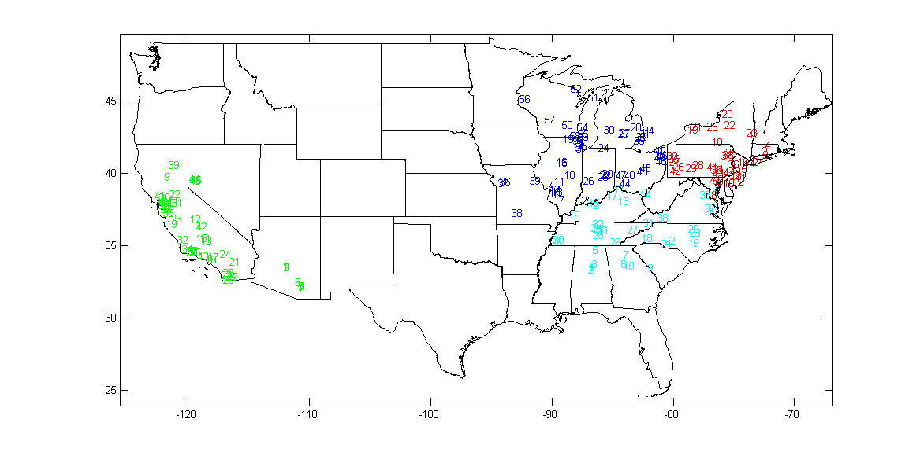
AQS Stations across CONUS (#186)
Region Station #:
NE 43 SE 38 SW 47 MW 58
Station selection: >80% coverage for 1990-2010
5/20

Slide 7
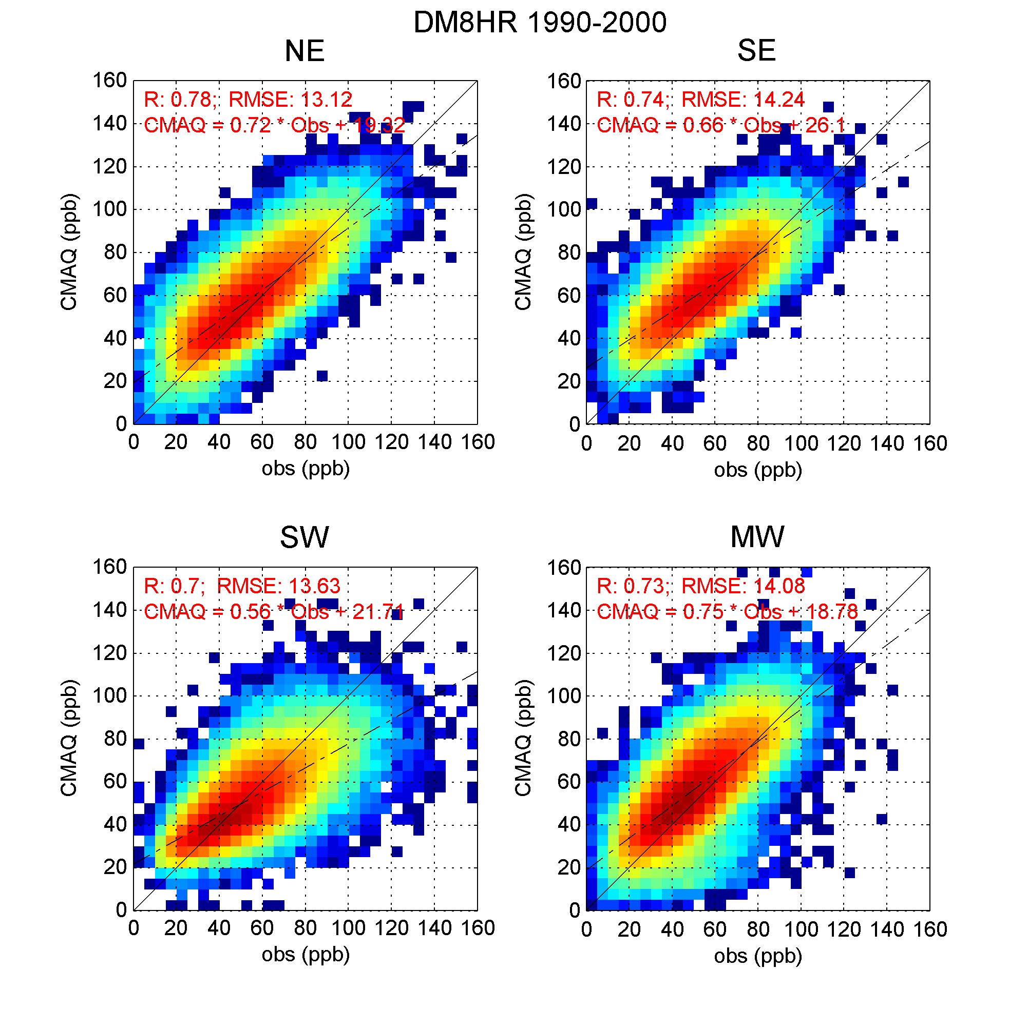
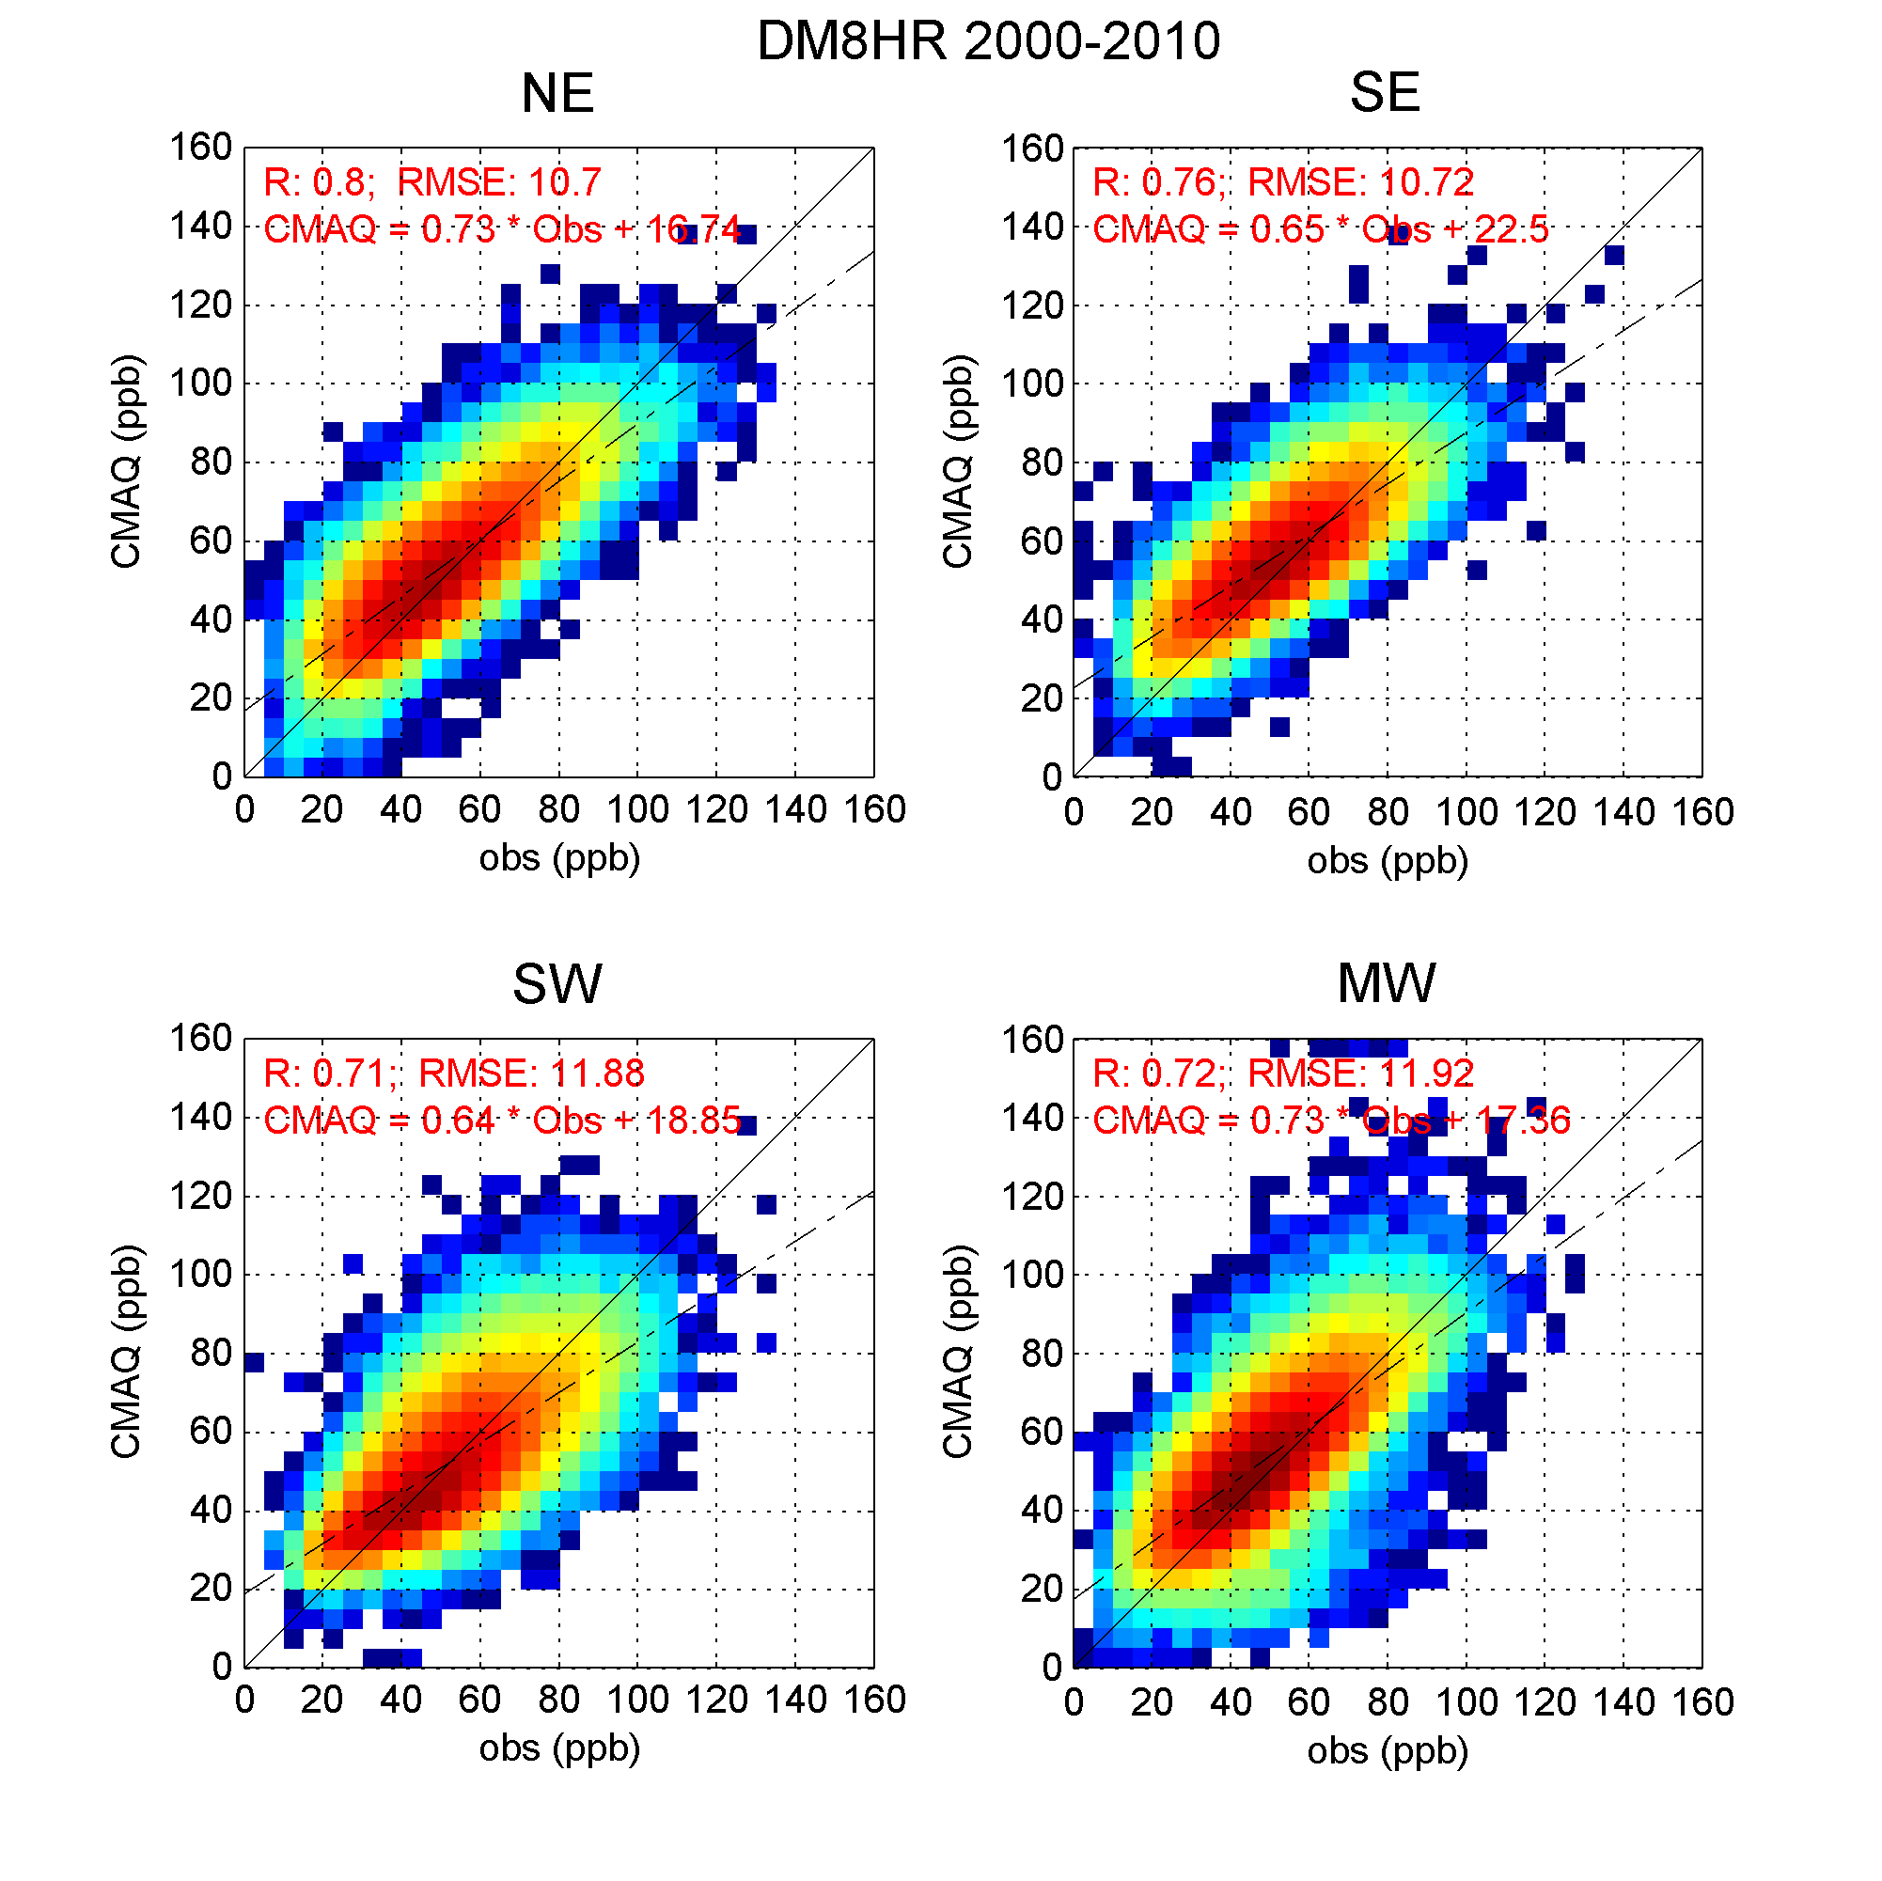
Operational Evaluation (DM8HR)
1990-2000
2000-2010
RMSE Reduction in the 2000-2010 period (13-14ppb → 10-12ppb).
Decrease in the higher O₃ conc; Increase of counts in the range of 30-60ppb.
6/20

Slide 8
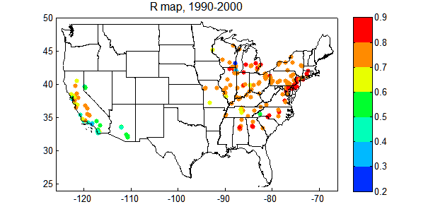
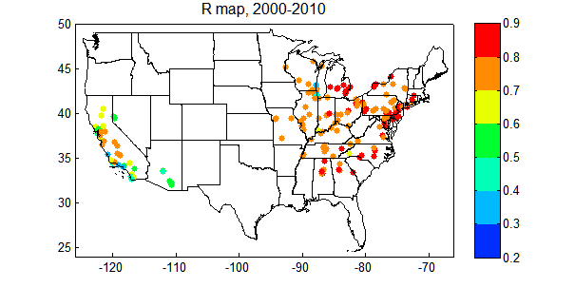
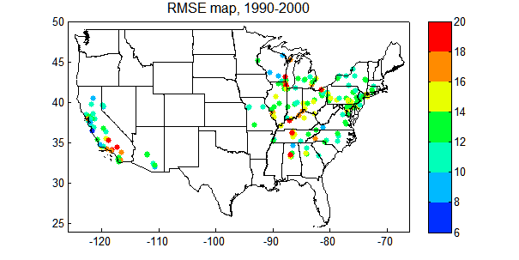
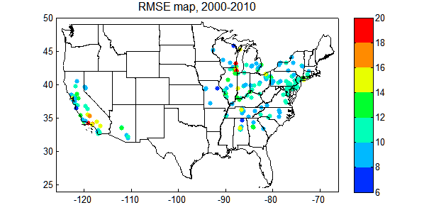
Spatial distribution of correlation and RMSE for DM8HR
1990-2000
2000-2010
Similar R ---- Decrease in RMSE
Almost no change for the SW U.S. (similar results in Foley et al. 2014, 14th CMAS)
7/20

Slide 9
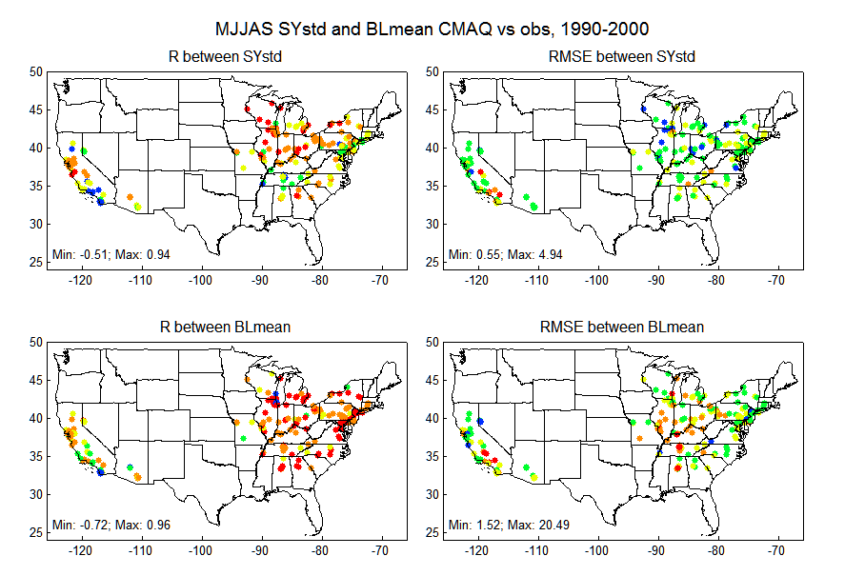
RMSE for SY and BL components
21-years: 1990-2010
1990-2000
2000-2010
RMSE of BL is higher for 1990-2010 compared to 2000-2010
What about air quality changes over the 21-years?
Role of emission-induced forcing vs. meteorological variability?
8/20

Slide 10
DYNAMIC EVALUATION
9/20

Slide 11
Trends in the BL component (slope)
21-years: 1990-2010
1990-2000
2000-2010
Decreasing emissions over 1990-2010 have led to a decrease in the BL across the Eastern US at a rate of ≈ 0.2-0.5 ppb/yr.
The slopes calculated by the model are more negative compared to the observed trends, especially for 2000-2010.
10/20

Slide 12
Relative change for 4th highest and the average of top 10 days
$$RC(CMAQ)=100 ∗ \frac{{CMAQ}_{future}−{CMAQ}_{base}}{{CMAQ}_{base}}$$
$$RC(Obs)=100∗ \frac{{OBS}_{future}−{OBS}_{base}}{{OBS}_{base}}$$
11/20

Slide 13
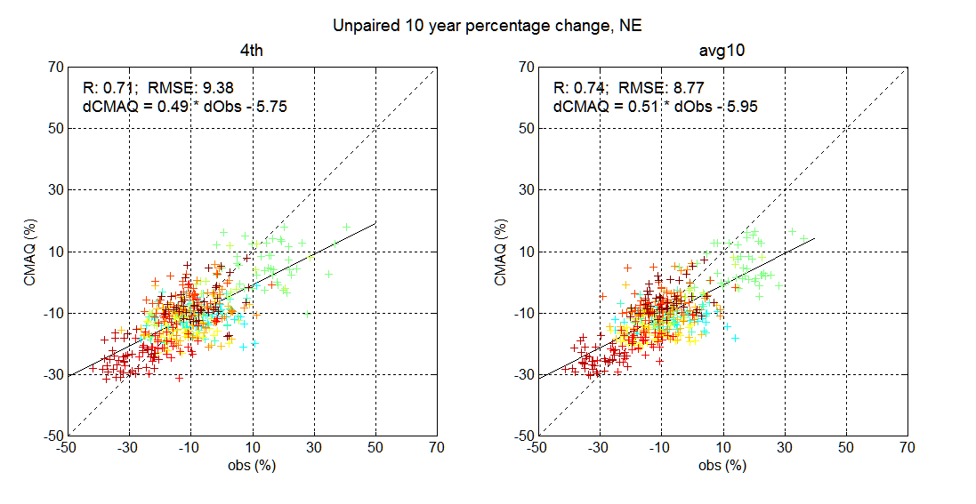
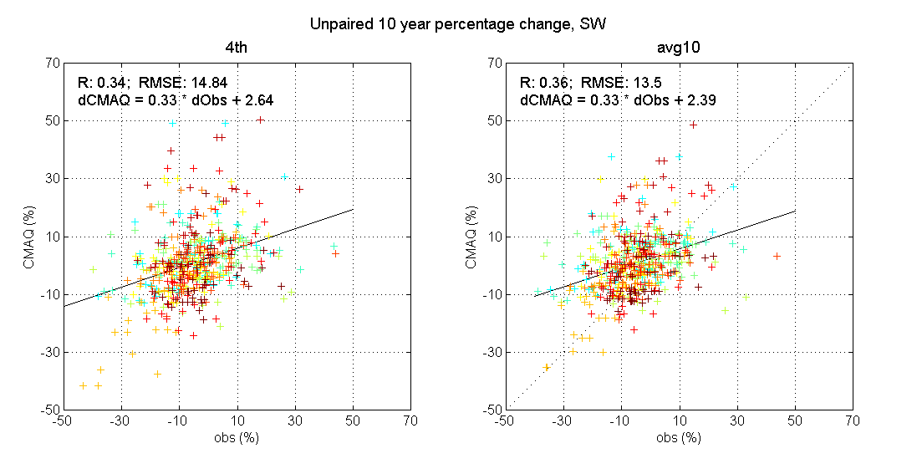
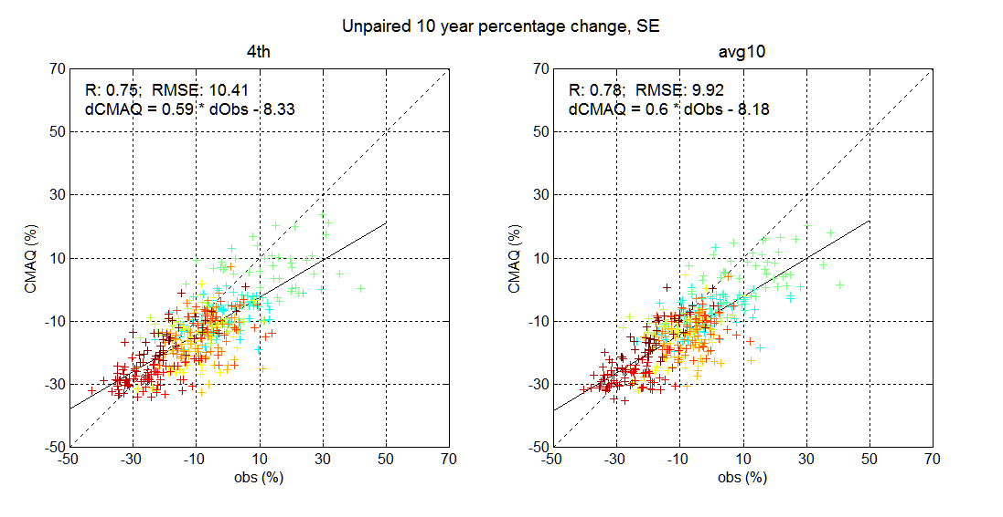
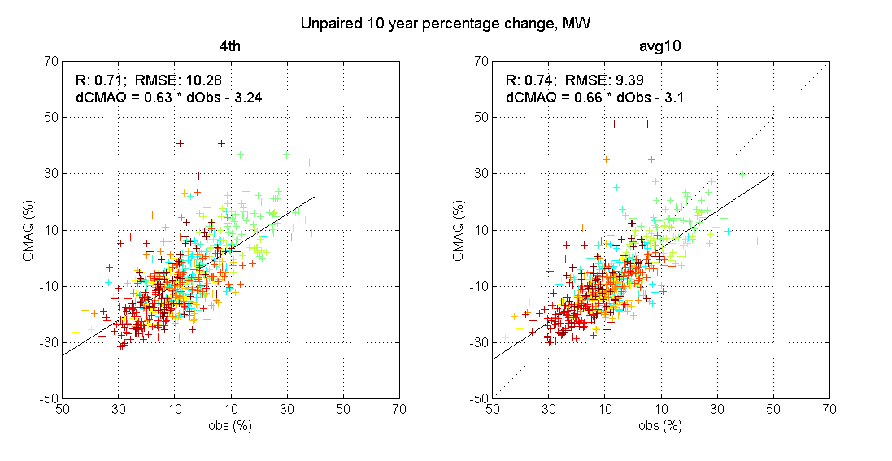
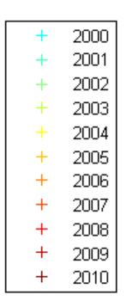
10-year interval
NE
SW
Relative changes for earlier years are underestimated
Relative changes for SW U.S. are poorly described
SE
MW
Future year
12/20

Slide 14
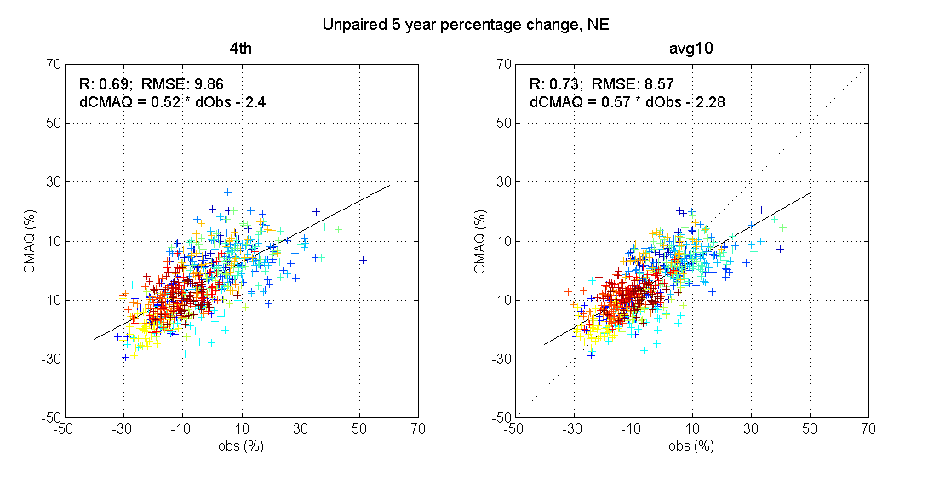
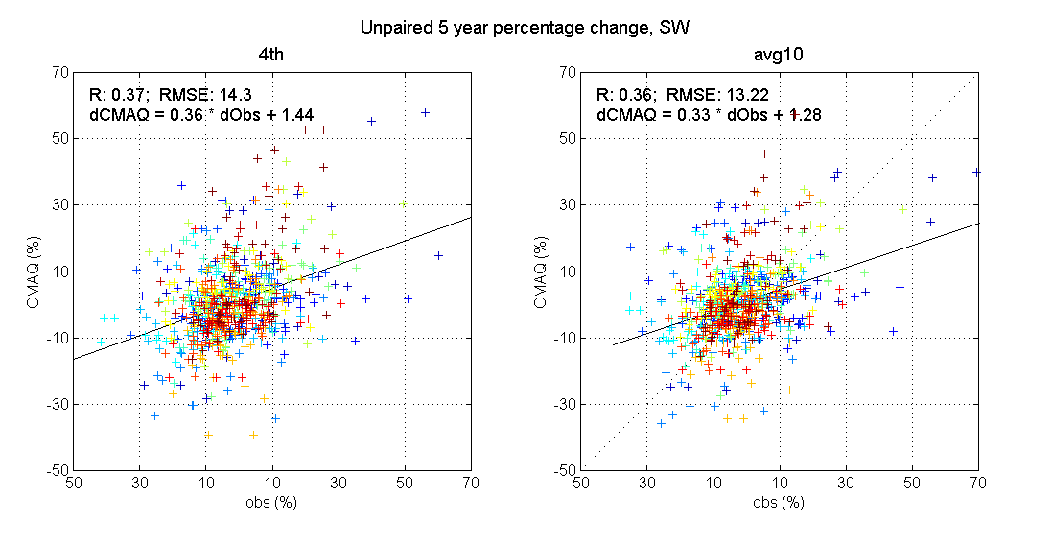
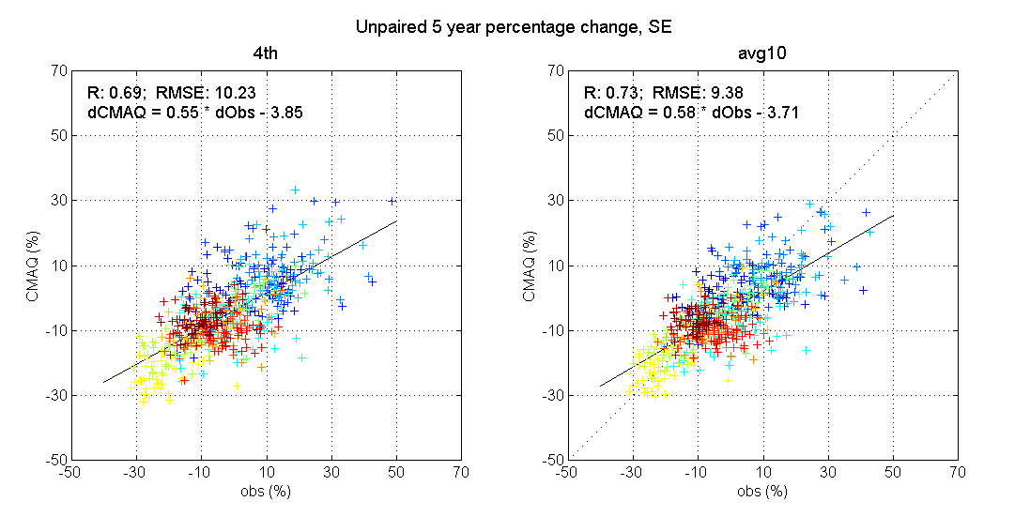
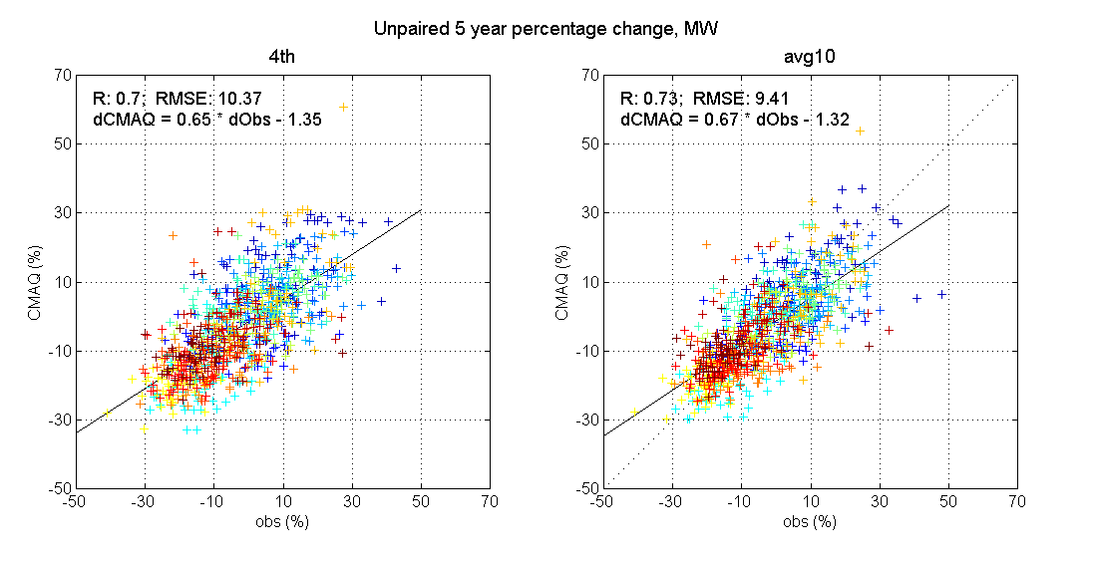
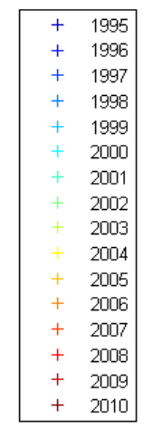
5-year interval
NE
SW
Future year
Relative changes for SW U.S. are poorly described
SE
MW
The model is more skillful in representing the relative changes in the 4th highest and Avg10 for NE, SE and MW than SW
Future
year
13/20

Slide 15
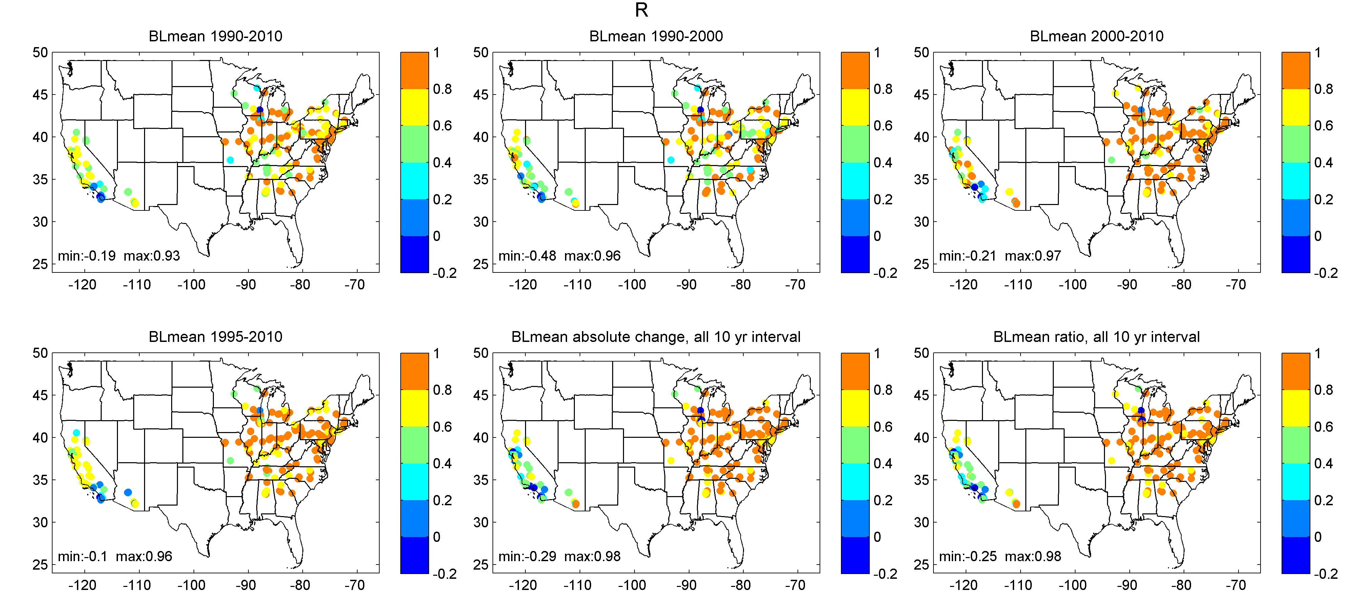
COMPARISON of ABSOLUTE value vs. CHANGE in MEAN BL
10-yr intervals
CORRELATION R
$$BL mean chang= \overline{{BL}_{CMAQ future}}−\overline{{BL}_{CMAQ base}}$$
$$BL mean ratio=\frac{\overline{{BL}_{CMAQ future}}}{\overline{{BL}_{CMAQ base}}}$$
14/20

Slide 16
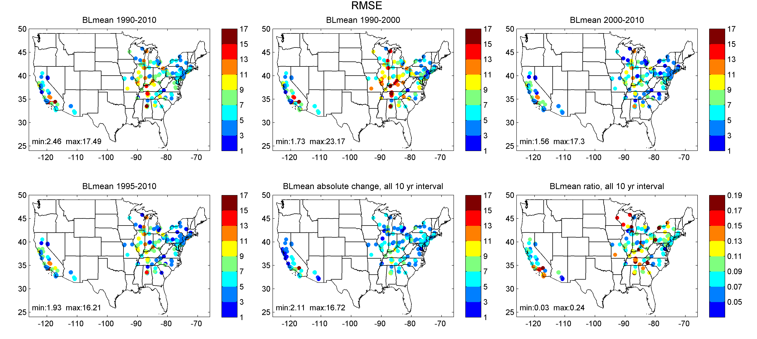
COMPARISON of ABSOLUTE value vs. CHANGE in MEAN BL
10-yr intervals
RMSE
ppb
The model shows lower RMSE and higher R when representing the changes in the baseline ozone concentration for most regions, mainly for the recent years
15/20

Slide 17
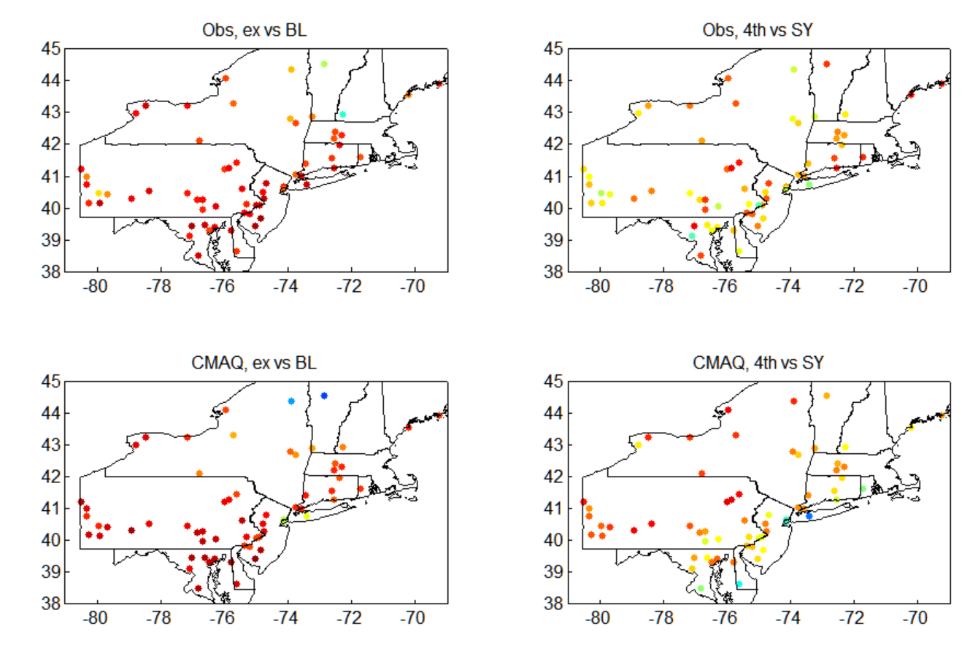
What controls O₃ exceedances? Correlations; NE U.S. for 1990-2010 (21-y)
BLmean vs. #days>70ppb
SY vs. 4th
Model and observations show that the Baseline is the main driver for the O3 exceedances
4th –4th highest; ex –# of days exceeding 70ppb;
BL – Baseline mean; SY – stdev of SY forcing
16/20

Slide 18
Confidence intervals for Design Values
(preliminary results)
Design Value (3-y average of 4th highest DM8HR)
Mean of 21 DV ± 2 std. dev. of 21 DV
Example:
Future year = 2010
Base year = 1995
$${Projected Baseline: BL}_{proj, 2010}={BL}_{Obs,1995}∙\frac{\overline{{BL}_{CMAQ 2010}}}{\overline{{BL}_{CMAQ 1995}}}$$
Reconstruction of the ozone time-series:
O₃(2010)_1 = BLproj(2010) + SYobs(1990)
O₃(2010)_2 = BLproj(2010) + SYobs(1991)
…
O₃(2010)_21 = BLproj(2010) + SYobs(2010)
4th (2010),1
4th (2010),2
…
4th (2010),21
DV(2010),1=MEAN4th(2010,2009,2008)
DV(2010),2=MEAN4th(2010,2009,2008)
…
DV(2010),21=MEAN4th(2010,2009,2008)
17/20

Slide 19
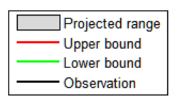
Bounds for the Design Value
(3-year average 4th highest ozone conc)
10-year projection interval
Sites showing agreement/disagreement
Greenwich, CT
2000-2010 projection
Green: Observed is within the estimated confidence bounds
Red: Outside (possible due to 36-Km CMAQ grids)
18/20

Slide 20
Bounds for the Design Value
(3-year average 4th highest ozone conc)
15-year projection interval
Sites showing agreement/disagreement
Greenwich, CT
1995-2010 projection
Green: Observed is within the estimated confidence bounds
Red: Outside (possibly due to 36-Km CMAQ grids)
19/20

Slide 21
CONCLUDING REMARKS
Long-term simulations provide a unique opportunity to assess the changes caused by emission reduction policies
Trends in the mean BL are improved during the 2nd half of the 21-years (2000-2010); Might be that emission inventory discrepancies in the two decades are influencing the trends (need for further analysis)
There is a strong relationship between the baseline (long-term forcing) and number of exceedances in both observations and model simulations
Accurate prediction of changes in baseline O3 coupled with observed historic SY provide a robust estimate of the impact of emission controls.
20/20

Slide 22
Acknowledgements
Two of the authors (MA and HL) gratefully acknowledge the support of the Electric Power Research Institute (EPRI) for this research under Contract #00-10005071, 2015-2017.
Although this work has been reviewed and approved for publication by the U.S. Environmental Protection Agency, it does not reflect Agency’s views and policies.

