Slide 1
Evaluation of the Community Multiscale Air Quality (CMAQ) Model Version 5.2
K. Wyat Appel, Sergey Napelenok, Christian Hogrefe, Kristen M. Foley, George Pouliot, Ben Murphy, Deborah Luecken, Nicholas Heath and the CMAQ development team
U.S. EPA, National Exposure Research Laboratory,
Computational Exposure Division, RTP, NC
15th Annual CMAS Conference – October 26, 2016
Chapel Hill, NC

Slide 2
Major Updates in the CMAQv5.2
Modeling System
Transition from WRFv3.7 to WRFv3.8
  PAR function and impact on transpiration modified by Jon Pleim
  Numerous other updates in WRFv3.8 (http://www2.ucar.edu/wrf/users/wrfv3.8/updates-3.8.html)
WRFv3.8 with lightning assimilation
  Assimilation of lightning strike data from the National Lightning Detection Network (NLDN)
  Force deep convection where lightning is observed; only allow shallow convection where it is not
Science updates in CMAQv5.2
  Increased O₃ deposition to wetted surfaces (particularly important in the early morning hours)
  Updated organic aerosol (OA) with semivolatile primary OA and empirical secondary OA formation from combustion sources (presentation yesterday by Ben Murphy)
    Large decreases in primary OA in both summer (75-95%) and winter (55-90%)
    In winter, the lack of photochemistry results in overall decreases in OA (and PM_{2.5}) in many cities
    In summer, increase in OA at due to the increased role from secondary OA formation pathways
  Updated windblown dust scheme (presentation yesterday by Hosein Foroutan)
  Updated sub-grid cloud scheme
Update from the 2011 NEI v2 eh to 2011 NEI v2 ek platform
  Updated from MOVES2014 to MOVES2014a for mobile emissions (updates for TX, OH, NJ, CA, AZ)
  Revised spatial surrogates for underway emissions from commercial marine
Update from the CB05e51 to CB6r3 chemical mechanism
  Generally lower O₃ and NO₂ from lower production of alkyl nitrates (winter), lack of NO_{X} recycling, lower HO2 and higher heterogeneous removal of nitrates
Transition from GEOS-Chem to hemispheric CMAQ for lateral boundary conditions

Slide 3
CMAQ Simulations Details
Model Version | CMAQ v5.1 | CMAQ v5.2
Domain | CONUS 12km | CONUS 12km
Meteorological Model | WRF v3.7 | WRF v3.8 w/ Lightning assim.
MCIP Version | MCIPv4.3 | MCIPv4.3
Emissions Platform | 2011 NEI v2 eh (Inline) | 2011 NEI v2 ek (inline)
BELD Version | BELD Version 4 | BELD Version 4
Lightning NO Emissions | Yes | Yes (Updated)
OMI Data | Yes | Yes
Photolysis | Inline | Inline
AERO Version | AERO6 | AERO6 (svPOA)
Chemical Mechanism | CB05e51 | CB6r3
Boundary Conditions | GEOS-Chem | Hemispheric CMAQ
Gravitational Settling | Yes | Yes
Wind-blown Dust | Yes (v5.2 version) | Yes
Halogen Chemistry | Yes | Yes
Multipollutant | No | No

Slide 4
Ozone

Slide 5
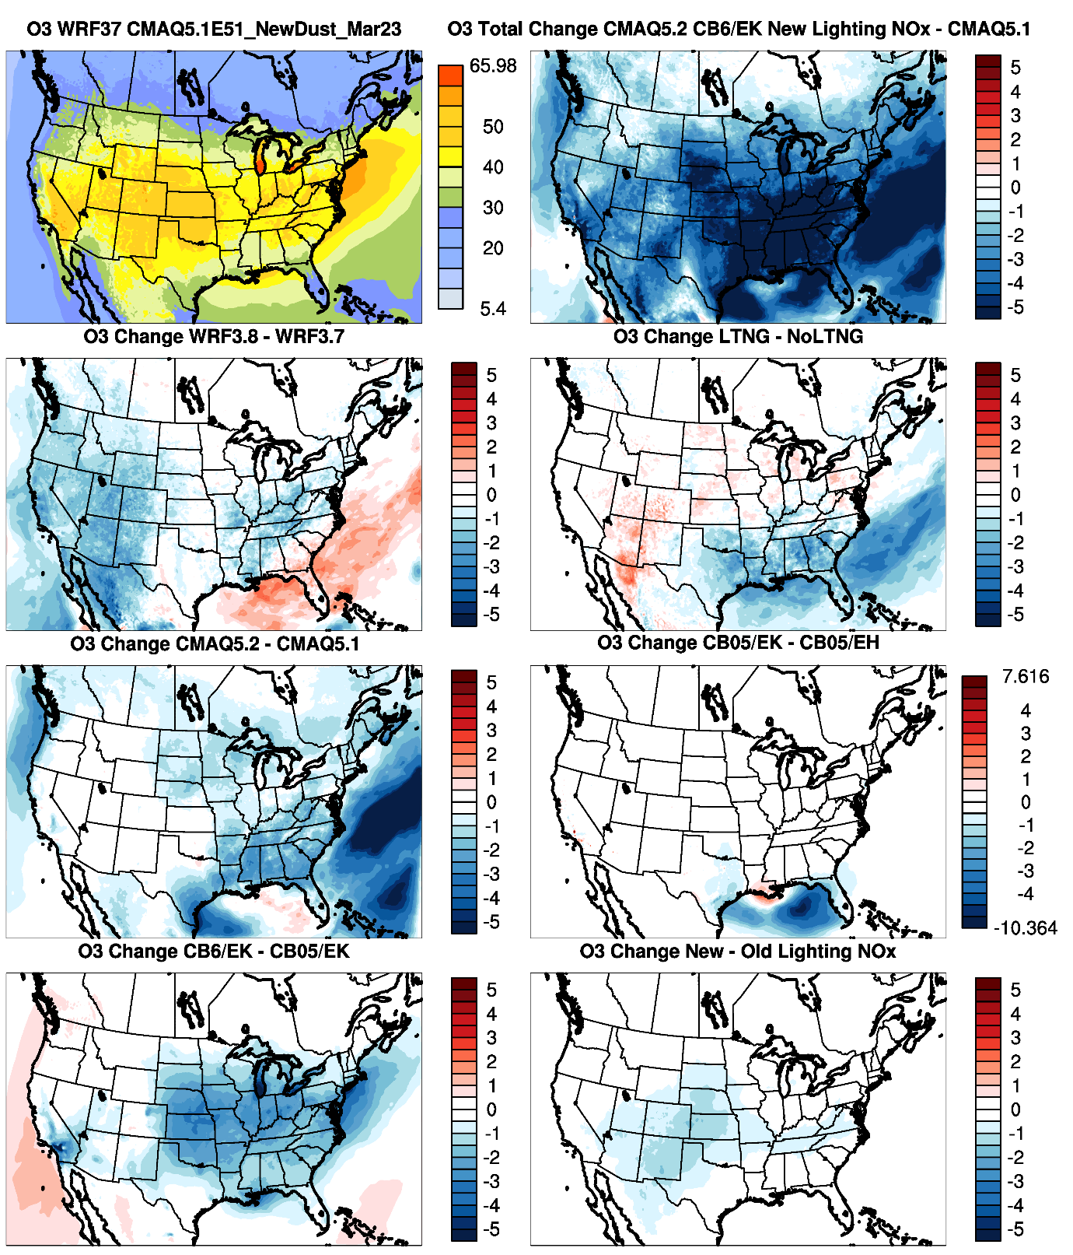
CMAQv5.1 Modeled O₃ Mixing Ratio
CMAQv5.2 (LTGNO) – CMAQv5.1
July
O₃ (all hours)
WRFv3.8
Lightning Assimilation
Large decrease in O₃ mixing ratios across the entire CONUS between v5.1 base and v5.2 final
O₃ decreased as a result of almost all the updates made to the CMAQ system, but in particular the WRF updates, updates in CMAQv5.2 (increased O₃ dry deposition), CB6r3 chemical mechanism and the updated lightning NO calculation
Updates in CMAQv5.2
Emissions Update
CB6r3 Chemical Mechanism
Lightning NO Calculation Update

Slide 6
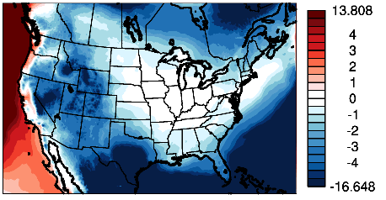
Impact of Hemispheric BCs on July O₃
Hemispheric CMAQ boundary conditions further lowers ozone mixing ratios in July

Slide 7
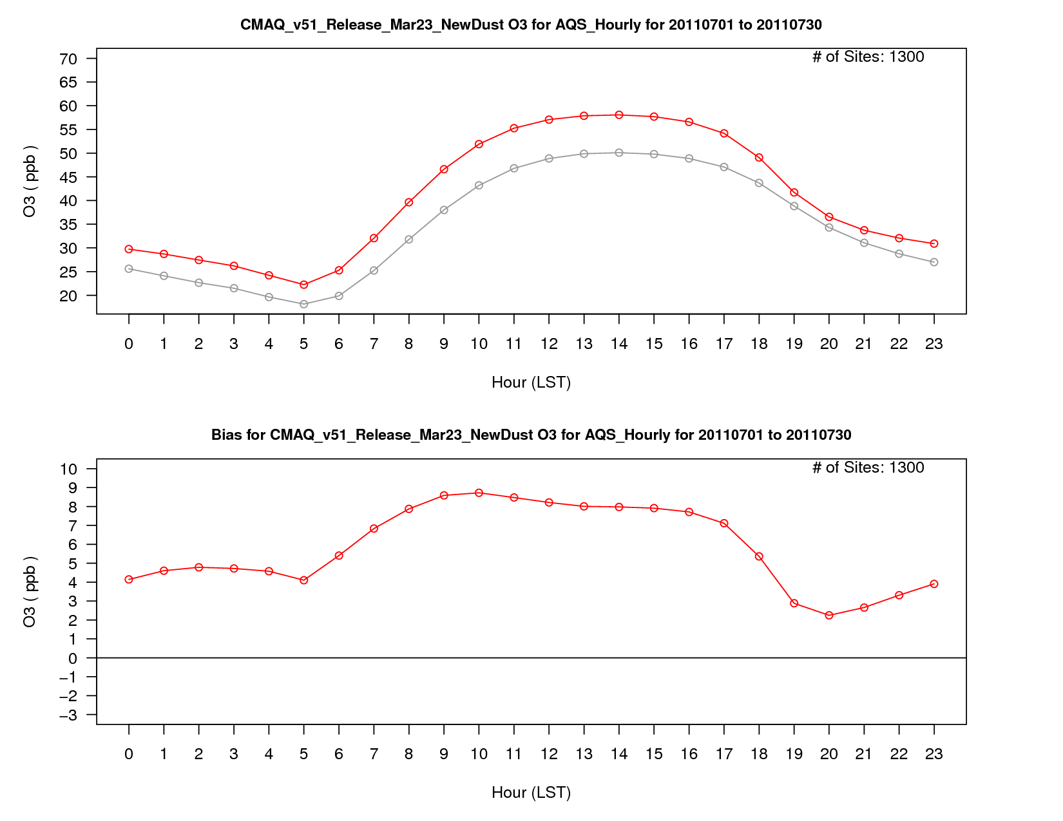
O₃ Mixing Ratio
v5.1 Base
O₃ Bias

Slide 8
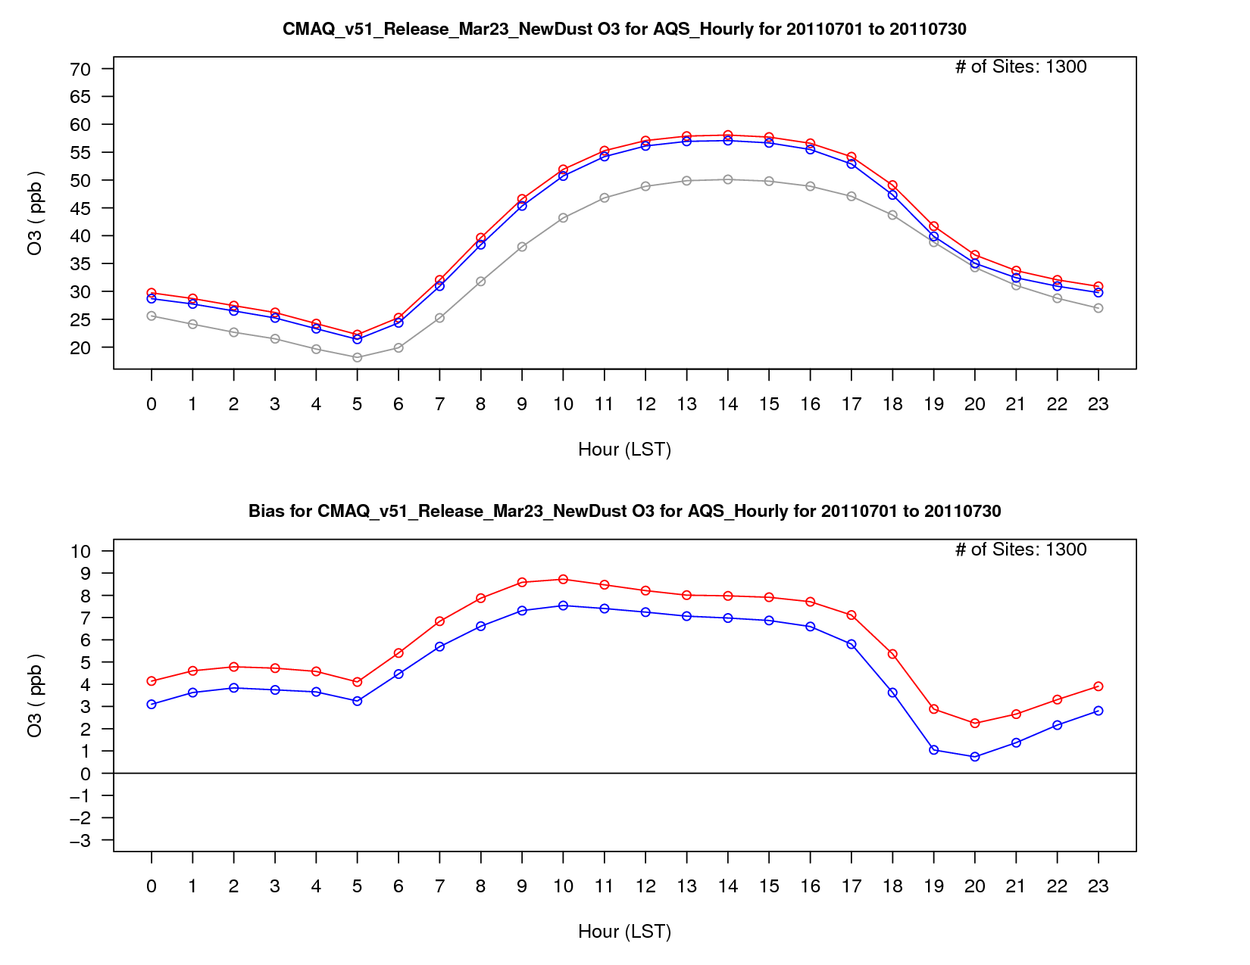
O₃ Mixing Ratio
v5.1 Base
v5.1 w/ WRF Updates
O₃ Bias

Slide 9
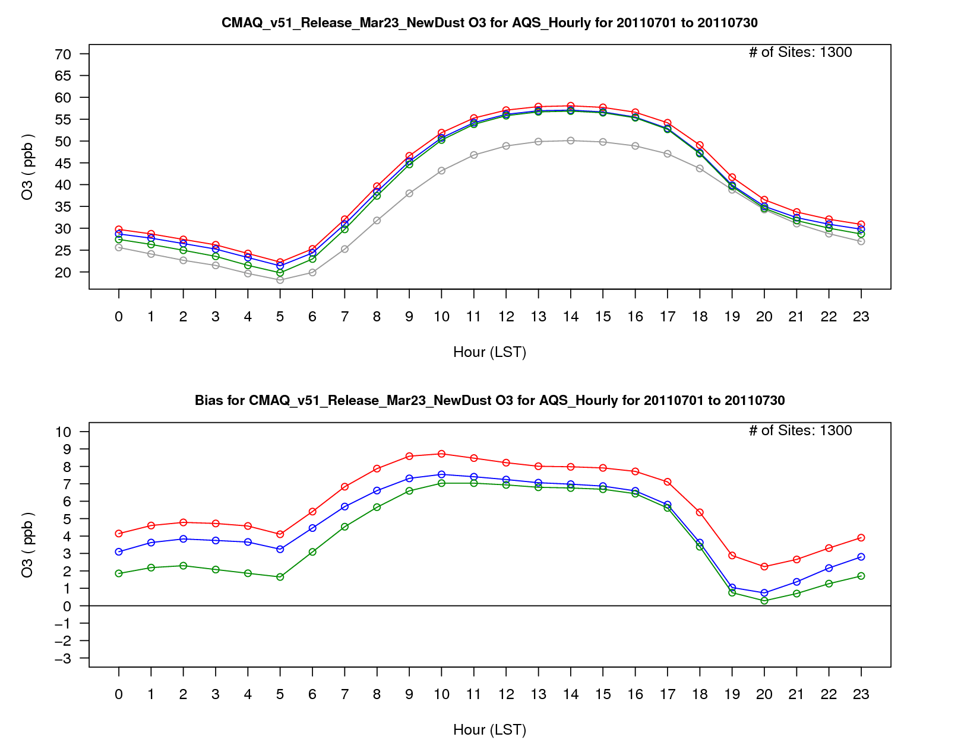
O₃ Mixing Ratio
v5.1 Base
v5.1 w/ WRF Updates
v5.2 CB05e51 (ek emis)
O₃ Bias

Slide 10
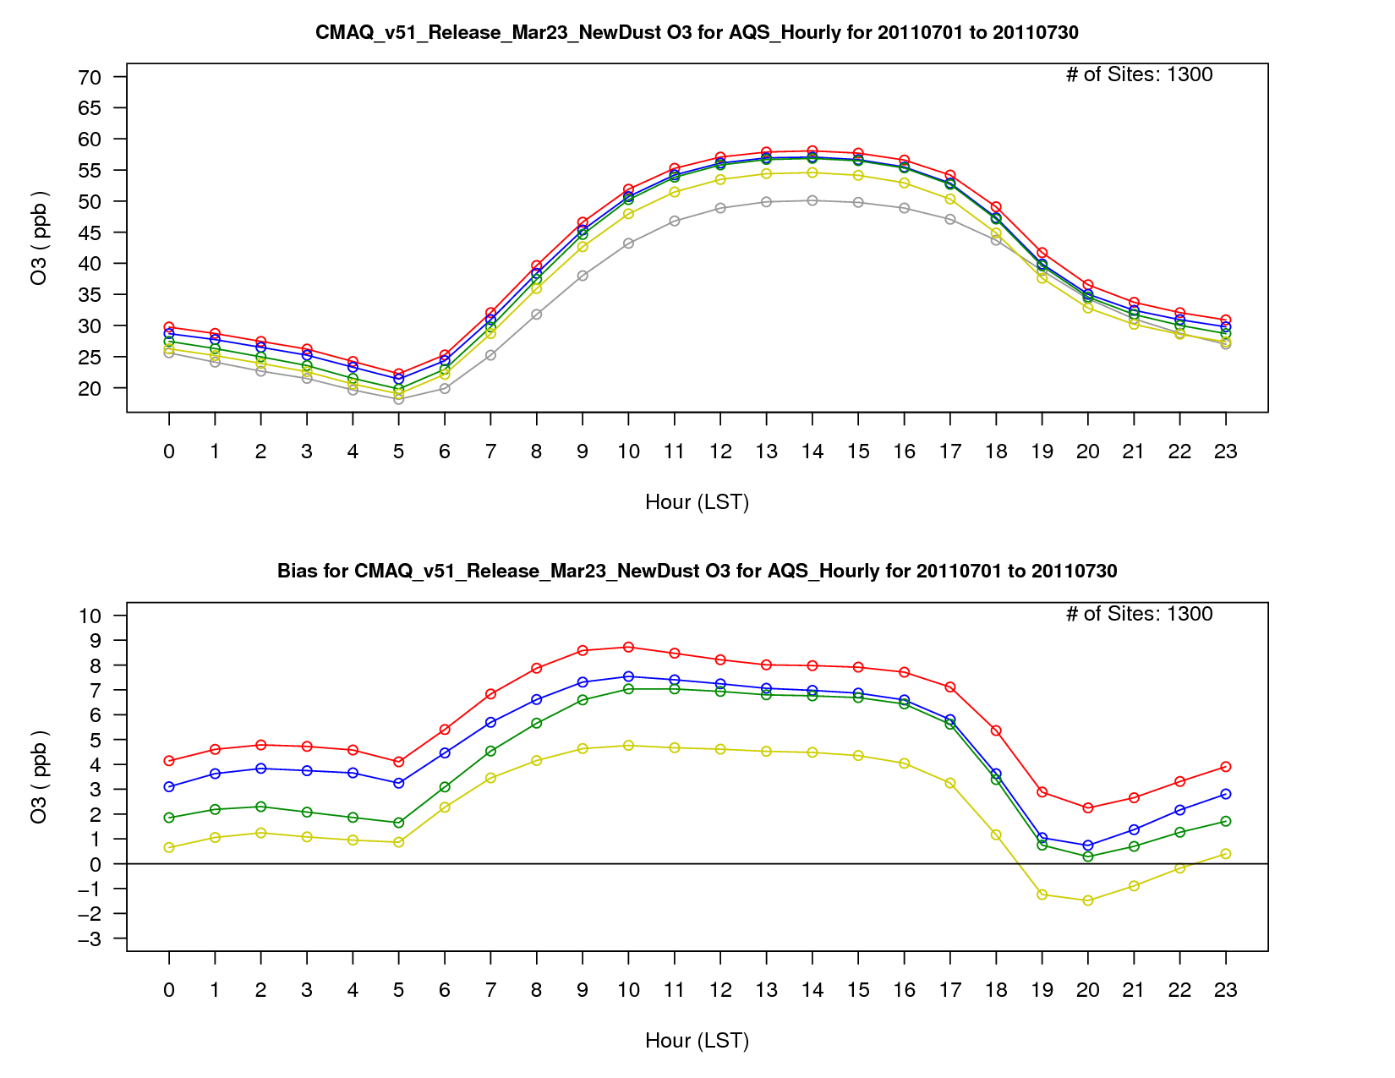
O₃ Mixing Ratio
v5.1 Base
v5.1 w/ WRF Updates
v5.2 CB05e51 (ek emis)
v5.2 CB6r3
O₃ Bias

Slide 11
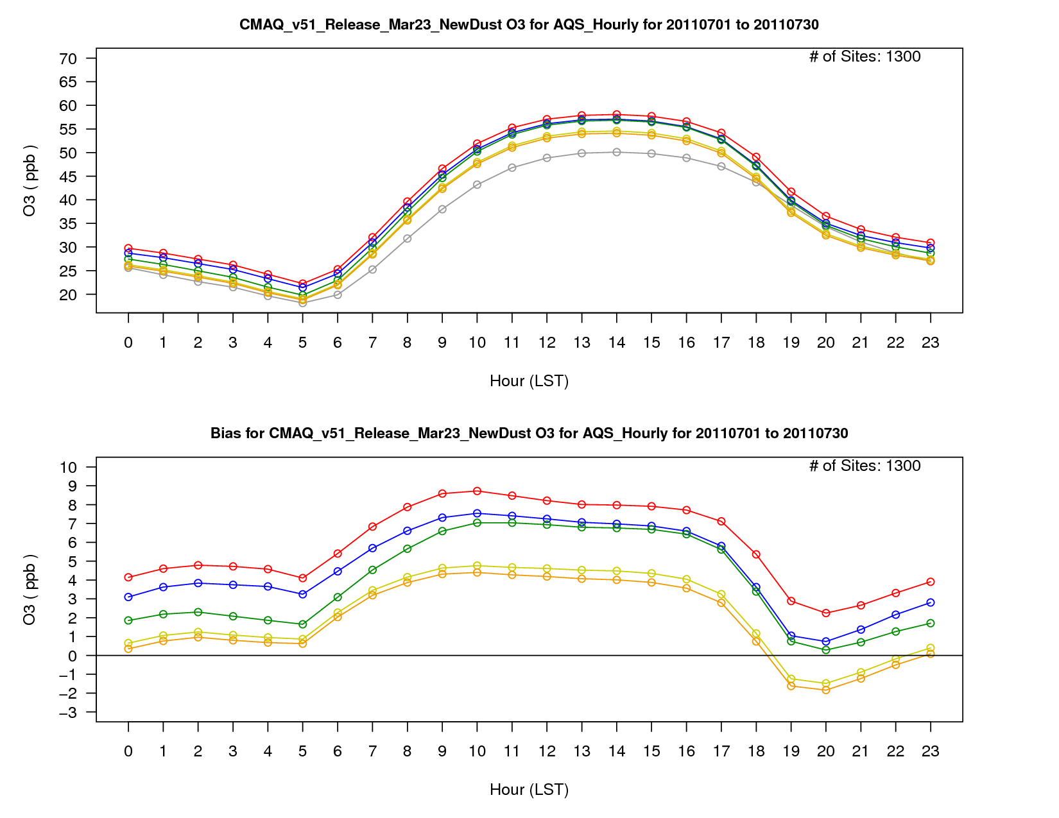
O₃ Mixing Ratio
v5.1 Base
v5.1 w/ WRF Updates
v5.2 CB05e51 (ek emis)
v5.2 CB6r3
Lightning NO Update
O₃ Bias

Slide 12
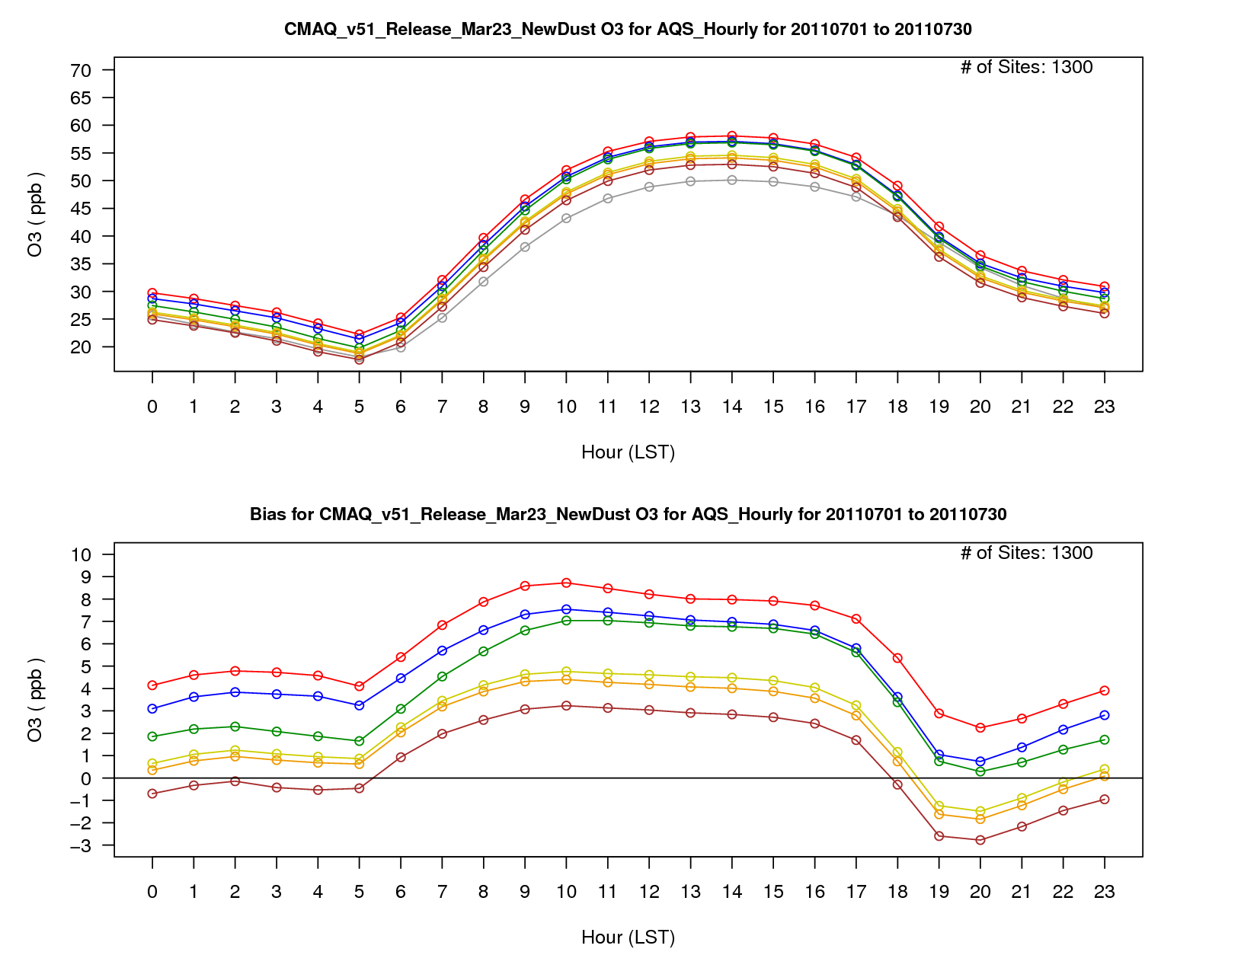
O₃ Mixing Ratio
v5.1 Base
v5.1 w/ WRF Updates
v5.2 CB05e51 (ek emis)
v5.2 CB6r3
Lightning NO Update
Hemispheric CMAQ BCs
O₃ Bias

Slide 13
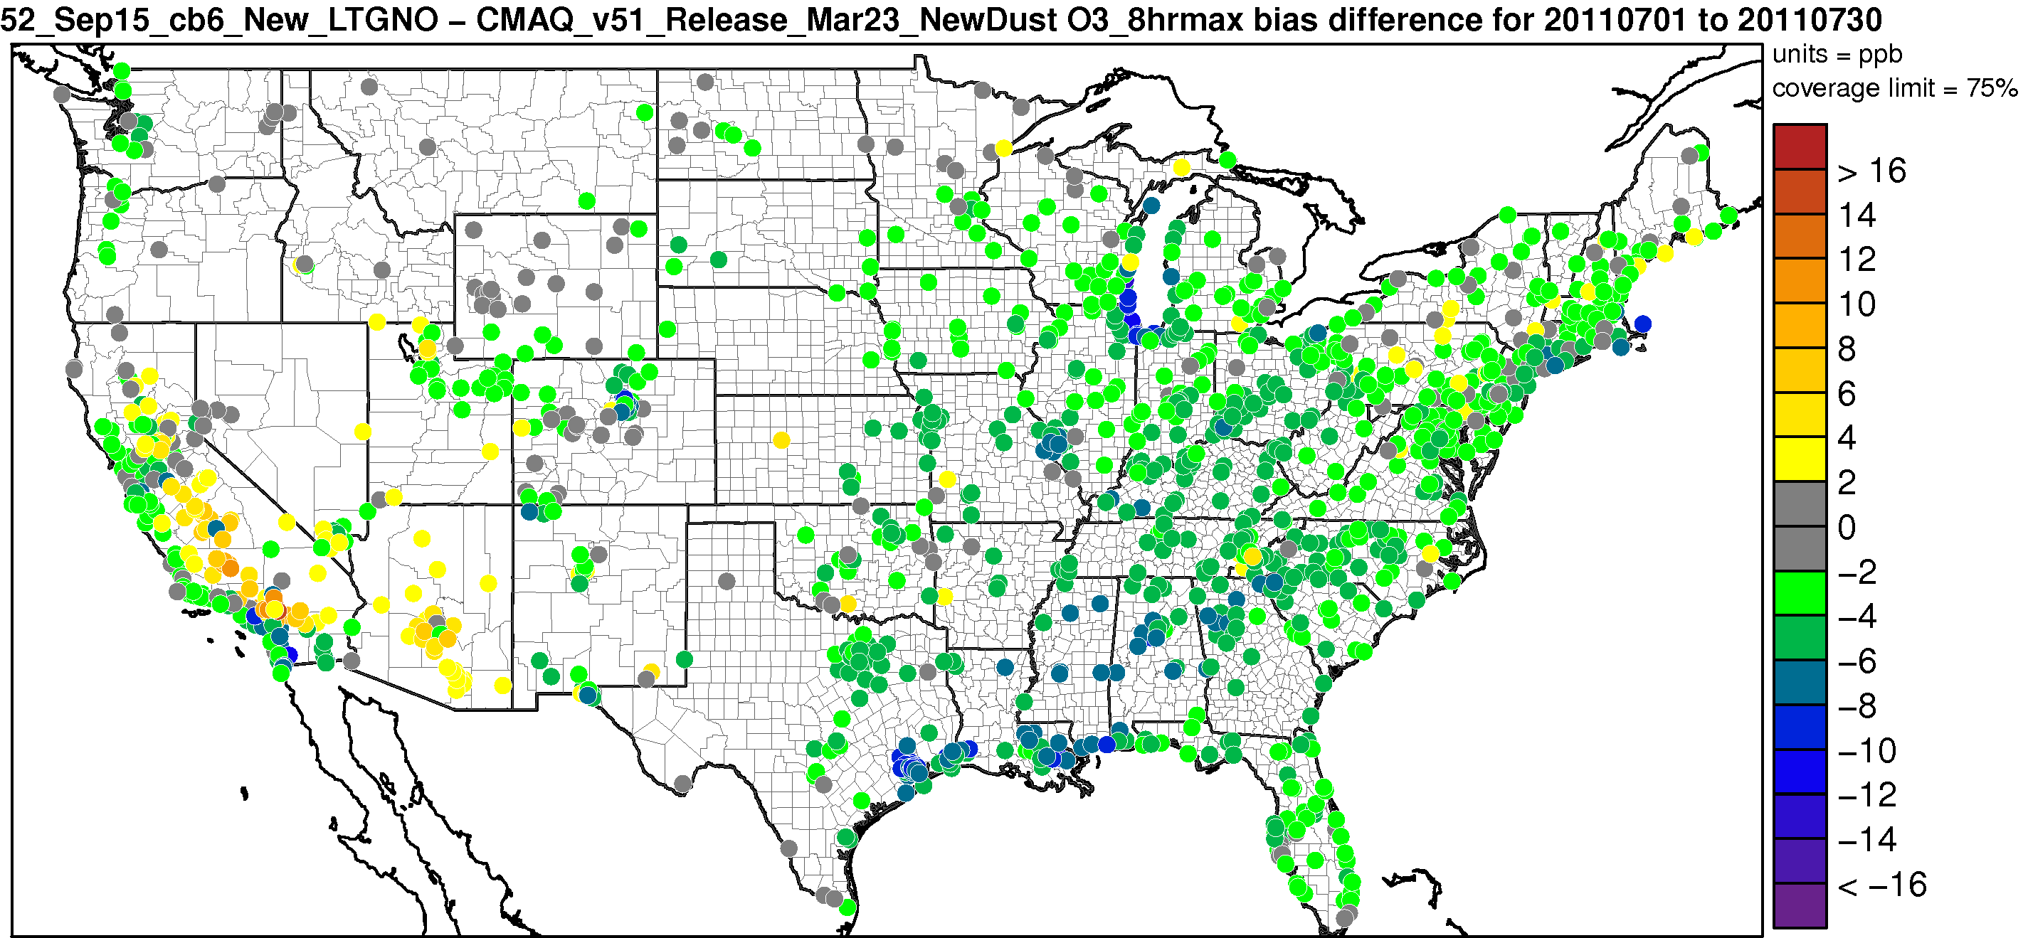
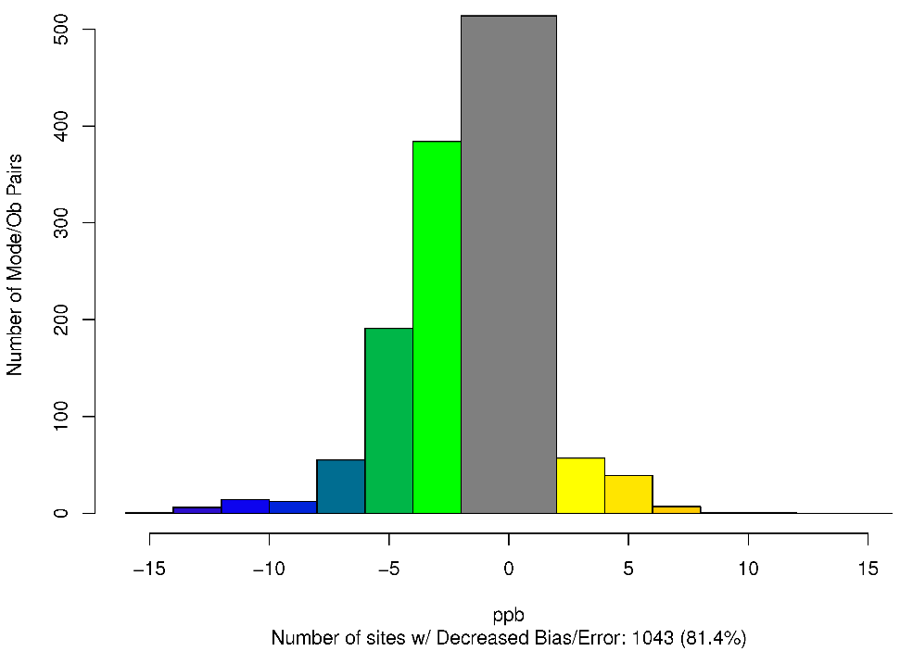
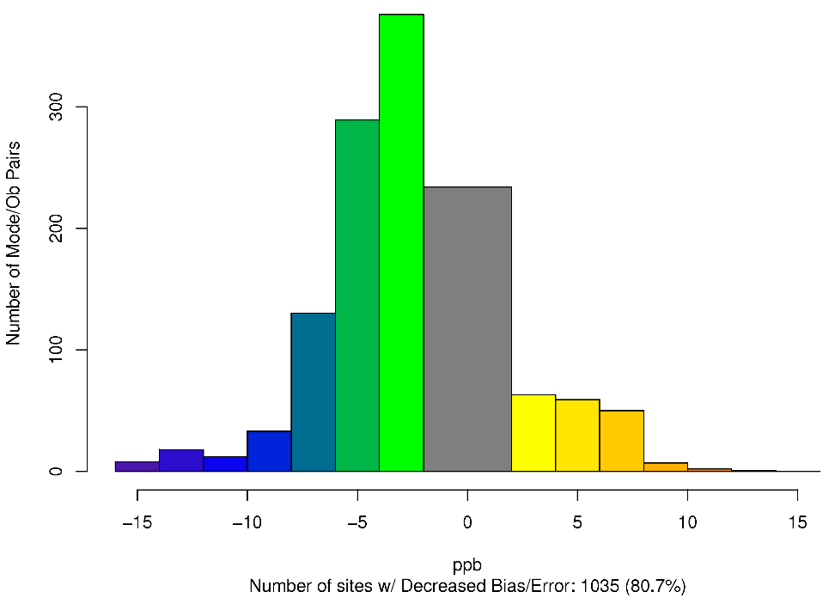
CMAQv5.2 (LTGNO) – CMAQv5.1 – Difference in MDA8 O₃ Absolute Bias July 2011
Worse Bias
Improved Bias
Worse Error
Worse Bias
Improved Error
Improved Bias

Slide 14
PM_{2.5}

Slide 15
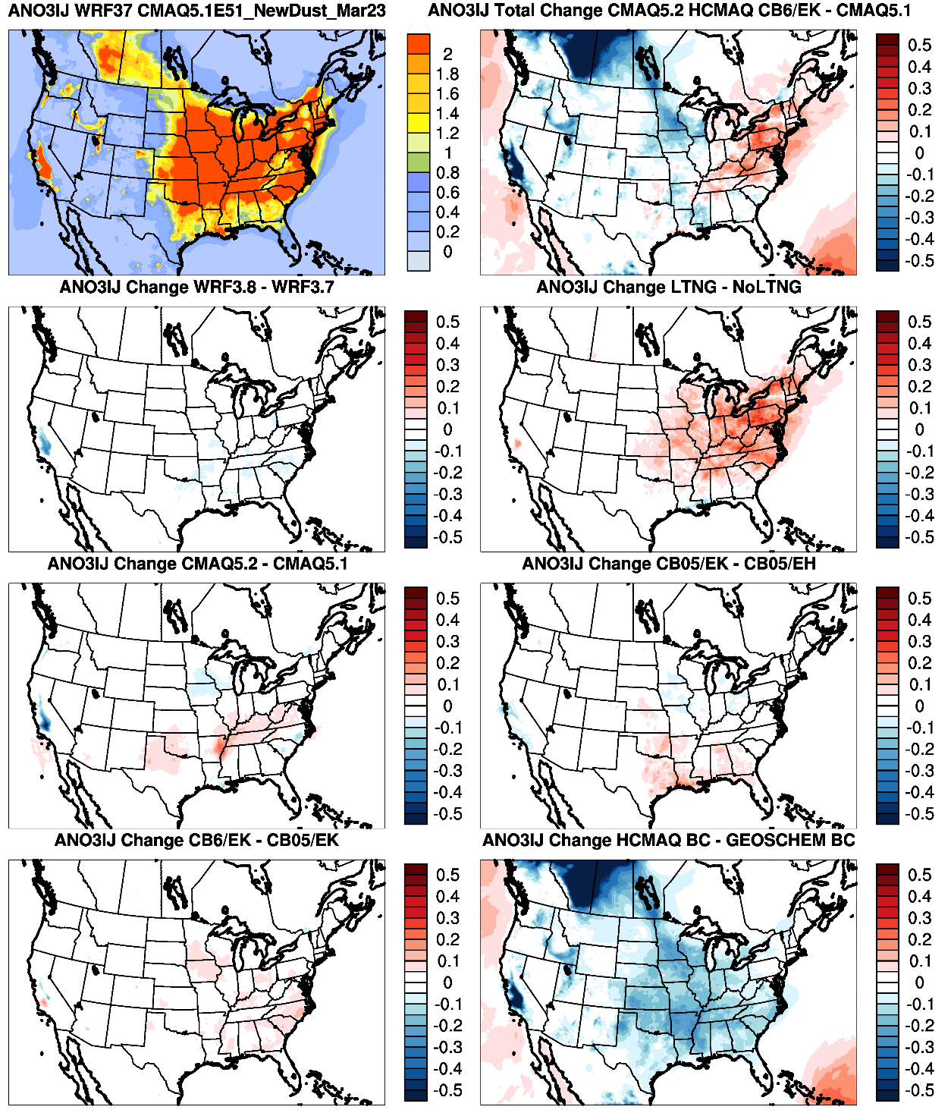
CMAQv5.1 Modeled NO₃ Concentration
CMAQv5.2 – CMAQv5.1
January NO₃
NO₃ increases in the Northeast and decreases across the rest of the CONUS
WRFv3.8
Lightning Assimilation
Increase in NO₃ due to lightning assimilation and CB6r3 chemical mechanism
Updates in CMAQv5.2
Emissions Update
Mixed changes do to changes in v5.2 and the emissions update
CB6r3 Chemical Mechanism
Hemispheric CMAQ BCs
Large decrease in NO₃ due to hemispheric CMAQ BCs

Slide 16
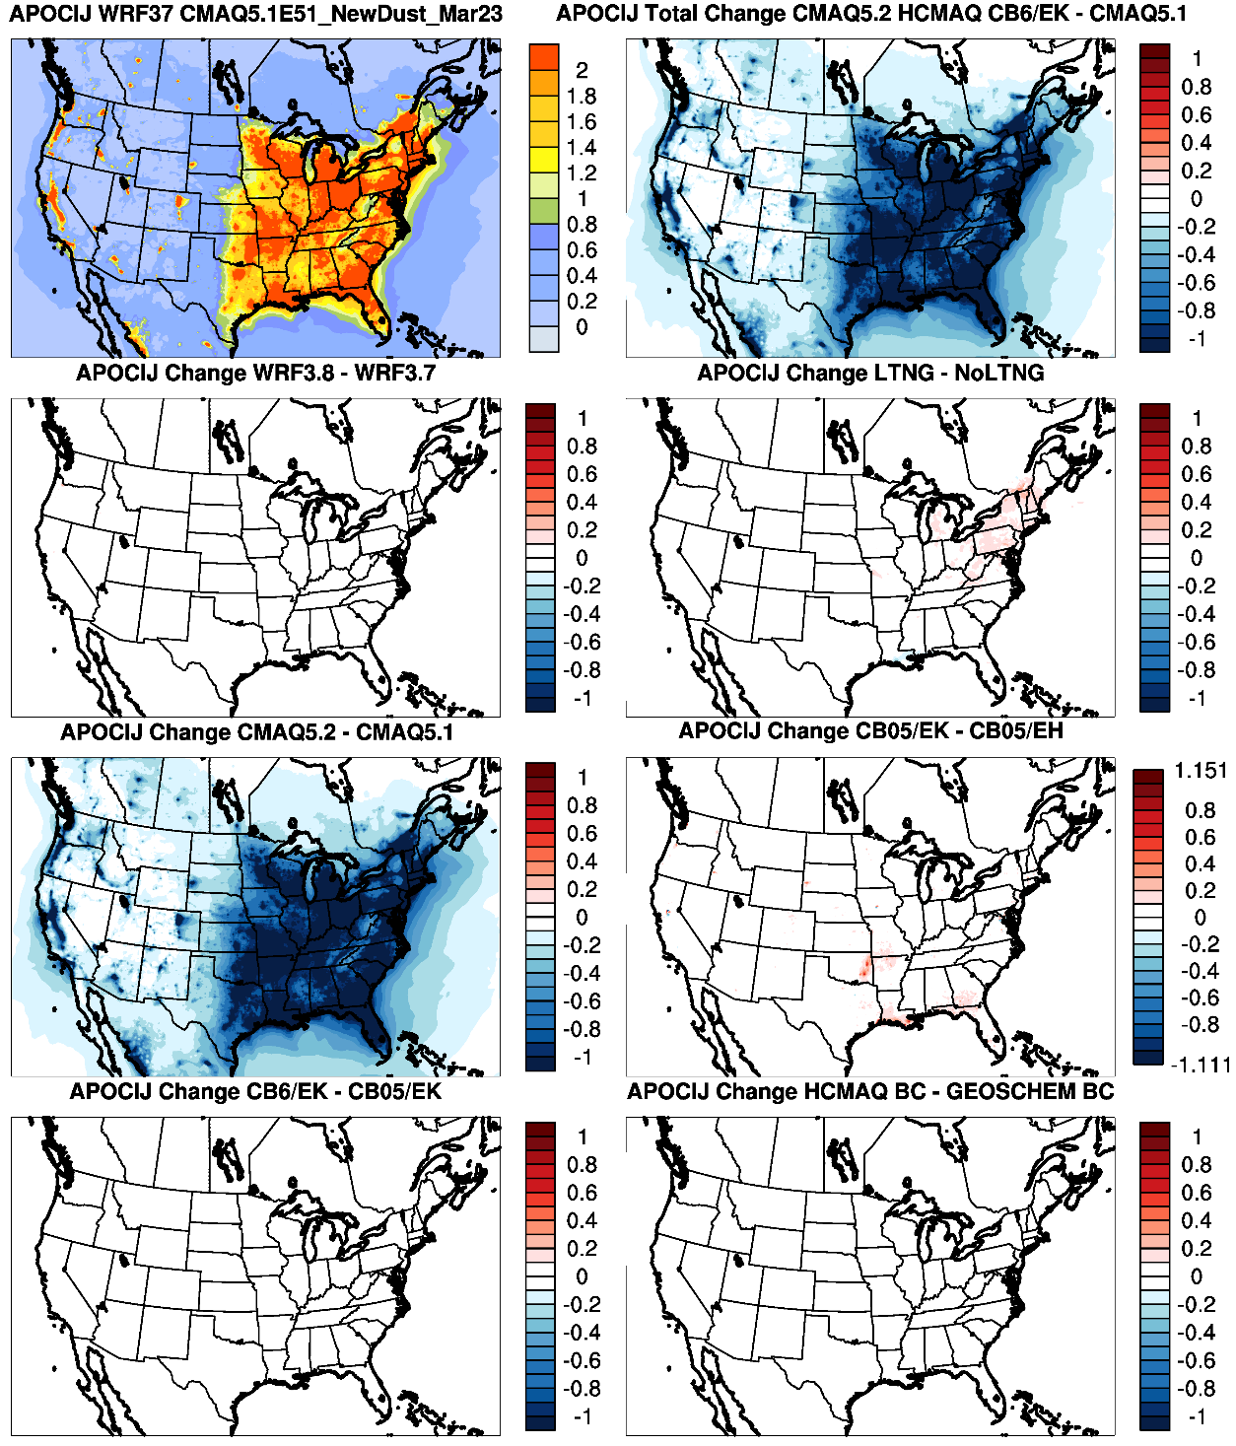
CMAQv5.1 Modeled POA Conc.
CMAQv5.2 – CMAQv5.1
January
Primary OA
WRFv3.8
Lightning Assimilation
Very large decrease in POC due to updates in CMAQv5.2 (as expected)
Very small increase due to lightning assimilation and emission updates
Updates in CMAQv5.2
Emissions Update
CB6r3 Chemical Mechanism
Hemispheric CMAQ BCs

Slide 17
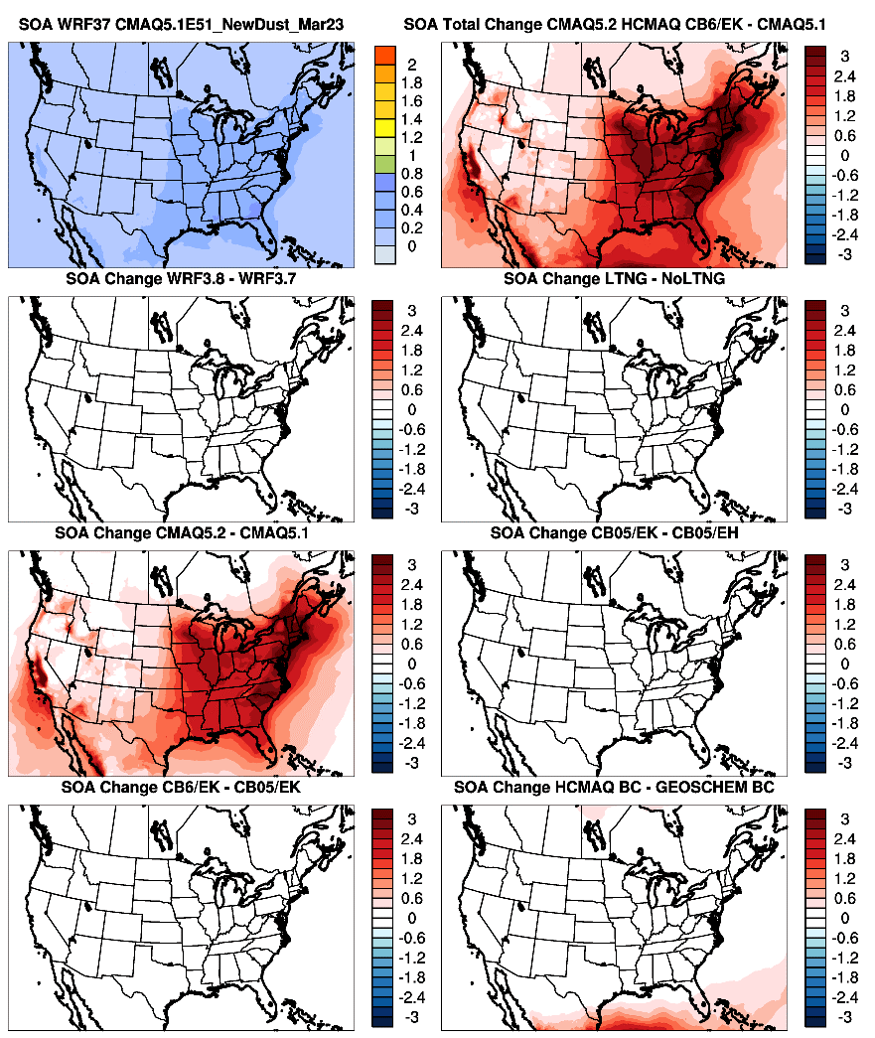
CMAQv5.1 Modeled SOA Conc.
CMAQv5.2 – CMAQv5.1
January
Secondary OA
WRFv3.8
Lightning Assimilation
Very large increase in SOA due to updates in CMAQv5.2 (increased role of SOA pathways)
Smaller increases near the southern boundary due to hemispheric BCs
Updates in CMAQv5.2
Emissions Update
CB6r3 Chemical Mechanism
Hemispheric CMAQ BCs

Slide 18
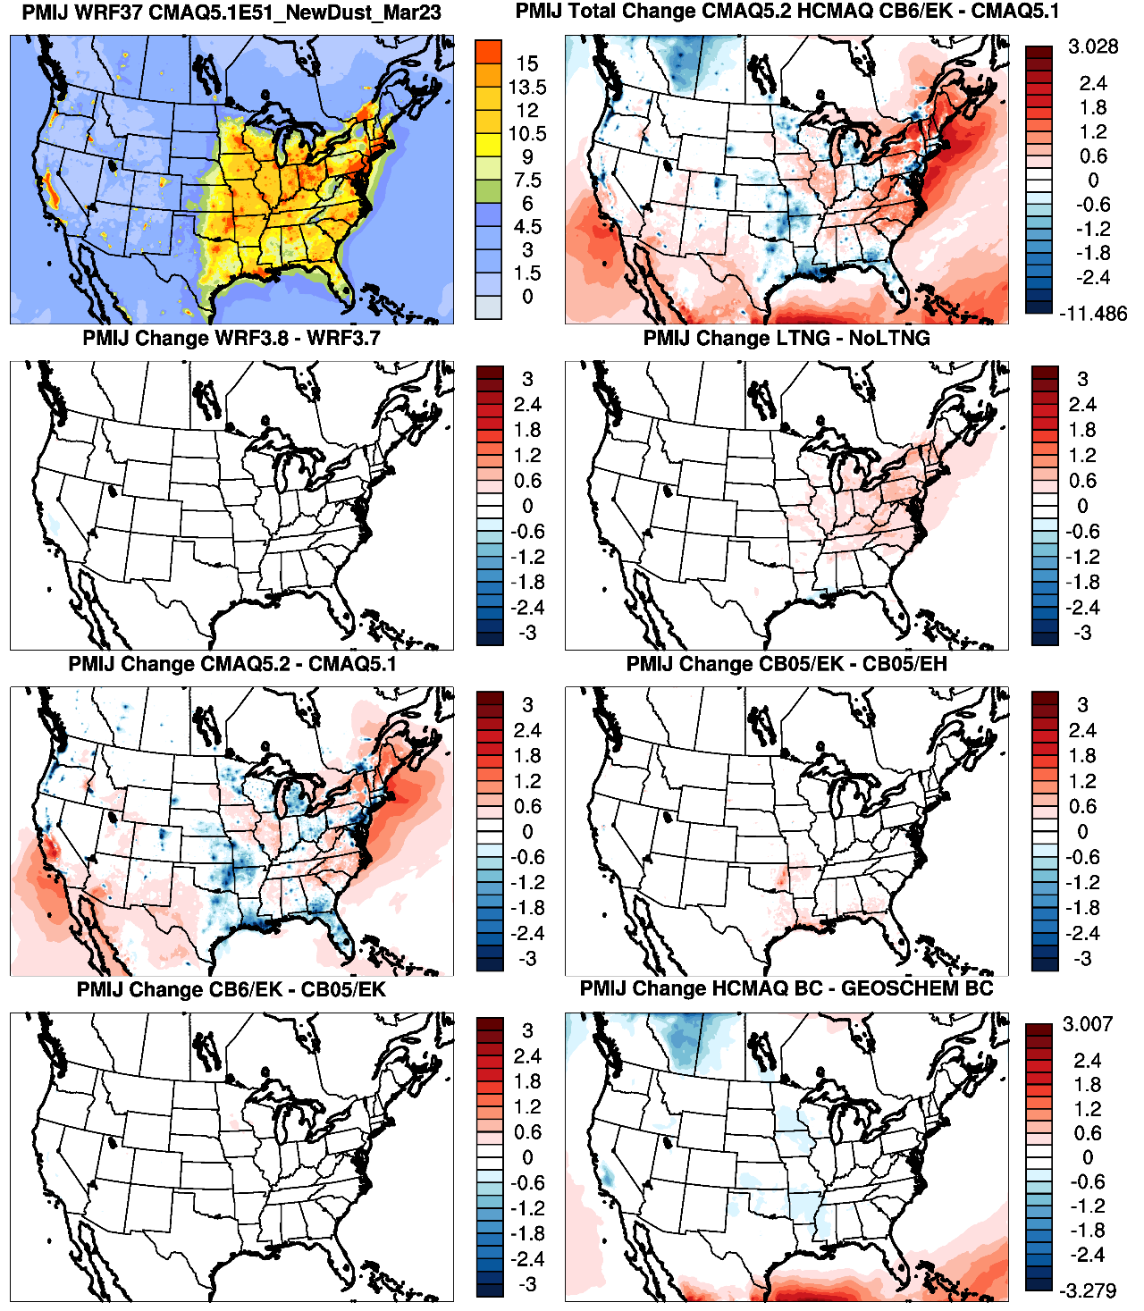
CMAQv5.1 Modeled PM_{2.5} Conc.
CMAQv5.2 – CMAQv5.1
January PM_{2.5}
Mixed increases and decreases in PM_{2.5} across the CONUS between v5.1 base and v5.2 final
WRFv3.8
Lightning Assimilation
Small increase in PM_{2.5} in the Northeast and mid-Atlantic due to inclusion of lightning assimilation
Updates in CMAQv5.2
Emissions Update
Mixed increases/decreases in PM_{2.5} due to changes in CMAQv5.2 (decreased POA and increased SOA)
CB6r3 Chemical Mechanism
Hemispheric CMAQ BCs
Small effect on PM_{2.5} from the other updates

Slide 19
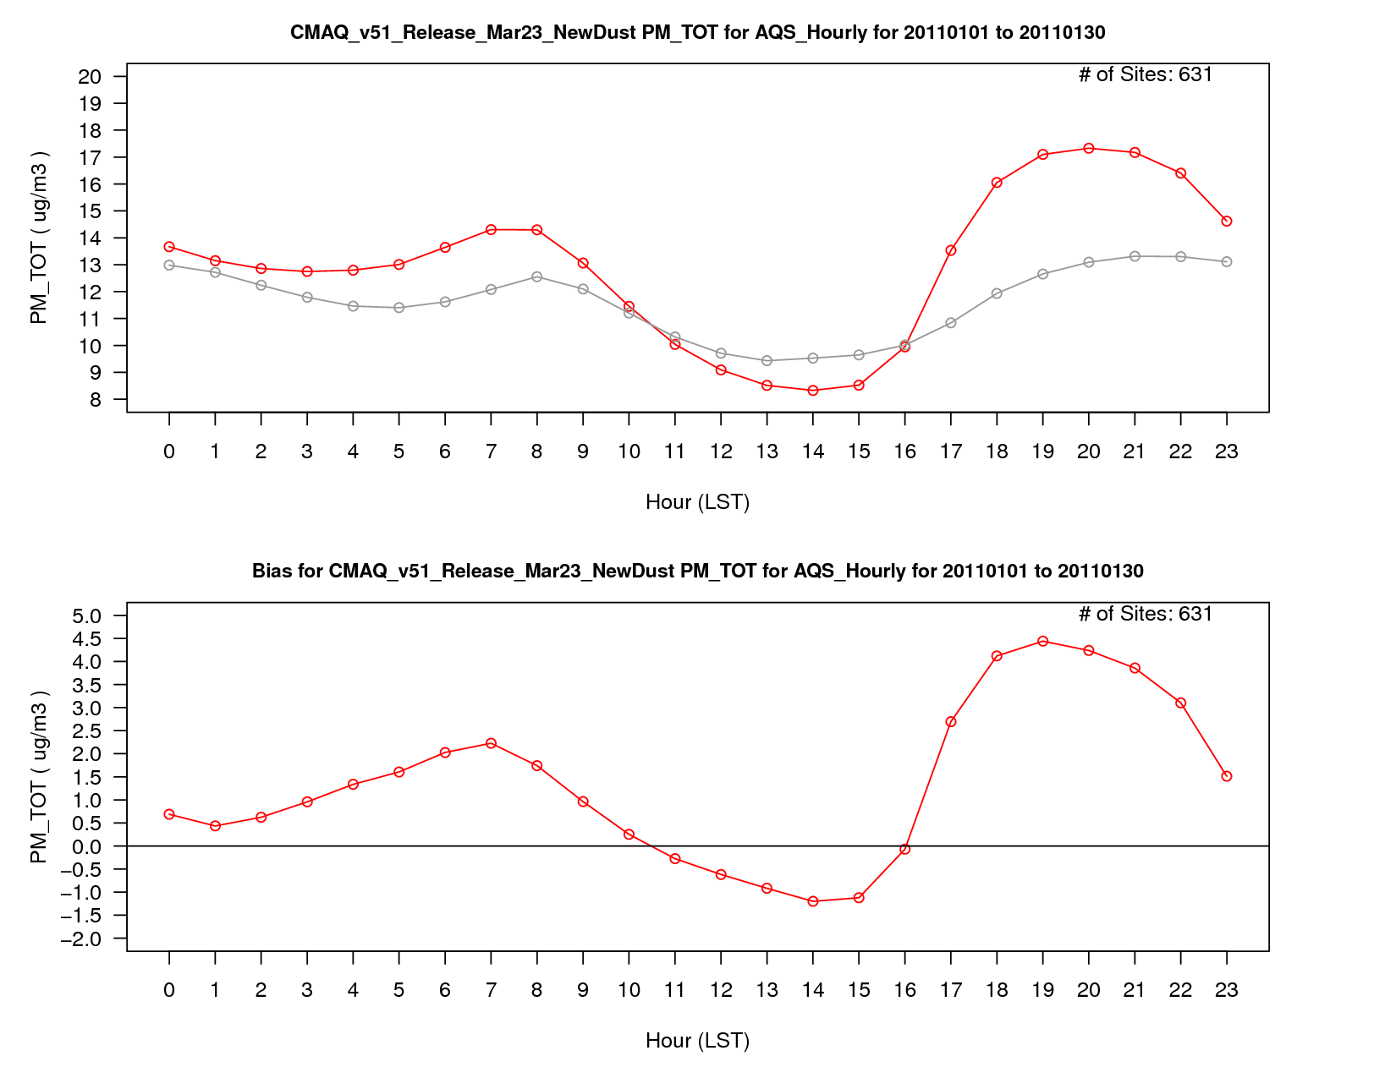
PM_{2.5} Concentration
v5.1 Base
PM_{2.5} Bias

Slide 20
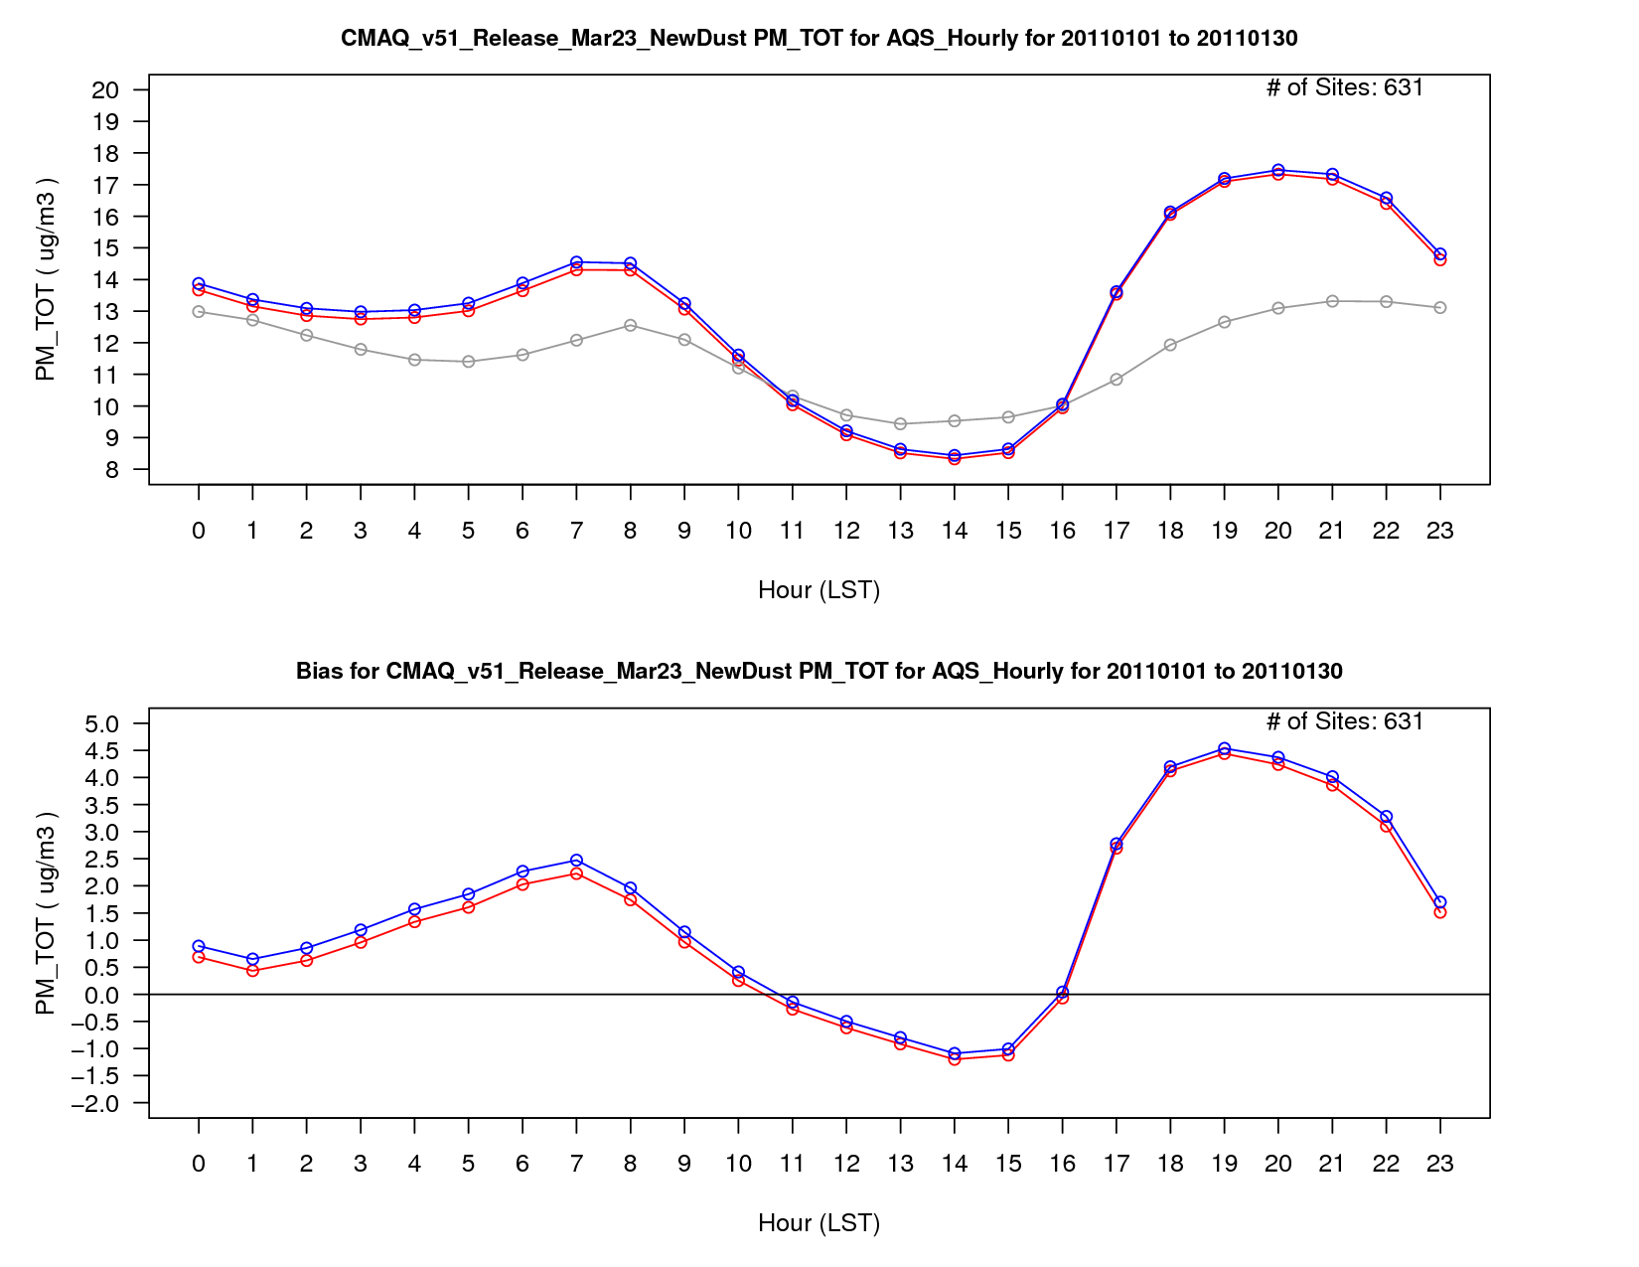
PM_{2.5} Concentration
v5.1 Base
v5.1 w/ WRF Updates
PM_{2.5} Bias

Slide 21
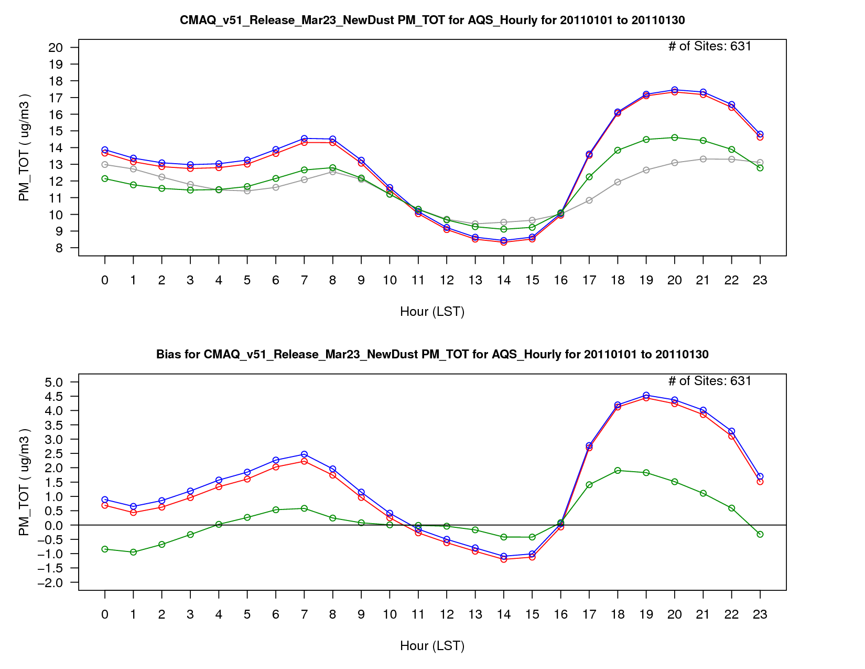
PM_{2.5} Concentration
v5.1 Base
v5.1 w/ WRF Updates
v5.2 CB05e51
PM_{2.5} Bias

Slide 22
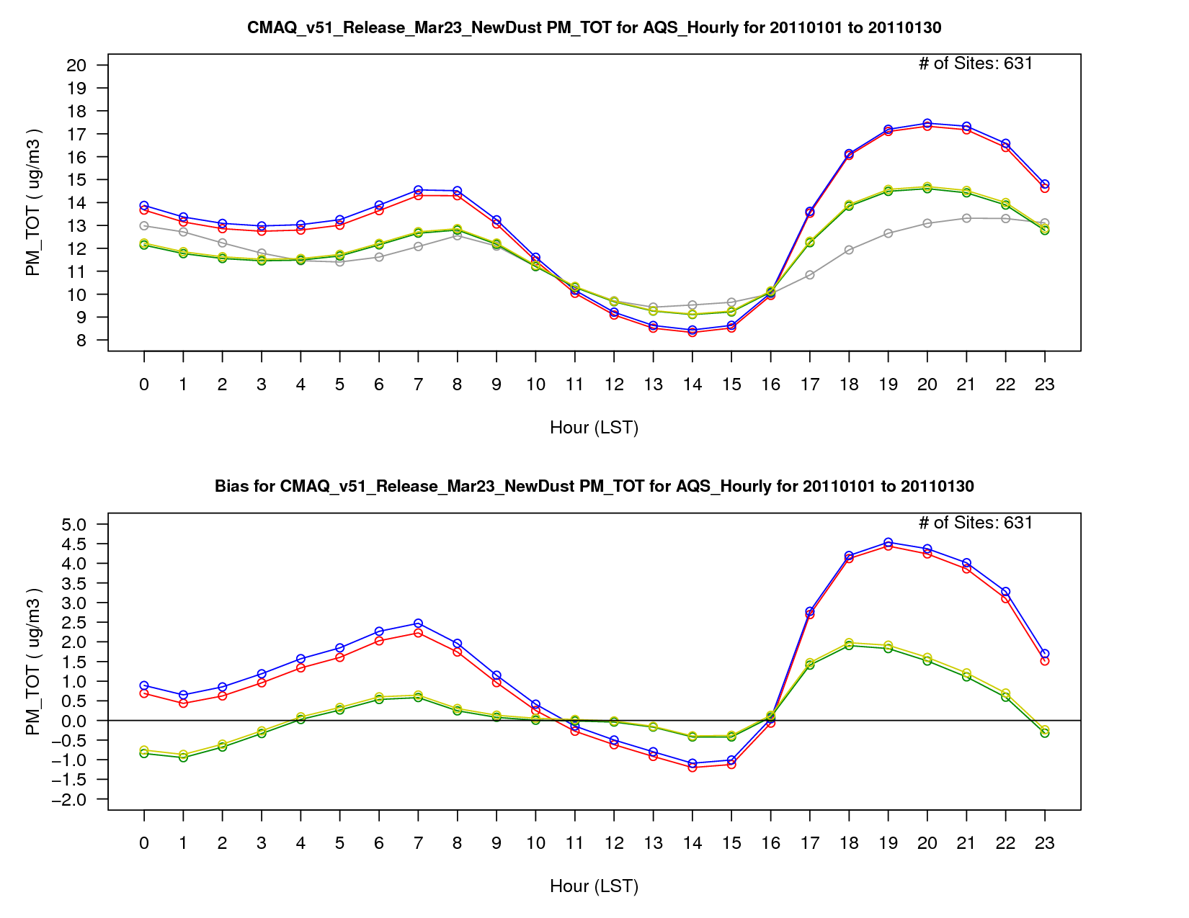
PM_{2.5} Concentration
v5.1 Base
v5.1 w/ WRF Updates
v5.2 CB05e51
v5.2 CB05e51 (ek emis)
PM_{2.5} Bias

Slide 23
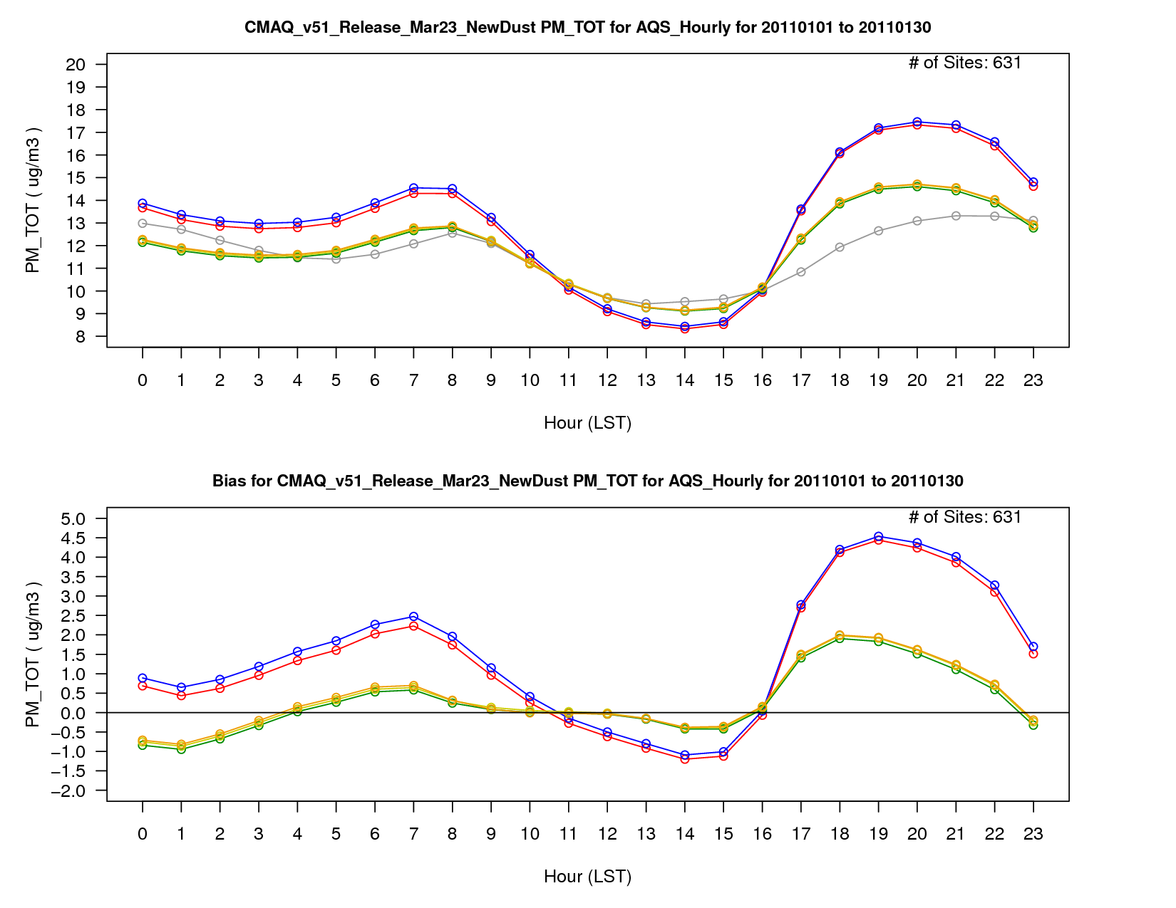
PM_{2.5} Concentration
v5.1 Base
v5.1 w/ WRF Updates
v5.2 CB05e51
v5.2 CB05e51 (ek emis)
v5.2 CB6r3
PM_{2.5} Bias

Slide 24
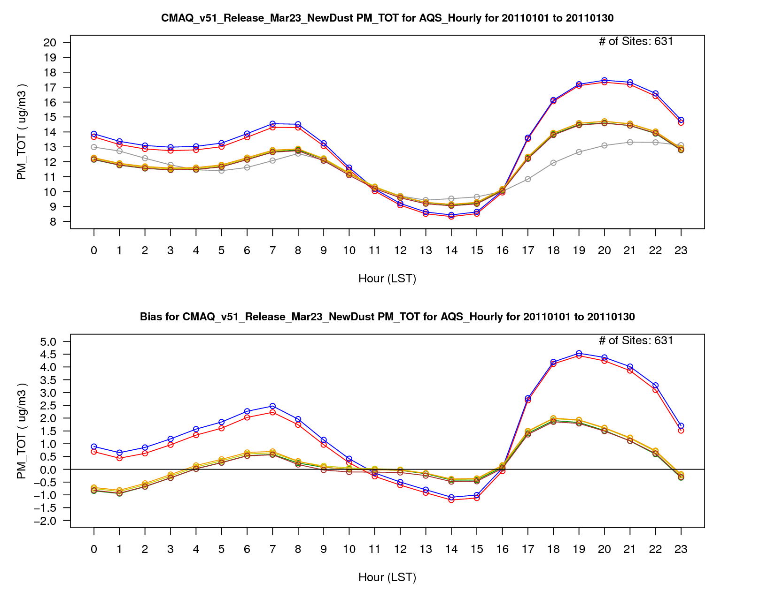
PM_{2.5} Concentration
v5.1 Base
v5.1 w/ WRF Updates
v5.2 CB05e51
v5.2 CB05e51 (ek emis)
v5.2 CB6r3
Hemispheric CMAQ BCs
PM_{2.5} Bias

Slide 25
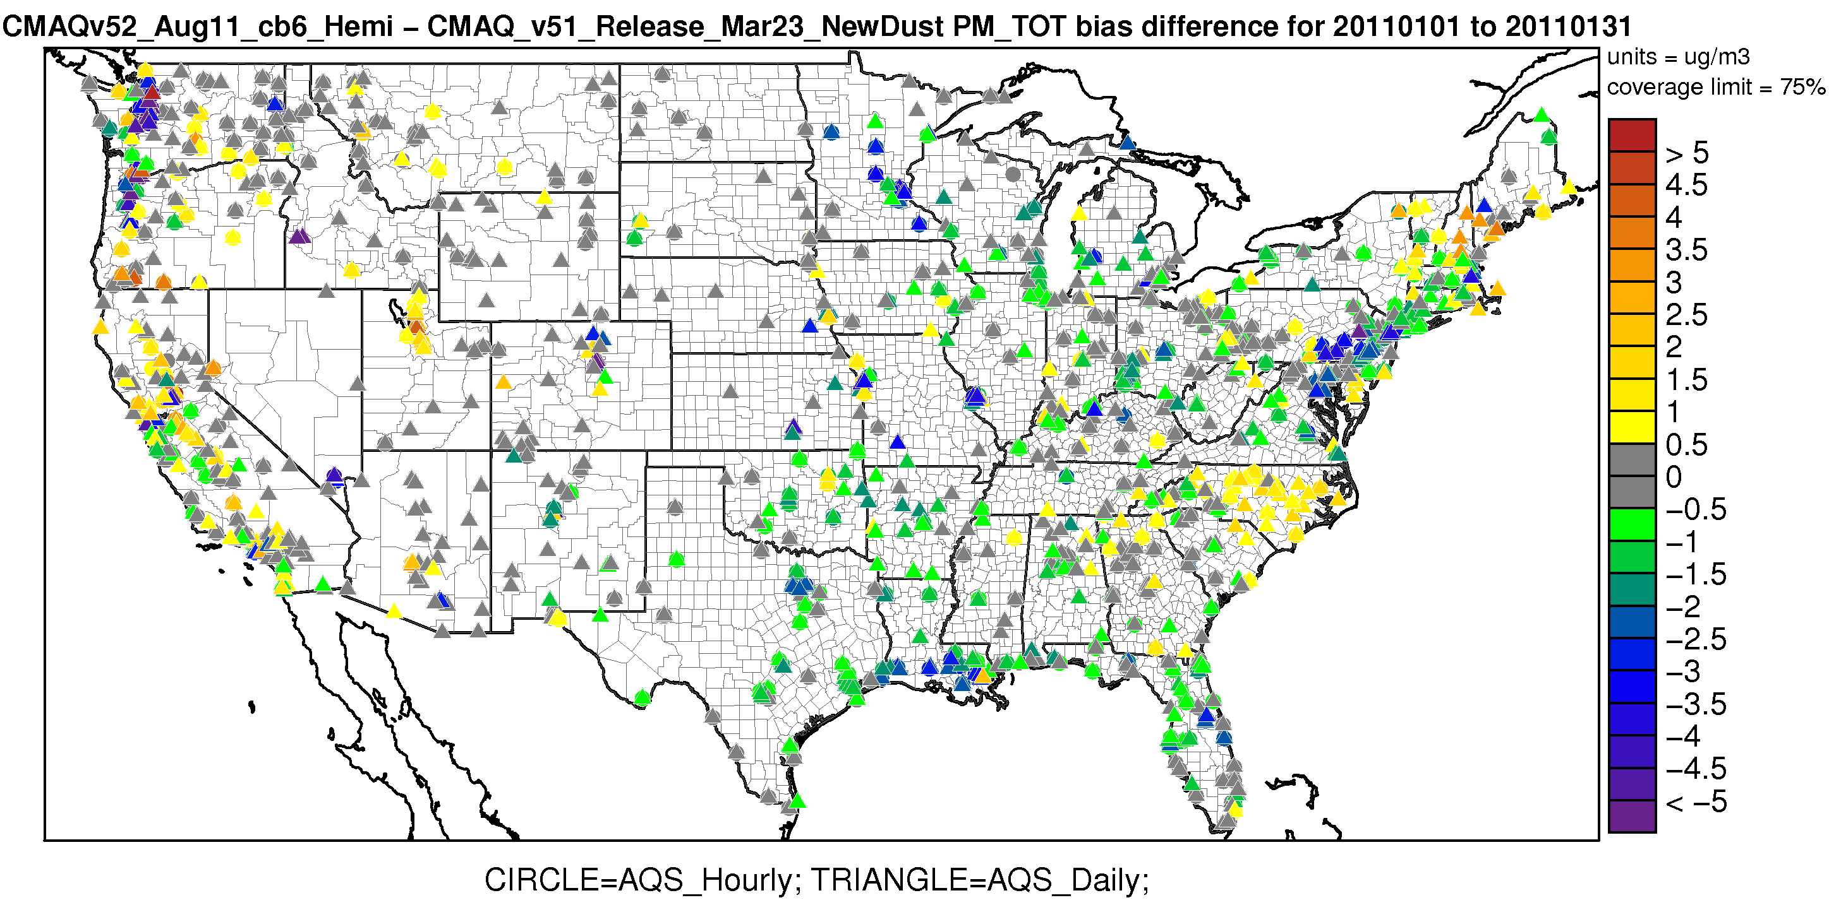
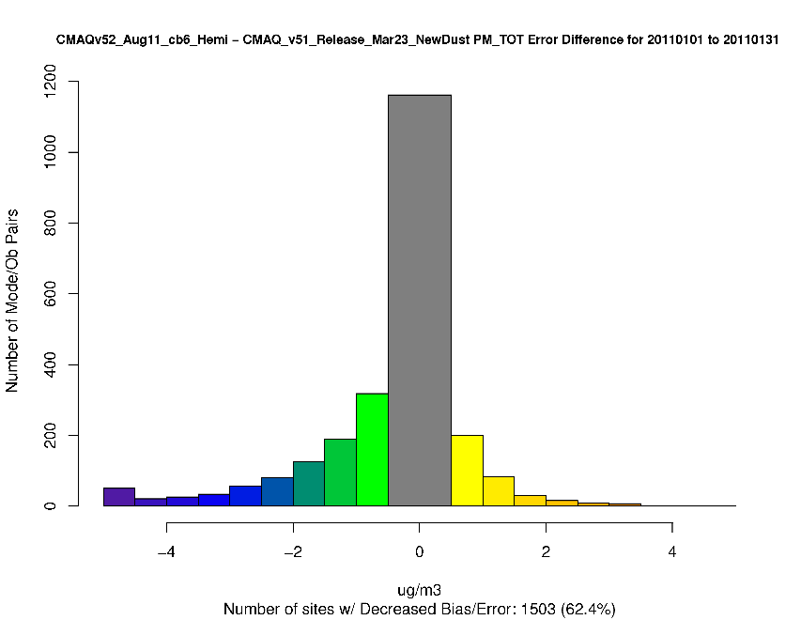
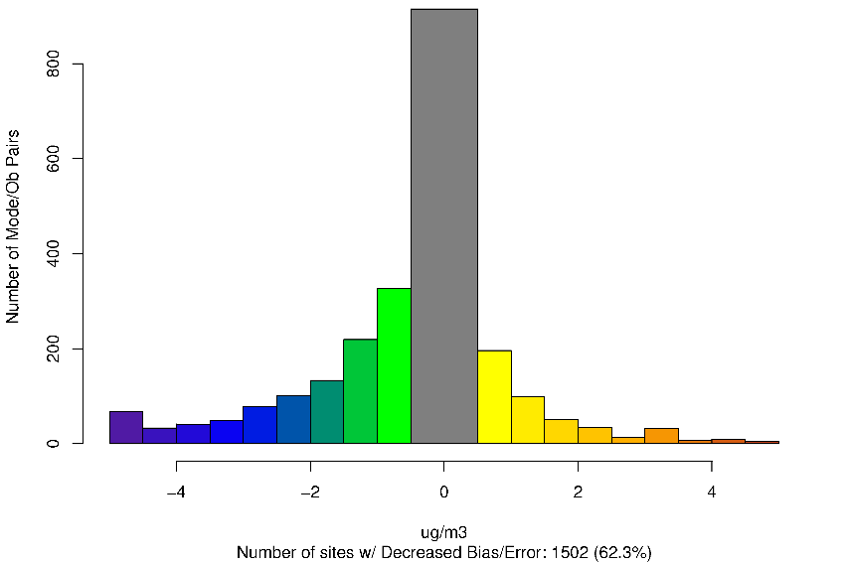
CMAQv5.2 (Hemi) – CMAQv5.1 – Difference in PM_{2.5} Absolute Bias January 2011
Worse Bias
Improved Bias
Worse Error
Worse Bias
Improved Error
Improved Bias

Slide 26
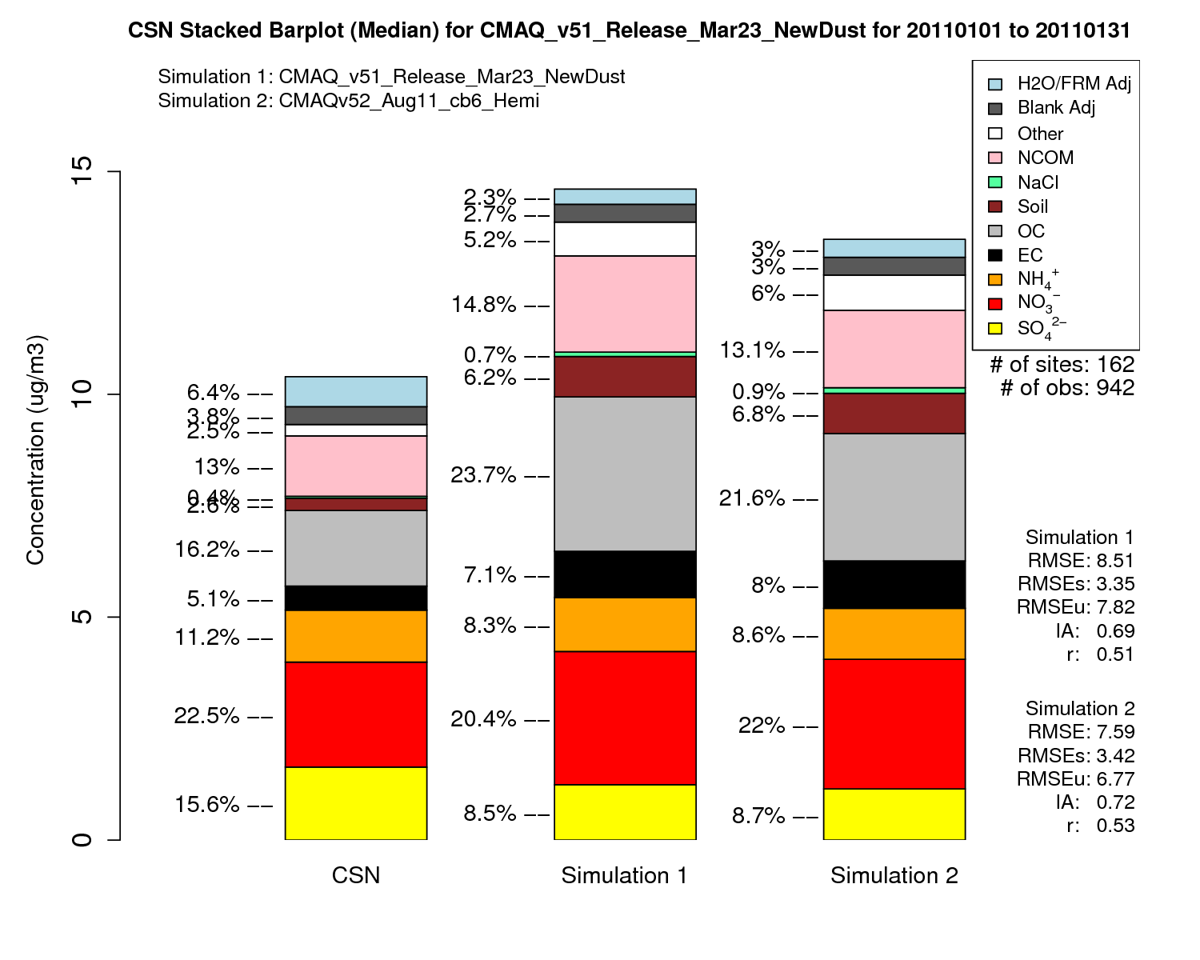
January PM_{2.5} Speciated Stacked Bar Plot
CMAQv5.1
CMAQv5.2
CMAQv5.1
CMAQv5.2

Slide 27
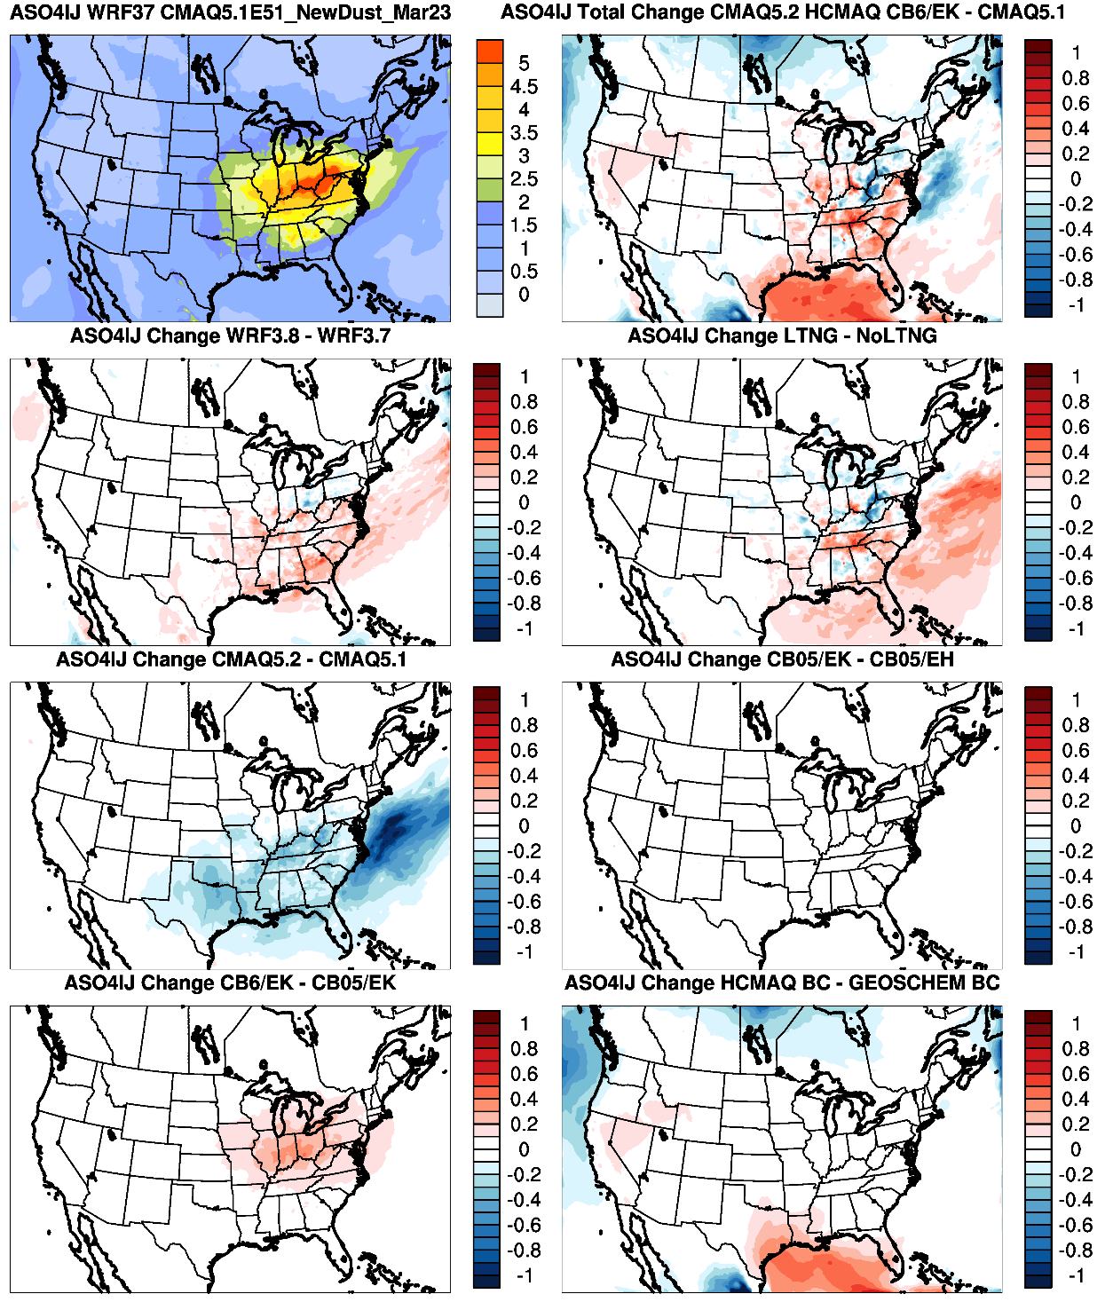
CMAQv5.1 Modeled SO₄ Conc.
CMAQv5.2 – CMAQv5.1
July SO₄
WRFv3.8
Lightning Assimilation
Mixed change in SO₄ due to lightning assimilation
Updates in CMAQv5.2
Emissions Update
Decreased SO₄ due to changes in CMAQv5.2 (likely due to sub-grid cloud updates)
CB6r3 Chemical Mechanism
Hemispheric CMAQ BCs
Increased SO₄ due to WRFv3.8, CB6r3 chemical mechanism and hemispheric BCs

Slide 28
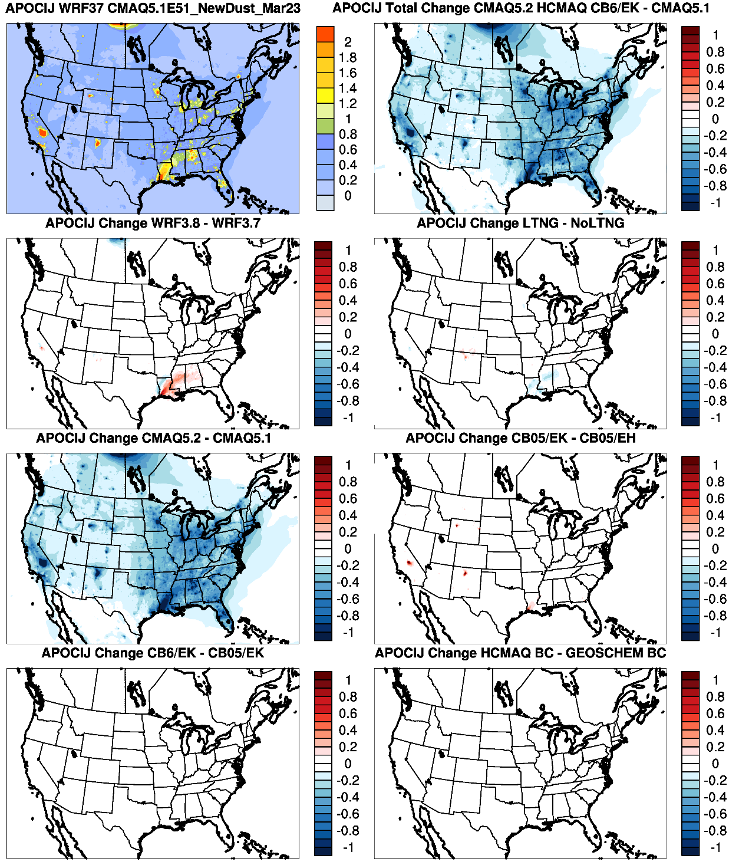
CMAQv5.1 Modeled POA Conc.
CMAQv5.2 – CMAQv5.1
July
Primary OA
WRFv3.8
Lightning Assimilation
Large decrease in primary OA due to updates in CMAQv5.2 (semivolatile POA)
Updates in CMAQv5.2
Emissions Update
Smaller changes due to WRFv3.8, lightning assimilation and emission updates
CB6r3 Chemical Mechanism
Hemispheric CMAQ BCs

Slide 29
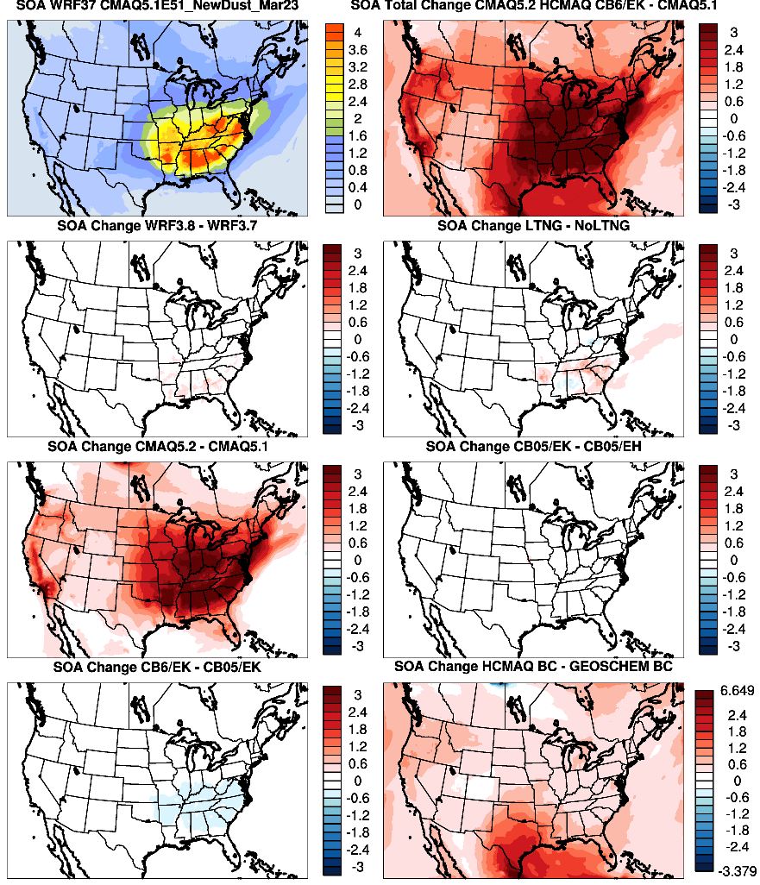
CMAQv5.1 Modeled SOA Conc.
CMAQv5.2 – CMAQv5.1
July
Secondary OA
WRFv3.8
Lightning Assimilation
Smaller increases due to WRFv3.8 and lightning assimilation
Large increase in SOA due to updates in CMAQv5.2 (new SOA formation pathways) and Hemispheric BCs
Updates in CMAQv5.2
Emissions Update
Small decrease in the SOA in the southeast due to CB6r3 chemical mechanism update
CB6r3 Chemical Mechanism
Hemispheric CMAQ BCs

Slide 30
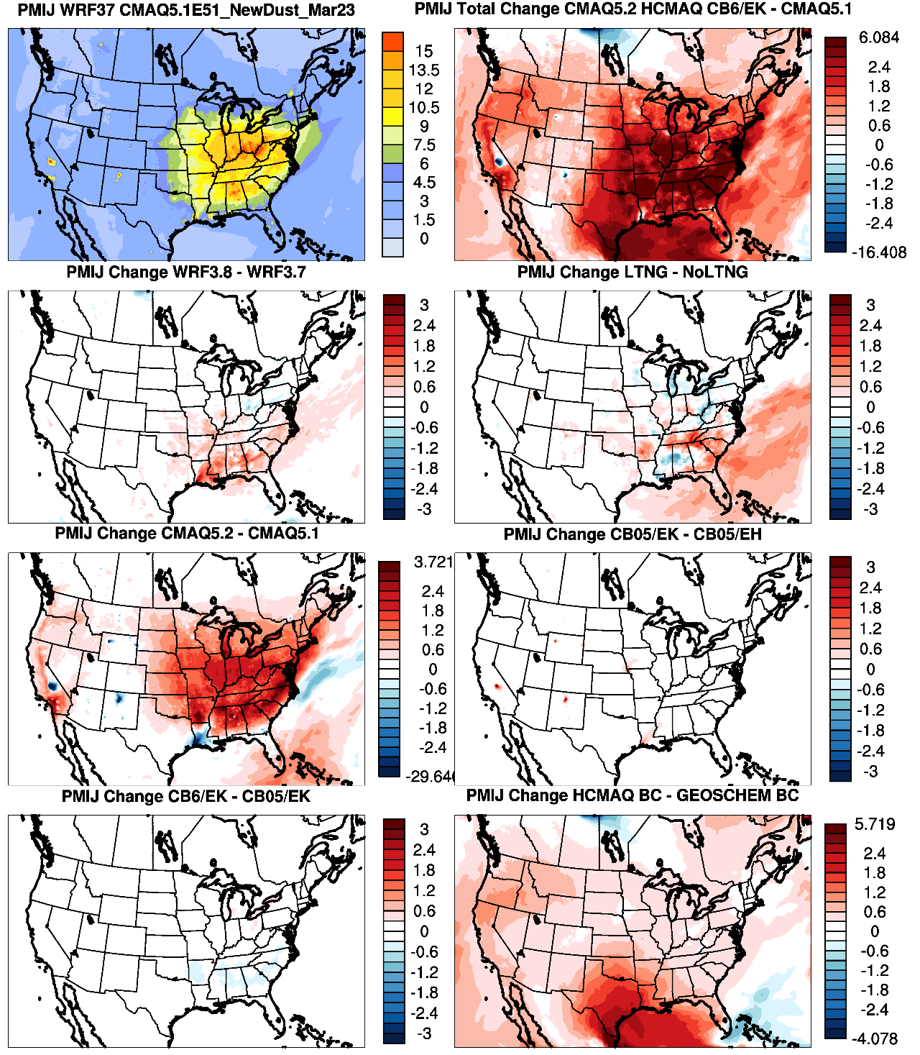
CMAQv5.1 Modeled PM_{2.5} Conc.
CMAQv5.2 – CMAQv5.1
July PM_{2.5}
Large increase in PM_{2.5} across the CONUS between v5.1 base and v5.2 final
WRFv3.8
Lightning Assimilation
Mixed increases/decreases in PM_{2.5} due to the WRFv3.8 and lightning assimilation
Updates in CMAQv5.2
Emissions Update
Large increase in PM_{2.5} across much of the CONUS due to updates in CMAQv5.2
CB6r3 Chemical Mechanism
Hemispheric CMAQ BCs
Relative large increase in PM_{2.5} due to hemispheric CMAQ BCs

Slide 31
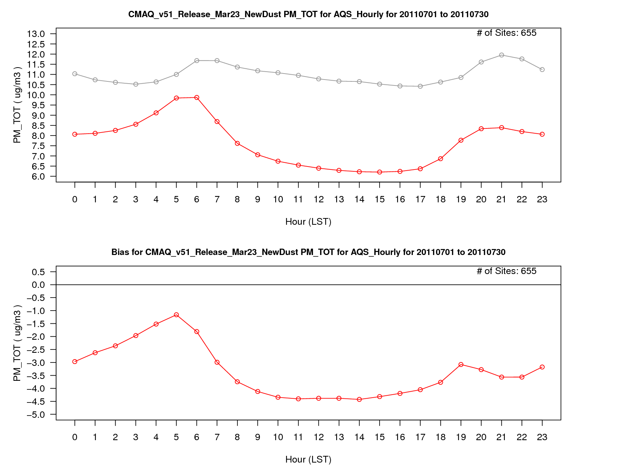
PM_{2.5} Concentration
v5.1 Base
PM_{2.5} Bias

Slide 32
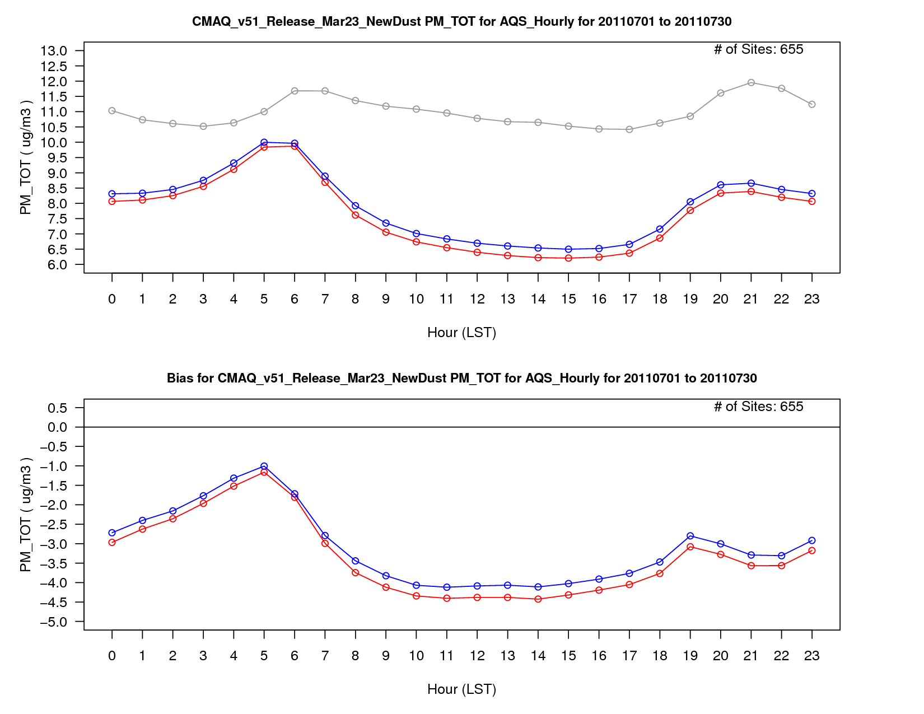
PM_{2.5} Concentration
v5.1 Base
v5.1 w/ WRF Updates
PM_{2.5} Bias

Slide 33
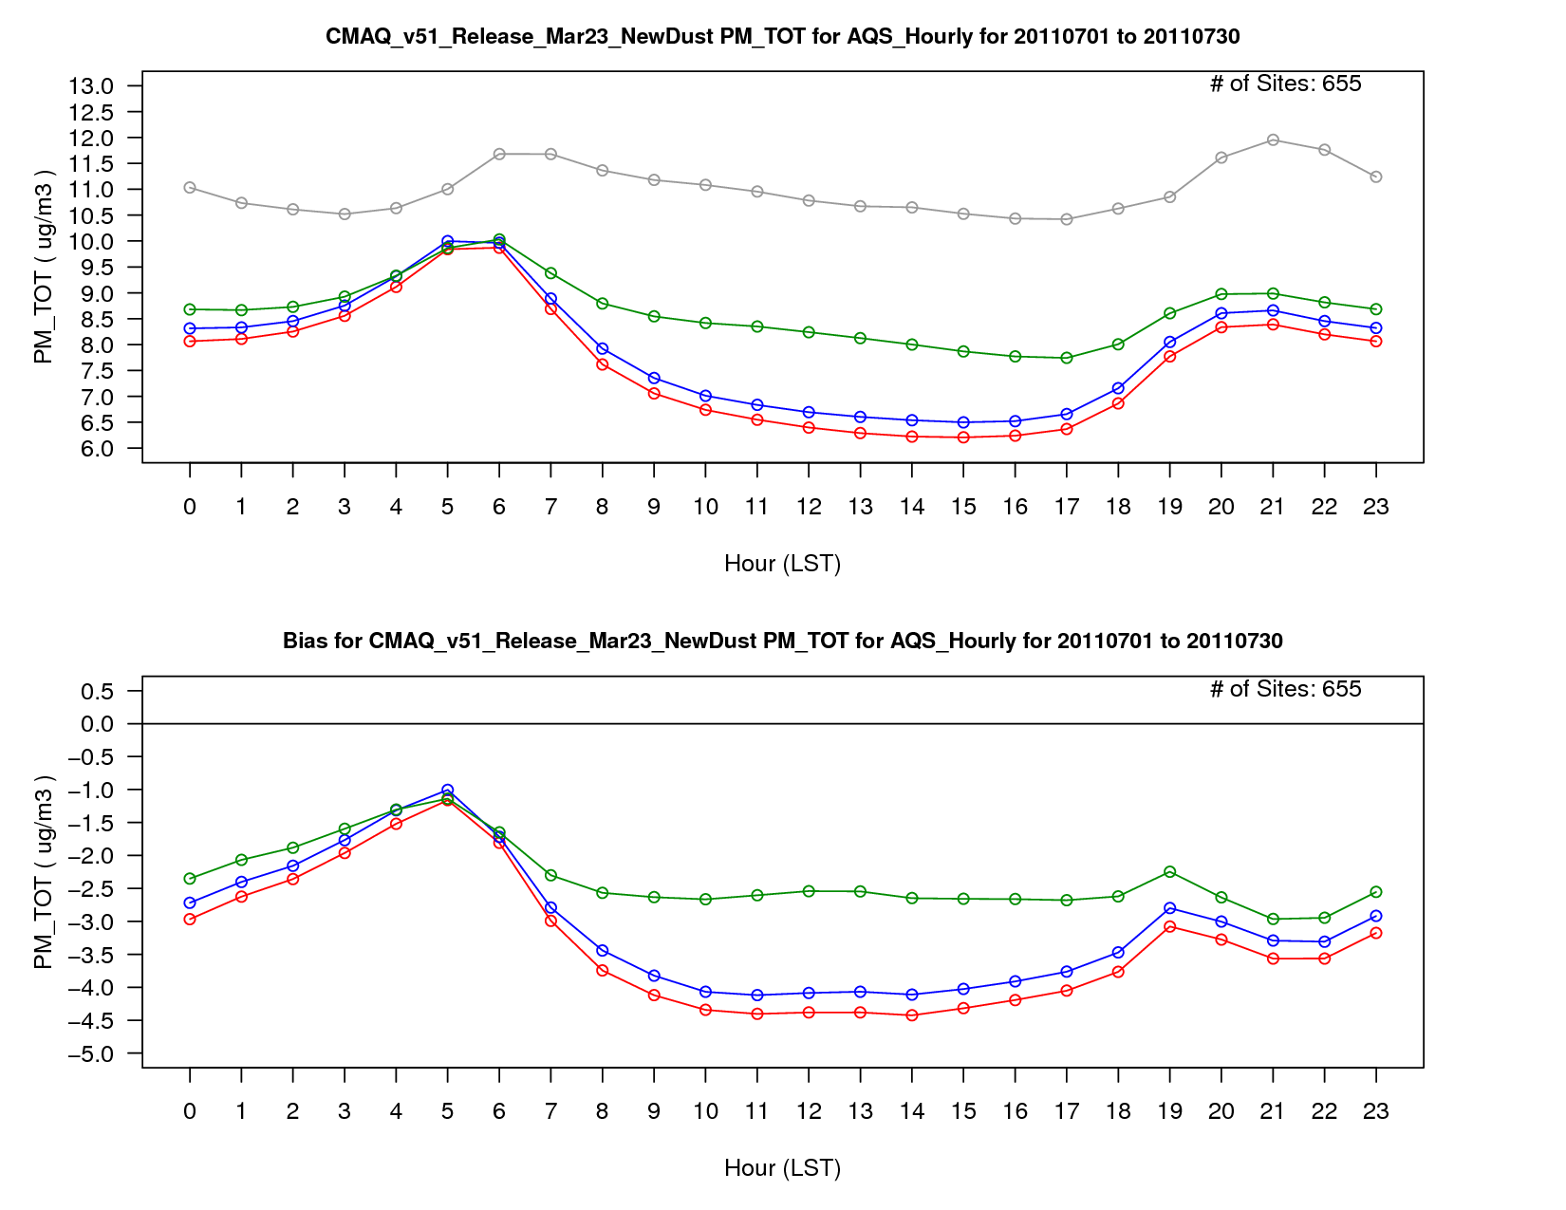
PM_{2.5} Concentration
v5.1 Base
v5.1 w/ WRF Updates
v5.2 CB05e51
PM_{2.5} Bias

Slide 34
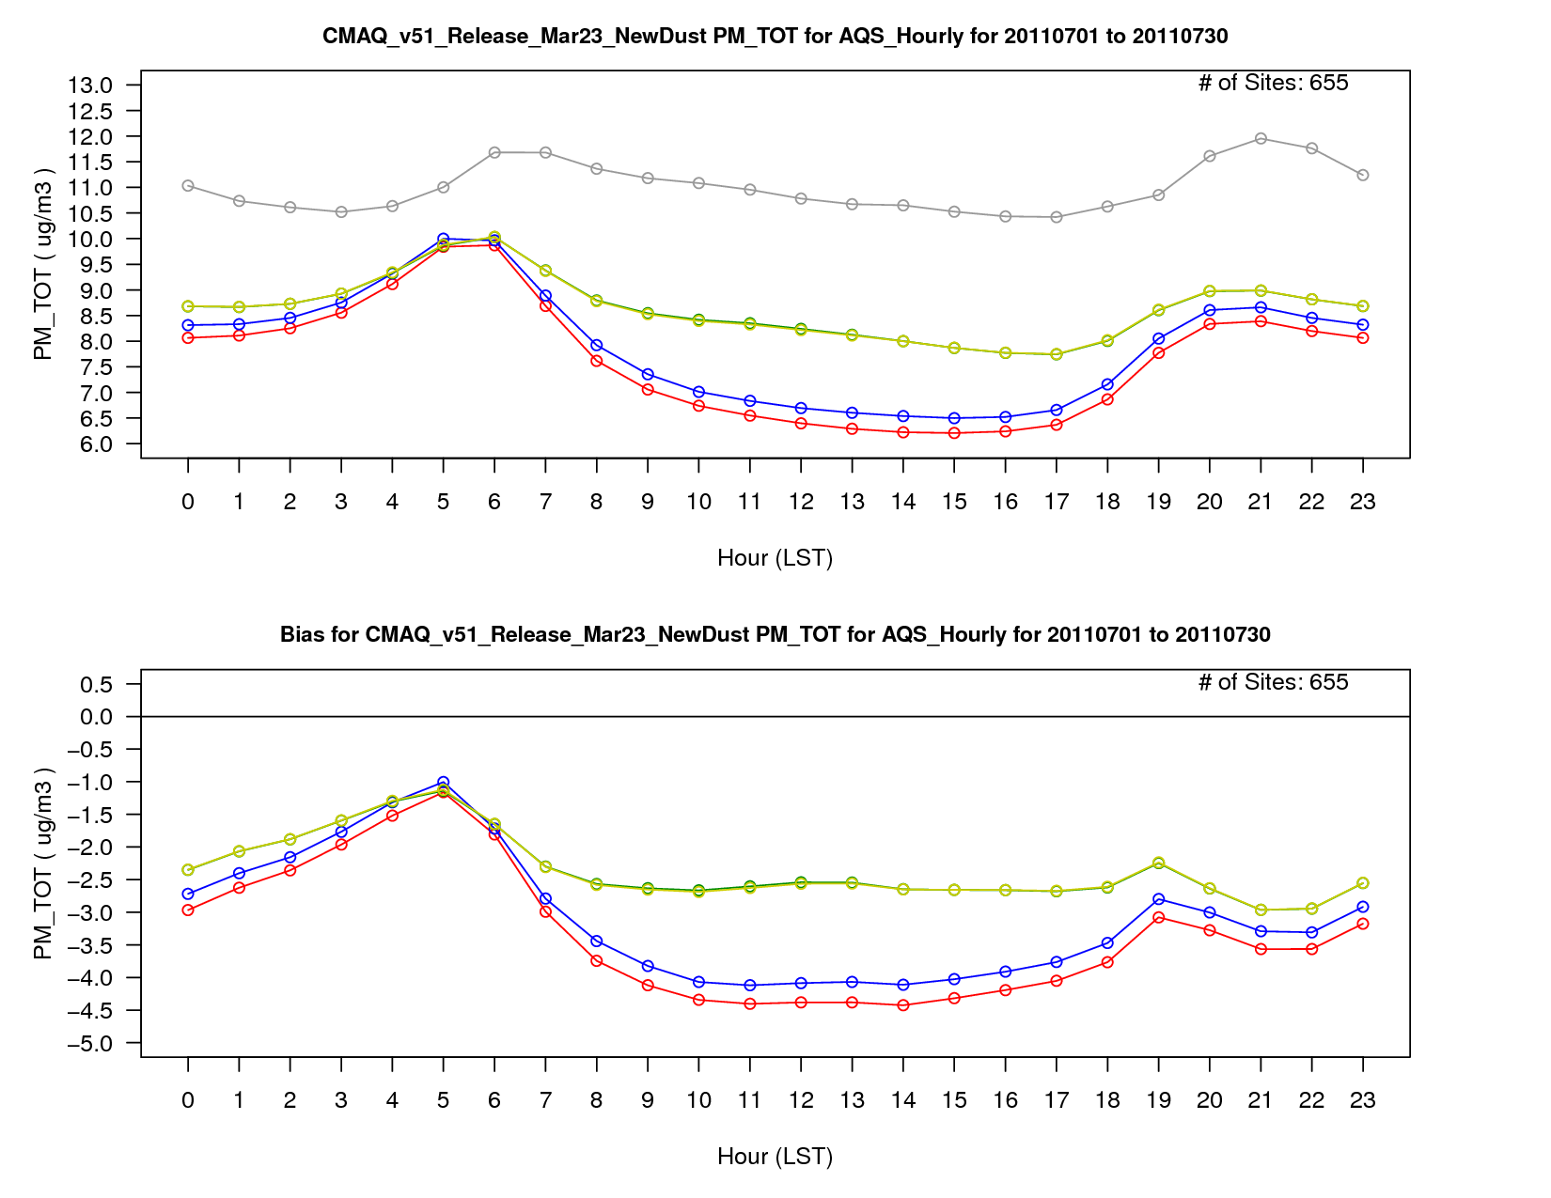
PM_{2.5} Concentration
v5.1 Base
v5.1 w/ WRF Updates
v5.2 CB05e51
v5.2 CB05e51 (ek emis)
PM_{2.5} Bias

Slide 35
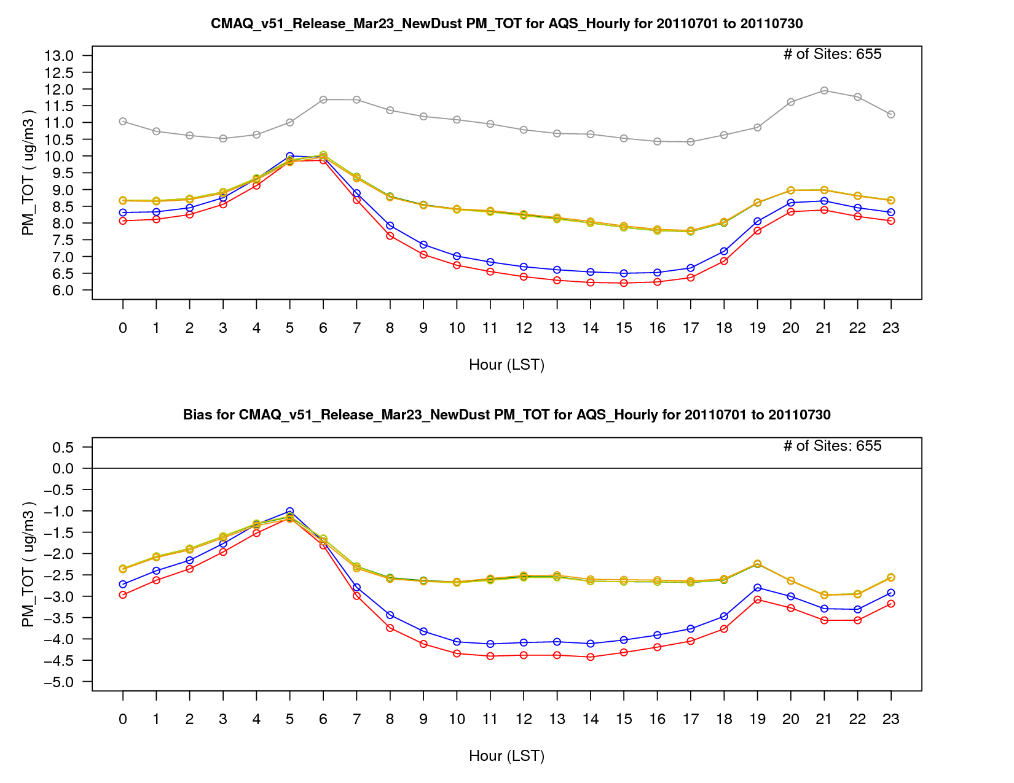
PM_{2.5} Concentration
v5.1 Base
v5.1 w/ WRF Updates
v5.2 CB05e51
v5.2 CB05e51 (ek emis)
v5.2 CB6r3
PM_{2.5} Bias

Slide 36
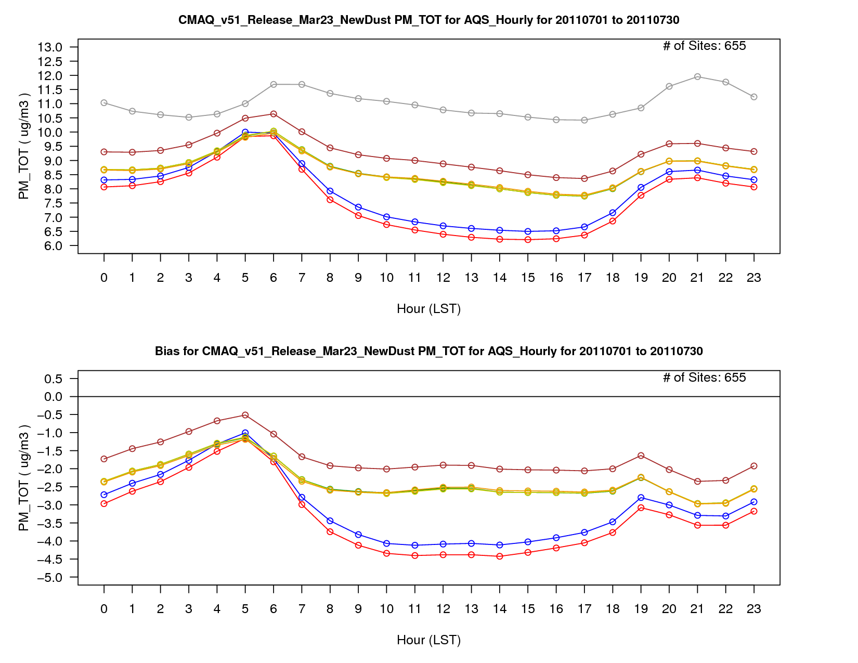
PM_{2.5} Concentration
v5.1 Base
v5.1 w/ WRF Updates
v5.2 CB05e51
v5.2 CB05e51 (ek emis)
v5.2 CB6r3
Hemispheric CMAQ BCs
PM_{2.5} Bias

Slide 37
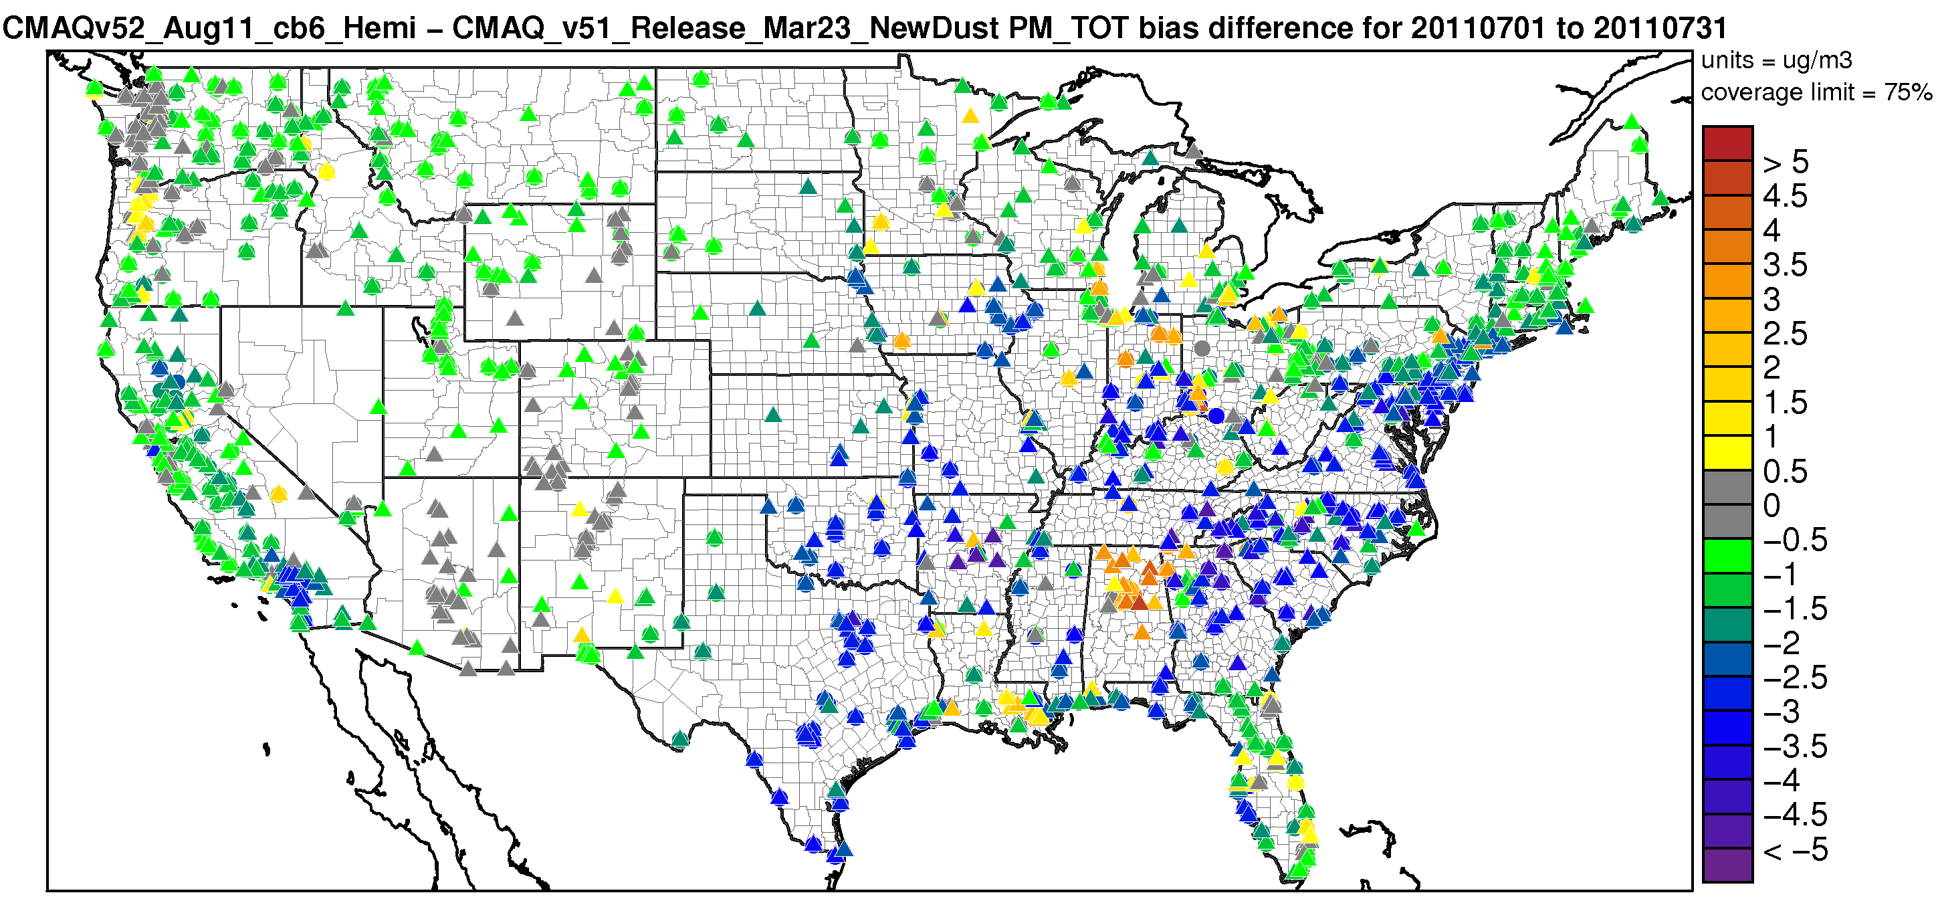
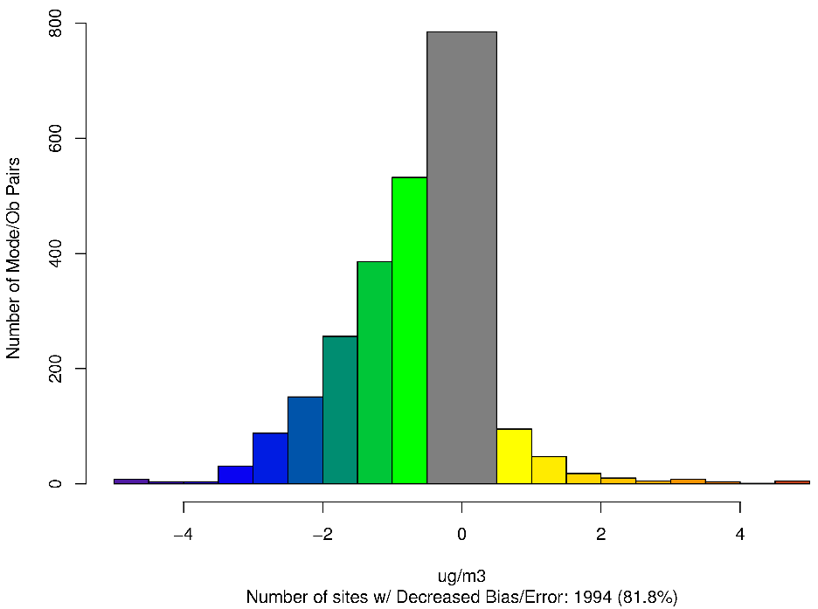
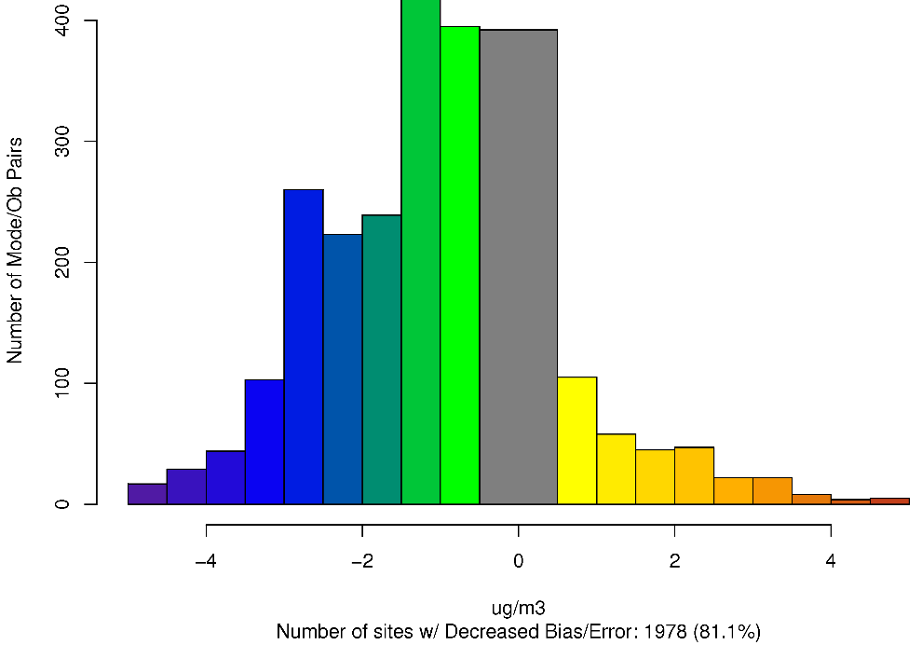
CMAQv5.2 (Hemi) – CMAQv5.1 – Difference in PM_{2.5} Absolute Bias July 2011
Worse Bias
Improved Bias
Worse Error
Worse Bias
Improved Error
Improved Bias

Slide 38
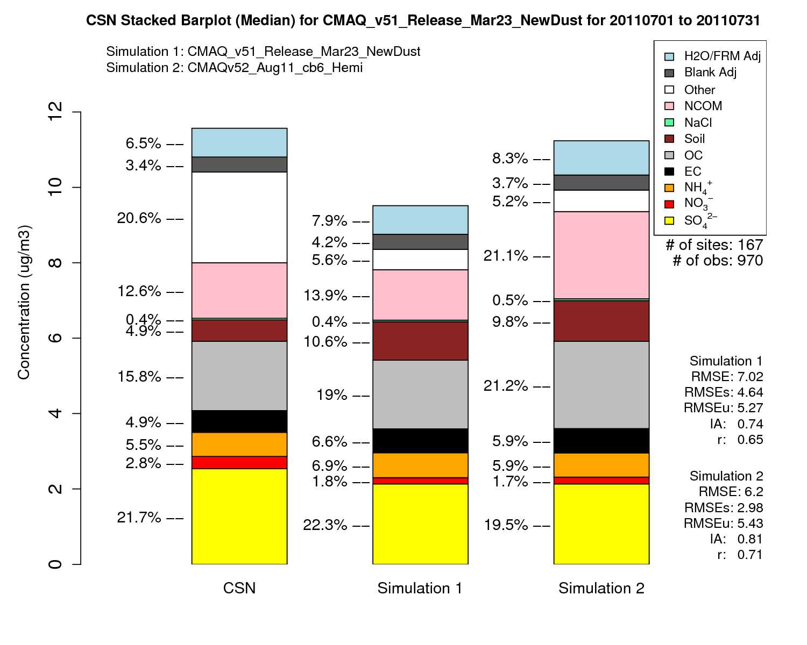
July PM_{2.5} Speciated Stacked Bar Plot
CMAQv5.1
CMAQv5.2
CMAQv5.1
CMAQv5.2

Slide 39
Windblown Dust

Slide 40
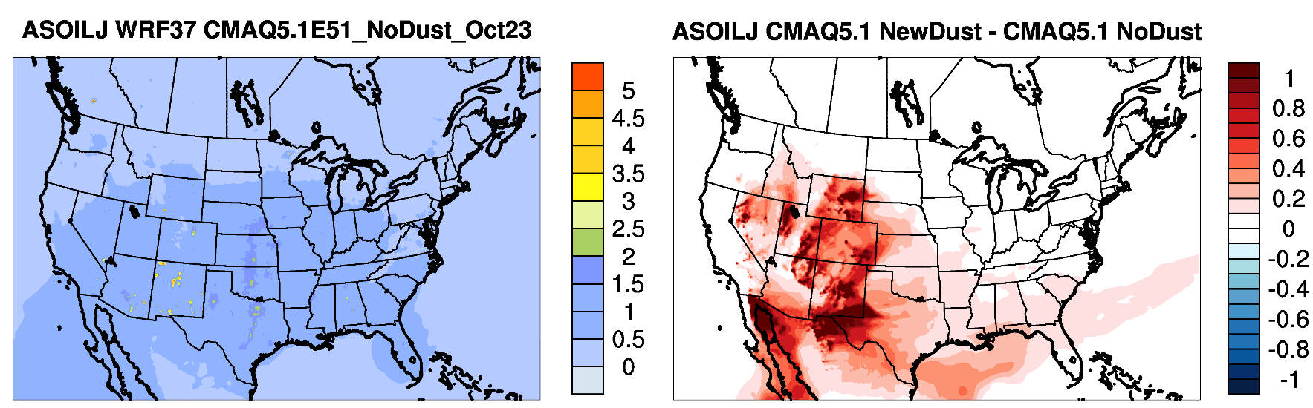
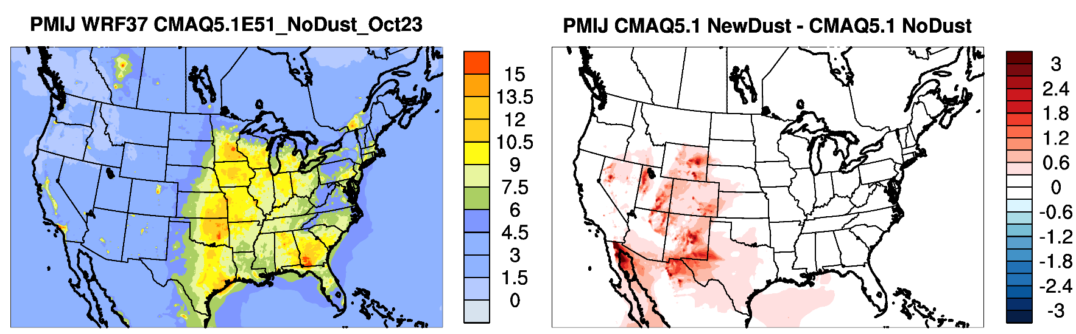
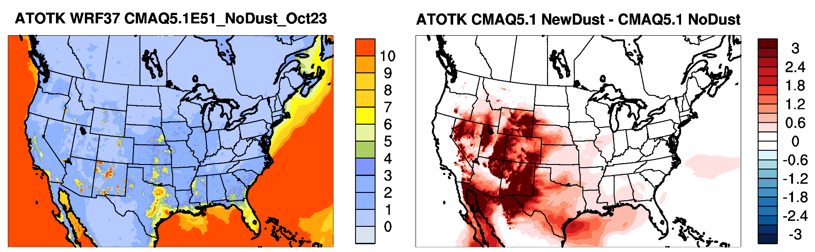
CMAQv5.1 Soil Concentration (no WBD)
CMAQv5.1 Soil Contribution from WBD
Soil
CMAQv5.1 PM_{2.5} Concentration (no WBD)
CMAQv5.1 PM_{2.5} Contribution from WBD
PM_{2.5}
CMAQv5.1 PM₁₀ Concentration (no WBD)
CMAQv5.1 PM₁₀ Contribution from WBD
PM₁₀

Slide 41
Summary
Ozone
  O₃ primarily increases over the CONUS in January (not shown)
    Improved bias in many areas (exception being California)
  O₃ mixing ratios greatly reduced across the CONUS in July
    Large improvement in bias, particularly the eastern U.S.
PM_{2.5}
  PM_{2.5} largely decreases in January
    Improved bias in many areas, particularly the eastern U.S.
    Primarily due to inclusion of semivolatile POA in CMAQv5.2
  PM_{2.5} concentrations increase significantly in July
    Large improvement in bias across the CONUS
    Primarily due to increased SOA (potential SOA from combustion sources) in CMAQv5.2 and hemispheric CMAQ BCs
    Smaller contribution from WRFv3.8 updates and lightning assimilation in WRF
  New windblown model produces reasonable PM_{2.5} and PM₁₀ in desert areas

Slide 42
CMAQv5.2 Release
CMAQv5.2 beta code should be available soon
  Will include all the updates shown here
CMAQv5.2 final release planned for spring 2017
  No major additional updates planned

Slide 43
Extra slides

Slide 44
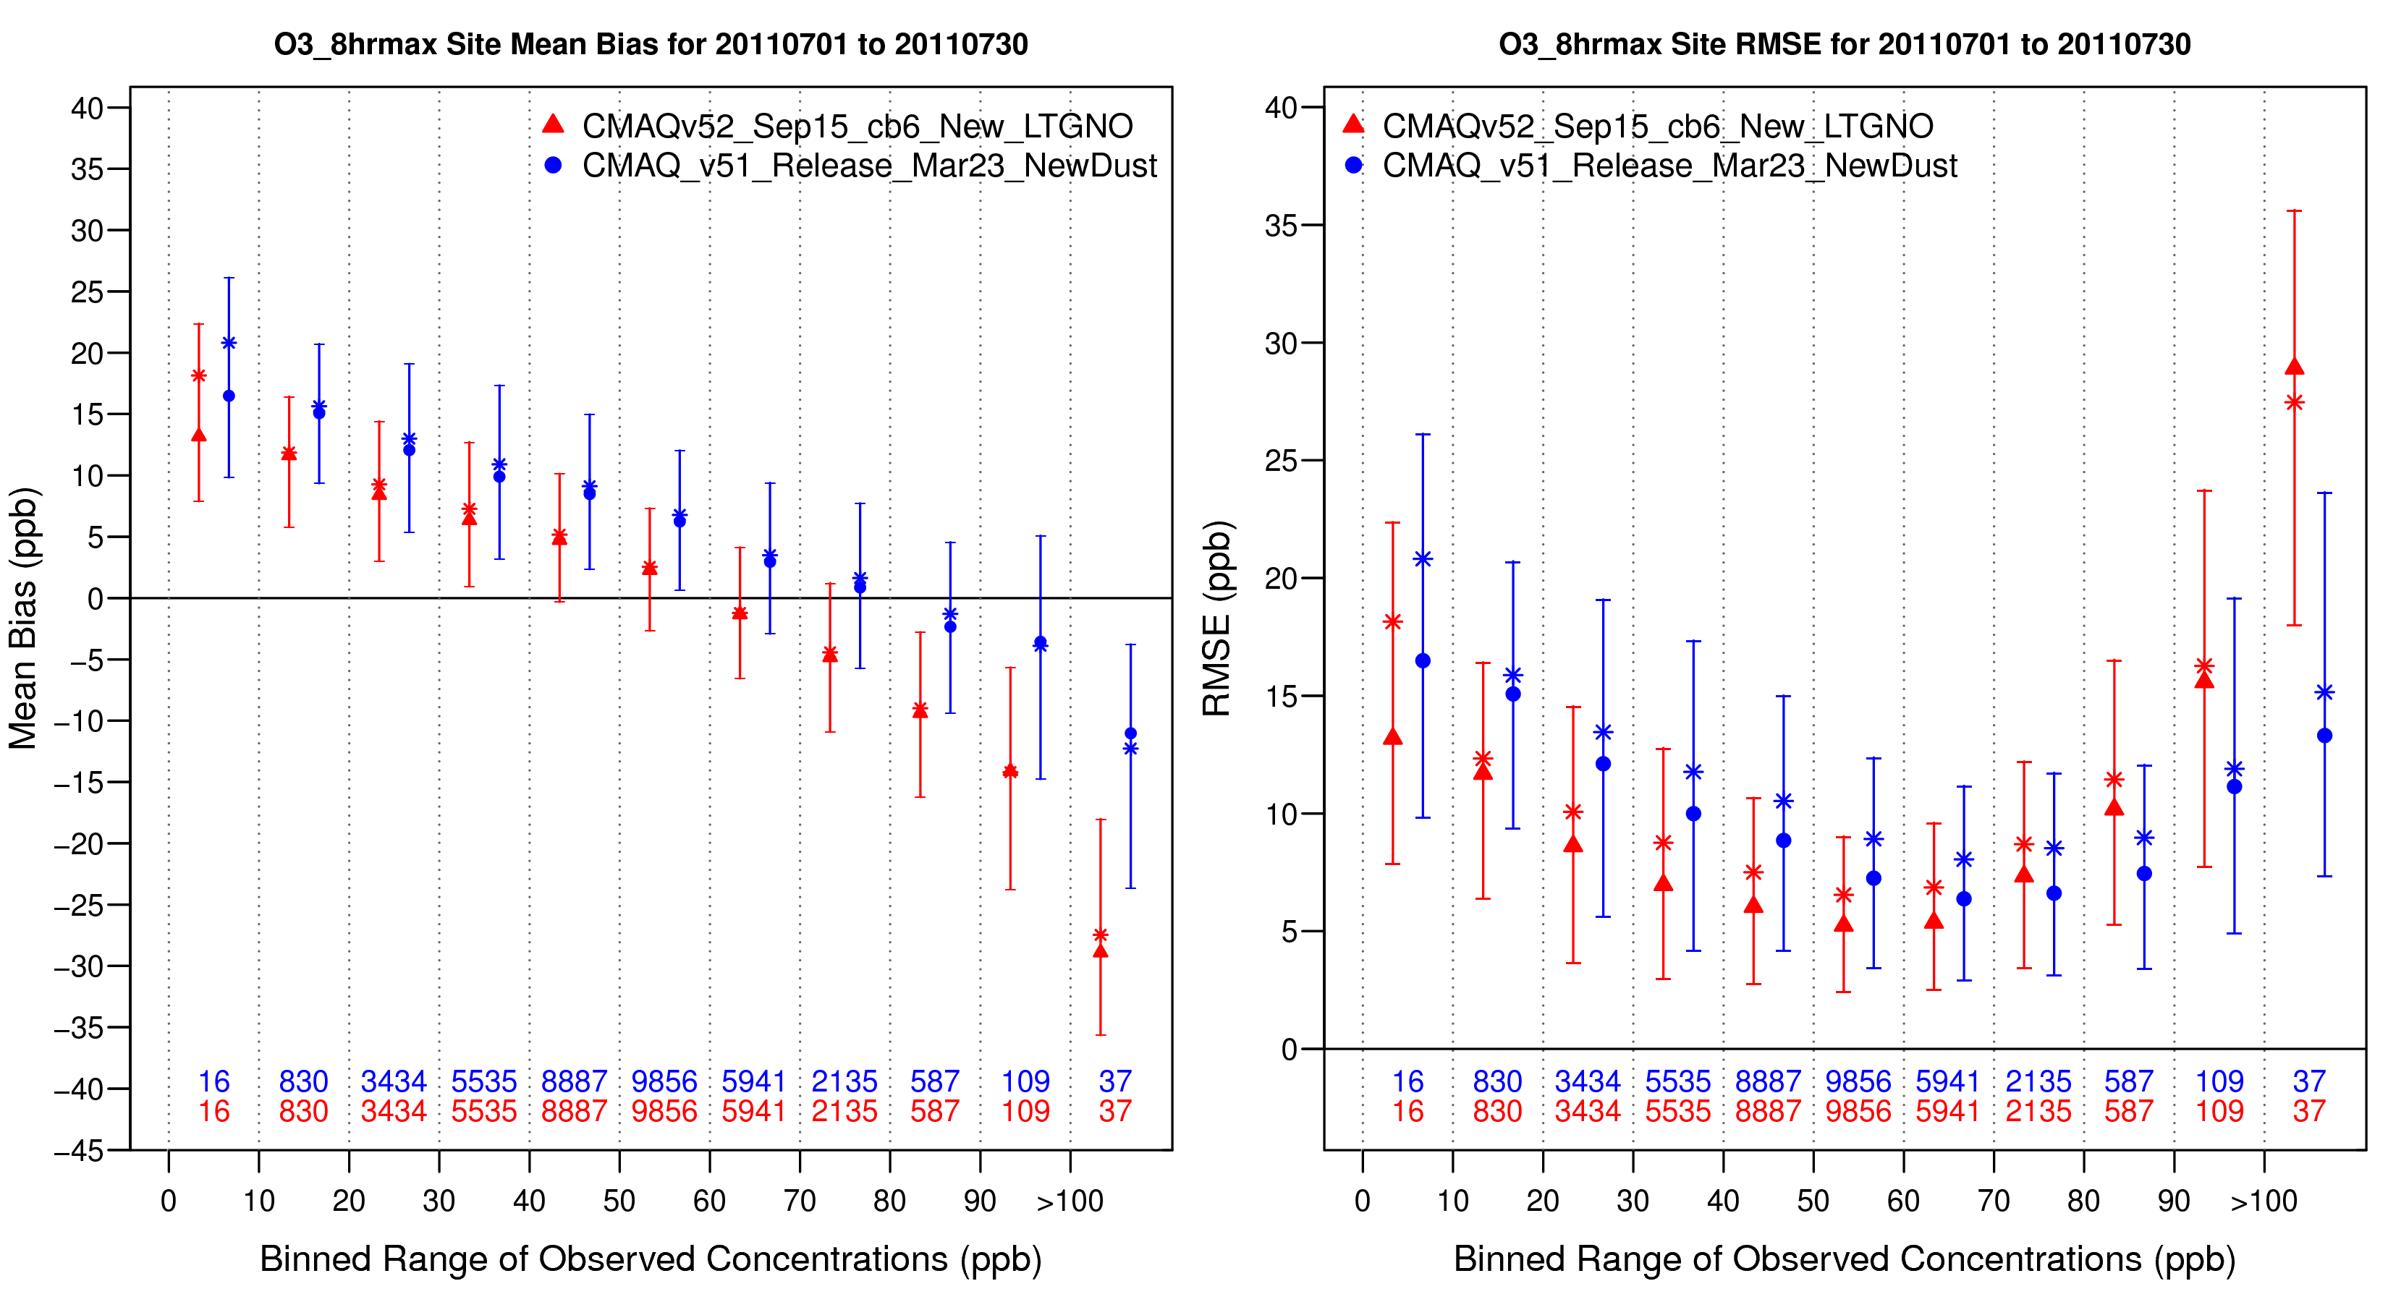
July O₃ Binned Bias/RMSE

Slide 45
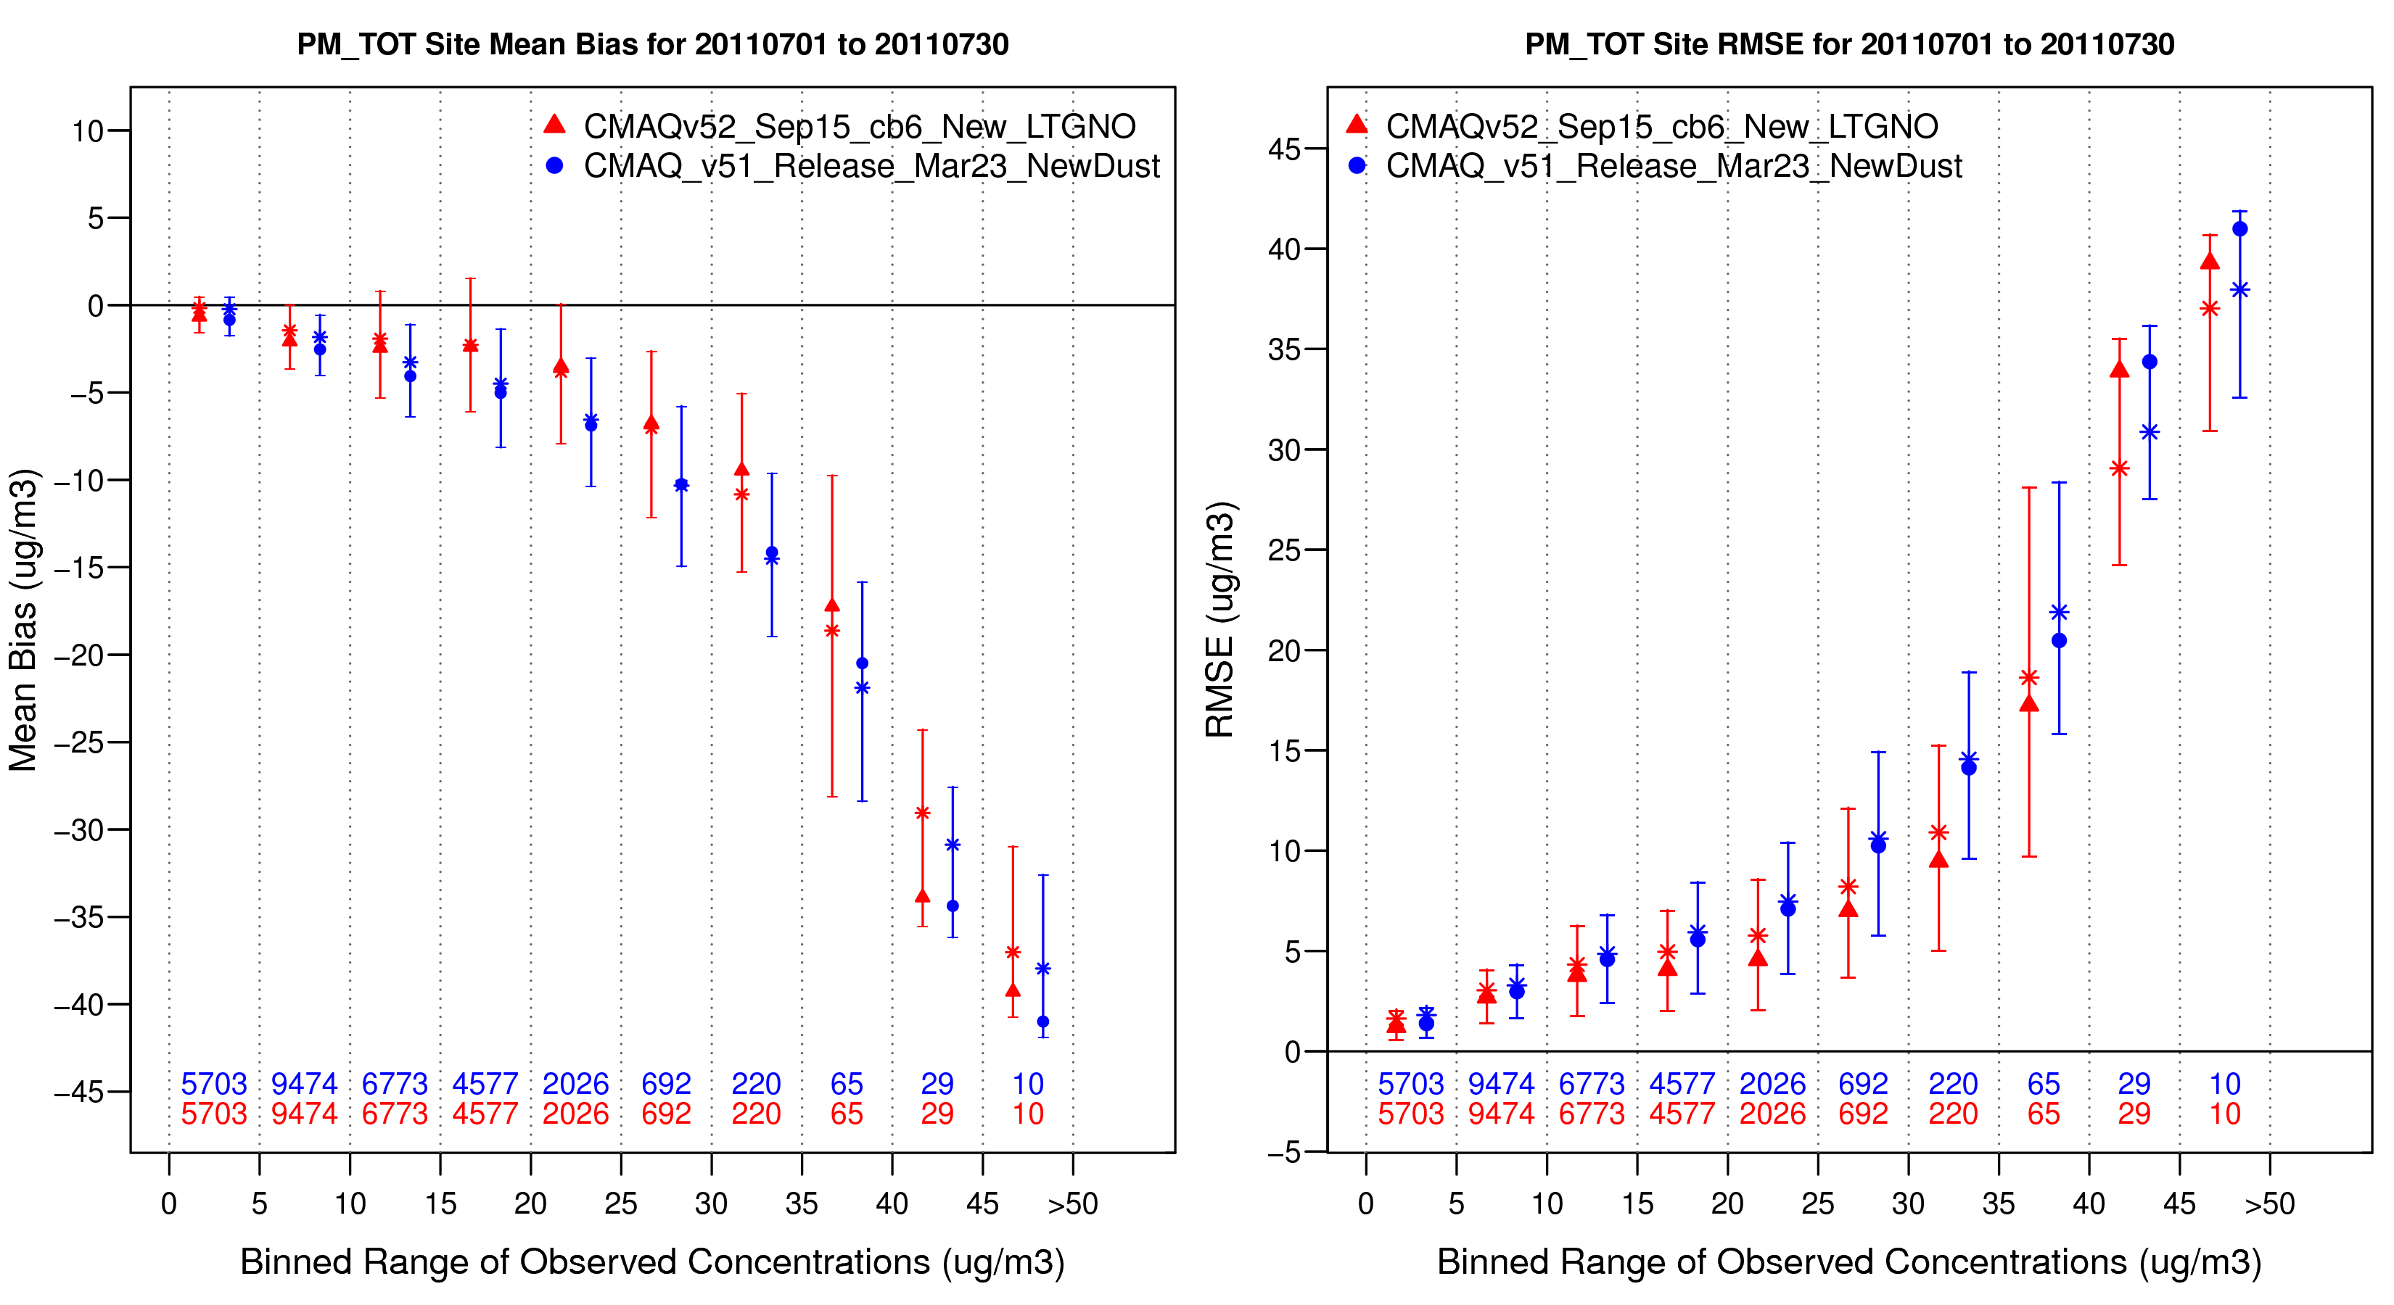
July PM_{2.5} Binned Bias/RMSE

Slide 46
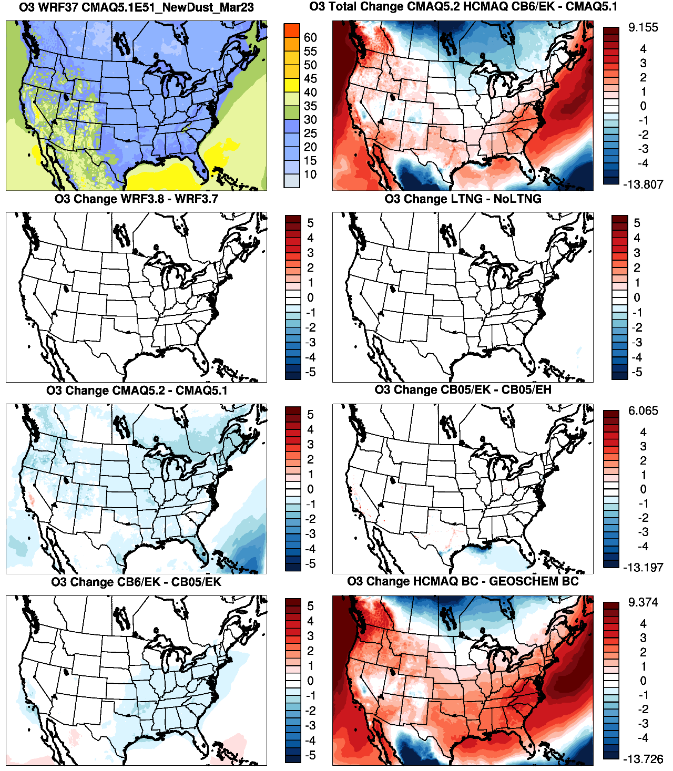
CMAQv5.1
CMAQv5.2 (Hemi) – CMAQv5.1
January
O₃ (all hours)
O₃ primarily increases over the CONUS between v5.1 base and v5.2 final
WRFv3.8
Lightning Assimilation
Decreased O₃ due to updates in v5.2 (increased O₃ dry deposition) and the CB6r3 chemical mechanism
Updates in CMAQv5.2
Emissions Update
CB6r3 Chemical Mechanism
Hemispheric CMAQ BCs
Increased O₃ due to hemispheric CMAQ boundary conditions

Slide 47
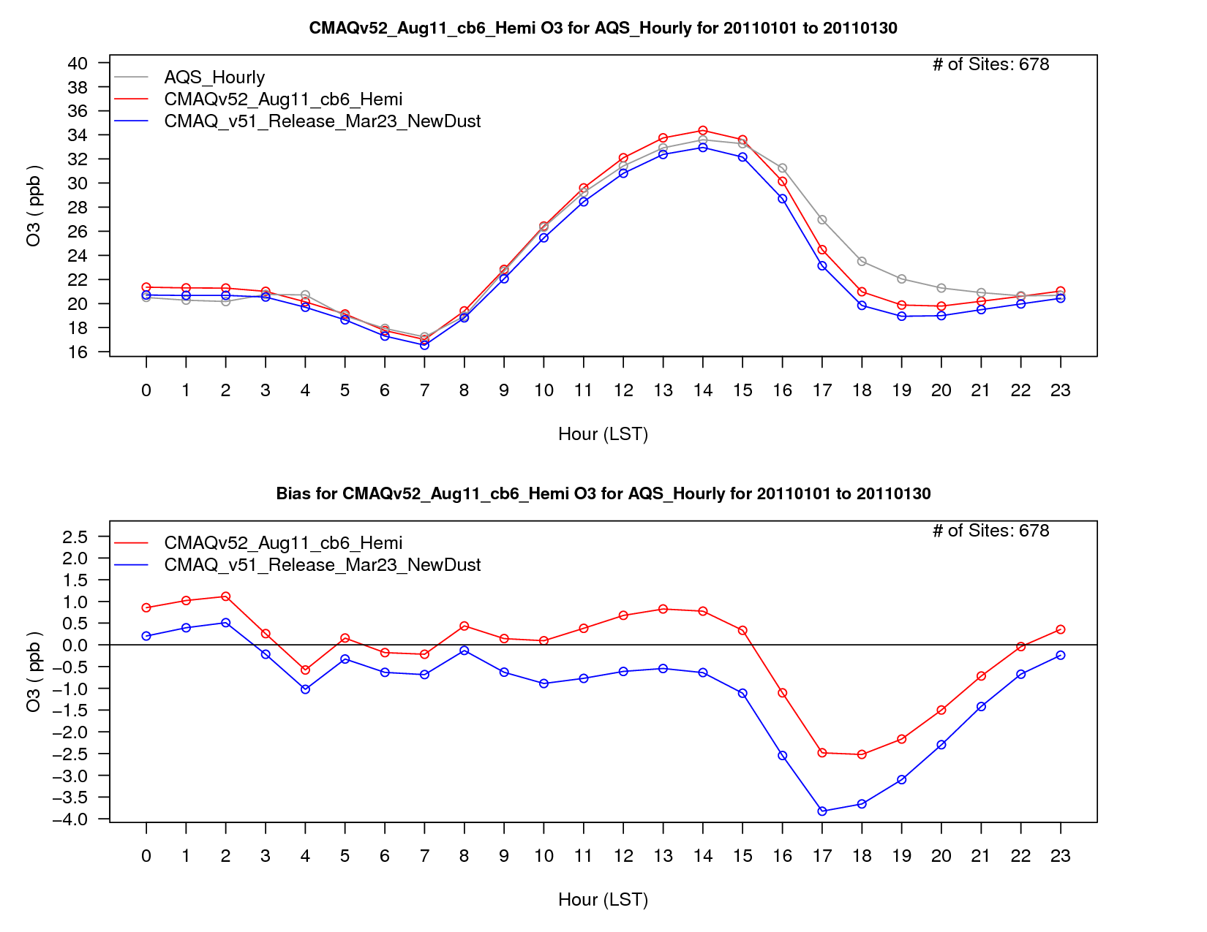

Slide 48
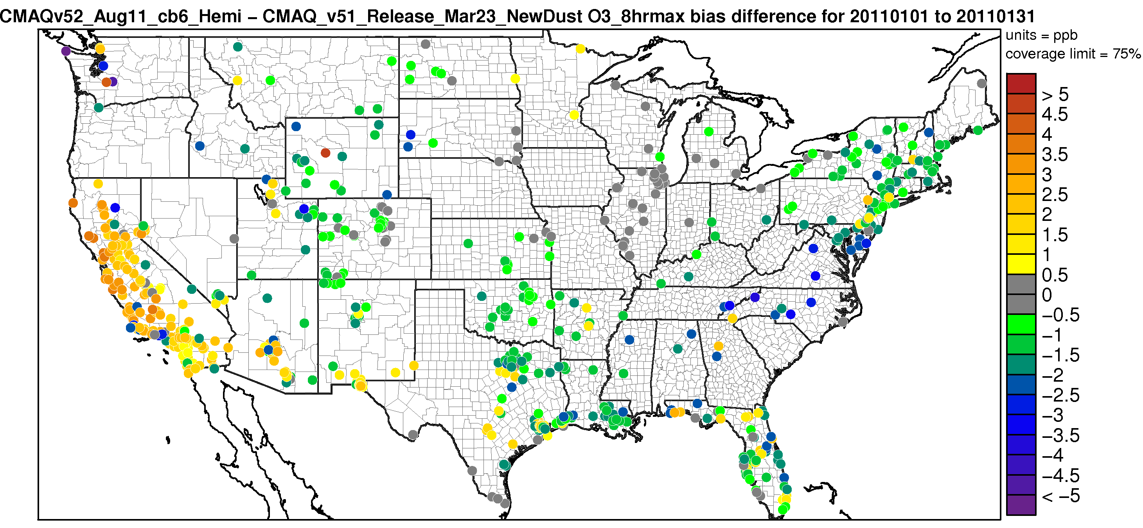
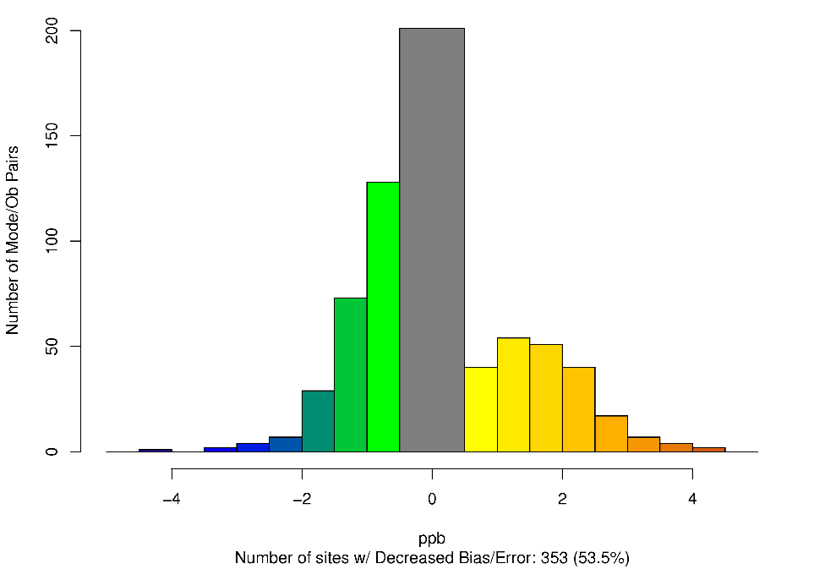
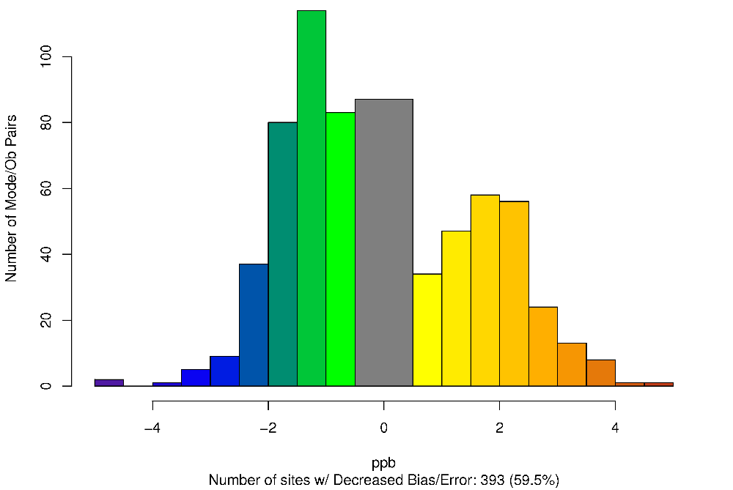
CMAQv5.2 (Hemi) – CMAQv5.1 – Difference in MDA8 O₃ Absolute Bias January 2011
Worse Bias
Improved Bias
Worse Error
Worse Bias
Improved Error
Improved Bias

Slide 49
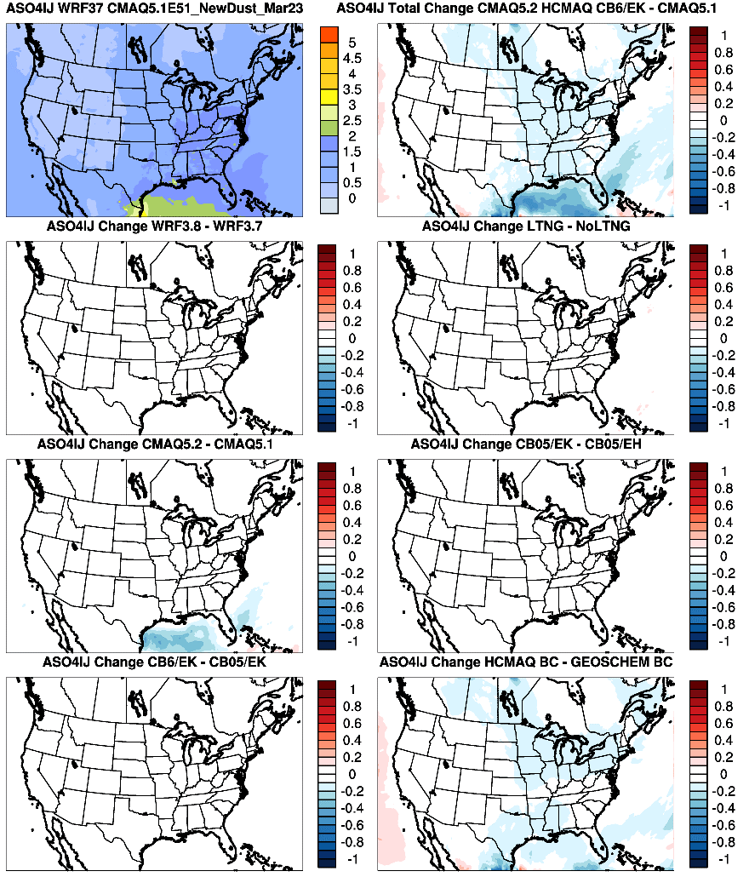
CMAQv5.1
CMAQv5.2 – CMAQv5.1
January SO₄
Small decreases due to changes in CMAQv5.2 and hemispheric BCs
WRFv3.8
Lightning Assimilation
Updates in CMAQv5.2
Emissions Update
CB6r3 Chemical Mechanism
Hemispheric CMAQ BCs

Slide 50

CMAQv5.1
CMAQv5.2 – CMAQv5.1
NO₃
Very small changes in NO₃ over the CONUS. Relatively large change over the eastern Atlantic Ocean due to changes in PM speciation in CMAQv5.2
WRFv3.8
Lightning Assimilation
Updates in CMAQv5.2
Emissions Update
CB6r3 Chemical Mechanism
Hemispheric CMAQ BCs

Slide 51
NO₂

Slide 52

CMAQv5.1
CMAQv5.2 – CMAQv5.1
NO₂
Overall NO₂ mixing ratios decrease over the CONUS in January
WRFv3.8
Lightning Assimilation
Increased NO₂ due to lightning assimilation and emission updates
Updates in CMAQv5.2
Emissions Update
Decreased NO₂ due to emission updates, CB6r3 and hemispheric CMAQ BCs
CB6r3 Chemical Mechanism
Hemispheric CMAQ BCs

Slide 53

NO₂
NO₂ mixing ratios largely decreases in July
Mixed NO₂ changes due to WRFv3.8 updates, lightning assimilation and emission updates
Decreased NO₂ due to CMAQv5.2 updates and CB6r3 chemical mechanism

Slide 54
EC

Slide 55

Elemental Carbon
EC generally increases due to lightning assimilation and emission updates

Slide 56

Elemental Carbon
Very small overall increase in EC due primarily to WRFv3.8, lightning assimilation, changes in CMAQv5.2 and emission updates

Slide 57
OC

Slide 58

CMAQv5.1 Modeled OC Conc.
CMAQv5.2 – CMAQv5.1
January
Organic Carbon
WRFv3.8
Lightning Assimilation
OC changes mixed due decrease in POA and increase in SOA from updates in CMAQv5.2
Updates in CMAQv5.2
Emissions Update
CB6r3 Chemical Mechanism
Hemispheric CMAQ BCs

Slide 59

CMAQv5.1 Modeled OC Conc.
CMAQv5.2 – CMAQv5.1
July
Organic Carbon
WRFv3.8
Lightning Assimilation
Small increase in OC due to WRFv3.8 and lightning assimilation
Updates in CMAQv5.2
Emissions Update
Large increase in OC due to changes in CMAQv5.2 (increased SOA) and hemispheric BCs
CB6r3 Chemical Mechanism
Hemispheric CMAQ BCs

Slide 60
PM₁₀

Slide 61

CMAQv5.1
CMAQv5.2 – CMAQv5.1
January PM₁₀
PM₁₀ increases due primarily to speciation changes in CMAQv5.2 and from additional PM₁₀ in the hemispheric CMAQ BCs
WRFv3.8
Lightning Assimilation
Updates in CMAQv5.2
Emissions Update
CB6r3 Chemical Mechanism
Hemispheric CMAQ BCs

Slide 62

CMAQv5.1
CMAQv5.2 – CMAQv5.1
July PM₁₀
PM₁₀ increases due to speciation changes in CMAQv5.2 and from additional PM₁₀ in the hemispheric CMAQ BCs
WRFv3.8
Lightning Assimilation
Updates in CMAQv5.2
Emissions Update
CB6r3 Chemical Mechanism
Hemispheric CMAQ BCs

