Slide 1
Top-Down Constraints on Emissions of NH₃, NO_{x}, and SO₂ during the 2013 NOAA SENEX Campaign
M. J. Alvarado¹, C. R. Lonsdale¹, E. Winijkul¹, C. M. Brodowski¹, K. E. Cady-Pereira¹, D. K. Henze², S. Capps^{2,*}
¹Atmospheric and Environmental Research
²Univerisity of Colorado – Boulder
*Now At Drexel University
With thanks to the SENEX science team
(A. Neuman, J. Nowak, J. Holloway, T. Ryerson, A. Middlebrook, J. Jimenez, J. Fry)
SEARCH Science Team (S. Shaw, K. Bauman, C. Blanchard)
and Environment and Climate Change Canada (C. McLinden, M. Shephard)
Copyright 2016, Government sponsorship acknowledged.

Slide 2
NH₃, SO₂, and NO_{x} are key PM_{2.5} precursors
NH₃ + HNO₃⬅➔NH₄NO₃
2 NH₃ + H₂SO₄➔(NH₄)₂SO₄
Increase incidence of cardiovascular and respiratory diseases
Increase number of CCN
SO₂, NO_{X} emissions decreasing due to controls but NH₃ increasing
Approach: Use model-based top-down approaches to constrain emissions
Identify emission-related errors in baseline model runs (this talk)
  Use chemical families (e.g., NH_{x} = NH_{3(g)} + NH_{4(p)}) to reduce impact of chemistry errors, then separate meteorology from emission errors
Future Work:
  Lagrangian models (e.g., WRF-STILT, Nehrkorn et al., 2010)
  CMAQ Adjoint (Hakami et al., 2007)

Slide 3
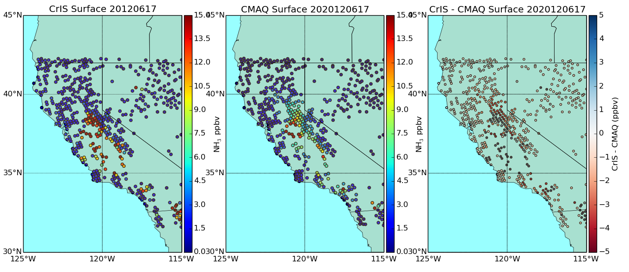
Using Satellites to Investigate NH₃ Sources
TES NH₃ transects over Bakersfield in CalNex suggested a x2 underestimate in afternoon due to diurnal cycle errors (Lonsdale et al., ACPD, 2016)
2012 CrIS NH₃ is consistent with CalNex TES results.
Some evidence of a transport error on June 17 – flow along slope not correct?

Slide 4
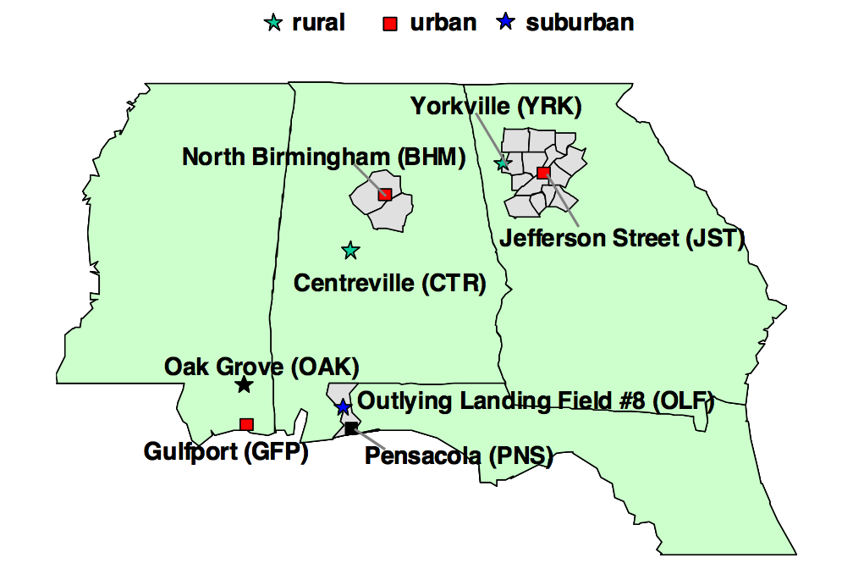
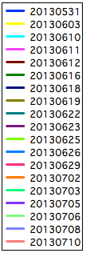
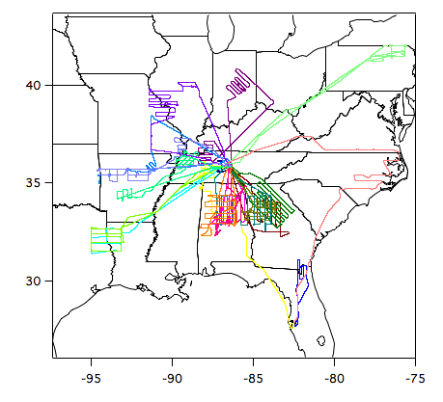
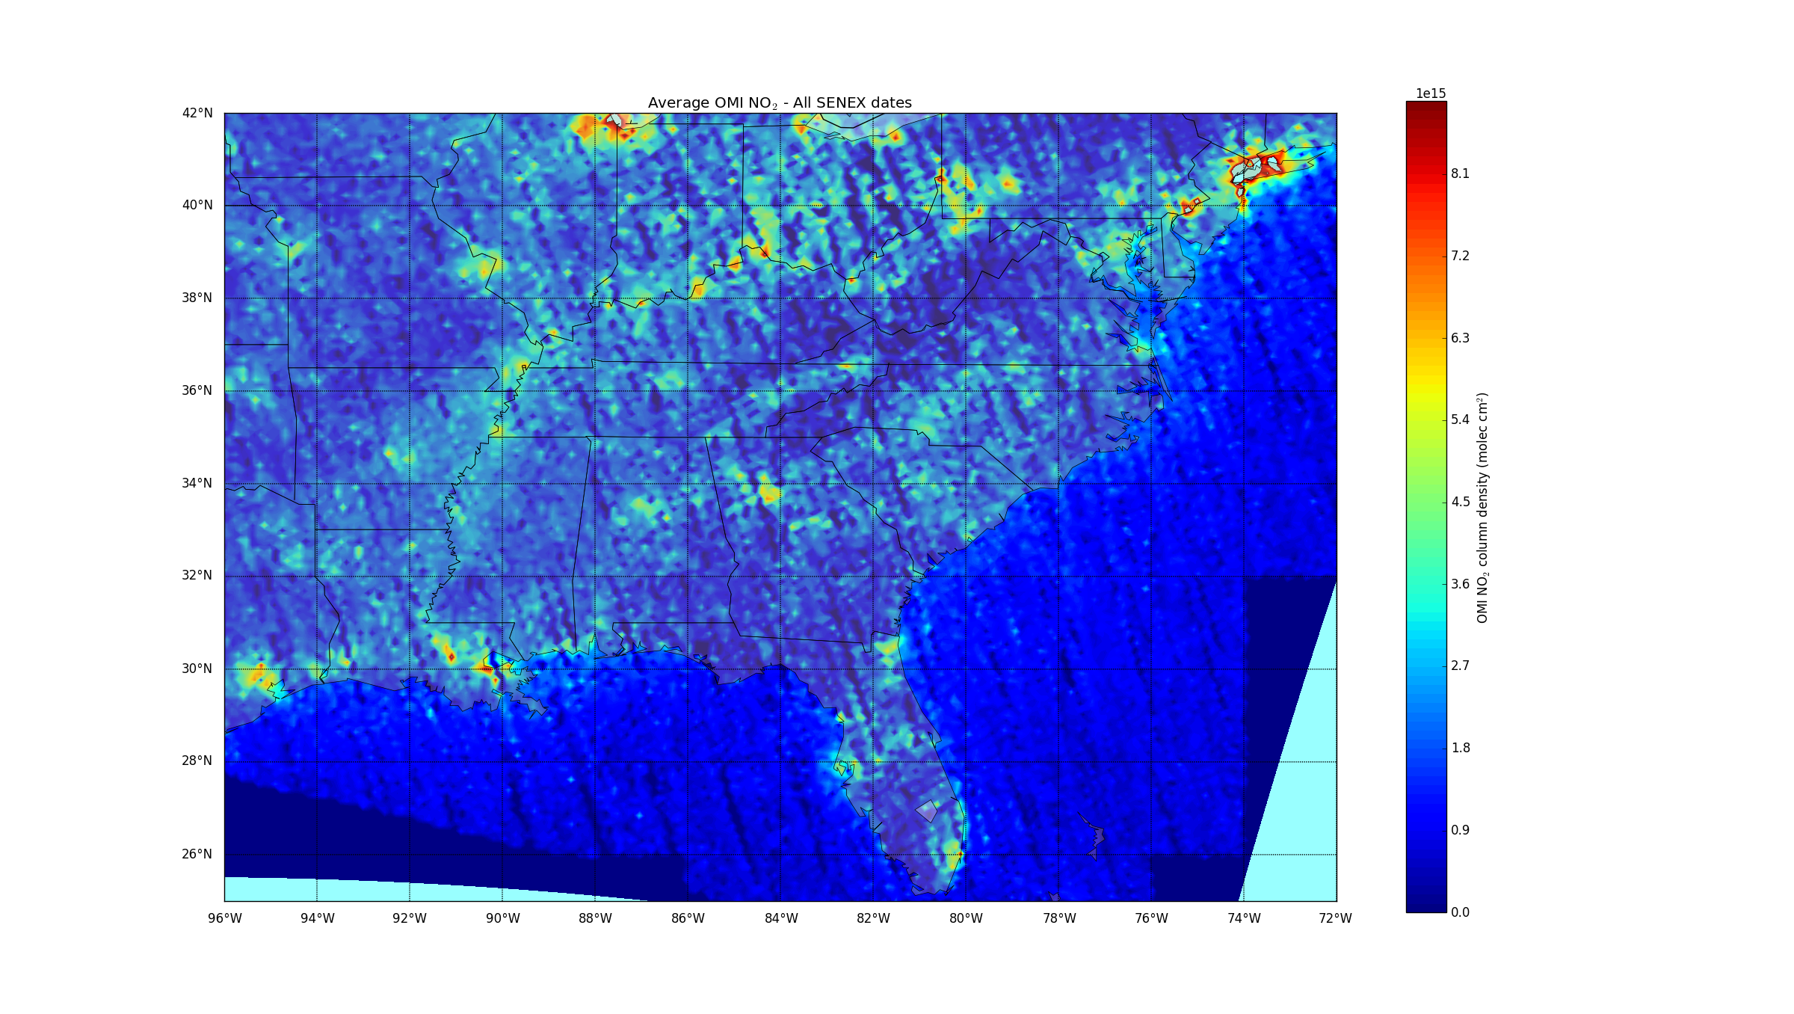
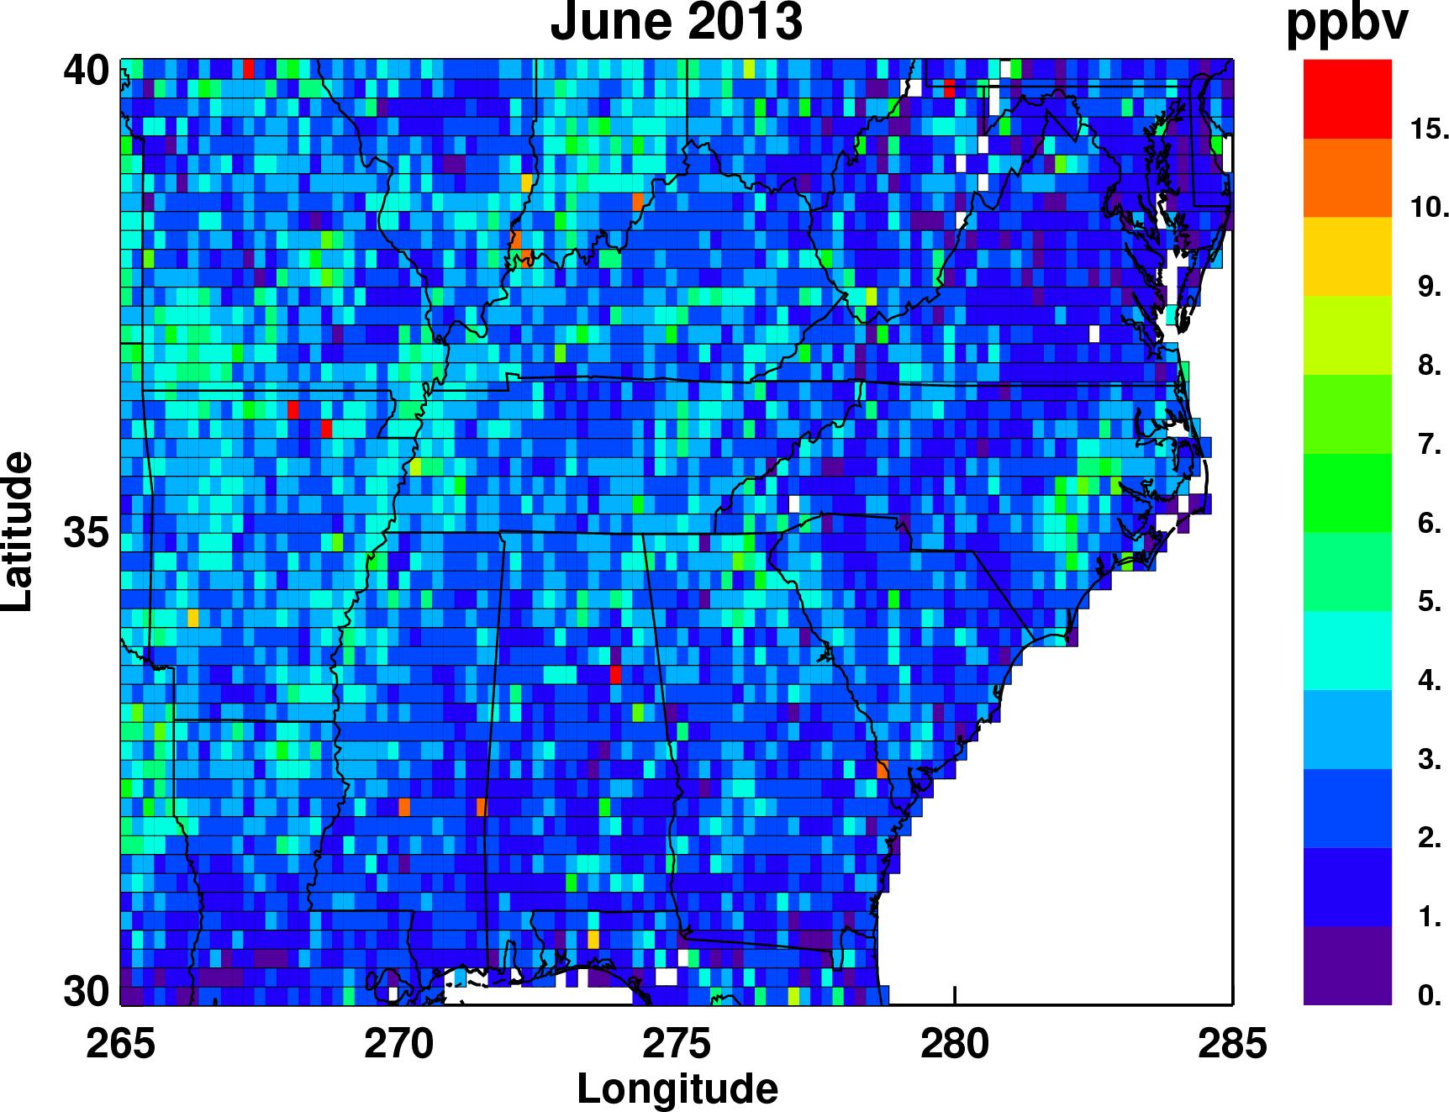
NOAA SENEX Campaign (June-July 2013)
SEARCH Network
NOAA P-3 Aircraft
CrIS NH₃
OMI NO₂

Slide 5
CMAQ Modeling Configuration
Files provided by US EPA to follow their SENEX configuration
Eastern US Grid
  12 km horizontal
  35 vertical layers
WRF 3.6.1
  CUMULUS: Kain-Fritsch
  MICROPHYSICS: Morrison 2-moment
  RADIATION: AER’s RRTMG
  PBL SCHEME: ACM2
  SURFACE LAYER: Pleim
  LAND-SURFACE: Pleim-Xiu
CMAQ v5.0.1
  SAPRC07tc gas chemistry
  AERO6 aerosols
  Aqueous chemistry
NEI 2011 Emissions
  Scenario 2013_ef_v6_13g_s07_hg
  No Bi-Di NH₃ Flux
  No Lightning NO_{x}

Slide 6
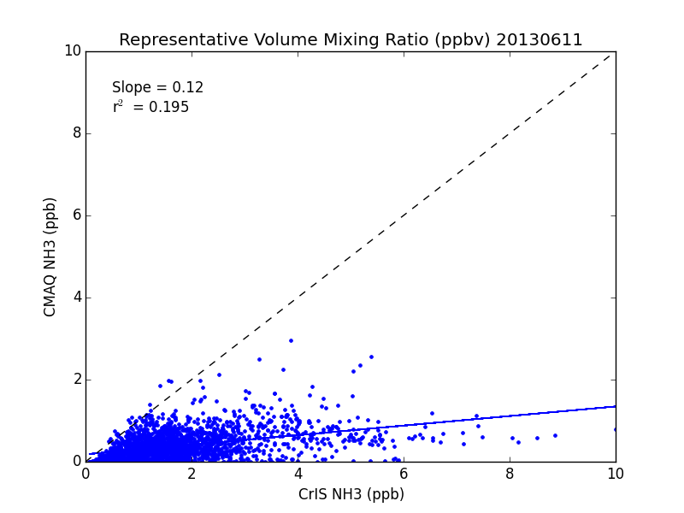
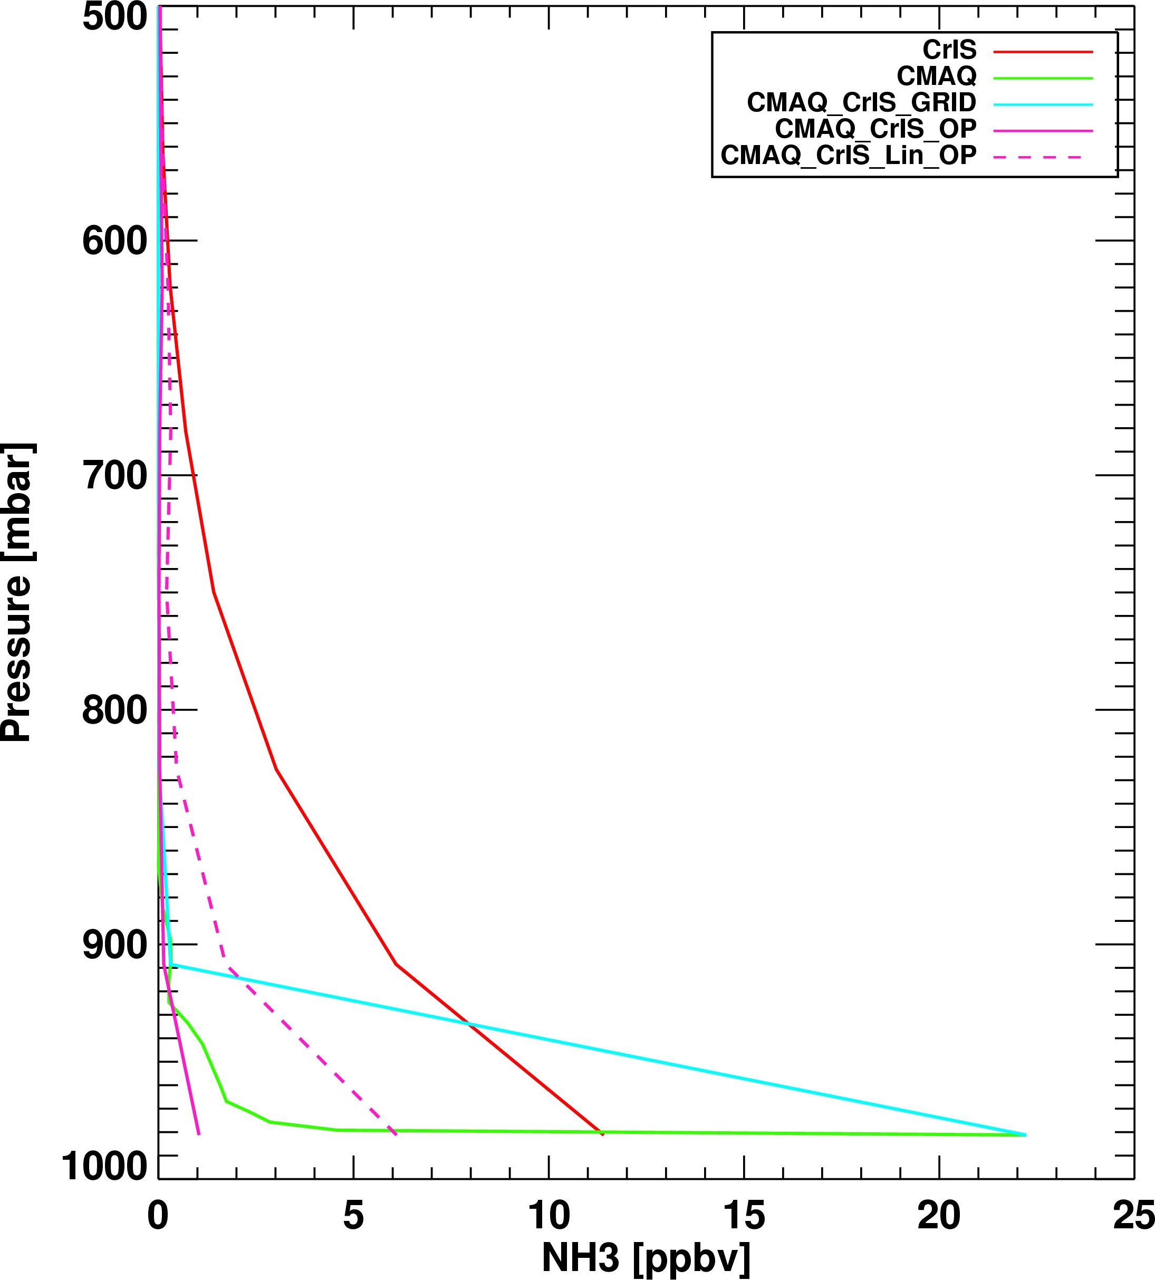
Difficulties Using NH₃ RVMR with CMAQ
Slope = 0.12
r² = 0.20
CMAQ NH₃ RVMR (ppb)
Raw CMAQ
CrIS
CMAQ RVMR
CrIS NH₃ RVMR (ppb)
CMAQ NH₃ profiles concentrated at surface.
CrIS sensitivity is at higher altitudes than TES
Using RVMR (Shephard et al., 2011) thus leads to spuriously low CMAQ values
Instead focus on NH₃ surface gradients

Slide 7
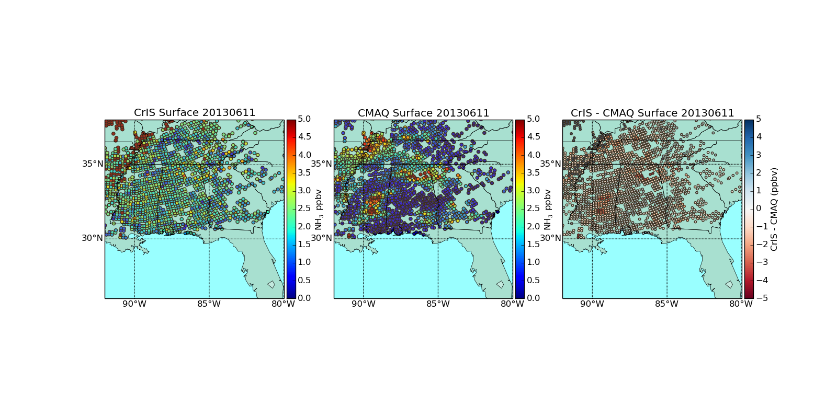
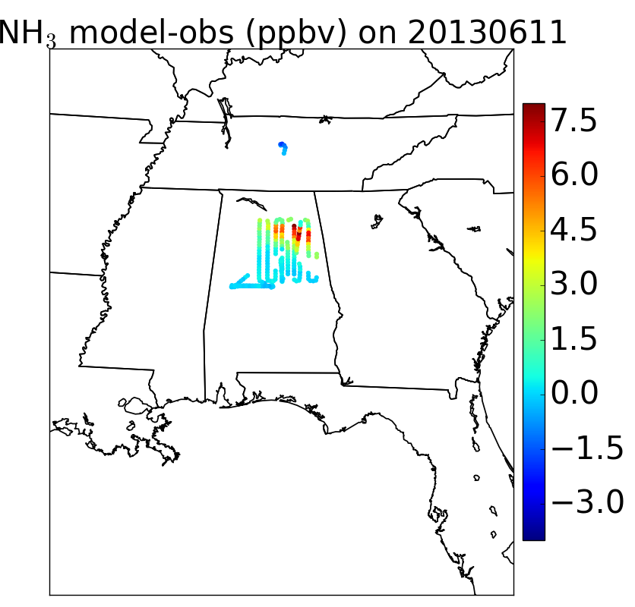
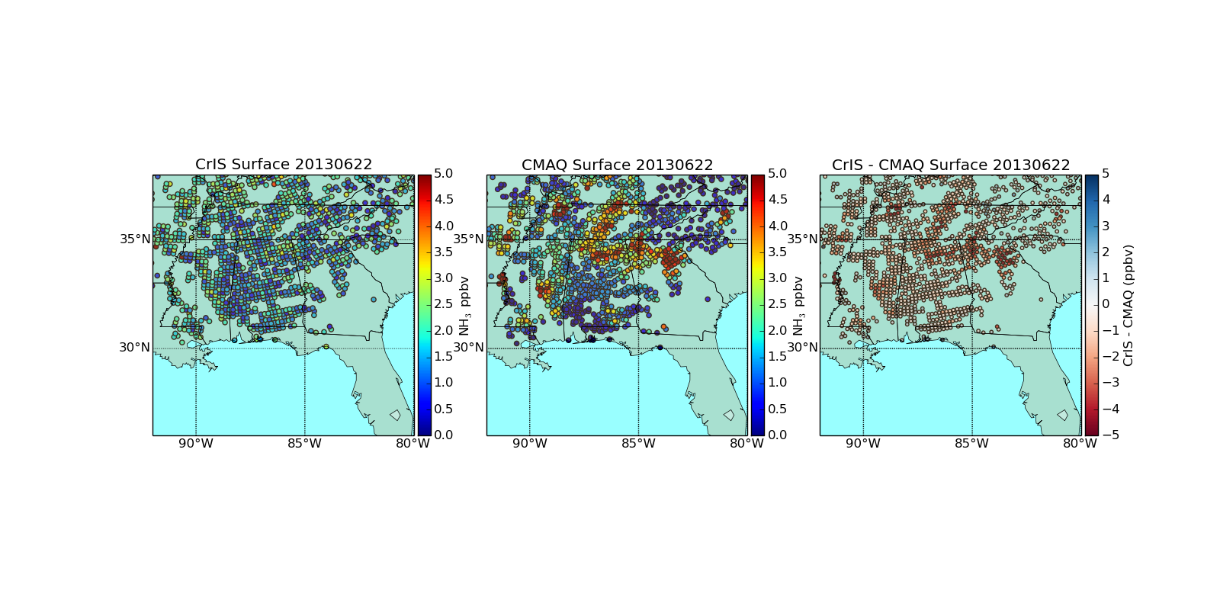
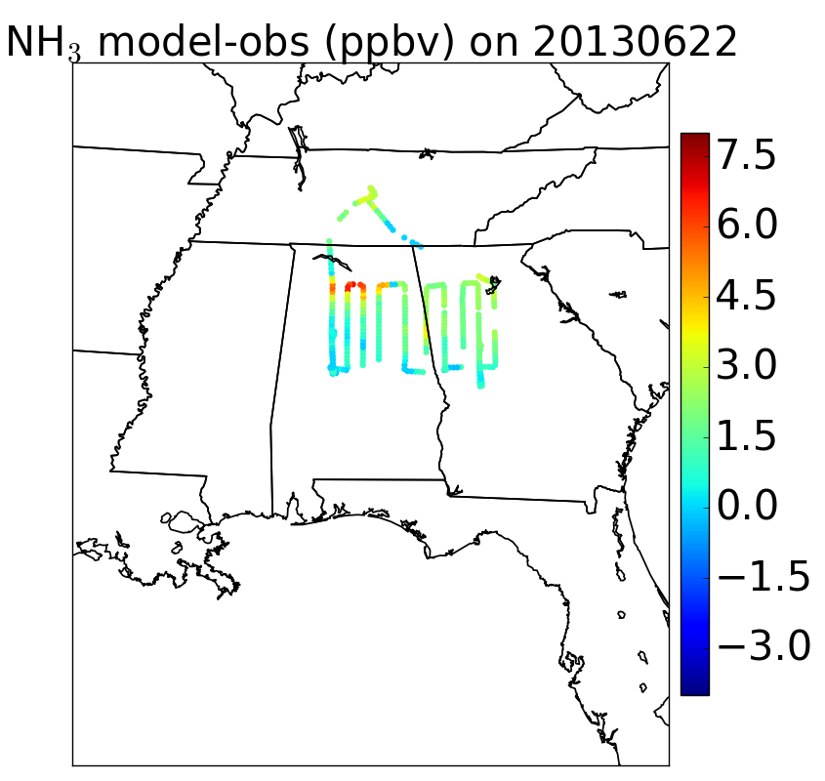
Feed lot NH₃ emissions overestimated in AL
CrIS Surface NH₃
CMAQ Surface NH₃
CMAQ – NOAA P3 NH₃
06/11/13
(Tuesday)
06/22/13
(Saturday)

Slide 8
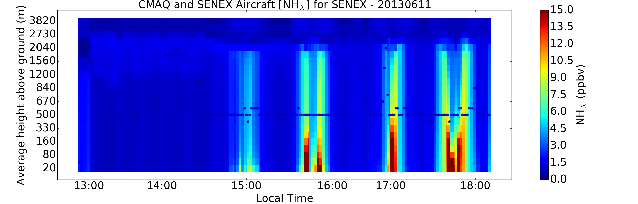
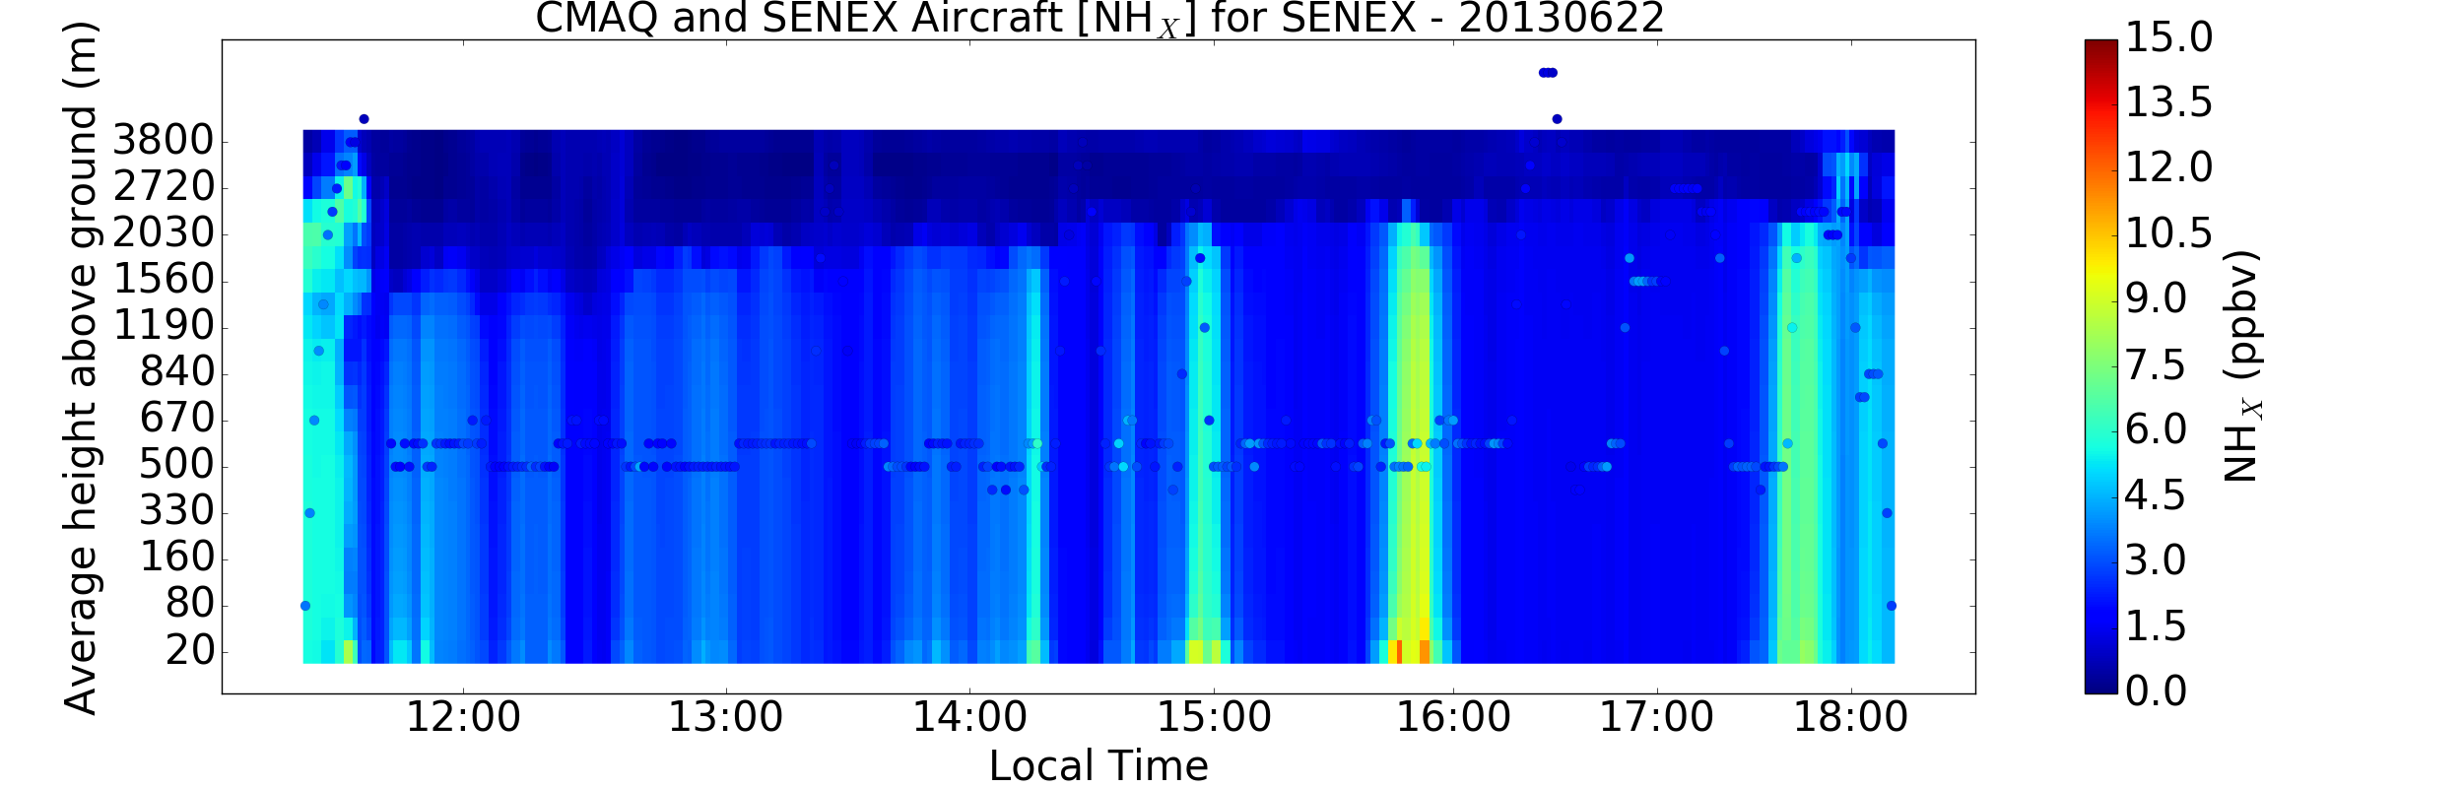
NH₃ errors not just due to partitioning

Slide 9
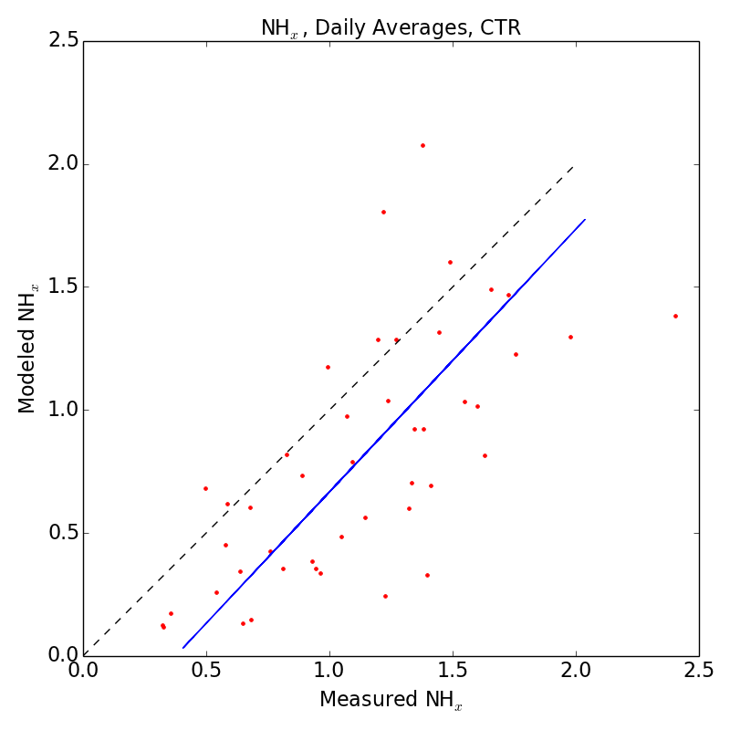
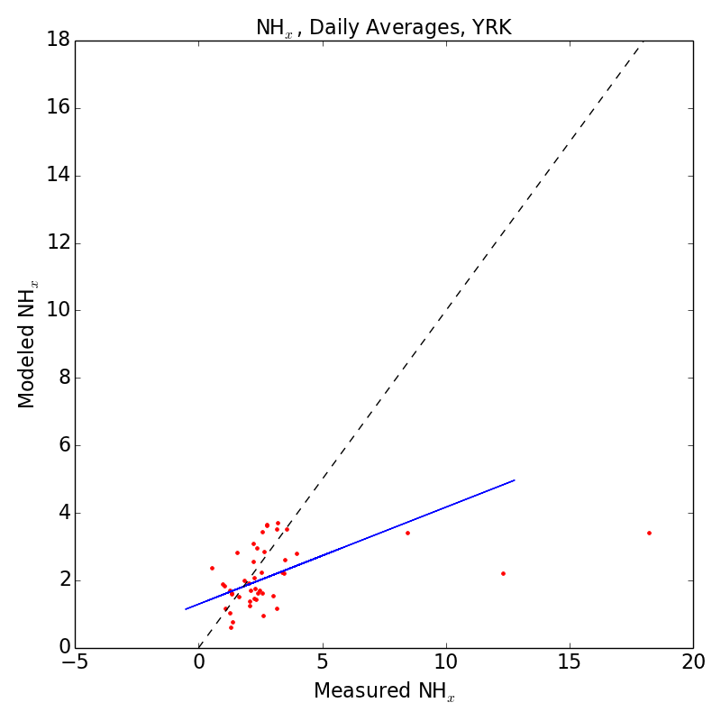
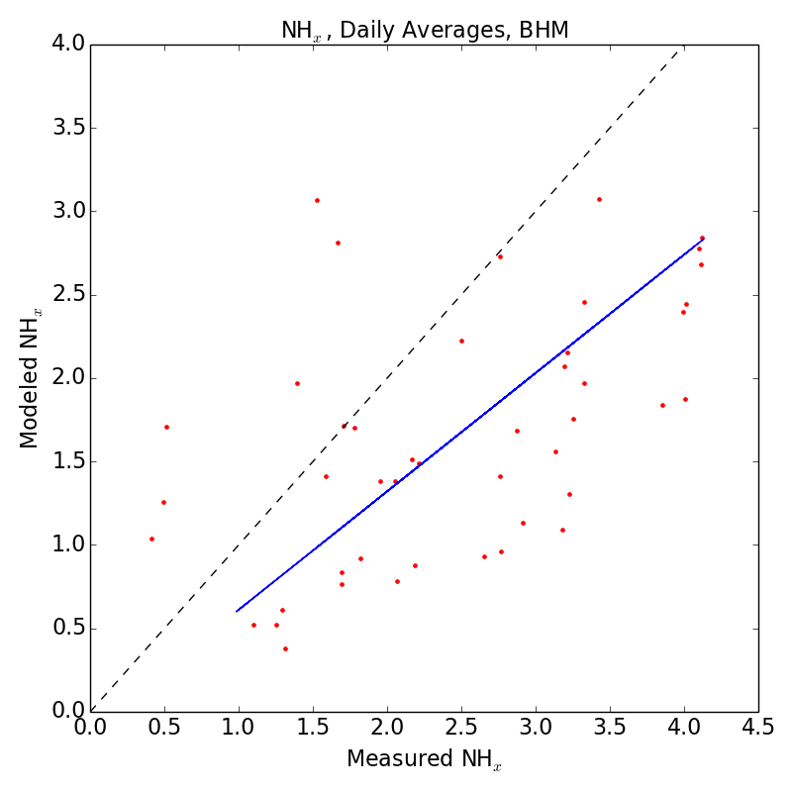
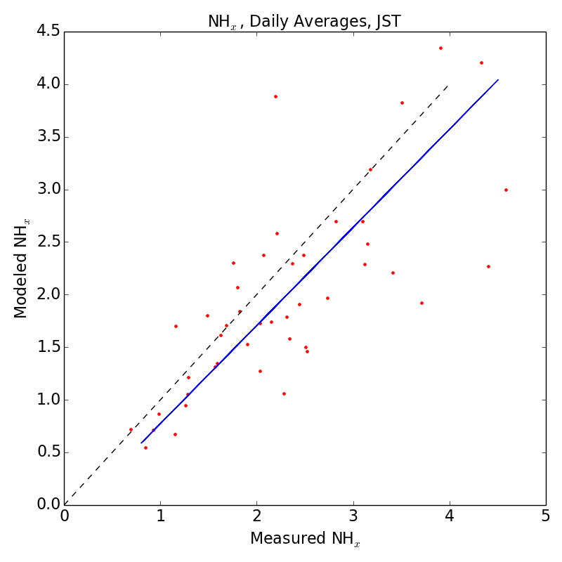
SEARCH NH_{x} daily averages
Alabama
Georgia
CTR
MNB = -30%
MANGE = 39%
r² = 0.47
Slope = 1.07
YRK
MNB = +1.1%
MANGE = 41.5%
r² = 0.13
Slope = 0.29
Rural
Data: Daily averages of continuous NH_{3(g)} and NH_{4(p)} at SEARCH sites
Daily NH_{x} generally underestimated (MNB = +1 to -30%)
A few days at Yorkville have dramatic underestimates
BHM
MNB = -19%
MANGE = 52%
Slope = 0.71
r² = 0.29
JST
MNB = -11%
MANGE = 23%
Slope = 0.93
r² = 0.56
Urban

Slide 10
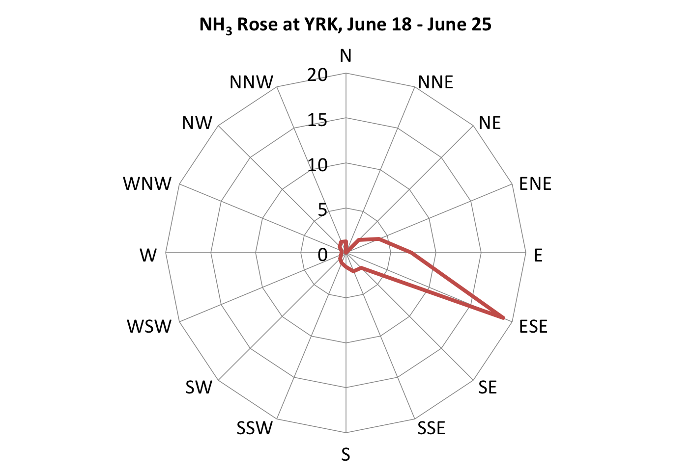
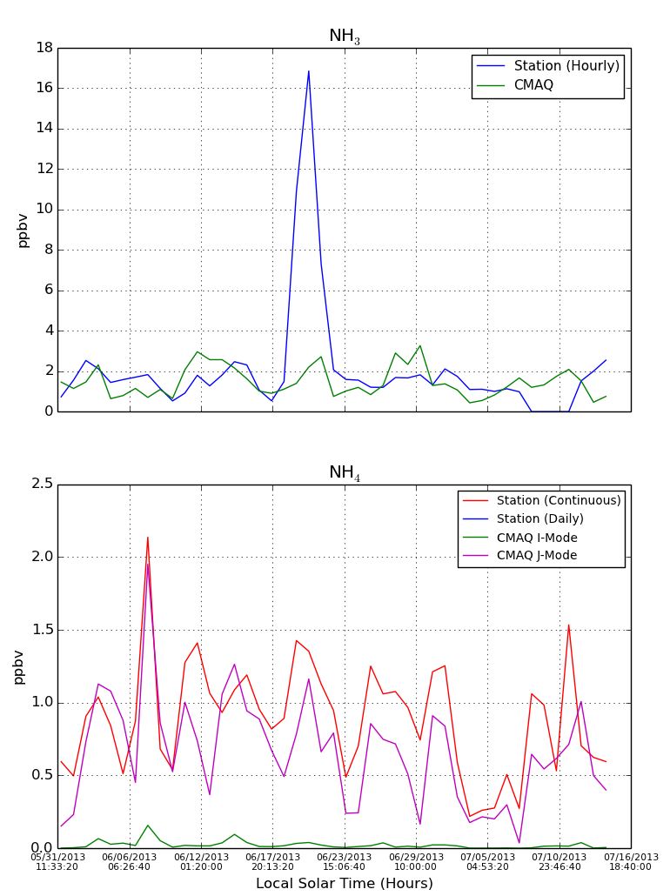
High NH_{x} event at Yorkville?
June 1 – July 15 Daily Averages
NH_{3(g)}
Obs.
CMAQ
NH_{4(p)}
Obs.
CMAQ
High NH₃ at Yorkville from poultry feed lots (broilers) to the ESE (Saylor et al., Atmos. Environ, 2010).
Observed sustained winds from ESE (100º ± 20º) for 3-day period.
Modeled wind direction much more variable, with afternoons generally from N.

Slide 11
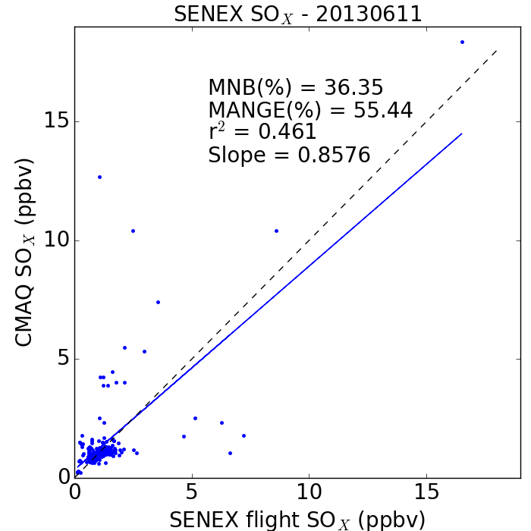
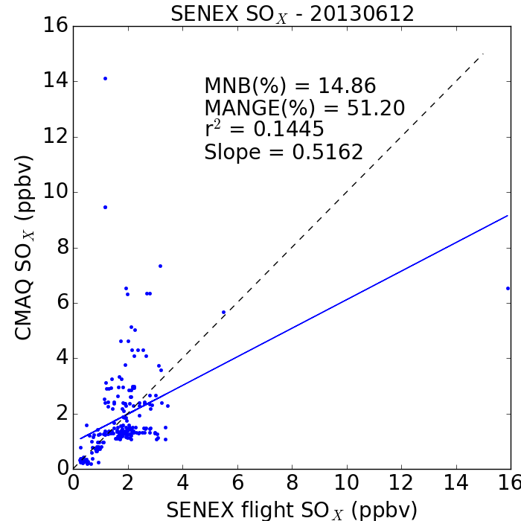
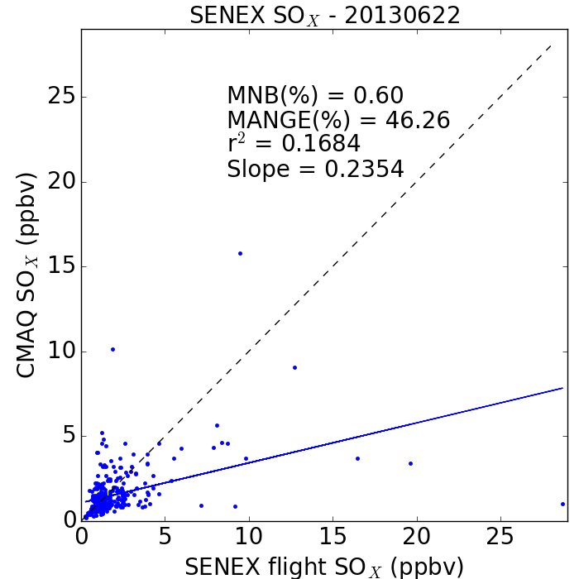
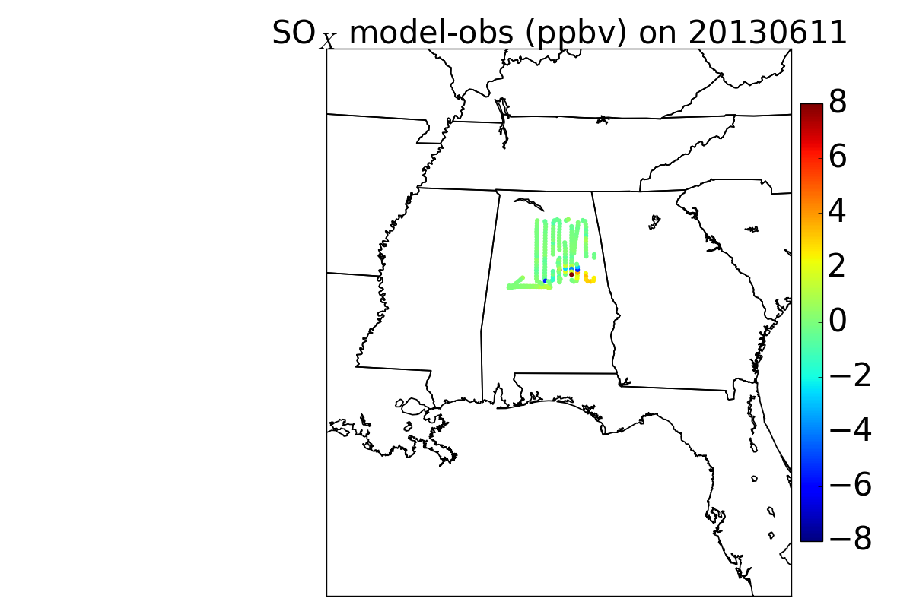
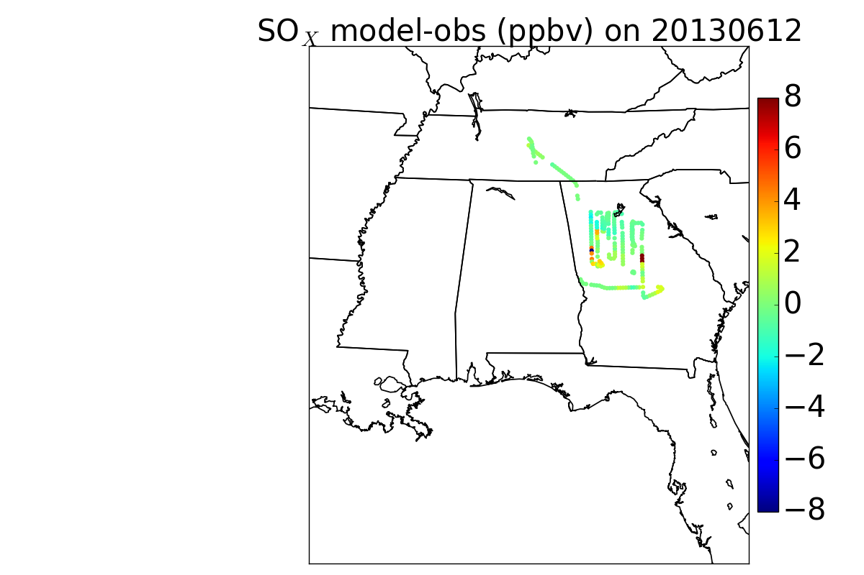
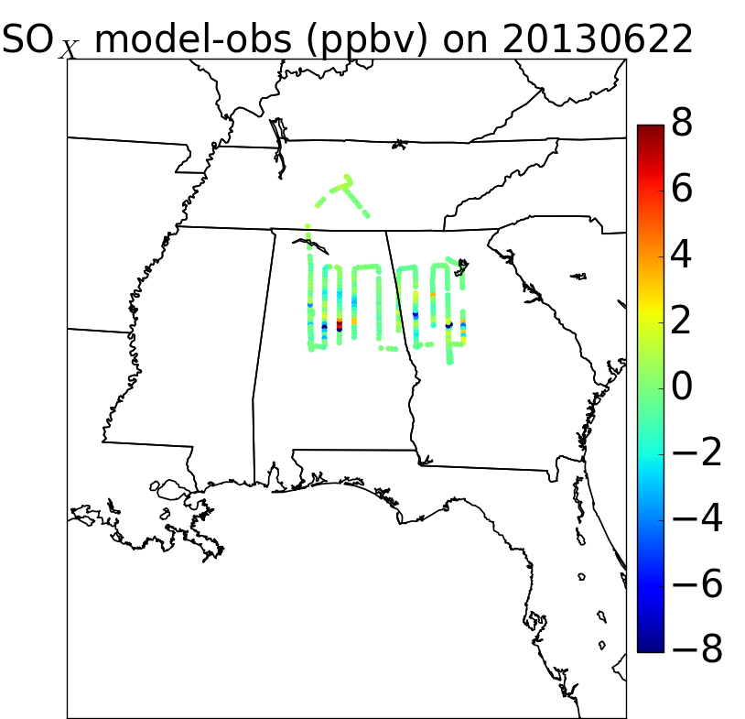
Aircraft SO_{x} over Alabama and Georgia shows combination of emission and transport errors

Slide 12
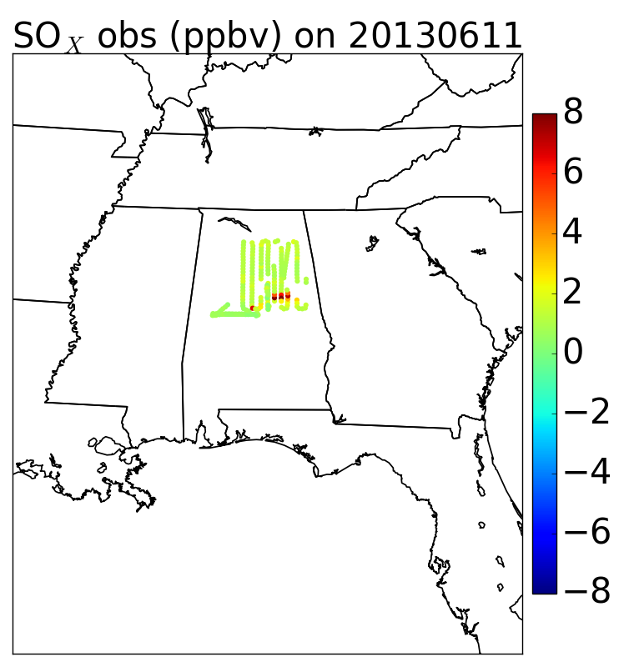
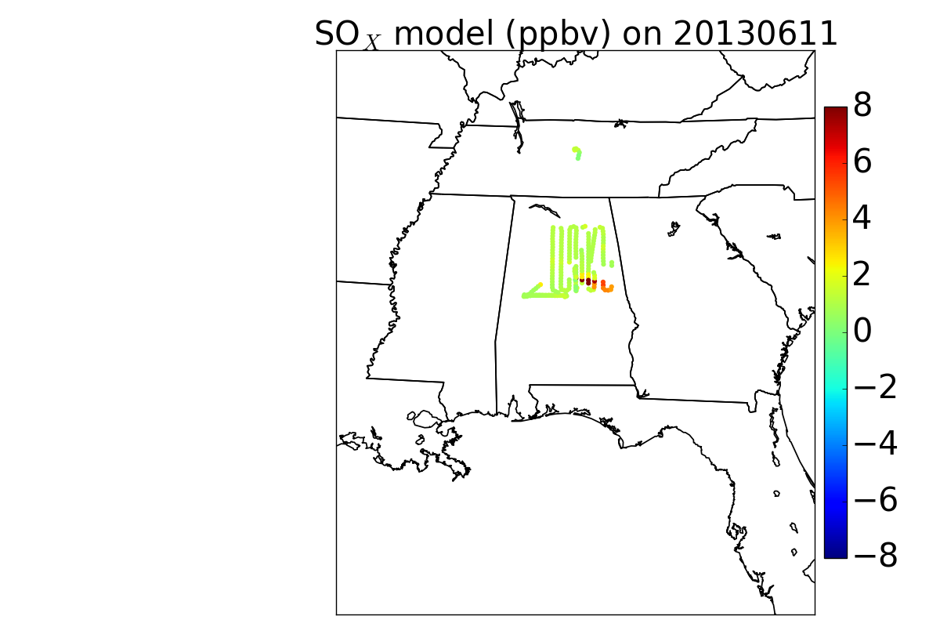
June 11 SO_{x}: CMAQ underestimates point source, gets location of EC Gaston power plant plume wrong

Slide 13
June 11 SO_{x}: CMAQ underestimates point source, gets location of EC Gaston power plant plume wrong

Slide 14
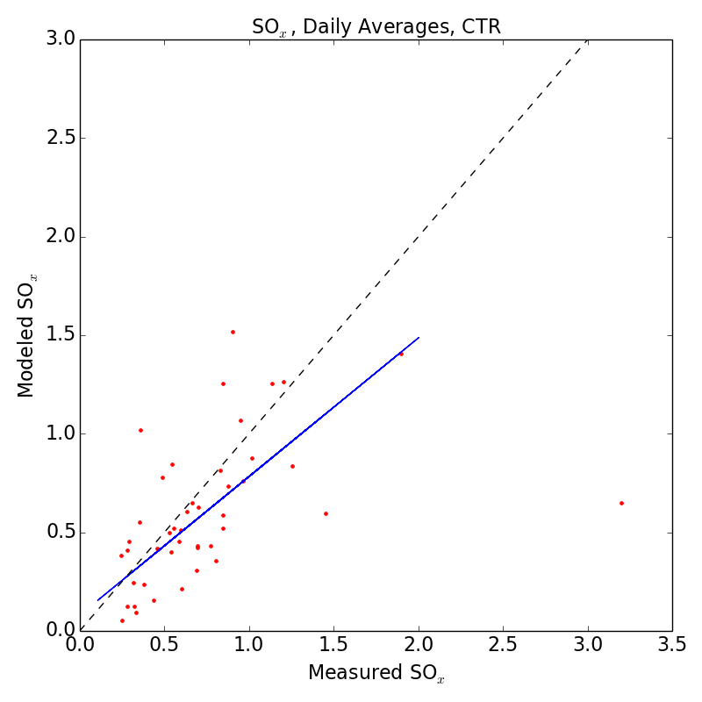
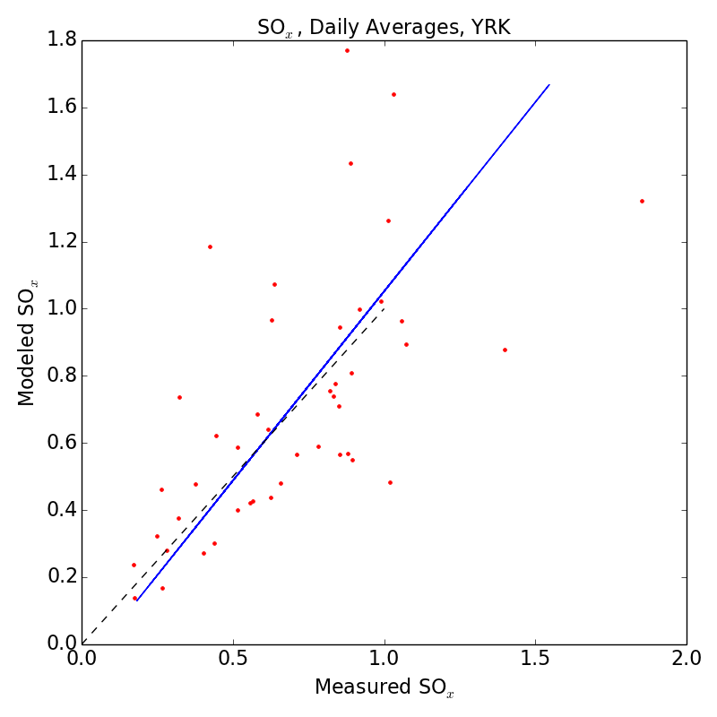
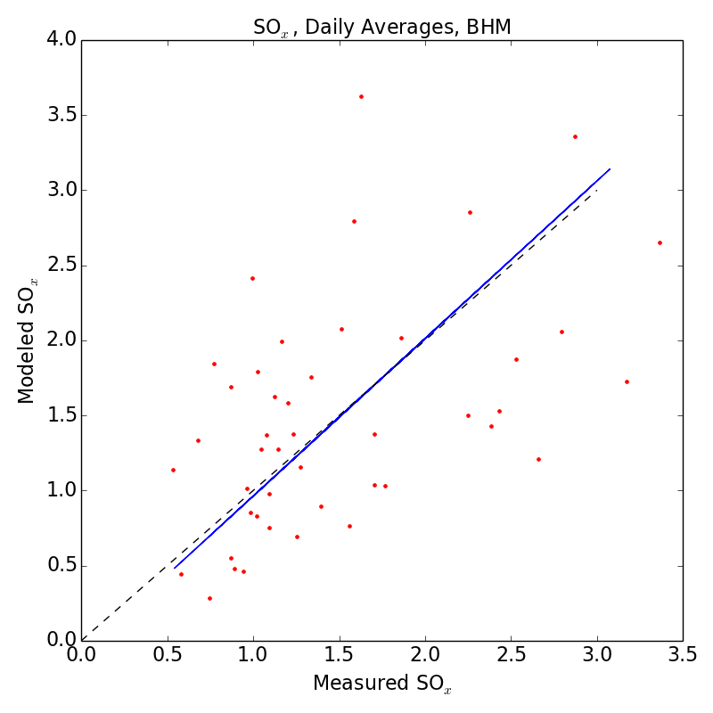
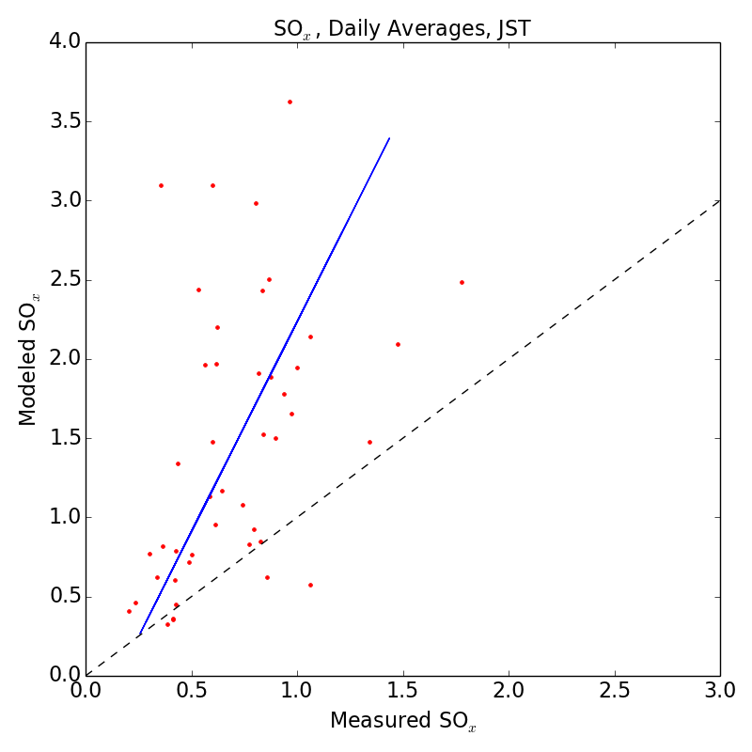
SEARCH daily SO_{x} observations
Alabama
Georgia
CTR
MNB = -10%
MANGE = 40%
r² = 0.23
Slope = 0.70
Rural
YRK
MNB = +8%
MANGE = 35%
r² = 0.41
Slope = 1.13
Data: Daily averages of continuous SO_{2(g)} and SO_{4(p)} at SEARCH sites
Daily SO_{x} generally accurate except:
  At JST (missing or underestimated local source?)
  For a few days at CTR
BHM
MNB = +8%
MANGE = 45%
r² = 0.25
Slope = 1.05
Urban
JST
MNB = +119%
MANGE = 125%
r² = 0.20
Slope = 2.65

Slide 15
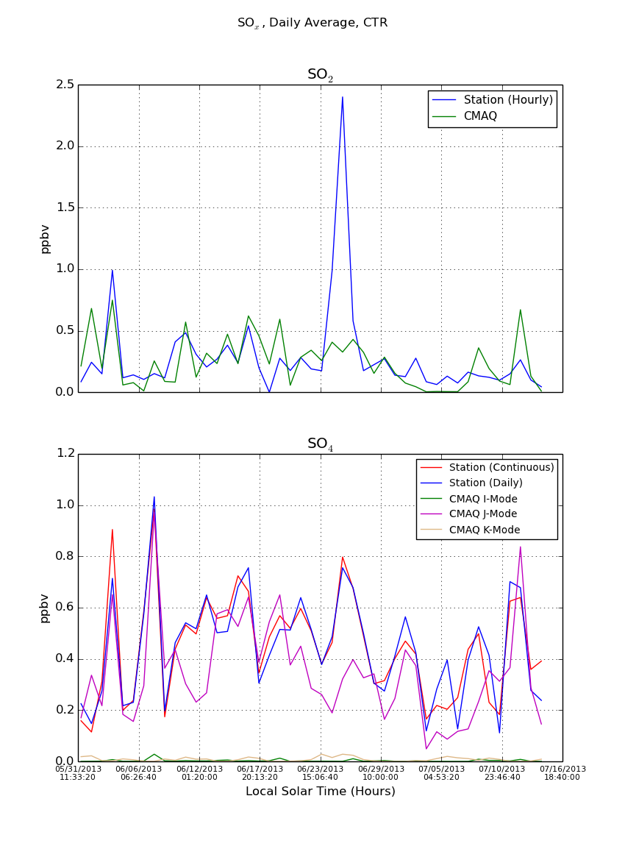
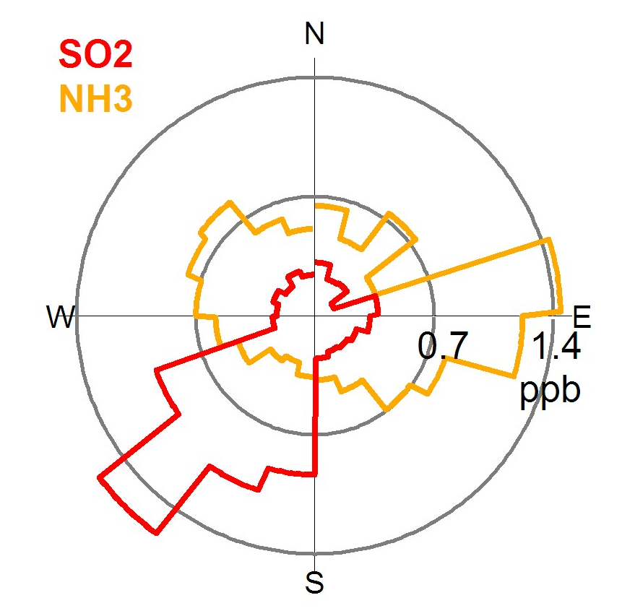
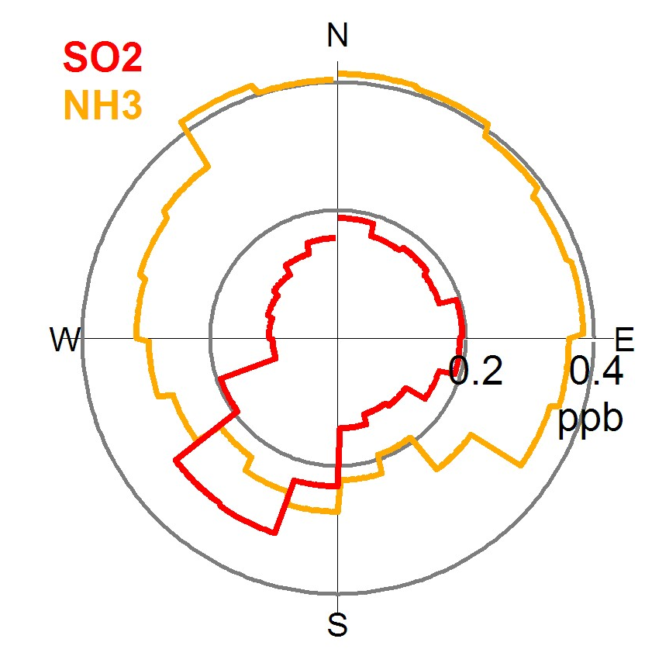
High SO_{x} event at Centreville?
June 1 – July 15 Daily Averages
Centreville Wind Rose, June 26-30
Hourly SO₂ data shows two peaks from SW:
8 AM, June 25
2 PM, June 26
SO₂ point sources to SW (NEI 2011):
Lowman Power Plant (4,300 tpy)
Barry Power Plant (11,644 tpy)
Chunchula Gas Plant (1,447 tpy)
Georgia Pacific Pulp and Paper (1,971 tpy)
Model winds from SSE and WSW, respectively, during events.
BUT measured winds from SW in other periods didn’t have same high SO₂ levels.
SO_{2(g)}
Obs.
CMAQ
Centreville Wind Rose, June 6-10
SO_{4(p)}
Obs. (continuous)
Obs. (daily teflon)
CMAQ

Slide 16
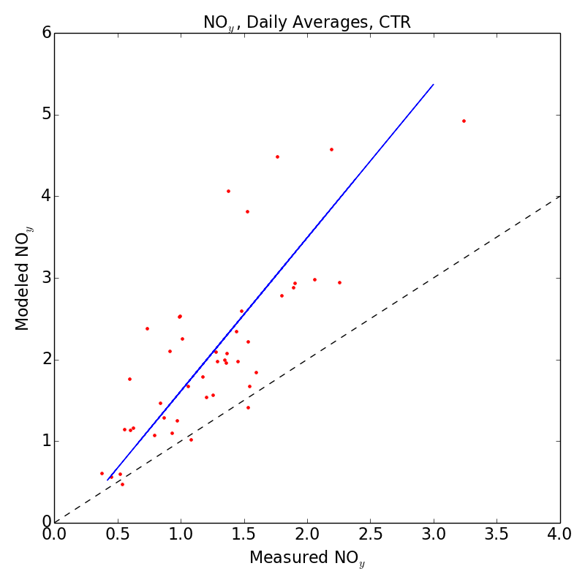
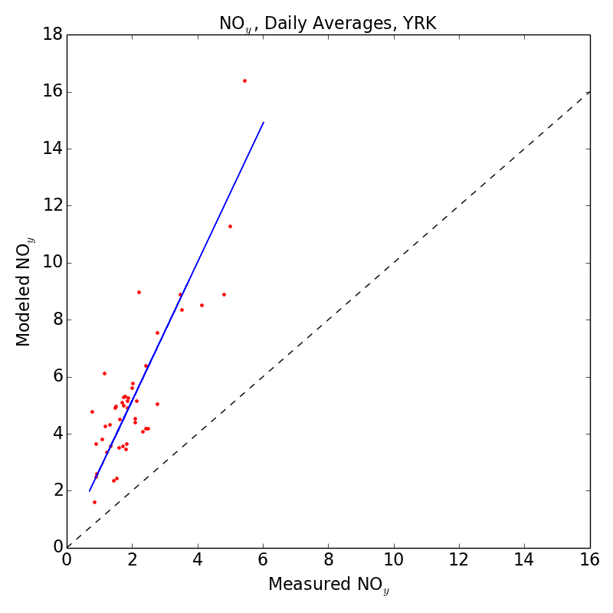
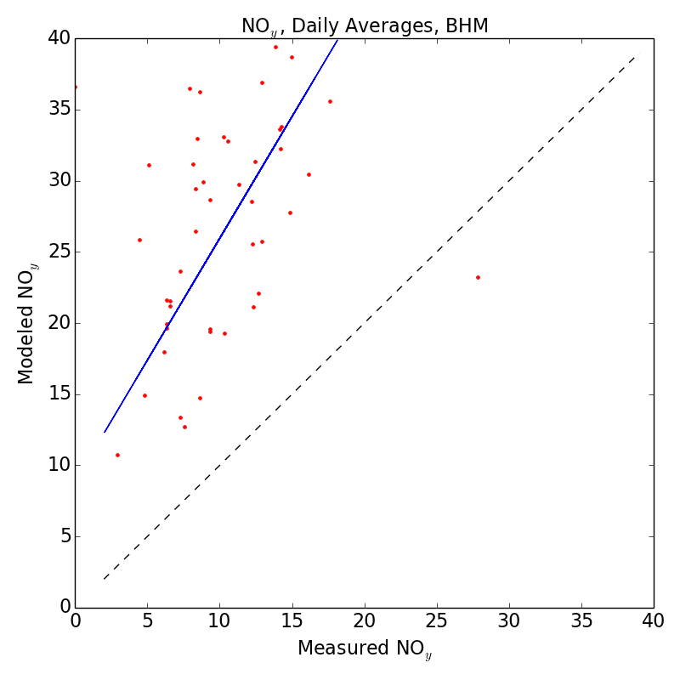
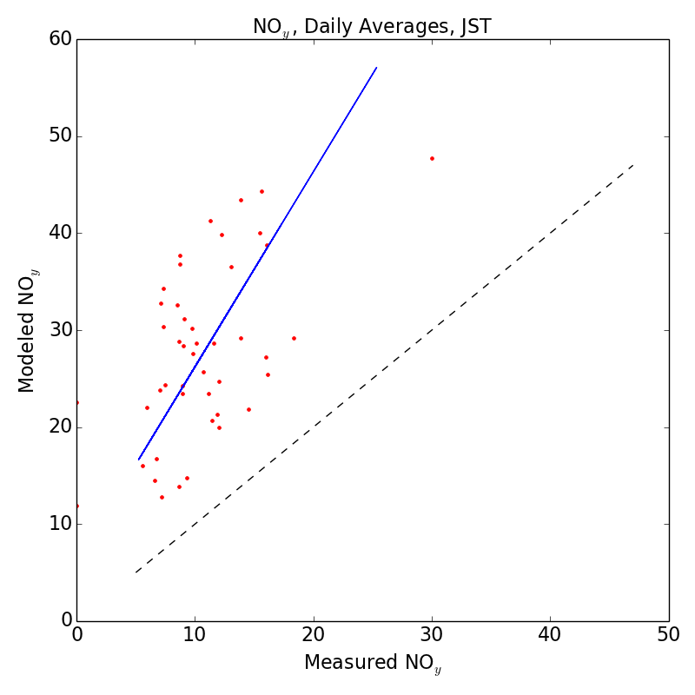
SEARCH daily NO_{y} suggests NO_{x} overestimate
Alabama
Georgia
Rural
CTR
MNB = +70%
MANGE = 71%
r² = 0.63
Slope = 1.88
YRK
MNB = +173%
MANGE = 173%
r² = 0.74
Slope = 2.43
Data: Daily averages of continuous NO_{y} compared with total modeled NO_{y} from CMAQ (including NO_{3(p)}) at SEARCH sites
Large overestimates of NO_{y} at all locations
  r² higher at rural sites than urban
Urban
BHM
MNB = +184%
MANGE = 185%
r² = 0.17
Slope = 1.71
JST
MNB = +173%
MANGE = 174%
r² = 0.27
Slope = 2.01

Slide 17
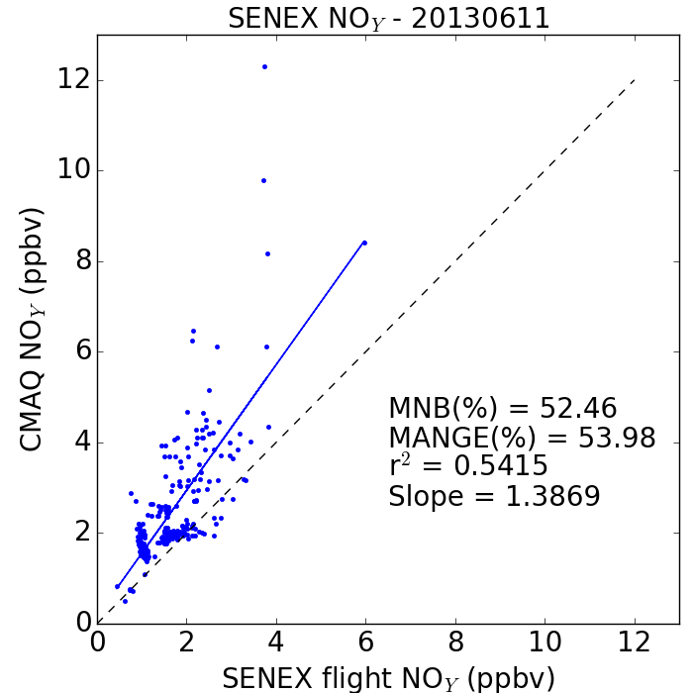
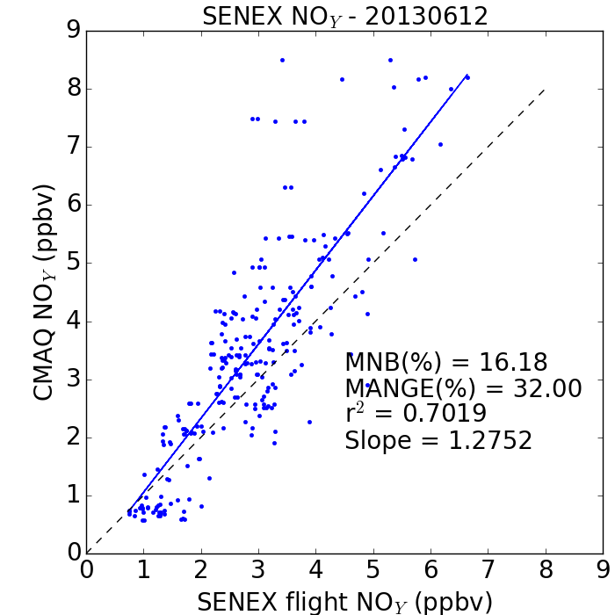
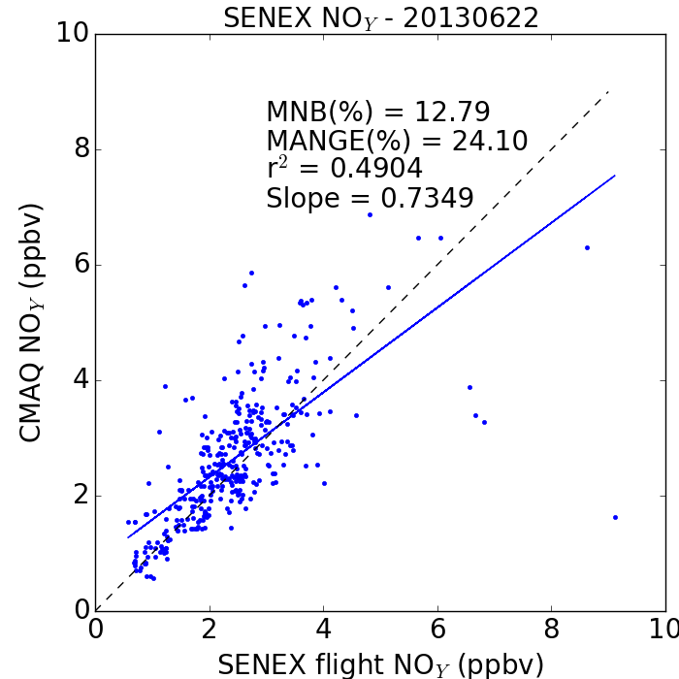
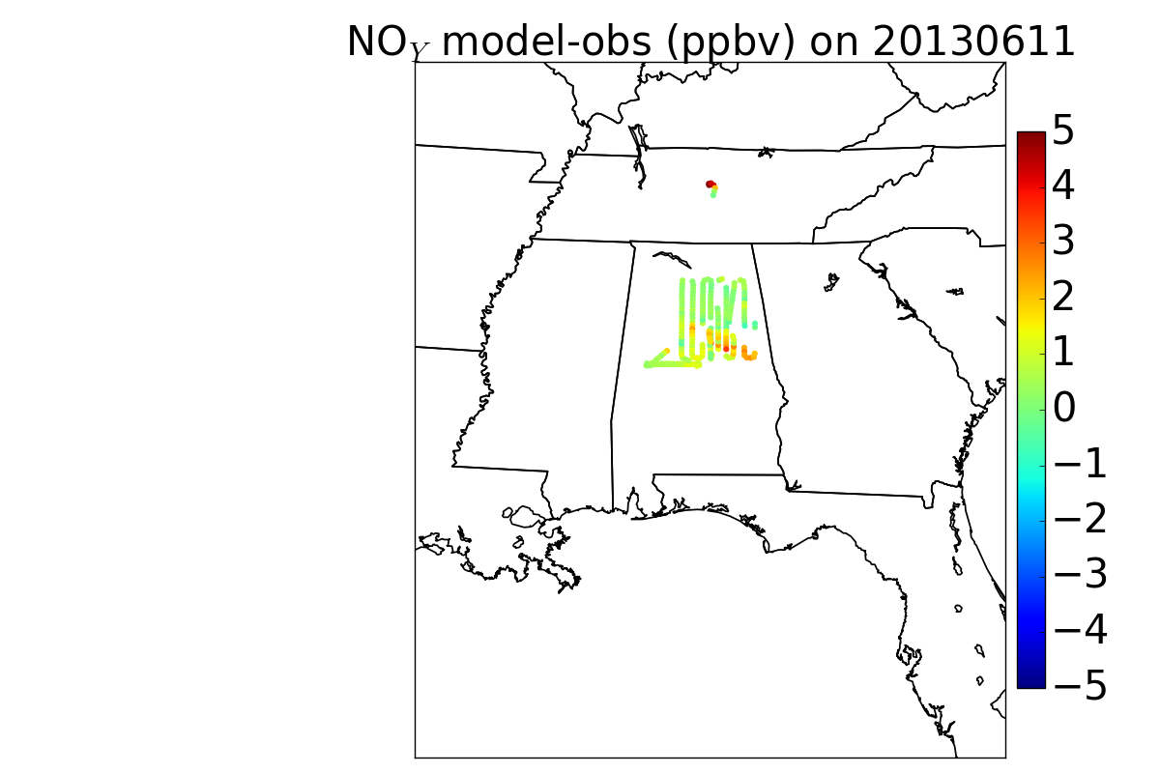
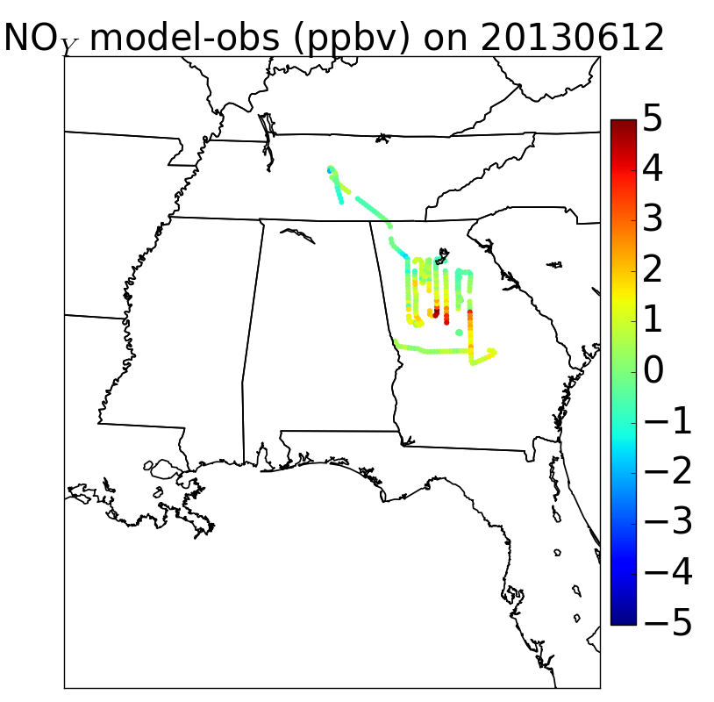
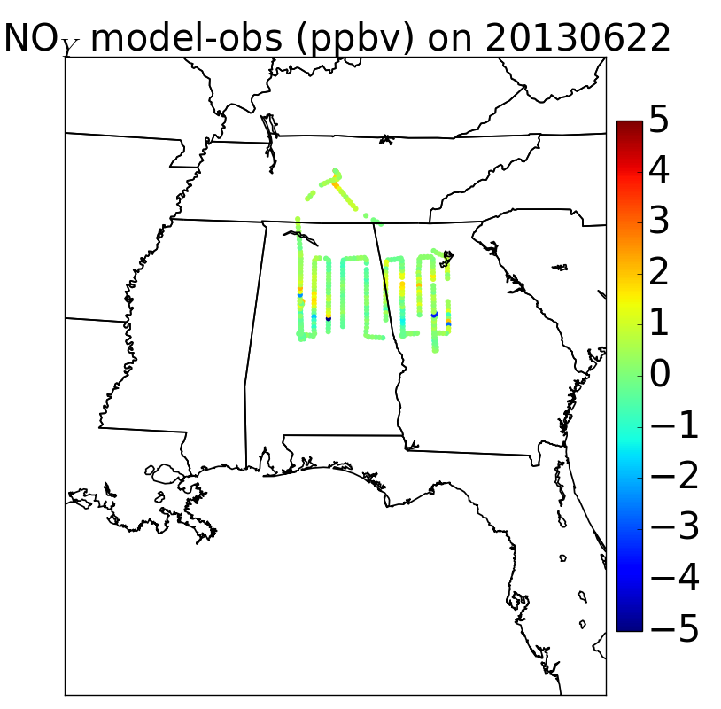
Aircraft NO_{y} also suggest NO_{x} overestimate, but not as severe as at SEARCH sites or on weekends?
Tuesday
Wednesday
Saturday

Slide 18

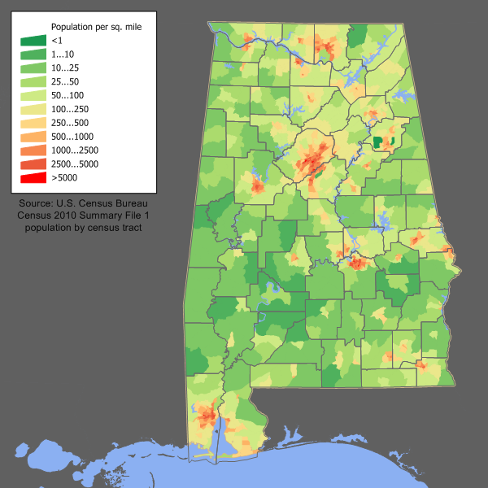
June 11 NO_{y}: NO_{y} overestimate consistent with NO_{x} emission overestimate in Birmingham

Slide 19
June 11 NO_{y}: Possible contribution from errors in transport of EC Gaston Power Plant plume

Slide 20
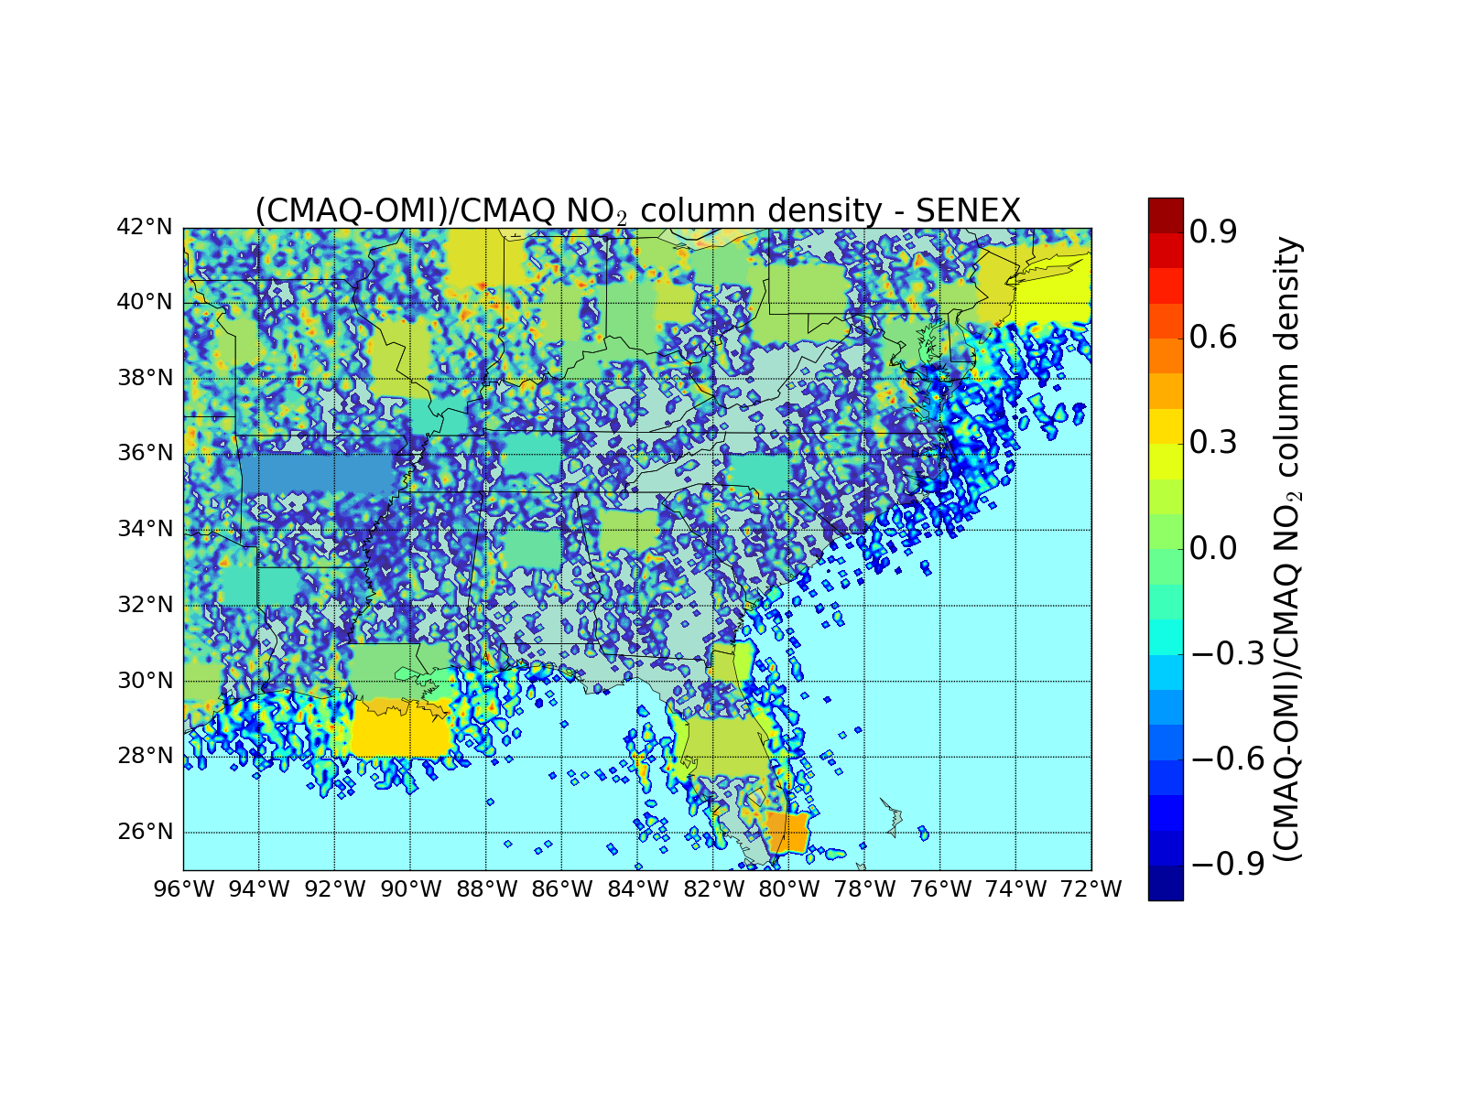
OMI NO₂ doesn’t show strong overestimate for Atlanta or Birmingham
Area | OMI NO₂*
Atlanta | +1%
Birmingham | -19%
Charlotte | -21%
Nashville | -21%
Louisville | -6%
Fayetteville | -49%
Miami | +39%
Offshore Louisiana | +47%
*Mean of (CMAQ-Obs)/CMAQ

Slide 21
Summary
NH₃
  CrIS and NOAA P-3 observations show NH₃ emissions from feed lots in northern Alabama are lower than in the 2011 NEI
  But NH_{x} at SEARCH sites is generally underestimated (MNB = +1% to -30%), including a high NH_{x} event at Yorkville missed in CMAQ due to errors in wind direction
SO₂
  SO_{x} errors seem more consistent with transport errors rather than emission errors, except at the Jefferson Street SEARCH site
NO_{x}
  SEARCH NO_{y} observations suggest NO_{x} emissions in NEI 2011 are overestimated (MNB = 70-180%)
  P3 aircraft also sees mean NO_{y} overestimates over Georgia and Alabama, but with MNB of 12-52%
  But CMAQ (without lightning NO_{x}) underestimates OMI NO₂ columns over Birmingham by 20%

Slide 22
Acknowledgements
    NOAA CPO AC4 Program Grant Numbers NA13OAR4310060 and NA14OAR4310129
NOAA CSD and SENEX science team (A. Neuman, J. Nowak, J. Holloway, T. Ryerson, A. Middlebrook, J. Jimenez, J. Fry)
SEARCH Science Team (S. Shaw, K. Bauman, C. Blanchard)
Environment and Climate Change Canada (C. McLinden, M. Shephard)
EPA (K. Baker, H. Pye)
UNC CMAS Center (B.H. Baek, Z. Adelman)

Slide 23
Backup Slides

Slide 24
Better emissions with TES NH₃
Largest changes western US and Mexico
Used GEOS-Chem adjoint with TES NH₃ profiles, averaging kernels and error covariances to optimize model
Optimized GC shows better agreement with AMoN network measurements
Zhu et al., 2013, JGR

Slide 25
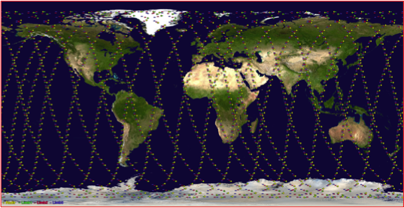
Why switch to CrIS?
TES is past its design lifetime, taking little new data, and has low spatial coverage
CrIS could monitor global NH₃ with high spatial coverage for many more years (>2022)
 | TES | CrIS
Satellite | AURA | NPP
Available Data | July 2004-present | October 2011-present
Resolution | 0.06 cm⁻¹ | 0.625 cm⁻¹
Footprint | 5x8 km rectangle | 14 km diameter circle
Repeat cycle | Once every 16 days | Daily
Equatorial crossing | 1:30 am and 1:30 pm | 1:30 am and 1:30 pm
Noise in NH₃ window | 0.09 – 0.12 K | 0.03 – 0.06 K

Slide 26
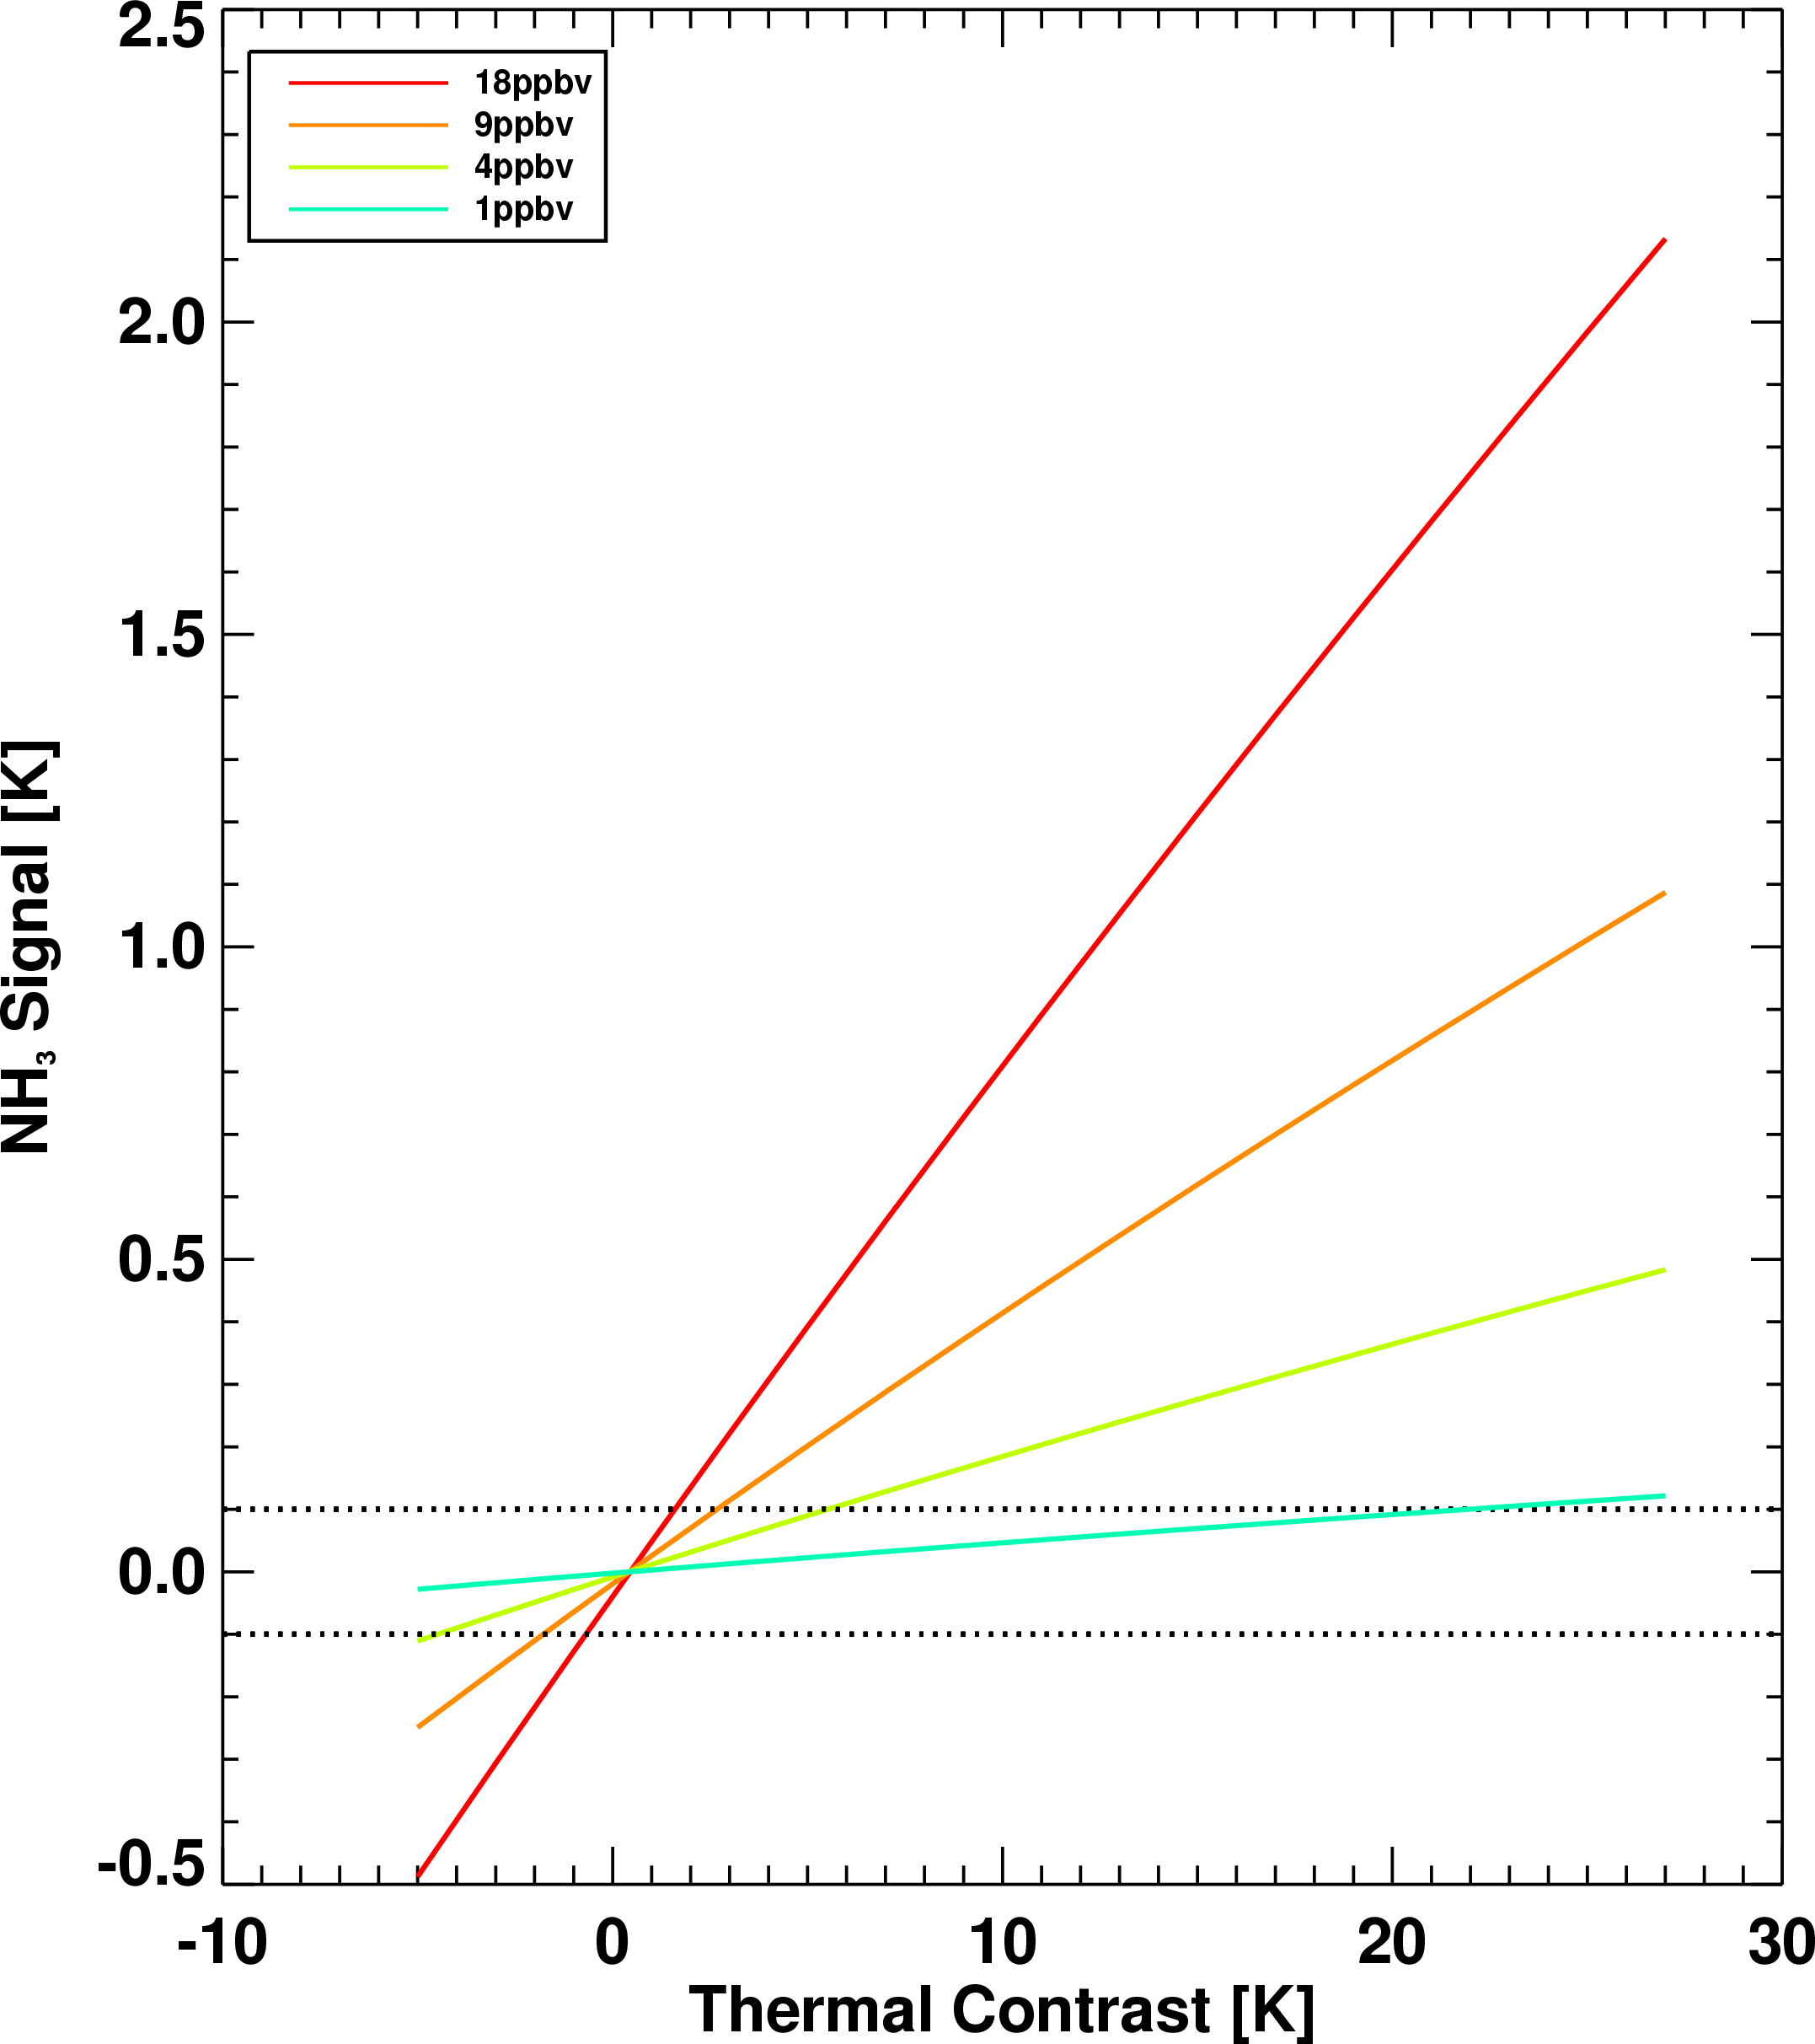
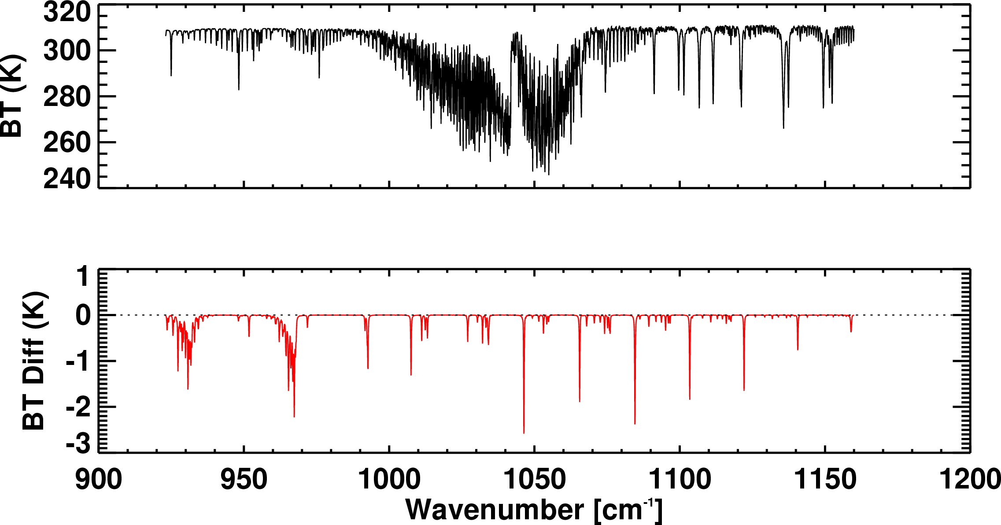

NH₃ signal from TES and CrIS
Simulated spectra and NH₃ signal
18 ppbv at surface
TES
CrIS
Detectability is ~1 ppbv under ideal conditions
But thermal contrast also plays a role

Slide 27

CrIS microwindows and constraints
Lower spectral resolution of CrIS required different microwindows.
A priori and constraints from TES (Shephard et al., 2011)
  Polluted, Moderately polluted, and Unpolluted profiles
A priori selected based on signal to noise ratio (SNR) and thermal contrast

Slide 28


TES and CrIS Sensitivity to NH₃
TES
CrIS
Both instruments most sensitive to NH₃ between 950 and 600 mbar
TES is more sensitive to amounts lower in the atmosphere
1 piece of information or less: DOFS<1.0
Collapse all information to a single point: RVMR
  Easier to compare with in situ measurements, models and other instruments

Slide 29

CrIS NH₃ Retrieval: Simulated Spectra
Notes:
Doubled NH₃ emissions in GEOS-Chem to generate “true” profiles
Profiles fed into RT model and CrIS noise added to get simulated spectrum.
Test ability of retrieval to reproduce the “true” profiles

Slide 30
CrIS California Monthly Average NH₃

Slide 31

June 11 NO_{y}: NO_{y} overestimate consistent with NO_{x} emission overestimate in Birmingham

Slide 32


CMAQ NH₃ profile very concentrated near surface
NOAA P3
Aircraft
CMAQ

Slide 33

CMAQ seems well-mixed in PBL based on CO
NOAA P3
Aircraft
CMAQ

