Slide 1
Modeling the Near-Source Chemistry of Biomass Burning Plumes at Local and Regional Scales
M. J. Alvarado¹, C. R. Lonsdale¹, R. J. Yokelson²,
K. Travis³, J. C. Lin⁴, D. R. Blake⁵, D. W. T. Griffith⁶, T. J. Johnson⁷, S. Kreidenweis⁸, T. Lee⁸, A. May⁹,
G. R. McMeeking⁸, S. Meinardi⁵, J. Reardon¹⁰, I. Simpson⁵, A. Sullivan⁸, S. P. Urbanski¹⁰, D. R. Weise¹⁰
¹AER ²University of Montana ³Harvard University ⁴University of Utah
⁵UC-Irvine ⁶University of Wollongong ⁷PNNL ⁸Colorado State University
⁹Ohio State University ¹⁰USDA Forest Service
CMAS Conference
October 5, 2015
Copyright 2015, Government sponsorship acknowledged.
Notes:
I’d like to thank the chairs for the opportunity to talk to you today about the work we are doing at AER to investigate the chemical transformations that take place within biomass burning smoke plumes in the first few hours after emission.

Slide 2
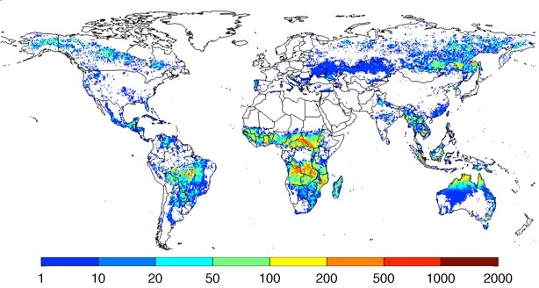
Biomass Burning Impacts Air Quality and Climate
Large global source of trace gases and particles
Emissions highly variable between fires
Many organic compounds in smoke are unidentified (e.g., SVOCs)
Rapid near-source chemistry creates SOA, O₃, PAN, etc.
Understanding this chemistry is critical to assessing air quality and climate impacts.
GFED3 annual carbon emissions (g C m⁻² year⁻¹) from biomass burning averaged over 1997-2009, derived using MODIS fire counts and burned area.
Notes:
Why is biomass burning important? Biomass burning is a large, global source of trace gases and particles. The map shows the global extent of biomass burning. However, the impacts of biomass burning on air quality and climate are not well understood. First, the emissions are highly variable between fires, and half of the organic compounds by mass in the smoke are unidentified, mostly a mixture of various semi-volatile to low-volatility organic compounds I’ll refer to here as SVOCs. In addition, rapid chemical changes take place within the smoke plume, creating ozone, PAN, and secondary organic aerosol. So understanding this chemistry is critical to assessing the air quality and climate impacts of biomass burning.

Slide 3
Aerosol Simulation Program (ASP v2.1)
ASP (Alvarado and Prinn, 2009) models the formation of O₃ and SOA in smoke plumes.
Gas-phase chemistry
  ≤C₄ gases follow Leeds Master Chemical Mechanism v3.2 (Saunders et al., 2003)
  Other organic gases follow RACM2 (Goliff et al., 2013)
Inorganic aerosol thermodynamics
OA thermodynamics using the Volatility Basis Set (VBS) (Robinson et al., 2007)
Evolution of the aerosol size distribution and optical properties
ASP can be run as a box model, or as a subroutine within 3D models (Alvarado et al., 2009).
Notes:
The model I use to study the chemistry of biomass burning smoke plumes is the Aerosol Simulation Program, or ASP. For organic gases with four or fewer carbons, the chemistry is unlumped and follows the Leeds Master Chemical Mechanism, while for larger organic gases we follow RACM2. The model simulates inorganic aerosol thermodynamics and uses the Volatility Basis Set to simulate the organic aerosol thermodynamics. The model also calculates the evolution of the aerosol size distribution and the aerosol optical properties. In this talk, I’ll mainly be running ASP within a simple Lagrangian parcel model, but it can be run as a subroutine in larger, 3D models. The figures on the right show the centerline results for 3D simulations of aerosol sulfate and organic carbon within a South African savannah fire plume

Slide 4
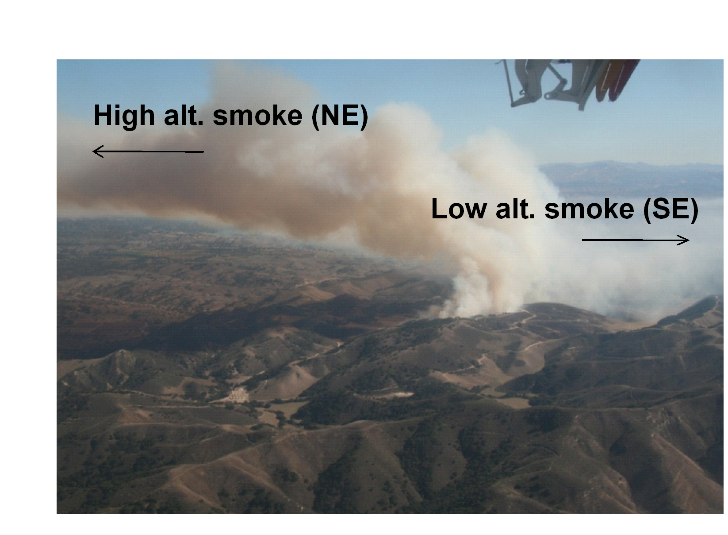
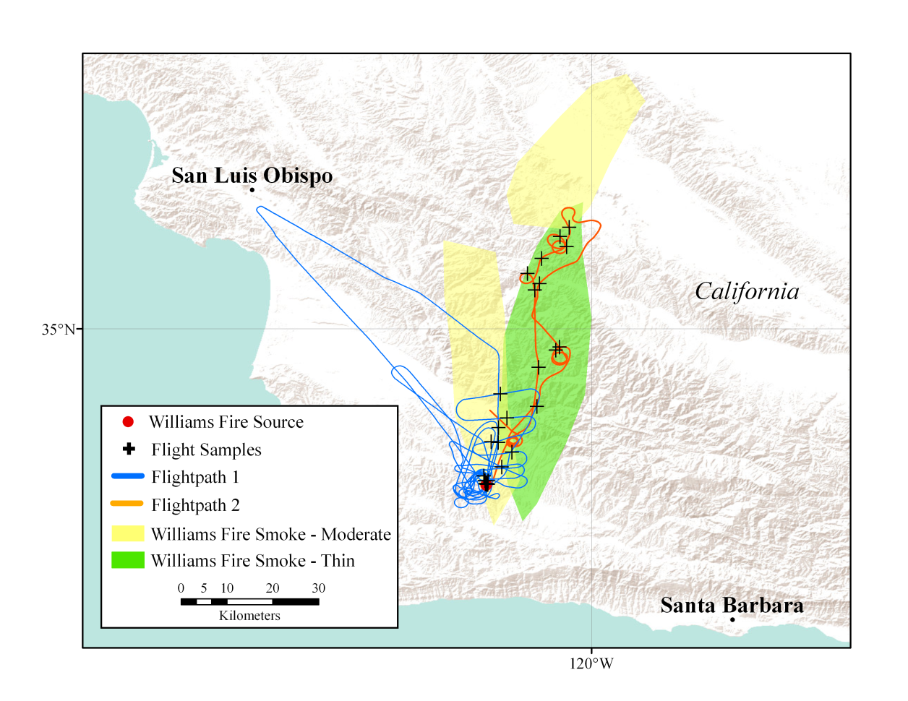
Williams Fire sampling (Akagi et al., 2012)
The Williams Fire (burning scrublands) was sampled near San Luis Obispo, CA from 10:50-15:20 LT on November 17, 2009. Skies were clear all day and RH was low (11-26%) with variable winds (2-5 m/s).
Measurements included U. Montana airborne FTIR (CO, O₃, NO_{x}, PAN, C₂H₄, etc.), compact ToF-AMS (OA, sulfate, nitrate, ammonium), SP2 (BC), nephelometer, and meteorological data.
Significant chemical formation of O₃ and PAN, but slight loss of OA downwind!
Notes:
In this talk, I’ll be using ASP to study the chemistry of the smoke plume from the Williams fire near San Luis Obispo which was sampled with the US Forest Service Twin Otter aircraft. This experiment is nice because the skies were clear all day with low RH, and the plume was reasonably isolated from other pollution sources. The top figure shows a picture of the smoke plume, showing low altitude and high altitude smoke going in different directions. The aircraft sampling followed the high-altitude plume along the flight tracks shown in the map below. Several gas-phase species were measured with the University of Montana airborne FTIR, while an AMS and SP2 provided aerosol composition data.

Slide 5
Adding SVOC chemistry
In the 1D-VBS framework, SVOCs react with OH to produce only less volatile SVOCs:
In reality, SVOCs form RO₂ radicals, which can fragment into higher volatility products, form O₃, and regenerate HO_{x}:
Notes:
Our second method for modeling the chemistry of the unidentified SVOCs is a little more rigorous, recognizing that in reality SVOCs react with OH to make peroxy radicals. The reaction of these peroxy radicals with NOx can make lower volatility SVOCs as above, but can also fragment to make higher volatility SVOCs, form O3 by producing NO2 and HO2, and can regenerate HOx radicals thereby continuing the chemistry.

Slide 6
ASP slightly overestimates O₃ and PAN
ΔO₃ /ΔCO
ΔPAN/ΔCO₂
Smoke Age (hr)
Smoke Age (hr)
Fast, Medium, and Slow Dilution Rates
Solid = In Plume, Dashed = Top of Plume, Dotted = Bottom of Plume
Alvarado et al., ACP, 2015.
Notes:
So how well does ASP do in simulating this plume? Here I’m showing the model results for O3 and PAN for the case where we assume the unidentified SVOCs are unreactive. The x axis is time after plume emission, and the horizontal error bars are due to the uncertainty in the average wind speed within the plume. The different line colors correspond to three different estimates of the plume dilution rate, while the solid lines are for the reduced photolysis rate in the plume, the dashed lines are for the enhanced photolysis at the top of the plume, and the dotted lines are for the bottom of the plume. We can see that the model slightly overestimates the O3 and PAN formation within the smoke plumes, but is pretty close to the observed formation rate.

Slide 7
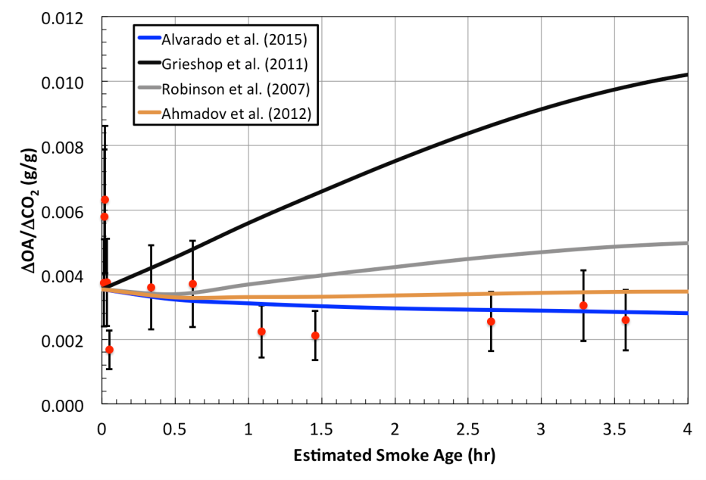
Need slow OH reaction rate and/or fragmentation to explain low OA downwind
k_{OH} = 2×10⁻¹¹, x100 less vol
k_{OH} = 4×10⁻¹¹, x10 less vol
k_{OH} = 1×10⁻¹¹, x10 less vol.
k_{OH} = 1×10⁻¹¹, x10 less vol, 0.5 frag., HO_{x}/NO_{x} Chem.
k_{OH} = 10⁻¹¹ cm³/s
  HC8 in RACM2: 1.1x10⁻¹¹ cm³/s
k_{OH} = 10⁻¹¹ cm³/s+ 50% RO₂ frag
  Formation of Acetic Acid?
ΔOA/ΔCO₂ (g/g)
Smoke Age (hr)
Alvarado et al., ACP, 2015.
Notes:
So what happens when we add this SVOC chemistry? Here I’m showing results for OA as before. The purple bar is like the brown bar, but assumes that 50% of the RO2 radicals fragment on reaction with NO, and is more consistent with the OA observations. But if the RO2 radicals fragment, what happens to the other half? One possibility is that the fragmentation reaction slices two carbons off of the SVOC, producing acetic acid.

Slide 8
Acetic acid formation consistent with formation by RO₂ fragmentation
k_{OH} = 10⁻¹¹ cm³/s
k_{OH} = 10⁻¹¹ cm³/s + 0.5 frag
ΔCH₃COOH/ΔCO
ΔCH₃COOH/ΔCO
Smoke Age (hr)
Smoke Age (hr)
Notes:
And here’s I’m showing the results for acetic acid if we assume that every time an SVOC RO2 radical fragments it produces acetic acid and a higher volatility SVOC. The model is now a little high, but the observation seem consistent with formation of acetic acid by SVOC fragmentation. This might explain why plumes with high acetic acid formation have relatively low OA formation and vice versa – I the RO2 radicals fragment, you get acetic acid, and if they don’t, you get large SOA production.

Slide 9
Williams Fire Summary
SVOC chemistry can impact not just OA formation, but also O₃, NO_{x}, and PAN in the smoke plume.
Reasonable SVOC chemistry can simulate OA, O₃, OH, and NO_{x} observations from the Williams Fire.
  k_{OH} ~10⁻¹¹ cm³/s with ~50% of RO₂ radicals fragmenting to produce higher volatility SVOC + CH₃COOH
  1.1 O₃ for each SVOC + OH reaction (vs 1.37 for alkanes)
  60% of OH regenerated as HO₂ (vs 63% for alkanes)
  50% of NO lost to organic nitrate formation (vs 26% for alkanes)
  Provides a model-based constraint on the chemistry of the SVOCs
Alvarado et al., ACP, 2015.

Slide 10
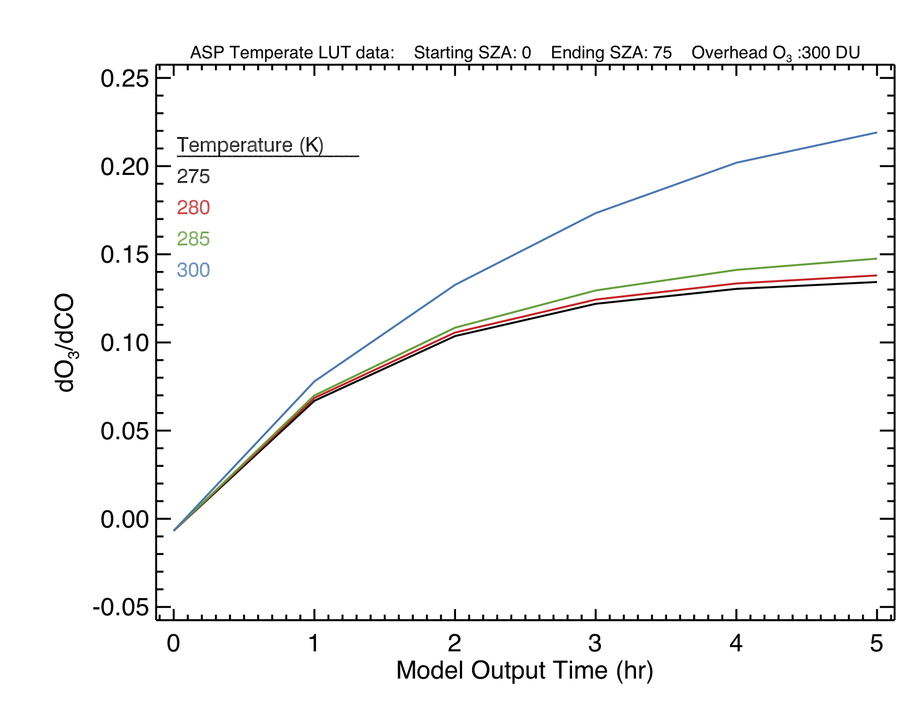
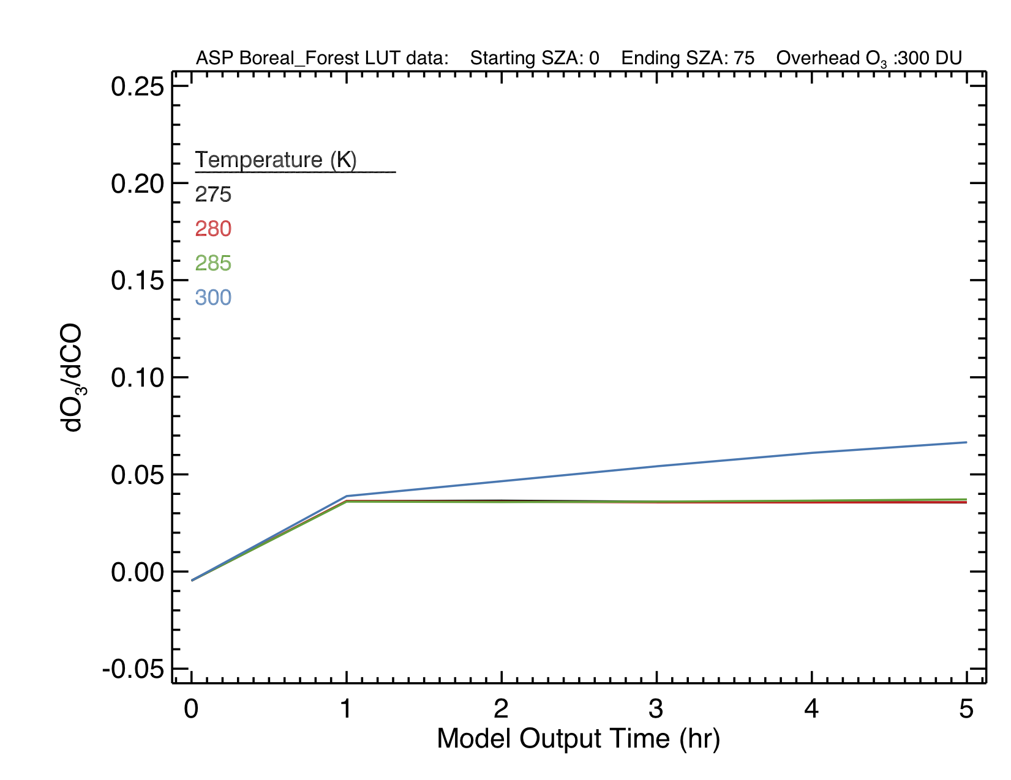
Application to “typical” fires: O₃ formation
Savanna/Grasslands
(MCE = 0.95, NMOC/NO_{x} = 10)
Boreal Forest
(MCE = 0.88, NMOC/NO_{x} = 100)
ΔO₃/ΔCO (mol/mol)
ΔO₃/ΔCO (mol/mol)
Smoke Age (hr)
Smoke Age (hr)
Notes:
Here I’m showing some results for ozone enhancement from the look-up tables we made with ASP for savanna fires and boreal forest fires. The different colors show the impact of different temperatures, and only values every hour are plotted.
These fires have very different combustion efficiencies and NMOC/Nox ratios, and as expected, the ozone formation is higher in the Savanna case with high MCE, and the O3 production increases with age. However, in the boreal case we can see the ozone production is nearly done after the first hour.

Slide 11
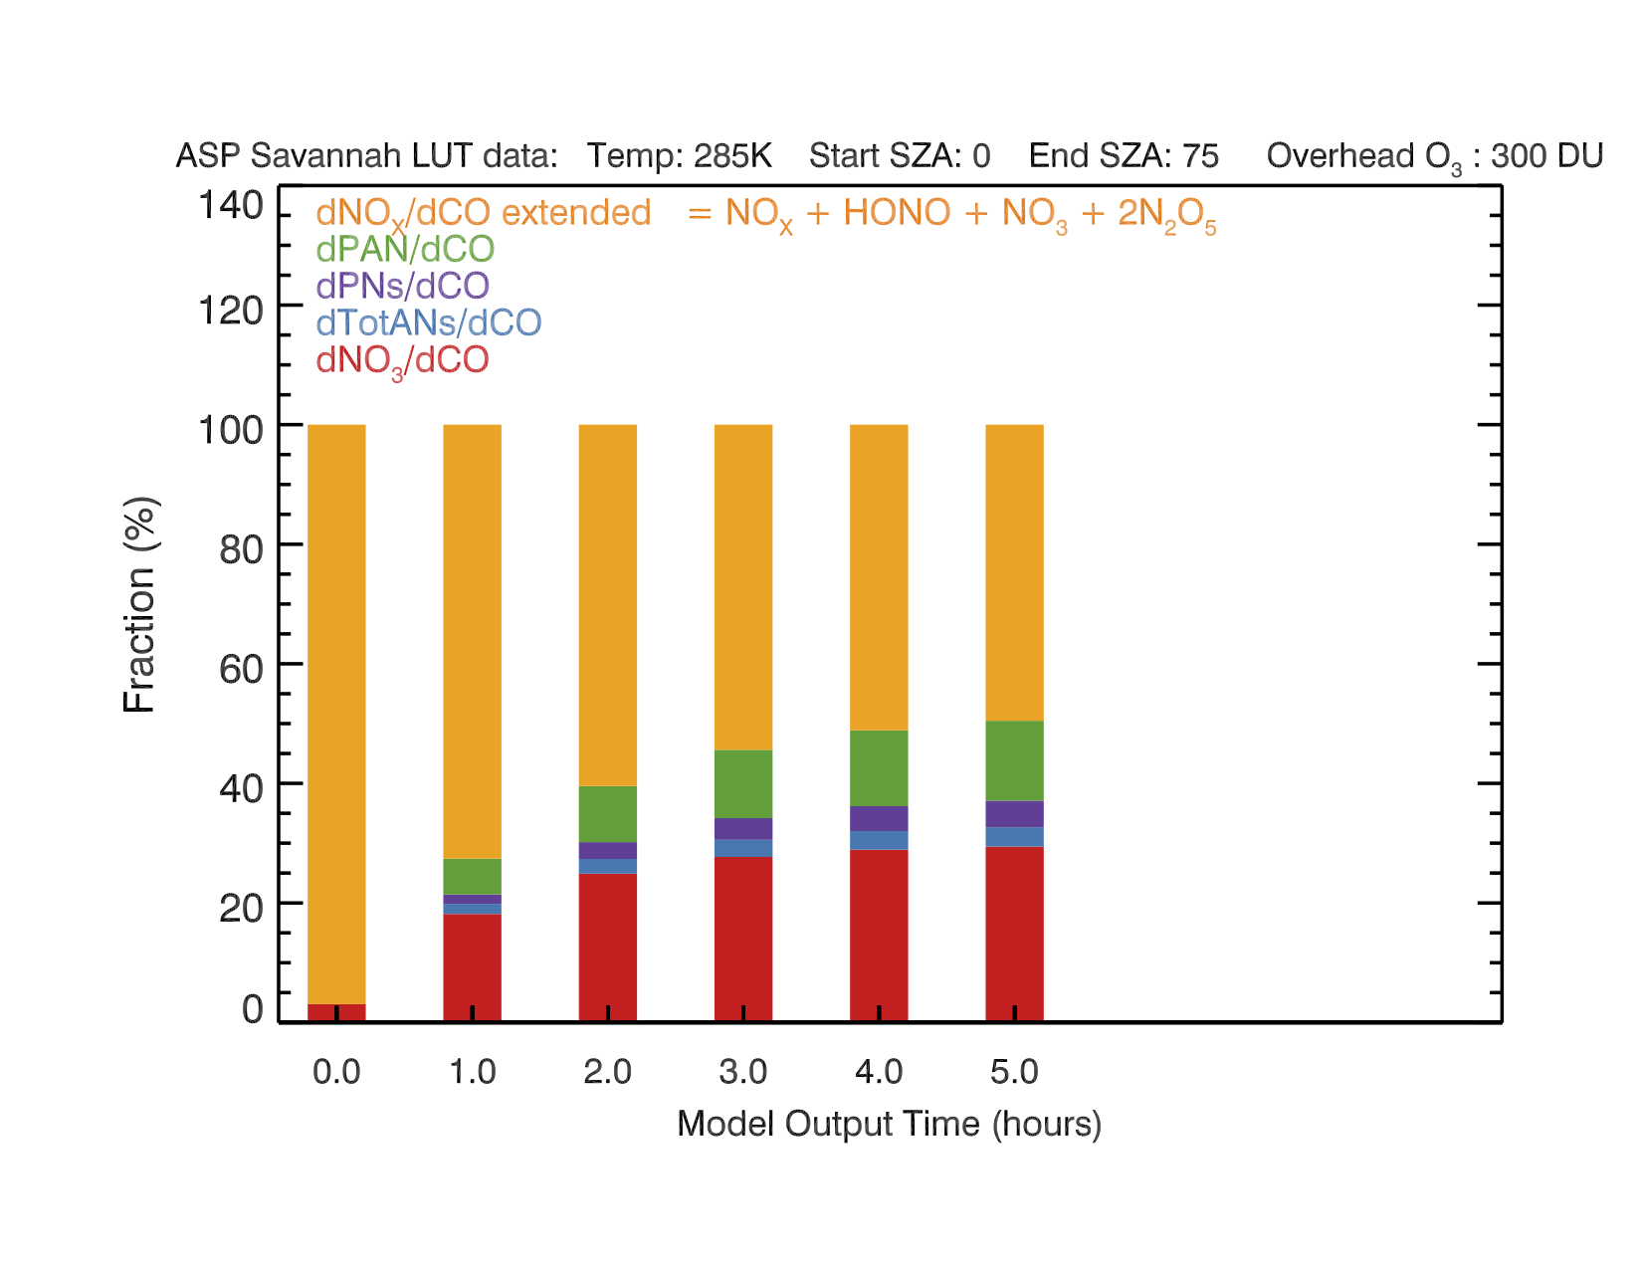
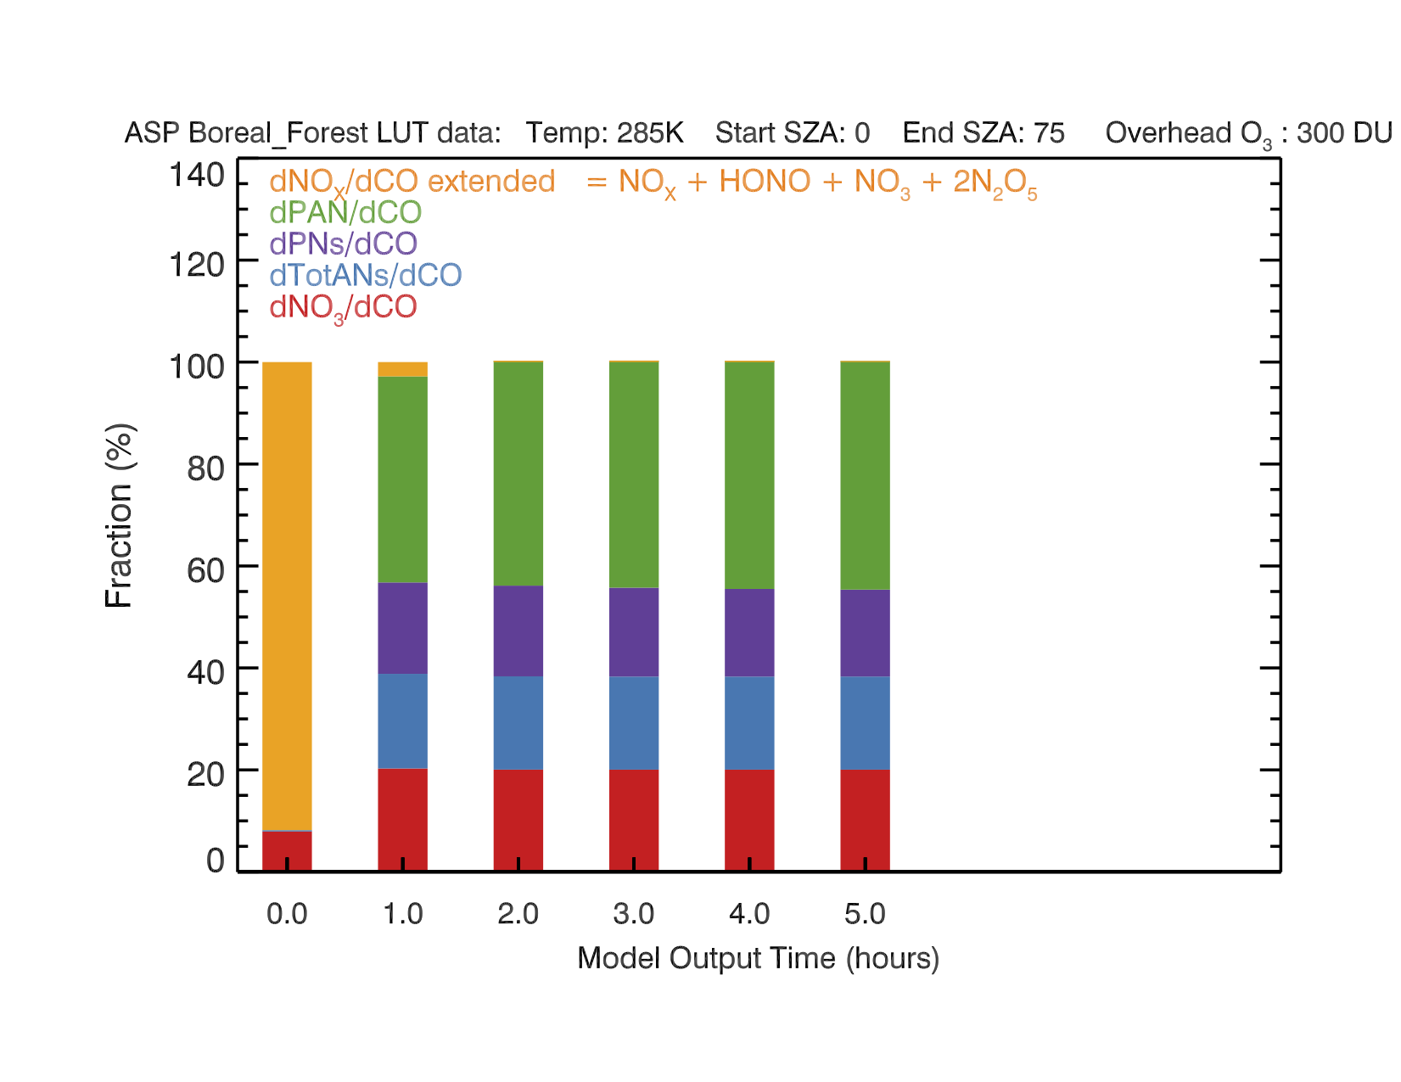
Application to “typical” fires: NO_{y} Partitioning
Savanna/Grasslands
(MCE = 0.95, NMOC/NO_{x} = 10)
Boreal Forest
(MCE = 0.88, NMOC/NO_{x} = 100)
NO_{x}
PAN
(% NO_{y})
(% NO_{y})
Smoke Age (hr)
Smoke Age (hr)
Notes:
We can explain this by looking at the Noy partitioning. In the savanna case, about 50% of the Noy is still present as Nox after five hours, sustaining the ozone production. However, after one hour nearly all the Nox in the boreal plume has been converted to other species, such as PAN. Thus in the boreal case we don’t expect any more near-source O3 production, but of course the PAN could decompoise back to Nox further downwind and start generating O3 again.

Slide 12
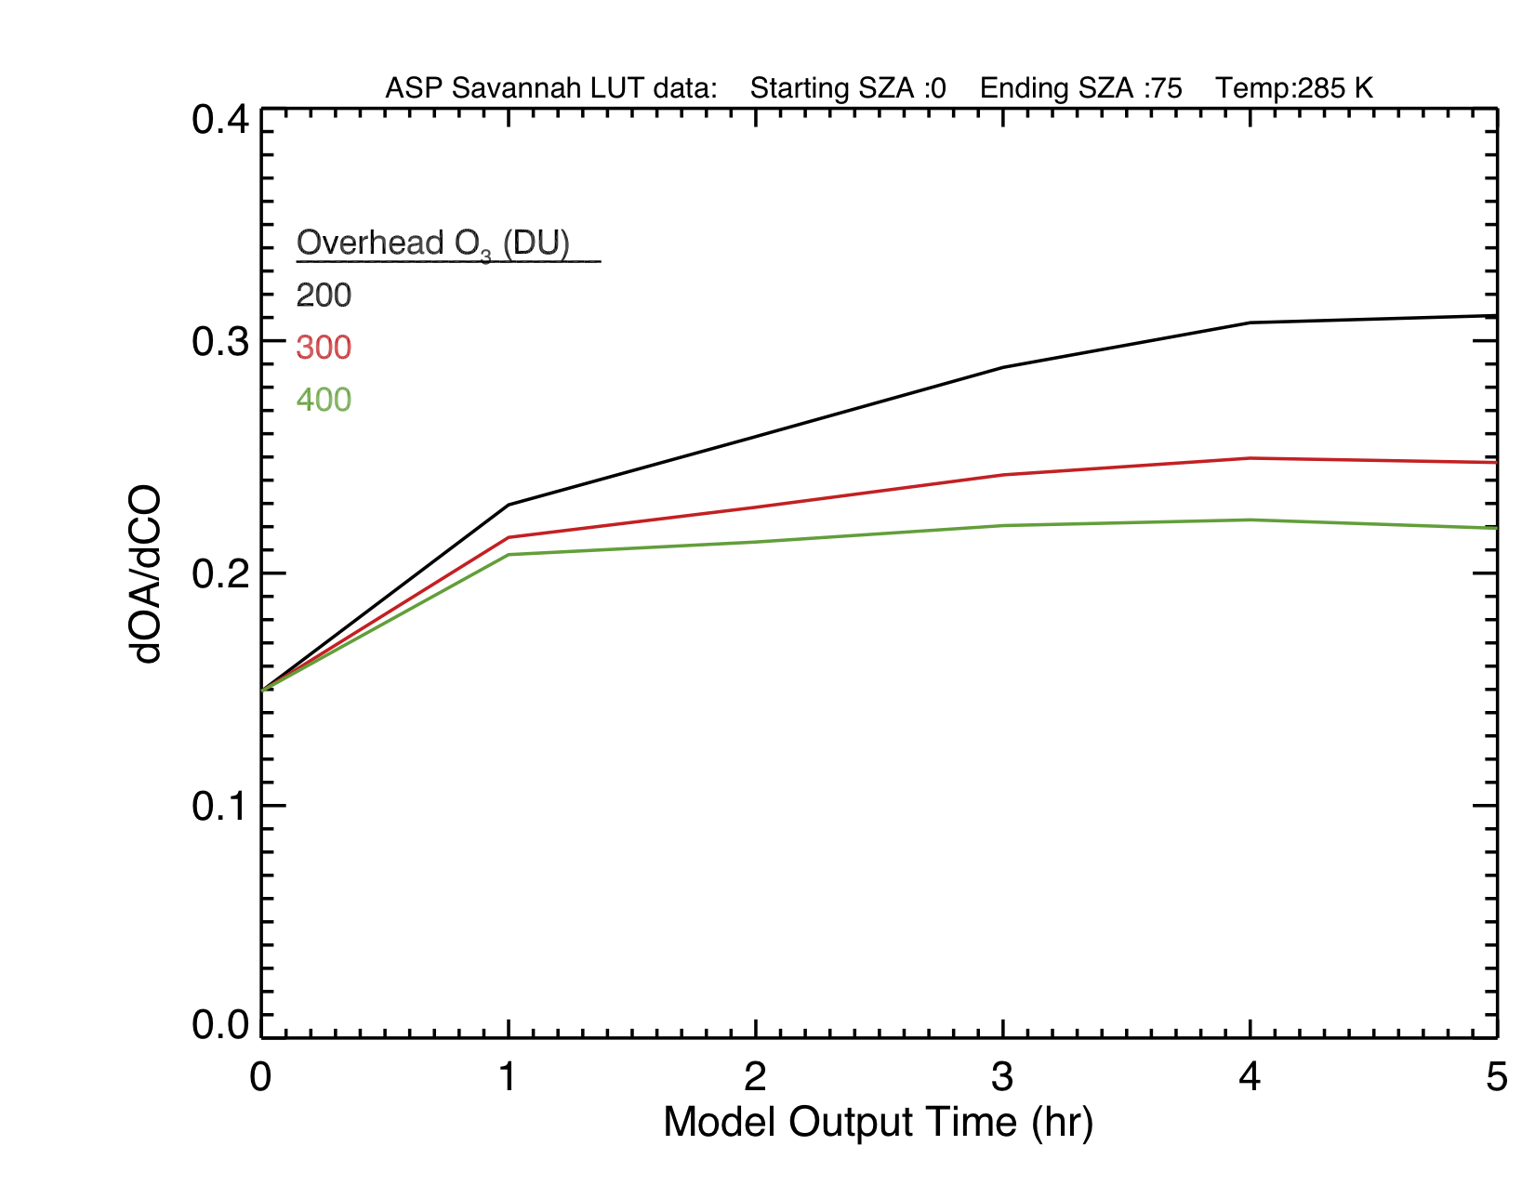
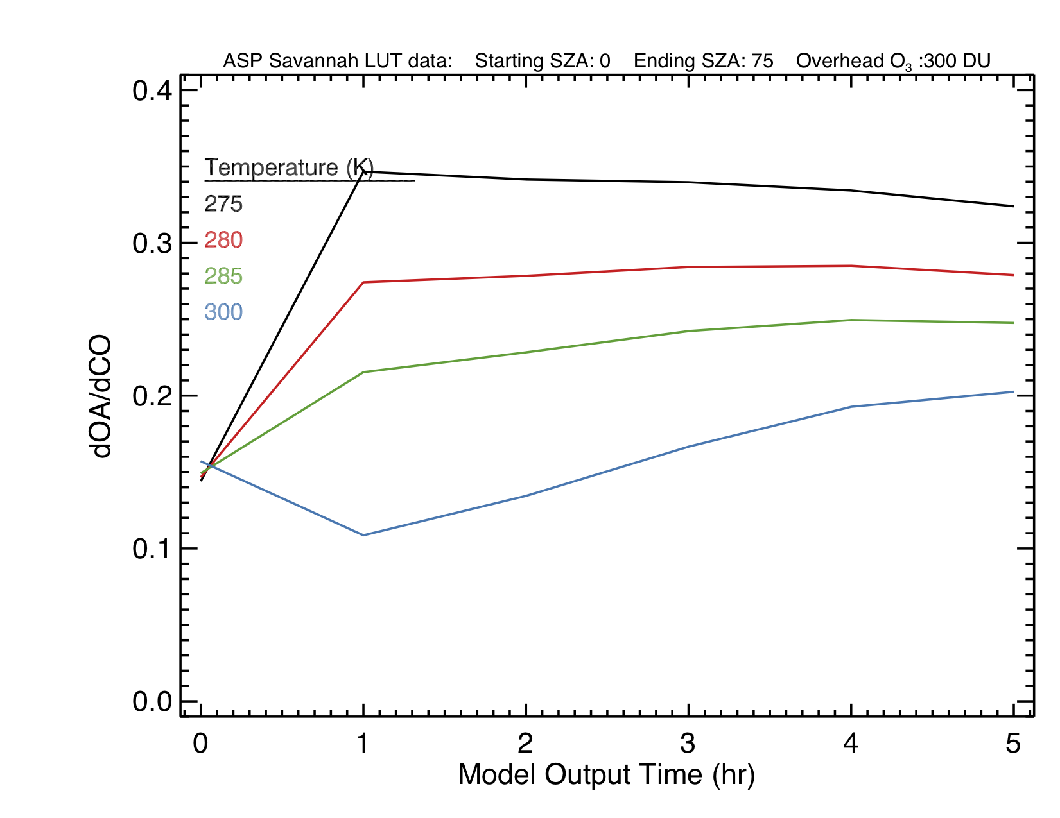
Application to “typical” fires: OA evolution
Grasslands vs. O₃ Col.
Grasslands vs. Temperature
ΔOA/ΔCO₂ (g/g)
ΔOA/ΔCO₂ (g/g)
Smoke Age (hr)
Smoke Age (hr)

Slide 13
Block 9b Fire (Akagi et al., 2013; May et al., 2015)
Columbia, SC (Pop 748,000)
plus airport
The Block 9b Fire (burning southern pines, sparkleberry trees, and litter) was burned on the US Army Fort Jackson base NE of Columbia, SC from 12:00-16:00 LT on November 1, 2011. Skies were clear all day with moderate RH (~60%) with winds ~6 m/s.
Measurements included U. Montana airborne FTIR (CO, O₃, NO_{x}, PAN, C₂H₄, etc.), HR-ToF-AMS (OA, sulfate, nitrate, ammonium), and SP2 (BC).
Very large O₃ and PAN formation (ΔO₃/ΔCO = 0.9!)
Slight loss of OA downwind!
Natural Gas Power Plant
Fort Jackson
Significant mixing of smoke plume with anthropogenic NO_{x} sources!

Slide 14
Impact of power plant NO_{x}
Williams Fire
Block 9b Fire
ΔNO_{x}/ΔCO
ΔNO_{x} /ΔCO₂
Smoke Age (hr)
Smoke Age (hr)

Slide 15
Simple model of power plant NO_{x} source
Smoke Plume and
Polluted Background
“NO_{x} Jump” forcing
ΔNO_{x} of 60 ppb at 0.75 hr
ΔNO_{x}/ΔCO
ΔNO_{x} /ΔCO

Slide 16
Anthropogenic NO_{x} jump kills off SOA chemistry
Smoke Plume and
Polluted Background
“NO_{x} Jump” forcing
ΔNO_{x} of 60 ppb at 0.75 hr
Smoke Age (hr)
Smoke Age (hr)
OH drops by factor of 6, likely due to increased OH+NO₂

Slide 17
ASP slightly underestimates O₃ and PAN formation without anthro. NO_{x} jump
ΔPAN/ΔCO
ΔO₃ /ΔCO
Fast, Medium, and Slow Dilution Rates
All clear sky photolysis rates

Slide 18
Underestimate is worse when NO_{x} Jump is added
Model not catching full range of ΔNO_{x}/ΔCO?
ΔO₃ /ΔCO
ΔPAN/ΔCO
Fast, Medium, and Slow Dilution Rates
All clear sky photolysis rates

Slide 19
Block 9b Fire Summary
Unlike Williams fire, this plume had significant impacts from anthropogenic NO_{x} sources, both in the background air and in the plume itself downwind.
OA matches observations reasonably well after sudden NO_{x} increase from power plant is added.
But amount of O₃ and PAN formed drops when sudden increases in NO_{x} is added; neither simulation matches the highest early values.
More work needed to simulate interaction of smoke and anthropogenic sources more realistically.

Slide 20
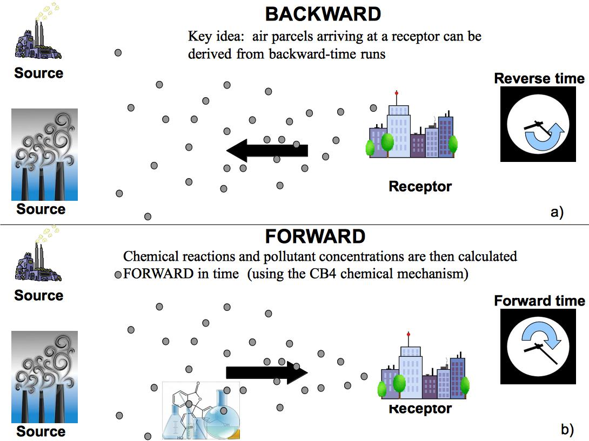


Next Steps: STILT-Chem Analysis of Block 9b Fire
STILT-Chem can determine the sources that impacted the aircraft obs. and then run chemistry.
We are adding ASP as the chemistry subroutine of a new version of STILT-Chem
D. Wen et al. (2012, 2013, 2014)

Slide 21
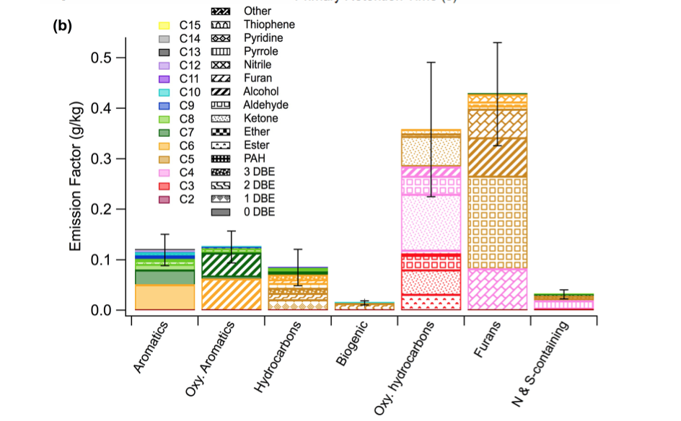
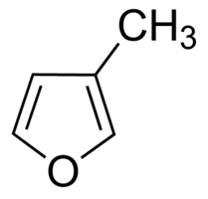
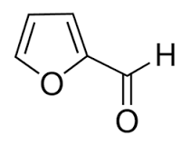
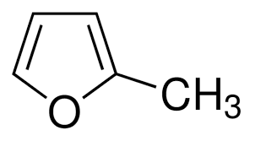
Next Steps: Incorporating New Measurements of NMOC and S/IVOC species
Several studies have identified many new BB species
  Hatch et al., ACP, 2015
  Stockwell et al., ACP, 2015
  Gilman et al., ACPD, 2015
6-20% NMOC unID’d
O₃ and SOA chemistry of many ID’d compounds poorly known
Applying Williams Fire method to multiple lab and field datasets could help constrain this chemistry.
Hatch et al.,
ACP, 2015.
EF = 0.05 g/kg
k_{OH} = 6.2e-11
Y_{SOA} = ???
EF = 0.005 g/kg
k_{OH} = 9.4e-11
Y_{SOA} = ~10%
(Strollo &
Ziemann, 2013)
EF = 0.16 g/kg
k_{OH} = 3.5e-11
Y_{SOA} = ???
Notes:
So studies like the Williams fire study I’ve been presenting can give us confidence in the ability of the ASP model to be used to develop a sub-grid scale parameterization of the chemistry of biomass burning plumes for larger chemical models. We’re currently building such a parameterization for GEOS-Chem, following the approach Vinken et al. used for ship plumes. We’ll use the ASP model to develop lookup tables of the enhancement ratios of ozone, NOx, PAN, and other nitrogen containing species versus smoke age. The lookup table will include the dependence of these enhancement ratios on the biome, temperature, solar zenith angle, and other fire and environmental parameters.

Slide 22
Next Steps: Smoke Chemistry in CMAQ
Approach
Implement RACM2, CB05, and/or SAPRC07 in ASP
Identify key species reactions that need to be added to make this condensed version of ASP (ASP-C) match the full model.
Quantify the errors from not considering the full ASP chemistry
Implement condensed mechanism in CMAQ
High-resolution CMAQ runs should be able to resolve smoke plumes.
However, common chemical mechanisms (e.g., CB05, SAPRC07) may not properly account for the organic species in biomass burning plumes.
Need a reduced form of this chemistry for implementation in CMAQ

Slide 23


Acknowledgements
This modeling work funded by NSF grant AGS-1144165 and NASA grant NNX14AP45G.
Improvements to ASP aerosol optical properties funded by NASA ACMAP grant NNX11AN72G.

Slide 24
Need to include SVOC NO_{x} and HO_{x} chemistry for NO_{x}, little impact on C₂H₄ or OH
0 NO_{x} lost per rxn
and 0% HO_{x} recycled
50% NO_{x} lost per rxn (vs. 26% for HC8) and 60% HO_{x} recycled (vs. 63%)
Notes:
So the purple bar case looks pretty good for organic aerosol and acetic acid. But what’s happened with the gas phase species? I’m not showing them here, but O3 and PAN generally look okay, but we can see that the loss of NOx and loss of C2H4 are underestimated in the purple case, because in the purple cases, the SVOCs are a sink for OH but do not react with NO or regenerate HOx. So what we want to do is use these gas-phase constraint to try to optimize our estimates of the NOx lost and HOx regenerated by the reaction of the SVOCs. The blue box shows the case where the SVOCs produce 1.1 O3 per reaction with OH, lose 50% of the NOx per reaction (presumably to organic nitrate formation), and recycle 60% of the OH as HO2. In this case, we still do a reasonable job of matching organic aerosol, ozone, and PAN, but were now overestimating the NOx loss, and OH is still underestimated, as we can see by the overestimate of ethylene. However, trying to reduce the NOx loss or increase the HOx recycled would lead to overestimates of OA, PAN, and O3. These assumed chemical parameters for the SVOCs are not unreasonable – in fact, they are pretty close to the chemistry of long-chain alkanes in RACM2.

Slide 25
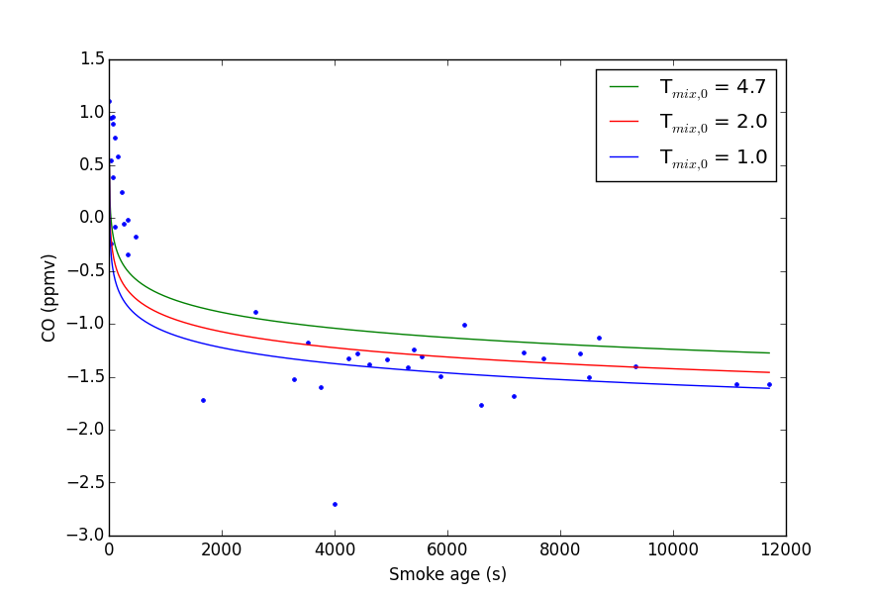
Block 9b fire CO slide

Slide 26
Next Steps: Using ASP to Build a Sub-grid Scale Parameterization for GEOS-Chem
Follow approach used by Vinken et al. (2011) for ship plumes
We use ASP to build look-up tables of ΔOA/ΔCO, ΔO₃/ΔCO, ΔPAN/ΔCO, etc. versus smoke age
Look-up table will include dependence on biome, temperature, solar zenith angle (SZA), and other fire and meteorological parameters
O₃
GC w/ASP – STANDARD GC O₃ (ppbv)
NO_{x}
GC w/ASP – STANDARD GC NO_{x} (ppbv)
Notes:
So studies like the Williams fire study I’ve been presenting can give us confidence in the ability of the ASP model to be used to develop a sub-grid scale parameterization of the chemistry of biomass burning plumes for larger chemical models. We’re currently building such a parameterization for GEOS-Chem, following the approach Vinken et al. used for ship plumes. We’ll use the ASP model to develop lookup tables of the enhancement ratios of ozone, NOx, PAN, and other nitrogen containing species versus smoke age. The lookup table will include the dependence of these enhancement ratios on the biome, temperature, solar zenith angle, and other fire and environmental parameters.

