Slide 1
Simulating Fire Event Impacts on Regional O₃ and PM2.5 and Looking Forward Toward Evaluation
October 5, 2015
Kirk Baker
U.S. Environmental Protection Agency
Research Triangle Park, NC

Slide 2
Objective & Motivation
Objective is to characterize O3 & PM2.5 impacts from specific fire events
  Better understand emissions and photochemical model application for Wildland and prescribed fire events
  Provide information about downwind O3 and PM2.5 impacts from different sized fire events
  Compare source attribution tools for single sources/single source complexes (compare source apportionment and sensitivity)
Potential regulatory needs include Exceptional Events Rule, Regional Haze Rule, PM NAAQS review, and O3 NAAQS review

Slide 3
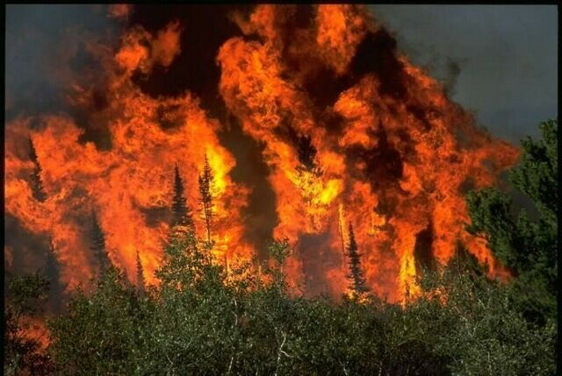
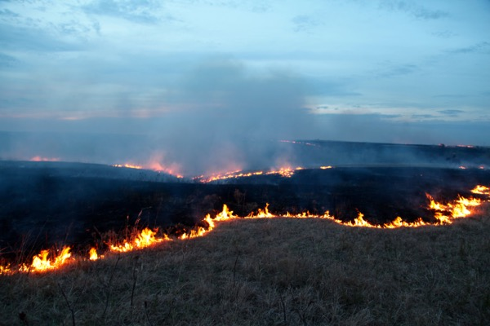
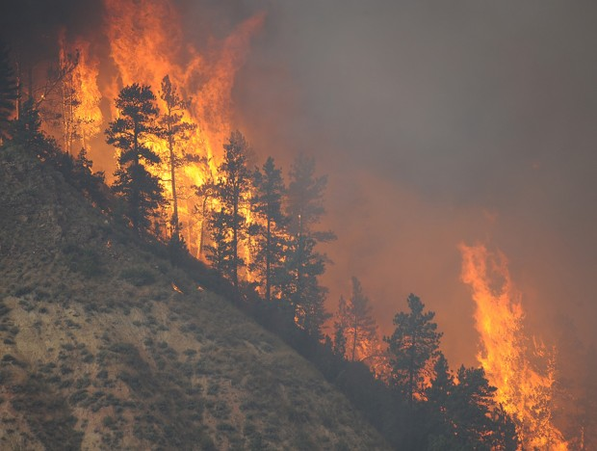
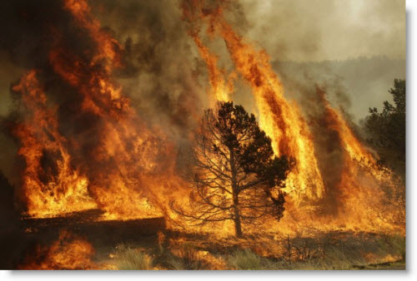
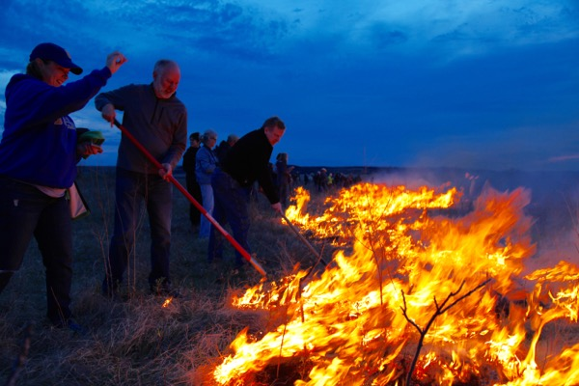
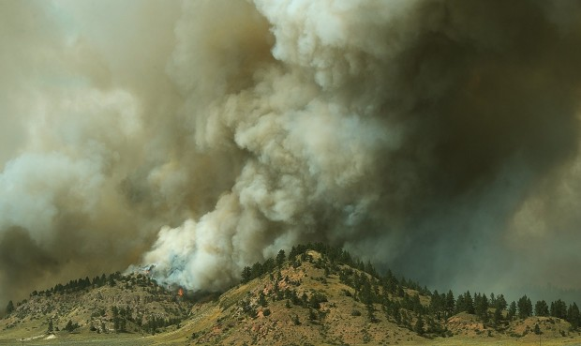
Wallow Fire
northern AZ/NM
Flint Hills Fire
central/eastern KS
Waterhole Fire
southeast MT

Slide 4
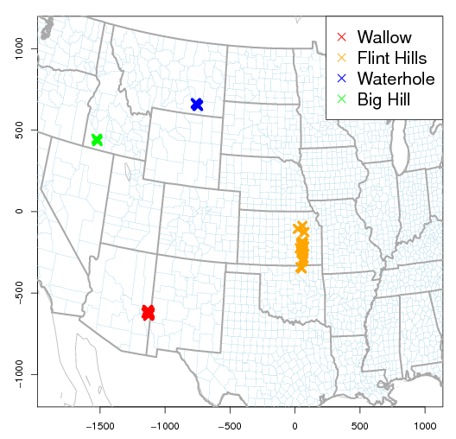
Methods: photochemical modeling
CMAQ v5.0.2 - 12 km horizontal grid resolution & 25 vertical layers
  CB05TU gas phase chemistry + AERO6 aerosol + source apportionment (ISAM)
  CB05TU + volatility basis set approach (only zero-out)
All runs initialized from annual NATA simulation of 2011
  Flint Hills fire episode April 1 to 15, 2011
  Wallow fire episode June 5 to 10, 2011
  Big Hill fire episode August 14 to 16, 2011
  Waterhole fire episode August 22 to 26, 2011
Tracked 1) all fires and 2) all fires except the fire event of interest (e.g. Wallow, Flint Hills, etc.) with ISAM and zero-out approaches
Tracked fire contribution to O3, CO, NOX, VOC, NH3, and PM2.5 (SO4, NH4, NO3, EC, primary OC) with ISAM (Kwok et al 2013, 2015)
Tracked fire contribution to O3, CO, NOX, VOC, NH3, and PM2.5 (SO4, NH4, NO3, EC, primary OC, SOA) with zero-out sensitivity

Slide 5
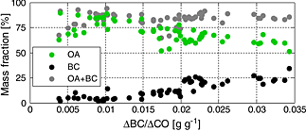
Fire event emissions modeling
85%
11%
Primary PM2.5 emissions largely organic aerosol (OA): 2 profiles
TOG emissions 40% non-reactive (CH4+UNR): 1 profile
SMOKE provides speciated daily emissions estimates for each fire (shown below); emissions highest during day
Plume rise calculated in CMAQ: flaming & smoldering
PM2.5 speciation profile (above)
Measured OA and BC % of PM2.5 (below)
*Vakkari et al, 2014

Slide 6
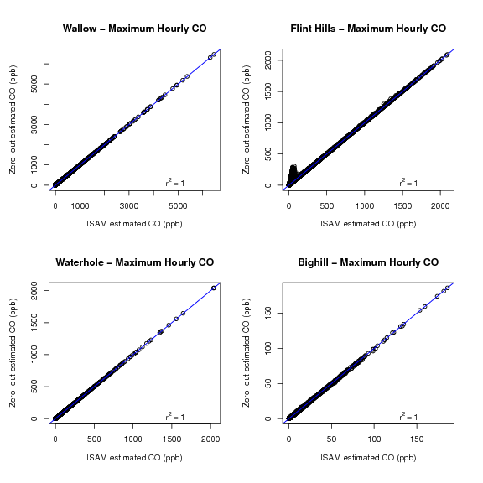
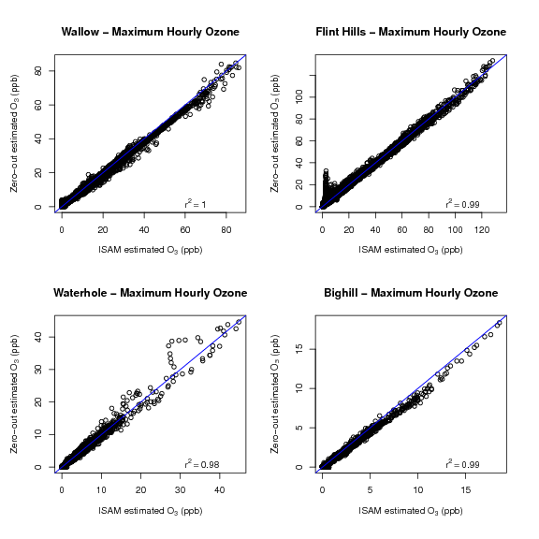
Source apportionment (ISAM) and brute-force zero-out comparisons for CO (left) and O3 (right) maximum event hourly mixing ratios

Slide 7
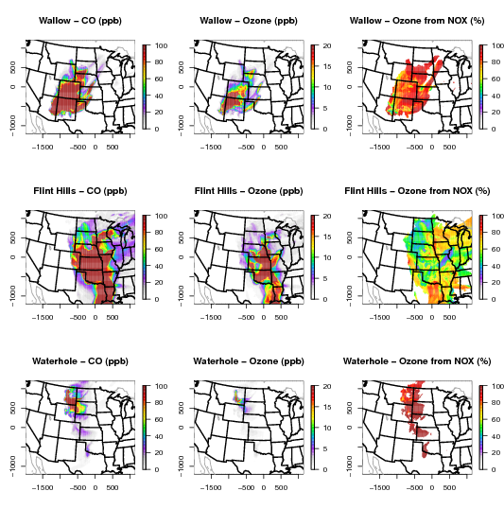
O3
Wallow (top), Flint Hills (middle), Waterhole (bottom)
Event maximum hourly CO (left) & O3 (middle)
Percent contribution from fire event NOX emissions (far right)
Both VOC and NOX important for Flint Hills event
Relative VOC and NOX importance likely depends on season and chemical environment
Smaller emissions lead to smaller impacts
Impacts tend to decrease as distance from event increases
Are these mixing ratios realistic?

Slide 8
How to constrain model estimates?
Comparing model predicted enhancement ratios with those observed from a variety of fires published in literature may provide a preliminary indication about whether the model is appropriately capturing plume chemistry and removal processes
Ambient based methods have been used to estimate ozone enhancements at monitor sites from fires
  Enhancement ratios typically expressed as the change in O3 divided by the change in CO
  CO is assumed to be a fairly well conserved tracer of fire emissions
  These ratios have also been used to examine changes in primary (e.g. elemental carbon) and secondary (e.g. sulfate and nitrate ion) PM2.5 related to the change in CO
Some constraint may be possible comparing model predictions with rural ambient measurements (CASTNET and IMPROVE) where the model estimates a large contribution from the fire event; many limitations with this approach
Best approach would be modeling field studies designed to capture local to regional scale wildfire O3/PM impacts for well studied and understood fire events

Slide 9
Jaffe and Wigder, 2012, Atmos. Env.

Slide 10
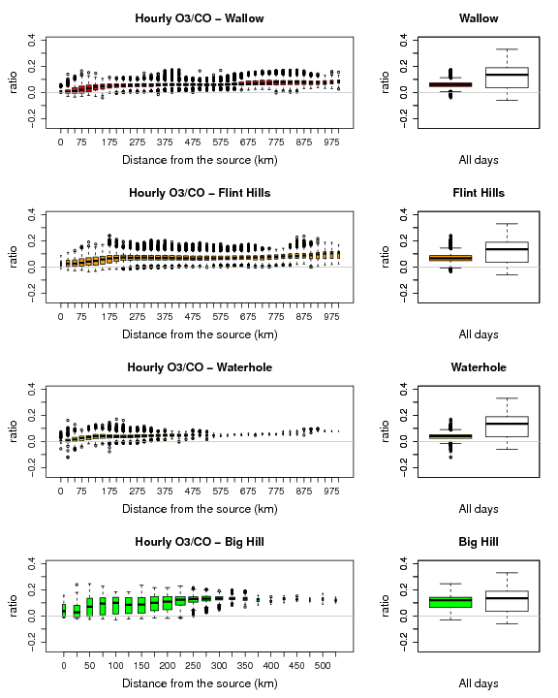
O3/CO
Hourly O3/CO impacts estimated with zero-out shown for each fire by distance from the fire
Observation based studies report plume “age”; how to equate “age” to these distances? One option may be to use timing tracers in future work
“Observed” enhancement ratios tend to be a little higher than model predicted but very little data exists and methods are disparate; here, mean values from Jaffe and Wigder, 2012 are shown

Slide 11
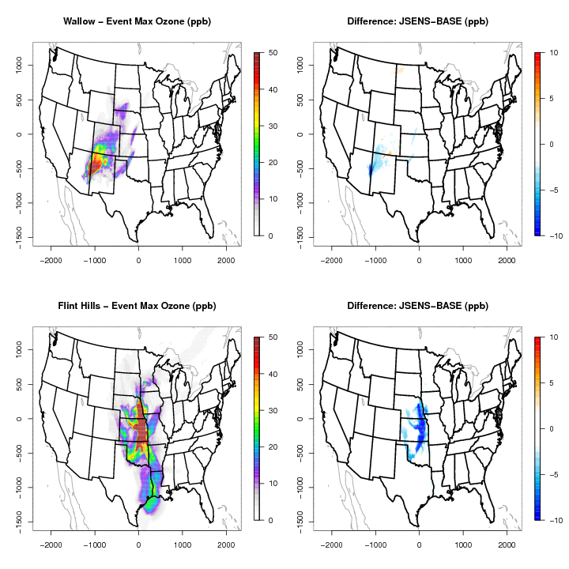
O3 Sensitivity
Need to use a coupled model system to capture meteorology-chemistry interactions?
  WRF-Chem study shows little impacts from changes in radiation due to fires in terms of PBL height, temperature, and biogenic emission rates (Jiang et al, 2012)
Elemental carbon attenuates photolysis in CMAQ
Sensitivity was done to include modeled primary organic aerosol in attenuation of photolysis
Intended to provide an alternative estimate of smoke impacts in the model since most fire PM is organic carbon and little is EC
Event hourly maximum O3 shown at right for Wallow (top) and Flint (bottom)

Slide 12
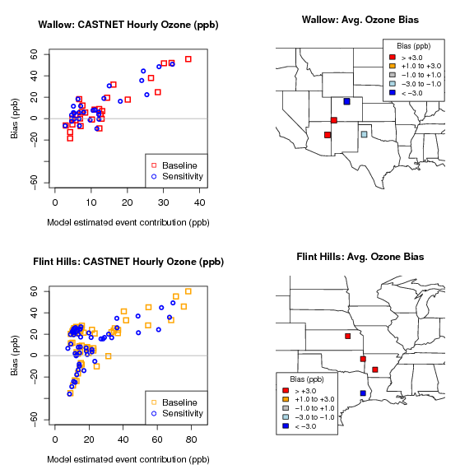
Routine Surface O3
Hourly O3 at rural CASTNET monitors compared with model estimates where fire event contributions are predicted
Overpredictions notable at sites near the event & under-estimates downwind
However, plume may be misplaced downwind meaning performance less likely to be related to fire event prediction
Photolysis sensitivity tended to lower event estimate and bias
Need in-plume measurements from known events for evaluation

Slide 13
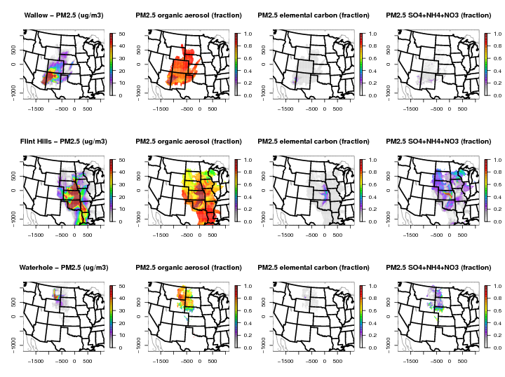
PM2.5
Total PM2.5 (left column) hourly maximum event impacts
Speciated PM2.5 hourly maximum event impacts shown as fraction of total
Estimated with brute-force zero-out
POA largest component
Reasonable estimates??

Slide 14
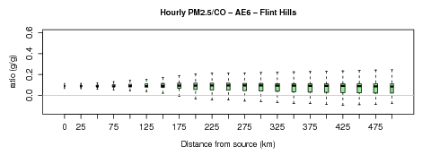
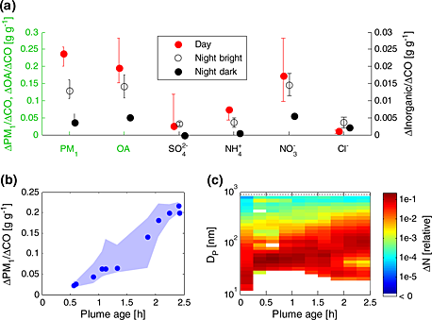
Enhancement Ratios
Observed OA enhancement ratios shown below for 3 different fires; very different patterns!
Need more information covering additional fire types and regional scale plume age information
AE6 modeled hourly PM2.5/CO ratios shown by distance for Flint Hills fire
The model is generally consistent with all 3 observed trends but includes plume ages far greater than 2-5 hours
Vakkari et al, 2014 May et al, 2015

Slide 15
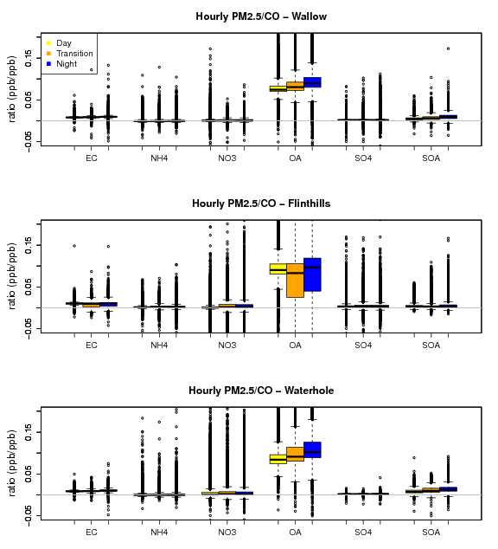
Enhancement Ratios
Ambient based biomass burning plume studies often present PM2.5 components as a function of CO as a proxy for chemical production (high positive ratio) or destruction (negative ratio)
Here, the modeled (AE6 based) ratio is separated for hours at night, daytime, and the transition between day/night
Some variability between fire events; most notably Flint Hills compared to the other events for OA; day/night patterns opposite observed shown below
*Vakkari et al, 2014

Slide 16
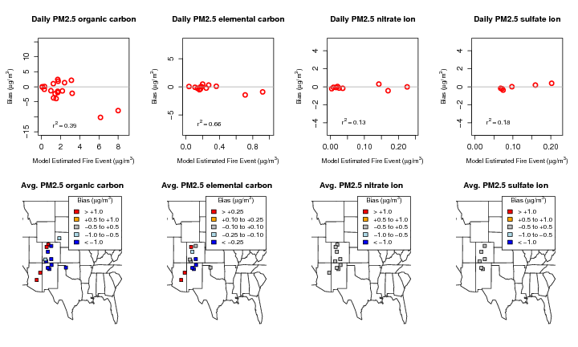
Daily avg. speciated PM2.5 at IMPROVE sites: Wallow fire event (AE6 aerosol chemistry)

Slide 17
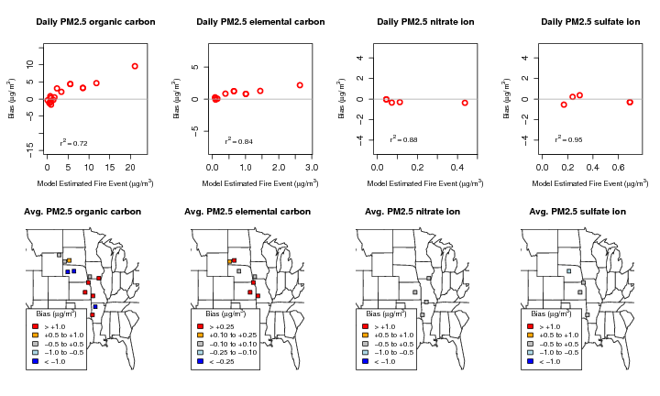
Daily avg. speciated PM2.5 at IMPROVE sites:
Flint Hills fire event (AE6 aerosol chemistry)

Slide 18
Volatility Basis
Set Approach
TOL, XYL, BNZ
0.2
0.1
0.1
0.2
0.4
(ISOP,TERP)
*from Woody et al, 2015
*CAMx v6.2 manual; www.camx.com

Slide 19
Volatility Basis Set implementation in CMAQ
Primary basis sets (2): OAF (biomass burning primary OA) and OAP (all anthropogenic primary OA)
Secondary basis sets (2): OAB (biogenic secondary) and OAA (anthropogenic secondary)
OAF includes primary OA and fraction of “aged” primary biomass emissions
  For biomass aging (OAF) ~16-46% (depending on the volatility) of primary mass converted to secondary (OAB)
  For comparison, in anthropogenic aging (OAP) ~10% of the primary mass converted to secondary (OAA)
Some of the “aged” primary OAF gets moved to the OAB basis set
IVOC_F (= 1.5 x POA_BB) oxidation products put in the OAB basis set
OAB basis set includes fire emissions of monoterpenes and isoprene
OAA basis includes fire emissions of toluene, xylene, and benzene

Slide 20
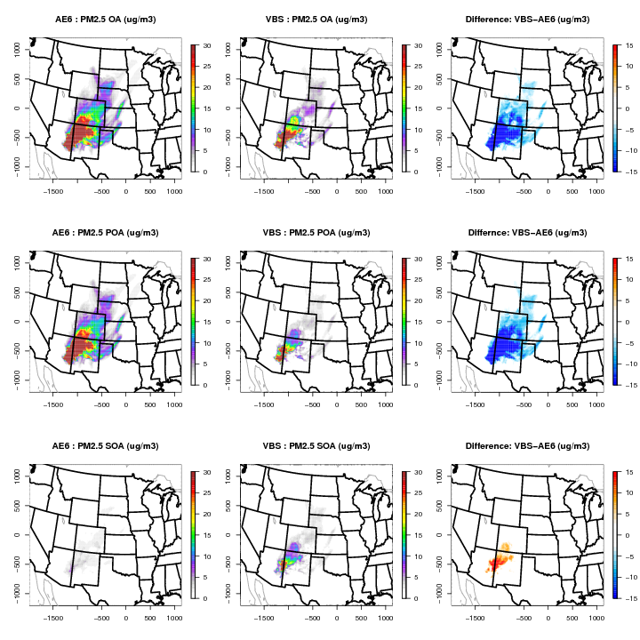
PM2.5 OA
OA
Wallow fire
Episode maximum hourly estimates
Compare model estimated PM2.5 OA, POA, and SOA
AE6 (left), VBS (middle), and difference (right)
POA
SOA

Slide 21
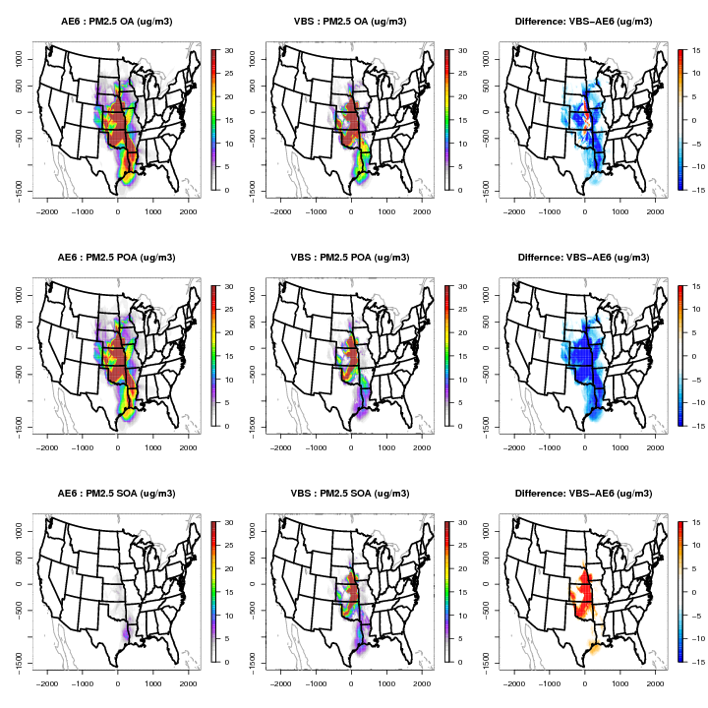
PM2.5 OA
OA
Flint hills fire
Episode maximum hourly estimates
Compare model estimated PM2.5 OA, POA, and SOA
AE6 (left), VBS (middle), and difference (right)
POA
SOA

Slide 22
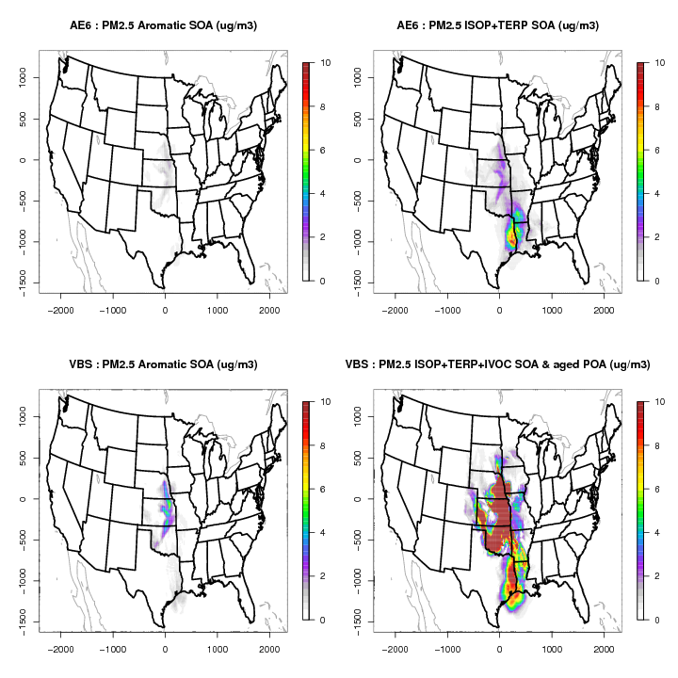
SOA
Flint hills fire
Episode maximum hourly estimates
Aromatic and biogenic pathways
AE6 and VBS
VBS biogenic SOA includes “aged” biomass POA & IVOC precursors
VBS ages aromatic SOA leading to slightly higher concentrations
What about biogenic SOA aging in VBS? (not default)

Slide 23
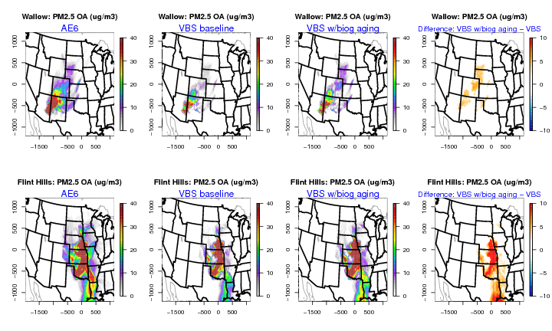
VBS biogenic aging sensitivity

Slide 24
Next Steps
Improve VOC and PM speciation of emissions; improve diurnal emissions profile
Better fire plume placement in time and space; flaming/smoldering plume rise vertical distribution
Better capture fire impacts on photolysis rates: currently CMAQ includes photolysis attenuation from black carbon, better long term approach for attenuation from organic (brown) carbon?
Fire plume chemistry for O3 and PM2.5; mercury?
More direct evaluation using in-plume measurements taken as part of past and planned field campaigns (e.g. FIREX 2017-2018 and FASMEE 2018-2020)
Collaborations —we can not solve all of these issues on our own!!

Slide 25
Acknowledgements & References
Melinda Beaver, Pat Dolwick
Matt Woody, Havala Pye, Bill Hutzell, Bonyoung Koo
Venkatesh Rao, George Pouliot, Alison Eyth, B.H. Baek
Allan Beidler, James Beidler, Chris Allen, Lara Reynolds, Ryan Cleary
Norm Possiel, Heather Simon, Jim Kelly, Sharon Phillips, Chris Misenis, Brian Timin, Carey Jang, Tyler Fox
The person (TBD) that will some day update CMAQ to read in multiple inline point format fire files
Jaffe, D.A., Wigder, N.L., 2012. Ozone production from wildfires: A critical review. Atmospheric Environment 51, 1-10.
Jiang, X., Wiedinmyer, C., Carlton, A.G., 2012. Aerosols from fires: An examination of the effects on ozone photochemistry in the Western United States. Environmental science & technology 46, 11878-11886.
Kwok, R., Baker, K.R., Napelenok, S., Tonnesen, G., 2015. Photochemical grid model implementation of VOC, NOx, and O3 source apportionment. Geoscientific Model Development 8, 99-114.
Kwok, R., Napelenok, S., Baker, K.R., 2013. Implementation and evaluation of PM2.5 source contribution analysis in a photochemical model. Atmospheric Environment 80, 398-407.
May, A., Lee, T., McMeeking, G., Akagi, S., Sullivan, A., Urbanski, S., Yokelson, R., Kreidenweis, S., 2015. Observations and analysis of organic aerosol evolution in some prescribed fire smoke plumes. Atmospheric Chemistry and Physics Discussions 15, 1953-1988.
Vakkari, V., Kerminen, V.M., Beukes, J.P., Tiitta, P., Zyl, P.G., Josipovic, M., Venter, A.D., Jaars, K., Worsnop, D.R., Kulmala, M., 2014. Rapid changes in biomass burning aerosols by atmospheric oxidation. Geophysical Research Letters 41, 2644-2651.
Woody, M. C. , Baker, K.R., Hayes, P.L., Jimenez, J.L., Koo, B. and Pye, H.O.T.: Understanding sources of organic aerosol during CalNex-2010 using the CMAQ-VBS. Atmospheric Chemistry and Physics Discussions, Vol. 15 (19), 2015. http://www.atmos-chem-phys-discuss.net/15/26745/2015/

Slide 27
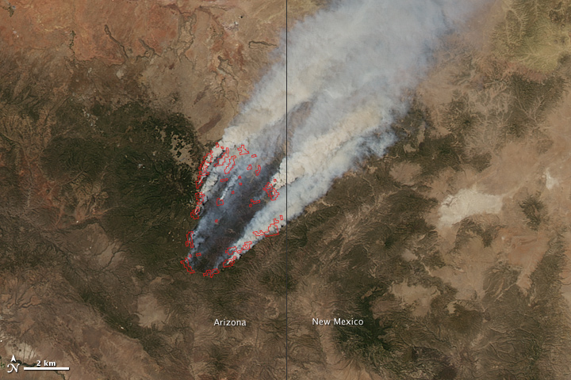
Wallow Fire
The Wallow Fire, named for the Bear Wallow Wilderness area where the fire originated, was a wildfire in eastern Arizona and a small part of western New Mexico. Started May 29 and ended July 8, 2011.
The fire was started accidentally by two men who were camping. They plead guilty to misdemeanor charges relating to mismanagement of their campfire. In November, 2012 they were ordered to pay restitution in the amount of $3.7 million.
As of 26 June 2011, it had burned about 841 square miles (2,180 km²) in Apache, Greenlee, Graham, and Navajo counties in Arizona and Catron County in New Mexico, and is the biggest fire recorded in Arizona.
NASA MODIS smoke image for June 8, 2011 (right)

Slide 28
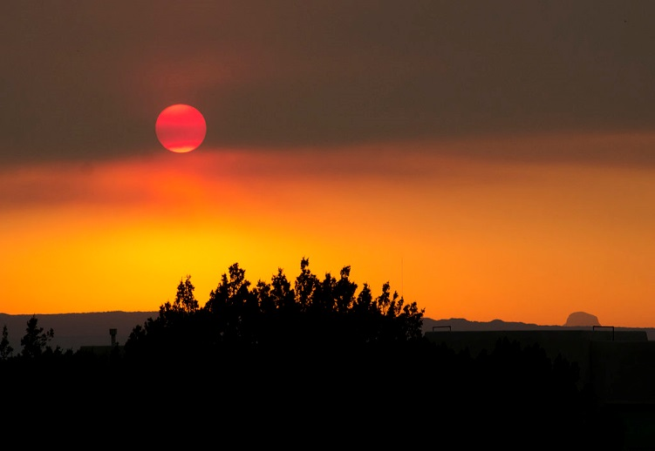
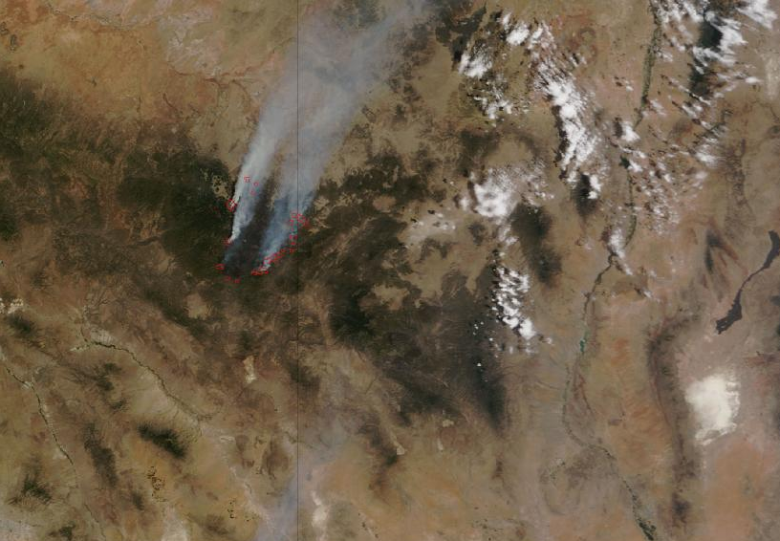
Wallow
(right) Smoke from Wallow Fire in Albuquerque, sunset, June 7, 2011
John Fowler from Placitas, NM, USA - Fire Smoke Sunset Uploaded by PDTillman
Wallow North and Horseshoe Two Fires, Arizona. NASA satellite image, midday, June 12, 2011. Vertical line is AZ-NM state line.
Arizona-New Mexico State line

Slide 29
Flint Hills
http://youshouldgohere.com/2015/04/burning-up-the-tallgrass-prairie-in-the-kansas-flint-hills/#jp-carousel-6522

Slide 30
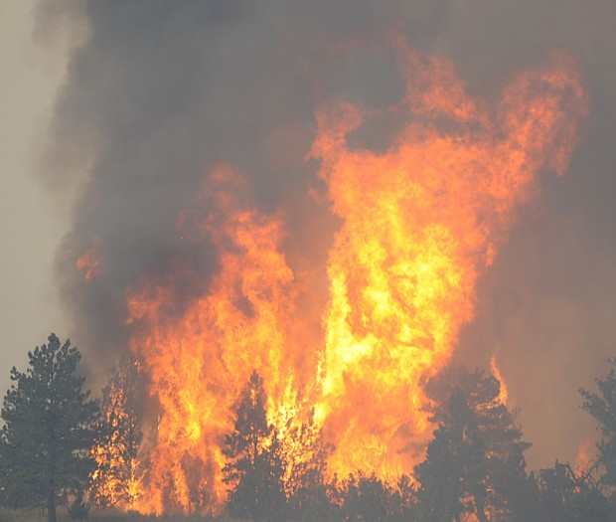
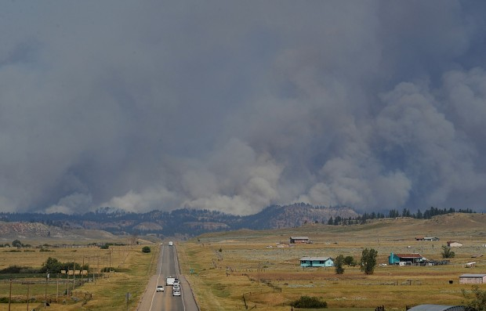
Waterhole
http://billingsgazette.com/news/state-and-regional/montana/gallery-waterhole-fire/collection_9c03278b-6666-50ab-8329-4a0846414fa7.html#8

