Slide 1
FireWork: Environment Canada’s Seasonal Air Quality Forecast System with Near-Real-Time Wildfire Emissions
Presented by: Sophie Cousineau
Authors: R. Pavlovic¹, S. Cousineau¹, P.-A. Beaulieu¹, H. Landry¹ and M.D. Moran²
¹Air Quality Modeling Applications Section, Environment Canada, Montreal, Quebec, Canada
²Air Quality Research Division, Environment Canada, Toronto, Ontario, Canada
14th Annual CMAS Conference, October 5-7, 2015,
Chapel Hill, North Carolina

Slide 2
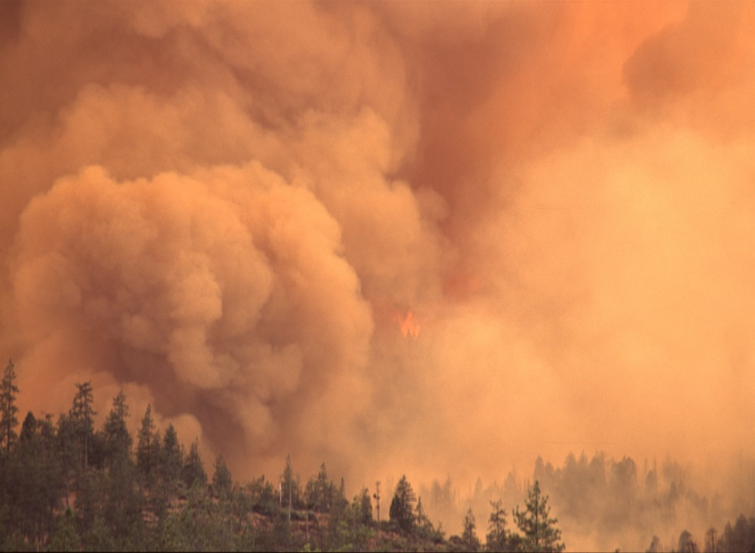
Forest Fires and Air Quality
Forest fires greatly affect air quality conditions
Emissions: primarily aerosols, VOCs, NO_{x} and CO_{x}
  Mainly affects PM
Forest fires have been identified as an important factor for summertime air quality in Canada
  The national air quality program wants to take them into account to improve forecasts
  Some AQHI program partners (provinces) have requested that the health index include the effects of wild fire smoke
"Wildfire in the Pacific Northwest (8776242994)" by Bureau of Land. Licensed under CC BY 2.0 via Wikimedia Commons - https://commons.wikimedia.org/wiki/
  ➔ FireWork is EC’s response to these requests. This model was developed in 2011 and 2012. It has been available to EC operational air quality forecasters since 2013. The model output has been available to external users since 2014.

Slide 3
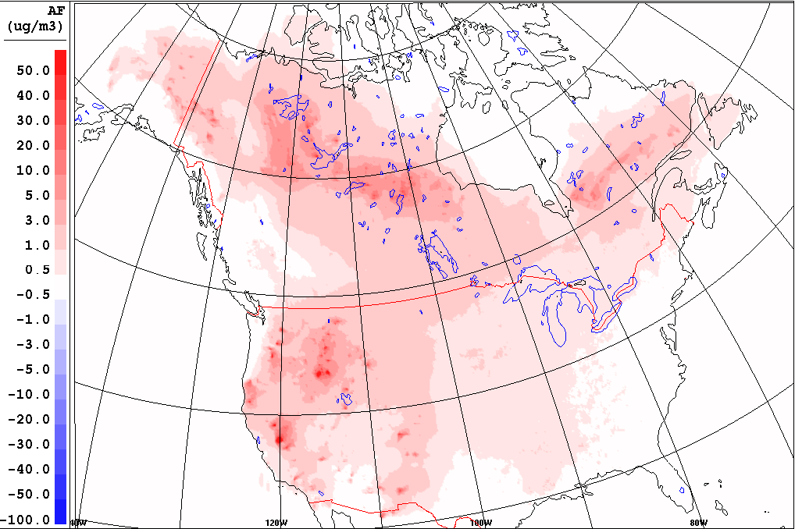
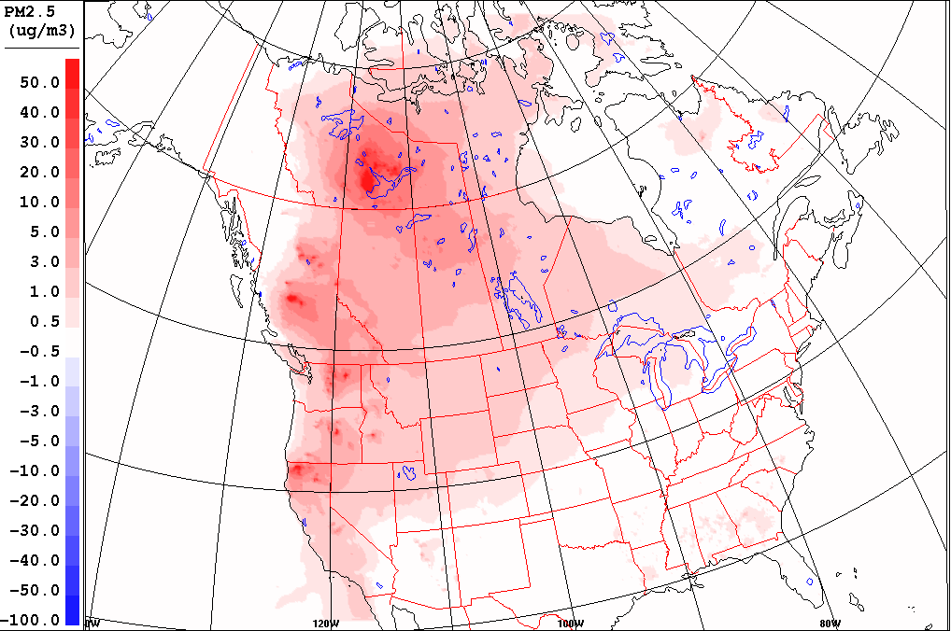
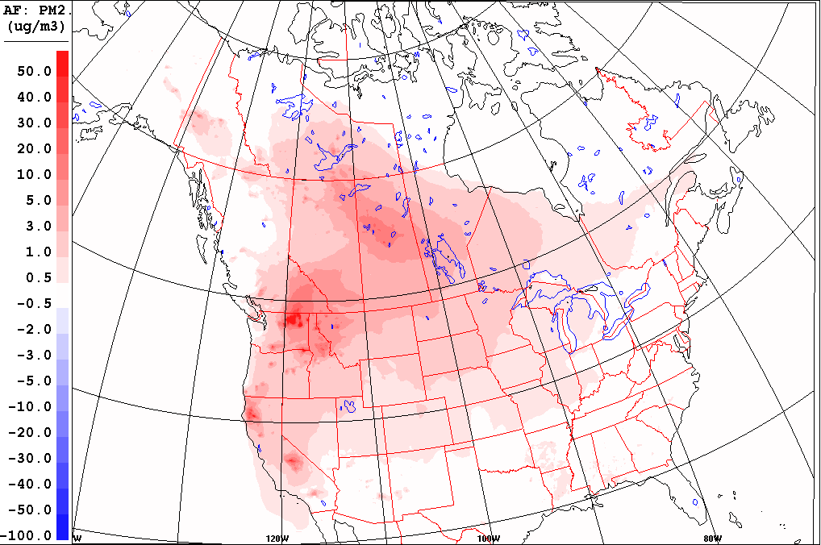
Forest Fires and Air Quality
Forecasted wildfire emissions contribution to average summertime PM_{2.5} concentrations
2013
2014
"Wildfire in the Pacific Northwest (8776242994)" by Bureau of Land. Licensed under CC BY 2.0 via Wikimedia Commons - https://commons.wikimedia.org/wiki/
2015
In Canada, the impact of wildfire smoke on air quality is very significant.
Forecasted wildfire emissions contribution to the average summertime PM_{2.5} concentrations (2013-2015) ranges from few µg/m³ to a over 30µg/m³.

Slide 4
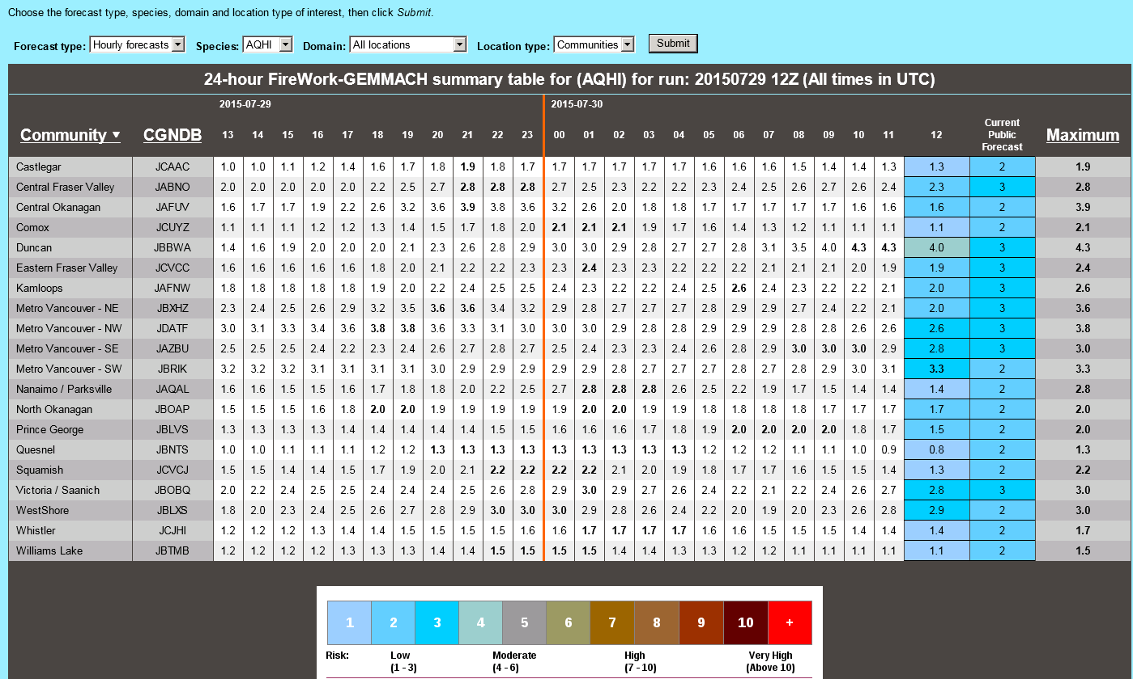
Environment Canada’s Objectives
Include near-real-time biomass burning emissions into EC’s operational air quality forecast system and provide public with improved air quality forecasts.
Since 2013, forecasts from FireWork serve as input for a FireWork version of the national Air Quality Health Index (AQHI*)
*AQHI = (10/10.4)*100*[(exp(0.000871*NO₂)-1) + (exp(0.000537*O₃)-1) + (exp(0.000487*PM_{2.5})-1)]
AQHI FireWork Forecast available via EC's Forecaster Resource Site
EC forecasters have access to AQHI values computed using wildfire emissions
Notes:
Dernière runs: été-2011-08-28 12utc et hiver-2011-03-31 12utc

Slide 5
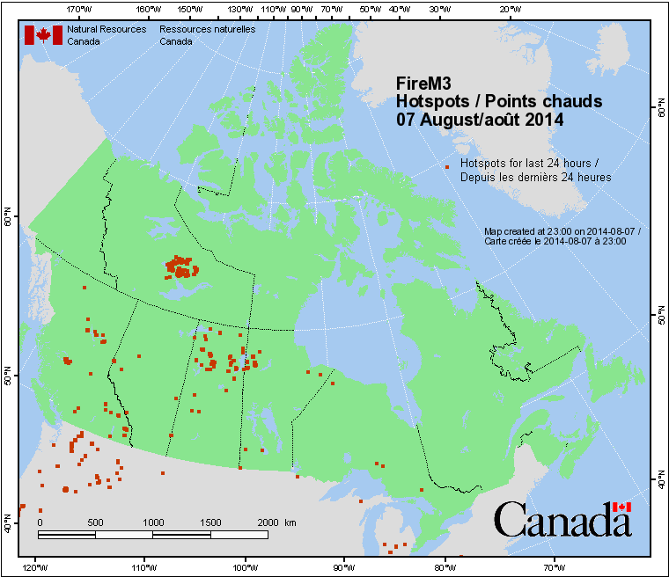
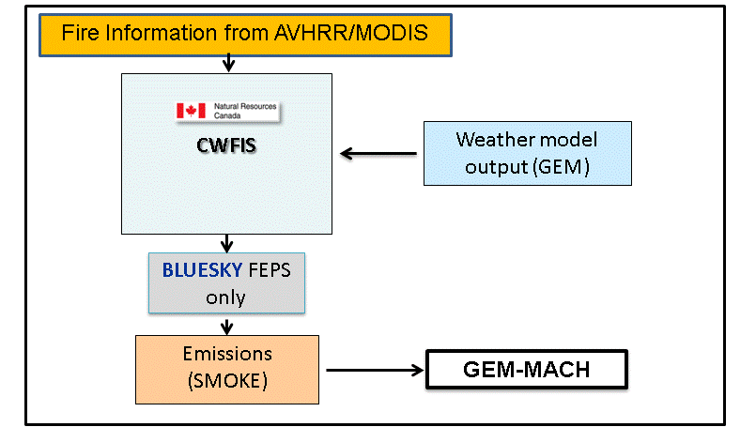
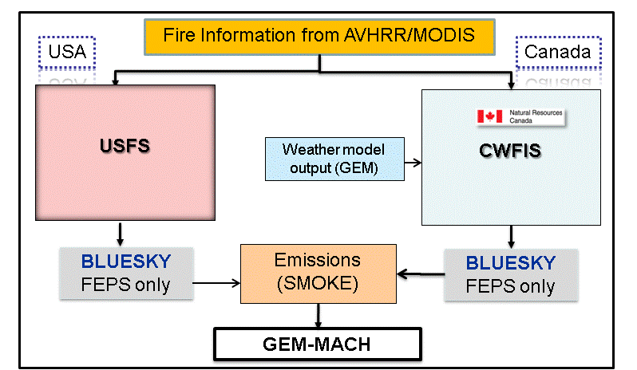
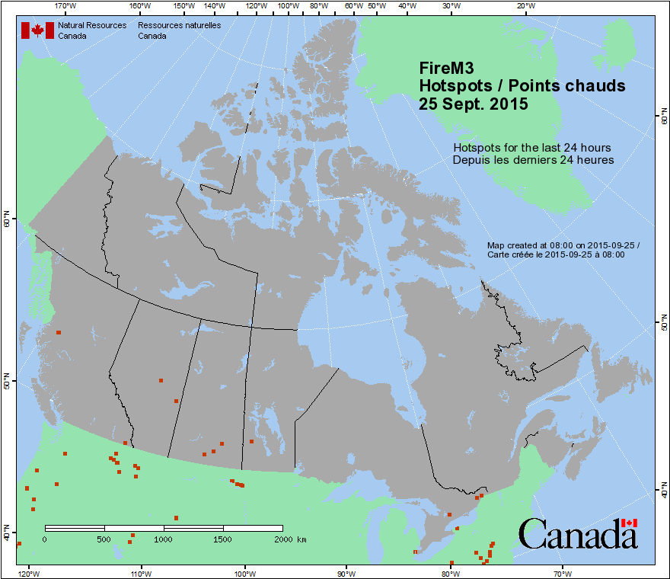

Wildfire Emissions Data
Current Approach
Planned Approach

Slide 6
Model-Ready Wildfire Emissions
Fire information for Canadian and American sources
  Hot-spot data contains the previous day’s fire locations and CWFIS estimated fuel type and consumption
Emissions processing
    BLUESKY
    - used to estimate total emissions via FEPS module. Emissions are generated as “Daily Total” per hotspot
  SMOKE
  Uses diurnal profile to convert daily total wildfire emissions into hourly values
  Converts VOC, NOx, PM into explicit model species
  Merges with other major anthropogenic point sources
  Some assumptions are applied to emitted species:
    PM_{2.5} ➔ 56% organic carbon, 34% Crustal material, 9% elemental carbon, 1% sulfates
    Organic gas ➔ 19% Ethene, 9% Propane, 6% Alkene, 1% Alkane.
Notes:
Default profiles in SMOKE used for PM2.5, provided by EPA

Slide 7
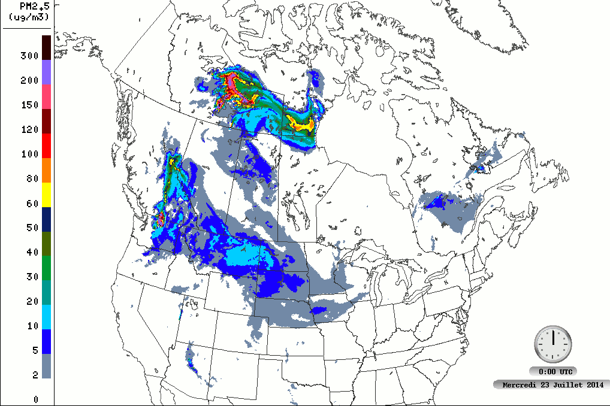
Current FireWork Modelling Strategy
FireWork has the same configuration as the operational AQ model: GEM-MACH. The only difference is the inclusion of wildfire emissions
FireWork is run twice daily
  initiated at 00 UTC and 12 UTC
FireWork products
  AQHI based on FireWork forecasts
  PM_{2.5}/PM₁₀ maps and animations based
  on the difference (FireWork – GEM-MACH)
  to isolate plumes
  Total column PM_{2.5}/PM₁₀ concentrations
  Other specialized product available upon request
FireWork forecast for the 2014-07-23 00UTC run

Slide 8
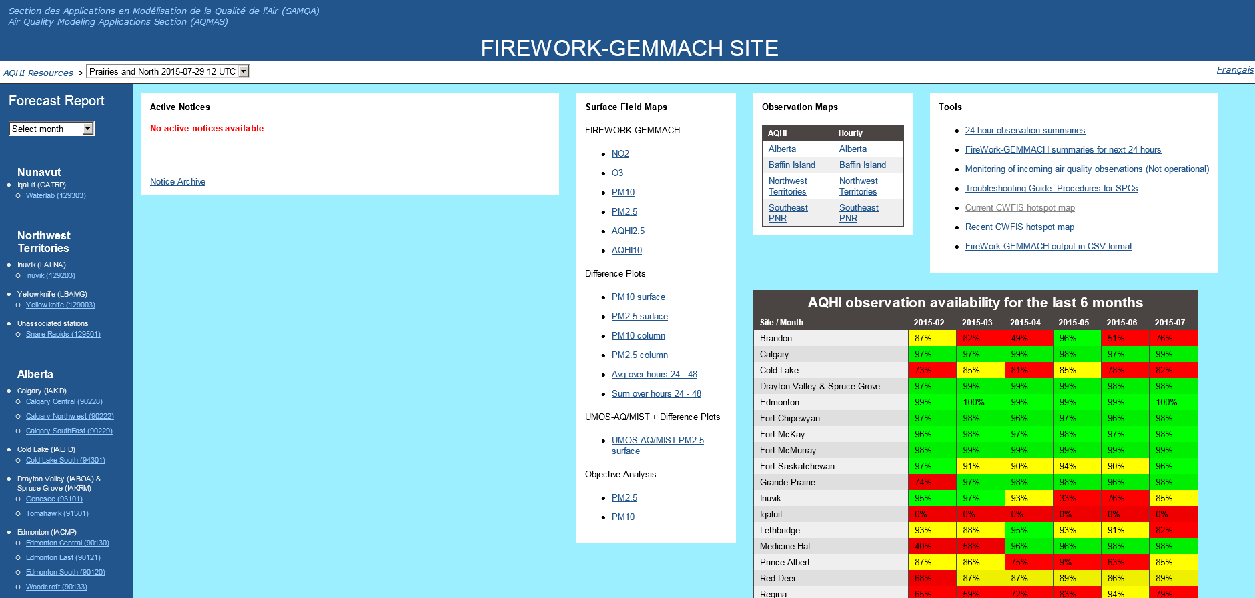
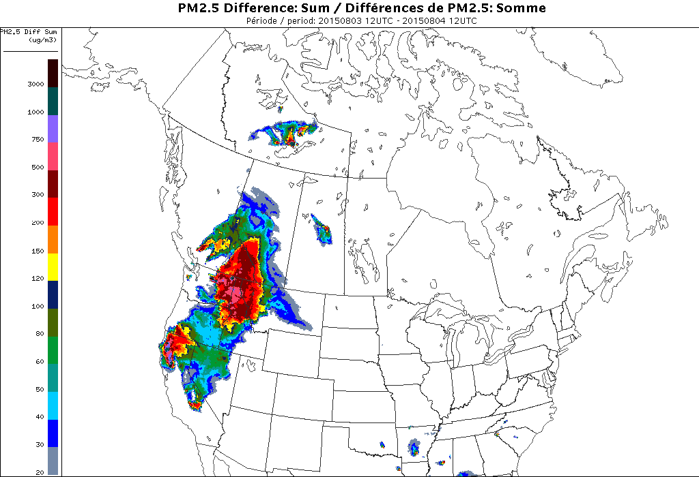
Products: FireWork Forecaster Resources Site
EC internal site

Slide 9
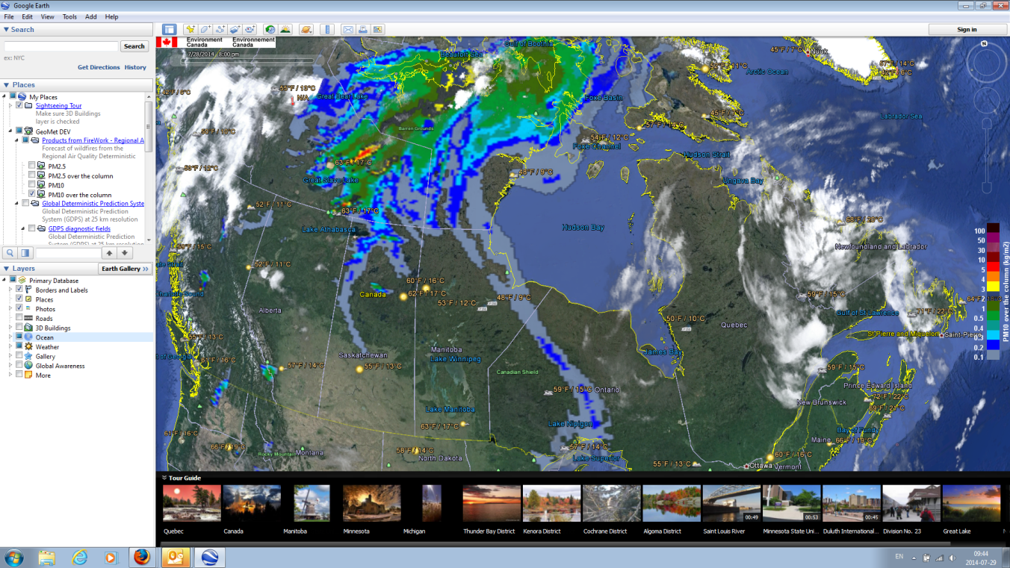
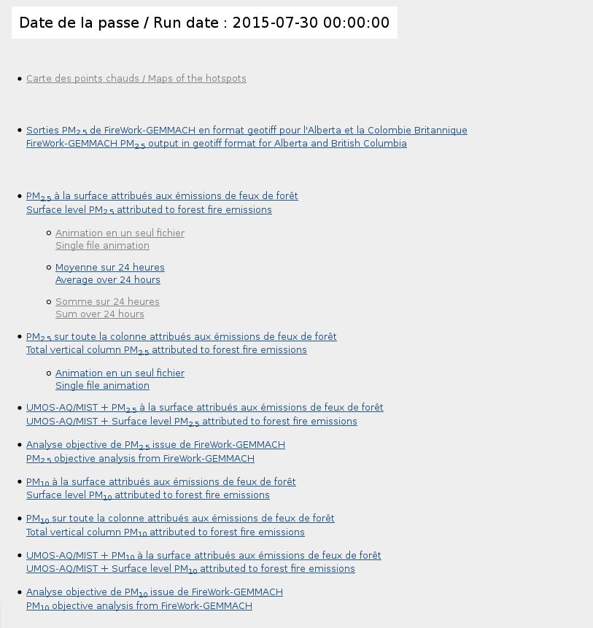
FireWork forecasts available as WMS/KML layers
  AQHI FireWork external web page: http://collaboration.cmc.ec.gc.ca/cmc/air/FireWork-GEMMACH

Slide 10
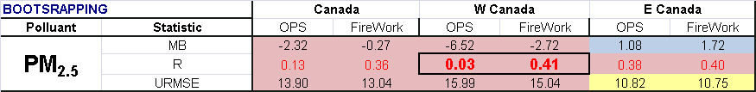
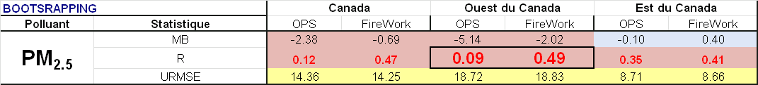

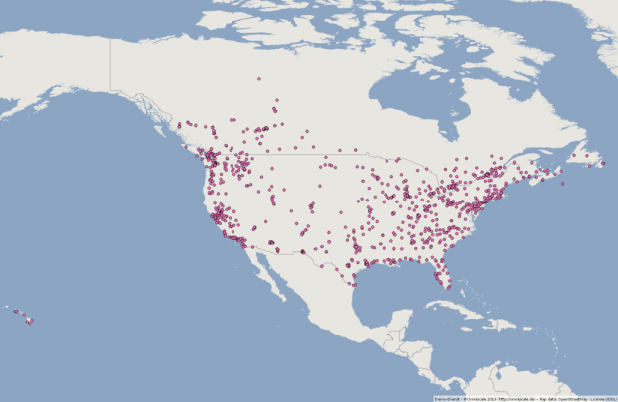

Objective Scores
2014 : June 10th – September 17th
2015 : June 2nd – September 2nd
Available PM_{2.5} monitoring stations across Canada and U.S. used for model performance evaluation

Slide 11
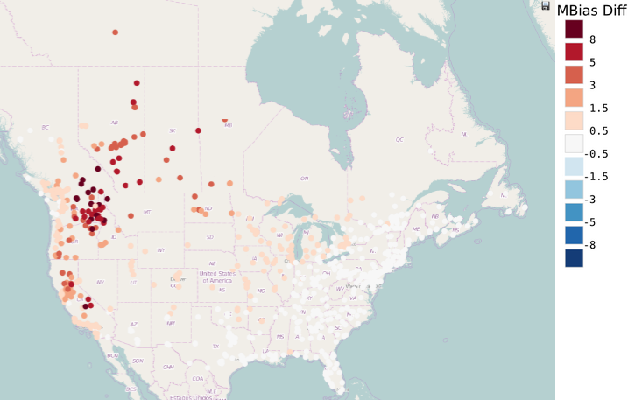
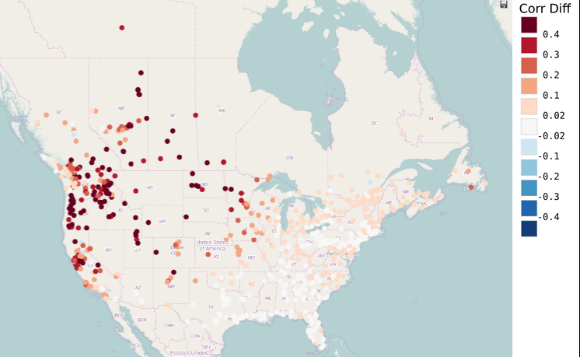
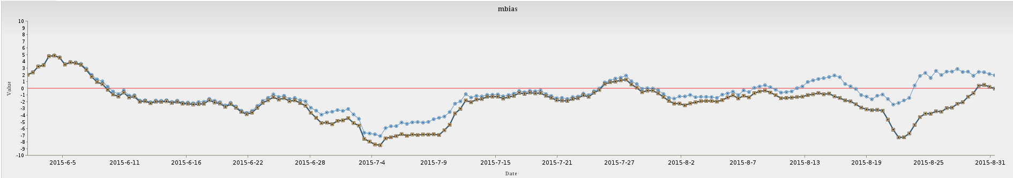
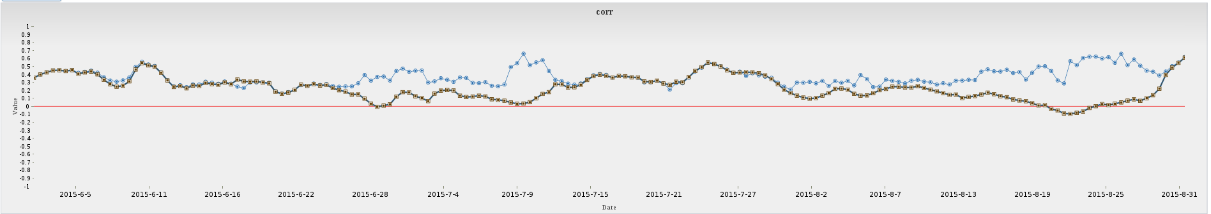
Difference: FireWork - GEM-MACH
2015 (June 2nd – Sept 1st) Statistics
MEAN BIAS
Forecasted wildfire emissions contribution to average summertime PM_{2.5} concentrations
2015
CORRELATION
MB and R Statistics over FireWork domain
MEAN BIAS
GM-OPS
FireWork
CORRELATION
PM_{2.5} correlation coefficient significantly improved with FireWork

Slide 12
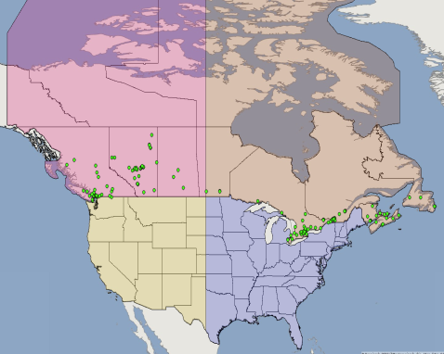
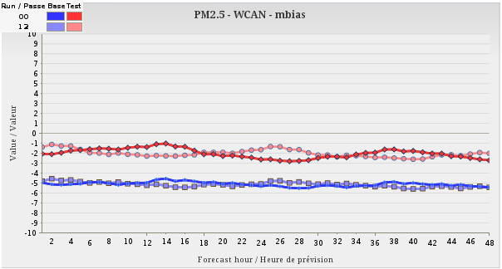
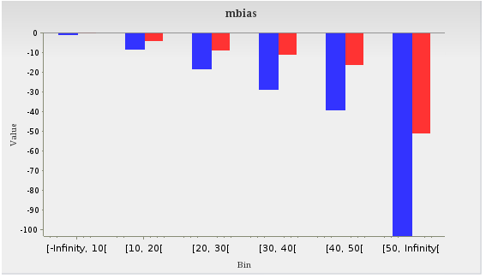
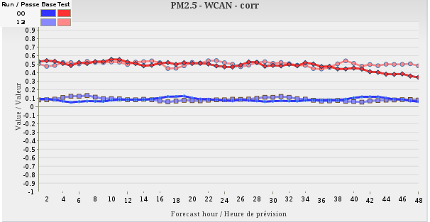
PM_{2.5} Hourly Statistics - Western Canada
2015 (June 2nd – Sept 1st) Statistics
WCAN
ECAN
WUSA
EUSA
GM-OPS
FireWork
MEAN BIAS
PM_{2.5} MB per observed bin
Improved forecast with FireWork, despite some under-estimations
CORRELATION

Slide 13
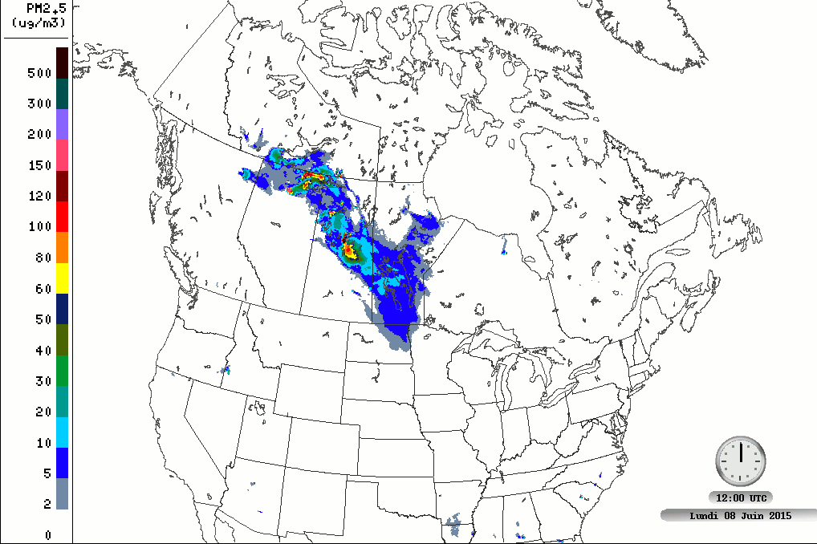
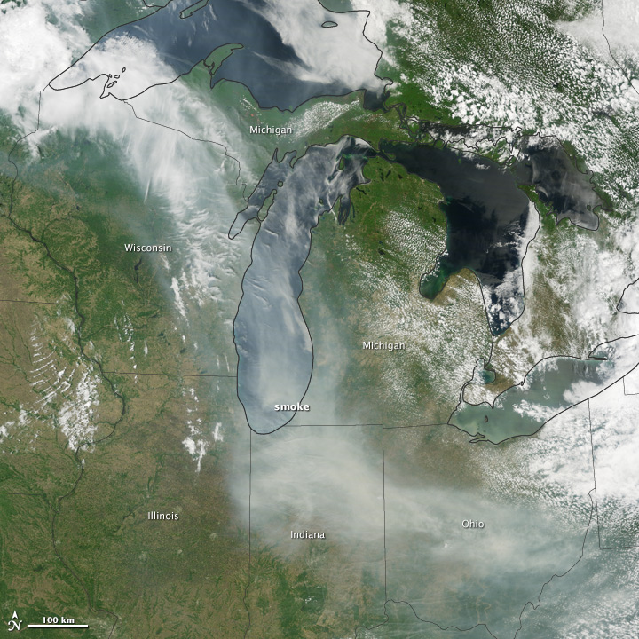
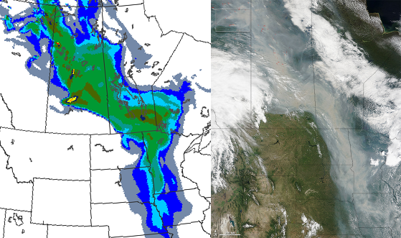
2015 Wildfire Season - June
Forecasted (2015-06-08 12utc run) wildfire emissions contribution to total surface PM_{2.5} concentrations
June 9, 2015
On June 8-10 dense smoke was advected down to the NE USA, reaching Washington DC. FireWork forecasted the region affected by smoke 48h in advance.
Source: NASA Earth Observatory
http://earthobservatory.nasa.gov
On June 29th, a dense "smoke river" from NW Canada to mid-USA was observed. FireWork performed well in forecasting the affected regions.
Total column PM_{2.5} concentration forecasted by FireWork (2015-06-28 00UTC run), valid at June 29th 12UTC.
June 29, 2015
Source: NASA Earth Observatory
http://earthobservatory.nasa.gov

Slide 14
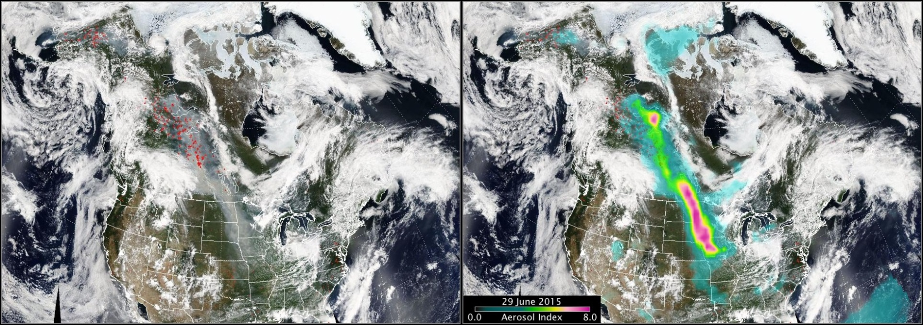
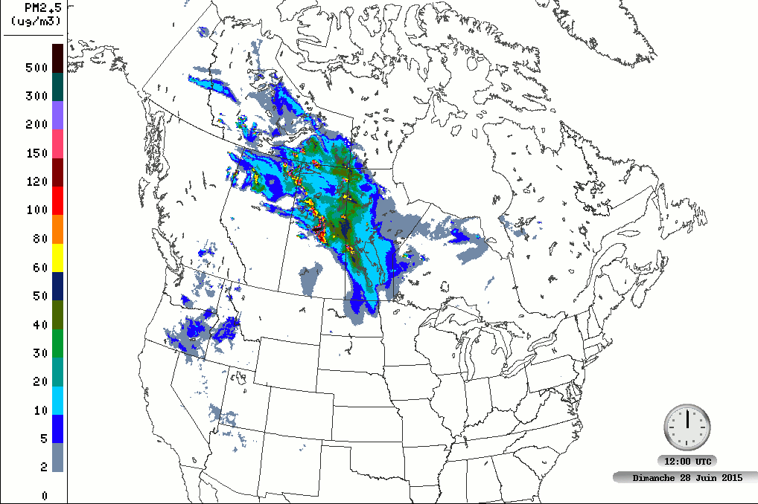
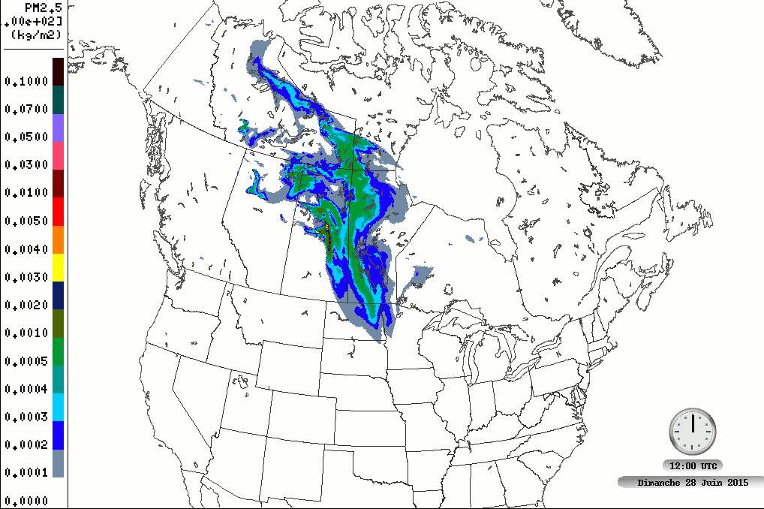
2015 Wildfire Season - June
Source: NASA-OMPS
http://ozoneaq.gsfc.nasa.gov/omps/blog/2015/06/smoke-northern-canada-southeastern-us
Forecasted (2015-06-28 12utc run) wildfire emissions contribution to total surface PM_{2.5} concentrations
Forecasted (2015-06-28 12utc run) wildfire emissions contribution to total column PM_{2.5} concentrations

Slide 15
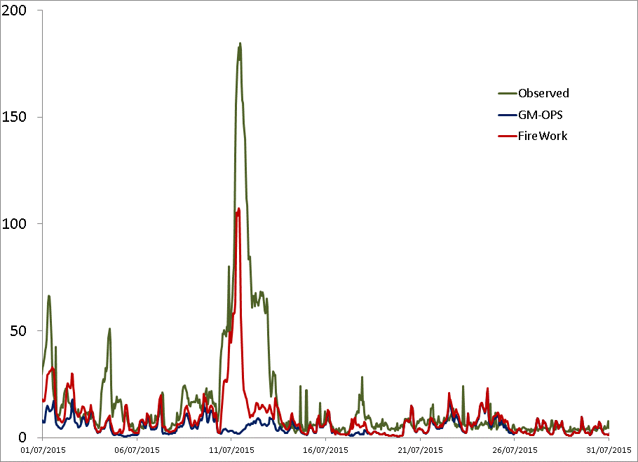
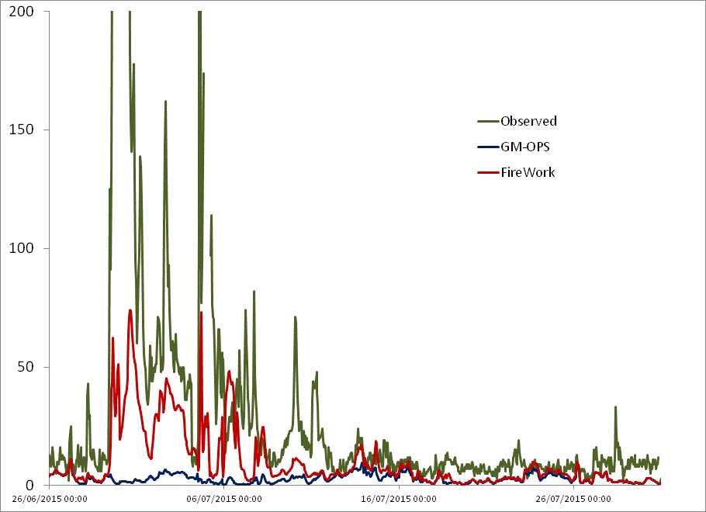
2015 Wildfire Season - July
EDMONTON
SASKATOON
FireWork was rather good in forecasting the period affected by pollution from forest fires. Before July 20th 2015, the impact was underestimated due to the extreme number of forest fires in Canada. The system was unable to handle all fires under operational time constraints, so many sources were rejected. It was fixed on July 20th and now the system can handle up to 28,000 hotspots.

Slide 16
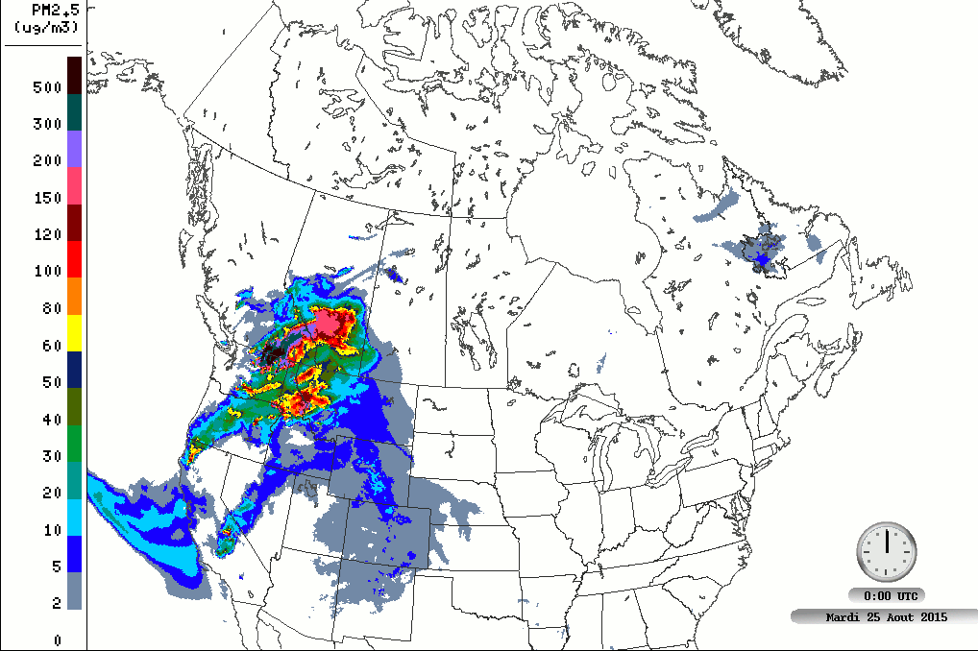
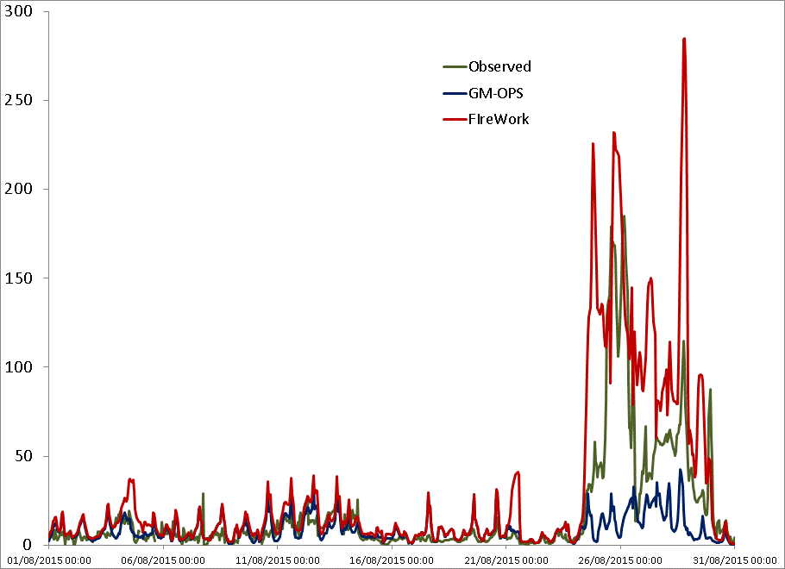
2015 Wildfire Season - August
Forecasted (2015-08-25 00utc run) wildfire emissions contribution to total surface PM_{2.5} concentrations
Wildfires in NW USA and BC greatly affected air quality in the Canadian prairies. A few days later, smoke was observed even in the central and eastern parts of Canada.
CALGARY

Slide 17
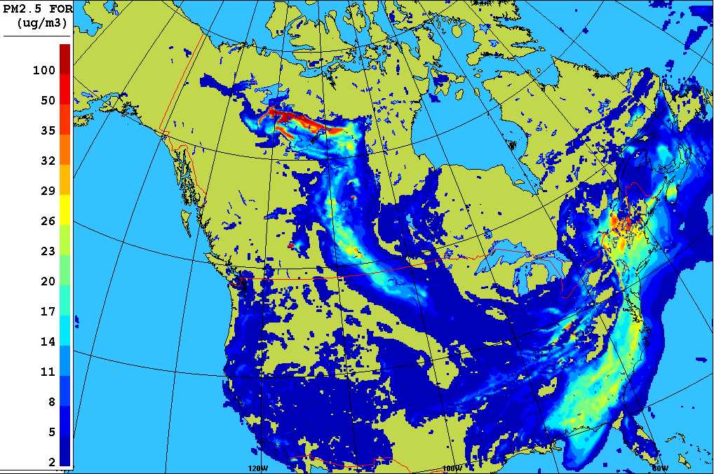
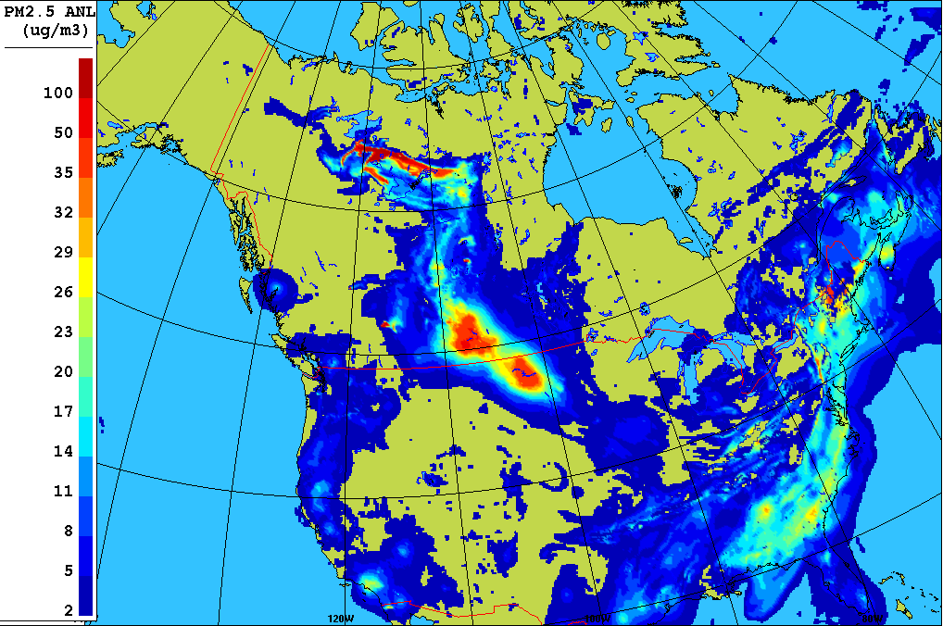
FireWork Objective Analysis
FireWork Objective analysis represents the forecasted FireWork fields corrected using surface observations. As wildfire pollution is advected thousands of kilometers away from sources , this product is very useful in adjusting FireWork forecasts. Early analysis is available with only an hour delay. This product is available to EC forecasters and external users.
Example for 2014-07-09 00utc
FORECAST
OBJECTIVE ANALYSIS
Early analysis: Late analysis: available after 65 minutes available after 125 minutes

Slide 18
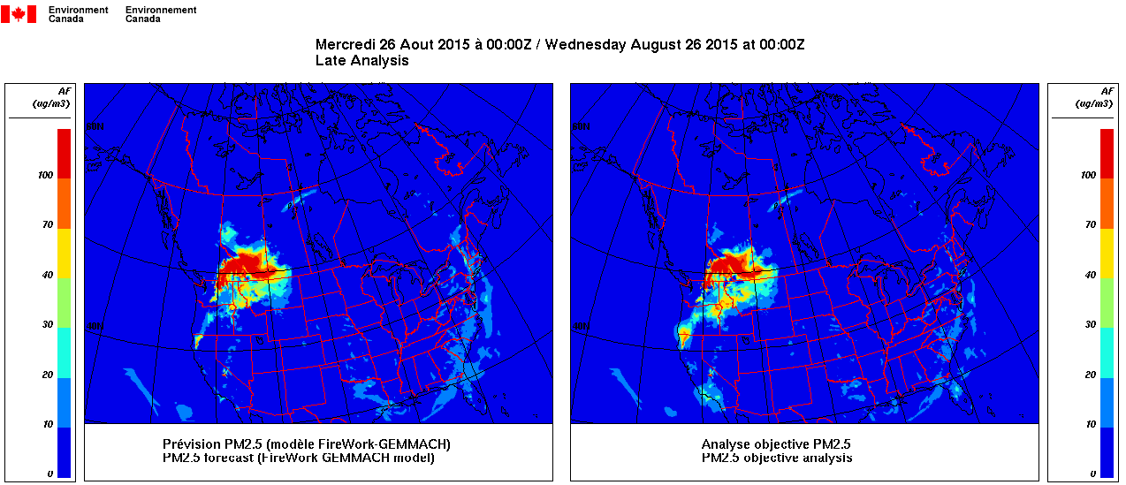
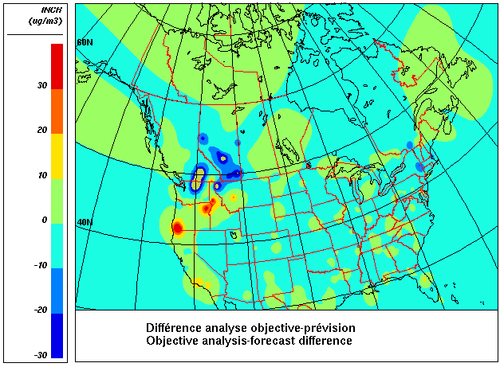
FireWork Objective Analysis
In some cases, regions affected by wildfire pollution are well forecasted, but concentrations are not. The FireWork objective analysis can be very useful in visualising the regions with under/over forecasts.
Example illustrating the Calgary over-forecast in August

Slide 19
Conclusions
Since 2013, Environment Canada has provided operational forecasters with air quality forecasts that take wildfire emissions into account. These forecasts have also been available to external users since 2014.
FireWork is primarily designed to support meteorologists in issuing AQ forecast and advisories
Based on few years experience :
    FireWork significantly improves PM_{2.5} forecasts
    FireWork is capable of forecasting long range pollution transport from wildfires
    Recently added products (like Objective Analysis, AQHI tables, etc) significantly help AQ forecasters in adjusting AQ forecasts and issuing related AQ warnings

Slide 20
Future Work
In 2016, the FireWork suite will start earlier - in April
Forecasts will be available to the public
Model improvements:
  FireWork will be updated to a new, improved model version for both meteorology and chemistry
  New improved plume-rise algorithm, etc.
Emissions:
  U.S. emissions
  PM, VOCs, NOx estimates will be revised, etc.

Slide 21
Acknowledgements
  Natural Resources Canada (NRCan)
    Canadian Forest Service: Kerry Anderson, Peter Englefield
    Canada Centre for Remote Sensing: Robert Landry
BC Ministry of Environment
US Forest Service
Sonoma Technology Inc.
Environment Canada
  Meteorological Service of Canada
  GEM-MACH development team
  EC Regional Offices
Parks Canada
BlueSky Canada

Slide 22
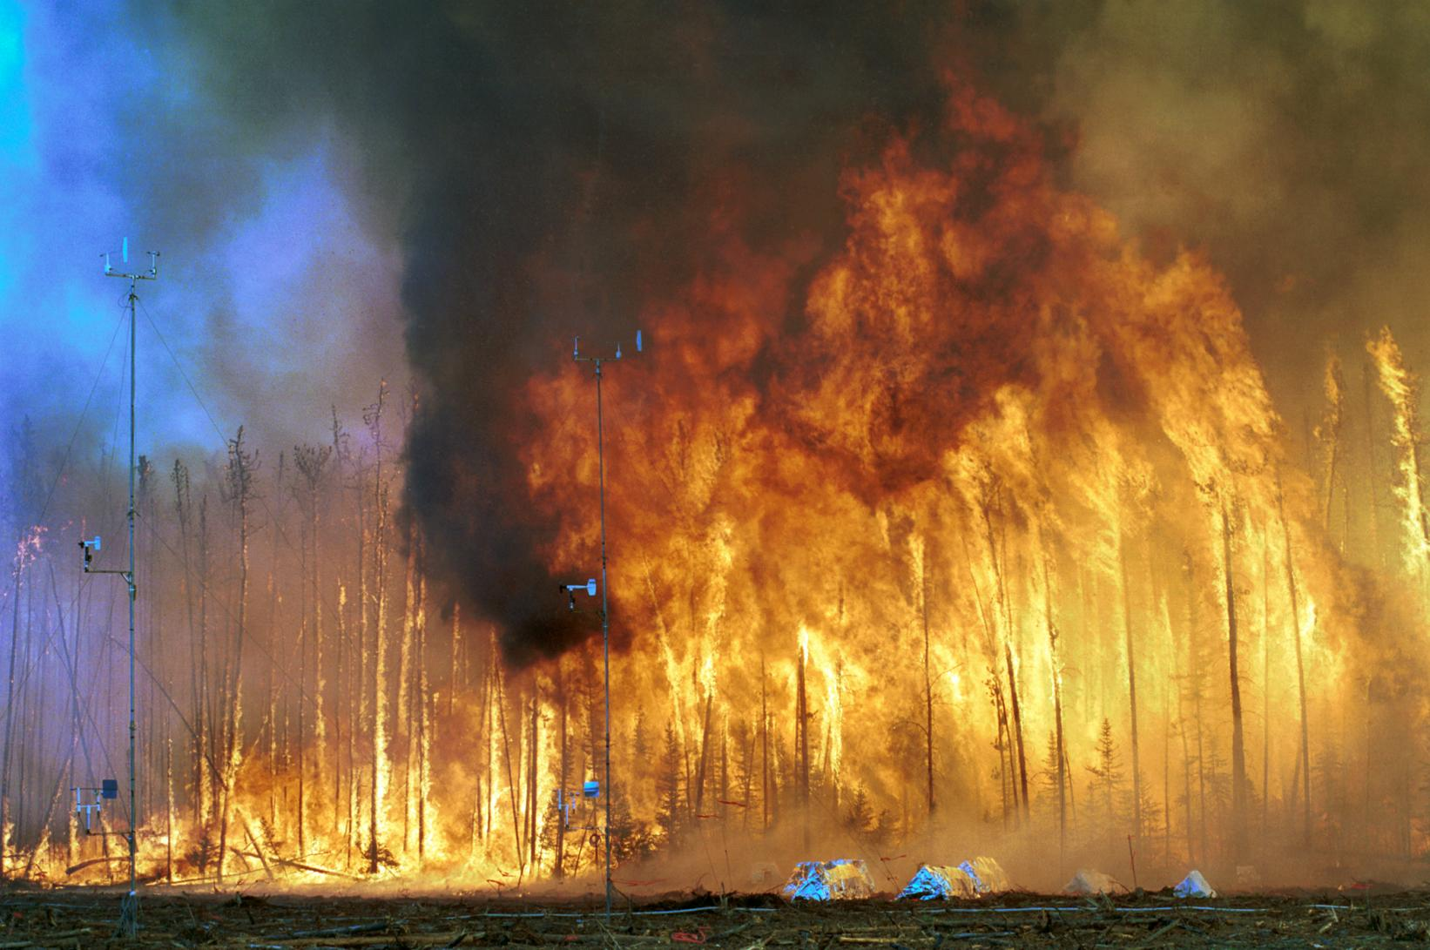
Questions:
Radenko Pavlovic ( Radenko.Pavlovic@ec.gc.ca) or Sophie Cousineau (sophie.cousineau@ec.gc.ca )
THANK YOU
"Northwest Crown Fire Experiment" by (Photograph used by permission of the USDA Forest Service.) - Bunk S: World on Fire. PLoS Biol 2/2/2004: e54. doi:10.1371/journal.pbio.0020054.g001. Licensed under CC BY 2.5 via Wikimedia Commons - https://commons.wikimedia.org/wiki/File:Northwest_Crown_Fire_Experiment.png#/media/File:Northwest_Crown_Fire_Experiment.png

