Slide 1
Megafires and Smoke Exposure Under Future Climate Scenarios in the Contiguous United States
Kenneth Craig¹, Sean Raffuse², Sim Larkin², ShihMing Huang¹, and Stacy Drury¹
¹Sonoma Technology, Inc., Petaluma, CA
²UC Davis, Davis, CA
³USDA Forest Service, Seattle, WA
14th Annual CMAS Conference
Chapel Hill, NC
October 5, 2015
STI-6361

Slide 2
Motivation
Issue: Observed increases in very large wildfires ("megafires") have heightened concerns about widespread air quality impacts
Question: Where will air quality impacts be most severe?
Relevance: Knowledge of areas of maximum impact could help prioritize long-term management actions to mitigate megafire risk (secondary to mitigating risks to life and property)

Slide 3
Approach
Literature survey of expected future occurrence of very large fires (VLFs; >~12,000 acres).
Trajectory-based analysis of population-weighted smoke impact potential from VLFs.
Ensemble dispersion modeling of specific VLF locations identified in the other analyses.

Slide 4
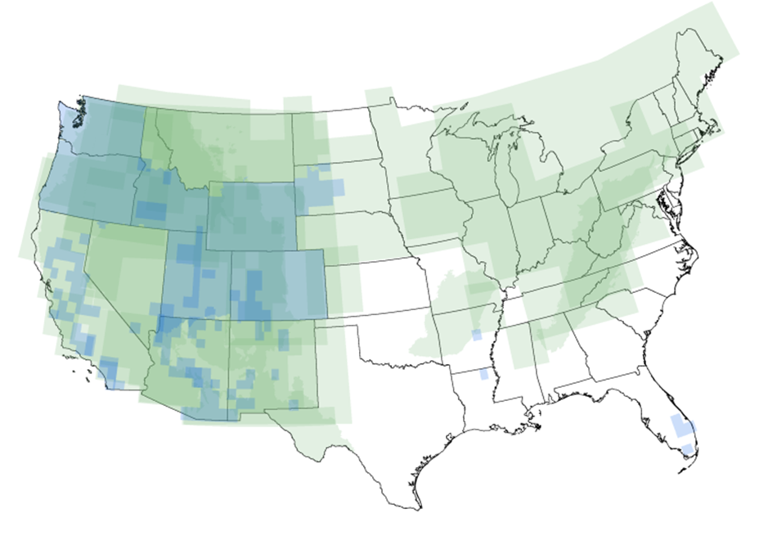
Literature Survey
Identified where VLFs are likely to occur through 2100.
Focused on literature that provided forecasts of long-term fire potential and explicit spatial information on future VLF occurrence.

Slide 5
Transport Analysis Approach
Given a megafire at a specific location, what is the probable relative population impact, based on
  Climate and transport patterns
  Population density or regulated airsheds (nonattainment, Class I) within the transport area
  Smoke emission rates
For each location, calculate a smoke impact potential score
Smoke impact potential can be multiplied by megafire occurrence probability to produce a metric of risk

Slide 6
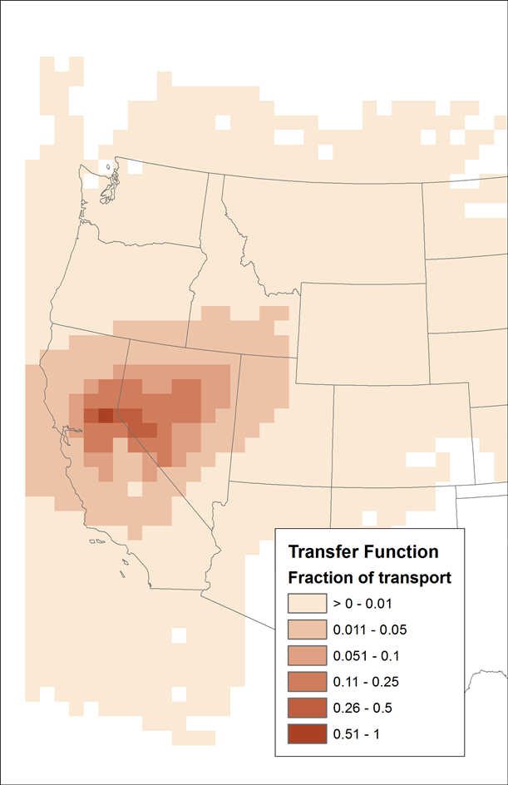
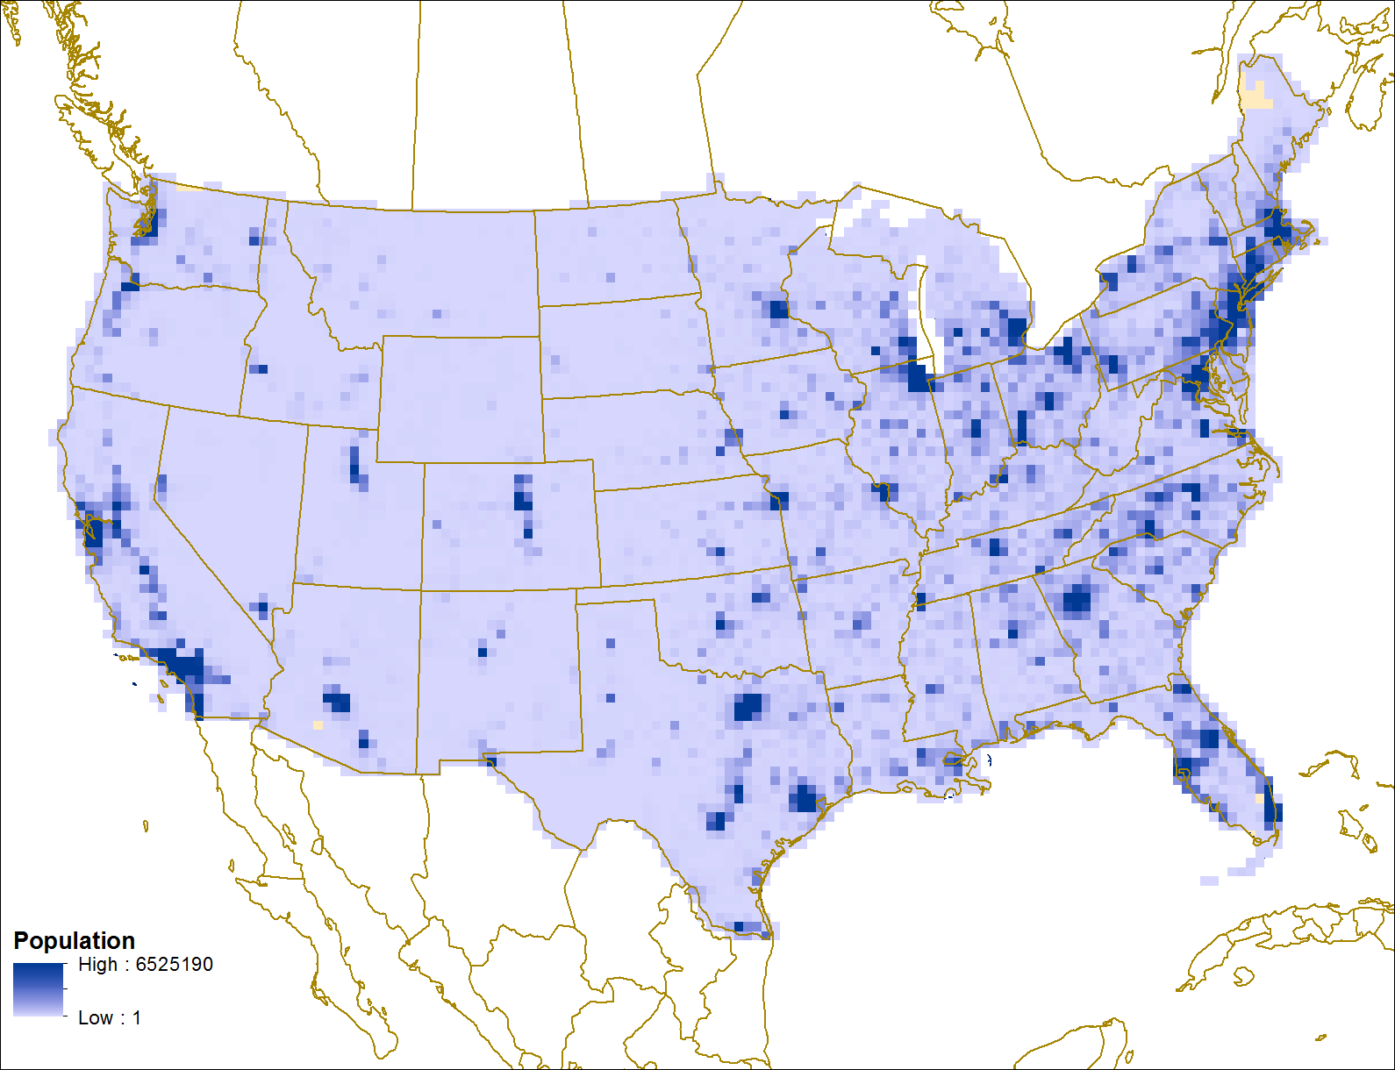
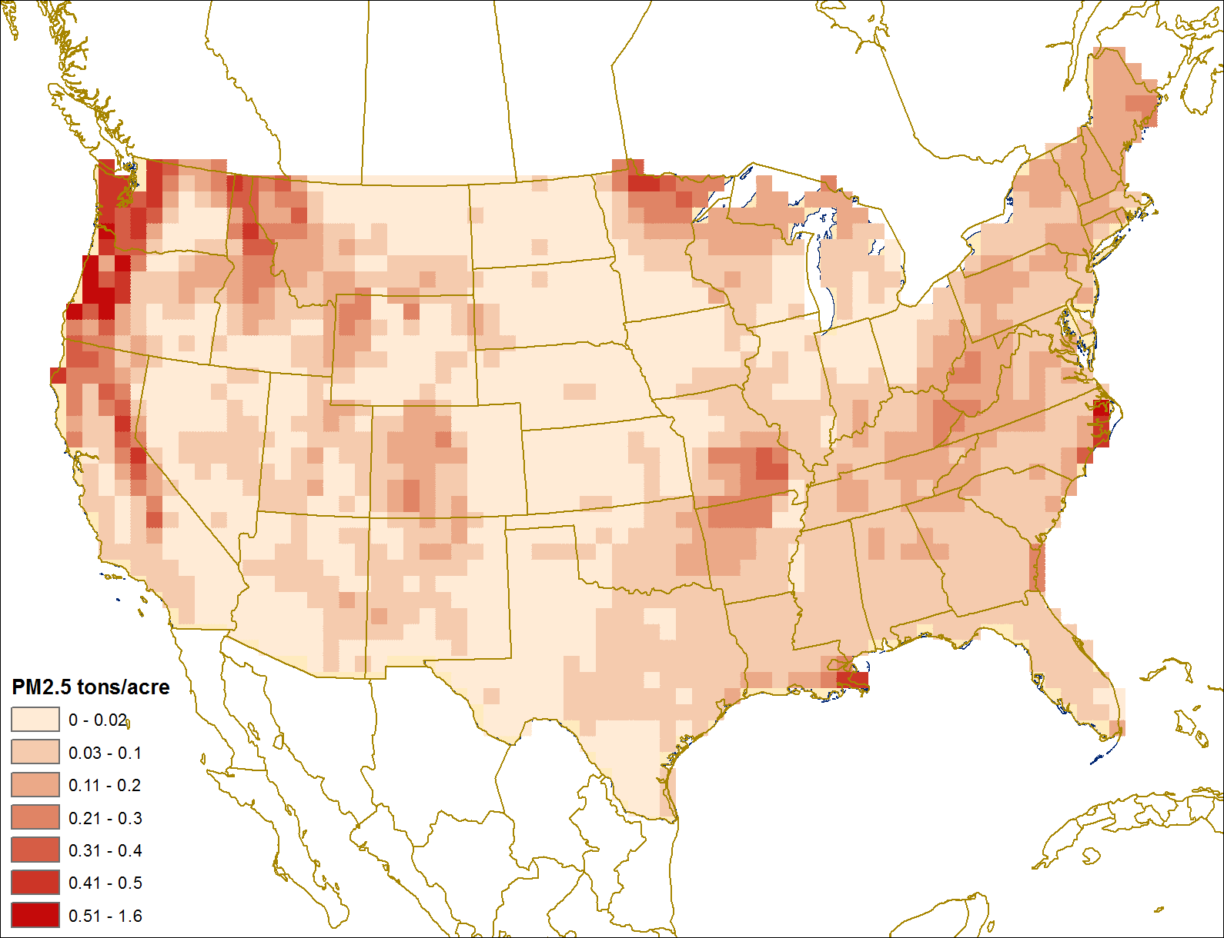
Smoke Impact Potential
Σ
Transport * Population
(across the full grid)
Emissions Rate
(at ij)
Smoke_
Impact_
Potential_{ij}
*
*

Slide 7
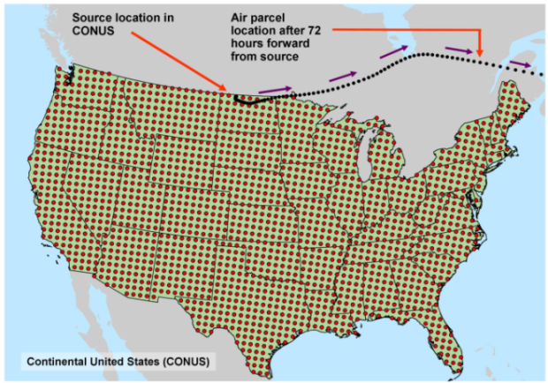
Transport Potential
For each 64-km² grid cell, modeled ~200,000 HYSPLIT trajectories
  5-day forward trajectories
  500, 1000, and 1500 m AGL starting height
  Four daily start times from 1979 to 2009
  NARR meteorological reanalysis
Counts of hourly trajectory points in each grid cell were summed and normalized
Result is a metric of frequency of transport from the origin cell
Example of transport potential for a Northern California grid cell

Slide 8
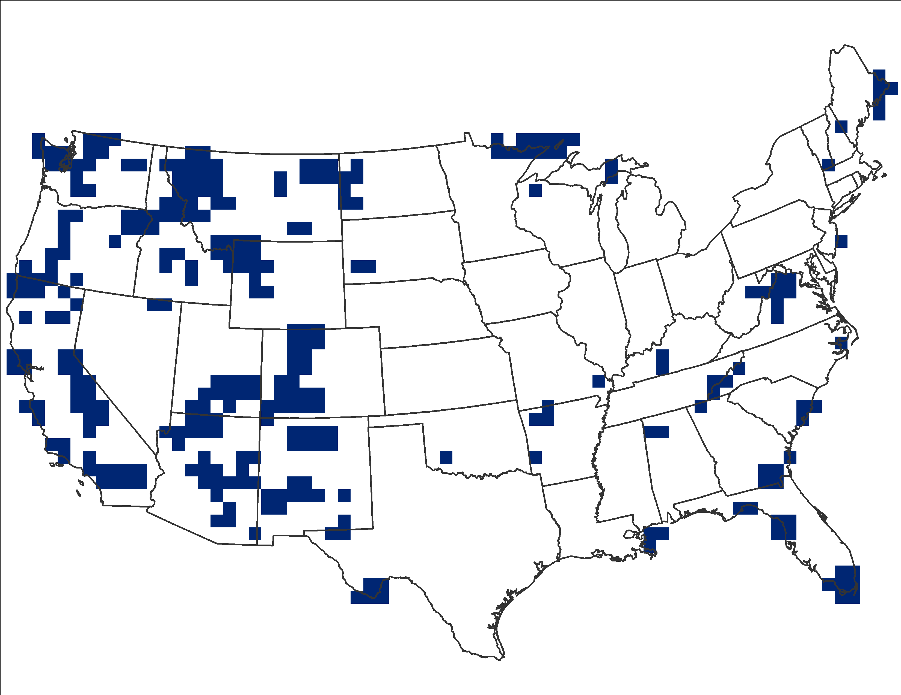
Population or Protected Airsheds
Population per grid cell developed from the
2010 U.S. Census at zip code level
Class I areas, ozone, and PM_{2.5} nonattainment from NPS and EPA shapefiles
Per Cell Population
Class I Area Mask

Slide 9
Smoke Emission Rates
FCCS-LANDFIRE fuels (1 km)
Consume4 consumption and PM_{2.5} emissions
Dry fuel conditions
Averaged across each grid cell

Slide 10
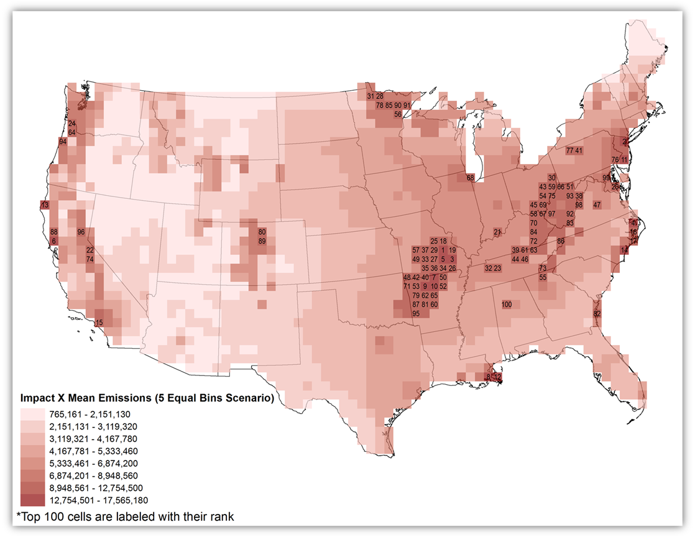
Smoke Impact Potential
(for Population)

Slide 11
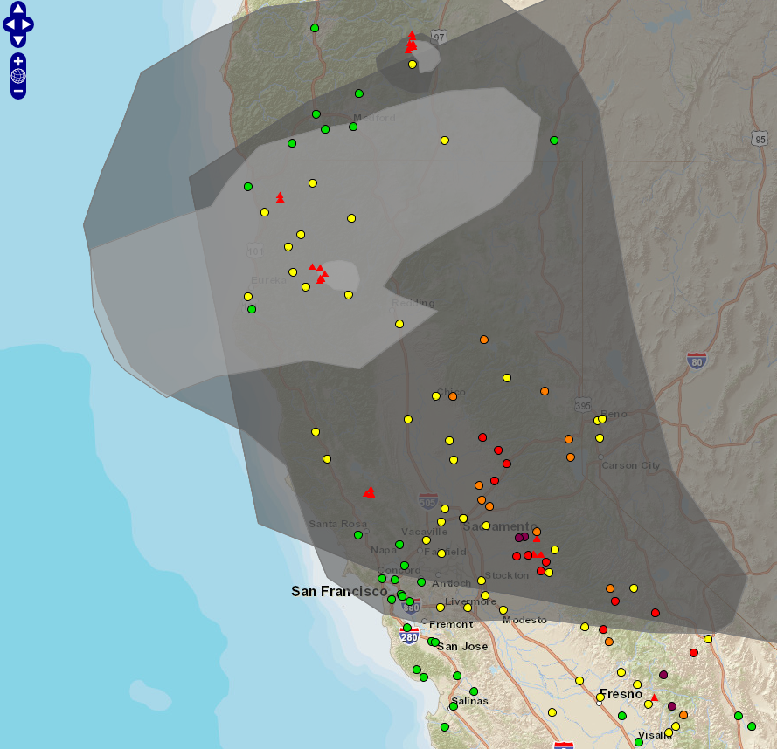
Recent Fire Activity in California
Valley Fire (Lake County)
76,000 acres consumed
  10,000 acres within first 5 hours
  25,000 acres within first 9 hours
AQI, HMS smoke plumes, and
MODIS fire detects from
AirNow-Tech on 9/13/2015.

Slide 12
Dispersion Modeling
Case Studies

Slide 13
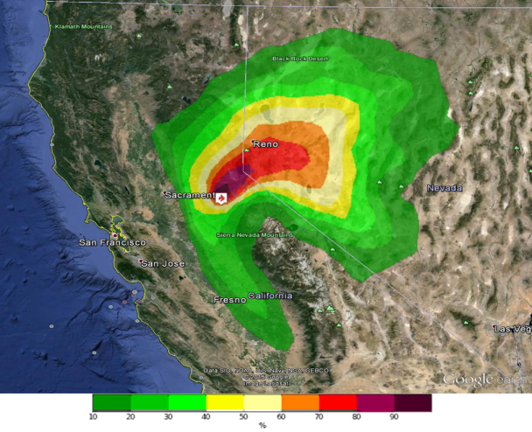
Ensemble Dispersion Modeling
Ensemble BlueSky-HYSPLIT dispersion modeling to corroborate transport-based analysis
Full particle mode simulations
1979 to 2009 NARR meteorology for month of likely VLF occurrence
  Up to 920 model runs per case
0.2 degree x 0.2 degree receptor grid
Statistics include
  Average PM_{2.5} impact
  Maximum PM_{2.5} impact
  Probability of impact (shown)
Probability of >1 µg/m³ PM_{2.5} impact

Slide 14
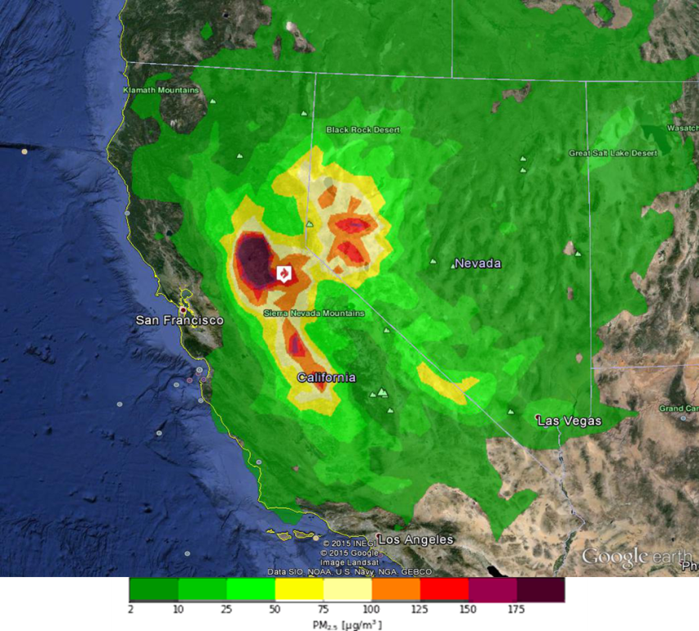

Ensemble Dispersion Modeling
Case Study 1: Northern Sierra (July)
Maximum PM_{2.5} impact (µg/m³)
Probability of >1 µg/m³ PM_{2.5} impact
Amador County, CA, 4,500 feet elevation
Jeffrey pine, ponderosa pine, Douglas-fir, black oak forest

Slide 15
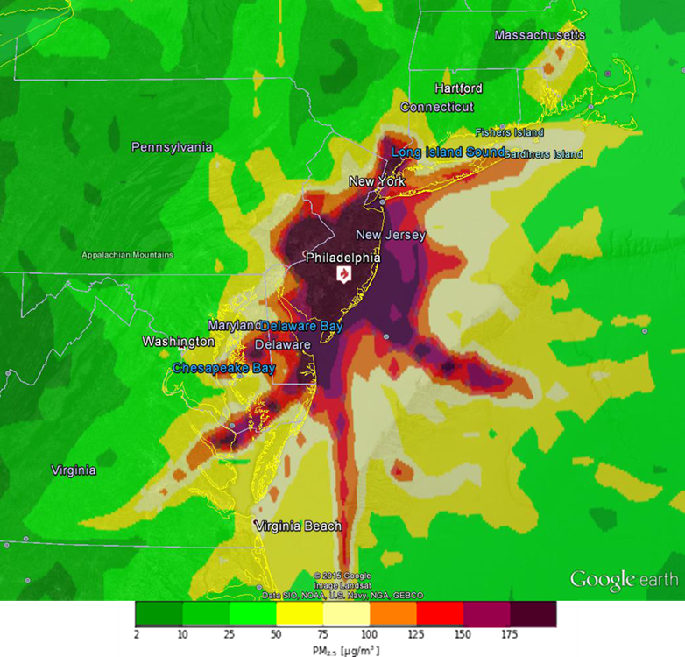
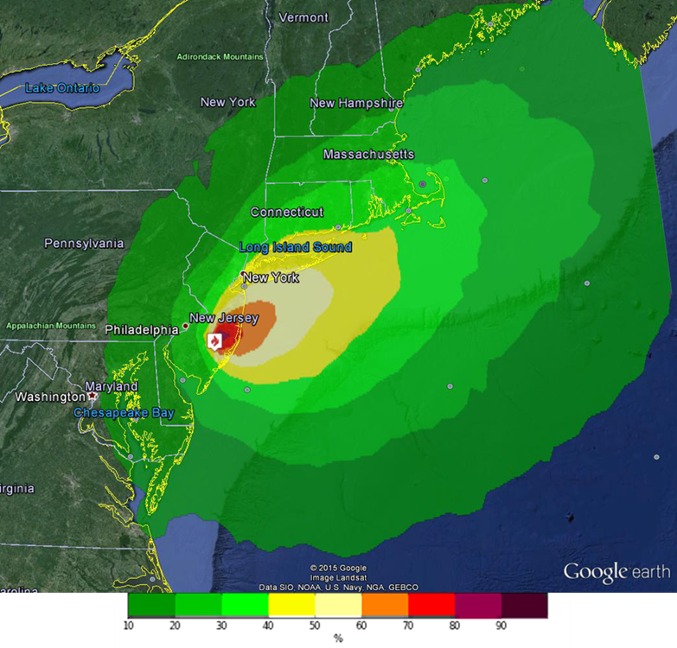
Ensemble Dispersion Modeling
Case Study 2: New Jersey Pine Barrens (July)
Maximum PM_{2.5} impact (µg/m³)
Probability of >1 µg/m³ PM_{2.5} impact
Burlington County, New Jersey
FCCS Fuels: pitch pine, scrub oak forest

Slide 16
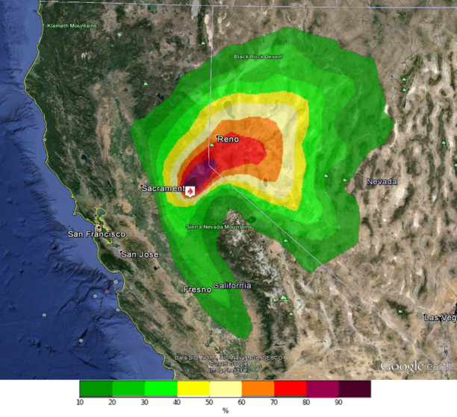


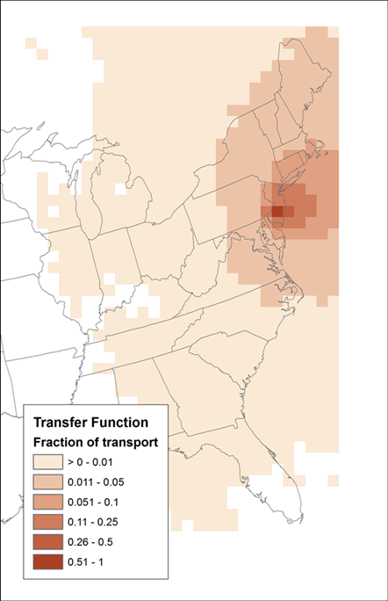
Ensemble Dispersion Modeling
California
New Jersey

Slide 17
Conclusions
Potential for megafire smoke impacts is governed by
  Likelihood of megafire occurrence
  Transport patterns
  Population and/or sensitive areas
  Smoke emission rates
Simple HYSPLIT trajectory approach is corroborated by more detailed dispersion modeling
Smoke impact potential analysis is relative and semi-quantitative
Identified high-risk areas
  The Sierra Nevada (and California generally)
  Northern Minnesota
  Northern Utah
  The Ozarks
  The Cascades

Slide 18


Thank you!
This work was funded as part of JFSP project #11-1-7-4.

Slide 19

Contact
sonomatech.com
Kenneth Craig
Manager, Atmospheric Modeling Group
kcraig@sonomatech.com
707.665.9900
sonomatech.com @sonoma_tech

Slide 20
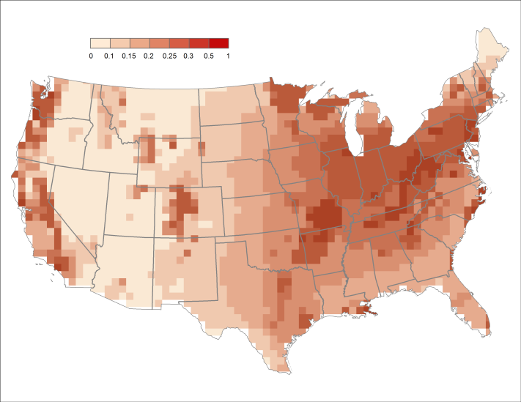
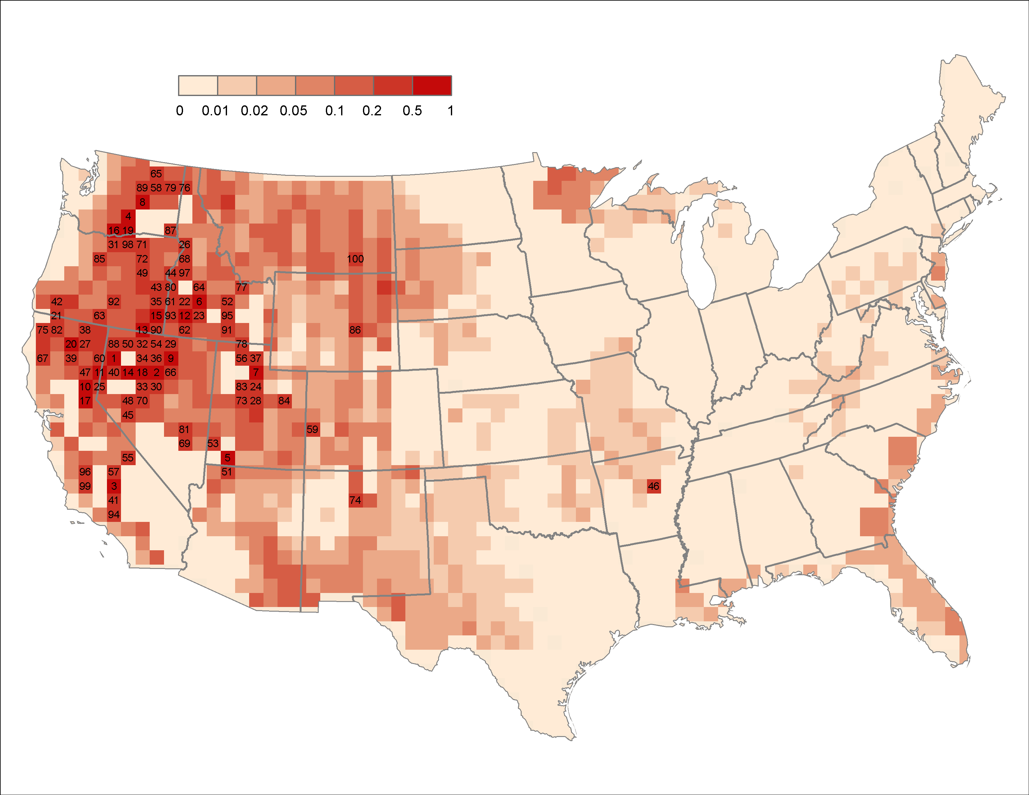
Fire Occurrence
Smoke Impact Potential
* = Risk
Smoke Impact Potential
2050 Megafire Probability
By population
Provided by Renaud Barbero, University of Idaho

Slide 21
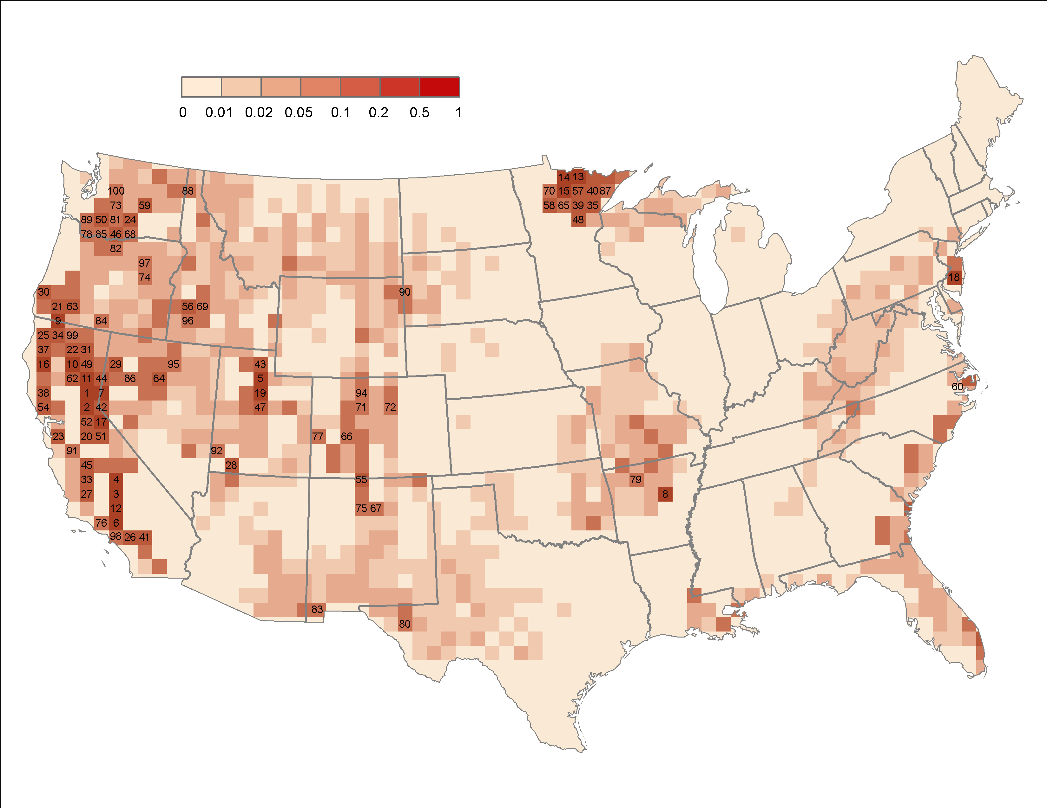
Smoke Impact Potential
Fire Occurrence
* = Risk

