Slide 1
Pollutant Emissions from Large Wildfires in the Western United States
Shawn P. Urbanski, Matt C. Reeves, W. M. Hao
US Forest Service Rocky Mountain Research Station
Robin P. Silverstein
College of Forestry and Conservation, University of Montana

Slide 2
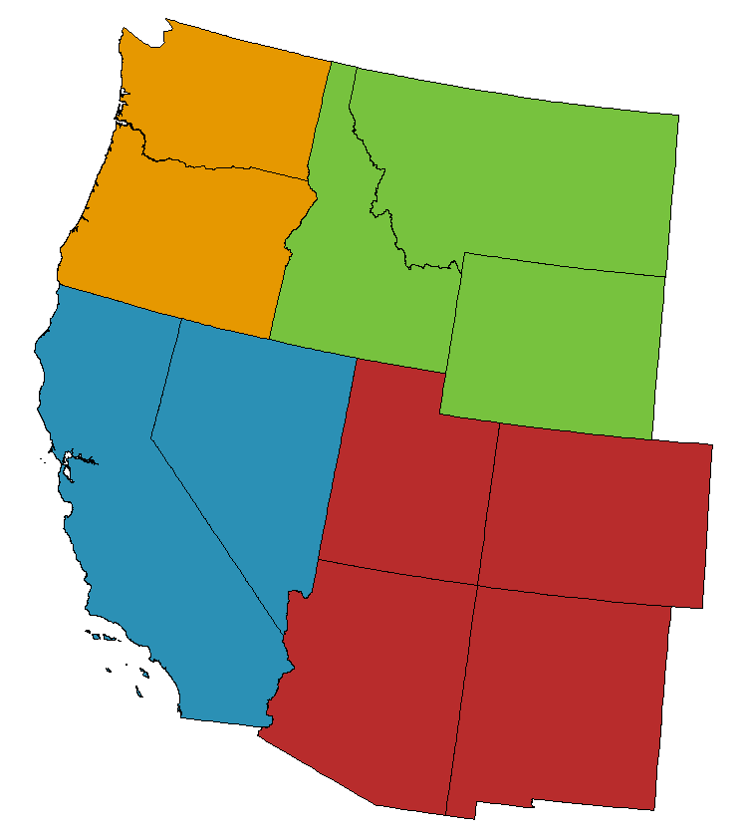
Introduction
Wildfires can have significant impacts on air quality
Goal of this work is to:
Quantify “large fire” pollutant emissions relative to anthropogenic sources in the western US from 2003 - 2014
How big is a “large fire”?
> 5,000 acres (∼2000 ha)

Slide 3
Wildfire Impacts on Air Quality
Contribution to O₃ in urban areas during NAAQS exceedances: Pfister et al. (2008); Jaffe et al., (2008); Jaffe (2011)
Contribution to PM_{2.5} (24-hour and annual) and Regional Haze in Class I Area (e. g. Park et al., 2007; Brewer & Moore, 2006)
Exceptional Event Demonstrations resulting in EPA concurrence wrt NAAQS for O₃ and PM_{2.5}¹
¹ http://www.epa.gov/ttn/analysis/exevents.htm
Notes:
Facts about air quality impacts

Slide 4
Method for Estimating Wildfire Emissions
EX = A × FL × FC × EF_{X}
A – Area Burned
FL – Fuel load
FC – Fuel Consumption (First Order Fire Effects Model)
EF_{X} –EF for PM_{2.5} or VOC
EPM = Emissions of PM_{2.5}
EVOC = Emissions of non-methane organic compounds

Slide 5
Method for Estimating Wildfire Emissions
Area Burned
Monitoring Trends in Burn Severity data¹ +
Daily burn scars & active fire detections from the MODIS¹
Fuel Consumption
First Order Fire Effects Model (FOFEM)²
Emission Factors (forest, rangeland)²
EF_{PM2.5} = 23.2, 8.5 g kg⁻¹
EF_{VOC} = 33.9, 23.8 g kg⁻¹
¹Monitoring Trends in Burn Severity Project, USFS, Remote Sensing Application center (RSAC);
² Reinhardt (2003); ³Urbanski (2014); Yokelson et. al (2013)

Slide 6
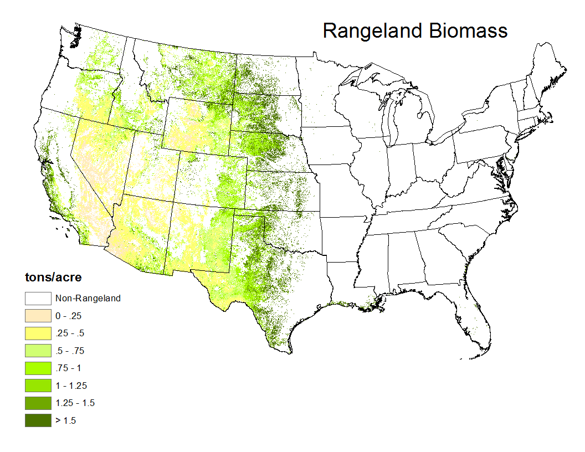
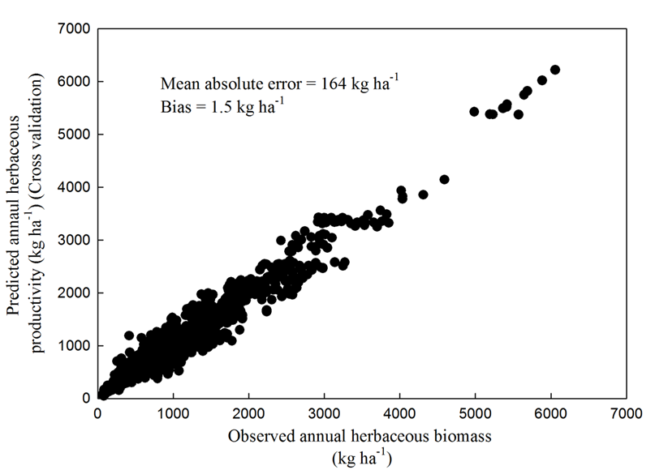
Method for Estimating Wildfire Emissions
Fuels - Rangeland Biomass Map
Normalized Differenced Vegetation Index (NDVI) based product developed from:
Field measurements of biomass and soil properties (USDA Soil Survey Geographic (SSURGO) database)
MODIS NDVI
Biophysical modeling
Based on the rangeland productivity project (Reeves & Mitchell, 2015)
The NDVI based rangeland biomass product accounts for the inter-annual variability in fine fuel loading which can exceed the decadal mean loading by more than 100%.
Notes:
These biomass maps were developed by Matt Reeves (US Forest Service) as part of a project funded by the Western Wildland Environmental Threat Assessment Center. The maps, which are not yet publicly available, were provided to us by Matt.

Slide 7
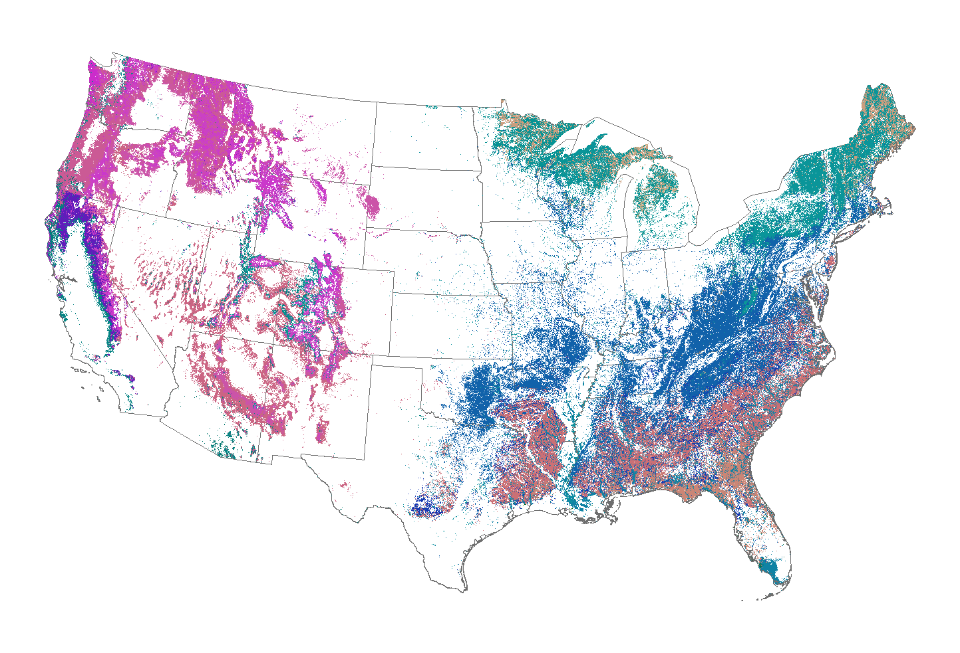
Method for Estimating Wildfire Emissions
Fuels – Forest Type Map
We used a forest type map developed by the US Forest Service
Forest Inventory and Analysis (FIA) Program (Ruefenacht et al., 2008):
28 forest type groups over CONUS
Developed from >83,000 FIA forested plots
Overall accuracy of 69%
Notes:
We didn’t build this map (to quote a certain President), USFS FIA / RSAC did! We are just using it. We did develop the fuel loading model (next two slides) which provides the estimates of burnable biomass by fuel class for each forest type.

Slide 8
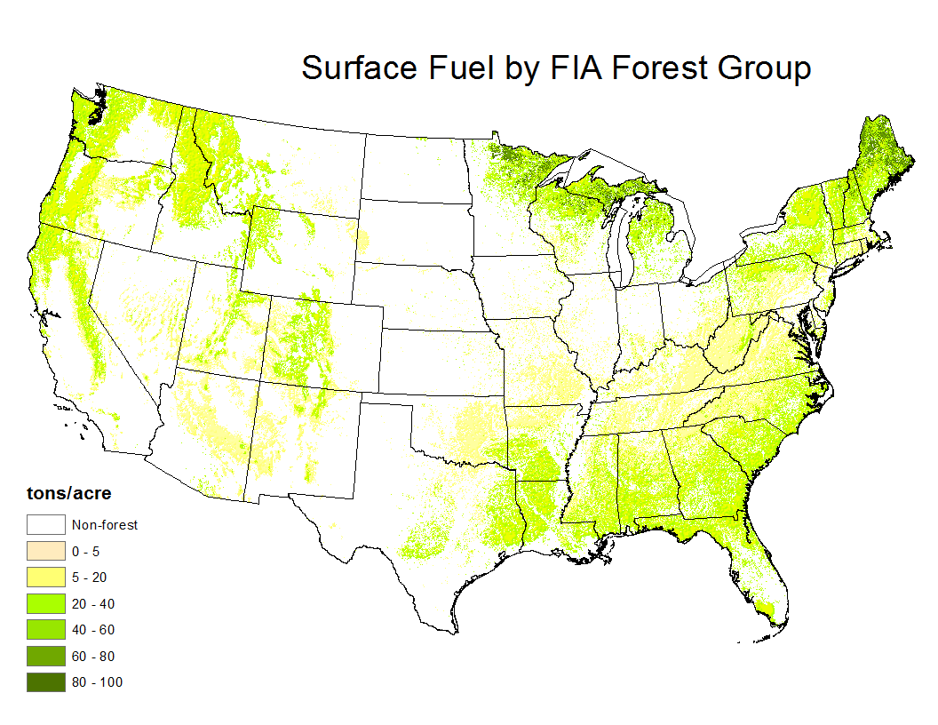
Method for Estimating Wildfire Emissions
Fuels – Forest Fuel Loading
Provides estimates of burnable biomass in each fuel component for 28 FTG classes
Developed from >29,000 FIA measurement plots¹
¹Extension / update of
Keane et al. (2013)
Notes:
28 FTG for CONUS. Top 10 = 84%. Top 15 = 95%.

Slide 9
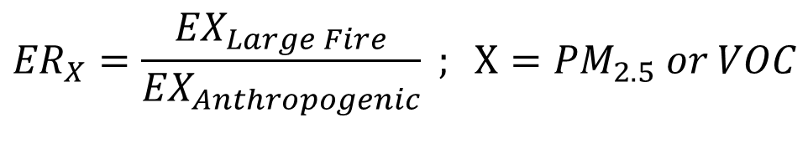
Large Fire Assessment
How do large fire emissions compare with anthropogenic sources?
Examine the ratio of emission:
$${ER}_{X}=\frac{{EX}_{Large Fire}}{{EX}_{Anthropogenic}} ; X={PM}_{2.5} or VOC$$
Anthropogenic emissions from
EPA 2011 National Emission Inventory
  Prescribed fire emission excluded
  Annual emissions distributed without seasonal adjustment
  Use 2011 NEI applicable across all years 2003 – 2014

Slide 10
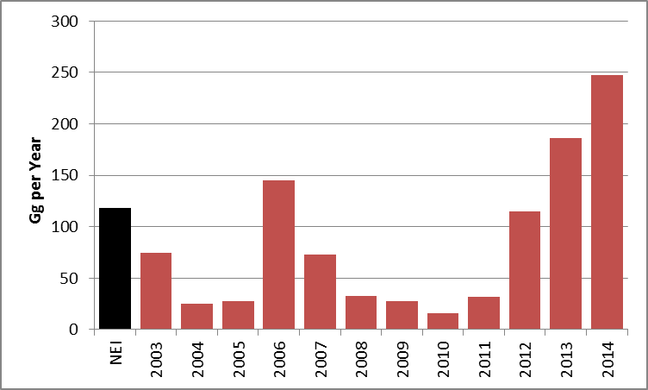
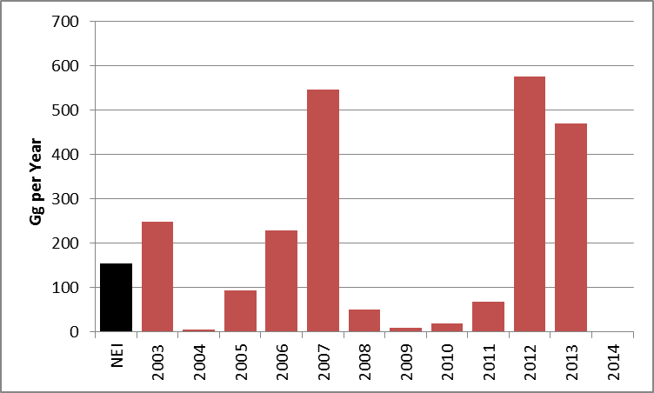
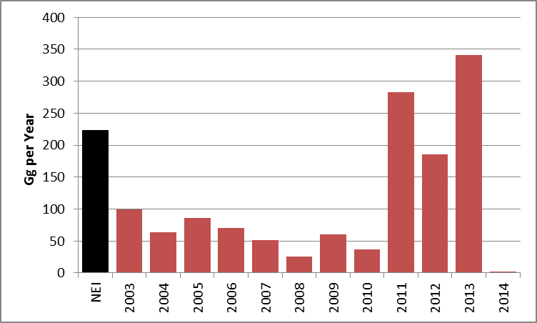
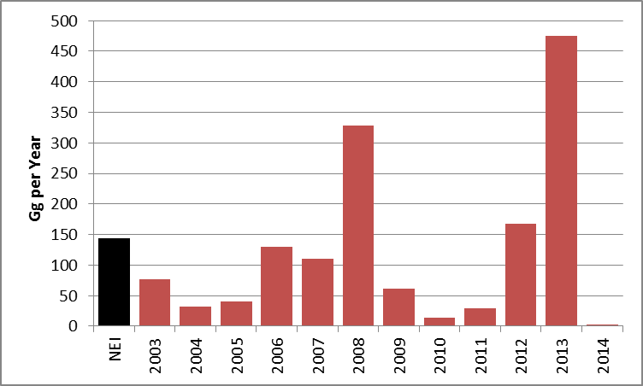
Annual PM_{2.5} Emissions by Region
Anthropogenic vs. Large Wildfire 2003-2014
Pacific Northwest (PNW)
Large Wildfire
Northwest (NW)
PNW
NW
Anthropogenic
PSW
Pacific Southwest
(PSW)
SW
Southwest (SW)
Units of Gg-PM_{2.5} yr⁻¹

Slide 11
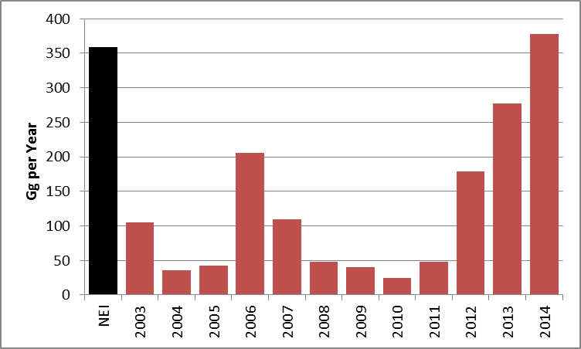
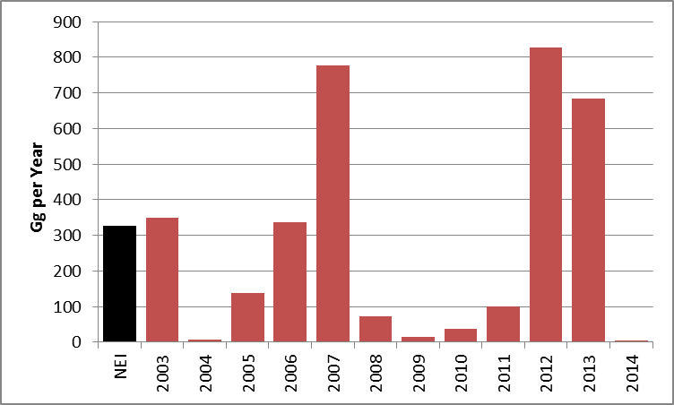
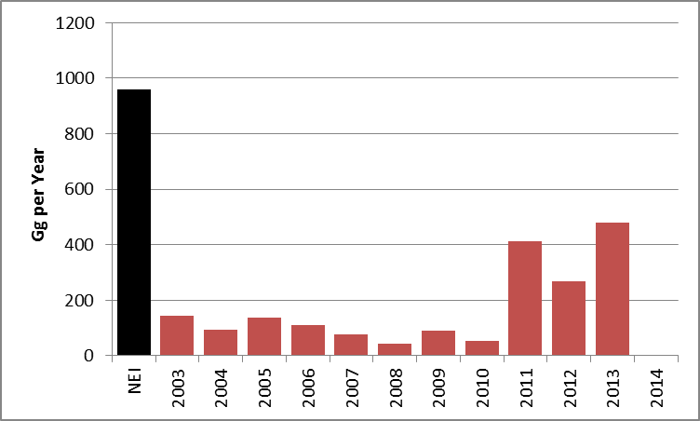
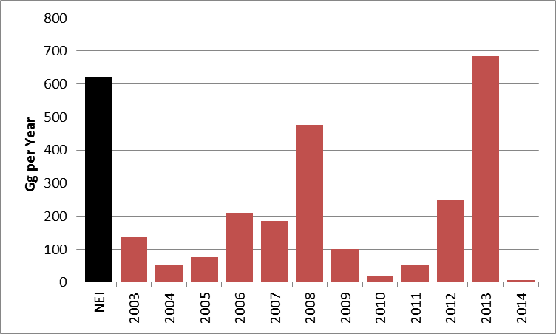
Annual VOC Emissions by Region
Anthropogenic vs. Large Wildfire 2003-2014
Pacific Northwest (PNW)
Northwest (NW)
PNW
NW
PSW
SW
Pacific Southwest
(PSW)
Southwest (SW)
Units of Gg-VOC yr⁻¹

Slide 12
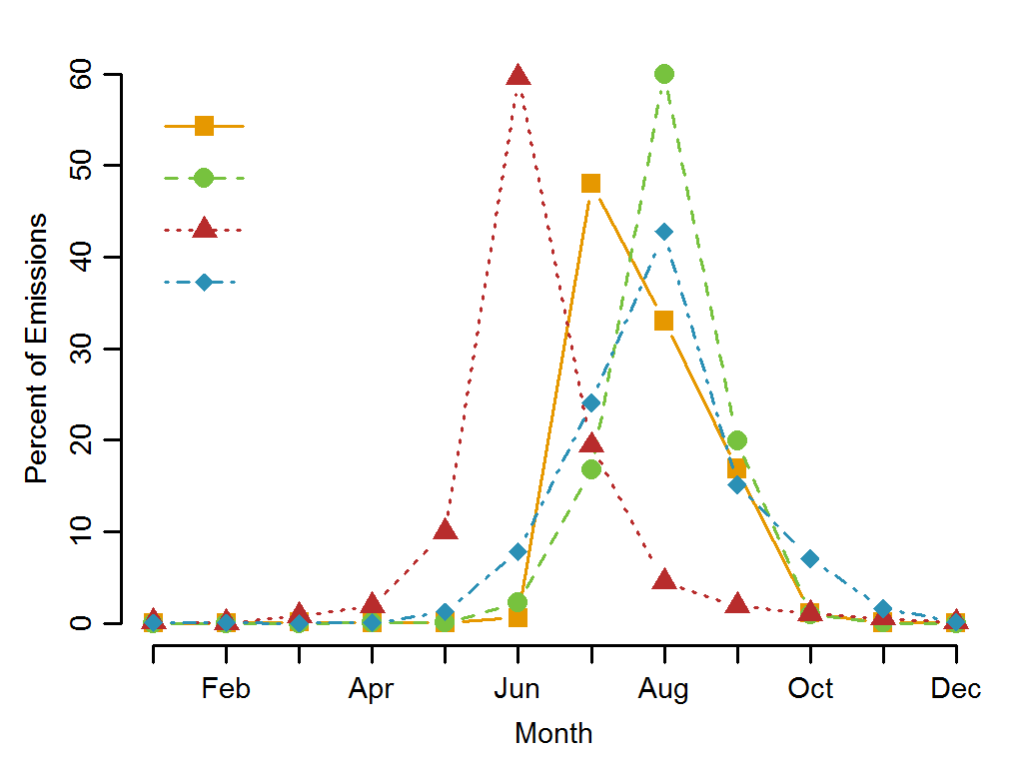
Temporal Distribution of
Large Fire Emissions 2003- 2014
PNW
NW
SW
PSW

Slide 13
Periods of High Fire Emissions
Air quality impacts:
PM_{2.5} regulations 24-hour standard
Regional Haze daily visibility
Ozone 8-hour average
Daily time step is most relevant for evaluating the significance of fire emissions for health impacts and regulatory consequences

Slide 14
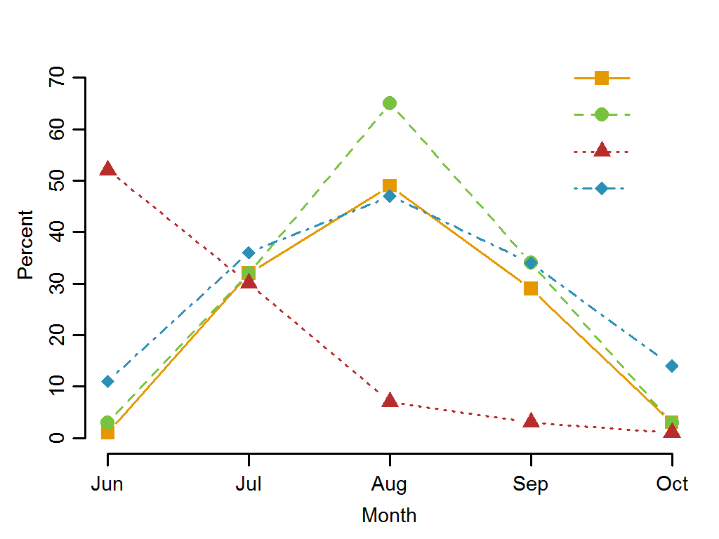
Large Fire vs. Anthropogenic
Percent of days with ratio of emissions, ER_{PM2.5} > 1
PNW
NW
SW
PSW

Slide 15
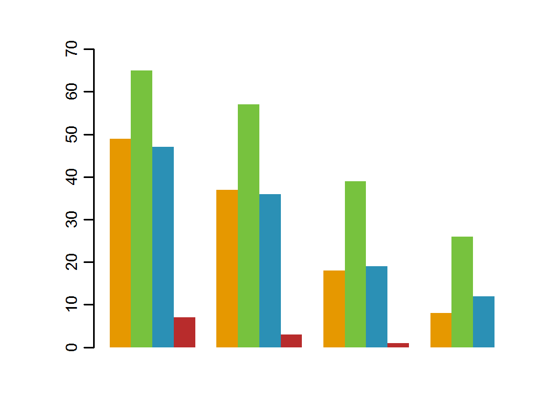
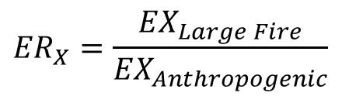
Fire-to-Anthropogenic PM_{2.5} Emissions
August (2003-2014)
$${ER}_{X}=\frac{{EX}_{Large Fire}}{{EX}_{Anthropogenic}}$$
PNW
NW
PSW
SW
Percent of Days
> 1
> 2
> 5
> 10
ER_{PM2.5}

Slide 16
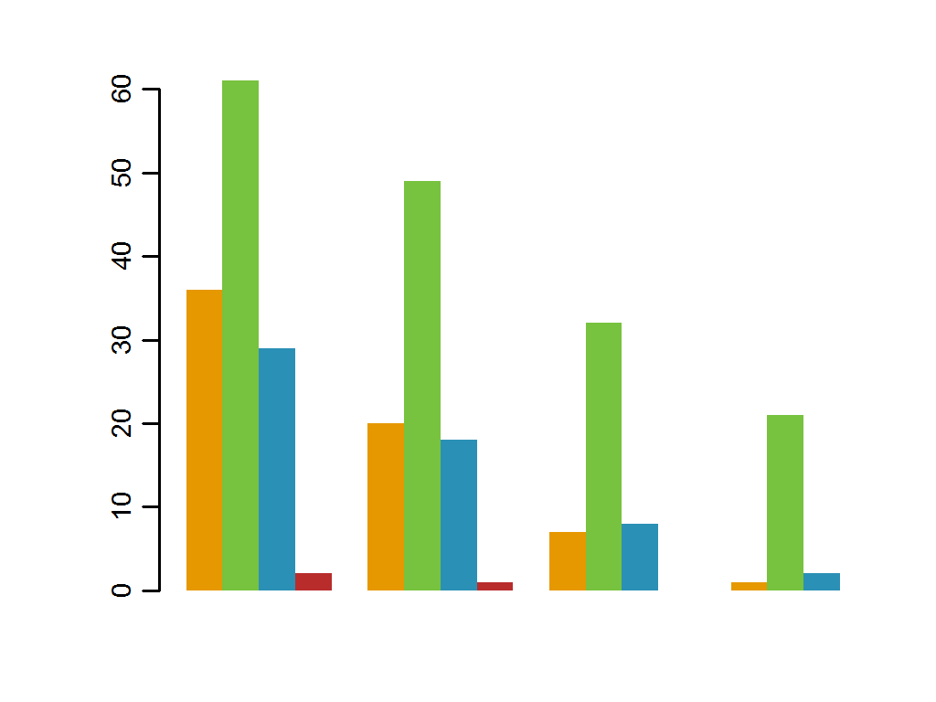
Fire-to-Anthropogenic VOC Emissions
August (2003-2014)
PNW
NW
PSW
SW
Percent of Days
> 1
> 2
> 5
> 10
ER_{VOC}

Slide 17
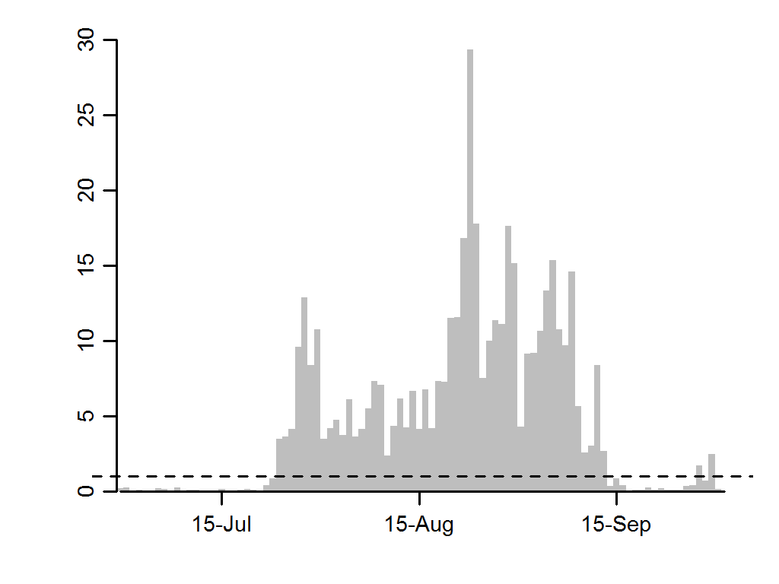
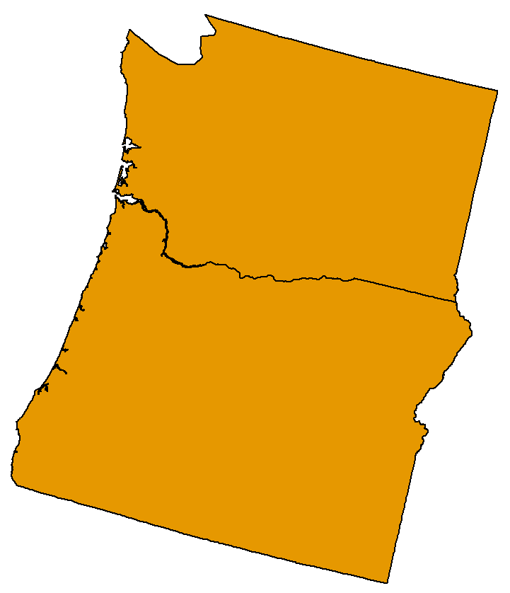
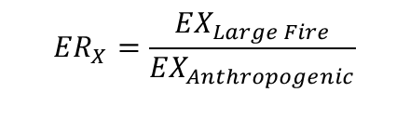
Daily ER_{PM2.5} Pacific Northwest 2006
$${ER}_{X}=\frac{{EX}_{Large Fire}}{{EX}_{Anthropogenic}}$$
ER_{PM2.5}
ER_{PM2.5} > 1 for 51 consecutive days
Median = 3.2 (VOC = 2.2)
Maximum = 29.3 (VOC = 14)

Slide 18
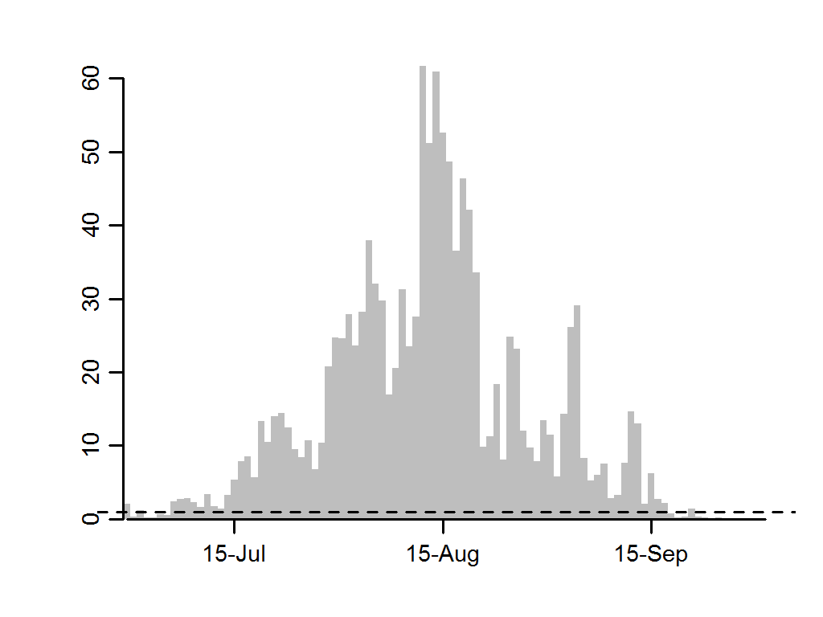
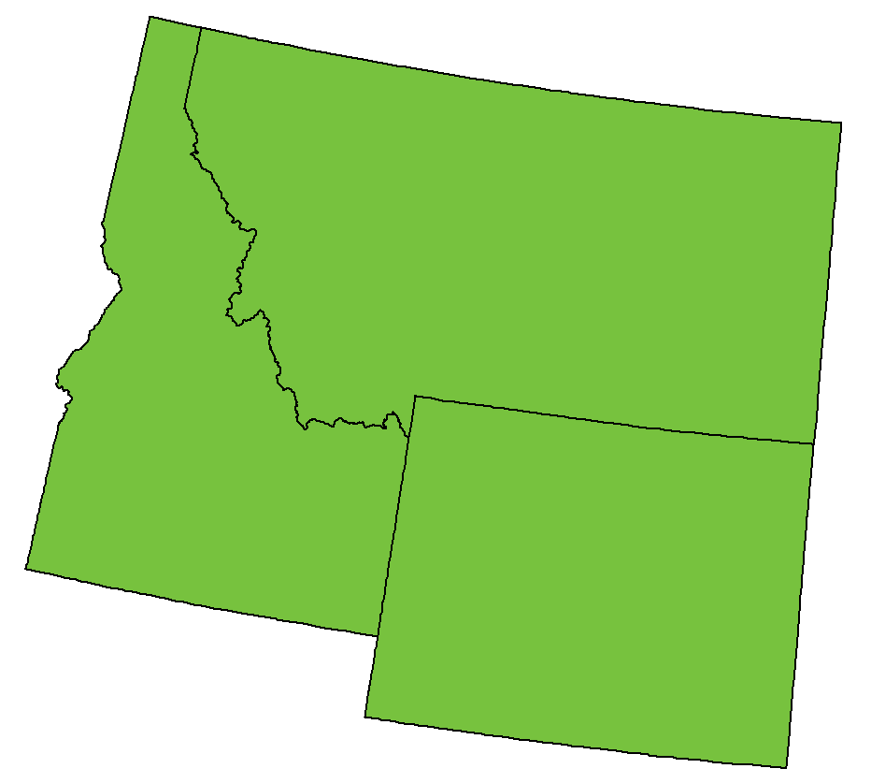
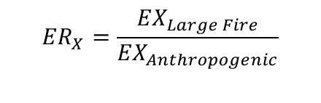
Daily ER_{PM2.5} Northwest 2007
$${ER}_{X}=\frac{{EX}_{Large Fire}}{{EX}_{Anthropogenic}}$$
ER_{PM2.5}
ER_{PM2.5} > 1 for 78 consecutive days
Median = 8.2 (VOC = 5.5)
Maximum = 61.7 (VOC = 41.5)

Slide 19
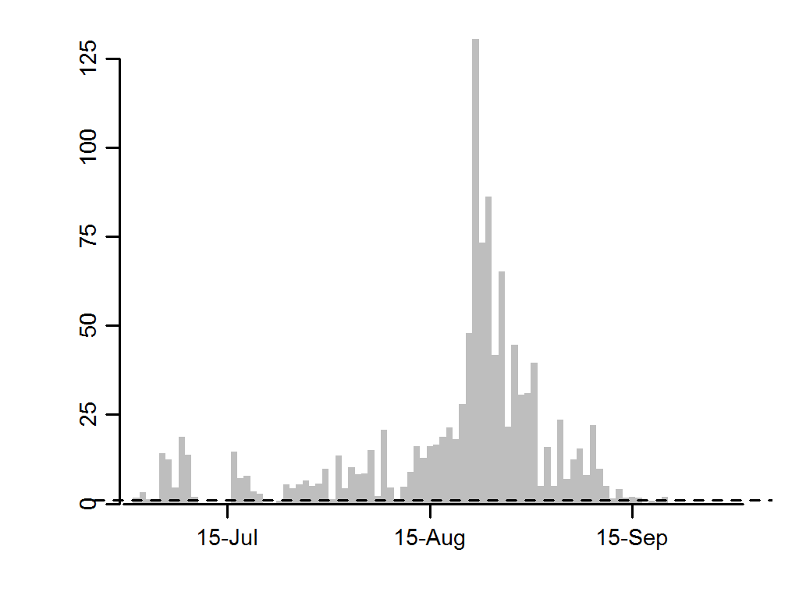
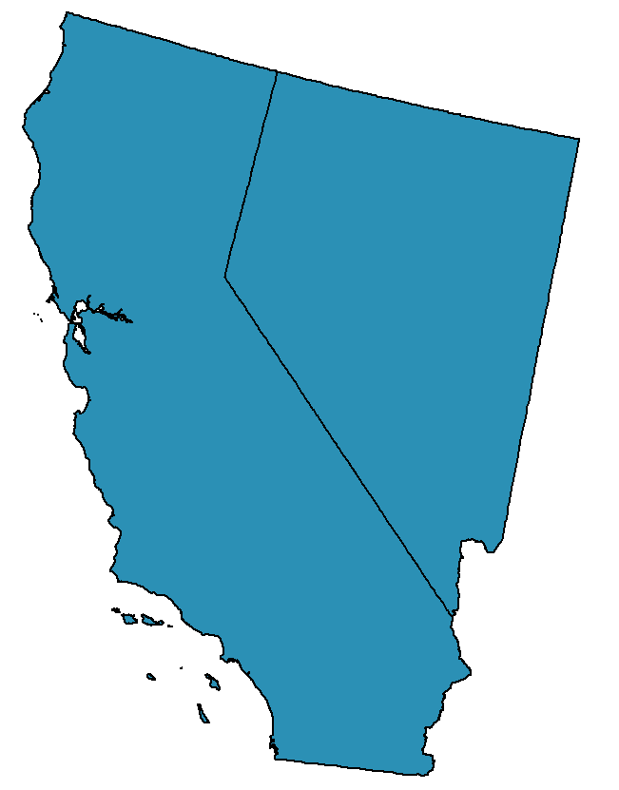
Daily ER_{PM2.5} Pacific Southwest 2013
$${ER}_{X}=\frac{{EX}_{Large Fire}}{{EX}_{Anthropogenic}}$$
ER_{PM2.5}
ER_{PM2.5} > 1 for 77 consecutive days
Median = 5.0 (VOC = 1.6)
Maximum = 130.5 (VOC = 43.6)

Slide 20
Conclusions
During active fire years PM_{2.5} and VOC emissions from large wildfires dominate anthropogenic emissions in the western US
Fire EPM_{2.5} can exceed anthropogenic sources by a factor of >5 for weeks
Fire EVOC can exceed sources by a factor of >2 in the Northwest and Pacific Northwest for weeks

Slide 21
Acknowledgements
US Forest Service Rocky Mountain Research Station
Joint Fire Sciences Program Project #12-1-07-1
Funding for the Rangeland Biomass Product
Western Wildland Environmental Threat Assessment Center (http://www.fs.fed.us/wwetac/)

