Slide 1
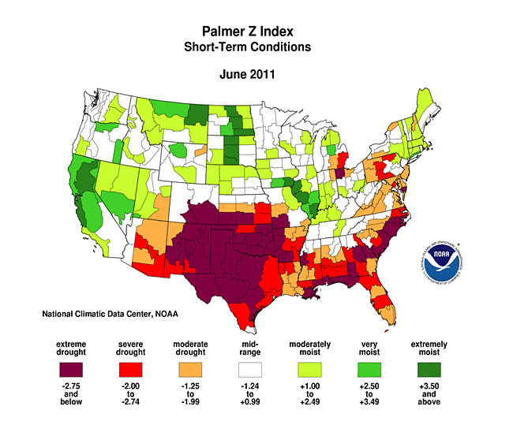
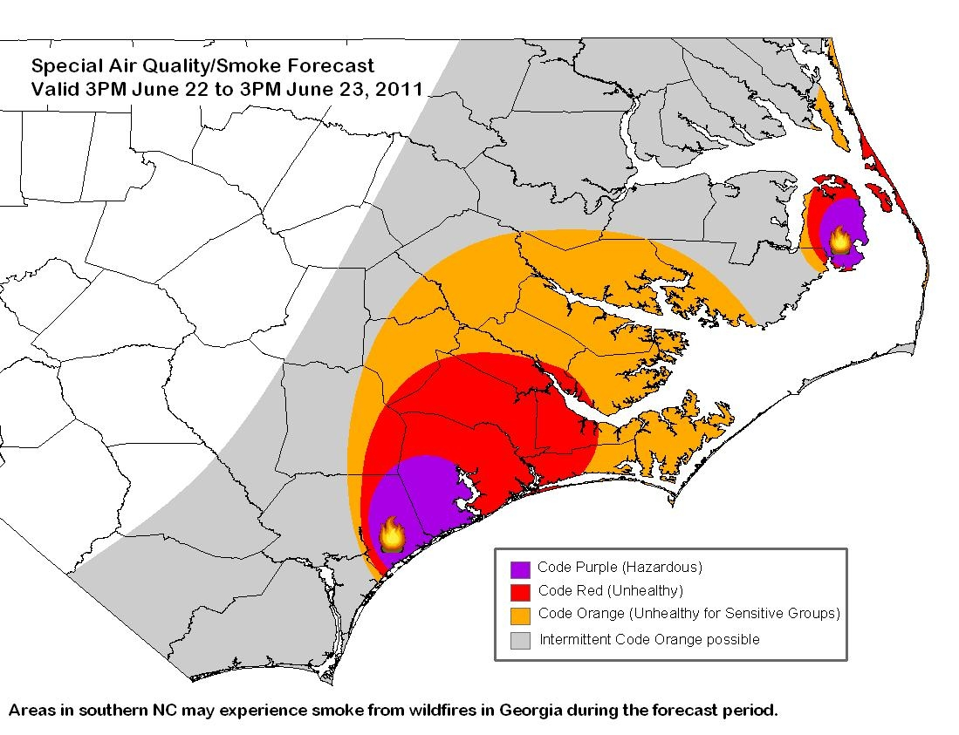
Assessing the Impact of Climate Change on Future Wildfire Activity over the Southeast U.S. using Dynamical Downscaling
Jared H. Bowden
Kevin D. Talgo
Uma Shankar
Aijun Xiu
CMAS Conference
October 5, 2015
NCDENR

Slide 2
Southeast U.S. and Climate Change (Mid- Century)
Large-scale shift expected in the atmospheric circulation during the summer (Bermuda High shift; Li et al. 2013)
Summer precipitation – mean expected to decrease but also the likelihood for an in increase in the extremes, such as droughts and floods (Li et al. 2013)
Summer mean temperatures expected to increase from 1.5°F to 4.5°F.
20-30 more days with extreme heat - days exceeding 95°F (Kunkel et al. 2013).
Largest warming anticipated for interior parts of the South (Carter et al. 2014).

Slide 3
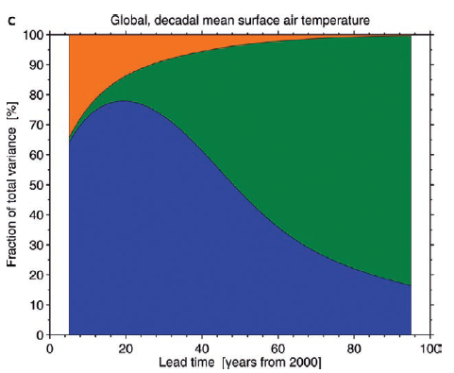
Wildfires Climate Change Challenge
Providing an efficient and robust approach to capture changes in the meteorology/fuels at spatial and temporal scales for modeling future fire weather impacts such as air quality.
Three Sources in Global Projections
Natural Variability – in absence of human influence
Model Uncertainty – representation of processes in individual GCMs
Scenario Uncertainty – about human actions
Regional Sources
Downscaling Uncertainty (methodology to parameterizations)
Natural Variability
Scenario Uncertainty
Model Uncertainty
Hawkins and Sutton, 2009

Slide 4
Downscaling Multiple GCMs-RCPs with WRF to 12km
108-km
36-km
12-km

Slide 5
Using a Fire Weather Index for Dynamical Downscaling
Haines Index (1988) – combines stability and moisture content of the lower atmosphere.
Larger the index the drier and more unstable the air ; maximum value of 6 – promotes spread and intensity of wildfires
Haines Index shown to be associated with large-scale atmospheric circulation patterns and the interannual variability of wildfires (Trouet et al. 2009)

Slide 6
Bounding “Sampling” Future Fire Weather Mid-Century
Haines Index calculated for two GCMs
NCAR/DOE - CESM and NASA-GISS-ModelE2
CESM and NASA GISSE for each day at 00Z for historical (1996-2005) and future (2041 - 2050) decade. Count the number of days that HI is greater than or equal to a value of 6
Downscale the lowest/high counts in a year for each decade and GCM.
12 Annual Simulations (8 Future / 4 Historical)
 | Historical (96-05) | RCP 4.5 (41-50) | RCP 8.5 (41-50)
CESM (low/high) | 2001 / 2005 | 2050 / 2042 | 2043 / 2041
NASA GISSE (low/high) | 2001 / 2005 | 2049/ 2043 | 2045 / 2043

Slide 7
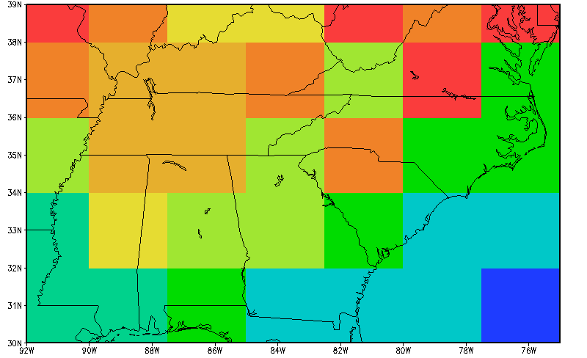
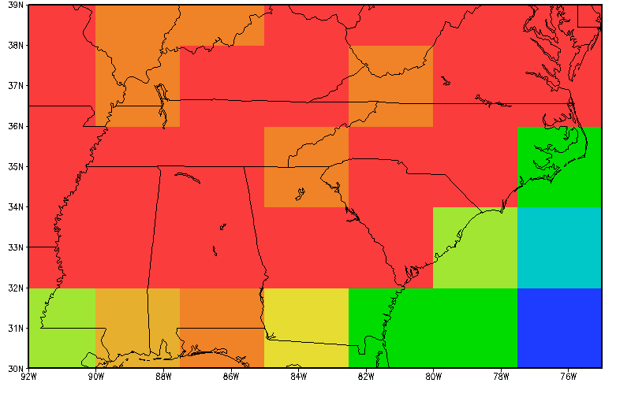
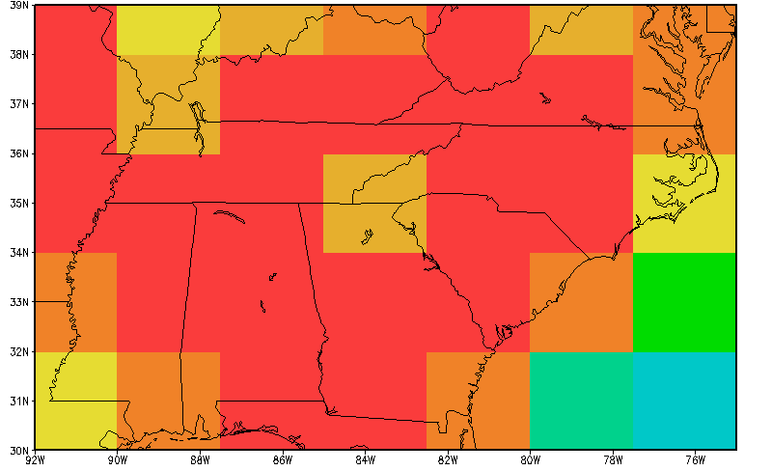
Number of Days/YEAR HI=6 NASA-GISS-ModelE2
HISTORICAL
RCP8.5
LOW YEAR
LOW YEAR
HIGH YEAR
HIGH YEAR

Slide 8
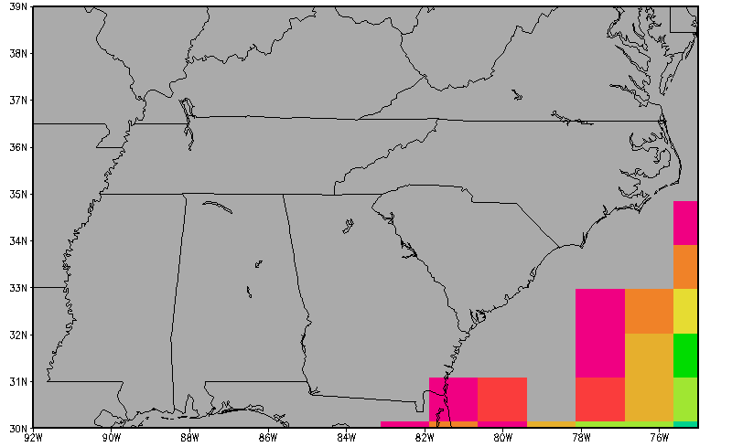
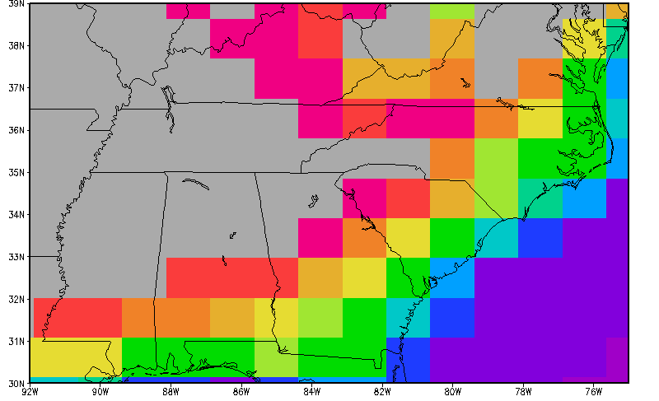
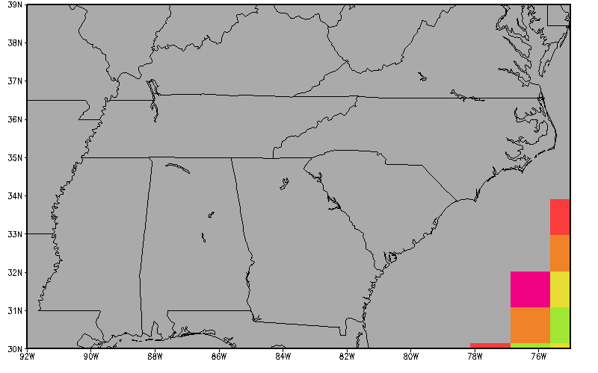
Number of Days/YEAR HI=6 NCAR/DOE-CESM
HISTORICAL
RCP8.5
LOW YEAR
LOW YEAR
HIGH YEAR
HIGH YEAR

Slide 9
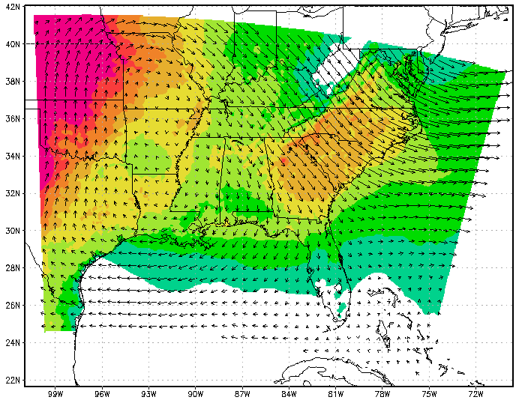
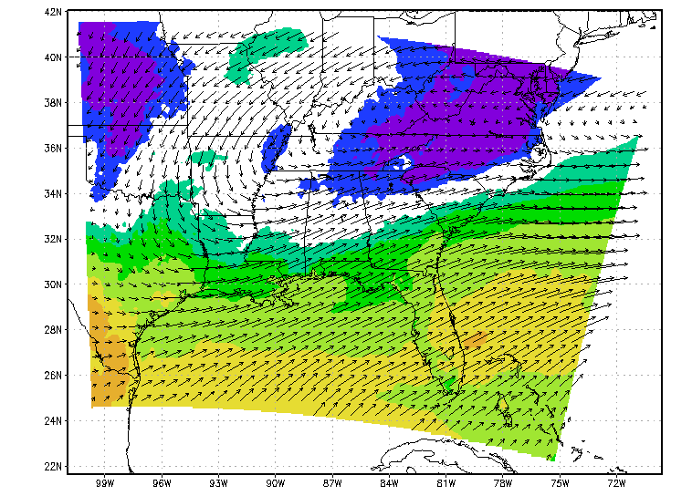
2-m Temperature Range – Summer Example NASA-GISSE ModelE2 RCP8.5
Future (high fire) minus Historical (low fire)
Future (low fire) minus Historical (high fire)
L
H
-1°C
4°C

Slide 10
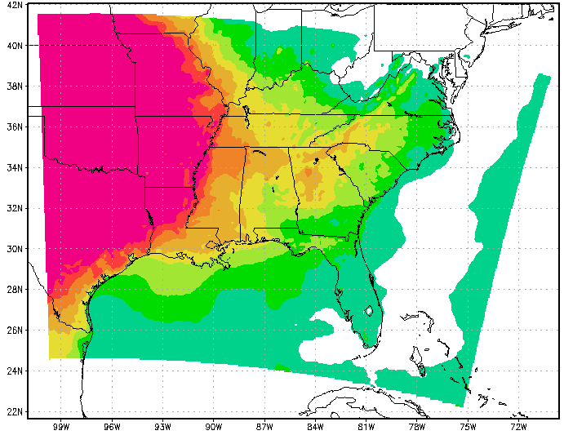
2-m Temperature – Extreme Change Ensemble
RCP4.5
RCP8.5
-1°C
4°C

Slide 11
Projecting Future Fuel Load
Compute 10 year average Litter, Coarse Woody, and Leaf for CESM grid cells over the continental US from:
Historical : 1996-2005; RCP4.5 & RCP8.5: 2041 – 2050
Compute changing ratio (Scenario / Historical) for plant litter, coarse woody debris, and live foliage
Average ratios for all cells with the same fuel bed number Future fuels are computed by
Future Fuel = MODIS enhanced FCCS loadings * Ratio_RCP

Slide 12
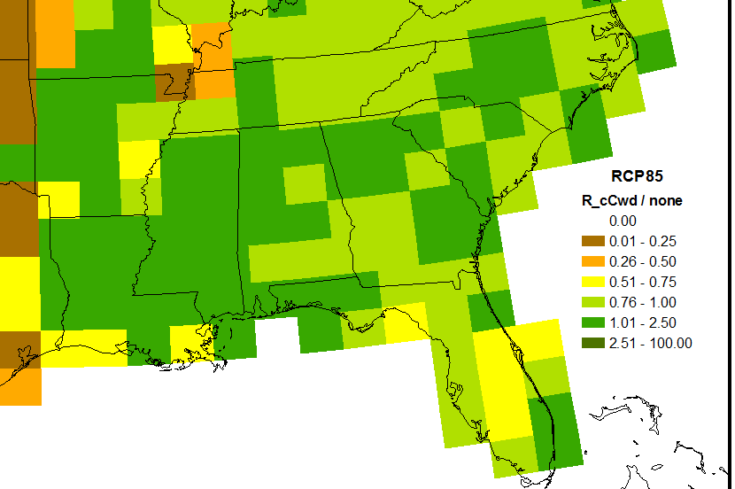
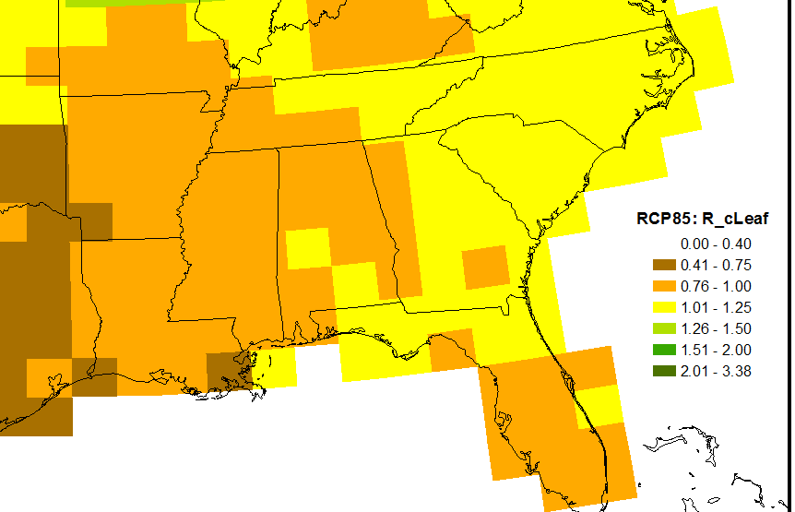
Fuel Load Ratio – RCP/Historical CESM RCP8.5 (Mid-Century)
Plant Litter
Coarse Woody Debris
INCREASE
INCREASE
Live Foliage
DECREASE

Slide 13
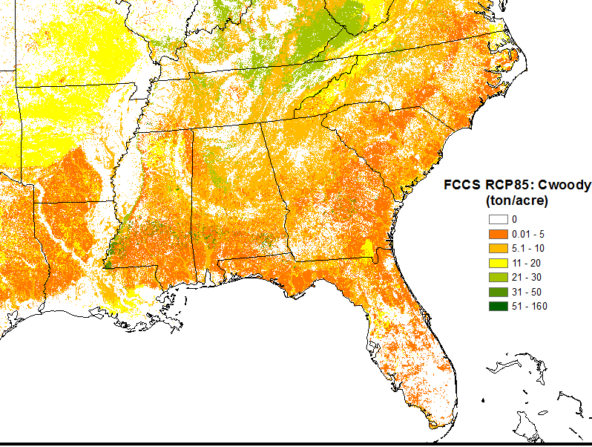
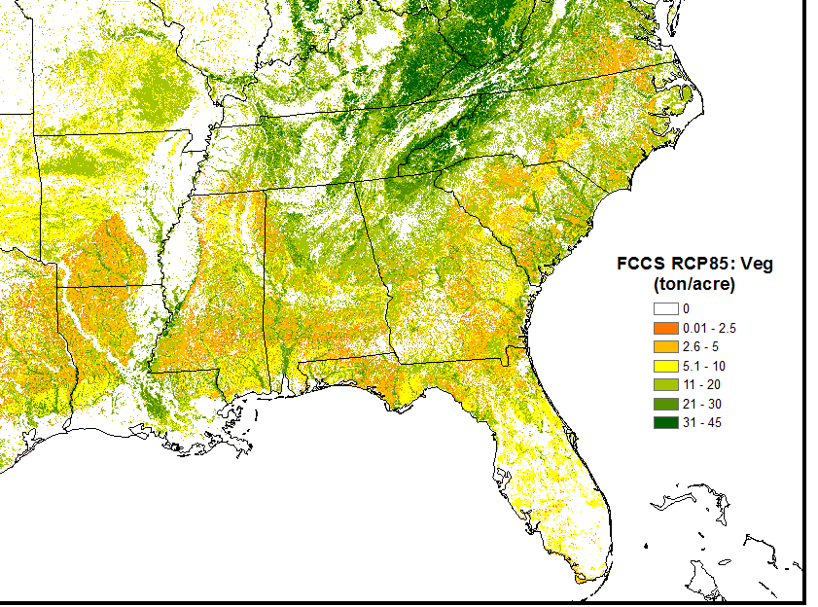
Future Fuels for RCP8.5 using MODIS FCCS
Plant Litter (tons/acre)
Coarse Woody Debris (tons/acre)
Live Foliage

Slide 14
Summary
Using the Haines Index to select future fire weather years for dynamical downscaling helped to bound future changes in the meteorology.
Similar approaches may help regional climate modelers provide an information-rich method to bound regional climate change for impact assessments at regional to local scales.
Atmospheric circulation change for high fire weather indicated a circulation that would be consistent with a westward shift in the North Atlantic Subtropical High (from prior studies).
Future fuels indicate an increase in plant litter and coarse woody debris and a decrease in live foliage. Fuels and meteorology will be used to create smoke from wildfire.
Changes in meteorology and fuel loads suggest that wildfires are more likely as a result of climate change over the Southeast U.S.

Slide 15
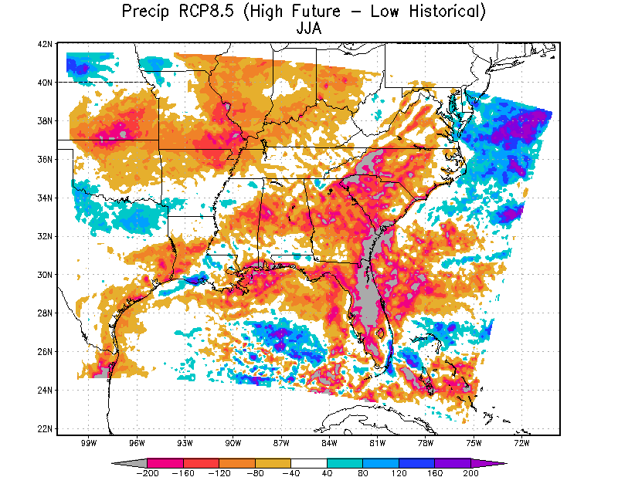
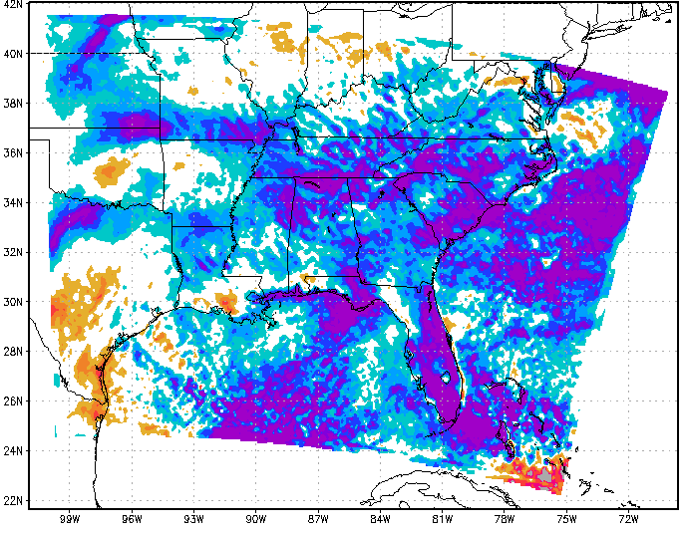
Precipitation Range – Summer Example NASA-GISSE ModelE2 RCP8.5
Future (high fire) minus Historical (low fire)
Future (low fire) minus Historical (high fire)

