Slide 1

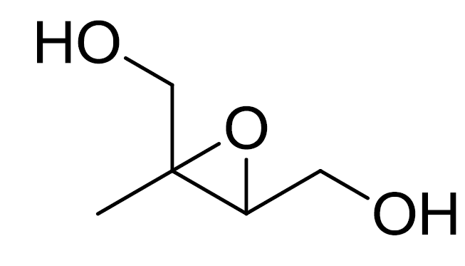
Constraining Condensed-Phase Kinetics of Secondary Organic Aerosol Components from Isoprene Epoxydiols
Theran Riedel, Ying-Hsuan Lin, Zhenfa Zhang, Kevin Chu, Joel Thornton, William Vizuete, Avram Gold, and Jason Surratt
Dept. of Environmental Sciences and Engineering
The Gillings School of Global Public Health
University of North Carolina at Chapel Hill
CMAS Conference
October 5, 2015

Slide 2

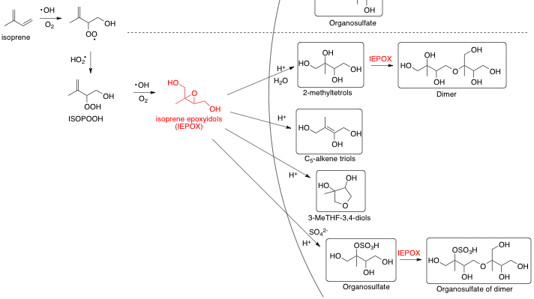
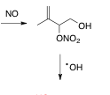


isoprene epoxydiols (IEPOX) and SOA
Gas Phase
Aerosol Phase
~50% of isoprene → IEPOX (rural)
~500 Tg/year isoprene
  even at low conversion (urban) lots of
potential mass to aerosols
“tracers” ≡ aerosol products from IEPOX that contribute to SOA mass

Slide 3

IEPOX-tracer formation
${IEPOX}_{(g) }\underset{→}{γ}{IEPOX}_{(aq)}$
${IEPOX}_{(aq)}+H^{+}+H_{2}O→2‑methytetrols+H^{+}$
${IEPOX}_{(aq)}+H^{+}+{SO}_{4}^{2−}→IEPOX‑organosulfate+H^{+}$
${IEPOX}_{(aq)}+H^{+}→C_{5}‑alkene triols+H^{+}$
${IEPOX}_{(aq)}+H^{+}→3‑MeTHF‑3,4‑diols+H^{+}$
${IEPOX}_{(aq)}+H^{+}+2‑methyltetrols→IEPOX‑dimer+H^{+}$
${IEPOX}_{(aq)}+H^{+}+IEPOX‑OS→IEPOX‑dimerOS+H^{+}$
k_{het} = γS_{a}ω/4
Recent interest in explicit modeling of SOA formation due to model-measurement deviations
  GAMMA: McNeill et al., ES&T 2012
  CMAQ: Pye et al., ES&T 2013; Karambelas et al., ES&TL 2014
Need for more constraints on SOA formation kinetics
  experiments and modeling
k ≈ 9e-4 M⁻² s⁻¹
k ≈ 2e-4 M⁻² s⁻¹
k = ??
k = ??
k = ??
k = ??
Gaston et al., ES&T 2014; Riedel et al., ES&TL 2015
Eddingsaas et al., JPCA 2010; Cole-Filipiak et al., ES&T 2010; Piletic et al., PCCP 2013

Slide 4
IEPOX chamber SOA experiments
10 m³ teflon chamber
RH: < 5%
aerosol seed: (NH₄)₂SO₄ + H₂SO₄
IEPOX injected: 600 ppbv
Filter
collection
SOA
seed injection
and stabilization
IEPOX
injection
Total SOA growth: 170 μg m⁻³

Slide 5
IEPOX-tracer quantification
GC/MS: 2-methyltetrols, C₅-alkene triols, 3-MeTHF-3,4-diols, IEPOX-dimer
LC/ESI-MS : IEPOX-OS, IEPOX-dimerOS
other SOA
“other SOA” ≡ IEPOX-SOA products not quantified through offline measurements

Slide 6
explicit chamber-SOA modeling
0-D time-dependent box model
Model run time = experiment duration
Initialize model with:
  chamber measured seed aerosol [S_{a}] and [mass]
  E-AIM calculated seed aerosol composition
    [SO₄²⁻], [HSO₄⁻], [H₂O], [H⁺]
Explicitly track:
  IEPOX_{(g)}, IEPOX_{(aq)}
  2-methyltetrols, organosulfate, C₅-alkene triols, 3-MeTHF-3,4-diols, IEPOX dimer, IEPOX dimer organosulfate, other SOA
  [SO₄²⁻], [HSO₄⁻]
Vary model aqueous rate constants to minimize difference between model output and filter measurements

Slide 7

explicit chamber-SOA modeling
H⁺, H₂O
H⁺, IEPOX
2-methyltetrol
dimer
H⁺, SO₄²⁻
organosulfate
H⁺, IEPOX
dimer OS
IEPOX_{(g)} IEPOX_{(aq)}
H⁺
C₅-alkene triol
H⁺
3-MeTHF-3,4-diol
H⁺
other SOA
volatile products
SOA yield (φ_{SOA}) < 1, so invoke volatile product formation

Slide 8
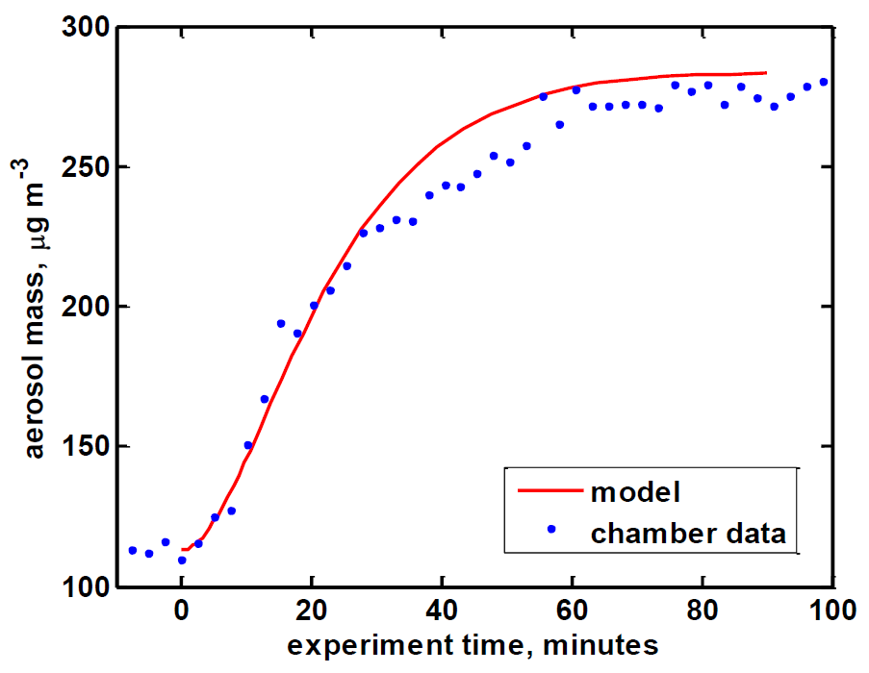
model output

Slide 9
model output

Slide 10
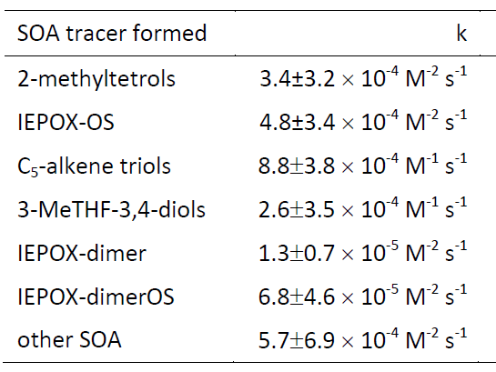
model-estimated rate constants
${IEPOX}_{(aq)}+H^{+}+H_{2}O→2‑methytetrols+H^{+}$ k ≈ 9e-4 M⁻² s⁻¹
${IEPOX}_{(aq)}+H^{+}+{SO}_{4}^{2−}→IEPOX‑organosulfate+H^{+}$ k ≈ 2e-4 M⁻² s⁻¹
Notes:
-Repeated 5 times varying the amount of IEPOX injected.

Slide 11
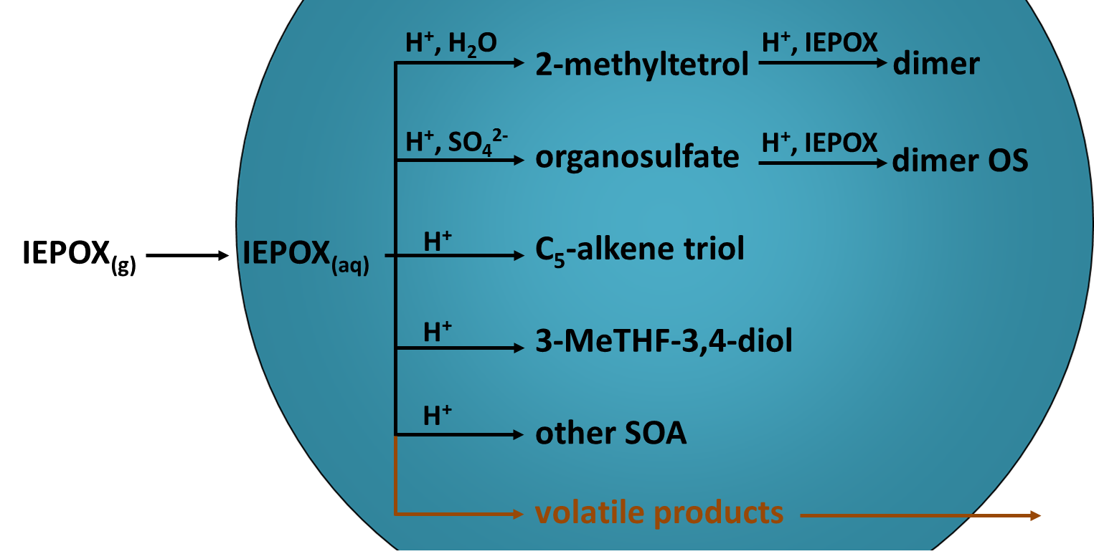
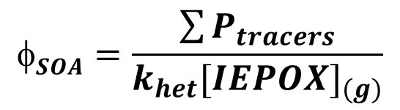
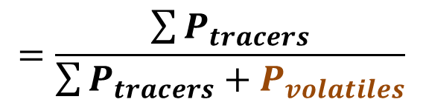

molar SOA yield (φ_{SOA})
$$SOA=\frac{\sum{P_{tracers}}}{k_{het}{[IEPOX]}_{(g)}}$$
$$=\frac{\sum{P_{tracers}}}{\sum{P_{tracers}}+P_{volatiles}}$$
$$=0.08$$
Riedel et al., ES&TL 2015: φ_{SOA} = 0.1 – 0.12
Notes:
-means that per mole about 8% of IEPOX

Slide 12
atmospheric-type simulation
Initialize with:
500 pptv IEPOX
ammonium bisulfate aerosol
250 μm²/cm³ aerosol S_{a}
50% RH
6-hour processing time
2-methyltetrols 288 ng/m³
IEPOX-OS 52 ng/m³
C₅-alkene triols 25 ng/m³
3-MeTHF-3,4-diols 7.4 ng/m³
IEPOX-dimer 0.1 ng/m³
IEPOX-dimerOS 0.1 ng/m³
other SOA 0.6 ng/m³
Total predicted SOA mass = 0.37 μg m⁻³

Slide 13
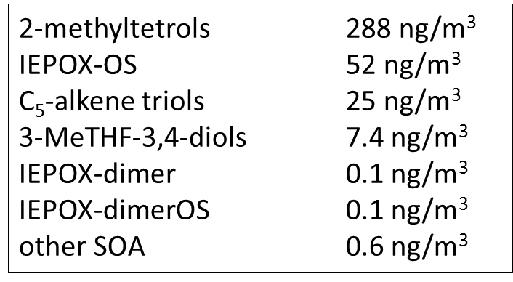
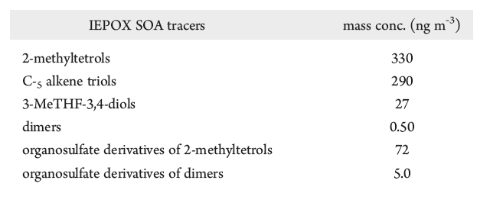
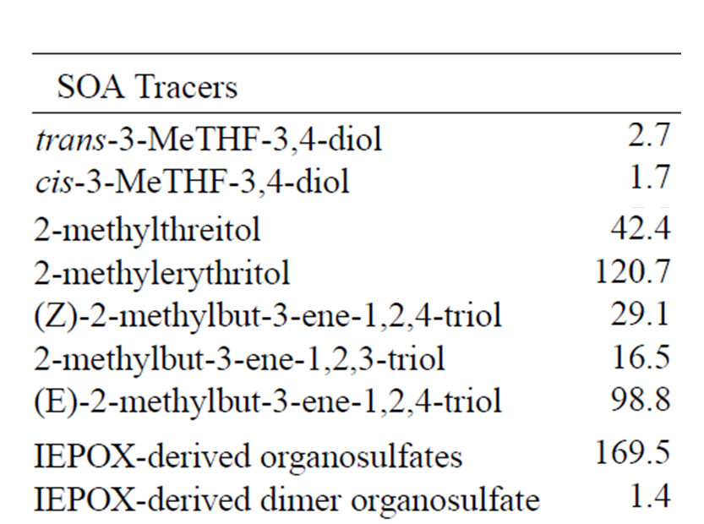
atmospheric-type simulation
Yorkville, GA (Lin et al., ES&T 2012)
Total predicted SOA mass = 0.37 μg m⁻³
∑tracers = 724.5 ng m⁻³
Look Rock, TN (Budisulistiorini et al., ACP 2015)
study mean (ng m⁻³)
∑tracers = 482.8 ng m⁻³

Slide 14
final thoughts
estimated formation rate constants for IEPOX-SOA tracers that have yet to be constrained by bulk measurements
  agreed well with experimentally obtained estimates
  (2-methyltetrols and IEPOX-OS)
can be extended to other SOA production systems (i.e., α-pinene)
important to test that current understanding can account for SOA production in simple systems
recently this work submitted to ACPD

Slide 15


acknowledgements
UNC Surratt Group
Jason Surratt
Ying-Hsuan Lin
Matthieu Riva
Sri Hapsari Budisulistiorini
Xinxin Li
Maiko Arashrio
Tianqu Cui
Weruka Rattanavaraha
Kevin Chu
UNC Gold Group
Avram Gold
Zhenfa Zhang
University of Washington
Joel Thornton
Cassandra Gaston
Funding:
83540401
NSF: CHE 1404644 and 1404573
Texas Commission on Environmental Quality

Slide 16
the end… thanks!

Slide 17
junk slides

Slide 18
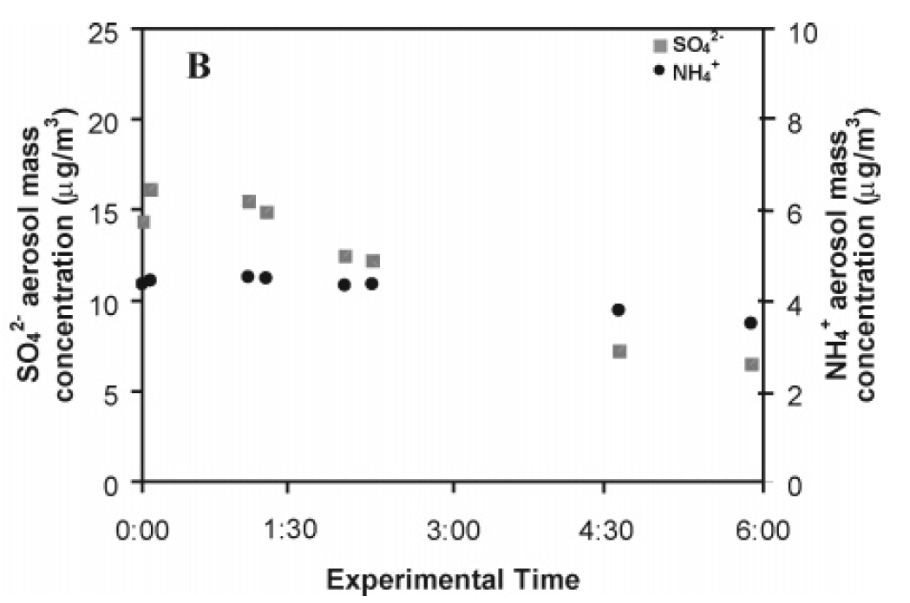
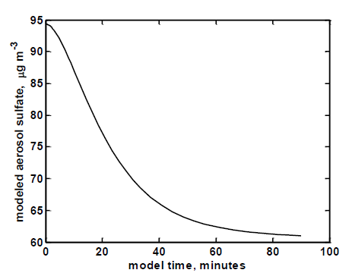
model output: titration of aerosol sulfate
Low-NO_{x} isoprene oxidation (IEPOX formation) with acidified ammonium sulfate seed aerosol from Surratt et al., ES&T, 2007
Model output (this study):

Slide 19
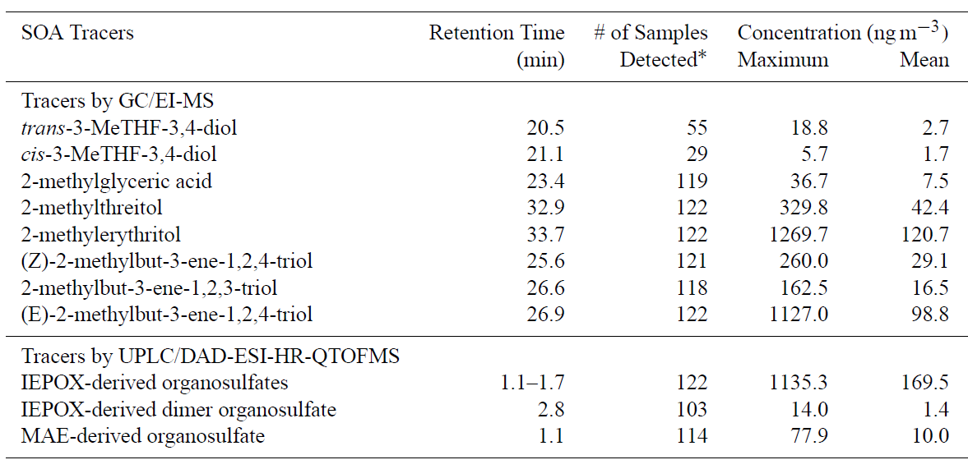

Slide 20
Recent interest in explicit modeling of SOA formation due to model-measurement deviations
  GAMMA: McNeill et al., ES&T 2012
  CMAQ: Pye et al., ES&T 2013; Karambelas et al., ES&TL 2014
Need for more constraints on SOA formation kinetics
  experiments and modeling

