Slide 1
14th Annual CMAS Conference
5-7th October, 2015
Improvement of Dust Module in CMAQ and Implement of Heterogeneous Chemistry
Xinyi Dong¹, Joshua S. Fu¹, Kan Huang¹, Daniel Tong^{2,3,4}, and Guoshun Zhuang⁵
¹University of Tennessee, Knoxville
²NOAA/OAR/ARL, NOAA Center for Weather and Climate Prediction
³Center for Spatial Information Science and Systems, George Mason University
⁴Cooperative Institute for Climate and Satellites, University of Maryland
⁵Department of Environmental Science and Engineering, Fudan University
Chapel Hill, NC
Oct. 5th, 2015

Slide 2
Outline
Brief review of dust emission scheme in CMAQ
Implement of model developments
Results and discussion

Slide 3
Why we care about dust in CMAQ
CMAQv5.0 (Oct. 2012): Wind-blown dust option became available
Before : some user-initiated model development studies (Wang et al., 2012, ACP; David et al., 2013, AE)
After : application of CMAQv5.0 in US (Appel et al., 2013, ACP) & East Asia (Fu et al., 2014, ACP)
Why it’s essential
How it’s unique
Having dust can promote the model to:
Speciation of dust particles, enable the model to:
Better predictions of Aerosols
Inline mode WRF/CMAQ
(Yu et al., 2014, ACP)
Chemical evolution of dust particles (CaCO₃, Fe₂O_{3 …})
Change of optical properties
Hemispheric scale simulation (Jia et al., 2015, ACP)
Notes:
A is constant
ρis air density
g is gravitational constant
S is desert area
u* is friction velocity (calculated by WRF)

Slide 4
Dust Emission Scheme
Calculation of dust emission flux (F) is based on modified Owen’s equation (Owen et al., 1964; Tong et al., 2015 )
Ratio between vertical and horizontal flux
Friction velocity threshold ( if the friction velocity exceeds this threshold, there will be dust particles elevated)
Soil erodible potential
Initial friction velocity threshold constant for 13 soil types, based on filed data from Gillette et al. (1980). The values in original CMAQ double count the impact of soil moisture, and our recent reanalysis of the field data provide new values of
Soil moisture adjusting factor
Surface roughness adjusting factor
Notes:
A is constant
ρis air density
g is gravitational constant
S is desert area
u* is friction velocity (calculated by WRF)

Slide 5
New Friction Velocity Threshold Constant
Land Cover Categories
Initial Friction Velocity Threshold Constants
Taklamakan
Gobi
Tibet
Soil Types

Slide 6
Source-dependent Speciation Profiles
CMAQ default
Taklamakan
Gobi
20% fine mode
Dust
80% coarse mode
Species | Description | Mass Conributions (%)
 |  | Fine Mode (I,J mode in CMAQ ≤2.5μm) |  |  | Coarse Mode (K mode in CMAQ ≤10 μm)
 |  | Default | Taklamakan | Gobi | Default | Taklamakan | Gobi
ACA | Calcium | 7.94 | 2.063 | 1.788 | 0 | 1.423 | 1.082
AMG | Magnesium | 0 | 0.165 | 0.799 | 0 | 0.121 | 0.819
AK | Potassium | 3.77 | 0.153 | 0.282 | 0 | 0.108 | 0.121
Notes:
note that different trace metals are treated in different form in the model:
(1). cation phase: SO42-, NO3-, Cl-, NH4+, Na+, Ca2+, Mg2+, K+
(2). elementary phase: Al, Fe, Si, Ti, Mn
Determine the phase of the trace metals is important. Because for example, for Ca, the elementary mass contribution is about 8%, but the cation phase is only 2.063% in Taklamakan and 1.788% in Gobi

Slide 7





Heterogeneous Chemistry
Heterogeneous reactions in original CMAQ:
C1
C2
13 reactions added into CMAQ in this study:
R1
R8
R2
R9
R3
R10
R4
R11
R5
R12
R6
R13
R7
Reaction Rate:
$$r_{p}$$
: radius of the particle
$$D_{g}$$
: diffusion coefficient of gas molecules
$$v_{g}$$
: molecular velocity of gas
$$γ_{g}$$
: uptake coefficient (values from Zhu et al.,2010, ACP)
$$A_{p}$$
: particle surface area

Slide 8
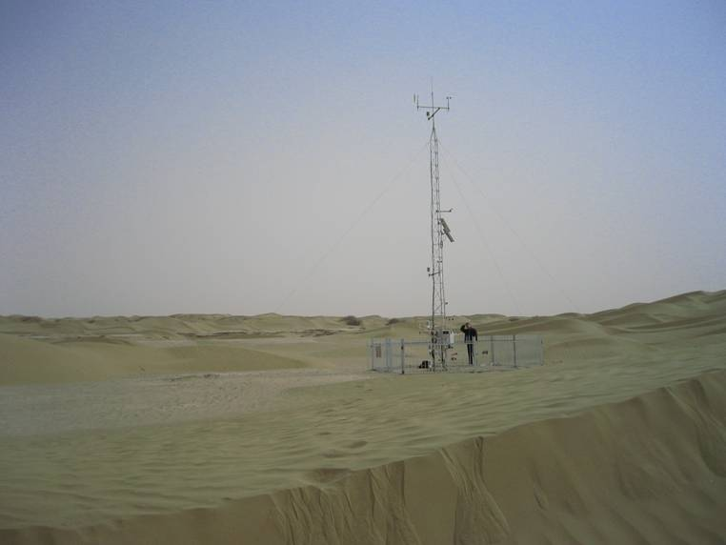
Method
Fudan observation station in Tazhong
Modeling domain and observation stations
Tazhong
API
AERONET
EANET
TAQMN
Fudan Obs.
Simulation period: March-April, 2006-2010
Simulation design
Scenario | Configuration of WRFv3.3/CMAQv5.0.1
Dust_Off | Without inline calculation of dust
Dust_Default | With default dust plume rise scheme
Dust_Revised | Revised initial friction velocity threshold constant in dust plume rise scheme
Dust_Profile | Same as Dust_Revised, but with implemented source dependent speciation profile
Dust_Chem | Same as Dust_Profile, but with implemented dust chemistry with lower limit of uptake coefficient
Dust_ChemHigh | Same as Dust_Chem, but with upper limit of uptake coefficients
Dust_Inline | Same as Dust_Profile, but with inline WRF/CMAQ

Slide 9
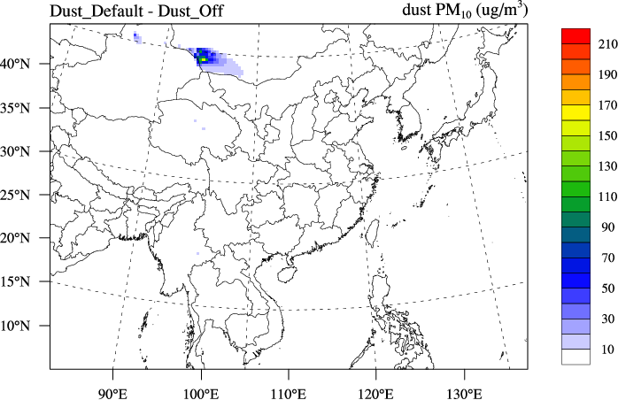
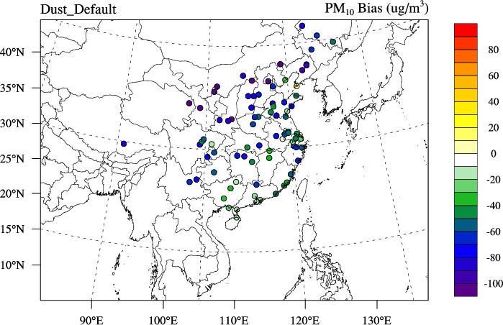
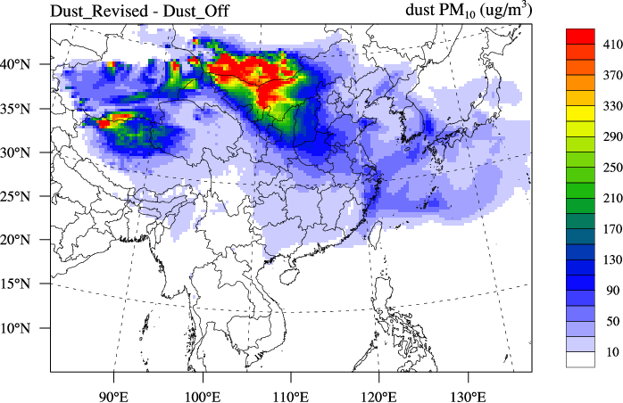
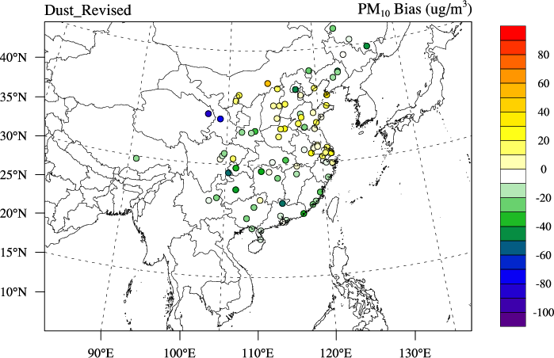
Results: Dust Emission
Simulated Dust PM₁₀
PM₁₀ Bias vs API
Default
Revised

Slide 10
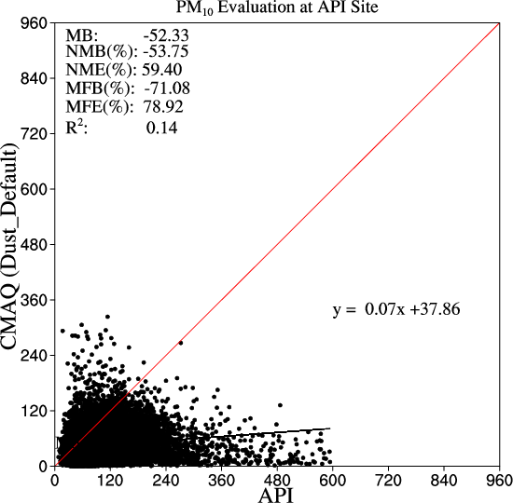
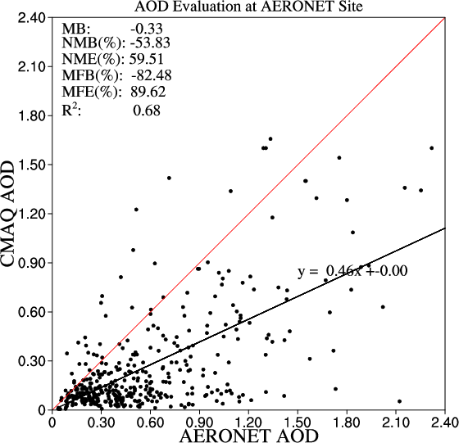
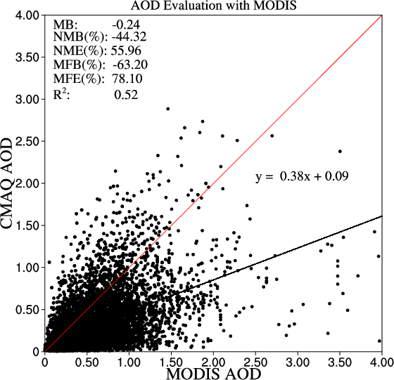
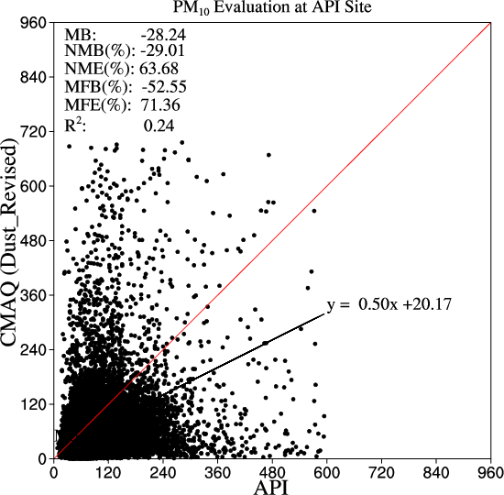
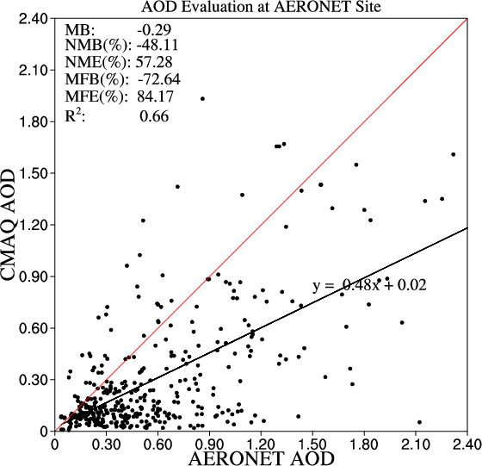

Evaluation Statistics
Revised dust scheme significantly improve the model’s performance of reproducing PM₁₀ and AOD over East Asia, but simulation still contain large uncertainties
PM₁₀ vs API
AOD vs AERONET
AOD vs MODIS
Default
Revised
Notes:
PM10 is evaluated with API data from China MEP, the scatter plot and statistics are calculated with 5-years (2006-2010) simulation/observation data for March and April.
AOD from simulation is evaluated against both surface observation AERONET and satellite MODIS

Slide 11
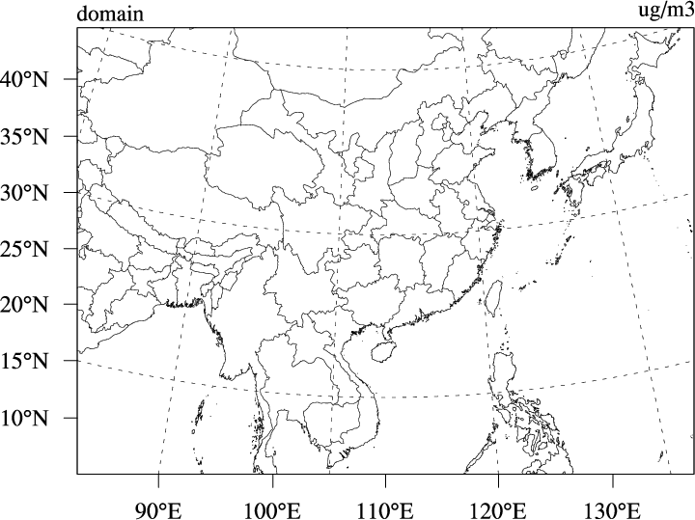
Model Improvement – Trace Metals
Model evaluations of fine mode trace metals with Default and Revised speciation profiles at Tazhong, Duolun, and Yulin
Taklamakan
Gobi
Tazhong
Duolun
 | PM_{2.5} | K⁺ |  | Mg²⁺ |  | Ca²⁺
 |  | Default | Revised | Default | Revised | Default | Revised
Mean Obs (µg/m³) | 81.52 | 0.23 |  | 0.19 |  | 2.24
Mean Sim (µg/m³) | 44.36 | 0.69 | 0.12 | 0.02 | 0.12 | 3.06 | 1.05
Mean Bias (µg/m³) | -37.17 | 0.46 | -0.11 | -0.17 | -0.07 | 0.82 | -1.19
Normalized MB (%) | -45.59 | 208.9 | -47.83 | -99.8 | -36.84 | 36.69 | -53.12
Correlation | 0.67 | 0.42 | 0.44 | 0.22 | 0.51 | 0.22 | 0.44
Yulin
Default Profile
Revised Profile
PM_{2.5}
Notes:
(1). CMAQ assign 20% of dust into fine mode (PM2.5) and 80% to coarse mode (PM10-PM2.5). Underestimation of PM2.5 should be due to this reason. But Fudan’s data only have TSP instead of PM10, so we cannot make changes in CMAQ. We need more local data to revise this ratio in future study.
(2). NMB values of K and Mg are reduced significantly, indicating the better model performance by using the source-dependent profile
(3). NMB of Ca is decreased from 36.69 to -53.12. Although it seems the performance is worse, but considering the overall underestimation of PM2.5, the underestimate of Ca is more reasonable in Revised model. Also, all correlation coefficient is increased in Revised model

Slide 12
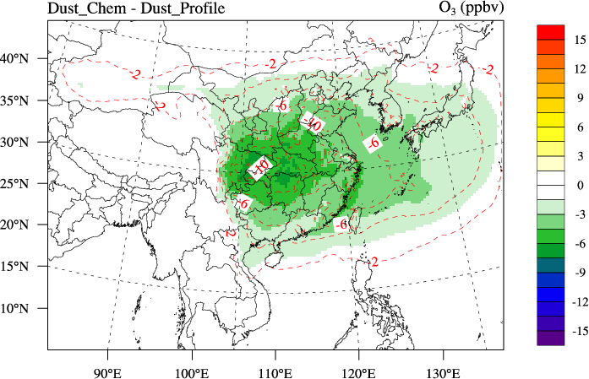
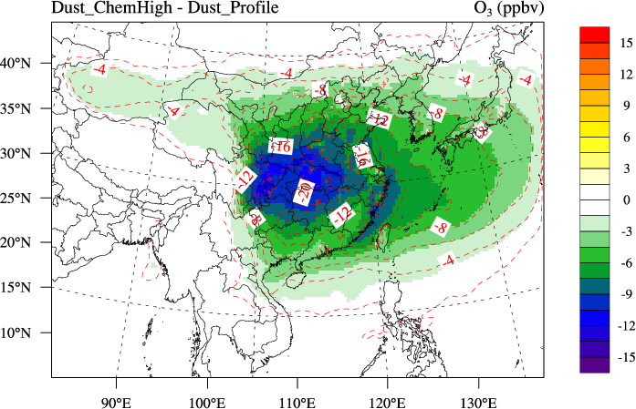
Impact of Dust Chemistry
Spatial Distribution
with lower uptake coefficient
with higher uptake coefficient
O₃
Evaluation Statistics Against EANET observation
 | Mean Bias |  |  | NMB (%) |  |  | Correlation
 | No_Chem | Chem_Low | Chem_High | No_Chem | Chem_Low | Chem_High | No_Chem | Chem_Low | Chem_High
O₃ (ppbv) | 0.59 | -0.92 | -2.07 | 1.26 | -1.97 | -4.43 | 0.63 | 0.62 | 0.59
SO₂ (ppbv) | 0.54 | 0.42 | 0.38 | 90.7 | 69.83 | 63.7 | 0.67 | 0.65 | 0.64
SO₄²⁻ (µg/m³) | -0.71 | 0.6 | 1.29 | -16.28 | 13.74 | 29.43 | 0.78 | 0.75 | 0.72
HNO₃ (ppbv) | 0.46 | 0.36 | 0.35 | 109.03 | 85.17 | 81.24 | 0.64 | 0.6 | 0.58
NOx (ppbv) | 0.63 | 0.67 | 0.68 | 35.61 | 37.79 | 38.21 | 0.7 | 0.7 | 0.7
NO₃⁻ (µg/m³) | -0.2 | -0.03 | 0.37 | -13.07 | -1.97 | 24.09 | 0.7 | 0.72 | 0.72
Notes:
ozone is decreased due to dust heterogeneous chemistry, the impact ranges from -2% to -10% with lower uptake coefficient, and from -4% to -20% with higher uptake coefficient
Chem_Low means model simulation with lower uptake coefficient; Chem_High means with higher uptake coefficient
Red means better performance with chemistry, green means worse performance with chemistry

Slide 13
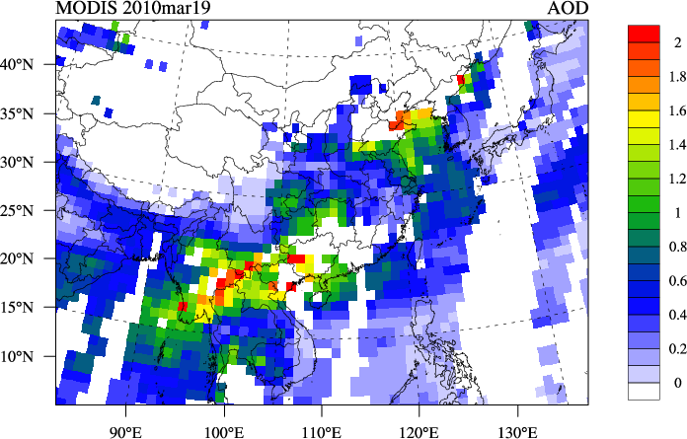
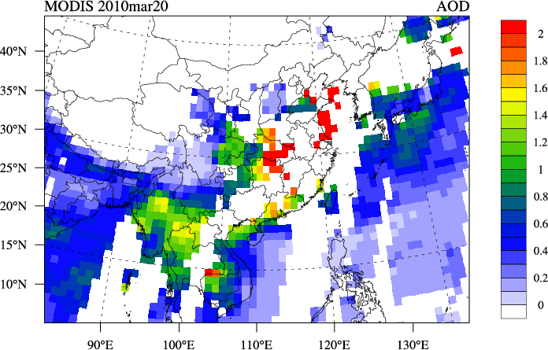
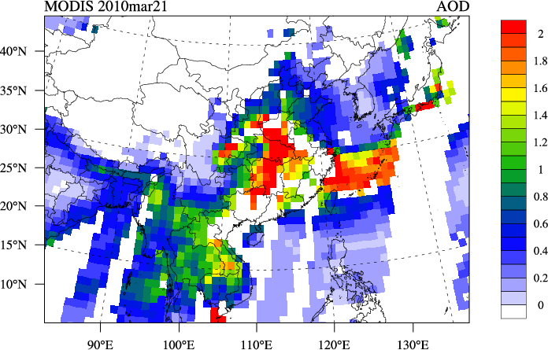
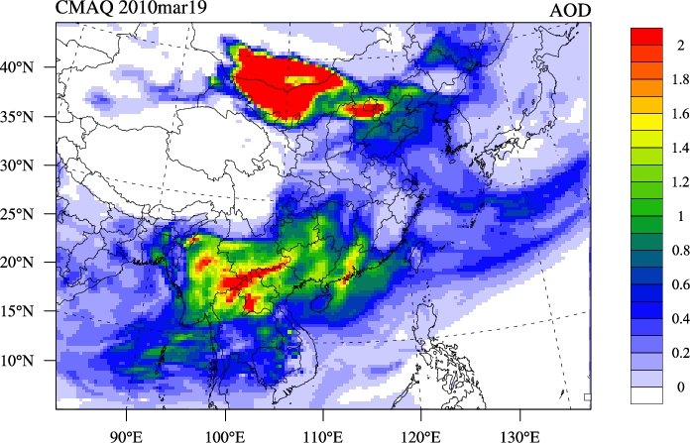
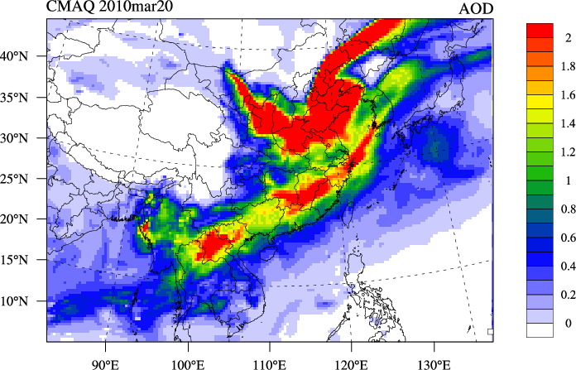
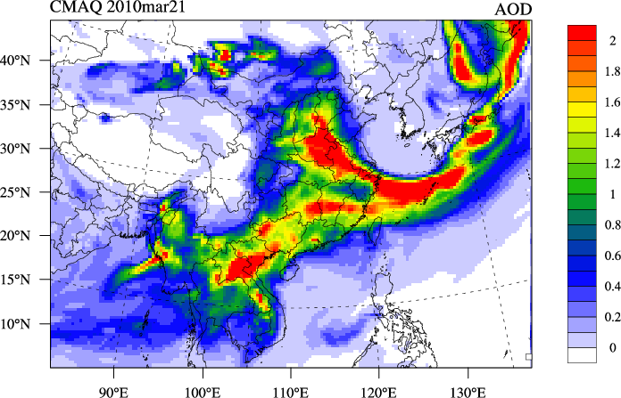
Case Study: Dust Strom Mar. 19-21, 2010
Spatial distribution of simulated AOD is consistent with MODIS product
Mar.19
Mar.20
Mar.21
MODIS
CMAQ
(revised)

Slide 14
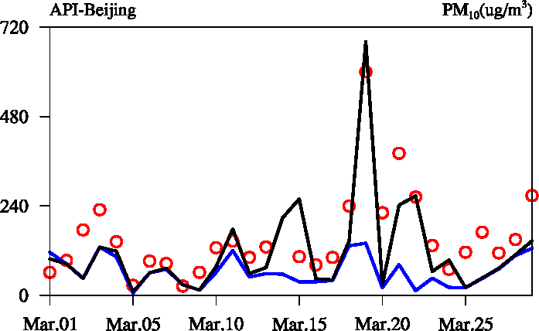
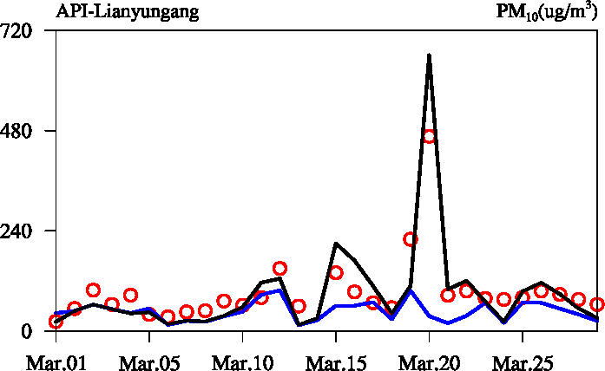
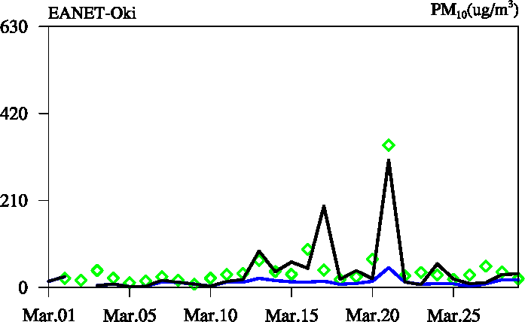
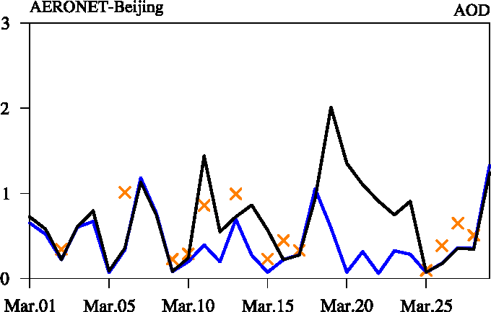
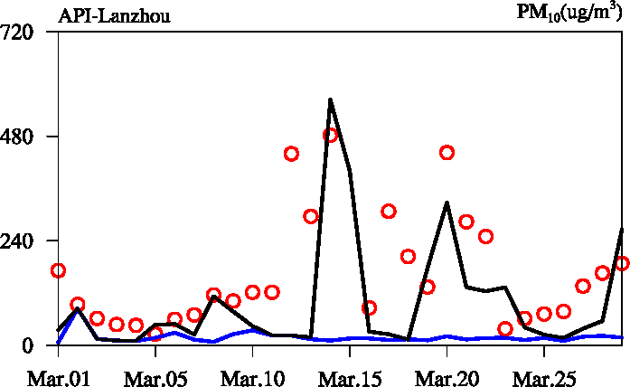
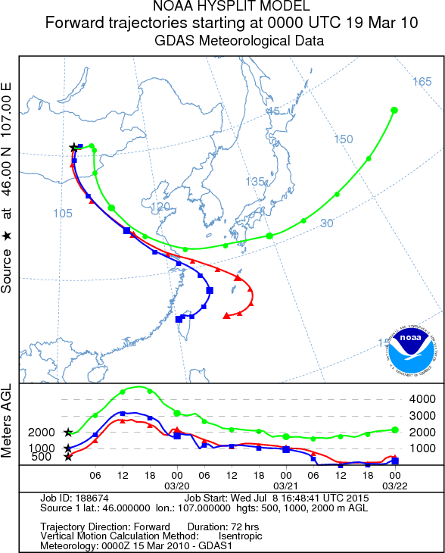
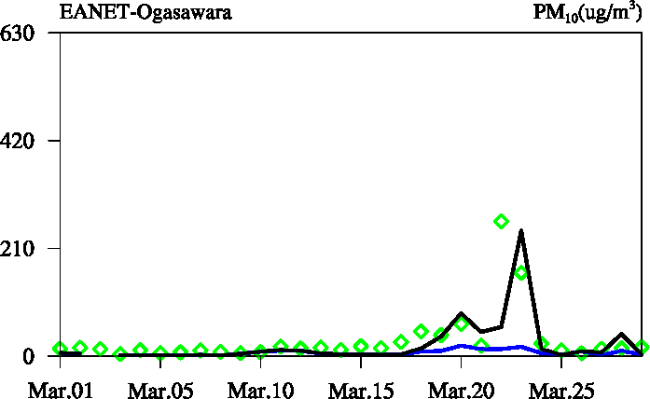
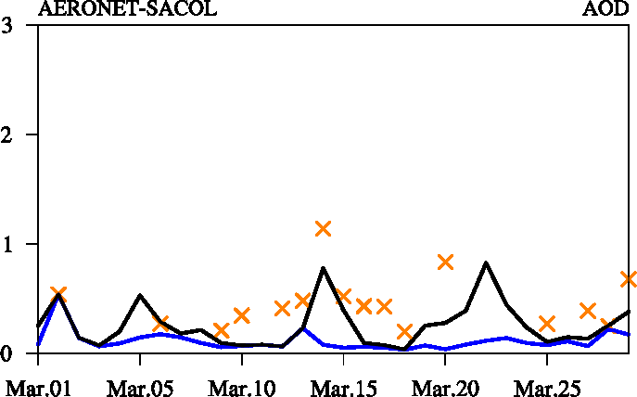
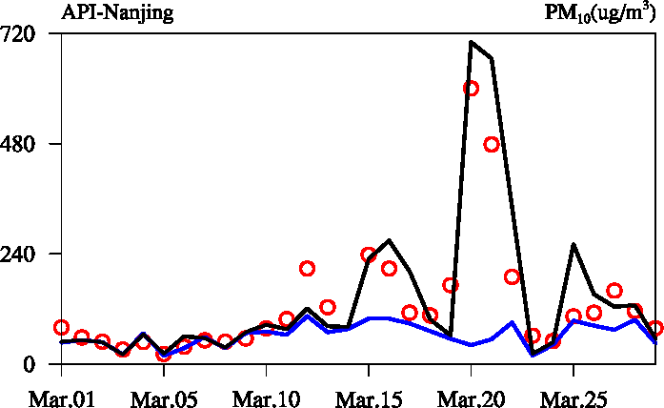
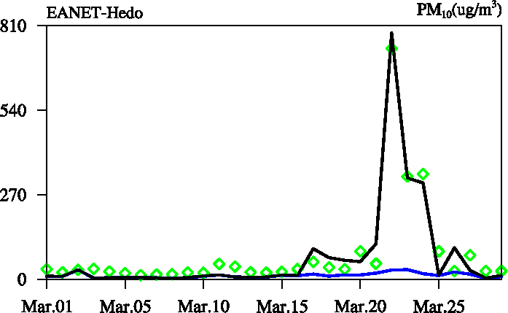
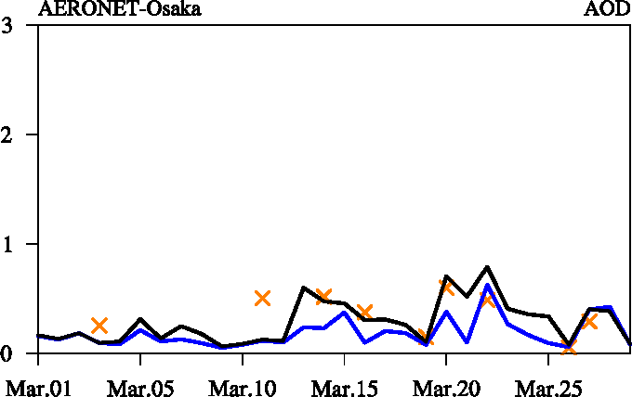
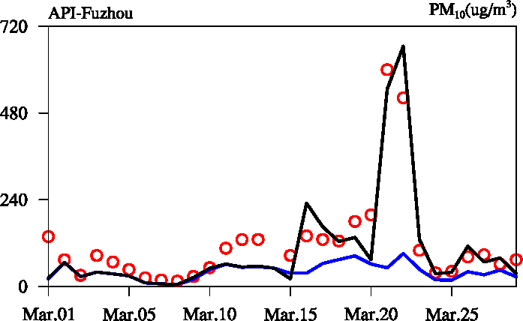
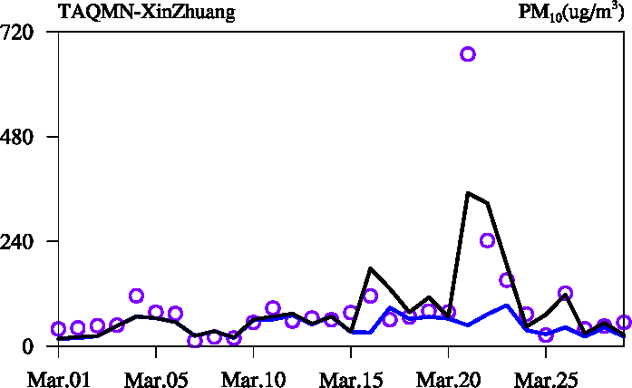
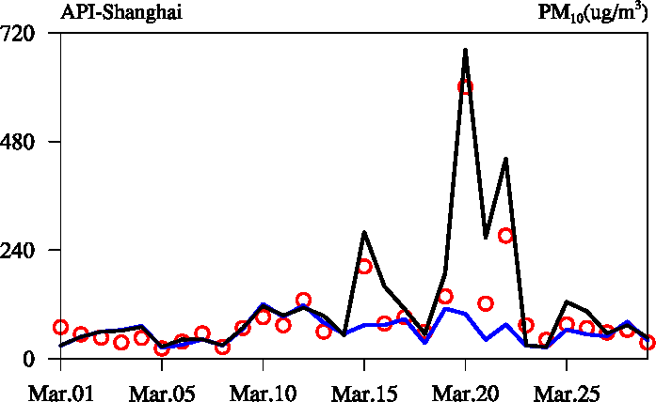
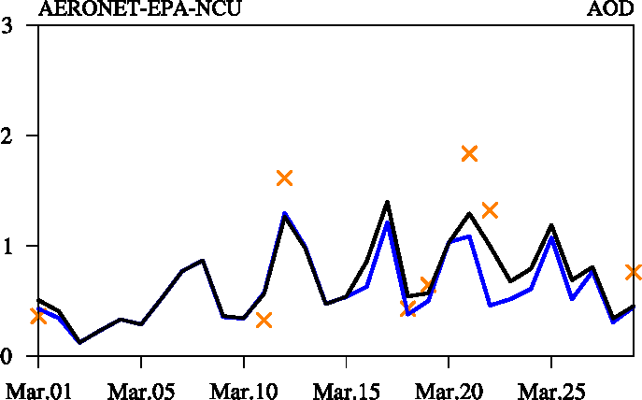
Case Study: Dust Strom Mar. 19-21, 2010
Default
EANET
x AERONET
Revised
API
Notes:
(1). severe dust strom on Mar.19-21, 2010
(2). Figure (f) is the HYSPLIT forward trajectory analysis
(3). Figure (a), (b), (c), (d), (e), (k) is the comparison of simulation (black line: revised model; blue line: default CMAQ) against API PM10 observations (red cycles)
(4). Figure (h), (i), (j) is the comparison of simulation against EANET PM10 (blue diamonds)
(5). Figure (g) is the comparison of simulation against Taiwan PM10 (purple cycles)
(6). Figure (l), (m), (n), (o) is the comparison of simulation against AERONET AOD (orange cross)

Slide 15
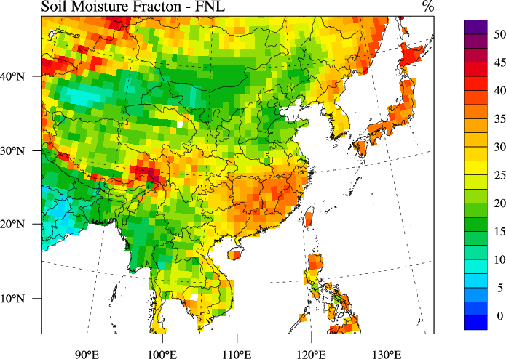
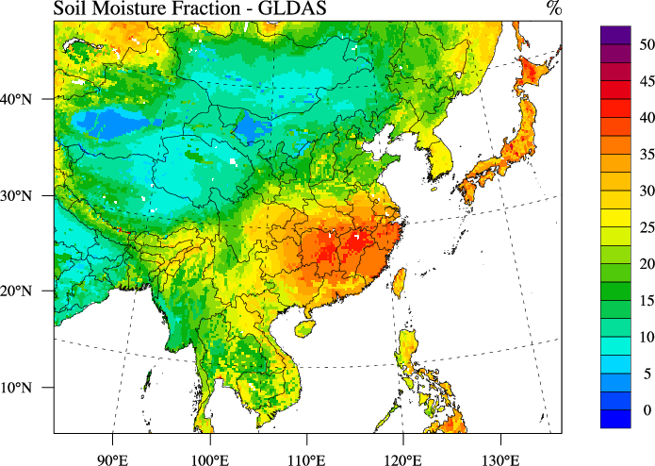

Uncertainties
(1) PM_{2.5} mass ration in dust emission
CMAQ (PM_{2.5}/PM₁₀) | Measurement (PM_{2.5}/TSP)
 | Tazhong | Duolun | Yulin
20% | 44.6% | 42.7% | 39.5%
Systematic underestimation of fine mode aerosols
$$u_{∗ti,j}$$
(1) Overestimation of
(2) Excessive soil moisture in FNL
(Zender et al., 2013; Haustein et al., 2012)
(2) Underestimation of T, wind speed
Notes:
(1). severe dust strom on Mar.19-21, 2010
(2). Figure (f) is the HYSPLIT forward trajectory analysis
(3). Figure (a), (b), (c), (d), (e), (k) is the comparison of simulation (black line: revised model; blue line: default CMAQ) against API PM10 observations (red cycles)
(4). Figure (h), (i), (j) is the comparison of simulation against EANET PM10 (blue diamonds)
(5). Figure (g) is the comparison of simulation against Taiwan PM10 (purple cycles)
(6). Figure (l), (m), (n), (o) is the comparison of simulation against AERONET AOD (orange cross)

Slide 16
Evaluation of Inline WRF/CMAQ
Shortwave radiation flux evaluate against CERES
Evaluate against NCDC observations
 |  | Mean Obs(W/m²) | Mean Sim(W/m²) | MB (W/m²) | NMB (%) | R
TOA | Clear sky | 66.14 | 75.9 | 9.79 | 14.80 | 0.91
 | All sky | 113.98 | 109.45 | -4.53 | -3.98 | 0.89
SFC | Clear sky | 282.03 | 280.29 | -1.73 | -0.61 | 0.86
 | All sky | 221.55 | 238.98 | 17.43 | 7.87 | 0.93
 | Mean Obs | Mean Sim | MB | NMB (%) | R
T | 283.43 (K) | 282.49 (K) | -0.95 (K) | 3.9 | 0.94
Humidity | 5.36 (g/kg) | 5.61 (g/kg) | 0.25 (g/kg) | 4.6 | 0.95
WS | 3.98 (m/s) | 4.86 (m/s) | 0.87 (m/s) | 21.8 | 0.71
WD | 239.57 (°) | 258.03 (°) | 18.46 (°) | 7.7 | 0.83
Temperature and Relative Humidity evaluated against MODIS
 | Height | Mean Obs (K) | Mean Sim (K) | MB (K) | NMB (%) | R
T | 1000hPa | 293.85 | 294.20 | 0.35 | 0.12 | 0.99
 | 950hPa | 290.77 | 290.81 | 0.04 | 0.01 | 0.99
 | 920hPa | 288.98 | 289.22 | 0.24 | 0.08 | 0.98
 | 850hPa | 284.47 | 285.03 | 0.55 | 0.19 | 0.99
 | 780hPa | 280.58 | 280.97 | 0.39 | 0.14 | 0.99
 | 700hPa | 275.32 | 276.00 | 0.68 | 0.25 | 0.99
 | 620hPa | 269.27 | 270.65 | 1.39 | 0.51 | 0.99
 | 500hPa | 258.71 | 260.58 | 1.87 | 0.72 | 0.99
 | Height | Mean Obs (%) | Mean Sim (%) | MB (%) | NMB (%) | R
RH | 1000hPa | 86.55 | 87.20 | 0.65 | 0.76 | 0.64
 | 950hPa | 82.61 | 86.72 | 4.11 | 4.97 | 0.87
 | 920hPa | 80.62 | 82.98 | 2.36 | 2.92 | 0.90
 | 850hPa | 74.04 | 74.69 | 0.64 | 0.87 | 0.93
 | 780hPa | 67.20 | 71.16 | 3.96 | 5.90 | 0.89
 | 700hPa | 62.93 | 68.42 | 5.48 | 8.72 | 0.87
 | 620hPa | 60.69 | 6.66 | 1.98 | 3.26 | 0.70
 | 500hPa | 53.09 | 59.47 | 6.38 | 12.02 | 0.76

Slide 17
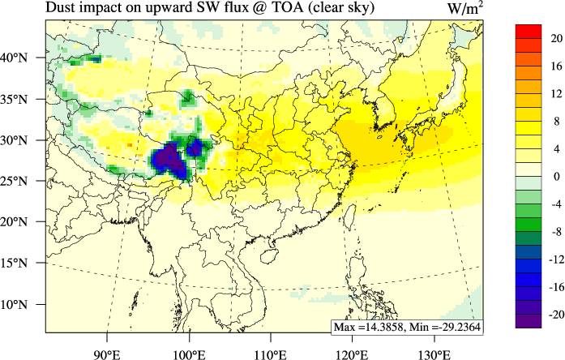
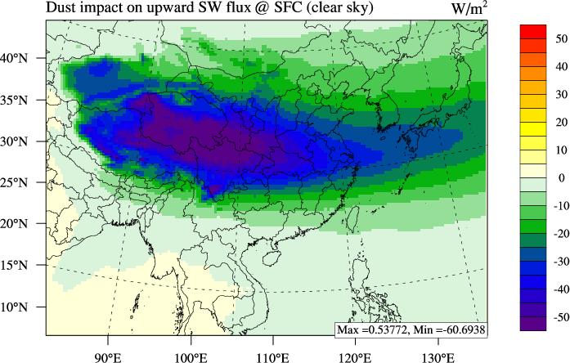
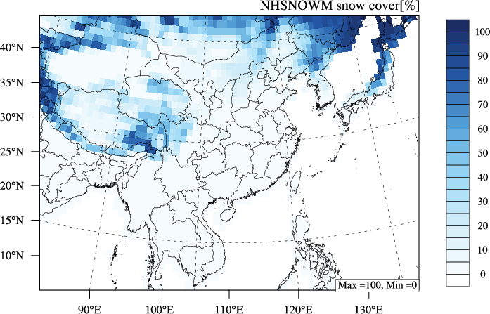
Dust Impact in Two-way WRF/CMAQ
Dust induced Shortwave Radiation Change
Upward @ TOA
Downward @ Surface
Compare with other studies
Snow cover (NHSNOWM)
Region | Method | Dust induced change @ TOA (W/m²) | Dust induced change @ SFC (W/m²)
South Korea | CCM3 (Won et al., 2005) | 5 ~ 10 | -20 ~ -10
 | This study | 5 ~ 10 | -30 ~ -10
East China | CCM3 (Park et al., 2005) | 10 ~ 20 | -40 ~ -10
 | ADAM (Park et al, 2008) | - | -40 ~ -20
 | This study | 5 ~ 15 | -60 ~ -20
Tibet Plateau | MFRSR (Ge et al., 2011) | -4 ~ 3 | -20 ~ -10
 | fvGCM (Lau et al., 2006) | -2 | -13
 | WRF-Chem (Chen et al., 2013) | -4 | -6
 | This study | -30 ~ 5 | -10 ~ -60
Taklamkan | RTM, CALIPSO (Kuhlmann and Quaas, 2010) | - | -60 ~ -90
 | This study | 0 ~ 5 | -20 ~ -40
Hengduan Mountains

Slide 18
Summary
Preliminary Conclusions:
  Revised friction velocity threshold constants and source-dependent speciation profiles help to improve the model predictions for PM10, AOD and trace metals
  Large discrepancies still remain due to possible uncertainties from: dust speciation, and soil moisture
  Inline mode indicated strong cooling effect of dust particles at surface, especially over snow cover areas
Next steps:
  Examine dust particle’s evolution through chemistry with CaCO₃ and Fe₂O₃
  Sensitivity studies to eliminate the uncertainties within fine particles ratio and soil moisture

Slide 19
Acknowledgement
We acknowledge Dr. David Wong for his help on reposing technical questions, and NSF National Institute for Computational Sciences (NICS) at the University of Tennessee for providing the computer sources for model simulations of this research.

Slide 20
Thanks !

