Slide 1
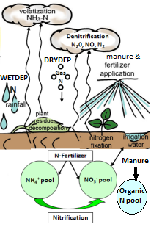
Further Steps for Improving Soil NOx Estimates in CMAQ
*Adapted from Cooter et al., 2012
Quazi Ziaur Rasool, Rui Zhang, Benjamin Lash, Daniel S. Cohan
Rice University, Houston, TX

Slide 2
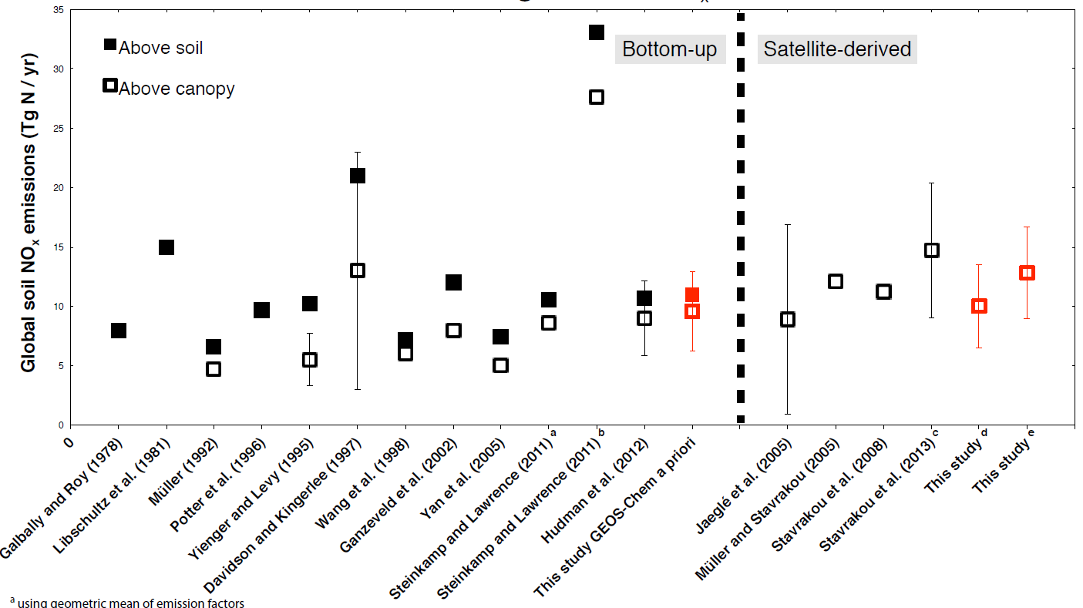
Why study soil NO_{x}?
NO_{x} contributes to:
Ozone and PM formation
Net cooling of the climate
N deposition and acid rain
Soil NO_{x} ~ 19% of Global NO_{x} Budget (Vinken et al. 2014)
Large underestimations and uncertainties in Soil NO_{x} inventories
Extrapolated
12.9
9
9.6
10
6.2
Conservative
OMI
Top-down
[Source: Vinken et al., ACP 2014]

Slide 3
Formation of Soil NO
Biotic (Nitrification-Denitrification):
Microbial action on soil N
All sources of N can be converted to NO₃⁻-N
Abiotic (Chemo-denitrification):
non-enzymatic conversion of NO₂⁻ or NO₃⁻
low pH; higher NH₄⁺ ,NO₂⁻, reduced metal, organic matter and moisture
NH₄⁺ NH₂OH HNO NO NO₂⁻
NO NO₂⁻ NO₃⁻
(NH₄⁺-N + NO₃⁻-N + Organic N)
Microbial Nitrification
Org-N
Mineralization
Fe²⁺ ; H⁺
Microbial Denitrification
Chemo-denitrification
NO
[Source: Pilegaard, Phil Trans R Soc B 2013
and Medinets et al., Soil Bio & Biochem 2015]
Affected by soil pH, moisture, Temp.; N availability & Vegetation type

Slide 4
Berkeley Dalhousie Soil NO Parameterization (BDSNP) vs. standard Yienger & Levy scheme in CMAQ
Features | Yienger-Levy | BDSNP
Land surface model | No LSM to be based upon | Uses GEOS-Chem LSM
Soil temperature (T) | Soil T = f (Air temp) | Soil T from GEOS-Chem LSM
Soil Moisture (θ) | Poor soil moisture data | Soil moisture from GEOS-Chem LSM
Response to Soil Moisture (θ) | Accounts for rainfall instead of soil moisture | Accounts for soil moisture, rain-induced pulsing after drought
Deposition | Not accounted for | Takes N deposition in to account
Emission response | Overestimated in wet soil Weak correlation in dry soil | Non-linear response to T & θ, sophisticated emission response
[Source: Hudman et al, ACP 2012]

Slide 5
Enhancements to BDSNP
Uses biomes from CMAQ fine-resolution LSM (Pleim-Xiu)
North American or global biome emission factors
Uses EPIC dynamic daily fertilizer fields in place of fixed
Created a stand-alone (offline) version
Allows rapid creation of soil NO inventories and testing of sensitivities to fertilizer application, input parameters, etc.
Uses meteorological fields but not photochemical model
Requires assumptions for N-deposition to soils

Slide 6
BDSNP Soil NO scheme implemented in CMAQ v5.0.2
Soil NO Flux = A’(Biome, Soil Nitrogen (Deposition, Fertilizer)) x f(T) x g(θ) x
Pulse(Dry Period) x Canopy Reduction
Biome Emission Factors
(LU/LC + climate zones)
(Steinkamp and Lawrence, 2011)
Old: GEOS-Chem LSM
New: Pleim-Xiu LSM from CMAQ (NLCD40 land use category - option of Global and North American emission factors )
Deposition
Inline BDSNP: Deposition from CMAQ
Offline BDSNP:
Uses deposition fields from benchmarked run
Fertilizer
Old: Potter (2010) for 1994-2001
New: Daily EPIC simulation for 2011
Potter or EPIC Fertilizer N pool data
Soil N = Biome N + Deposition N + Fertilizer N
Meteorology (WRF) and
Land Surface Model (Pleim Xiu)
Soil Temperature (T) and Soil Moisture (θ) for emission response
Antecedent dry period length for Pulse Emission Factor
Radiation/wind/pressure for Canopy Reduction Factor
Soil NO Emission Rate

Slide 7
Soil biome/Land Use Dataset Comparison
GEOS-Chem Biome map (0.25° x 0.25°)*
CMAQ MODIS NLCD40 biome map (12 km)*
(Warm)
(Cold)
Previous BDSNP (inline with GEOS-Chem)
24 Land use categories - MODIS LU/LC classification
Too coarse for regional modeling
Current BDSNP (inline with CMAQ / offline)
MODIS 24 Land use types regrouped (from NCLD 40 category LU/LC map)
Köppen-Geiger climate zone definition (Kottek et al., Meteorol. Z. 2006), re-gridded to 12 km grid size
*Both based on global emission factors Stienkamp & Lawrence, ACP 2011

Slide 8
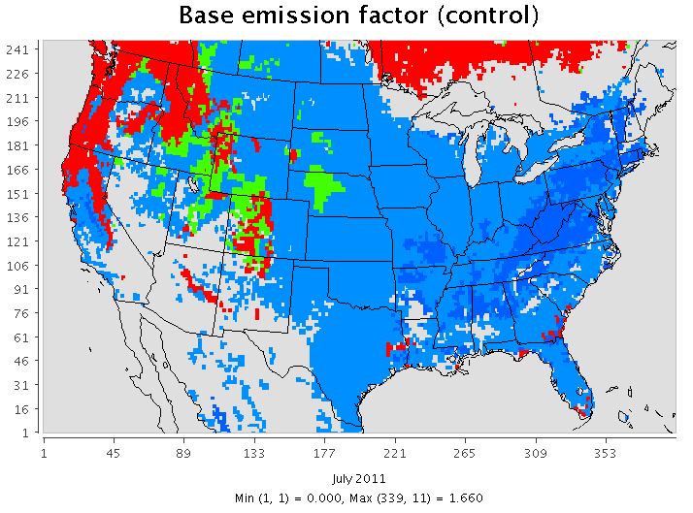
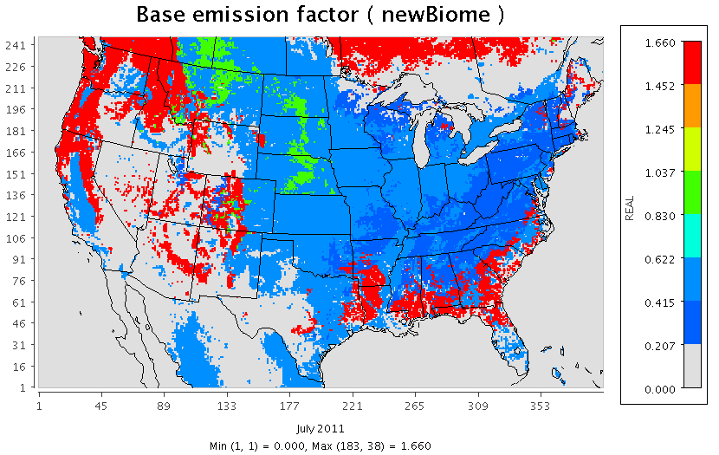
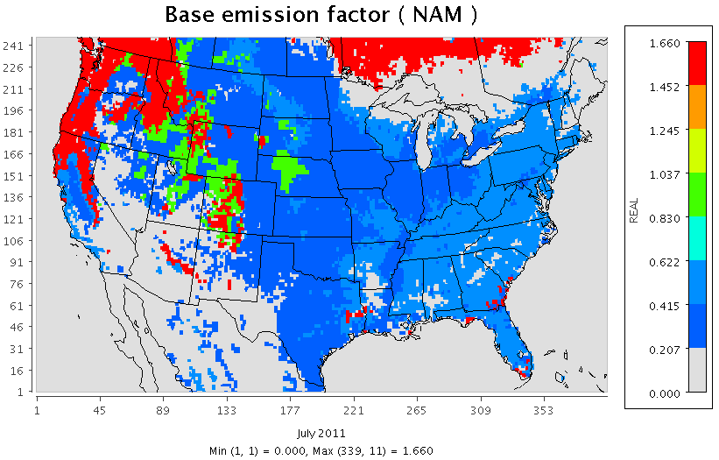
Flexibility to use different biome emission factors
GEOS-Chem biomes with global S&L* CMAQ NLCD biomes with global S&L*
CMAQ NLCD biomes with
North American S&L*
East US- more broadleaf forest (higher biome emission factor) than other parts of world
Midwest- Croplands in other regions like Asia emit higher NO than in US
^{*S&L}Steinkamp, J. and Lawrence, M. G. (2011) Improvement and evaluation of simulated global biogenic soil NO emissions in an AC-GCM. Atmospheric Chemistry and Physics, 11(12), 6063–6082. doi:10.5194/acp-11-6063-2011

Slide 9
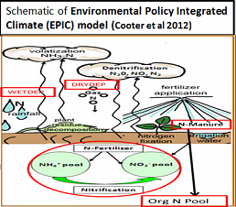
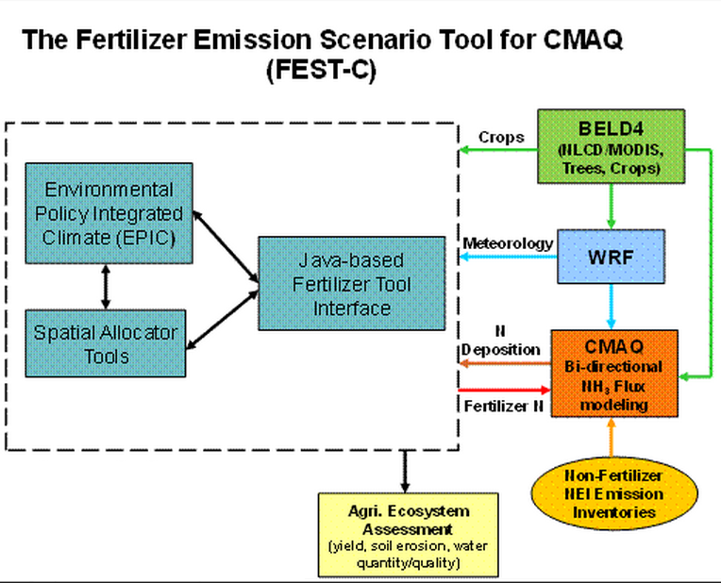
Dynamic Fertilizer & Control Scenarios input:
EPIC outputs as CMAQ inputs
EPIC
Grid-wise Crop types cultivated (Crop fraction file consistent with NLCD LU/LC)
+
Grid-wise daily soil N (classified as separate NH₄⁺-N , NO₃⁻-N , Organic N pools)
Total daily soil N (= NH₄⁺-N + NO₃⁻-N + Organic N ) pool input into BDSNP
[Weighted sum as per grid crop fraction]
[Source: Cooter et al., Biogeosciences 2012 and FEST-C User manual]

Slide 10
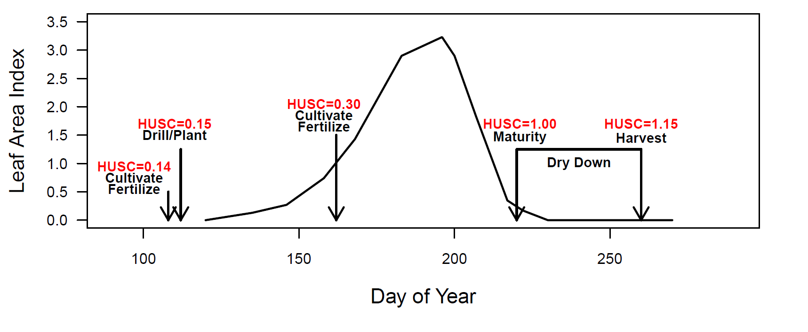
Environmental Policy Integrated Climate (EPIC) model
Fertilizer Application Rate estimates-
USDA Agricultural Resource Management Survey database
Validated with fertilizer sales rate
Heat Unit Scheduling (HUSC), plant nutrient stress drive fertilizer timing
[Source: Cooter et al., Biogeosciences 2012]

Slide 11
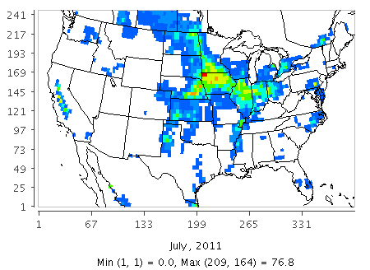
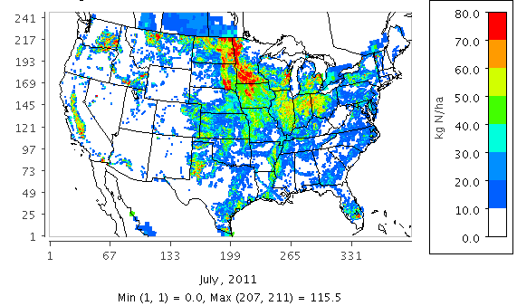
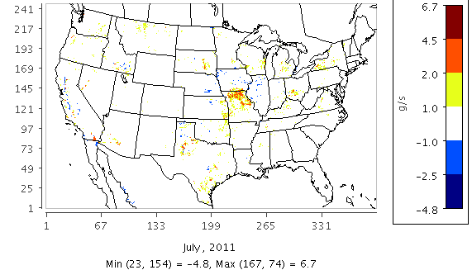
Impact of EPIC vs. Potter Fertilizer Data on Soil NO
Control (Potter)
EPIC
Fertilizer
Application (kgN/ha)
EPIC - Potter
Difference in Soil NO (g/s) (EPIC - Potter)*
*Averaged over July 2011, and based on NLCD biome map with global emission factors from S&L 2011

Slide 12
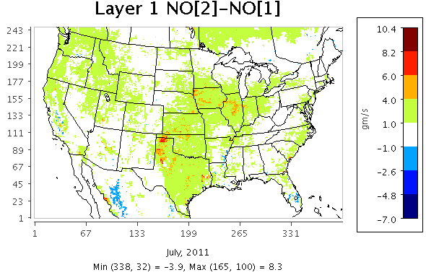
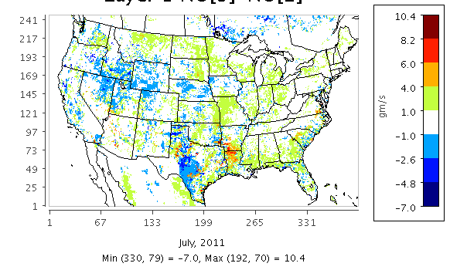
Sub-domain soil NO (monthly mean)
BDSNP (Potter with Old Biome) - YL
(EPIC with New Biome) – (Potter with Old Biome)
NW
NW
Mid-West
Mid-West
NE
NE
SW
SW
SE
SE
South
South

Slide 13
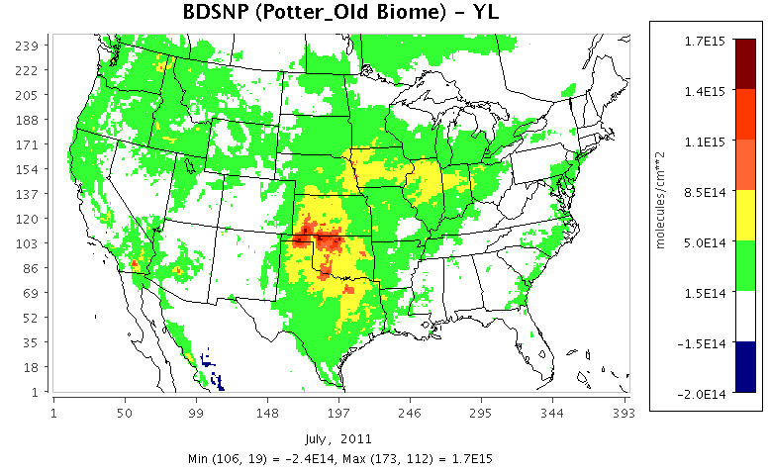
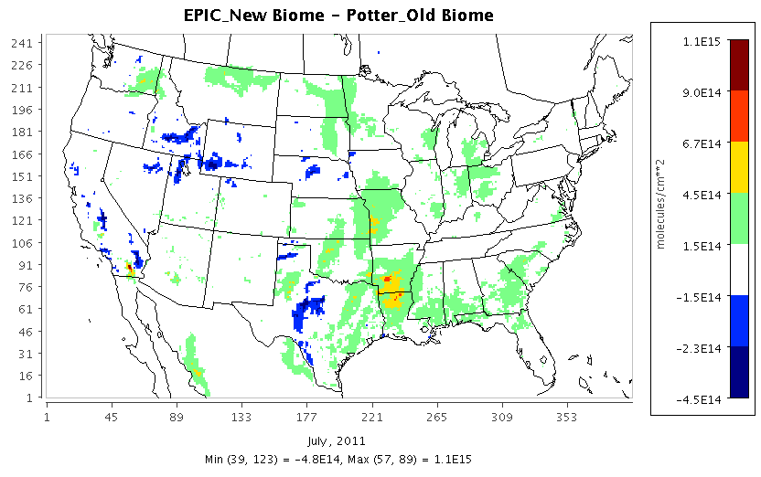
Impact of different soil NO schemes on NO₂ column (Monthly mean)
BDSNP (Potter with Old Biome) - YL
(EPIC with New Biome) – (Potter with Old Biome)

Slide 14
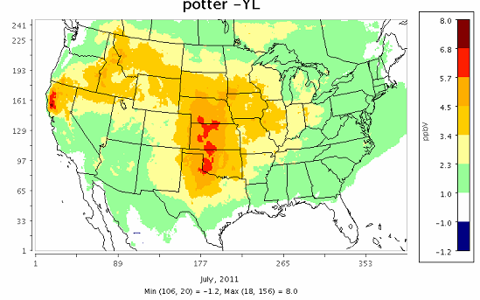
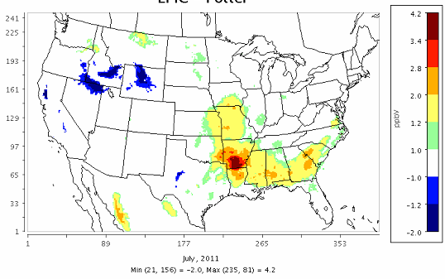
Impact of different soil NO schemes on MDA8 Ozone (Monthly Mean)
BDSNP (Potter with Old Biome) - YL
(EPIC with New Biome) – (Potter with Old Biome)

Slide 15
Aggregated metrics for model performance (3 cases inline with CMAQ)
MDA8 Ozone (July 2011)
Daily Avg. PM2.5 (July 2011)
PM2.5 (Daily) Observed data from IMPROVE sites¹
Ozone Observed data from EPA’s AIRS AQS (Air Quality System) network²
Aggregated performance metrics for sites showing higher sensitivities between 3 cases (including sites exceeding EPA standard in case of Daily max. 8-hr ozone)
¹http://www3.epa.gov/airquality/airdata/
²http://views.cira.colostate.edu/fed/Datasets/Default.aspx

Slide 16
Conclusions
BDSNP updates: Finer-scale representation of soil NO dependence on land use, soil conditions, and N availability
Finer resolution results in higher sensitivity of soil NO to biome emission factors
New BDSNP predicts higher soil NO due to dynamic fertilizer data and fine resolution biomes
Non-linear trend in soil NO with soil parameters and meteorology
Slight decrease in NMB for ozone and PM
Need closer inspection of performance in regions with largest soil NO changes

Slide 17
Acknowledgements
NASA AQAST TIGER Soil NOx Project funding
Ellen Cooter, Jesse Bash (US EPA)

Slide 18
Extra Slides

Slide 19
Inline BDSNP: Three WRF-BEIS-CMAQ simulation cases
YL - EPA standard configuration with YL95 soil NO scheme
BDSNP (Potter with old Biome) – BDSNP soil NO scheme with GEOS-Chem soil biome classification and Potter at al. (2010) fertilizer data
BDSNP (EPIC with new Biome) – BDSNP soil NO scheme with NCLD40 Global soil biome and EPIC fertilizer data

Slide 20
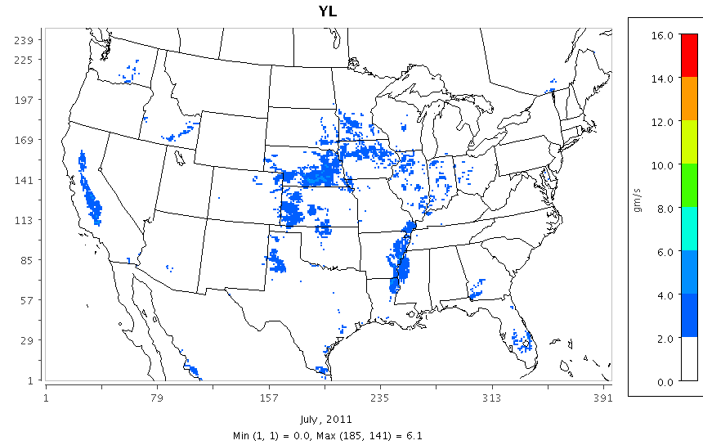
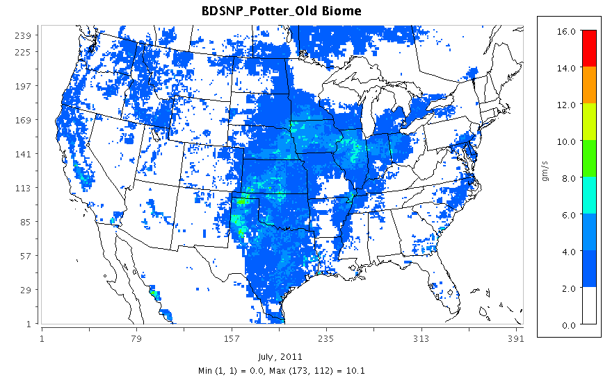
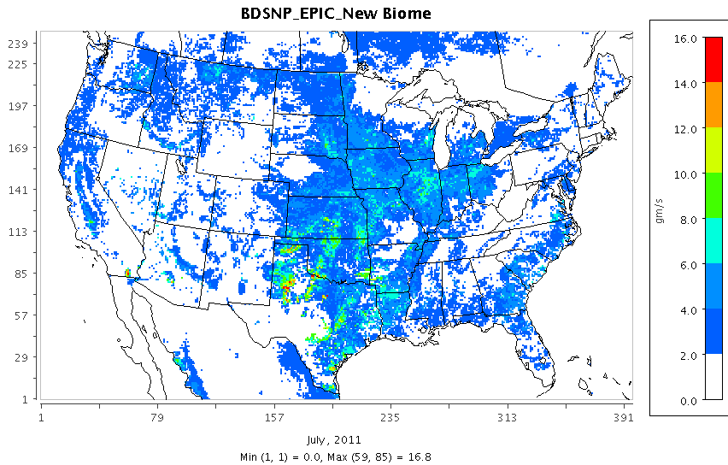
Monthly Mean (July 2011) Soil NO
YL
BDSNP (Potter with Old Biome)
BDSNP (EPIC with New Biome)

Slide 21
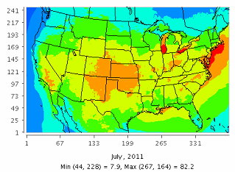
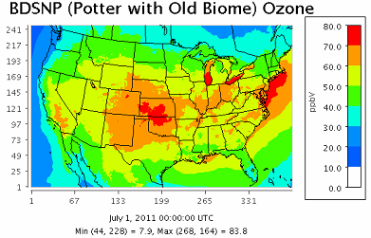
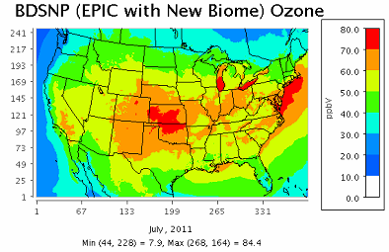
Monthly mean(July 2011) MDA8 O₃
YL
BDSNP (Potter with Old Biome)
BDSNP (EPIC with New Biome)

Slide 22
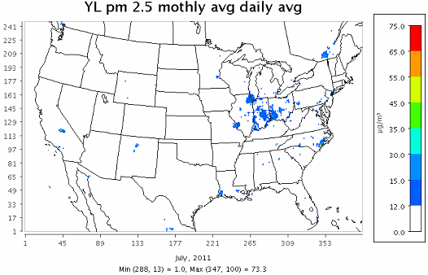
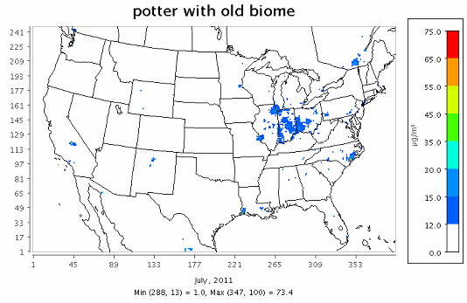
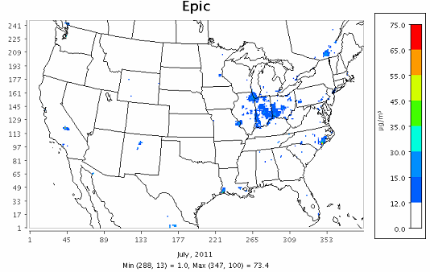
Monthly mean(July 2011) Daily Avg. PM 2.5
YL
BDSNP (Potter with Old Biome)
BDSNP (EPIC with New Biome)

Slide 23
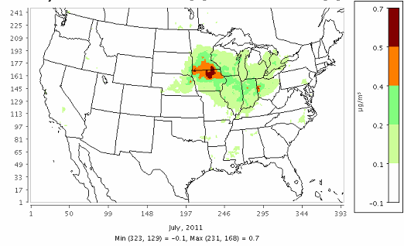
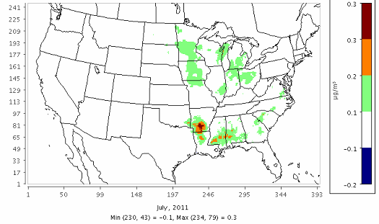
Impact of different soil NO schemes on Daily Avg. PM 2.5 (Monthly mean)
BDSNP (Potter with Old Biome) - YL
(EPIC with New Biome) – (Potter with Old Biome)

Slide 24
Effect of varying Fertilizer and Biome inputs on soil NO (based on Monthly mean estimates for July 2011)

