Slide 1
Parallel I/O in CMAQ
David Wong, C. E. Yang*, J. S. Fu*, K. Wong*, and Y. Gao**
*University of Tennessee, Knoxville, TN, USA
**now at: Pacific Northwest National Laboratory, Richland, WA, USA
CMAS Conference
October 5, 2015

Slide 2
Background
IOAPI was developed over 20 years ago
It was designed for serial operation (with OpenMP capability)
CMAQ uses it for performing data input and output functions
IOAPI package provides very simple and nice interface to handle netCDF format of data
I/O has been reported as one of the performance bottlenecks in CMAQ

Slide 3
PARIO
It was developed in 1998
It was built on top of IOAPI with a “pseudo” parallel implementation
Single read and single write

Slide 4
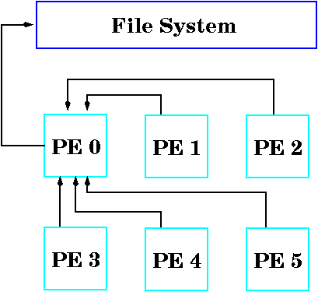
CMAQ I/O Scheme

Slide 5
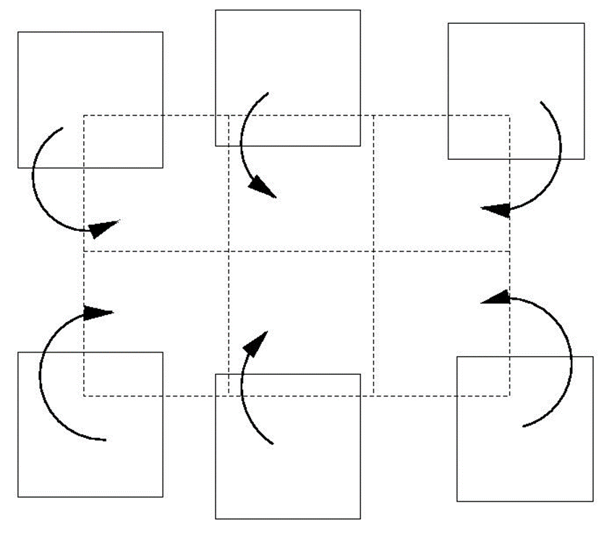
CMAQ I/O Scheme (cont’)

Slide 6
What is pnetCDF?
developed by Northwestern University and Argonne National Laboratory
Build on top of MPI2
Based on netCDF format
Requires Parallel File System (e.g. Lustre, GPFS)
Publicly available free software

Slide 7
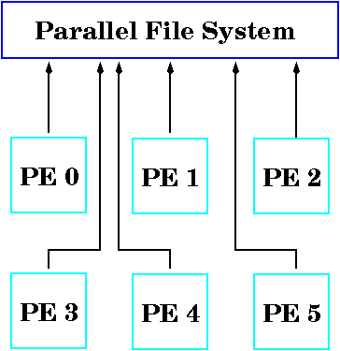
Parallel I/O Scheme

Slide 8
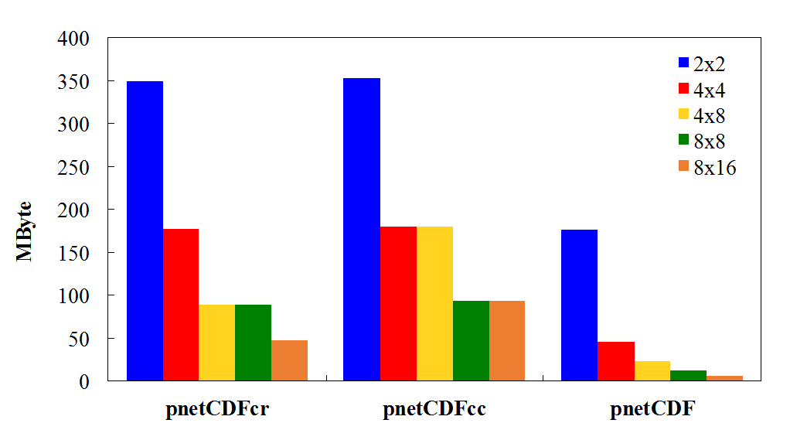
Among of Data in a Processor

Slide 9
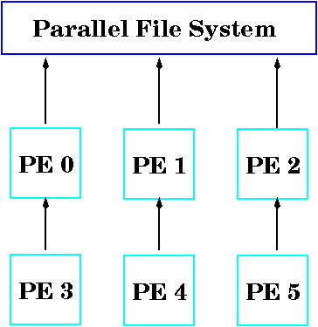
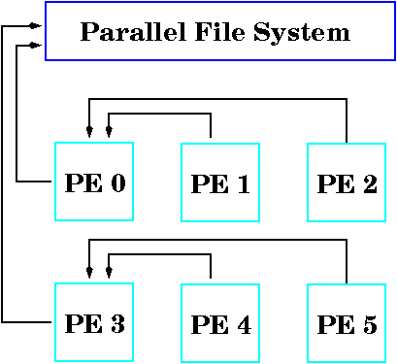
With Data Aggregation
aggregate along column, cc
aggregate along row, cr

Slide 10

With Data Aggregation (cont’)

Slide 11
Experiment Setup
Consider three sizes of domain: CA (89x134), Eastern US (279x299), and US conus (459x299)
35 layers and 146 species
Reading in or writing out three time steps of data, using variable techniques: regular, pnetcdf, and data aggregation along a dimension
Tested on two DOE machines: Edison and Kraken with Lustre file system
Experimenting various stripe counts (2, 5, 11) and sizes (1M, 2M, 4M, 8M, 16M)

Slide 12
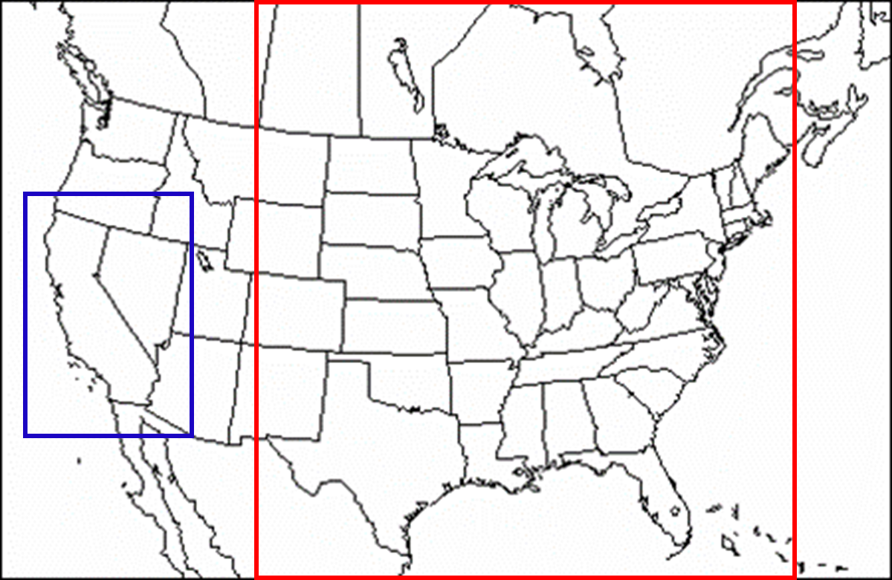
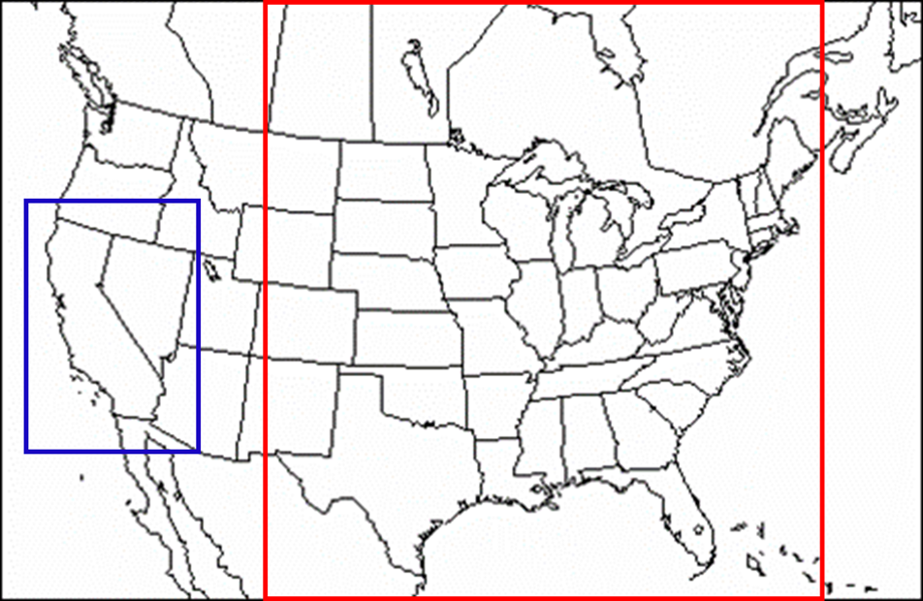
Simulation Domains

Slide 13
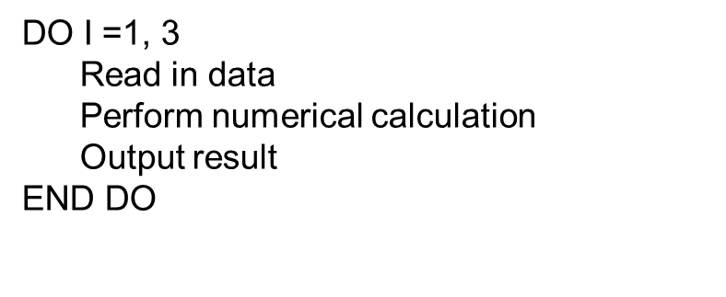
Experiment Code

Slide 14
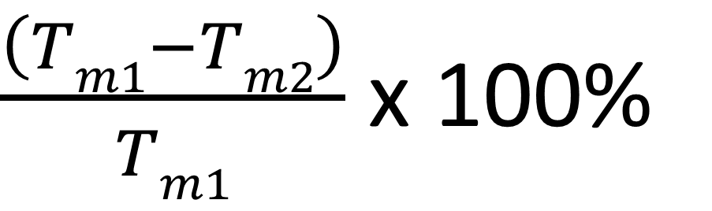
Performance Metric

Slide 15
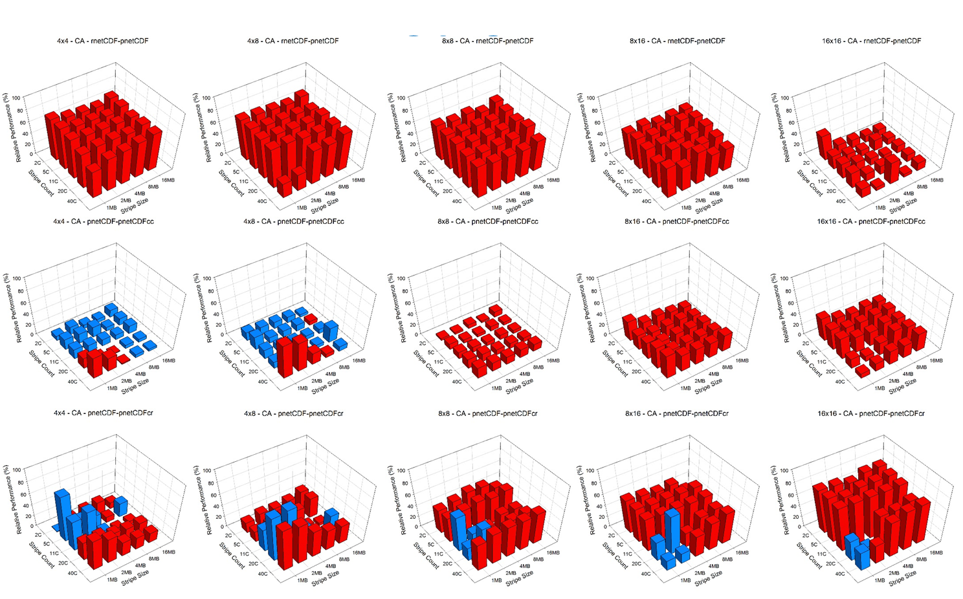
CA Case on Kraken

Slide 16
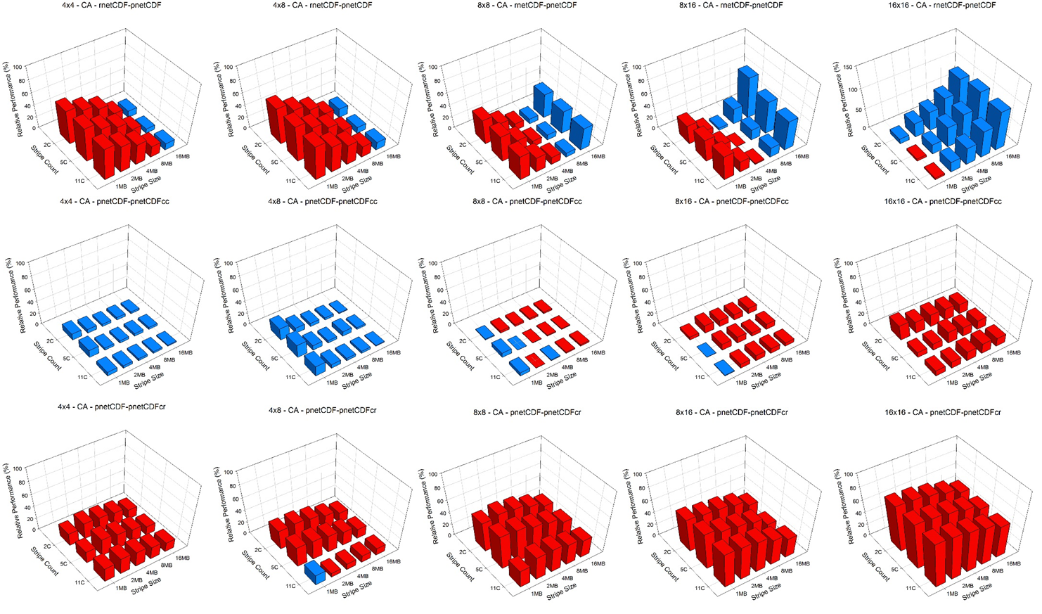
CA Case on Edison

Slide 17
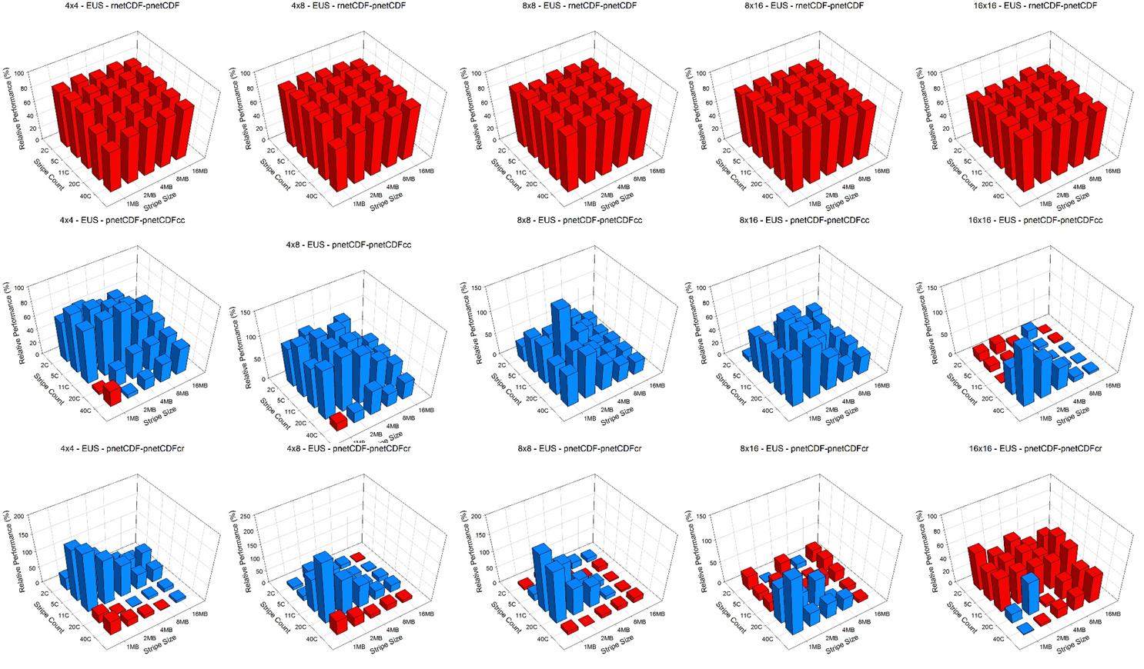
EUS Case on Kraken

Slide 18
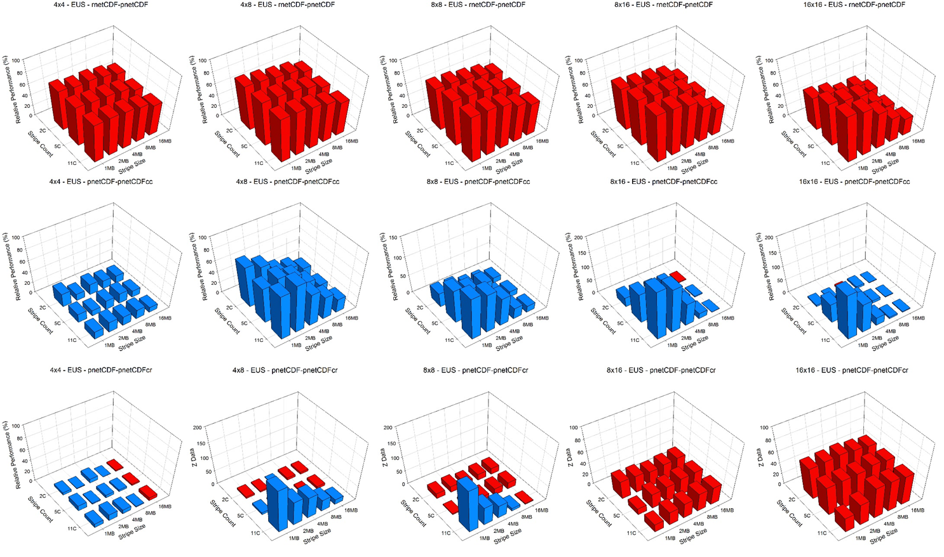
EUS Case on Edison

Slide 19
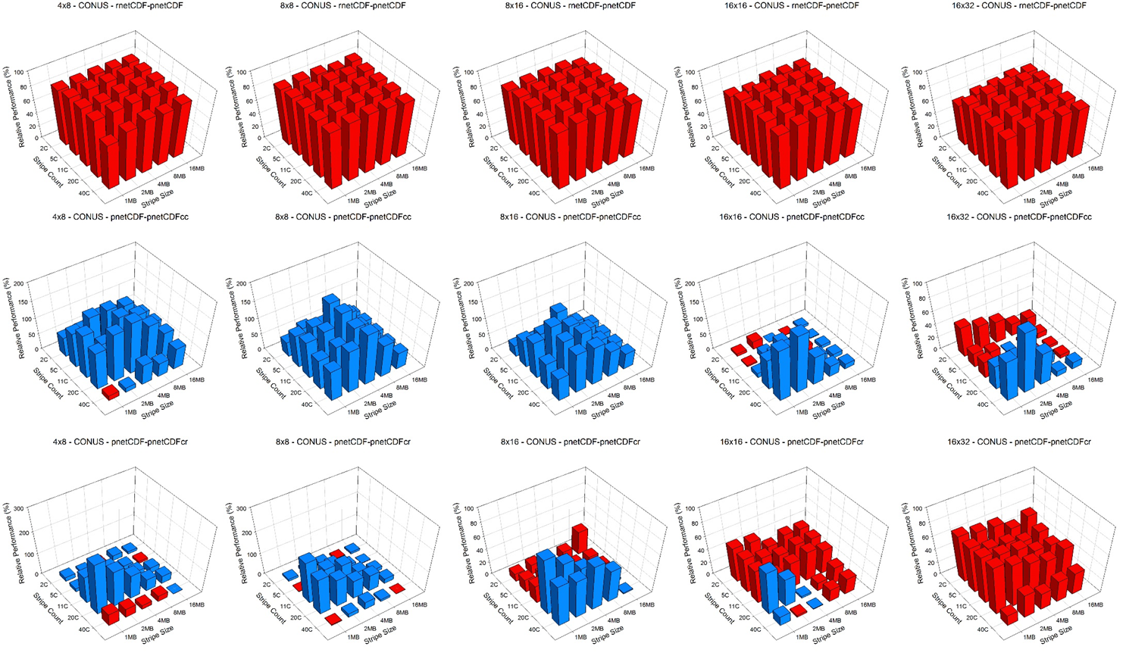
CONUS Case on Kraken

Slide 20
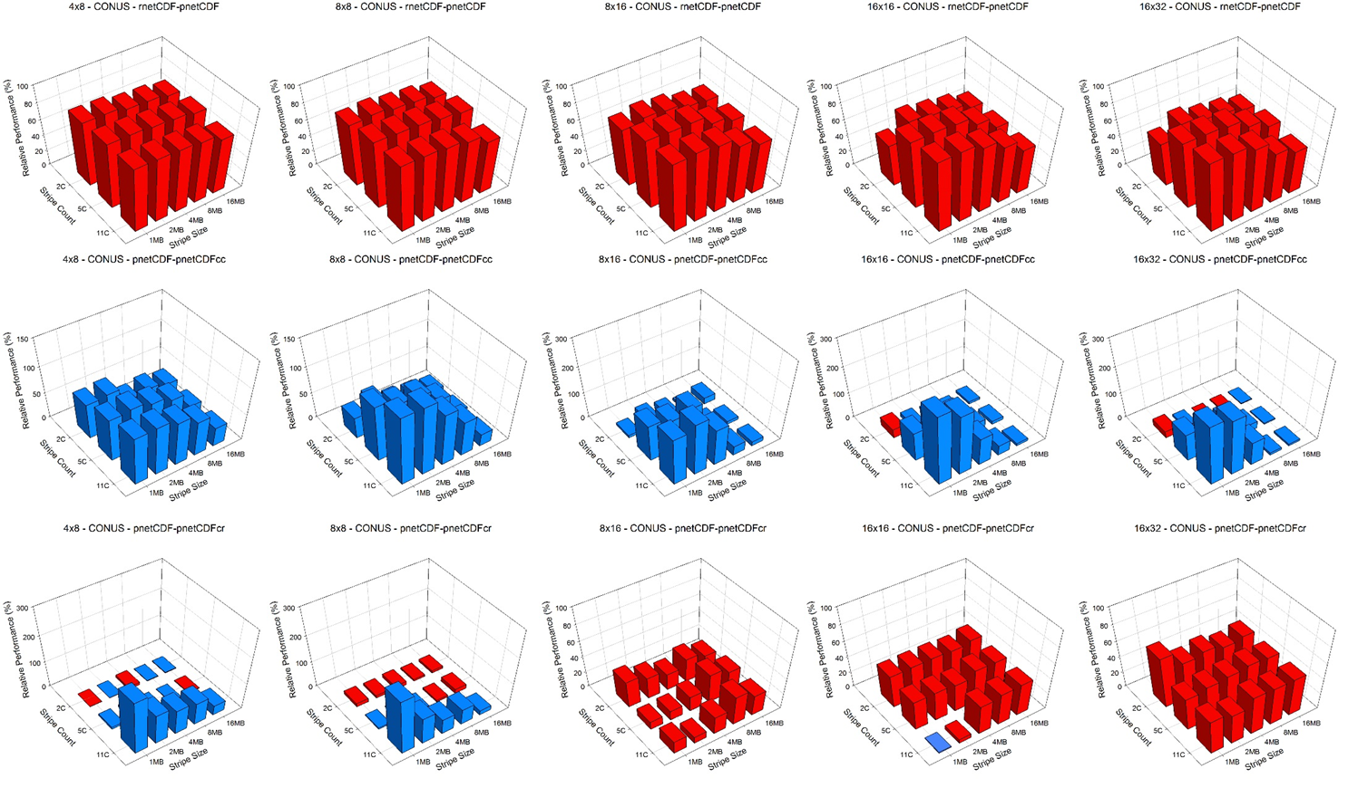
CONUS Case on Edison

Slide 21
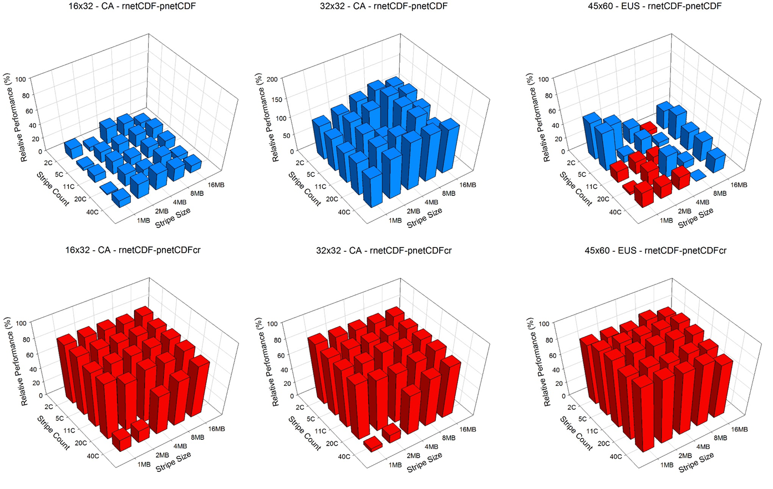
pnetCDF Failure?!

Slide 22
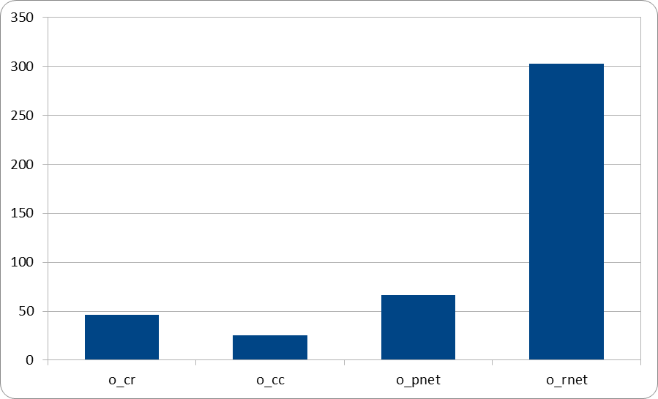
With GPFS
NOAA machine, 16x32 Conus domain
Time (sec)
Different I/O methods

Slide 23
Test on CMAQ
Test with 120, 180, and 360 CPUs on Kraken and Edison with one day simulation on EUS 4km domain
Write out VIS, WET_DEP, CONC, DRY_DEP, A_CONC and S_CGRID files only
Stripe count is 11 and stripe size 2M

Slide 24
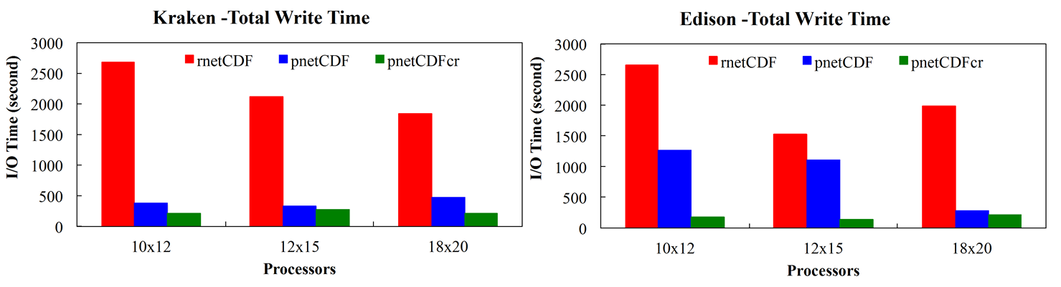
Timing

Slide 25
Summary
True parallel I/O using pnetCDF renders excellent performance
Data aggregation technique enhances the performance of pnetCDF
The new technique has been applied to CMAQ output operation and has shown significant improvement
Collaborating with Dr. Carlie Coats to implement this in IOAPI_3 library
Current implementation only works with gridded files with same size as the model domain

