Slide 1
A new version of the Community Multiscale Air Quality Model: CMAQv5.1
EPA CMAQ Development Team
Atmospheric Modeling and Analysis Division
National Exposure Research Laboratory
Office of Research and Development
CMAS Conference
October 5, 2015

Slide 2
Recent CMAQ Versions
Periodic Public Release of Improved versions of the Modeling System
CMAQv4.7 (Fall 2008) and CMAQv4.7.1 (June 2010)
  Supporting evaluation: Foley et al, Geoscientific Model Development, 2010
CMAQv5.0 (Feb. 2012)
  Updates to gas-aqueous-aerosol chemistry and photolysis
  Improved advective and turbulent transport
  Major structural upgrades that improve flexibility and maintainability
  2-way coupling between WRF-CMAQ
  Bi-directional exchange: NH₃ and Hg
CMAQv5.0.2 (May 2014)
  Instrumented Models (Direct Decoupled Method (DDM), Source Apportionment, Sulfur Tracking)
  Community Contributions (Volatility Basis Set (VBS))
CMAQv5.1 (October 2015)

Slide 3
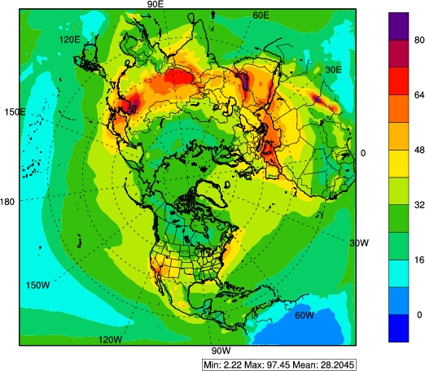
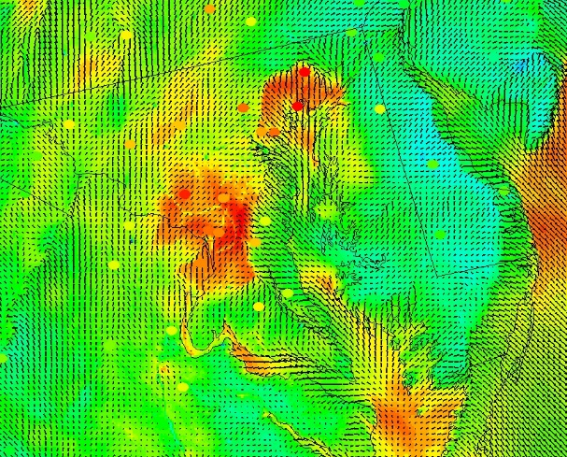
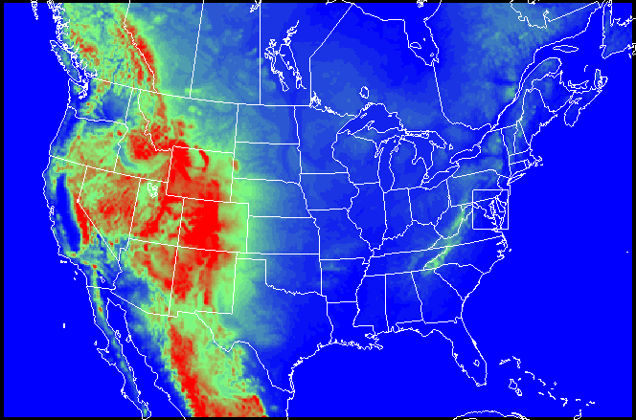
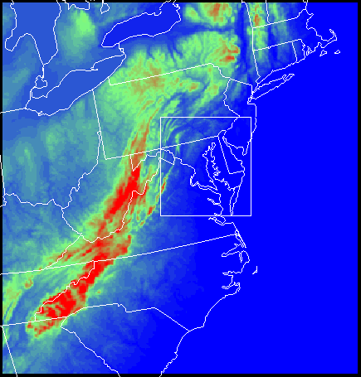
Drivers: Multi-scale modeling
Hemispheric model needed to provide LBCs for US Domain
  Intercontinental input increases importance as NAAQS are reduced
Fine scales:
  Urban Environments
  Linkage with human exposure & health studies
  Residual non-attainment
Hemispheric model at 108 km provides LBCs for 12 km CONUS with nests to 4 km and 1 km

Slide 4
CMAQv5.1 Chemistry updates
Moving towards improved integration of chemistry across all phases
  Updates to CB05 to improve nitrogen cycling and nitrogen deposition
  Additional sources of secondary organic aerosol (see talk by Pye)
  Restructuring heterogeneous reactions and link with gas phase chemistry
    more transparency and higher accuracy in fast reactions on aerosols and soil surfaces
  Expanded capability for aqueous organic chemistry (see Fahey poster)
  Updates to photochemistry for effects of BC aerosol and improved representation of clouds (see talk by Hutzell)
Updates to all three chemical mechanisms (CB05, SAPRC07, and RACM2)
  Standard mechanisms more consistent with current research and reviews
  Added first order marine depletion parameterized from halogens
    reduces ozone over marine environments and coastal regions

Slide 5
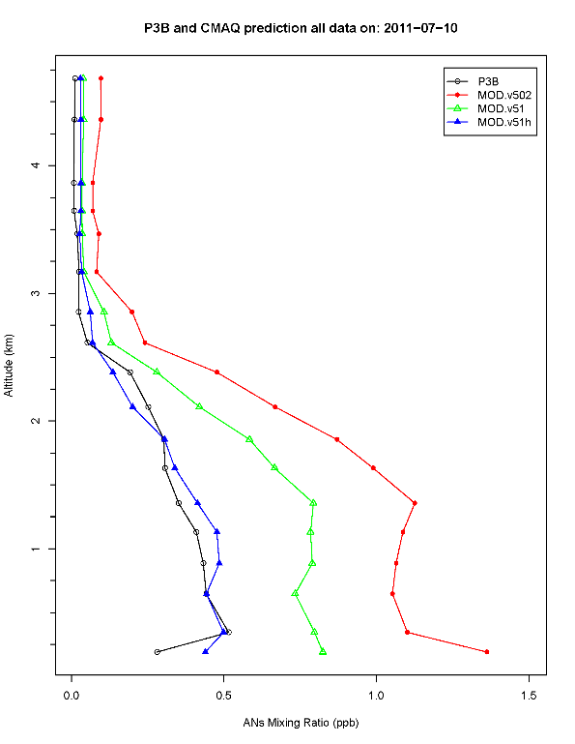
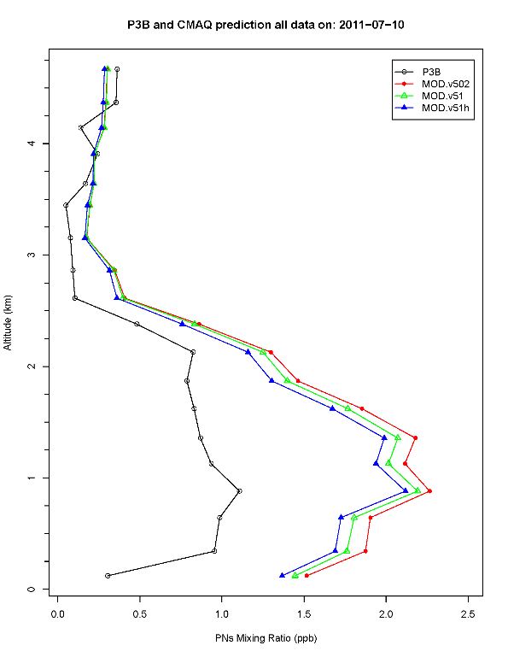
CMAQv5.1 Updates:
Organic Nitrogen Chemistry and Deposition
Issue: All organic nitrates are lumped into one species in CB05, but they can vary widely in physical and chemical properties. CMAQv5.1 has 7 modeled organic nitrate species
Parameter | Representative values | CMAQ v5.02 | CMAQ v5.1 (7 species)
Henry’s Law coef. (M/atm) | 0.6 to 40,000 | 1.7 | 0.65 to 17,000.
Reaction rate with OH (cm3/molecule-sec) | 1.8e-13 to 1.1e-10 | 1.8e-13 | 1.1e-12 to 3.3e-11
Alkyl nitrates
PANs
Example (07/10/11) results for NOy
Measurements (Discover AQ)
CMAQv5.02
CB05e51
CB05e51 with hydrolysis
Better characterization of alkyl nitrates can improve predictions of NOy species and organic nitrogen deposition

Slide 6
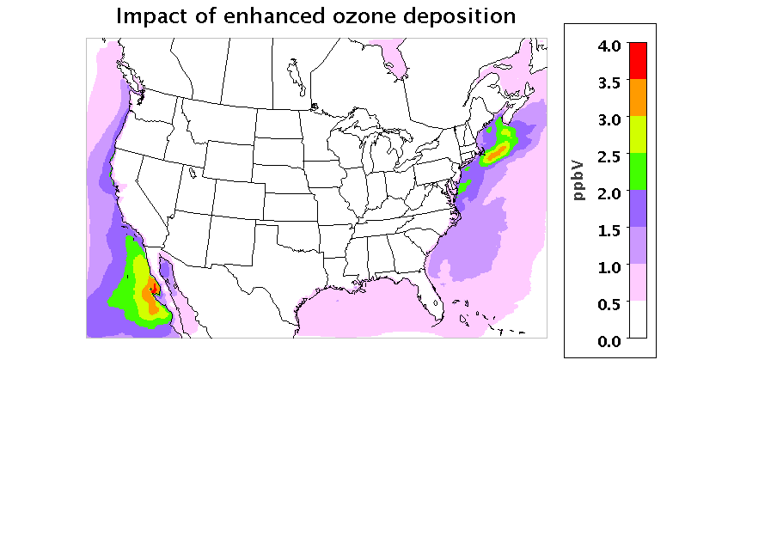
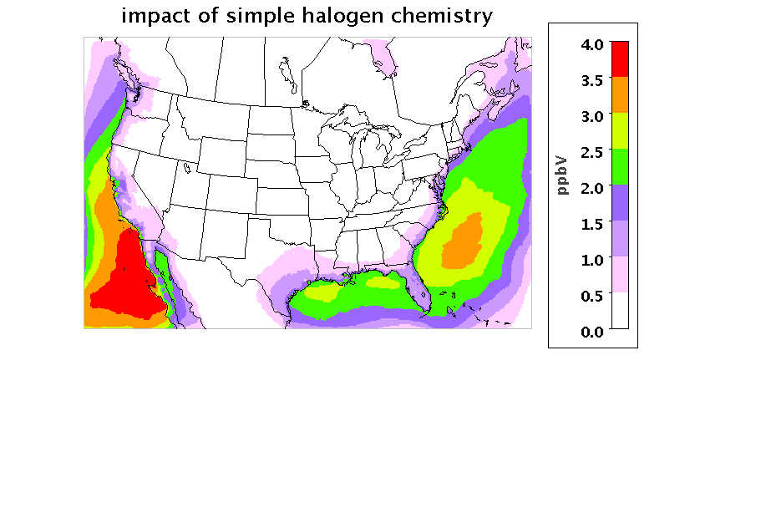
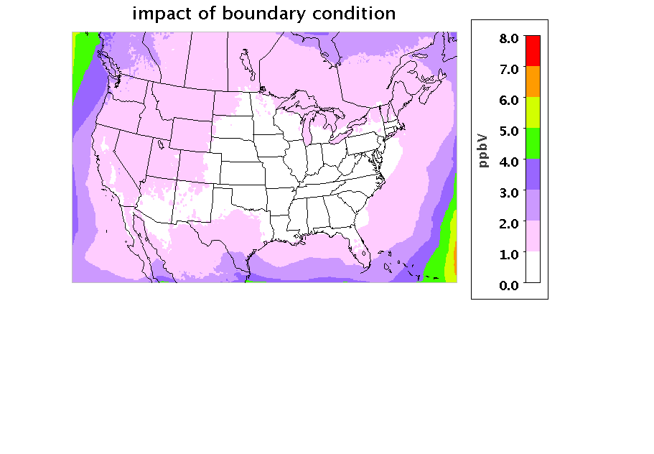
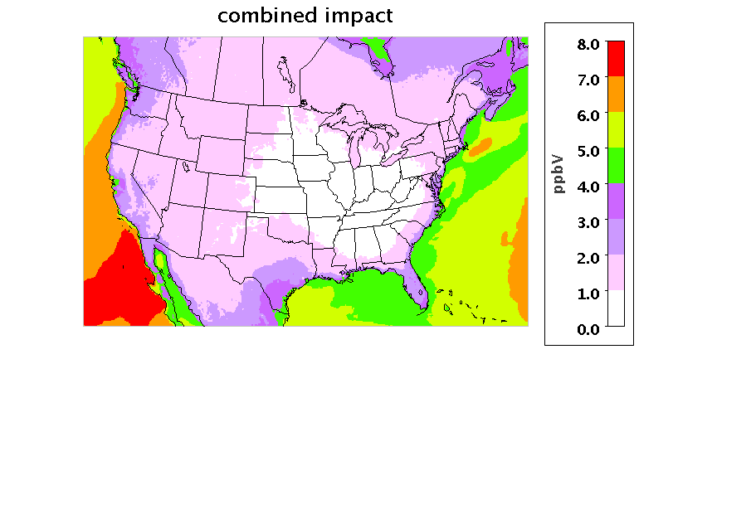
CMAQv5.1 Updates:
Improving representation of marine environments
Issue: Impact of deposition to seawater, simple halogen chemistry, and boundary conditions on O₃ over the CONUS domain. Boundary conditions accounting the effect of halogen chemistry is important
Enhanced deposition effect
halogen chemistry effect
Boundary condition effect
Combined effect

Slide 7
CMAQv5.1 Updates:
Aqueous chemistry with Rosenbrock Solver and kinetic mass transfer: AQCHEM-KMT
Available for both standard AQCHEM chemistry as well as expanded mechanism that includes SOA formation from IEPOX/MPAN
  Readily expandable for new chemistry or processes
  Reduced potential for coding error (KPP-generated code)
  Increased linkage between aqueous chemistry and cloud microphysical parameters
  Increased computational requirements
Notes:
Simultaneously treats phase transfer, chemistry, ionization, and deposition

Slide 8
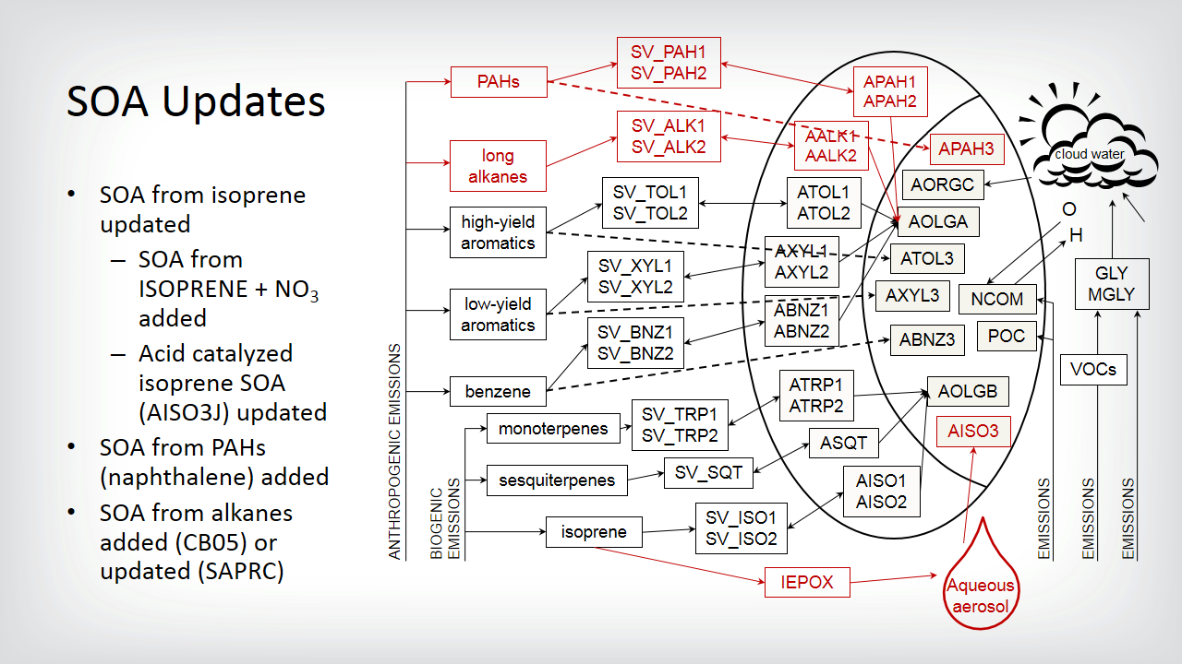
CMAQv5.1 Updates:
Secondary Organic Aerosols
AERO6 module updated
SOA from isoprene updated
  SOA from ISOPRENE + NO₃ added
  Acid catalyzed SOA (AISO3J) updated to form from IEPOX [Pye et al. 2013 ES&T]
SOA from PAHs (naphthalene) added [Pye and Pouliot 2012 ES&T]
SOA from alkanes added (CB05) or updated (SAPRC) [Pye and Pouliot 2012 ES&T]
New AERO6i module
Works with detailed isoprene chemistry (saprc07tic)
Speciated epoxide SOA
SOA from BVOC nitrates (see Pye talk)
SOA from GLY/MGLY uptake on particles (see Pye talk)

Slide 9
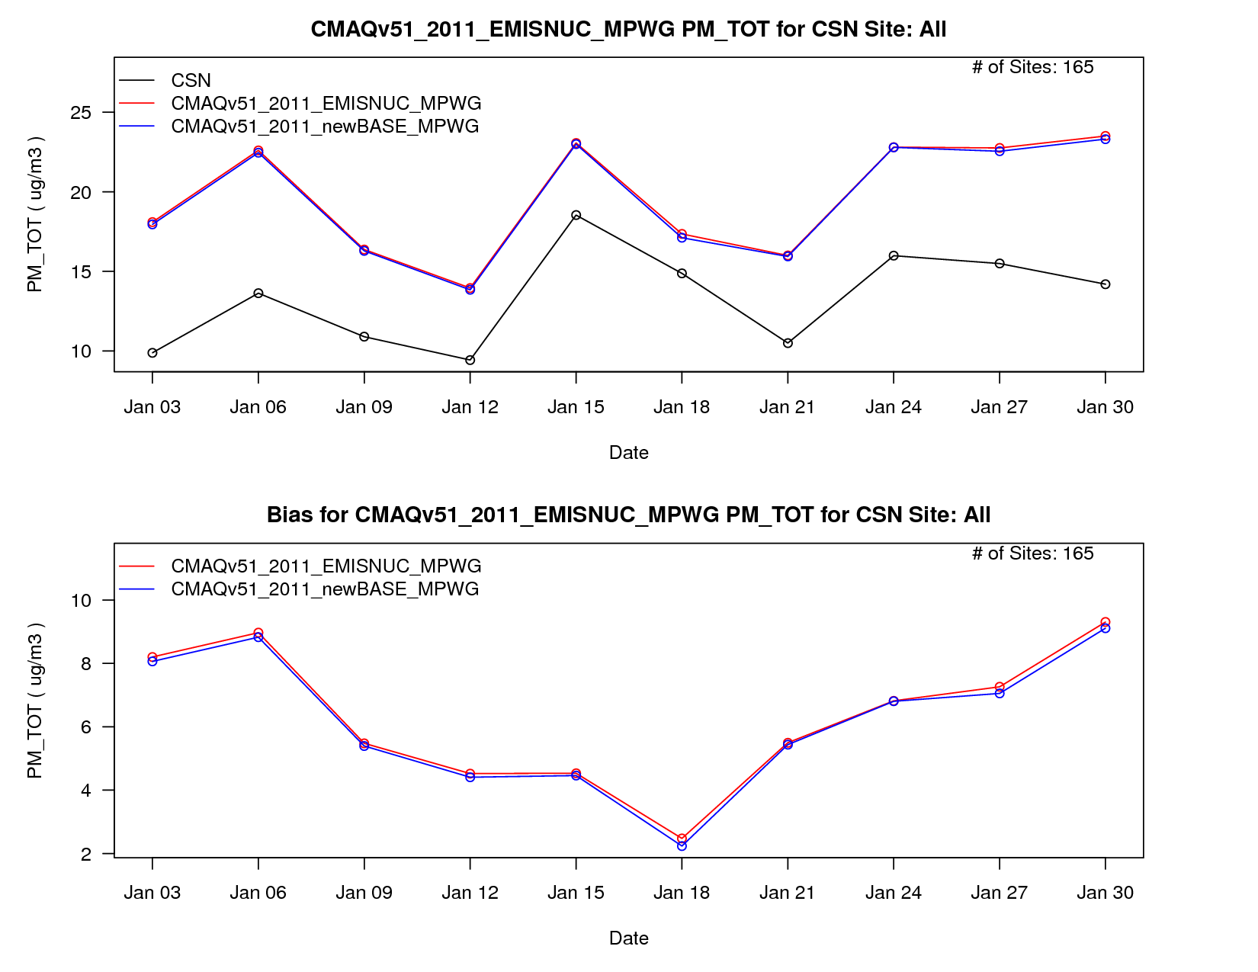
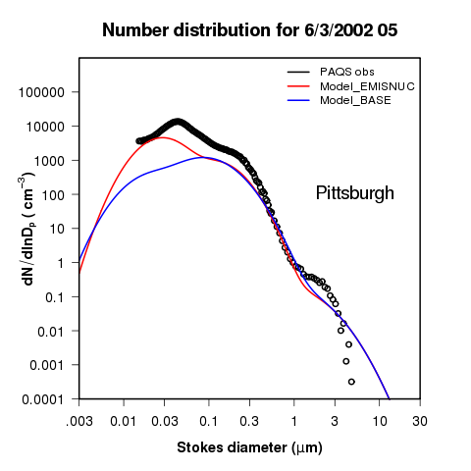
CMAQv5.1 Updates:
Aerosol Size Distribution
Motivation:
  Accurate aerosol size distribution is needed for estimating impacts on human health, ecosystems, visibility, and climate
  Previous (limited) studies indicate particle number underestimated
Updates:
  Correction of current binary nucleation scheme (Vehkamaki et al., 2002)
  Update PM emissions modal mass fractions and size distribution based on modern measurements (Ellerman and Covert, 2010)
  Added gravitational settling of aerosols
Impacts:
  Small impact on mass concentrations, as expected
  Compared to Pittsburgh Air Quality Study SMPS measurements, simulated number distributions better represent the observed magnitude and size distribution of particles
Courtesy: Kathleen Fahey

Slide 10
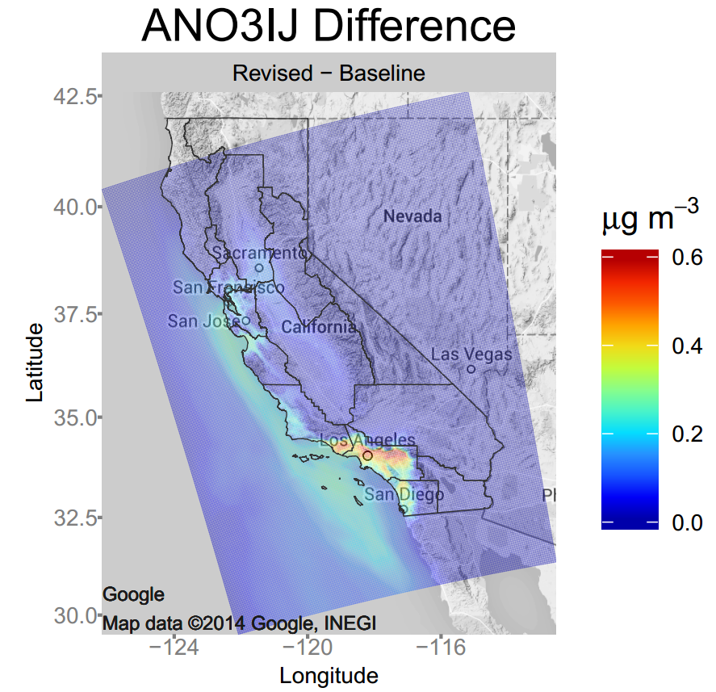
CMAQv5.1 Updates:
Sea-salt Emissions
Model updates
  Added dependency on sea surface temperature
    Better reflects recent measurements and findings
  Reduced the size of the surf zone emissions
Early Results
  Less coarse mode sea salt aerosols
    In agreement with size resolved observations
  More fine scale sea salt emissions
    In agreement with recent observations
  Results in more aerosol nitrate in coastal areas
    As indicated by CALNex observations (Kelly et al. 2014 JGR)
    Improves model biases but non-volatile NO₃ aerosol concentrations are still underestimated (Gantt et al. 2015 GMDD)
    Improves evaluation against base cation wet deposition observations
Summer 2010
Courtesy: Jesse Bash

Slide 11
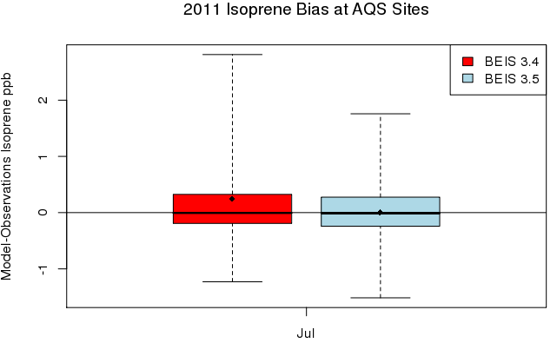
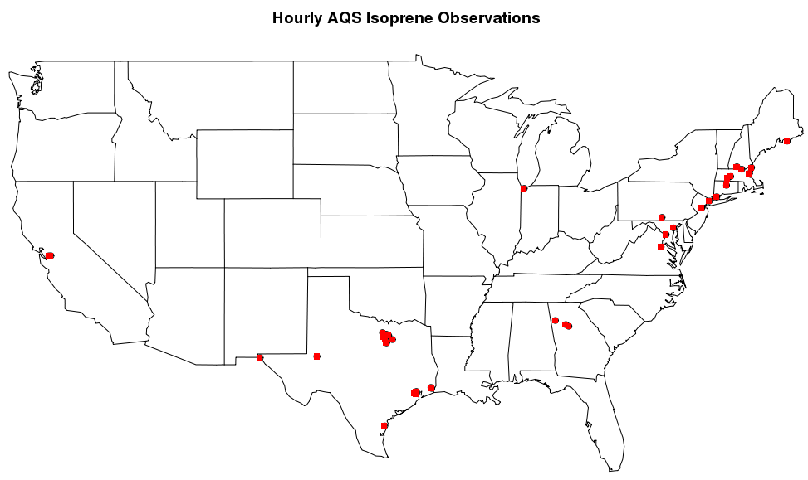
CMAQv5.1 Updates:
Biogenic Emissions
Updates to the BEIS
  BEIS Canopy Model
    Two layer model with leaf temperature parameterization
    Integrated with metrological model surface energy balance
  BELD data
    Updated to 2001-2011 NLCD, MODIS, and Forest Inventory Analysis (FIA) data
    Finer (grid cell versus county) spatial allocation of tree species
Early Results
  Improvements in evaluation against AQS hourly isoprene observations
    ~30% reduction in NMB and 15%
    reduction in NME
  Small, ~1%-5%, Reduction bias and
  error in modeled PM_{2.5} and O₃ estimates
For details see, Bash et al. 2015 GMDD
Notes:
Top figures: County level BELD data on left, new BELD on right, USGS species range map in red outline.

Slide 12
CMAQv5.1 Updates:
Dry Deposition and Bidirectional Exchange
Redesign of dry deposition and vertical diffusion codes
  Utilizes a shared data module for meteorological and calculated environmental variables
  Shares data and calculated parameters between vertical diffusion, deposition, bidirectional exchange, and emissions
  Easier to maintain, update and modify code
Revised O₃ deposition to vegetation
    Measurements indicate that it is not governed by O₃ solubility
    Set wet cuticular resistance to 385 s/m (Altimir et al. 2006)
    Scaled cuticular resistance at physisorbed H₂O at RH > 70% Altimir et al. (2006) between dry and wet values
    Dry cuticular resistance of Wesley (1989)
    Results in approximately a 25% increase in nighttime O₃ deposition velocity and lower background O₃ concentration

Slide 13
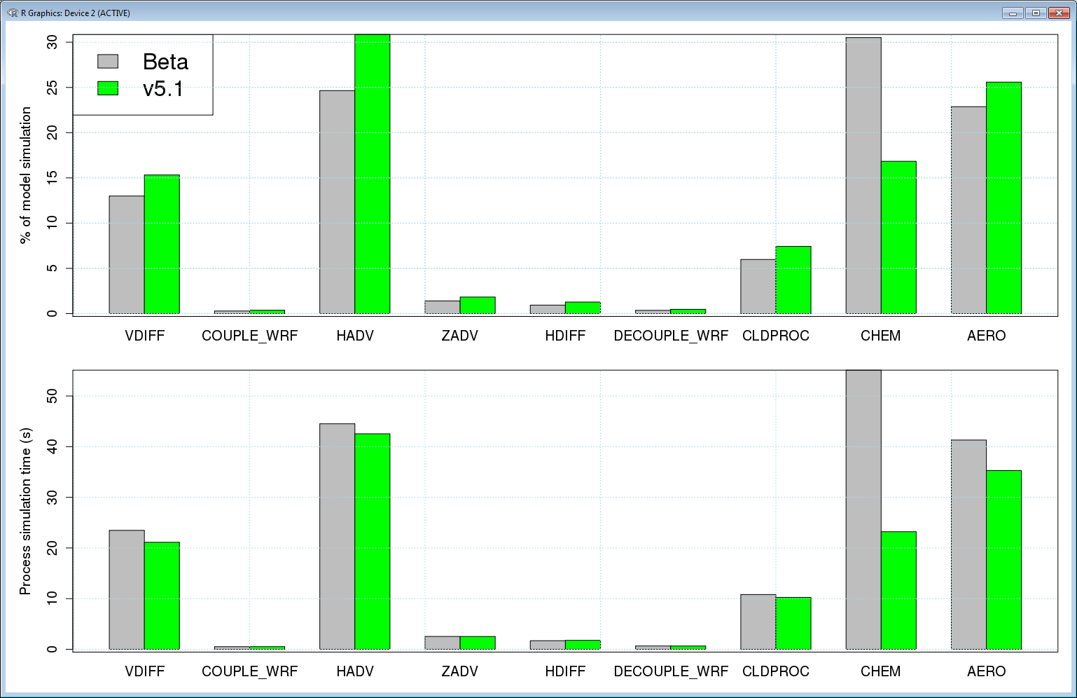
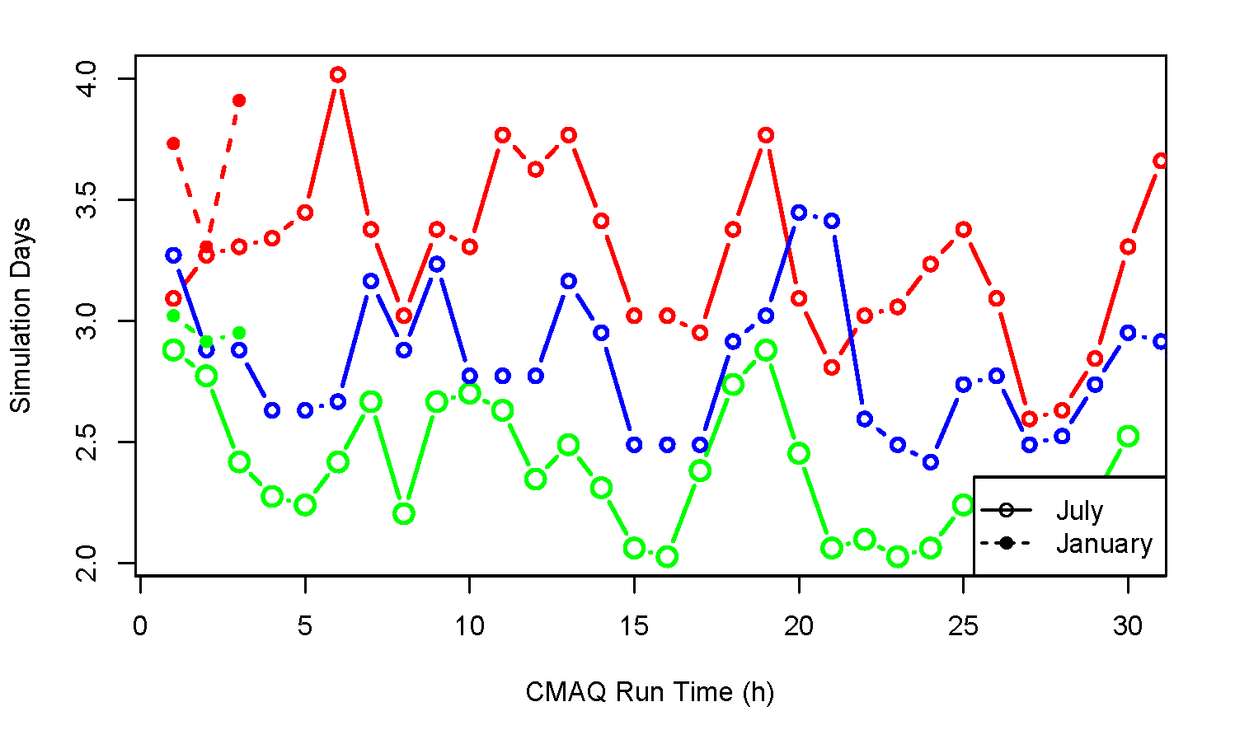
Model structure and numerics
Parallel I/O (Talk by Wong)
More efficient PBL solver for ACM2
Run-time optimization
  Optimized code in horizontal advection, aerosols, and chemistry
  Large run time improvements in chemistry (~60%) and Aerosols (~15%)
Run Time Results
  Approximately 25% faster model run time over beta
  Approximately 15% faster than v5.0.2
  Despite larger chemical mechanism (CB05TUCL vs CB05e51)
  Despite more gas species in the CONC file (86 versus 91)
Beta
Run time (h)
V5.0
V5.1
Simulation days
13

Slide 14
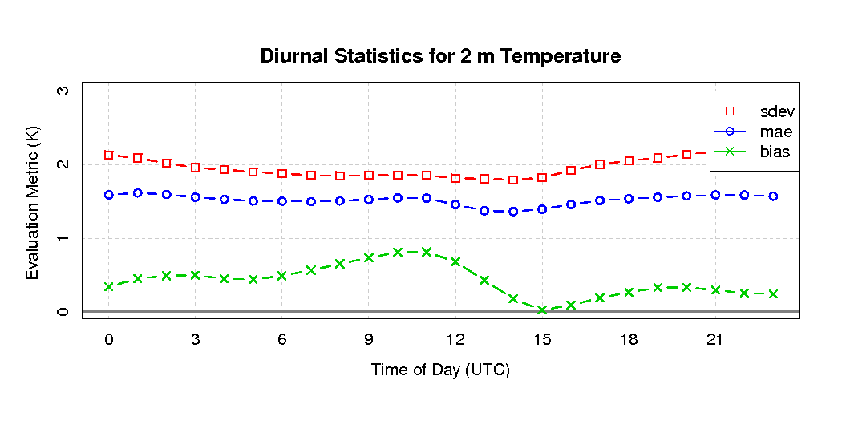
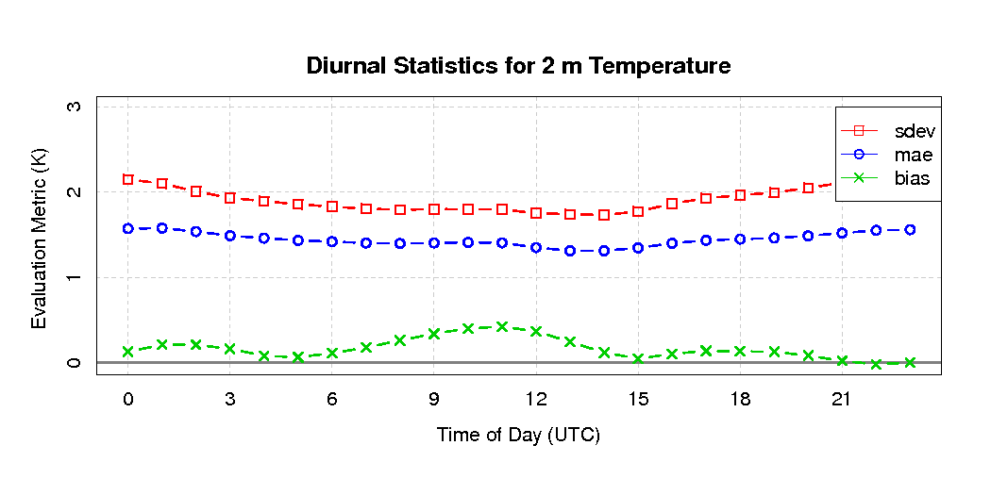
Updates to Meteorology Modeling
Improvement to WRFv3.7 (released April 2015)
  Improvements in land surface and atmospheric boundary layer processes (PX LSM, ACM2)
  Consistent changes in ACM2 in CMAQ
    more accurate representation of surface meteorology and pollutant concentrations day and night
  Improved treatment of wetlands in PX LSM
  Simple parameterization for urban development
    better prediction of effects of urban heat islands
Base
New ACM2 and PX LSM
Advanced data and assimilation techniques
  Iterative data assimilation techniques for high resolution (i.e. 1 – 4 km grids)
    improved fine-scale simulations
  High resolution SST, and snow analyses
Re-calculation of Monin-Obukhov length in CMAQ to be consistent with ACM2 in WRF
  Tends to reduce stability in CMAQ run and increase ozone concentrations

Slide 15
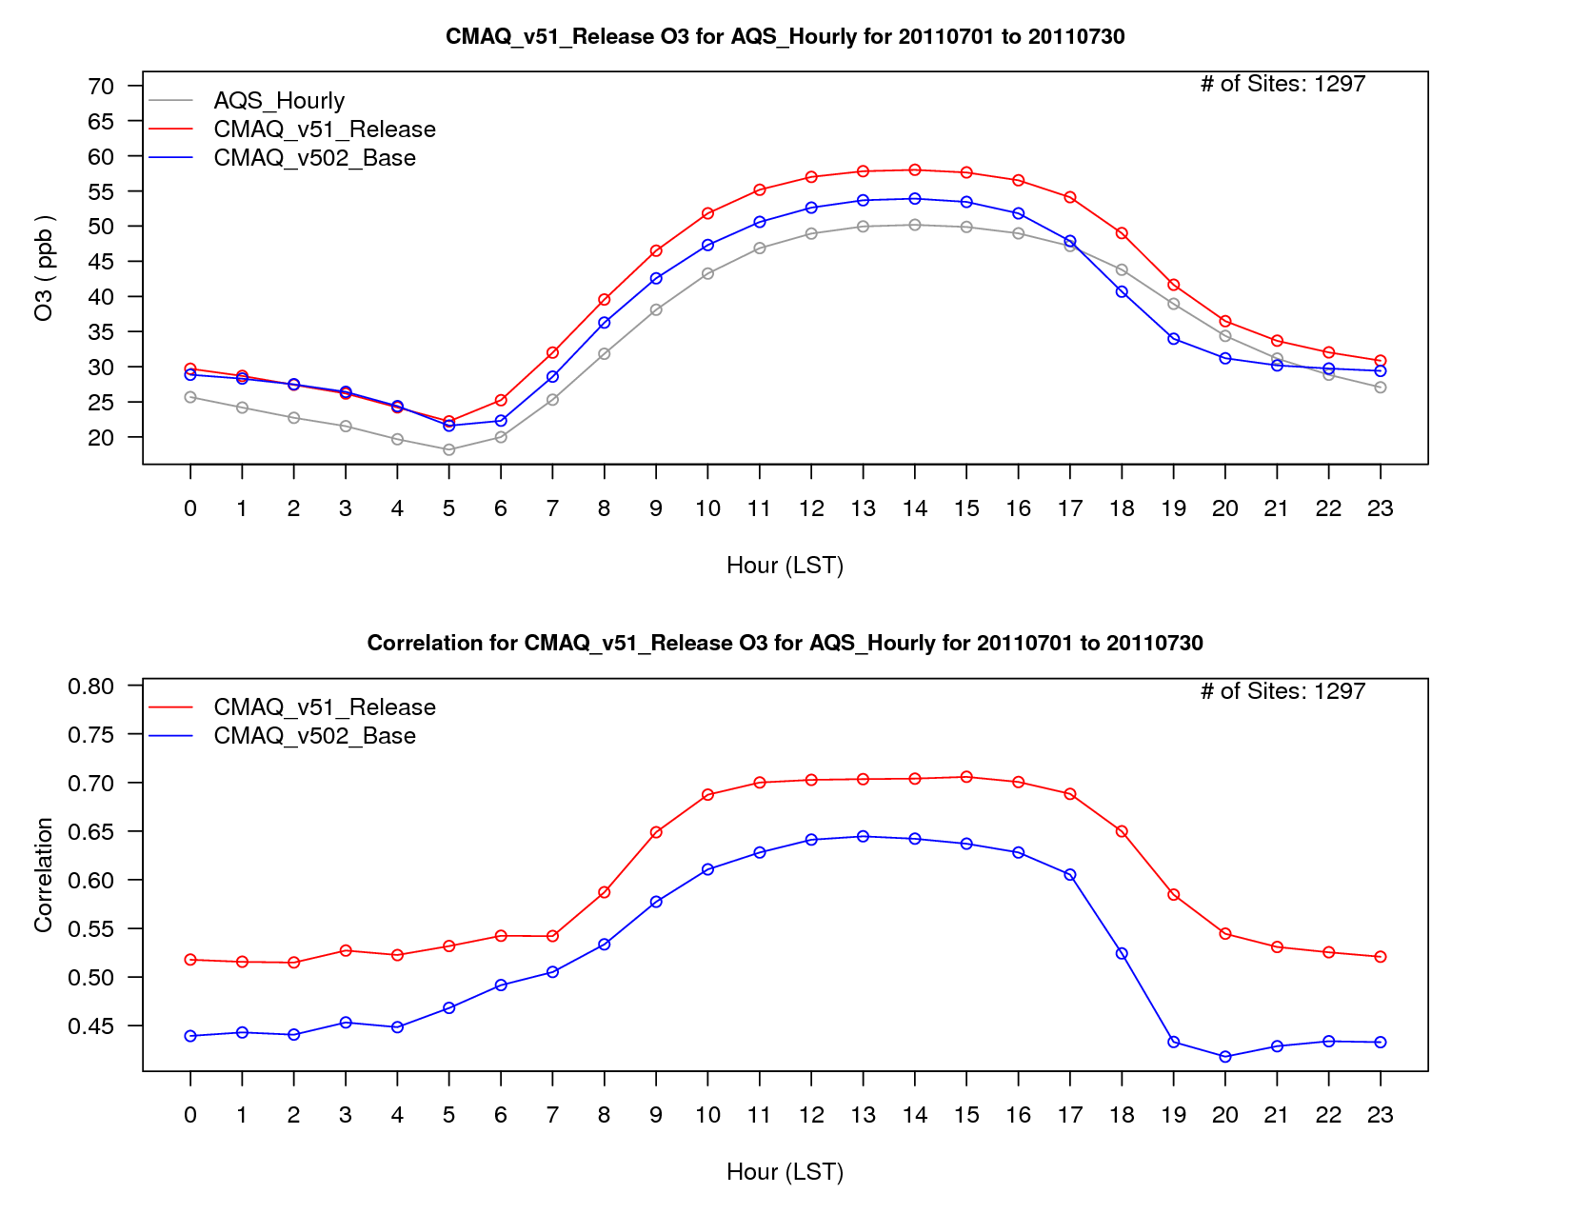
Evaluation Teaser
See Wyat Appel’s talk on Wednesday for thorough evaluation
CMAQv5.1/WRF3.7 compared to CMAQv5.0.2/WRFv3.4 for ozone CONUS July 2011

Slide 16
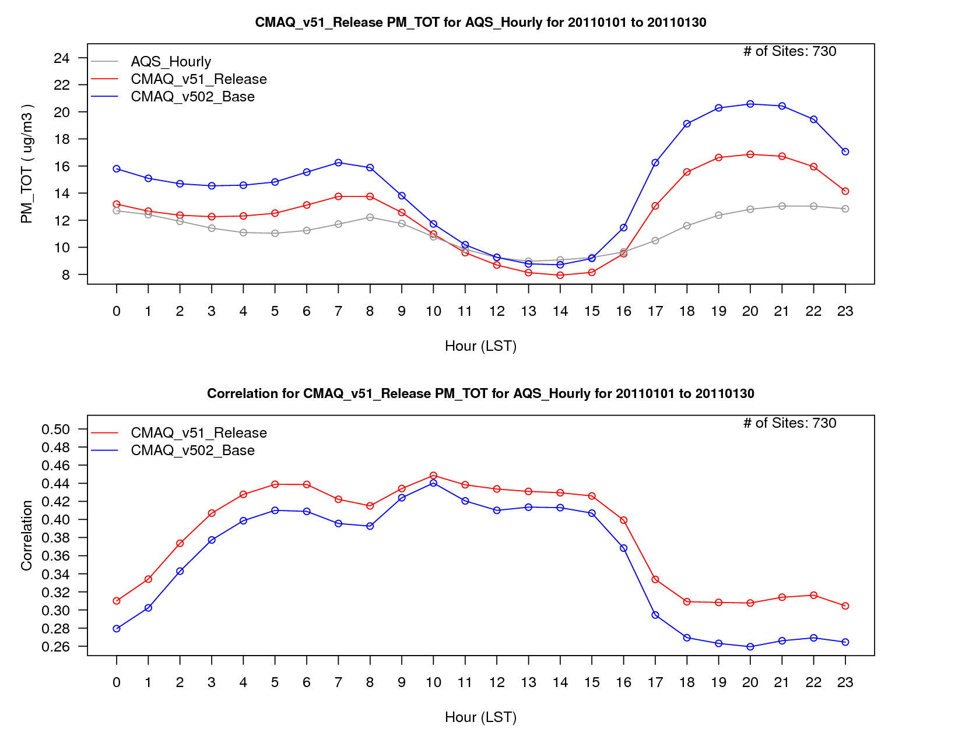
PM2.5 in January 2011

Slide 17
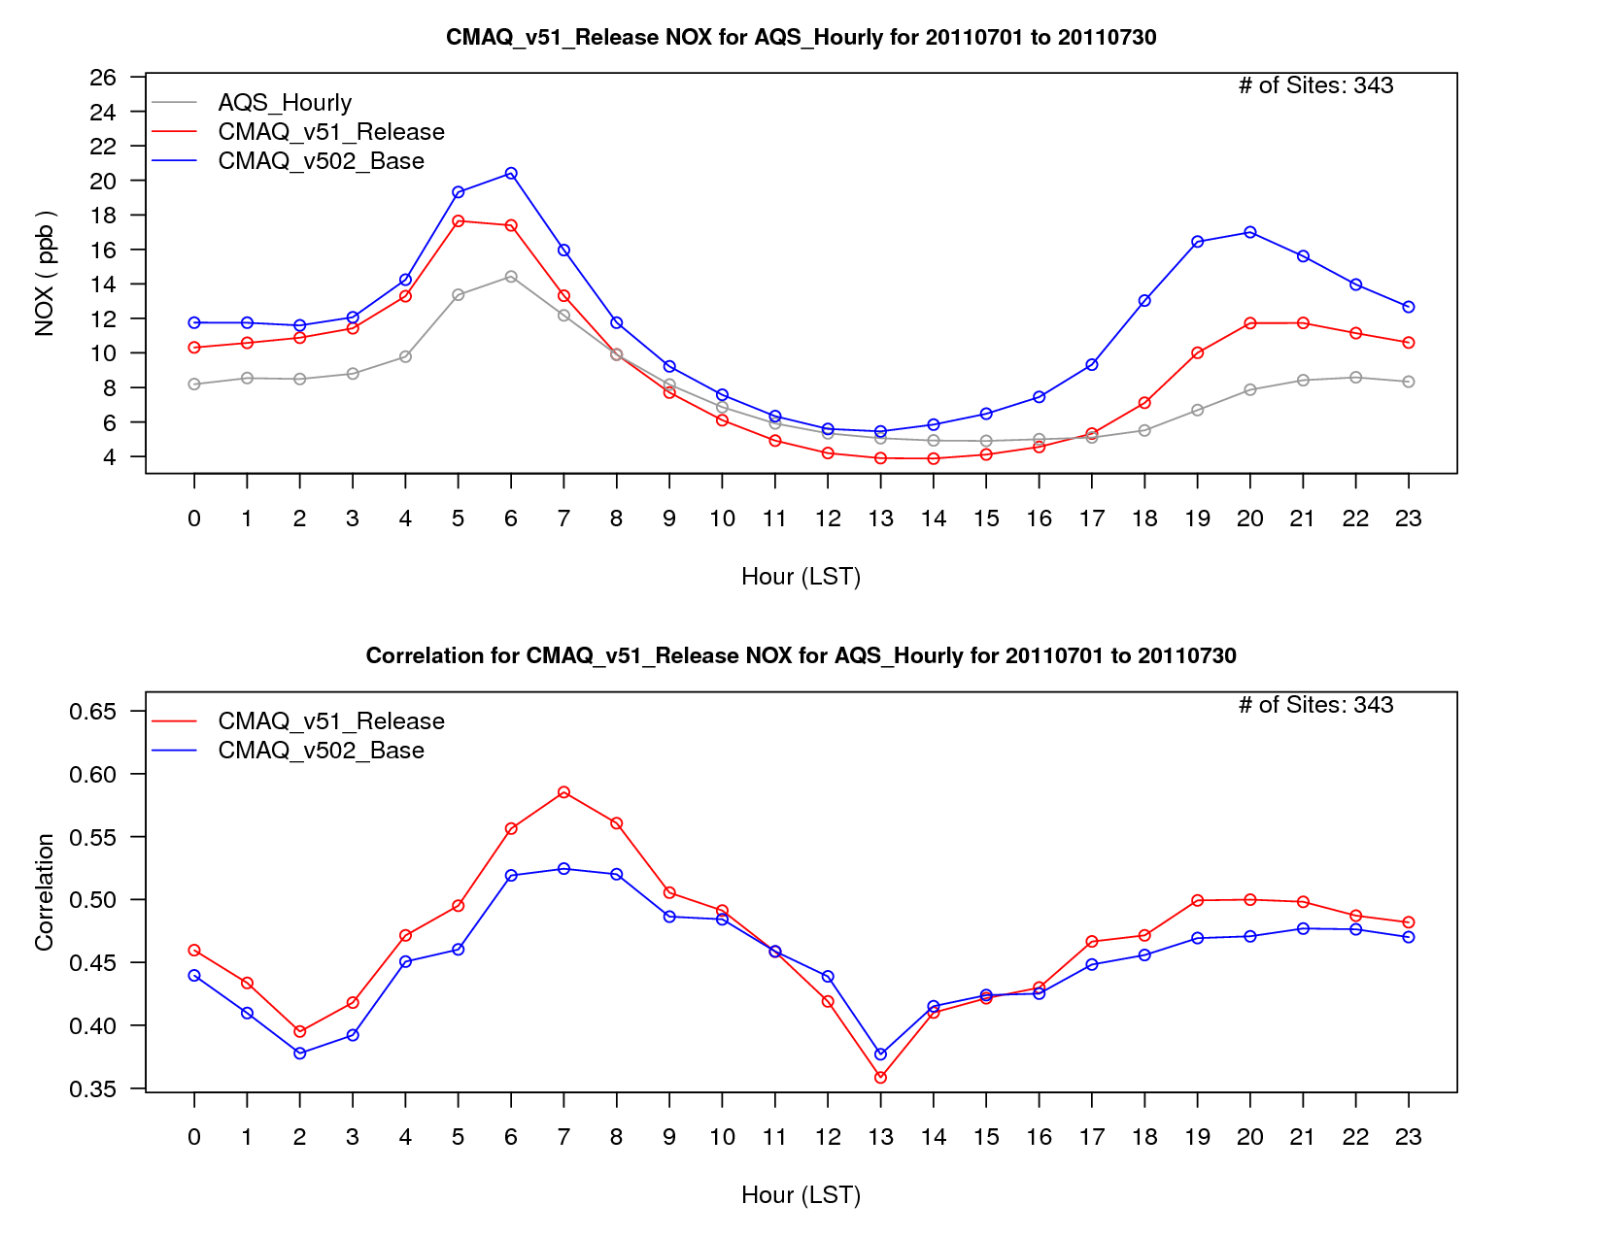
NO_{x} in July 2011

Slide 18
Conclusions
Advanced science in chemistry (gas, aerosol, aqueous and heterogeneous), dry deposition, photolysis, boundary layer, biogenic emissions
Improved computational efficiency
Improved capabilities at large (hemispheric) and small (urban) scales
Preliminary evaluation shows improved statistics for most metrics except increased mean ozone bias but also increased ozone correlation
2-way WRF/CMAQ has been updated to CMAQv5.1 and WRFv3.7

Slide 19
Extra

Slide 20
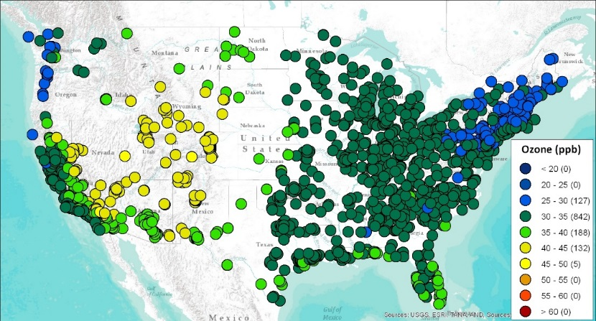
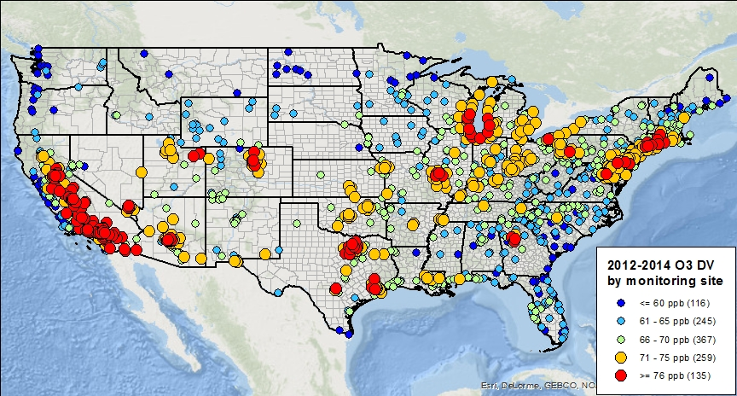

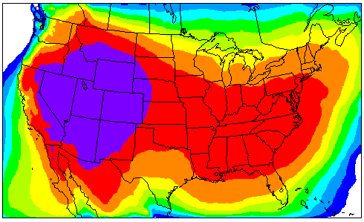
Drivers: Better Representation of concentration range (background to extreme)
Scale Interactions: Tightening NAAQS and greater importance of characterizing
“background” air pollution
Modelled Apr-Oct mean US Background O₃
2012-2014 8-Hour Ozone Design Values across the U.S.
66-70ppb 71-75ppb >75ppb
“FT” boundary contribution to surface O₃
Air quality modeling suggests that an appreciable portion of the ozone in the western U.S. can be the result of sources other than U.S. anthropogenic emissions. Apportionment modeling suggests that much of this transport of ozone into the western U.S. from outside the domain occurs within the free troposphere. Plots courtesy of Kirk Baker and Pat Dolwick.

Slide 21
CMAQv5.1 Updates:
Improving representation of marine environments
Issue: Halogen chemistry and deposition to water are key sinks for O₃ in marine environments; their accurate representation impacts predictions of both long-range transport and ambient levels in coastal areas.

Slide 22
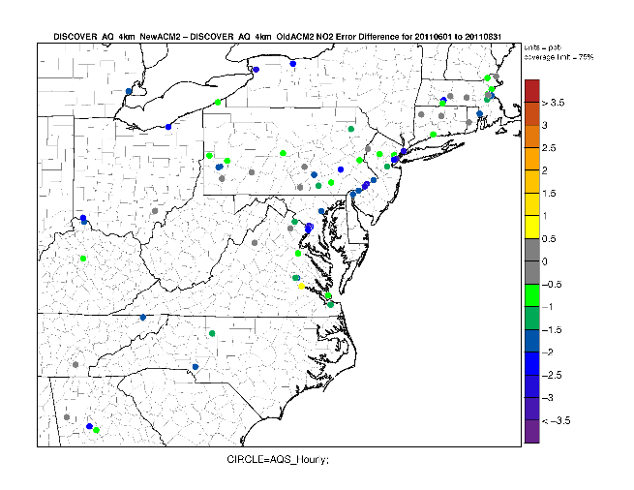
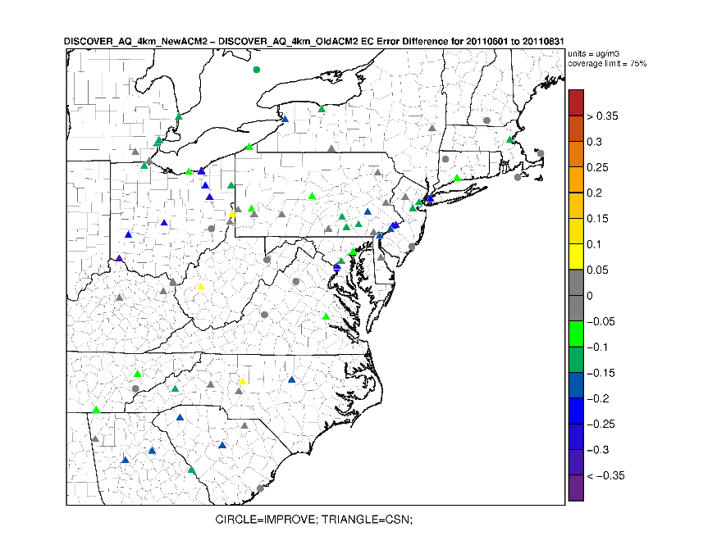
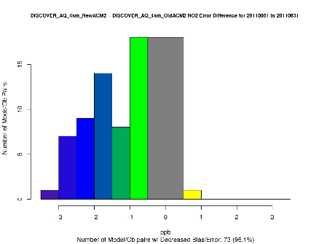
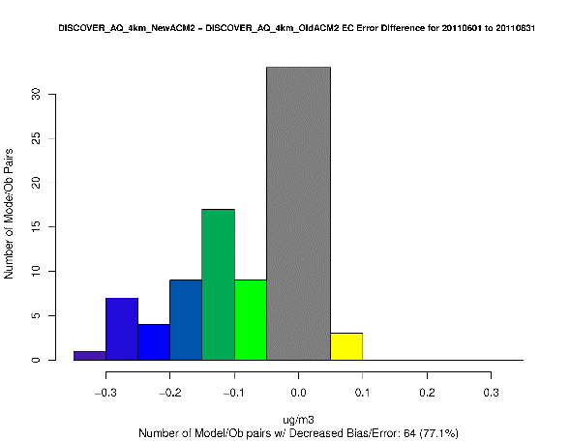
WRF/CMAQ 4 km comparison
NO₂ Error difference:
New ACM2 – Old ACM2
EC Aerosol Error difference:
New ACM2 – Old ACM2
Number of Model/Obs Pairs
Small differences in Max 8-h Ozone Error in both direction (not shown)
Reduction in EC error at most CSN sites but little difference at IMPROVE sites
Very little difference in other aerosol species
The new ACM2 results in substantial reductions in NO₂ error and bias, particularly in the Washington through New York urban corridor

Slide 23
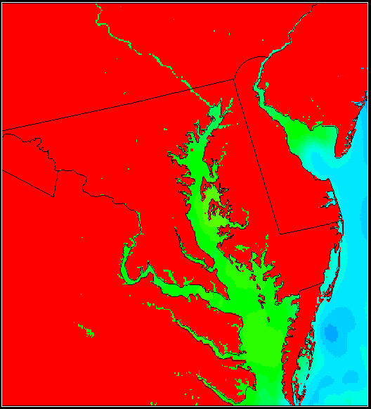
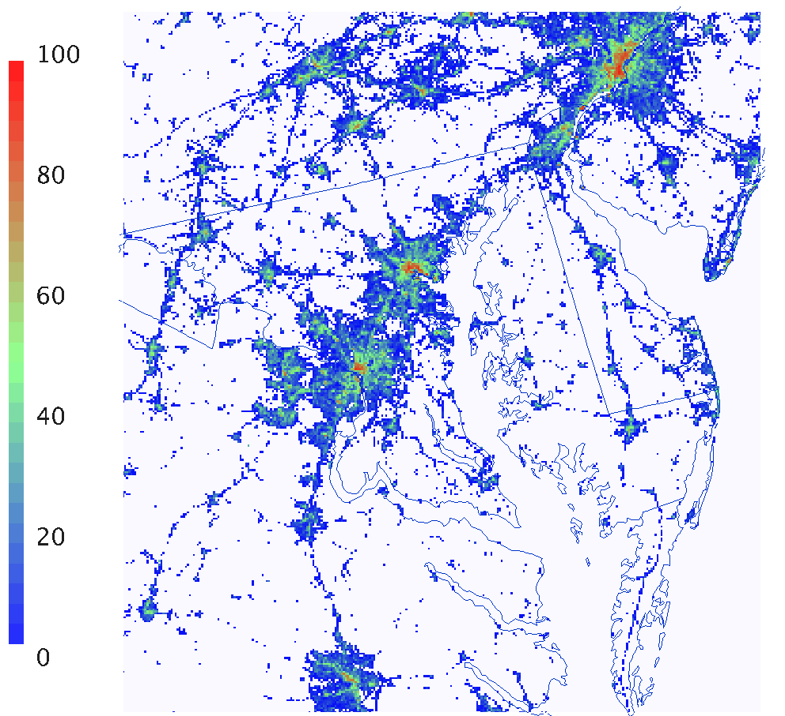

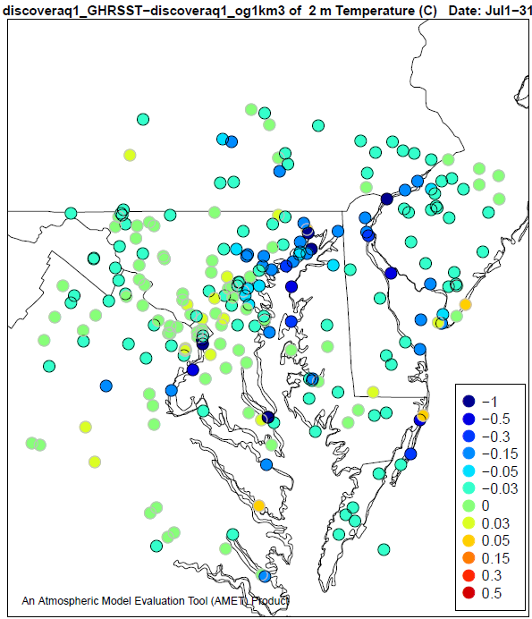
Enabling Fine-scale Applications:
Improvements in Dynamics
GHRSST(daily; 1km)
Impervious Surface Fraction
Improving representation of urban areas
Higher surface heat capacity of impervious surfaces
  Greater heat storage → warmer nighttime temp.
  Less stable nocturnal boundary layer
  Urban heat island effects on pollutant mixing
Reduction in
Error
RMSE and bias reduced with GHRSST. Reduction is even greater compared to NAM 12-km SST data.
Implications for representing Bay Breeze and pollutant transport
Increase in
Error

Slide 24
CMAQv5.1 Updates:
Gas-Phase Chemistry
Mechanism Options: CB05, SAPRC07, and RACM2
(a) Predicted mean fromm CB05TU, (b) percent differences in mean HO between RACM2 and CB05TU, (c) a comparison of predicted median HO to observed median data from the 2006 Texas Air Quality Study
A comparison of predicted daily maximum 8 h O3 with observations from the Air Quality System (when 8 h O3 > 75 ppbv). Error bars represent minimum and maximum values
Sarwar et al., ACP, 2013

Slide 25
2-way coupled WRF-CMAQ
Coupled Meteorology and Air Quality model
  Affords tighter temporal coupling between meteorological and chemical processes
  Facilitates feedback effects where gas and aerosol concentrations can affect meteorological processes which then feedback to Air Quality
  Last released version was based on WRFv3.4 and CMAQv5.0.2
  New release is updated to WRFv3.7 and CMAQv5.1

Slide 26
CMAQ 5.1 Run Time Optimization
Profiled CMAQ 5.1 subroutines
Model Changes
  Optimized code in horizontal advection, aerosols, and chemistry
  Large run time improvements in chemistry (~60%) and Aerosols (~15%)
Run Time Results
  Approximately 25% faster model run time over beta
  Approximately 15% faster than v5.0.2
    Despite larger chemical mechanism (CB05TUCL vs CB05e51)
    Despite more gas species in the CONC file (86 versus 91)
Beta
Run time (h)
V5.0
V5.1
Simulation days
Notes:
Top bar plot is the fraction of run time in each subroutine, bottom bar plot is the total time in each subroutine.

Slide 27
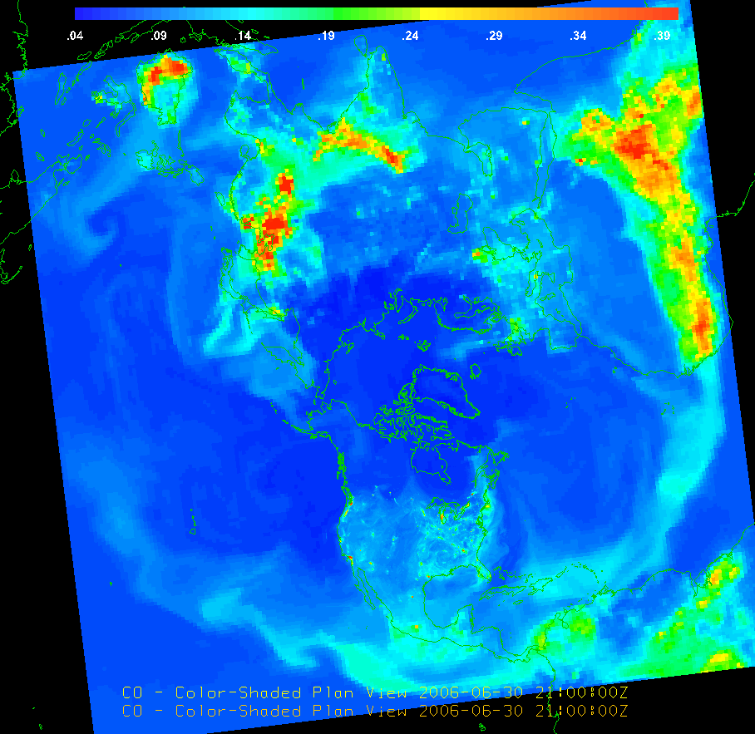
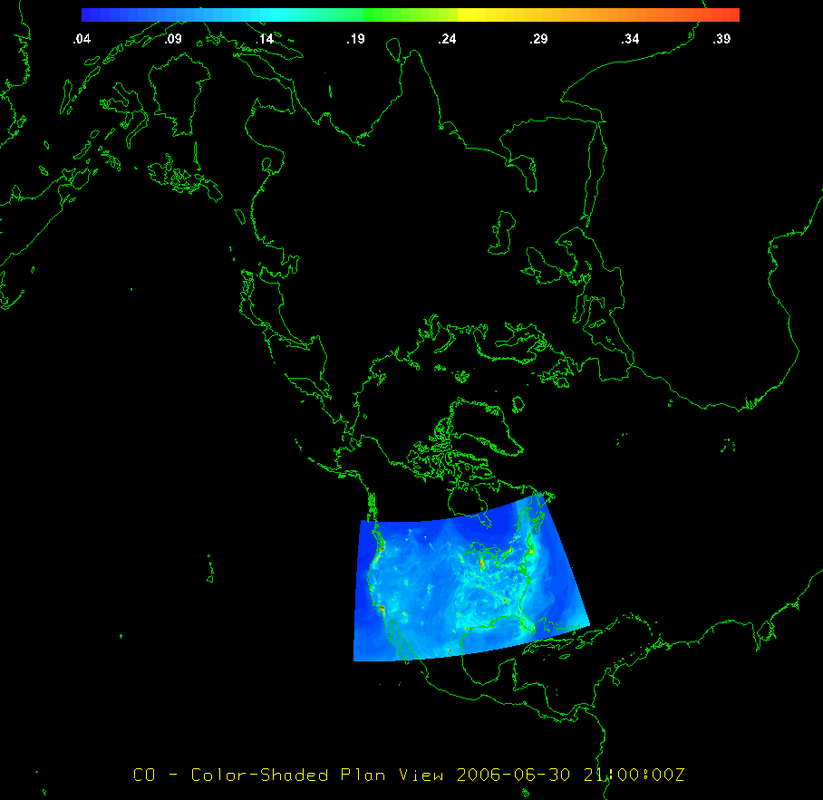
Drivers: CMAQ Evolution
Scale Interactions: Examining U.S. air quality in context of the global atmosphere

Slide 28

CMAQv5.1 Updates:
Heterogeneous Chemistry
Current model: Uptake of N₂O₅ on aerosols
N₂O₅(g) + H₂O (aq) $→$ 2 HNO₃ (g)
When particle contain Cl, uptake of N₂O₅ can also produce ClNO₂
N₂O₅(g) + H₂O (aq) + y Cl (aq) $→$ y ( HNO₃(g) + ClNO₂(g) ) + 2(1-y) HNO₃ (g)
Average change in winter-time predictions due to ClNO₂ Chemistry
TNO3 O₃ SO₄²⁻
Alters partitioning of reactive nitrogen, impacts oxidant chemistry, and thus
impacts production of secondary pollutants (Sarwar et al., GRL, 2014)

Slide 29
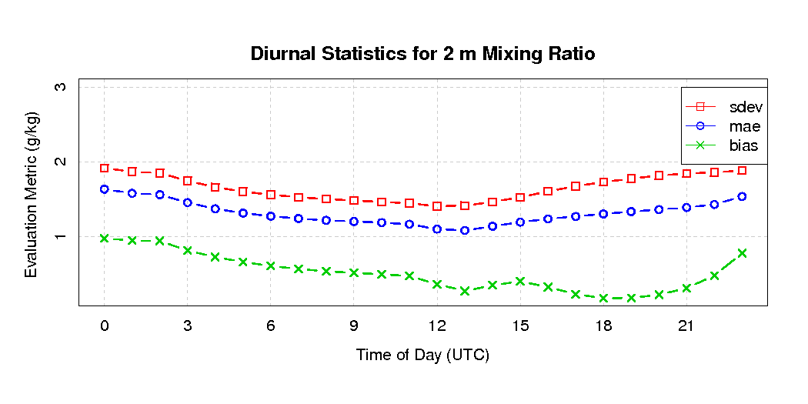
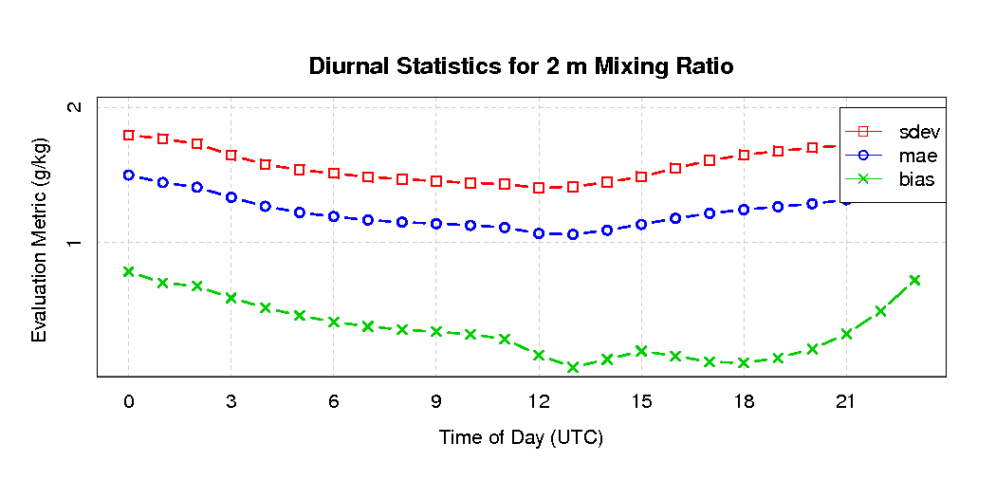
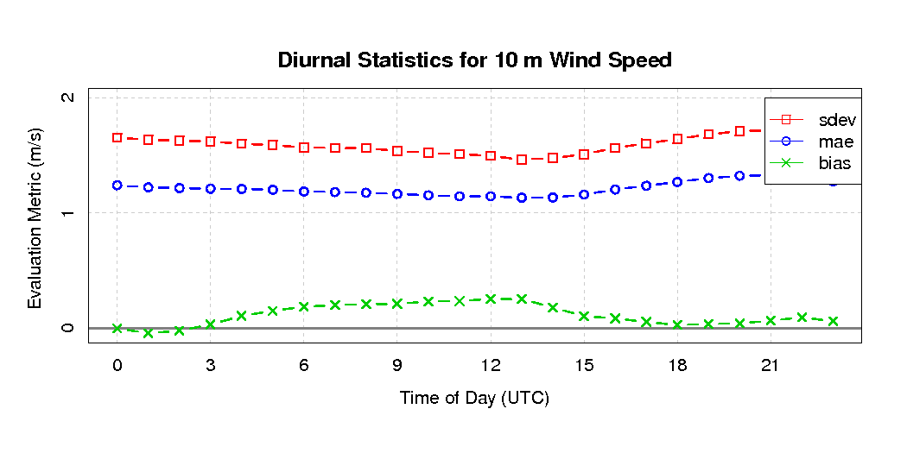
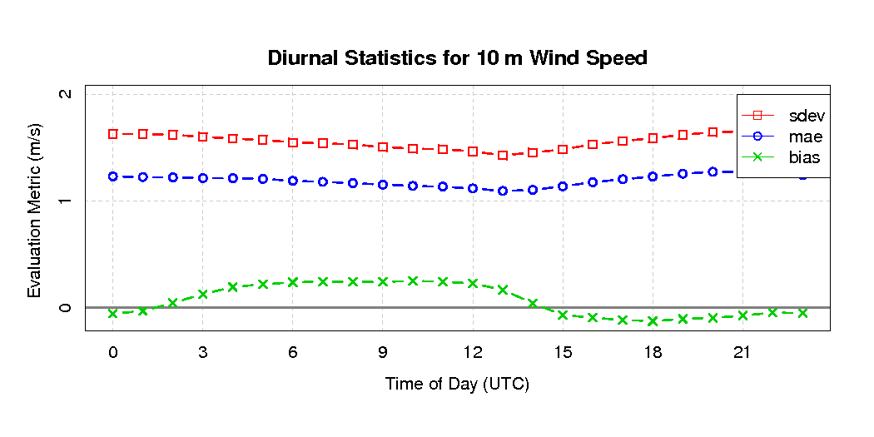
WRF Δx = 12 km: revised PX LSM and ACM2 vs Base
August 2006
Base Model
New Model with
Revised LSM
Revised PBL
Significant improvements in 2-m T and Q bias and error

