Slide 1
Towards a Fuller Understanding of the Benefits of US Emissions Reductions
Drew Shindell
Nicholas School of the Environment
Duke University
Thanks to many colleagues, especially Greg Faluvegi & Yunha Lee

Slide 2
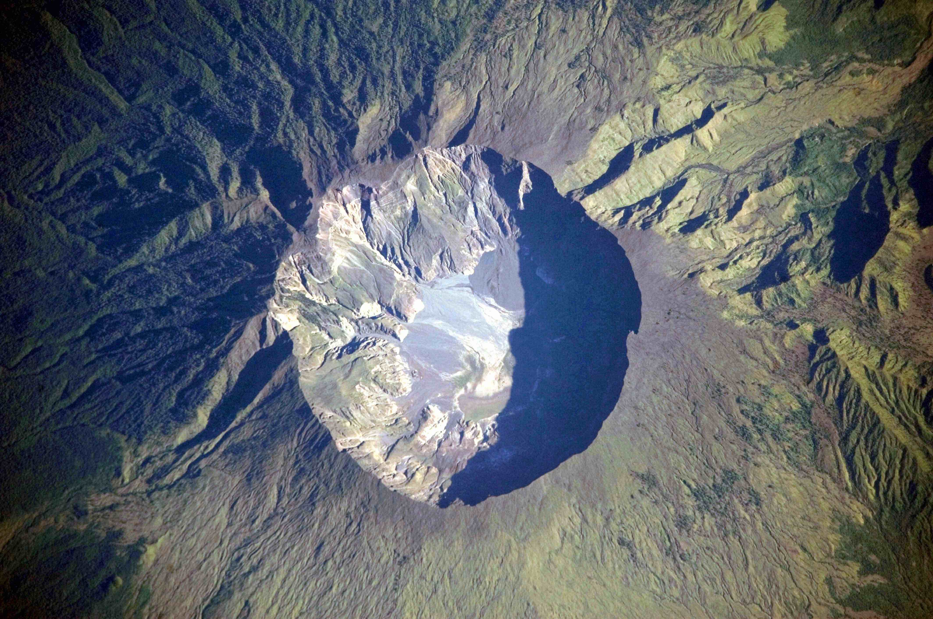
1815...
Global Temperature dropped several tenths of a degree

Slide 3
1815...
‘Dry fog’ dimmed sunlight everywhere
Aerosols less influential in winter, very influential in summer
Frost and snow in NY and New England in June!
Growing season shortened, less sun for photosynthesis
Asian monsoon disrupted for 3 years
Crop failures & famines in N America, Europe, India, China

Slide 4
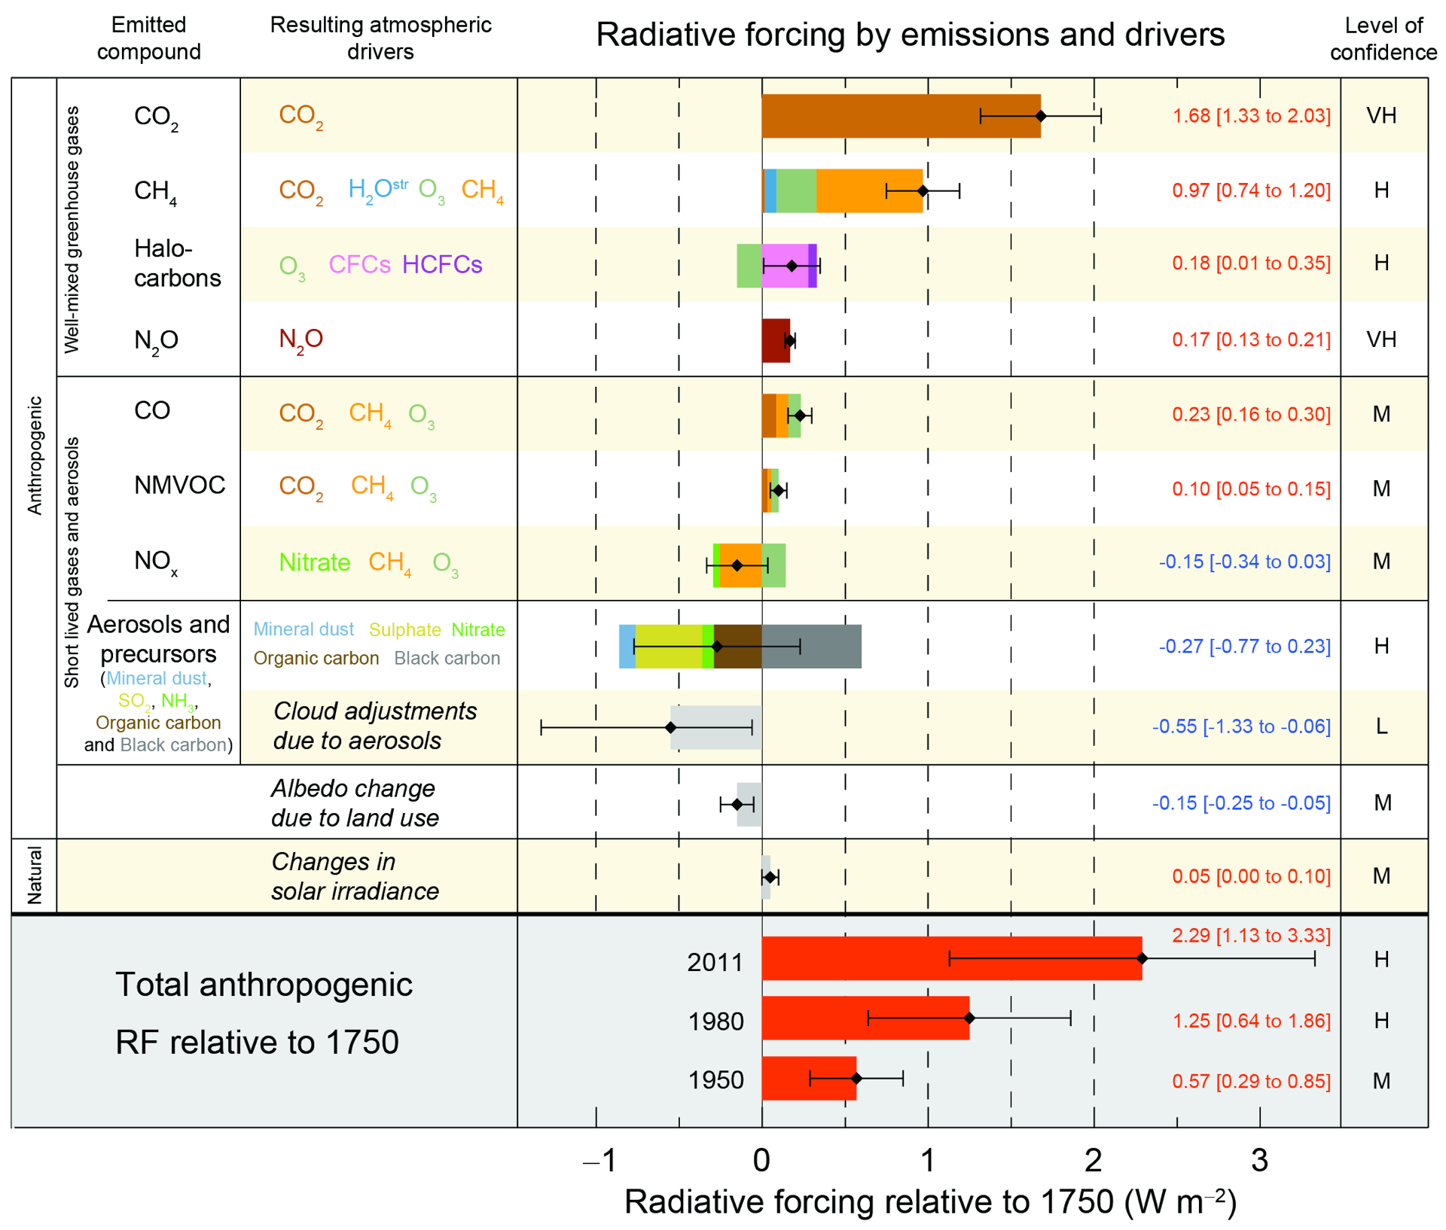
Drivers of Climate Change
IPCC AR5, 2013
Notes:
Given the damages resulting from emissions to the air, how can we raise awareness and determine the best pathways to reducing emissions?

Slide 5
Currently...
Obama Administration executive order for all federal agencies to include Social Cost of Carbon (SCC) analysis: “intended to include (but not limited to) changes in net agricultural productivity, human health, property damages from increased flood risk, and the value of ecosystem services due to climate change.”
EU has the Emissions Trading System
All impacts assumed proportional to global mean annual average radiative forcing or temperature change
Air Quality falls under a variety of rules, costs typically analyzed for major legislation
Notes:
But SCC leaves out air pollutants impact on climate, and air pollutants impact on health/ag even though the latter are much of reason for social costs. Whether impact has value depends on PATHWAY of occurrence rather than impact itself!

Slide 6
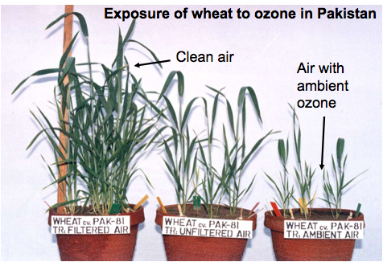
Air Quality affects Agriculture
Up to 36% reduction in wheat & rice yields in India due to air pollution (Burney et al., PNAS, 2014)

Slide 7
Agricultural Impacts
40-50% of premature deaths due to climate change are from malnutrition (WHO, 2007)
Notes:
But SCC leaves out air pollutants impact on climate, and air pollutants impact on health/ag even though the latter are much of reason for social costs. Whether impact has value depends on PATHWAY of occurrence rather than impact itself!

Slide 8
How to decide what is best to do where?
Comparing impacts & robustness
Pollutant Climate Damages Health Damages
CO2 Very large (certain) None
SO2 Opposite (global) Very large
HFCs Large (very likely) None
Methane Large (certain) Medium
BC+ Moderate and/or Very large
large uncertainty

Slide 9
Valuing Emissions:
Social Cost of Atmospheric Release (SCAR)
Develop a broader Social Cost that includes impacts on human health, agriculture, etc. via climate & air quality;
includes all the key pollutants causing both problems
Model response to emissions of one pollutant at a time
Climate impacts of pollutants other than carbon dioxide
Same valuation methodology for air quality and climate
(similar work for methane/ozone/health in Sarofim, Waldhoff & Anenberg, Environ. Res. Econ., 2015)
Notes:
Point out > impact of non-CO2 on ag (no fertilization)

Slide 10
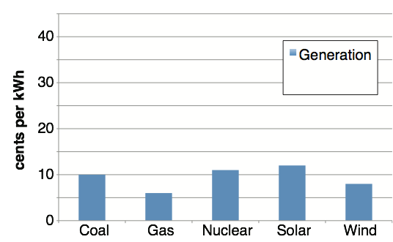
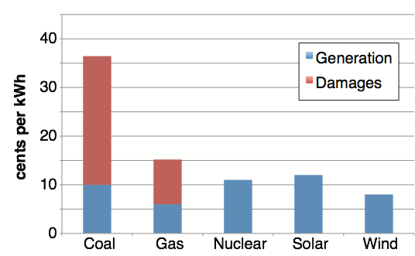
Valuing Clean Air
Shindell, Climatic Change, 2015
Generation costs from US Energy Information Administration, 2012

Slide 11
Valuing Clean Air
Fossil fuels subsidized by $10m a minute worldwide;
~$150 per ton CO₂
IMF, May 2015
Notes:
subsidies primarily via tax expenditures and research and development credits
~180,000 non-fatal heart attacks, ~150,000 cases of hospitalization for respiratory and cardiovascular disease in 2005 in US!

Slide 12
Valuing Clean Air
Shindell, Climatic Change, 2015
Current US vehicles, typical yearly driving, MPG, etc.
Notes:
Evs also have much smaller water footprint

Slide 13
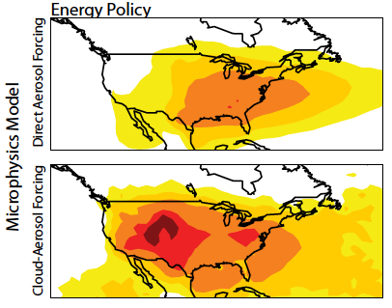
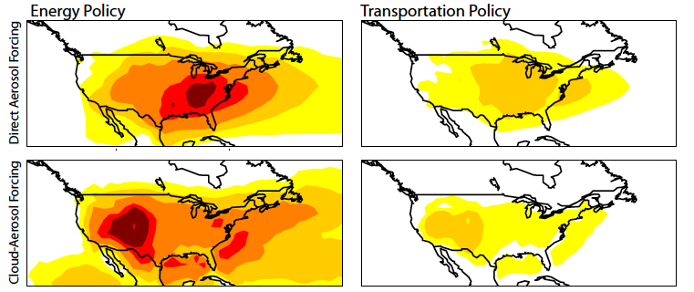
Policy Benefits: US
Clean Energy & Transportation Consistent with 2°C

Slide 14
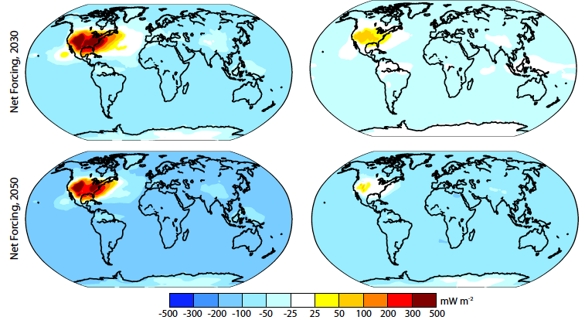
Policy Benefits: US
Clean Energy: Avoids ~0.25C warming by 2100
Clean Transportation: Avoids ~0.1C warming by 2100

Slide 15
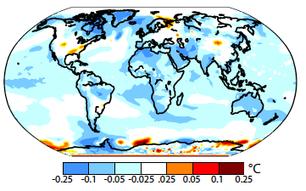
Policy Benefits: US
Clean Energy: Owing primarily to localized sulfate forcing, summer temperatures increase by up to 0.1C over parts of the US.

Slide 16
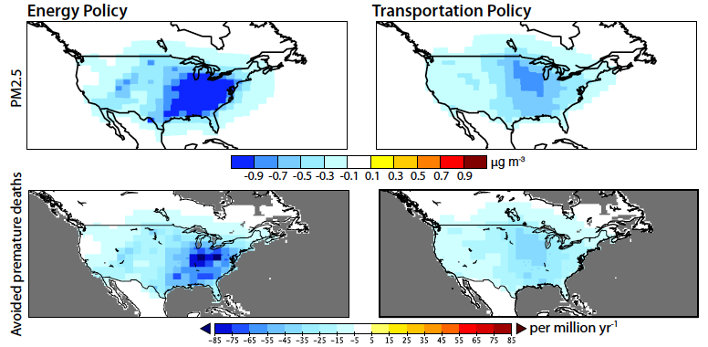
Policy Benefits: US
Clean Energy: Avoids ~175,000 premature deaths by 2030 (-50%/+450%; ~80% PM_{2.5}, 20% O₃)
Clean Transportation: ~120,000 lives by 2030 (-36%/+360%; ~66% PM2.5, 33% O3)
Notes:
Mostly in US!

Slide 17
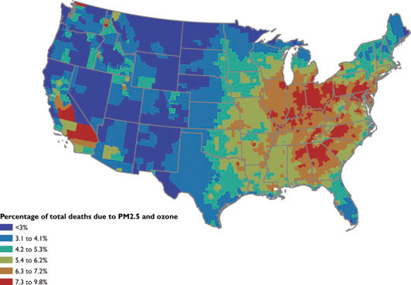
Percent of premature deaths due to poor air quality
<3%
3-4%
4-5%
5-6%
6-7%
7-10%
Fann et al., Risk Analysis, 2012

Slide 18
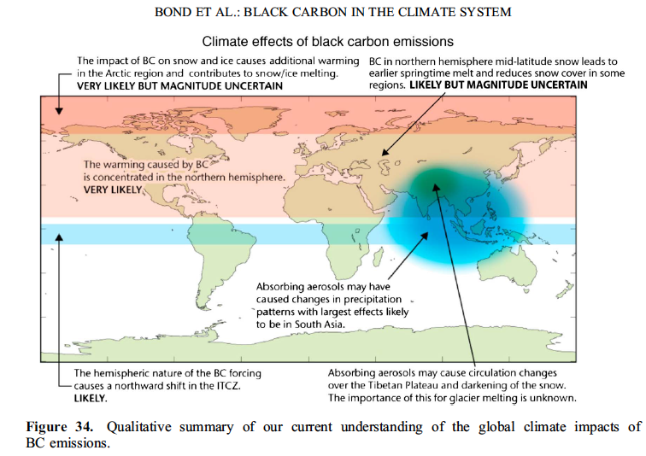
Regional Climate Impacts
Bond et al, J. Geophysical Research, 2013
Notes:
not a ‘war on coal’ or anything else but a question of fairness - incorporating costs of waste disposal into the world’s only atmosphere in decision-making

Slide 19
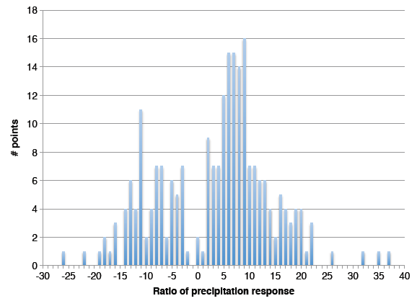
Regional Climate Impacts
Response to BC+ vs
response to
CO₂
Shindell, Climatic Change, 2015
Notes:
not a ‘war on coal’ or anything else but a question of fairness - incorporating costs of waste disposal into the world’s only atmosphere in decision-making

Slide 20
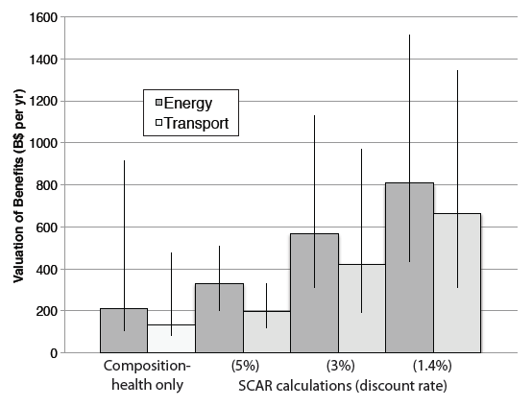
Policy Benefits: US
Implementation costs ~$100-210B (2030 economy-wide)

Slide 21
Valuing Emissions
Notes:
not a ‘war on coal’ or anything else but a question of fairness - incorporating costs of waste disposal into the world’s only atmosphere in decision-making

Slide 22
Avoiding Pitfalls
Lock in new CO₂-intenstive capital stock
Reduce SO₂ and NO_{x} (both with net cooling effects)
Ongoing push for coal-to-gas to be used in Western China
Notes:
not a ‘war on coal’ or anything else but a question of fairness - incorporating costs of waste disposal into the world’s only atmosphere in decision-making

Slide 23
Pursuing Multiple Benefits
49 nations, ~same # IGOs/NGOs (incl. World Bank, WHO, FAO, UNEP, etc.)
Notes:
not a ‘war on coal’ or anything else but a question of fairness - incorporating costs of waste disposal into the world’s only atmosphere in decision-making

Slide 24
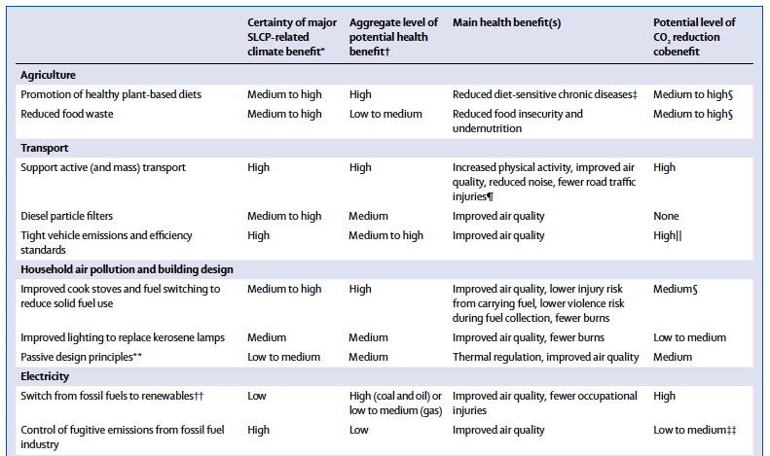
Pursuing Multiple Benefits
Greater Provision of Safe Active and Mass Transit
Large Air Quality Benefits
Large CO₂ Benefits
Increased Physical Activity, Reduced Noise, Fewer Road Traffic Injuries
Scovronick et al, Lancet, 2015
Notes:
not a ‘war on coal’ or anything else but a question of fairness - incorporating costs of waste disposal into the world’s only atmosphere in decision-making

Slide 25
How can policy maximize societal benefits?
Need to define broad targets (e.g. UN Sustainable Development Goals)
Need to relate specific actions to broad targets (wider metrics)
At the same time, provide flexibility by providing aggregated impacts ($) and affects on individual factors (e.g. AQ)

