Slide 1
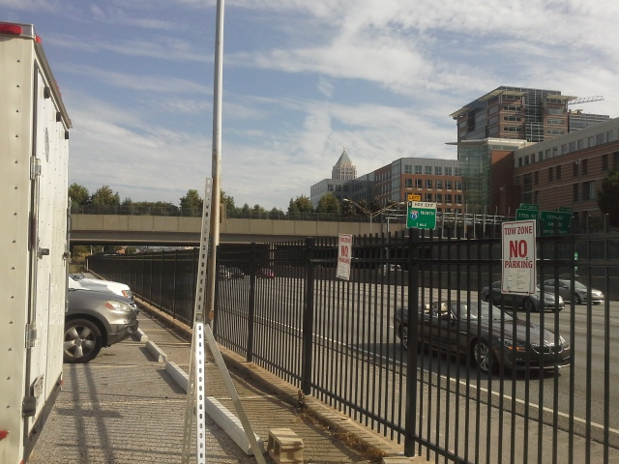
Low-cost Sensor Packages for Roadside Emissions Factor Estimation
CMAS – 10/7/2015
Karoline K. Johnson, Michael H. Bergin, Duke University
Armistead G. Russell, Georgia Institute of Technology

Slide 2
Overview
Advantages of low-cost sensing
Applications of interest to modeling
Emissions factors estimation

Slide 3
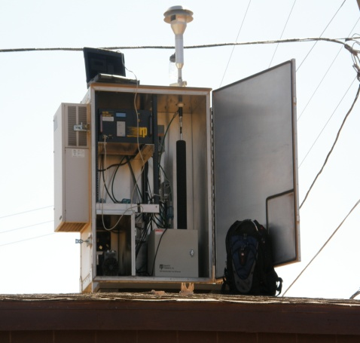
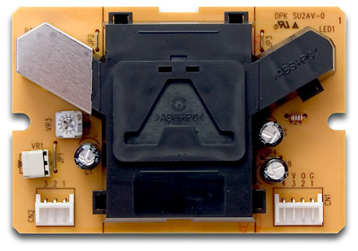
Advantages of Sensors
Inexpensive ($10 - $6000)
Many models commercially available
Small
Lightweight
Low power consumption
Easier to use and maintain once assembled
Real-time fast response
Portable and robust
US Federal Equivalence Method
$40,000
Shinyei
particle sensor
$100
Img sources: Shinyei.co.jp, www.navajonationepa.org /aqcp/AirMonitoringSite.html
Notes:
http://www.ecotech.com/gas-analyzers/co-analyzer
www.shinyei.co.jp

Slide 4
Applications

Slide 5
Spatial and Temporal Distribution
Low-cost and low upkeep allows more nodes
Real-time data
Portable
Identifying hot spots
  Find areas higher than expected
  Deploy more expensive equipment in specific locations of interest
PM2.5 comparison across campus (~1 mile)
Sensor Pilot – Georgia Tech
Notes:
Integrated filter samples

Slide 6
Health Studies
Estimating exposure
Can use network of sensors to estimate ambient concentrations throughout a community in microenvironments
Indoor and outdoor
Some sensors can be used as personal monitors

Slide 7
Other applications
  Mobile monitoring
  Citizen science
  Not feasible at this time
  Litigation
  Regulatory compliance

Slide 8
Emissions Factors
Locate sensors near roadways and other sources
Calculate based on pollutant and CO2 concentrations
Emissions factors variable regionally and over time

Slide 9
Sensors & Modeling
  Benefits of sensors for modeling
  Additional data for inputs, training, and evaluation of models (especially important for fine-scale modeling)
  Custom emissions factors for models
  Benefits of modeling for sensors
  Combining sensor data into useful product (concentration over a city, etc.)
  Identifying problematic nodes in network

Slide 10
Emissions Factors Estimation

Slide 11
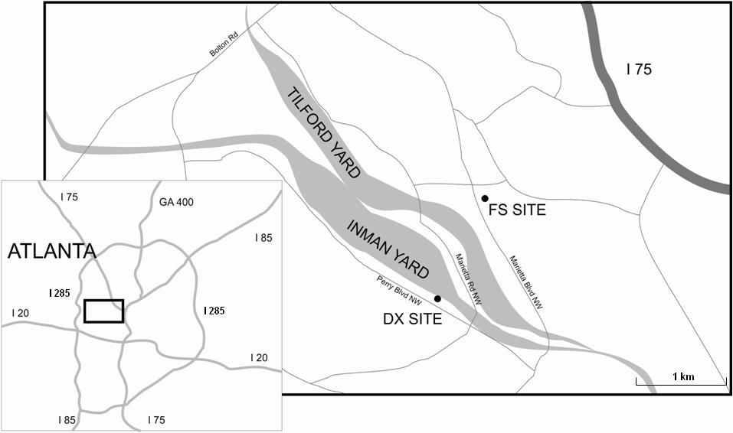
Railyard Emissions Factors: Conventional Instruments
(Galvis et al., 2013)

Slide 12
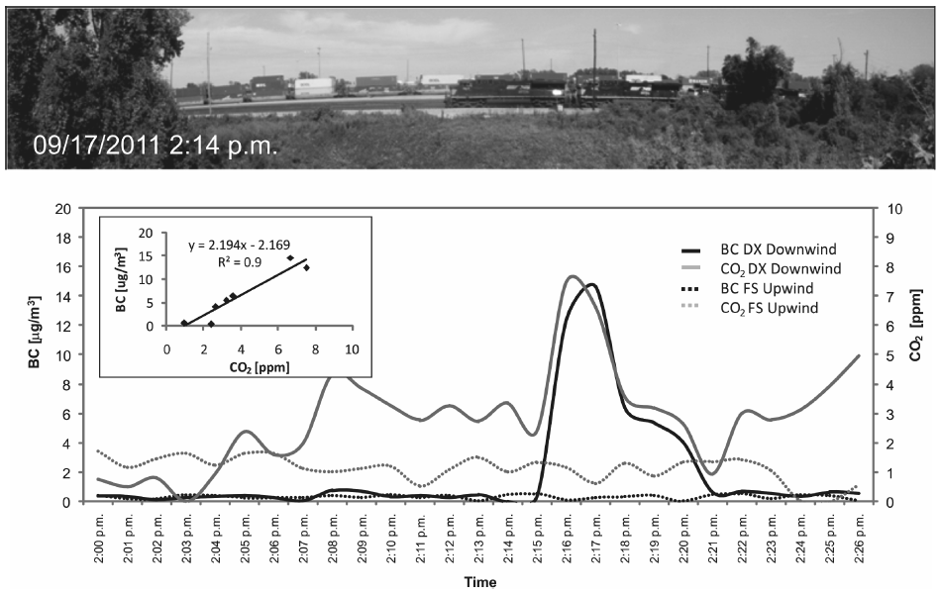
Railyard Emissions Factors: Conventional Instruments cont.
(Galvis et al., 2013)

Slide 13
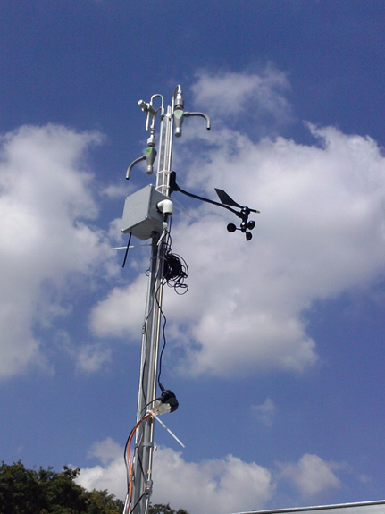
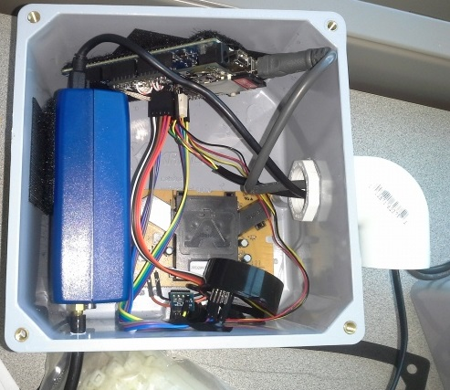
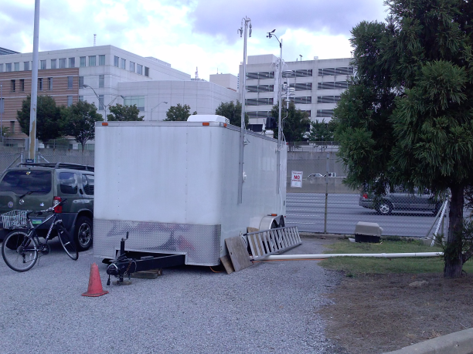
Road Emissions Factors: Low-cost Sensors
microAeth – black carbon
Arduino-microcontroler
Shinyei
PM sensor
COZIR
CO2 sensor
temperature and humidity sensor
Monitoring station and sensor package installation
(Atlanta, GA)
Sensor Package

Slide 14
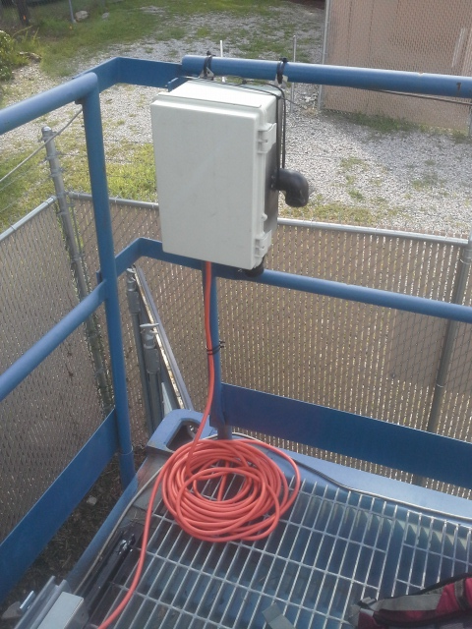
Package Design for Emissions Monitoring
Shoebox-sized
Weatherproof design
Fan draws air through the box
Price: 1-2 orders of magnitude less expensive
  PM2.5, CO2, and microcontroller ~$400
  + Optional microAeth ~$6,000
  + Optional gas-phase sensors ~$200 each
    (CO, NO, NO2, O3-Alphasense)
Emissions Package Deployed at I-40
Durham NC
Notes:
Different format for bullets

Slide 15
How accurate are these measurements?
Comparison with reference methods:
PM2.5
  Atlanta roadside, R² ~0.5
  India (high ambient concentrations), R² ~0.9
  Ideal range ~20 - 300 µg m⁻³
CO2
  Atlanta roadside, R² ~0.75

Slide 16
Emissions Factor Application
Calculate: pollutant per unit fuel or unit activity
Identify a period where both CO₂ and the pollutant of interest rise and fall together
Baseline concentration
Notes:
Something weird happened to the image….?

Slide 17
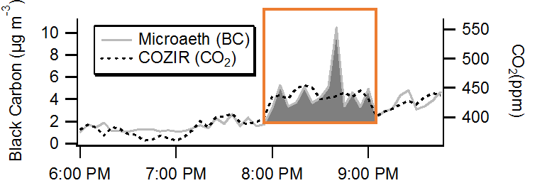
Emissions Factor Application
2. Integrate black carbon above background levels

Slide 18
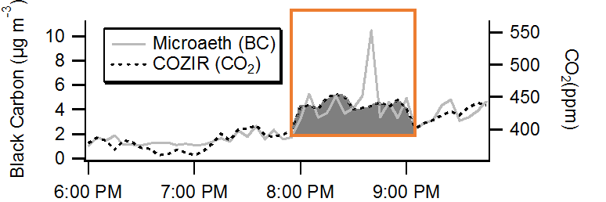
Emissions Factor Application
3. Integrate CO₂ above background concentrations
4. Convert to kg gasoline

Slide 19
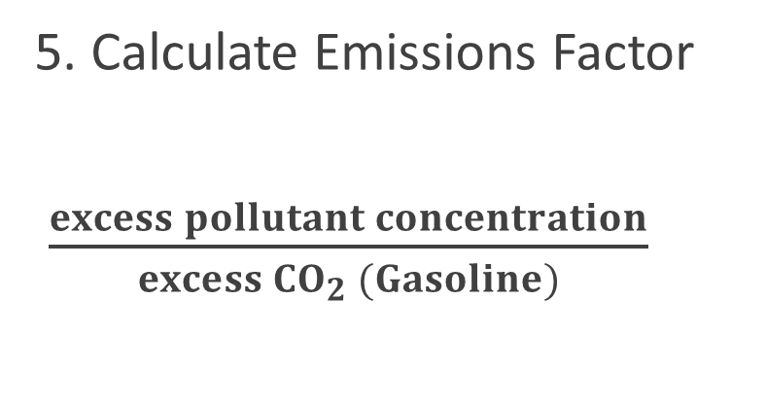
Emissions Factor Application
5. Calculate Emissions Factor
$\frac{excess pollutant concentration}{excess {CO}_{2} (Gasoline)}$

Slide 20



Emissions Factors Results
Light Duty
Gasoline
(g kg⁻¹)
Sensors
Atlanta Roadside
(g kg⁻¹)
Mid Duty and Heavy Duty Diesel
(g kg⁻¹)
PM2.5 0.038 0.39 1.4
Black Carbon 0.010 0.11 0.92
(Dallmann et al., 2013)
(Ban-Weiss et al., 2008)

Slide 21
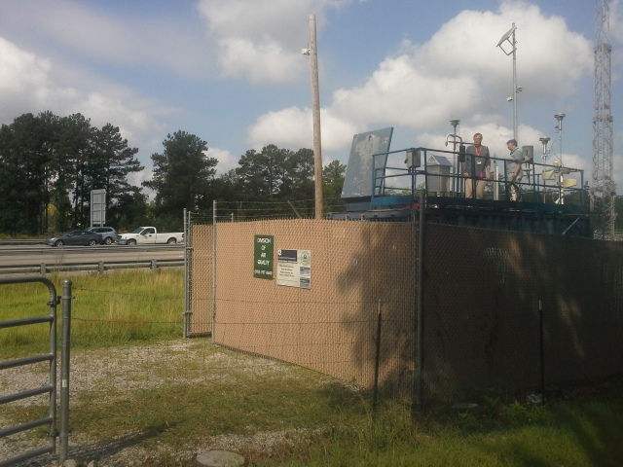
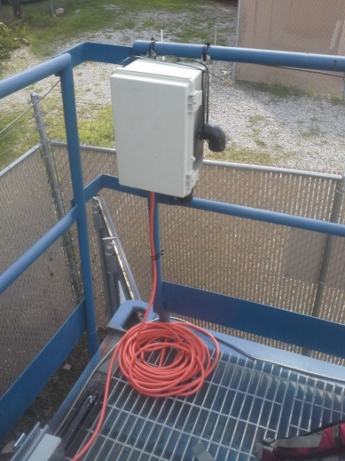

Durham Emissions Factors: In Progress
Use wind data to determine when background vs when from road
PM concentrations slightly lower (~20%, 4 ug m⁻³)
Monitoring station
RDU
I-40
130° SW
N
Monitoring Station
Durham, NC
Sensor Package Deployed at I-40
Durham, NC
22

Slide 22
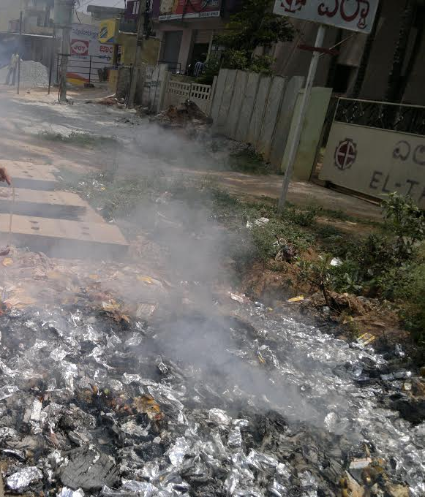
Additional Applications for EFs
Other large sources like airports, railyards, etc.
Small sources such as biomass- or refuse burning
Trash Burning in India

Slide 23
Summary
New low-cost sensors have many benefits over conventional methods
Many potential applications
Accuracy must be taken into account
Sensing and modeling can be used together to provide even more valuable information

Slide 24
Acknowledgements
This work was made possible by the NSF PIRE grant 1243535 and EPA Star grant R83503901.
Thanks to Gayle Hagler at EPA, Jason Hu, Jaidevi Jeyaraman, Laura King, Jennifer Mountino, and Rodney Weber at Georgia Tech.
This presentation’s contents are solely the responsibility of the grantee and do not necessarily represent the official views of the US EPA or NSF. Further, US EPA or NSF do not endorse the purchase of any commercial products or services mentioned in this presentation.

Slide 25
References
Ban-Weiss, G. A., J. P. McLaughlin, R. A. Harley, M. M. Lunden, T. W. Kirchstetter, A. J. Kean, A. W. Strawa, E. D. Stevenson, and Kendall, G. R.(2008) Long-term changes in emissions of nitrogen oxides and particulate matter from on-road gasoline and diesel vehicles, Atmospheric Environment, 42, 220-232, 2008.
Dallmann, T. R., Kirchstetter, T. W., DeMartini, S. J., and Harley, R. A.(2013): Quantifying on-road emissions from gasoline-powered motor vehicles: accounting for the presence of medium- and heavy-duty diesel trucks Environmental Science & Technology 46, 13873-13881.
Galvis, B., Bergin, M., and Russell, A., (2013) Fuel-based fine particulate and black carbon emission factors from a railyard area in Atlanta, Journal of the Air & Waste Management Association, 63:6, 648-658, DOI: 10.1080/10962247.2013.776507

Slide 26
Questions?
Contact: Karoline.Johnson@duke.edu

