Slide 1

The effect of future ambient air pollution on global premature mortality and the impact of climate change to 2100
Raquel A. Silva, J. Jason West,
Jean-François Lamarque, Drew T. Shindell,
and the ACCMIP modelers
14th Annual CMAS Conference
10/07/15

Slide 2
Motivation
Since the industrial revolution, anthropogenic ambient air pollution has increased significantly.
Exposure to ozone and PM_{2.5} has been associated with cardiopulmonary morbidity (e.g. asthma exacerbation) and mortality (e.g. death from cardiovascular and respiratory diseases as well as lung cancer).
Changes in ambient concentrations have been mainly driven by changes in emissions, but they are also affected by climate change.
Introduction Methods Results Conclusions Q&A

Slide 3
Air quality and climate change
Changes in:
Photochemical reaction rates
Biogenic emissions
Deposition
Atmospheric circulation
Climate
change
Air Quality
Jacob and Winner 2009;
Weaver et al 2009; Fiore et al 2012
Ozone:
  Likely increase in polluted regions during the warm season,
  particularly in urban areas and during pollution episodes
  Likely decrease in remote regions (background ozone)
PM_{2.5}:
  Effects are uncertain and vary regionally
  (different changes in precipitation, wildfires and biogenic emissions,
  different PM_{2.5} composition, etc.)
Introduction Methods Results Conclusions Q&A

Slide 4
Objective
Use modeled ozone and PM_{2.5} concentrations from the ACCMIP ensemble to quantify the global ozone- and PM_{2.5}-related mortality impacts of:
  Future concentrations considering the effects of both emissions and climate change - four RCP scenarios;
  Future climate change by using pairs of simulations – one simulation ensemble with present emissions and climate and one with present emissions but future climate (RCP8.5 climate).
Introduction Methods Results Conclusions Q&A

Slide 5
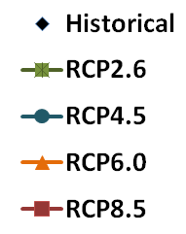
Representative Concentration Pathways (RCPs)
Source: RCP Database - http://tntcat.iiasa.ac.at:8787/RcpDb/dsd?Action=htmlpage&page=compare
Introduction Methods Results Conclusions Q&A

Slide 6
Health impact function
Ozone: Log-linear model,
with RR from Jerrett et al. 2009
PM_{2.5}: IER model (Burnett et al. 2014)
∆Mort – Premature mortality due to exposure to air pollution
(0.5°x0.5°
resolution)
∆Mort = y₀ x AF x Pop
Baseline mortality rate
Exposed Population
Attributable fraction
AF=(RR – 1)/RR
Population 25+
(IFs: 2030, 2050, 2100)
- Respiratory diseases (RESP)
(inc. COPD)
- Cardiovascular diseases
(inc. IHD, STROKE)
- Lung Cancer (LC)
(International Futures, IFs:
2030, 2050, 2100)
RR = f(air pollutant concentrations)
- Future (Future minus 2000)
and Anthropogenic global burden (Future minus 1850)
- Climate change impact (Em2000Cl2030/2100 minus 2000)
RR= Relative risk of death attributable to changes in pollutant concentration (long-term exposure)
Introduction Methods Results Conclusions Q&A

Slide 7
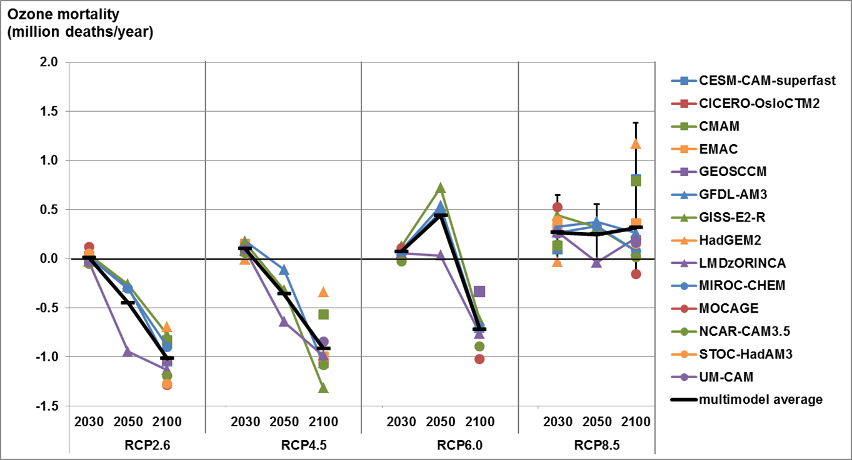
Future ozone-related mortality (I)
Global Respiratory Premature Ozone Mortality: 2030, 2050 and 2100 vs. 2000 conc.
Uncertainty for the ensemble mean is a 95% CI including uncertainty in RR and across models. -
Introduction Methods Results Conclusions Q&A

Slide 8
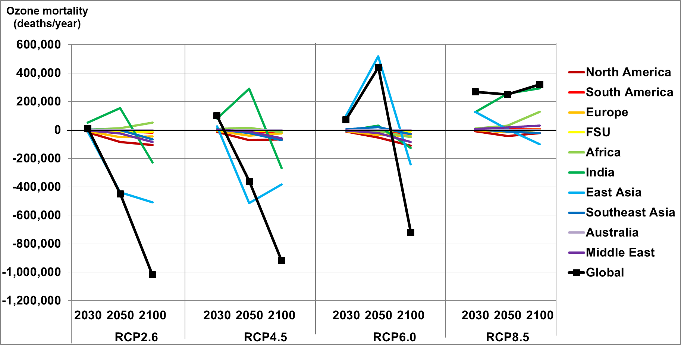
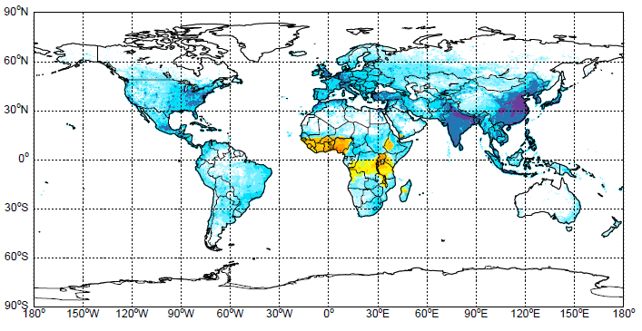
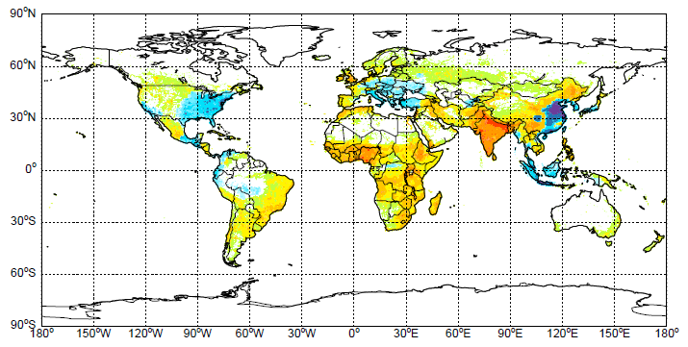
Future ozone-related mortality (II)
Respiratory premature ozone mortality - 2030, 2050, 2100 vs. 2000
RCP2.6 11 models
RCP8.5 13 models
Respiratory premature ozone mortality - 2100 (two scenarios)
deaths yr⁻¹ (1000 km²)⁻¹
-1000 -100 -10 -1 -0.1 -0.01 0.01 0.1 1 10 100 1000
Introduction Methods Results Conclusions Q&A

Slide 9
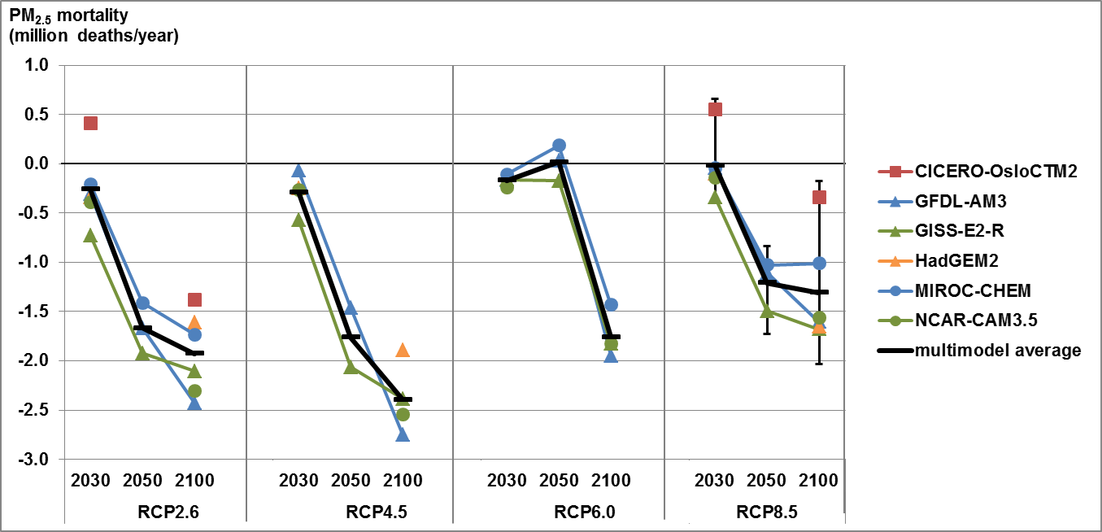
Future PM_{2.5}-related mortality (I)
Global CPD+LC Premature PM_{2.5} Mortality: 2030, 2050 and 2100 vs. 2000 conc.
Uncertainty for the ensemble mean is a 95% CI including uncertainty in the RR and across models. –
Introduction Methods Results Conclusions Q&A

Slide 10
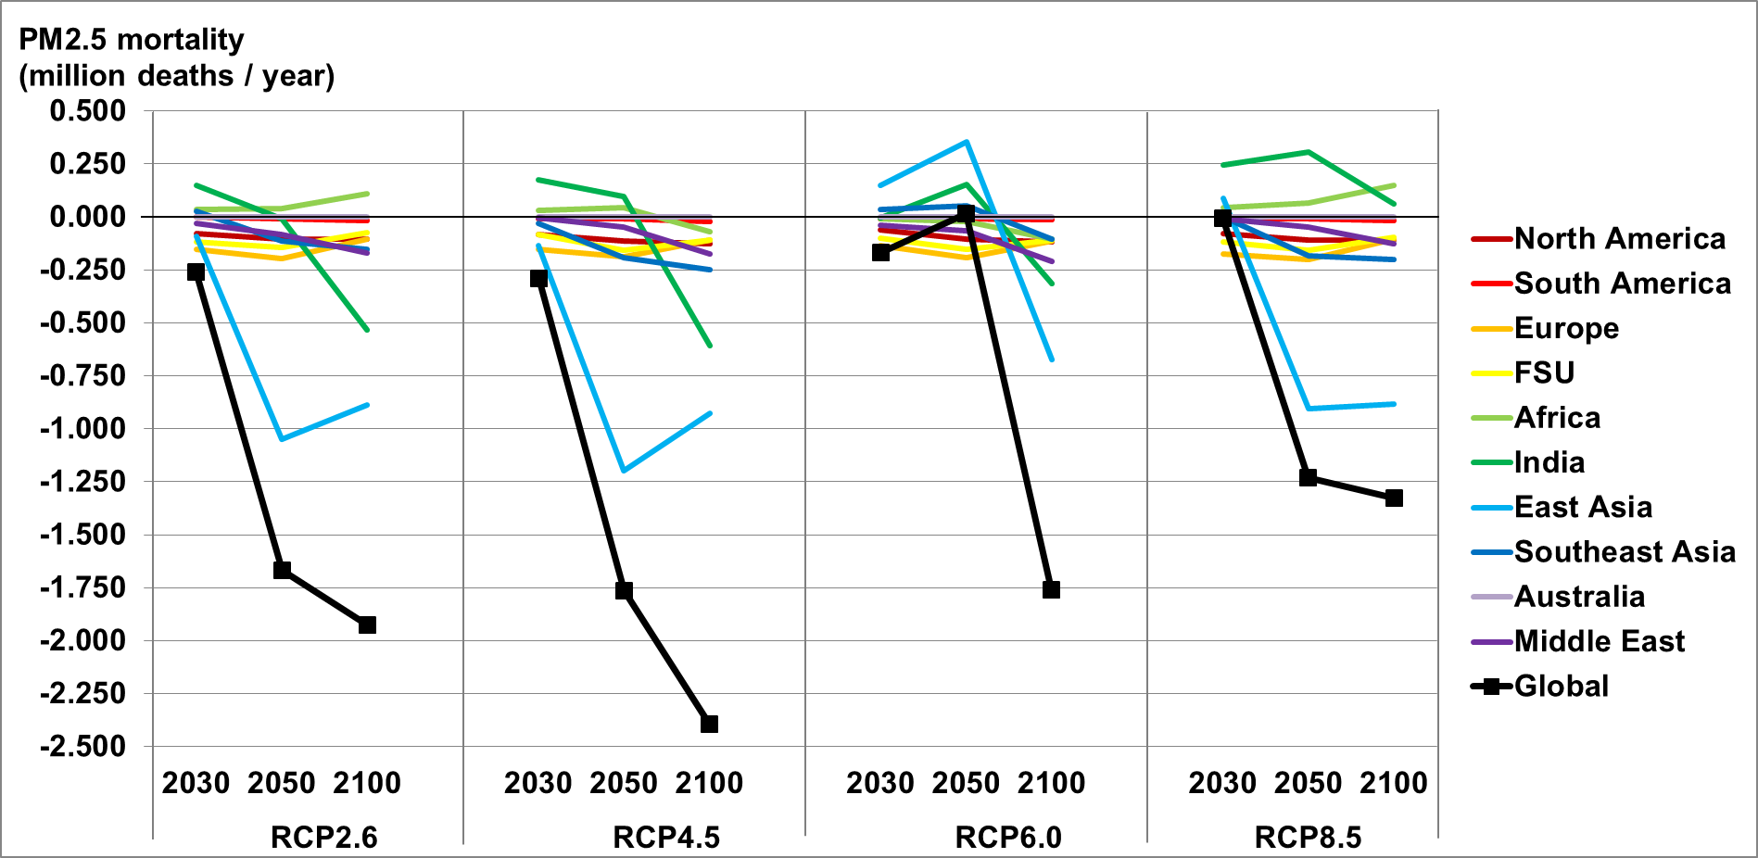
Future PM_{2.5}-related mortality (II)
IHD+Stroke+ COPD+LC Premature PM_{2.5} Mortality
RCP2.6 6 models
RCP8.5 6 models
IHD+Stroke+COPD+LC Premature PM_{2.5} Mortality – 2100 (two scenarios)
-1000 -100 -10 -1 -0.1 -0.01 0.01 0.1 1 10 100 1000
deaths yr⁻¹ (1000 km²)⁻¹
Introduction Methods Results Conclusions Q&A

Slide 11
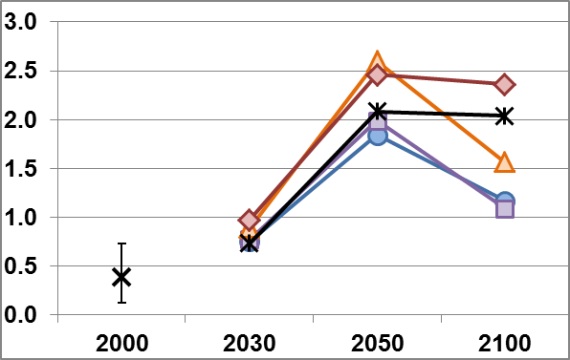
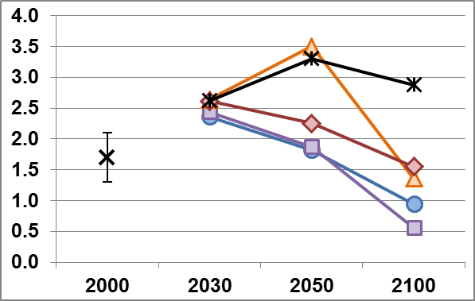

Global air pollution burden on mortality
Ozone
PM_{2.5}
Respiratory mortality
(million deaths/year)
IHD+Stroke+COPD+LC mortality
(million deaths/year)
Concentrations | Population | Baseline MR
2000 minus 1850 | Present-day | Present-day
2000 minus 1850 | Future | Future
Future minus 1850 | Future | Future
RCPs
Introduction Methods Results Conclusions Q&A

Slide 12
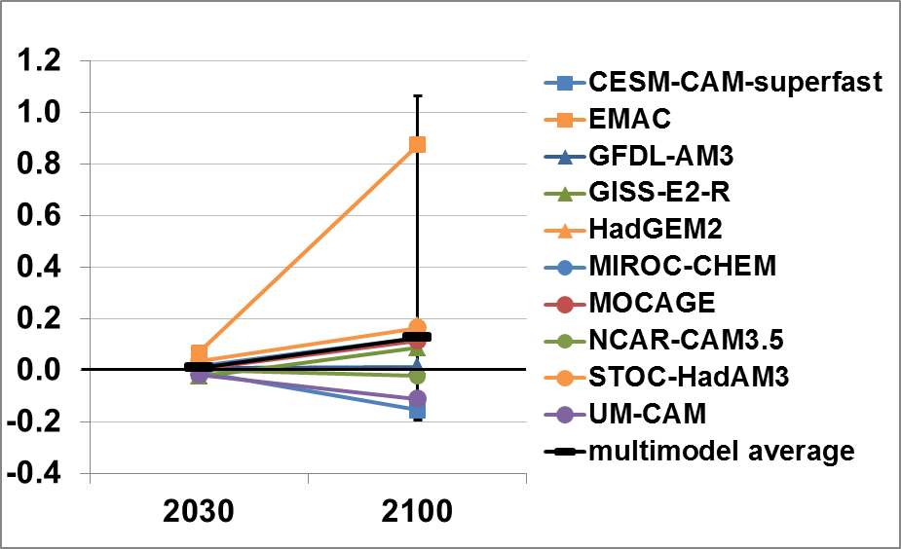
Impact of Climate Change: ozone mortality (I)
Million deaths yr⁻¹
Mean | (95% CI)
(thousands deaths . yr⁻¹)
2030
11 (-30, 86)
2100
127 (-193, 1,070)
Impact of Climate Change on Global Respiratory Premature Ozone Mortality
Uncertainty for the ensemble mean is a 95% CI including uncertainty in RR and across models. -
Introduction Methods Results Conclusions Q&A

Slide 13
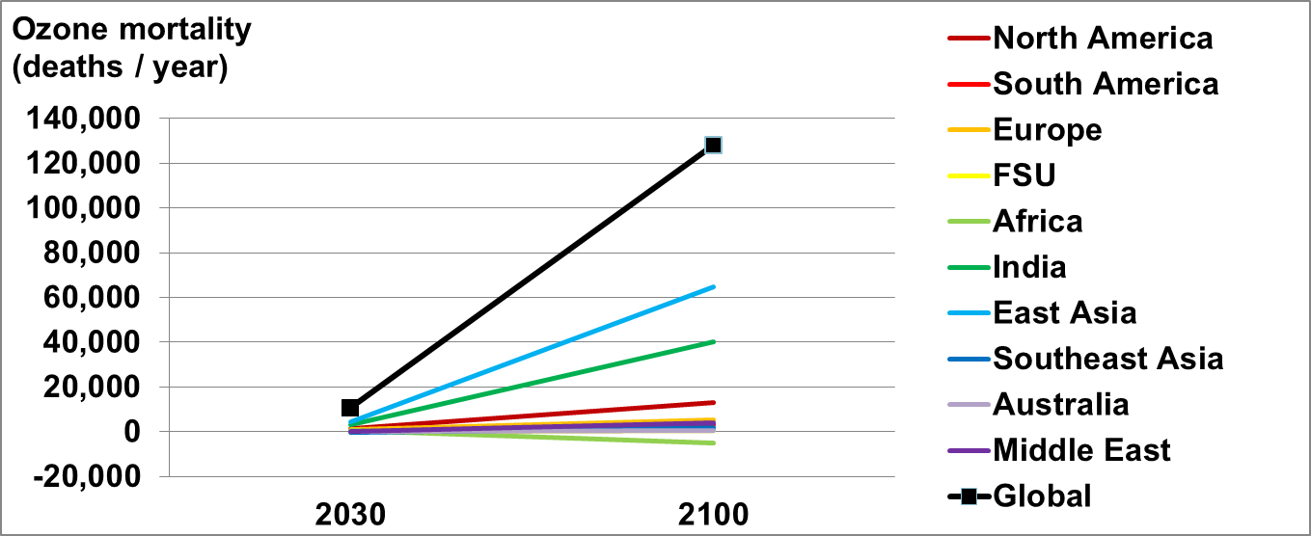
Impact of Climate Change: ozone mortality (II)
2030 9 models
2100 10 models
Premature Ozone Mortality – 2030, 2100
-1000 -100 -10 -1 -0.1 -0.01 0.01 0.1 1 10 100 1000
deaths yr⁻¹ (1000 km²)⁻¹
Introduction Methods Results Conclusions Q&A

Slide 14
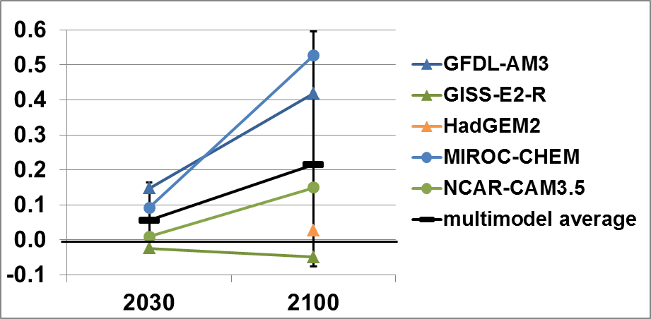
Impact of Climate Change: PM_{2.5} Mortality (I)
Million deaths yr⁻¹
Mean | (95% CI)
(thousand deaths . yr⁻¹)
2030
56 (-34 , 164)
2100
215 (-76 , 595)
Impact of Climate Change on Global IHD+STROKE+COPD+LC Premature PM_{2.5} Mortality
- Uncertainty for the ensemble mean is a 95% CI including uncertainty in RR and across models. -
Introduction Methods Results Conclusions Q&A

Slide 15
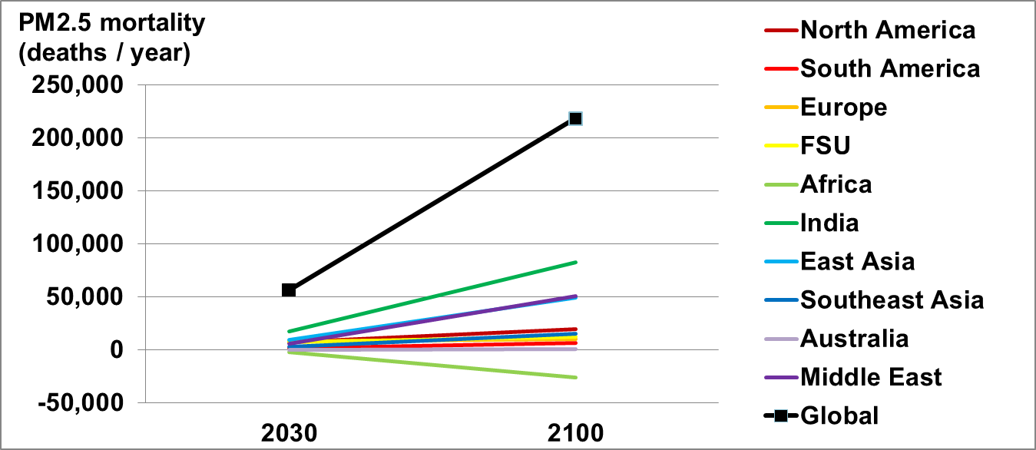
Impact of Climate Change: PM_{2.5} Mortality (II)
2030 4 models
2100 5 models
IHD+Stroke+COPD+LC Premature PM_{2.5} Mortality – 2030, 2100
-1000 -100 -10 -1 -0.1 -0.01 0.01 0.1 1 10 100 1000
deaths yr⁻¹ (1000 km²)⁻¹
Introduction Methods Results Conclusions Q&A

Slide 16
Main uncertainties
Uncertainty in air quality modeling
  Emission inventories
  Climate and air quality interaction and feedback mechanisms
  Non-linearities in model response to changes in emissions
Uncertainty in RRs
  Same RRs applied worldwide and into the future;
Uncertainty in population and baseline mortality rates projections
Exposed population restricted to adults 25+
Introduction Methods Results Conclusions Q&A
Notes:
Climate and air quality interaction and feedback mechanisms
Climate sensitivity to biogenic emissions (e.g. isoprene, soil NOx and methane)
Stratosphere-troposphere interactions (e.g. stratospheric influx of ozone)
Aerosol-cloud interactions
Impact of climate change on wildfires, etc.
Future research:
Improve air quality modeling;
Build/model other scenarios of future emissions;
Epidemiological research on the
long-term effects of air pollution (narrow uncertainty in RR; focus on developing nations).
Box – Uncertainty in GCM projections
Source:
(ProjectingClimateRelatedDiseaseBurden_FINAL.doc)
Saha et al. Projecting Climate-Related Disease Burden: A Guide for Health Departments. Climate and Health Technical Report Series, Climate and Health Program, Centers for Disease Control and Prevention.
The three important categories of uncertainty in GCM projections are: (1) that deriving from different approaches to modeling, (2) that deriving from natural climate variability, and (3) that deriving from different emissions scenarios.
The uncertainty associated with different approaches to modeling can, to some degree, be addressed through use of projections from multiple GCMs: Using projections from a random sample of ten or more GCMs may provide a representative sample of scientific uncertainty.⁴⁰ Multi-model ensembles do not capture the full range of scientific uncertainty because differences in model outputs may cancel out in the average ensemble output.
The uncertainty associated with natural climate variability can best be managed by increasing the number of model runs included. Due to natural variability, even projections from the same model can be notably different.⁴¹ Each modeling group produces 1-9 GCM runs for each scenario and period. Natural variability can be reduced by using the average of each GCM’s runs or propagated by including each run in the sample used to project health impacts.
Societal uncertainty is represented by the emissions scenarios. For the middle of the 21st century, the four RCPs provide largely similar U.S. climate projections. Thus, some studies use an ensemble of GCM from only one RCP for this period. However, there is a large divergence in climate projections from the four RCPs by the end of the century. As a result, climate change health impact projections should use GCM outputs based on two or more RCPs for projections for projections beyond 2050.

Slide 17
Conclusions
Future Mortality
Impact of Climate Change
  Under the RCP scenarios, global PM_{2.5} mortality generally decreases in the future relative to 2000 concentrations, but ozone mortality increases in some scenarios/periods (e.g. RCP8.5/2100);
  Mortality estimates differ among models - for most scenarios, uncertainty associated with modeled air pollutant concentrations exceeds that from the RRs;
  Increases in exposed population and in baseline mortality rates of respiratory diseases magnify impact of changes in air pollution
  RCP8.5 climate change in 2100 will likely increase global mortality
  Ozone: 127,000 (-193,000 to 1.07 million) deaths/year;
  PM_{2.5}: 215,000 (-76,100 to 595,000) deaths/year;
  Increases occur in all regions, except Africa, especially in highly populated and highly polluted areas.
  Uncertainty in modeled air pollutant concentrations contributes the most to uncertainty in mortality estimates
Introduction Methods Results Conclusions Q&A

Slide 18


The effect of future ambient air pollution on global premature mortality and the impact of climate change to 2100
The research described in this presentation has been funded by a fellowship from the Portuguese Foundation for Science and Technology, a Dissertation Completion Fellowship from The Graduate School (UNC – Chapel Hill), and NIEHS grant #1 R21 ES022600-01.
THANK YOU
Raquel A. Silva
rasilva@live.unc.edu
CMAS Conference
10/07/2015

Slide 19
Supplemental Material

Slide 20
ACCMIP model ensemble
- Simulations in 2030, 2050, 2100
- Main purpose: study climate forcing
SSTs (sea surface temperature)
SICs (sea-ice concentrations)
GHGs
Air pollutants
OCEAN
CLIMATE
CHEMISTRY
SSTs, SICs
ATMOSPHERE
Ocean-Atmosphere Chemistry-Climate Model (fully coupled)
GISS-E2-R
Chemistry-Climate Model (driven by SSTs and SICs)
CESM-CAM-superfast, CMAM, EMAC, GEOSCCM, GFDL-AM3, HadGEM2*, MIROC-CHEM, NCAR-CAM3
Chemistry-General Circulation Model
(driven by SSTs and SICs)
LMDz-ORINCA*, STOC-HadAM3*, UM-CAM*
Chemical Transport Model
CICERO-OsloCTM2*, MOCAGE
* No stratospheric chemistry
Notes:
SSTs (sea surface temperature) and SICs (sea-ice concentrations)
Atmospheric Chemistry and Climate Model Intercomparison Project (ACCMIP)
An ensemble of 14 chemistry-climate models, some of which reported past and future surface concentrations of ozone but not PM2.5
Simulations performed to support the IPCC’s Fifth Assessment Report (AR5).
As described by Lamarque et al (2013) not all models are truly coupled chemistry-climate models. OsloCTM2 and MOCAGE are chemical transport models driven by external meteorological fields, and UM-CAM and STOC-HadAM3 do not model the feedback of chemistry on climate.

Slide 21
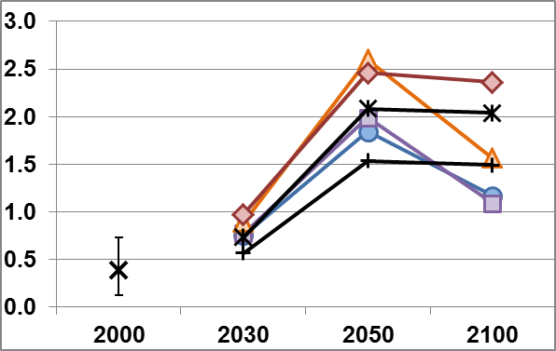
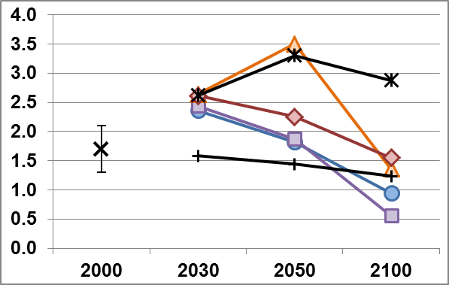
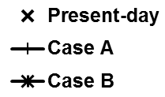
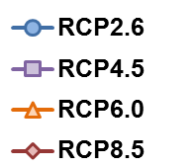
Global air pollution burden on mortality
Ozone
PM_{2.5}
Respiratory mortality
(million deaths/year)
IHD+Stroke+COPD+LC mortality
(million deaths/year)
Concentrations | Population | Baseline MR
2000 minus 1850 | Present-day | Present-day
2000 minus 1850 | Present-day | Future
2000 minus 1850 | Future | Future
Future minus 1850 | Future | Future
RCPs
Introduction Methods Results Conclusions Q&A

Slide 22
Uncertainty in air quality modeling
  Emission inventories
  Climate and air quality interaction and feedback mechanisms
    Climate sensitivity to biogenic emissions
    (e.g. isoprene, soil NOx and methane)
    Stratosphere-troposphere interactions
    (e.g. stratospheric influx of ozone)
    Aerosol-cloud interactions
    Impact of climate change on wildfires, etc.
  Non-linearities in model response to changes in emissions
Introduction Methods Results Conclusions Q&A

