Slide 1
Chemical Condition and Surface Ozone in Urban Cities of Texas During the Last Decade: Observational Evidence from OMI, CAMS, and Model Analysis
Yunsoo Choi & Amir Souri
University of Houston

Slide 2
Ozone and its precursors
Ozone production
    Nitrogen oxides (NO_{x}=NO+NO₂) and Volatile Organic Compounds (VOCs)
    Complex non-linear photochemistry
    HCHO/NO₂ ratio
      NO_{x}-saturated, -mixed or –sensitive regimes
Introduction
Trend analysis
NO2
HCHO
HCHO/NO2
Ozone
Model Analysis
Conclusion

Slide 3
Ozone monitoring
The anthropogenic emissions of NO_{x} declined by 48% between 1990 and 2013 (EPA, 2013)
VOC emissions from anthropogenic sources declined by 38% between 1990 and 2013
EPA (2010) has lowered the ozone standard from its 8-hour average (i.e. 75ppbv to 60-70 ppbv)
Introduction
Trend analysis
NO2
HCHO
HCHO/NO2
Ozone
Model Analysis
Conclusion

Slide 4
Ozone monitoring
Lefohn et al. (2010) using a period data of 1980-2008 and 1994-2008 found that most metropolitan and rural regions in the United States exhibited either a negative or zero trend.
The low ozone concentrations have likely increased as NO_{x} has decreased, resulting from a decline in the amount of ozone quenched through NO_{x} titration.
Introduction
Trend analysis
NO2
HCHO
HCHO/NO2
Ozone
Model Analysis
Conclusion

Slide 5
Research Objectives
Trend of NO2 (2005-2013)
Trend of HCHO
Seasonal pattern of ozone and its relationship to air masses
Trend of ozone (maximum, annual, minimum)
The relationship between the trends
Model analysis (different emission inventories)
Introduction
Trend analysis
NO2
HCHO
HCHO/NO2
Ozone
Model Analysis
Conclusion

Slide 6
OMI NO₂
OMI NO₂ daily observations (0.25º×0.25º, level 2) from NASA (noisy observations have been filtered out)
Left: OMI, Right (MACCity)
NO2
HCHO
HCHO/NO2
Ozone
Model Analysis
Conclusion

Slide 7
OMI NO₂
OMI: Austin (-6%), Dallas (-21%), Fort Worth (-16%), Houston (-11%) and San Antonio (-7%)
CAMS: Dallas (-40.1%), Fort Worth (-43.9%) and Houston (-34.6%)
Except for San Antonio, our results showed was 10% lower, which may be the result of different spatial resolutions and subsets
Introduction
Trend analysis
NO2
HCHO
HCHO/NO2
Ozone
Model Analysis
Conclusion

Slide 8
OMI HCHO
SAO OMI HCHO (0.25º×0.25º) (filtering+ normalizing using remote location in Pacific Ocean)
Left: OMI HCHO, Right:MACCity
NO2
HCHO
HCHO/NO2
Ozone
Model Analysis
Conclusion

Slide 9
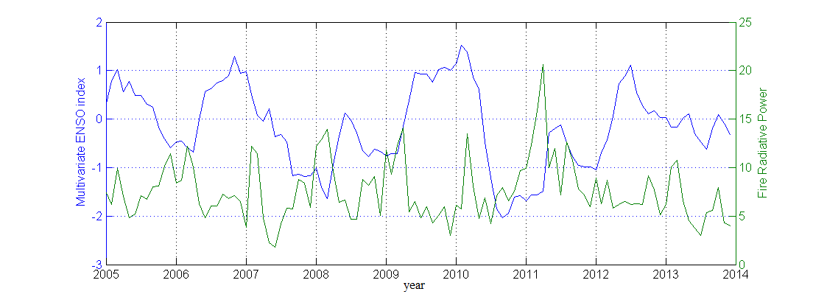
OMI HCHO
Austin (+9%), Dallas (-1%), Fort Worth (-4%), Houston (-5%) and San Antonio (+1%)
Possible reasons for trends:
  La Niña (warmer summers) periods of 2006, 2008-2009, and 2011 years
  Austin typically gets warmer than other cities.
  Differences in anthrpogenic emissions
Introduction
Trend analysis
NO2
HCHO
HCHO/NO2
Ozone
Model Analysis
Conclusion

Slide 10
OMI HCHO/NO₂
From HCHO/NO₂, the most NO_{x}-saturated (Dallas) and NO_{x}-sensitive cities (Austin) were shown.
The 2%, 7%, 6%, 5%, 3% of the selected days were NO_{x}-saturated (i.e., the NO_{x}-saturated regime to be the ratio <1) for Austin, Dallas, Fort Worth, Houston, and San Antonio
The cities have gradually become more NO_{x}-sensitive because of higher downward trend of NO₂ than HCHO.
The slope of this change was for Austin (0.10±0.04 yr⁻¹), Dallas (0.08±0.03 yr⁻¹), Fort Worth (0.07±0.03 yr⁻¹), Houston (0.06±0.03 yr⁻¹), and San Antonio (0.08±0.03 yr⁻¹)
Introduction
Trend analysis
NO2
HCHO
HCHO/NO2
Ozone
Model Analysis
Conclusion

Slide 11
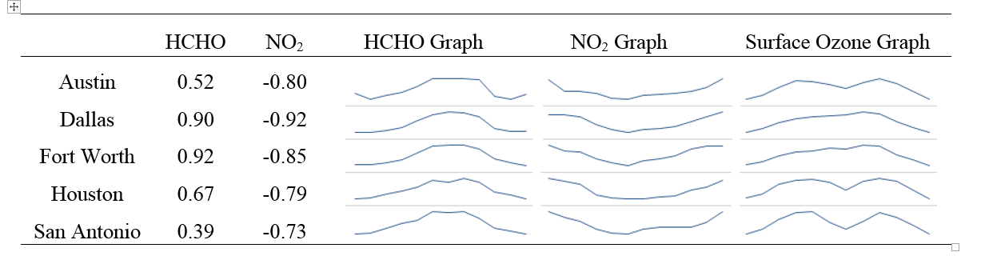
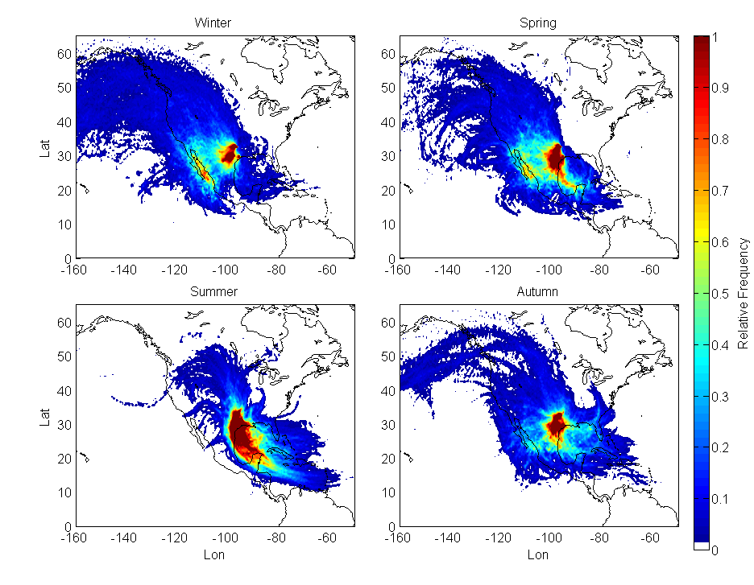
Surface Ozone
Introduction
Trend analysis
NO2
HCHO
HCHO/NO2
Ozone
Model Analysis
Conclusion

Slide 12
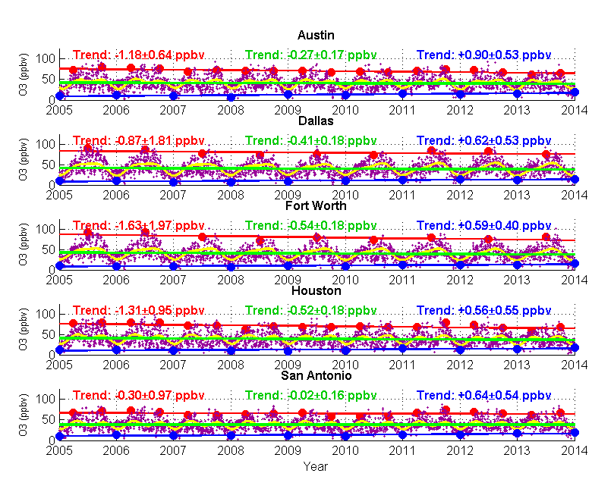
Surface Ozone
Introduction
Trend analysis
NO2
HCHO
HCHO/NO2
Ozone
Model Analysis
Conclusion

Slide 13
Surface Ozone
If observations after 2011 were excluded, the cities show a reduction in ozone maxima resulting from a decline in NO_{x} in an NO_{x}-sensitive regime, suggesting how climatic variability and associated wildfires after the period were crucial.
The cities showed an upward minimum trend
Downward trends of 5%, 8%, 11%, 11%, and 1% were found with respect to the 2005 ozone.
Introduction
Trend analysis
NO2
HCHO
HCHO/NO2
Ozone
Model Analysis
Conclusion

Slide 14
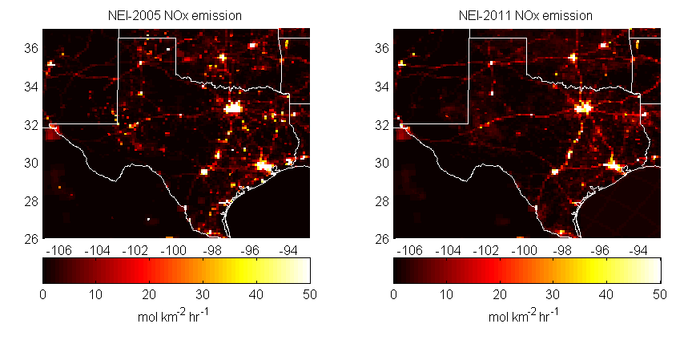
Model analysis (Sep. of 2013)
EPA National Emission Inventory (NEI) 2005 and NEI2011
NO_{x} emissions decreased by 19%, 20%, 16%, 50%, and 18% in Austin, Dallas, Fort Worth, Houston, and San Antonio.
Introduction
Trend analysis
NO2
HCHO
HCHO/NO2
Ozone
Model Analysis
Conclusion

Slide 15
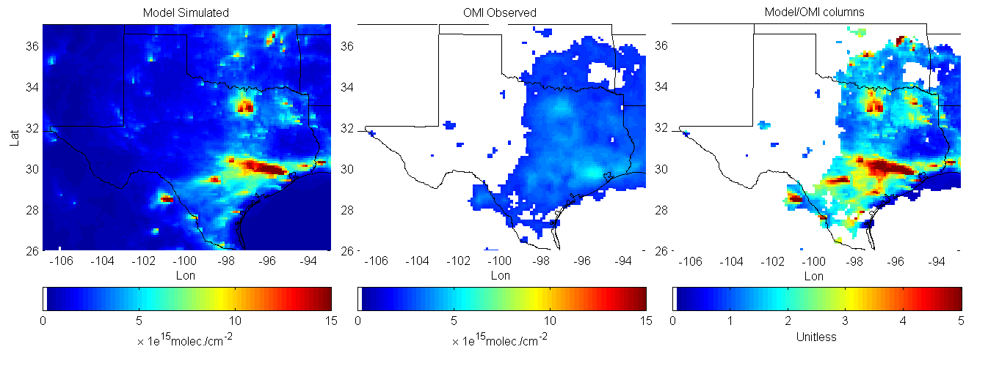
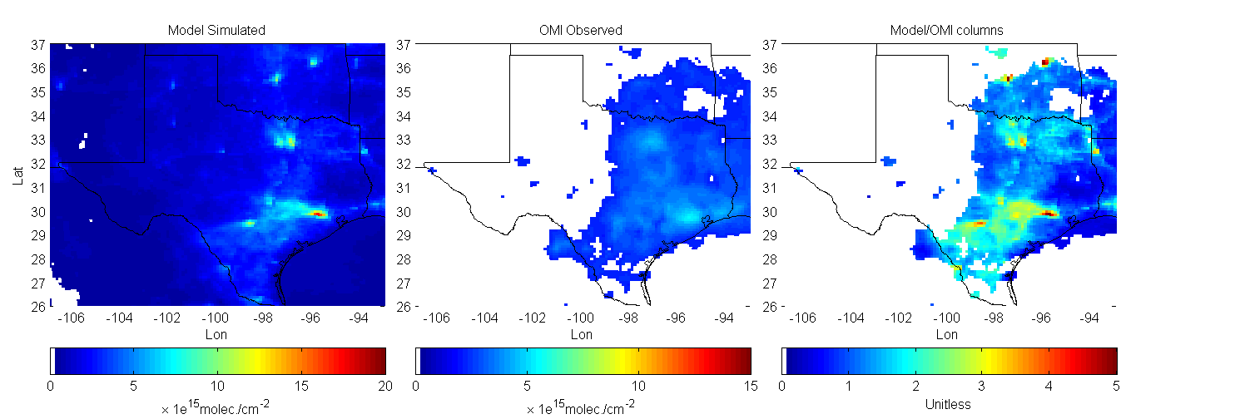
Model analysis (NO₂ column)
OMI NO₂ versus WRF-Chem
NEI2005
NEI2011
Introduction
Trend analysis
NO2
HCHO
HCHO/NO2
Ozone
Model Analysis
Conclusion

Slide 16
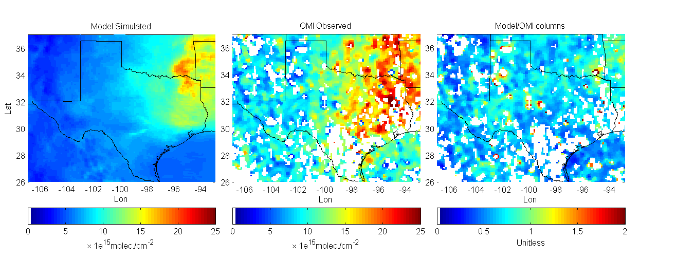
Model analysis (HCHO column)
OMI HCHO versus WRF-Chem
Introduction
Trend analysis
NO2
HCHO
HCHO/NO2
Ozone
Model Analysis
Conclusion

Slide 17
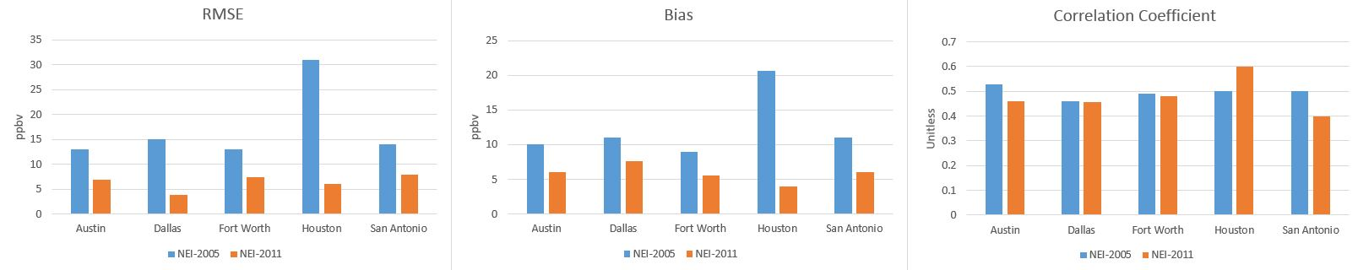
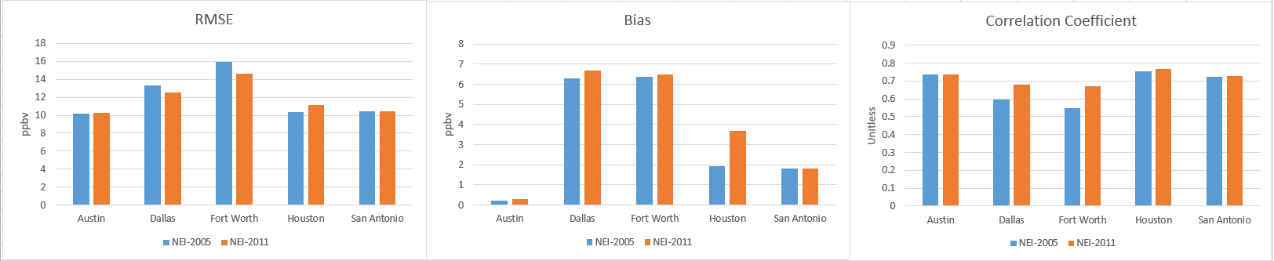
Model analysis (In-situ comparison)
Model versus CAMS (NO₂)
Model versus CAMS (O₃)
Introduction
Trend analysis
NO2
HCHO
HCHO/NO2
Ozone
Model Analysis
Conclusion

Slide 18
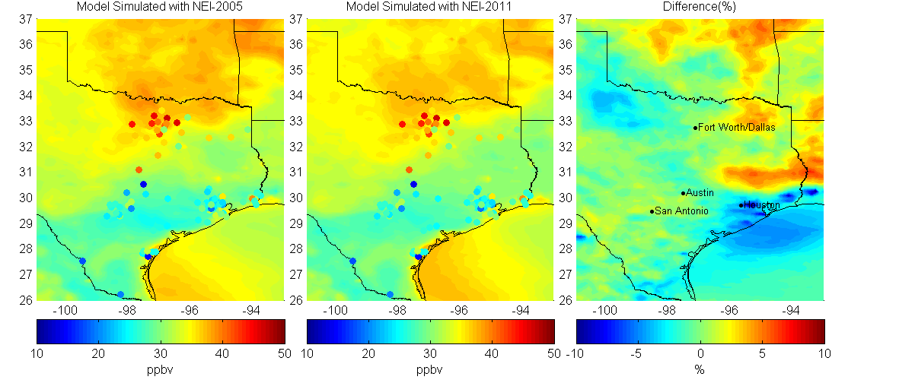
Model analysis (surface O₃)
Reduction 3% in Dallas and 0.5% in Fort Worth.
Increase by 0.7% in Austin, 0.8% in San Antonio, and 7% in Houston.
Overestimation of NO₂ and underestimation of HCHO might deplete available radicals in cities, leading to less production of ozone.
Introduction
Trend analysis
NO2
HCHO
HCHO/NO2
Ozone
Model Analysis
Conclusion

Slide 19
Conclusion
Decreased anthropogenic sources led to a significant downward trend for NO₂.
Austin showed a statistically significant increase (+9%) in annual trends of HCHO, resulting from climatic variability that cancelled out the decrease in anthropogenic HCHO emissions.
The differences between both trends gradually changed the chemical conditions of the Texas cities from NO_{x}-saturated/mixed to more NO_{x}-sensitive chemical conditions.
Introduction
Trend analysis
NO2
HCHO
HCHO/NO2
Ozone
Model Analysis
Conclusion

Slide 20
Conclusion
Climatic variability plays a major role in summertime surface ozone trends
Decline in annual ozone was shown
Introduction
Trend analysis
NO2
HCHO
HCHO/NO2
Ozone
Model Analysis
Conclusion

Slide 21
Conclusion
MTSE air masses influenced ozone pattern in July in the lower latitudes, and ozone precursors from the eastern US resulted in high ozone in Fall.
WRF-Chem in two different scenarios in September 2013:
  Decreases in ozone from the first to second case in Dallas (3%) and Forth Worth (0.5%), but increases in Austin (0.7%), San Antonio (0.8%), and Houston (7%) shown.
  Possibly resulting from underestimation of VOC contributions from petrochemical and biogenic and overestimation of NO_{x} in NEI-2005 inventory that led to low HCHO/NO₂ ratios.
Introduction
Trend analysis
NO2
HCHO
HCHO/NO2
Ozone
Model Analysis
Conclusion

Slide 22
Acknowledgements
Air Quality Research Program – The University of Texas at Austin & Texas Commission on Environmental Quality (TCEQ)
Texas Air Research Center – Lamar University
TCEQ CAMS monitoring site team
OMI NO₂ & HCHO column retrieval team
Introduction
Data
Methodology
Results
Conclusion

Slide 23
Thank you for your attention

