Slide 1
Assessment of aerosol plume dispersion products and their usefulness to improve models between satellite aerosol retrieval and surface PM2.5
Chowdhury Nazmi^{1,2}, Barry Gross^{1,2} , Yonghua Wu², Fred Moshary^{1,2}
¹Department of Electrical Engineering, The City College of NY
²NOAA-Cooperative Remote Sensing Science and Technology Center
The 14th Annual CMAS Conference, October 5-7, 2015

Slide 2
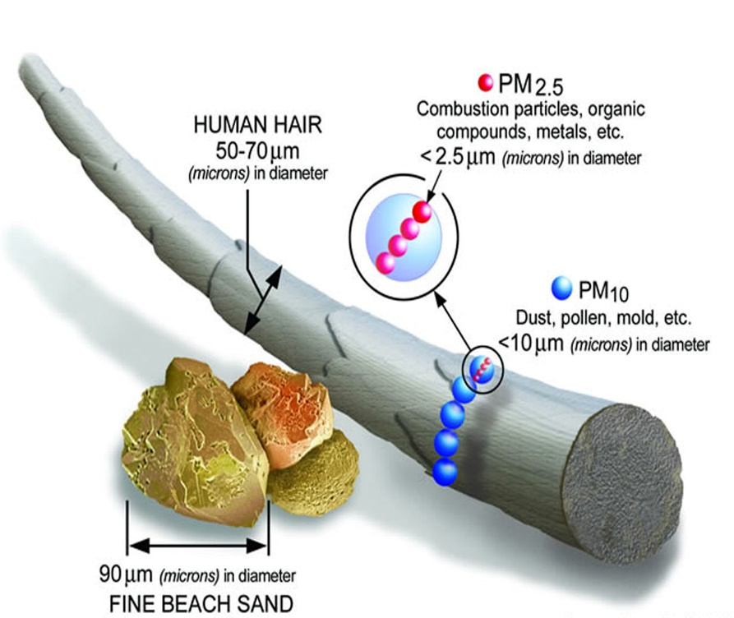
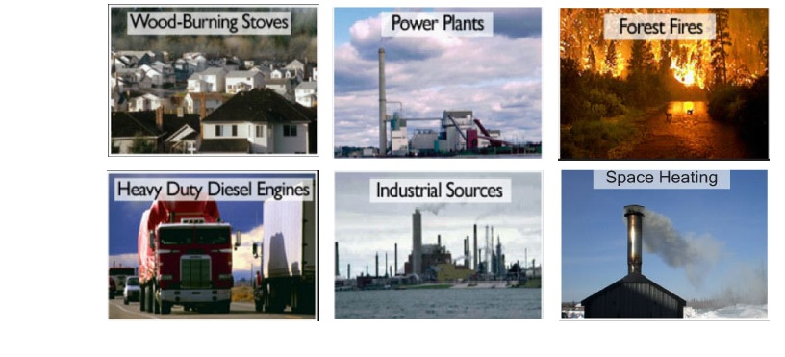
Motivation
Relative size of
Particulate Matter
Human Health is strongly affected by the ambient concentration of Fine Particulate Matter (PM2.5)
EPA Guidelines have been developed to address these issues.
Surface sampling is quite expensive and existing networks are very limited.
Satellites provide column integrated information that can potentially be used to estimate PM2.5.
Wide range of factors such as aerosols variability, meteorology and the vertical structure of aerosols affect the PM2.5-AOD relationship.

Slide 3
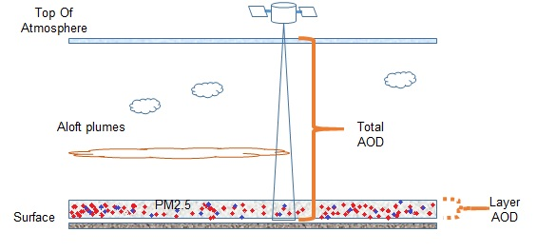
How can Remote Sensing extract PM2.5?
Total column integrated aerosol optical depth (AOD) measurements can be connected to surface PM2.5 using a simple linear model.¹
Strongly depends on aerosol properties, PBL height, meteorological conditions, presence of different aerosols of different mass/optical properties, aloft plumes (smoke) etc.
Many attempts have been made to connect surface PM2.5 measurements to column AOD, but it is expected that any simple relationship does not work in the presence of aloft plumes or mixed aerosol types. ³
¹ Zhang et al., 2014
²Al-Saadi et al., 2005; Hoff et al., 2009
³ Engel-Cox et al., 2004
PM2.5 - AOD relationship illustration

Slide 4
Proposal
Most operational satellite algorithms for AOD do not have a way of identifying/quantifying the existence of aloft plumes such as smoke.
This makes the use of satellite AOD’s risky and therefore the use of complementary smoke tools is very important as a way of better utilizing satellite AOD
Some tools that can theoretically identify smoke events/plumes include
CCNY LIDAR
GOES ASDTA Smoke product
NAAPS aerosol model
Our proposal is to see if these tools can help detect and compensate for the presence of smoke events and exploring if the Smoke Index can be used in a pre-processing mode to filter smoke cases and as an extra input to modify existing PM2.5 estimators including multivariable regressions and NN.

Slide 5
Instruments and datasets used
Ground-based multi-wavelength elastic-Raman scattering LIDAR:
Detects Aloft plume days
MODIS(AQUA/TERRA Satellite) Level 2 Aerosol Product:
Detects Aerosol Optival Depth(AOD)
“Optical_Depth_Land_And_Ocean” parameter is used which is “Aerosol Optical Thickness” at 0.55 µm for both Ocean (best) and Land (corrected) with best quality data (QA Confidence Flag = 3)
Spatial resolution of a 10x10 1-km (at nadir)-pixel array.
New York City Department of Environmental Conservation (NYCDEC):
PM2.5 concentration data
15 urban and 5 non-urban PM2.5 station data were available
Provides PM2.5 concentration of every hour of a day
ASDTA(Automated Smoke Detection and Tracking Algorithm) Smoke Product:
Semi-quantitative retrieval of column average smoke concentration (µg/m3)
Spatial resolution: 0.15 degree, Temporal Resolution: Hourly
NAAPS (Navy Aerosol Analysis and Prediction System) Global Aerosol Model:
Outputs: Smoke, Sulfate, SO2, Dust and Sea-Salt mass concentration profile at different altitudes
Need to convert from Concentrations to AOD
1X1 degree spatial resolution, 24 vertical levels, forecasts every 6 hour intervals
Time Frame Used: Summer 2010-2012

Slide 6
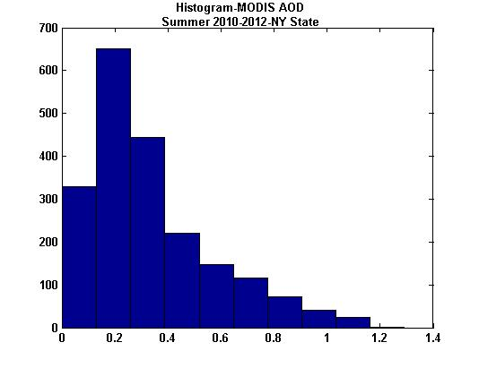
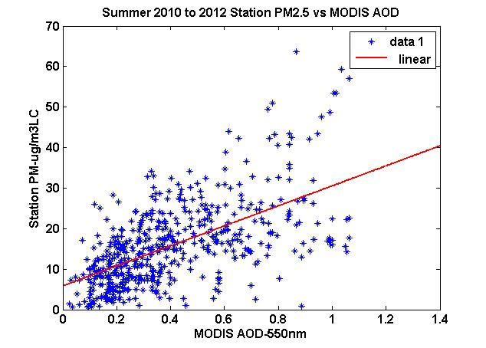
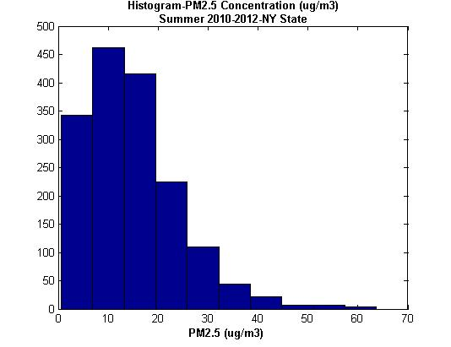
Hourly PM2.5 vs Satellite AOD
PM2.5 concentration data collected for available 15 urban and 5 non-urban NY stations from NYDEC for summer 2010-2012.
AOD data at PM2.5 station locations are collected from MODIS AQUA/TERRA for summer 2010-2012.
PM2.5 vs AOD plotted for all 20 PM2.5 station locations at MODIS hours.
Note low slope and fairly high offset
y= 25x+5.9
R=0.5968
rmse=18.39

Slide 7
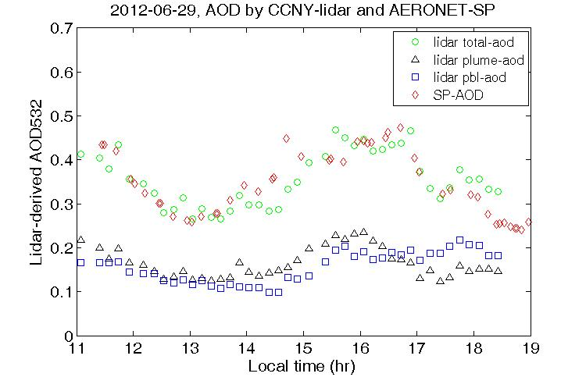
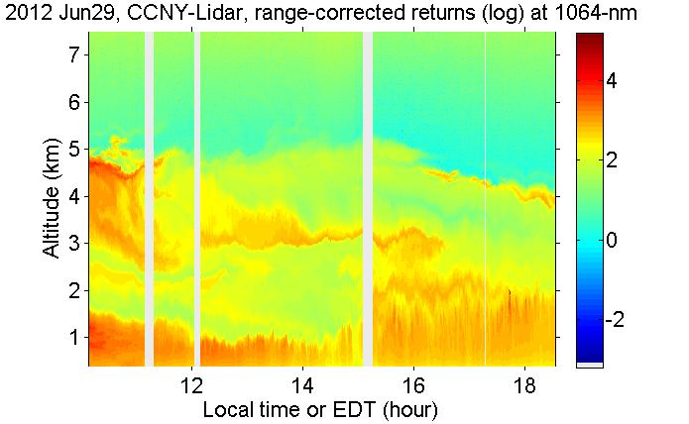
LIDAR (Light Detection and Ranging) Imagery for plume detection
NOAA CREST LIDAR can be used to detect existence of plumes.
Direct integration of the extinction coefficient can be used to estimate the plume AOD as well as the resulting PBL AOD
Plumes can easily be > 50% of total AOD.

Slide 8
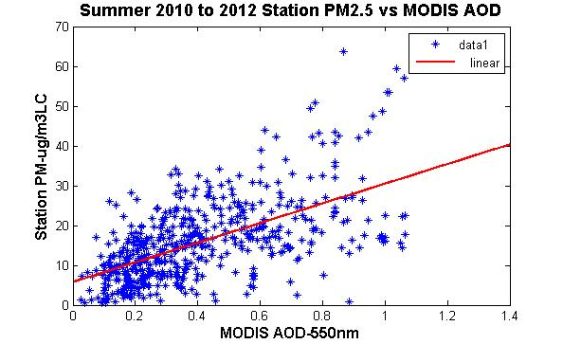
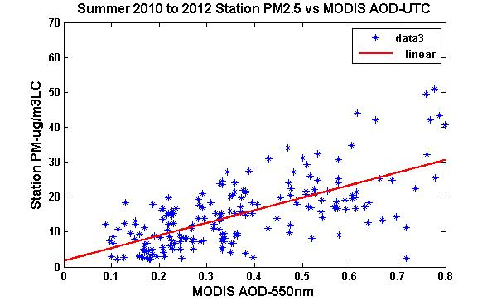
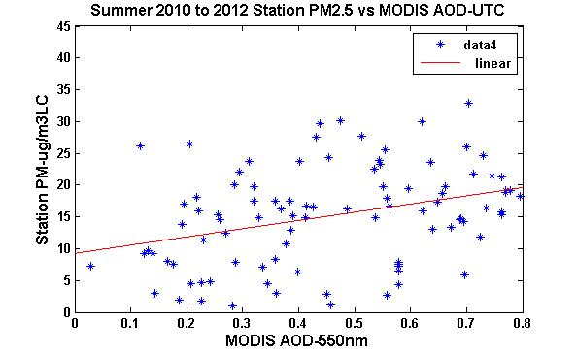
Evidence of Smoke Event contamination at CCNY
LIDAR can be used to study the effect of plumes on potential linear behavior between satellite AOD and surface PM2.5
When filtering out plume cases, a better linear correlation factor as well as a much improved slope and RMSE are observed
As expected, poor correlation is seen when only the smoke plume cases are studied.
y=26x+4.5
R=0.6056
rmse=20.35
No Filter
URBAN Stations
y=36x+1.9
R=0.6732
rmse=17.63
y=13x+9.3
R=0.3377
Filtered out aloft plume days
Aloft plume days

Slide 9
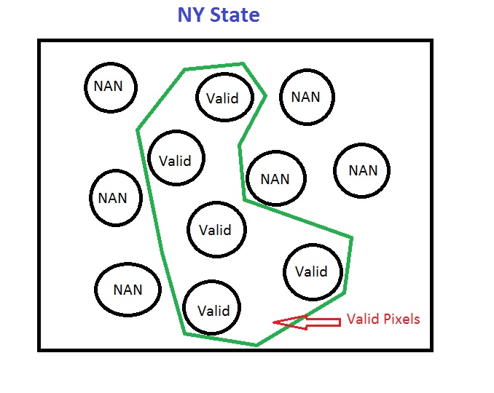
Quantifying high plume contamination cases with ASDTA
Plume transport algorithms are not expected to have very good spatial accuracy.
Therefore, using it to determine the smoke content of a single pixel is not recommended.
A more conservative approach is to use an extended domain and estimate the smoke likely hood based on statistics.
The smoke contamination of each event is quantified as:
Smokiness=average smoke AOD in the domain * fraction of smoky pixels in the domain
A CDF distribution allows us to develop a long term climatology of “smokiness” within a given domain.
From this, we can study the PM2.5 vs AOD as a function of the degree of “smokiness”.
Focusing on summer where best connection between AOD and PM2.5 expected and smoke plume contamination is most frequent.
Fraction of smoky pixels
=(valid # of pixels)/(total # of pixels)

Slide 10
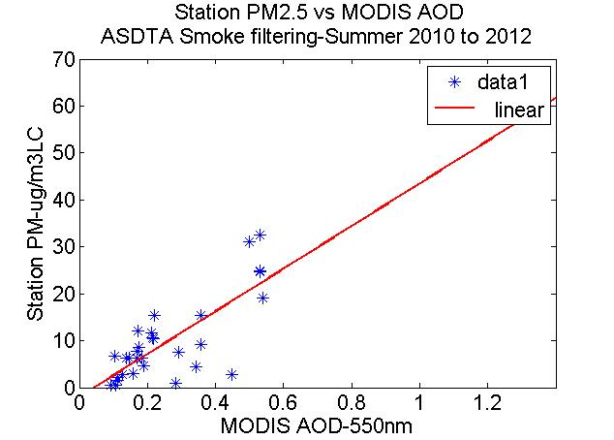
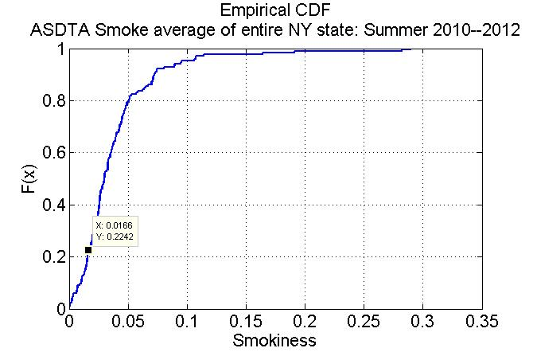
Filtering based on average smokiness of entire NY
y= 25x+5.9
R=0.5968
rmse=18.39
y= 45x-1.9
R=0.7754
rmse=12.82
No Filter
Filter out
Smokiness>=0.016

Slide 11
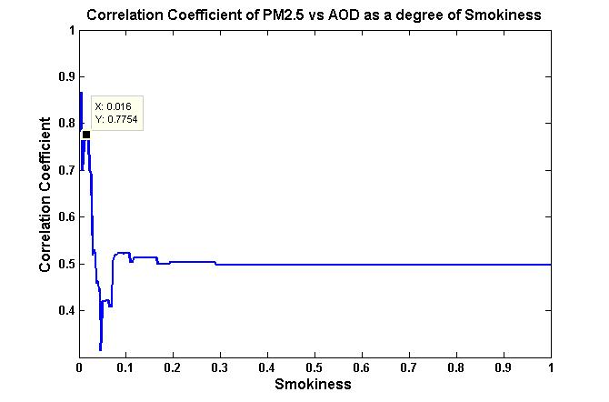
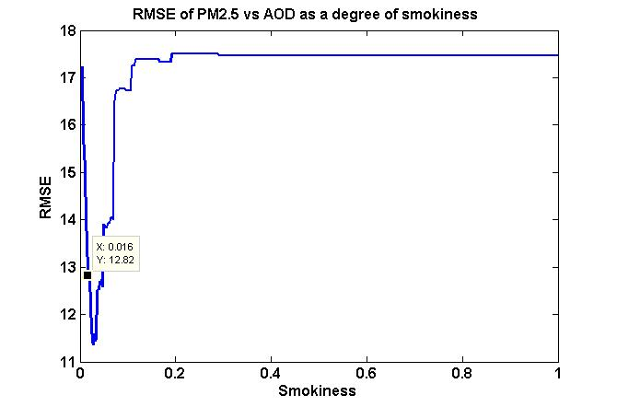
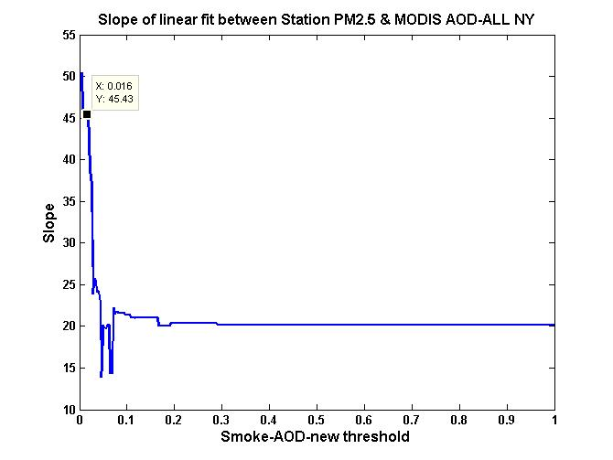
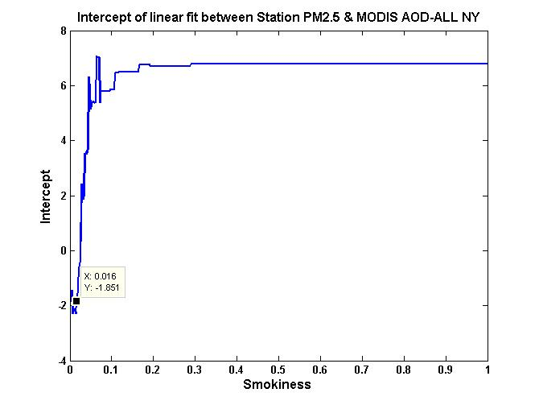
Filtering based on average smokiness of entire NY
Correlation
RMSE
Slope
Intercept

Slide 12
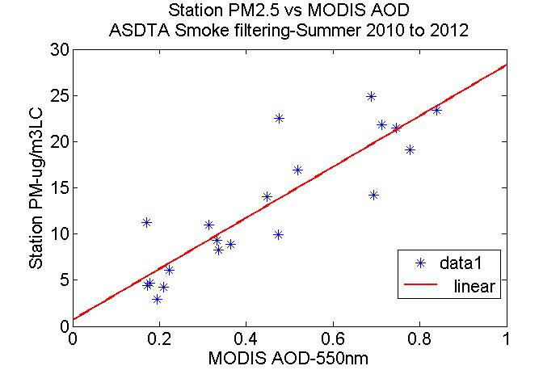
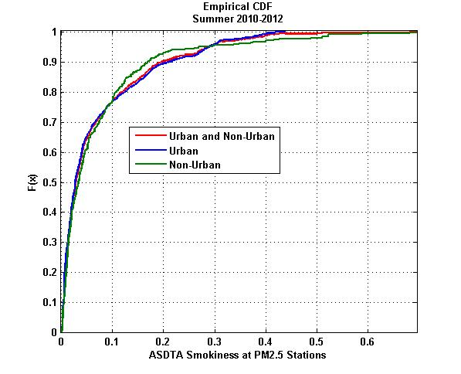
Reducing domains to 20km boxes Urban Cases Only
y=26x+4.5
R=0.6056
rmse=20.35
y=28x+0.73
R=0.8722
rmse=14.25
No Filter
Filter out
Smokiness>=0.018
Note that when the domain size shrinks, the CDF is skewed to
higher value which is reasonable since it is easier to fill a smaller cell with smoke
In addition , we see that the CDF is consistent for different regions (urban or nonurban)
which is reasonable for transported smoke.

Slide 13
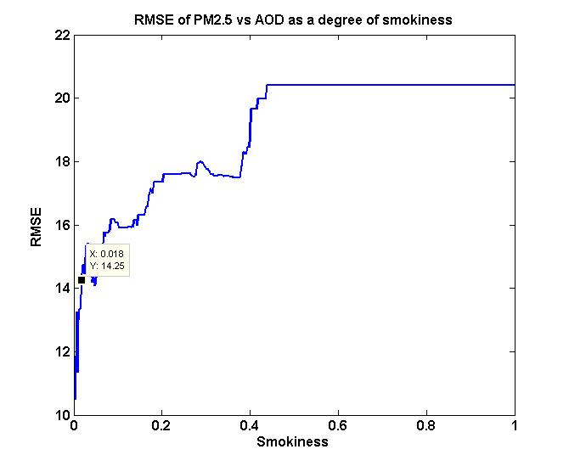
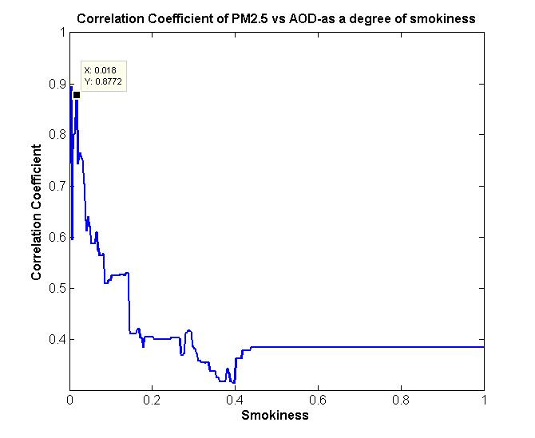
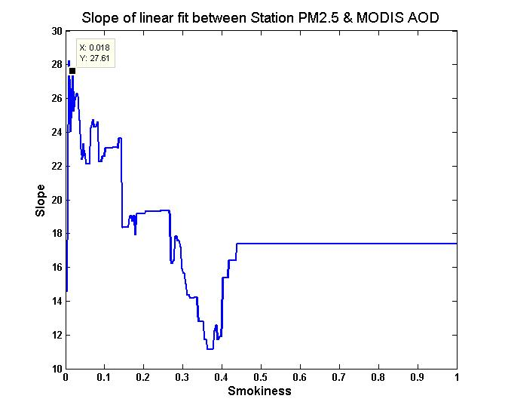
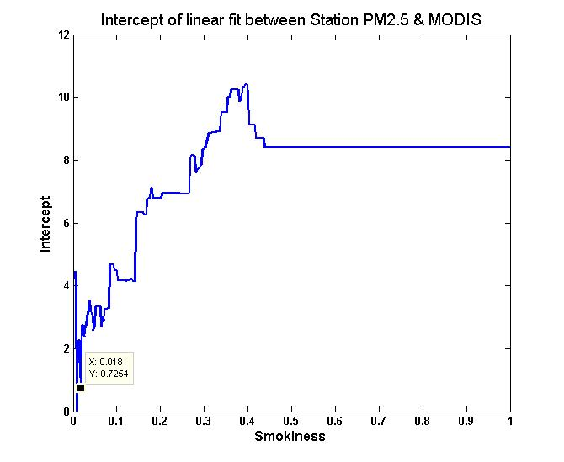
Reducing domains to 20km boxes Urban Cases Only
Correlation
RMSE
Significant improvement seen as the smoke Indicator decreases.
If too small, not enough points left.
Slope
Intercept

Slide 14
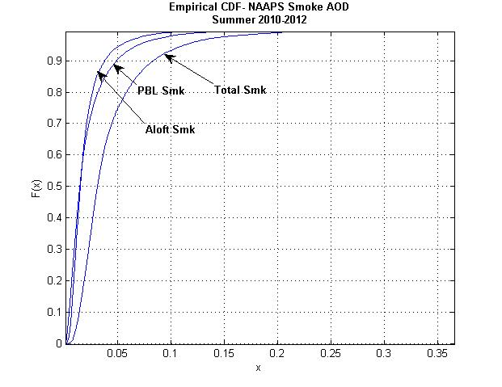
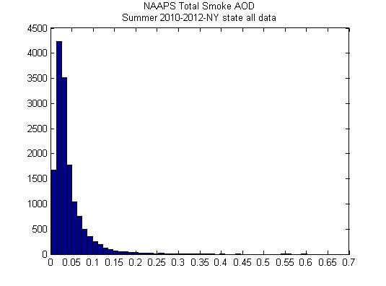
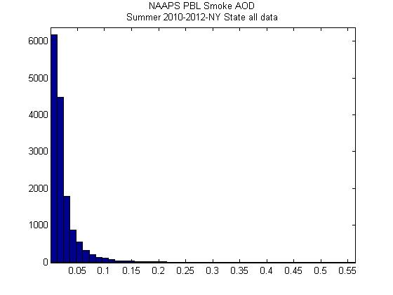
NAAPS Global Aerosol Model
ALOFT Smoke AOD
Interestingly
PBL Smoke ~ Aloft Smoke
TOTAL Smoke AOD
PBL Smoke AOD

Slide 15
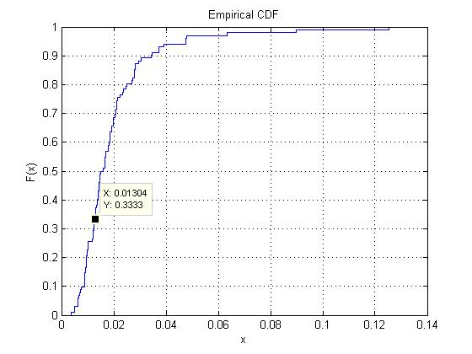
Filtering out contaminated cases using
NAAPS Aloft Smoke AOD as smoke indicator
NAAPS Aloft smoke AOD
NAAPS Aloft Smoke AOD<0.013
y= 25x+5.9
R=0.5968
rmse=18.39
No Filter

Slide 16
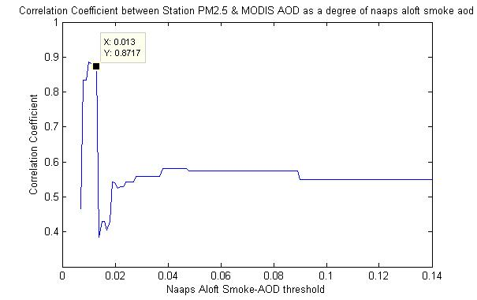
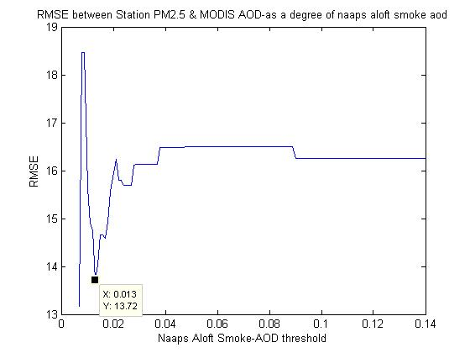
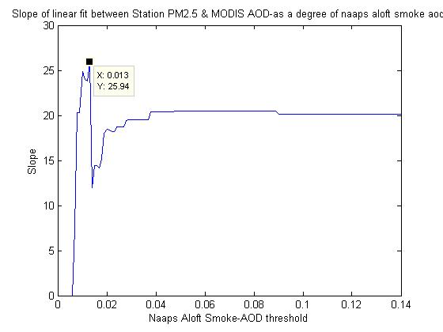
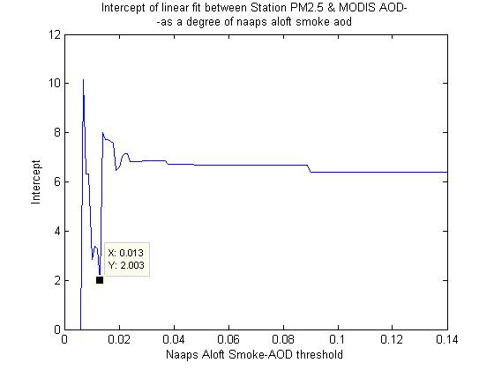
Filtering out contaminated cases using
NAAPS Aloft Smoke AOD as smoke indicator
Correlation
RMSE
Intercept
Slope

Slide 17
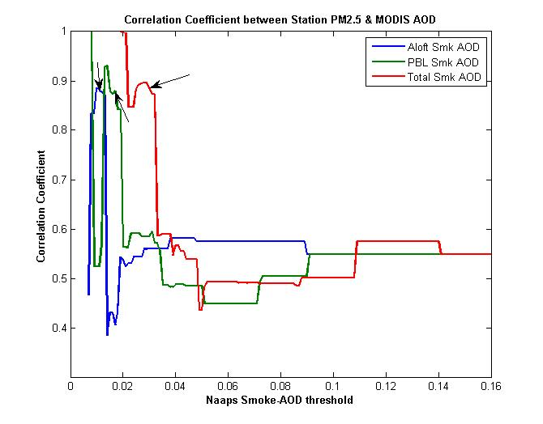
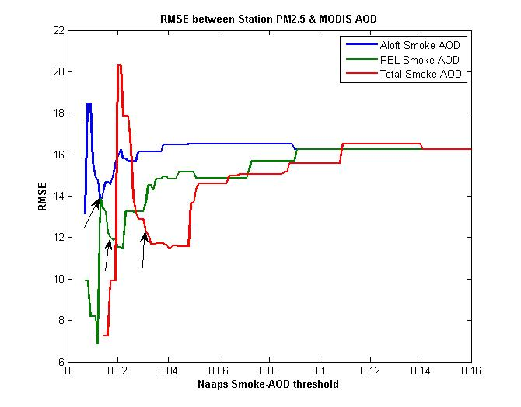
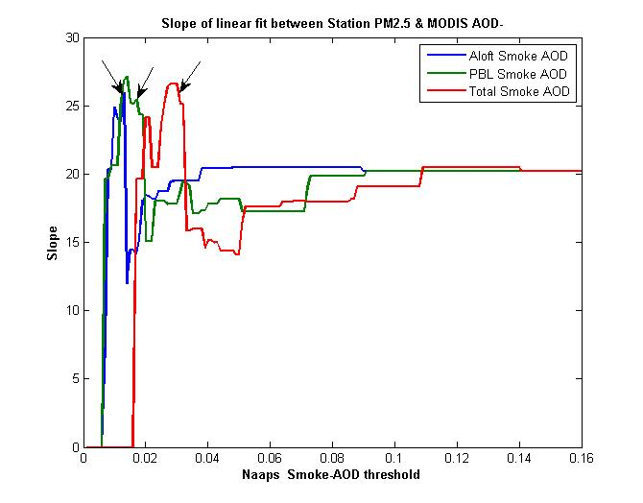
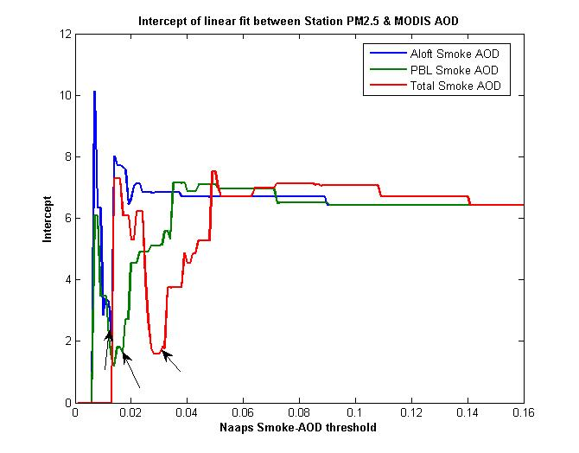
NAAPS Smoke Indicator comparison
Correlation
RMSE
Slope
Intercept

Slide 18
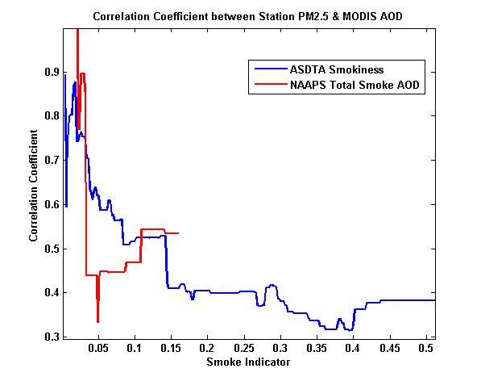
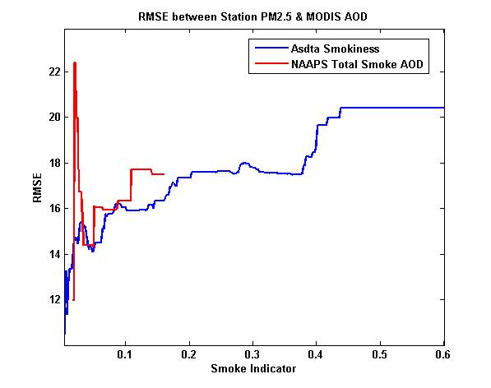
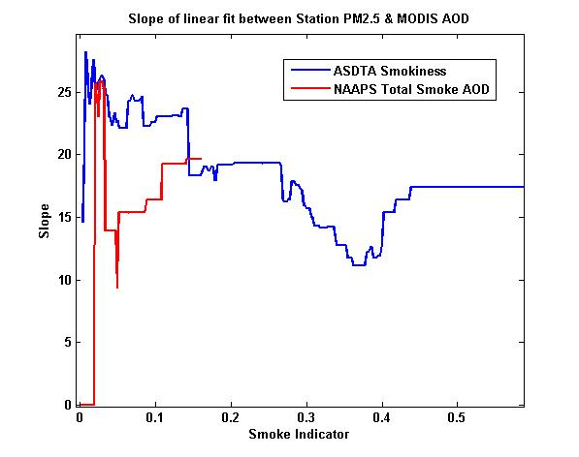
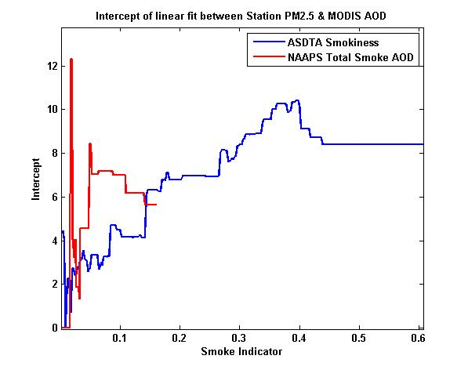
NAAPS & ASDTA Smoke Indicator comparison
Correlation
RMSE
URBAN CASES
Intercept
Slope

Slide 19
Conclusions / Future Work
In general, we have demonstrated that by applying either ASDTA or NAAPS smoke index, there is a general improvement in the resultant relationship between satellite AOD and station PM2.5 as the SI decreases.
In particular, the Correlation and slope increases as the smoke index becomes lower and the RMSE and y-intercept decreases which is consistent with removal of smoke from inorganic aerosol conditions.
This implies that the SI can be used in a pre-processing mode to filter smoke cases.
In the future, we plan to add the SI as an additional factor to more complex processing approaches such as NN’s to improve PM2.5 estimations.
Also, we will transition from MODIS AOD to VIIRS AOD products including an assessment of the different resolution (6km EDR and .75km pixel.)
We will also look at other smoke tools such as OMI’s Absorbing Index and the VIIRS smoke mask and look for correlations and best combinations to use between all of these products.

