Slide 1





Air Quality Reanalysis
(Configuration for 2010 HTAP production)
Greg Carmichael¹, Pius Lee² , Youhua Tang² , Li Pan² , Hyuncheol Kim², Daniel Tong² , Brad Pierce³, Ted Russell⁴, Yongtao Hu⁴, Talat Odman⁴, Dick McNider⁵,
Arastoo Pour Biazar⁵, Yang Liu⁶, Ed Hyer⁷, Ken Pickering⁸
¹ College of Engineering, University of Iowa, Iowa City, IA
²Air Resources Lab., NOAA Center for Weather and Climate Prediction, College Park, MD
³National Environmental Satellite and Information Service (NESDIS), Madison, WI
⁴School of Civil and Environmental Engr., Georgia Institute of Technology, Atlanta, GA
⁵Department of Atmospheric Science, University Alabama, Huntsville AL
⁶Department of Environmental Health, Emory University, Atlanta, GA
⁷Naval Research Laboratory, Monterey, CA
⁸Atmospheric Chemistry and Dynamics Lab., NASA, Greenbelt MD
14th CMAS, Chapel Hill, NC October 5-7, 2015

Slide 2
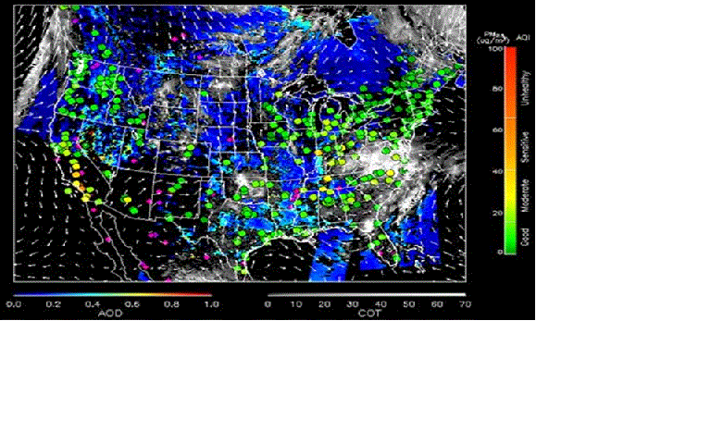
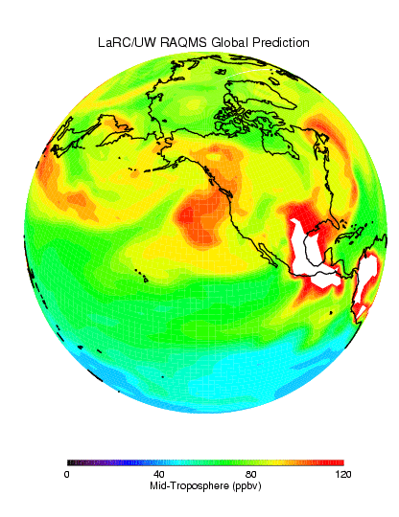
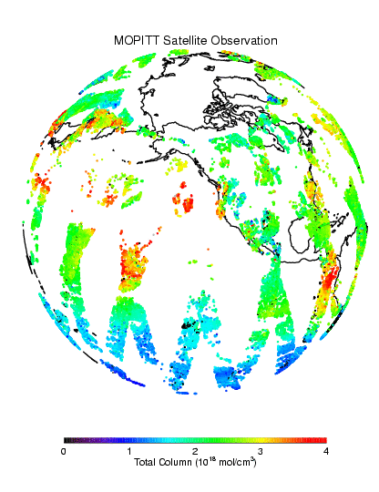
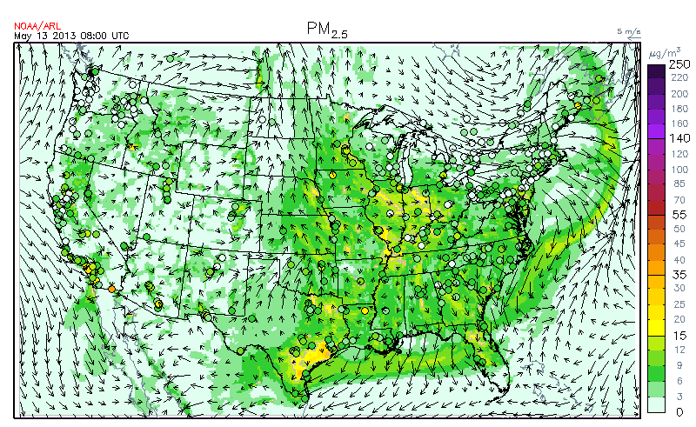

AQAST Project: Air Quality Reanalysis
(Translating Research to Services)
+ AQ Assessments
+ State Implementation Plan Modeling
+ Rapid deployment of on-demand rapid-response forecasting; e.g., new fuel type,…, etc.
+ Health Impacts assessments
+ Demonstration of the impact of observations on AQ distributions
+ Ingestion of new AQAST products into operations
Global
Assimilation
Satellite
Products
Constrained
Posters D1_03: Ho-Chun Huang
D2_10: Min Huang
D2_34: Li Pan
http://acmg.seas.harvard.edu/aqast/projects.html
14th CMAS, Chapel Hill, NC October 5-7, 2015
Notes:
Objective: Best estimated state of the chemical composition of the atmosphere (lower troposphere)
A sizeable user group: AQ application as well as health epidemiology scenarios
A ‘reanalysis’ is a climate or weather model simulation of the past that includes data assimilation of historical observations. The observations can be very comprehensive (satellite, in situ, multiple variables) or relatively sparse (say, sea level pressure only), and the models themselves are quite varied. Generally these models are drawn from the weather forecasting community (at least for the atmospheric components) which explains the odd terminology. An ‘analysis’ from a weather forecasting model is the 6 hour (say) forecast from the time of observations. Weather forecasting groups realized a decade or so ago that the time series of their weather forecasts (the analyses) could not be used to track long term changes because their models had been updated many times over the decades. Thus the idea arose to ‘re-analyze’ the historical observations with a single consistent model. These sets of 6 hour forecasts using the data available at each point are then more consistent in time (and presumably more accurate) that the original analyses were.

Slide 3

Applications of Reanalysis
Ozone – modeled (~ 3 yr data lag) & monitor (~ 1 yr data lag), both from EPA
PM2.5 mass - modeled (~ 3 yr data lag) & monitor (~ 1 yr data lag), both from EPA
Air Toxics - benzene, formaldehyde, modeled from EPA, 2005 only (NATA)
Reanalysis would be able to provide PM_{2.5} speciation data with national coverage at county level, which are highly valuable for health effects studies
AQAST-8 Dec 2-4, 2014, Atlanta, GA
Notes:
Tracking currently group their data into 4 categories. The first order application of our reanalysis data would be in the subcategory “Outdoor Air” under “Environments”.
The call out box shows what Tracking currently has and the data limitations
Second order application would be to provide more up to date air toxics data – needs further discussion to make it useful to Tracking.

Slide 4
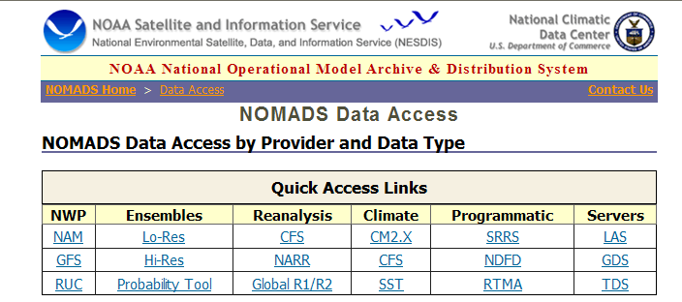
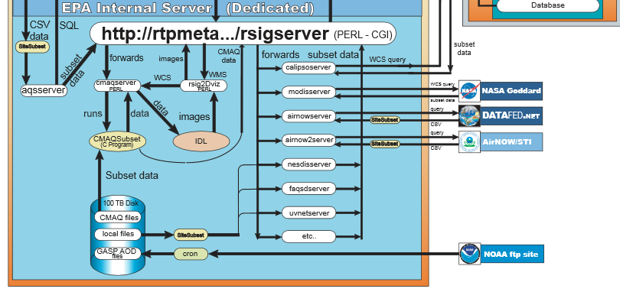
Goal: A user friendly downloadable archive
NOMADS
RSIG .
New
analysis
14th CMAS, Chapel Hill, NC October 5-7, 2015
Notes:
Long term – user, and on-demand subseting and downloading gui e.g.
NOAA Operational Model Archive and Distribution System
Remote Sensing Information Gateway

Slide 5
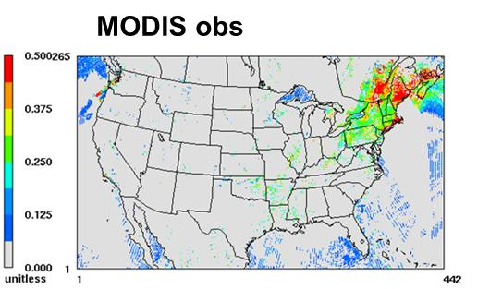

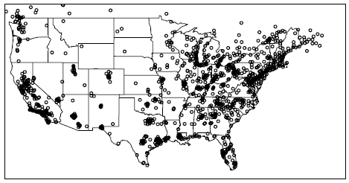
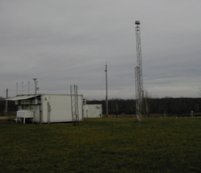
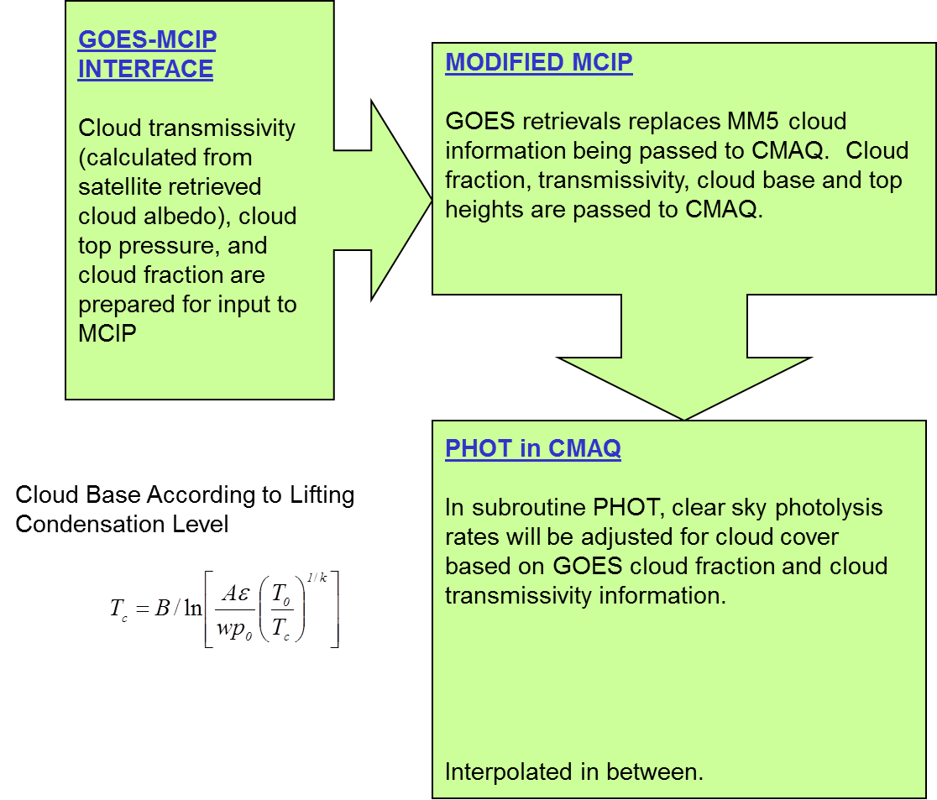

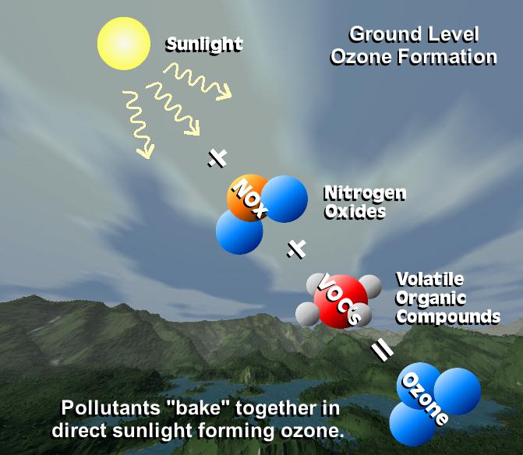
done
done
AIRNow
done
Cloud-obs Photolysis rates
testing
Yet to do
Isoprene
& PAR
Lightning NOx
14th CMAS, Chapel Hill, NC October 5-7, 2015
Notes:
Raqms
The RAQMS analyses include assimilation of real-time Aura MLS stratospheric ozone profiles (above 50mb) and cloud cleared OMI total column ozone as well as Terra and Aqua MODIS aerosol optical depth that uses modeled upper tropospheric RH to filter potential cirrus cloud contamination. Wild fire emissions are based on Terra and Aqua MODIS fire detections.
HMS

Slide 6
Optimal Interpolation (OI)
OI simplifies the cost function minimization (Dee et al. Q. J. R. Meteor. Soc. 1998) by limiting the analysis problem to a subset of obs.
Obs far away (beyond background error correlation length scale) have no effect in the analysis.
Injection of obs through OI takes place at 1800 UTC for AOD obs and 6 unevenly spaced intervals for AIRNow obs.
AQAST-8 Dec 2-4, 2014, Atlanta, GA

Slide 7
MODIS AOD & AIRNow PM_{2.5} assimilated
For initial condition adjustment
MODIS AOD (Terra and Aqua)
18Z
00Z
06Z
12Z
14Z
17Z
19Z
AIRNOW PM2.5, PM10, Ozone
14th CMAS, Chapel Hill, NC October 5-7, 2015
Notes:
6 hour forecasts and retain the optimal analysis states

Slide 8
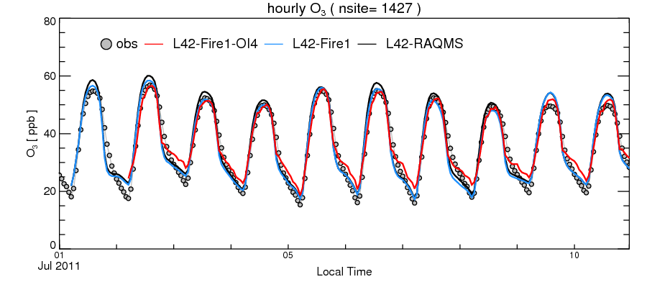
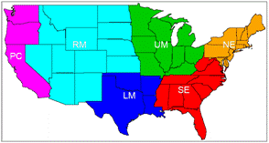
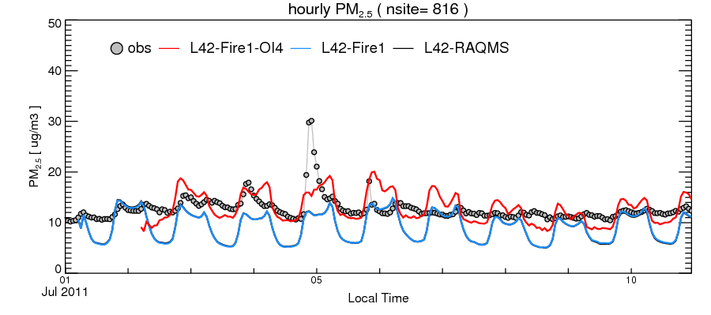
Analysis field Verification: AIRNOW O₃ & PM _{2.5} over CONUS
PM_{2.5} low biases: esp. daytime
SO₄²⁻, Criegee
SOA
Small fires
Fire-work
14th CMAS, Chapel Hill, NC October 5-7, 2015
Notes:
,Raqms
The RAQMS analyses include assimilation of real-time Aura MLS stratospheric ozone profiles (above 50mb) and cloud cleared OMI total column ozone as well as Terra and Aqua MODIS aerosol optical depth that uses modeled upper tropospheric RH to filter potential cirrus cloud contamination. Wild fire emissions are based on Terra and Aqua MODIS fire detections.

Slide 9
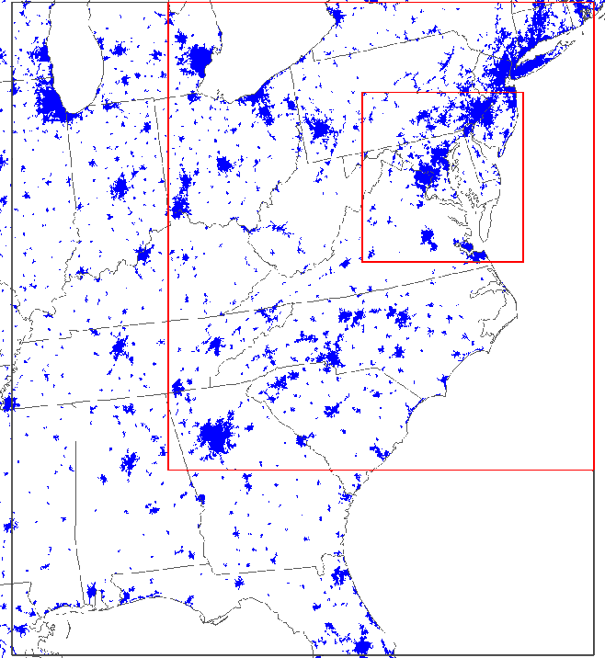
Analysis fields as IC and forecast with Total AOD Assimilation basis for LBCs
WRF 3.2.1 for meteorological fields
  NCEP North American Regional Reanalysis (NARR) 32-km resolution inputs
  NCEP ADP surface and soundings observational data
  MODIS landuse data for most recent land cover status
  3-D and surface nudging, Noah land-surface model
SMOKE 2.6 for CMAQ ready gridded emissions
  NEI inventory projected to 2011 using EGAS growth and existing control strategies
  BEIS3 biogenic emissions based on BELD3 database
  GOES biomass burning emissions: ftp://satepsanone.nesdis.noaa.gov/EPA/GBBEP/
CMAQ 4.6 revised to simulate gaseous & PM species
  SAPRC99 mechanism, AERO4, ISORROPIA thermodynamic, Mass conservation,
  Updated SOA module (Baek et. al. JGR 2011) for multi-generational oxidation of semi-volatile organic carbons
4 km
12 km
36 km
DISCOVER-AQ
GA_Tech
4 km
IC/BC of Base and AOD_DA cases
14th CMAS, Chapel Hill, NC October 5-7, 2015
Notes:
Calculate differences between forecasts (B) and observations (O) at each AIRNOW station as a time series
Pair up AIRNOW stations, and calculate the correlation coefficients between the two time series at the paired stations
Plot the correlation as a function of the distance between the two stations,
Intercept Rz can be used to calculate the ratio between model error (EB) and and observational error (including representative error)
Horizontal length scale can be inferred as well

Slide 10
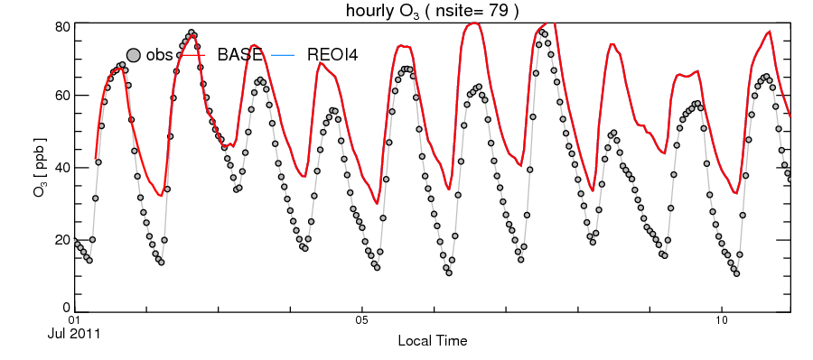
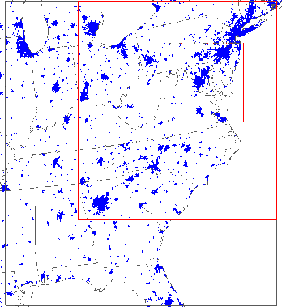
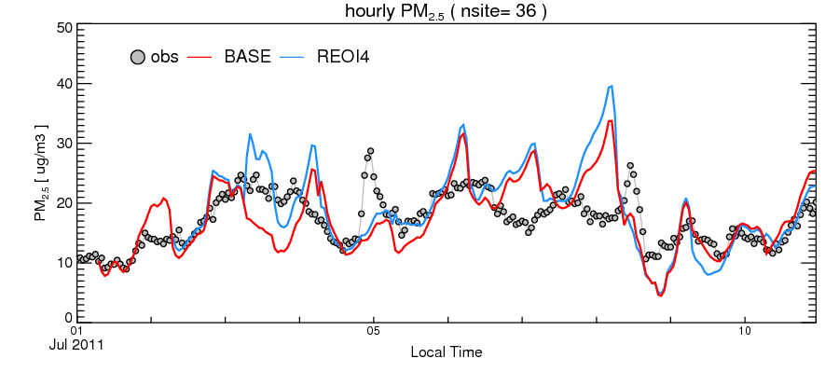
Analysis field Verification: AIRNOW O₃ & PM _{2.5} over BW SIP
14th CMAS, Chapel Hill, NC October 5-7, 2015
Notes:
Raqms
The RAQMS analyses include assimilation of real-time Aura MLS stratospheric ozone profiles (above 50mb) and cloud cleared OMI total column ozone as well as Terra and Aqua MODIS aerosol optical depth that uses modeled upper tropospheric RH to filter potential cirrus cloud contamination. Wild fire emissions are based on Terra and Aqua MODIS fire detections.

Slide 11
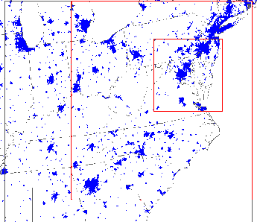
PM2.5 24h avg | Obs mean | Mean bias | RMSE | Corr. Coef.
L42 | 12.3 | -7.7 | 10.4 | 0.4
L42RAQMS | 12.3 | -5.4 | 8.5 | 0.5
L42-Fire1 | 12.3 | -7.6 | 10.6 | 0.3
L42-Fire1-OI4 | 12.3 | -1.11 | 6.65 | 0.61
CONUS
Application of analysis field for State Implementation Planning
DISCOVER-AQ
GA_Tech
4 km
PM2.5 24h avg | Obs mean | Mean bias | RMSE | Corr. Coef.
Base | 19.8 | -0.67 | 24.18 | 0.49
With L42-Fire1-OI4 field to derive LBC | 19.8 | 1.15 | 5.79 | 0.53
14th CMAS, Chapel Hill, NC October 5-7, 2015

Slide 12
Lightning Process currently used in CMAQ 5.0*
NLDN (National Lightning Detection Network) data
Model’s convective Precipitation rate
Map to CMAQ grid
Model’s strike count (monthly total)
Calculate Total monthly Lightning flash Count over each grid
Mean LTratio used in
CMAQ NLDN/Model
*CMAQ Version 5.0 and higher contains a scheme based on Allen et al. (2012, ACP) that was funded under NASA Applied Sciences Air Quality Program project (Ken Pickering, PI):
    Method for estimating lightning flash rates
    LNO_{x} production per flash
    Method of allocating LNO_{x} production in the vertical
14th CMAS, Chapel Hill, NC October 5-7, 2015
Notes:
Options in CMAQ:
On-line: Use convective precipitation rate from WRF to
parameterize flash rate
On-line: Use convective precipitation rate from WRF to
parameterize flash rate, but scale model predicted rate
such that monthly total flashes in each grid cell match
the numbers observed by the National Lightning Detection
Network (adjusted for detection efficiency and IC/CG ratio)
Off-line: Use observed hourly, gridded flash rates from NLDN
in calculation of 4-D LNO_{x} production rates

Slide 13
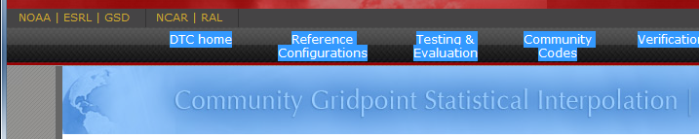
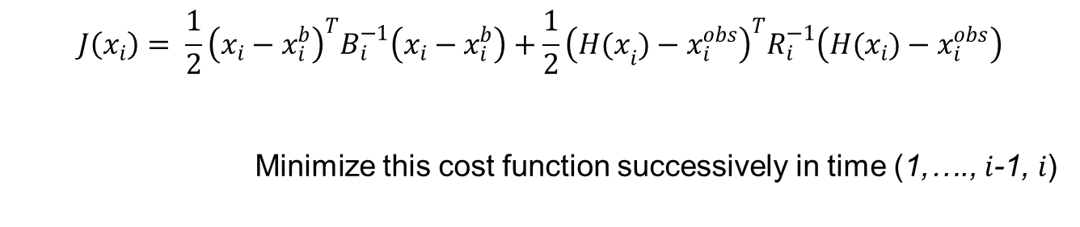
Preparation for operational compliance: Change OI to
Grid-point Statistical Interpolation (GSI):
$$J\left(x_{i}\right)= \frac{1}{2}{\left(x_{i}−x_{i}^{b}\right)}^{T}B_{i}^{−1}\left(x_{i}−x_{i}^{b}\right)+\frac{1}{2}{\left({H(x}_{i})−x_{i}^{obs}\right)}^{T}R_{i}^{−1}\left(H(x_{i})−x_{i}^{obs}\right)$$
Minimize this cost function successively in time (1,…., $i$-1, $i$)
13

Slide 14
Share GSI-CMAQ configuration, meteorological and emission files with GaTech for perturbation study:
Solve for R_{j} that minimizes χ²
DDM-3D calculated sensitivity of concentration i to source j emissions
weigh for the amount of change in source strengths
number of sources
number of obs
uncertainties
emission adjustment ratio
Courtesy: Yongtao Hu et al., “Source impacts
can be used for dynamic air quality
management” CMAS 2014
Georgia Institute of Technology
Notes:
14

Slide 15
Summary
Construction & applications of a Regional Chemical Reanalysis service:
The analysis forward model is tested and used to generate July 2011
analysis fields.
Data Set assimilated: RAQMS (MLS, OMI O3, MODIS AOD); HMS Fire; GOES cloud fraction for photolytic rate correction; MODIS AOD; AIRNow PM_{2.5}
July 2011 analysis fields was used by Georgia Tech for a 14-day SIP simulation and showed significant improvement in RMSE
DISCOVER-AQ related lessons-learned that can help this project:
  Flight transects to help fine tune vertical structure
Next sets: VIIRS AOD, Fire-work emissions, lightning NOx; OMI SO2;
PAR adjustment by retrievals
Verification to include data from O₃ lidar network & AERONET
Transition assimilation codes to GSI-based NCEP ops compliance
Production mode generation of analysis field for 2010
Application and development of end-users:
  Health impact studies (Lee and Liu 2014, IJER & Public Health)
  HTAP tasks
  Outreach: Hosted in RSIG and NOAA forecasting sites
14th CMAS, Chapel Hill, NC October 5-7, 2015
Notes:
An important source of pm -- strong sensitivity to seasonality and geographical characteristics

Slide 16
EXTRA SLIDES
Contact: Pius.Lee@noaa.gov
http://www.arl.noaa.gov/
16

Slide 17
LNO_{x} Production Per Flash:
500 moles NO_{x} per flash assumed for continental US based on
INTEX-A GEOS-Chem results (e.g., Hudman et al., 2007, JGR)
and cloud-resolved model simulations for individual storms
constrained by anvil aircraft observations from several
field programs (Ott et al., 2010, JGR)
However, estimates of LNO_{x} production from OMI observations
over the Gulf of Mexico and surrounding coastal regions
are ~190 to 250 moles per flash (Pickering et al., 2015, JGR,
to be submitted)
User can modify moles per flash for IC and CG flashes
Vertical Distribution of LNO_{x} Production:
Based on Koshak et al. (2014, Atmos. Res.) vertical distributions
of lightning channel lengths from Northern Alabama Lightning
Mapping Array -- work sponsored by NASA Applied Science
Air Quality Program

Slide 18
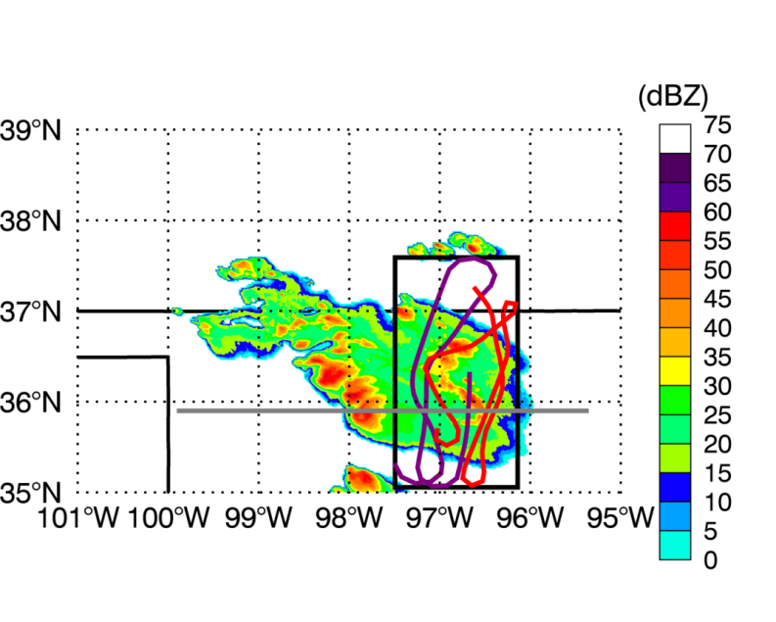
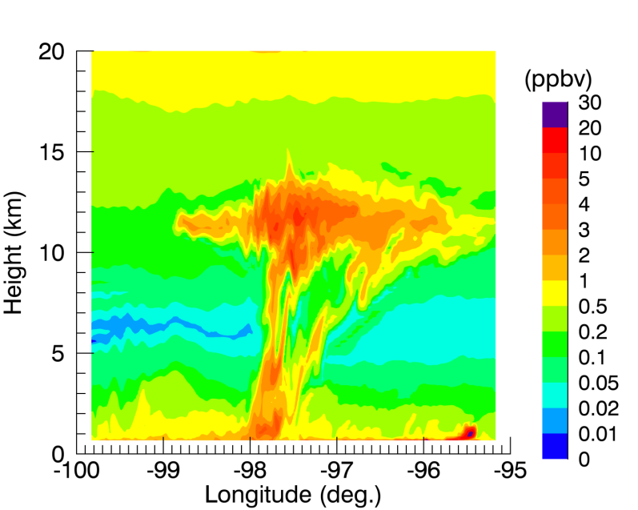
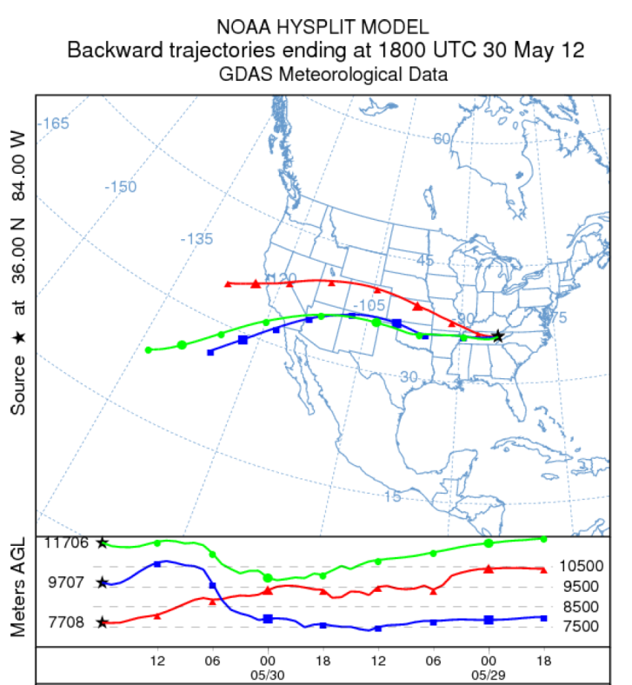
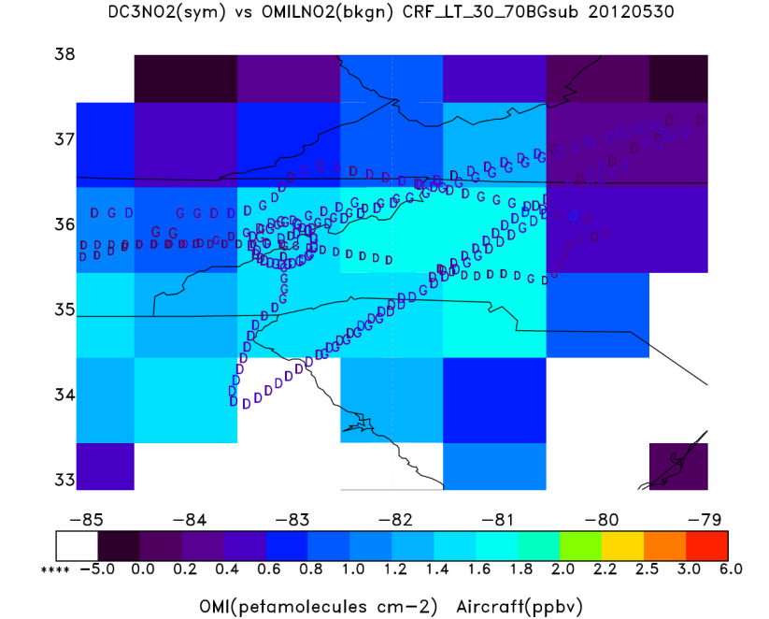
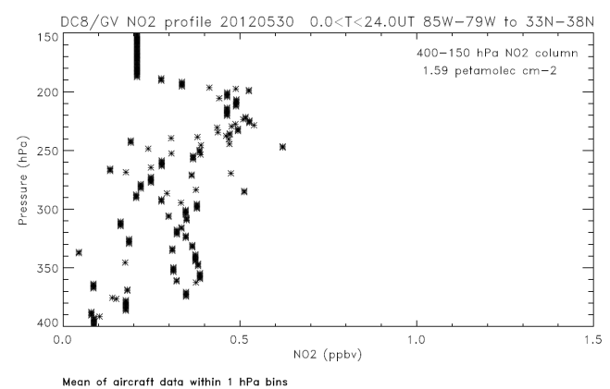
Deep Convective Clouds and Chemistry (DC3) Case Study – May 29-30, 2012
WRF-Chem (cloud-resolved) 0100 UT
WRF-Chem -- Vertical Cross Section for NO_{x}
Multicell storm in
NW Oklahoma in
early evening of
May 29 sampled by
NASA DC-8 and
NCAR G-V; storm
simulated using
WRF-Chem at 1-km
resolution
Model-calculated reflectivity and aircraft tracks
Trajectories show transport of storm outflow to Southern Appalachians by early afternoon May 30, where NO₂ peak was detected by OMI and DC3 research aircraft
14th CMAS, Chapel Hill, NC October 5-7, 2015
Pickering, Cummings, Allen

Slide 19
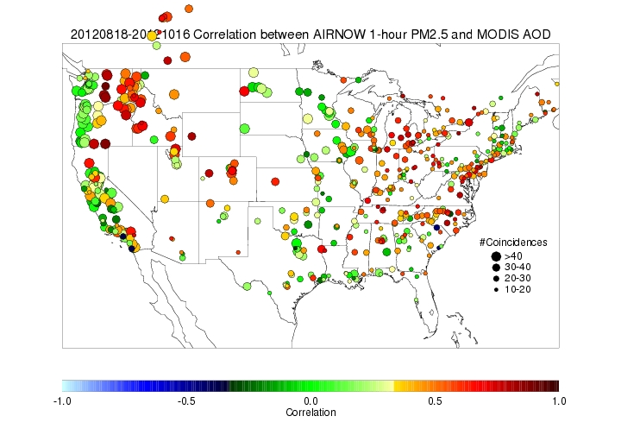
MODIS (Moderate Resolution Imaging Spectroradiometer) AOD
National correlation map between AIRNow measurement and MODIS AOD
Typically good correlation between
surface PM_{2.5} and AOD retrieved
by MODIS
Courtesy :NESDIS
Orbit: | 705 km, 10:30 a.m. descending node (Terra) or 1:30 p.m. ascending node (Aqua)
Swath Dimensions: | 2330 km (cross track) by 10 km (along track at nadir)
Spatial Resolution: | 250 m (bands 1-2) 500 m (bands 3-7) 1000 m (bands 8-36)
http://terra.nasa.gov/About/

