Slide 1


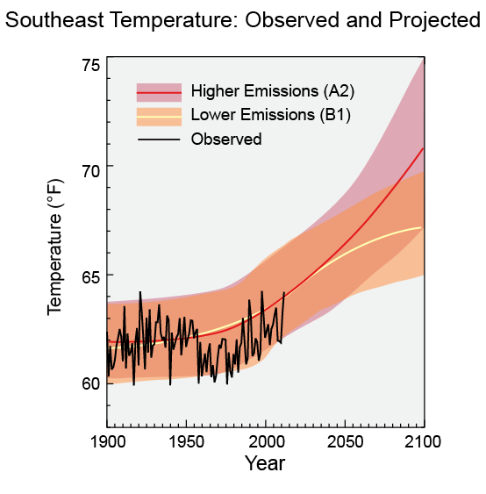
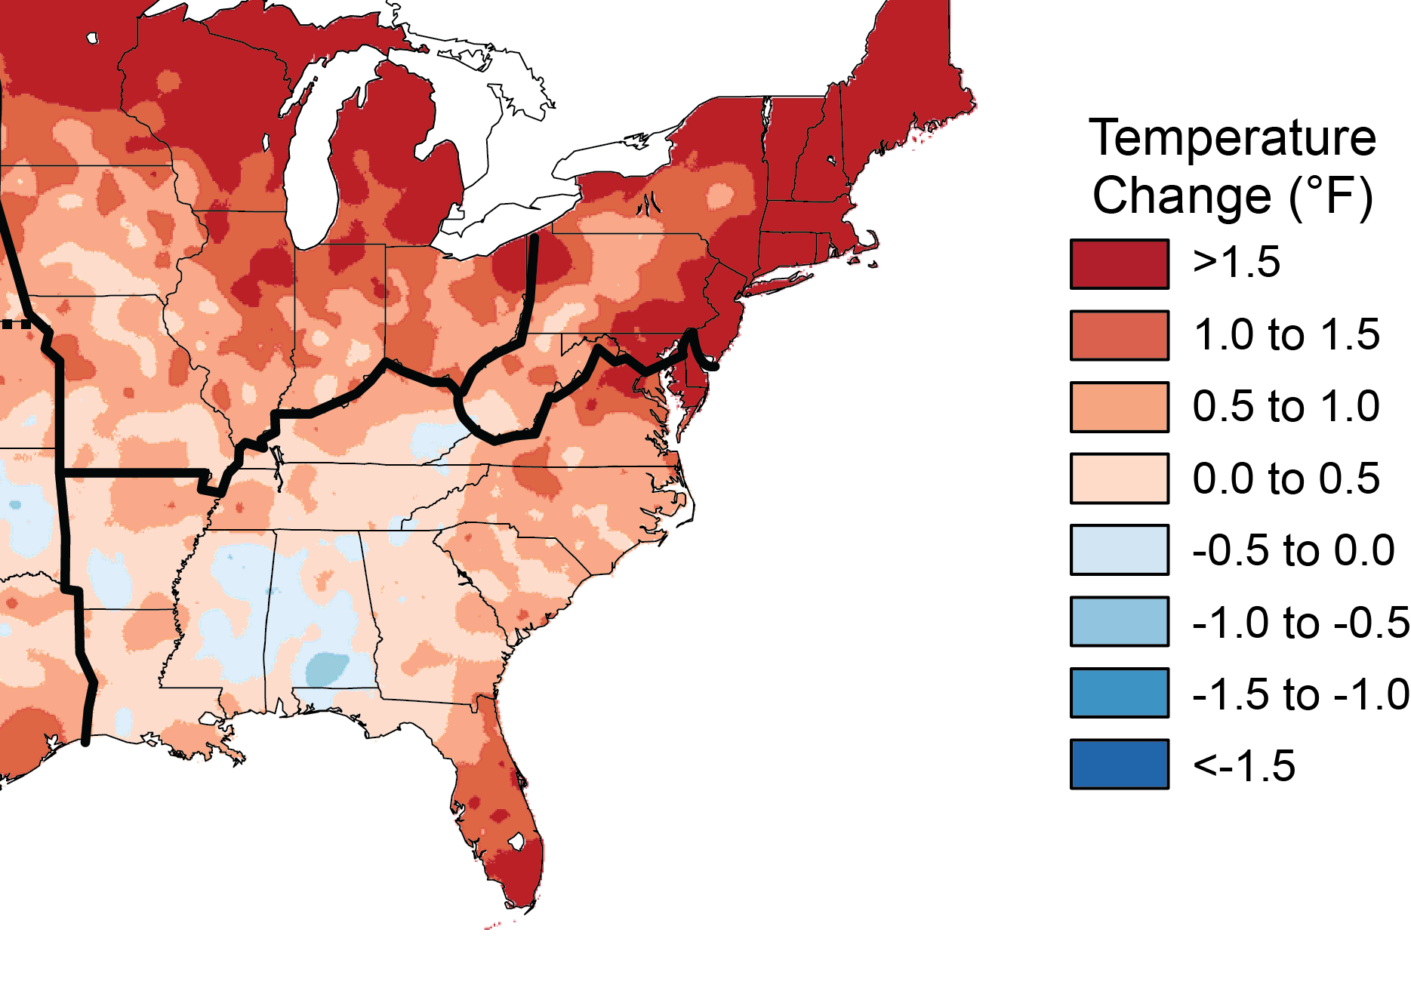
Using WRF for Regional Climate Modeling:
An Emphasis on the Southeast U.S. for Future Air Quality
Jared H. Bowden (UNC)
Kevin D. Talgo (UNC)
Tanya L. Spero (EPA)
Christopher G. Nolte (EPA)
Megan Mallard (UNC)
CMAS Conference
October 7, 2015

Slide 2
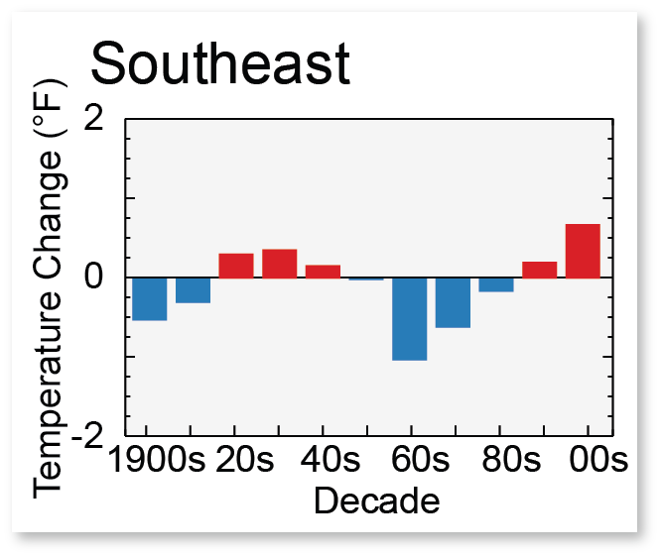
Motivation
North Atlantic Subtropical High (NASH)
JGR, 2013
NCEP-DOE Reanalysis Position of NASH
National Climate Assessment
Notes:
Dr. Wenhong Li at Duke has studied the position of the NASH in historical context using the CMIP5 models. There is a clear westward trend that the NASH in recent decades that is projected to continue to shift west with recent warming. The black contour is the climatology of the 1560 geopotential height isoline used to represent the western boundary of the NASH.

Slide 3
Projected Shift in the NASH
Li et al., JGR (2013)
NASH Location Year (JJA Average)
Probability of Occurrence of Ridge Type
CMIP5 ENSEMBLE
DRY
WET
Precipitation Rate (mm/day)
Historical
Future
Notes:
Using the CMIP5 models, there is a clear trend that the NASH has extended westward in the prior decades and is projected to continue to shift west. North – South position is important dry or wet conditions on average. In the future the CMIP5 GCM ensemble shows westward shift that favors drier conditions but an incrase in the rainfall variability.

Slide 4
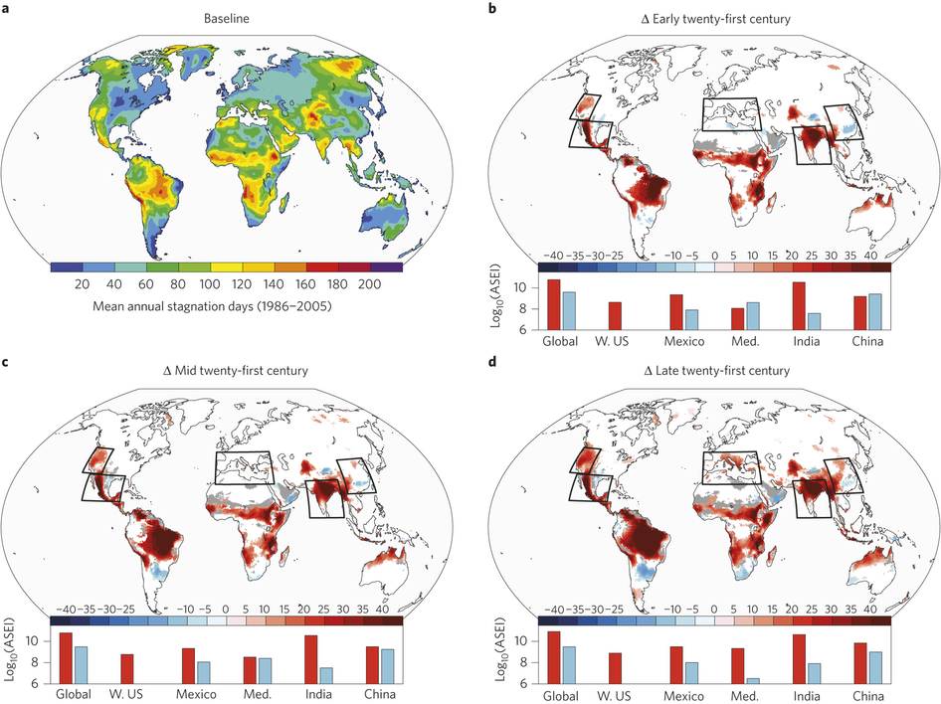
NASH Shift on Future Air Quality
Mid-Century
Westward shift impact on Air Quality
  Stagnation Days (Horton et al. 2014 – Nature Climate Change)
    Daily-mean 10-m wind speeds are < 3.2 m/s
    Daily-mean 500hPa wind speeds are < 13 m/s
    Daily-mean precipitation accumulation is < 1mm
Use dynamical downscaling to assess regional change for the Southeast for change in maximum temperature and stagnation days
Horton et al. (2014) – Occurrence and persistence of future atmospheric stagnation events, Nature Climate Change
Notes:
The Baseline number of annual number of stagnation days from CMIP5 Ensemble and the projected shift by mid-century. Note that Southeast doesn’t show large change in stagnation. Hypothesize a westward shift in the NASH would impact stagnation (stability, winds, precipitation). Dynamical downscaling may be helpful at adding additional information to assess regional change, such as daily precipitation in the Southeast during the summer.
Hypothesis : Projected westward shift in the NASH will result in poor air quality for the Southeast – Shift in the NASH is related to the change in maximum temperature and the number of stagnation days.

Slide 5
WRF Simulations
“towards the development of an ensemble”
Historical | RCP 4.5 | RCP 6.0 | RCP 8.5
CESM (1995-2005) | CESM (2025-2055) | CESM (2025-2055) | CESM (2025-2055)
ModelE2 (1995-2005) |  | ModelE2 (2025-2035)
CM3 (1995-2005) |  |  | CM3 (2025-2055)
Notes:
EPA and UNC have worked toward development of a WRF RCM ensemble. Currently based on US GCMs. The members includes various techniques to improve the representation of the climate for the Southeast including : nudging techniques on mean and extreme near surface meteorology and atmospheric circulation; subgrid cloud feedback to radiation (Kain-Fristch CP scheme); improving representation of resolvable lakes;

Slide 6
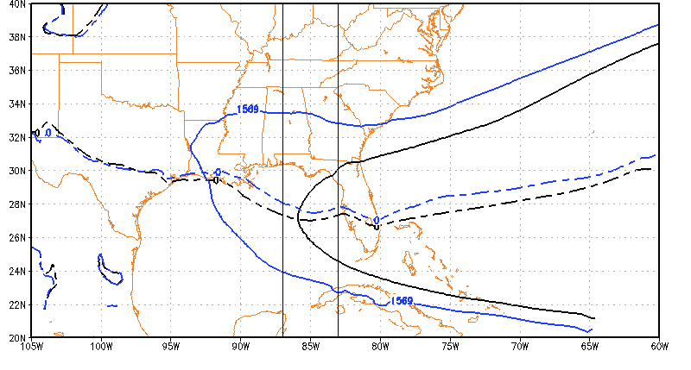
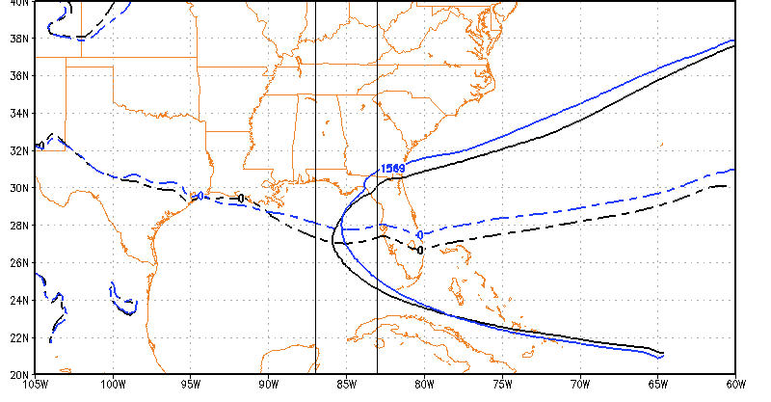
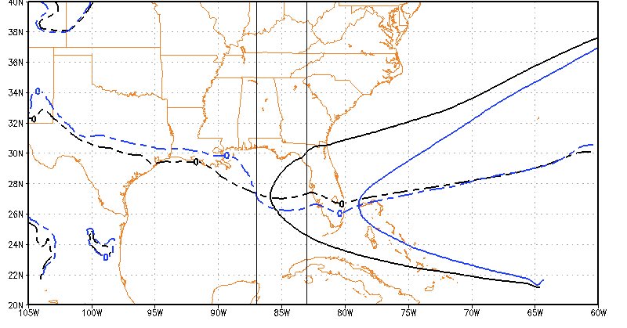
Westward Extent of the NASH
JJA Average 850hPa Geopotential Height
Dynamic Contribution Only
WEST (W)
NEUTRAL (N)
EAST (E)
CESM Climatology (1995-2005)
CESM One Future Year
Notes:
We define a neutral category as years within two degrees of longitude from 85W. Use this longitude to define the climatological 850hPa geopotential height contour (1569m for CESM). This climatology for geopotential height is WRF-GCM sensitive; GFDL is 1542m. When the above geopteontial height contours intersect the u=0 then you have the western location of the NASH. Neutral is considered within 2 degrees longitude of the 1995-2005 climatology. Note that this calculation is the same as Li et al. and considers removing the uniform increase in the geopotential height in response to warming. We have removed the thermal direct component and thus this is the dynamic contribution of the NASH.

Slide 7
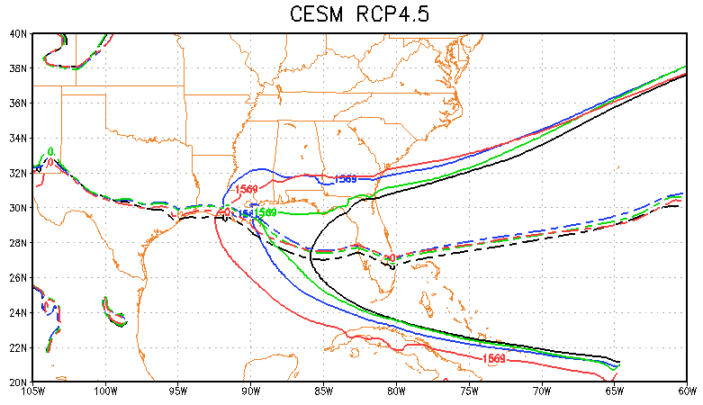
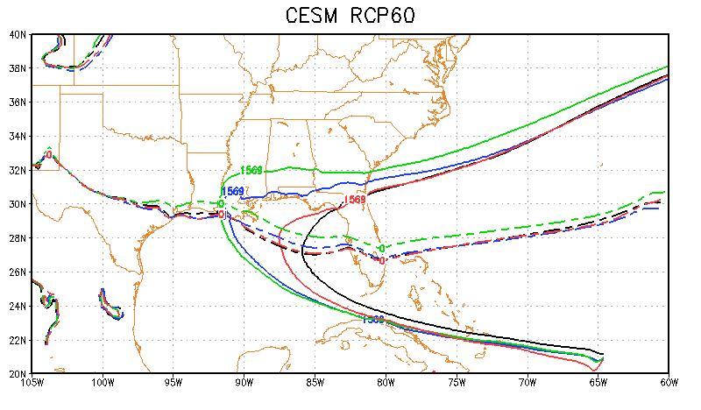
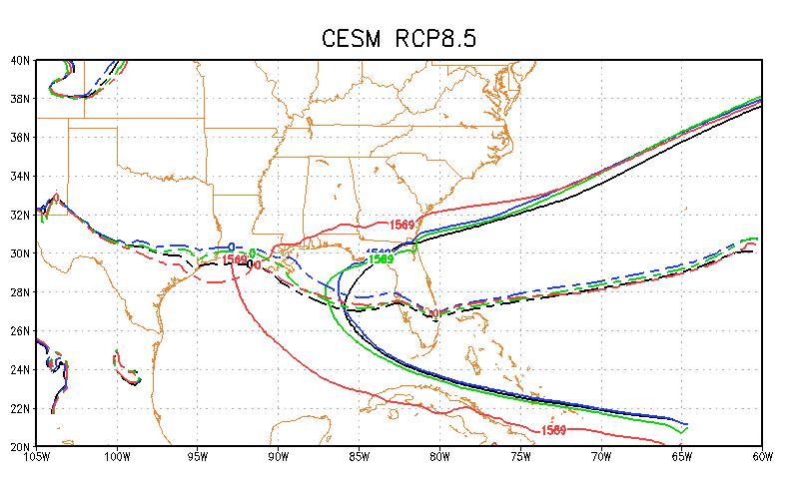
CESM - NASH Westward Extent - JJA
Decadal Average
RCP4.5
W – 58% years (2025-2055) WEST of normal
N – 13% years (2025-2055) NEUTRAL
E – 29% years (2025-2055) EAST of normal
2025-2035 average
2036-2045 average
2046-2055 average
RCP6.0
W – 65%
N – 23%
E – 13%
1996-2005
RCP8.5
W – 51%
N – 23%
E – 26%
Notes:
Notice lots of decadal variability in the western ridge location for CESM with different RCP scenarios. However, the frequency of occurrence using average summer position is towards the west for all RCPs. Largest frequency of west is actually for RCP60.

Slide 8
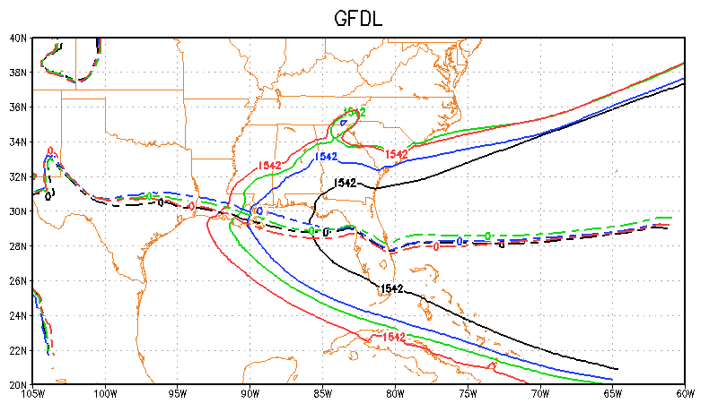
CM3 - NASH Westward Extent - JJA
Decadal Average for RCP8.5
2025-2035 average
2036-2045 average
2046-2055 average
W – 77% years (2025-2055) WEST of normal
N – 23% years (2025-2055) NEUTRAL
E – 0% years (2025-2055) EAST of normal
1996-2005
Notes:
For the GFDL downscaled simulations there is a a progressive westward movement of the NASH. More than ¾ of the 31 years are west of the climatological normal.
The prior slide indicated an increasing trend for GFDL downscaled simulation compared to CESM. Is the consistent shift in the NASH helping to contribute to this trend?

Slide 9
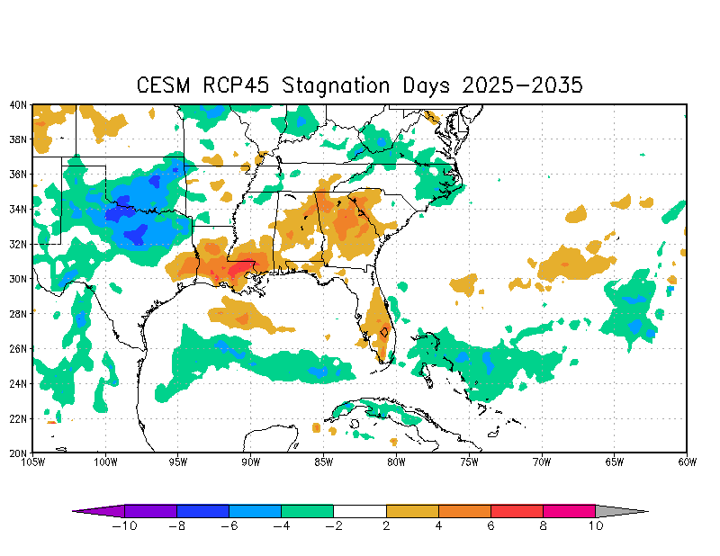
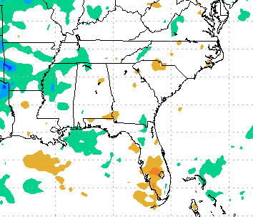
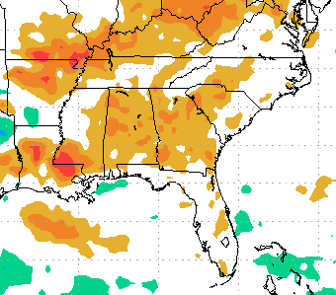
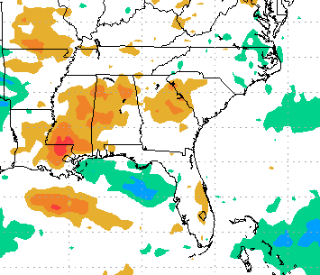
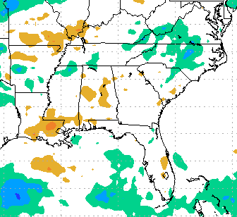
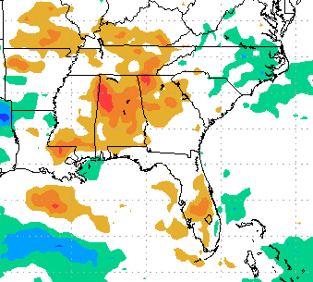
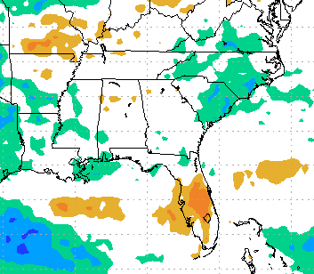
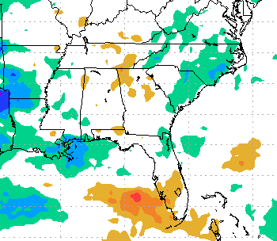
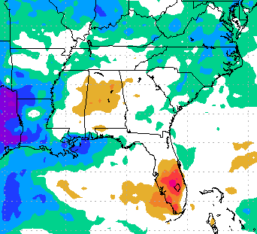
CESM Change in Stagnation Days – JJA
RCP4.5
RCP6.0
RCP8.5
45%
NASH
Years
West
55%
NASH
Years
West
27%
NASH
Years
West
2025-2035
50%
NASH
Years
West
90%
NASH
Years
West
50%
NASH
Years
West
2036-2045
2046-2055
90%
NASH
Years
West
50%
NASH
Years
West
90%
NASH
Years
West
Notes:
Results are not as I anticipated for CESM and change in stagnation days as a result of NASH westward shift.
Larger number of years when NASH is WEST of normal position (e.g. bottom circles) – results in small change in stagnation days (*some decrease)
Note that when NASH is EAST (e.g. top circles) there is an overall increase in stagnation days for a majority of the Southeast.
Decadal variability and scenario sensitivity important when constructing the ensemble.

Slide 10
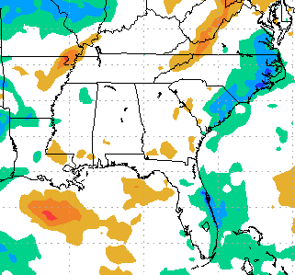
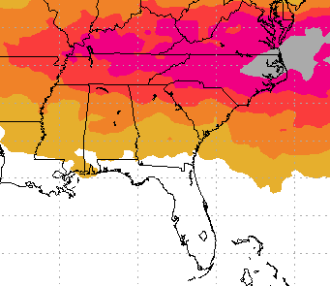
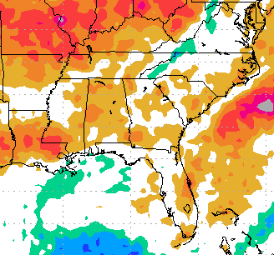
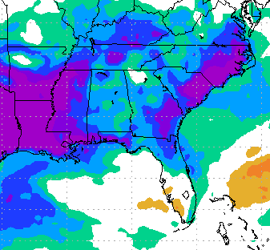
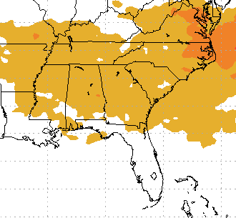
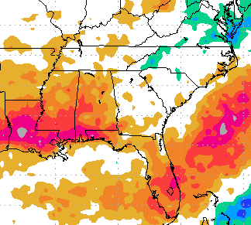
CESM RCP8.5 2025-2035 (JJA)
27% NASH WEST
Change in
# Stagnation Days
Change in # days with
10m Winds < 3.2 m/s
Change in # days with
500 hPa Winds < 13 m/s
Change in # days with
Precip. < 1 mm
90% NASH WEST
CESM RCP8.5 2046-2055 (JJA)
Change in
# Stagnation Days
Change in # days with
10m Winds < 3.2 m/s
Change in # days with
500 hPa Winds < 13 m/s
Change in # days with
Precip. < 1 mm
Notes:
Red means more favorable conditions for individual component for an increase in the number of stagnation days. You see consistency for 500 hPa wind speeds and precipitation (more days with light winds and an increase in number of dry days)
Big difference is for low-level winds between the two decades. There are fewer days with light winds for 2046-2055 (not a favorable condition for stagnation).

Slide 11
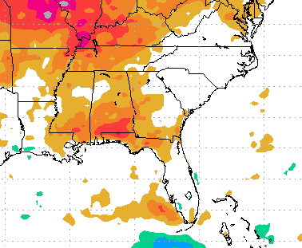
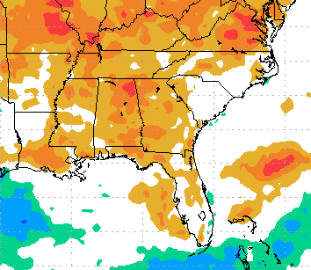
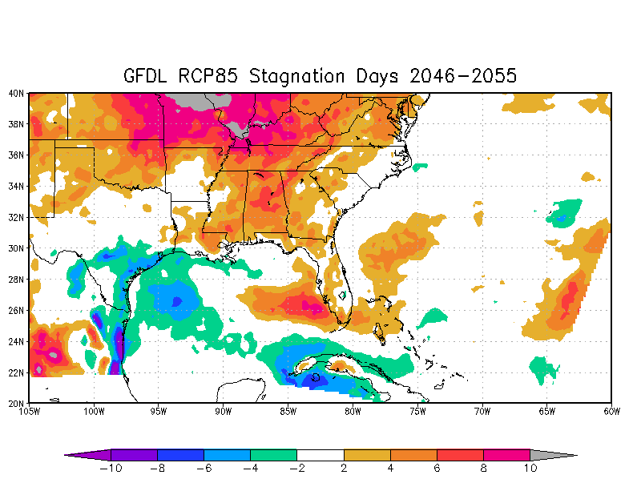
CM3-RCP8.5 Change in Stagnation Days – JJA
2025-2035
2036-2045
45%
NASH
Years
West
80%
NASH
Years
West
2046-2055
90%
NASH
Years
West
Notes:
Stagnation days increasing throughout the SE with larger warming in CM3.
CM3 response is what I anticipated – westward shift would increase the number of stagnation days.
Need to look at what defines stagnation day – precip. and lower and upper winds

Slide 12
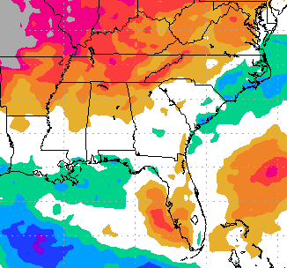
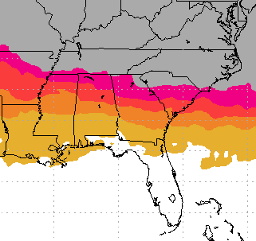
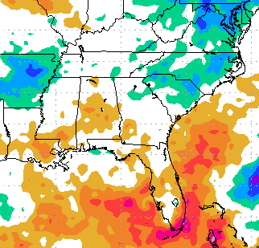
CM3 RCP8.5 2046-2055 (JJA)
Change in # Stagnation Days
90%
NASH
Years
West
Change in # days with
10m Winds < 3.2 m/s
Change in # days with
500 hPa Winds < 13 m/s
Change in # days with
Precip. < 1 mm
Notes:
Low level wind day change is very different for CM3 compared to CESM.

Slide 13
Conclusions
NASH is projected to shift westward and seen in all ensemble members (despite decadal variability and scenario sensitivity).
  By mid-century CESM and CM3 ensemble members show between 50% to 90% of the summer seasons will have an average position west of its climatological position.
The impact of the westward shift in the NASH shift for stagnation reveals
  Very large uncertainty regarding NASH location and stagnation days with respect to the GCM
  Westward shift for CESM reveals a decrease in the number of stagnation days
  Westward shift for CM3 reveals an increase in the number of stagnation days
  The largest differences between CESM members and CM3 for stagnation is the projected change in the number of days with light winds.
  All simulations tend to agree on favorable wind conditions aloft (lighter winds in the future)

Slide 14
Extra Material for maximum temperature in following slides

Slide 15
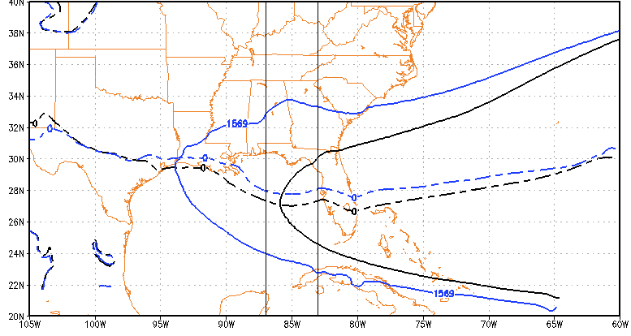
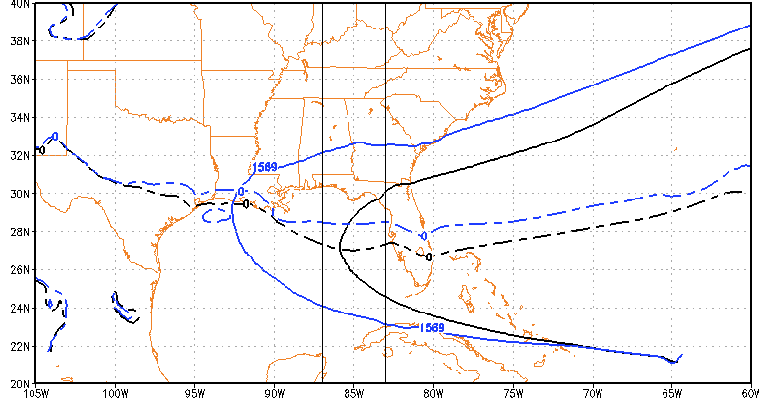
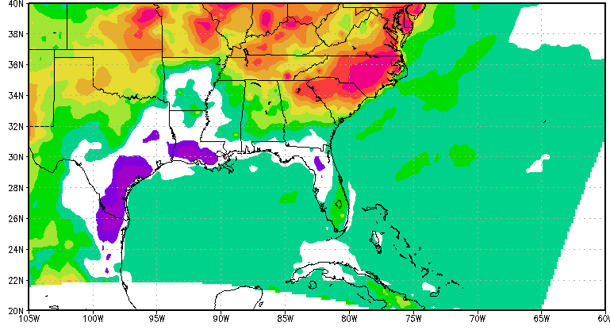
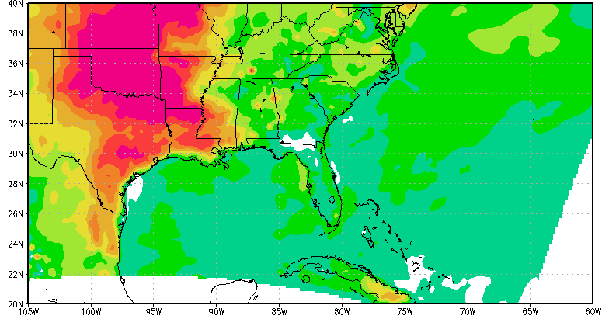
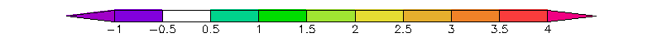
NASH position and projected maximum temperatures
CESM RCP8.5
2043
2044
Notes:
Different maximum temperature response when the NASH is west of its position.
Role of NASH on air quality needs to be explored further. Role is much more complicated than originally thought. The NASH westward shift and impact on AQ parameters is not linear.
For instance, NASH is modulated by other climate teleconnections including PDO and AMO
To estimate and understand the climate change impact on AQ for the SE requires future research.
Likely best to use raw GCM fields to provide a more robust ensemble to understand the implications of the NASH for AQ metrics such as stagnation.
Need for extra ensemble members or longer time series because of decadal variability in the position of the NASH.

Slide 16
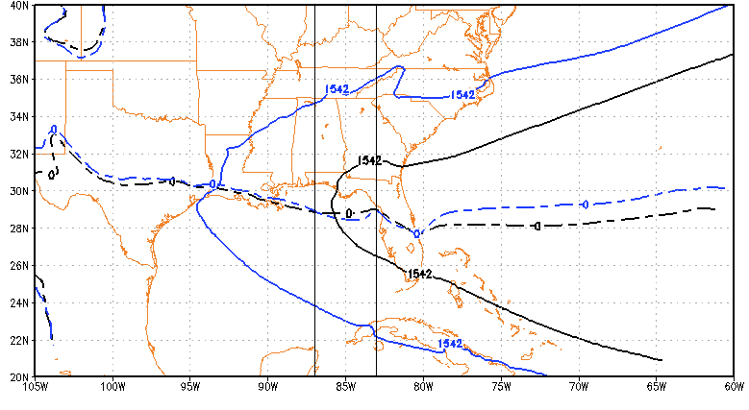
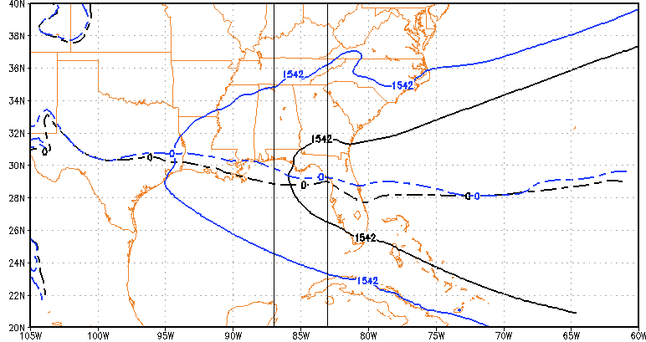
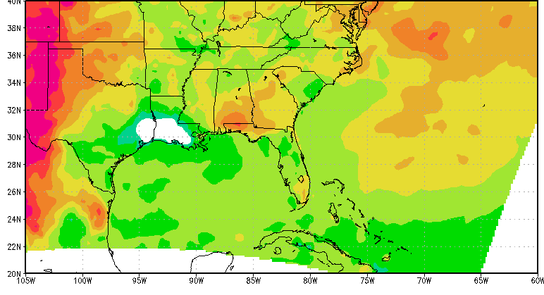
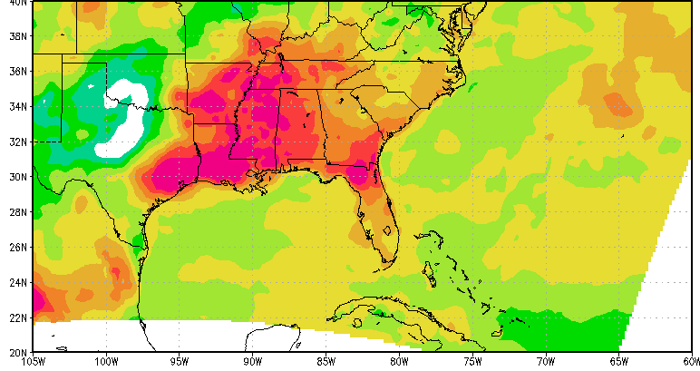
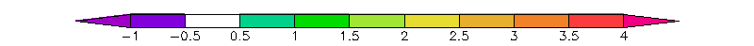
NASH position and projected maximum temperatures
CM3 RCP8.5
2041
2043
Notes:
Same true for GFDL-CM3.
Regional temperature response can be very different despite similar westward shift in NASH.
Need to understand causes of differences
Future work – Source of differences for maximum temperature – radiation and others.

